Slide 1
Improving the guest experience in themed entertainment venues through handheld RFID assemblies
Project Apricorn
Group 15
Rebecca Casimir - CpE
Trey Sandefur - EE
Kalindi Desai - CpE
Darren Yong - EE

Slide 2
Contents
Motivation & Concept
Results
Design Approach
Testing Procedure
Goals & Specifications
Administrative Content
Hardware
Overview
Software
Overview

Slide 3
Motivation
Why Pokémon?
Highest selling media franchise of all time
Multi-generational
Celebrated 25th Anniversary in 2021

Slide 4
Motivation
Why Pokémon?
Highest selling media franchise of all time
Multi-generational
Celebrated 25th Anniversary in 2021

Slide 5
Motivation
Why Pokémon?
Highest selling media franchise of all time
Multi-generational
Celebrated 25th Anniversary in 2021

Slide 6
Motivation
Why Pokémon?
Highest selling media franchise of all time
Multi-generational
Celebrated 25th Anniversary in 2021

Slide 7
Motivation
Why Themed Entertainment?
Capital of Themed Entertainment
Rich ties to UCF
Personal & Professional Interest

Slide 8
Motivation
Why Themed Entertainment?
Capital of Themed Entertainment
Rich ties to UCF
Personal & Professional Interest

Slide 9
Motivation
Why Themed Entertainment?
Capital of Themed Entertainment
Rich ties to UCF
Personal & Professional Interest

Slide 10
Motivation
Why Themed Entertainment?
Capital of Themed Entertainment
Rich ties to UCF
Personal & Professional Interest

Slide 11
Concept

Slide 12
Concept

Slide 13
Concept

Slide 14
Design Approach

Slide 15
Design Approach
Hardware
Software
Portable Assembly
Robust Data Structure
Durable Housing
Responsive To Requests
Extended Lifespan
Secure Backend
Scalable Design
Accurate Returns
Reliable Transmission
Reliable System Updates

Slide 16
Design Approach
Hardware
Software
Portable Assembly
Robust Data Structure
Durable Housing
Responsive To Requests
Extended Lifespan
Secure Backend
Scalable Design
Accurate Returns
Reliable Transmission
Reliable System Updates

Slide 17
Design Approach
Hardware
Software
Portable Assembly
Robust Data Structure
Durable Housing
Responsive To Requests
Extended Lifespan
Secure Backend
Scalable Design
Accurate Returns
Reliable Transmission
Reliable System Updates

Slide 18
Design Approach
Engineering Specifications
Activation time of <3 Mins.
Pokémon Connection <5 Mins.
Battle Sequence <2 Mins.

Slide 19
Design Approach
Engineering Specifications
Activation time of <3 Mins.
Register new user and login
Activate Pokéball and register to user
Pokémon Connection <5 Mins.
Battle Sequence <2 Mins.

Slide 20
Design Approach
Engineering Specifications
Activation time of <3 Mins.
Pokémon Connection <5 Mins.
Detect and Capture Pokémon
Deny more than one Pokémon connection to the same Pokémon
Battle Sequence <2 Mins.

Slide 21
Design Approach
Engineering Specifications
Activation time of <3 Mins.
Pokémon Connection <5 Mins.
Battle Sequence <2 Mins.
User plays short battle game
Leaderboard and Scores update

Slide 22
Design Approach
Project Constraints
Activation time of <3 Mins.
Pokémon Connection <5 Mins.
Functional Constraints
Leaderboard and Scores update
User plays short battle game
Portability
Durability
Battle Sequence <2 Mins.
Longevity
Financial Constraints
Unsponsored
Low Cost

Slide 23
Design Approach
Project Constraints
Activation time of <3 Mins.
Pokémon Connection <5 Mins.
Functional Constraints
Leaderboard and Scores update
User plays short battle game
Portability
Durability
Battle Sequence <2 Mins.
Longevity
Financial Constraints
Unsponsored
Low Cost

Slide 24
Design Approach
Project Constraints
Activation time of <3 Mins.
Pokémon Connection <5 Mins.
Functional Constraints
Leaderboard and Scores update
User plays short battle game
Portability
Durability
Battle Sequence <2 Mins.
Longevity
Financial Constraints
Unsponsored
Low Cost

Slide 25
Overall Block Diagram
User Experience
Pokéball
Base Station
Database

Slide 26
Hardware Block Diagram
Pokéball
Base Station
Power & Voltage Reg.
32KHz & 24MHz Xtal. Osc.
User Experience
LoRa
RFM95W
CC1310
MCU
Database
915MHz
ATMEGA
328P
Reset Switch
FTDI
FT232RL
RFID Matching & Antenna
JTAG Debugging Pin Headers

Slide 27
Software Block Diagram
User ID
& Pokéball ID
Register
Pokéball & Pokémon
Login
Update Leaderboard
Battle
Update Statistics

Slide 28
Group Work Distribution
Pokéball
Database
Schematic
PCB Design
PCB Construction
Housing Design
Housing Construction
Battle Sequence Frontend
Battle Sequence Backend
Updates API
Database
Base Station
User Experience
Schematic
Protoboard Construction
Protoboard Design
Transmission Programming
Login System
Registration System
Pokédex System
Leaderboard System
Trey Sandefur
Darren Yong
Rebecca Casimir
Kalindi Desai

Slide 29
Hardware Overview

Slide 30
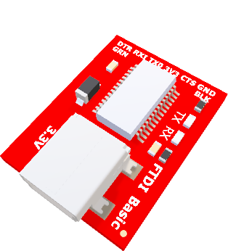
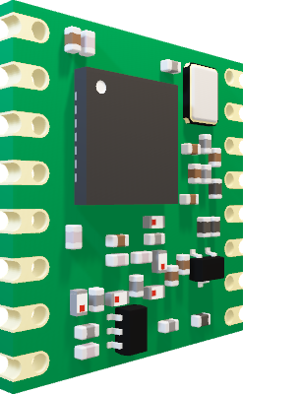
Base Station Breakdown

Slide 31
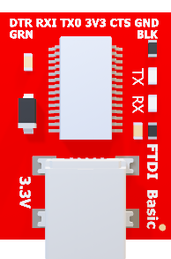
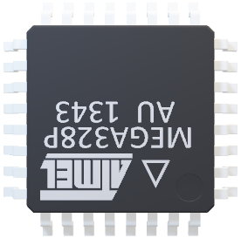
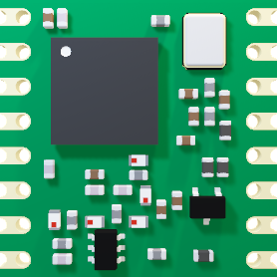
Base Station Breakdown
FTDI
FT232RL
ATMEGA
328P
LoRa RFM95W

Slide 32
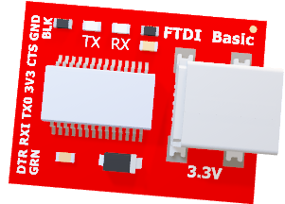
LoRa RFM95W
Base Station Breakdown
FTDI FT232RL
ATMEGA
328P

Slide 33
FTDI FT232RL
Base Station Breakdown
LoRa RFM95W
ATMEGA 328P

Slide 34
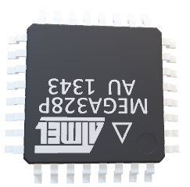
LoRa RFM95W
FTDI FT232RL
Base Station Breakdown
ATMEGA 328P

Slide 35
Pokéball Breakdown

Slide 36
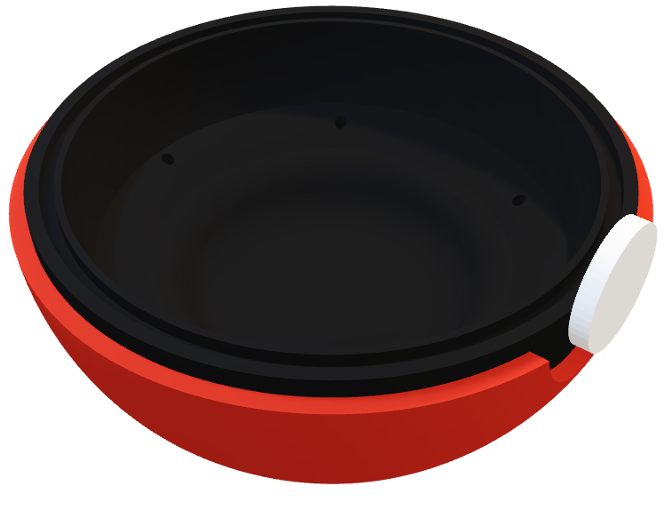
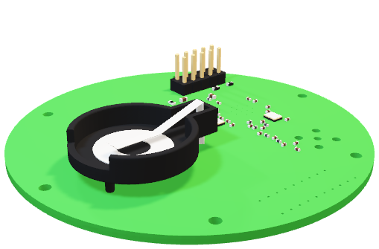
Pokéball Breakdown
Lower Shell Assembly
Upper Shell Assembly

Slide 37
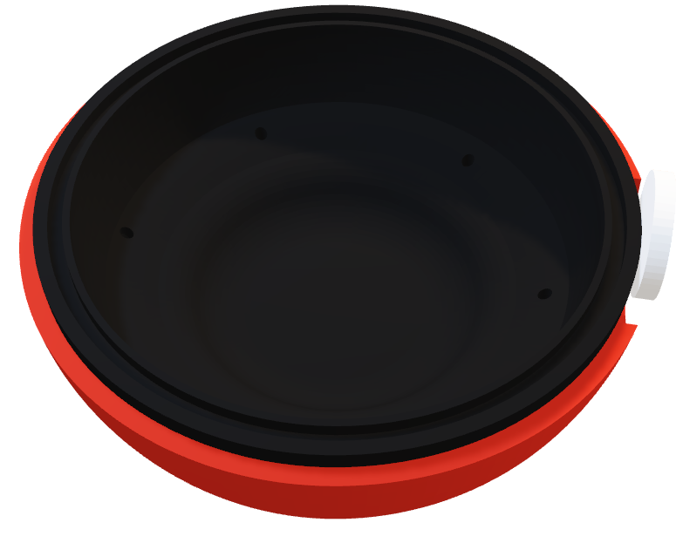
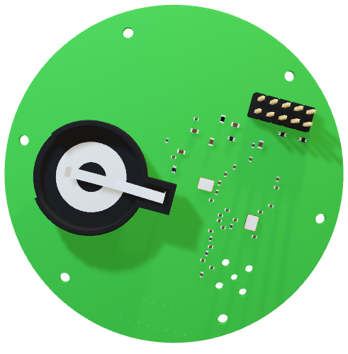
Pokéball Breakdown
Upper Exterior
Upper Interior
Push
Button
Lower Interior
Lower Exterior

Slide 38
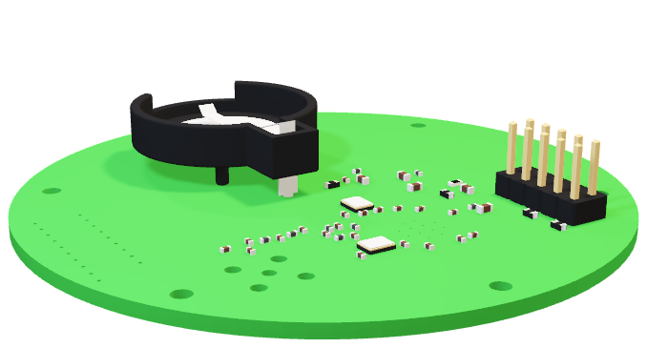
Pokéball Breakdown

Slide 39
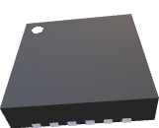
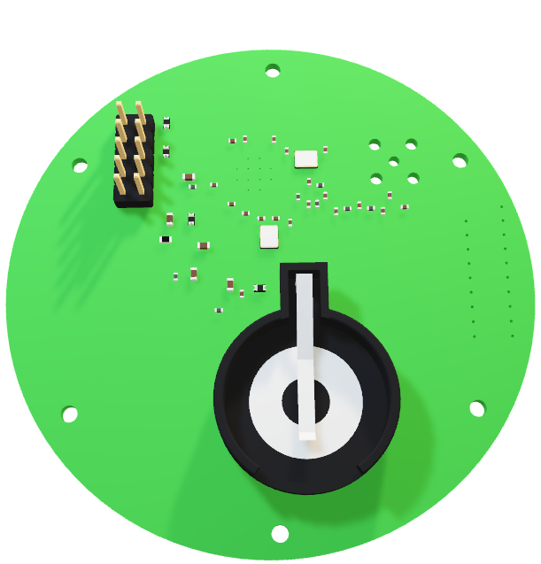
Pokéball PCB Breakdown
Mounting Holes

Slide 40
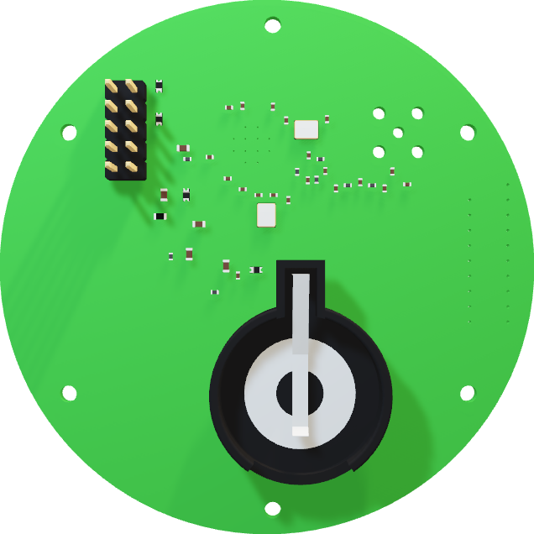
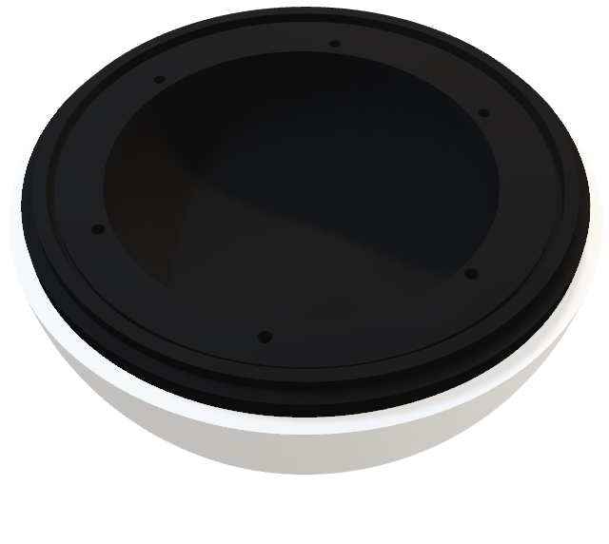
Pokéball PCB Breakdown

Slide 41
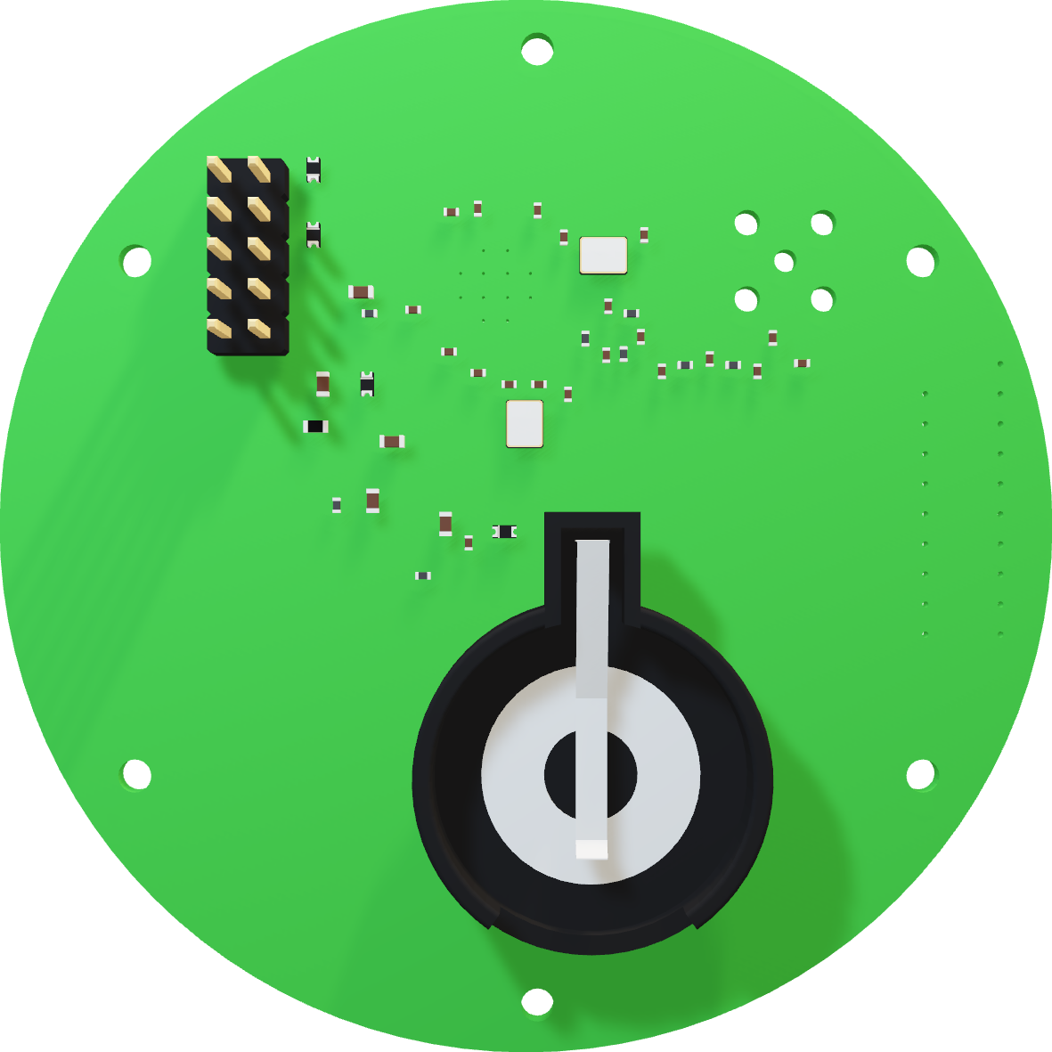
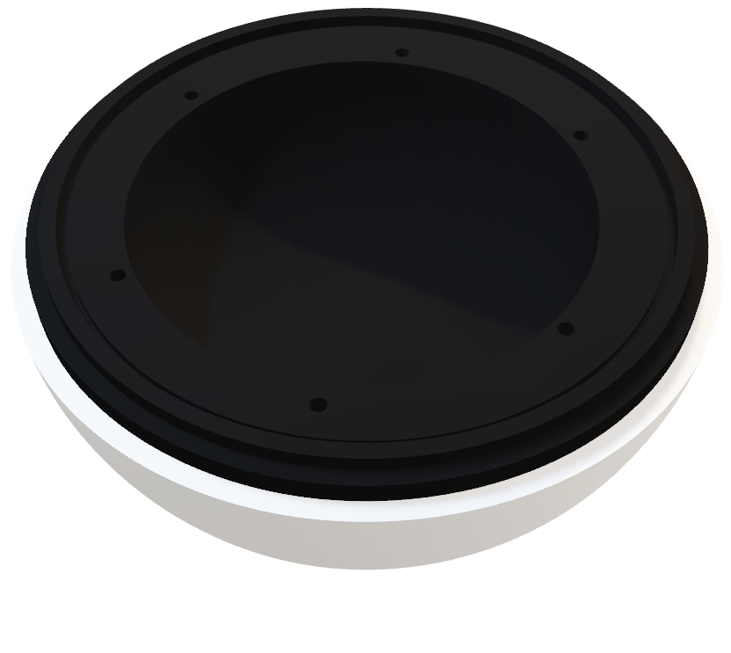
Pokéball PCB Breakdown
Power & Regulation
Why CC1310?
JTAG Pin Headers & Debugging
Reset Switch
24MHz Crystal Oscillator
32KHz Crystal Oscillator
CC1310 Microcontroller
Radio Frequency Impedance Matching & Balun

Slide 42
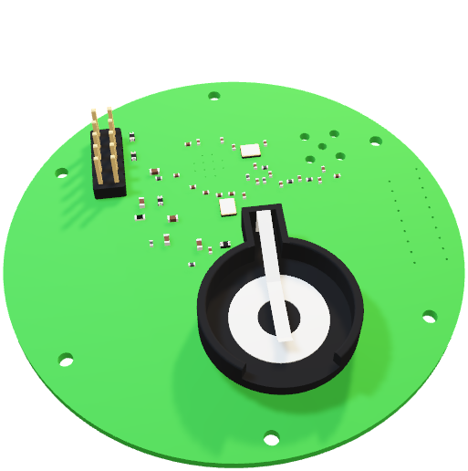
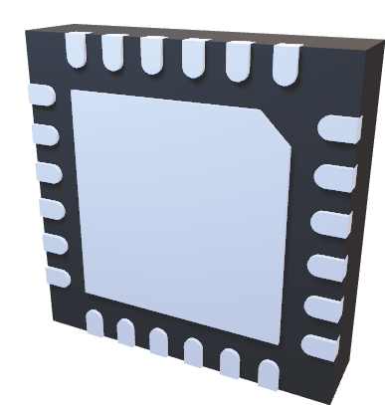
Pokéball PCB Breakdown
Why CC1310?
Availability
3-day lead times
Embedded Modules:
Robust RF Core with a -110dBm sensitivity
Ultra Low Power
2.5mA in Active-Mode MCU at 48MHz
Operating Supply Voltage range of 1.8-3.8V
Longevity

Slide 43
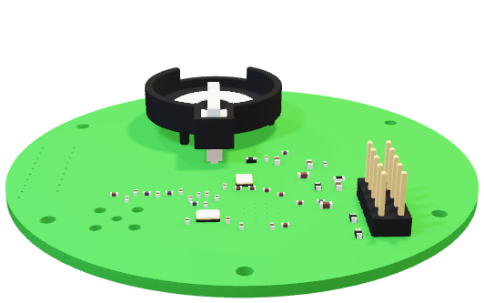
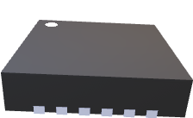
Pokéball Breakdown

Slide 44
Software Overview
L
A
M
P

Slide 45
Software Stack
L
A
M
P

Slide 46
Software Stack
A
L
M
P
A
C
H
E
Y
S
Q
L
I
N
U
X
P
H
P

Slide 47
Software Stack
A
L
M
P
A
C
H
E
Y
S
Q
L
I
N
U
X
P
H
P

Slide 48
Software Stack
L
A
M
P
Reliable
Fast
Secure
Highly Scalable
Low Maintenance
Multi-Language Support
Limited OS Support

Slide 49
L
A
M
P
Software Stack
C
JAVA
PHP
JAVASCRIPT
Procedural Programming Language
Object-Oriented Programming Language
Easier database interaction
Easier interaction with front end
No support for MCU programming
Compatible with LAMP stack
Useful for MCU programming
Most compatible with MEAN stack

Slide 50
MySQL Database
USERS
Date Created
Date Last Logged In
F. Name
L. Name
ID *PK
Login
Password
1
2022-11-08
02:29:20
2022-11-21
10:04:25
Kalindi
Desai
apricorn
Group15

Slide 51
MySQL Database
Pokéballs
PokémonScore *FK
PokémonID *FK
ID *PK
isEmpty
uID *FK
PokéballScore
10001
true
1
0
NULL
NULL
10002
false
2
100
320
75

Slide 52
MySQL Database
Pokémon
ID
NAME
TYPE
SCORE
WEAKNESS
RESISTANCE
M1
M2
M3
M4
1
Grass, Poison
Water, Electric
Water, Electric
Vine Whip
Poison Powder
Synth-esis
Solar Beam
Bulb.
318
2
Squirtle.
Fire, Water
Fire, Water
Water Gun
Water Pulse
Rain Dance
Hydro Pump
Water
314
6
Pidgey.
Normal Flying
Grass, Bug
Grass, Bug
Gust
Twister
Tail
Winds
Hurric-ane
251
Machop
Bug, Rock
Bug, Rock
Focus Energy
Dual Chop
Dyn. Punch
Cross Chop
27
Fighting
305

Slide 53
Administrative Content

Slide 54
Project Milestones
Planned
Actual
9/25 - Web App Draft
9/26 - Receive PCB
9/28 - PCB Debugging
10/10 – Initial Pokéball Print
10/27 - Complete First Assembly
11/2 - Testing & Debugging
11/10 - Final Testing
11/21 - Final Documentation
11/23 - Final Demonstration
9/25 - Web App Draft
9/29 - Receive PCB
9/30 - PCB Debugging
10/10 – Initial Pokéball Print
10/31 - Complete First Assembly
11/2 - Testing & Debugging
11/10 - Final Testing
11/21 - Final Documentation
11/23 - Final Demonstration

Slide 55
Project Milestones
Planned
Actual
9/25 - Web App Draft
9/26 - Receive PCB
9/28 - PCB Debugging
10/10 – Initial Pokéball Print
10/27 - Complete First Assembly
11/2 - Testing & Debugging
11/10 - Final Testing
11/21 - Final Documentation
11/23 - Final Demonstration
9/25 - Web App Draft
9/29 - Receive PCB
9/30 - PCB Debugging
10/10 – Initial Pokéball Print
10/31 - Complete First Assembly
11/2 - Testing & Debugging
11/10 - Final Testing
11/21 - Final Documentation
11/23 - Final Demonstration

Slide 56
Project Milestones
Planned
Actual
9/25 - Web App Draft
9/26 - Receive PCB
9/28 - PCB Debugging
10/10 – Initial Pokéball Print
10/27 - Complete First Assembly
11/2 - Testing & Debugging
11/10 - Final Testing
11/21 - Final Documentation
11/23 - Final Demonstration
9/25 - Web App Draft
9/29 - Receive PCB
9/30 - PCB Debugging
10/10 – Initial Pokéball Print
10/31 - Complete First Assembly
11/2 - Testing & Debugging
11/10 - Final Testing
11/21 - Final Documentation
11/23 - Final Demonstration

Slide 57
Project Milestones
Planned
Actual
9/25 - Web App Draft
9/26 - Receive PCB
9/28 - PCB Debugging
10/10 – Initial Pokéball Print
10/27 - Complete First Assembly
11/2 - Testing & Debugging
11/10 - Final Testing
11/21 - Final Documentation
11/23 - Final Demonstration
9/25 - Web App Draft
9/29 - Receive PCB
9/30 - PCB Debugging
10/10 – Initial Pokéball Print
10/31 - Complete First Assembly
11/2 - Testing & Debugging
11/10 - Final Testing
11/21 - Final Documentation
11/23 - Final Demonstration

Slide 58
Planned
Project Budget
9/25 - Web App Draft
9/26 - Receive PCB
9/28 - PCB Debugging
10/10 – Initial Pokéball Print
10/27 - Complete First Assembly
11/2 - Testing & Debugging
11/10 - Final Testing
11/21 - Final Documentation
11/23 - Final Demonstration
ITEM
COST
DESCRIPTION
PCB
$93.18
5x PCBs and Components
Pokéball
$65.00
3D Materials and Hardware
Base Station
$36.78
Components & Casing
Domain
$2.99
Ordered via GoDaddy
25GB Server
$10.00
Purchased via Digital Ocean
TOTAL PROJECT COST: $207.97

Slide 59
Testing & Results

Slide 60
Hardware Testing
TEST
RESULT
Continuous Transmission at 14dBm
20x – 60s trials from 5m away between Pokéball and Base Station ranged from -50dBm to -40dBm
20x – 100 packet trials from 5m away between Pokéball and Base Station averaged a 2% packet loss
Packet Transmission
5m distance: -40dBm
8m distance: -60dBm
10m distance: -80dBm
Detection Range (peak)

Slide 61
Software Testing
NAME
TRIALS
RESULT
3/21 - Trials returned an error, all other succeeded through all API endpoints
Credentials
21
3/28 – Returned error
2/28 – Did not update leaderboard
1/28 – Did no initialize proper battle
25/28 – Successful through all endpoints
Battle Sequence
28
Pokéball Connectivity
5/30 – Did not update database
2/30 – Took over 3 minutes to connect
3/30 – Did not return results
30

Slide 62
Challenges
Establishing a M.V.P.
Pure coding
Hardware assembly & component acquirement
Selling the idea

