Slide 1
Smart Interior Monitoring Plug:
Final Demo
Group 11
Austin Raynor CpE
Anthony Perez CpE
Edin Durgutovic EE
Jose-Valentin Sera-Josef EE
Notes:
Hi
Introduce myself
Introduce project

Slide 2
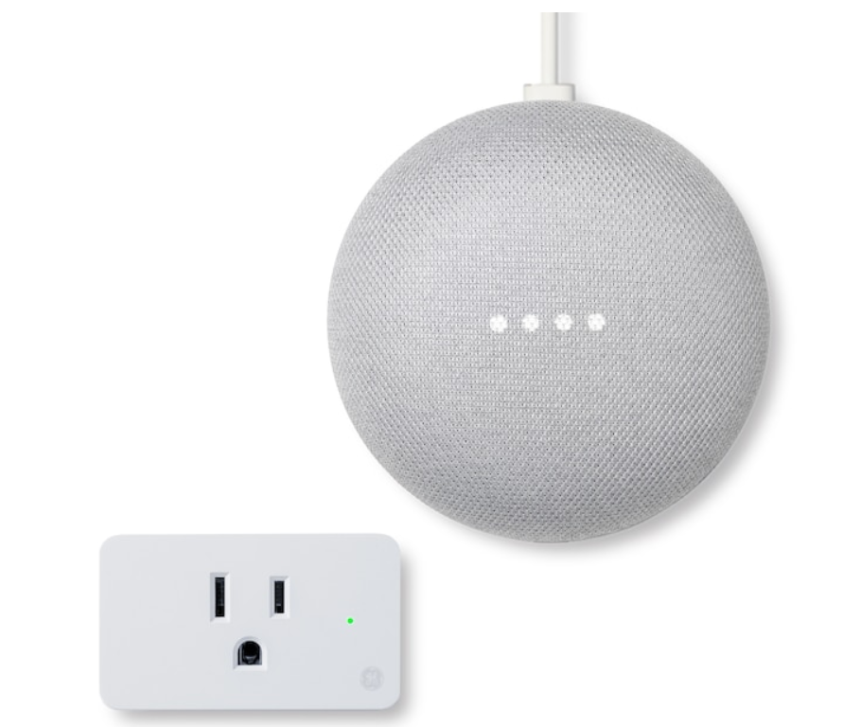
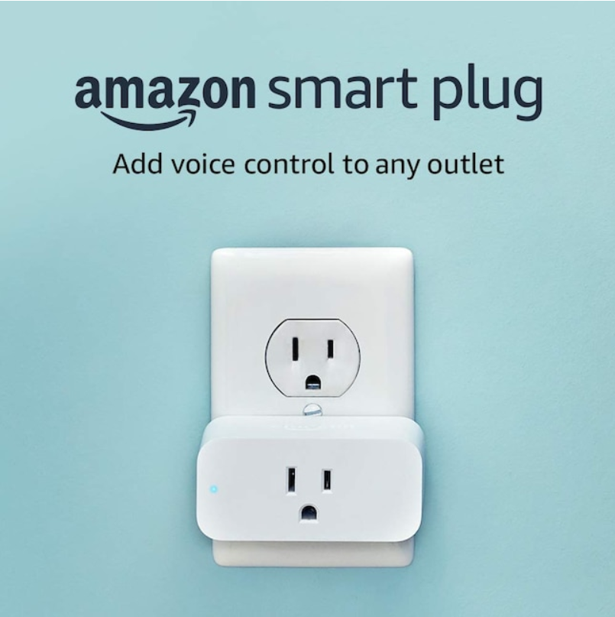
Introduction and Motivation
The SIMP is designed to help users both better insights into their power consumption habits and allows for more control over those habits through their phone.
“Did I leave my (common house appliance, hair dryers,lamps, phone charger) plugged in?”
Similar products already exist but the browser based approach for our system allows for access to the controls from any Wi-Fi enabled device
Notes:
-What is SIMP, why is simp

Slide 3
Market Research
 | GHome Smart | Geeni | Amazon | TP-Link | Sense | S.I.M.P.
Size/Weight | 2 x 2 x 1.1 inches; 1.6 ounces | 1.7 x 2.75 x 4.5 inches | 3.2 x 1.5 x 2.2 inches; 3.1 ounces | 2.4 x 1.5 x 1.6 inches; 6.4 ounces | 5.4 x 2.6 x 1.26 inches; 7.75 ounces | 5 x 5 x 3 inches; 8 ounces (Estimate)
Alexa & Google Home | ✅ | ✅ | ✅ | ✅ | ✅ | ❌
Scheduling | ✅ | ✅ | ✅ | ✅ | ❌ | ✅
Away- From-Home Controls | ✅ | ✅ | ✅ | ✅ | ❌ | ✅
SIMPY | ❌ | ❌ | ❌ | ❌ | ❌ | ✅
Easy Installation | ✅ | ❌ | ✅ | ✅ | ❌ | ✅
Price/ Quantity | $7.99/1 | $39.99/2 | $24.99/1 | $17.99/1 | $299.99 | ~$60*
Examples of similar systems on the market and their features
We used these examples as a benchmark for our system, trying to meet as many features as the pre-existing systems as well as adding a new feature not yet on the market
Notes:
-Our project mimics similar functionalities of products on the market but not evil

Slide 4
Key Engineering Specifications:
Dimensions | The enclosure of the SIMP is to be no larger than 5 x 5 x 3 inches.
Plug Style | The SIMP should be compatible and operate via a standard NEMA 5-15R (120V~15A).
Male Plug | The SIMP will consist of no more than 1 standard NEMA 5-15P.
Female Plug(s) | The SIMP will consist of no more than 2 standard NEMA 5-15R.
Data Reporting | The SIMP will collect and report data via a 2.4GHz Wireless Network Connection every 15 seconds.
Platform | The SIMP UI will consist of a low cost web-based platform.
Daily/Weekly Report | The SIMP UI will summate Power Consumption Costs (either per kWh or per U.S. Dollar) per SIMP Device and report them to the end user in the form of a table/chart every 24 hours and every 7 days.
Main Controls | The SIMP UI will enable a user to control the power output within 10 seconds from the web interface.
Dashboard | The SIMP UI will contain a dashboard indicating pertinent information such as Device Schedules, Device State, and Activity Metrics.
“High-Priority” Warning | The SIMP UI will warn the user of any “high-priority” devices suddenly losing power or loss of power draw within 10 seconds of said power loss.
Notes:
-Focusing on green highlighted boxes and why those are most important

Slide 5
SIMP Hardware
Research and Design
Notes:
Hey, heres how we built the thing, mention Edin

Slide 6
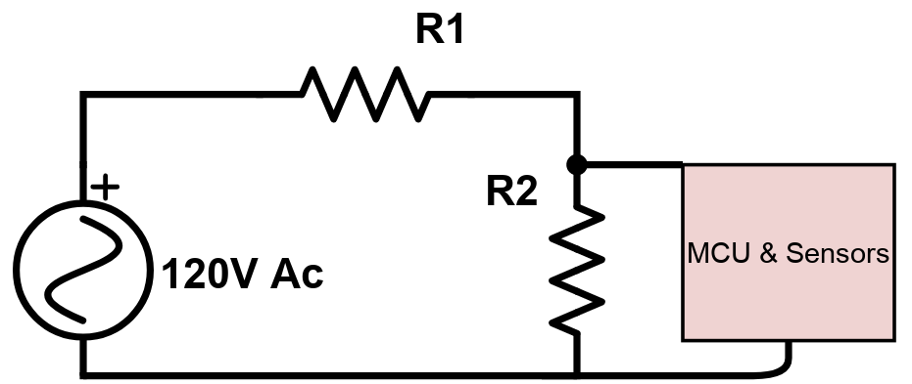
Theory Behind Hardware Design: Method #1
Device plugged into SIMP will draw a certain amount of current(X current)
Our initial design had the SIMP MCU and sensors in parallel with a high value resistor in series with the load, which will be in parallel with a lower value resistor.
When the load would draw X current it would create a corresponding voltage difference across its corresponding resistor which could be extrapolated from the voltage across the resistor connected to the SIMP using Voltage Division
We decided to move on from this methodology following research into shunt resistors that would have made assembly costly and time consuming
Notes:
-We thought we could use voltage division to determine power dissipated by the load but couldn’t do it in a timely/cost effective manner

Slide 7
Method #2: Non-Invasive Split Core
The AC current going through the wire powering the load induces a magnetic field.
Using the Lenz’s Law, the split core transformer creates a secondary current that has a known ratio to the incident current
Methodology abandoned due to the scale of current being drawn by appliances meant for the SIMP
Notes:
-easiest method of measuring in theory, not accurate in practice

Slide 8
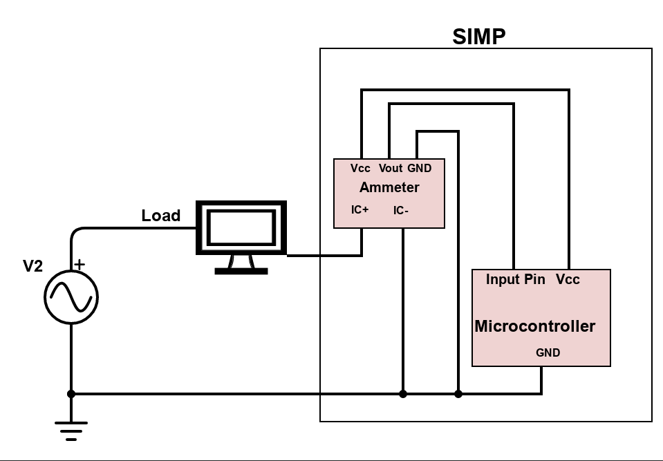
Method #3: Hall Effect
The most accurate and reliable current sensing method has been using Hall Effect Current Sensors.
The hall effect sensors create a voltage output that is dependent on the current being passed through the sensor with a known ratio
Sensitive enough at the current scale that most appliances used for testing operated in with sufficient accuracy with data post processing using the Arduino
Notes:
Talk about how hall effect sensor works, harder to work with in assembly but works best in practice

Slide 9
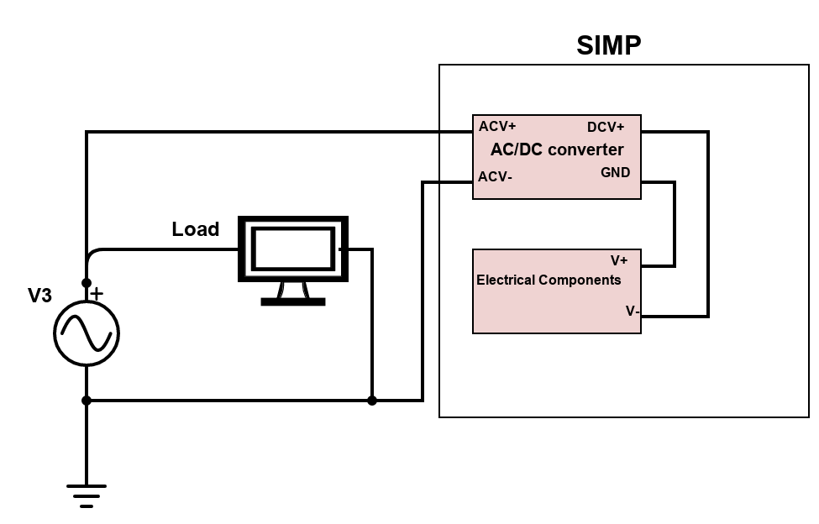
AC-DC Converter
The components we are working with and the microcontroller can not safely receive the AC power coming from the wall so we have employed an AC/DC converter to rectify and step down the voltage to a level safe for the SIMP hardware
Notes:
-We have to power the stuff not directly from wall power or it would defeat the purpose of the system and would blow up

Slide 10
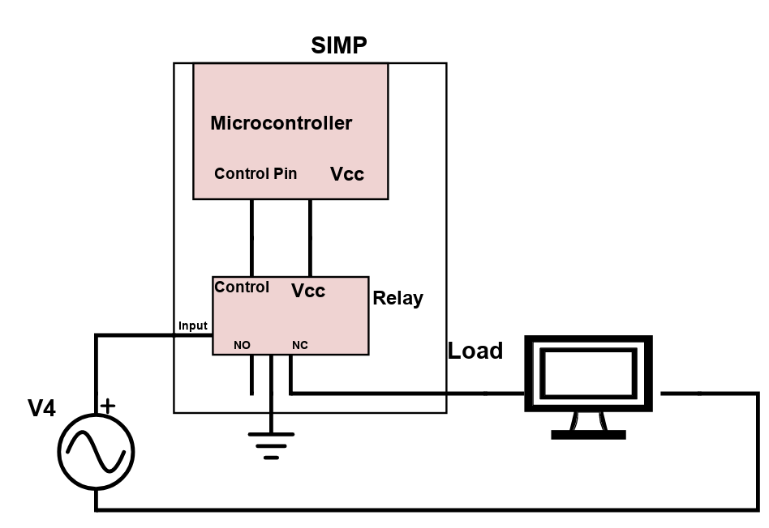
Power control via Relay
To control when power is sent to the devices plugged into the SIMP system we employed the use relays whose control signals can be generated by the Arduino

Slide 11
Microcontroller Name | Arduino Portenta X8 | Arduino Nano 33 IoT | Arduino MKR Wi-Fi 1010 | Texas Instruments MSP430
Price | $239.00 | $22.10 | $35.40 | $20.00
Dimensions (mm) | 66 x 25 | 18 x 45 | 61.5 x25 | 76 x 50
Input Voltage(V) | 5 | 5(USB-C) 4.5-21 | 5 | 5(USB) 3.3
Operating Voltage(V) | 3.3 / 5 | 3.3 | 3.3 | 1.8-3.6
GPIO pins | 7 | 26 | 26 | 83
RAM | 2 GB | 32 KB | 32KB | NA
Flash Memory | 16 GB | 256 KB | 256 KB | 128KB (FRAM)
Connectivity | Bluetooth,WiFi | Bluetooth,WiFi | WiFi | USB
Notes:
-We chose the nano since it was readily available at the time, in price range, had all the features we needed, had plenty of available documentation

Slide 12
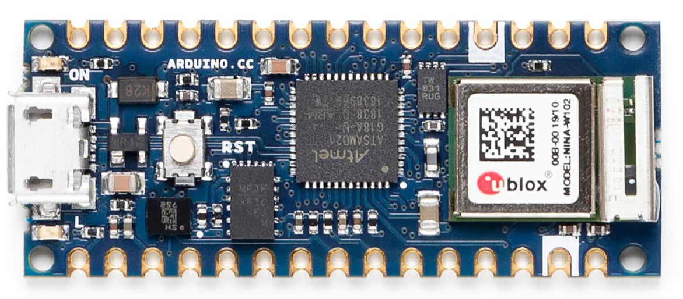
Microcontroller
Arduino Nano 33 IoT
Operating Voltage: 3.3v
Input Voltage:4.5v-21v
Flash memory:256KB
SRAM:32KB
Length x Width(mm): 45 x 18
SAMD21 Cortex®-M0+ 32-bit low power ARM MCU
12-bit ADC
Notes:
Here we have an image of the Arduino Nano 33 IoT and it’s technical specifications.(read specs)

Slide 13
Part Comparison of NEMA 5 Outlets
Name | Decora 15 Amp Residential Grade Self Grounding Duplex Outlet | X Series 20 Amp 125-Volt Tamper Resistant USB A/A 4.8 Amp Duplex Decorator Outlet Back Wire Clamps | Leviton 20 Amp Commercial Grade Duplex Outlet
Dimensions | 1.063” x 1.625” x 4.25” | 4.06” x 1.73” x 1.73” | 4.122” x 1.875” x 1.375”
Socket Type | NEMA 5-15R, 2P and 3W | NEMA 5-20R, 2P and 3W | NEMA 5-20R, 2P and 3W
NEMA Rating | 15A / 125V | 20A / 125V | 20A / 125V
Grounding | Self-Grounding | Self-Grounding | Self-Grounding
Price | $2.67 | $40.00 | $3.64
Notes:
The deciding factor in the case of choosing an outlet plug was simply price and the fact that a member of our group has worked with and owns multiple of the ones we selected.

Slide 14
SIMP System Diagram
AC/DC Converter
Heroku Web Server
House Power
(120V AC; 60 Hz)
Microcontroller
Device Plugged In
Relay
NEMA-1 Outlet
(Standard Household American Outlet)
Current Sensor
Notes:
Heres the overall block diagram for the hardware side

Slide 15
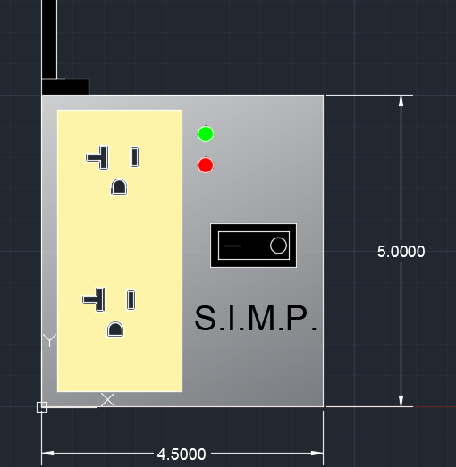
Hardware Enclosure
As per our desired standards the S.I.M.P. will have a wired connection into the wall with all of it’s internals held in a single unit
The unit will be 3D printed out of either PLA or other heat resistant filament
LED indicators for power and timer notifications
ON/OFF switch for manual shut off of power
Notes:
-Describe how it fits in the box

Slide 16
PCB/EAGLE Circuit Design
Steps:
Part Selection
Schematic Design
PCB Design
Notes:
Hello, my name is Edin Durgutovic, I am the other electrical engineer in the group and I will be continuing the part selection process of our PCB components and talking about the steps we took to make our final PCB as well as the challenges we faced along the way.

Slide 17
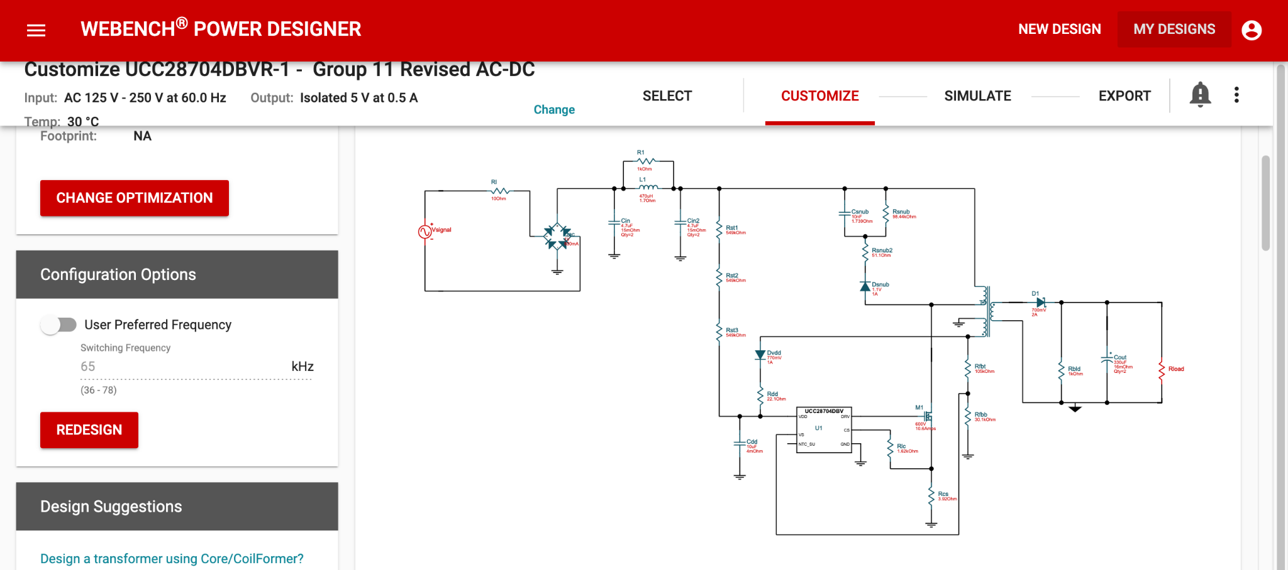
AC/DC Converter
Notes:
The first idea we had to tackle was converting the 120 AC voltage to 5V DC to act as an operating voltage for numerous electrical components in our PCB. This brought back memories of Junior Design, where we used WEBENCH by Texas Instruments to provide us with a circuit layout for our AC/DC converter. After a wide selection of different AC/DC converter circuits, this is the one we went with. You can see it uses an integrated circuit, a transformer, and a mix of inductors, diodes, resistors, and capacitors.

Slide 18
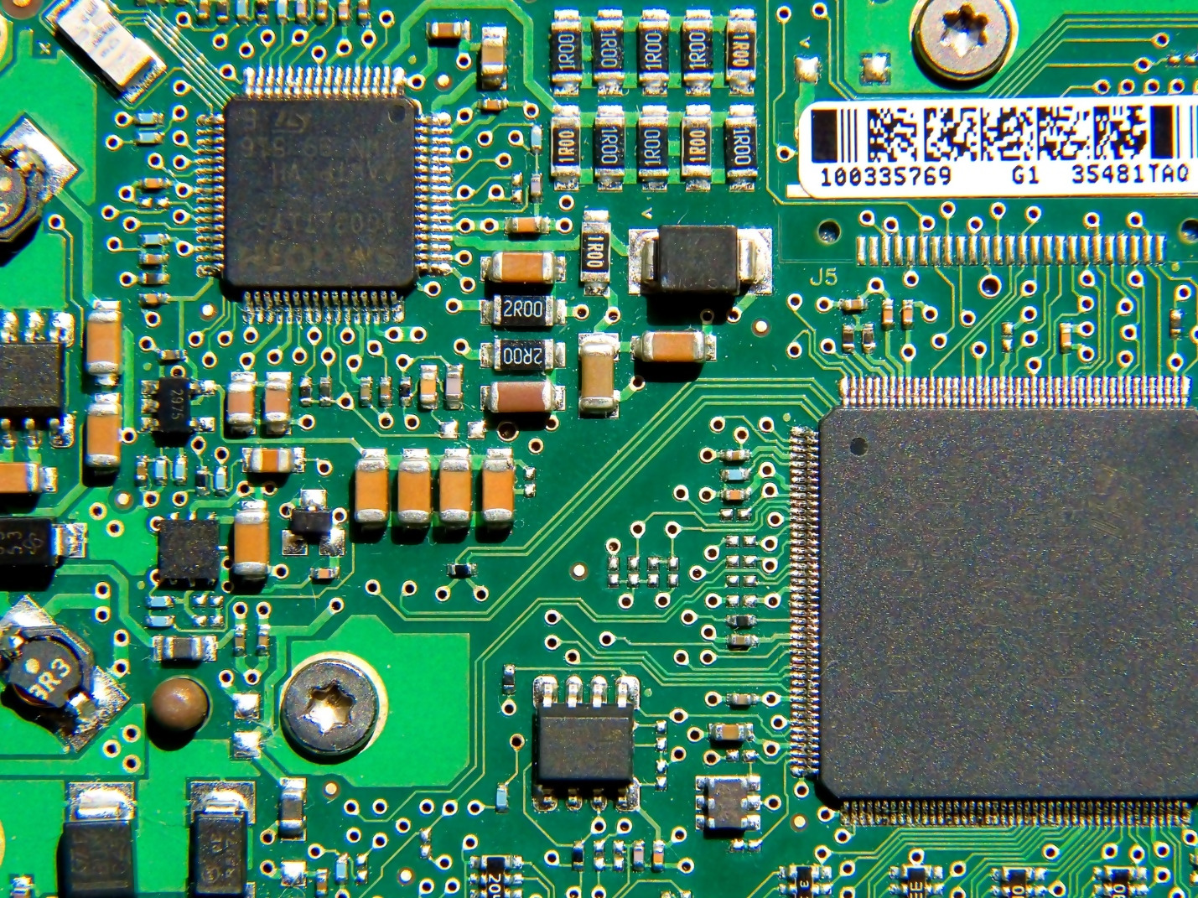
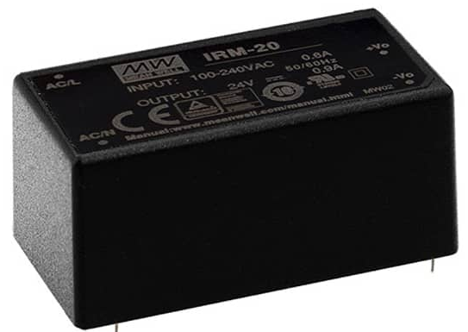
AC/DC Converter
Notes:
Before finishing up the work on our AC/DC converter we realized we never checked to see if there were AC/DC converters with the specifications we wanted that already existed. After searching using the specification dials on DigiKey, we were able to find an already-manufactured AC/DC converter made by a company called MEAN WELL that met beyond our specifications. This meant we no longer had to make our own AC/DC converter and meant we would save space and money in the bulk of the final device.

Slide 19
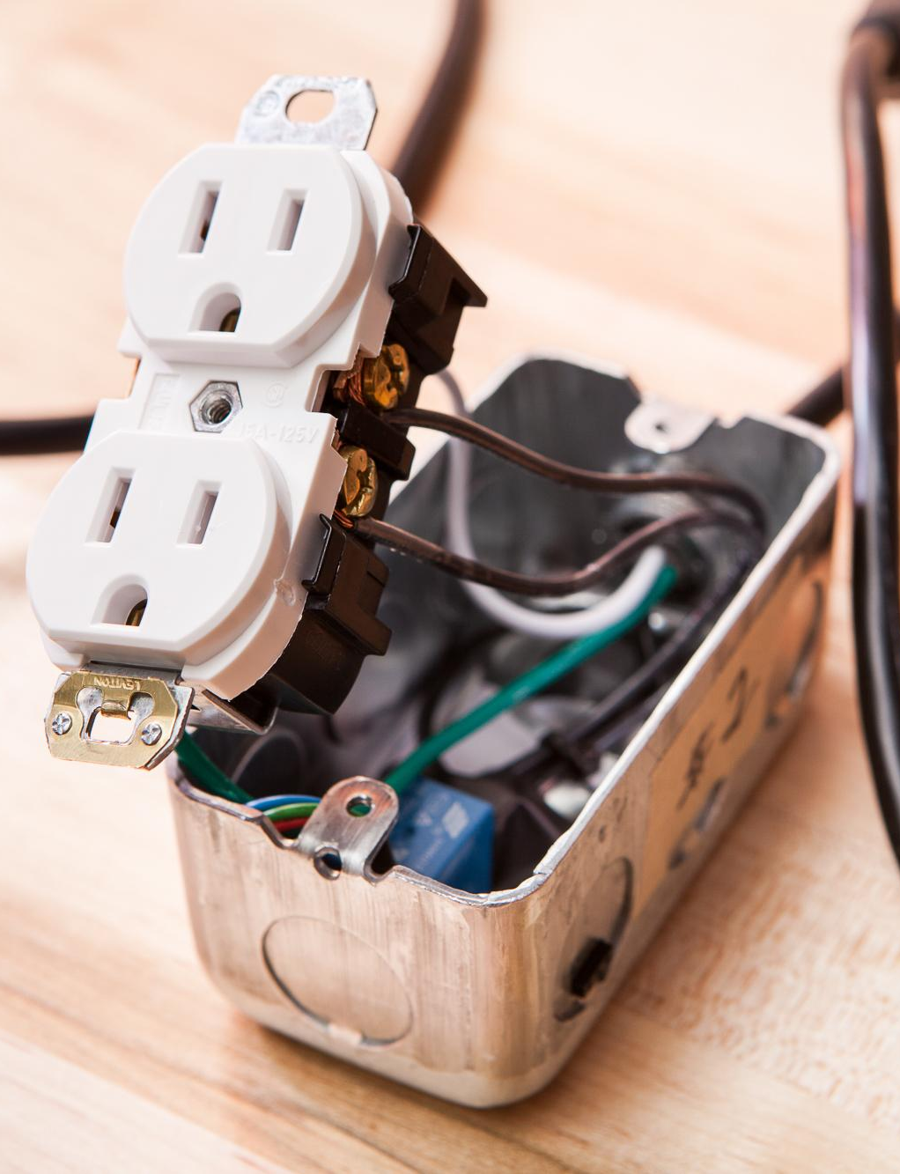
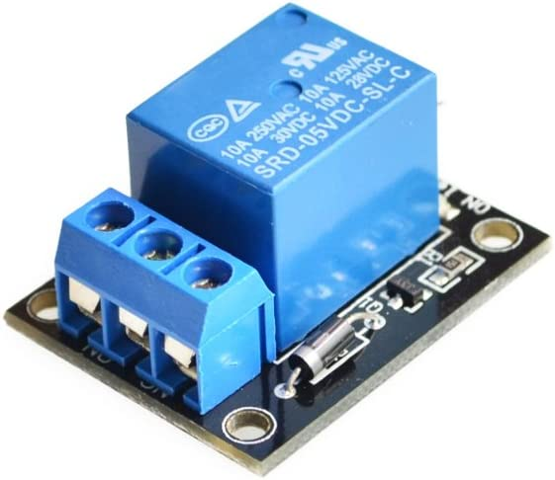
Electrical Relay/Relay Module
Notes:
When searching the internet for a relay that would be suitable for our application, we were lucky enough to stumbled upon a detailed article describing someone’s experience with a relay module they equipped to an electrical outlet to demonstrate connecting and disconnecting the power using this relay module paired with an Arduino. This relay module was readily available on amazon for a cheap price and the relay itself was also readily available on amazon in the form of a 12-pack. After successful breadboard testing of connecting and disconnect the power to a device using this relay module and a signal produced by our Arduino Nano 33 IoT, the decision to use this relay in our final PCB was made.

Slide 20
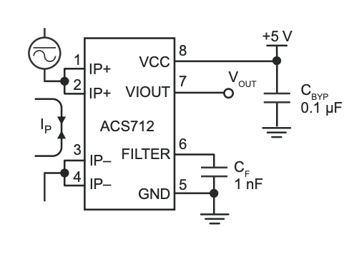
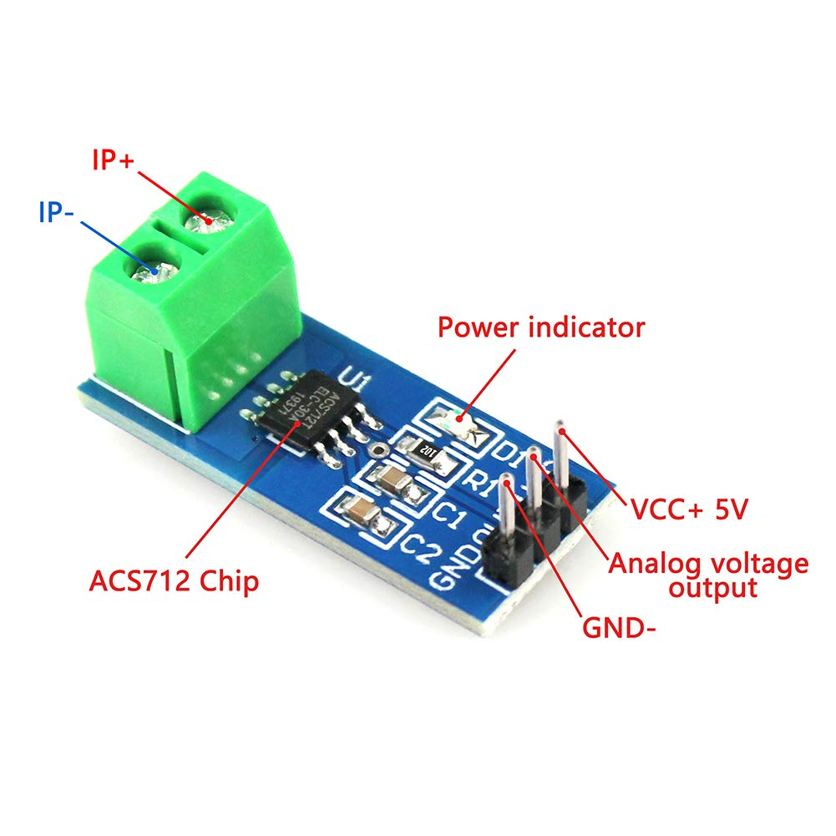
Ammeter
Notes:
When it came to finding an ammeter for our project, we noticed all the suitable ones were surface mount style and were extremely small, which brought the added difficulty and frustration of soldering at a level we were not experienced enough to attempt. Because of this, we decided to use a module with a surface mounted current sensor already soldered and equipped with the corresponding capacitors and resistor for a typical application, as shown in the figure on the right. This setup also allowed us to connect a more accurate ammeter in series with the circuit so we could fine-tune the current sensor’s output, which wouldn’t be possible if we didn’t use PCB board screw-down terminals.

Slide 21
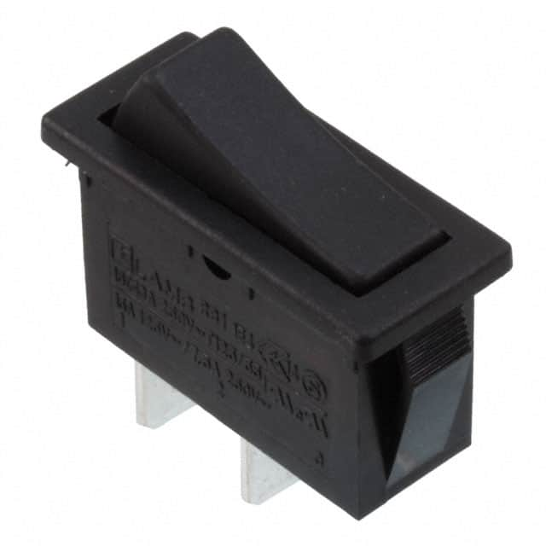
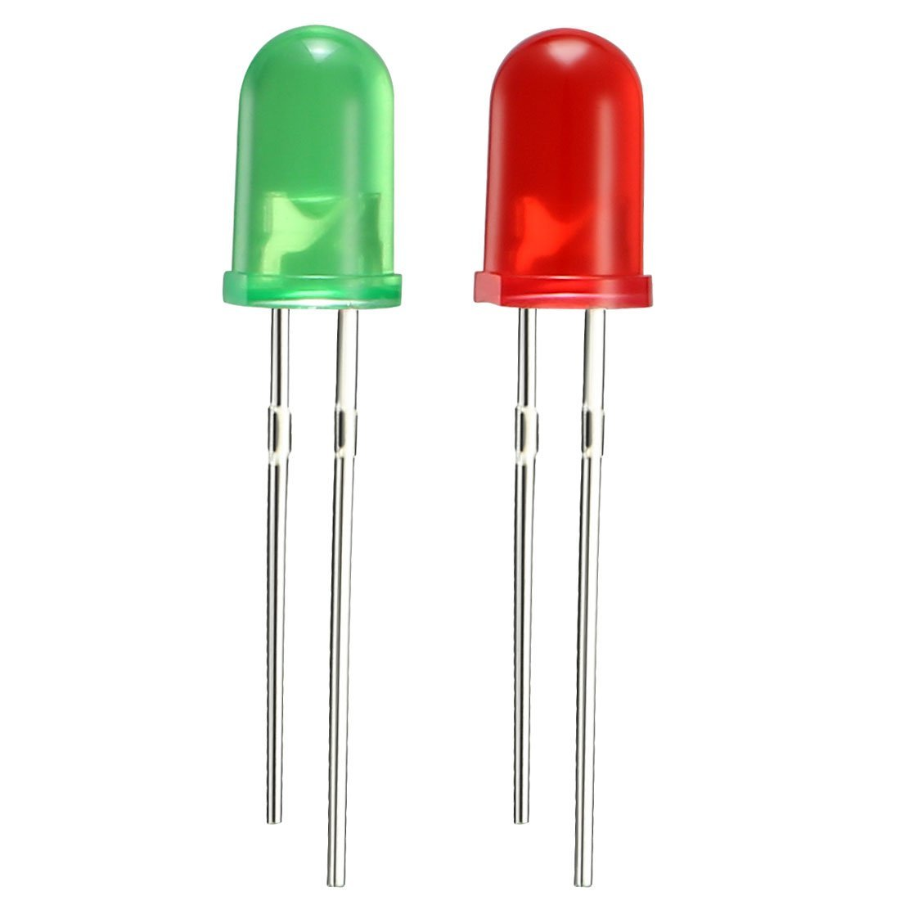
Physical User Interface
Message Being Delivered | LED Color(s) | Frequency
“Initial Setup; Ready To Pair To Wi-Fi” | Green | 2 Hz ON/OFF
“Setup Finished & Running” | Green | ON; No Frequency
“10 Minutes Before SIMP Cuts Power To Device; Save Your Progress” | Red/Green | 1 Hz RED/GREEN
“5 Minutes Before SIMP Cuts Power To Device; Save Your Progress” | Red/Green | 2 Hz RED/GREEN
“1 Minute Before SIMP Cuts Power To Device; Save Your Progress” | Red/Green | 4 Hz RED/GREEN
“Error Detected; Check Server Hub For Detailed Message” | Red | ON; No Frequency
“Notification from SIMPY” | Green | Two 8-Hz Flashes Per Second
Notes:
The LEDs and toggle switch will be the physical form of communication between the user and the device. Our design uses two LEDs, one red and one green, to communicate different messages to the user based on programs in our Arduino. An example of what those messages might look like and how they might be communicated is shown in this slide. The toggle switch will act as a fail-safe reset button incase our code finds itself in a constant loop or our software otherwise crashes for reasons beyond our understanding. The toggle switch also acts as a physical way for the user to cease power going to the device altogether in the event they cannot communicate that action through the software.

Slide 22
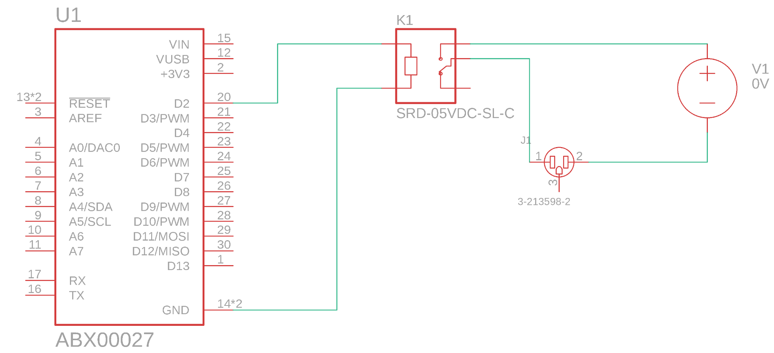
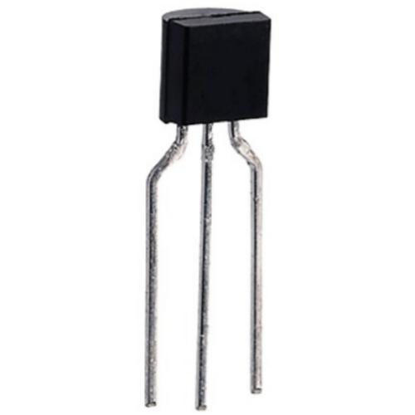
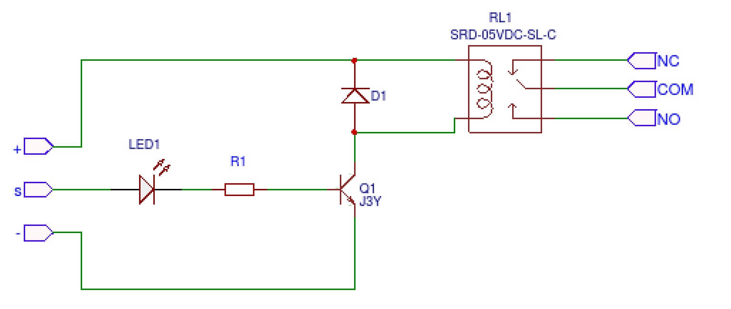
PCB Process:
Notes:
One of the main problems came after soldering and testing our first PCB, where we realized our relays would not work due to the way we connected them. We assumed the signal coming from the Arduino Nano was enough to trigger the relay in the on or off position without any supporting electrical components. After taking a further look at the schematic of the relay module we used in testing, we realized the relay depended on the combination of a diode and an NPN transistor to make the signal coming from the Arduino strong enough to trigger it. We found the same diode used in the module, and found an NPN transistor with the same specifications as the one found on the module. The only difference is the one we used had a through-hole design which took away the hassle of soldering an extremely small surface mounted transistor to our PCB.

Slide 23
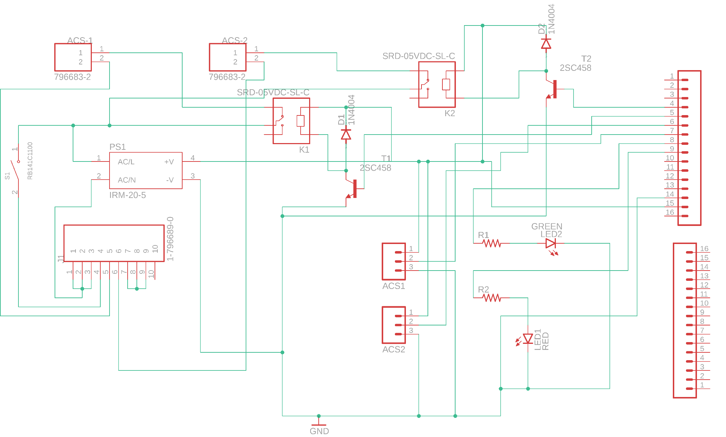
Full Overall Schematic:
Notes:
This slide shows our schematic for our final PCB.
The 10-pin terminal block is where all the wiring for the male and female wall outlet plugs.
When the switch is flipped in its ON position, it will provide power to the AC/DC converter as well as the common pin of the relay.
Talk about the diode and transistor added after looking at the relay module schematic.
Talk about the AC/DC converter providing power to the Arduino, the analog current sensor modules and the relays.
When the relays are turned on, the electricity will travel through the analog current sensors and to the terminal pin that connects to the hot side of the female outlet, providing power to the device that is plugged in.
The LED’s will strictly be controlled by the Arduino Nano.
The 16-terminal pin headers are place holders for the arduino as there is no definitive footprint for our microcontroller online.

Slide 24
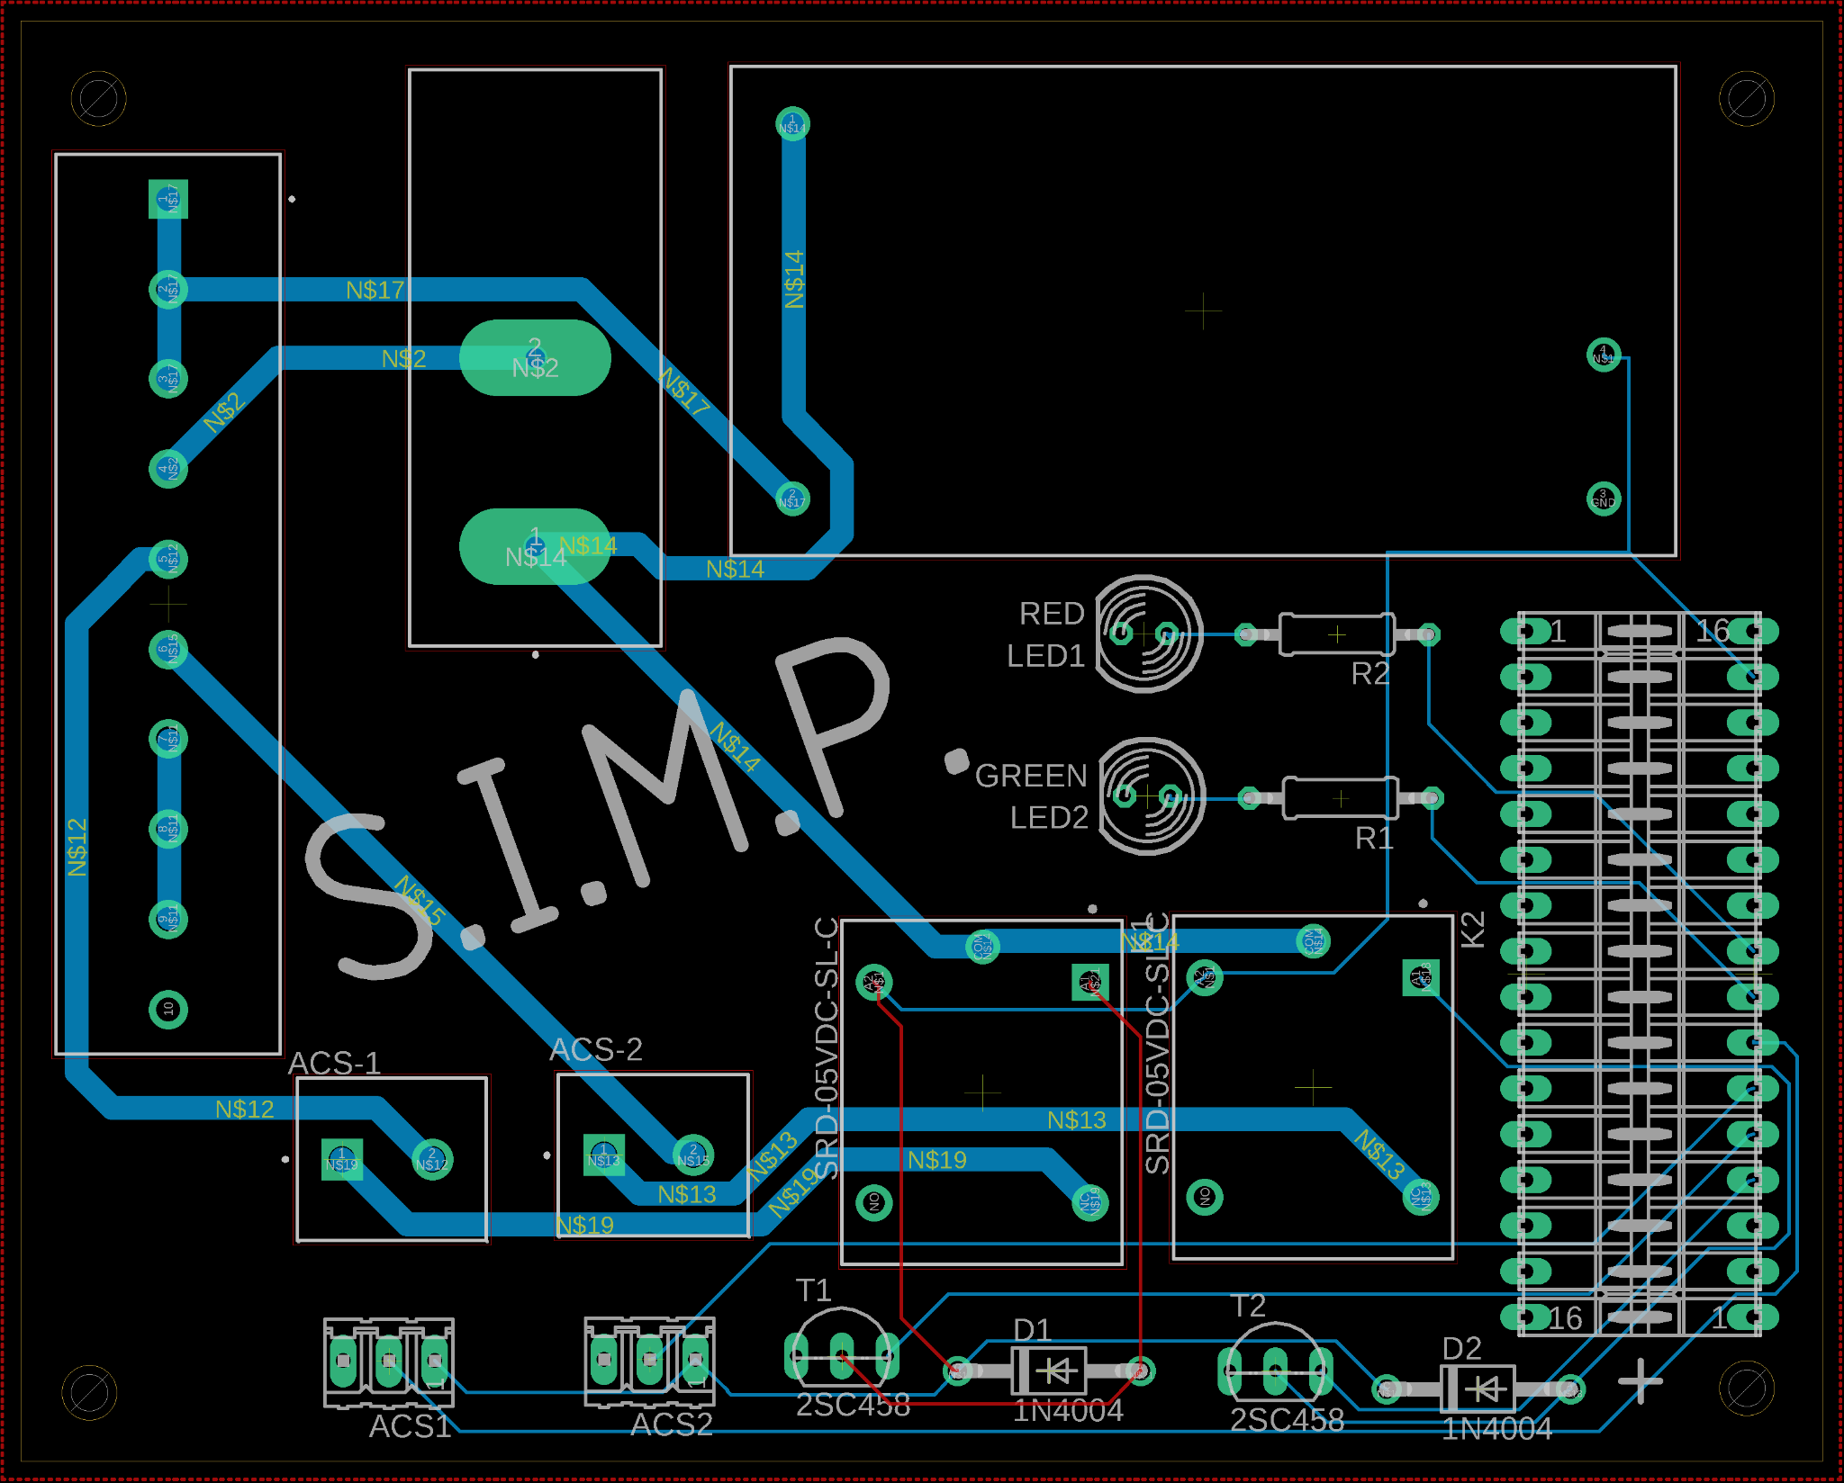
Final PCB
Layout:
Notes:
With all our parts selected and tested, our final schematic was designed using EAGLE, with size efficiency and board layout being our main concern.

Slide 25
SIMP Software
Design and Implementation
Notes:
Now that we’ve given a general overview of what hardware and decision-making processes were involved in designing the overall schematic of the SIMP module, we will now move forward with explaining the software components and product features that we have chosen thus far to interface with our product.

Slide 26
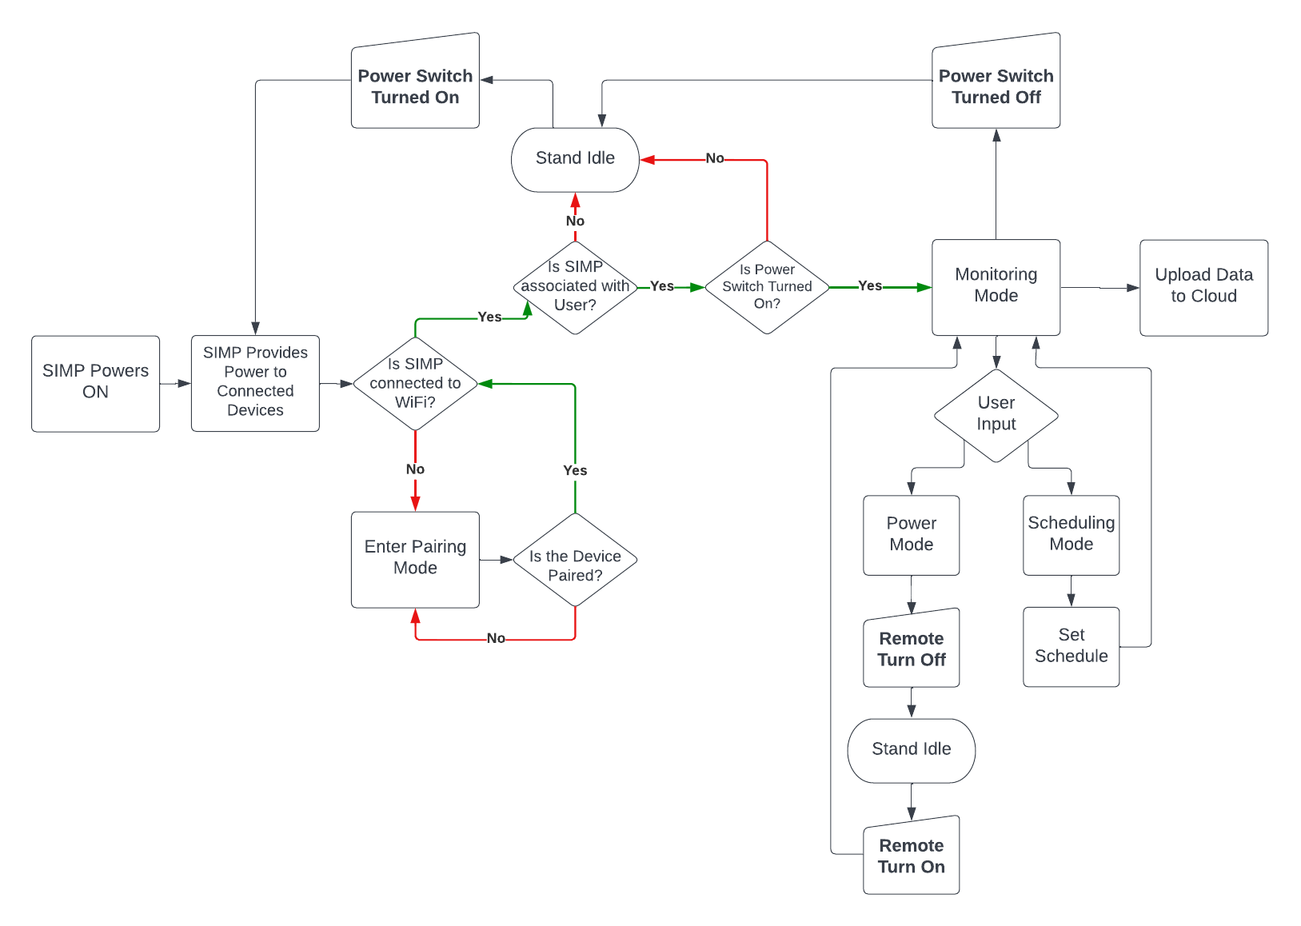
Software Design:
Notes:
Here we have a general flowchart dictating the state, action and response to inputs dictated by an external system, in other words via manual input, or remotely pushed requests. In the most basic scenario, we begin by first providing power to the SIMP module via connection through a standard 15-amp receptacle. Any device plugged into the SIMP therein after will receive power so long as the SIMP is not associated with any home wireless connection. Following this, we enter a set of conditional actions based on whether the SIMP is connected to a user’s home Wi-Fi and associated with a user account. If the SIMP module is not associated with a home Wi-Fi connection, the SIMP will enter a pairing mode. Until the SIMP is paired with an end users home Wi-Fi, the SIMP will continue to draw current and provide power to any connected devices but won’t enable an end user the ability to monitor and remotely alter the configuration of the device. Upon pairing the SIMP module with an end users home Wi-Fi, they will be required to visit the SIMP web portal, register an account, and link any active SIMP module discovered on their home network with their newly registered account. If the SIMP remains connected to the end users home network, but never becomes associated with a registered account, the module will remain in an Idle state until a link has been established. Upon associating the SIMP with a registered account, the internal MCU will verify the active state of the manual override button. If at any point, the manual override button is toggled low, this would be an indicator that all power output to any existing devices should be halted until realizing an active high state. Once an active connection to the web server has been established by the SIMP, and power output to any connected devices is enabled, the SIMP module can then move into its regular state of Monitoring. In monitoring mode, the SIMP will record and calculate Voltage, Amperage, and Wattage accordingly. This data will be collected, delivered, and displayed graphically on an end users account. From an end users account, they are given the option to entirely terminate power being broadcasted to directly connected devices via a simple on off button, or a via a remote scheduler. These general operations are what make up the bulk of how we plan to bring our product to fruition.

Slide 27
Web Stack:
Web Stacks | Components | Programming Languages | Framework | Database
LAMP | Linux, Apache, MySQL, PHP | HTML, CSS, PHP | Linux | MySQL
MERN | MongoDB, Express.JS, React, Node.JS | HTML, CSS, JavaScript | React | MongoDB
MEAN | MongoDB, Express.JS, AngularJS, Node.JS | HTML, CSS, JavaScript | AngularJS | MongoDB
Notes:
When formulating the web stack used to create our web application, our group had a general idea of what would not only be most efficient to see our design, but also prove most intuitive to the developers in our group. The LAMP stack, though well renowned for its ease of implementation, relies on a Linux framework and a MySQL database management system. With this, the opportunity for general flexibility of development is greatly constrained and the efficiency of data handling on the back-end may be susceptible to poor performance. The MEAN stack, being the more favored of the two, adopts an AngularJS framework and MongoDB as its database management system. The general consensus in the end was to move forward with the MERN web stack, comprised of MongoDB, Express.JS, React, and Node.JS. Members of our team were more familiarized in the development of React apps and felt moving to AngularJS would create an unnecessary learning curve in the development of our application.

Slide 28
Web Hosting:
Hosting Platforms | Pros | Cons
AWS | Provides a full application suite to manage every aspect of our project having everything seamlessly integrate. | Cost of Implementation. Group members lack experience in AWS, creating challenges and time constraints moving forward.
Digital Ocean | Simple solution that provides full virtualization of operating systems to allow any web stack hosting. | Requires maintenance of server from within the virtual machine giving more problems for us to deal with.
Heroku | A platform based solution that works with JS based stacks to host applications with plugins to allow for easy development and data analysis | Due to it’s platform solution we can’t change hardware as freely, operating systems, and more customization if we wanted to have specific upgrades to improve performance.
Notes:
Selecting our web hosting platform came with its own challenges. Whereas some platforms are used solely based off their popularity, others are used because of their versatility in the hands of a basic end user. With this in mind, we took into consideration 3 separate web hosting applications: AWS or Amazon Web Services, Digital Ocean, and Heroku. Of the three, AWS is possibly the largest and most well-known web-hosting platform. It provides many tools and features within its utility suite and allows for much easier integration across different items because they’re all hosted by the same service. The issue with AWS comes with the cost of implementation and a general lack of knowledge within our group on how to setup and implement a Web UI using their platform. Digital Ocean appeared to be a good alternative to AWS because it was cheaper, full of in-app services and features, and was well understood by members within our group. The challenge we faced with Digital Ocean was again, cost of implementation but also other minor intricacies that would prove cumbersome in the development of our app. With all this in mind, the general consensus was that we move forward with using Heroku as our web hosting platform. Its significantly cheaper cost to implement, dualled with a platform that works with JavaScript based stacks, made it so that those in our group who were already familiar with it had an easier time moving forward in development.

Slide 29
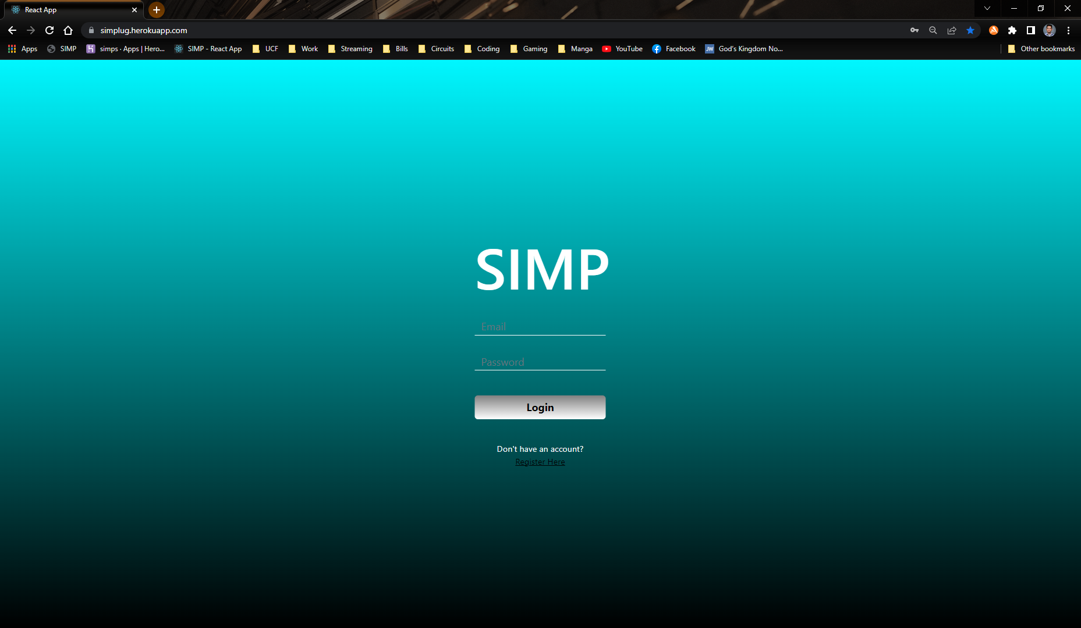
Web UI:
Notes:
Here, we have the landing page of the SIMP UI currently being hosted at simplug.herokuapp.com. The login page enables a user to login via a username and password that’s cross-referenced against what’s stored in MongoDB and then populates a dashboard which can be seen here. Components of the dashboard are fetched using the users ID and whatever pre-populated devices have already been added to the database. The Line Chart is a component of Chart.js that will populate according to a days worth of measurements and generate a chart depicting the amperage, voltage, and wattage used throughout the course of the last hour or so. The values are populated using those same measurements and calculating the daily costs of KiloWatts used perhour, alongside the state average cost in kilowatts per hour which is around 14 cents. In the picture in the bottom right, we see a device page depicting a chart and subsequent data as previously called from the dashboard. Difference here being that on the device page, we have the option to alter the power state switch for corresponding relays located on the simp device. Flipping the toggle switch to ON or OFF will eventually enable the SIMP device to update the relay state. Thereby turning on or off any directly connected devices to the Smart Interior Monitoring Plug.

Slide 30
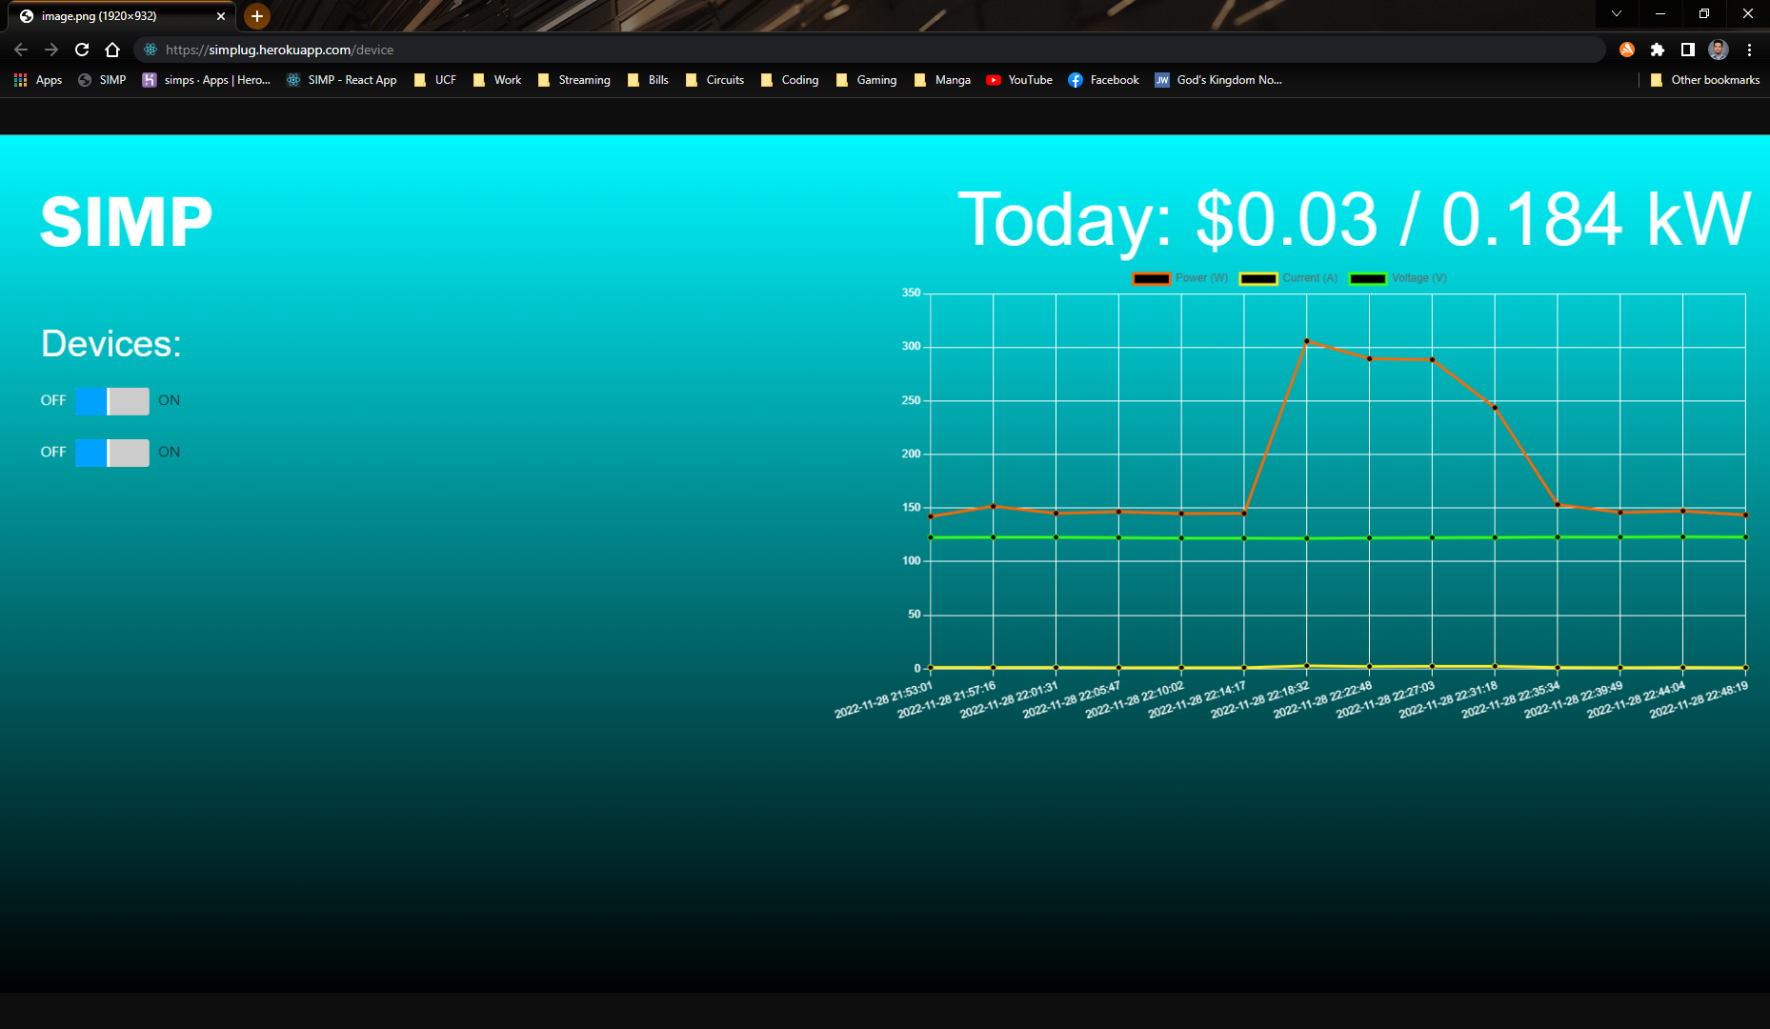

Slide 31
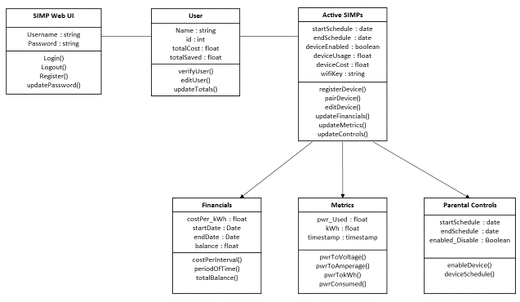
Backend (APIs)
APIs are functions built into our web server that act as connection between our SIMP and our web server, these APIs will help store our energy data, and control the SIMP remotely.
Notes:
Hi I’m Austin Raynor, Computer Engineering Major who was primarily working on the backend. The backend is what we use to connect our SIMP module to the web server to allow us to monitor and store the data remotely. We do this through the use of APIs using Express.js as our framework. The features we have included can be seen in the Diagram but to name a few we have Power Usage Monitoring, Plug Scheduling and User Electricity Costs. These all help provide the user with more ways to be informed of their energy usage.

Slide 32
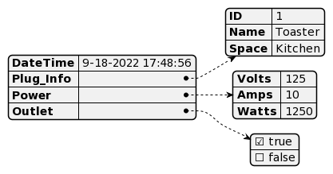
Database
MongoDB
Time Series Collections for efficient storage of our power usage over time data.
Easy to understand Document style storage
Notes:
We chose to use MongoDB for it’s easy and efficient storage of data over time. This allows us to quickly access the collection for fast display of data. Especially when we plan for the user to be able to see a month’s worth of data points at a given moment. It’s crucial to have this data be displayed in a promptly manner and MongoDB is able to provide that. We also have the JSON payload that the SIMP shown here visually that will be sent to our web server that provides it the ID, Location, Power usage, and Outlet Power state.

Slide 33
Microcontroller Programming
Connects to WiFi and establishes current time using a Internet Time API for synchronization.
Requests Outlet’s desired power state from database, once this value is received it will change the relay state accordingly.
Current Readings are measured over a 1 second period and averaged out to give a more consistent reading.
Current Time, Voltage, Current, and Power are then Packaged into a JSON Payload to be sent to the database from storage.

Slide 34
Project Management
Budgeting, Milestones and Division of Labor
Notes:
Engineering any design or product takes thorough coordination between each team member involved. Regarding Project Management, tasks must be delegated, and milestones must be kept to ensure steady progress on the completion of our project.

Slide 35
Distribution of Tasks
Edin: Schematic Design and PCB Design
JV: Breadboard Testing and Diagnosing
Austin: Back-End, Microcontroller Programming
Anthony: Front-End User Interface Design
Notes:
Throughout the development of the SIMP, tasks were broken down so that major project components had a group member assigned to ensuring its completion. Edin, dualling as project manager, would ensure that any schematics regarding the SIMP circuitry and PCB layout are drafted, tested, and properly integrated with external components. Jose would be responsible for bench testing and ensuring the accuracy of any published schematics used to develop the SIMP module. Anthony will be responsible for the development of most front-end components in the SIMP UI, and I will be responsible for ensuring the proper communication between front-end and back-end software applications.

Slide 36
Budgeting (Actual):
Item | Price (Total)
First Ammeters and Voltmeters | $12.77
5V Relay Module | $5.86
2x20 Pin Headers | $9.57
Solder | $7.44
2nd 5V Relay Module | $5.86
3.3V Relay Modules | $9.57
De-solder wick | $10.64
5A Current Sensors | $7.99
Red & Green LEDs | $5.31
5V Naked Relays | $8.51
2 POS Terminal Blocks | $5.99
Female Pin Headers | $6.49
First PCB | $28.00
“Final” PCB | $30.00
Actual Final PCB | $30.00
2nd Set of 5A Current Sensors | $7.23
Diodes & Transistors | $12.23
Grand Total | $203.46
Notes:
With financial commitment being an unavoidable ordeal in developing any new product, each member of our group agreed upon a preset amount of 125$ per person to guarantee no monetary disputes would be encountered. After having realized the bulk of components we intended to use when developing the SIMP, we budgeted to include the cost of duplicate components should anything come to us late or in an unusable state. With that in mind, individual hardware was purchased as seen in the chart on the right. Disparities in cost can be observed between what was originally budgeted for on the left, and what our group has actually purchased on the right. Our total budgeting thus far to test and manufacture the SIMP equates to just over 100$’s.

Slide 37
Milestones
Milestones | Dates
Ordering Prototypes of Design to Test | August 10th
Initial Web Server Creating | August 15th
Testing and Fixing Design Flaws | September 10th
Redesigning Hardware and Software | October 10th
Finalizing Projects Software and Enclosing | November 10th
Practicing Presentation of Project | November 30th
Presenting Our Project | December (Presentation Week)
Notes:
These were the milestones that we had set in place towards the end of last semester as guidance dates to work towards to give us enough time for the development of the SIMP. Once the new semester had started we were hard at work to meet our deadlines, while we did not meet our milestones at the exact dates, we were never too far behind from them. Towards the end of our milestones if we happen to finish them earlier than anticipated we have planned stretch goals to help further improve the experience with the SIMP. These stretch goals include Machine Learning to identify devices connected to the plug based off their power usage signature, a Mobile app for easier setup and mobility, advanced geofencing and scheduling to allow for users to set power state based on distance from home.

