Slide 1
Smart Interior Monitoring Plug
Austin Raynor CpE
Anthony Perez CpE
Edin Durgutovic EE
Jose-Valentin Sera-Josef EE

Slide 2
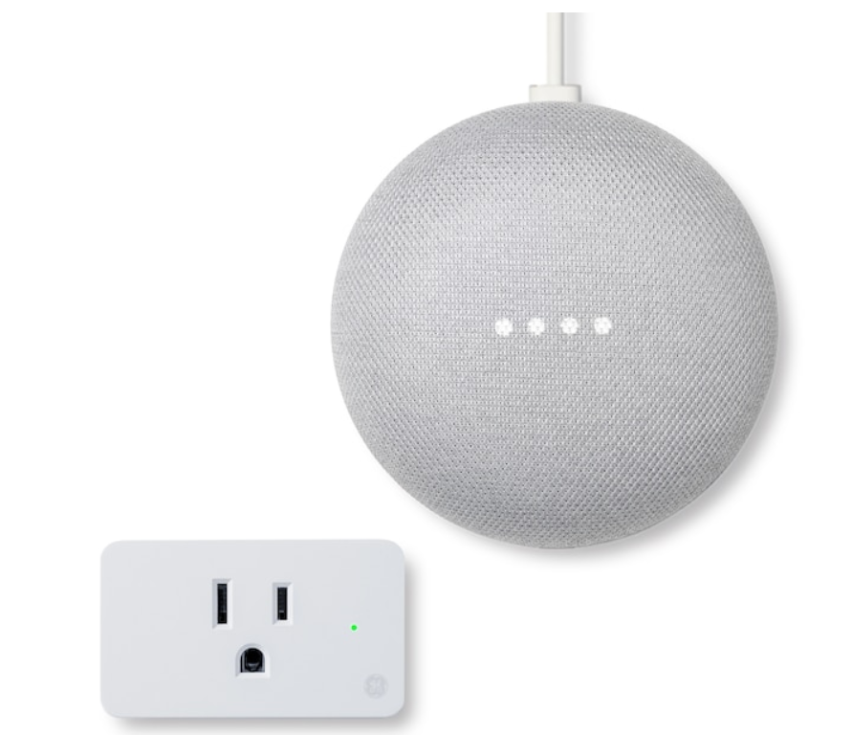
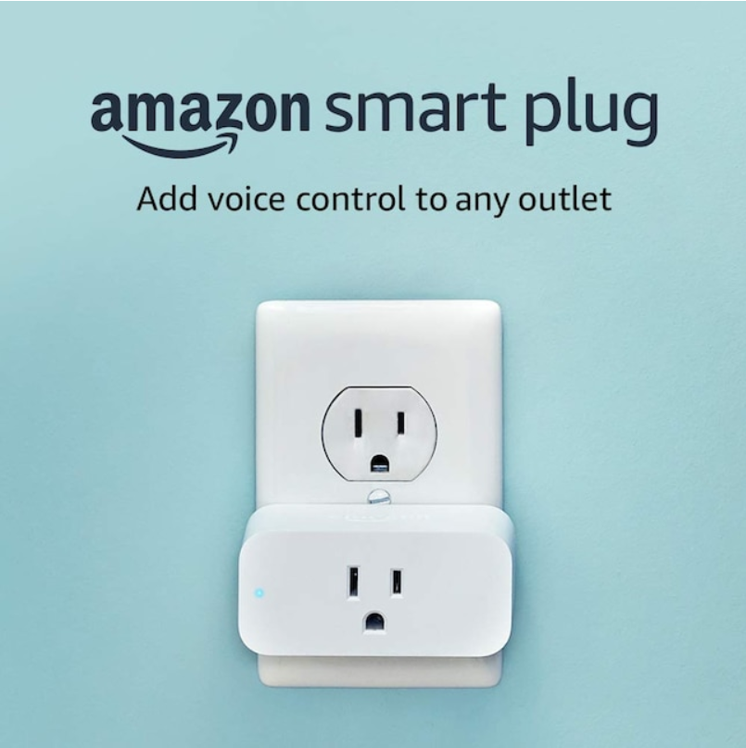
Introduction and Motivation
The SIMP is meant to aid consumers in having both better insights into their power consumption habits and enabling them to have more control over them.
“Did I leave my (common house appliance, hair dryers,lamps, phone charger) plugged in?”
Similar products already exist on the market, but none come with smart assistants already built in, requiring an Alexa or google home.
Notes:
-Introducing what the SIMP is, what it will do(in general terms), touch on SIMPy

Slide 3
Market Research
 | GHome Smart | Geeni | Amazon | TP-Link | Sense | S.I.M.P.
Size/Weight | 2 x 2 x 1.1 inches; 1.6 ounces | 1.7 x 2.75 x 4.5 inches | 3.2 x 1.5 x 2.2 inches; 3.1 ounces | 2.4 x 1.5 x 1.6 inches; 6.4 ounces | 5.4 x 2.6 x 1.26 inches; 7.75 ounces | 5 x 5 x 3 inches; 8 ounces (Estimate)
Alexa & Google Home | ✅ | ✅ | ✅ | ✅ | ✅ | ❌
Scheduling | ✅ | ✅ | ✅ | ✅ | ❌ | ✅
Away- From-Home Controls | ✅ | ✅ | ✅ | ✅ | ❌ | ✅
SIMPY | ❌ | ❌ | ❌ | ❌ | ❌ | ✅
Easy Installation | ✅ | ❌ | ✅ | ✅ | ❌ | ✅
Price/ Quantity | $7.99/1 | $39.99/2 | $24.99/1 | $17.99/1 | $299.99 | N/A
Examples of similar systems on the market and their features
We used these examples as a benchmark for our system, trying to meet as many features as the pre-existing systems as well as adding a new feature not yet on the market

Slide 4
Key Engineering Specifications:
Dimensions | The enclosure of the SIMP is to be no larger than 5 x 5 x 3 inches.
Plug Style | The SIMP should be compatible and operate via a standard NEMA 5-15R (120V~15A).
Male Plug | The SIMP will consist of no more than 1 standard NEMA 5-15P.
Female Plug(s) | The SIMP will consist of no more than 2 standard NEMA 5-15R.
Data Reporting | The SIMP will collect and report data via a 2.4GHz Wireless Network Connection every 15 seconds.
Platform | The SIMP UI will consist of a low cost web-based platform.
Daily/Weekly Report | The SIMP UI will summate Power Consumption Costs (either per kWh or per U.S. Dollar) per SIMP Device and report them to the end user in the form of a table/chart every 24 hours and every 7 days.
Main Controls | The SIMP UI will enable a user to control the power output within 10 seconds from the web interface.
Dashboard | The SIMP UI will contain a dashboard indicating pertinent information such as Device Schedules, Device State, and Activity Metrics.
“High-Priority” Warning | The SIMP UI will warn the user of any “high-priority” devices suddenly losing power or loss of power draw within 10 seconds of said power loss.
Notes:
-Focusing on green highlighted boxes and why those are most important

Slide 5
SIMP Hardware
Research and Design

Slide 6
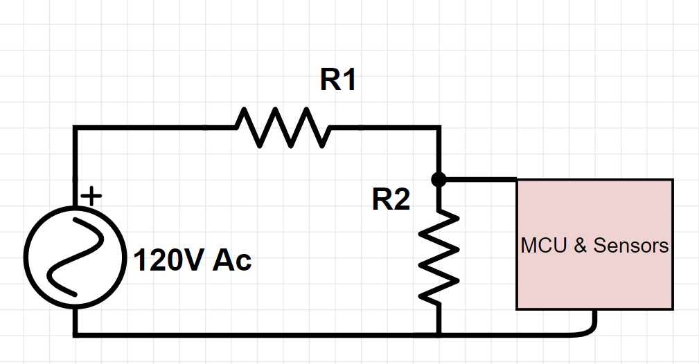
Theory Behind Hardware Design
Device plugged into SIMP will draw a certain amount of voltage(X voltage)
Our initial design had the SIMP MCU and sensors in parallel with a high value resistor in series with the load, which will be in parallel with a lower value resistor, allowing us to do voltage division and using the ratio between resistors to extrapolate the voltage across the load from the voltage detected by the SIMP
We have since moved on from this methodology
Notes:
-Explaining older method of detecting voltage

Slide 7
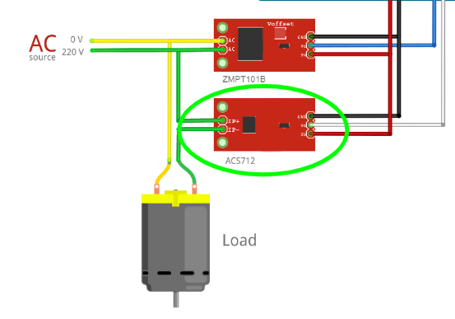
Transformer & Ammeter
We have decided to move on to using a transformer to rectify the AC current to DC and then using a voltage divider to step down the voltage to a level the microcontroller can read safely
We will also be employing an ammeter to measure the current more precisely for an accurate reading

Slide 8
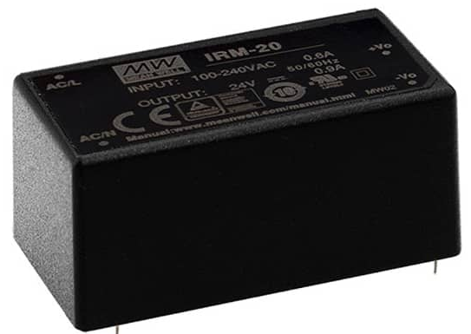
AC-DC Converter
The microcontroller we have chosen to work with for this project cannot be powered by an AC input so we have to utilize an AC/DC converter to step down and rectify the power going into the microcontroller

Slide 9
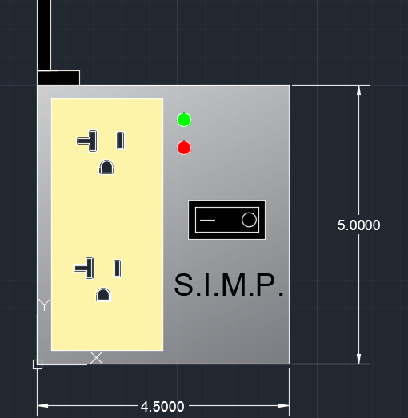
Projected Hardware Enclosure
As per our desired standards the S.I.M.P. will have a wired connection into the wall with all of it’s internals held in a single unit
The unit will be 3D printed out of either PLA or other heat resistant filament
LED indicators for power and timer notifications
ON/OFF switch for manual shut off of power
Notes:
Talking about what we want the final product to look like

Slide 10
Microcontroller Name | Arduino Portenta X8 | Arduino Nano 33 IoT | Arduino MKR Wi-Fi 1010
Price | $239.00 | $22.10 | $35.40
Dimensions (mm) | 66 x 25 | 18 x 45 | 61.5 x25
Input Voltage(V) | 5 | 5(USB-C) 4.5-21 | 5
Operating Voltage(V) | 3.3 / 5 | 3.3 | 3.3
GPIO pins | 7 | 26 | 26
RAM | 2 GB | 32 KB | 32KB
Flash Memory(GB) | 16 GB | 256 KB | 256 KB
Connectivity | Bluetooth,WiFi | Bluetooth,WiFi | WiFi

Slide 11
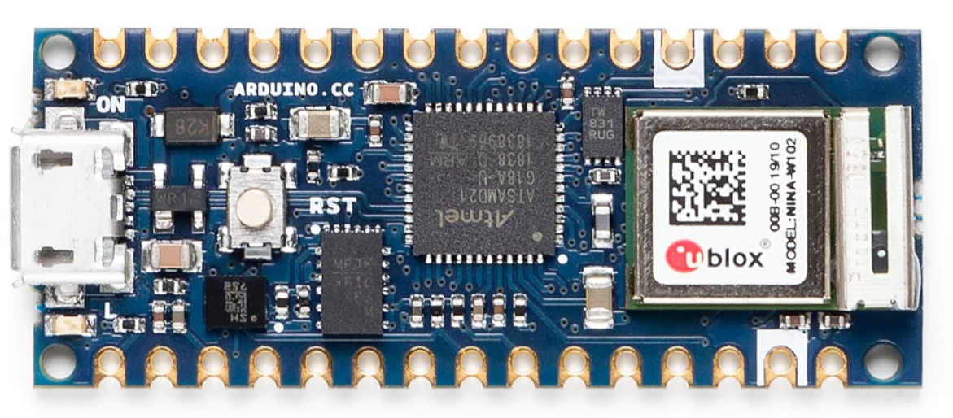
Microcontroller
Arduino Nano 33 IoT
Operating Voltage: 3.3v
Flash memory:256KB
SRAM:32KB
Length x Width(mm): 45 x 18
SAMD21 Cortex®-M0+ 32-bit low power ARM MCU
Compatible with several cloud based services (AWS,Firebase,Azure,Heroku)

Slide 12
Part Comparison of NEMA 5 Outlets
Name | Decora 15 Amp Residential Grade Self Grounding Duplex Outlet | X Series 20 Amp 125-Volt Tamper Resistant USB A/A 4.8 Amp Duplex Decorator Outlet Back Wire Clamps | Leviton 20 Amp Commercial Grade Duplex Outlet
Dimensions | 1.063” x 1.625” x 4.25” | 4.06” x 1.73” x 1.73” | 4.122” x 1.875” x 1.375”
Socket Type | NEMA 5-15R, 2P and 3W | NEMA 5-20R, 2P and 3W | NEMA 5-20R, 2P and 3W
NEMA Rating | 15A / 125V | 20A / 125V | 20A / 125V
Grounding | Self-Grounding | Self-Grounding | Self-Grounding
Price | $2.67 | $40.00 | $3.64
Notes:
The deciding factor in the case of choosing an outlet plug was simply price and the fact that a member of our group has worked with and owns multiple of the ones we selected.

Slide 13
SIMP System Diagram
AC/DC Converter
Microcontroller
House Power
(120V AC; 60 Hz)
Transformer
Heroku Web Server
NEMA-1 Outlet
(Standard Household American Outlet)
Device Plugged In
Relay

Slide 14
PCB/EAGLE Circuit Design
Steps:
Circuit Idea(s)/Part Selection
Schematic Design
PCB Design
Notes:
We can all agree that there are a multitude of steps that need to take place before you can hold a finalized PCB in your hand. I’m here to talk about the main steps we took to show how we arrived at our overall schematic as well as our first prototype PCB for our project.

Slide 15
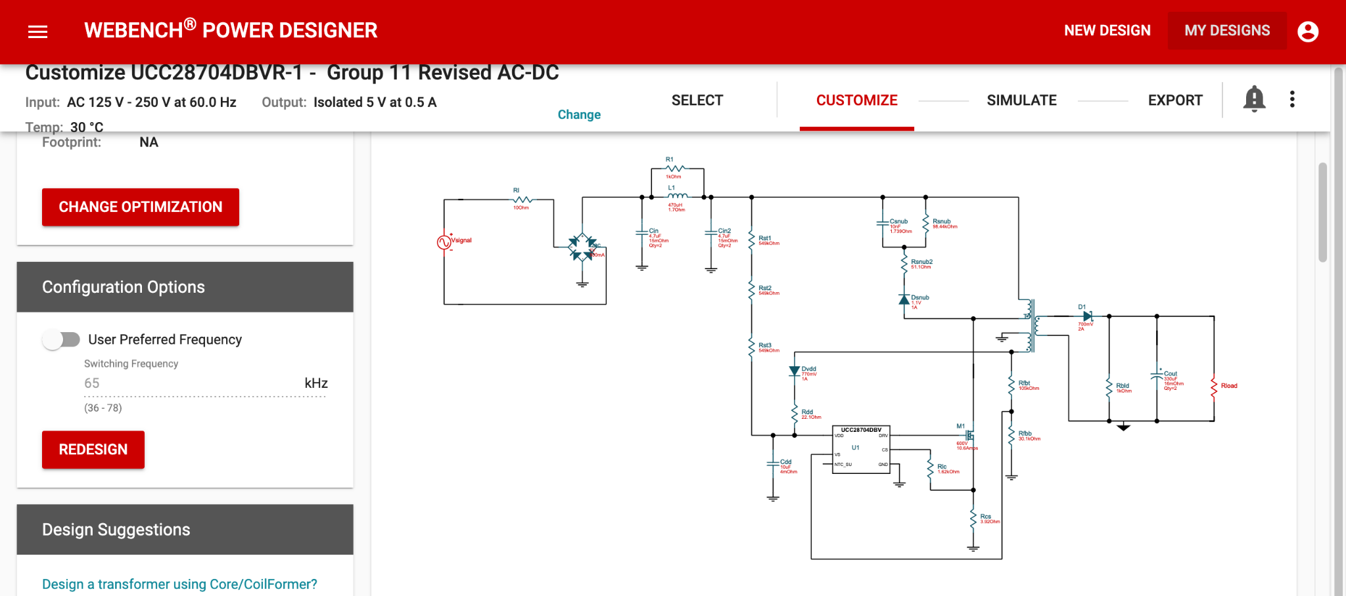
Circuit Idea #1: AC/DC Converter
Notes:
The first idea we had to tackle was converting the 125-250 AC voltage to 5V DC. This brought back memories of Junior Design, where we used WEBENCH by Texas Instruments to provide us with a circuit layout for our AC/DC converter. After a wide selection of different AC/DC converter circuits, this is the one we went with. You can see it uses an integrated circuit, a transformer, and a mix of inductors, diodes, resistors, and capacitors.

Slide 16
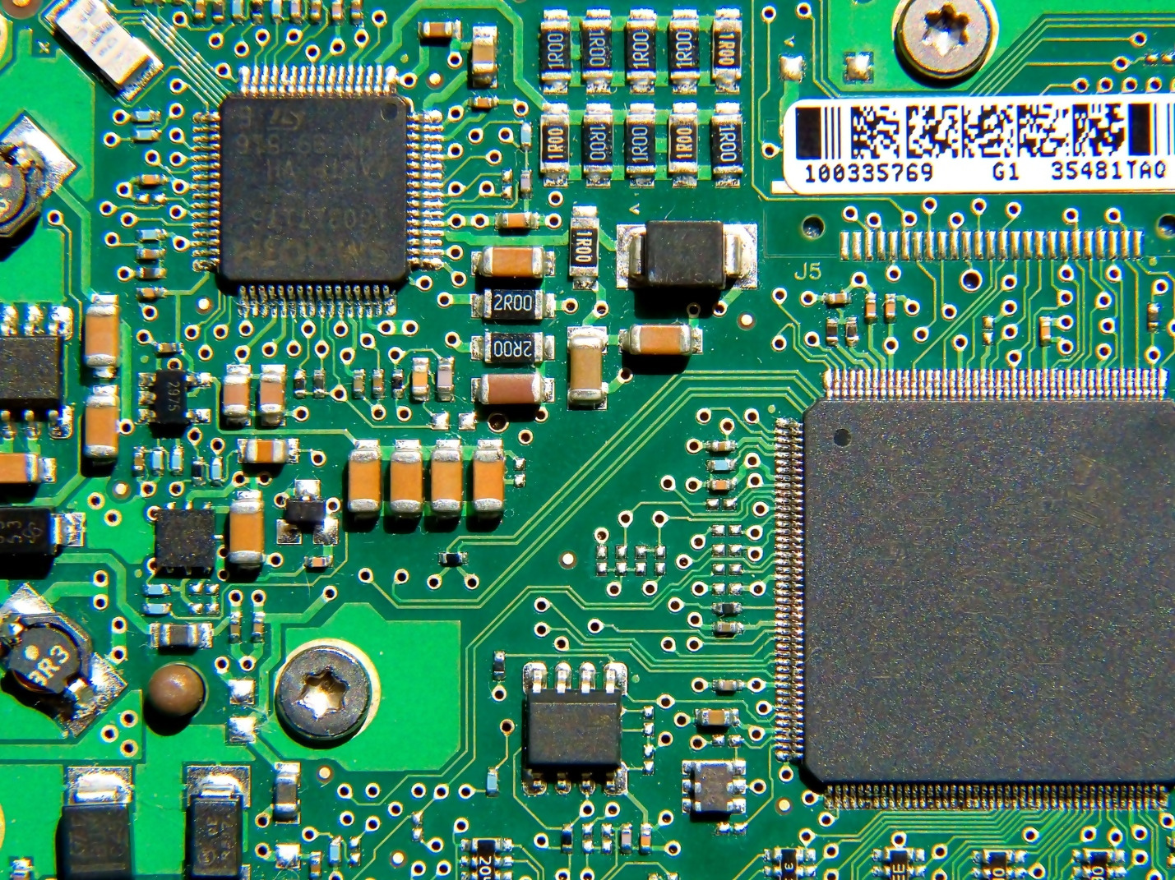
Circuit Idea #1: AC/DC Converter
Notes:
Before finishing up the work on our AC/DC converter I realized we never thought to check if there were AC/DC converters with the specifications we wanted that already existed. After a brief google search, we were able to find an already-manufactured AC/DC converter that met beyond our specifications. This made all the work on the AC/DC converter circuit pointless and meant we would save space in the bulk of the final device, since we no longer needed to manufacturer an entire PCB for our AC/DC converter.

Slide 17
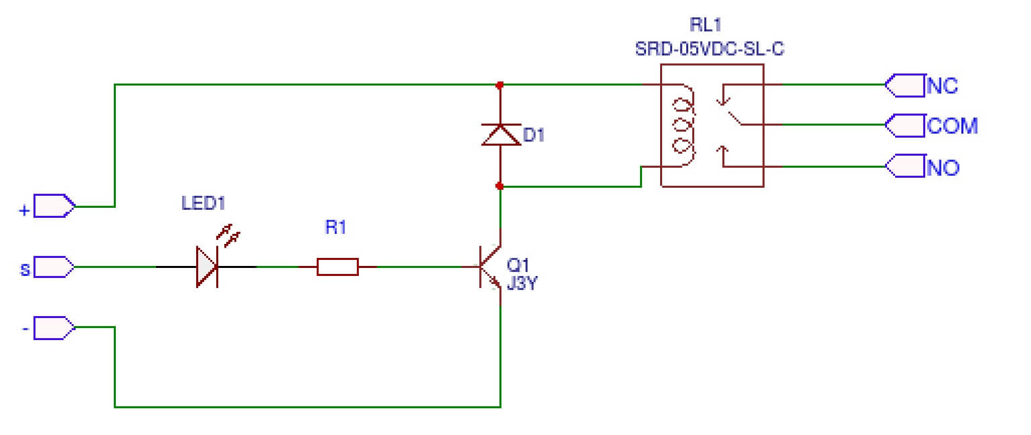
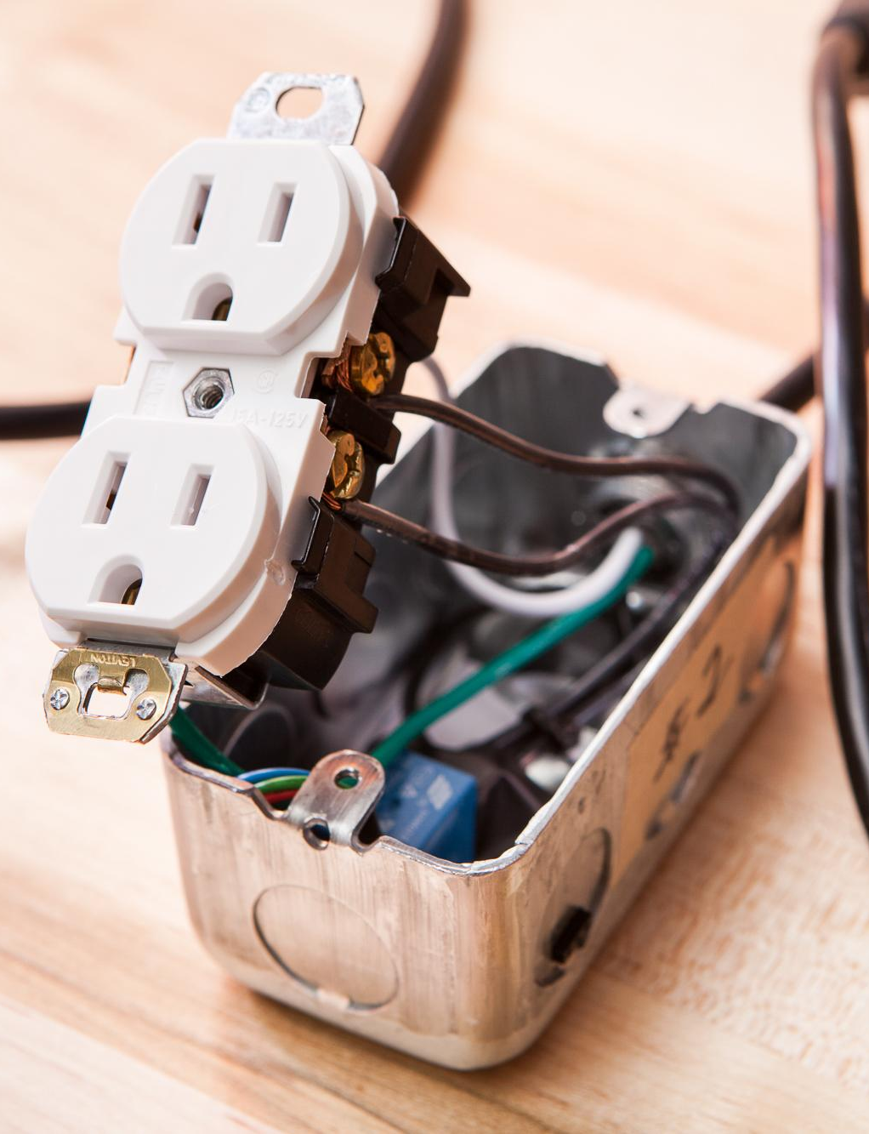
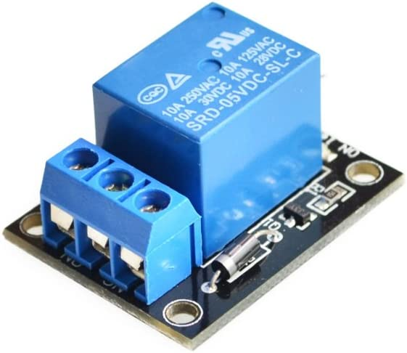
Circuit Idea #2: Electrical Relay Module
Notes:
When searching the internet for a relay that would be suitable for our application, we were lucky enough to stumbled upon a detailed article describing someone’s experience with a relay module they equipped to an electric outlet to demonstrate turning it on or off using the relay module in question pair with an Arduino. The author of the article was generous enough to provide an Amazon link to the relay, and with over 300 positive reviews and many examples of use, we found there was no reason to look anywhere else. With the testing and reliability already proved, followed by the multitude of work done around it, the decision to use it as our relay was made, seeing as it was perfect for our planned application in terms of price, reliability, and production.

Slide 18
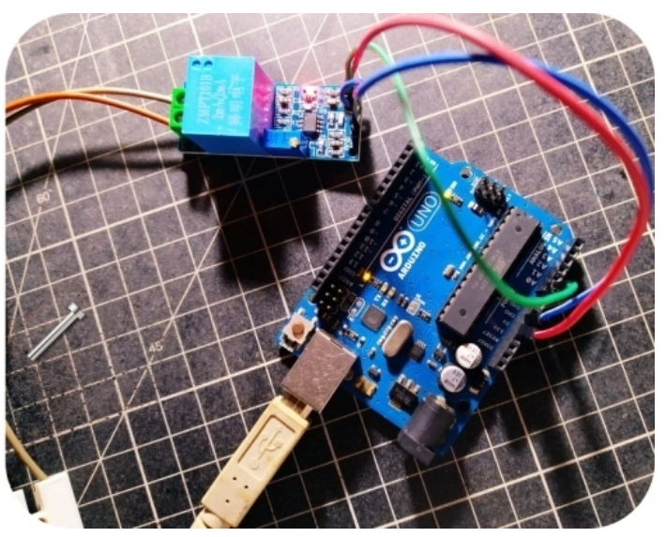
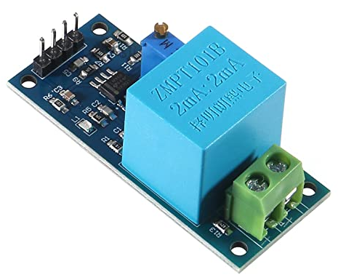
Circuit Idea #3: Transformer/Voltage Sensor
Notes:
When searching for a transformer to allow our Arduino to measure AC voltages that are much higher than it can take, we stumbled upon another module, this time with a transformer as its main component. After further research, we found multiple articles and videos done surrounding this module stepping down voltages for Arduinos to read and interpret. Being easily accessible through Amazon was also a big plus for this module, as we could test the component faster and move onto other steps in the hardware.

Slide 19
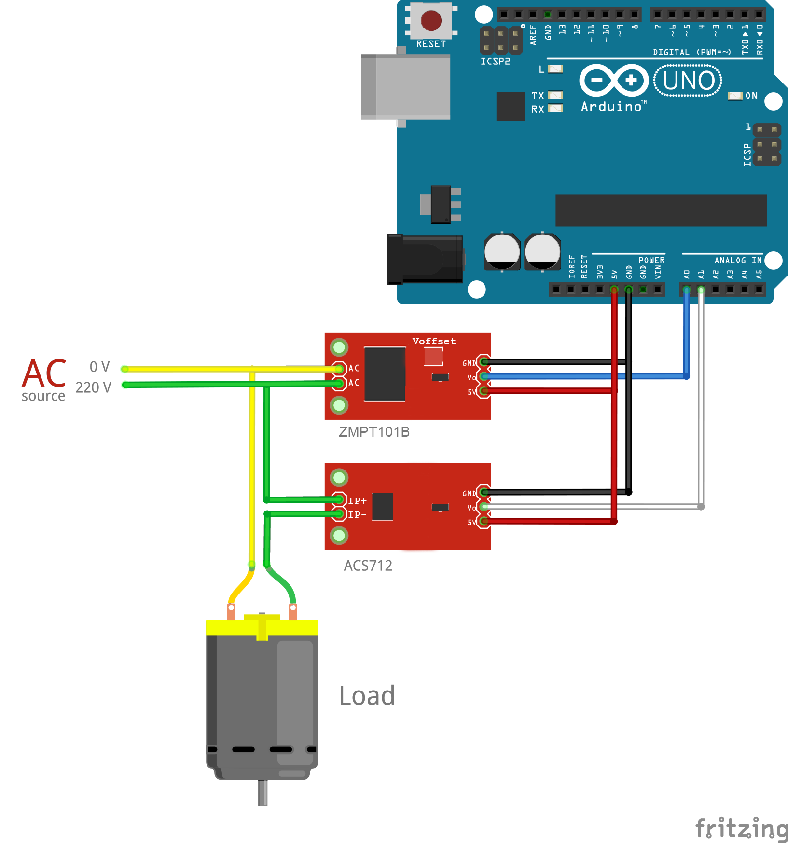
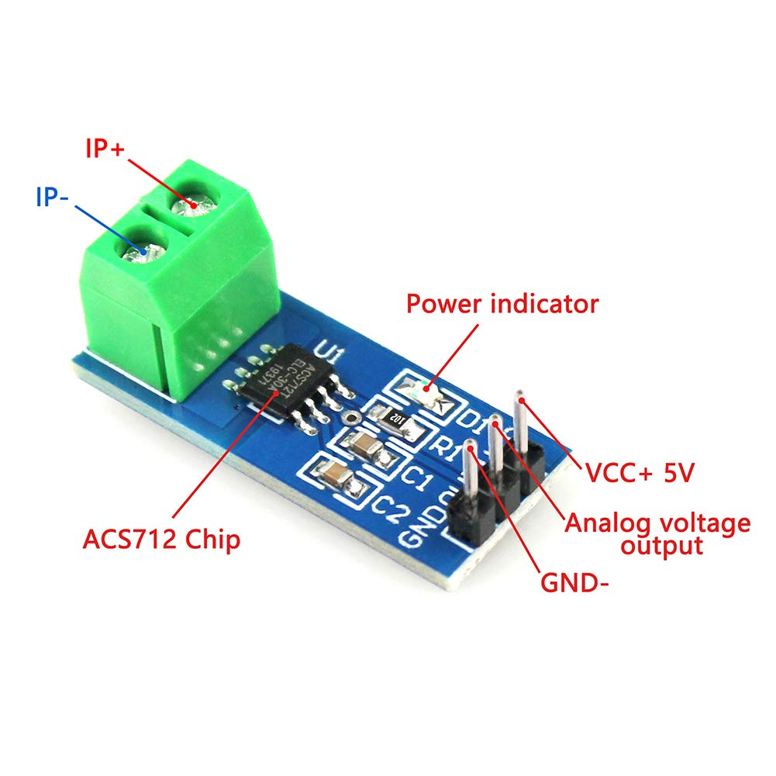
Circuit Idea #4: Ammeter
Notes:
When it came to selecting an ammeter, we didn’t need to look to hard as the average home outlet will not provide a current that exceeds 20 amps. We selected the one shown as it was readily available through Amazon and came with a voltmeter which we initially thought we would need. It was helpful that it came in a module for filtering with capacitors and a resistor. We also found an article where the author used the voltage sensor shown in the previous slide in conjunction with the ammeter we found, so we could assume they were paired well with one-another.

Slide 20
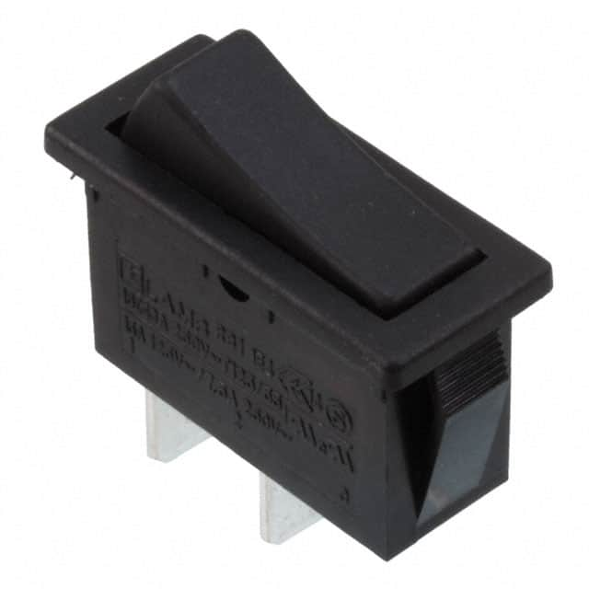
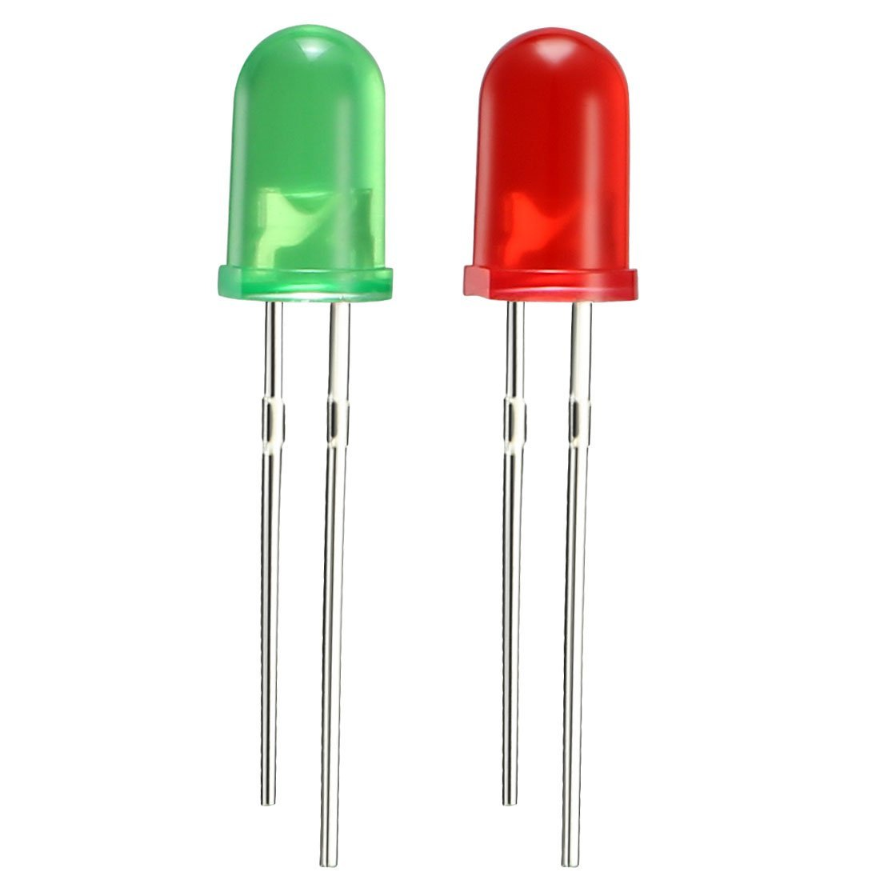
Circuit Idea #5: Physical User Interface
Message Being Delivered | LED Color(s) | Frequency
“Initial Setup; Ready To Pair To Wi-Fi” | Green | 2 Hz ON/OFF
“Setup Finished & Running” | Green | ON; No Frequency
“10 Minutes Before SIMP Cuts Power To Device; Save Your Progress” | Red/Green | 1 Hz RED/GREEN
“5 Minutes Before SIMP Cuts Power To Device; Save Your Progress” | Red/Green | 2 Hz RED/GREEN
“1 Minute Before SIMP Cuts Power To Device; Save Your Progress” | Red/Green | 4 Hz RED/GREEN
“Error Detected; Check Server Hub For Detailed Message” | Red | ON; No Frequency
“Notification from SIMPY” | Green | Two 8-Hz Flashes Per Second
Notes:
The LEDs and toggle switch will be the only physical form of communication between the user and the device. Our current design uses two LEDs, one red and one green, to communicate different messages to the user based on programs in our Arduino. The toggle switch will be a fail-safe reset button incase our code finds itself in a constant loop or our software otherwise crashes. The toggle switch also acts as a physical way for the user to cease power going to the device altogether in the event they cannot communicate that action through the software.

Slide 21
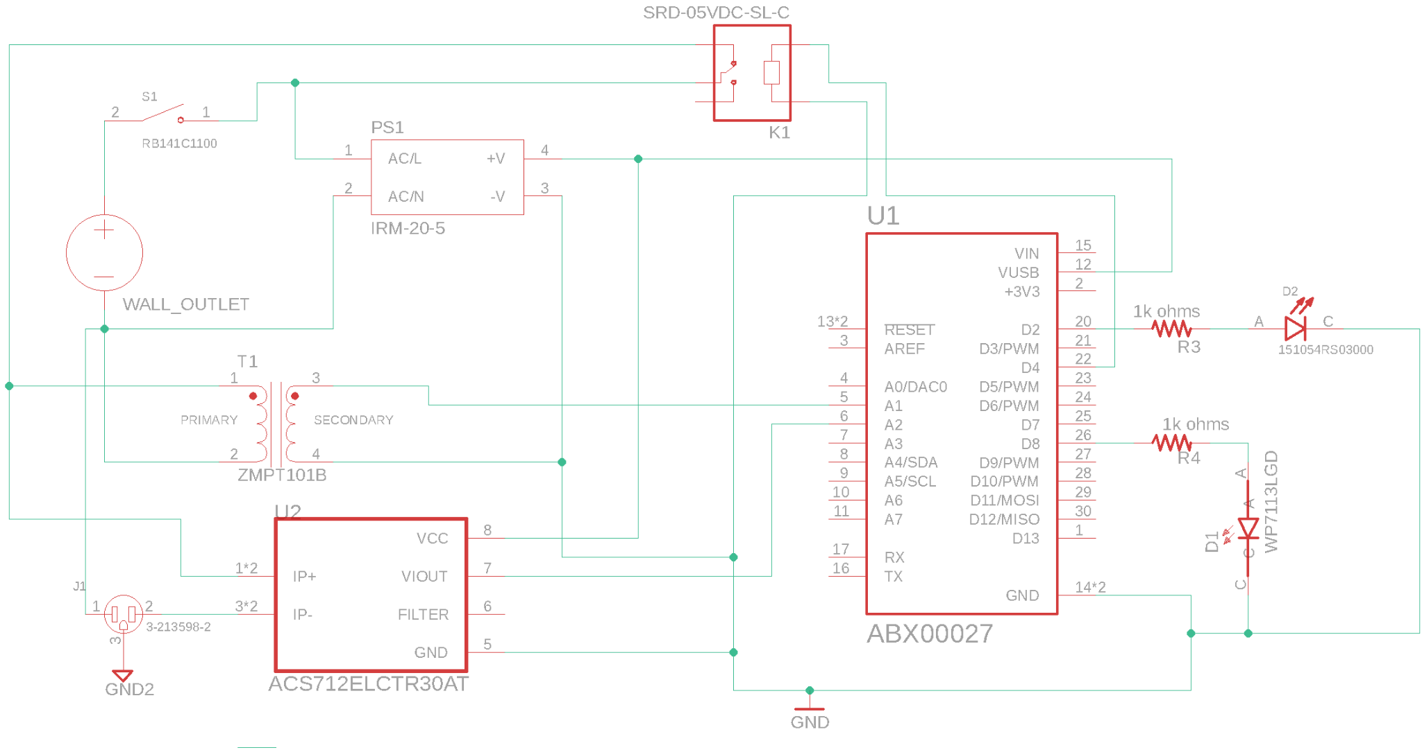
Full Overall Schematic:
Notes:
This slide shows a full schematic of our planned overall schematic. In this case, the wall outlet that will provide the AC power is represented as an independent voltage source. When the toggle switch is flipped in its ON position, AC power will be sent to the transformer, as well as the AC/DC converter. The AC/DC converter will then output the 5V DC to the Arduino, providing it with enough power to run its internal programs provided by our computer engineers. These programs will flash the LEDs, read AC voltage output from the transformer and operate the relay that controls power going to the device plugged into the SIMP.

Slide 22
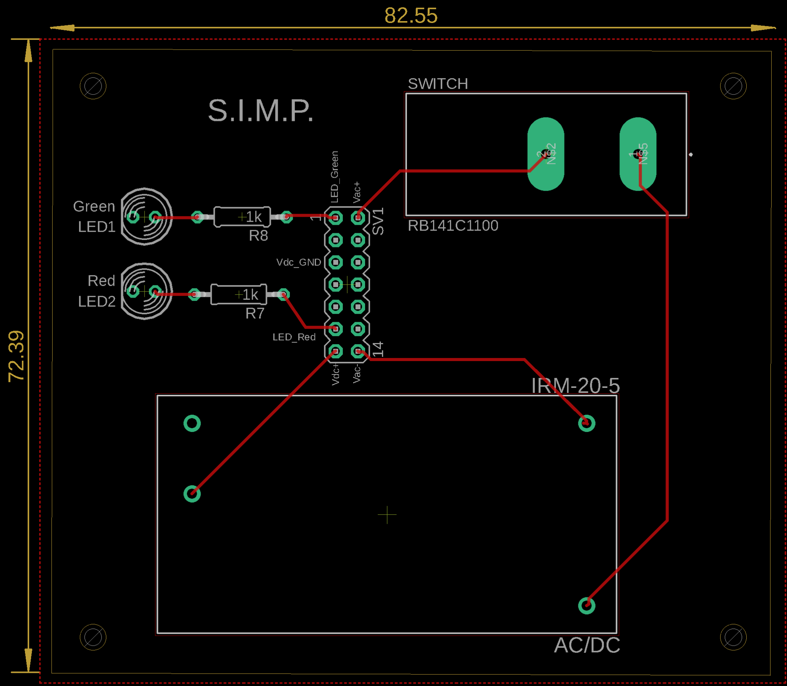
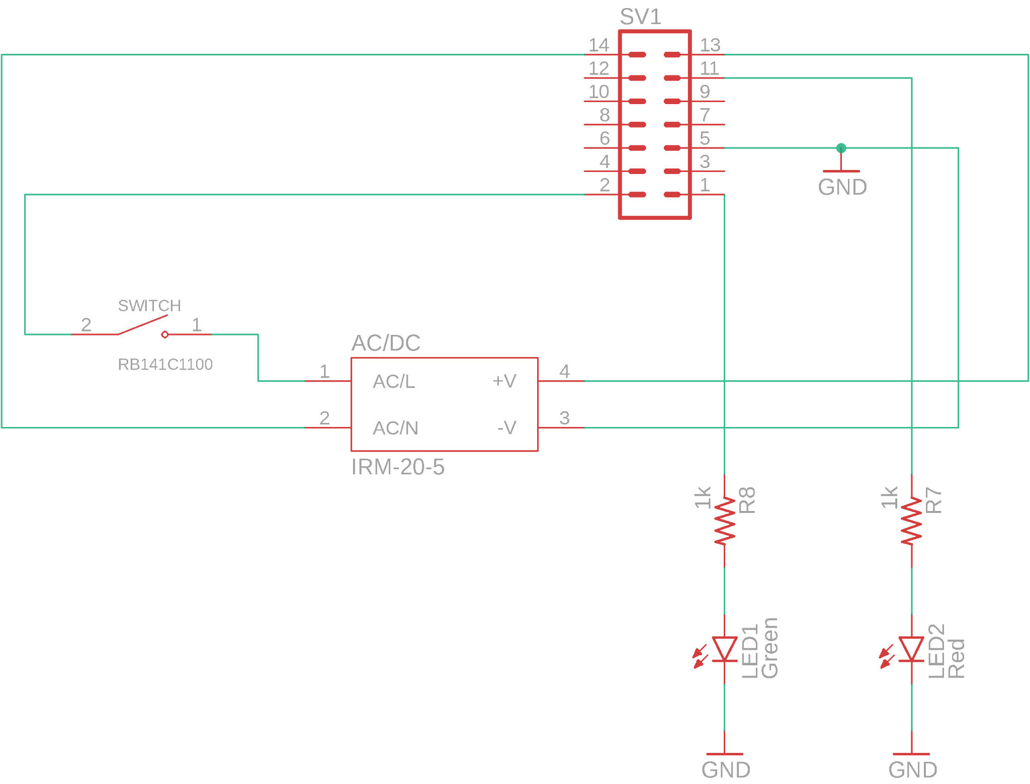
PCB Prototype A:
Notes:
For our first PCB prototype, I set out to create as much of the full schematic circuit as possible, without including the relay or transformer, which both already came on small, space-efficient PCBs. I also didn’t include the Arduino Nano, as we might be opting for a different Arduino microcontroller and do not wish to waste time. The pin headers in this schematic are included so we can assemble the full schematic in one breadboard test and see if everything works as a group. With there always being a chance of not working, we will work to diagnose the problem and include the solutions in future PCB designs.

Slide 23
Future Prototype Checklist:
A place on the PCB for Arduino Nano IoT using calculated placement of pin headers.
Slimmer and more compact design to reach peak space efficiency.
Notes:
As stated before, more work can and will be done in the future regarding PCB prototypes. Once dimensions of our Arduino Nano, such as distance between pin header holes, are known I can add a place on the PCB so that it fits properly like normal PCB component. Once we can assemble a full schematic that we know will work how we want it to, I can put effort into making the PCB as small and space-efficient as possible without sacrificing reliability of the device or safety of the components.

Slide 24
SIMP Software
Design and Implementation
Notes:
Now that we’ve given a general overview of what hardware and decision-making processes were involved in designing the overall schematic of the SIMP module, we will now move forward with explaining the software components and product features that we have chosen thus far to interface with our product.

Slide 25
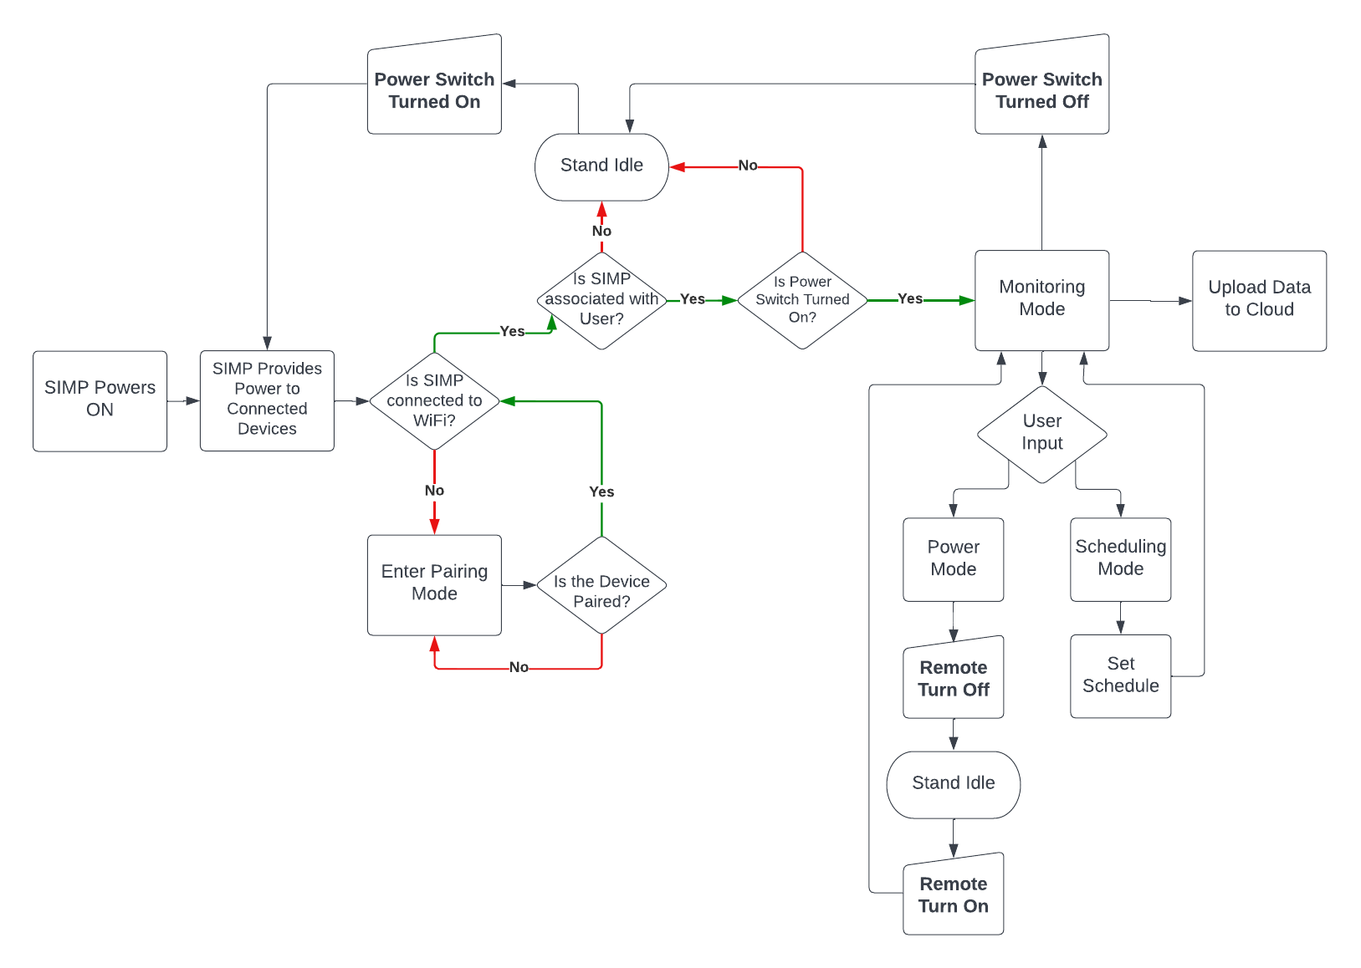
Software Design:
Notes:
Here we have a general flowchart dictating the state, action and response to inputs dictated by an external system, in other words via manual input, or remotely pushed requests. In the most basic scenario, we begin by first providing power to the SIMP module via connection through a standard 15-amp receptacle. Any device plugged into the SIMP therein after will receive power so long as the SIMP is not associated with any home wireless connection. Following this, we enter a set of conditional actions based on whether the SIMP is connected to a user’s home Wi-Fi and associated with a user account. If the SIMP module is not associated with a home Wi-Fi connection, the SIMP will enter a pairing mode. Until the SIMP is paired with an end users home Wi-Fi, the SIMP will continue to draw current and provide power to any connected devices but won’t enable an end user the ability to monitor and remotely alter the configuration of the device. Upon pairing the SIMP module with an end users home Wi-Fi, they will be required to visit the SIMP web portal, register an account, and link any active SIMP module discovered on their home network with their newly registered account. If the SIMP remains connected to the end users home network, but never becomes associated with a registered account, the module will remain in an Idle state until a link has been established. Upon associating the SIMP with a registered account, the internal MCU will verify the active state of the manual override button. If at any point, the manual override button is toggled low, this would be an indicator that all power output to any existing devices should be halted until realizing an active high state. Once an active connection to the web server has been established by the SIMP, and power output to any connected devices is enabled, the SIMP module can then move into its regular state of Monitoring. In monitoring mode, the SIMP will record and calculate Voltage, Amperage, and Wattage accordingly. This data will be collected, delivered, and displayed graphically on an end users account. From an end users account, they are given the option to entirely terminate power being broadcasted to directly connected devices via a simple on off button, or a via a remote scheduler. These general operations are what make up the bulk of how we plan to bring our product to fruition.

Slide 26
Web Stack:
Web Stacks | Components | Programming Languages | Framework | Database
LAMP | Linux, Apache, MySQL, PHP | HTML, CSS, PHP | Linux | MySQL
MERN | MongoDB, Express.JS, React, Node.JS | HTML, CSS, JavaScript | React | MongoDB
MEAN | MongoDB, Express.JS, AngularJS, Node.JS | HTML, CSS, JavaScript | AngularJS | MongoDB
Notes:
When formulating the web stack used to create our web application, our group had a general idea of what would not only be most efficient to see our design, but also prove most intuitive to the developers in our group. The LAMP stack, though well renowned for its ease of implementation, relies on a Linux framework and a MySQL database management system. With this, the opportunity for general flexibility of development is greatly constrained and the efficiency of data handling on the back-end may be susceptible to poor performance. The MEAN stack, being the more favored of the two, adopts an AngularJS framework and MongoDB as its database management system. The general consensus in the end was to move forward with the MERN web stack, comprised of MongoDB, Express.JS, React, and Node.JS. Members of our team were more familiarized in the development of React apps and felt moving to AngularJS would create an unnecessary learning curve in the development of our application.

Slide 27
Web Hosting:
Hosting Platforms | Pros | Cons
AWS | Provides a full application suite to manage every aspect of our project having everything seamlessly integrate. | Cost of Implementation. Group members lack experience in AWS, creating challenges and time constraints moving forward.
Digital Ocean | Simple solution that provides full virtualization of operating systems to allow any web stack hosting. | Requires maintenance of server from within the virtual machine giving more problems for us to deal with.
Heroku | A platform based solution that works with JS based stacks to host applications with plugins to allow for easy development and data analysis | Due to it’s platform solution we can’t change hardware as freely, operating systems, and more customization if we wanted to have specific upgrades to improve performance.
Notes:
Selecting our web hosting platform came with its own challenges. Whereas some platforms are used solely based off their popularity, others are used because of their versatility in the hands of a basic end user. With this in mind, we took into consideration 3 separate web hosting applications: AWS or Amazon Web Services, Digital Ocean, and Heroku. Of the three, AWS is possibly the largest and most well-known web-hosting platform. It provides many tools and features within its utility suite and allows for much easier integration across different items because they’re all hosted by the same service. The issue with AWS comes with the cost of implementation and a general lack of knowledge within our group on how to setup and implement a Web UI using their platform. Digital Ocean appeared to be a good alternative to AWS because it was cheaper, full of in-app services and features, and was well understood by members within our group. The challenge we faced with Digital Ocean was again, cost of implementation but also other minor intricacies that would prove cumbersome in the development of our app. With all this in mind, the general consensus was that we move forward with using Heroku as our web hosting platform. Its significantly cheaper cost to implement, dualled with a platform that works with JavaScript based stacks, made it so that those in our group who were already familiar with it had an easier time moving forward in development.

Slide 28
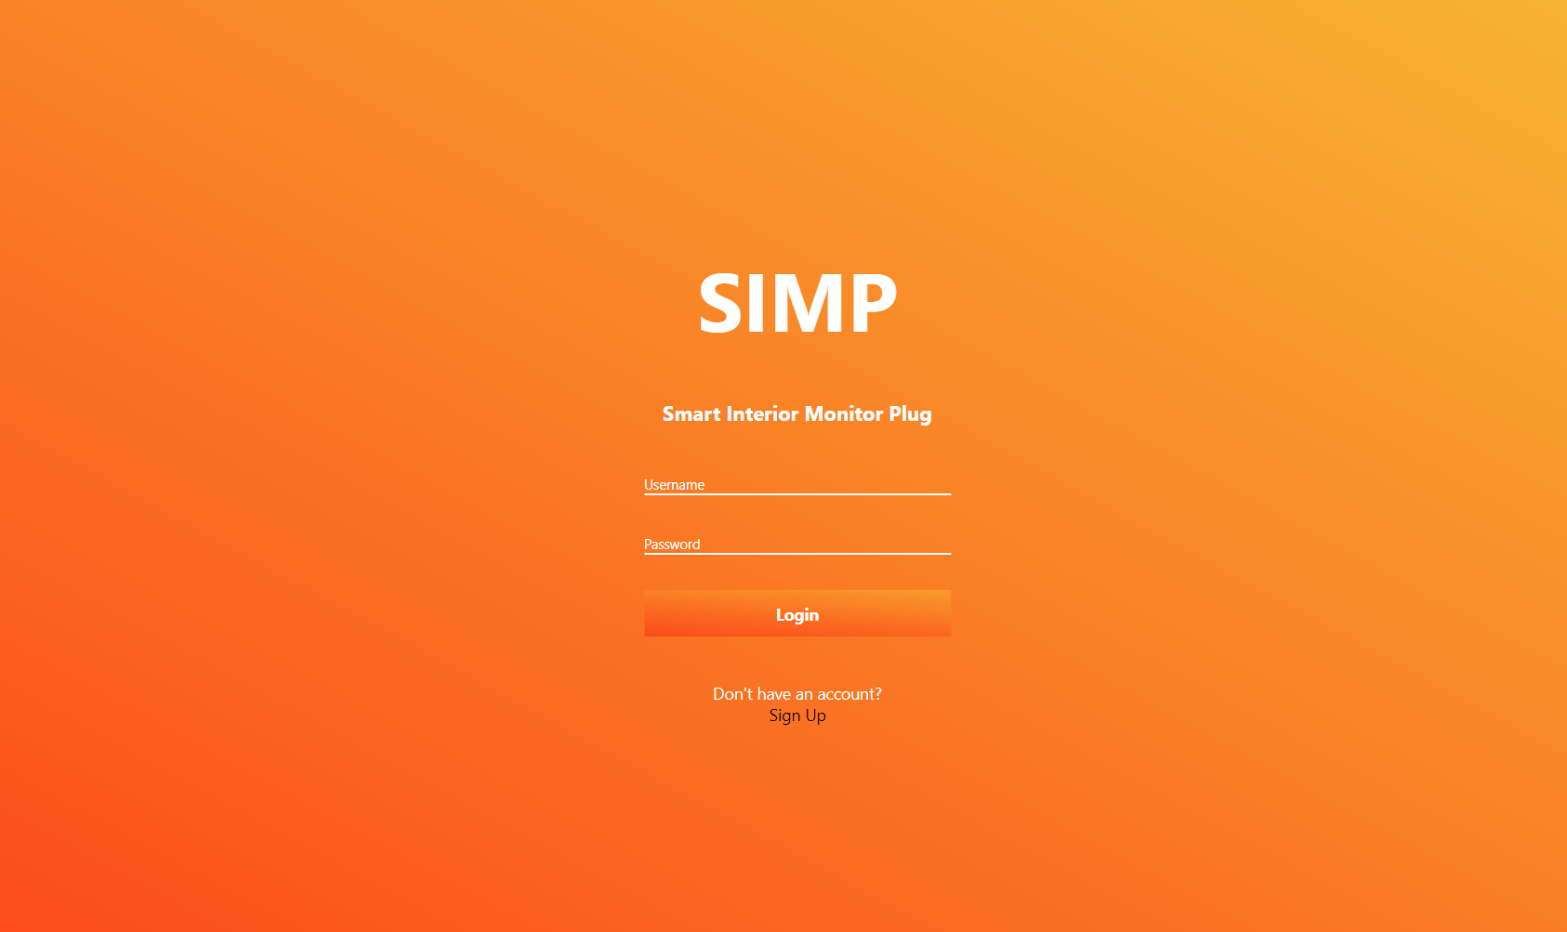
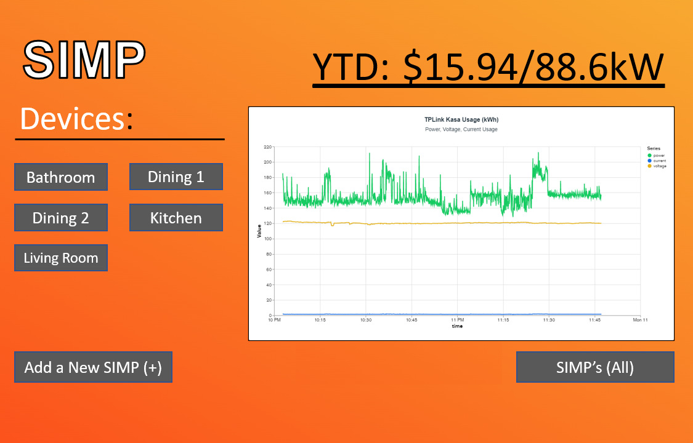
Web UI:
Notes:
Here, we have mockups of what a typical login screen and dashboard will look like for any recurring end user. The goal is to create an app that will not only be straightforward to navigate, but also, to quickly and easily display pertinent information regarding home wattage use. Any standard user, at home or remote, should be granted the ability to not only log into their SIMP dashboard, but also add a device, monitor existing devices, be provided a graphical representation of wattage usage and costs, and set scheduling for when a device should or shouldn’t be on or off.

Slide 29
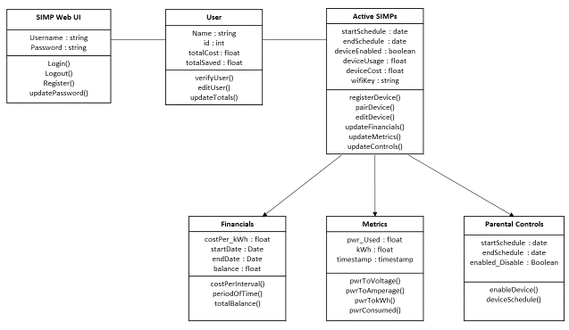
Backend (APIs)
APIs are functions built into our web server that act as connection between our SIMP and our web server, these APIs will help store our energy data, and control the SIMP remotely.
Notes:
Hi I’m Austin Raynor, Computer Engineering Major who was primarily working on the backend. The backend is what we use to connect our SIMP module to the web server to allow us to monitor and store the data remotely. We do this through the use of APIs using Express.js as our framework. The features we have included can be seen in the Diagram but to name a few we have Power Usage Monitoring, Plug Scheduling and User Electricity Costs. These all help provide the user with more ways to be informed of their energy usage.

Slide 30
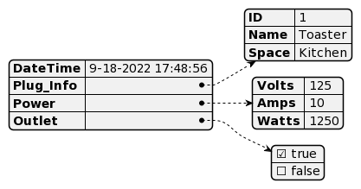
Database
MongoDB
Time Series Collections for efficient storage of our power usage over time data.
Easy to understand Document style storage
Notes:
We chose to use MongoDB for it’s easy and efficient storage of data over time. This allows us to quickly access the collection for fast display of data. Especially when we plan for the user to be able to see a month’s worth of data points at a given moment. It’s crucial to have this data be displayed in a promptly manner and MongoDB is able to provide that. We also have the JSON payload that the SIMP shown here visually that will be sent to our web server that provides it the ID, Location, Power usage, and Outlet Power state.

Slide 31
Project Management
Budgeting, Milestones and Division of Labor
Notes:
Engineering any design or product takes thorough coordination between each team member involved. Regarding Project Management, tasks must be delegated, and milestones must be kept to ensure steady progress on the completion of our project.

Slide 32
Distribution of Tasks
Edin: Schematic Design and PCB Design
JV: Breadboard Testing and Diagnosing
Austin: Back-End
Anthony: Front-End
Notes:
Throughout the development of the SIMP, tasks were broken down so that major project components had a group member assigned to ensuring its completion. Edin, dualling as project manager, would ensure that any schematics regarding the SIMP circuitry and PCB layout are drafted, tested, and properly integrated with external components. Jose would be responsible for bench testing and ensuring the accuracy of any published schematics used to develop the SIMP module. Anthony will be responsible for the development of most front-end components in the SIMP UI, and I will be responsible for ensuring the proper communication between front-end and back-end software applications.

Slide 33
Budgeting (Theoretical/Actual):
Theoretical Hardware | Quantity | Budgeted Cost
Project Processor | 1 | $50
Relay Switch | 1 | $20
Voltmeter | 1 | $20
Ammeter | 1 | $20
Buttons | 2 | $10
Resistors/Capacitors/Inductors | 10+ | $15
WiFi Module | 1 | $20
NEMA 5-15 Plugs (Male) | 1-2 | $5
NEMA 5-15 Plug (Female) | 1 | $5
Printed Circuit Boards | 5 | $30
Total Budget |  | ~$200
Actual Hardware | Quantity | Actual Cost
Arduino Nano 33 IoT | 1 | $26.00
Voltage Sensors | 2 | $12.77
Current Sensors | 2
Relay Module | 1 | $5.86
PCB | 39.5 | $31.99
2x20 Pin Headers | 20 | $9.57
Transformer/Voltage Sensors | 6 | $15.96
Rocker Switches | 3 | $3.36
AC/DC | 3 | $36.18
Total Budget |  | ~$100
Notes:
With financial commitment being an unavoidable ordeal in developing any new product, each member of our group agreed upon a preset amount of 125$ per person to guarantee no monetary disputes would be encountered. After having realized the bulk of components we intended to use when developing the SIMP, we budgeted to include the cost of duplicate components should anything come to us late or in an unusable state. With that in mind, individual hardware was purchased as seen in the chart on the right. Disparities in cost can be observed between what was originally budgeted for on the left, and what our group has actually purchased on the right. Our total budgeting thus far to test and manufacture the SIMP equates to just over 100$’s.

Slide 34
Milestones
Milestones | Dates
Ordering Prototypes of Design to Test | August 10th
Initial Web Server Creating | August 15th
Testing and Fixing Design Flaws | September 10th
Redesigning Hardware and Software | October 10th
Finalizing Projects Software and Enclosing | November 10th
Practicing Presentation of Project | November 30th
Presenting Our Project | December (Presentation Week)
Notes:
These were the milestones that we had set in place towards the end of last semester as guidance dates to work towards to give us enough time for the development of the SIMP. Once the new semester had started we were hard at work to meet our deadlines, while we did not meet our milestones at the exact dates, we were never too far behind from them. Towards the end of our milestones if we happen to finish them earlier than anticipated we have planned stretch goals to help further improve the experience with the SIMP. These stretch goals include Machine Learning to identify devices connected to the plug based off their power usage signature, a Mobile app for easier setup and mobility, advanced geofencing and scheduling to allow for users to set power state based on distance from home.

