Slide 1





Trashporter
Group 7

Slide 2





Team Introduction
Jourdan Callahan
AnnaBelinda Zhou
Andy Kuang
Dhanesh Singh
Computer Engineering
Electrical & Computer Engineering
Computer Engineering
Computer Engineering
Notes:
Hi, my name is Anna. I’m majoring in Electrical & Computer Engineering.

Slide 3
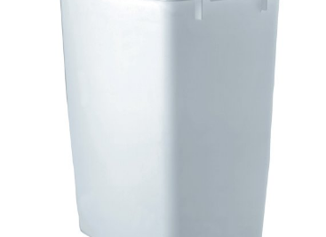
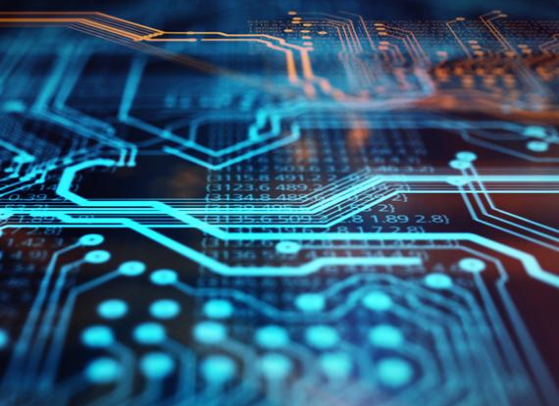
What Are We Making?
Andy
Autonomous Trash Bot
Mobile App
Ease of use

Slide 4
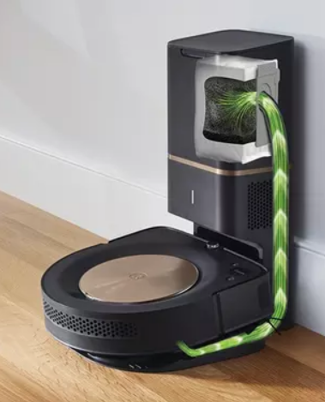
How We Came Up With It?
Andy
Inspired by other autonomous home products
Robotics
Unique to the market
Machine Learning

Slide 5
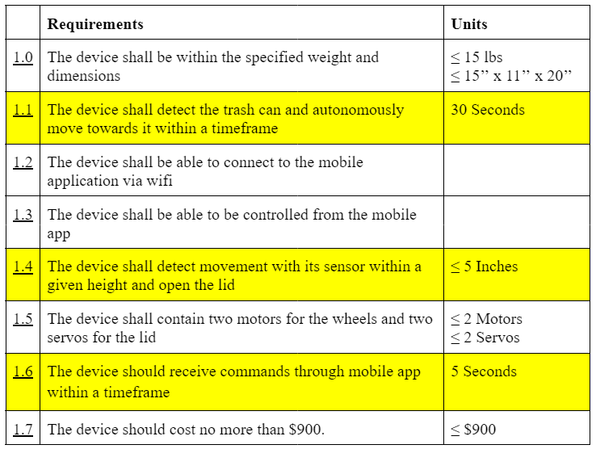
Engineer Specifications
Andy

Slide 6
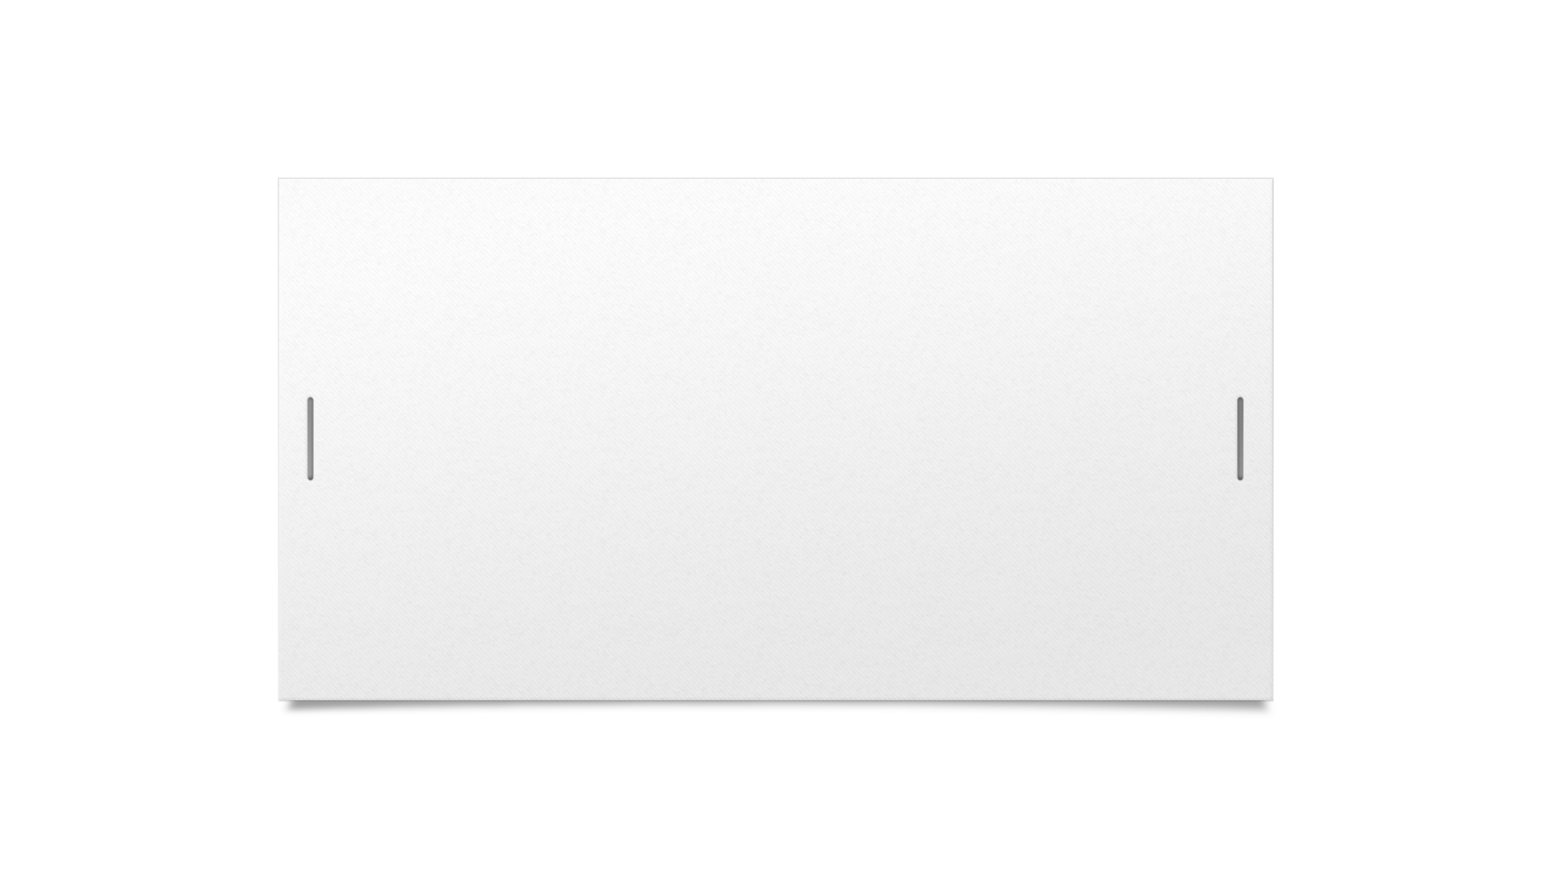
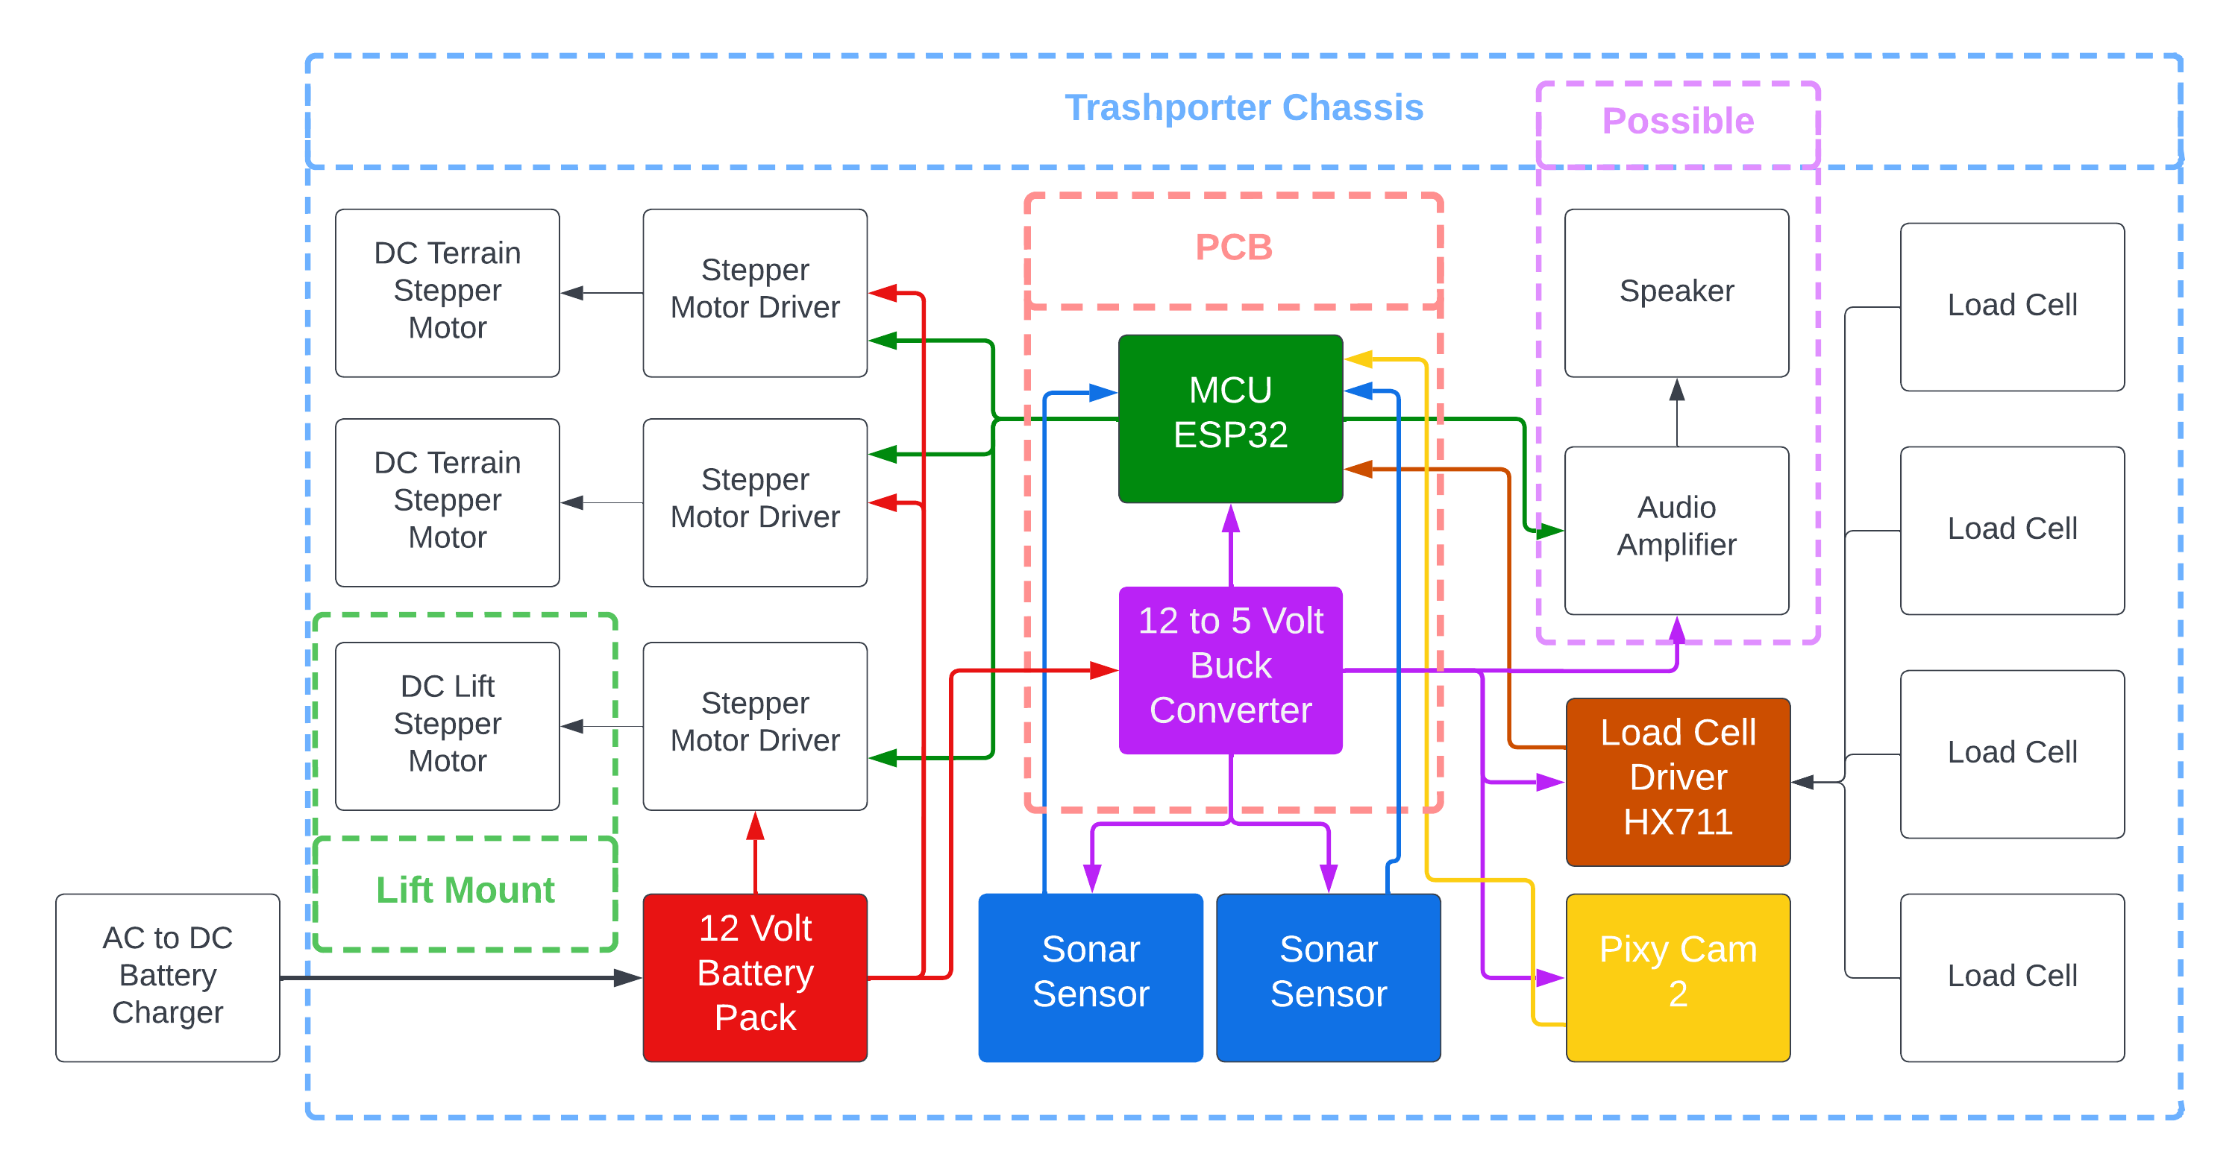

Hardware Design V1
Dhanesh
Notes:
Here is a visual for our overall hardware design. We plan to place everything on the trashporters chassis, except the battery charger.
Our MCU and buck converter will be mounted on our PCB, and it will communicate with the other devices in our project. If we have enough time we plan to place an audio system on the trashporter.

Slide 7
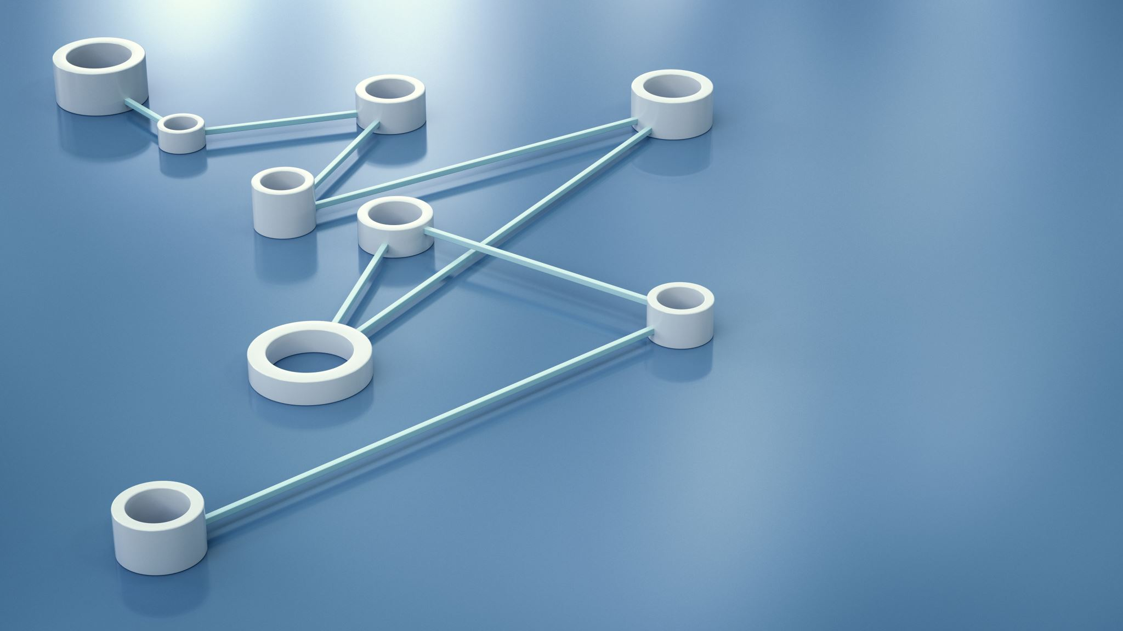
Parts Selection

Slide 8
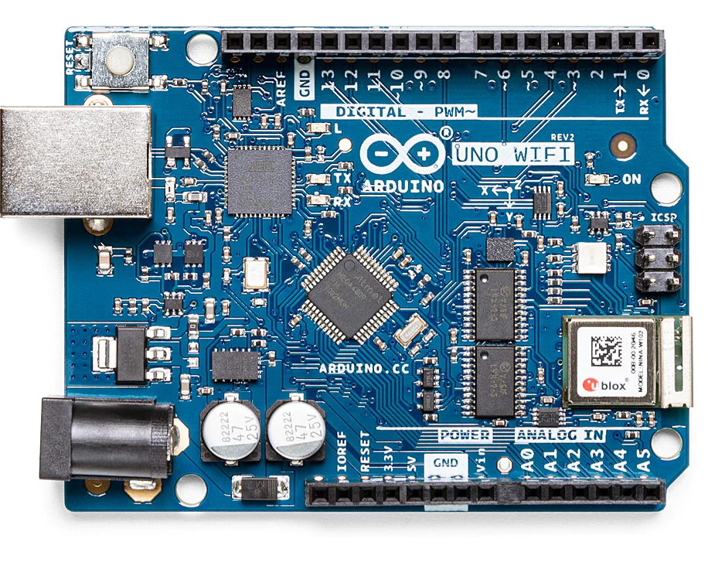
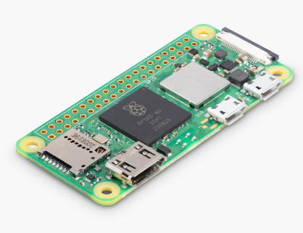
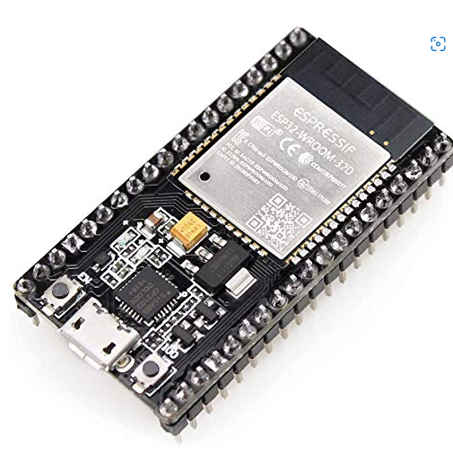

Parts Consideration: MCU
Dhanesh
 | Arduino Uno Wifi Rev 2 | Raspberry Pi Zero 2 | ESP32-WROOM-32E
Current | 50mA | 2A | 50mA
CPU | ATmega4809 16MHz | 1Ghz Quad-Core 64-bit CPU | 240MHz Dual-Core 32-bit CPU
RAM | 6KB SRAM + 48KB Flash | 512MB SDRAM | 520KB SRAM
# of Pins | 38 pins | 40 pins | 38 pins
Cost | $54 | $15 | $11
Notes:
For our object detection sensors, they will be used to prevent our robot bumping into walls and obstacles. They will also be used to detect when the trash bin on the robot is full. We chose to use the HC-SR04 because of its decent sensing range, operating voltage, weight, and its cheap cost compared to the other 3 options.

Slide 9
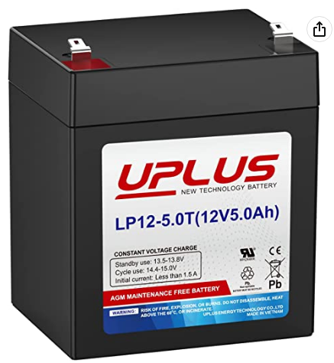
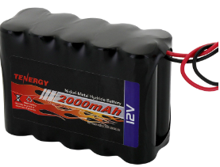
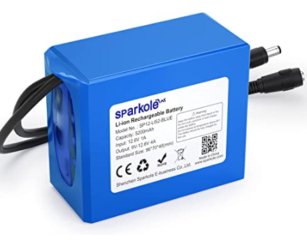
Parts Consideration: Battery
Dhanesh
 | UPLUS Lead Acid Battery | Tenergy 12V Pack | SPARKOLE 12 Pack
Voltage | 12 Volts at 5Ah | 12 Volts at 2Ah | 12 Volts at 5.2Ah
Weight | 3.5 lbs | 0.5 lbs | 0.74 lbs
Current Flow | High Current Flow | 1A Current Flow | 3A Current Flow
Price | $22 | $43 | $35
Notes:
For our object detection sensors, they will be used to prevent our robot bumping into walls and obstacles. They will also be used to detect when the trash bin on the robot is full. We chose to use the HC-SR04 because of its decent sensing range, operating voltage, weight, and its cheap cost compared to the other 3 options.

Slide 10

Parts Consideration: Object Detection Sensors
Anna
 | Ultrasonic Sensors | Lidar | Radar
Type of Emission | Sound Waves | Light Waves | Electromagnetic Waves
High Reading Frequency | No | Yes | -
Range Detection | Small | Small | Long
3D Imaging Compatible | No | Yes | No
Resolution | High | High | Low
Size | Small | Medium | Big
Cost | Low | High | Medium
Notes:
For our object detection sensors, they will be used to prevent our robot bumping into walls and obstacles. They will also be used to detect when the trash bin on the robot is full. We chose to use the HC-SR04 because of its decent sensing range, operating voltage, weight, and its cheap cost compared to the other 3 options.

Slide 11
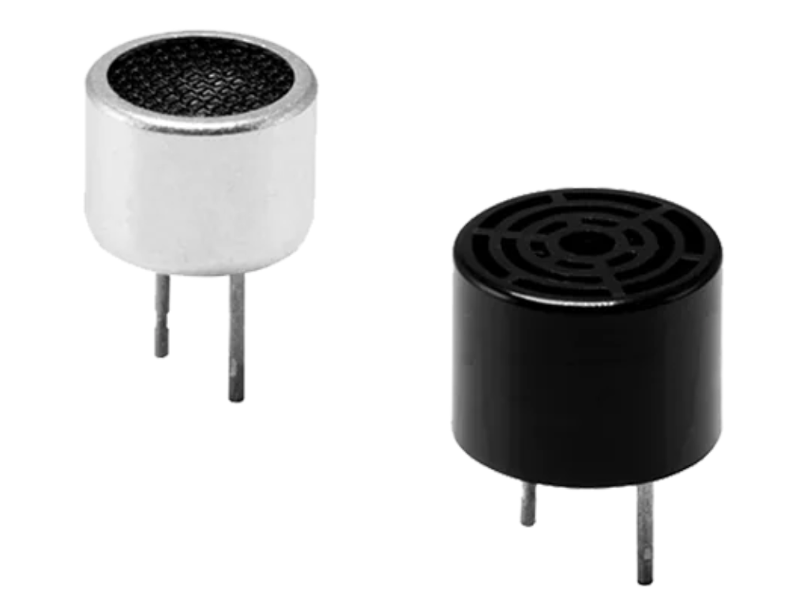
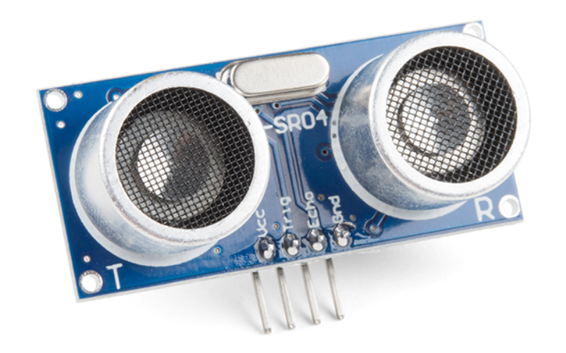
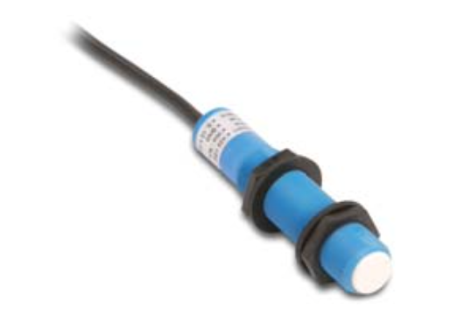
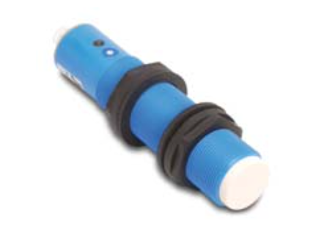
Parts Consideration: Object Detection Sensors
 | CUS Proximity Sensors | HC-SR04 | SU Series Ultrasonic Sensors | TU Series Ultrasonic Sensors
Sensing Range | 0 – 708'' | 0.78 - 157.48'' | 3.94 - 59.06'' | 11.81 - 98.43''
Operating Voltage | 80 – 180 V | 3 – 5 V | 15 – 30 V | 19 – 30 V
Dimension | 0.49 x 0.37'' | 1.77 x 0.78'' | 5.47 x 0.71'' | 4.88 x 1.18''
Weight | <2 g | 8.5g | 54g | 124g
Cost | <$5.00 | $4.50 | $305-333 | $357
Anna
Notes:
For our object detection sensors, they will be used to prevent our robot bumping into walls and obstacles. They will also be used to detect when the trash bin on the robot is full. We chose to use the HC-SR04 because of its decent sensing range, operating voltage, weight, and its cheap cost compared to the other 3 options.

Slide 12
Parts Consideration: Weight Sensors
Anna
 | Hydraulic Weight Sensors | Resistance Strain Weigh Sensors | Vibrating Weight Sensors
Weight Range | Wide | Medium | Low
Accuracy | Low | High | High
Size | Big | Small | Small
Cost | High | Low | High
Notes:
For our weight sensors, they will mainly be used to weigh the trash in the trash can on the robot. We chose the 50 kg half-bridge strain gauge load cell because it is easier to set up for
our big trash can compared to the 20 kg load cell as you can see in the pictures shown in the setup row. Overall, the object detection sensor and weight sensor will be used together as a limit to determine when the robot stops to collect more trash.

Slide 13
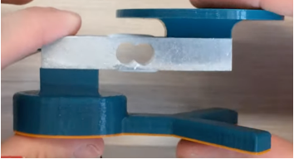
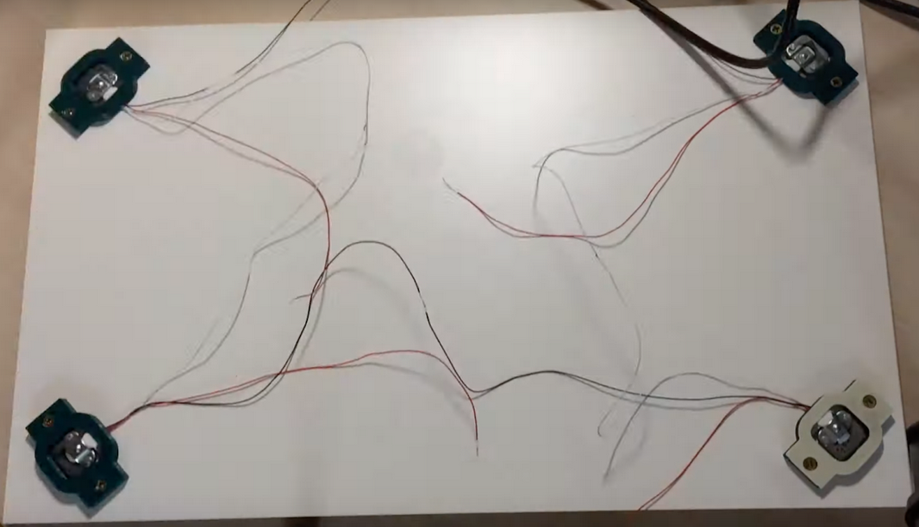
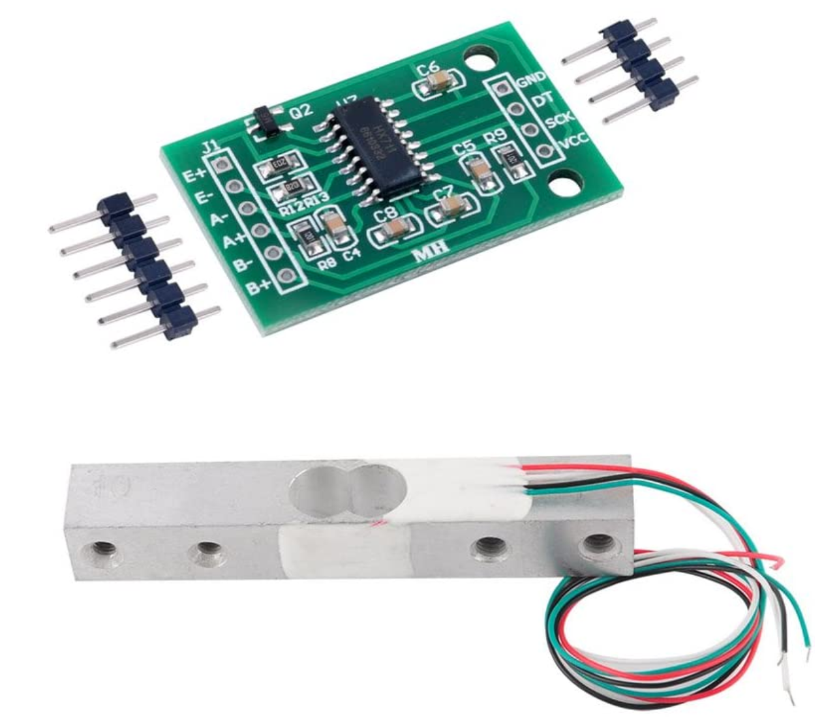
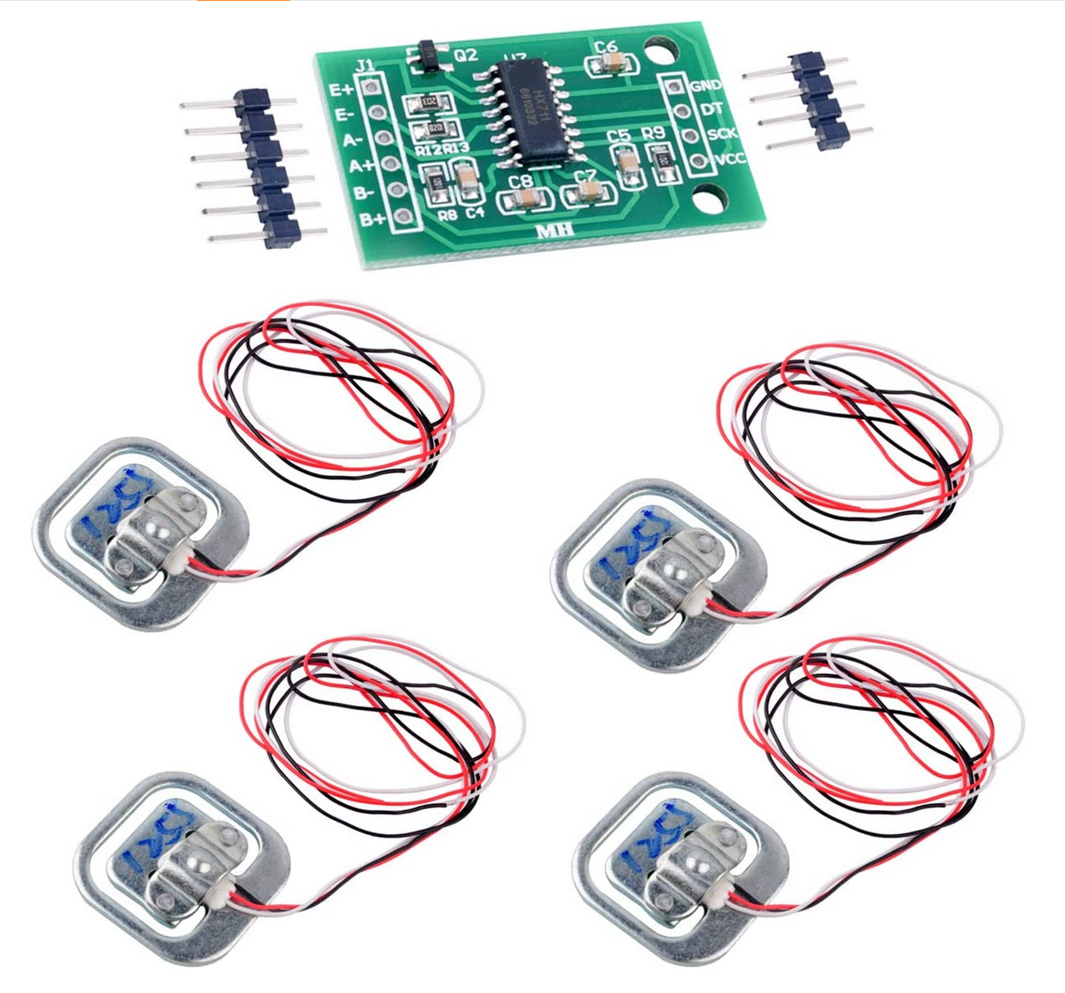
Parts Consideration: Weight Sensors
Anna
 | 20 kg Load Cell | 50 kg Half-Bridge Strain Gauge Load Cell
Dimensions | 0.5'' x 0.5'' x 3.15'' | 1.33'' x 1.33''
Weight | 36 g | 28 g
Cost | $9.99 | $8.99
Setup
Notes:
For our weight sensors, they will mainly be used to weigh the trash in the trash can on the robot. We chose the 50 kg half-bridge strain gauge load cell because it is easier to set up for
our big trash can compared to the 20 kg load cell as you can see in the pictures shown in the setup row. Overall, the object detection sensor and weight sensor will be used together as a limit to determine when the robot stops to collect more trash.

Slide 14
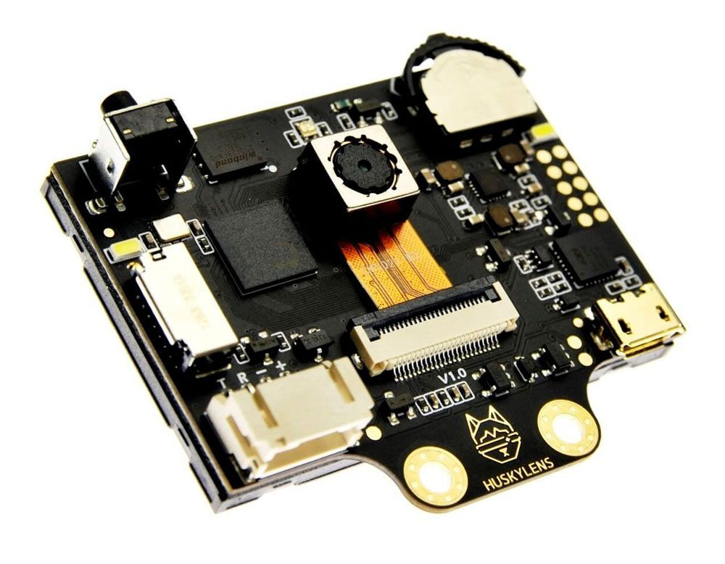
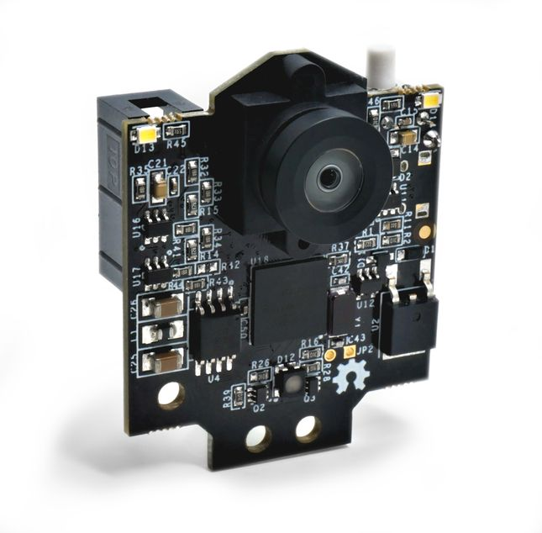
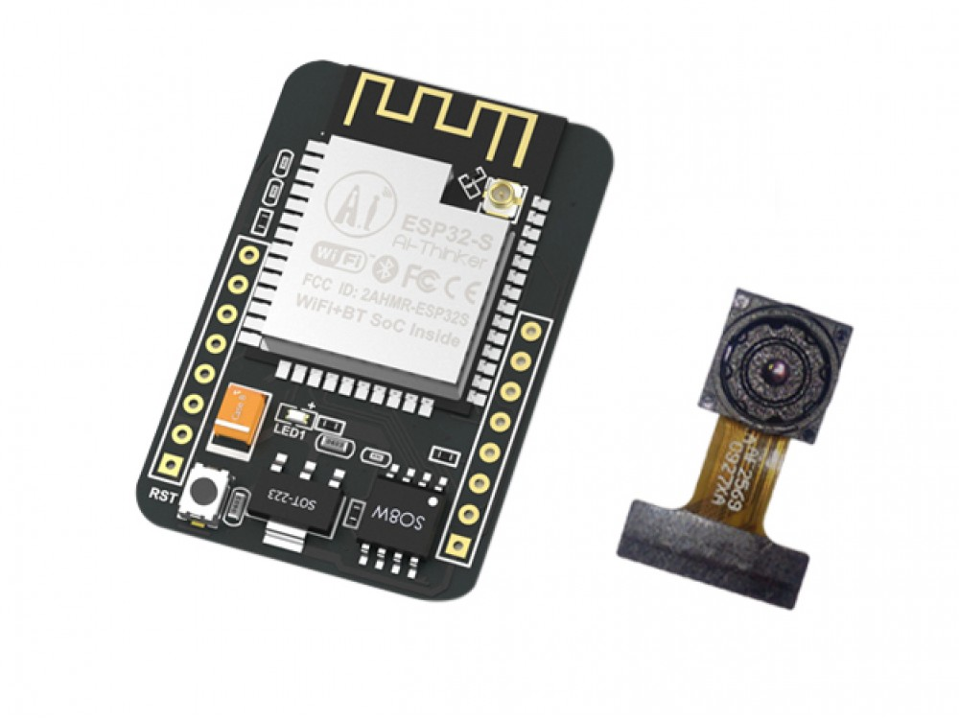
Parts Consideration: Camera
​ | Huskylens​ | Pixy2​ | ESP32 Cam​
Camera​ | 320x240​ | 1296x976​ | 1600x1200​
WiFi​ | No​ | Yes​ | Yes​
MCU compatibility​ | Arduino, Raspberry Pi, LattePanda, and micro:bit​ | Any controller that uses SPI, I2C, UART, and USB​ | ESP​
Machine Vision Capability​ | Yes​ | Yes​ | No​
Cost​ | $54.90​ | $69.95​ | $12.60​
Jourdan

Slide 15
Hardware Design

Slide 16
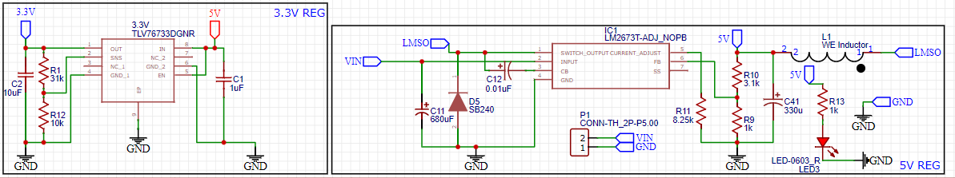
Schematic Design: DC-DC Converters
Dhanesh

Slide 17
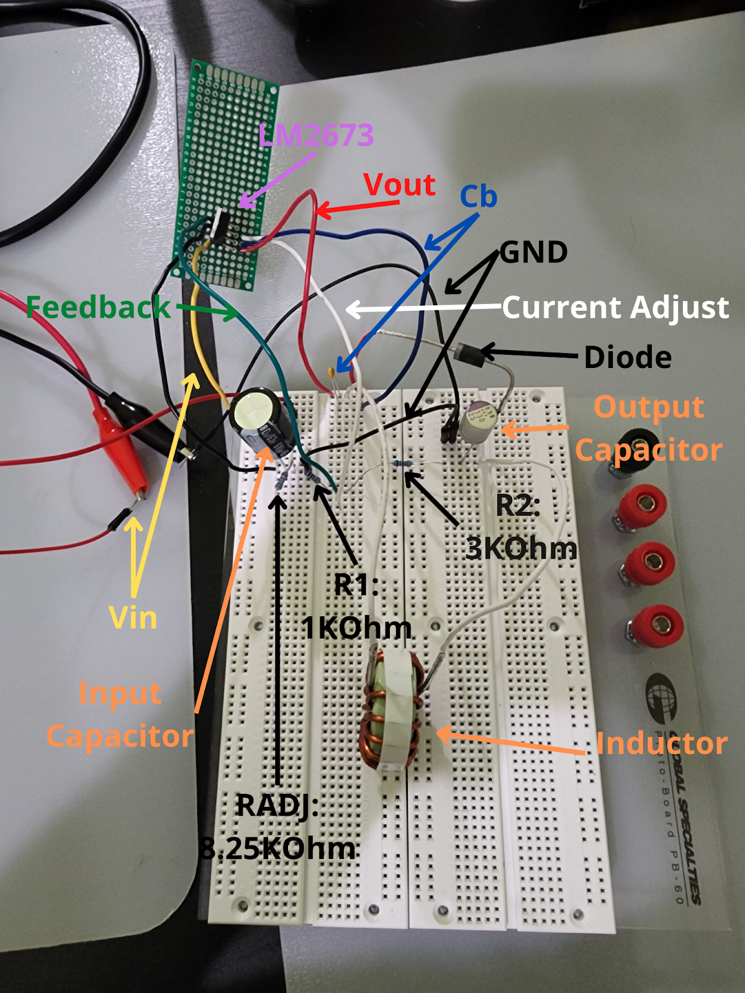
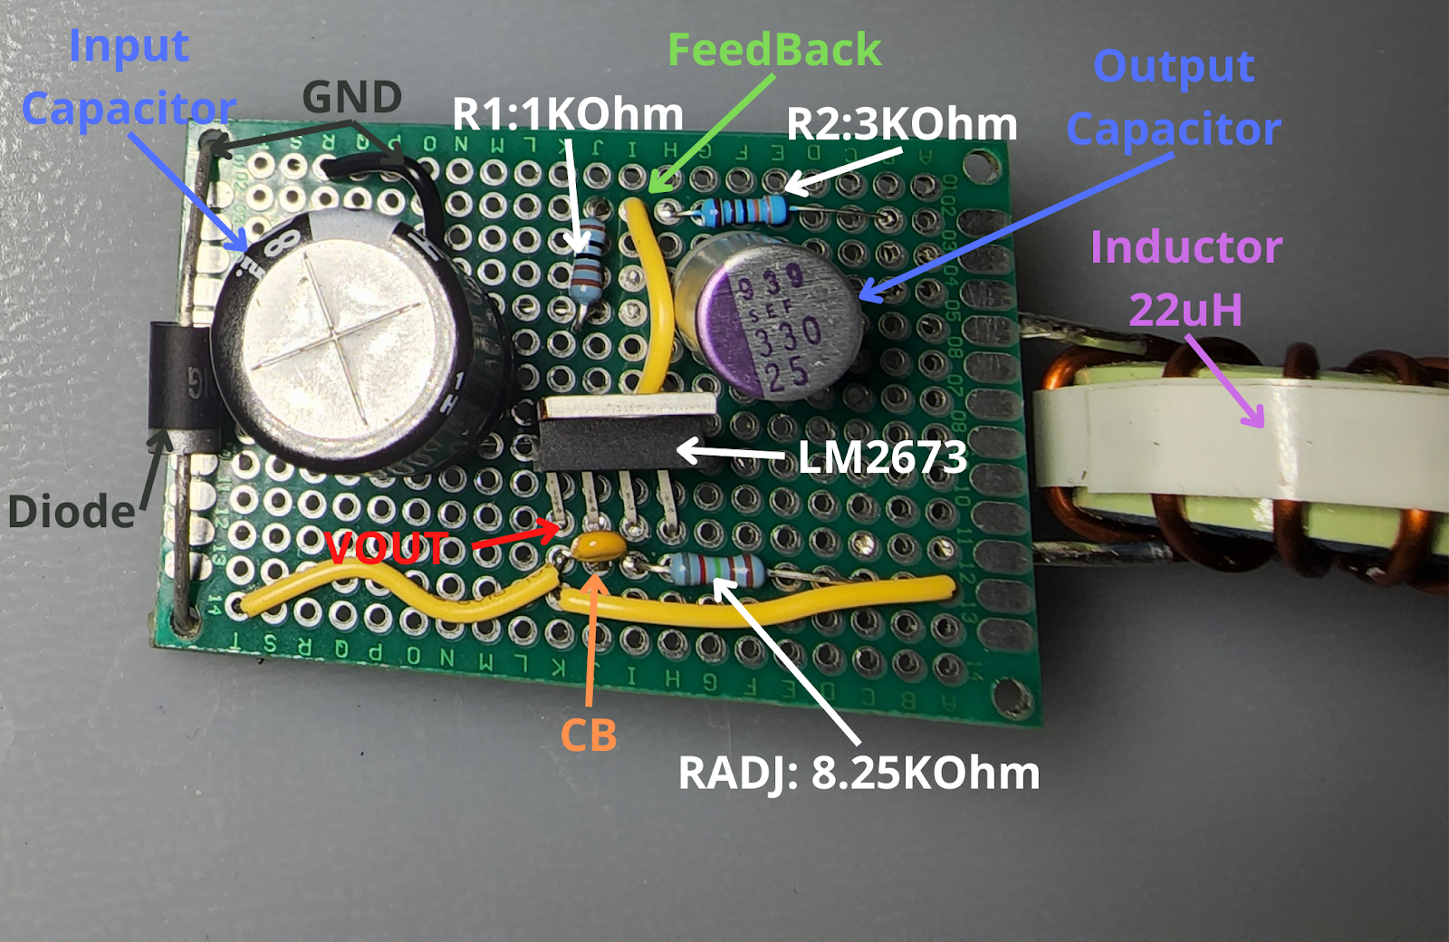
Hardware: Testing
Dhanesh

Slide 18
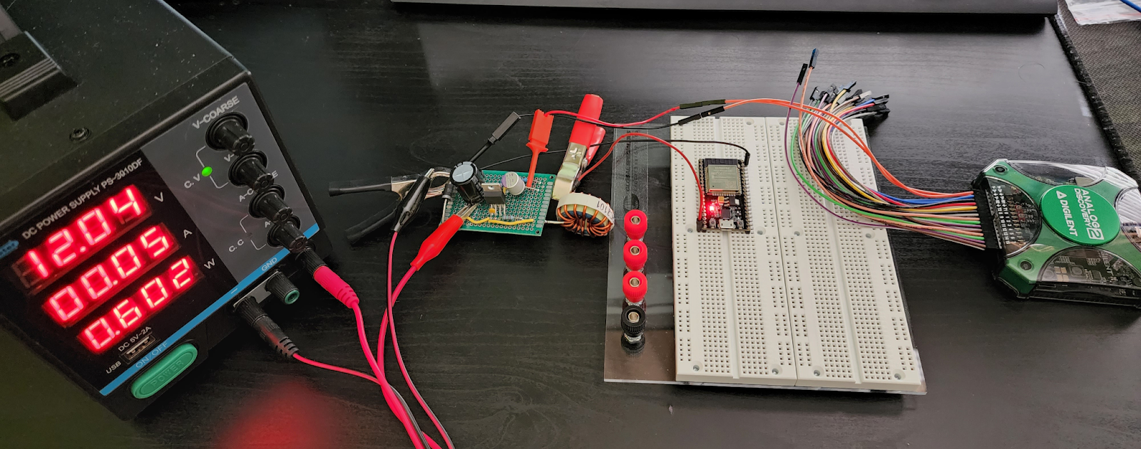
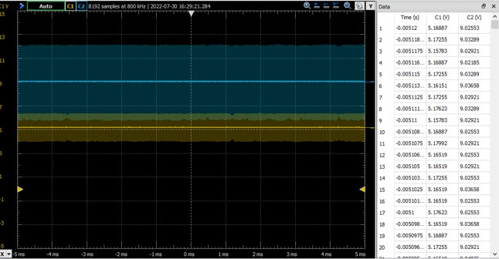
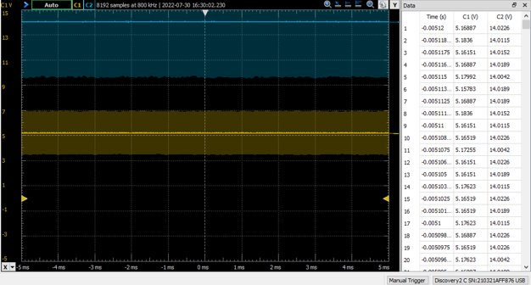
Hardware: Testing
Dhanesh

Slide 19
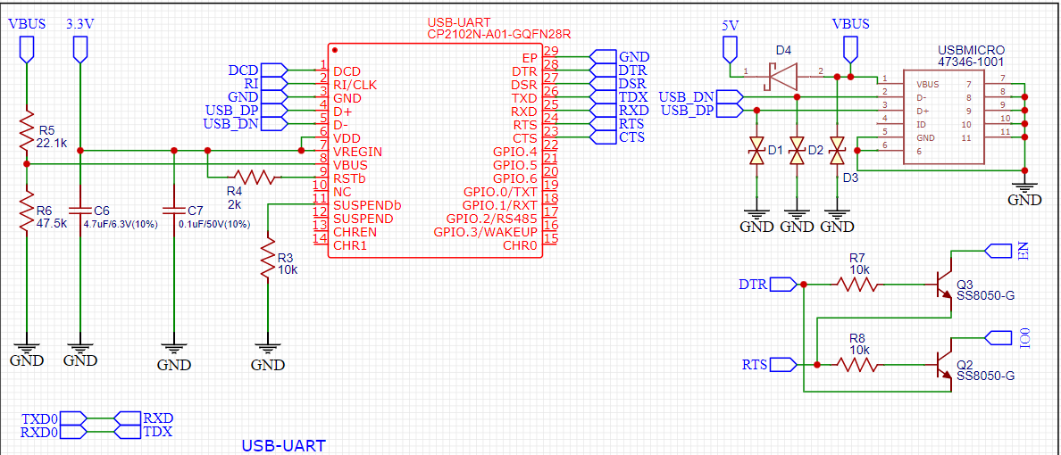
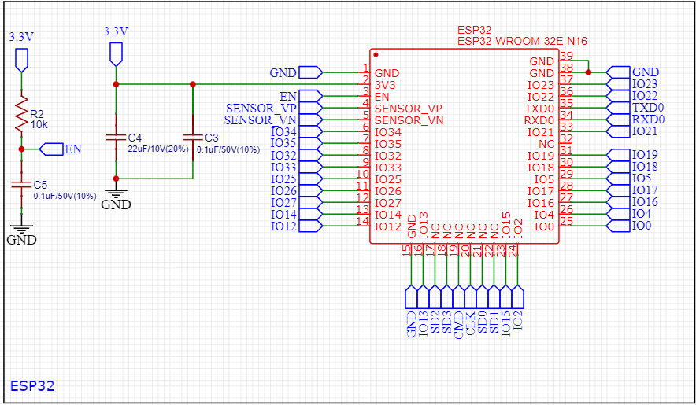
Schematic Design: USB & ESP32
Dhanesh

Slide 20
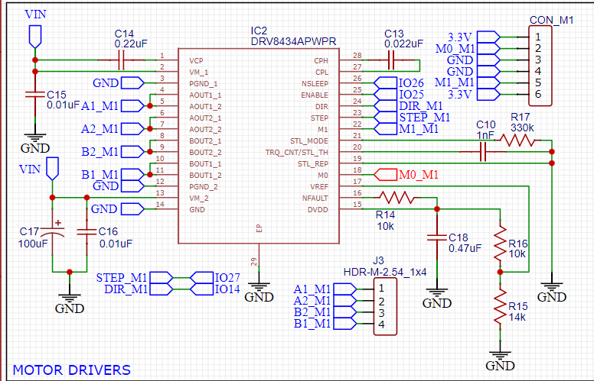
Schematic Design: Motor Driver x 4
Dhanesh

Slide 21
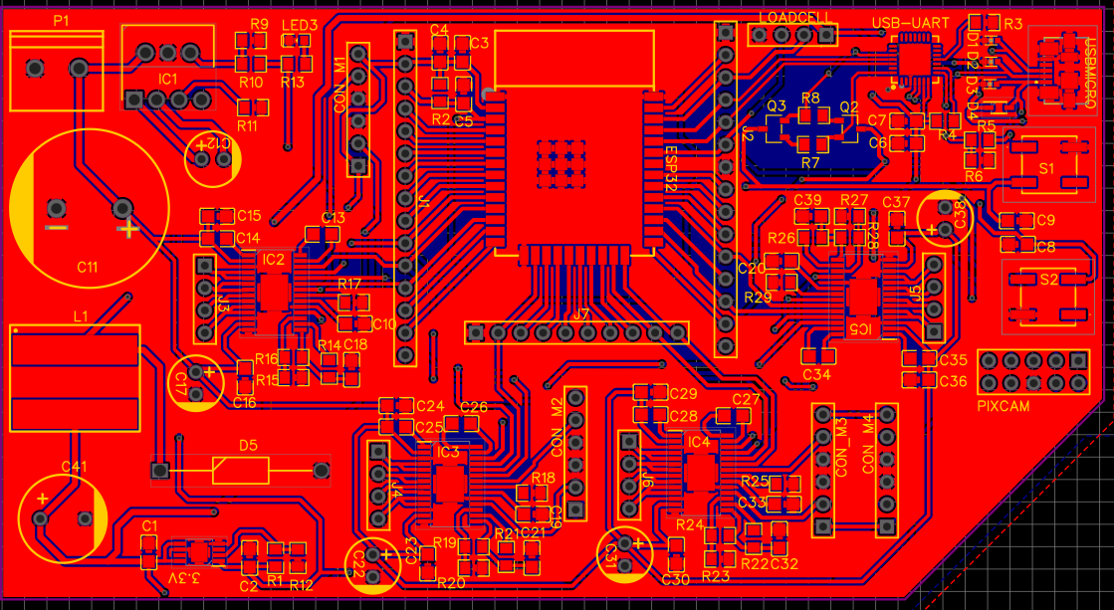
Schematic Design: Final PCB Design
Dhanesh

Slide 22
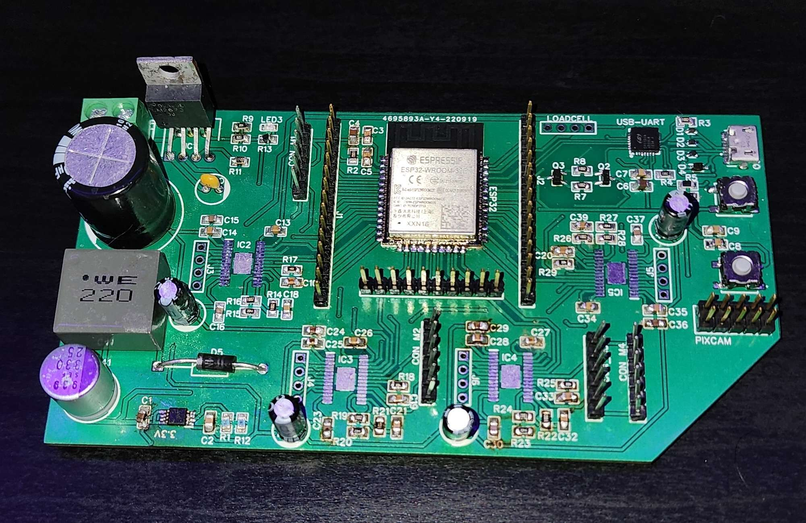
Schematic Design: Final PCB Design
Dhanesh

Slide 23
Software Design

Slide 24
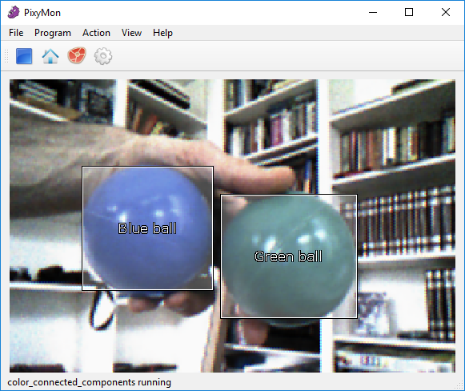
Software: Pixy2 Cam Robot Vision
Jourdan
A smart camera with its own processor
Detects solid color objects by using a color connected component algorithm
“Draws” a square around trained objects

Slide 25
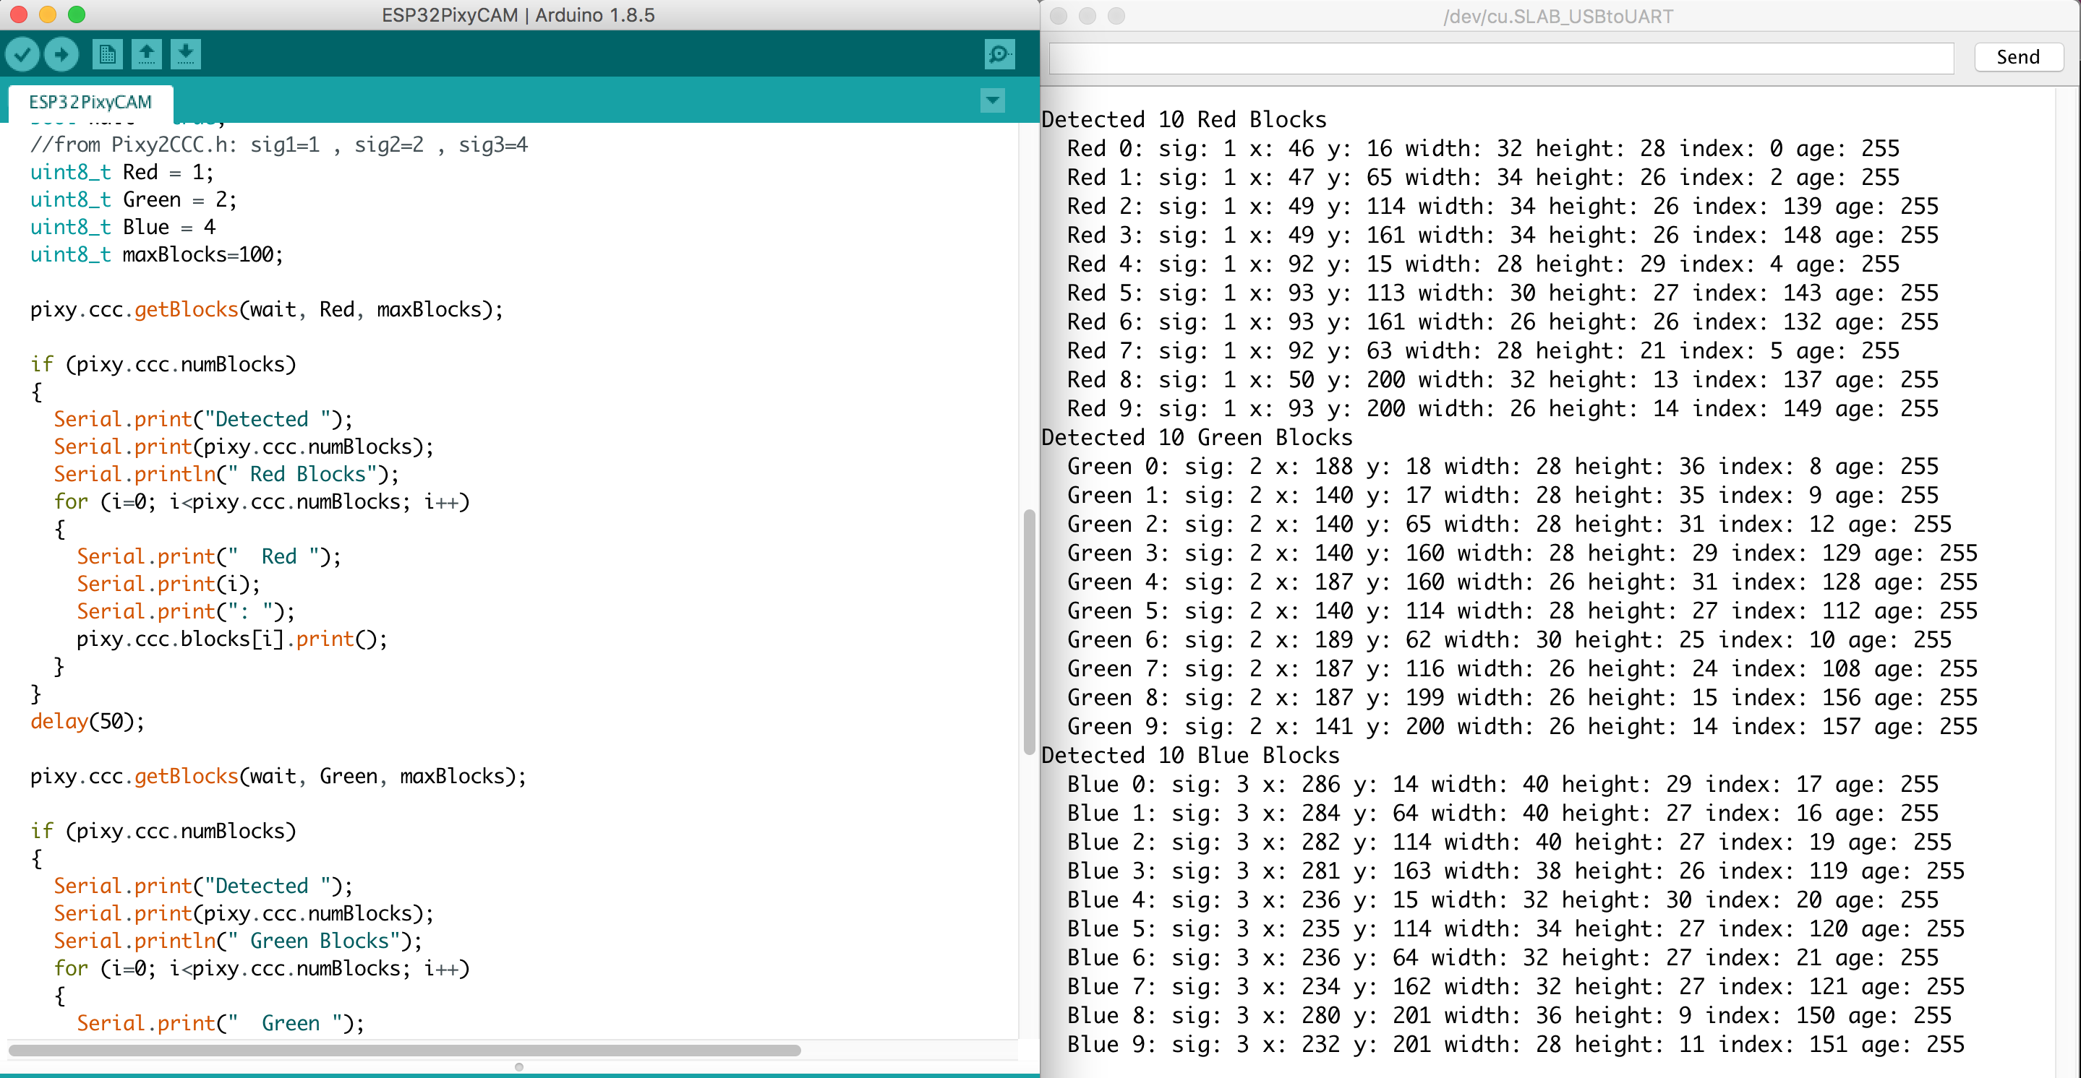
Software: SPI communication
Jourdan
We used SPI communication with slave select (ss) to communicate with the Pixy Camera.
The data the ESP received from the Pixy Camera that we used was the X, Y, and width of the square the camera makes around a trained object.

Slide 26
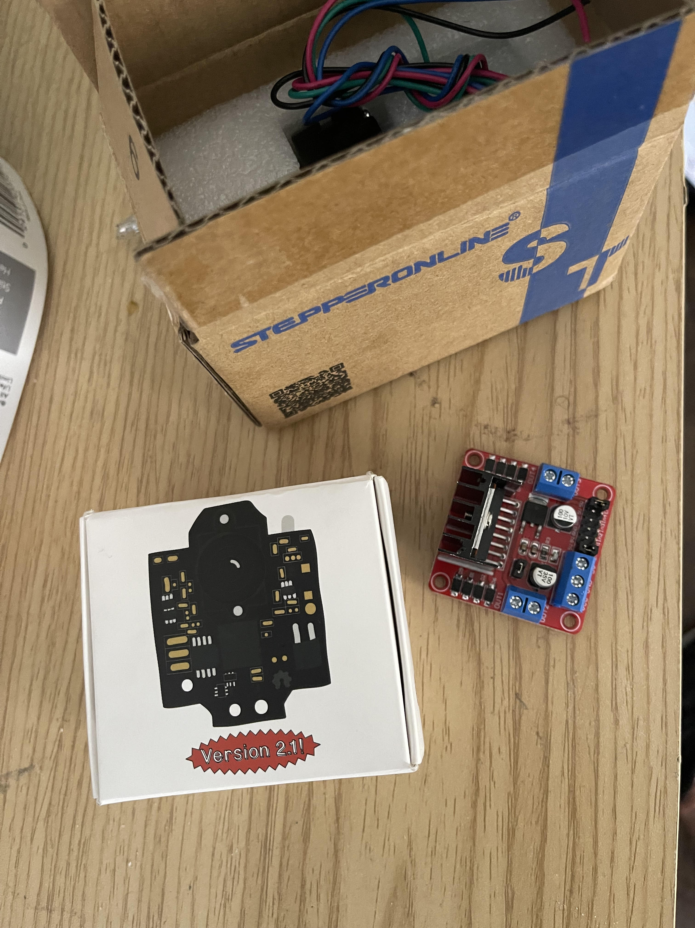
Software: Autonomous Functionality
Jourdan
Since stepper motors moves in “steps” it limited the speed of the autonomous algorithm
Two stepper motors was used and was program to go in opposite directions to turn left and right.

Slide 27
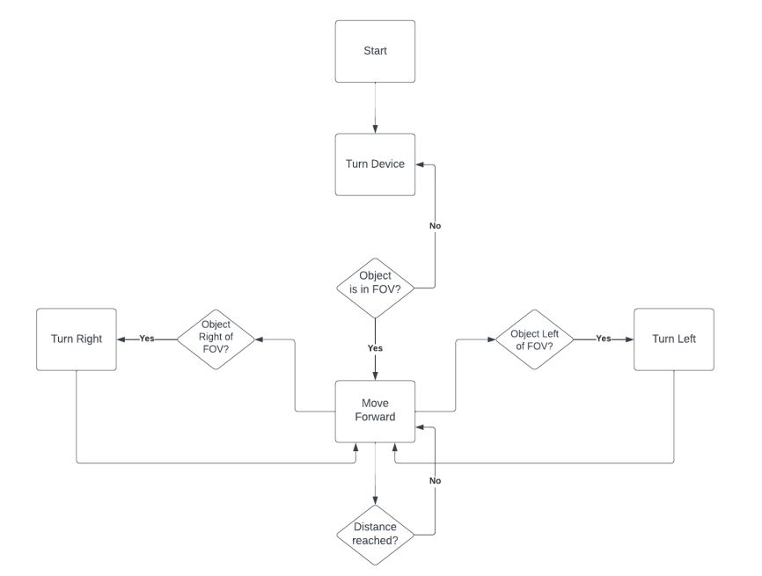
Software: Search Algorithm with Pixy Camera
Jourdan

Slide 28
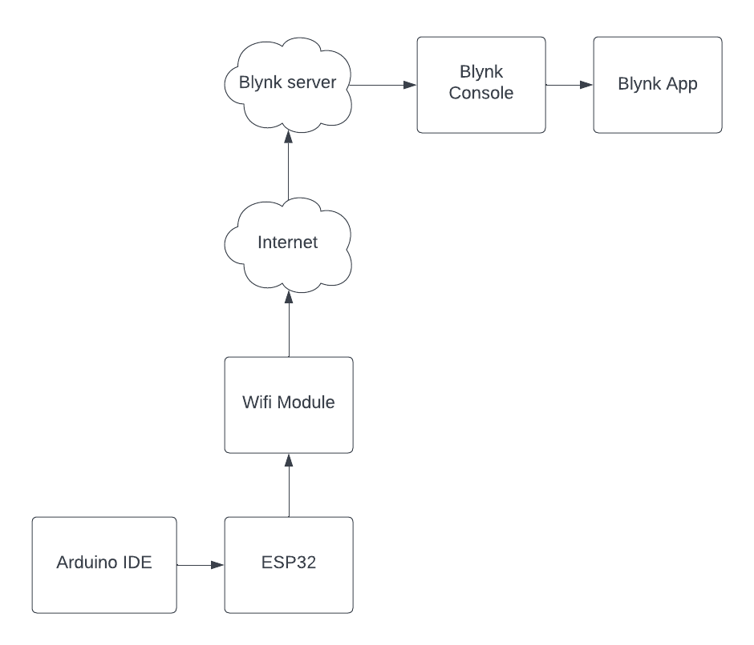
Software: Blynk Communication
Jourdan
Will use the Arduino IDE and Blynk console to setup up MCU and components
Will be able to speak to the Wi-Fi module on our ESP32
Other option would have been Bluetooth

Slide 29
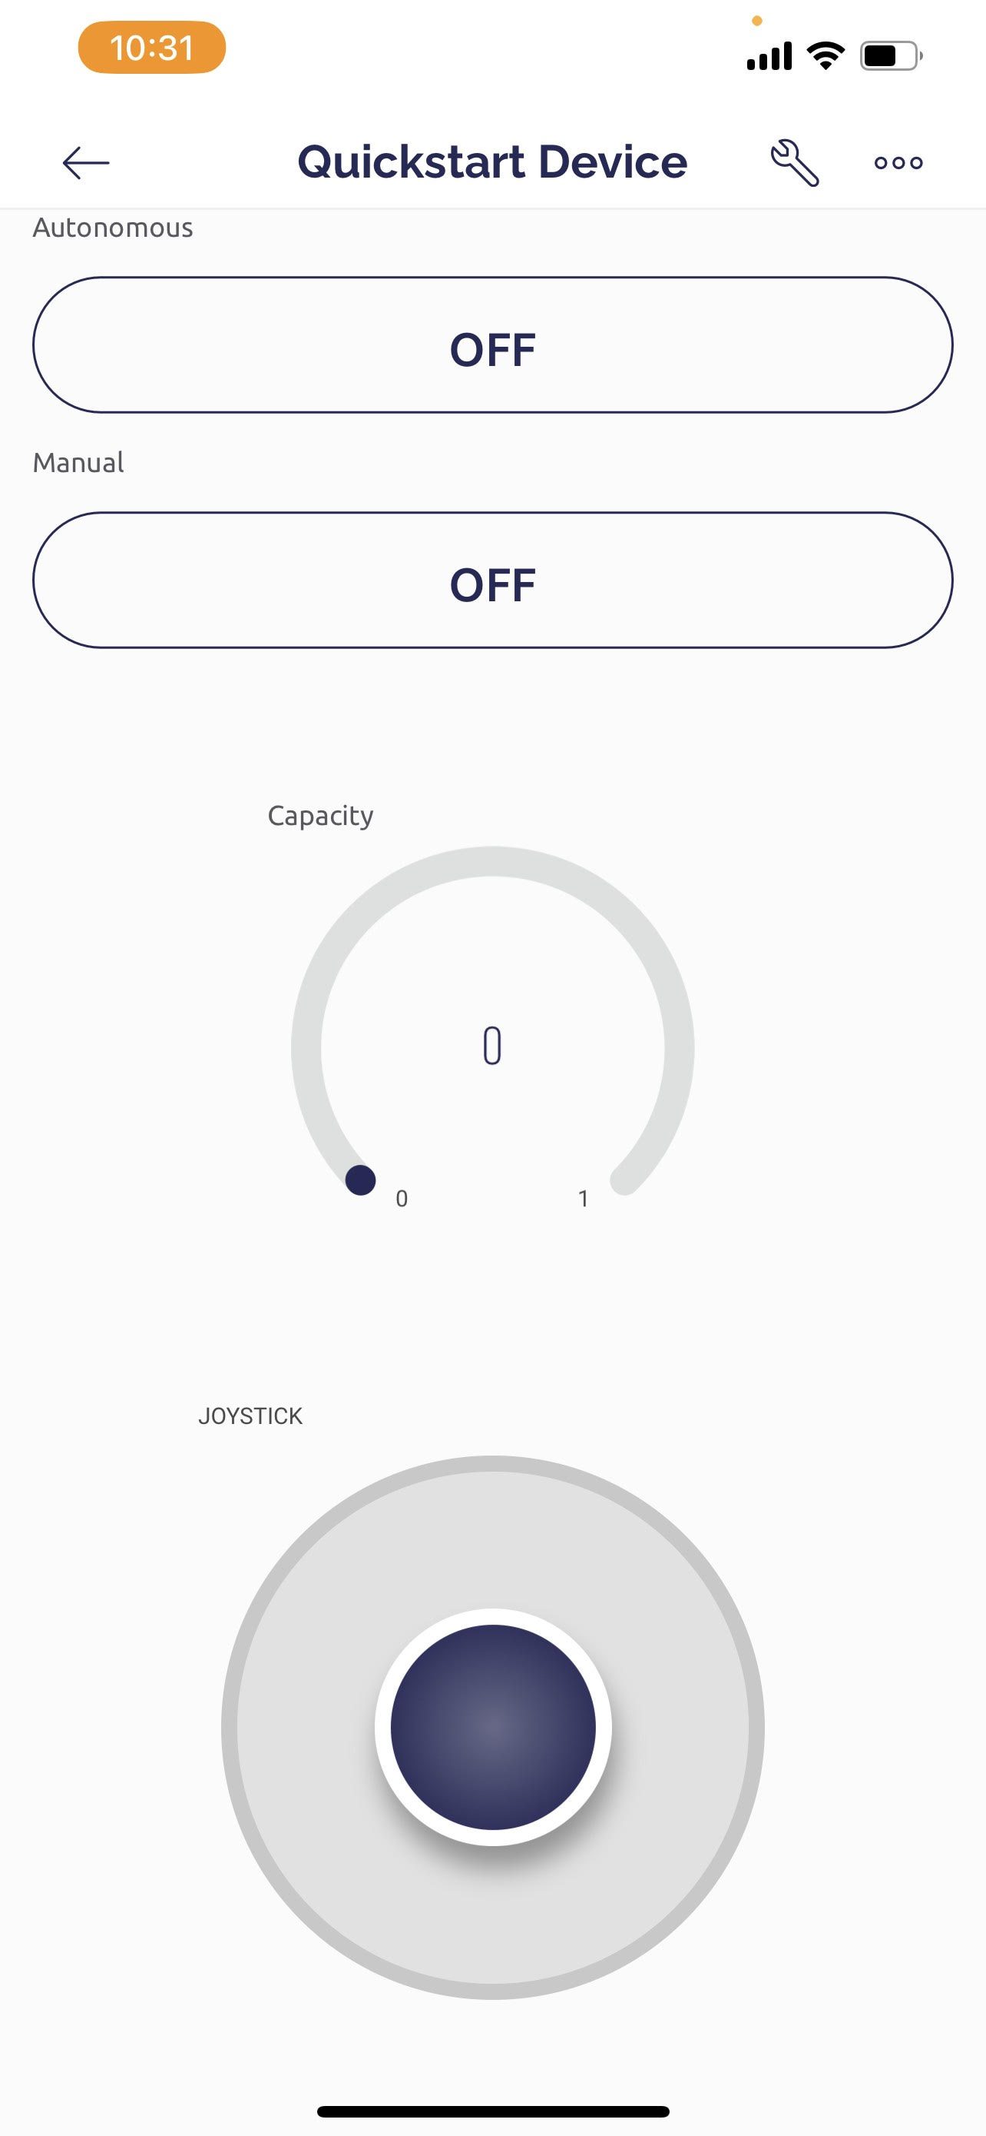
Software: App Layout
Jourdan
Has two buttons to change the state of the Trashporter
The gauge will display the current capacity of the
The Joystick controls the movement

Slide 30
Building Process

Slide 31
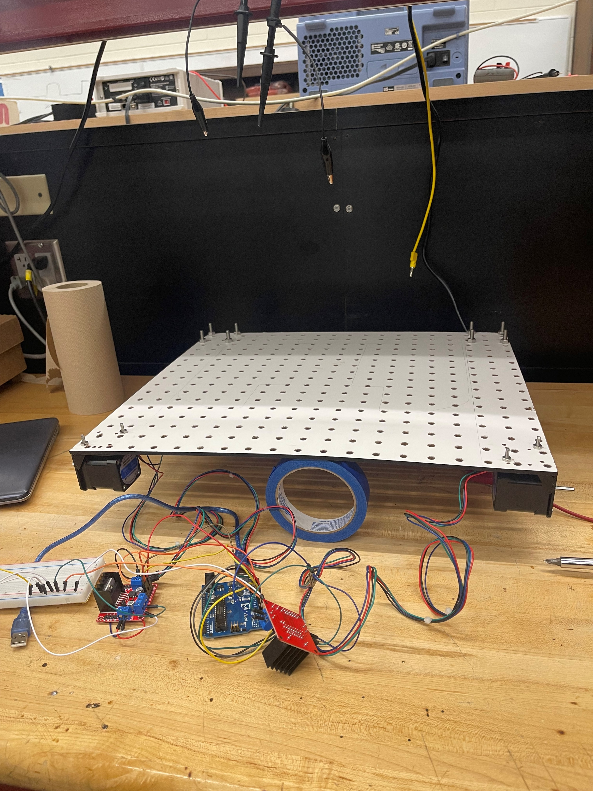
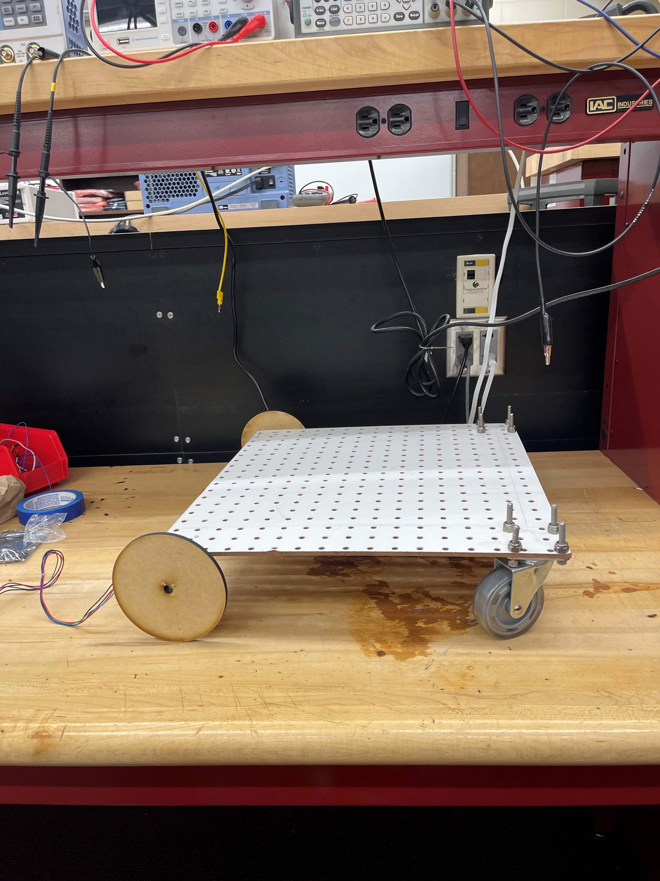
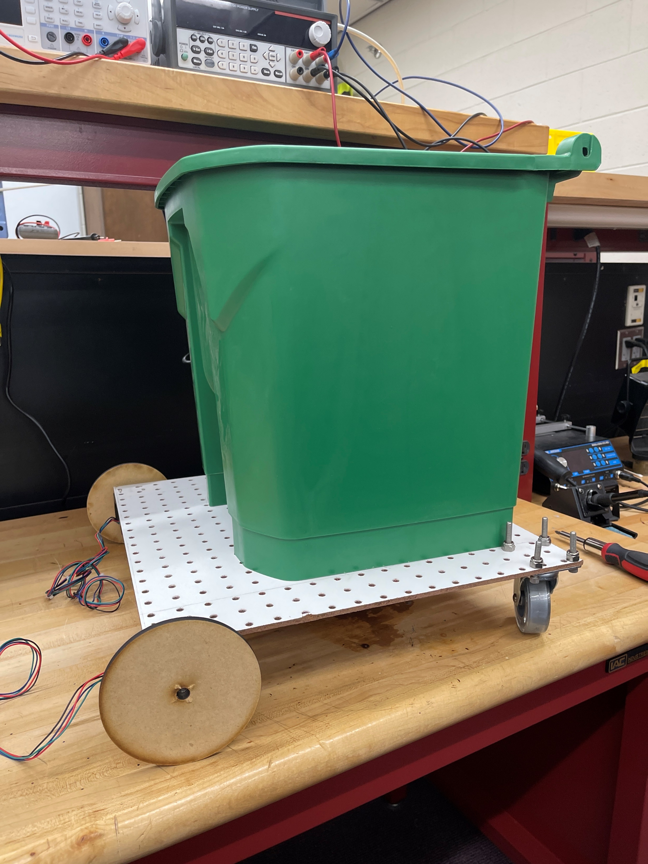
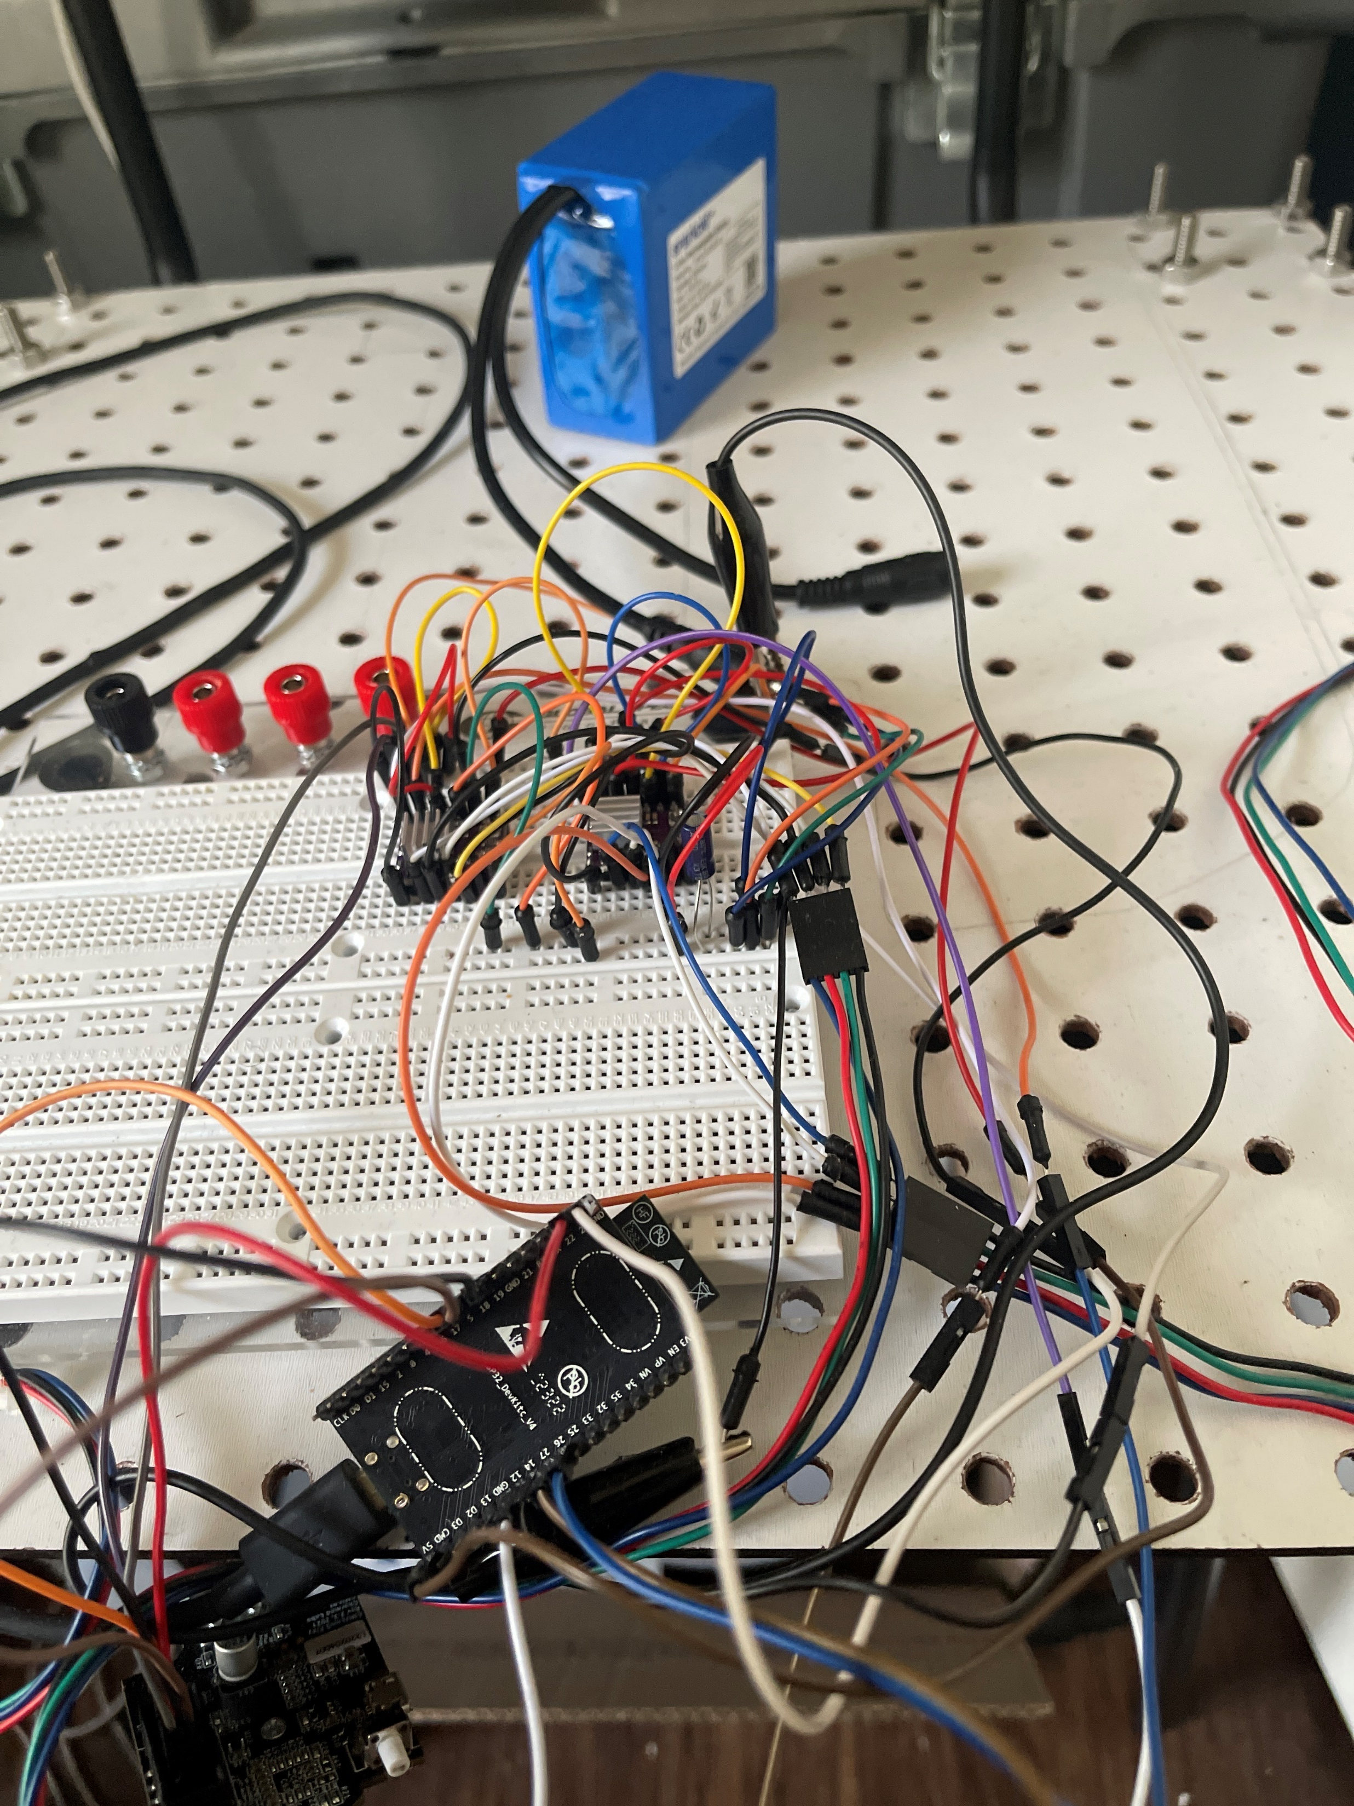
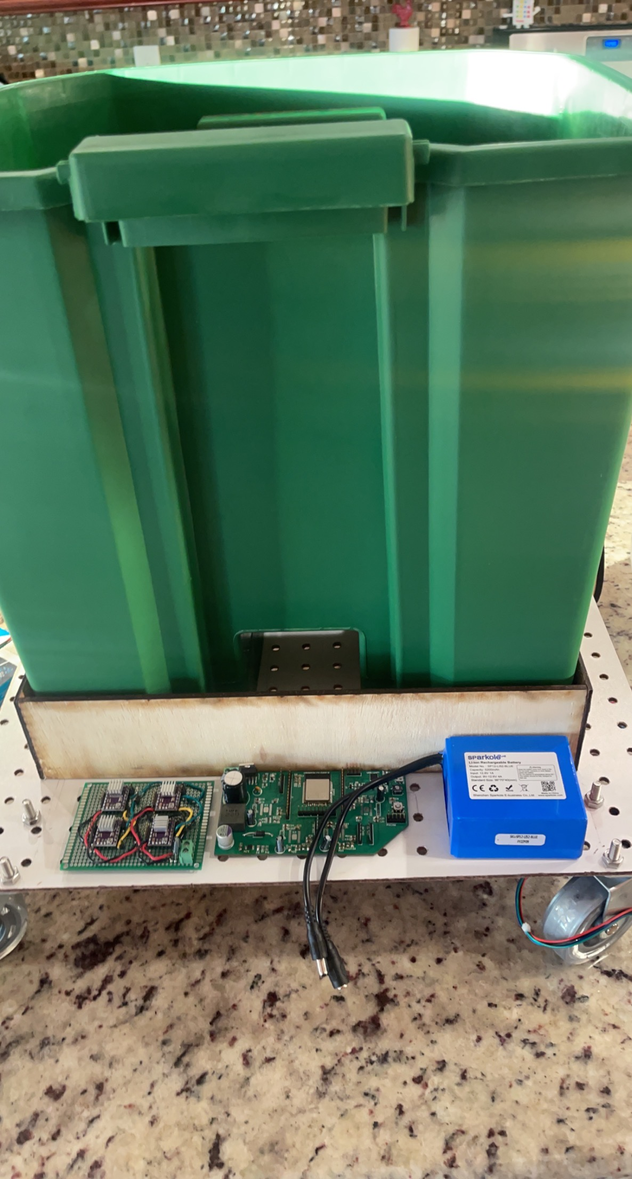
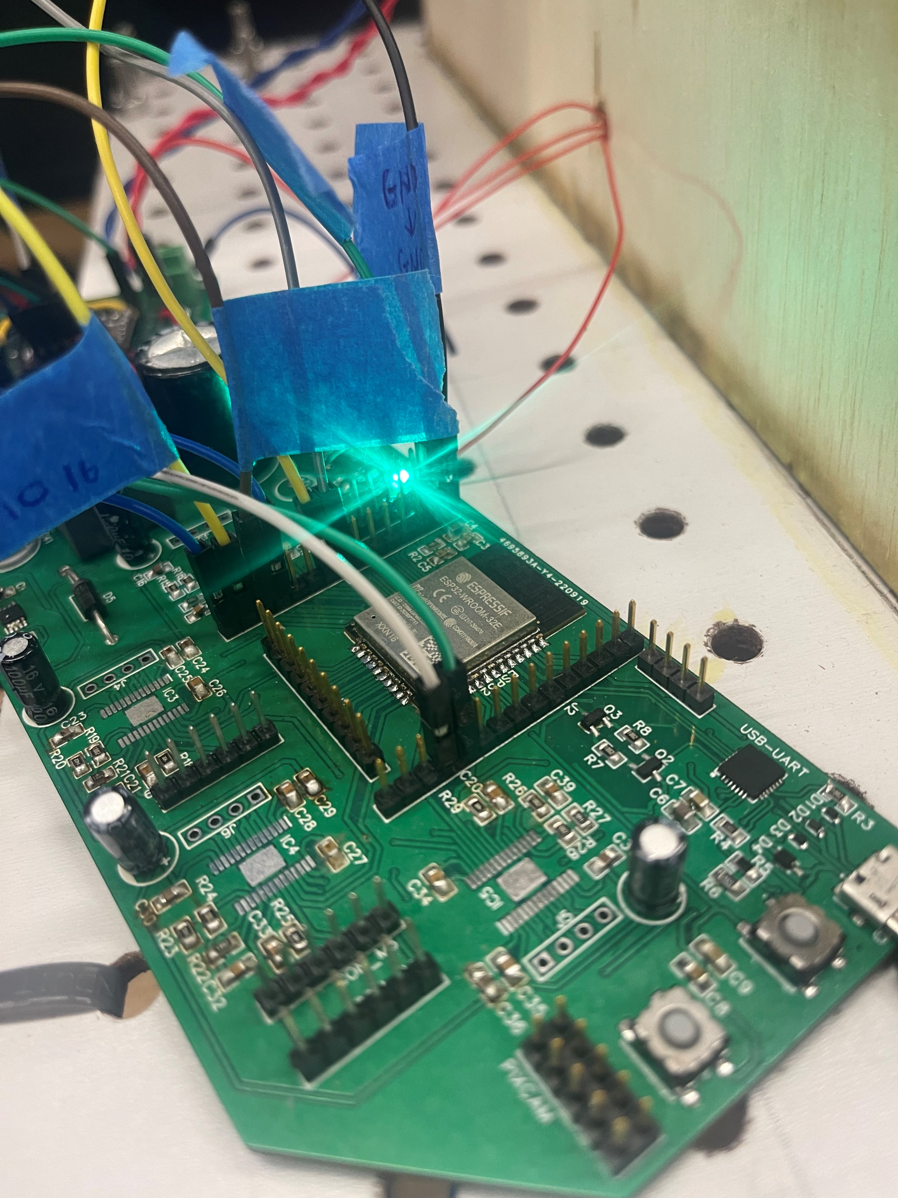
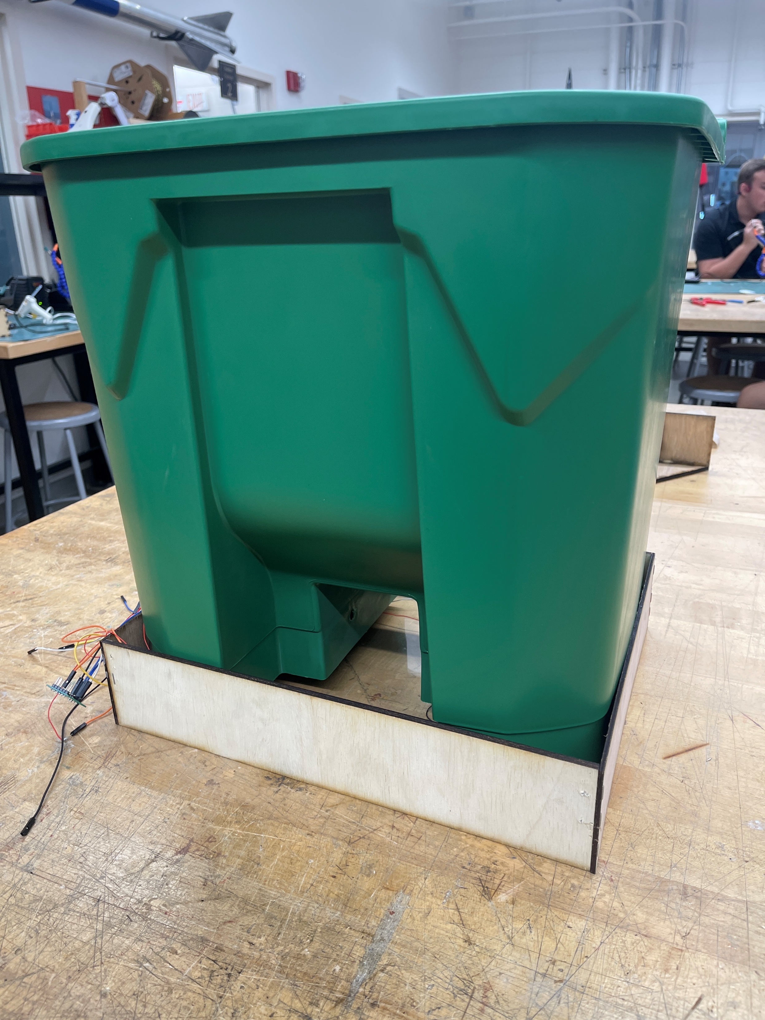
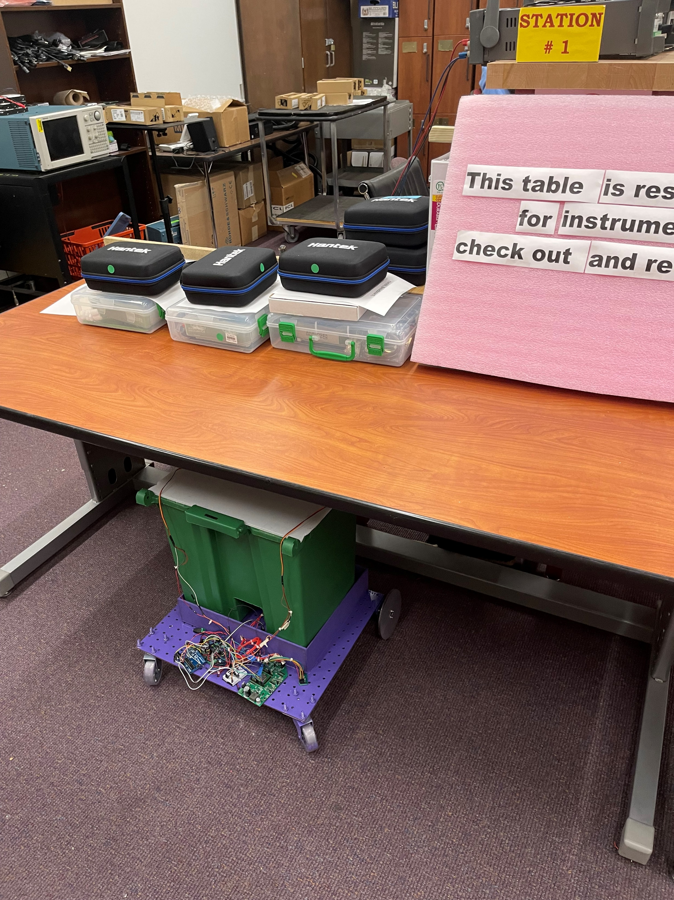
Anna

Slide 32
Administration Content

Slide 33
Anna Anna managed the electrical work for the project and weight sensor functionality Primary: Weight Sensors Secondary: Assembly | Andy Andy is the project manager who oversees meetings and played a role in software development Primary: Mobile Application Secondary: Assembly | Nesh Nesh is focused on the overall hardware and electrical development along with PCB creation Primary: PCB research and development Secondary: Assembly | Jourdan Jourdan is focused on the overall software development and construction of the Trashporter Primary: Autonomous algorithm Secondary: Assembly
Anna

Slide 34
Material List & Budget
Total: $597.06
Parts | Price ($) | Parts | Price($)
Battery | 40.60 | Wooden Wheels | Free
Nema 17 Stepper Motor | 28.00 | Metal Flanges | 8.59
Arduino Uno | Free | Caster Wheels | 12
DRV8825 | 14.50 | 3D Printed Frames | Free
Pixy Camera | 69.65 | Trash Bin | Free
Washers | 1 | Corrugated Plastic | 3.60
Weight Sensors | 18.82 | Servos | Free
Acrylic Weight Platform | 8.33 | SMD Components | ~300
Robot Base | 18.00 | Power Jack Plug | 7.99
ESP32 | 18.99 | Wires
PCB | ~30.00 | Motor Mounts | 16.99
Anna
Notes:
This is a general material list & budget table for our project. We got stepper motors, motor driver, stepper driver, pixy cam, weight sensors, wooden and acrylic materials, esp32 board, and accounting for the PCB, the total would be about $285.89. However, we expect to go over this budget with more materials that we still need.

Slide 35
Project Deadlines
Anna
Task | Due Date
Assemble the base with wheels and trash can | 9/16/2022
Finalize PCB design | 9/16/2022
Pixy Cam setup | 9/30/2022
Weight scale setup | 9/30/2022
Trash can lid | 10/20/2022
Assemble everything together | 10/28/2022
Testing & troubleshooting | 11/11/2022
Final project | 11/25/2022
Final video | 11/26/2022
Final ppt | 11/27/2022
Notes:
Project deadlines. So, we made some deadlines in the beginning of this semester. We expect the assembled base with wheels and trash can to be done this Friday as well as finalizing our PCB. We expect to finish the arm design, pixy cam setup which is pretty much done at this point, and the weight scale setup to be done on the 30th of this month. We expect to have everything assembled into the robot and have it working by 28th of next month. We gave a period of testing and troubleshooting after that and until the 11th of November. We expect everything is done and good to go by the 25th of November. We also have our final video demo on the 26th of November and final presentation deadline on the 27th of November.

Slide 36

Thank you!
Notes:
Thank you, that concludes our presentation.

