Slide 1
Autonomous Sanitation Robot
Group 9
Abel Assefa, EE
Shawn Manohar, EE
Allan McCormick, CpE
Rishi Patel, EE

Slide 2
Content
Introductions and Roles
Goals, Motivations and Deliverables
Component Selection
PCB Design
Relevant Technologies and Standards
Budget

Slide 3
Introduction and Roles
Allan (CPE): Coding sensors and robot as well working with the microcontroller and raspberry pi modules
Abel (EE): Conducted component testing and research, assisted in PCB design and platform design
Shawn (EE) : Conducted PCB Design, managed components and designed and built robot platform.
Rishi (EE): Managed PCB, tested integration of components, and assisted coding.

Slide 4
Motivation
The recent COVID-19 pandemic has shown everyone how easy it is to spread germs in an environment.
With areas of the highest foot traffic being hallways we need to maintain the cleanliness of hallways the most.
This self-driving robot would help people such as building managers ensure that high traffic areas like hallways and lobbies are always sanitized and clean

Slide 5
Goals and Objectives
Very light in weight for ease of mobility for users
Autonomously patrol an area and sanitize
Discerning environment
Liquid level sensor that will manage the solution
Speaker mounted to the top to notify users of its presence and when it will spray.

Slide 6
Deliverables
The robot spraying system will be triggered by a relay that will spraying for every 15 seconds
The robot will determine if an object or person is within <40 cm and the marked color is green, this will then produce a beep to alert users of spraying.
The robot will determine if there is <10% of the solution, and this will also a emit a different a sound for 5 seconds and shuts the robot down.

Slide 7
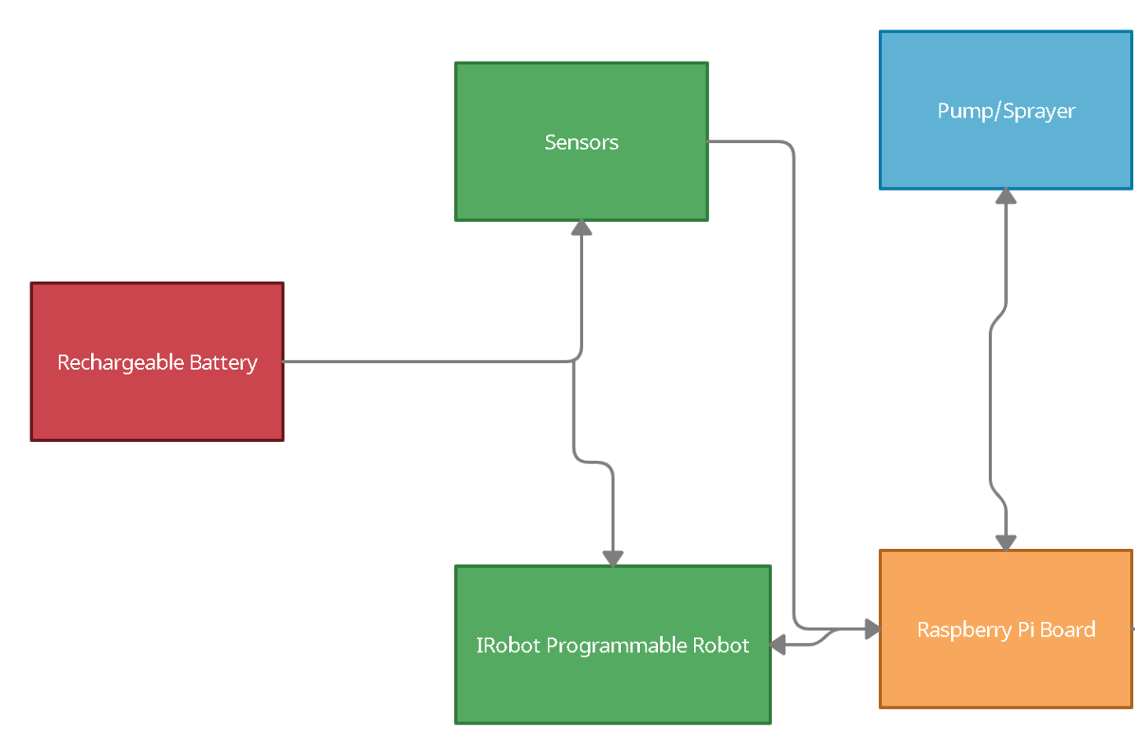
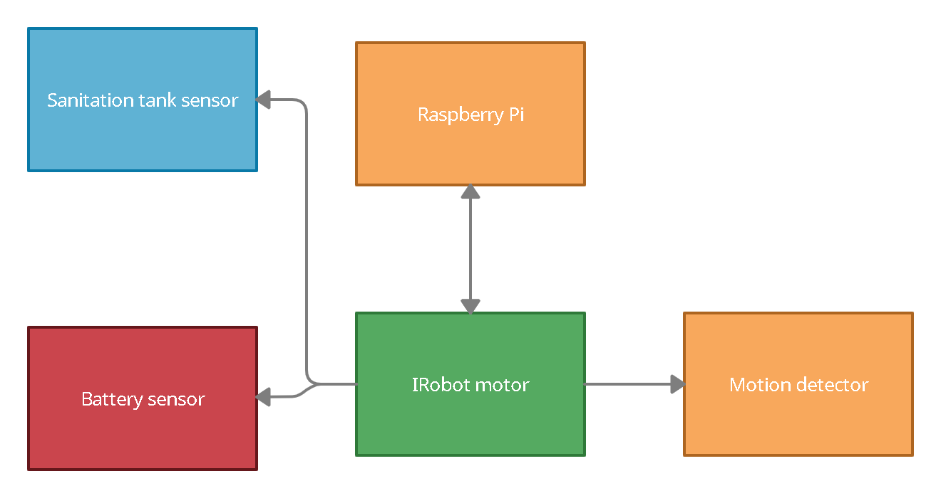
Block Diagrams
Figure 1: Block Diagram
Figure 2: Software Block Diagram

Slide 8
Distance Sensor Comparison
Sensor | Voltage | Range | Price
HC - SR04 | 5 DC | 2 cm - 4 m | $3.94
Parallax Ping | 5 DC | 2 cm - 3 m | $29.99
IR Break Beam | 3.3 - 5 DC | 50 cm | $5.95
LaserPING | 3.3 - 5 DC | 2 cm - 200 cm | $22.99
Garmin Lite V3 | 4.5 - 5.5 DC | 40 m | $131.25
Garmin Lite V4 | 4.75 - 5.25 DC | 5 cm - 10 m | $68.75

Slide 9
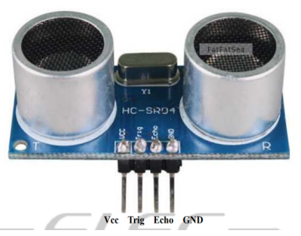
Sensor Selection
After our research we selected that the HC-SR04 sensor would work best to our needs
Some of the reasons why are
The low cost
The low power and current consumption
Sensor that is familiar to our group

Slide 10
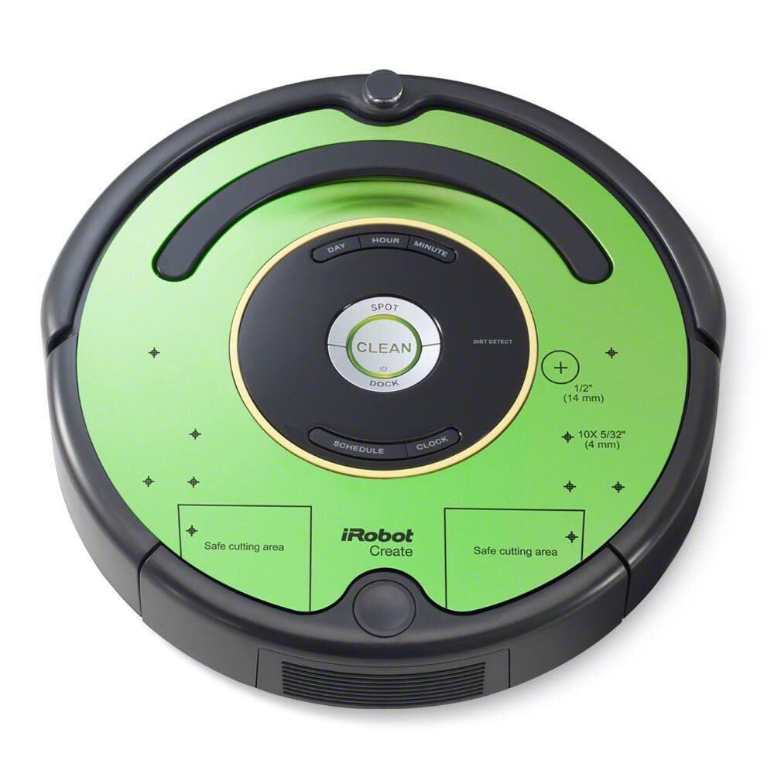
Chassis Selection
The base of out robot is the iRobot Create 2
Some of the key features that attracted us to this model were
The number of available on board sensor
Compatibility with microcontroller and other external hardware/computers
Open interface commands and flexibility in language coded
Mounting area on faceplate

Slide 11
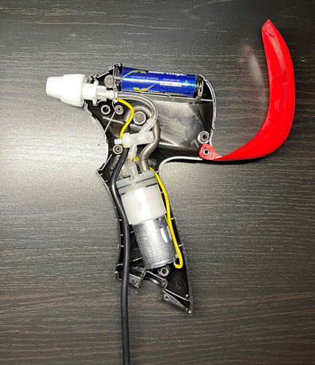
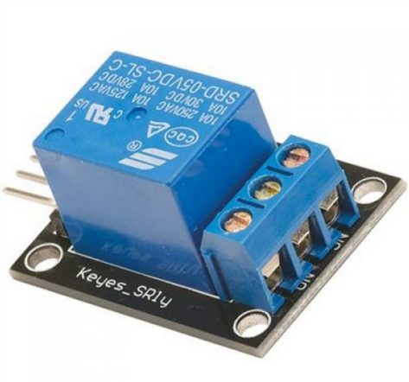
Sprayer System
This system will comprise of the sprayer head (seen to the right) and a reservoir.
The sprayer head will be connected to the PCB utilizing a relay to turn on and off the sprayer.
Relay
Disassembled Sprayer Head

Slide 12
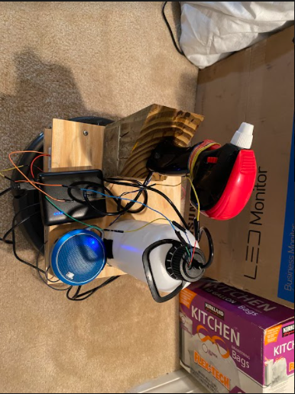
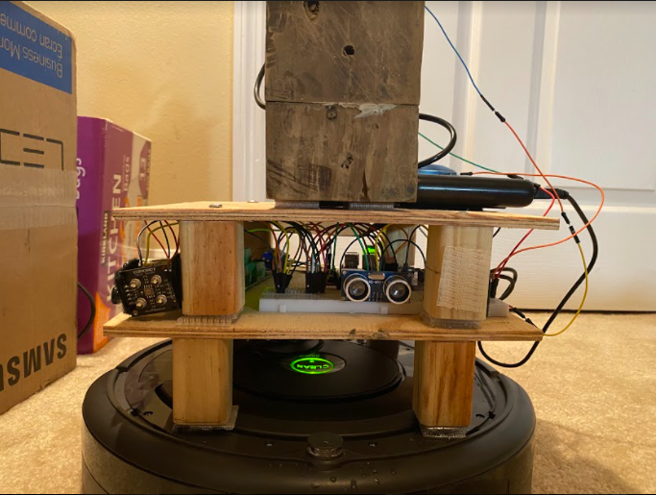
Platform

Slide 13
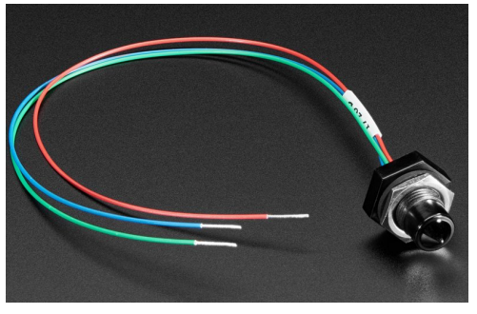
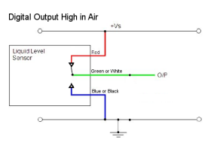
Liquid Level Sensor

Slide 14
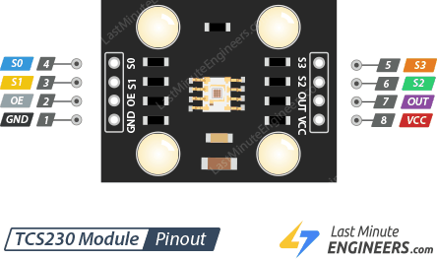
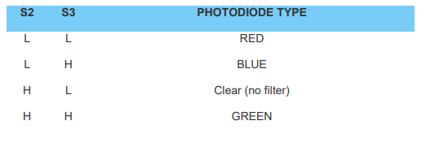
TCS3200 Color Sensor

Slide 15
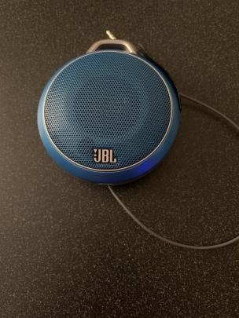
Speaker Selection
We wanted a Speaker that would be able to signal to oncoming pedestrians that the iRobot system is going to spray its solution.
We decided to go with the JBL Micro Wireless | Ultra-portable Bluetooth speaker with bass port that can connect with the Pi’s 3.5mm audio jack
Speaker

Slide 16
Cleaning Solution Comparison
Cleaning Solution | Cost | Effectiveness | Misc.
Medical Grade | $24 per Gallon | Highly effective | Ready made solution to be used immediately
Consumer Grade | $36 per Gallon Concentrate | Moderately effective | Concentrate to be diluted
Self-Made | $10 per gallon | Moderately effective | Needs to be self mixed to proportions

Slide 17
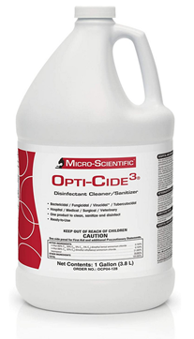
Final Cleaning Solution (Micro-Scientific Opti-Cide3)
For this selection we wanted to choose the grade of cleaning solution that could have the most effectiveness of getting rid of bacteria and combating viruses.
This was an easy choice of picking the hospital grade solution help us achieve this task.
The Opti-Cide 3 Hospital Solution by Mirco-Scientific gives us the best confidence that it will be the most effective to properly clean and sanitize all germs and dirt in a given area.
This formula advertises that it is Antiviral, Antibacterial and Antifungal; thus this would be the most optimal solution for our goal
Micro-Scientific Opti-Cide3

Slide 18
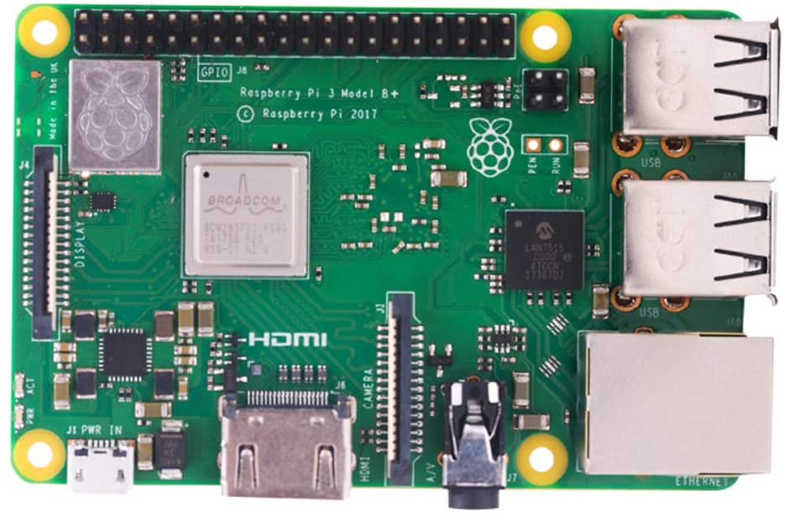
Raspberry PI
Raspberry PI 3 B+
Affordable
Highly intelligible code to work with our sensors to feed to the microcontroller
A lot of examples online
Runs a Linux environment

Slide 19
Microcontroller Table Comparison
Specs and Return Time | 8051 Microcontroller | PIC Microcontroller Family | MSP430FR6989
Number of Bits | 8-Bit Controller | 12-bit program word architecture | 12-bit SAR ADC
Memory | 40KB of ROM and 128 bytes of RAM | 50KB of ROM and 128 bytes of RAM | 128KB of nonvolatile memory
Pin Layout/Type | 40 Pin Dual Line Package | 28 Pin Package | 81 GPIO pins
Clock Frequency/Type | 16-bit Clock Timer | 16-bit Crystal Clock Timer | Crystal clock frequency of 16 MHz
Number of Channels | 5 interrupt sources | Serial peripherals such as: SPI, USART | 16 ADC channels, 4 UART channels
Cost Per Unit | $4.95 USD | $1.85 USD | $4.73 USD

Slide 20
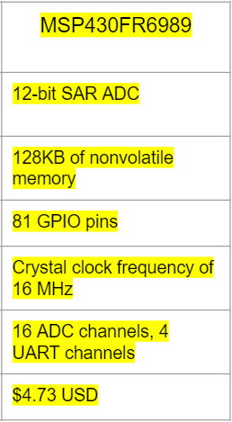
Why the MSP430FR6989 Microcontroller?
After doing some research about the following microcontrollers we determined the FR6989 would work best with the iRobot System.
The amount of memory and GPIO pins were a key pick in determining what kind of controller we wanted while still keeping cost reasonable.
Another added benefit this controller can easily communicate with other controllers, such as the Raspberry Pi system, through the UART channels.

Slide 21
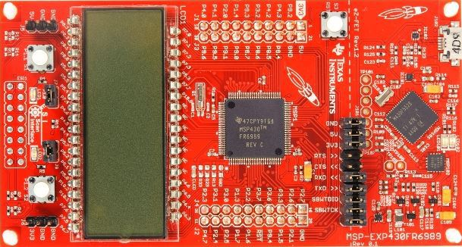
MSP430FR6989 Microcontroller (Continued)
We wanted a controller that could handle the amount of data we would be sending through it from the Raspberry Pi system and wanted enough pins on the controller so we could have both systems communicate with all the deliverable parts, such as the LED’S, Liquid Sensors and Ultrasonic Sensors.
MSP430FR6989

Slide 22
Coding with Microcontroller and Raspberry PI
IDE is Code Composer Studio
Raspberry Pi and MSP430FR6989 written in C
The computer programmer on the team has the most experience and feels comfortable in C
A lot of examples and tutorials online
Can use old code from a previous embedded systems class that utilized a serial communication between two systems using UART

Slide 23
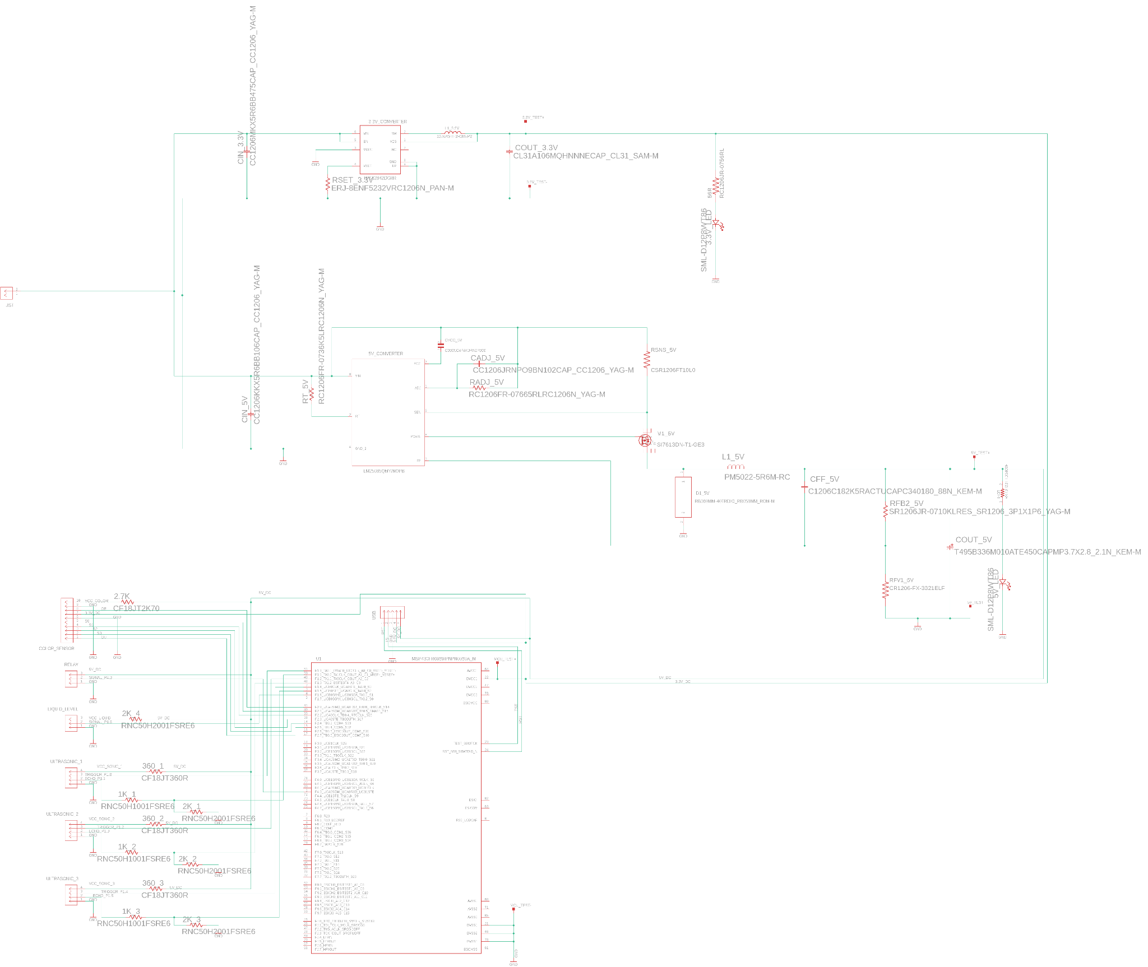
PCB Overall Schematic

Slide 24
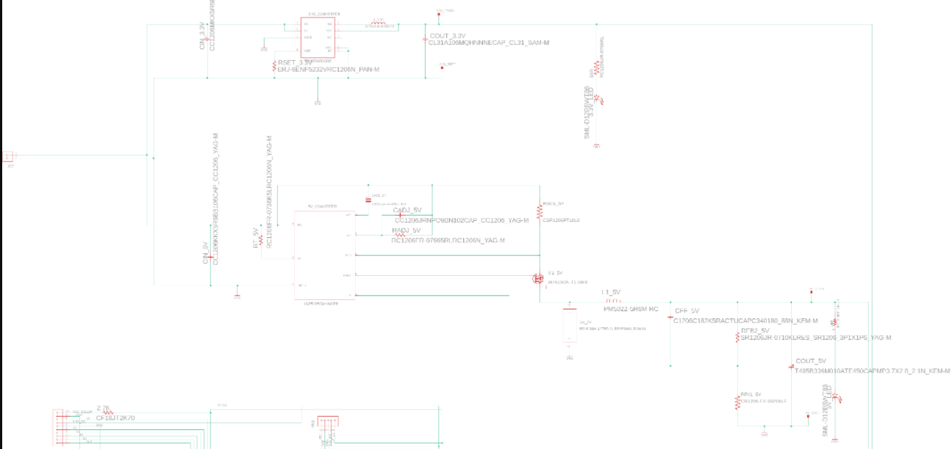
5 and 3 V Converters

Slide 25
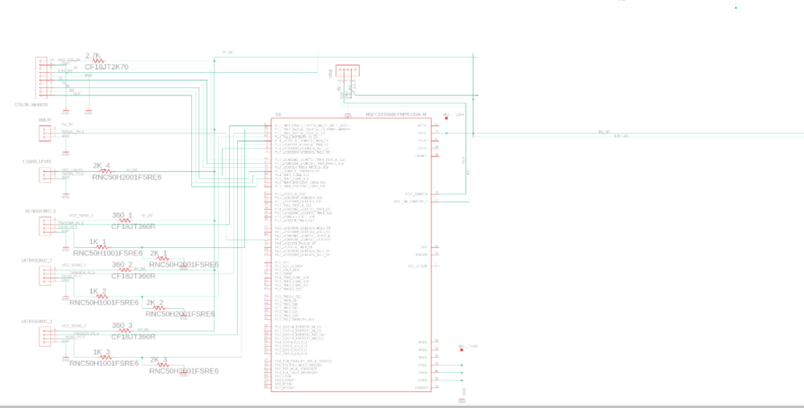
MCU and Headers

Slide 26
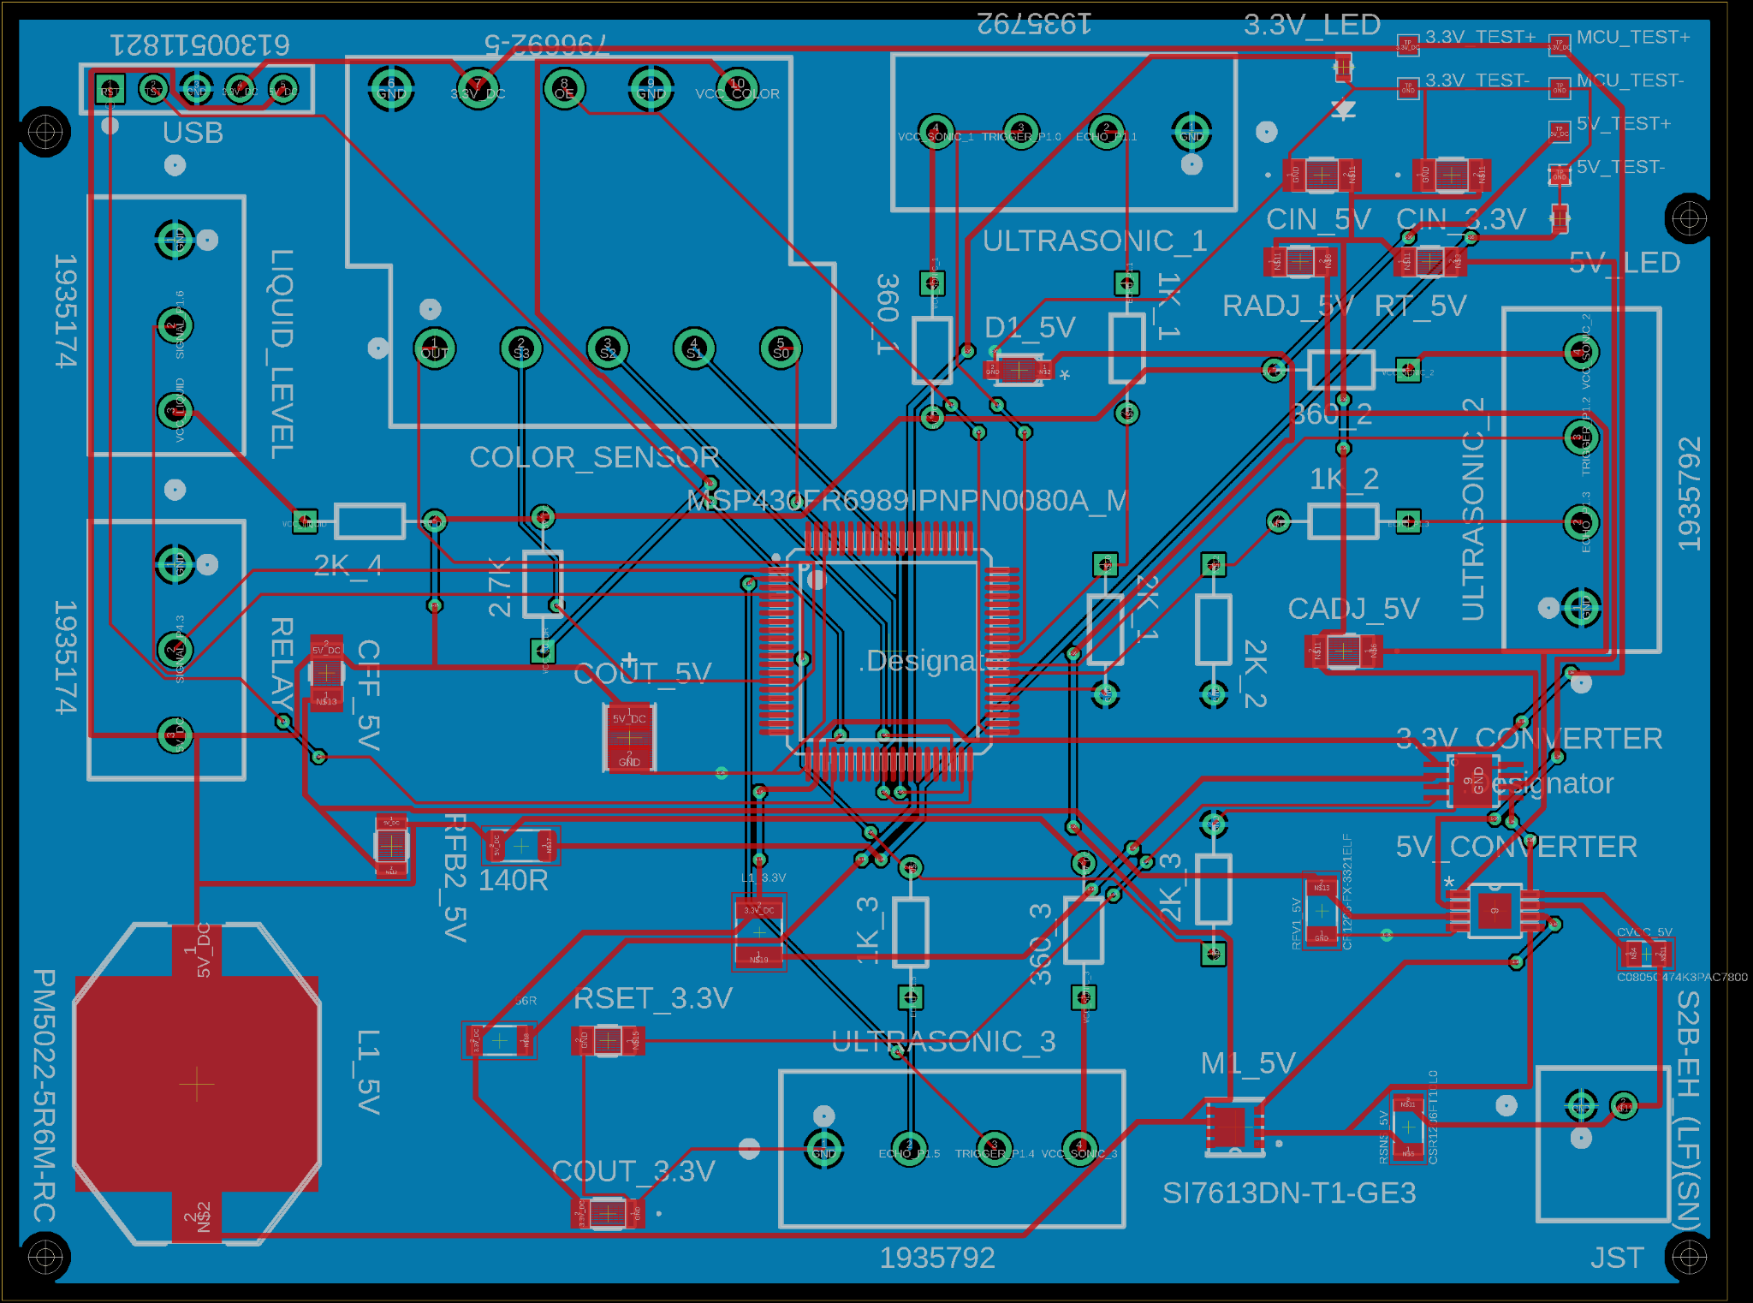
PCB Board Design

Slide 27
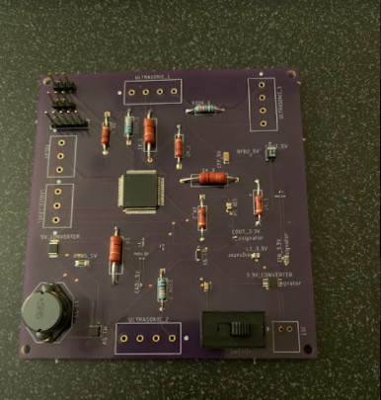
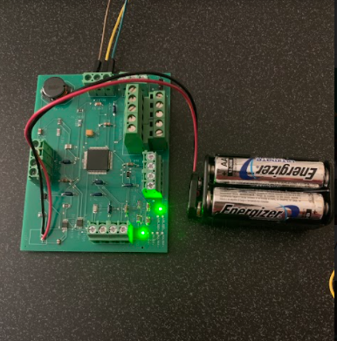
Final PCB’s
First board
Current board

Slide 28
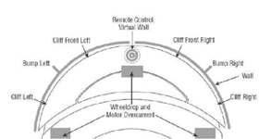
Existing Products and Technologies
We wanted to take inspiration from some similar technologies that already existed when determining what our Senior Design Project would ultimately be.
Logic and chassis design were taken from Roomba systems; Cleaning and Sanitation parameters were taken from Electronic Mop and UV-C Robots.
We wanted to combine the ideas of being fully autonomous, cost effective and have the ability to sanitizing a specific area, all combined into one whole system.
Roomba Sensor Diagram

Slide 29
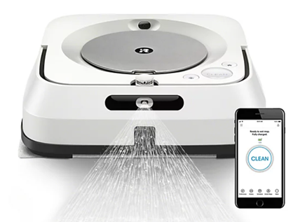
Existing Products and Technologies
The Roomba is know from being fully autonomous and can read/maneuver an environment at ease.
The UV-C Robot is very good and cleaning and sanitizing a selected area but is unable to freely maneuver around its environment.
The Jet Mop has a trigger spray system but is unable to fully sanitize the area that it is in.
On top of all this we wanted a product that would be able to move around movie theaters chains and gyms, while still being affordable and effective for the average consumer.
Jet Mop Spray Trigger Mechanism

Slide 30
Engineering Standards
Motors, batteries, circuit board, disinfectant sprayer have been technically regulated
We used various IPC standards for designing our PCB
We have looked at different vendors for the PCB to compare cost and efficiency of the design
Through power designer and webench we looked extensively for what kind of power sources would be the safest and most efficient

Slide 31
Ethical and Health Constraints
Safety is of the utmost importance when releasing this product, this is why we wanted to make our product react to its environment around it with speed and agility.
As a group we determined to add extra ultrasonic sensors mounted to the top of the chassis so we can meet our requirement of being able to react to its environment quickly.
We have chassis designed with bumpers so if it does ever come into contact with something it won’t do any harm or damage to it.
We have also added a sound application to our system, in that when our system is about to spray its solution it shall emit a chime to indicate to all pedestrians that it is about to spray.
Disinfectant liquid used in hospitals

Slide 32
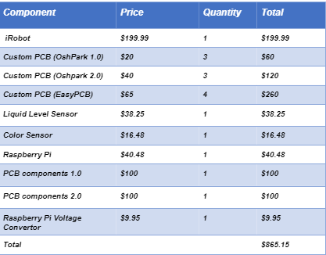
Budget

Slide 33
Thank you.

