Slide 1
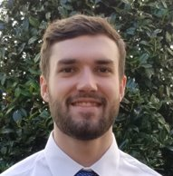
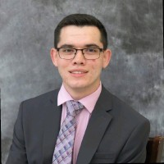
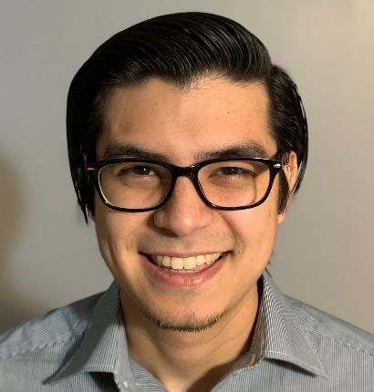
Distributed Sound Event Location - DiSEL
Group D
Mark Judy
Computer Engineering
Brandon LaGuerre
Electrical Engineering
Christopher Santana
Electrical Engineering
Drew King
Computer Engineering

Slide 2
Motivation
Sound plays a major role in communication and making observations about the world around us
Using technology, sound can be converted into useful information even when we are not around to physically hear it ourselves
This information can be used for many things, such as:
Increasing safety and security
Research
Conservation of animals
General hobby activities
Brandon
Laguerre

Slide 3
Objectives
An array of multi-directional audio sensors to detect multiple categories of sound events. Connected to both solar and battery power for indoor and outdoor use.
An application to allow users to interact with data that is retrieved and analyzed from the devices.
A microcontroller connected to the sensors to analyze sound events.
Desired Sound Event
Sensors Triggered
Location Calculated
ID and Location Displayed
Sound Identified
Brandon
Laguerre

Slide 4
Specifications
The array of sensors is connected to a central server.
The central server analyzes the sound events from multiple sensors. It will determine if all sounds being analyzed are of the same origin by filtering out other noise.
The sensors will timestamp all audio that is transmitted to the central server.
The central server will triangulate the location of the sound event using time of arrival.
The central server is supported by a machine learning model trained for multiple categories of sounds for classification.
The program will adjust for environmental factors such as temperature that may affect the distance a sound might travel when determining the originating location of a sound event.
Sensors will be mountable to pre-existing light or utility poles for outdoor applications, and wall or ceiling mountable for indoor applications.
Sensors will be able to withstand various environmental conditions for outdoor use.
Brandon
Laguerre

Slide 5
Requirements
Identify the originating location of the sound event within: | 5 | Meters
Verify the same sound is being analyzed from all sensors with greater than: | 90% | Accuracy
Identify what originated the sound event with greater than: | 80% | Accuracy
Analyze the location and label the sound event within: | 5 | Seconds
Have a minimum required distance between sensors of less than: | 5 | Meters
Have a maximum operating distance between sensors of greater than: | 100 | Meters
Determine the temperature of environment within: | 1 | °C
Maintain a sensor weight of less than: | 5 | lbs.
Have a sound event capture range of greater than: | 100 | Meters
Achieve an IP rating for sensor equal or better to: | I45 | IP
Maintain a cost of less than: | 500 | USD
Brandon
Laguerre

Slide 6
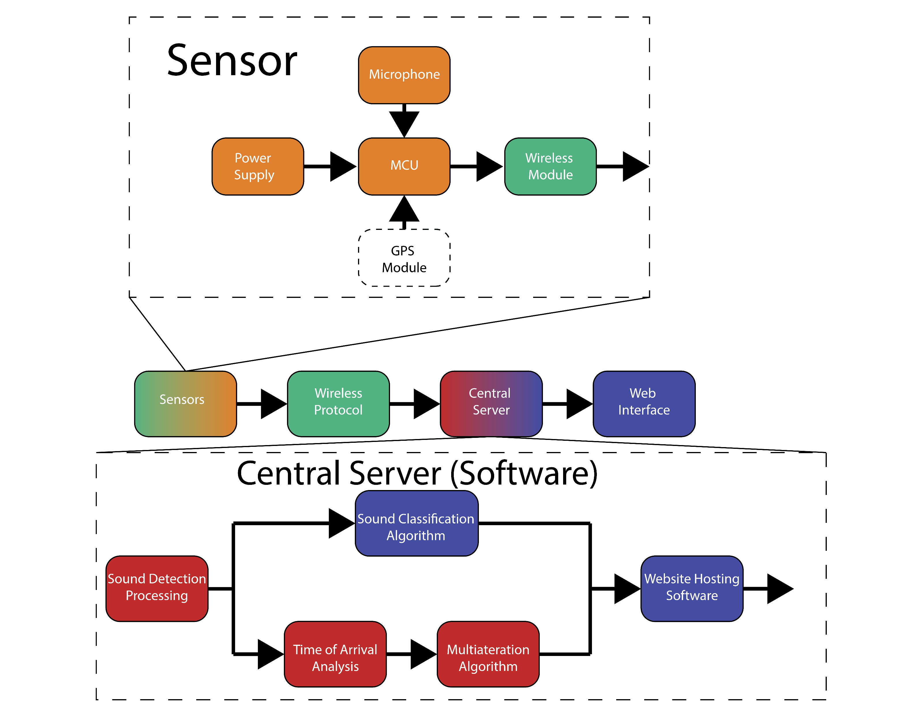
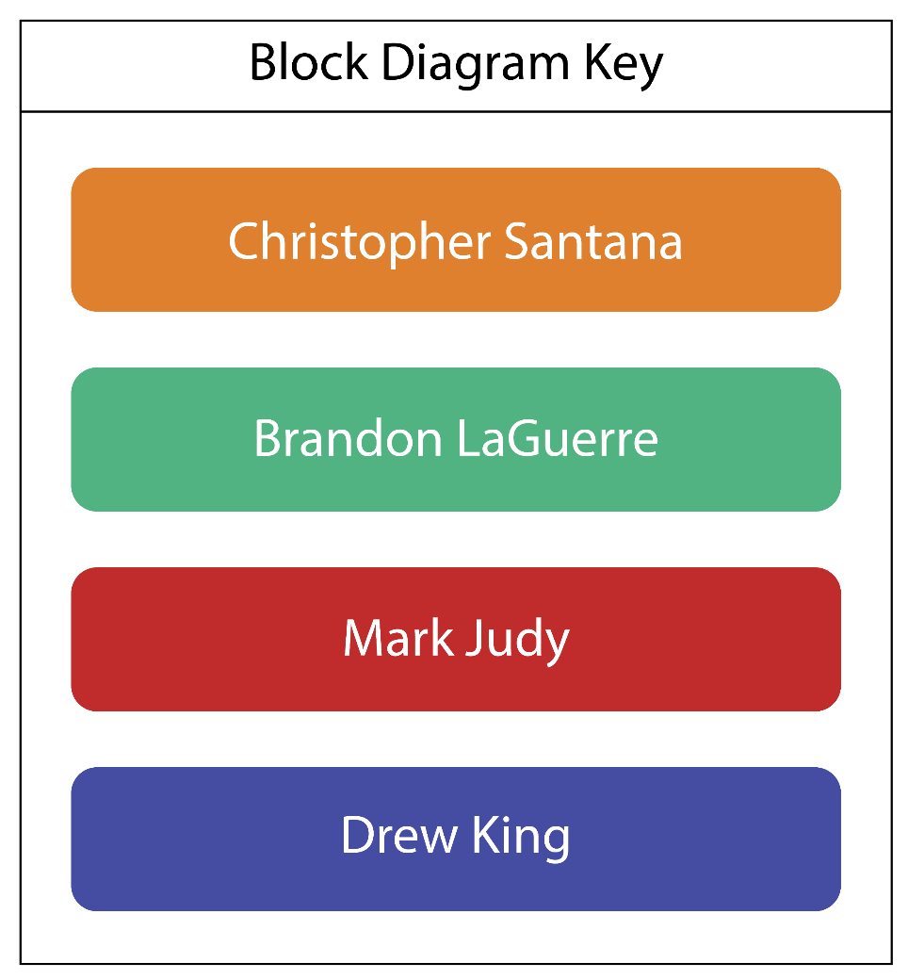
Overall Block Diagram
MCU
Brandon
Laguerre

Slide 7
Hardware

Slide 8
MCU Comparisons
Device | Typical Power Usage | Software Support | Hardware Support | Processing Capability
TI MSP430FR5994 | 1.9 mA @ 16 MHz | C programmable TI libraries Other C libraries | TI BoosterPacks UART, SPI, I2C SD card support | 16-bit RISC Architecture up to 16 MHz
Raspberry Pi Zero W | 170 mA @ 5V | Linux Any software compatible with ARMv6 | Built-in Wi-Fi SD card support Full USB support | 32-bit ARMv6 at 1 GHz
BeagleBone Black | 210-460 mA @ 5V | Linux Any software compatible with ARM | Full USB support BeagleBone capes | 32-bit ARM Cortex-A8 up to 1 GHz
Teensy 4.0 | 100 mA @ 600 MHz | C/C++ programmable Teensy libraries Arduino libraries Other C/C++ libraries | Teensy shields UART, SPI, I2C SD card support | 32-bit ARM Cortex M7 up to 600 MHz
Brandon
Laguerre

Slide 9
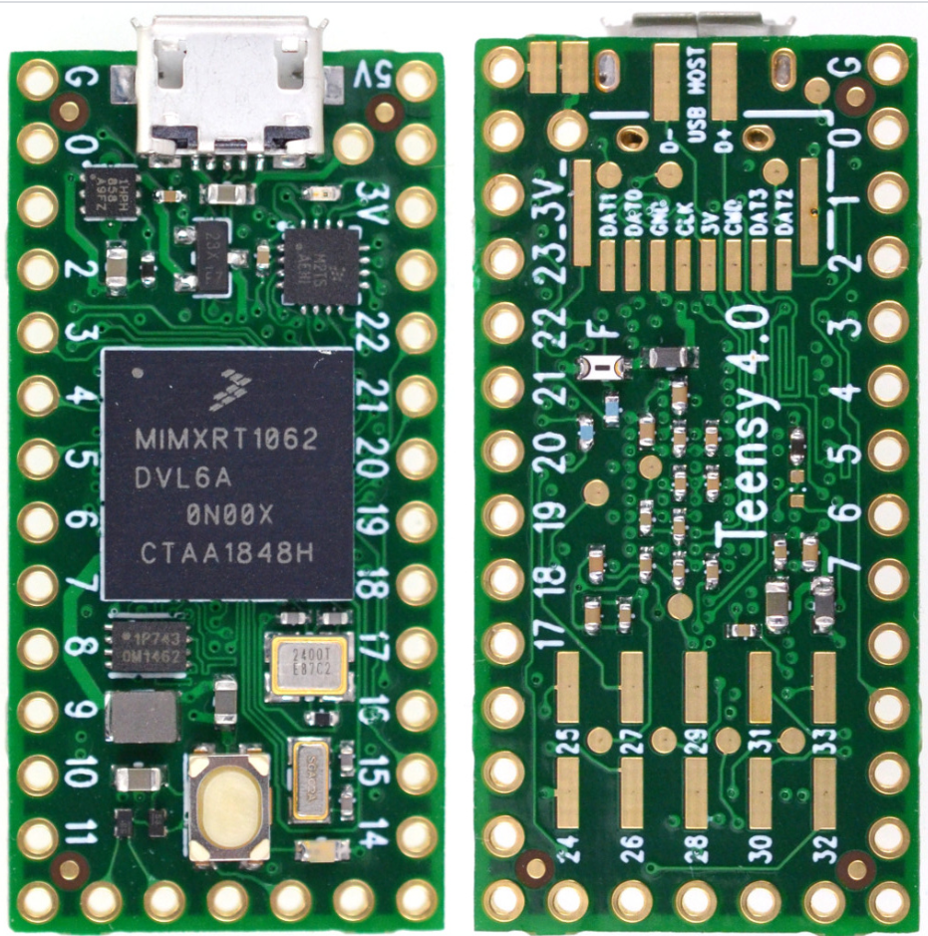
Microcontroller
The Teensy 4.0 development board was chosen
It houses a MIMXRT1062DVL6A Arm Cortex-M7 Processor
Simple Design
Many tutorials and add-on boards
Can be programmed with either C or C++
Also compatible with most Arduino software
Specification | Value
Operating Voltage | 3 – 3.3V
Maximum Clock Frequency | 600 MHz
Number of I/0 | 127
RAM Size | 1 MB
I/O Pin Voltage | 1.8 V, 3.3 V
Connectivity | I2C, SPI, UART, USB OTG, CAN, Ethernet
Brandon
Laguerre

Slide 10
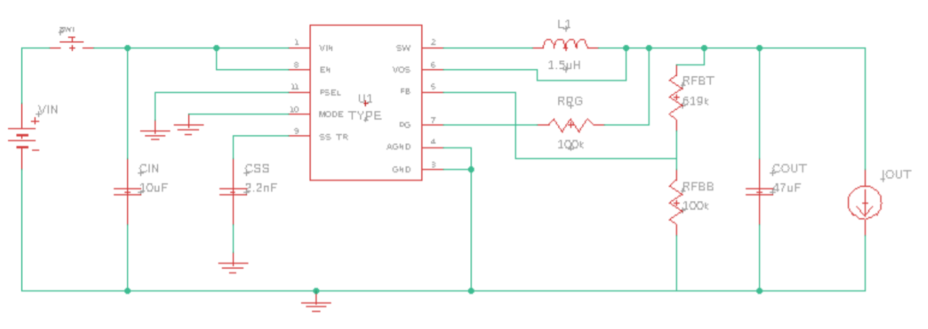
Power Supply – DC-DC Converter
The device is powered using an array of rechargeable batteries
It will also have a secondary solar powered battery
The microcontroller has the following electrical specifications:
Operating Supply Voltage: 3.0 - 3.6 V
Maximum Supply Current: 110 mA
The DC-DC converter circuit below will be used to maintain a nominal supply voltage of 3.3V at the input of the microcontroller
Brandon
Laguerre

Slide 11
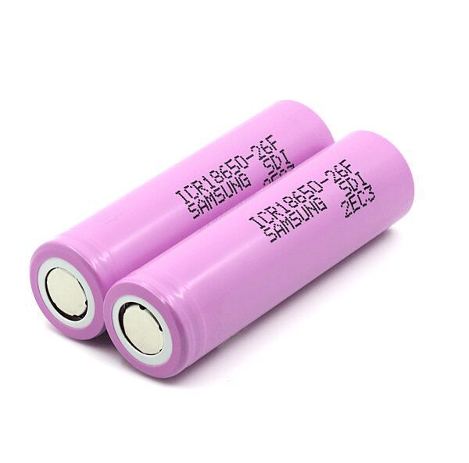
Power Supply – Batteries
18650 Lithium-Ion
3.7 volts
Can be charged to a maximum of 4.2 volts
Can be discharged to 2.5 volts
Used for flashlights, laptops, and power tools
Low self discharge rate
2 Batteries in series for an output of 7.4 volts
Comparison Factors | Lithium-Ion | Nickel-Metal-Hydride | Lithium-Iron-Phosphate
Voltages | 3.7 V | 1.2 V | 3.2 V
Specific Energy | 100 - 265 wh/kg | 50 - 70 wh/kg | 90-120 wh/kg
Charge Cycle Life | 300 - 500 cycles | 180-2000 cycles | 1,000 – 10,000 cycles
Self Discharge | 1.5%/month | 20%-50%/month | 1.5%/month
Safety Comments | Known to potentially overheat | Non-toxic | Less likely to overheat than Lithium-Ion
Christopher Santana

Slide 12
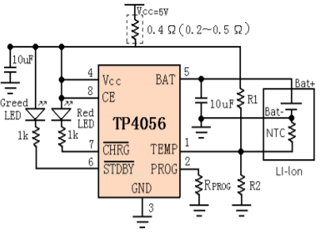
Power Supply – BMS
BMS – Battery Management system
Prevent overcharge
Prevent overdischarge
Ensure battery cells charge to the same voltage
TP4056
Lithium-Ion charging IC
Charges with constant current and constant voltage
Charges batteries to 4.2 volts
Stops discharging at 2.9 volts
Christopher Santana

Slide 13
Solar Panel
Selected solar panel: Polycrystalline
Maximizes price and efficiency
Comparison Factors | Monocrystalline | Polycrystalline | Thin-Film
Efficiency | 20% | 15% | 11%
Cost | Most Expensive | Average Cost | Least Expensive
Size Needed to Produce Same Power | Smallest | Average | Largest
Flexible | No | No | Yes
Life Span | 25 years | 25 years | 20 years
Christopher Santana

Slide 14
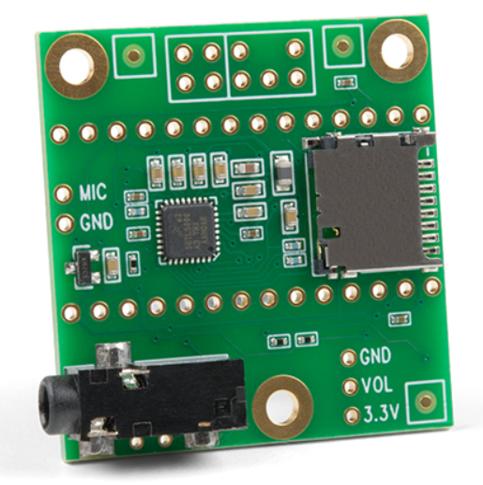
Microphones
Device | Hardware Compatibility | Recording Capability
SunFounder USB Mini Microphone | USB Only | Omnidirectional
TI Audio Signal Processing BoosterPack | SPI | 12-bit ADC 20 KHz sample rate
Teensy Audio Shield | I2C and I2S | 16-bit ADC 44.1 KHz sample rate
Used to detect the desired sound events
The microcontroller does not have built in audio recording capability
Quality of sound is important so higher sampling frequencies and bit resolutions are desired
Teensy Audio Shield chosen due to the high quality of the mic and easy interfacing
Christopher Santana

Slide 15
Wi-Fi Module Comparisons
Information received to the microcontroller will be transmitted to the central server through Wi-Fi
Data rate is important for the Wi-Fi module so the central service can begin testing the sound data quickly
The ESP32-WROOM-32E was selected
Newest module from Espressif Systems, has many great features and is very cheap
Added benefit is Teensy 4.0 has a breakout board spot for ESP-32
Device | Hardware Compatibility | Networking Capability
ESP32-WROOM-32E | Control via UART, SPI, I2C, or I2S | 802.11 b/g/n 150 Mb/s 20 dBm output
SimpleLink Wi-Fi CC3120 BoosterPack | UART or SPI | 802.11 b/g/n 16 Mb/s 18 dBm output
ESP8266 | Control via UART, SPI, I2C, or I2S | 802.11 b/g/n 7 Mb/s 20 dBm output
Christopher Santana

Slide 16
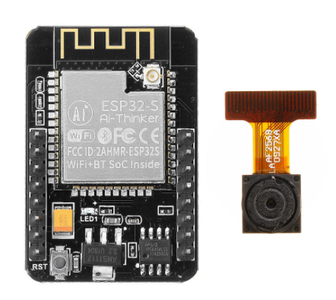
Camera
Device | Megapixels | Resolution | Pixel Size
OV2640 | 2 | 1600x1200 | 2.8 µm x 2.8 µm
OV5647 | 5 | 2593x1944 | 1.4 µm x 1.4 µm
OV7670 | 0.3 | 640x480 | 3.6 µm 3.6 µm
OV9655 | 1.3 | 1280x1024 | 3.18 µm x 3.18 µm
Will activate and capture video after sound event has occurred
Will provide user with live video feed through the main user application
This will help users visually identify and track the source of the sound event
The OV2640 camera was selected as the possible camera due to its easy interfacing with ESP32 Wi-Fi module
Christopher Santana

Slide 17
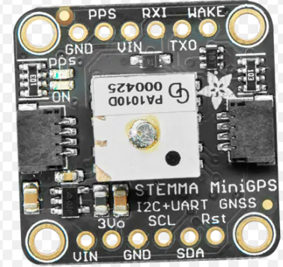
GPS Module
Device | Power Usage | Hardware Compatibility | GPS Capability | Cost
NEO-6M | 37 mA @ 3.3V | UART, USB, SPI, I2C | -162 dBm | $16.99
NEO-M9N | 36 mA @ 3.3V | UART, USB, SPI, I2C | -167 dBm | $64.95
Adafruit Ultimate GPS | 25 mA @ 3.3-5V | USB | -165 dBm | $39.95
Adafruit Mini GPS | 30 mA @ 5V | I2C, UART | -165 dBm | $29.95
This is an optional addition
GPS could be used to provide up-to-date senor location
Allows for quicker and easier installation
Allows for the device to potentially be mobile
Major concern for implementing GPS module is battery usage
Neo-6M was selected due to its lower cost, small size and number of communication options.
Christopher Santana

Slide 18
Software
Drew King
Notes:
Drew: Hi my name is Drew King; we will now discuss the software for our project.

Slide 19
Machine Learning
Machine learning will be used for classifying the originator of collected sounds.
The collected audio will pass through a Fourier transform algorithm to create a spectrogram to be used for classification.
A Convolutional Neural Network (CNN) will be trained to be able to classify audio signals at a high rate of accuracy.
Drew King
Notes:
Drew: We will be using machine learning for our classification. Once the audio collected by the sensors has been determined to be of the same origin, we can then pre-process the collected audio through a Fourier Transform. The result will be a visual representation of the spectrum of frequencies of the audio signal as it varies with time. This image can then be passed through our Convolutional Neural Network to be classified.

Slide 20
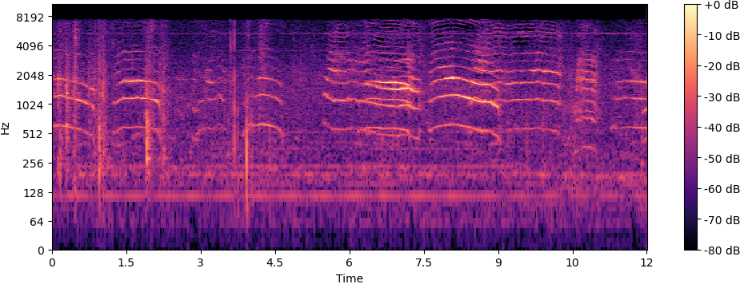
Drew King
Notes:
Drew: This displays a spectrogram of a .wav file containing audio from the ESC-50 dataset. This image represents three dimensions in a 2-D graph. The x-axis displays time. The y-axis represents the frequencies of the audio signal on a log scale. The colors of the graph represent the amplitude of a given frequency at a given time with darker colors representing low amplitudes and brighter colors representing high amplitudes. This resulting spectrogram produces an image representation of the audio signal.

Slide 21
CNN Model Development and Datasets
The development of a CNN model is mostly done through trial and error.
TensorBoard will be used to compare developed models throughout the process.
Data will be compiled from free-to-use and academic datasets available for research and development.
Drew King
Notes:
Drew: Since developing a CNN model is done through mostly a trial and error method, this process will be continuously done throughout the project. Code has been written to develop different models that can then be trained and compared. To compare these developed models, tensorboard will be used. Tensorboard is a visualization toolkit that will provide tracking and graphical representations of the metrics such as loss and accuracy to easily compare the different models and find the one best suited for our needs. The data used for training and testing purposes will be taken from multiple resources that provide the data freely. This will reduce the time of producing a working model since it will help eliminate the time-consuming task of data collection.

Slide 22
CNN Training and Testing
The training of a CNN is necessary to produce a working model.
Training is done through a separate program that will use backpropagation to change the weights of the neurons.
Testing will then be conducted by providing the model with data not seen during training and calculating its accuracy in classifying those samples.
Drew King
Notes:
Drew: To produce a CNN that is accurate and effective, training is necessary. This will be provided by the development of a separate program that will conduct this training. This developed program will use backpropagation to adjust weights of neurons based on the results of outputs in previous epochs during training. Testing will then be conducted where samples not given to the model during its training phase will be used for the model to classify the samples. The accuracy of the models classifications of these testing samples will then be calculated to determine the models accuracy.

Slide 23
CNN Implementation
Once a CNN has been trained, the model and its weight values will be saved within a .h5 file.
The central server will then read the .h5 file whenever a new classification is needed.
This prevents the need to train and test the model any further, as the desired weights have been determined, so the model can simply make classifying predictions with the new data without implementing any training or testing for accuracy.
Drew King
Notes:
Drew: The CNN model and its neuron weights determined during training and testing can be saved within a .h5 file. This file can then be loaded by the central server whenever new data comes in to be classified, without the need for retraining and testing.

Slide 24
Web Application Flow
Drew King
Notes:
Drew: For our web application we will use a MEAN stack, this is due to the use of Javascript throughout the stack and the benefits provided by that continuity. As shown in the figure the application will use AngularJs for the frontend, NodeJS w/ Express for our server and API, and MongoDB for our database.

Slide 25
UI Features
Drew King
Notes:
Drew: The following features will be required for a functioning user interface. The homepage will require a login and signup form. The Dashboard will hold the data collected by the system. This will include a map that will show the user the location of the most recent sound event. The UI will also include a section to display the information for the most recent sound event that has been analyzed by our system, and a section to display the history of sound events collected by the system.

Slide 26
Use Case
Drew King
Notes:
Drew: The use case shows a simple view of a user’s interaction with our web application. The user will first go to the web application’s web address and will be presented with the options of either logging in if they are a returning user or signing up if they are new. If the user is new, they will complete the signing up process and then continue as if they are a returning user. The user will then be brought to a dashboard where they will have the ability to access the features discussed previously. The user can then continue to view the presented data, or log out of the application.

Slide 27
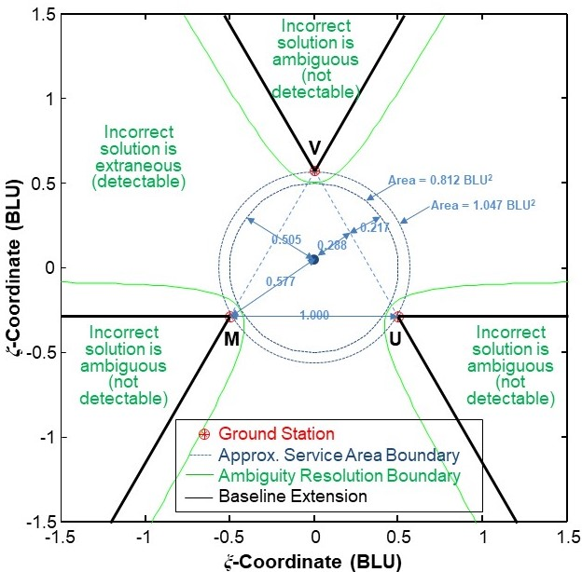
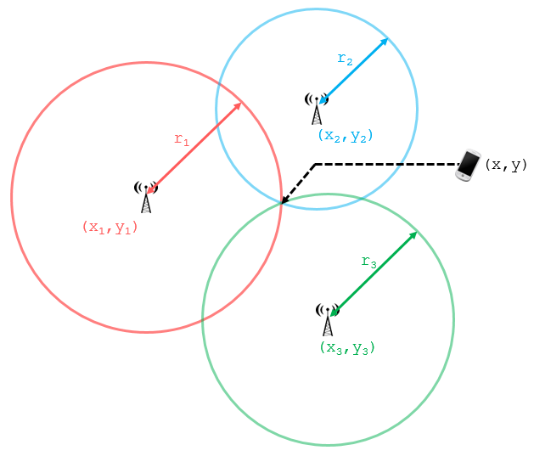
Multilateration
Not quite the same as triangulation
Based on Time Of Arrival (TOA)
Used by GPS
Complex math
Limited operating area
Open source libraries available
https://github.com/ucnl/UCNLNav
https://github.com/topics/multilateration
Mark Judy
Notes:
Mark

Slide 28
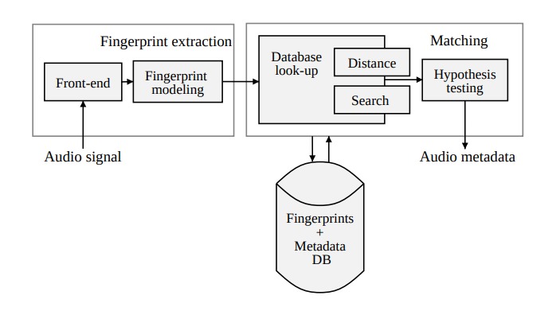
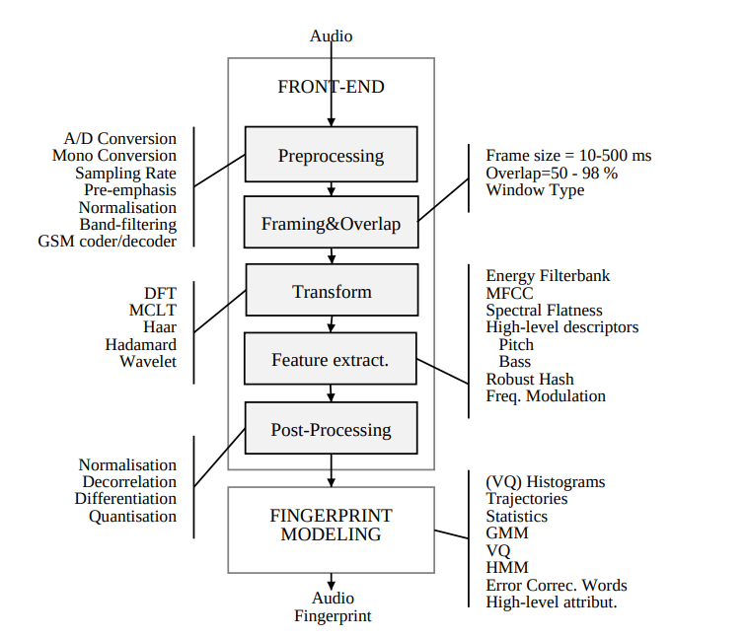
Audio Fingerprinting/Detection
Algorithm for detecting shared sounds
Used by Shazam
Service area lowers database requirements
Metadata is TOA + location recorded
Audio samples need to be short
Possible to create fingerprints on MCU
Open source libraries available
https://github.com/acoustid/chromaprint
https://github.com/topics/audio-fingerprinting
Mark Judy
Notes:
Mark

Slide 29
Microcontroller Programming
Teensy is essentially Arduino with custom libraries
Supports C++
Extensive audio processing library
https://github.com/PaulStoffregen/Audio
Needs to connect
ESP32 for WiFi/Networking
Audio hardware
GPS
Potentially camera
ESP32 may be used as a coprocessor
Mark Judy
Notes:
Mark

Slide 30
Processing on Central Server
Needs to receive data from each MCU
Generate fingerprints using raw audio data
Detect shared fingerprints
Make audio locations available to web server
Data can be stored in-memory
Needs a static IP or URL for MCUs/web interface
Mark Judy
Notes:
Mark

Slide 31
Administrative Content
Mark Judy
Notes:
Drew: Hi my name is Drew King; we will now discuss the software for our project.

Slide 32
Work Distribution
Group Members | Power | Circuit Design | MCU Programming | Central Server | Web Interface
Christopher Santana, EE | X | X
Brandon LaGuerre, EE |  | X | X
Mark Judy, CpE |  |  | X | X
Drew King, CpE |  |  |  | X | X
Mark Judy
Notes:
Mark

Slide 33
Project Budget
Part | Quantity | Price | Total
PCB | 3 | $30 | $90
Microphone | 5 | $0.40 | $2
Casing | 3 | $7 | $21
MCU | 3 | $60 | $180
Solar Cell | 3 | $7 | $21
Lithium-ion 18650 Battery | 6 | $6 | $36
Thermocouple Temperature Probe | 3 | $3 | $9
Camera | 3 | $35 | $105
Overall Cost |  |  | $464
Mark Judy
Notes:
Mark

Slide 34
Financing
Done ourselves
One MCU per person
Mark Judy
Notes:
Mark

Slide 35
Drew King
Notes:
Drew: The graph shows are current progress. We have most of our research required for the project completed. Our designing for both hardware and software are mostly complete, with only some minor tweaks to be completed. Our implementation and overall progress are on track to be completed on time.

Slide 36
Difficulties
Acquiring the amount of data that is properly labeled and accurate needed to train an accurate CNN model.
The trial and error nature of developing a CNN model, resulting in a time-consuming process of training and testing each proposed model.
Fingerprints need to use short audio samples for precise TOA which limits robustness of matching
Need to test microphone recording capability (Sound loudness/distance)
Some libraries that could be used on the MCU are not implemented in C++
Drew King
Notes:
Drew: Some difficulties that we have come upon include, for the machine learning aspect of our project acquiring the amount of data needed, and the time-consuming nature of training a model. We have also had some difficulties of creating a robust system of audio fingerprinting due to having to use short audio samples to determine the audio data’s time of arrival, there has been some difficulty in being able to accurately test the full capability of our microphones in respect to the distance that it will be able to pick up audio. With our MCU we have discovered some libraries that could be useful but lack any implementation in C++.

Slide 37
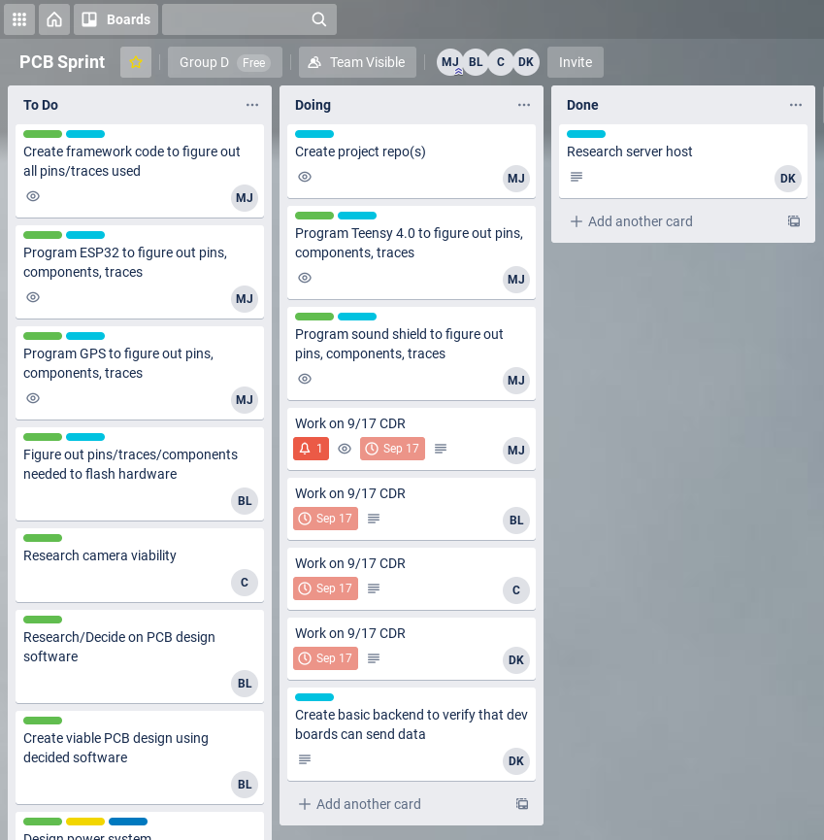
Immediate Plans
Continue weekly Group Chats/Calls in Discord
Complete PCB design and get it fabricated and tested
Follow through on remaining Trello tasks
Drew King
Notes:
Drew: Some plans that we have started for the successful completion of the project is having weekly group chats and calls using discord. We are also utilizing Trello to have a centralized organization location to view required tasks, tasks currently in progress by each group member, and tasks that have been completed.

