Slide 1
GARBAGE & RECYCLE AUTOMATED DISPOSAL (GRAD) Bot
GROUP B
Lei Wei - Advisor
Abdulsalam Khan - CpE
Heba Nasseredden - CpE
Sadiyah Bhuria - CpE
Sean Quinlan - EE

Slide 2
Meet the TEAM
Abdulsalam Khan
CpE
Heba Nasseredden CpE
Sadiyah Bhuria CpE
Sean Quinlan
EE
Drive System
Physical design and housing
Software - Web
Microcontroller
IR sensory
Communication System
Software System
Sensor system
Solar System
Power System
PCB Design

Slide 3
AGENDA
01
Motivation
02
03
04
05
Goals & Requirements
Block Diagram
Design Approach
Design & Component Decisions
Constraints
Standards
06
Successes & Difficulties
07
Project Budget (to date)
08
Progress status
09
Plans for Successful Completion

Slide 4
01
MOTIVATION
Problem
Solution
Taking out garbage and recycling cans to the curb forgotten with busy schedule
Physically demanding task for those with special needs
Vacation rental property guests not taking out trash/recycle bins on the correct schedule, leading to pile-up of garbage creating extraneous work for the property manager.
An automated controllable system to schedule trash bin curbside placement to:
Eliminate the physical demands
Incorporate ease
Facilitate efficiency
Notes:
SQ
Problem:
Taking the garbage and recycling cans to the curb can be easily forgotten during a busy schedule or when rushing to work in the mornings.
For those with physical constraints, it can be demanding to accomplish such a task.
Especially for vacation rental properties where guests forget to take out the trash/recycle bins to the curb on the correct schedule, and the pile-up of garbage creates extraneous work for the property manager.
Solution:
This project aims to eliminate the physical demands, incorporate ease, and facilitate efficiency by providing an automated controllable system to schedule trash bin curbside placement.

Slide 5
REQUIREMENTS & SPECIFICATIONS
02
Deliverable | Deliverable Description
GRAD System Movement Accuracy | The GRAD system should end up 5 feet from intended goal.
Solar Charging | Solar panel charges the battery 50Wh/day for standard operation conditions.
Latency | GRAD shall implement movement to the desired goal within two minutes of user implementing a desired action within the provided app (ex. when the user presses the button for the system to go to the curb, it should act within 2 minutes)
Object Detection Safety Measures | The GRAD system should be able to detect object within 1 feet and stop.
Other Specifications:
Trash can robot hold at least twenty pounds of waste
Trashcan robot will work on a performance of 85% no obstacle collision.
GRAD system shall wait 10 seconds before continuing if stopped by an external object.
Notes:
SQ

Slide 6
REQUIREMENTS & SPECIFICATIONS
02
Deliverable | Deliverable Description
GRAD System Movement Accuracy | The GRAD system should end up 5 feet from intended goal.
Solar Charging | Solar panel charges the battery 50Wh/day for standard operation conditions.
Latency | GRAD shall implement movement to the desired goal within two minutes of user implementing a desired action within the provided app (ex. when the user presses the button for the system to go to the curb, it should act within 2 minutes)
Object Detection Safety Measures | The GRAD system should be able to detect object within 1 feet and stop.
Other Specifications:
Trash can robot hold at least twenty pounds of waste
Trashcan robot will work on a performance of 85% no obstacle collision.
GRAD system shall wait 10 seconds before continuing if stopped by an external object.
Notes:
SQ

Slide 7
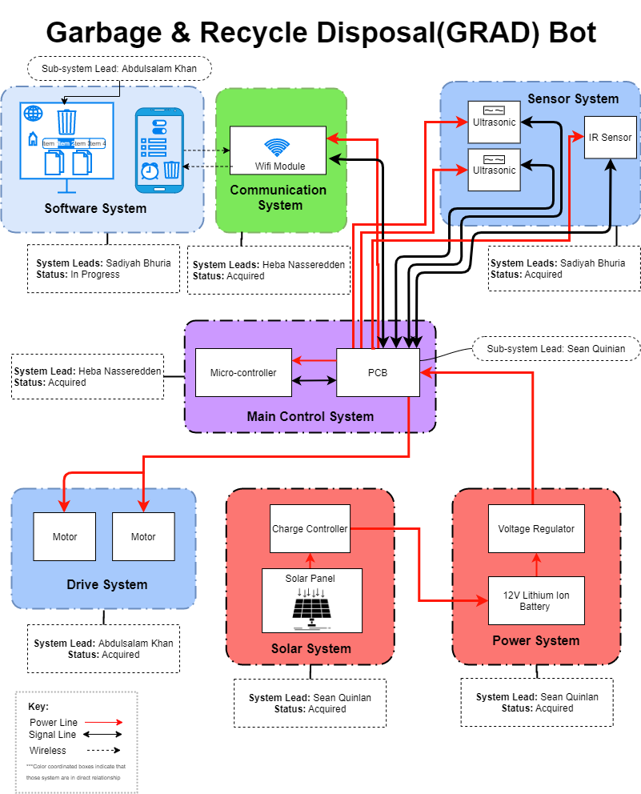
BLOCK DIAGRAM
03
GRAD system divided into sub-systems with a system lead
Software
Communication
Sensor
Control
Drive
Solar
Power
Current Overall Status:
Parts acquired
Initial tests/proof of concept complete
Preparing for integration
Notes:
AK

Slide 8
04
DESIGN APPROACH Features
End User Designed | Portable | Flexible
Features:
Smart Phone App
Cordless/No Wall Plug-In
Lead Acid Battery
Draggable
Stand Alone System:
Solar Panel
Battery Storage
Integrated Communication
Commands
Notifications
Notes:
AK

Slide 9
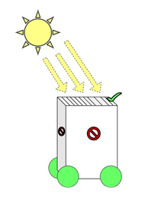
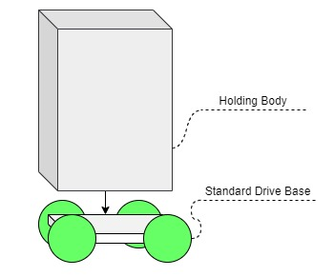
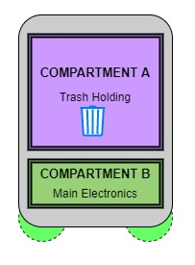
04
DESIGN APPROACH Physical Design Concept
Side view drawing Illustrating Compartment A & B
Visual depicting GRAD Holding Body & Standard Drive
Visual depicting solar panel at the top side
Notes:
AK

Slide 10
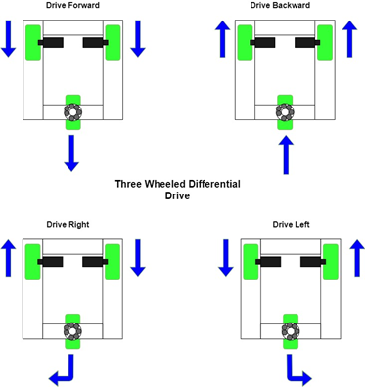
DRIVE SYSTEM Hardware Selection
05
Three wheeled differential drive base was selected for the drive system due to:
ease of mechanical construction
simple control system
& cost effectiveness
Parts required for this design:
This drive base would require use of two motors with wheels in the back for applying force.
There will be one swivel wheel in the front for steering.
Venus has a beautiful name and is the second planet from the Sun. It’s terribly hot—even hotter than Mercury—and its atmosphere is extremely poisonous. It’s the second-brightest natural object in the night sky after the Moon
Notes:
AK
Two motors in the back to independently control each wheel
Motors will work together to move wheel forward and backward
Be able to move in opposite directions to each other in order to make left and right turns making it critical for the motors to be independently controlled.

Slide 11
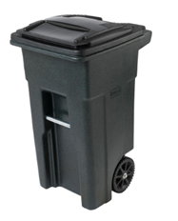
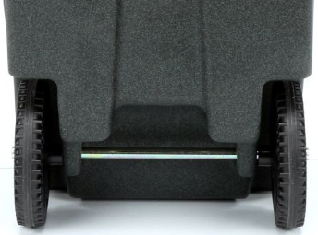
DRIVE SYSTEM
05
Hardware Selection – GRAD Body
Utilize available trash can in the market to modify it for our design.
Advantage of using wheels that come with trash can instead of purchasing separate.
Quality material that can outstand weather conditions
 | Blue Hawk | Toter | Rubbermaid
Wheels | 2 | 2 | 4
Weight (lbs.) | 7.6 | 19.9 | 20.7
Quality | OK | Great | Great
Cost ($) | $19.98 | $59.98 | $197.11
37.50”(in.)
Venus has a beautiful name and is the second planet from the Sun. It’s terribly hot—even hotter than Mercury—and its atmosphere is extremely poisonous. It’s the second-brightest natural object in the night sky after the Moon
24.25”(in.)
19.75”(in.)
Motor
Motor
Notes:
AK

Slide 12
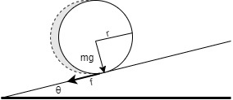
DRIVE SYSTEM Motor Calculation
05
Motors are an integral part of our GRAD system that will allow our GRAD system the ability to move.
After understanding the mechanics, we calculated some requirements that our motor should have based on the environment that included:
Gradient resistance (FG = w· sin(θ))
35.834kg * 9.8 m/s^(2)* sin(5)
= 30.6067N
Illustration of different forces acting
Rolling resistance (FR = RR coefficient x mg)
FR = 0.01 * 35.834kg * 9.8m/s^(2)
= 3.511N
Torque (Force x Distance)
= 48.2N x 0.1016m
= 4.897 Nm
RPM
Round Per Trip(RPT) = Distance/Cw
= 50ft/2.073ft
= 24.11 RPT
18.95 RPM
Illustration of forces to calculate Gradient Resistance
Notes:
AK

Slide 13
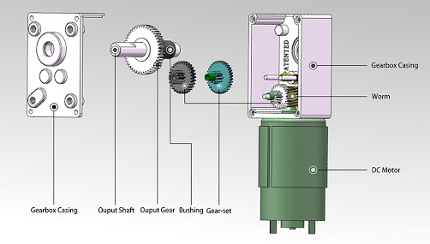
DRIVE SYSTEM DC Motors Selection
05
In order to choose between DC motors, we wanted to choose one that can handle load while being able to precisely work together to go straight and work with our electronic system.
Brushed DC Motor
Brushless Motor
Gear Motor
Stepper Motor
Gear motors can handle heavy loads better
Illustration of DC Gear Motor
Notes:
AK
We have concluded that DC gear motors would be best in our case as there is a heavy load that will require high torque.

Slide 14
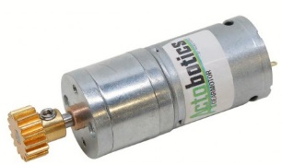
DRIVE SYSTEM Motor Selection
05
12V DC Gear Motors | Bringsmart Worm | AndyMark NeveRest | Sparkfun Standard Gearmotor | ServoCity-Econ Spur Gear Motor
RPM: | 16 | 105 | 20 | 19
Torque: (Nm) | 70 kg/cm 6.86 Nm | 593 oz/in 4.18 Nm | 185 oz-in 1.30 Nm | 192 kgf-cm 18.82 Nm
Price: ($) | $28.24 | $28.00 | $24.95 | $14.99
76.8mm
Venus has a beautiful name and is the second planet from the Sun. It’s terribly hot—even hotter than Mercury—and its atmosphere is extremely poisonous. It’s the second-brightest natural object in the night sky after the Moon
24.8mm
Notes:
AK

Slide 15
Circuitry Overview
05
Overall Circuitry is broken into 3 Subsystems:
Purpose:
Implementing three subsystems is useful to point out the change of voltage between each subsystem. Due to changes of voltage, group member breakdown, integration, troubleshooting, and COVID implementing three subsystems benefits our group best.
Benefits:
Testing
Integration
Troubleshooting
Notes:
SQ

Slide 16
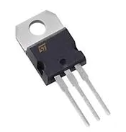
Voltage Regulators
05
Voltage Regulators | LP2985 | LD1117V33 | LM1084IT-5.0 | LM7805MP/NOPB | LM317 | LM2576T-12/NOPB
Input Voltage Min (V) | 2.2 | 0 | 2.6 | 7.5 | 4.2 | 4
Input Voltage Max (V) | 16 | 15 | 25 | 35 | 40 | 40
Output Voltage (V) | 3.3 | 3.3 | 5 | 5 | 1.2 V to 37 V | 12
Output Current (A) | 0.150 | 1.3 | 5 | 1 | 1.5 | 3
Price | $0.51 | $0.55 | $2.59 | $2.77 | $0.64 | $2.77
Type | Linear/ Low Voltage Dropout | Linear/ Low Voltage Dropout | Linear/ Low Voltage Dropout | Linear Voltage Regulator | Linear Voltage Regulator | Switching Regulator
9.15 mm
10.4 mm
LM317
Notes:
SQ

Slide 17
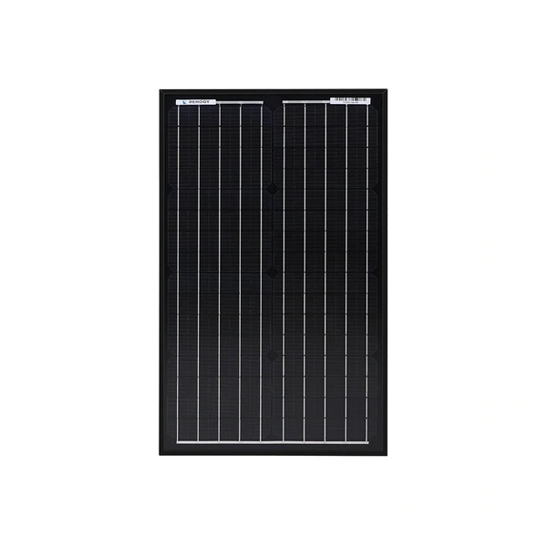
Solar Panel
05
Purpose:
Solar panel implemented for convenience for GRAD use for the end user and as a source of renewable energy generation.
Calculations:
22.4”
NREL the Normal Operating Cell Temperate (NOCT) Derate factor is .731
13.4”
Orlando (32817) has a 5.09 hours/day of sun
$$\left.Energy(Wh/d)=PDC, STC∗Derate Factor∗ (h/d Peak Sun\right)$$
Manufacturer | Wattage | Voltage
Renogy | 30W | 12
$$Energy(Wh/d)= 30W ∗.731 ∗ 5.09 =111.6 Wh/day$$
Notes:
SQ

Slide 18
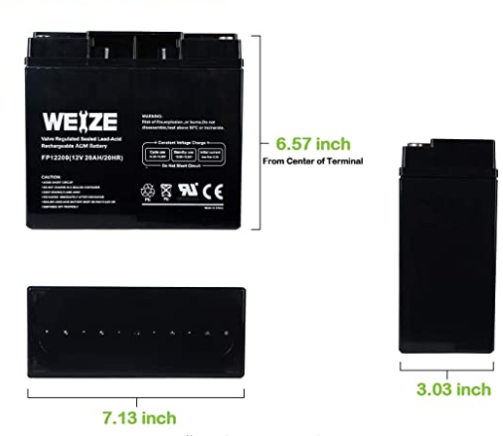
Lead Acid Battery
05
Battery Comparison ` | Cost | Weight (lbs.) | Capacity (Wh) | Additional Info
Tenergy 12V 10000mAh NiMH | $96.99 | 3.35 | 120 | Made of D Cells, build time required
Lithium Battery Power 12V 12AH LITHIUM | $124 | 3.2 | 144 | Lithium Tends to be explosive
BatterySpace Polymer Li-ion Battery: 12V | $204.95 | 1.9 | 133.2 | Built in Regulator, Fire Retardant Bag
Weize 12V 20AH Lead Acid Battery | $36.99 | 12.3 | 240 | Heaviest, Cheapest and Most Capacity
11.25 lbs
$37
Common
12v
20Ah
240 Wh
Notes:
SQ

Slide 19
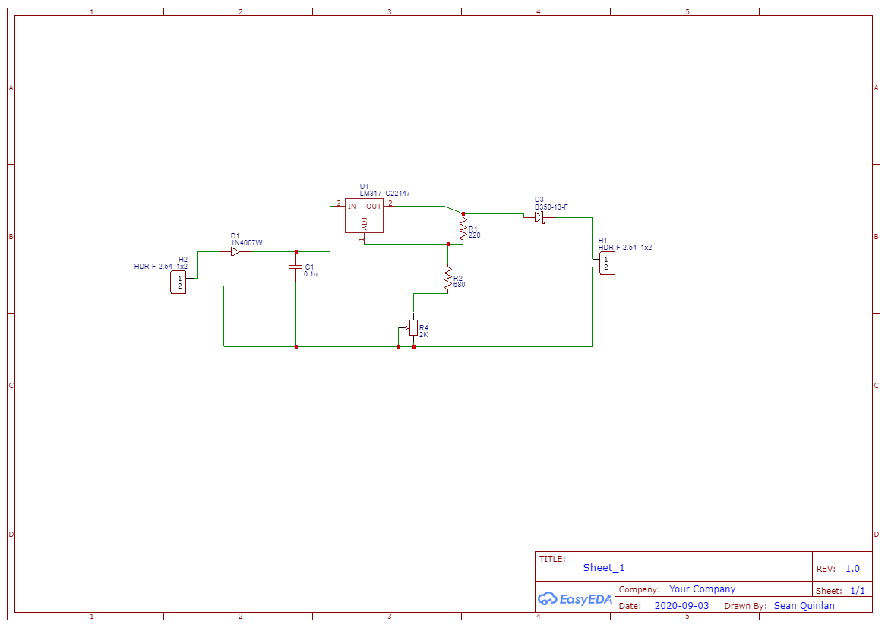
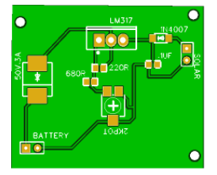
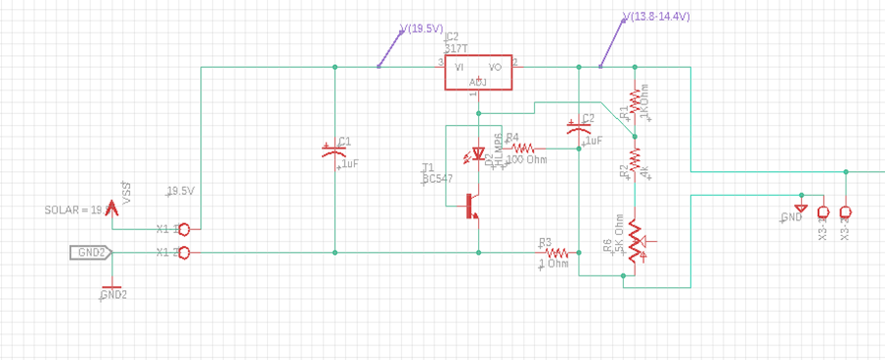
Battery Charger
05
35 mm
41 mm
JLCPCB : IPC Certified
EasyEDA
Import Solar, Export Solar
Implement Ammeter
Failed
Notes:
SQ

Slide 20
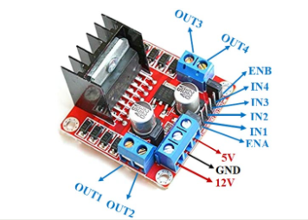
Motor Control Voltage Regulation
05
Purpose:
The Motor control acts as a controller for the motors and as a voltage regulator. Since this device has an output of 5V using the LM7805, this can be used as the input voltage into our GRAD microcontroller PCB system.
1.14”
Decisions:
The L298N will be used for motor control. This device can cause heating. Implementing a premade chip allows for proper functionality due to heating concerns. This also reduces price while increasing flexibility in testing and reliability
0.98”
Notes:
SQ

Slide 21
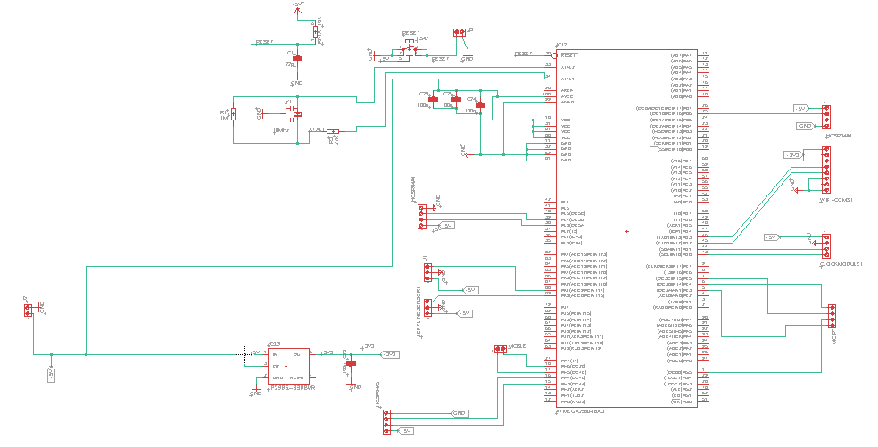
GRAD Circuitry
05
Notes:
SQ

Slide 22
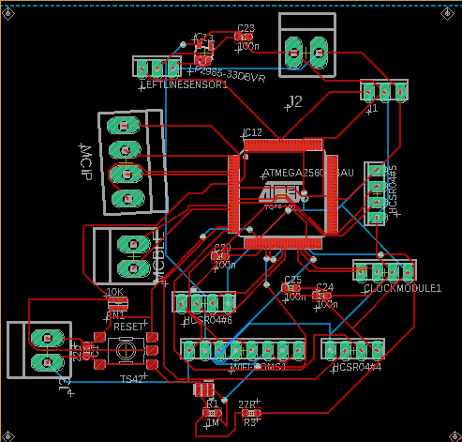
Printed Circuit Board for GRAD System
05
Purpose:
72 mm
The PCB for the GRAD system is separate from other subsystem and acts as the brain of the project. This subsystem contain our ATMega 2560 microcontroller chip (to be discuss later). Sensors and WI-FI communication are implemented into this system with pinouts for flexibility and proper component placement.
75 mm
Decisions:
JLCPCB : IPC Certified
Eagle
Layout has flexibility
Sensors and Wi-Fi Communication
Notes:
SQ

Slide 23
Printed Circuit Board for GRAD System
05
Purpose:
72 mm
The PCB for the GRAD system is separate from other subsystem and acts as the brain of the project. This subsystem contain our ATMega 2560 microcontroller chip (to be discuss later). Sensors and WI-FI communication are implemented into this system with pinouts for flexibility and proper component placement.
75 mm
Decisions:
JLCPCB : IPC Certified
Eagle
Layout has flexibility
Sensors and Wi-Fi Communication
Notes:
SQ

Slide 24
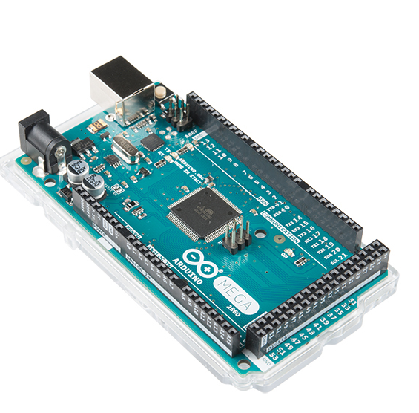
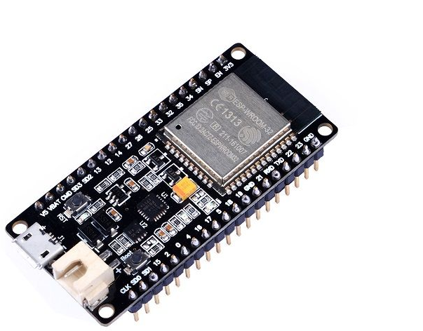
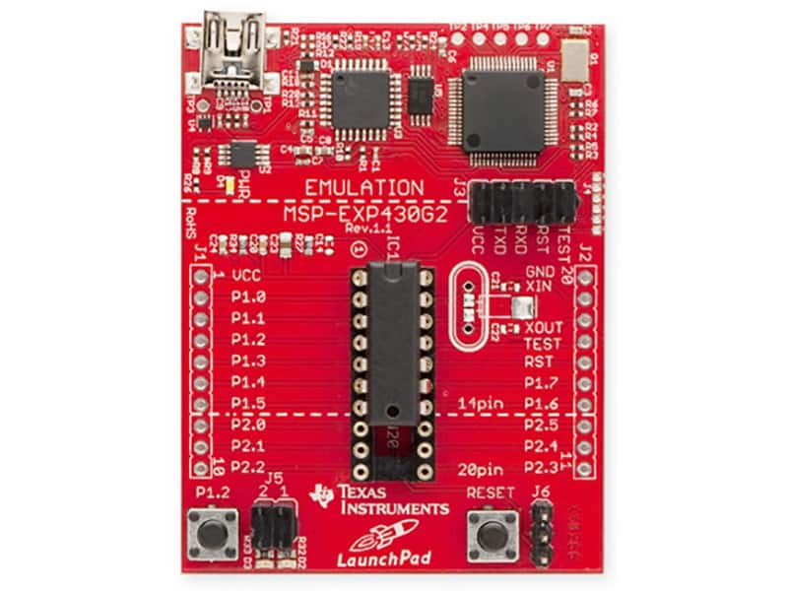
Microcontroller Selection
05
53.3 mm
51 mm
27.8 mm
67 mm
58.8 mm
101.5 mm
 | Arduino Mega 2560 | TI MSP430 | GeeekNET ESP32
CPU | 8-bit ATmega2560 processor at 16 MHz | 16-bit RISC Architecture at 16-MHz | Xtensa dual-core 32-bit processor at 2.4 GHz
Programming Languages | C, C++, Python | C, C++ | C, C++, JavaScript, Python
SRAM | 8 KB | 2 KB | 512 KB
GPIO Pins | 54 | 83 | 36
Power Source | 6 to 20V | 1.8 V to 3.6 V | 2.3 V to 3.6 V
Bluetooth/Wi-Fi Module included | X | X | ✔
Starting Price | $38.50 | $27.99 | $10.99
Venus has a beautiful name and is the second planet from the Sun. It’s terribly hot—even hotter than Mercury—and its atmosphere is extremely poisonous. It’s the second-brightest natural object in the night sky after the Moon
Notes:
SQ
The microcontroller that we have chosen is the Arduino Mega 2560- due to its friendly user interface, existence of supporting documentation, and worldwide popularity, we can find a wealth of information and tutorials on implementing line following into our project.

Slide 25
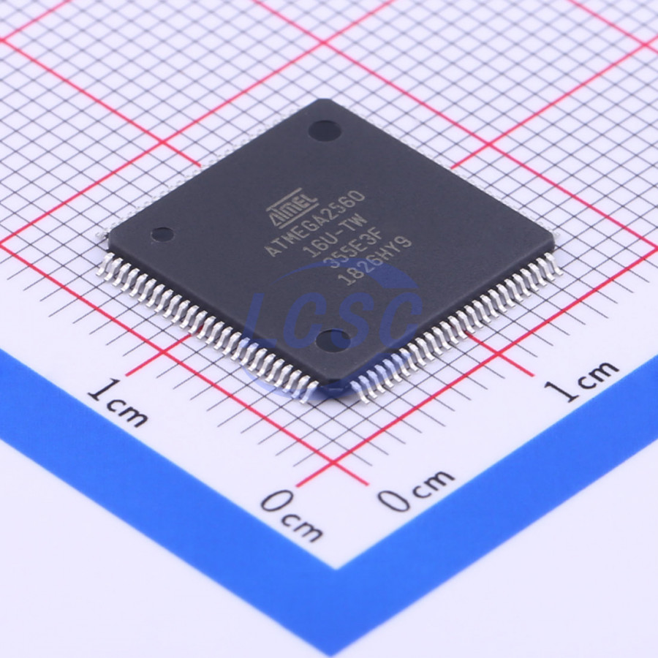
Microcontroller Purpose
05
The microcontroller that we have chosen, the Arduino Mega 2560, will be interfaced with the Wi-Fi module, motor drivers, and power supply.
The mobile application for GRAD will communicate with the microcontroller through the Wi-fi module.
When the user deploys GRAD from the application, the microcontroller will receive a signal from the Wi-Fi module to turn on the motors and drive to the user’s curb
Notes:
HN

Slide 26
Wireless Technology Selection
05
Several factors were considered in deciding between Wi-Fi/Bluetooth
The most important variable in comparing each wireless standard was the operating range
GRAD must always be able to access the database
1) It must retrieve information in the database regarding when to take out the trash
2) It must be able to add to the database to send notifications to the user
Since Wi-Fi allows for a larger operating range, we chose Wi-Fi over Bluetooth
 | Wi-Fi | Bluetooth Classic
Standard | IEEE 802.11b/g/n | IEEE 802.15.1
Applications | High speed access to the Internet | Small media transfers
Range | 20 m – 150 m | 100 m (Class 1) / 10 m (Class 2)
Power Consumption | High | Medium
Network Size (number of devices) | 255 | 1 master device, up to 7 slave devices
Data Rate | b: 11 Mbps/ g: 54 Mbps /n: 600 Mbps | 1-3 Mbps
Venus has a beautiful name and is the second planet from the Sun. It’s terribly hot—even hotter than Mercury—and its atmosphere is extremely poisonous. It’s the second-brightest natural object in the night sky after the Moon
Notes:
HN
GRAD must be able to retrieve information stored in the database regarding the date and time to take out the trash (as specified by the user through the mobile/web application), and it must be able to add information into the database whenever it needs to send a notification to the user (for instance, if GRAD was unable to reach the user’s curb for any reason)

Slide 27
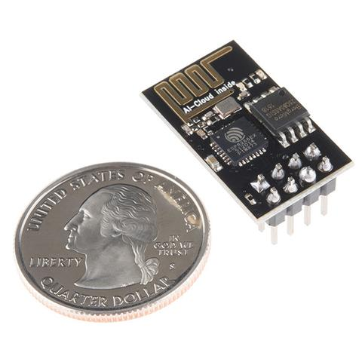
Wireless Communications
05
The opportunity cost of choosing Wi-Fi over Bluetooth is higher power consumption.
Using a Wi-Fi module will drain the battery source more quickly than a Bluetooth module would.
We will be using the ESP8266-01 Wi-Fi module, which is a system on a chip (SOP) containing 802.11 b/g/n protocols
The module can act as an access point (AP) to allow other devices to connect to it, and it can also connect to a Wi-Fi network in station mode
Manufacturer | Espressif Systems
Price | $2.71 each
Power Supply | 3.3 V
Current Consumption | Up to 215 mA
Maximum Data Transfer Rate | 72.2Mbps using a 2.4 GHz band
Venus has a beautiful name and is the second planet from the Sun. It’s terribly hot—even hotter than Mercury—and its atmosphere is extremely poisonous. It’s the second-brightest natural object in the night sky after the Moon
Notes:
HN

Slide 28
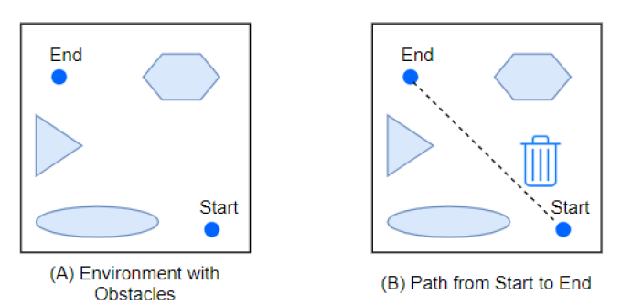
Path Planning
05
Path planning- or the process of driving a robot from a specified start point to a specified end point- is an integral part of GRAD.
For GRAD to be autonomous, it must be able to distinguish free space from space with obstacles to avoid collisions with nearby objects and safely transport itself to the user’s curb
The path planning system must be carefully designed to meet the requirement that GRAD should end up 5 feet from the intended destination
Notes:
HN

Slide 29
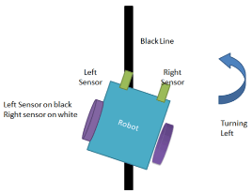
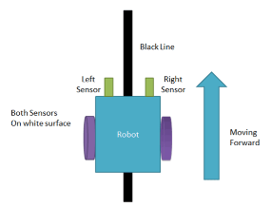
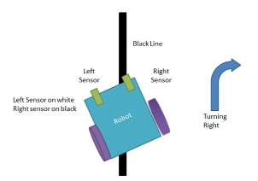
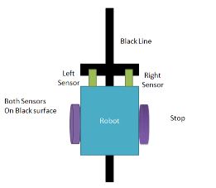
Path Planning
05
We will be using a line-following algorithm to implement GRAD’s path planning system
A line following robot is a machine that follows a line, usually a black line in a white background or a white line in a black background.
Line following robots can distinguish the line from their background and run over it, hence the reason for choosing contrasting colors for the line and background.
Notes:
HN

Slide 30
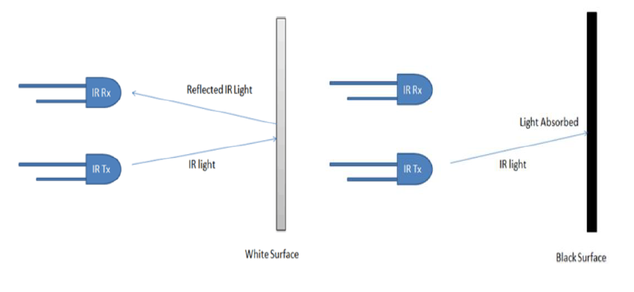
Path Planning
05
IR sensors- either two individual sensors or an array sensor- will be used to implement line following by calculating the reflectance of the surface beneath them
A white line would almost completely reflect any light that falls on it, while a black line would absorb most of the light that falls onto it.
The value of reflectance detected by IR sensors is used as a parameter to detect the position of the line
Notes:
HN

Slide 31
Path Planning
05
Thus, the IR sensors allow the robot to “see” the line and notify the robot if any adjustments need to be made if it strays from the path.
Line following robots estimate if the line beneath them is shifting too much to the right or left, and based on these estimations, it signals the motors to turn left or right in order to keep the line at the center of the robot.
1.5 cm
3.1 cm
Manufacturer | Osoyoo
Distance Detection | 2 ~ 30cm, detection angle 35 (adjustable)
Power Supply | 3.3V-5V
Price | $0.91 each
Notes:
HN

Slide 32
Path Planning
05
Thus, the IR sensors allow the robot to “see” the line and notify the robot if any adjustments need to be made if it strays from the path.
Line following robots estimate if the line beneath them is shifting too much to the right or left, and based on these estimations, it signals the motors to turn left or right in order to keep the line at the center of the robot.
1.5 cm
3.1 cm
Manufacturer | Osoyoo
Distance Detection | 2 ~ 30cm, detection angle 35 (adjustable)
Power Supply | 3.3V-5V
Price | $0.91 each
Notes:
HN

Slide 33
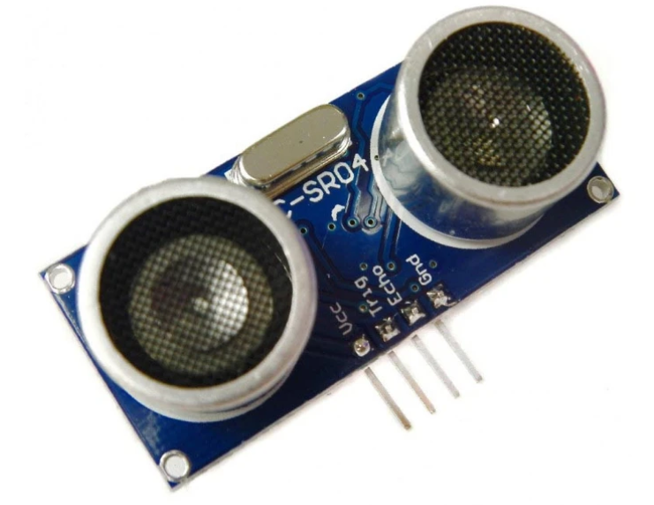
Selection of Obstacle Avoidance Sensors
05
Features | Infrared Sensor | Ultrasonic Sensor
Range for detecting an object | < 10mm. | 1 m
Interference of natural light | Very sensitive to sunlight and not good for outdoors | Insensitive to light, dust smoke, color and good for outdoors
Accuracy in detecting an object | Not completely accurate and reliable. Helpful only to know if an object is present. | More reliable and provides more accurate data of the distance of the object
Cost | Cheaper in price | Not cheaper
21.3mm
45.7mm
Notes:
The GRAD system will require sensors that will be able to detect the level of waste in the trashcan which will be placed inside the lid of the trash can. Apart from the waste level detection in the trash can, the GRAD system will require more than one sensor. The other sensors will be placed on the front and back of the trash can in order to detect any object near it. These sensors will be integrated into the GRAD navigation system in order to avoid obstacles.
The ultrasonic sensor waits for the sound waves to be reflected back when it detects an object and also calculates the distance based on the time required.
Ultrasonic sensor and insensitive to light, dust color and are good for outdoors compared to IR. Even thought it costs more than IR sensor the range for detecting an object in ultrasonic sensor more than IR sensor.

Slide 34
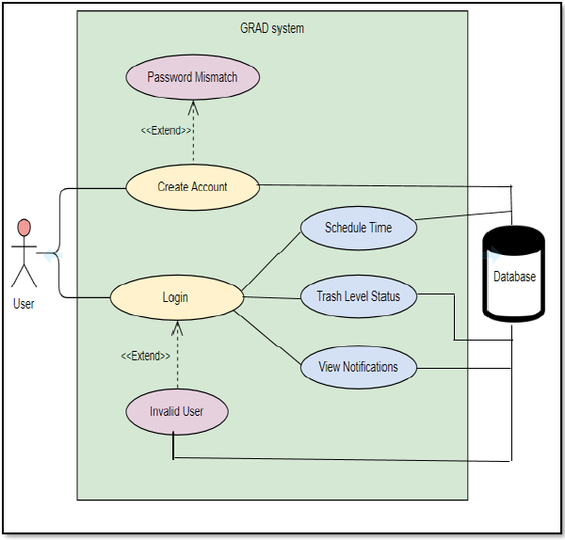
Use Case Diagram
05
The use case diagram is a graphic representation of the user’s interaction with the system
Drive to Curb Flag
Return Home
Notes:
The main purpose of creating a mobile app is that the user can keep track of the outdoor garbage bin remotely.

Slide 35
Database
05
In Firebase database, the data is synced across all clients in real-time, and remains available when your app goes offline.
The information of each user utilizing the mobile application will be stored in the database.
The notification message for each user will be also be stored in the database
Notes:
SB
The database is required for the mobile application so that the application can have access to all information stored in the database. In this case, the information stored would be the user's login information

Slide 36
Android Studio for Mobile Application
05
Android Studio has an intelligent code editor that allows the user to write better code and it also offers advanced code completion.
Has built-in debugger that allows easy debugging
It is very popular and has a lot of documentation that can be found online
Adding layouts is easier as it uses XML that helps in GUI development
Notes:
SB
Android Studio IDE is an officially supported Google developing Android app. This IDE offers a variety of developer tools and a strong coding editor. It supports programming languages such as C++, Java, Go (with extension) and Kotlin. I will be using java. The IDE has a built-in debugger. Android Studio has a fast emulator that allows the user to see how the application will look like in actual physical devices such as phones, tablets, and Android TV devices. The Android Studio gives suggestions as the user is typing the code.

Slide 37
Mobile App Features
05
Login Page
User Registration Page
Main page/Homepage (Display and controls)
Trash Level Status
Drive to Curb
Return Home
Notifications
Logout
Notes:
SB
The mobile application for GRAD system will communicate with the microcontroller through WIFI module.
The mobile application for the GRAD system will comprise of some displays and functionalities. For any basic mobile application that is account-based, the mobile application for GRAD system will have a secured login page that will allow the user to login to a specific account.
It will have a register page and the main page where the user can see and has control over different features such as trash level status,drive to curb return home , notifications and log out button.

Slide 38
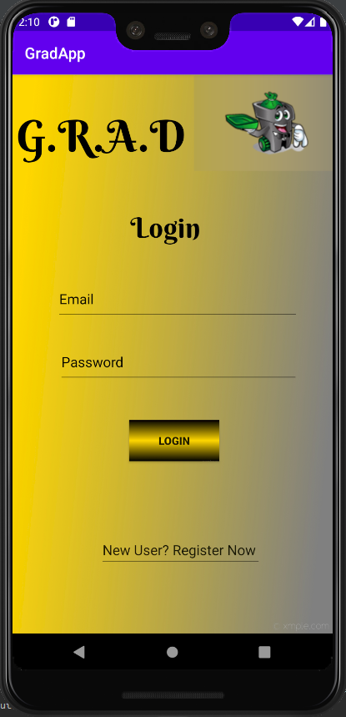
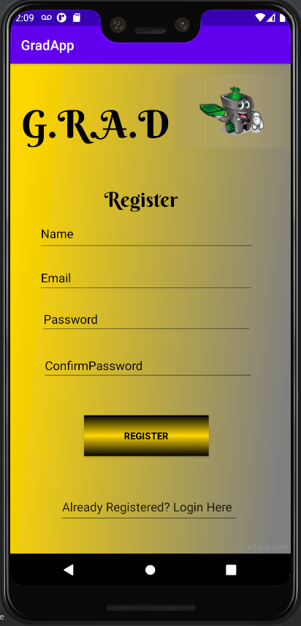
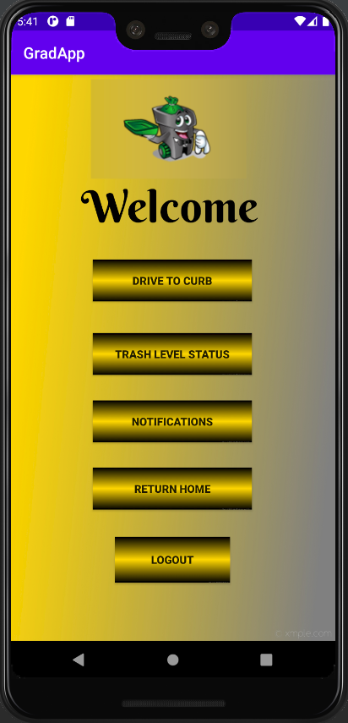
Mobile App Design
05
Notes:
SB
The implementation of login page, register page and homepage are shown.
The homepage also has a “Trash Level Status” button which redirects the user to the trash level status page, where the user can see if the trashcan is empty or full. The trash level status page has a button “Drive to the curb”. If the status of the trash level shows full, the user presses the “Drive to the curb” button that will allow the outdoor trash bin to drive itself to the curb.
This is how the mobile app looks like on emulator. If time permits we might have few more functionalities added to the mobile application. This mobile app was implemented on android studio and firebase database was used to store the credentials for the user. Now my friend heba will be talking about design issue

Slide 39
Design Issues
06
Difficulties in powering the ESP8266-01 Wi-Fi module
The Wi-Fi module requires 3.3 V to operate, but the 3.3 V power supply of the MCU does not provide sufficient current
Solution: Use a 3.3 V voltage regulator to step down the MCU’s 5 V power source
Overall Circuitry Testing
Solar Panel Battery Charger Circuitry Current
Mobile application design
Due to time constraints and not being able to meet due to COVID-19, we may implement a mobile app based on a webserver (rather than a native app)
Notes:
HN
DC Current for 3.3V Pin -> 50 mA
DC Current for Wi-Fi module -> 215 mA

Slide 40
Budget
07
Project Audit
Part # | Description | Vendor | Unit Price | Units | Total Price
1 | Renogy Solar Panel 30W 12V | Renogy | $56.99 | 1 | $56.99
2 | Wei 12V Battery 20Ah | Amazon | $36.99 | 1 | $36.99
3 | HC-SR04 Sensors (5 Pack) | Amazon | $7.99 | 1 | $7.99
4 | 19 RPM Econ Spur Gear Motor | ServoCity | $14.99 | 2 | $29.98
5 | L298N H-Bridge Motor Driver | Amazon | $6.49 | 1 | $6.49
6 | Arduino Mega 2560 | SparkFun | $38.95 | 1 | $38.95
7 | ESP8266 Wi-Fi Module | Amazon | $2.71 | 4 | $10.84
8 | HiLetgo DS3231 Real Time Clock Module | Amazon | $2.30 | 5 | $11.50
9 | OSOYOO IR Obstacle Avoidance Sensors | Amazon | $0.99 | 10 | $9.90
10 | PCB Parts | OSH Park | $16.67 | 3 | $50.00
11 | Torter Trash Can | Home Depot | $59.98 | 1 | $59.98
Total |  |  |  |  | $322.61
Notes:
HN
The total budget set for the design was set at $600 with $100 for unforeseen circumstances. This totals the overall budget to $700.

Slide 41
Project Progress
08
Notes:
SB
In a nut shell this is the current progress of our project. We have almost ordered all the parts rqruired for the GRAD system. The mobile application for the grad system has been implemented with the basic features. We only have to integrate and test it with the wifi module and mcu. The hardware testing of the GRAD system such as motor testing has been completed. The most important part of this project is integration and the team is looking forward to finish it soon. My friend heba will be talking about our next steps.

Slide 42
Next Steps
09
Interfacing the mobile app with the Wi-Fi module
Integrating the motors and wheels into the robot body
Attaching the solar panel on top of the robot body
Loading code onto PCB
Final assembly/integration of all subsystems
Notes:
HN

