Slide 1


Solar Powered UV Water Purifying and Monitoring System
Designed and Presented by:
Kendra Kordack
Bradley Blackburn
Lucas Heredia
Grant Cooper

Slide 2




Sponsors:
Ocean Insight: Lending a Raman Spectrometer and laser module for the water quality monitoring.
MKS Newport: Providing optics needed to complete Raman spectroscopy system.
BCI Technologies: Supplying electrical equipment for implementation and testing.
Bradley Blackburn

Slide 3
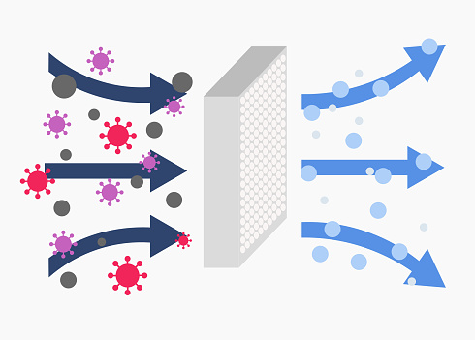
Motivation
Wide-spread viruses
Filtration Quality
Sponsorships
Bradley Blackburn
Notes:
Most filtration systems only use one type of filter
Ocean Insight

Slide 4
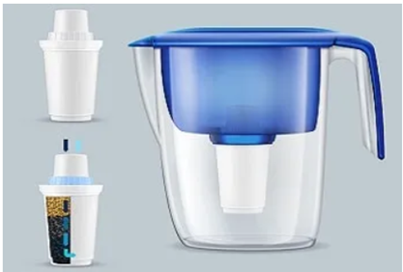
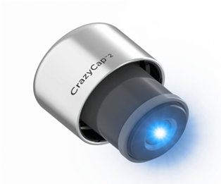
Similar Products
Brita Filter
One filter
No monitoring
No UV treatment
Crazy Cap
No filters
No monitoring
Bradley Blackburn
Notes:
CHANGE AUDIO RECORDING

Slide 5
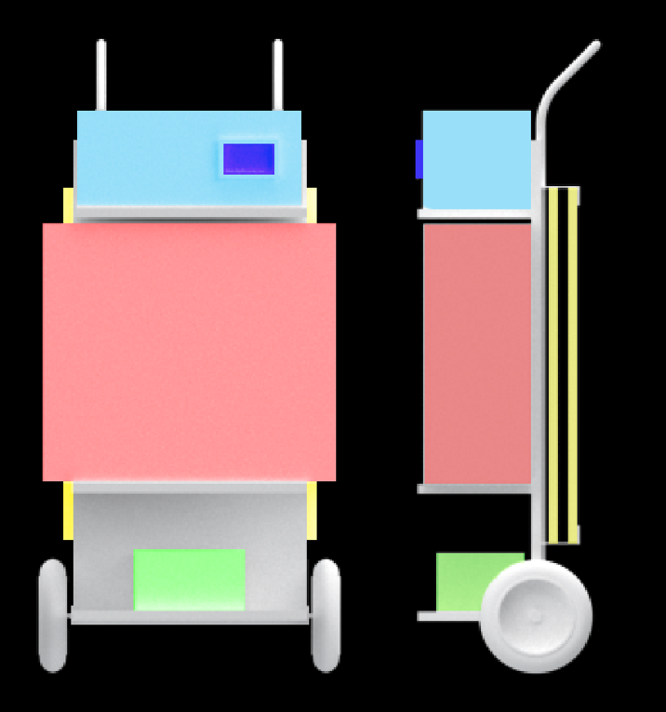
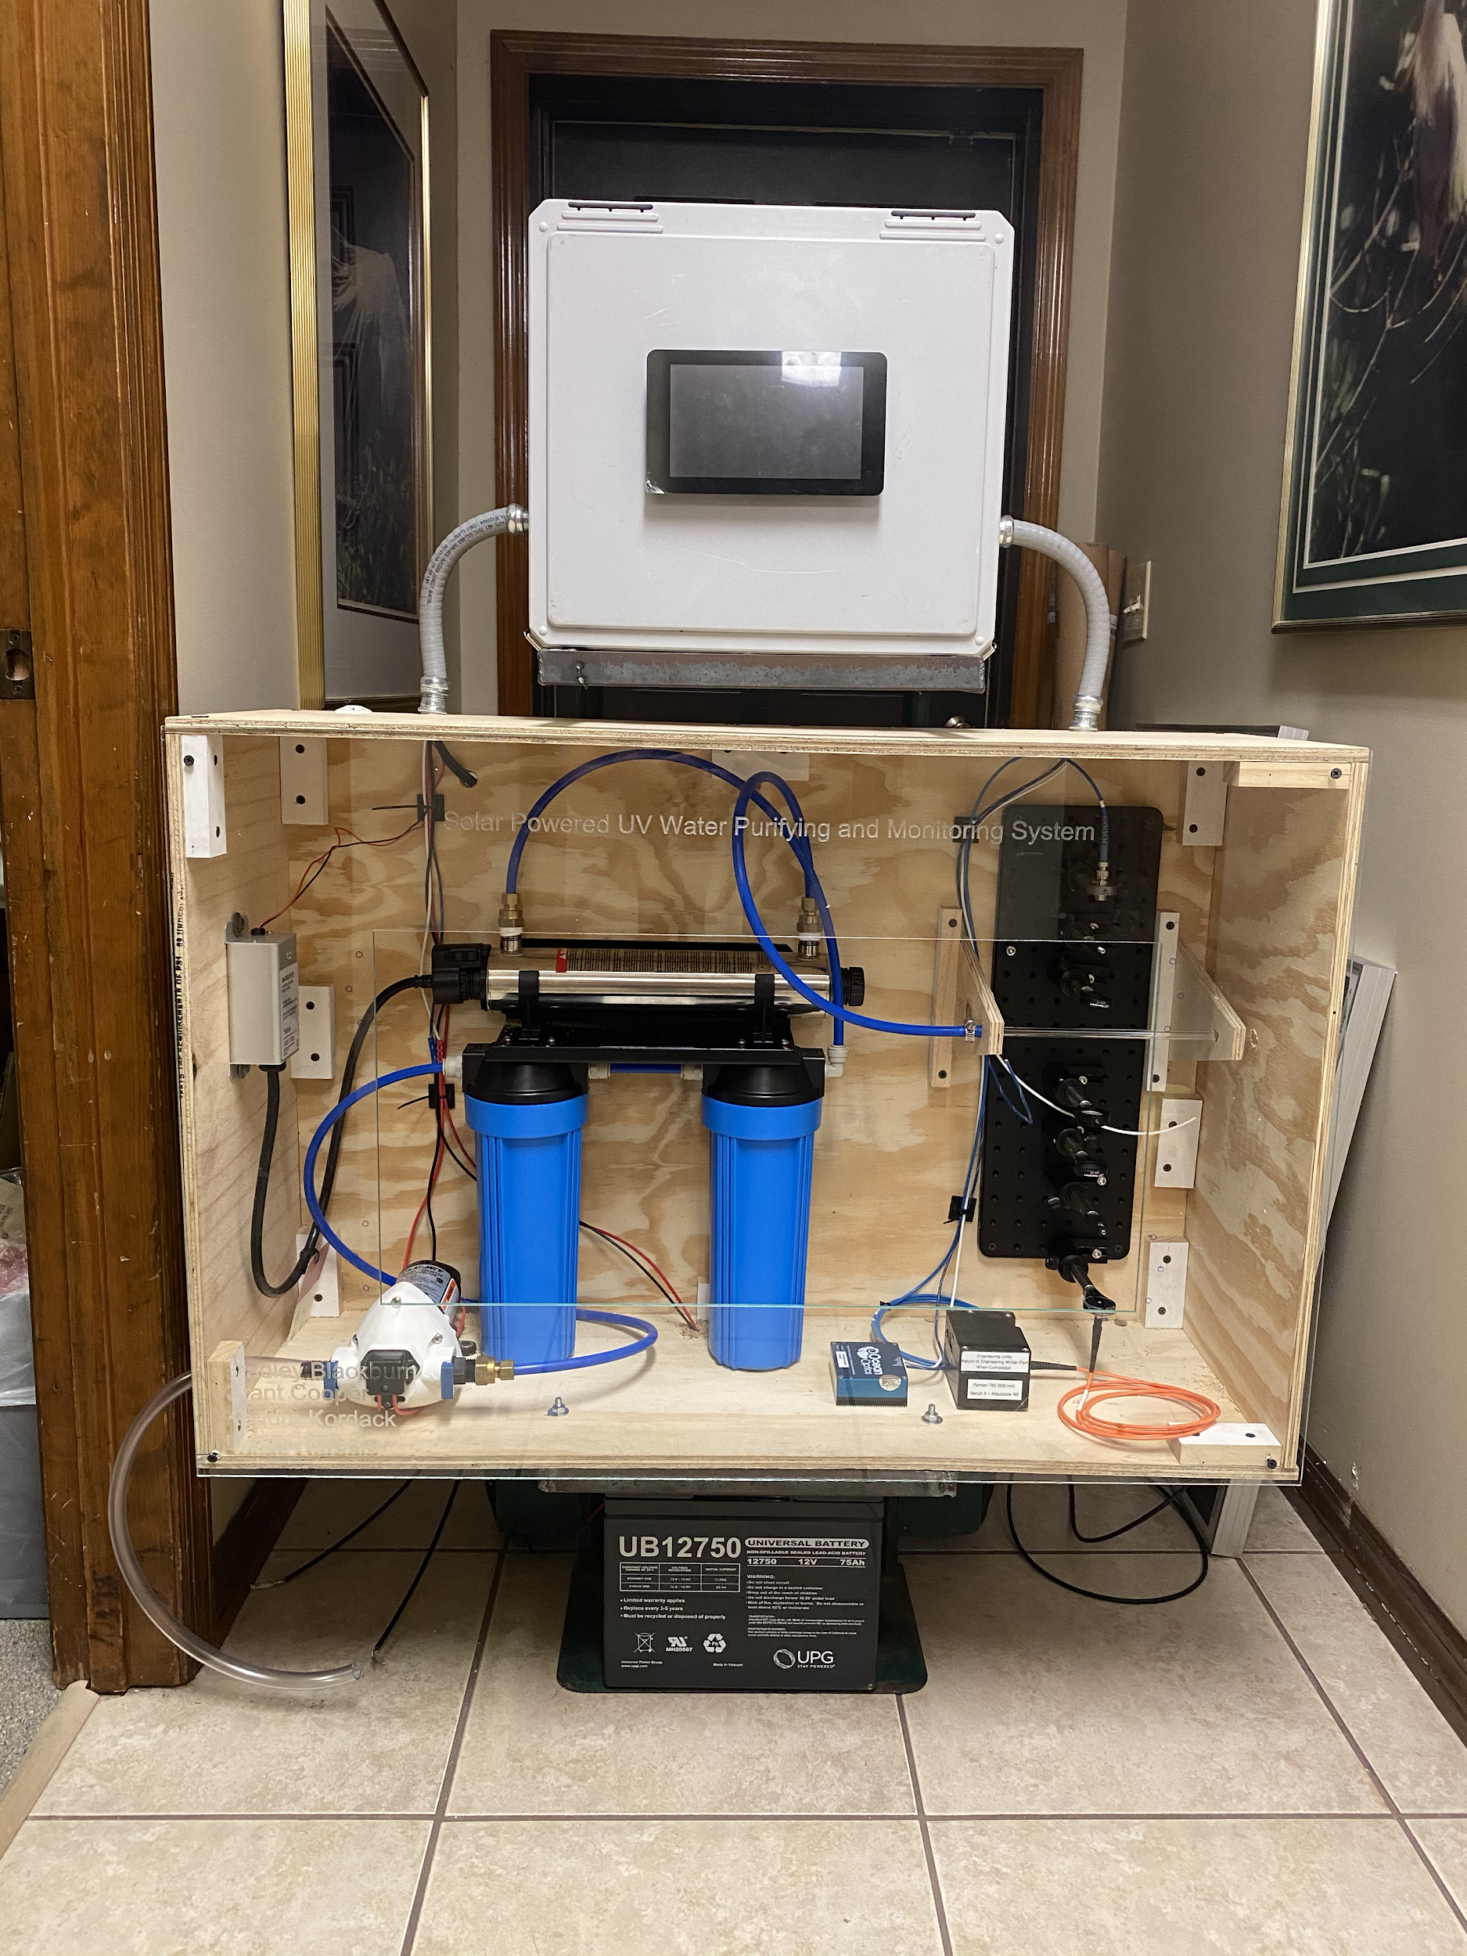
System Overview
Bradley Blackburn

Slide 6
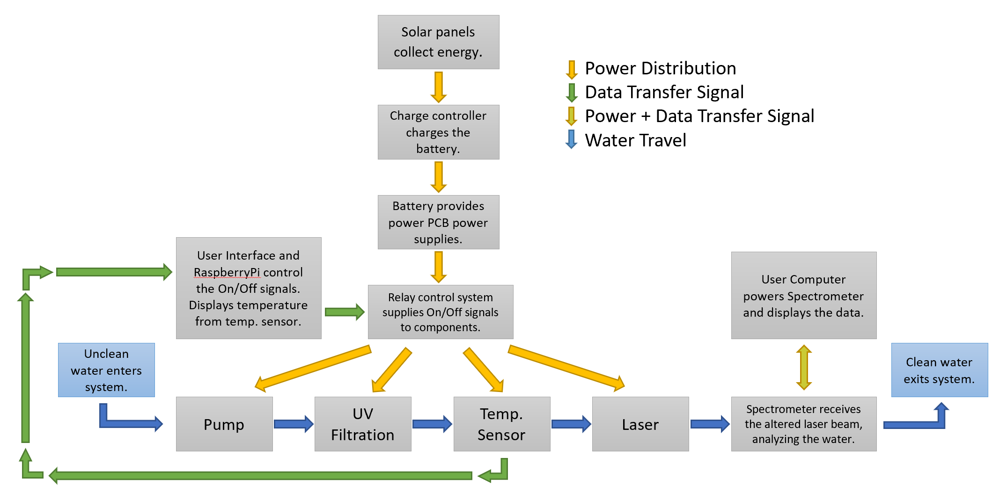
System Block Diagram
Bradley Blackburn

Slide 7
Workload Distribution
Solar Power System
Charge Controller
Brad
Grant
PCB Power Supplies
Lucas
Kendra
User Interface
RaspberryPi
Control Relay System
Spectroscopy
Filtration System
Pump
UV Filtration
IR Temp. Sensor
Bradley Blackburn

Slide 8
Objectives and Demonstrable Goals
In-Line contaminant and temperature monitoring
Off-Grid Operation
Interactive User Interface
Bradley Blackburn
Notes:
CHANGE AUDIO RECORDING

Slide 9
Specifications
 | Subsystems | Specification
1 | Solar Power System | Full off grid operation, generating 12-24V, 12V battery
2 | Water Analysis | Raman Spectrometer @ 785nm, 24V 4-20mA IR temperature sensor
3 | User Interface | Control over system operation, display (via LCD) feedback/data from the system
4 | Charge Controller | 12V, maximum operating current 20A
5 | Filtration System | 2.9 gpm, class C UV lamp, (1) 5 micron sediment filter, (1) carbon filter
6 | RaspberryPi4B | 4GB memory, Quad core Cortex-A72 ARM 64-bit CPU, (2) USB 3.0 ports, (2) USB 2.0 ports
7 | Control Relay System | Opto22 I/O board, 60V/3A output modules, 12V AD relays
Bradley Blackburn
Notes:
CHANGE AUDIO
Solar/Power Supply: Completely off-grid (solar charges battery, battery supplies power), 8 hours of autonomy minimum
Water Filtration: 5 micron and carbon filter, Class C UV lamp (originally 6.5 gpm) Around 3 gpm to meet filtration system requirement,
Water Analysis: Done through raman spectroscopy Temperature monitoring Snake Poison, Laundry Detergent, Chlorine
Water Quality: Water should be cleaned via the filtration system. Free of: Sediment, heavy metal, Benzene, Chlorine
Zinc Cyanide, Arsenic free, Water temp between 70 F and 50 F
Microcontroller: Must be able to interface the spectrometer being used, at least 2GB RAM, include USB2 or 3
UI: offer control over system, LCD touch screen, be able to connect/interface with microcontroller
https://pixabay.com/vectors/clipboard-student-writing-work-pen-2899586/

Slide 10
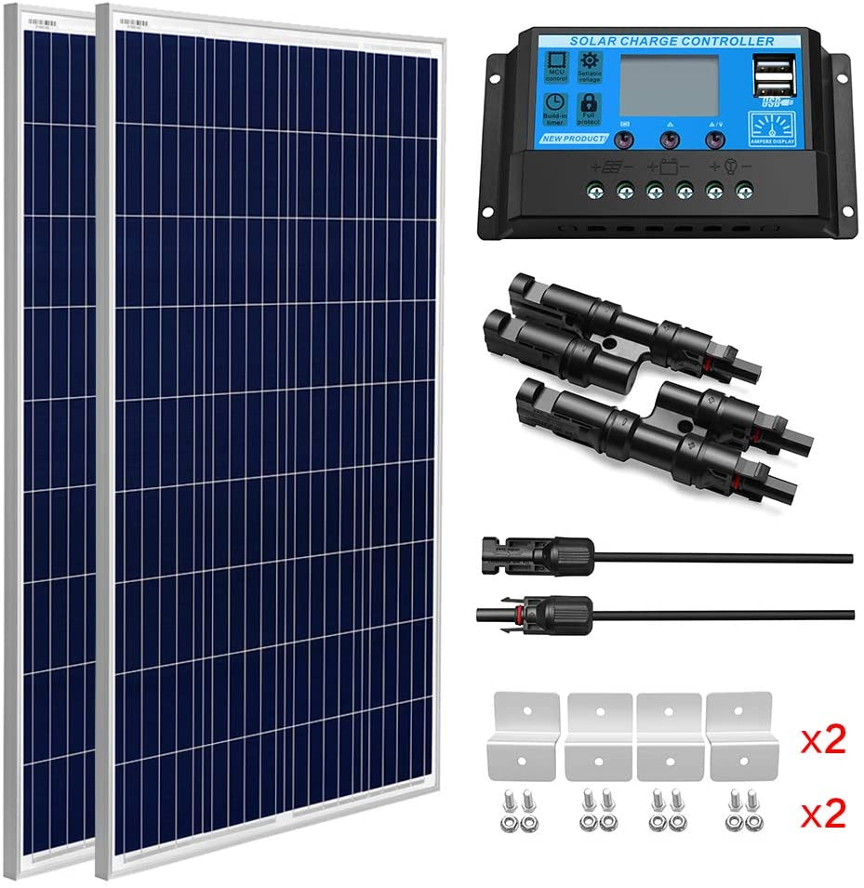
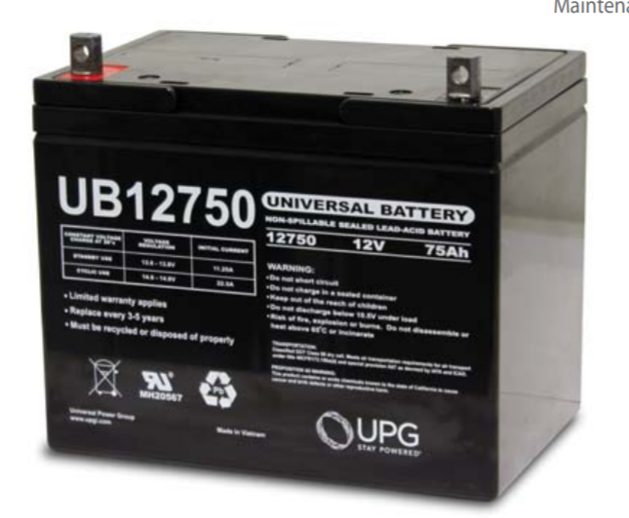
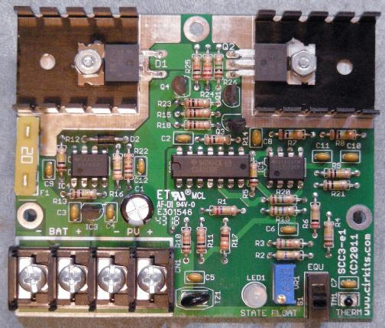
Solar Power System
2 x 100 Watt Polycrystalline Solar Panels
1 x 12V/20A Charge Controller, Cirkits.com, Model:SCC3
1 x 12V 75 Ah Battery, UPG, UB12750
Bradley Blackburn
Notes:
Polycrystalline: b/c cheaper option (mono twice the price), 36x26x1, 12 VDC ($239)
Charge controller: THE ORIGINAL came with panels, has 2 USB ports 5V/3A can power LCD/mcu, protection features (ovr curr, shrt circ, low/high bat V), has its own UI (traverse fns: charge type, bat type, display for V I and P)
Battery: 75 Ah at 12 V, sealed lead acid, Depth of discharge high for many cycles
https://www.amazon.com/gp/product/B07S6MHGS1/ref=ppx_yo_dt_b_asin_title_o01_s00?ie=UTF8&psc=1
UPG (Universal Power Group). (n.d.). Sealed Lead-Acid Battery. Http://Files.Upgi.Com:8086/UPGFileService.Svc/GetSpecSheet/46082 . Retrieved July 16, 2020

Slide 11
Solar Alternative Components
Solar Cell Tech. | Differences | Price
Monocrystalline | Made of one type of silicon Higher efficiency | High
Thin Film | Flexible Space efficient | Medium
Charge Controllers
Shunt/Series | Short circuit and Current interruption implementation | Low
MPPT | High efficiency Mainly commercial application | High
Batteries
Lithium Ion | Large depth of discharge Substantial protection circuitry needed | High
AGM Lead Acid | Light weight Low internal resistance | High
Bradley Blackburn

Slide 12
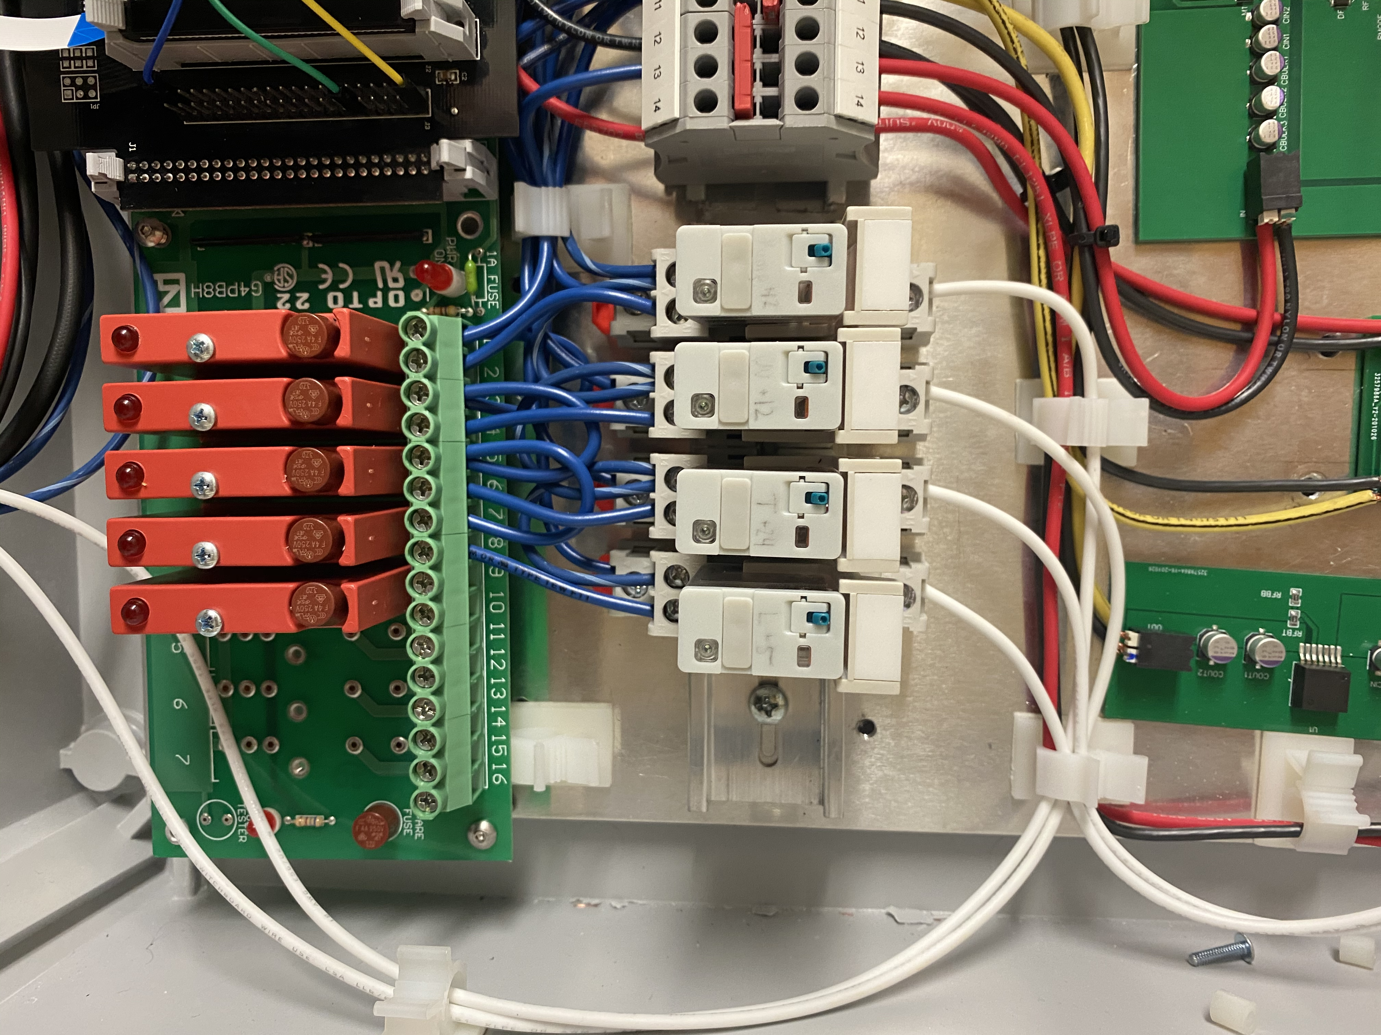
Control Relay System
Why?
  The RaspberryPi was not built to handle large external loads.
Bradley Blackburn

Slide 13
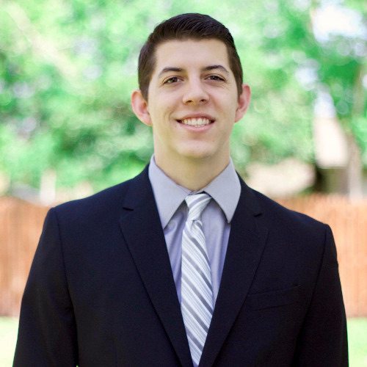

Filtration Technologies Comparison
Filtration Technologies | Pros | Cons
Sediment | Removes rust, dust, heavy metals, and any particles equal or larger than the micron rating | Doesn't remove particles smaller than the micron rating and doesn’t remove pathogens
Activated Carbon | Removes particles sized .5 - 1 micron Positively charged activated carbon attracts all the negatively charged chemicals in the water like chlorine and sulfur Removes unwanted odors Can remove some strains of bacteria | Cannot remove small bacteria, viruses, or other small pathogens Can fill up fast if used independent of other filters
Reverse Osmosis | Removes bacteria and small particles from water | Expensive Filter can be eaten away by bacteria Wastes a lot of water
Distillation | Removes pathogen via boiling | Sediment is not removed Energy intensive method Slow output
Chemical Disinfectant | Eliminates bacteria and viruses | Unsuccessful in treating protozoan cyst and parasites Can be harmful if exposed to humans
UV Water Sanitation | Eliminates bacteria, viruses, protozoan cyst, and parasites | Requires prefiltering e.g. sediment and carbon filters
Grant Cooper

Slide 14
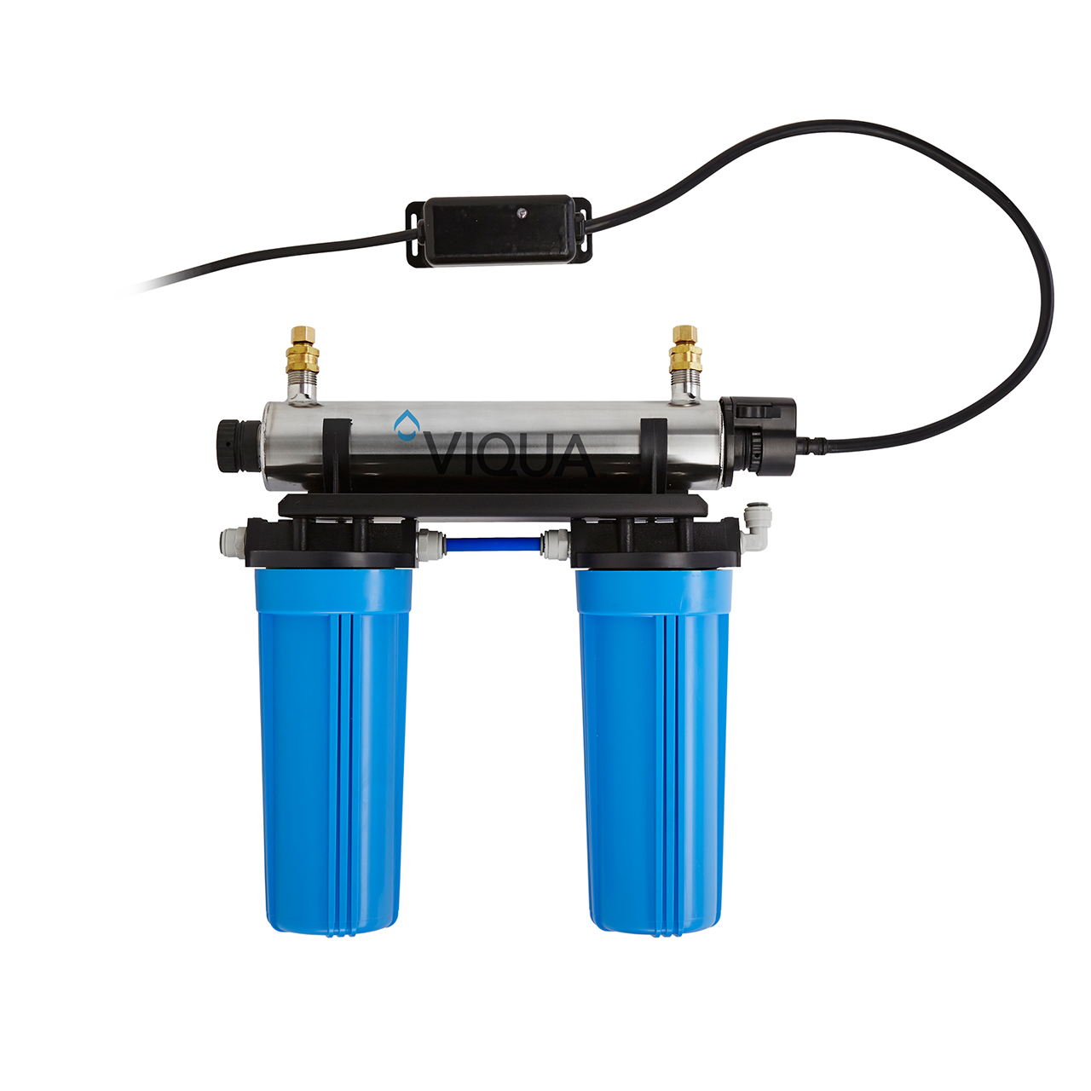
Filtration System
  Viqua VT4-DWS/12 UV Filter 3.5GPM (Gallons per Minute)
  AWP110-2 5 Micron Sediment filter
  C-02PB Carbon Block Filter for taste and odour removal
Grant Cooper

Slide 15
Pump Technologies Comparisons
Water Pumping Technology | Self-Priming | Output Volume | Debris Sensitivity | Current Draw
Impeller | No | Middle | Highest | Middle
Centrifugal | No | Highest | Lowest | Highest
Diaphragm | Yes | Lowest | Middle | Lowest
Grant Cooper

Slide 16
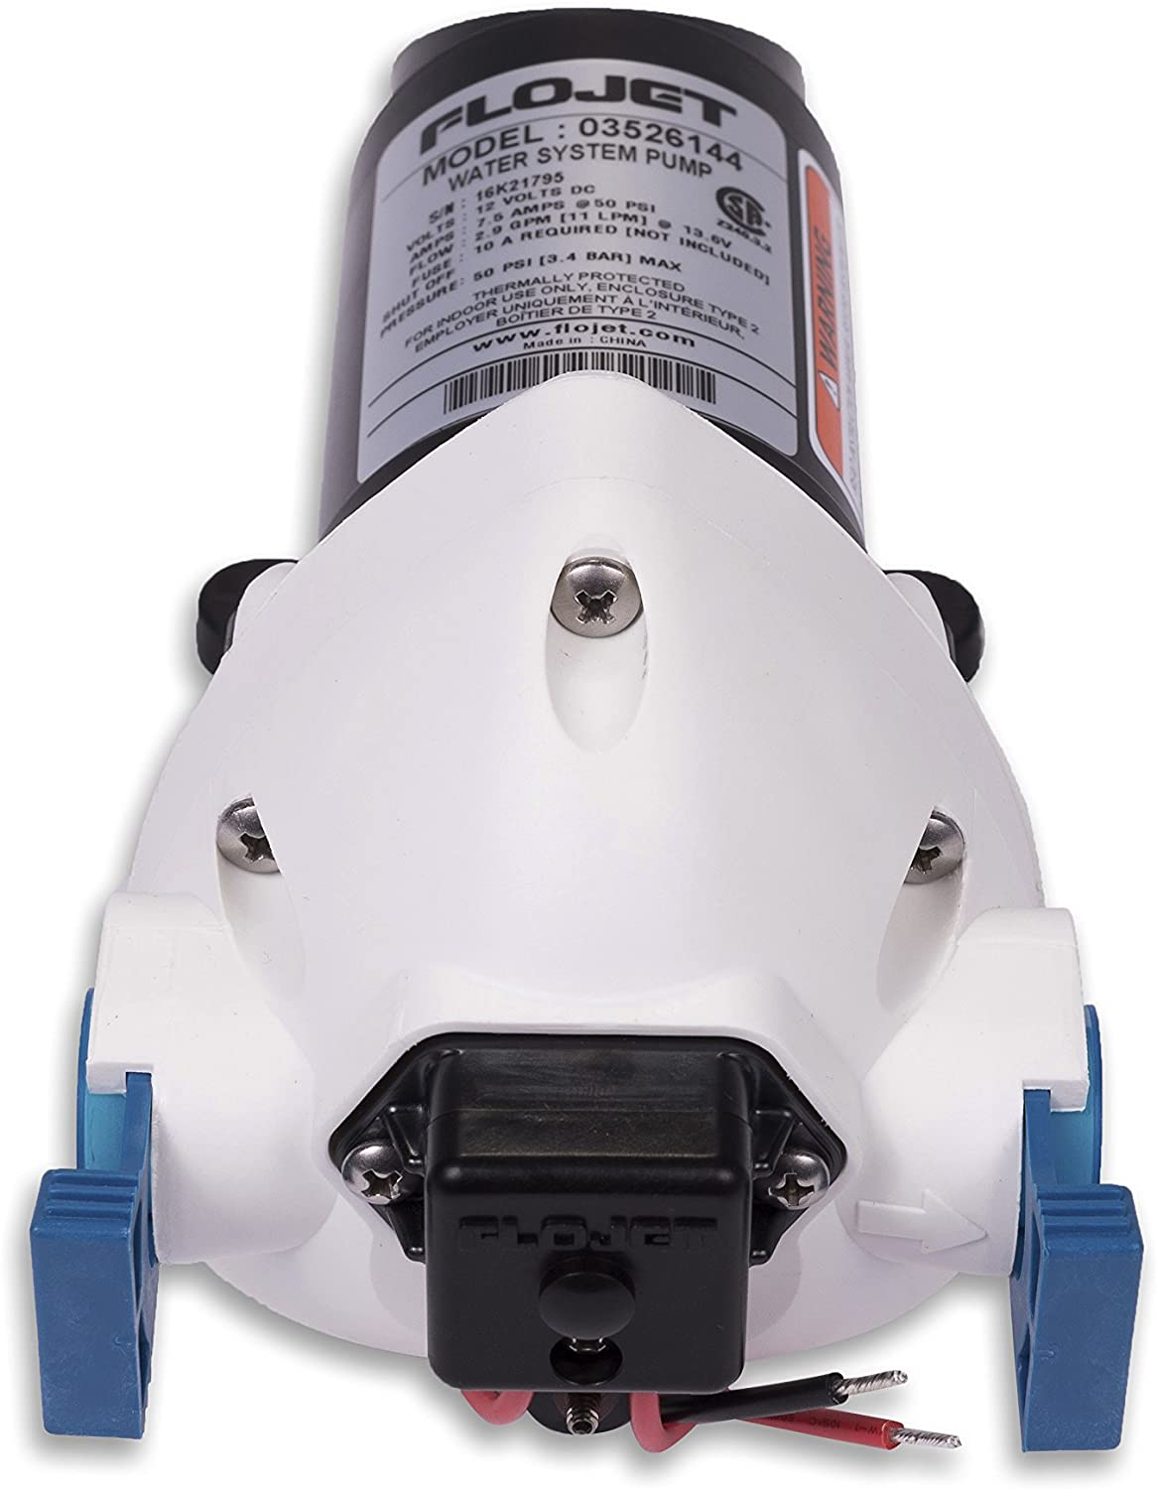
Water System Pump
Flojet 03526-144A Triplex Diaphragm Automatic Water System Pump
Self-priming up to 10ft and can be run dry.
Automatic pumps feature a mechanism that will start the pump by the opening of a faucet.
Flow rate of 2.9 GPM (Gallons per Minute)
Operates on 12V DC
Grant Cooper

Slide 17
PCB Block Diagram
Raspberry Pi 4b GPIO Pins
12V 12A Voltage Regulator
PWM Charge Controller
5V 4.5A Voltage Regulator
Relay / MOSFET component control circuits
Loads
24V .3A Voltage Regulator
Grant Cooper

Slide 18
Voltage Regulators
Why separate PCBs?
0805 parts
If max current increases, complexity increases
Reality of Webench Power Supply Designer
Grant Cooper
Grant Cooper

Slide 19
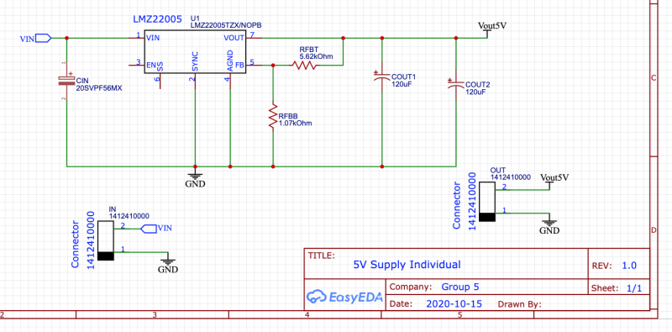
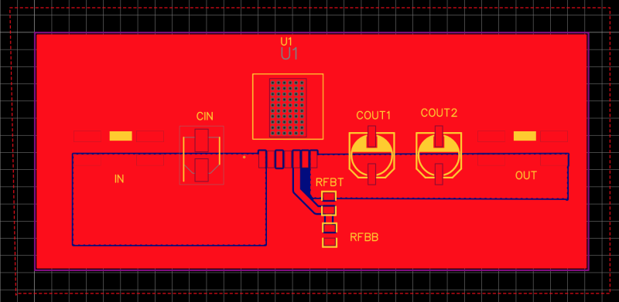
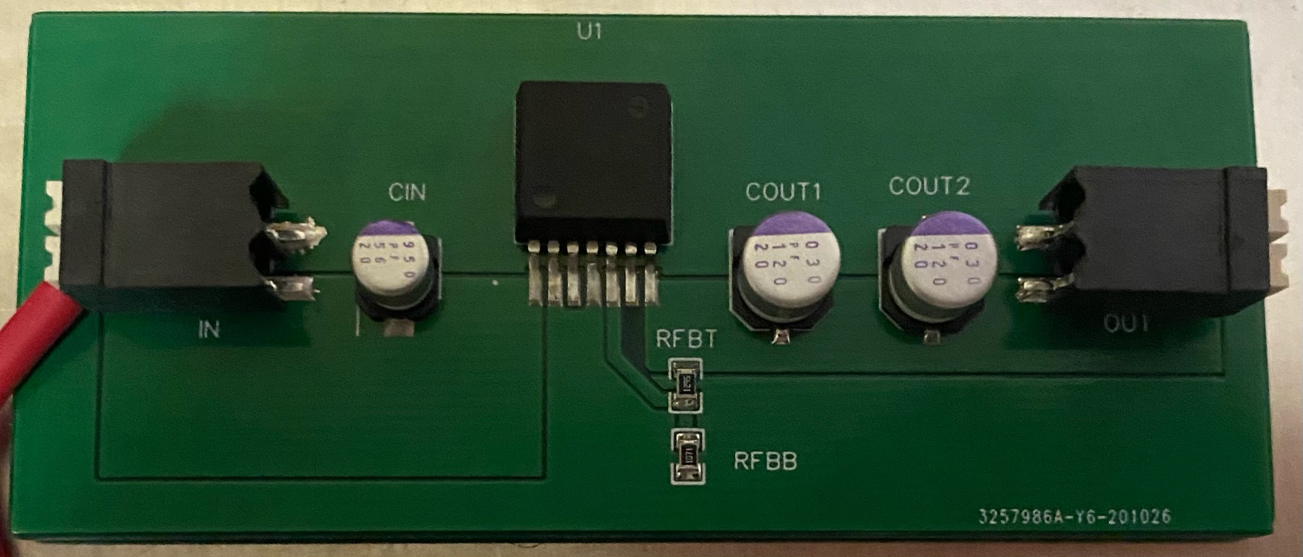
5V 5A REGULATOR
LMZ22005 5-A SIMPLE SWITCHER Power Module With 20-V Maximum Input Voltage
Grant Cooper

Slide 20
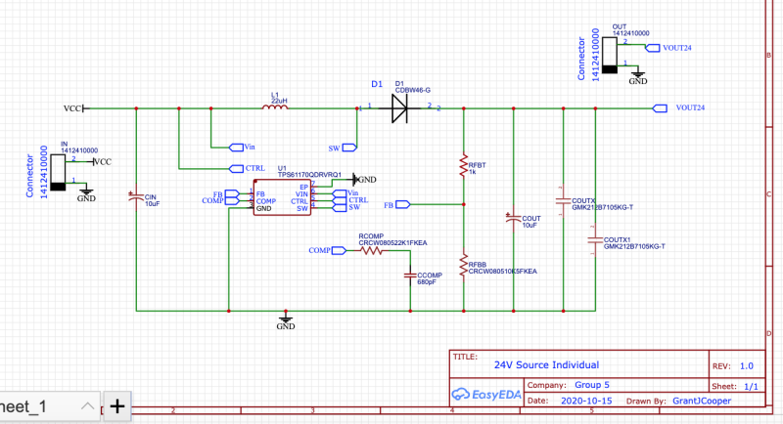
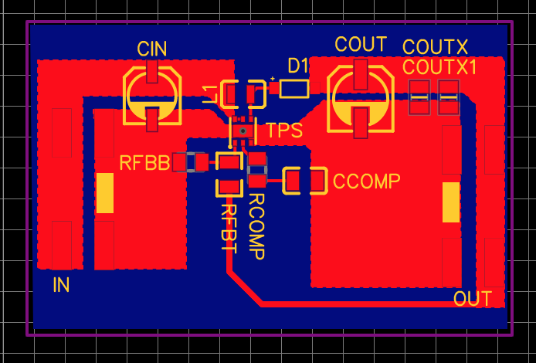
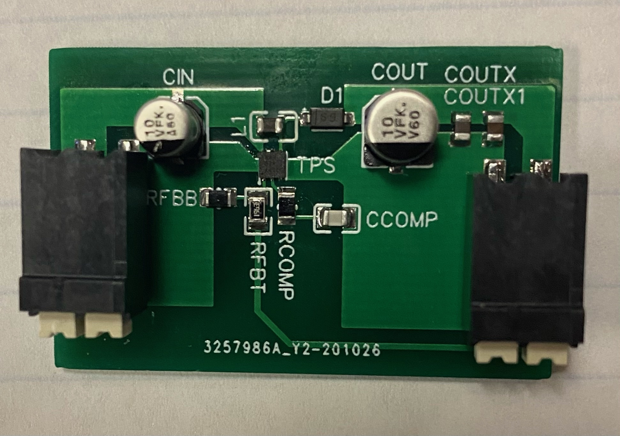
24V .03A REGULATOR
TPS61170QDRVRQ1 Automotive 3V to 18V Wide Input Range, 1.2A Boost Converter
Grant Cooper

Slide 21
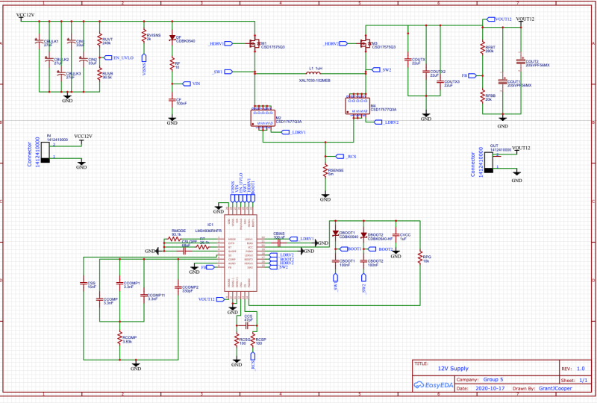
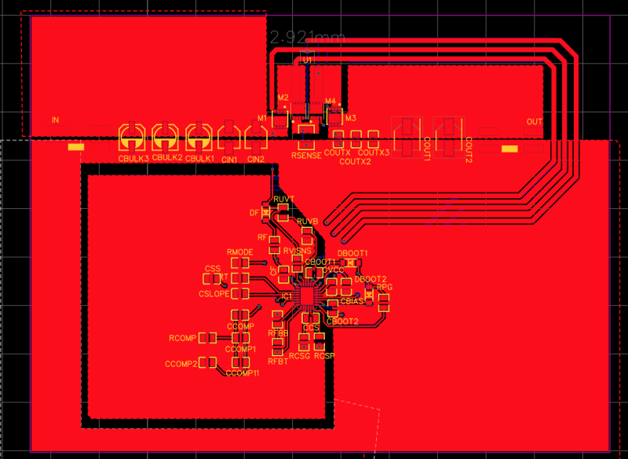
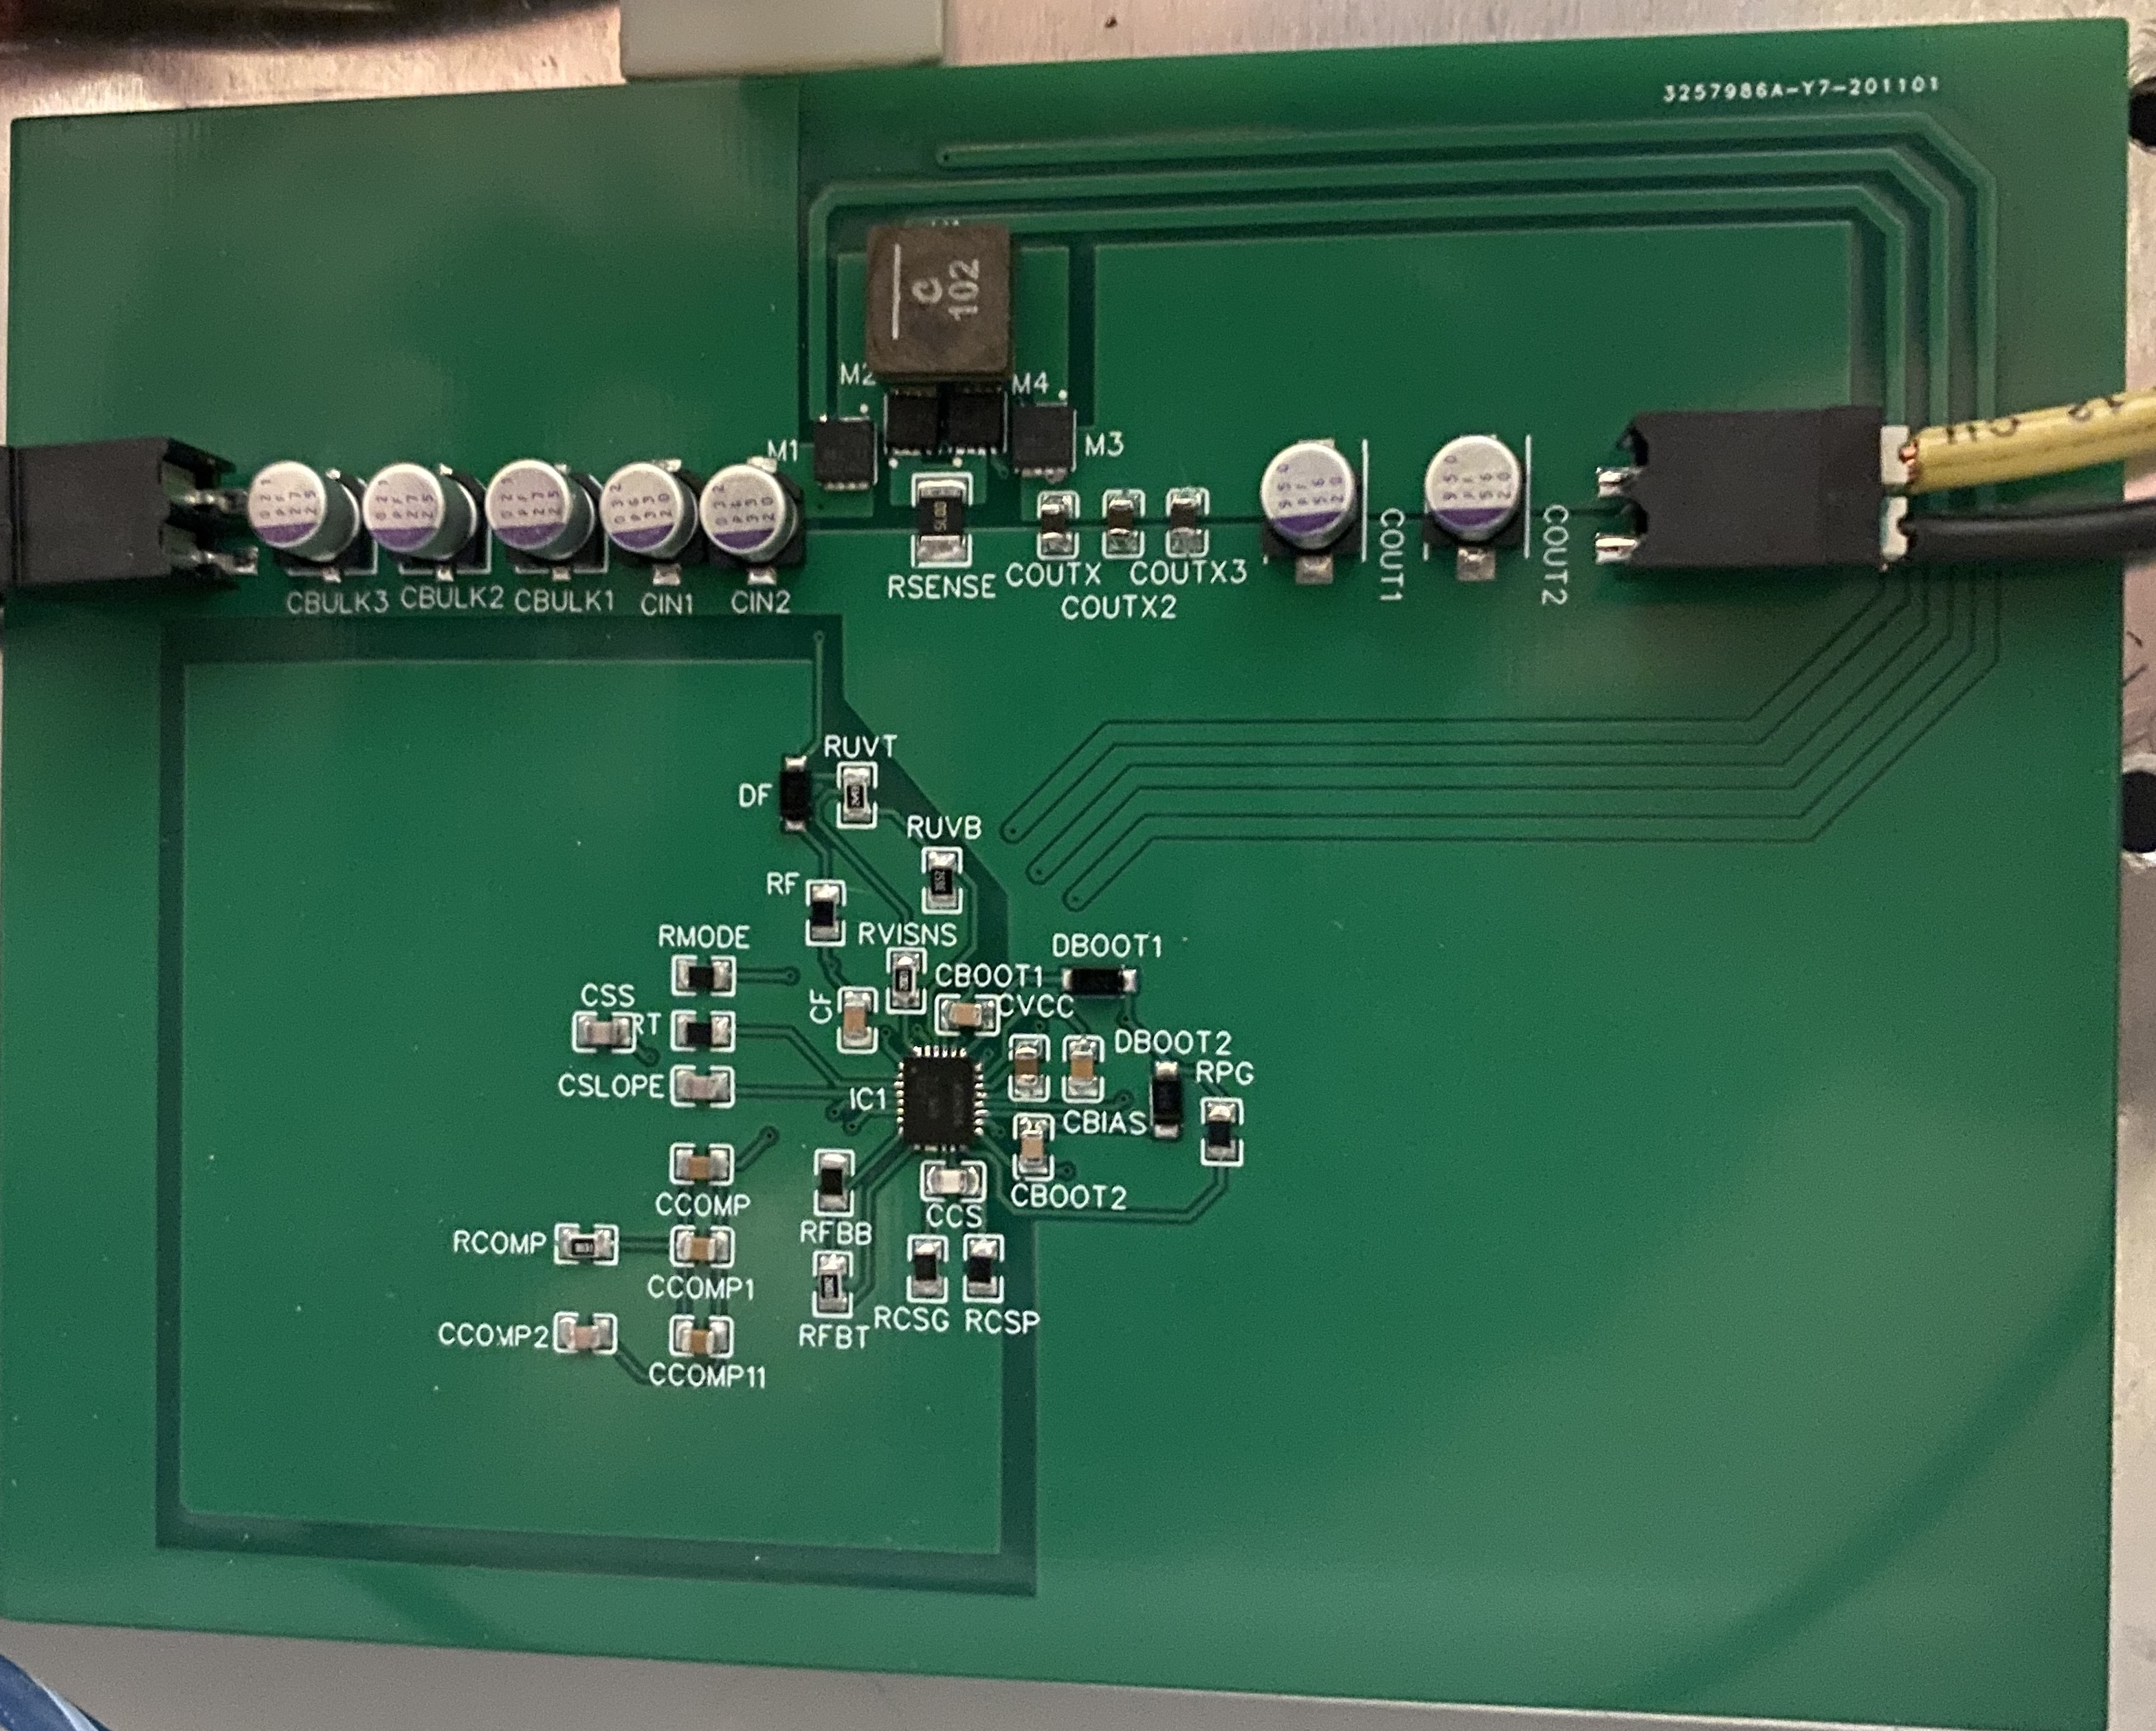
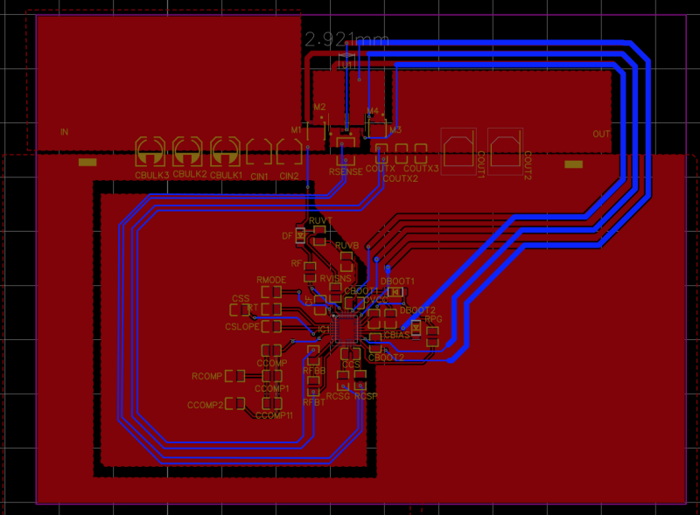
12V 12A REGULATOR
LM34936RHFR 30-V Wide VIN Synchronous 4-Switch Buck-Boost Controller
Grant Cooper

Slide 22
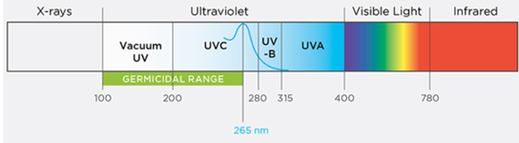
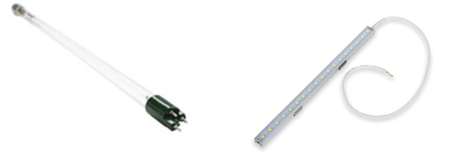
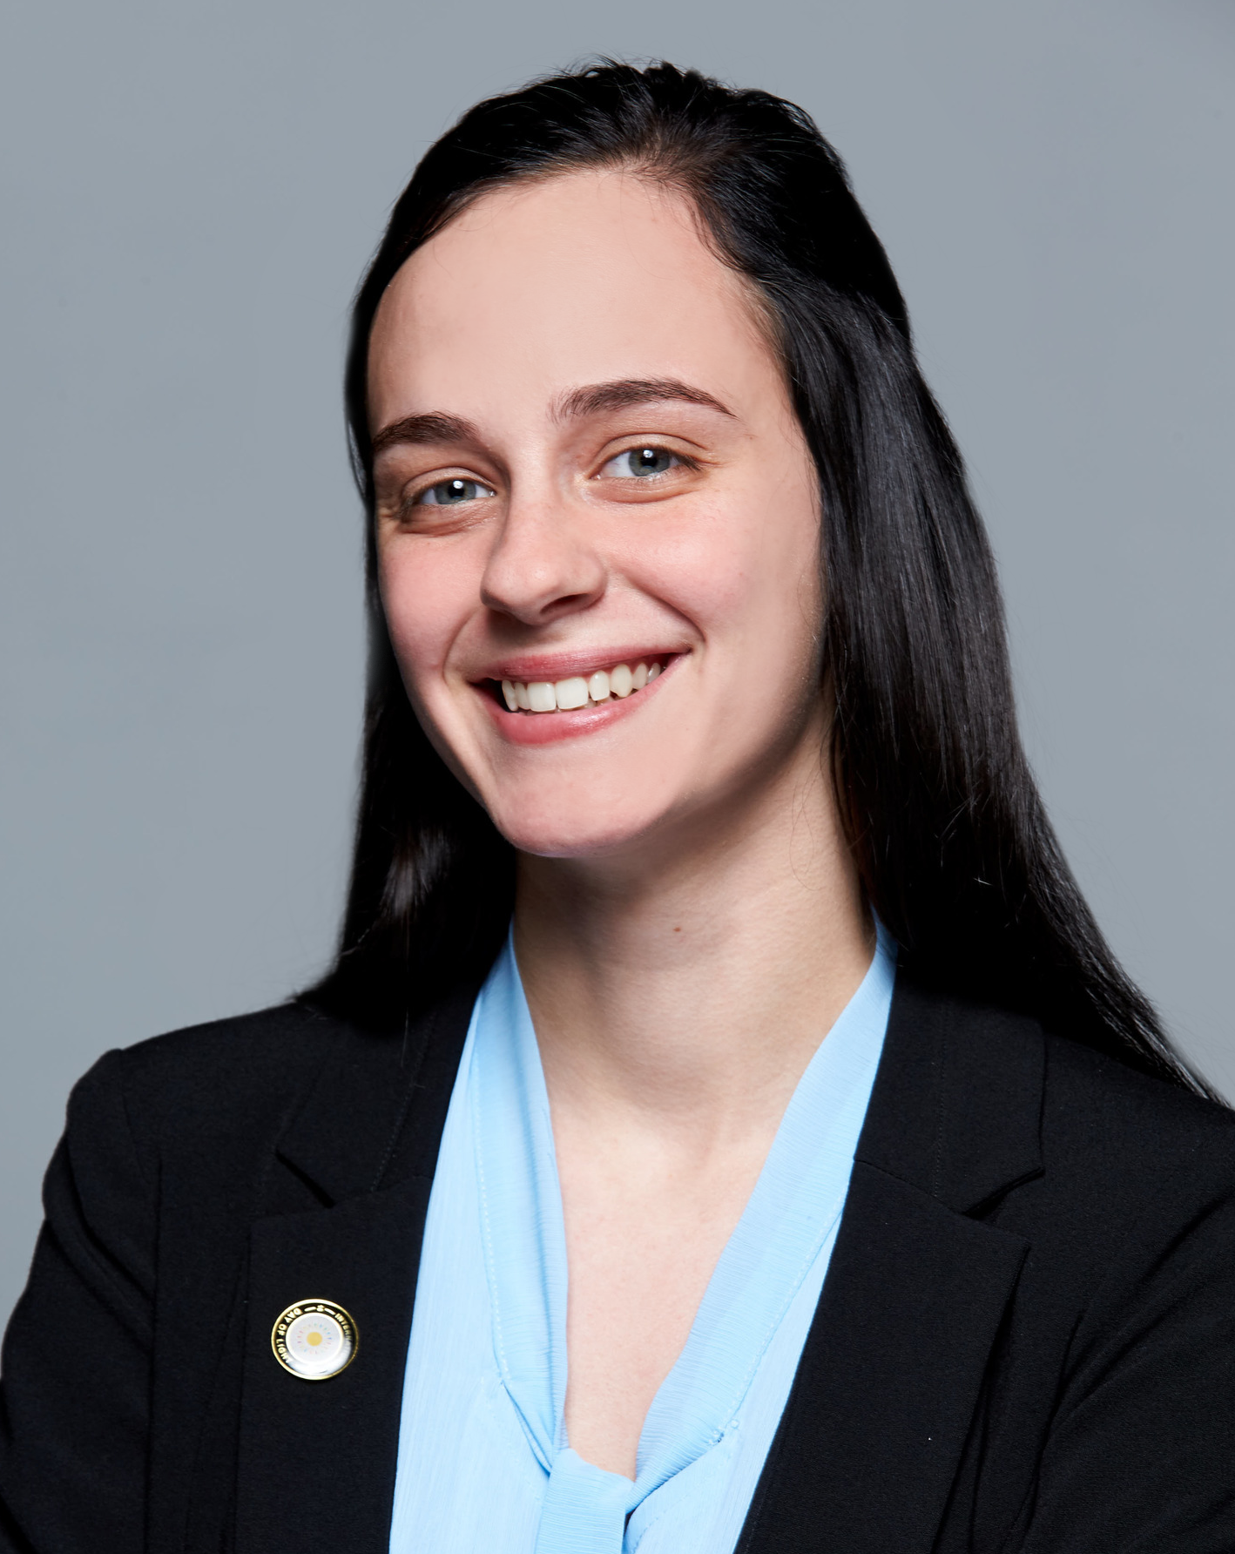
UV Cleaning
Moore, Photonics Online (2015)
The wavelength of light for UV sanitation is from about 100 nm to 260 nm, otherwise known as deep UV, or UVC
There are both lamps and LEDs that produce this wavelength of light can sanitize water.
Servapure (2020)
12VMonster, 2020
Kendra Kordack

Slide 23
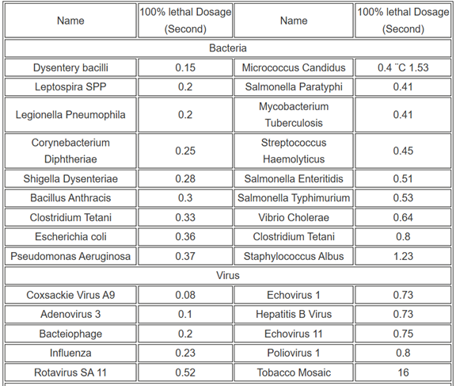
UV Cleaning Requirements
Oram, Water Research Center 2020
100% lethal dosage is 16,000 μW-sec/cm²
Kendra Kordack

Slide 24
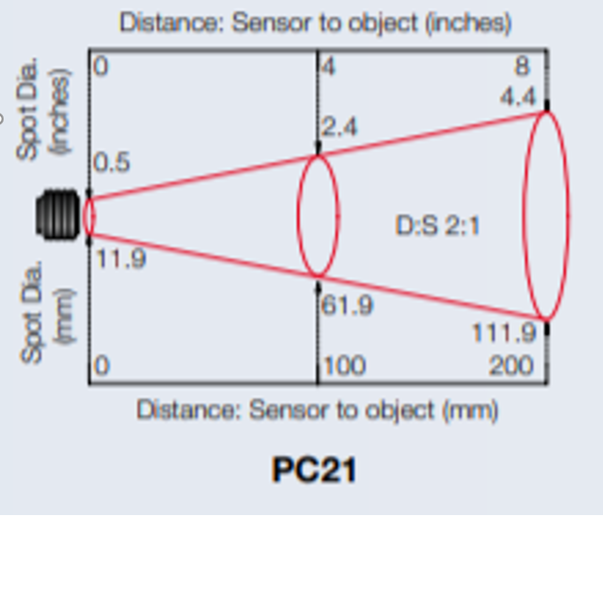
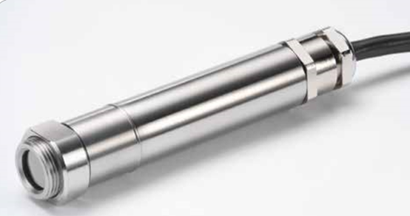
IR Temperature Sensor
Calex Electronics Limited
Contactless
Digital readout
Fast
2:1 ratio
Calex Electronics Limited
Kendra Kordack

Slide 25
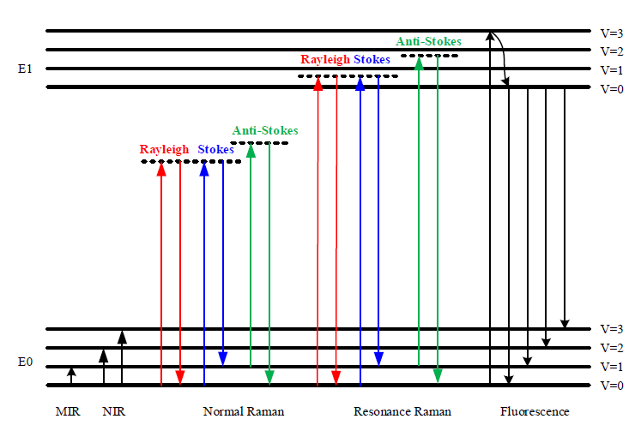
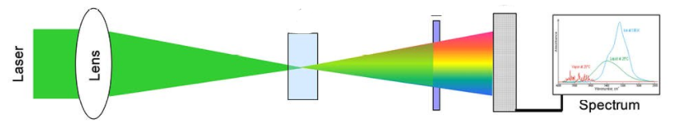
Raman Spectroscopy
Li, Sensors (2014)
In-line monitoring
Water is a weak Raman Scatterer
NIR to avoid fluorescence
Stokes Raman scattering
Expensive
Wegner, Geo Chemistry Worldwide (2018)
Kendra Kordack

Slide 26
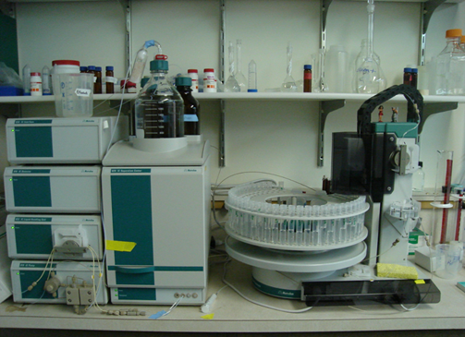
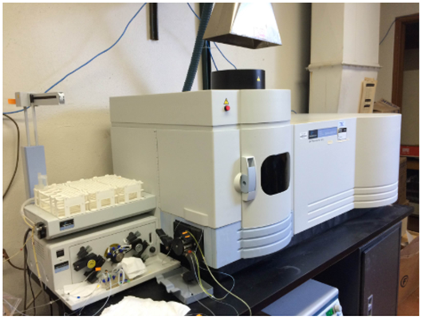
Other Forms of Contaminant Evaluation
Buckner, Bio-Geochemical Methods (2020)
UC Berkeley (2020)
Chromatography
Inductively coupled plasma mass spectrometer
Kendra Kordack

Slide 27
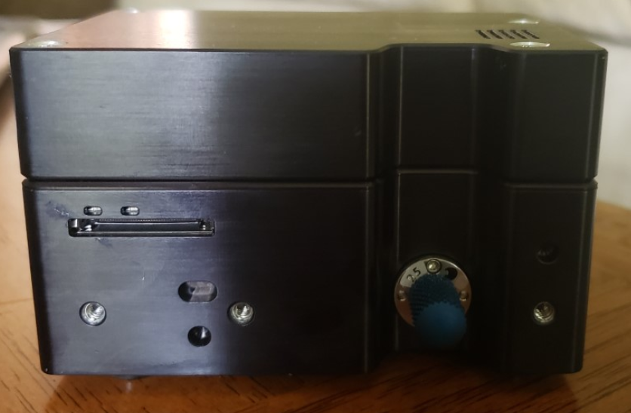
Raman Spectrometer
Specifications
785 nm
SMA Fiber connected
Oceanview Software
Powered through computer
  USB C
3.5x2x2 inch
Kendra Kordack

Slide 28
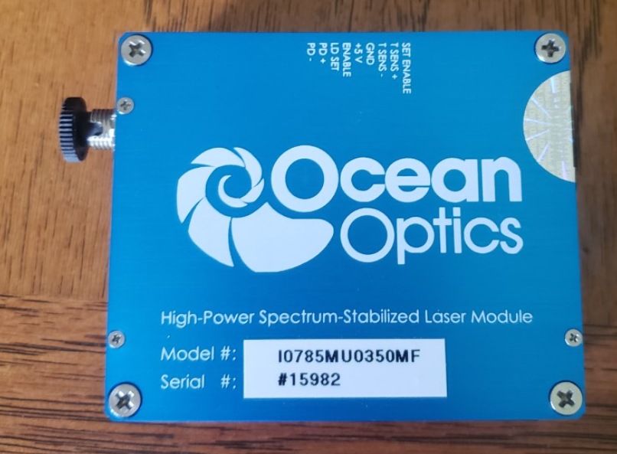
Raman Spectrometer Laser Source
Specifications
785 nm
499 mW
FC Fiber Connector
5 volt intake

Slide 29
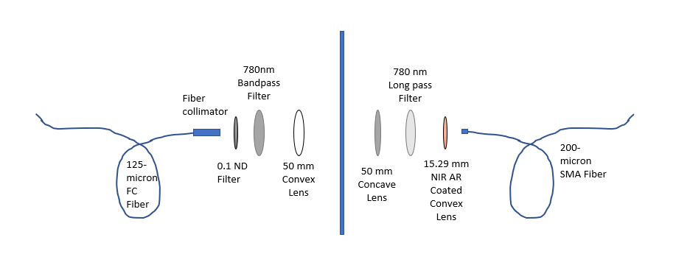
Spectroscopy System
Kendra Kordack

Slide 30
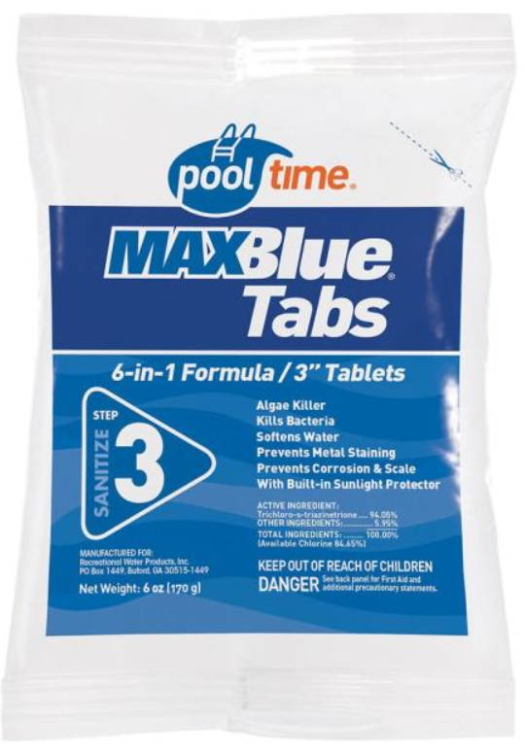
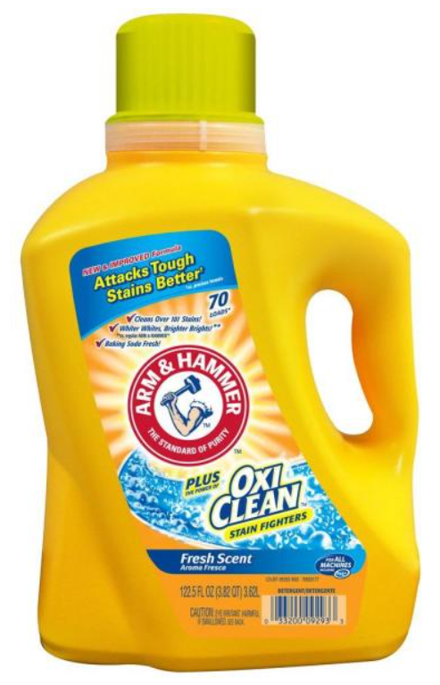
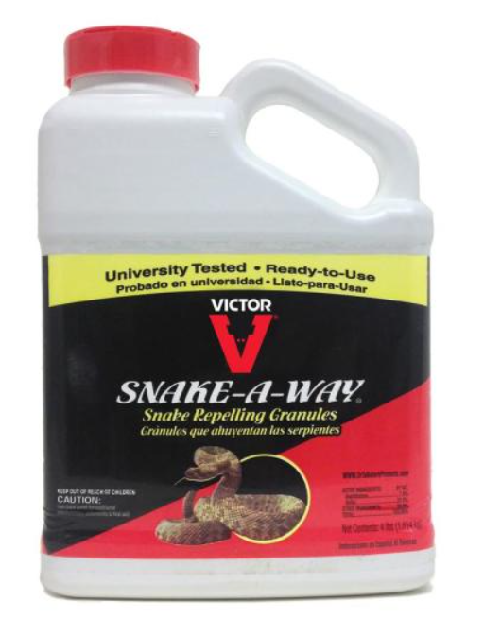
Contaminants
Contains naphthalene (7%) and sulfur (28%) as its active ingredients. Snake-A-Way has greater than 91% repellency rate for rattlesnakes and garter snakes.
Contains multiple toxic chemicals including benzyl acetate, methylisothiazolinone, and calcium chloride.
Contains 94.05% trichloro-s-triazinetrione and 5.95% other ingredients
Kendra Kordack

Slide 31
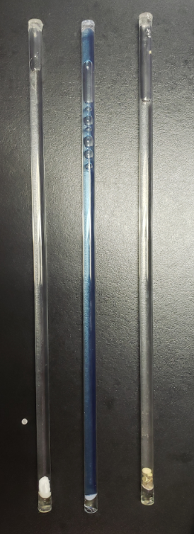
Comparing Spectras
Three main Contaminant being observed:
Snake Poison
Laundry Detergent
Chlorine
Kendra Kordack

Slide 32
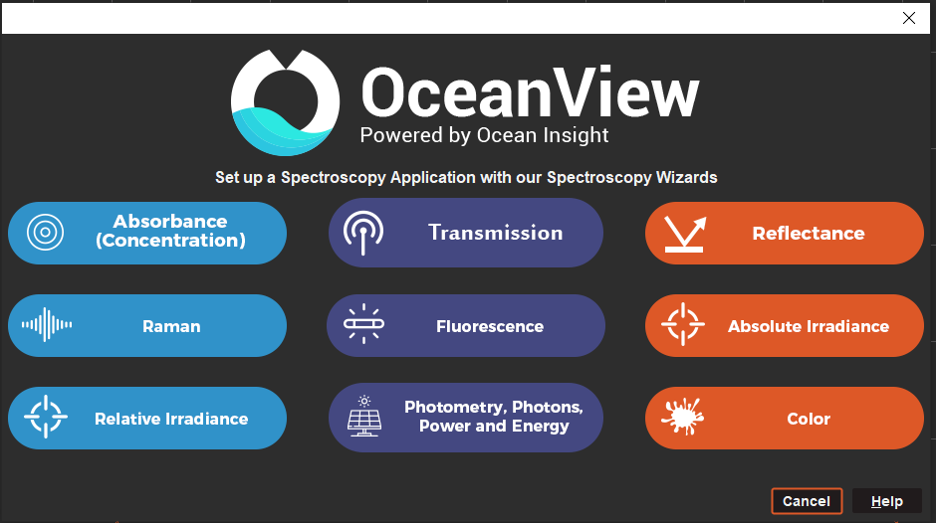
Ocean View Raman Spectroscopy
Integration time: 40 ms
Boxcar width: 6
Shift range: 552.78-1084.42 cm^-1
Light and dark spectrum subtraction
Records Raman shift with graph and table
Kendra Kordack

Slide 33
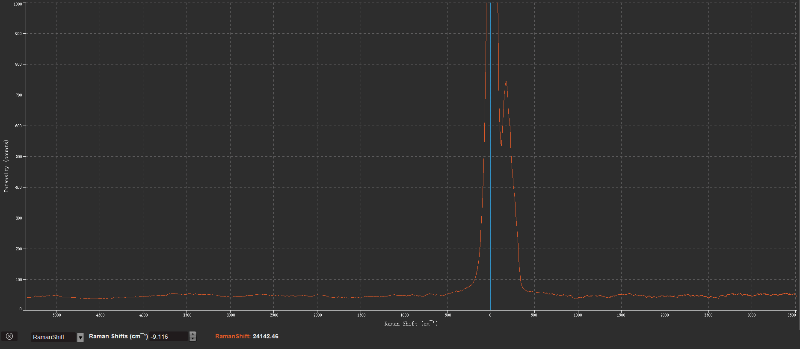
Clean Water Spectrum
Kendra Kordack

Slide 34
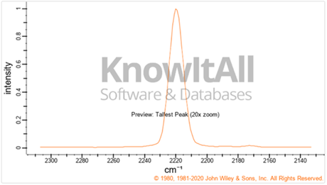
Spectroscopy Constraints
Wiley & Sons, Spectrabase (2020)
Parts per billion
Exact contaminants
Over saturation
Consistent movement
Arsenic Raman Shift
Kendra Kordack

Slide 35
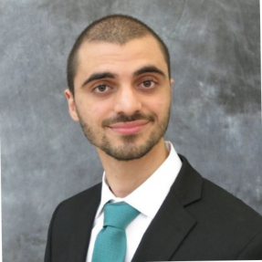
Overall Connection
PUMP
UV light
temperature
sensor
Display
Sensor
laser
Control
Microcontroller
(RaspberryPi)
DSI Cable
USB connection
Spectrometer
Laptop
Lucas Heredia

Slide 36
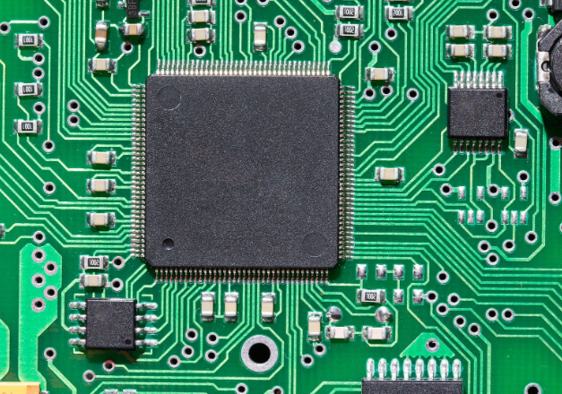
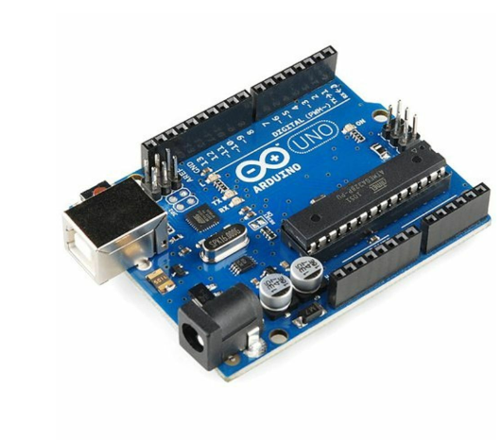
Microcontrollers
Initial idea failed
$ Cheaper $
Soldered directly on the PCB
Arduino library
Difficult to interface
5V/ 2.5-12V
SRAM 2kB
Flash 32kB
It was clear that a microcontroller be not able to have enough memory to process the data from the spectrometer.
Lucas Heredia

Slide 37
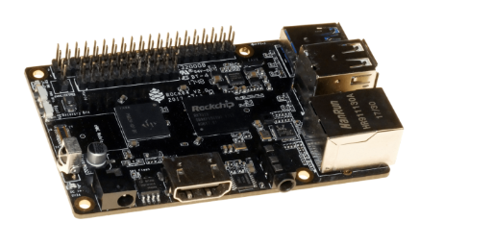
Rock64 Alternative
The rocket64 was the first one our first
options for the microcomputer
$45
4GB Ram / variable
HDMI
USB
It didn’t work because it was not touchscreen friendly. Using raspberry the raspberry pi would be simpler to interface.
Lucas Heredia

Slide 38
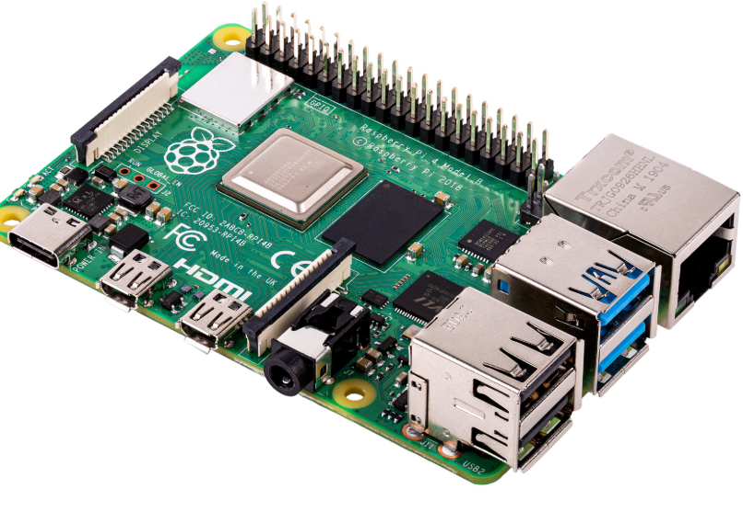
Raspberry pi 4b
So we needed to use microcomputer
that possess more memory and cpu.
1 MicroSD socket
4 USB ports
4 core Cortex-A72 (ARM v8) 64-bit
DSI
Having a standard DSI cable that can be easily connected to the standard was a big advantage of using the microcomputer
Can be powered by a 5V pin and GND
Lucas Heredia

Slide 39
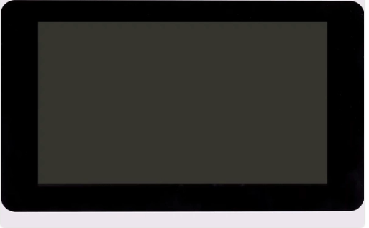
Display
We decided to use a touch screen because it would we wouldn’t need to connect it a pad to the computer by doing so it also make the device a fancier.
The display by choice connects using an DSI cable it is designed to be used in with raspberry pi the raspberry pi
The other microcomputers did not have a DSA cable making interfacing the components trickier
The display is easier to interface with the raspberry pi
Resolution: 800x600 pix
Lucas Heredia

Slide 40

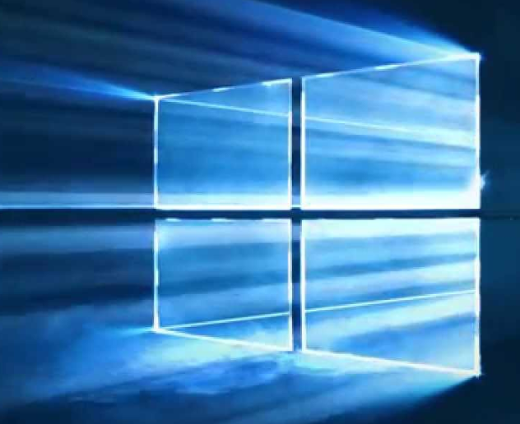

Operating systems
Linux
Mac
Windows
>
>
The microcomputer will run a Linux distro, Ubuntu specifically
Linux is free and has no patent
Windows requires a license to use and is patent
Mac requires license and it is locked by hardware
Windows would be good.
Lucas Heredia

Slide 41

OmniDriver/ Spam
Libraries given by Ocean Insights to control the spectrometer
OmniDriver and spam are both java native
Since both libraries are native to java(yet compatible with other languages) we decided to program the application entirely natively
OmniDriver is higher level than Spam
We decide to not use Spam it requires us to develop the regression algorithms to finding peaks in the data, it would run the application more efficiently, but it is not worth the time.
Lucas Heredia

Slide 42


Programming language
Omnidrive and scam were written in Java
Omnidrive is not compatible with Python
The Omnidriver is not compatible with python
Time to execute the application is negligible to the time required to filter the water
Application doesn’t require very high performance
Lucas Heredia

Slide 43


UI frameworks
Using JavaFX the design looks more modern
Java Fx frameworks can be easily designed using netbeans designer tool.
Java Swing vs JavaFX
VS
Java Swing standard Library
JavaFX
Lucas Heredia

Slide 44


Graphical User Interface
Before After
GUI zero
Java fx UI
Lucas Heredia

Slide 45

Every component is now being handled by python scripts since we gave up on interfacing omniDriver
We switched to using python Scripts to Handle the IO
GUIzero
adafruit_DHT
Rasperry GPIO
widgetlord.pi_spi
Lucas Heredia

Slide 46
Overall Progress
Task | New Deadline | Status
Build Software and User Interface | 11/20/20 | Finished
Build Electrical Panel | 11/20/20 | Finished
Integration of whole system | 11/20/20 | Finished
Test | 11/22/20 | Finished
Implementation & Presentation | 11/28/20 | Finished

Slide 47
Successes & Difficulties
Successes
  UV Filtration System
  Solar Power System
  User Interface
  Analyzing the water
Difficulties
  Temperature Sensor
  Displaying Spectrometer Data
Calex Electronics Limited
Spectrometer
RaspberryPi
Bradley Blackburn

Slide 48
Final Budget
The original budget goal
  $1000
The actual amount spent
  $1848
Bradley Blackburn

Slide 49
Thanks for watching!

