Slide 1
Solar Powered UV Water Purifying and Monitoring System
Designed and Presented by Group 5:
Kendra Kordack
Bradley Blackburn
Lucas Heredia
Grant Cooper

Slide 2
Sponsors:
Ocean Insight: Lending a Raman Spectrometer and laser module for the water quality monitoring.
MKS Newport: Providing optics needed to complete Raman spectroscopy system
BCI Technologies: Supplying electrical equipment for implementation and testing.

Slide 3
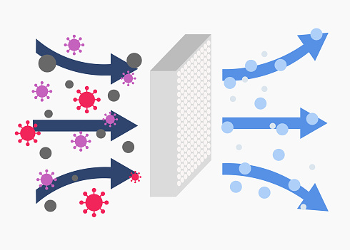
Motivation
Wide-spread viruses
Filtration Quality
Sponsorships
Notes:
Most filtration systems only use one type of filter
Ocean Insight

Slide 4
Goals and Objectives
In-Line contaminant and temperature monitoring
Solar Powered
Mobile Design
Interactive User Interface
Notes:
CHANGE AUDIO RECORDING

Slide 5
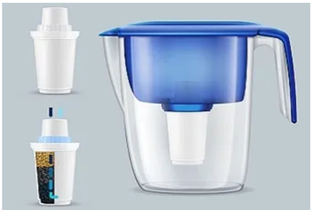
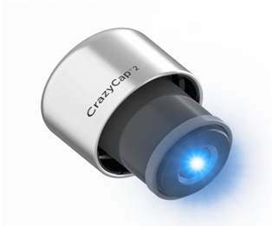
Similar Products
Brita Filter
One filter
No monitoring
No UV treatment
Crazy Cap
No filters
No monitoring
Notes:
CHANGE AUDIO RECORDING

Slide 6
Specifications
 | System Topic | Specification
1 | Power Supply/Solar | Full off grid operation, (2) 100W Solar Panels, Re-charging capability, 12V 75Ah battery
2 | Water Analysis | 785nm Raman Spectroscopy, interpretation of water data, IR temperature reading
3 | User Interface | Control over system operation, display (via LCD) feedback/data from the system
4 | Water Quality | Free of sediment, heavy metal
5 | Filtration System | Class C UV lamp, (1) 5 micron sediment filter, (1) carbon filter, 2.9 gpm
6 | RaspberryPi4B | 4GB memory,Quad core Cortex-A72 (ARM v8) 64-bit SoC, 2 USB 3.0 ports; 2 USB 2.0 ports
7 | Charge Controller | PWM controller, 12V at a max of 20A
Notes:
CHANGE AUDIO
Solar/Power Supply: Completely off-grid (solar charges battery, battery supplies power), 8 hours of autonomy minimum
Water Filtration: 5 micron and carbon filter, Class C UV lamp (originally 6.5 gpm) Around 3 gpm to meet filtration system requirement,
Water Analysis: Done through raman spectroscopy Temperature monitoring Snake Poison, Laundry Detergent, Chlorine
Water Quality: Water should be cleaned via the filtration system. Free of: Sediment, heavy metal, Benzene, Chlorine
Zinc Cyanide, Arsenic free, Water temp between 70 F and 50 F
Microcontroller: Must be able to interface the spectrometer being used, at least 2GB RAM, include USB2 or 3
UI: offer control over system, LCD touch screen, be able to connect/interface with microcontroller
https://pixabay.com/vectors/clipboard-student-writing-work-pen-2899586/

Slide 7
Demonstrable Specifications
Water analysis via spectroscopy
Full off-grid solar and battery dependance
User interface control and data interpretation
Notes:
Water analysis: determine cleanliness of water, detect/don’t detect benzene cyanide and arsenic
Solar/Power Supply: Completely off-grid (solar charges battery, battery supplies power)
UI: offer control over system, interpret frequency response from spectrometer, display data
https://wiki.anton-paar.com/en/basics-of-raman-spectroscopy/raman-spectroscopy-applications/
Solar Charge Controllers | Got Questions? Get the Answers Here. (2020, April 27).
Morningstar Corporation. https://www.morningstarcorp.com/solar-charge-controllers

Slide 8
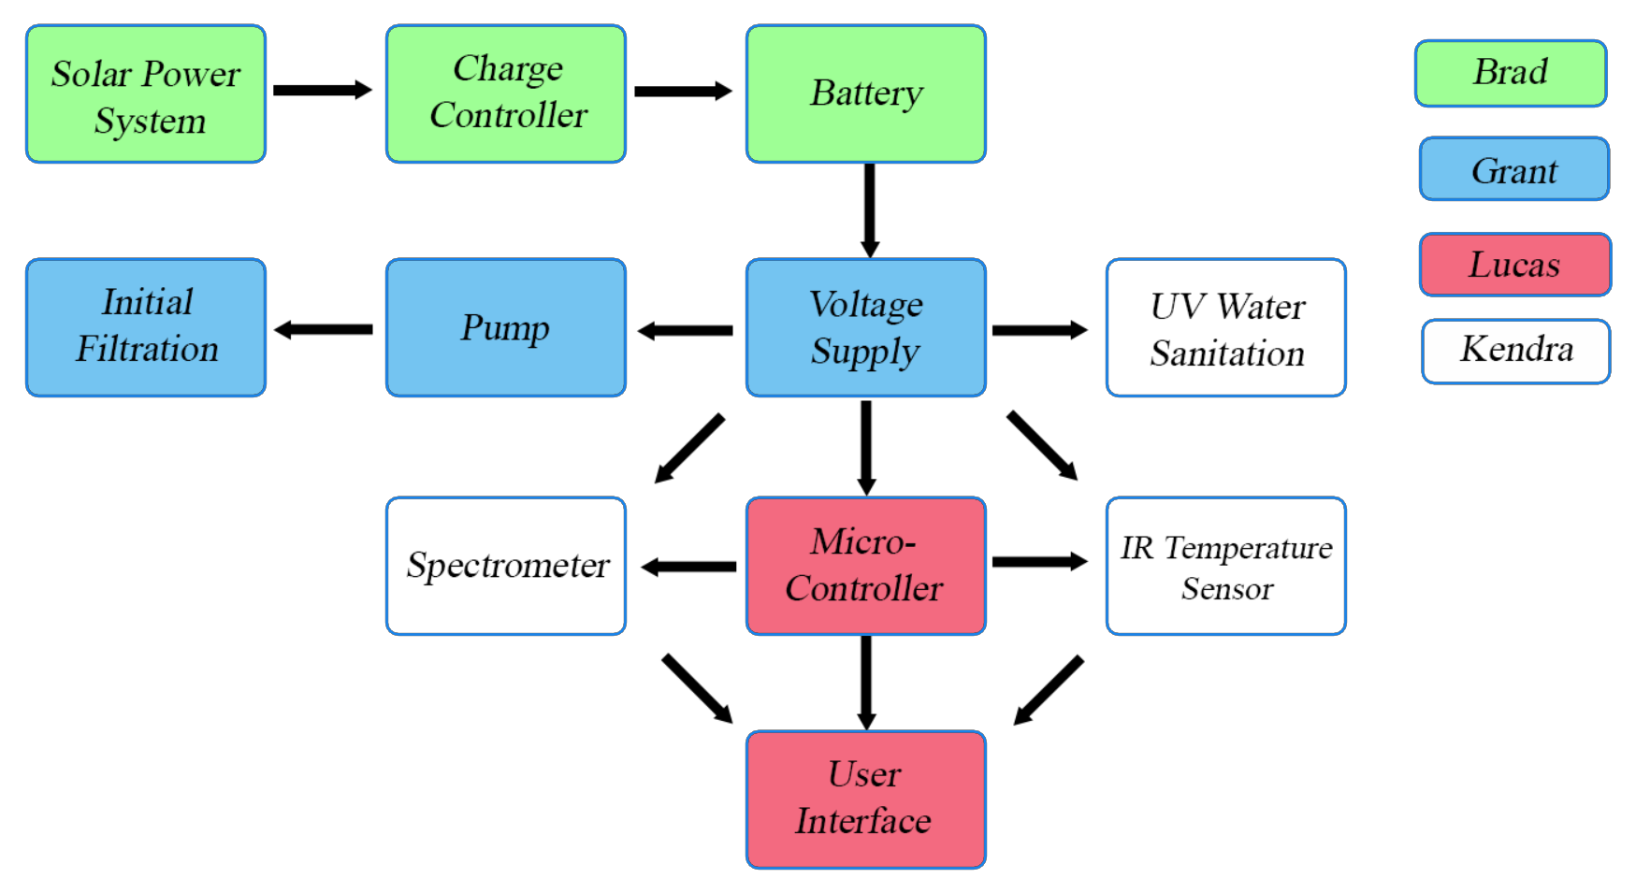
Workload Distribution

Slide 9
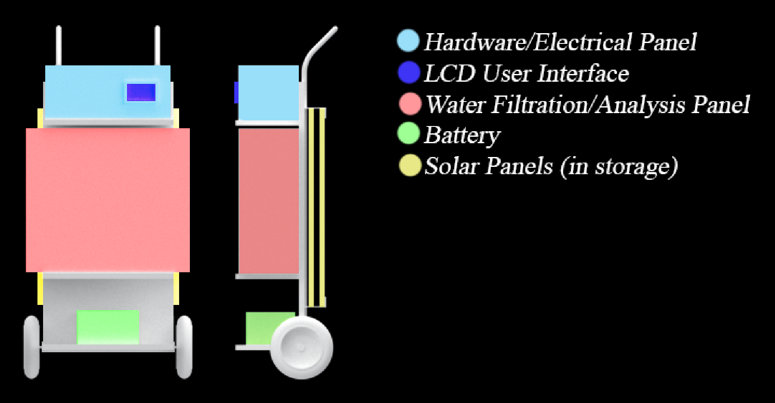
System Design Diagram

Slide 10
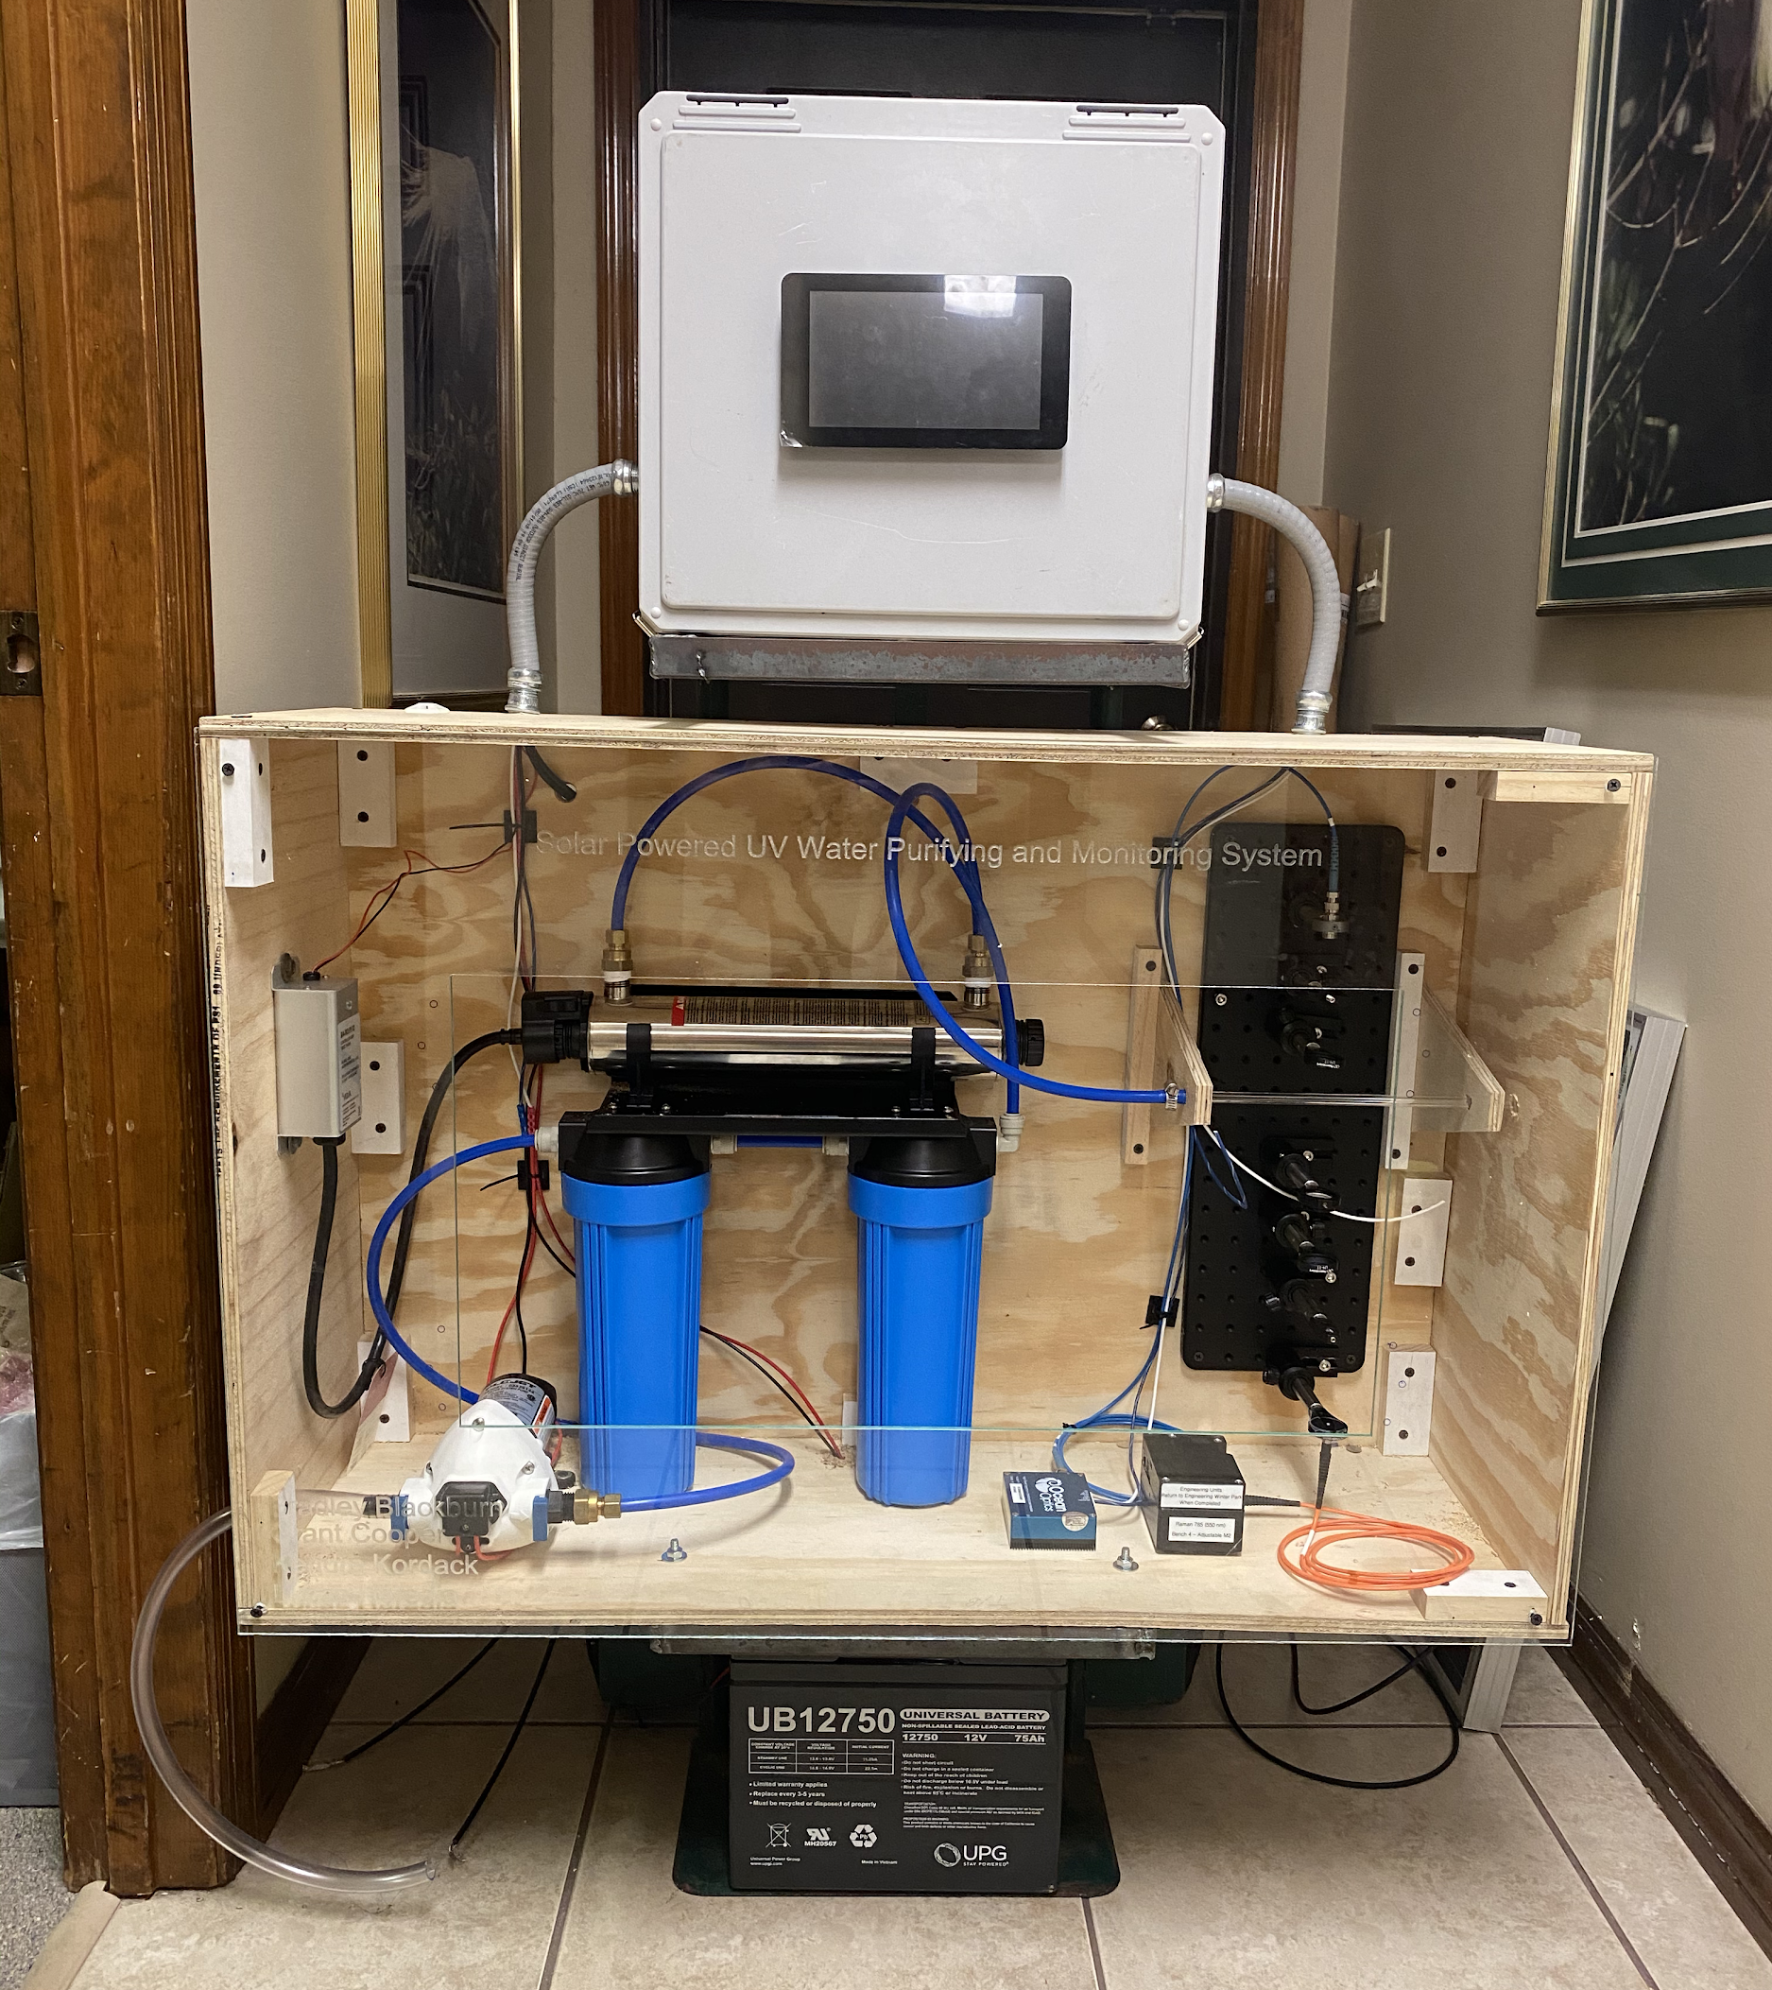
Final System

Slide 11
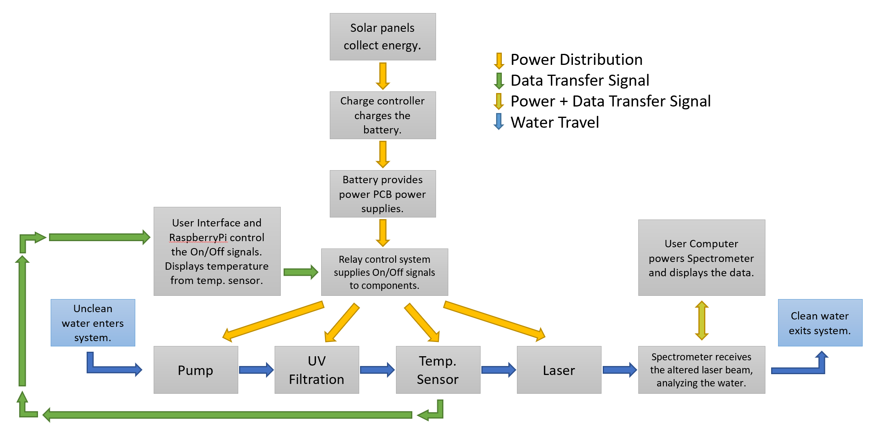
System Block Diagram

Slide 12
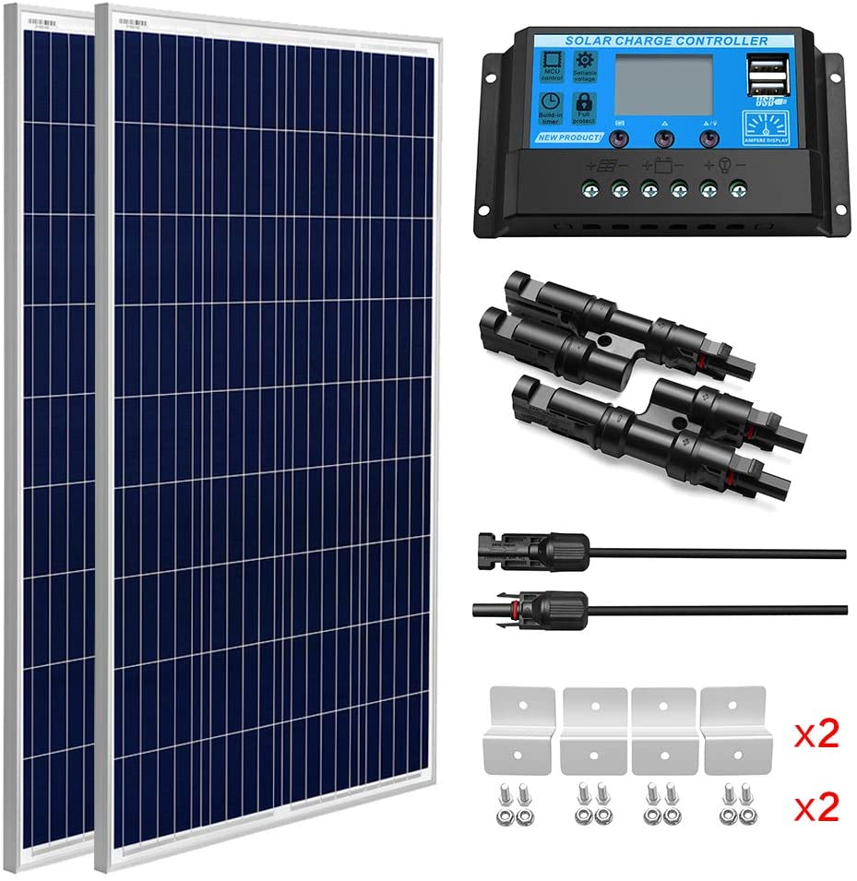
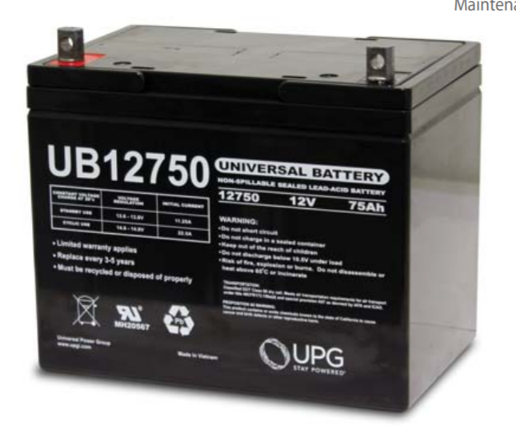
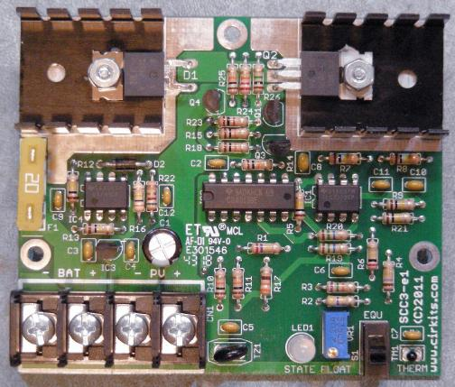
Solar Power System
2 x 100 Watt Polycrystalline Solar Panels
1 x 12V/20A Charge Controller
1 x UPG UB12750 Battery
Notes:
Polycrystalline: b/c cheaper option (mono twice the price), 36x26x1, 12 VDC ($239)
Charge controller: THE ORIGINAL came with panels, has 2 USB ports 5V/3A can power LCD/mcu, protection features (ovr curr, shrt circ, low/high bat V), has its own UI (traverse fns: charge type, bat type, display for V I and P)
Battery: 75 Ah at 12 V, sealed lead acid, Depth of discharge high for many cycles
https://www.amazon.com/gp/product/B07S6MHGS1/ref=ppx_yo_dt_b_asin_title_o01_s00?ie=UTF8&psc=1
UPG (Universal Power Group). (n.d.). Sealed Lead-Acid Battery. Http://Files.Upgi.Com:8086/UPGFileService.Svc/GetSpecSheet/46082 . Retrieved July 16, 2020

Slide 13
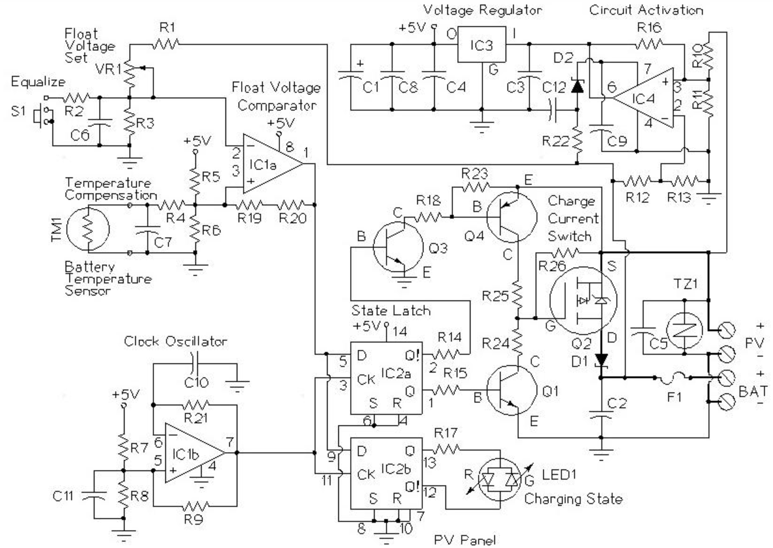
SCC3 Charge Controller
CirKits.com
Notes:
http://solorb.com/elect/solarcirc/scc3/

Slide 14
Solar Alternative Components
Solar Cell Tech. | Differences | Price
Monocrystalline | Made of one type of silicon Higher efficiency | High
Thin Film | Flexible Space efficient | Medium
Charge Controllers
Shunt/Series | Short circuit and Current interruption implementation | Low
MPPT | High efficiency Mainly commercial application | High
Batteries
Lithium Ion | Large depth of discharge Substantial protection circuitry needed | High
AGM Lead Acid | Light weight Low internal resistance | High

Slide 15
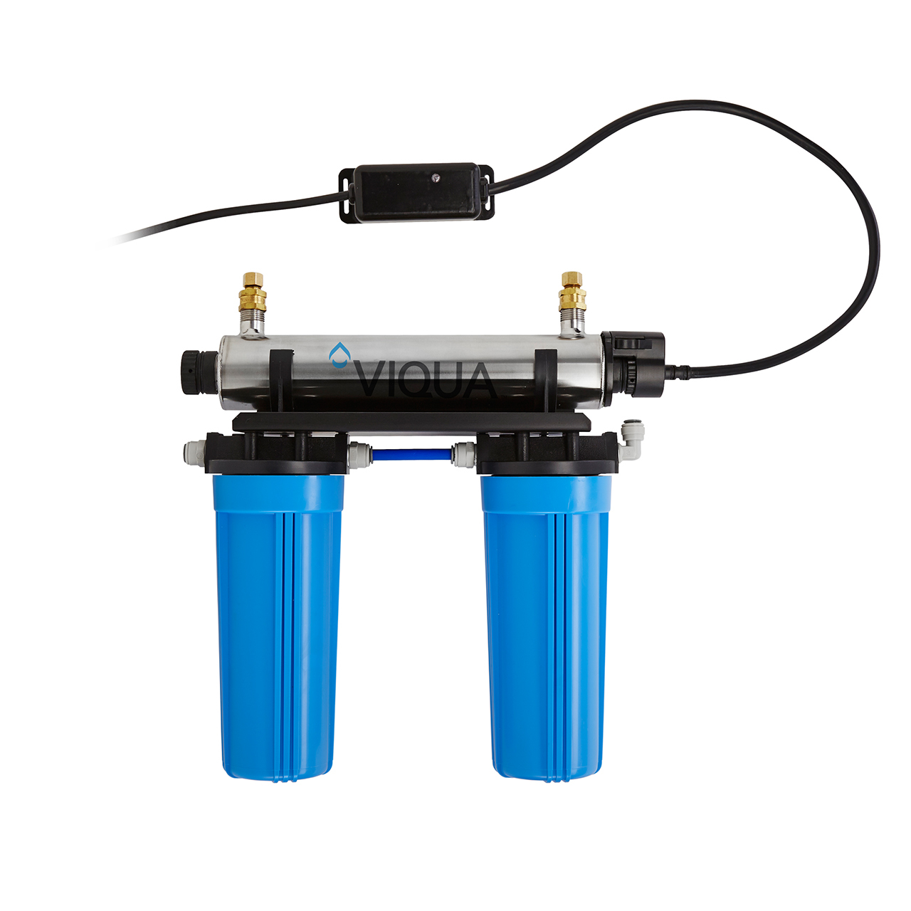
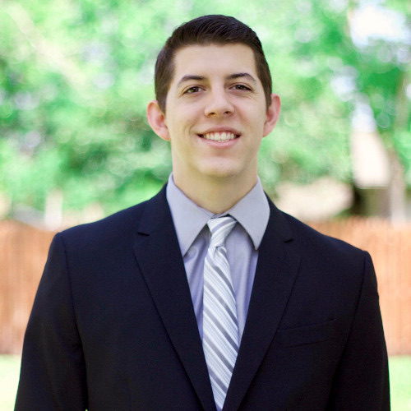
Filtration System
Viqua VT4-DWS/12 UV Filter 3.5GPM (Gallons per Minute)
AWP110-2 5 Micron Sediment filter
C-02PB Carbon Block Filter for taste and odour removal

Slide 16
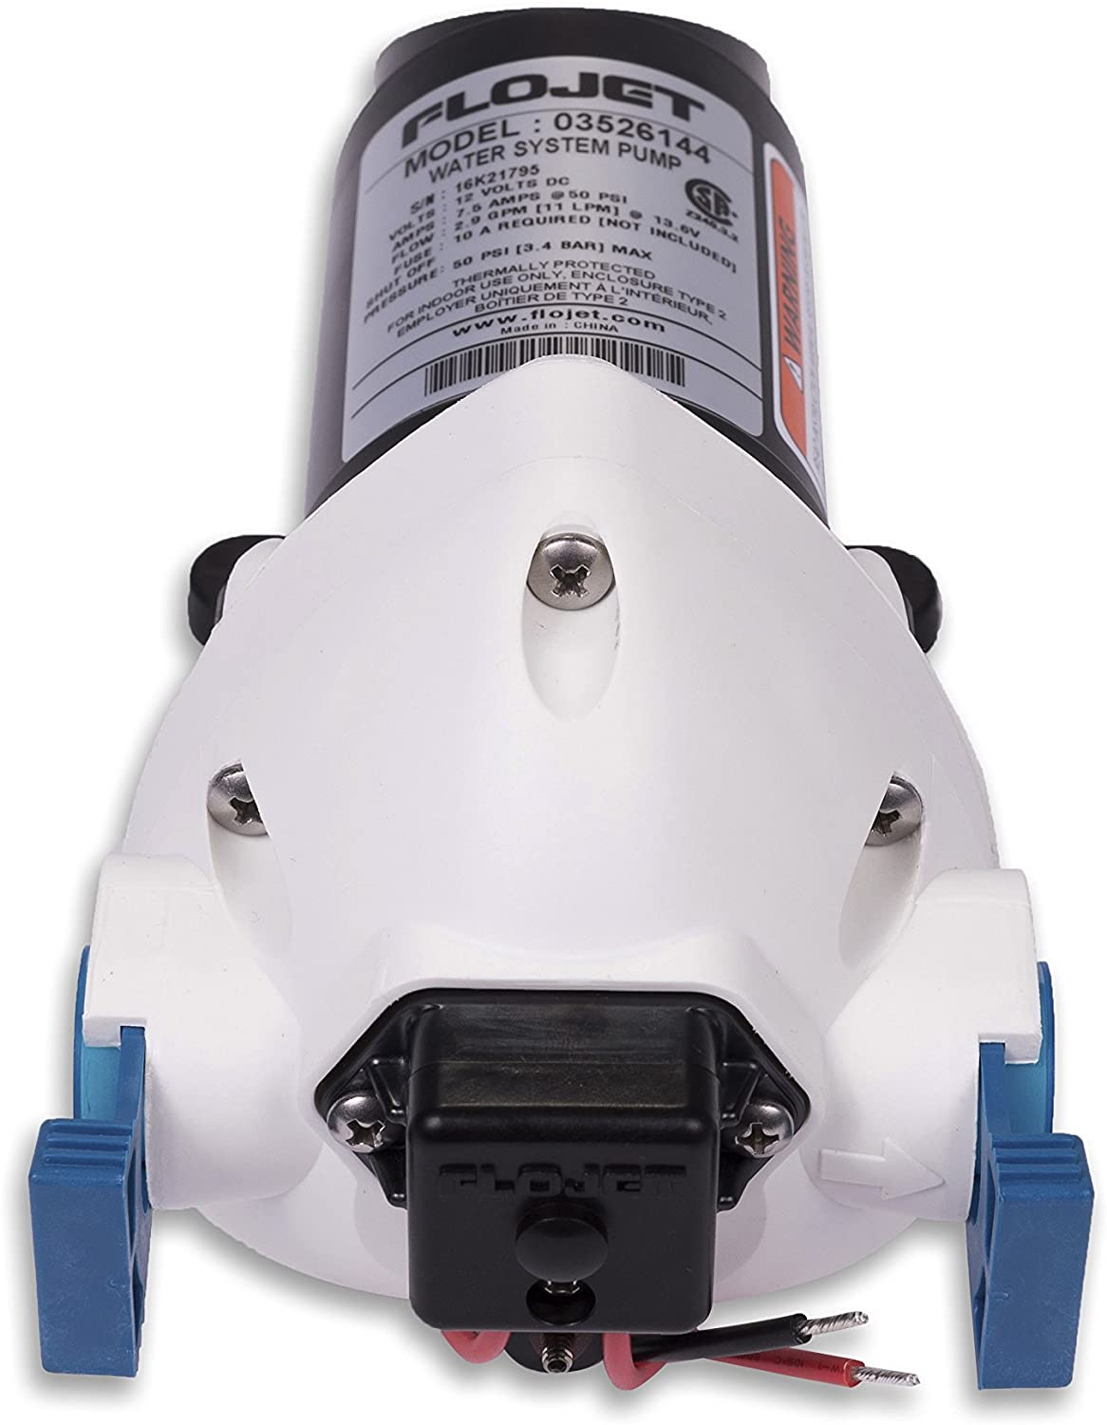
Water System Pump
Flojet 03526-144A Triplex Diaphragm Automatic Water System Pump
Self-priming up to 10ft and can be run dry.
Automatic pumps feature a mechanism that will start the pump by the opening of a faucet.
Flow rate of 2.9 GPM (Gallons per Minute)
Operates on 12V DC

Slide 17
VOLTAGE REGULATORS
Why separate PCBs?
0805 parts
If max current increases, complexity increases
Reality of Webench Power Supply Designer
Grant Cooper

Slide 18
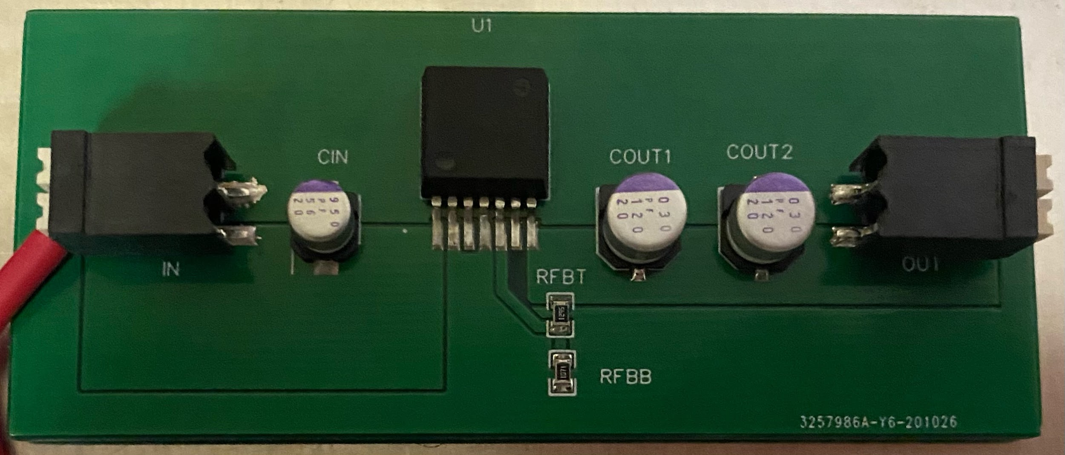
5V 5A REGULATOR
Grant Cooper

Slide 19
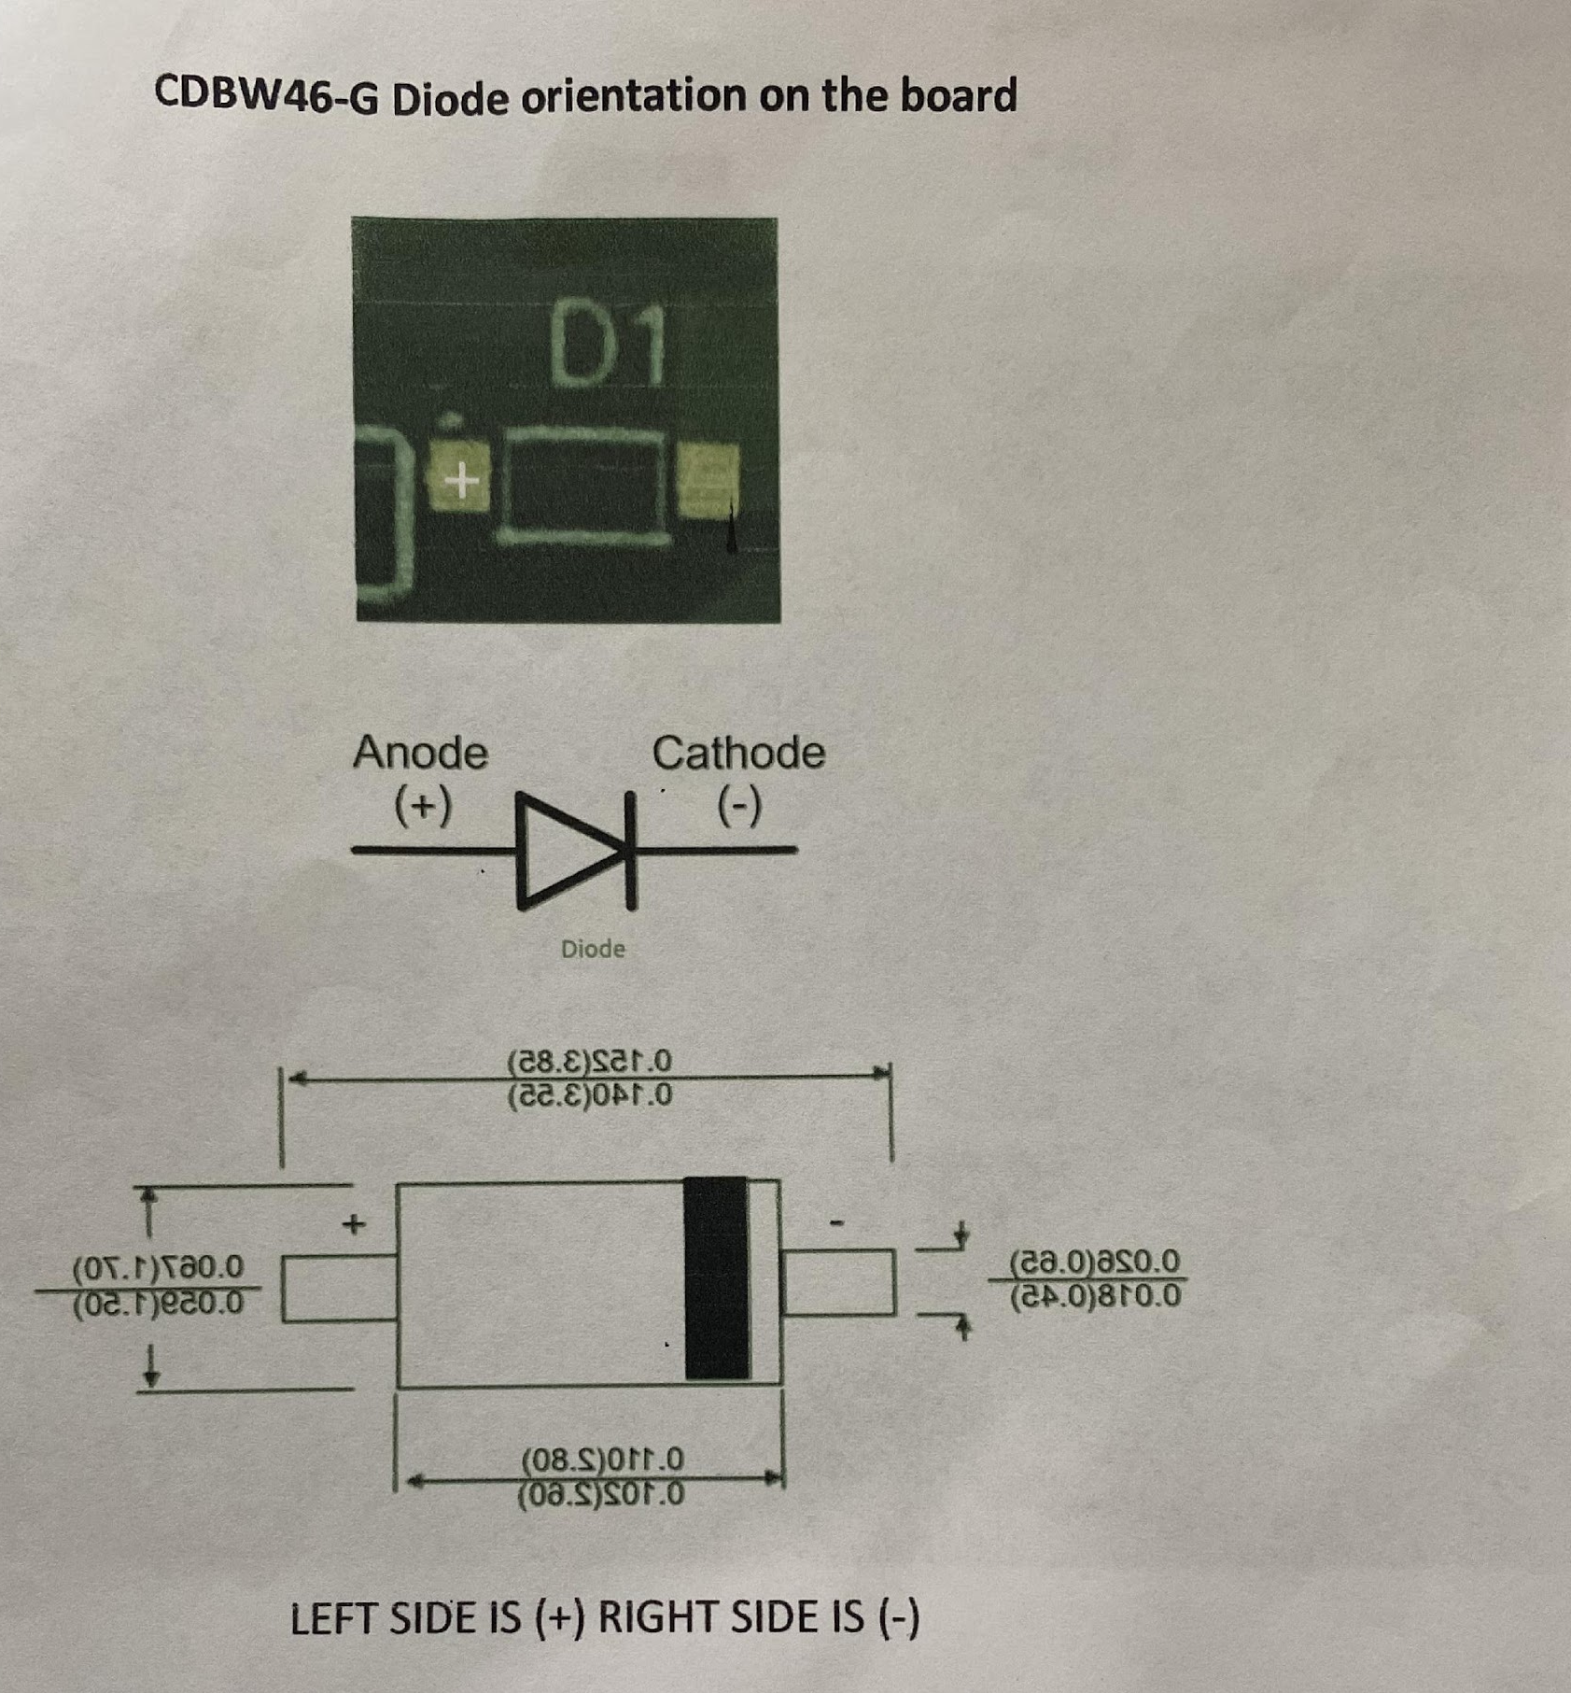
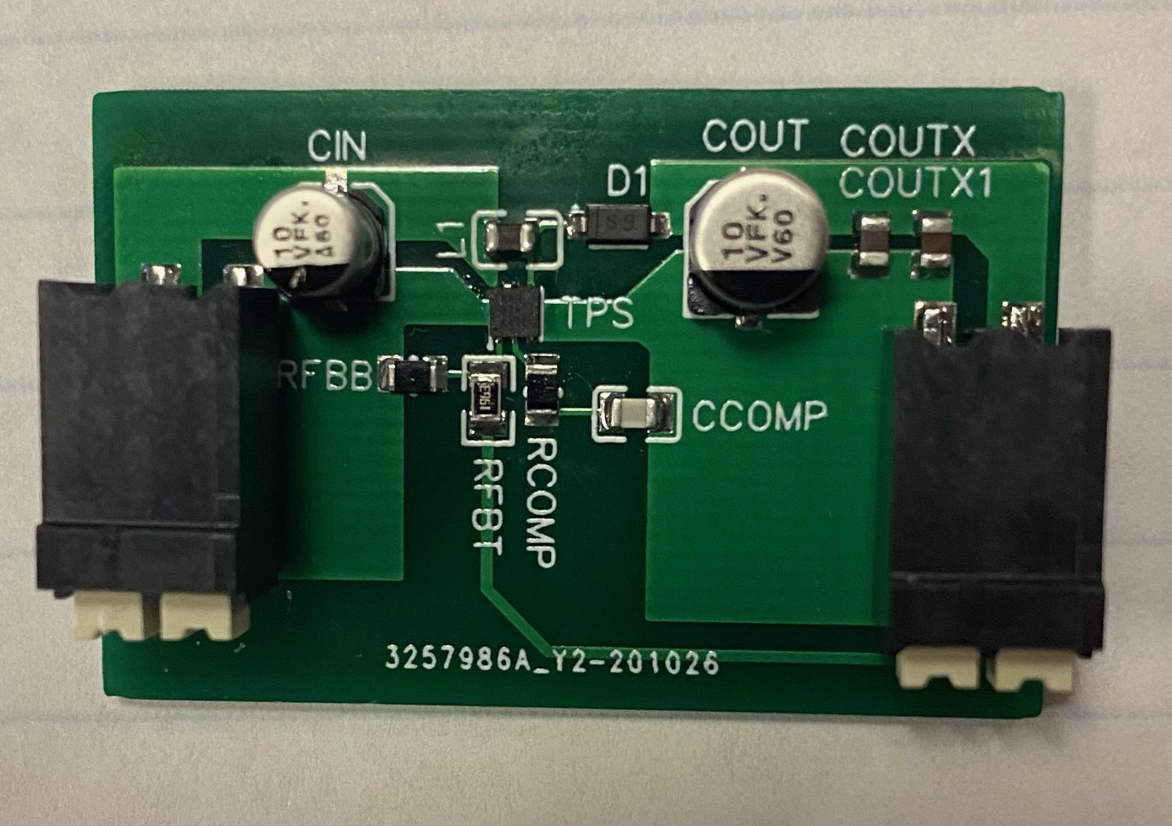
24V .03A REGULATOR
Grant Cooper

Slide 20
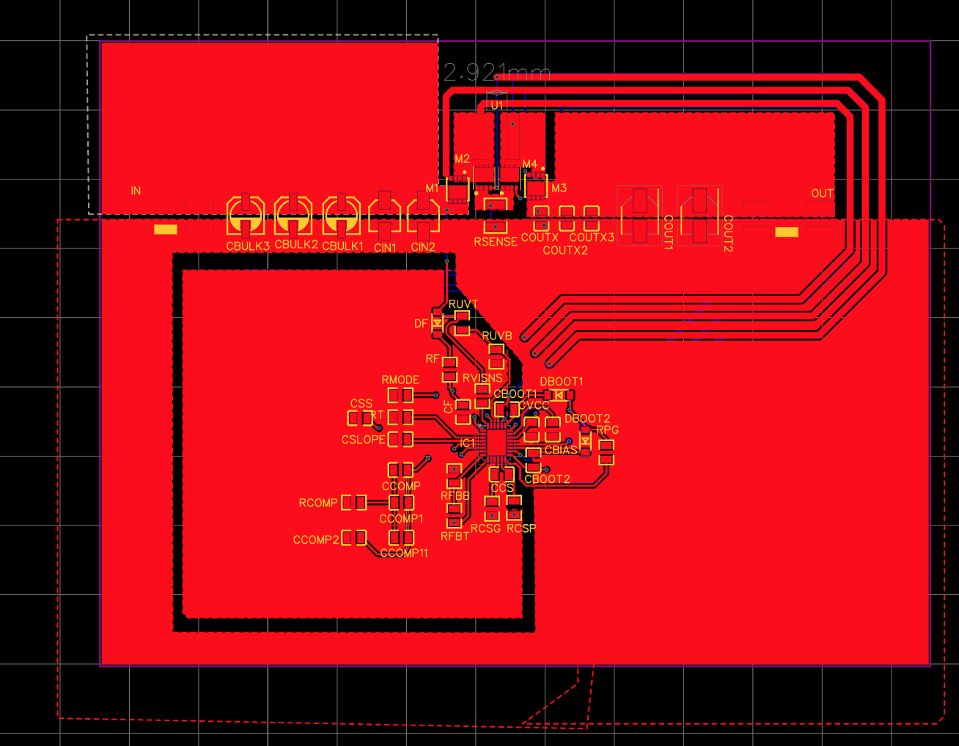
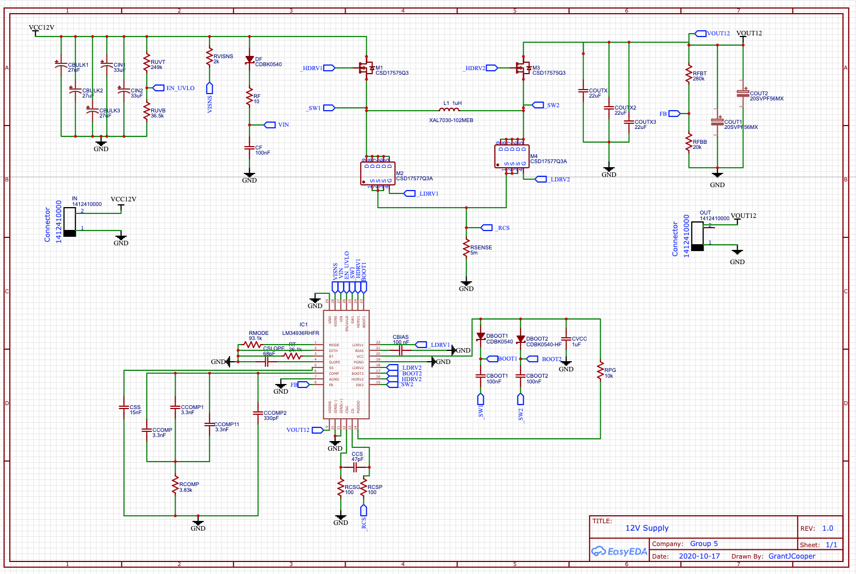
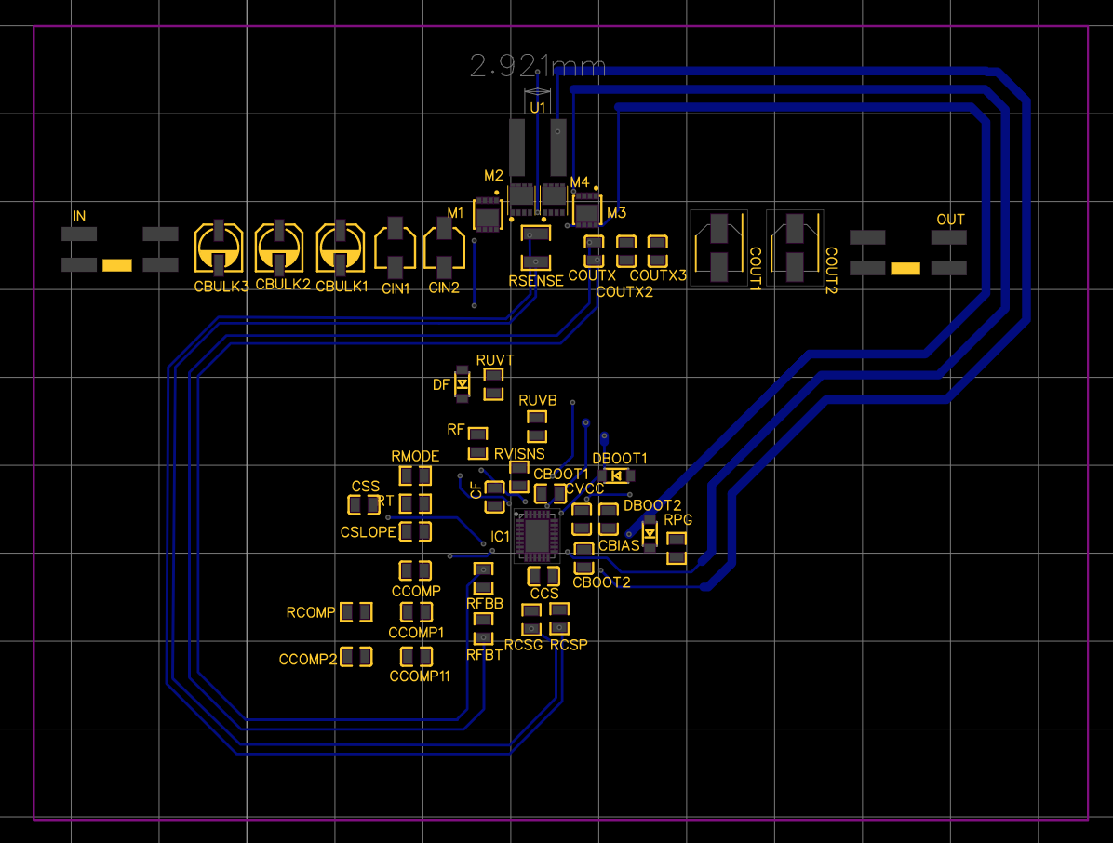
12V 12A REGULATOR
Grant Cooper

Slide 21
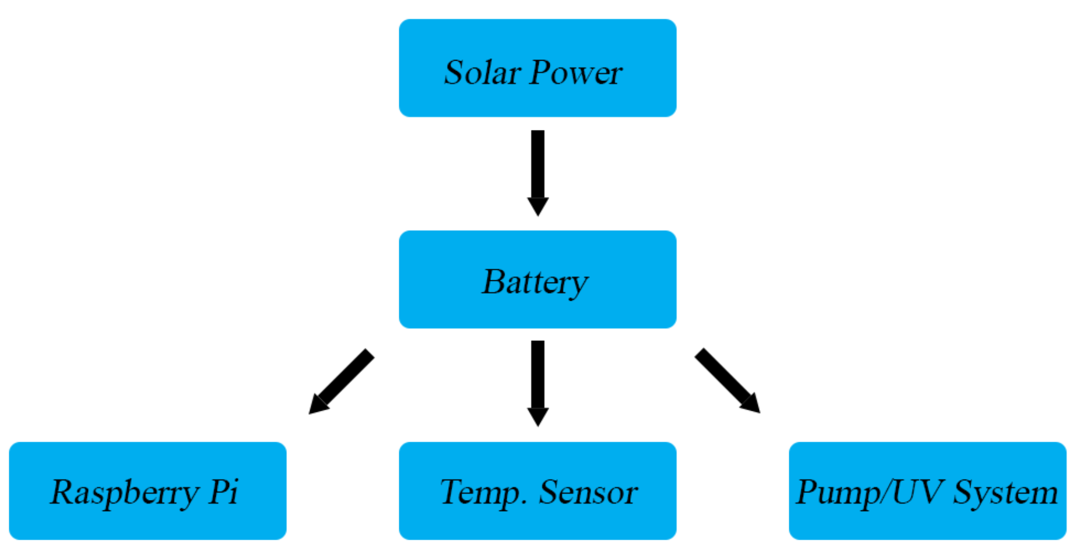
Voltage Regulation
Pump and UV Filtration System
12V at 12A
Temperature Sensor
5V at 3A
Raspberry Pi
5V at 4.5A
Linear or Switching?
Notes:
Pump/UV Sys: 4-switch buck-boost controller, LM34XXX 30-V Wide VIN Synchro
Temp Sens: TPS611XX automotive wide input boost converter
Raspb: LMZ22XXX 5A simple switcher power module

Slide 22
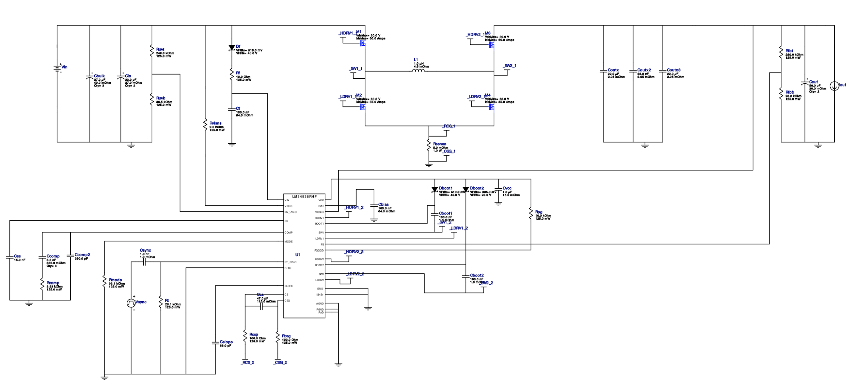
12V Regulated 12A Maximum Current
LM34936RHFR 30-V Wide VIN Synchronous 4-Switch Buck-Boost Controller
Multiple regulators in parallel on a single IC
97.9% efficiency

Slide 23
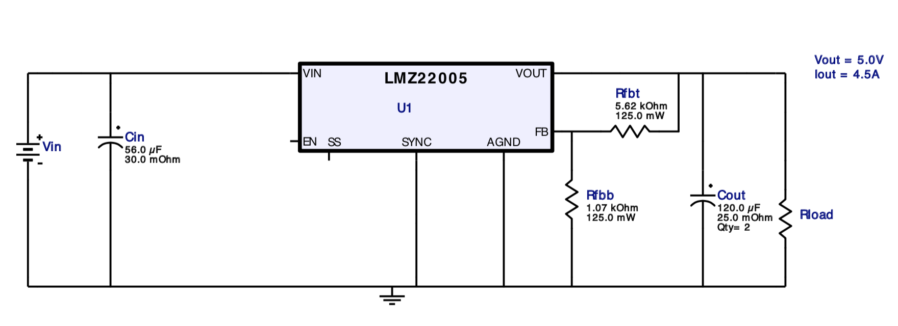
5V Regulated 4.5A Maximum Current
LMZ22005TZX/NOPB 5A SIMPLE SWITCHER Power Module with 20V Maximum Input Voltage
Low BOM

Slide 24
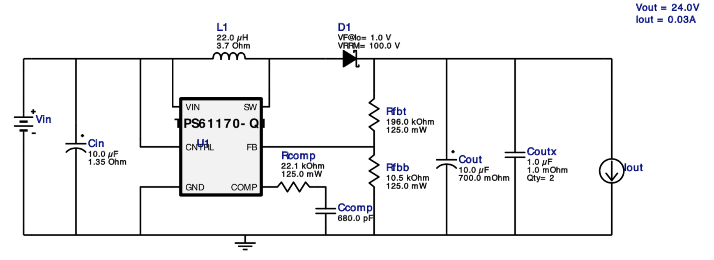
24V Regulated .3A Maximum Current
TPS61170QDRVRQ1 Automotive 3V to 18V Wide Input Range, 1.2A Boost Converter
BOM optimized over efficiency

Slide 25
PCB Block Diagram
Raspberry Pi 4b GPIO Pins
12V 12A Voltage Regulator
PWM Charge Controller
5V 4.5A Voltage Regulator
Relay / MOSFET component control circuits
Loads
24V .3A Voltage Regulator

Slide 26
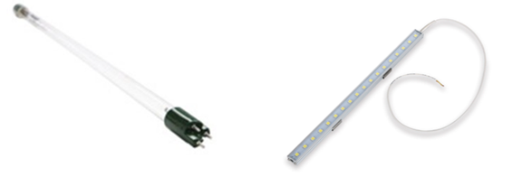
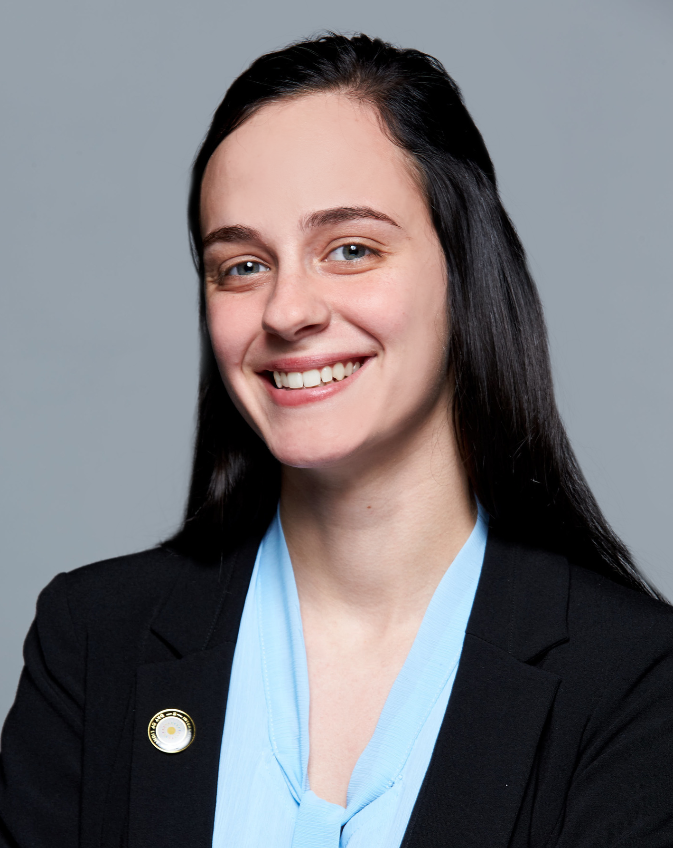
UV Cleaning
The wavelength of light for UV sanitation is from about 100 nm to 260 nm, otherwise known as deep UV, or UVC
There are both lamps and LEDs that produce this wavelength of light are able to sanitize water.

Slide 27
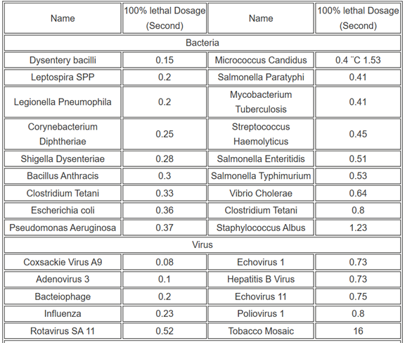
UV Cleaning Requirements
100% lethal dosage is 16,000 μW-sec/cm²

Slide 28
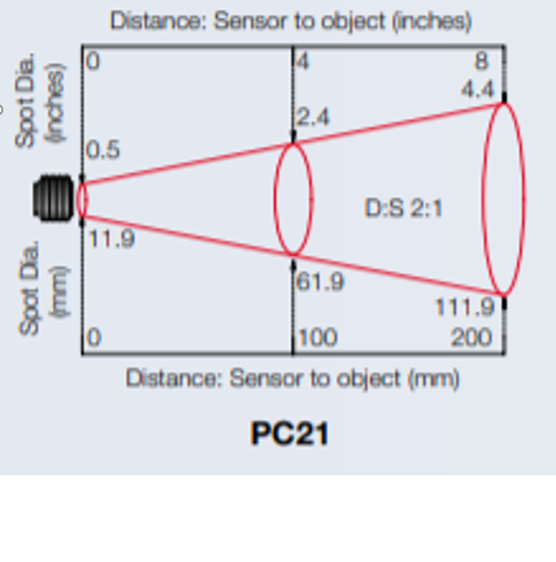
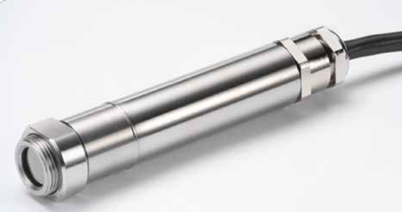
IR Temperature Sensor
Contactless
Digital readout
Fast
2:1 ratio

Slide 29
Raman Spectroscopy
Raman Spectroscopy was chosen because it is the best choice for in-line monitoring, many other methods required a secondary location and professional scientists. Although this is the best in-line method, it is also very expensive. We are able to use spectroscopy because Ocean Insight lended us a Raman spectrometer and light source.

Slide 30
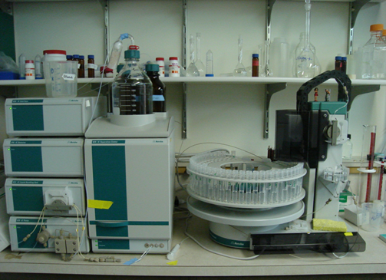
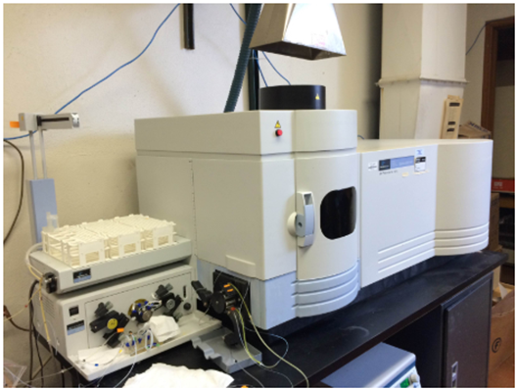
Other Forms of Contaminant Evaluation
Chromatography
Inductively coupled plasma mass spectrometer

Slide 31
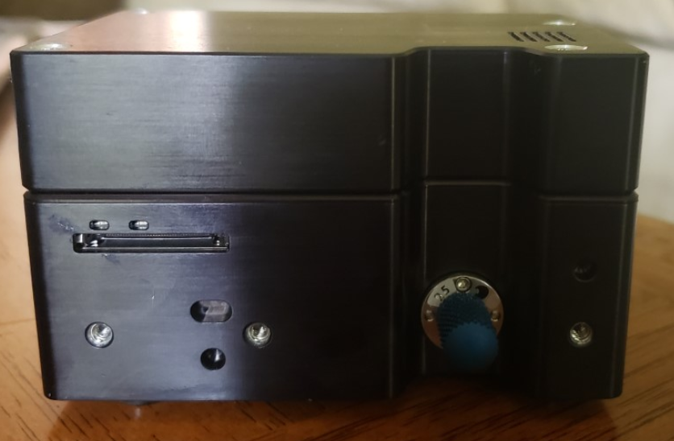
Raman Spectrometer
Specifications
785 nm
SMA Fiber connected
Oceanview Software
Powered through computer
USB C

Slide 32
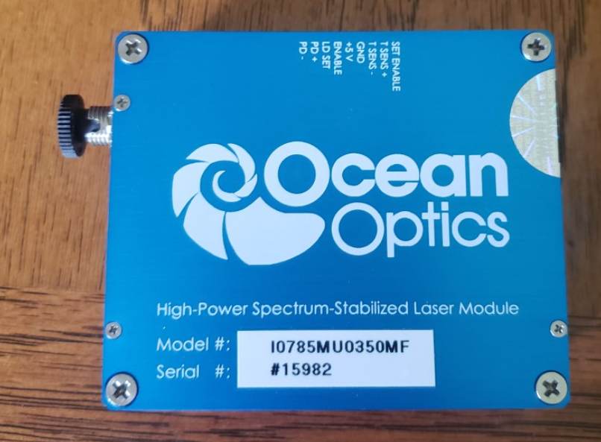
Raman Spectrometer Laser Source
Specifications
785 nm
499 mW
FC Fiber Connector
5 volt intake

Slide 33
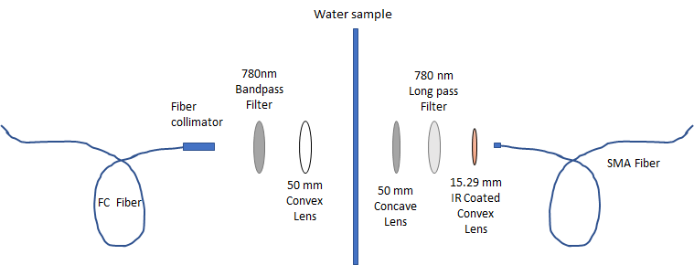
Spectroscopy System

Slide 34
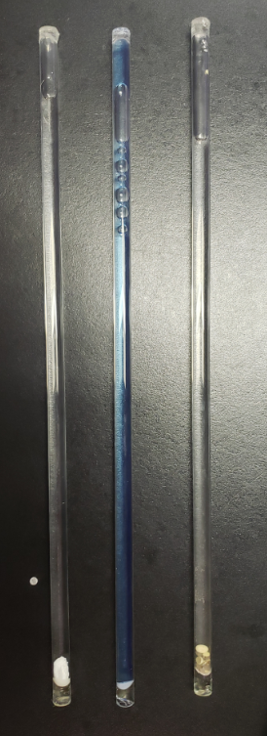
Comparing Spectras
Three main Contaminant being observed:
Snake Poison
Laundry Detergent
Chlorine

Slide 35
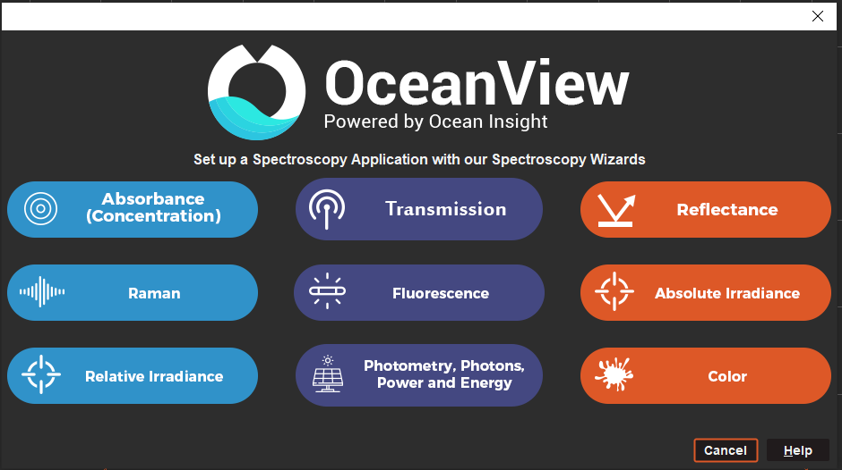
Ocean View Raman Spectroscopy
Integration time: 40 ms
Boxcar width: 6
Range 552.78-1084.42
Light and dark spectrum subtraction
Records Raman shift with graph and table

Slide 36
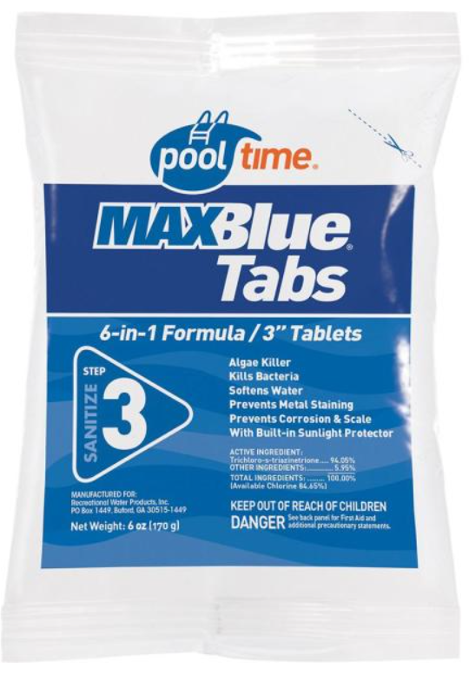
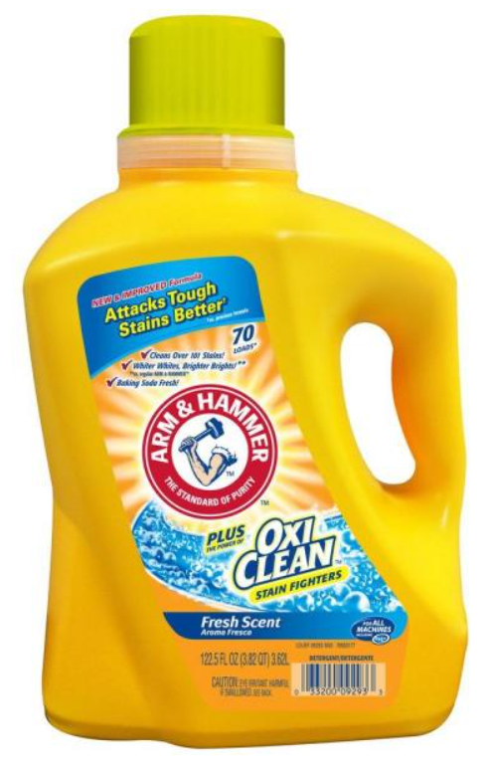
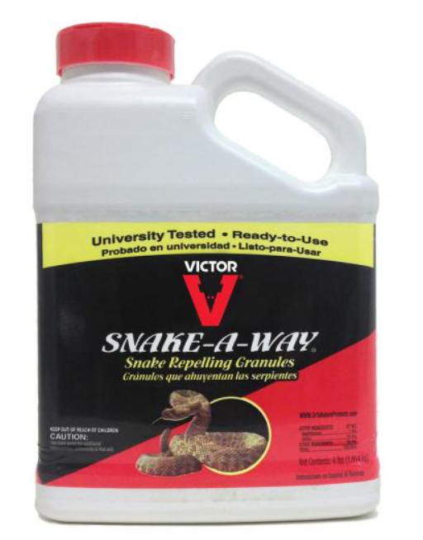
Contaminants
Contains naphthalene (7%) and sulfur (28%) as its active ingredients. Snake-A-Way has greater than 91% repellency rate for rattlesnakes and garter snakes.
Contains multiple toxic chemicals including benzyl acetate, methylisothiazolinone, and calcium chloride.
Contains 94.05% trichloro-s-triazinetrione and 5.95% other ingredients

Slide 37
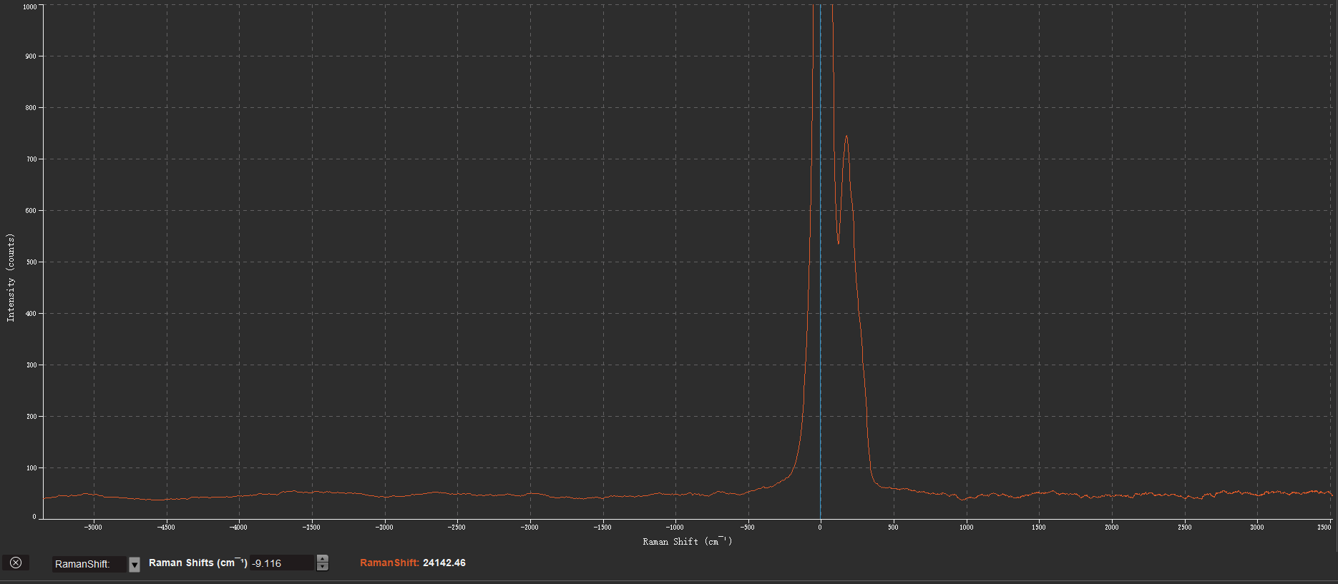
Clean Water Spectrum

Slide 38
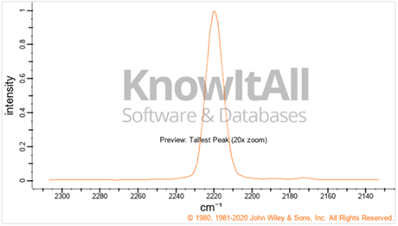
Spectroscopy Constraints
Parts per billion
Exact contaminants
Over saturation
Arsenic Raman Shift

Slide 39
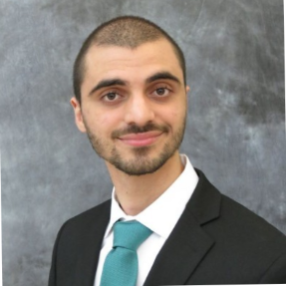
overall connection
PUMP
UV light
temperature
sensor
Display
Sensor
laser
Control
microcomputer
DSA
wire
wire
5V
GND
Spectrometer
USB connection
Laptop

Slide 40
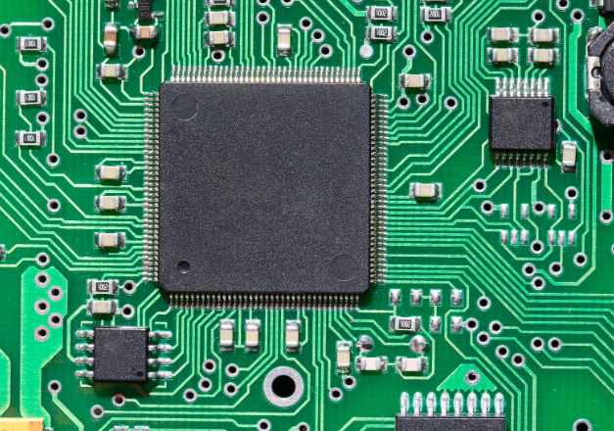
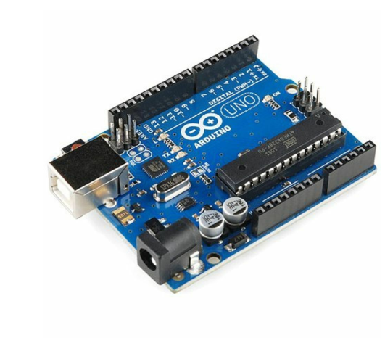
Microcontrollers
Initial idea failed
$ Cheaper $
Soldered directly on the PCB
Arduino library
Difficult to interface
5V/ 2.5-12V
SRAM 2kB
Flash 32kB
It was clear that a microcontroller be not able to have enough memory to process the data from the spectrometer.

Slide 41
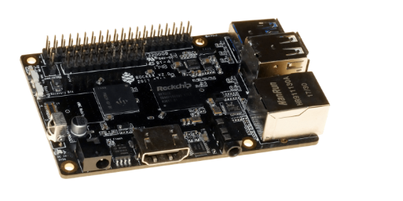
Rock64
The rocket64 was the first one our first
options for the microcomputer
$45
4GB Ram / variable
HDMI
USB
It didn’t work because it was not touchscreen friendly. Using raspberry the raspberry pi would be simpler to interface.

Slide 42
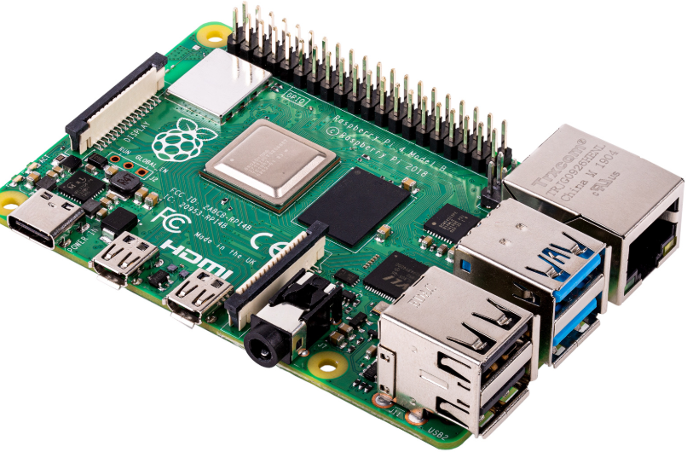
Raspberry pi 4b
So we needed to use microcomputer
that possess more memory and cpu.
1 MicroSD socket
4 USB ports
4 core Cortex-A72 (ARM v8) 64-bit
DSI
Having a standard DSI cable that can be easily connected to the standard was a big advantage of using the microcomputer
Can be powered by a 5V pin and GND

Slide 43
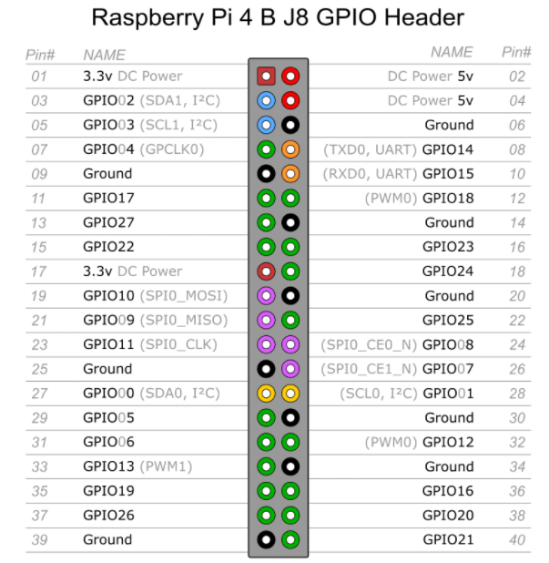
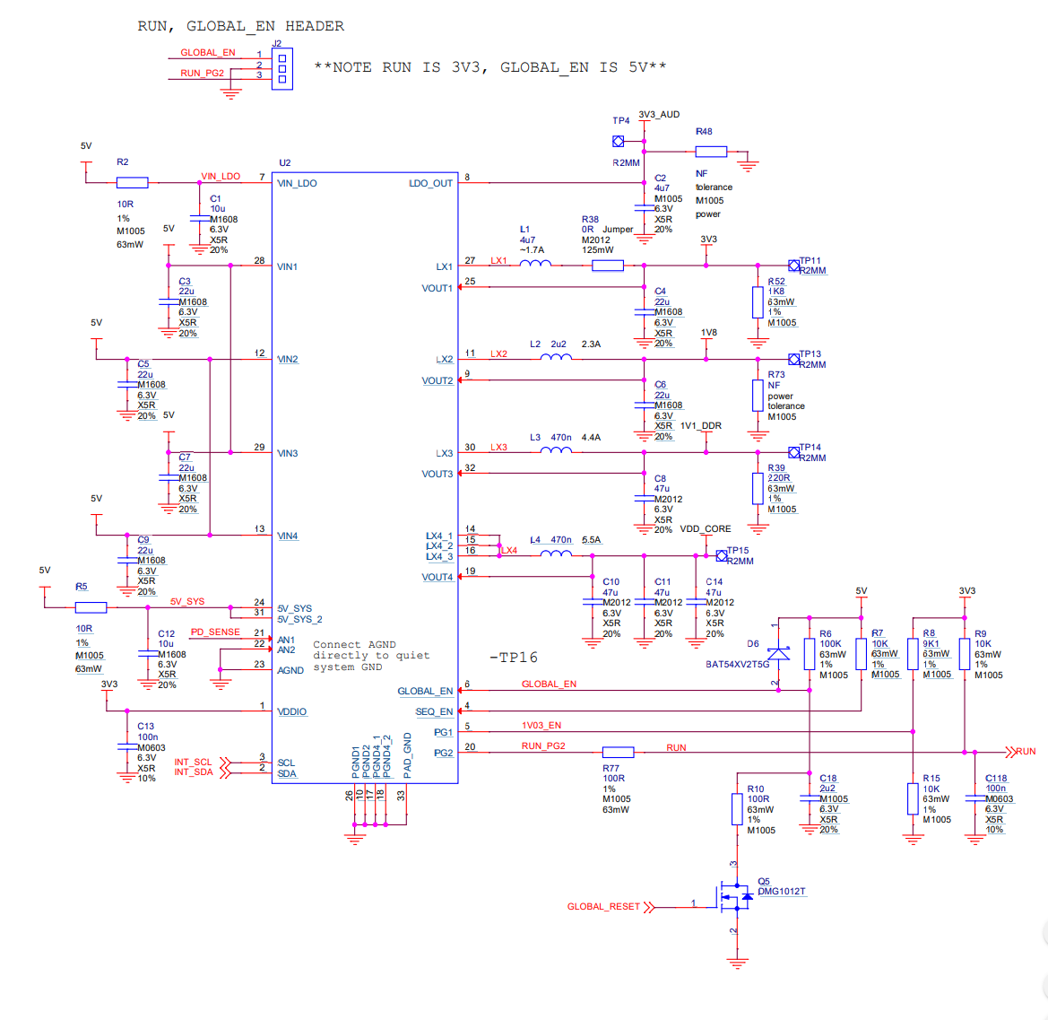
Raspberry pi 4B schematic/ Pin

Slide 44
Display
We decided to use a touch screen because it would we wouldn’t need to connect it a pad to the computer by doing so it also make the device a fancier.
The display by choice connects using an DSI cable it is designed to be used in with raspberry pi the raspberry pi
The other microcomputers did not have a DSA cable making interfacing the components trickier
The display is easier to interface with the raspberry pi

Slide 45
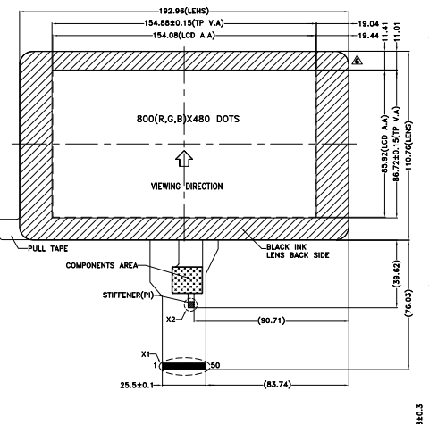
Display schematic
800x600 resolution
7 inches
DSA port

Slide 46
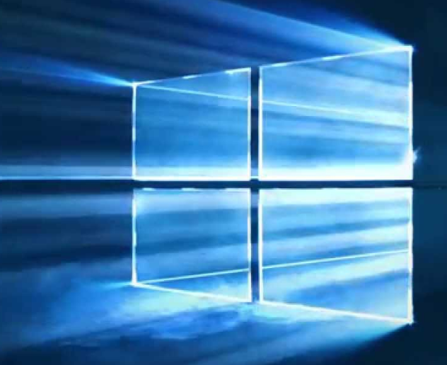
Operating systems
Linux
Mac
Windows
>
>
The microcomputer will run a Linux distro, Ubuntu specifically
Linux is free and has no patent
Windows requires a license to use and is patent
Mac requires license and it is locked by hardware
Windows would be good.

Slide 47
OmniDriver/ Spam
Libraries given by Ocean Insights to control the spectrometer
OmniDriver and spam are both java native
Since both libraries are native to java(yet compatible with other languages) we decided to program the application entirely natively
OmniDriver is higher level than Spam
We decide to not use Spam it requires us to develop the regression algorithms to finding peaks in the data, it would run the application more efficiently, but it is not worth the time.

Slide 48
Ocean View
This program was
used to estimate
the capacities of the
spectrometer
Ocean insights own
application to interpret
the information from the
spectrometer
This application uses the same library, featured by ocean Insights, OmniDriver and Spam, but, it contains a lot more features

Slide 49
Programming language
Omnidrive and scam were written in Java
Omnidrive is not compatible with Python
The Omnidriver is not compatible with python
Time to execute the application is negligible to the time required to filter the water
Application doesn’t require very high performance

Slide 50
UI frameworks
Using JavaFX the design looks more modern
Java Fx frameworks can be easily designed using netbeans designer tool.
Java Swing vs JavaFX
VS
Java Swing standard Library
JavaFX

Slide 51
GUI
Before After
GUI zero
Java fx UI

Slide 52
Every component is now being handled by python scripts since we gave up on interfacing omniDriver
We switched to using python Scripts to Handle the IO
GUIzero
adafruit_DHT
Rasperry GPIO
widgetlord.pi_spi

Slide 53
Components

Slide 54
Successes & Difficulties
Successes
UV Filtration System
Water Pump
Microcontroller
Difficulties
Solar Power
Spectrometer and Laser Source
User Interface
Some libraries are compatible with an OS but not the other.

Slide 55
Budget Thus Far
Financed by each group member, excluding the loaned parts.
The original budget goal
$1000
The actual amount spent
$1051

