Slide 1
Group 1 Midterm Demo
Laser Guitar
Jacob Legler (Photonics Engineer)
Juan Gamero (Computer Engineering)
Alexander Truong Mai (Computer Engineering)
Jonathan Spurgeon (Electrical Engineer)

Slide 2
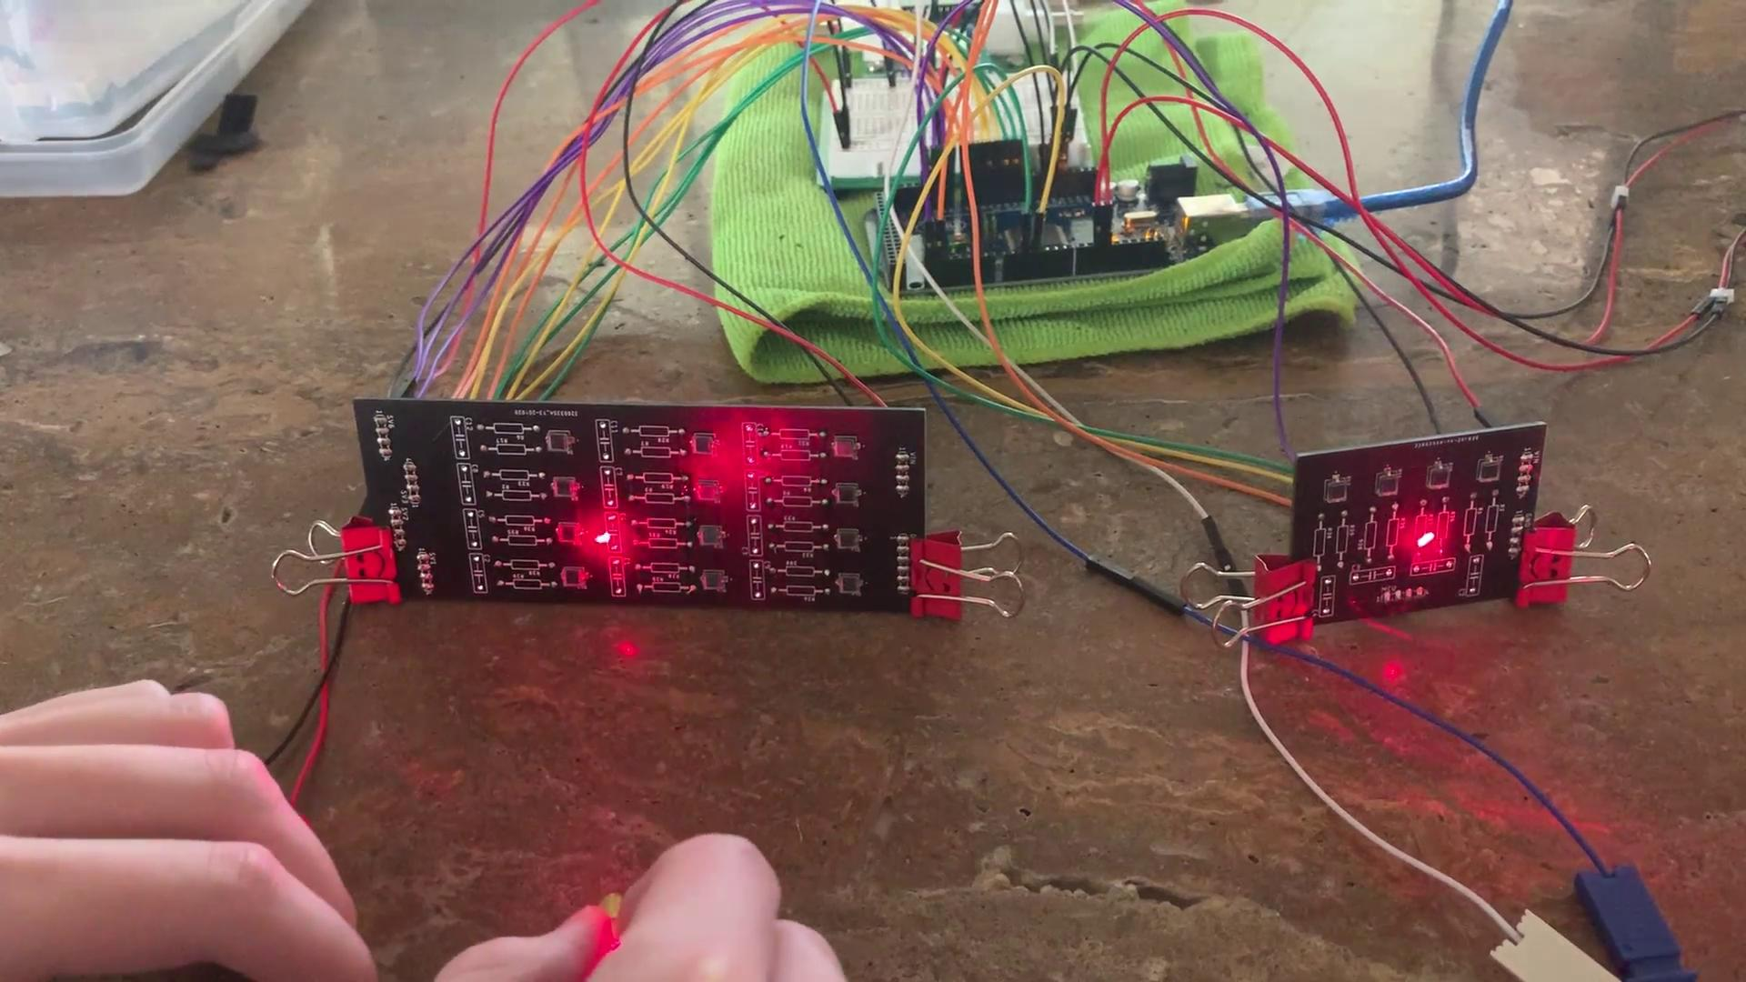
Fretting System
The video shows how our fretboard changes the note played by each individual string.
In the final design, the fretboard will only measure light reflected off the finger.

Slide 3
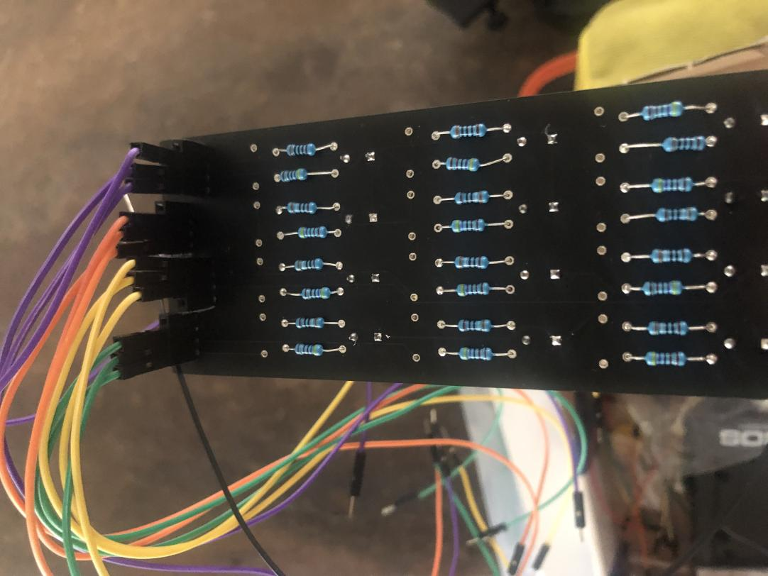
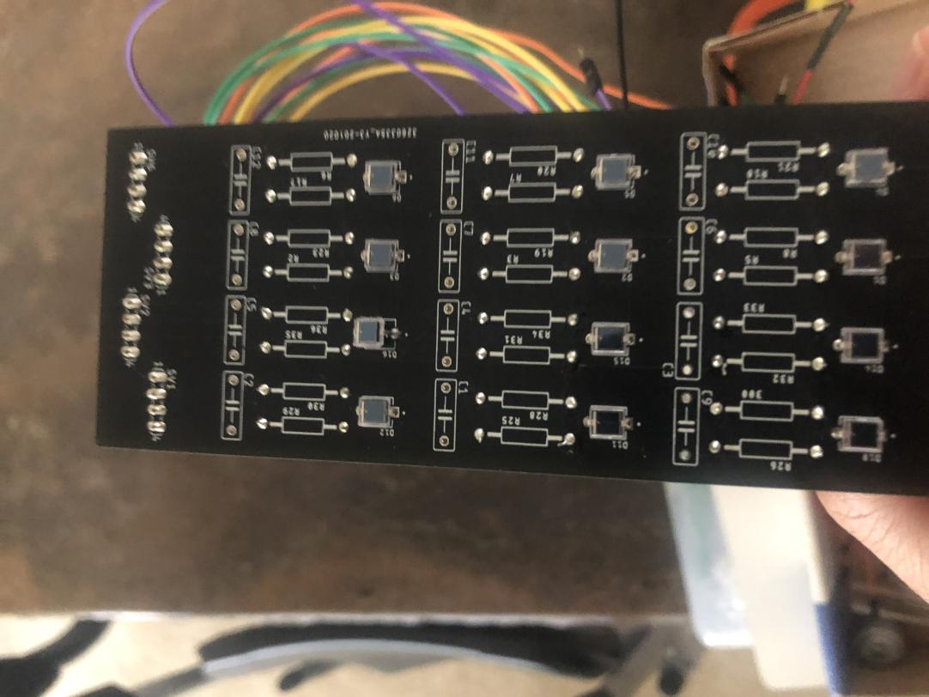
Fretting System

Slide 4
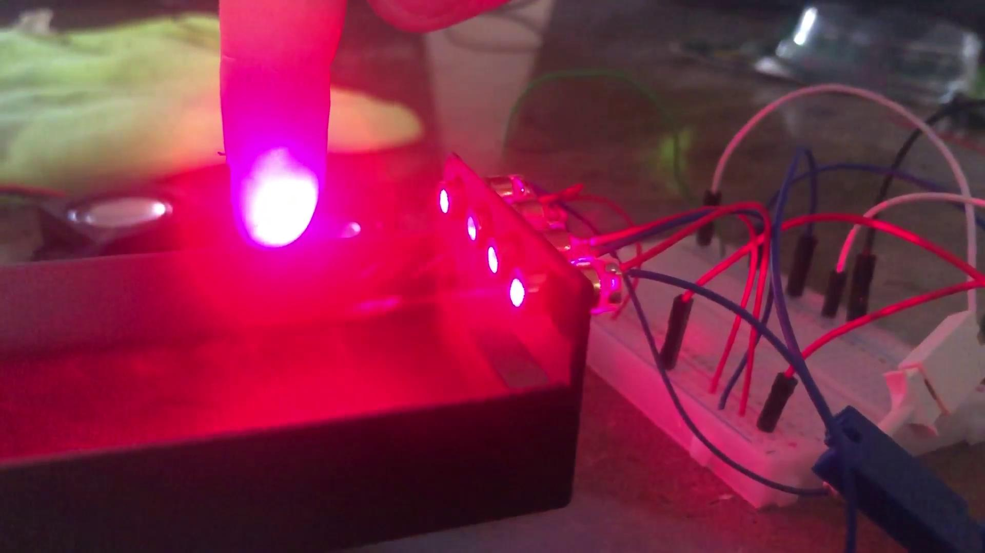
Strumming System
The strings currently play sound only while being interrupted by the user.
The response to the interrupts is almost immediate, however strumming quickly can cause issues.

Slide 5
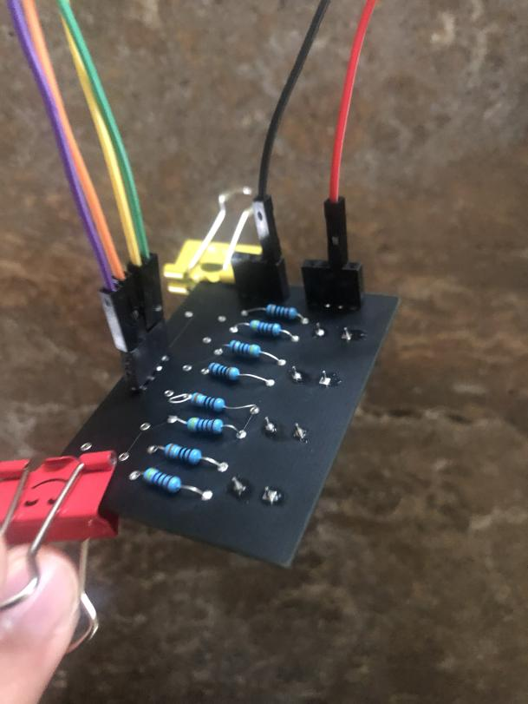
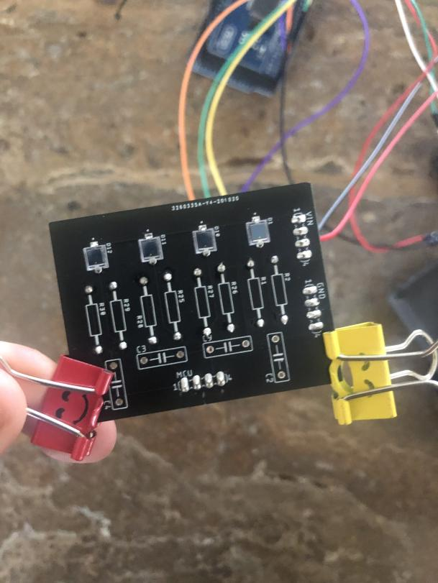
Strumming System

Slide 6
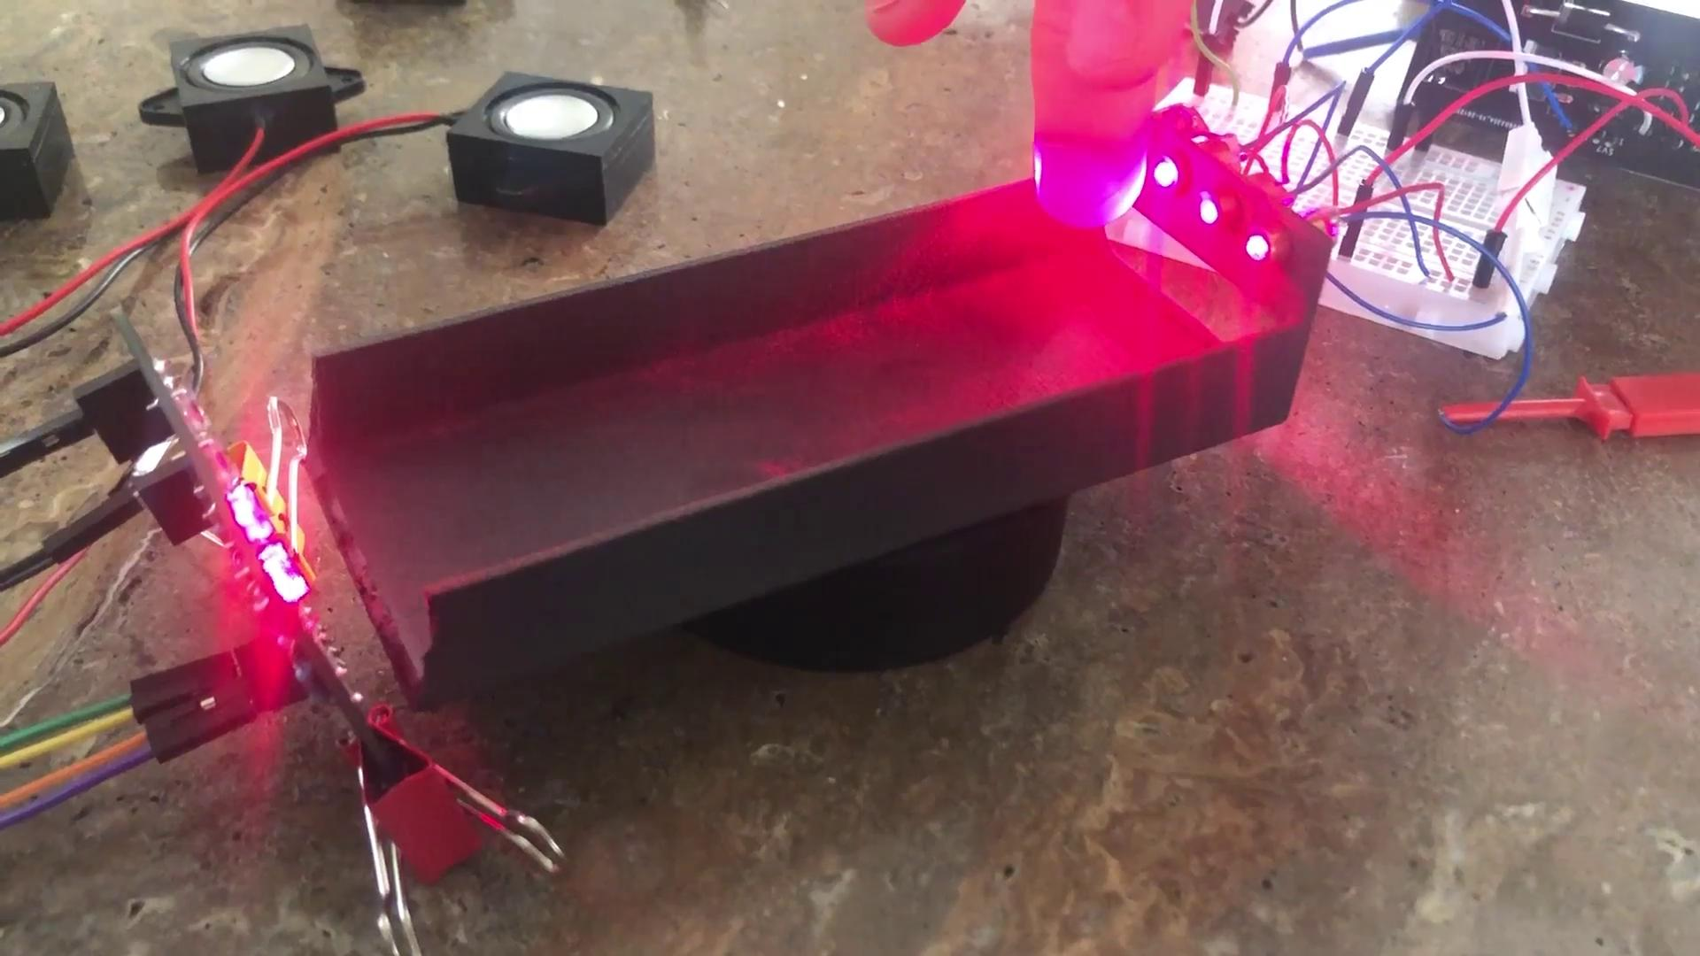
Polyphony
Polyphony is the ability to play multiple tones at once.
Our initial goal was to achieve four notes of polyphony across four strings.
This video shows our first step in accomplishing four notes of polyphony by achieving two

Slide 7
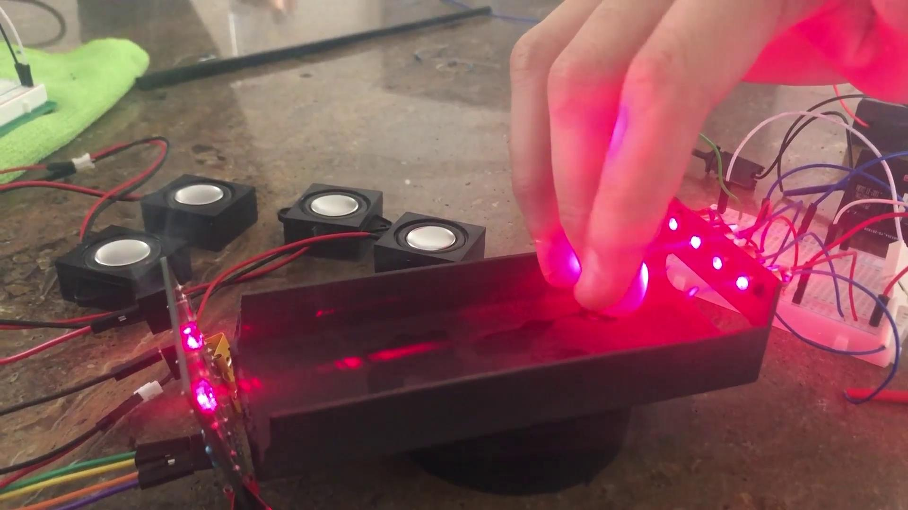
Polyphony
Achieved three and four sounds of polyphony.
We can play changing notes while still maintaining other notes.

Slide 8
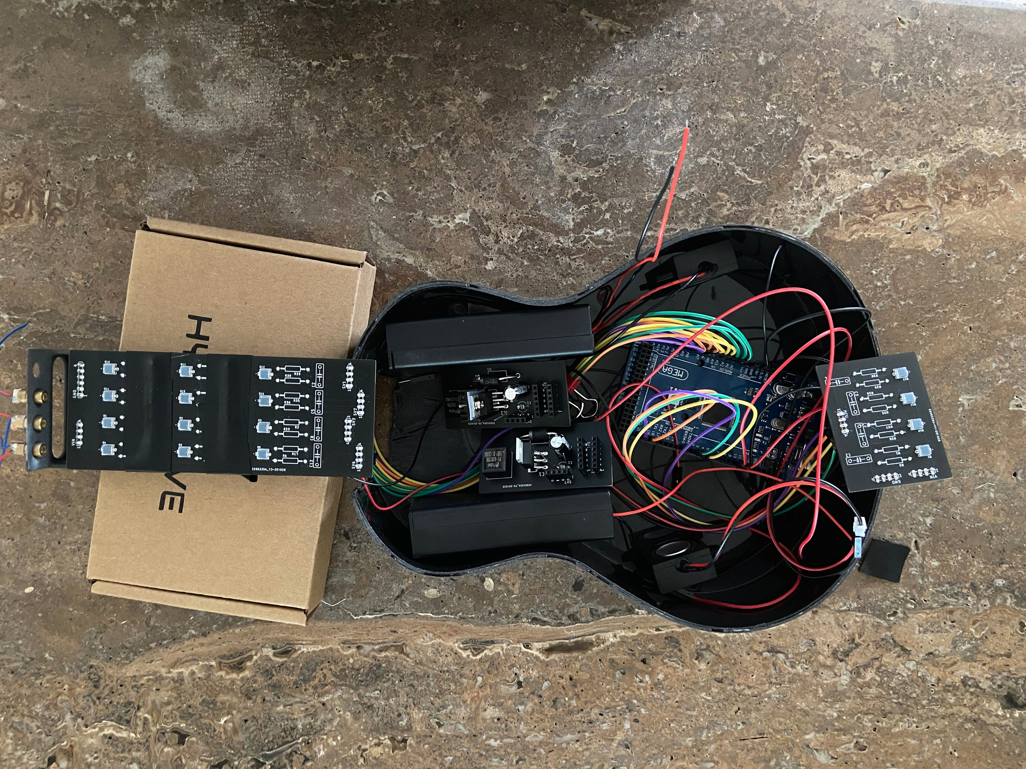
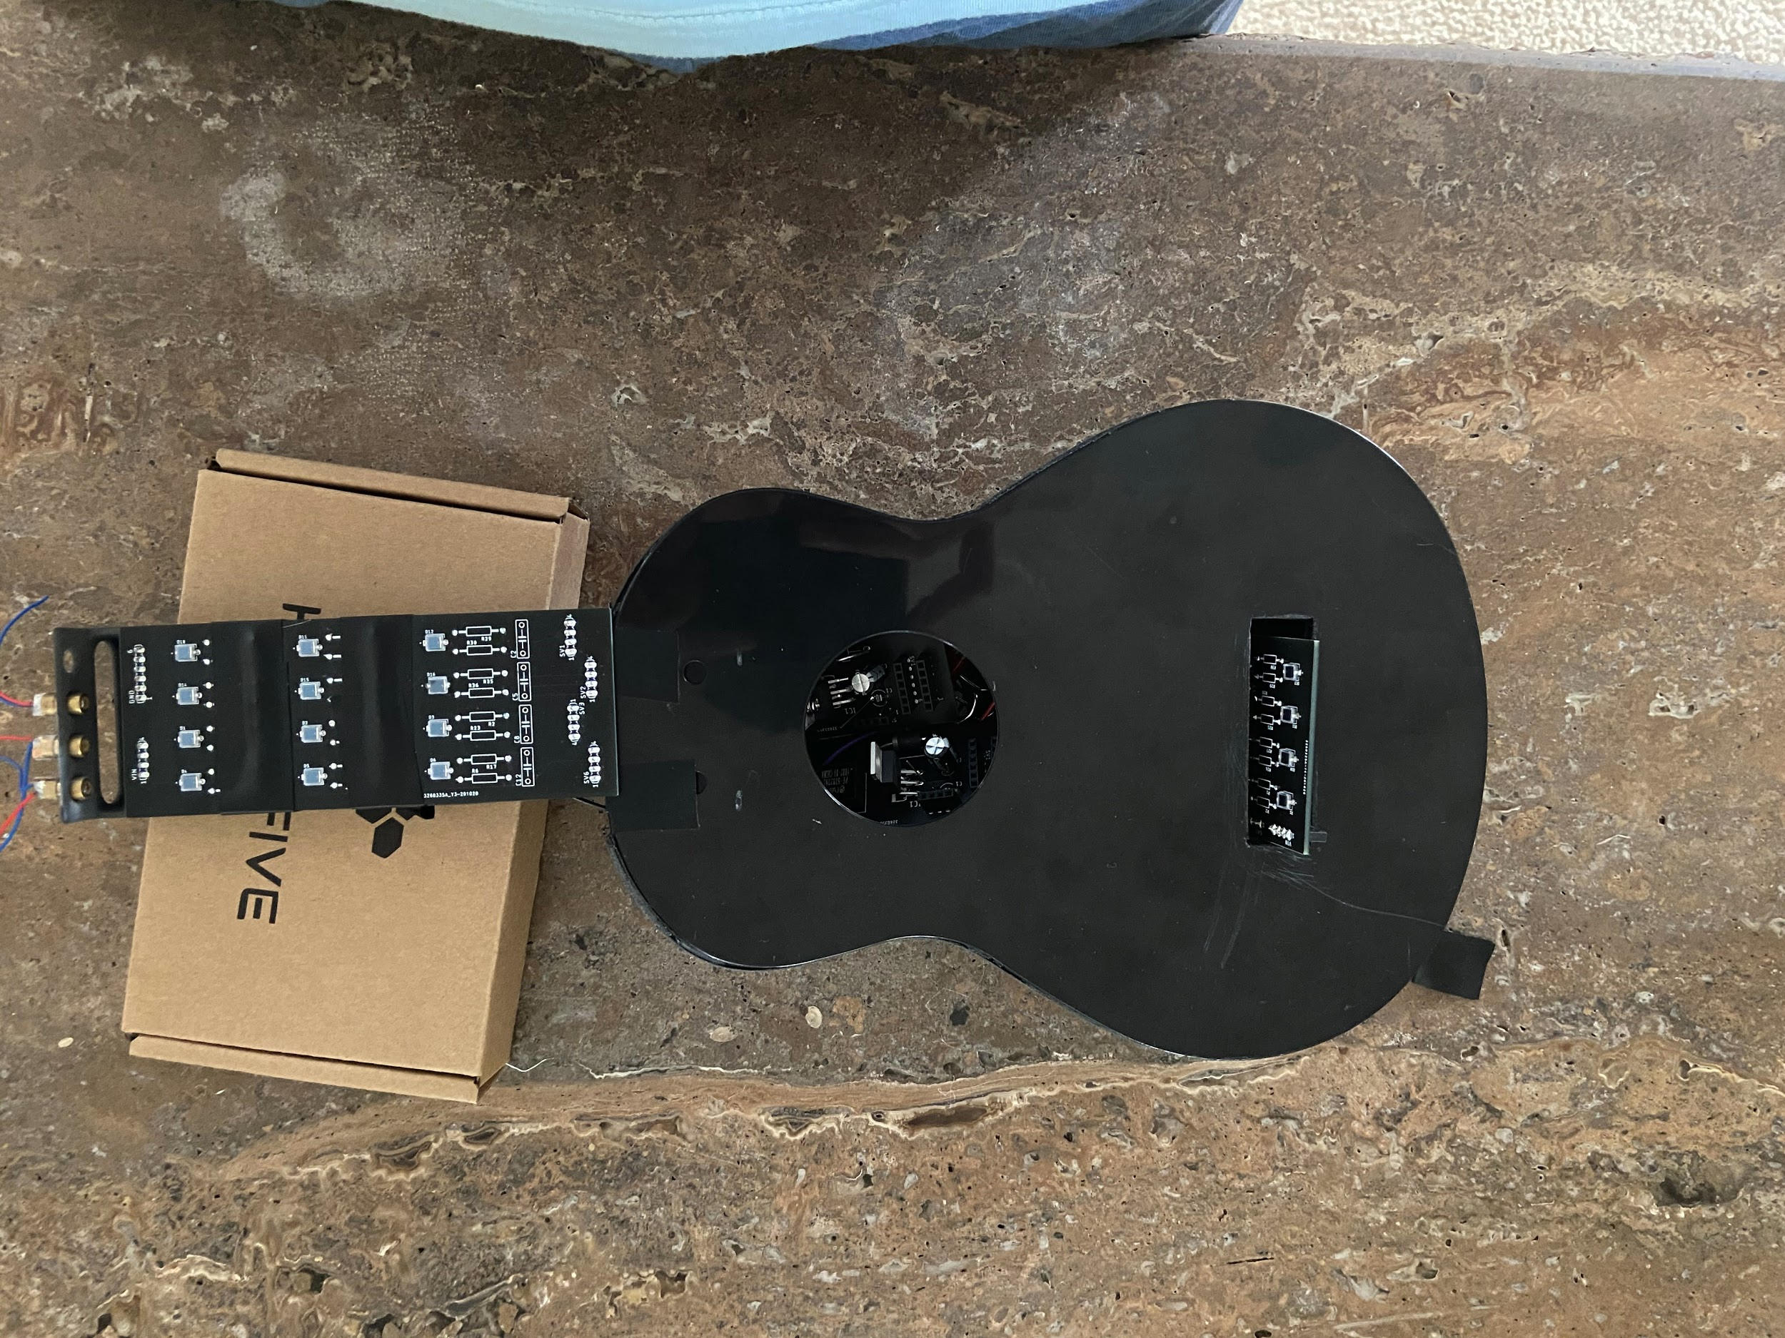
Housing

Slide 9
Roadblocks
Initial housing design is a bit small. New housing in works.
Security of lasers in housing, alignment was troubling.
Damage to our first fretboard PCB has prevented further testing, we are waiting on more photodiodes to begin testing further with integrated fretboard.
Achieving polyphony requires us to use a specific library at the moment, however we are hoping to be able to play custom sounds polyphonically.

Slide 10
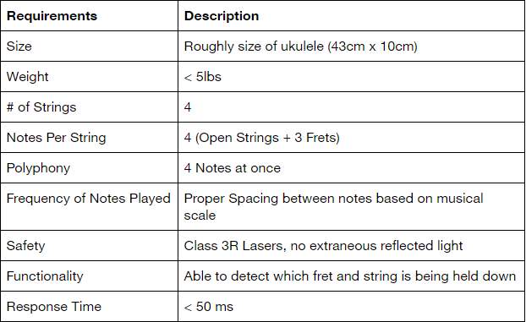
Specifications
The main focus so far was to achieve the correct functionality, polyphony and response time.
We are currently working on improving the functionality of the fretboard

Slide 11
Future Goals
Our main priorities are completing the design of a secure housing for the device and allowing for polyphonic tones across the entire fretboard.
Once the device has been fully assembled, we will focus on other functions such as:
Notes continuing to play on release.
Possibly custom tones.
General improvements to responsiveness of the device.

Slide 12
Youtube Video Link:
https://www.youtube.com/watch?v=KMBgygwdG6g&feature=youtu.be

