Slide 1
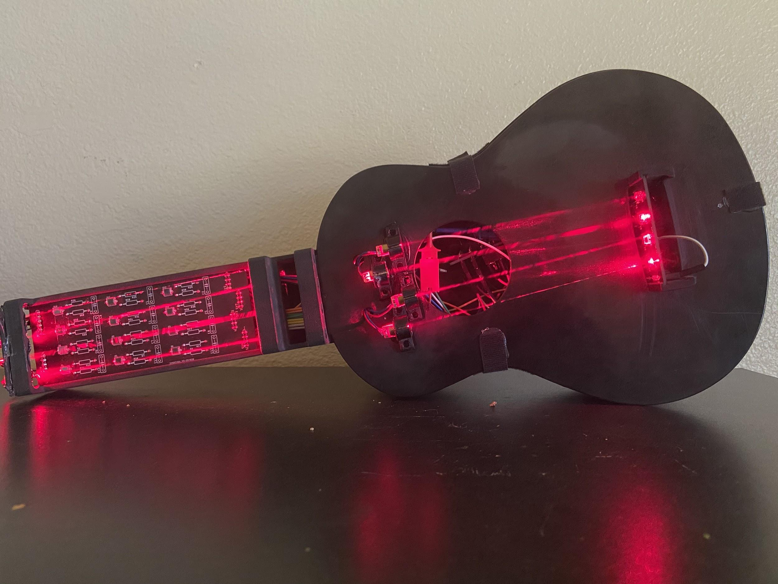
Laser Guitar
Group 1
Jacob Legler - Photonic Science and Engineering
Jonathan Spurgeon - Electrical Engineering
Juan Gamero - Computer Engineer
Alexander Truong-Mai - Computer Engineer

Slide 2
Project Description
Our project was inspired by a previous senior design group’s “Laser Musical Instrument”.
We wanted to take this concept and improve on it in the following ways:
Make the user experience based on a more popular instrument than the theremin
Make the instrument polyphonic so that you can play chords
Play sounds that are more pleasing to hear
Provide an overall more instrumental, musical experience
The idea we had based on this was to build a guitar that uses lasers as the strings.

Slide 3
Objective
Our objective with this project was to design a guitar with laser strings which achieves the following:
Portability: The device should be no larger than a standard guitar and should operate on battery power.
Functionality: The device should be polyphonic, and have a fast enough response time to where it feels natural to play.
Provide an instrumental experience: The user should feel as if they are playing a real instrument while using this device.

Slide 4
Goals
Considering the aforementioned objectives, we decided on the following goals:
Design based on a ukulele: four strings with notes being played by fretting and strumming the laser strings.
Four notes of polyphony, so that chords can be played by strumming all four strings.
Have the instrument sound and feel like a real ukulele, hardware design that gives a natural feel and software design that provides a natural sounding instrument.

Slide 5
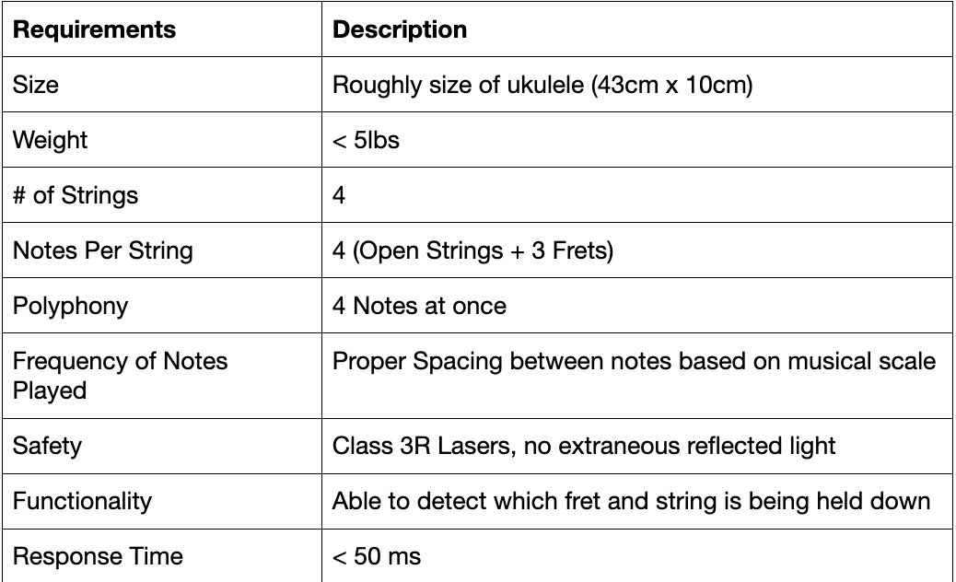
Specification & Requirements
The chart shown gives the specifications for
our instrument.

Slide 6
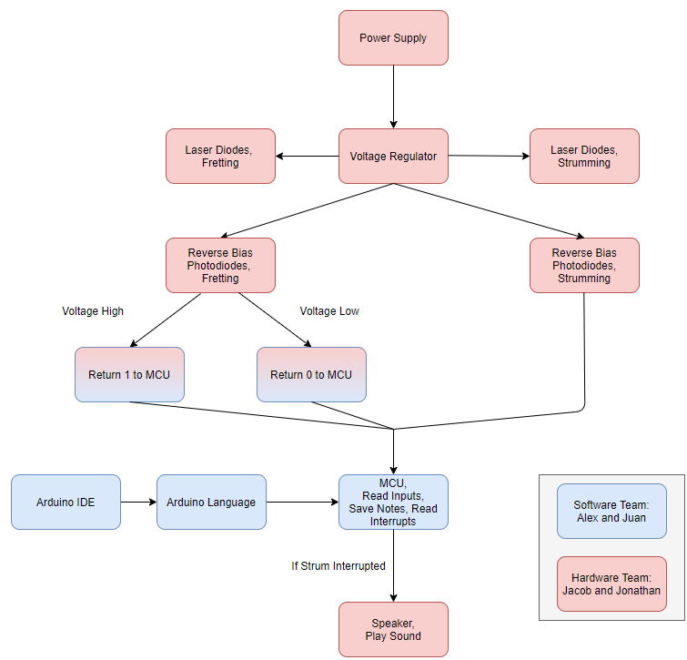
System Diagrams
The block diagram shown explains how we went about
designing the instrument.

Slide 7
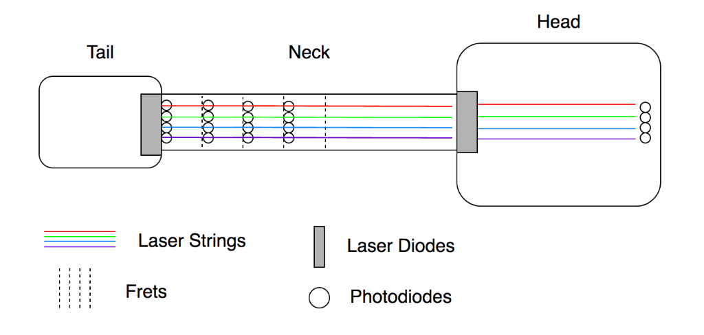
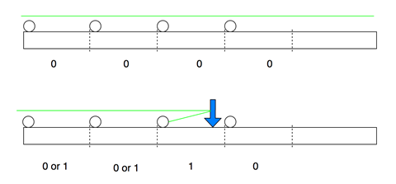
System Diagrams (conituned)
Top down view
Side view of Fretboard

Slide 8
Design and Implementation
Photonics Design
The decision to use photodiodes that are sensitive to infrared and near infrared wavelengths provided that our device was less susceptible to ambient light
Photodiodes and laser diodes in this range of wavelengths were generally cheaper and more available than other wavelengths
The use of photodiodes in photoconductive mode to read the amount of light reflected off the user provides a lot of control in terms of the device sensitivity
Digital and analog readings from the photodiodes gave us a lot of freedom in our software design.

Slide 9
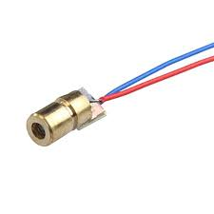
Laser Diodes - GeeBat Mini
Power Output: 5mW at 5V (Class 3R)
Wavelength: 650nm
Size: 6mm
Price: $5.99 for 10

Slide 10
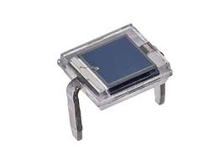
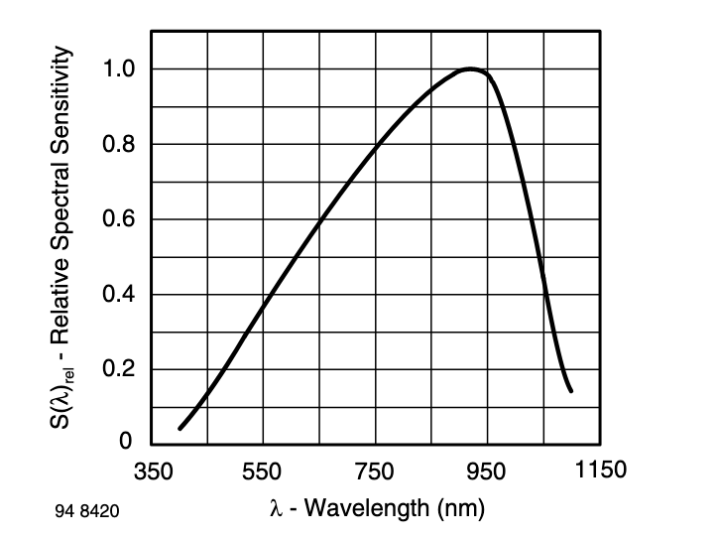
Photodiodes - Vishay BPW34
Type: PIN
Spectral Sensitivity: 70% at 650nm
Response Time: 20ns
Size: 5x5mm
Price: $10.50 for 10

Slide 11
Design and Implementation (cont.)
Hardware Design - Battery Technology
Lead Acid | Lithium Ion | Nickel Metal Hydride | Nickel Cadmium
Low Cost High Current Low Energy-to-weight ratio Toxic | High energy density Low self discharge High cost | High energy density Low internal resistance High discharge | High current Large number of cycles Toxic

Slide 12
Design and Implementation (continued)
Hardware Design - Battery Selection
Lithium Ion 3.6V, 2500mAh cells
2 Cells (2s) at 7.2V, 2500mAh
6 cell design
Fret Board | Head
12 Photodiodes at 3.3 Volts 4 laser diodes at 5 Volts | MCU at 5 Volts 4 laser diodes at 5 Volts 4 Photodiodes at 3.3 Volts

Slide 13
Design and Implementation (continued)
Hardware Design - Voltage Regulator
Photodiodes require 3.3V and MCU/Laser diodes require 5V
Utilize two buck regulators
LM2596-3.3/5
Buck regulator, 1.2 to 37 Volt input 3A and High efficiency Set output for 3.3-V and 5-V Low Quiescent Current of 80μA TO-220 with over temperature and current protection

Slide 14
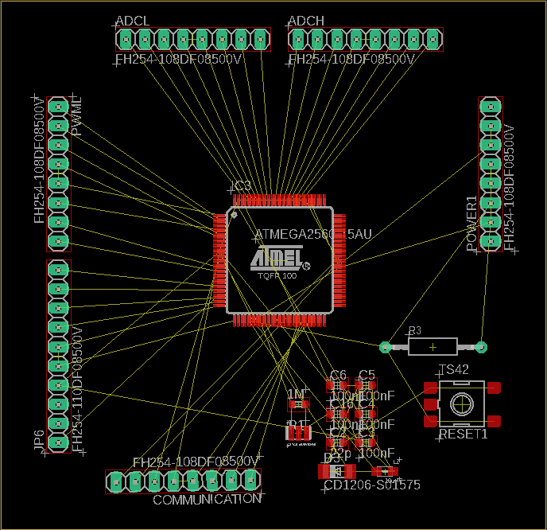
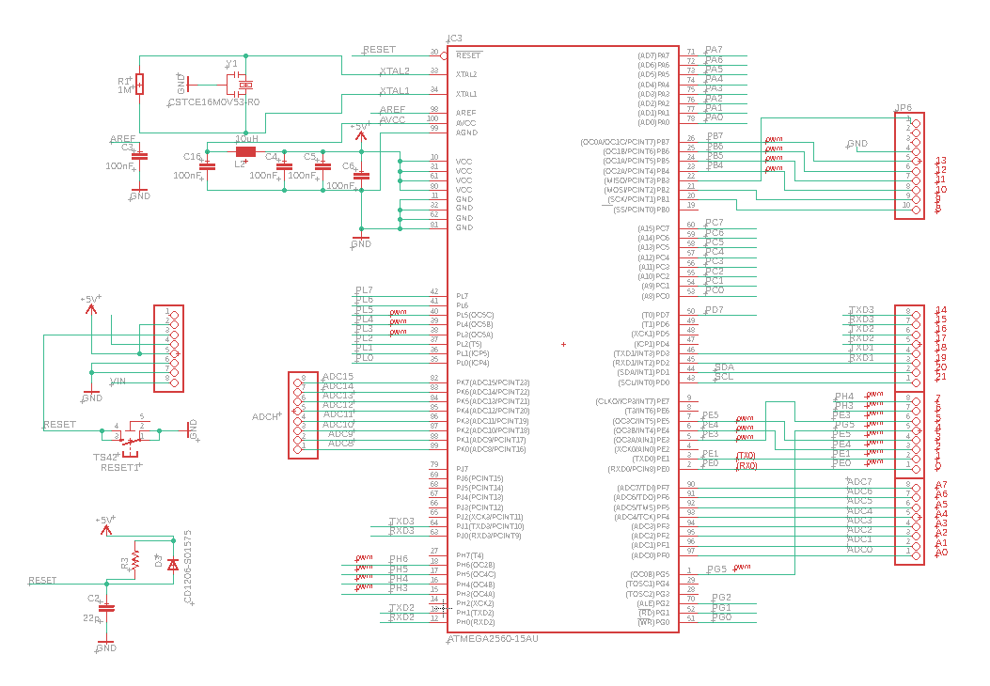
Design and Implementation Decisions (continued)

Slide 15
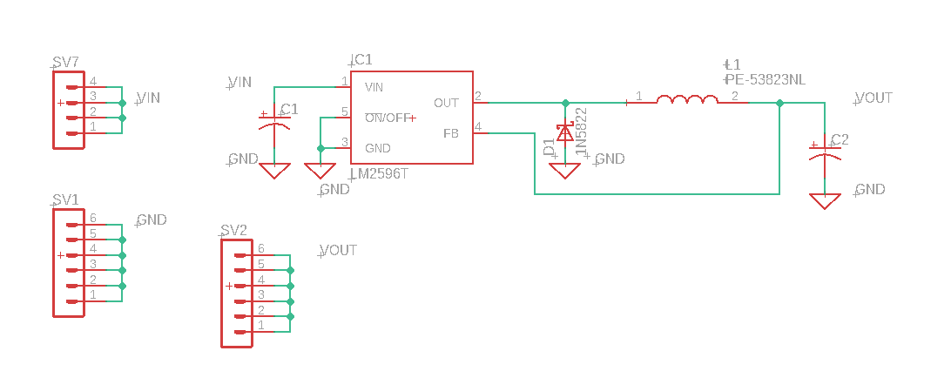
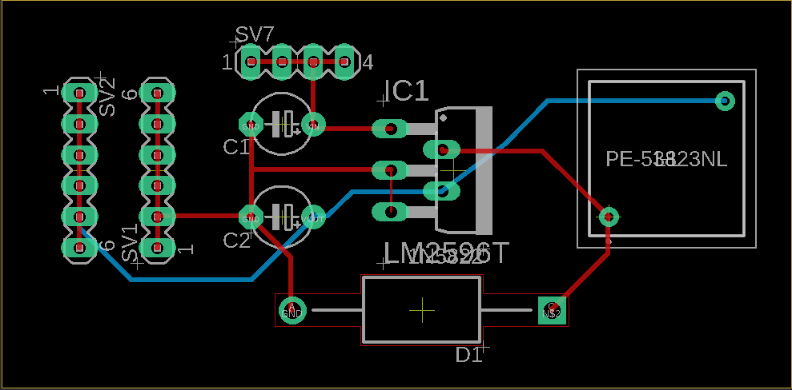
Design and Implementation Decisions (continued)

Slide 16
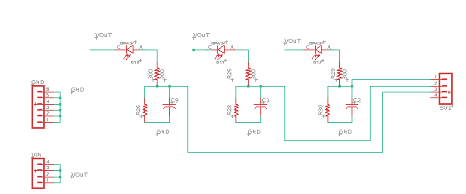
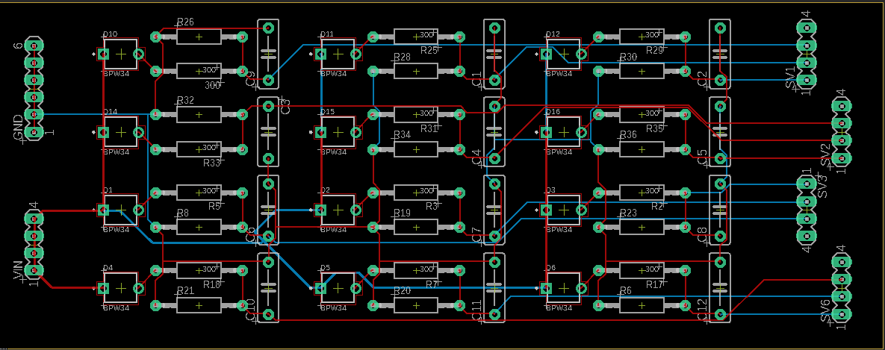
Design and Implementation Decisions (continued)

Slide 17
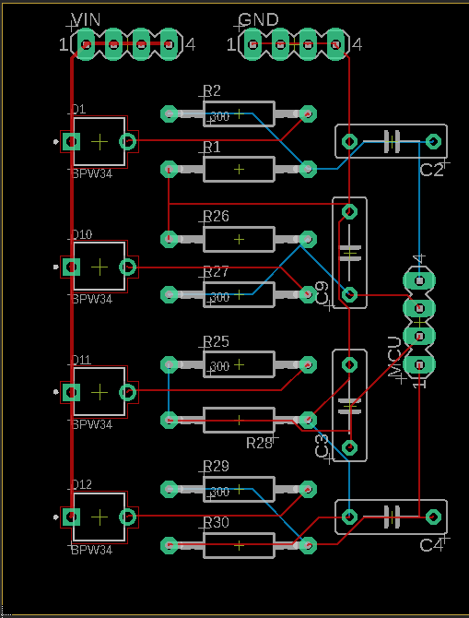
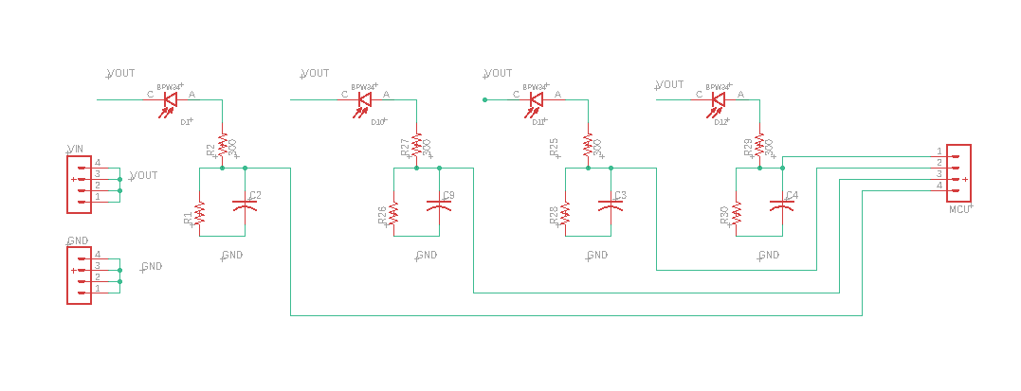
Design and Implementation Decisions (continued)

Slide 18
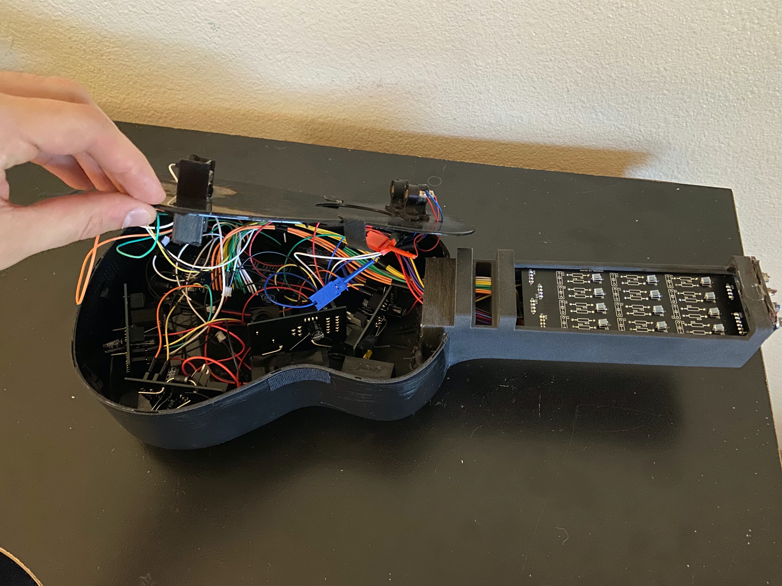
Housing
Had to fit all components while meeting size constraints
Real ukulele was used for the head of the guitar
Fretboard was 3D printed to suit our needs
Housing was a bit small

Slide 19
Design and Implementation (continued)
Software Design
Arduino Language
Libraries
Functions
Bootloading

Slide 20
Design and Implementation (continued)
Software Design - Arduino
Programmed Arduino language.
Gives us object oriented programming paradigm
No multithread or multiprocessing.

Slide 21
Design and Implementation (continued)
Software Design - Libraries
Instead of initializing and configuring the Timers within our MCU, there's a library that takes care of that for us.
MCU has 6 different times.
6 timers -> 6 different speakers
Tone Library: https://code.google.com/archive/p/rogue-code/wikis/ToneLibraryDocumentation.wiki

Slide 22
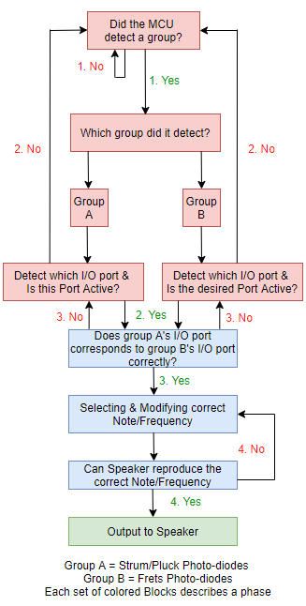
Design and Implementation (continued)
Software Design - Functions
Logic
Phases are dependent on one another
Phases:
Phase 1
MCU detects which group is detected
Phase 2
Software selects the sound
Phase 3
Sound will output
Phase 1
Phase 2
Phase 3
Notes:
Juan, this is your section.

Slide 23
Design and Implementation (continued)
Software Design - Functions
BIG PROBLEM:
What frets are constantly being held down?
How can we achieve polyphony?

Slide 24
Design and Implementation (continued)
Pin Configuration
pins.h File
Digital Pins
54 Digital Pins
Can hold only two values, either high or low
We used Digital Pins 2, 3, 20, & 21 for interrupts
Digital pins 9, 10, 11 & 12 for speakers
Analog Pins
16 Analog pins
Can hold a range of values from 0-1023, relative to reference voltage
Used analog pins A0-A11 for fretboard
Notes:
Juan, this is your section.

Slide 25
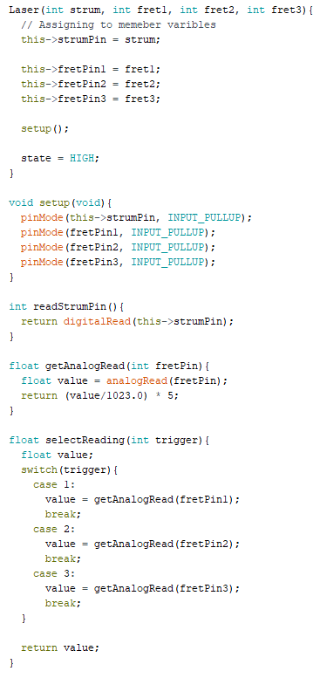
Design and Implementation (continued)
Laser.h File

Slide 26
Design and Implementation (continued)
Setting up classes
Instantiating Laser class
Instantiating Tone Class
Interrupt function

Slide 27
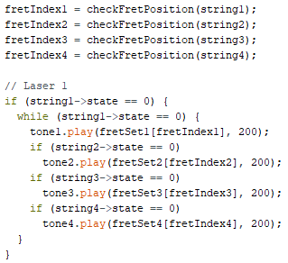
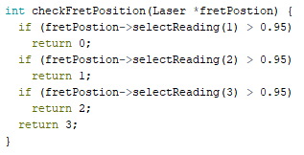
Design and Implementation (continued)
Array of notes
Logic for Polyphony
CheckFretPosition Function

Slide 28
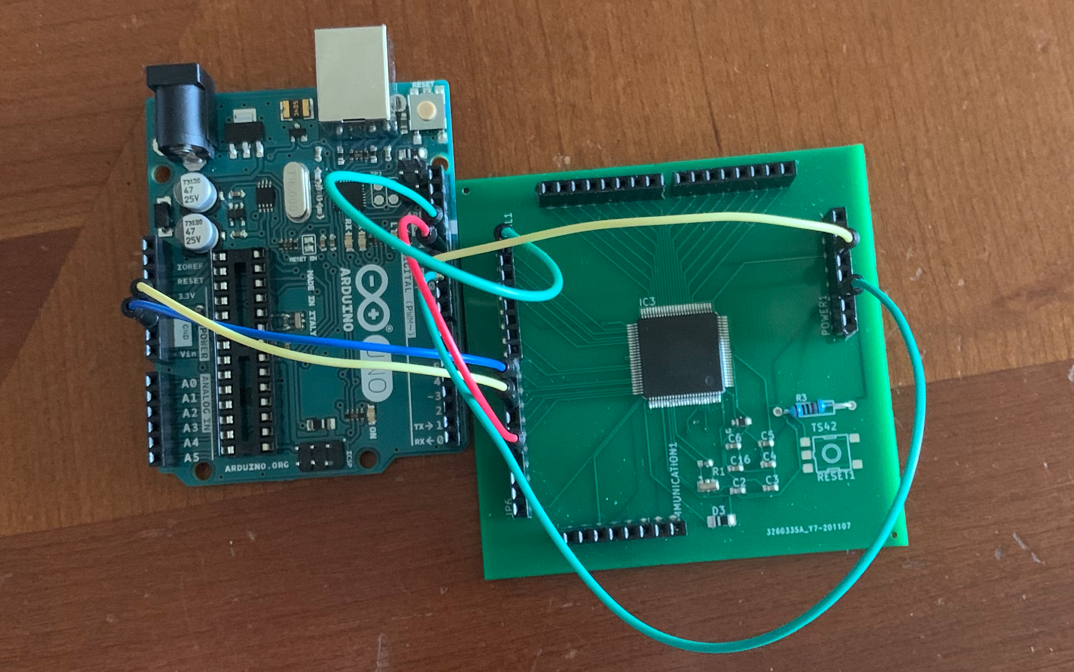
Design and Implementation (continued)
Software Design - Bootloading
https://www.instructables.com/ATMEGA2560-Standalone-Using-Arduino-UNO/

Slide 29
Relative Standards
Hardware Standards
ANSI Z136.1-.9 | ANSI Z87.1 | UL1642 & UL2054
Safe use of lasers between 180nm and 1000μ 4 Classes of lasers; 0.39mW to 0.5W Use in other industries from healthcare to R&D | Eye safety Standards Listing PPE for sites with laser activity Common signs will letters such as a ‘W’ for welding or ‘Heat’ for Infrared red | Battery Standards for safe use of lithium ion cells and household packs UN/DOT 38.3 allows for travel by air, rail or truck. Compliance standards needed to pass

Slide 30
Relative Standards (continued)
Software Standards
IEC/ISO 12207 | BARR-C2018 | GNU Standard
Total number of processes is down to 30 from 43 | Created specifically for applications and designs written in C/C++ The rules cover things such as basic formatting | This standard was structured towards programs written in C Basic formatting GNUs objective is to write clean, portable and dependable

Slide 31
Design Constraints
Economic/Time Constraints | Environmental, Social, and Political Constraints | Ethical, Health, and Safety Constraints | Manufacturability and Sustainability Constraints
External factor that affects the success of our design The amount of time needed to complete our task | Safe use of lasers Performance viewed by an audience Restrictions set and by nations involving safety/related standards | Industry ethics Proper handling Maintain safety with appropriate eyewear and distance | Available manufacturers Cost Overheating Consistency of response time

Slide 32
Final Prototype
Main goals achieved:
4 notes per string
4 notes of polyphony
Fast, natural feeling response time
Plays like a real ukulele
Completely portable, battery powered, and small size
Fun to play!

Slide 33
Challenges Faced
Meeting size constraints
Laser diodes drawing too much power to run MCU using the same battery pack
Keeping lasers aligned while also being portable
Cable management

Slide 34
Potential Improvements
Custom sounds
More frets
Adjustable volume
MIDI functionality
Larger housing

Slide 35
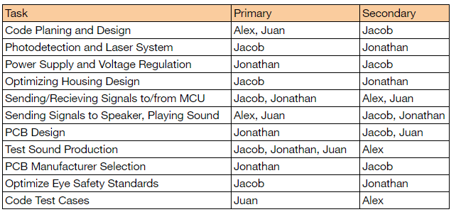
Work Distribution

Slide 36
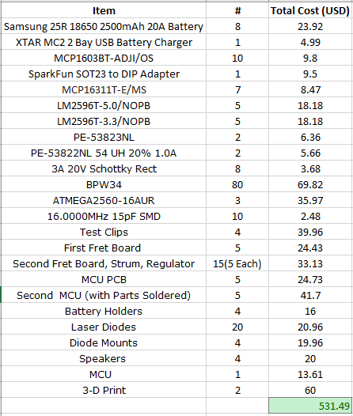
Final Budget

Slide 37
The End

