Slide 1
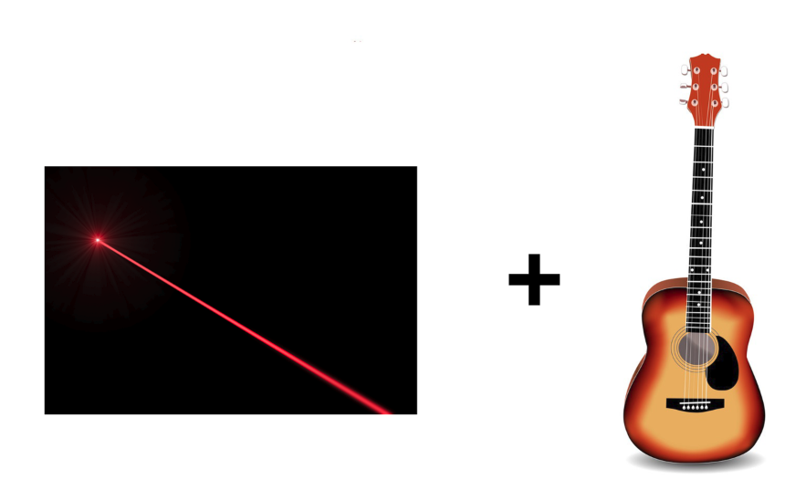
Laser Guitar
Group 1
Jacob Legler - Photonic Science and Engineering
Jonathan Spurgeon - Electrical Engineering
Juan Gamero - Computer Engineer
Alexander Truong-Mai - Computer Engineer

Slide 2
Project Description
Our project was inspired by a previous senior design group’s “Laser Musical Instrument”.
We wanted to take this concept and improve on it in the following ways:
Make the user experience based on a more popular instrument than the theremin
Make the instrument polyphonic so that you can play chords
Play sounds that are more pleasing to hear
Provide an overall more instrumental, musical experience
The idea we had based on this was to build a guitar that uses lasers as the strings.

Slide 3
Objective
Our objective with this project was to design a guitar with laser strings which achieves the following:
Portability: The device should be no larger than a standard guitar and should operate on battery power.
Functionality: The device should be polyphonic, and have a fast enough response time to where it feels natural to play.
Provide an instrumental experience: The user should feel as if they are playing a real instrument while using this device.

Slide 4
Goals
Considering the aforementioned objectives, we decided on the following goals:
Design based on a ukulele: four strings with notes being played by fretting and strumming the laser strings.
Four notes of polyphony, so that chords can be played by strumming all four strings.
Have the instrument sound and feel like a real ukulele, hardware design that gives a natural feel and software design that provides a natural sounding instrument.

Slide 5
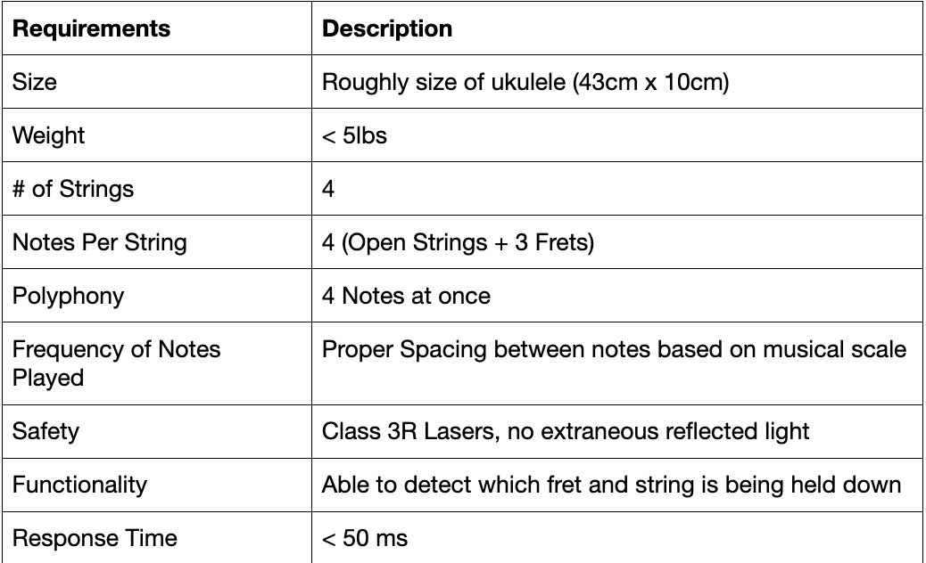
Specification & Requirements
The chart shown gives the specifications for
our instrument.

Slide 6
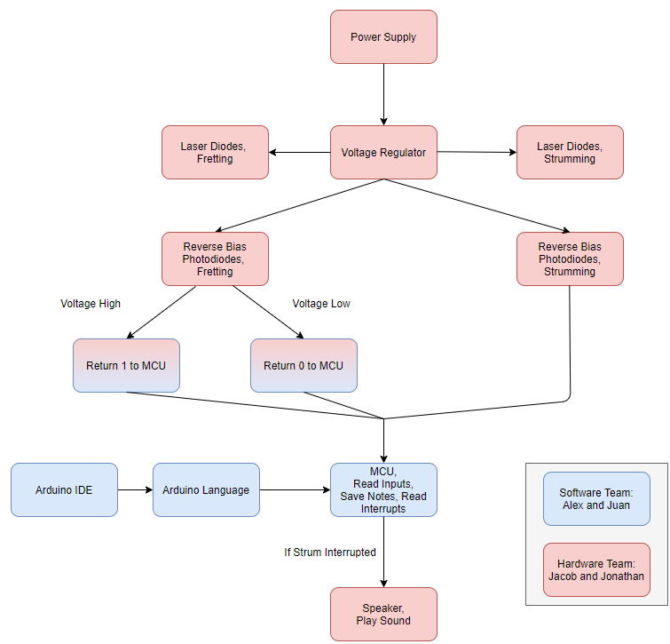
System Diagrams
The block diagram shown explains how we went about
designing the instrument.

Slide 7
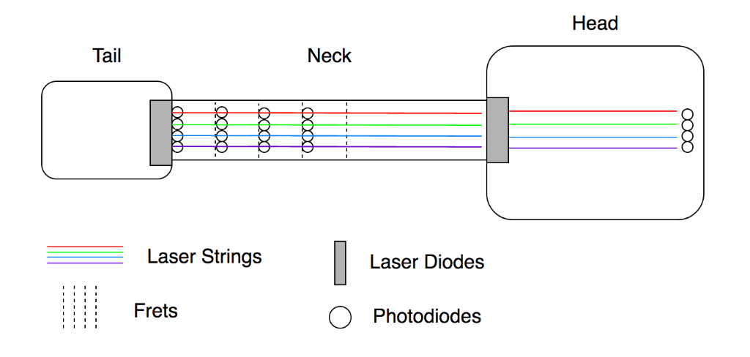
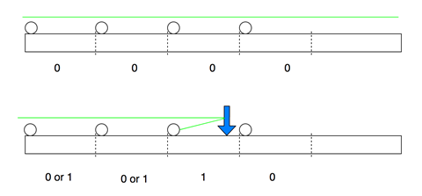
System Diagrams (conituned)
Top down view
Side view of Fretboard

Slide 8
Design and Implementation Decisions
Photonics Design
The decision to use photodiodes that are sensitive to infrared and near infrared wavelengths provided that our device was less susceptible to ambient light
Photodiodes and laser diodes in this range of wavelengths were generally cheaper and more available than other wavelengths
The use of photodiodes in photoconductive mode to read the amount of light reflected off the user provides a lot of control in terms of the device sensitivity
Our optical system provides user inputs that are entirely digital, which allows for simple and intuitive software design and fast response times.

Slide 9
Design and Implementation Decisions (continued)
Hardware Design - Battery Technology
Lead Acid | Lithium Ion | Nickel Metal Hydride | Nickel Cadmium
Low Cost High Current Low Energy-to-weight ratio Toxic | High energy density Low self discharge High cost | High energy density Low internal resistance High discharge | High current Large number of cycles Toxic

Slide 10
Design and Implementation Decisions (continued)
Hardware Design - Battery Selection
Lithium Ion 3.6V, 2500mAh cells
2 Cells in parallel to increase capacity to 5000mAh
2 Cells (2s) at 7.2V, 2500mAh
4 to 6 cell design
Fret Board | Head
12 Photodiodes at 2 Volts 4 laser diodes at 5 Volts | MCU and laser diodes at 5 Volts 4 laser diodes at 5 Volts 4 Photodiodes at 2 Volts

Slide 11
Design and Implementation Decisions (continued)
Hardware Design - Voltage Regulator
Photodiodes require 2V and MCU/Laser diodes require 5V
Utilize two buck regulators
MCP1603 | MCP1631
Buck regulator, 2.7 to 5.5 Volt input 500mA and High efficiency(90%) Adjustable output for 2V with 3.6V Input Low Quiescent Current of 45μA Small Package with over temperature and current protection | Buck Regulator, 4.4 to 30 Volt input 1A and High efficiency(95%) Adjustable output for 5V from 7.2V Input Low Quiescent Current of 45μA MSOP package with overtemperature protection and UVLO

Slide 12
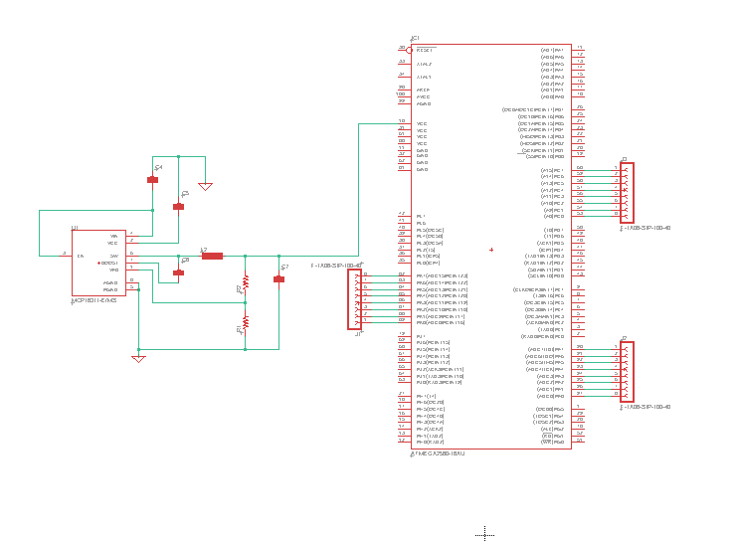
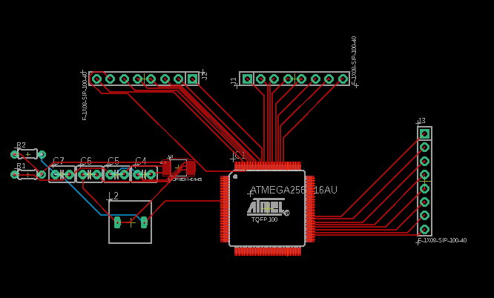
Design and Implementation Decisions (continued)
Hardware Design - PCB
MCU with Voltage Regulator supplying power and pinouts to photodiodes

Slide 13
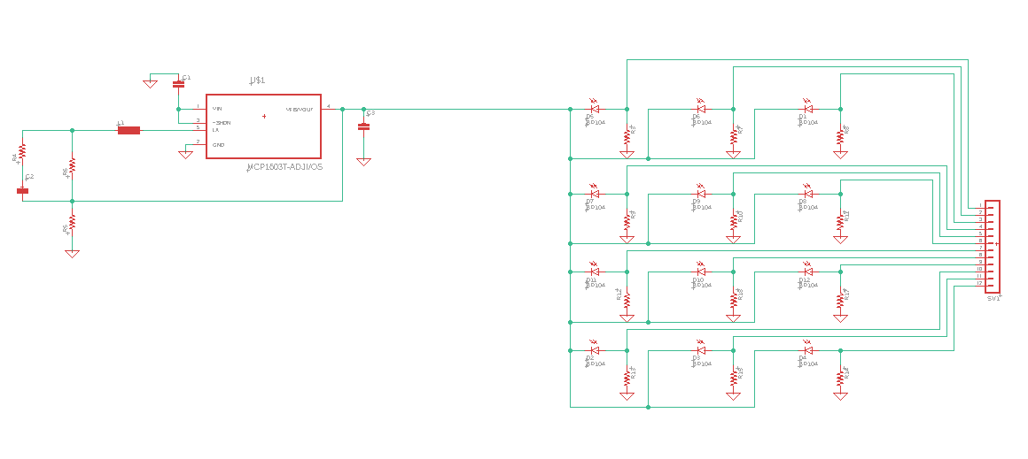
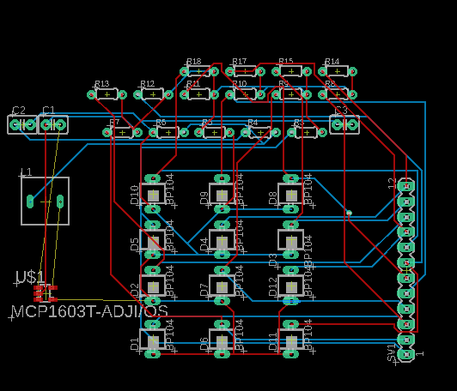
Design and Implementation Decisions (continued)
Hardware Design - PCB
Fret board with 3 photodiodes per string and a 2V regulator supplying power

Slide 14
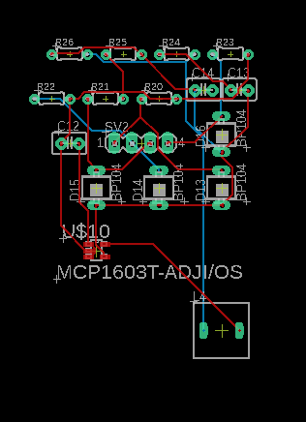
Design and Implementation Decisions (continued)
Hardware Design - MCU
4 photodiodes on head of guitar for strumming

Slide 15
Design and Implementation Decisions (continued)
Software Design
Code Design Parameters
Code implementations
Configurations

Slide 16
Design and Implementation Decisions (continued)
Software Design - Code Design Parameters
Language Type
Development Environment
Emulation of Sounds
Language Type:
A language that will work with our MCU
Language features
Coding paradigms and design patterns
Development Environment:
MCU function properly
Tools and functionality
Emulation of Sound:
Correct note, pitch, and frequency

Slide 17
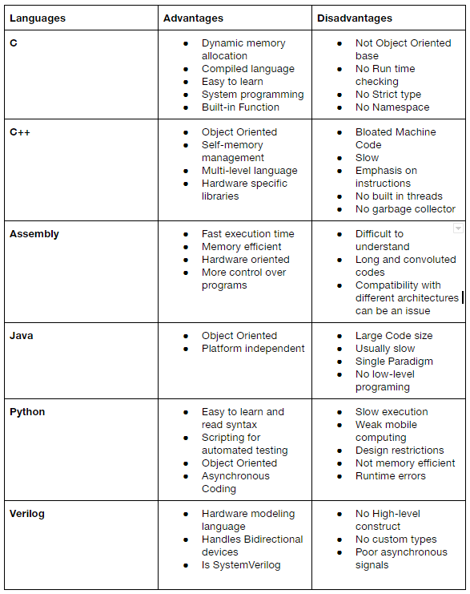
Design and Implementation Decisions (continued)
Software Design - Code Design Parameters
Language Types:
Various languages type
Many libraries
Coding paradigms and patterns

Slide 18
Design and Implementation Decisions (continued)
Software Design - Code Design Parameters
Language Type:
Arduino Language
Our MCU is ATmega2560 is found on the Arduino Mega 2560 microcontroller board.
Native language is Arduino
C & C++
Arduino
Object Oriented Programming
Design patterns
Development Environment:
MPLAB X IDE
Atmel Studios 7
Arduino IDE
Arduino IDE
All in one solution

Slide 19
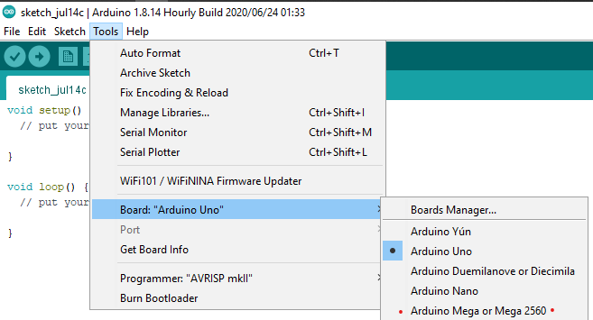
Design and Implementation Decisions (continued)
Software Design - Code Design Parameters
Development Environments:
Arduino IDE

Slide 20
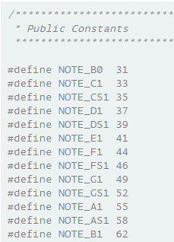
Design and Implementation Decisions (continued)
Software Design - Code Design Parameters
Emulation of sounds
Libraries
Custom sounds
Custom Sound - Converting mp3 to PCM
Each element within the array “char sample [] “ contains a note.
Library - pitches.h file

Slide 21
Design and Implementation Decisions (continued)
Software Design - Code Implementation
Using Object Oriented Programming
Two classes
Using Design Patterns
Factory Pattern
Notes:
Juan, this is your section.

Slide 22
Design and Implementation Decisions (continued)
Software Design - Code Implementation
Two groups, A & B
Group A
Each Diode is an object
Group B
Each rows of diodes in Group B is an object.
Group B
Group A
Notes:
Juan, this is your section.

Slide 23
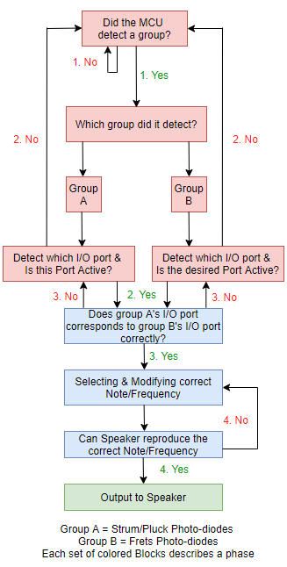
Design and Implementation Decisions (continued)
Software Design - Code Implementation
Logic
Phases are dependent on one another
Phases:
Phase 1
MCU detects which group is detected
Phase 2
Software selects the sound
Phase 3
Sound will output
Phase 1
Phase 2
Phase 3
Notes:
Juan, this is your section.

Slide 24
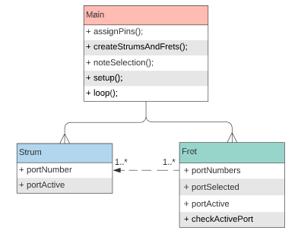
Design and Implementation Decisions (continued)
Software Design - Code Implementation
UML Diagram

Slide 25
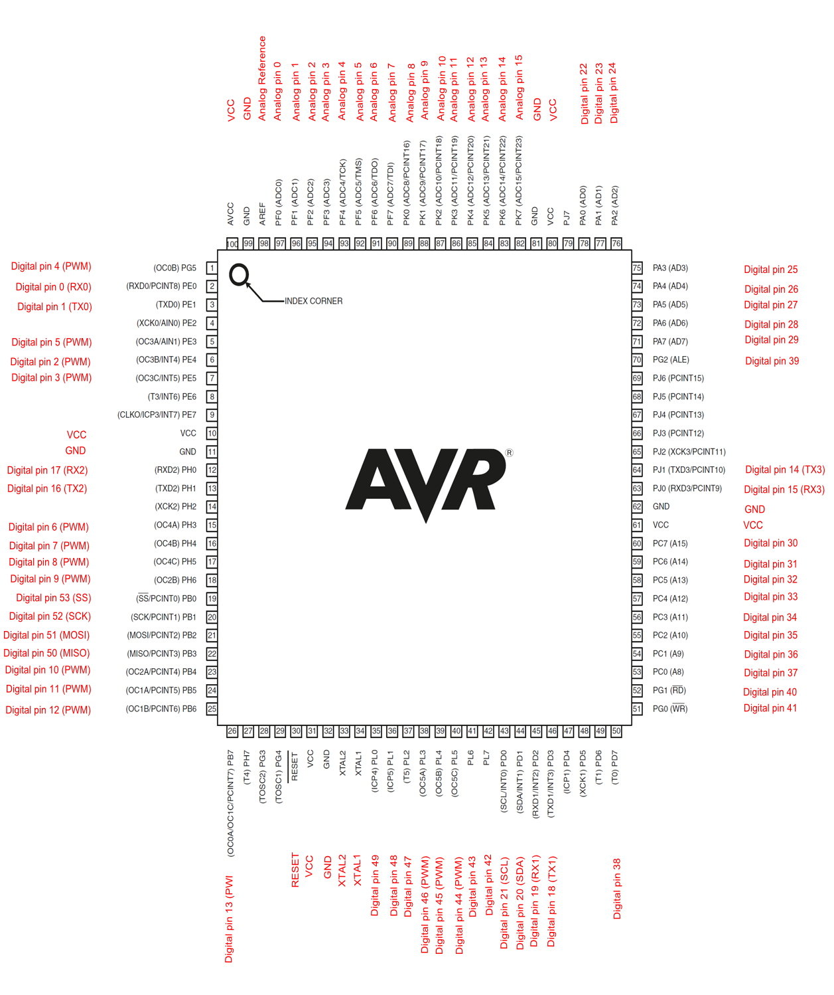
Design and Implementation Decisions (continued)
Software Design - Configurations
Atmega2560 Datasheet
Digital Pins
Analog Pins
Interrupts
Sleep modes
Timers

Slide 26
Design and Implementation Decisions (continued)
Digital Pins vs Analog pins
Digital Pins
54 Digital Pins
Can hold only two values, either high or low
Digital Pins 2, 3, 18, 19, 20, 21 support interrupts
Use of digitalRead() and digitalWrite()
Analog Pins
16 Analog pins
Can hold a range of values from 0-1023, relative to reference voltage
No analog pins support interrupts
Use of analogRead() and analogWrite()
Notes:
Juan, this is your section.

Slide 27
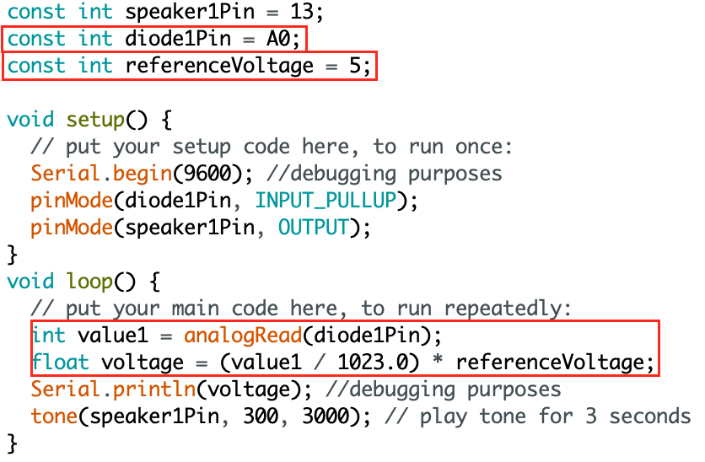
Design and Implementation Decisions (continued)
Analog pin configuration syntax
Diode Pin connected to Analog Pin
Code Output
Notes:
Juan, this is your section.

Slide 28
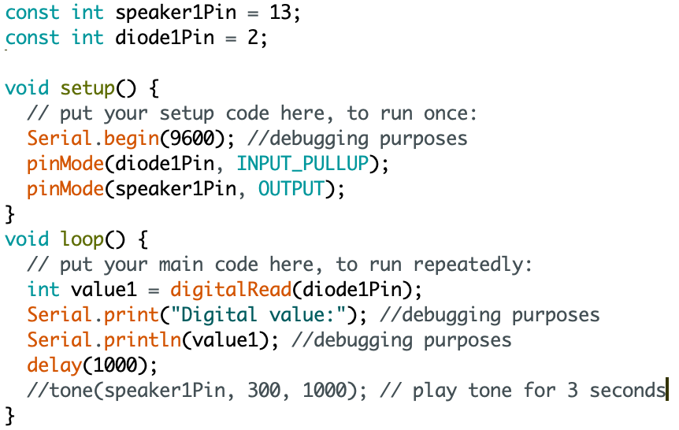
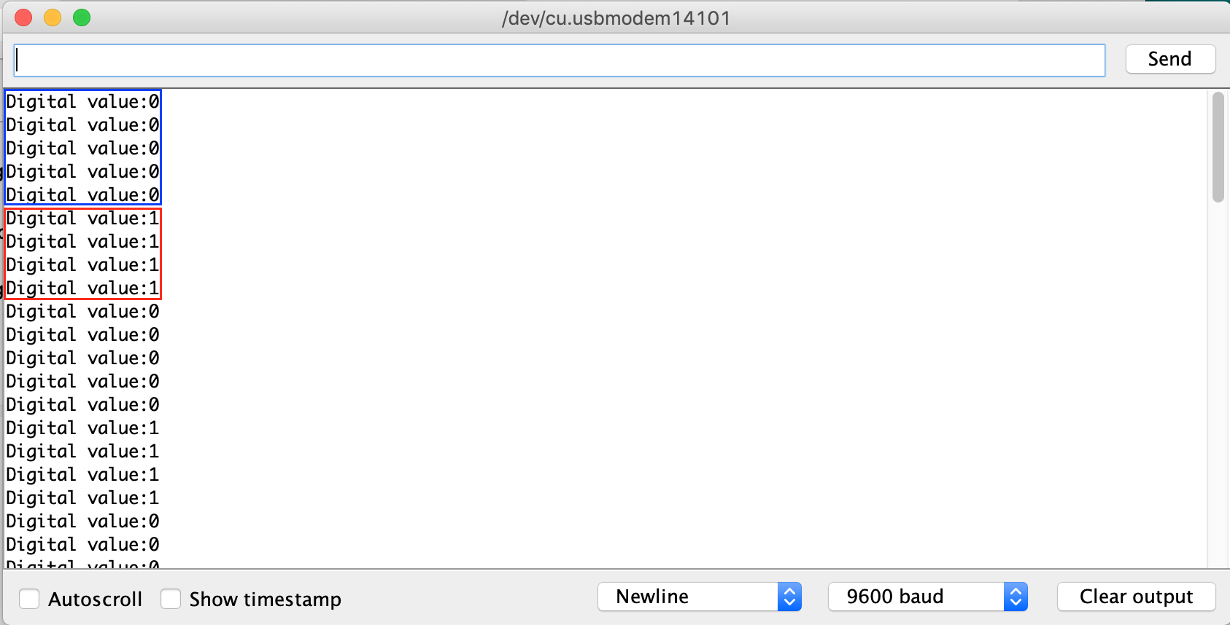
Design and Implementation Decisions (continued)
Digital pin configuration syntax
Diode Pin connected to Digital Pin
Code Output
Notes:
Juan, this is your section.

Slide 29
Design and Implementation Decisions (continued)
Interrupts vs. Polling
Interrupts
External components notify CPU when an event needs to occur
Can occur at any time,
Can become inefficient if CPU is constantly being interrupted
Only digital pins 2, 3, 18, 19, 20, 21
Polling
CPU has to repeatedly check the status of external components
Occurs at regular intervals
Can become inefficient
Notes:
Juan, this is your section.

Slide 30
Design and Implementation Decisions (continued)
Sleep Modes and Timers
Sleep Modes
6 different sleep modes
Idle
ADC Noise Reduction
Power-save
Power-down
Standby
Extended Standby
Timers
6 Timers/ Counters
Consider use cases
Timed Interrupts
Notes:
Juan, this is your section.

Slide 31
Relative Standards
Hardware Standards
ANSI Z136.1-.9 | ANSI Z87.1 | UL1642 & UL2054
Safe use of lasers between 180nm and 1000μ 4 Classes of lasers; 0.39mW to 0.5W Use in other industries from healthcare to R&D | Eye safety Standards Listing PPE for sites with laser activity Common signs will letters such as a ‘W’ for welding or ‘Heat’ for Infrared red | Battery Standards for safe use of lithium ion cells and household packs UN/DOT 38.3 allows for travel by air, rail or truck. Compliance standards needed to pass

Slide 32
Relative Standards (continued)
Software Standards
IEC/ISO 12207 | BARR-C2018 | GNU Standard
Total number of processes is down to 30 from 43 | Created specifically for applications and designs written in C/C++ The rules cover things such as basic formatting | This standard was structured towards programs written in C Basic formatting GNUs objective is to write clean, portable and dependable

Slide 33
Design Constraints
Economic/Time Constraints | Environmental, Social, and Political Constraints | Ethical, Health, and Safety Constraints | Manufacturability and Sustainability Constraints
External factor that affects the success of our design The amount of time needed to complete our task | Safe use of lasers Performance viewed by an audience Restrictions set and by nations involving safety/related standards | Industry ethics Proper handling Maintain safety with appropriate eyewear and distance | Available manufacturers Cost Overheating Consistency of response time

Slide 34
Design Testing
Our initial goal was to get our device to play a sound upon interrupt of the laser beam, this would act as the strumming section of our guitar.
The following video shows successful implementation of this concept.

Slide 35
Design Testing (continued)
Our next goal was to sustain the sound being played for a second after the interrupt, so that multiple notes can be hear at once when we implement multiple strings.
The video below shows the note being sustained after being strummed.

Slide 36
Design Progression
The foundation of our project is essentially finished, we are currently working on implementing the fretboard design to select which note to play.
Once the design is completed for one string it is only a matter of implementing the design across all four strings and building the housing.
We are hoping to have breadboard testing complete by next week and order our PCB and begin building the final project in the next two weeks.

Slide 37
Roadblocks
The issues we were initially worried about, such as noise from ambient light or adjacent strings, did not end up being as much of an issue as we initially thought, as the photodiodes picked up very little light that was not directly on the photodiode.
This lead to the issue of not drawing enough voltage to provide a digital reading under our initial photodiode bias of two volts. We have solved this problem by using analog readings already, however to improve performance we would like to use purely digital readings.
Simply increasing the resistance seemed like the most straightforward solution, however this lead to inconsistent performance in practice.

Slide 38
After Successful Completion
We have many stretch goals that we would like to implement upon completing our basic requirements. Some we may try to implement include:
Dynamic response to velocity of strums
Inclusion of a library of different playable sounds
A full fretboard of 12 frets

Slide 39
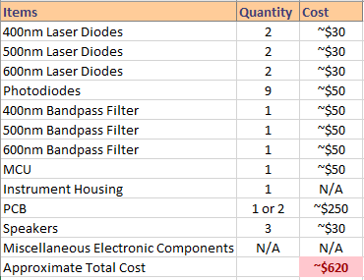
Financials
For the project there will not be any type of outside funding or sponsors from any parties. Instead, the project will be funded by the members of the group.
Projected Budget

Slide 40
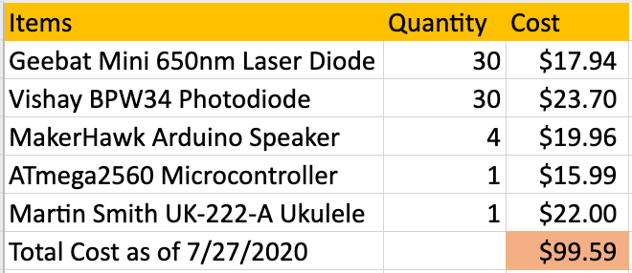
Financials (Continued)
The group was prepared to spend $1,000.00
Cost
Projected Budget

Slide 41
END
Notes:
ONLY USE THIS SLIDE AS A TEMPLATE

