Slide 1
SunShade
Smart-blinds appliance
Group 13
Conor Ferring, EE
Alex Rosado, CpE
Terrell Richardson, CpE
Miloud Ennemar, EE

Slide 2
Project Description
The SunShade is an internet-of-things home appliance designed for daily use, in order to create a comfortable and cost-efficient home environment.
SunShade is a cordless, solar-powered window blinds system, controlled either with the manual control pad, Alexa personal voice assistant, or the mobile application. It is capable of tilting shades, lifting or lowering blinds, or lifting or lowering a diffuser shade for enhanced environmental control, as well as numerous other technical features.

Slide 3
Features
App control - This will allow the user to adjust the up, down, and tilt blinds positions with ease, having only to lift a finger from the comfort of their homes, or from long distance.
Automatic brightness control - Accounts for direction and exterior brightness to adjust the tilt of your blinds throughout the day in order to only allow a reasonable amount of natural light.
Scheduling - This will allow for users’ SunShade to protect their window-dwelling plantlife from over-exposure, as well as save the user on monthly electricity costs by limiting the effects of the sun on air conditioning usage.
Voice controlled - Amazon Echo, aka Alexa functionalities will provide a completely hands-free control for the user. Commands such as “Alexa, shades down.”,”Alexa, shades up.”, “Alexa, close shades.”, “Alexa, open shades.”

Slide 4
Goals
Create a utility for apartment-living home gardening
Create a green-energy focused home appliance
Create an energy-saving device to alleviate monthly bills
Create a product that is user-friendly
Stay within both time and budget constraints

Slide 5
Requirements
Blinds tilt under 30 seconds
Blinds lift under a minute
Shade opens and closes under a minute
Light turns on and off
Alexa able to communicate with database
Mobile app able to access and update database

Slide 6
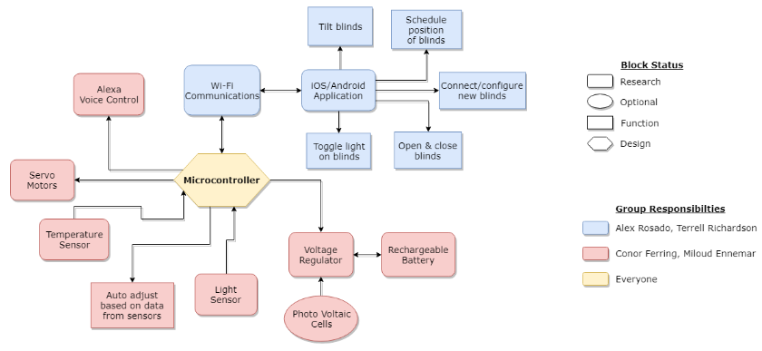
Work Distribution

Slide 7
Design

Slide 8
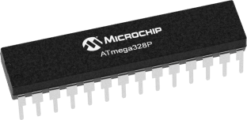
MCU
 | AtMega328p | AtMega2560 | MSP430g2553
Mount Type: | Through Hole | Surface Mount | Through Hole
CPU Speed: | 20 MHz | 16-MHz | 16-MHz
Program Memory: | 32 KB | 256 KB | 16 KB
SRAM: | 2 KB | 8 KB | 512 Bytes
Operating Voltage: | 1.8V-5.5V | 1.8V - 5.5V | 1.8V - 3.6V
I/O: | 23 | 54 | 24 pins
Cost: | 2$ per unit | 11.85$ | 1$

Slide 9
Wifi Module vs Bluetooth
 | ESP-12E | BLE CC2540
CPU Speed: | 80 MHz | 2.4 GHz
Program Memory: | 4 MB | 8 KB
Operating Current: | 80 mA | 24 mA
Operating Voltage: | 3.3V | 3.6V
Cost: | 7$ per unit | 1.79$ per unit

Slide 10
Motors
 | 180° Servo Motor | 360° Servo Motor | DC Rollerhouse Motor
Weight: | 56 g | 55.6 g | 204 g
Operating Voltage: | 4.8 to 6V | 4.8 to 6V | 12V
Operating Current: | 500 mA | 1 A | 500 mA
Operating Speed: | 0.13sec/60° | 0.14sec/60° | 37 rpm
Stall Torque: | 11 kg-cm | 20.32 kg-cm | N/A

Slide 11
Solar Cells
Type: | Monocrystalline | Polycrystalline | Epoxy Poly
Power: | 2.8 W | 4.5 W | 1.5 W
Current: | 5.24 A | ~5 A | 30mA
Voltage: | 0.5 V | 0.5 V | 5 V
Efficiency: | 17.64 % | 18.4 % | 16%
Brand: | Vikocell | Vikocell | AOSHIKE
Cost and Vender: | 15 $ from Amazon | 18.99$ from Amazon | 15.87$ from Amazon
Available at Alibaba.com but shipping times are too long

Slide 12
Battery
Type: | Lead Acid | Eneloop Ni-MH | Li-ion 18650 INR
Capacity: | 8 AH | 1900mAH | 3000mAH
Current: | 2.4 A | 3 A | 15 A
Voltage: | 12 V | 1.2 V | 3.7 V
Weight: | 4.96 Lbs | 29.9 g | 48 g
Brand: | Universal | Panasonic | Samsung
Cost and Vender: | 19.99$ | 11.54$ for 4 from Amazon | 4.73 $ from liionwholesale

Slide 13
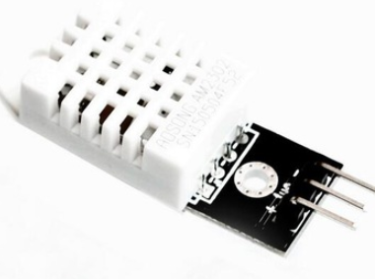
 | DHT22 | DS18B20
Operating Voltage: | 3.3 - 6V | 3.0 - 5.5V
Manufacturer: | Adafruit | Maxim integrated
Tech: | 1 channel Temp and Hum | 1-Wire Temp Network
Cost: | 2-6$ | 1-3$
DHT22 Temperature and Humidity sensor.
Good for -40 to 80 Celsius temperature readings with ±2% accuracy.
low cost
Excellent for 0 to 100% humidity readings.
Uses only one single digital pin.

Slide 14
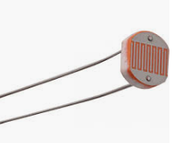
Light Dependant Resistor
simple
Depends on ambient light
Easy to solder
 | Light Dependant Resistor GM5539 | Photodiode OPT101P
Accuracy | Not Guaranteed | Not Guaranteed
Manufacturer | Wodeyijia | TI
Range | 1 to 100 Lux | 7 Lux to 50 KLux
Uses | Used in application requires ON/OFF | Street Light
Cost | $4.85 for 30Pcs | $8.80 per piece

Slide 15
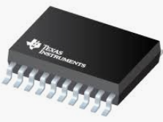
TPS56339 Switching voltage Regulator
Easy to modulate the voltage.
Maintain a regulated output voltage when the input voltage is less or greater than the output voltage
Wide range operating input voltage.
Cost: $ 4.95

Slide 16
Design | Switching voltage Regulator TPS56339 | Linear Regulator LP2950
Complexity | Medium to High | Low
V-in Range | Wide | Narrow
Size | Medium | Small
Efficiency | High (95%) | Medium
Cost | $4.95 | $1.25
Manufacturer | TI | TI

Slide 17
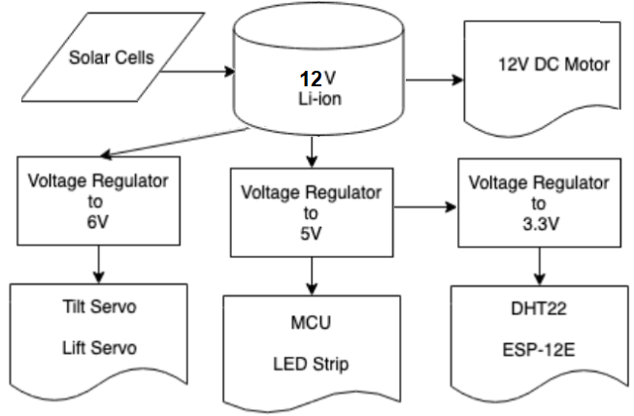
Power Diagram

Slide 18
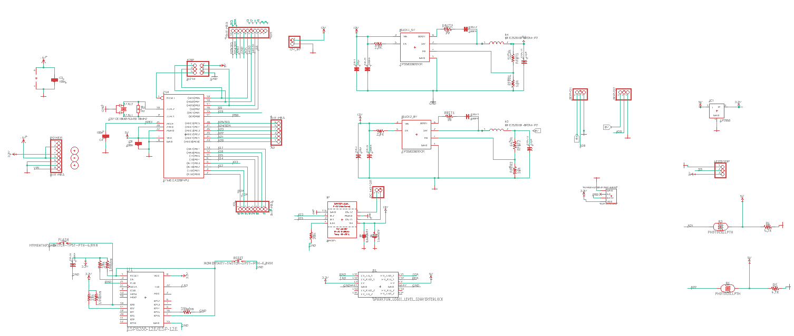
Initial Schematic

Slide 19
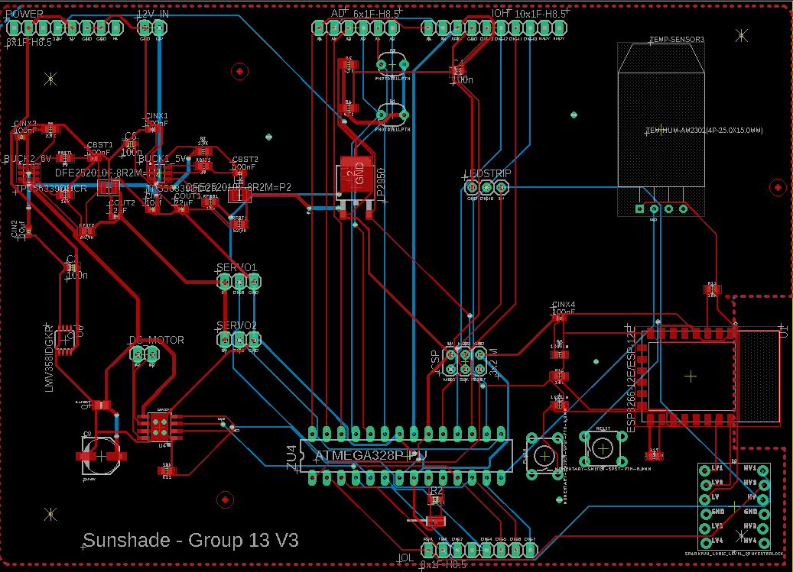
Board Layout

Slide 20
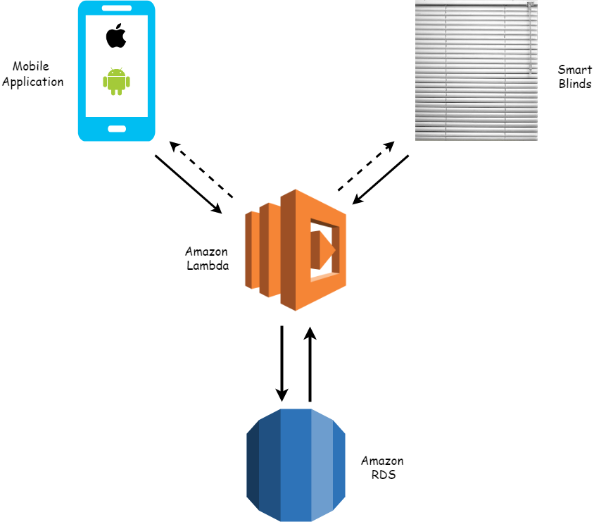
Software Design
Ensure consistent communication between blinds and user
Scalable and customizable storage
Accessible on the majority of platforms
Autonomous smart adjustments

Slide 21
 | React Native | Flutter
Learning Curve | High | High
Language | Javascript | Dart
Community | Great | Good
Documentation | Low | Great
GUI | Native | Built Widgets
Developers | Facebook | Google

Slide 22
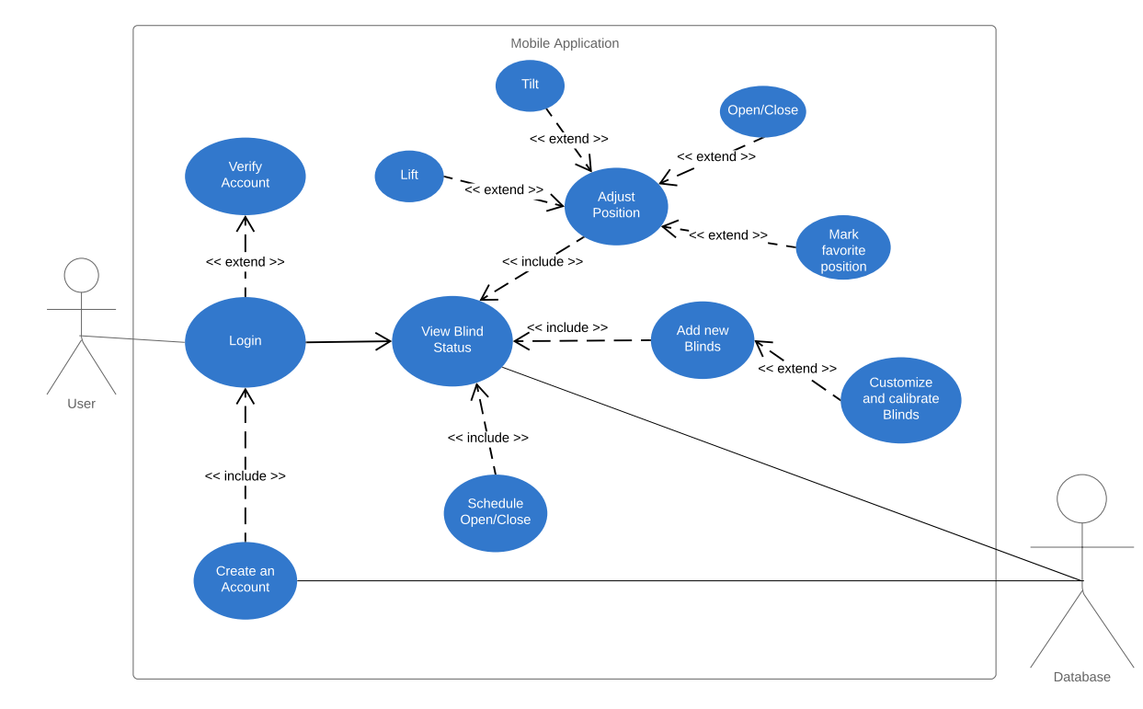

Slide 23
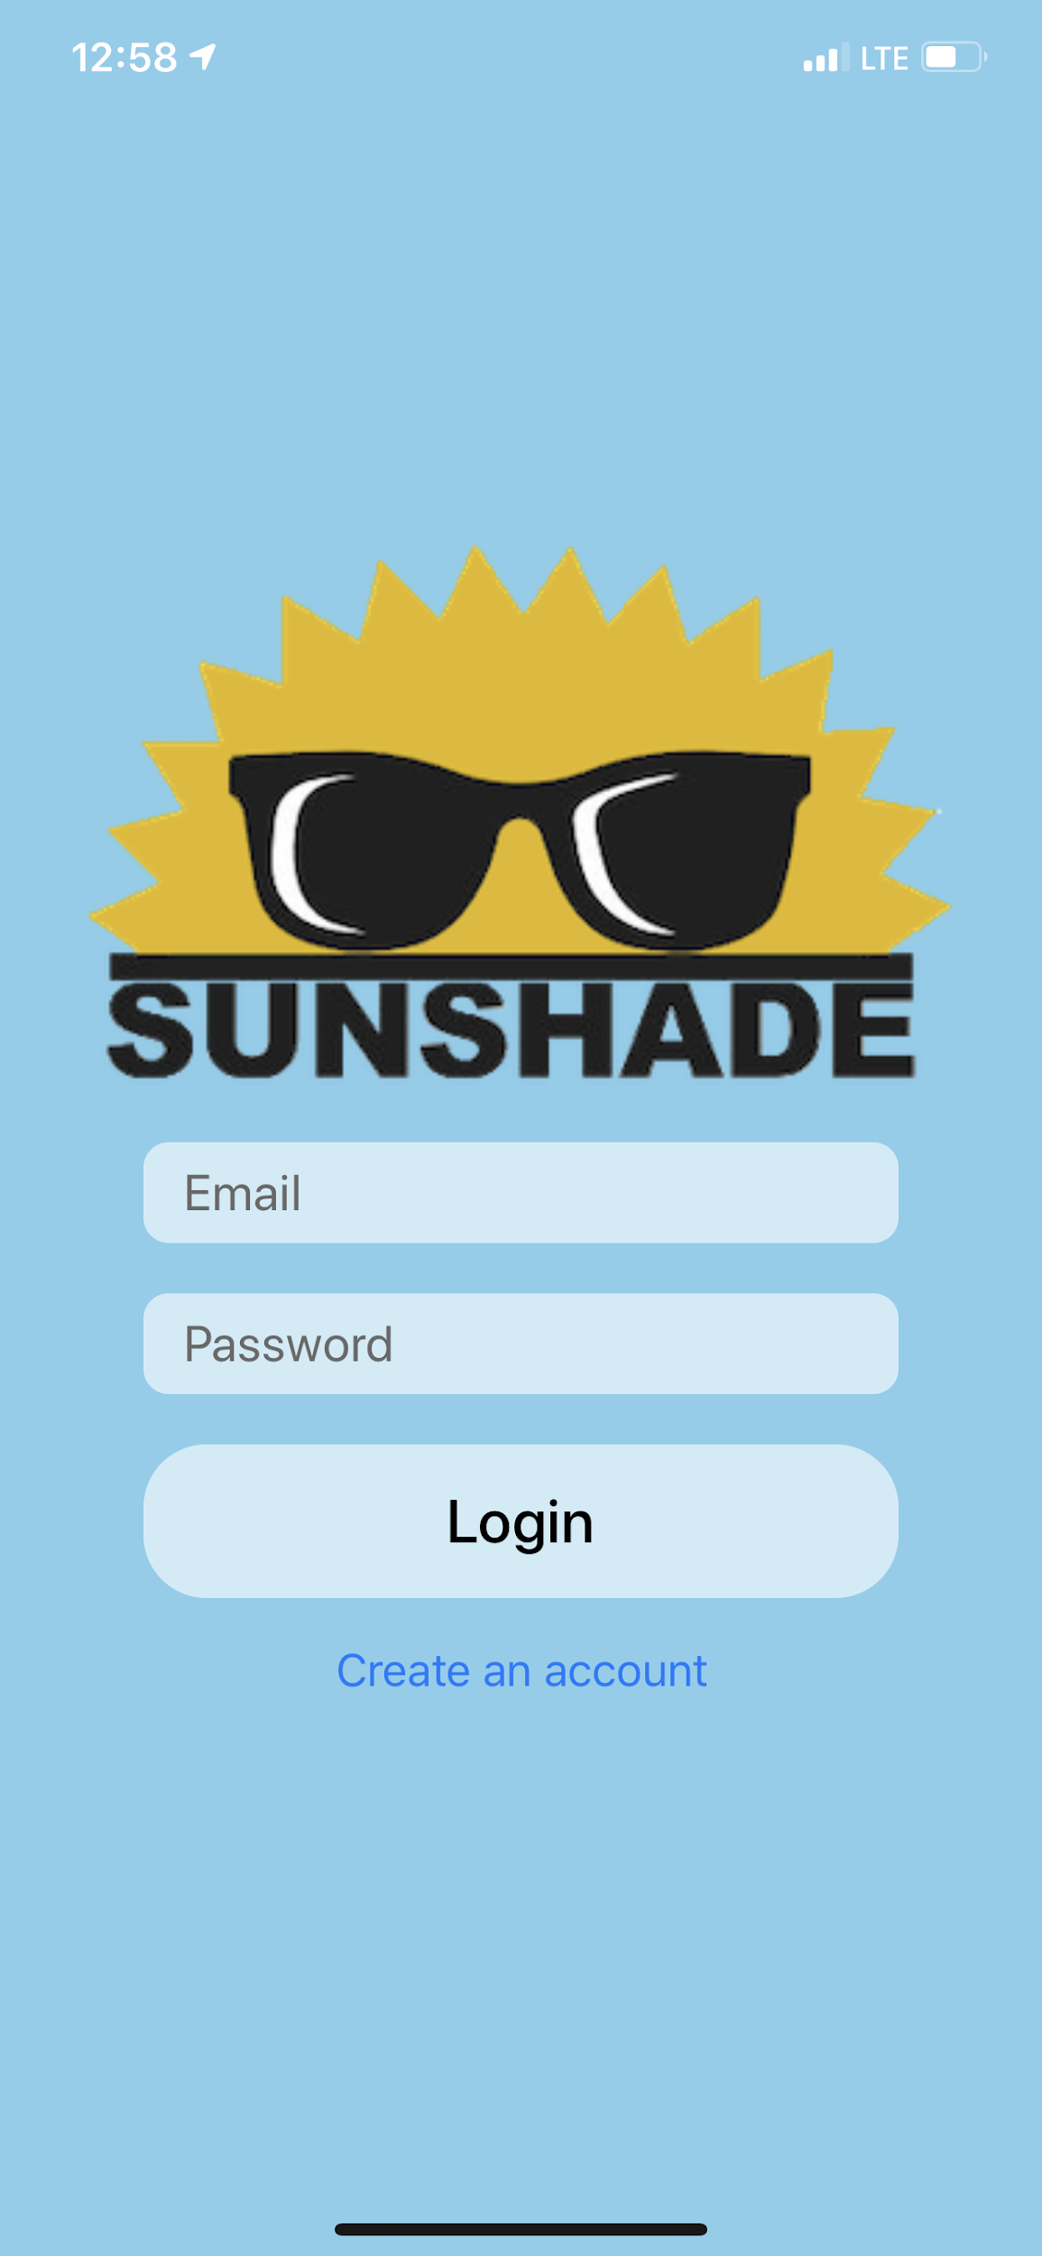
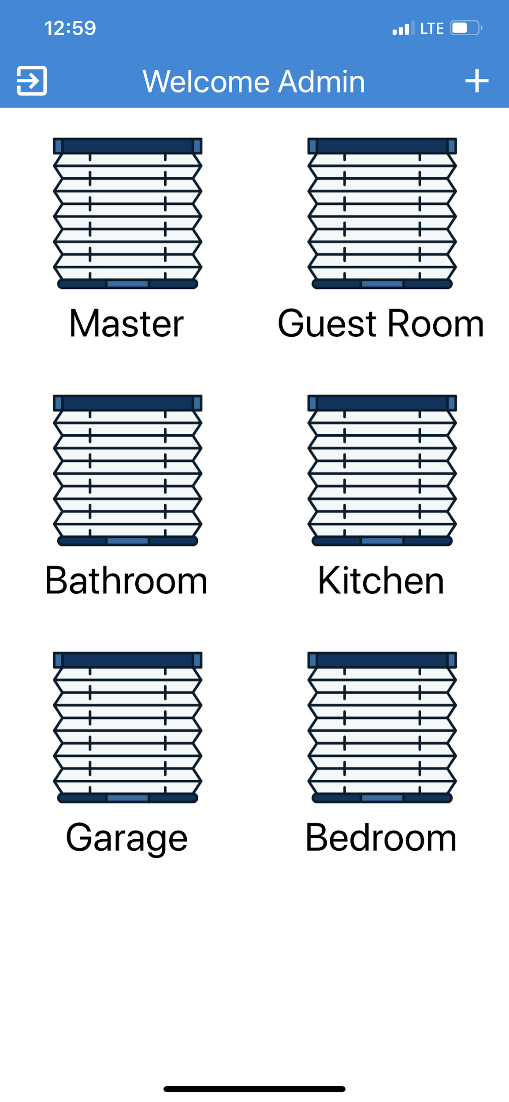
App Design
Simple and visually appealing
Easy to use
Plenty features and customizable

Slide 24
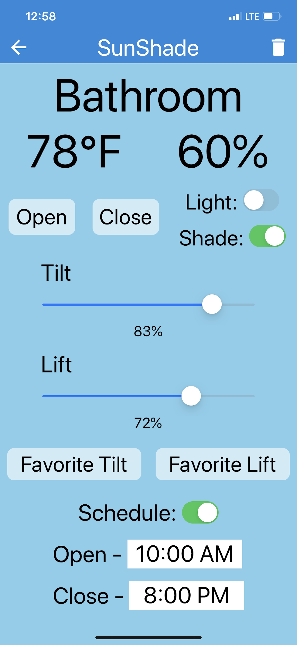
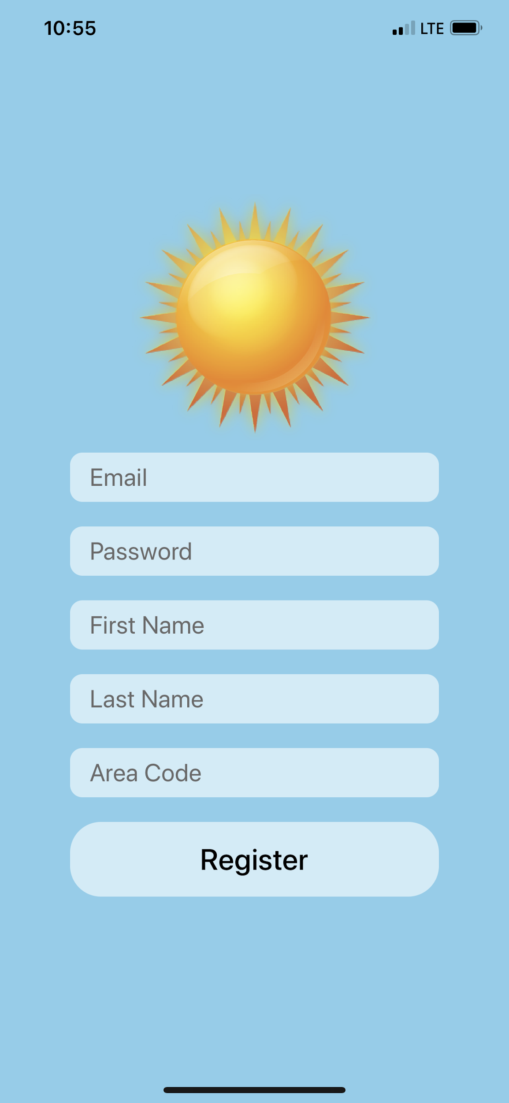

Slide 25
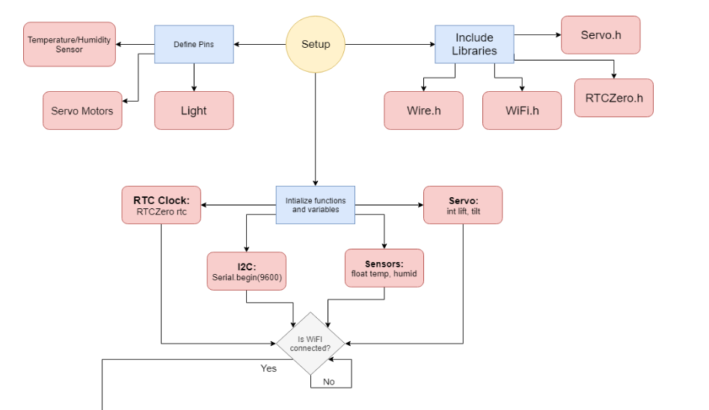
Arduino Programming
Sends/receives adjustments and data from sensors in a loop
Smart adjustments based on data
Power management

Slide 26
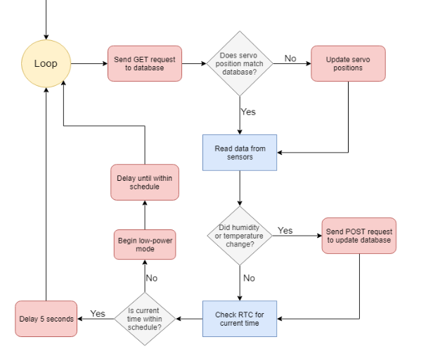

Slide 27
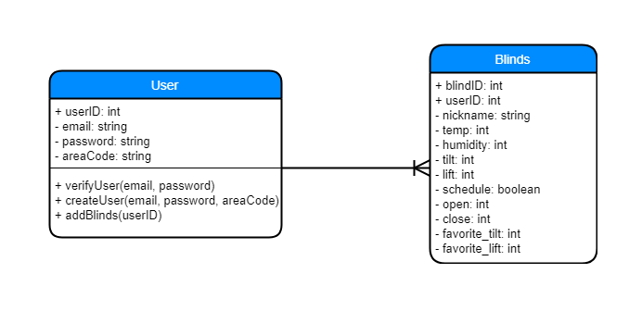
Amazon Web Services
RDS - One to Many
Lambda - Serverless
API Gateway - Requests
Scalable and accessible

Slide 28
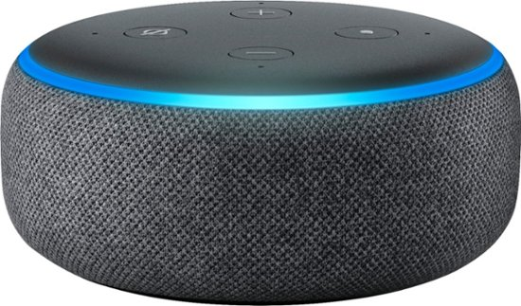
Voice Control
Will be using the Amazon Echo
Alexa Voice Service, ‘AVS’, is Amazon's very own built-in base of services built around the Echo
AVS provides the automatic speech recognition software required, along with natural language understanding, text-to-speech engines, APIs, hardware kits, software tools and all necessary documentation for such a design.
“Skill creation” is where builders can program specific voice commands and select the desired actions/reactions for their device
“Alexa, blinds closed.”

Slide 29
Timeline
Components mounted: | 9/28
Prototype testing phase: | 10/1-10/8
Arduino code complete: | 10/12
Prototype complete: | 10/18
PCB Design complete, ordered: | 10/18
*MIDTERM DEMO* | 10/21-10/23
Solar power system testing phase: | 10/23-10/29
Solar power system complete: | 10/29
Application online: | 10/26
8-PAGE Conference paper DUE | 11/8
Features online: | 11/11
Alexa Compatibility complete: | 11/15
PCB Testing phase: | 10/23-11/15
Alteration, redesign phase: | 11/11 -11/18
***Project Complete*** | 11/18
Showcase | 11/21-11/22
Final Document DUE | 12/2

Slide 30
Work Distribution Table
 | Alexander | Terrell | Miloud | Conor
Power: | Tertiary |  | Primary | Secondary
PCB: | Tertiary |  | Primary | Secondary
Embedded: | Shared | Shared | Shared | Shared
Application: | Secondary | Primary
Backend: | Secondary | Primary
Frame: | Primary |  |  | Secondary
Part Testing and Assembly | Secondary |  |  | Primary

Slide 31
Budget = 300$
Product: | Cost:
Servo 360: | 22.79$
Servo 180: | 19.99$
DC 12V Rollerhouse motor: | 42.88$
MCU Atmega328p: | 2$
ESP 12-E | 7$
18650 LI-ION IMR cell: | 5$ per cell (8 cells)
DHT22: | 11$
Blinds: | 33.88$
Product: | Cost:
Shades: | 15$
LDR: | 5$
Solar Panel Cells: | 15$ for 10
NeoPixel LED strip: | 10.99$
Frame; | 27$
Amazon Dot | 22$
Total: | 274.53
Not included: PCB, Voltage Regulators, Prototype Board, and Misc costs.

Slide 32
Issues
Delivery delays caused setbacks.
ESP12e Wifi Module connectivity issues.
6v buck was burned this morning.

Slide 33
Questions

