Slide 1
Smart Tabletop Gaming
By:
Richard Almario CpE
Hubert Barrantes CpE
Coraima Orochena EE
Jose Castano EE

Slide 2
Motivation and Objectives
Motivation | Objectives
To make the game paperless | To move the game pieces with a magnetic XY plotter
To merge a physical session with a Virtual tabletop | Implementation of the LEDs to add effect on the game
Able to communicate online | Able to use an application to command the game pieces' movement using an Wifi module

Slide 3
Features
Main | Secondary | Stretch goals
Move the pieces of the board by using the app | Pinpoint Ending and Starting points for game objects while the object is moving. | LED Spell effects
Track the pieces on the board | Web app: have a responsive gui | LED range of sight of game pieces
Pinpoint pos on the board by using the web app |  | Layered/Scalable maps
Have a working pathfinding with the plotter (don’t collide game objects)

Slide 4
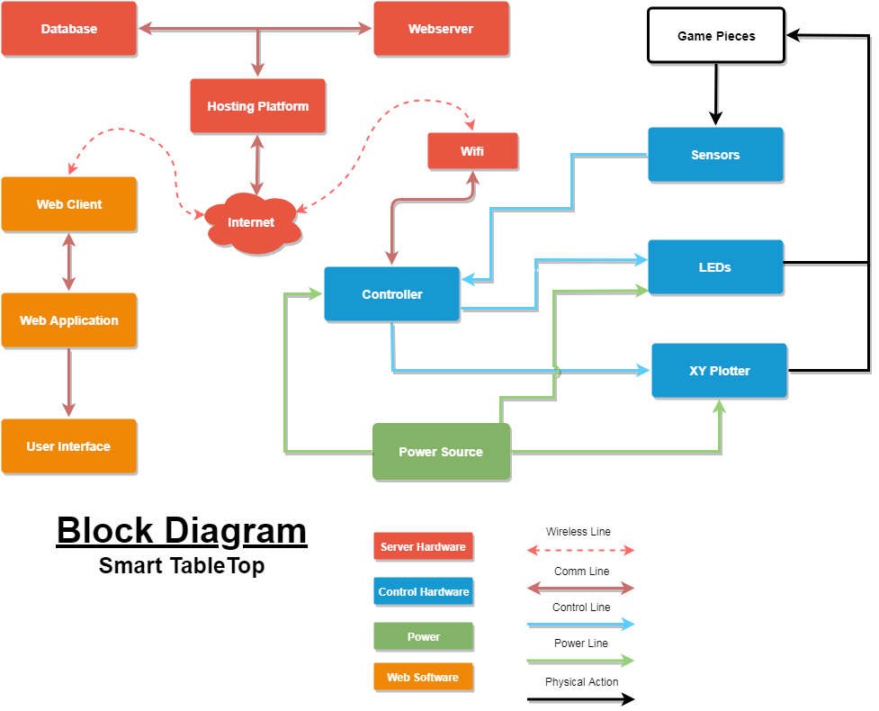
Block Diagram

Slide 5
Project Concept

Slide 6
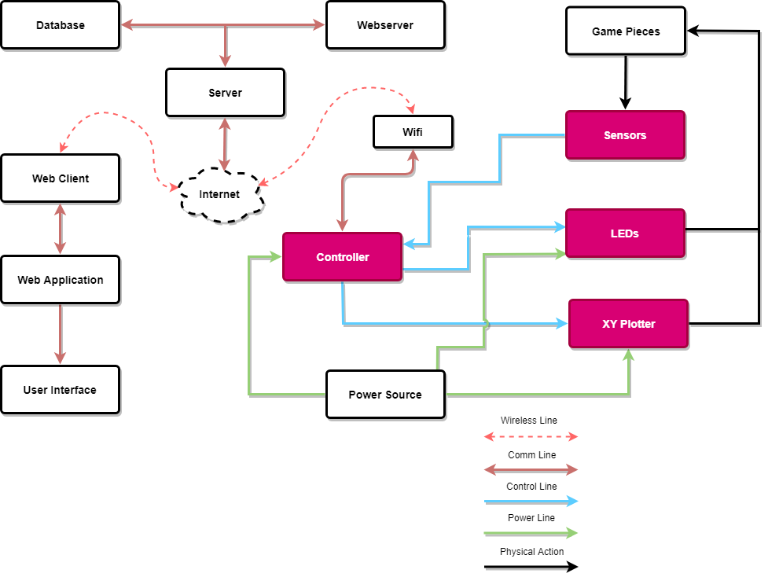
Controller and Schematics

Slide 7
MCU Dev Board Types
Arduino MEGA 2560 | Raspberry PI
Relatively Cheap | Relatively Expensive
Less computational power | Mainly used for computer's HDMI visual I/O
Used perfectly for hardware | Used perfectly for software

Slide 8
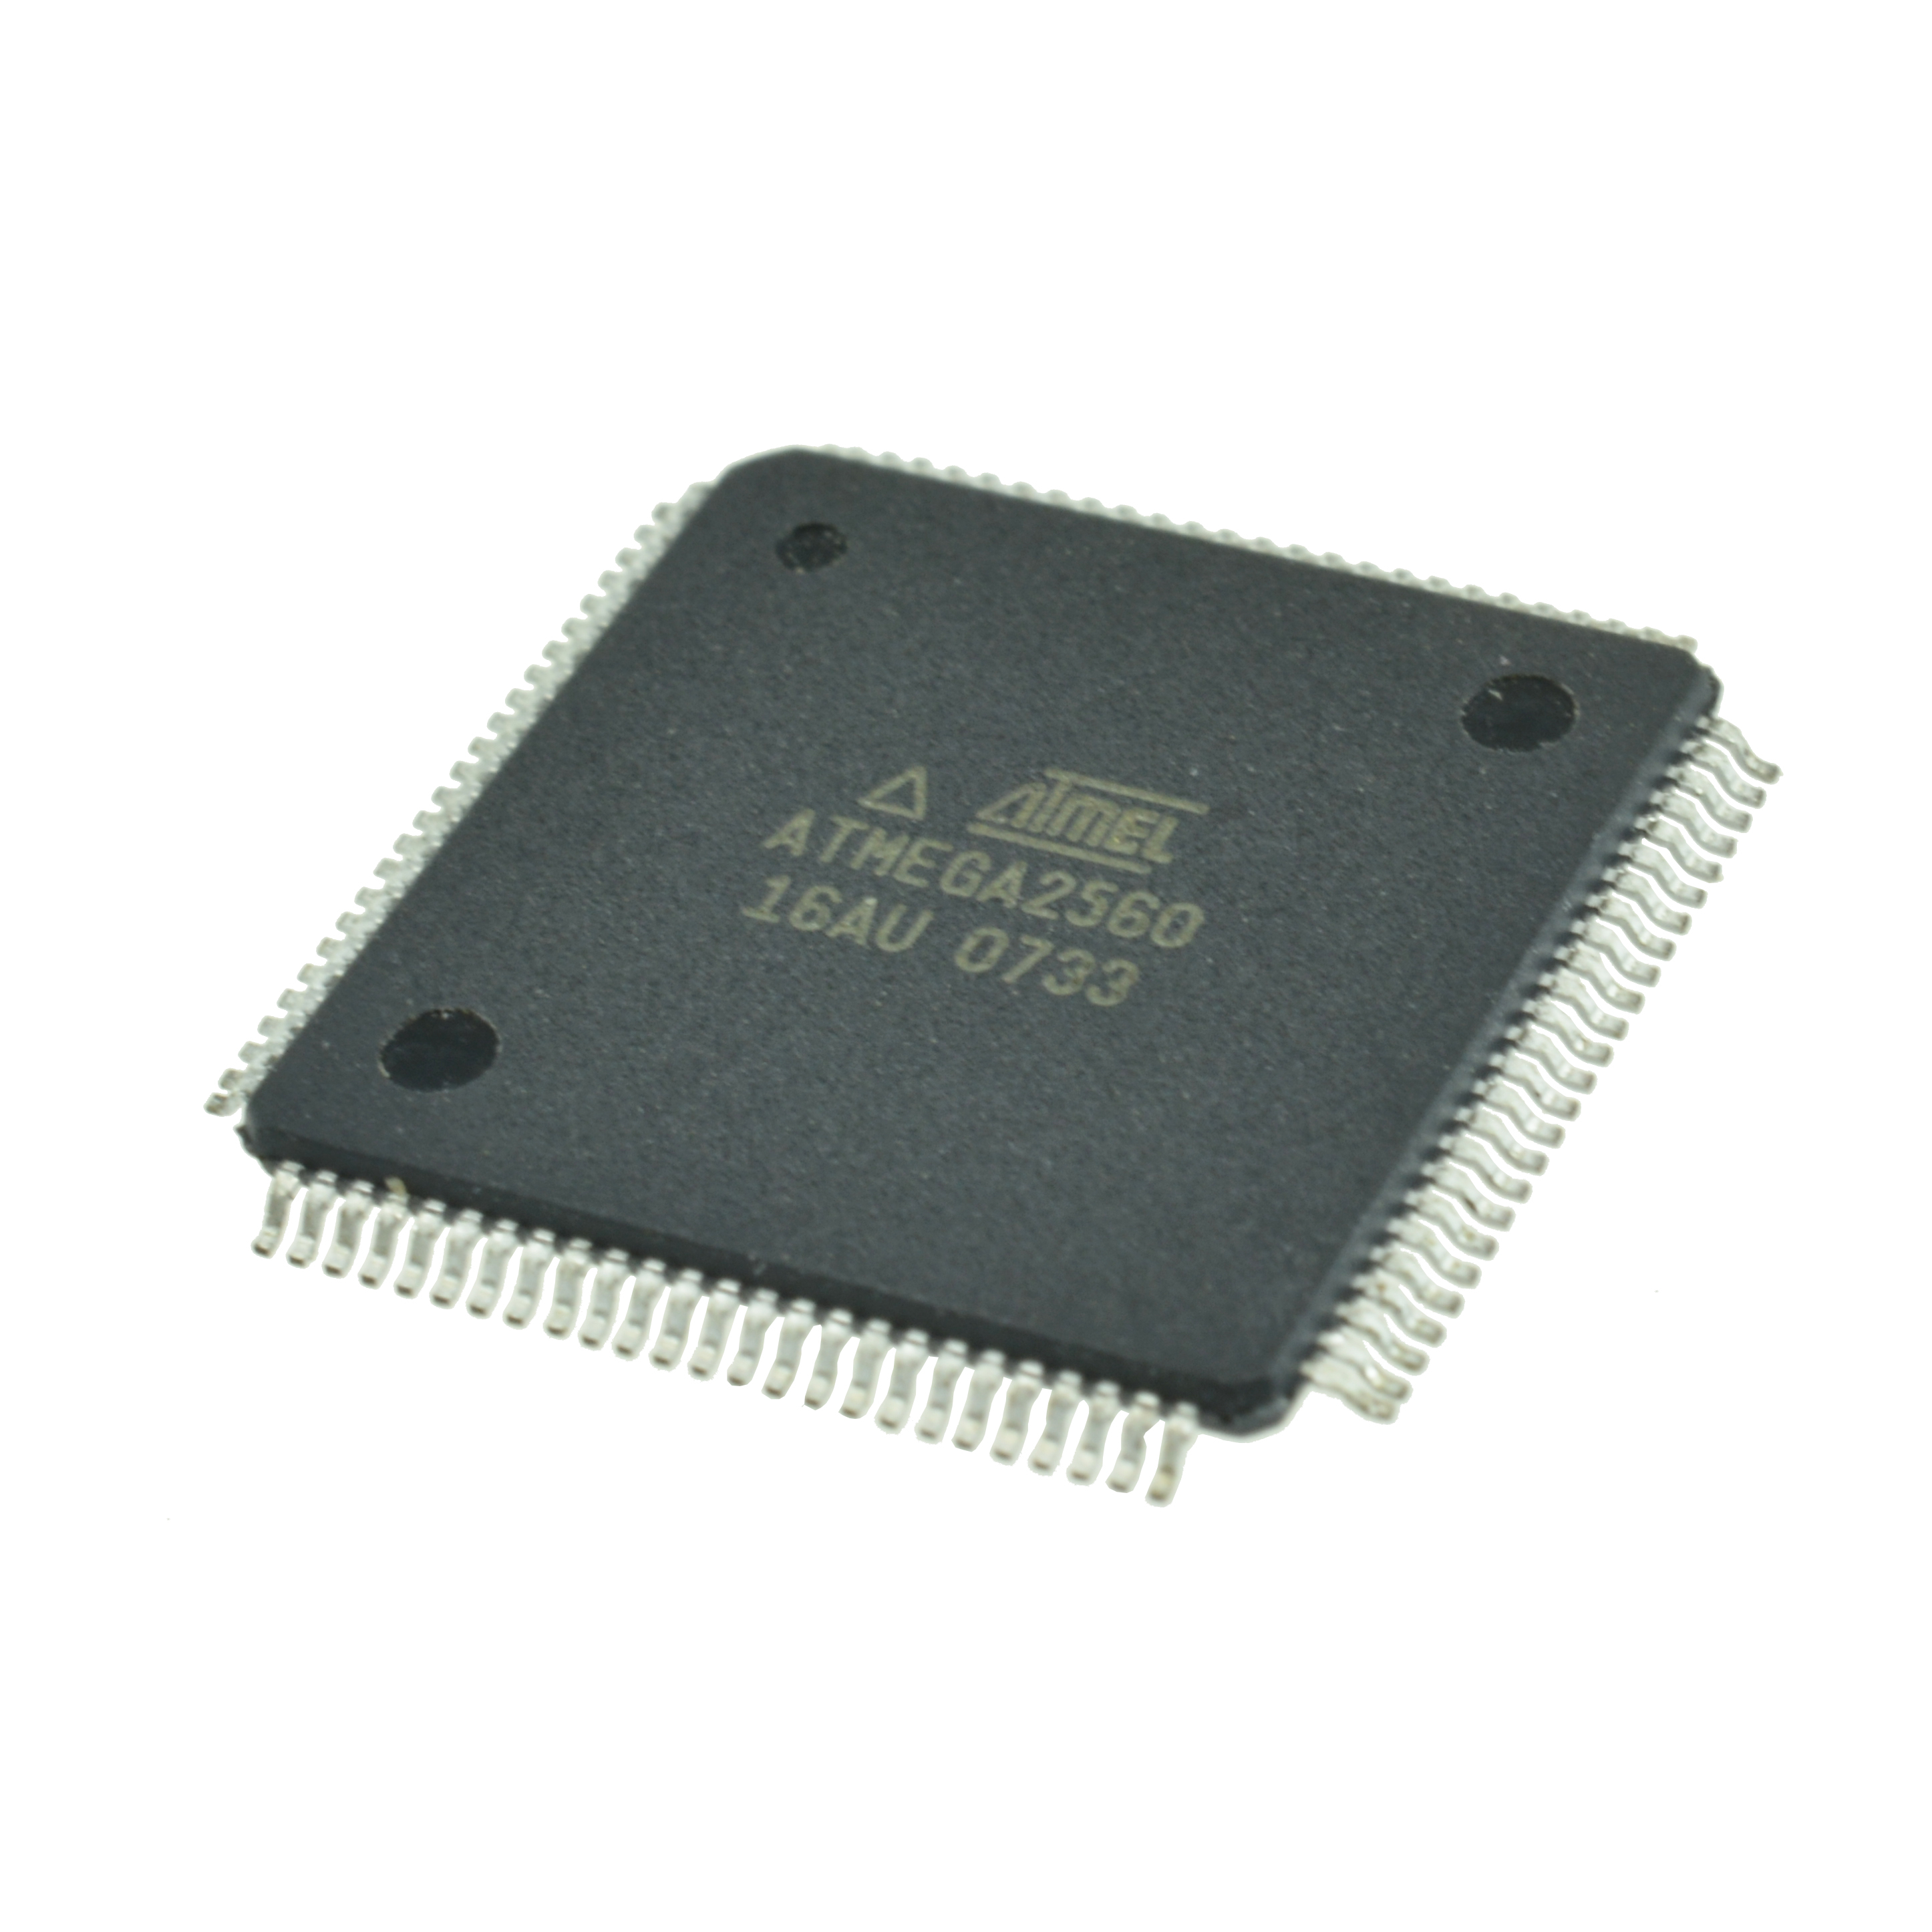
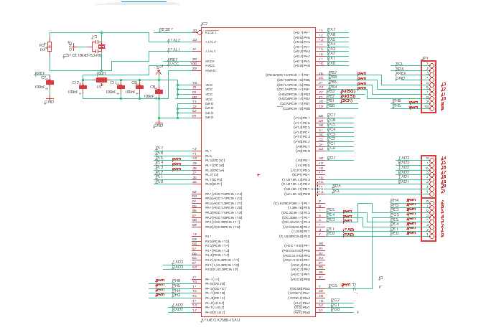
ATMEGA2560 MCU

Slide 9
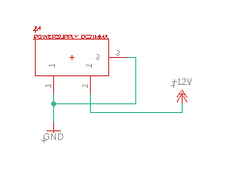
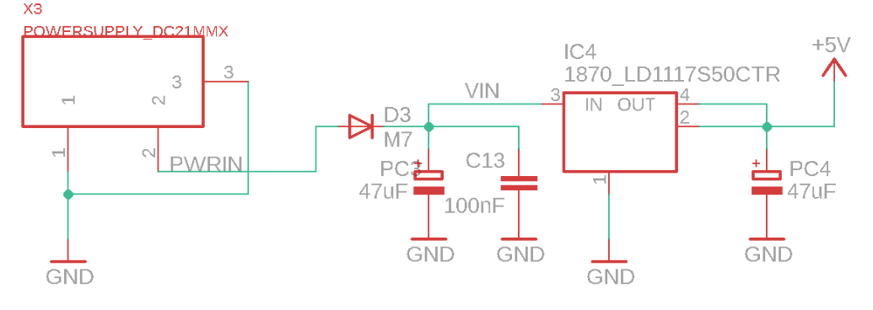
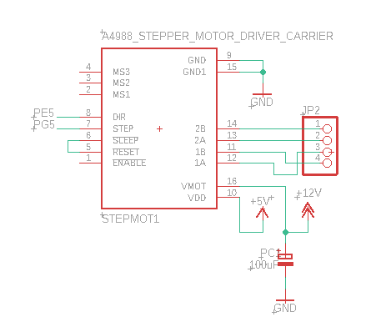
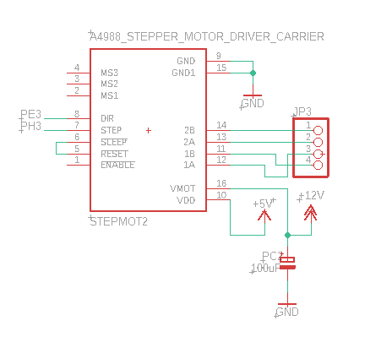
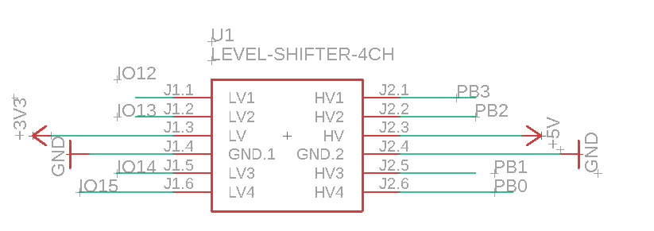

Slide 10
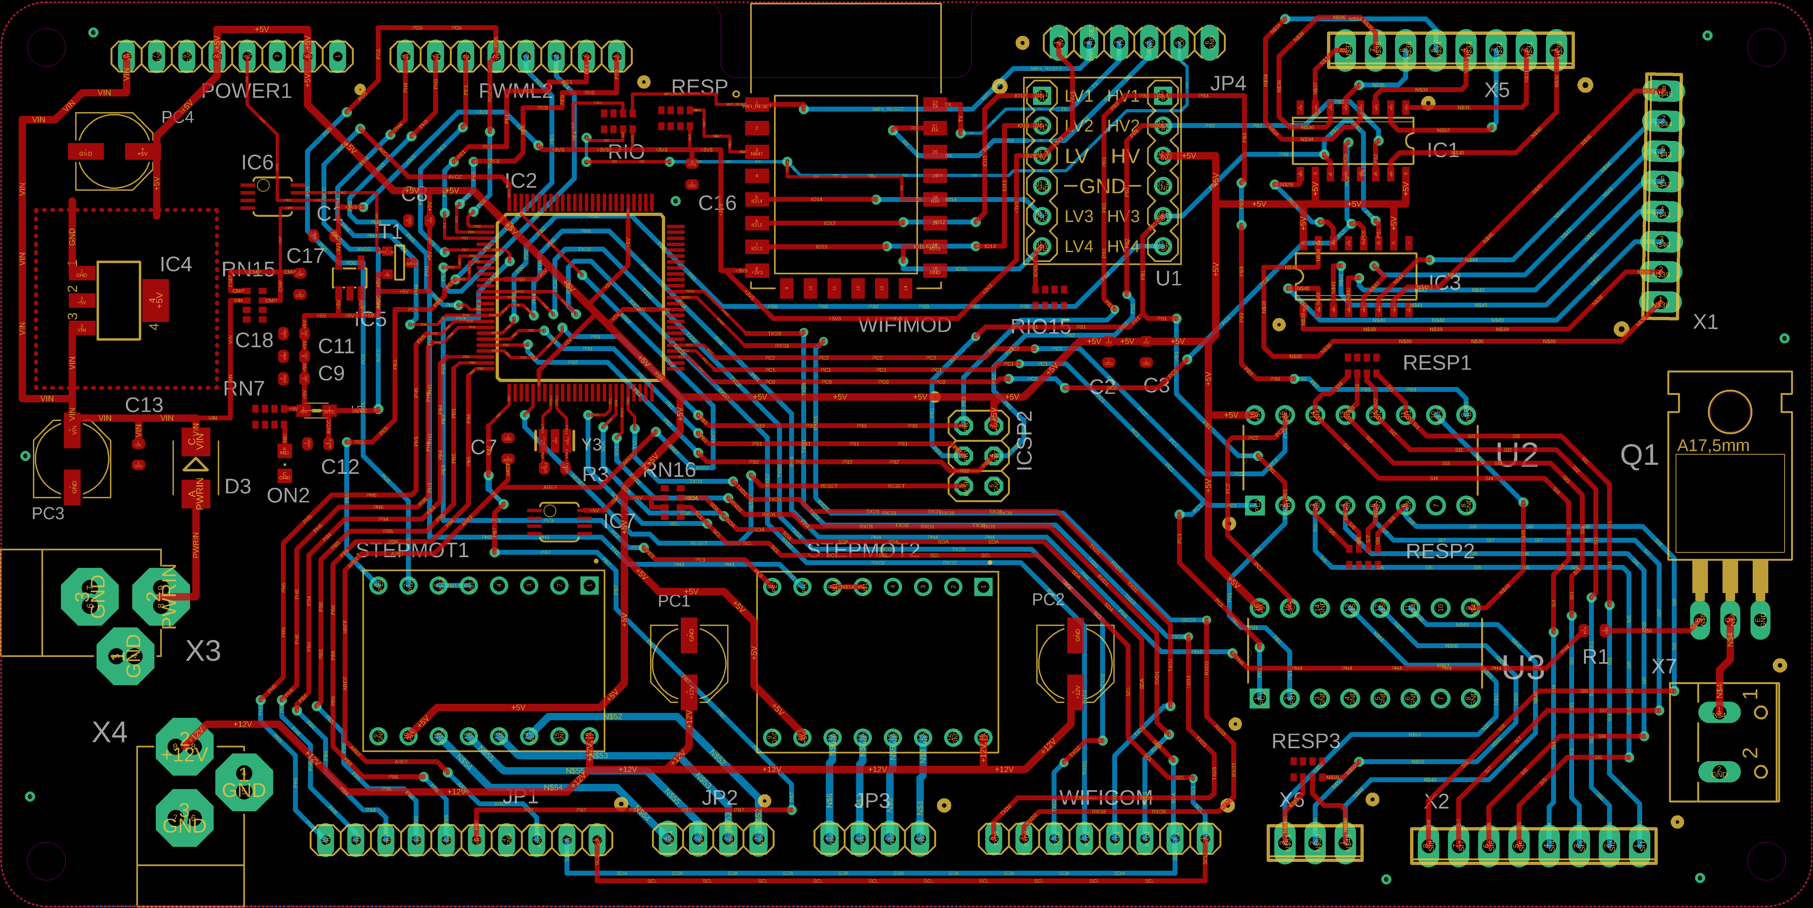
PCB Diagram

Slide 11
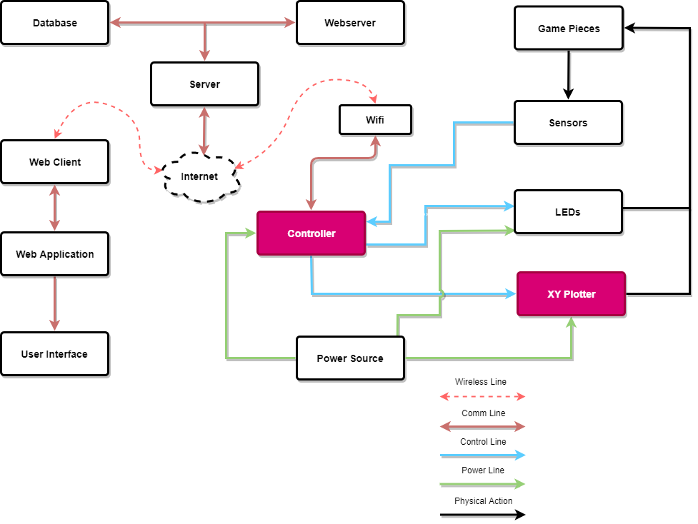
XY Plotter

Slide 12
XY Plotters
Name | Working Area | Price
Laser Engraver Machine | 15.7 X 19.7 in | $198.00
GoooGi Geeklab | 8.3 X 11.7 in | $255.00
EleksDraw Pen Writing Machine | 11 X 7.9 in | $299.90
IDRAW Machine | 11.7 X 16.5 in | $350.00

Slide 13
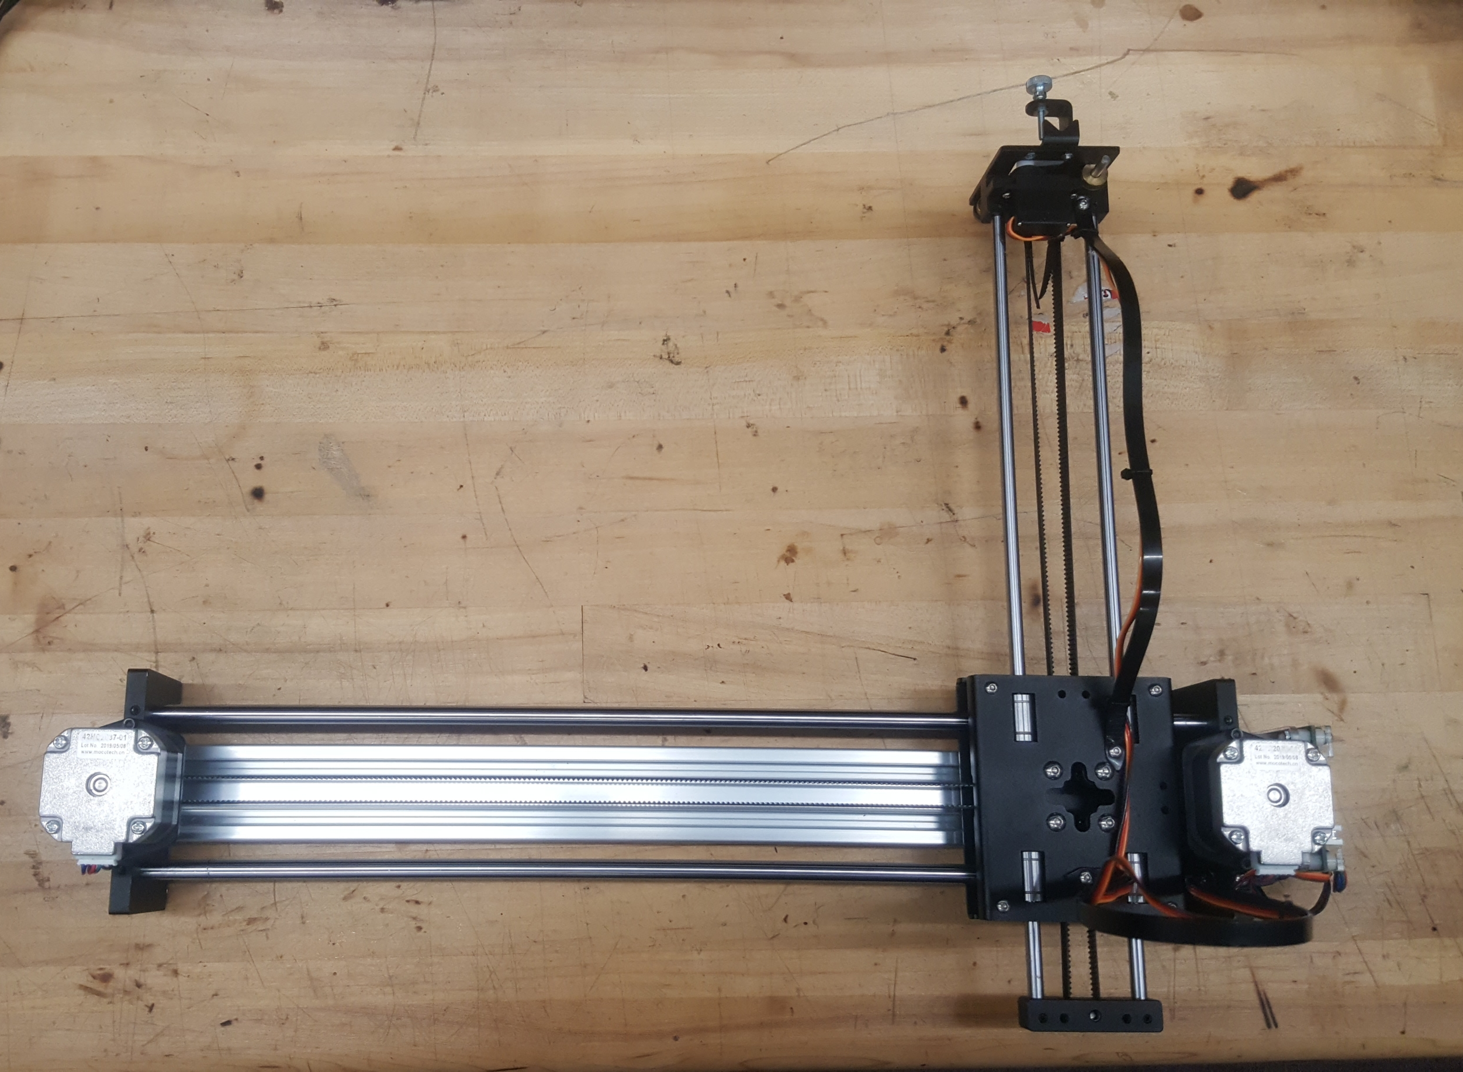
IDRAW Machine

Slide 14
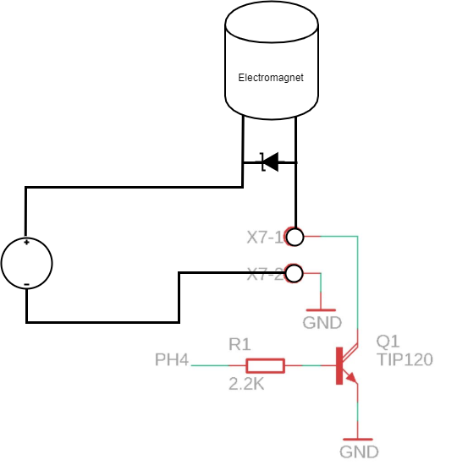
Electromagnet Diagram

Slide 15
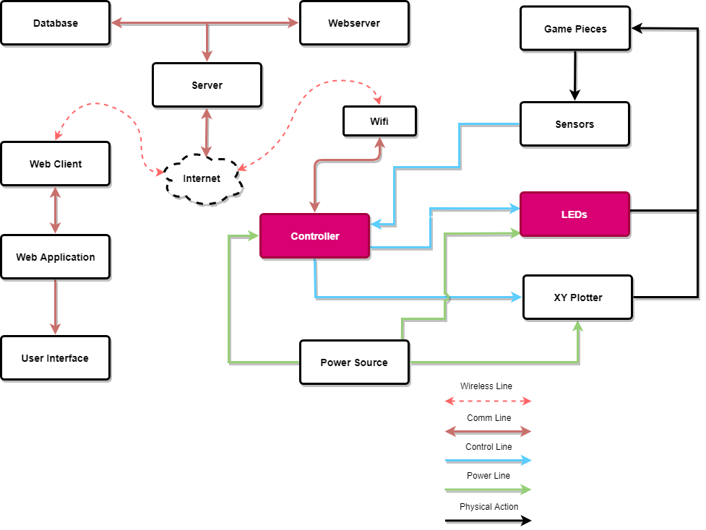
LEDS

Slide 16
LEDS

Slide 17
FastLED Library
Used to program LED's
FastLED has a more robust feature set
Fast math and memory functions
color palettes
Newer than Adafruit Neopixel Library

Slide 18
LED WS2182B Sequence Diagram

Slide 19
LED Matrix Construction

Slide 20
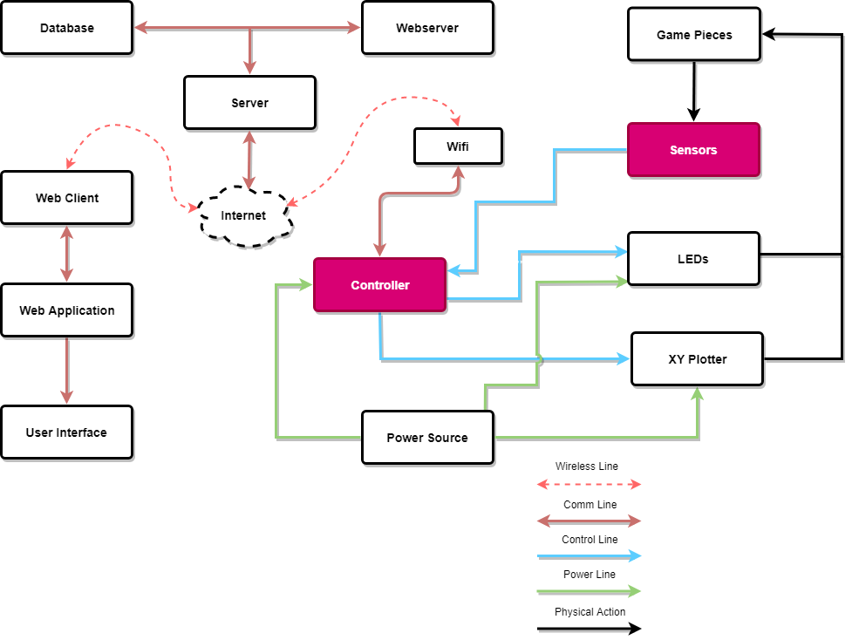
Sensors

Slide 21
Reed Switch Matrix

Slide 22
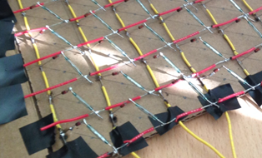
Reed Switch Matrix Construction

Slide 23
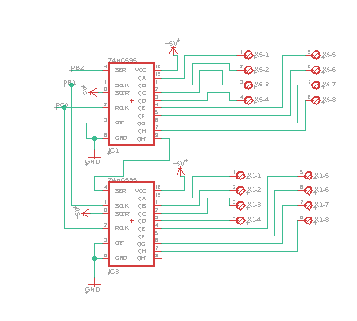
Sensor Input

Slide 24
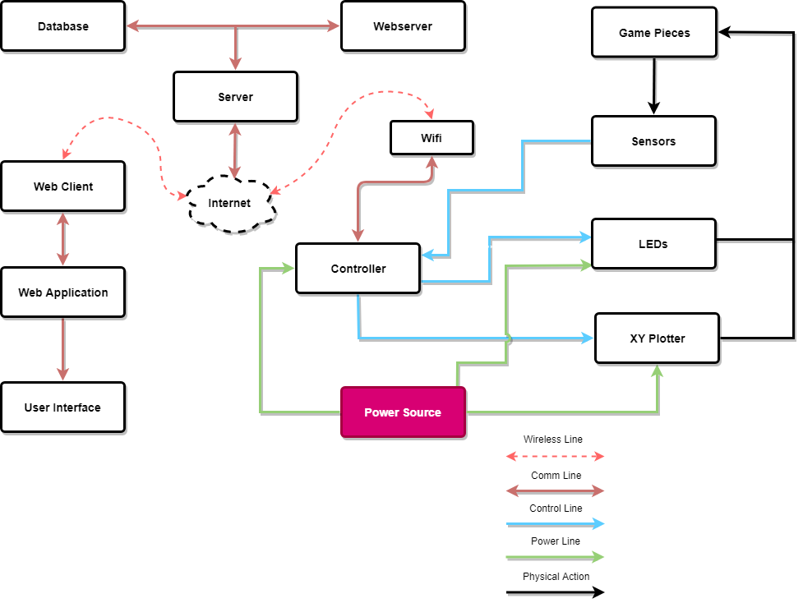
Power

Slide 25
Voltage Source
Voltage Source | Component
5V-12V | PCB
5V | LED Drivers
12V | XY Plotter

Slide 26
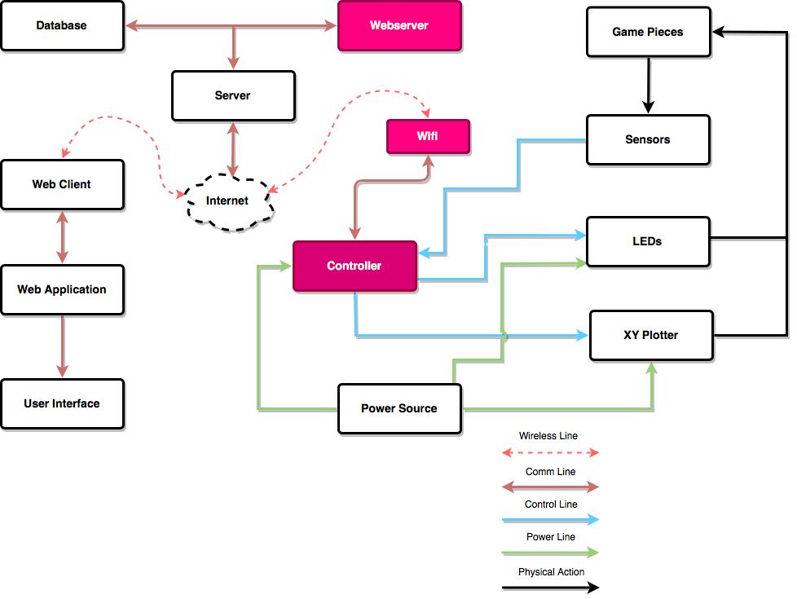
WiFi-Communication

Slide 27
WiFi Module: ESP8266-12e
Specifications:
Operating Voltage | 3.3V
Operating Current | 80mA
Package size | (16x24x3)mm
Security | WPA/WPA2
User Configurations | AT instruction set Cloud server
Network Protocols | IPv4, TCP/UDP/HTTP
Used to stablish wireless network connection for the microcontroller
Integrated cache to improve the performance of the system and minimize memory requirements
Abundant Learning Resources
Relatively inexpensive
Flexible designed and enhanced functions

Slide 28
Communication Protocol: Websocket vs SocketIO
Websocket | SocketIO
Protocol which is established over the TCP connection | Library used to work with websocket
Provides full duplex communication between client and server | Provides the event-based communication between browser and server
Proxy and load balancer are not supported | Connection can be established in the presence of proxies and load balancers
Doesn't support broadcasting | Supports Broadcating
doesn’t have a fallback option. | It supports fallback options.

Slide 29
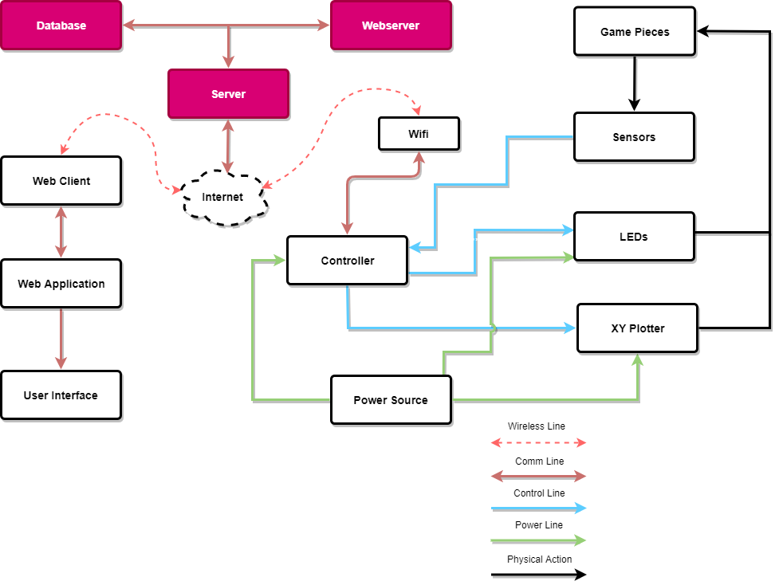
Web Server and Data Storage

Slide 30
Webserver Comparison : PHP Vs NodeJS
PHP | NodeJS
Easy to configure the development environment | Built in server support
All internet hosting services support PHP | Uses a single syntax for client and server side of the website. (This improves the reusability of the code and makes the work of a full stack developer easier
Supports more frameworks and CMS | Module caching – modules are downloaded and initialized when they are called for the first time, afterward they are constantly available
uses its own memory, so the workload of the server and loading time gets reduced automatically | Stream module makes it easier to work with large files
Great for CMS technologies | Almost identical syntax to JavaScript, thus it easy to pick-up and learn for JS developers.

Slide 31
Webserver Comparison : PHP Vs NodeJS
-Node JS is the chosen webserver to utilize in our web application:
Reasons:
allow us to create high performance, highly scalable, “real-time” applications.
benefit from re-usability of code and the lack of context switching.
Only one programming language used(JavaScript) which allows user to write both front and back end in the same language.

Slide 32
Local Datatabase Storage
Free to store data locally, can use a json file to store all data
Very secure
User does not require internet connection to access it

Slide 33
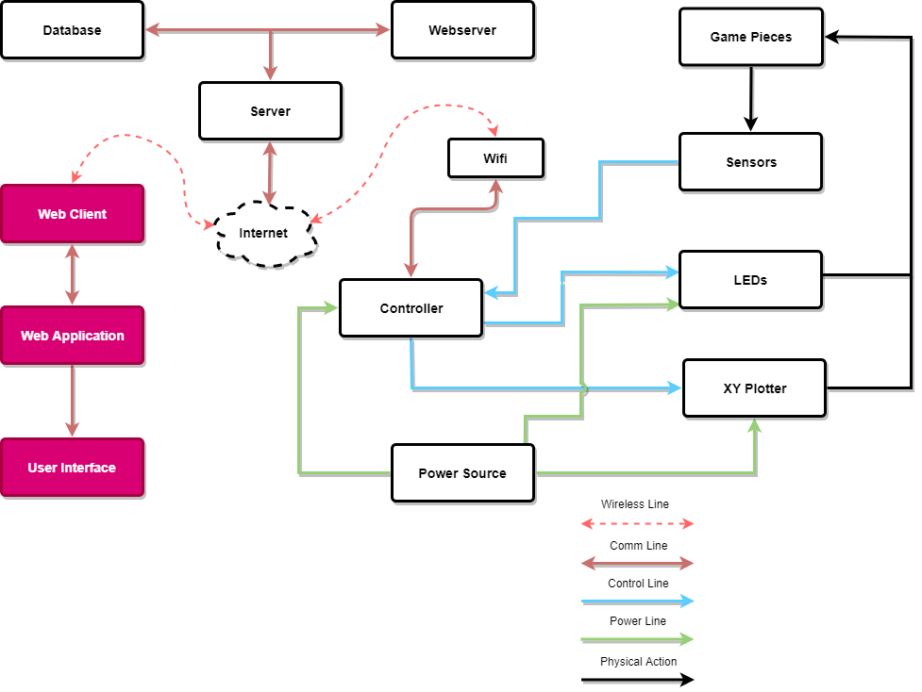
Web & Gameboard App Design

Slide 34
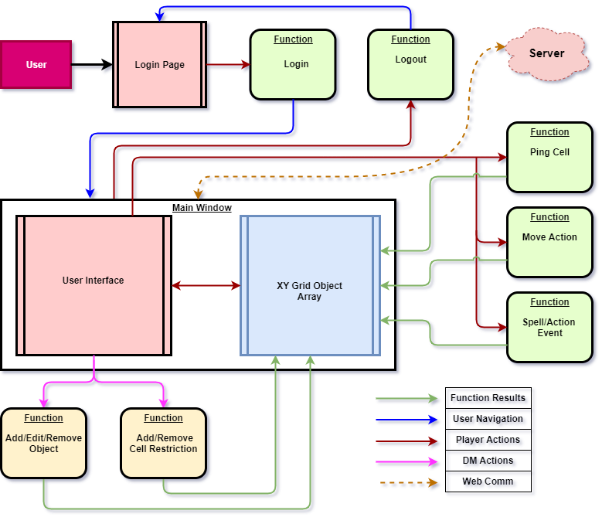
Web App Block Diagram
Landing page after login validation
Large Grid space
User interaction with the Grid table reflects these actions on the physical gameboard

Slide 35
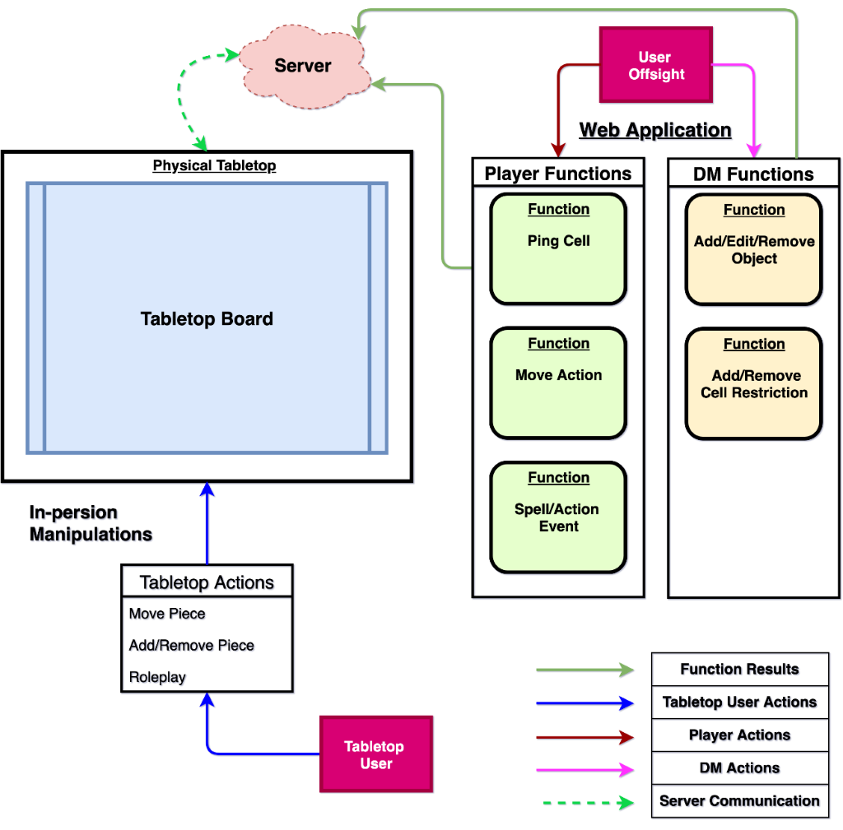
Tabletop Block Diagram
User Actions are transmitted over the web
Offsite user actions reflect on the gameboard.
Tabletop users actions are also picked up as an interrupt.

Slide 36
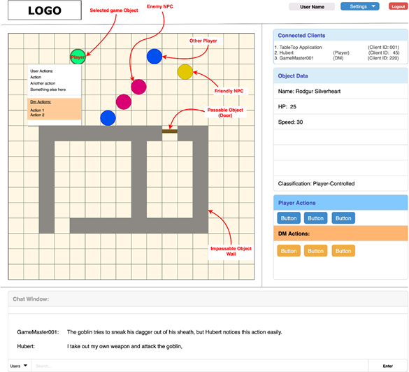
User Interface
The Game board matrix displays the current state of the board
Selected objects display basic information on the UI

Slide 37
Software Design
Graphical UI Advantages vs Disadvantages
Advantages | Disadvantages
Relatively easy to use, ideal for a beginner. | GUIs take a large amount of hard disk space compared to other interfaces
Easy to explore and find way around system using the WIMP/GUI interface method | Need significantly more memory(RAM) to run compared to other type interfaces
No need to learn complicated commands | Use more processing power compared to other type of interfaces

Slide 38
Software Design

Slide 39
Administrative

Slide 40
Financing
Budget Expectations
Unit | Quantity | Cost
XY Plotter | 1 | $350
Sensors | 176 | ~$150
LEDs | 176(11x16) | $45
Controller | 1 | $15-$30
Server | 1 | $100
Power Source | 3 | $80
Magnet | Variable | ~$2-$20
PCB Frame |  | ~$700
Project Enclosure |  | ~150

Slide 41
Work distribution
 | X/Y plotter | Sensors/LED | PCB/ Schematic Desgin | WiFi Communication | Web Application/Server
Jose | X | X | X
Coraima | X | X | X
Hubert |  | X | X | X | X
Richard | X | X | X | X | X

Slide 42
Progress

Slide 43
Issues
Wifi connection
Current drain on the MISO bus

