Slide 1
Smart Tabletop Gaming
By:
Richard Almario CpE
Hubert Barrantes CpE
Coraima Orochena EE
Jose Castano EE

Slide 2
Motivation and Objectives
Motivation | Objectives
To make the game paperless | To move the game pieces with a magnetic XY plotter
To merge a physical session with a Virtual tabletop | Implementation of the LEDs to add effect on the game
Able to communicate online | Able to use an application to command the game pieces' movement using an Wifi module

Slide 3
Features
Main | Secondary | Stretch goals
Move the pieces of the board by using the app | Pinpoint Ending and Starting points for game objects while the object is moving. | LED Spell effects
Track the pieces on the board | Web app: have a responsive gui | LED range of sight of game pieces
Pinpoint pos on the board by using the web app |  | Layered/Scalable maps
Have a working pathfinding with the plotter (don’t collide game objects)

Slide 4
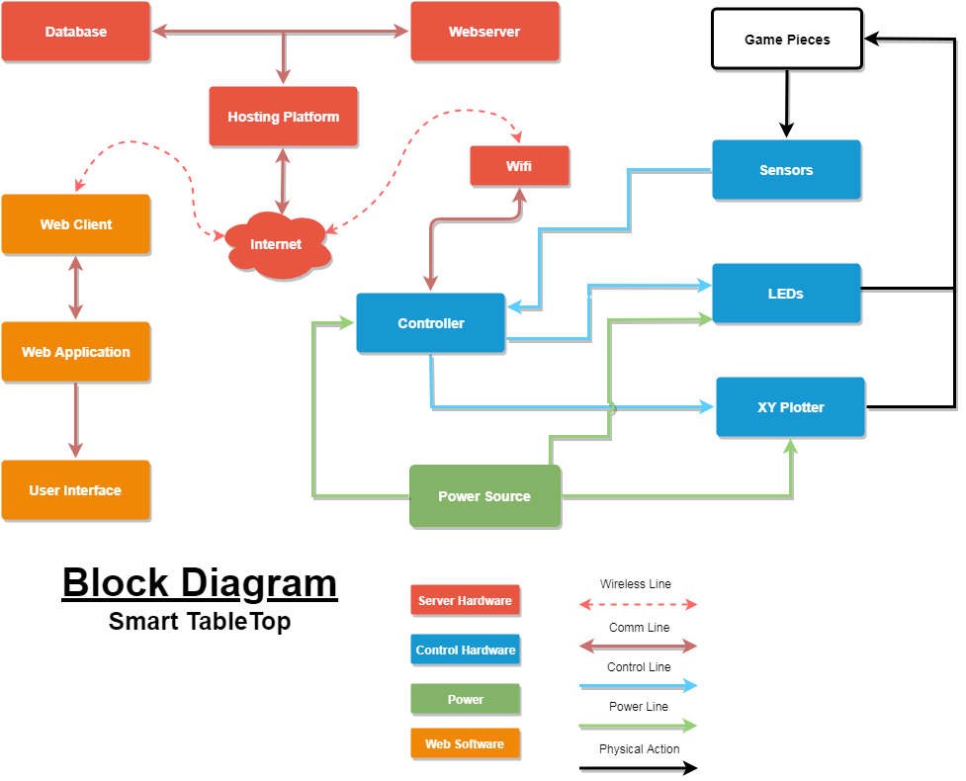
Block Diagram

Slide 5
Project Concept

Slide 6
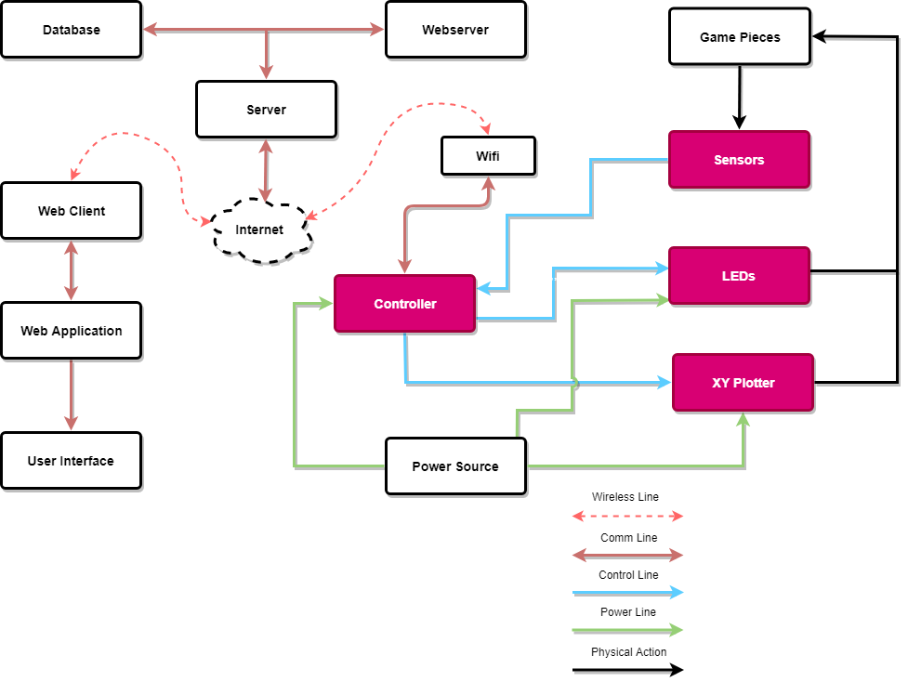
Controller and Schematics

Slide 7
MCU Dev Board Types
Arduino MEGA 2560 | Raspberry PI
Relatively Cheap | Relatively Expensive
Less computational power | Mainly used for computer's HDMI visual I/O
Used perfectly for hardware | Used perfectly for software

Slide 8
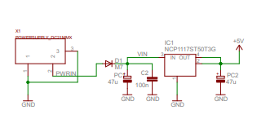
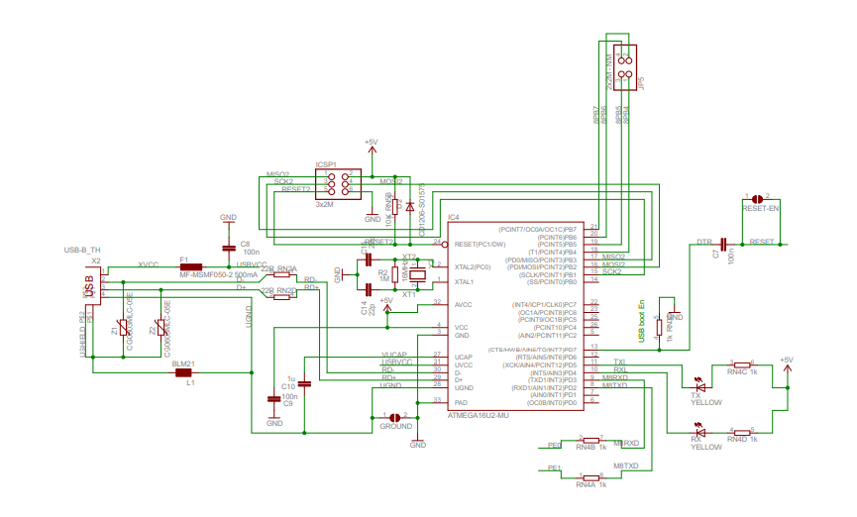
Arduino MEGA 2560

Slide 9
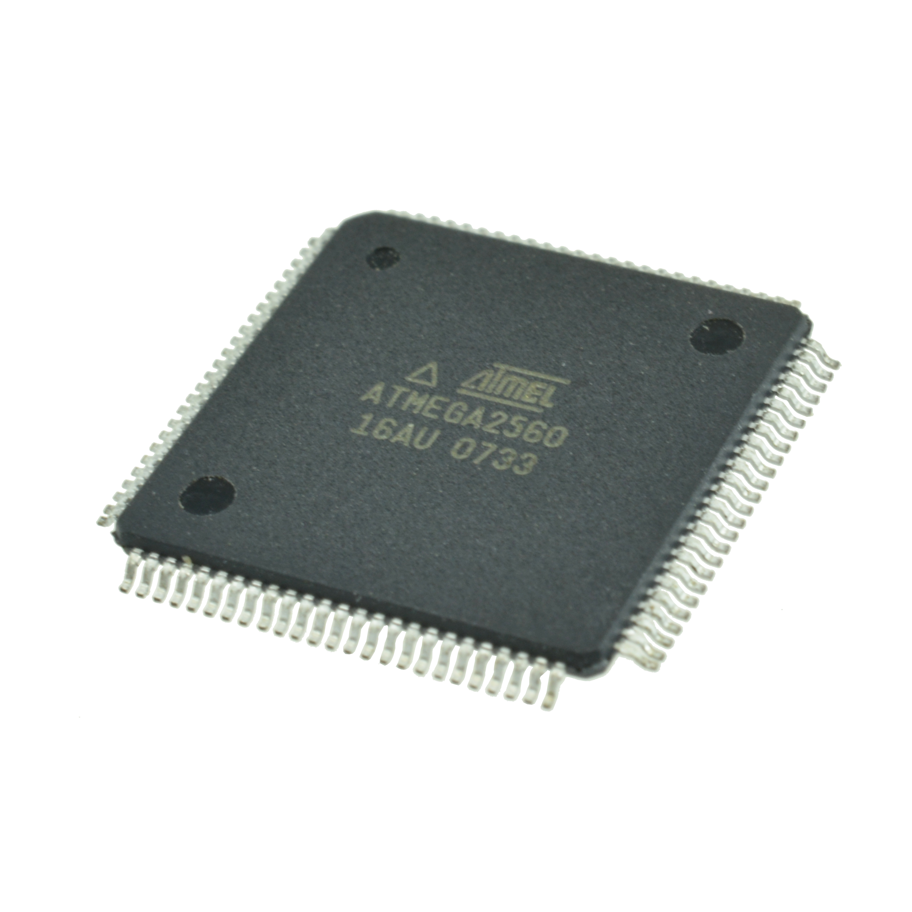
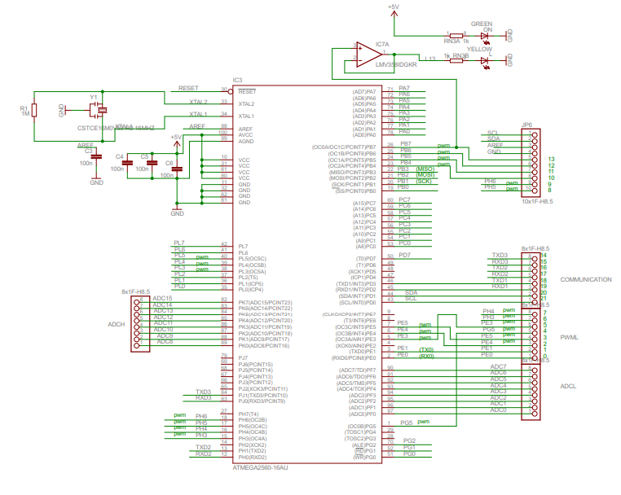
ATMEGA2560 MCU

Slide 10
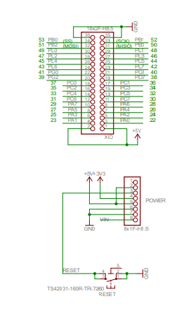
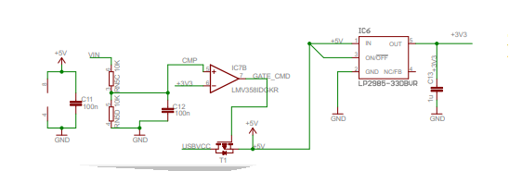
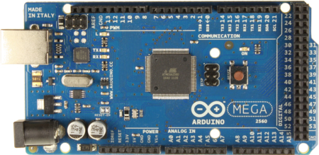

Slide 11
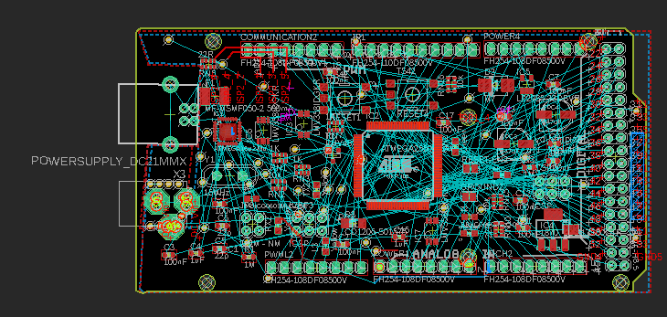
PCB Diagrams

Slide 12
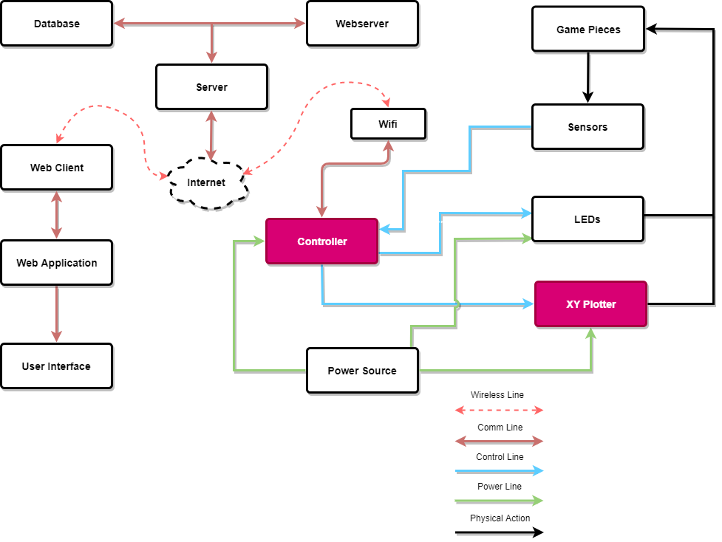
XY Plotter

Slide 13
XY Plotters
Name | Working Area | Price
Laser Engraver Machine | 15.7 X 19.7 in | $198.00
GoooGi Geeklab | 8.3 X 11.7 in | $255.00
EleksDraw Pen Writing Machine | 11 X 7.9 in | $299.90
IDRAW Machine | 11.7 X 16.5 in | $350.00

Slide 14
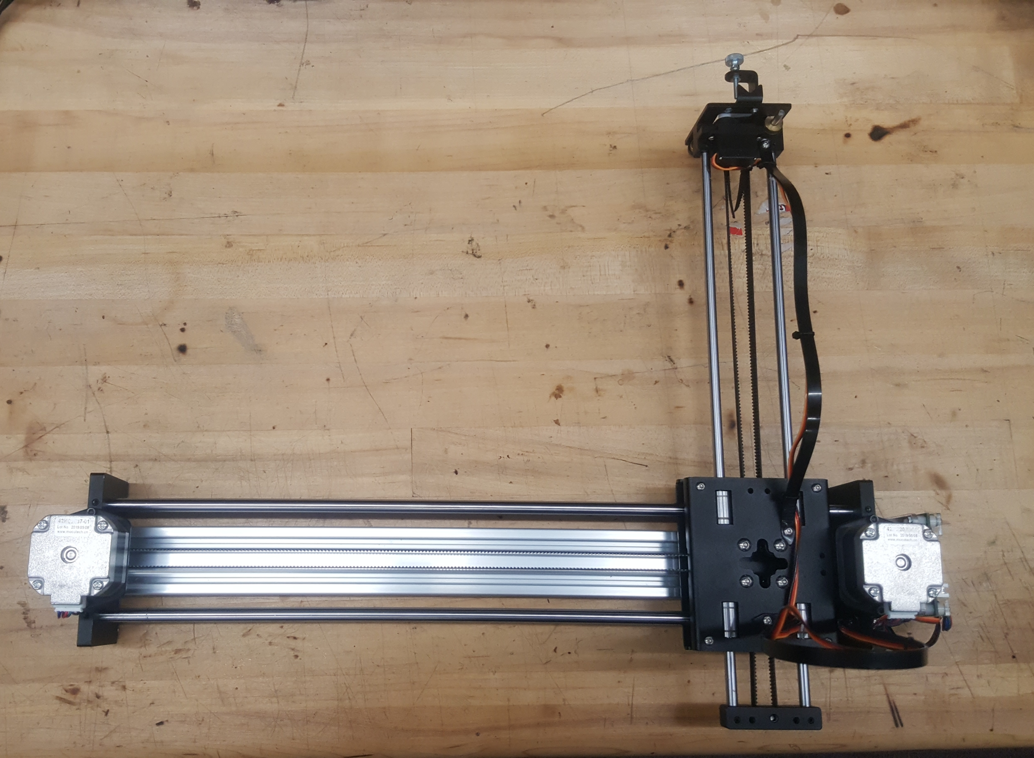
IDRAW Machine

Slide 15
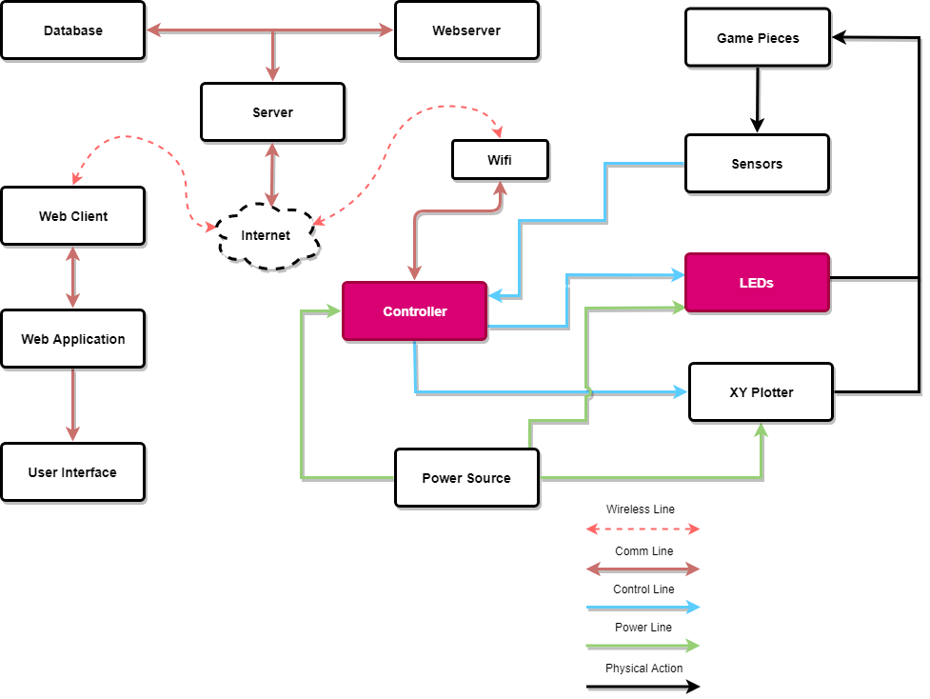
LEDS

Slide 16
LEDS

Slide 17
LED WS2182B Matrix Diagram

Slide 18
FastLED Library
Used to program LED's
FastLED has a more robust feature set
Fast math and memory functions
color palettes
Newer than Adafruit Neopixel Library

Slide 19
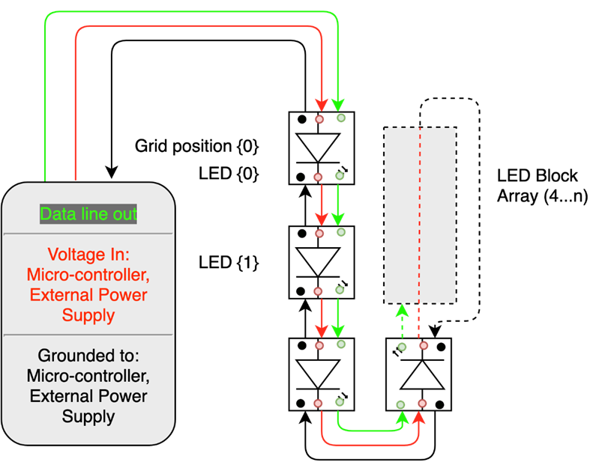
LED WS2182B Sequence Diagram
For the power supply

Slide 20
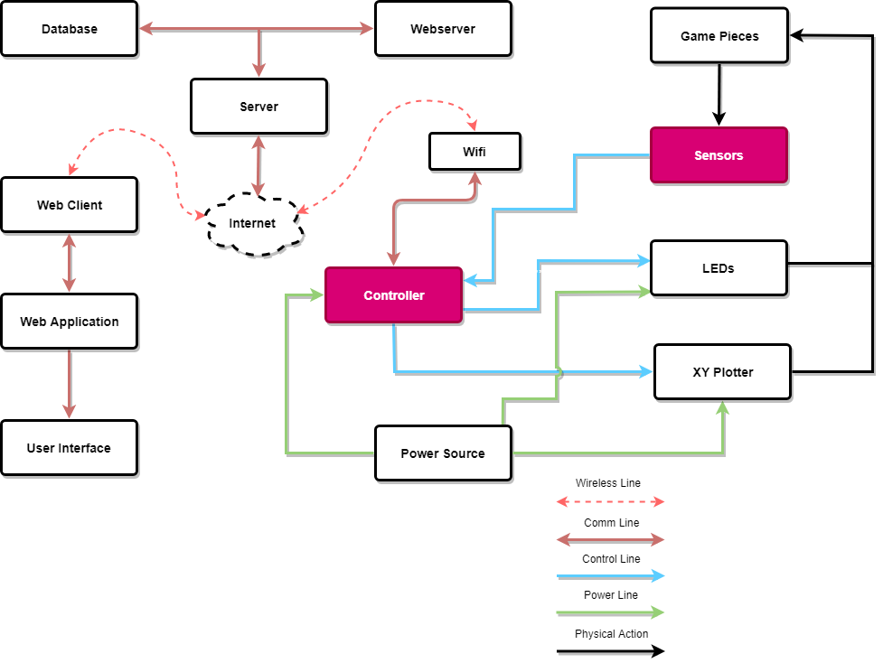
Sensors

Slide 21
Reed Switch Matrix

Slide 22
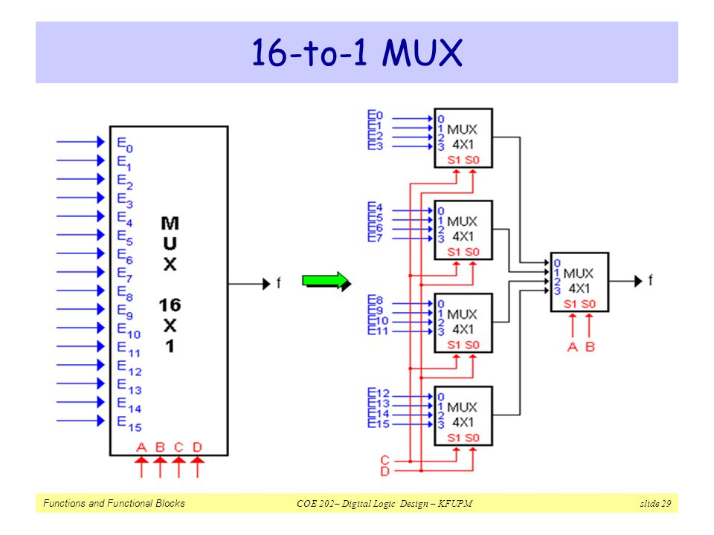
Sensor Input
Will be used to reduce the sensors input in the Arduino
Coding Algorithm to reduce input pins.
27 8:1 Mux and 1 4:1 Mux to create up to 192 inputs.
11x 16 positions = 176 sensor positions
8-bit binary data

Slide 23
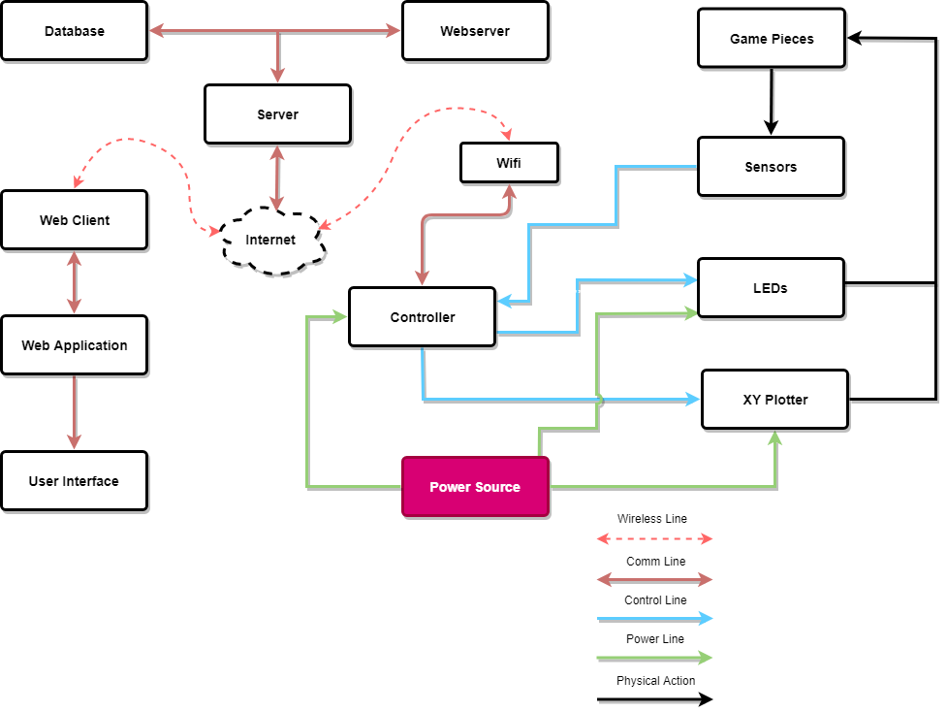
Power

Slide 24
Voltage Source
Voltage Source | Component
5V | PCB
5V | LED Drivers
12V | XY Plotter

Slide 25
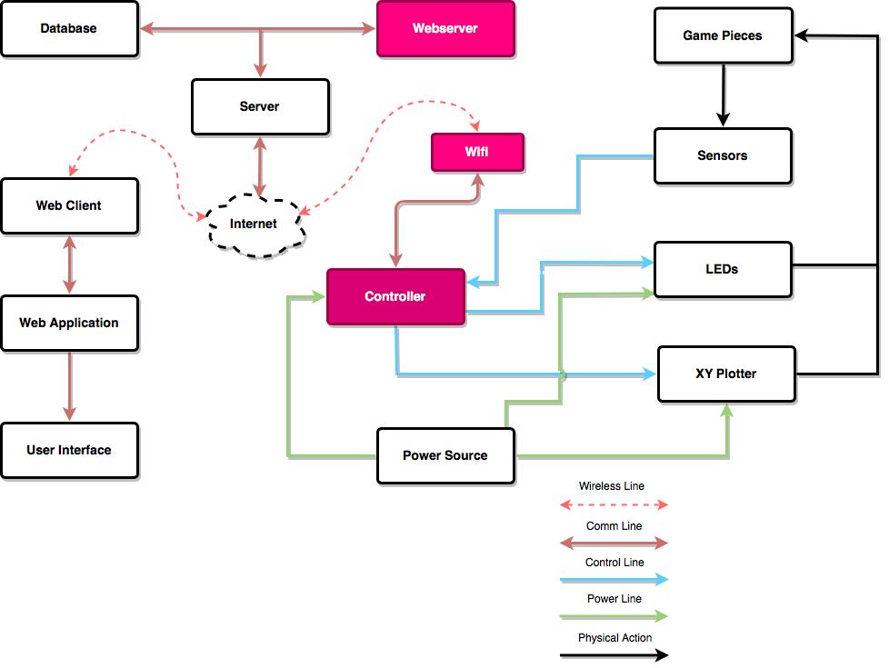
WiFi-Communication

Slide 26
WiFi Module- ESP8266
Item | Specification
CPU | Tensilica L106 32-bit processor
Operating Voltage | 2.5V ~ 3.6V
Wi-Fi Mode | Station/SoftAP/SoftAp
Security | WPA/WPA2
User Configurations | AT instruction set Cloud server
Network Protocols | IPv4, TCP/UDP/HTTP
Self-contained SOC with integrated TCP/IP protocol stack
Integrated cache to improve the performance of the system and minimize memory requirements
Abundant Learning Resources
Relatively inexpensive
Flexible designed and enhanced functions

Slide 27
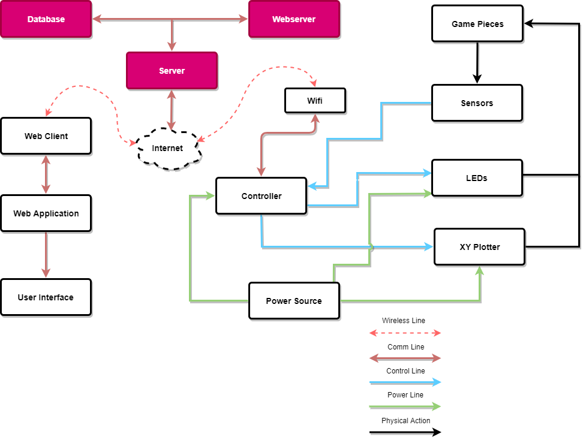
Web Server and Database

Slide 28
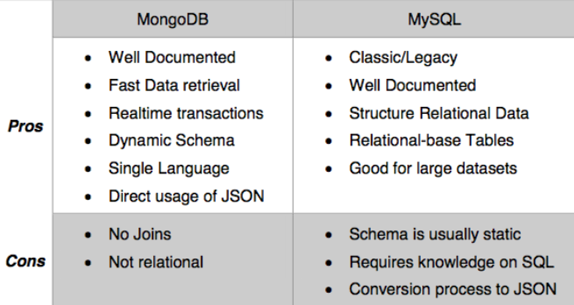
DATABASE SELECTION
Database selection is between MongoDB and MYSQL systems

Slide 29
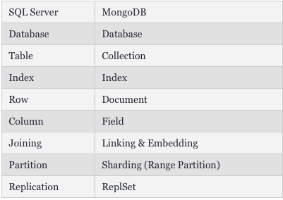
MONGO DB
Object-oriented, simple, dynamic, and scalable NoSQL database
Data objects stored as separate documents inside a collection, instead of storing the data into the columns and rows of a traditional relational database

Slide 30
Selection criteria
-Good For:
Single language use
Real-time analytics and high-speed logging, caching, and high scalability.
Configuration management.
Mobile and social networking sites.
Evolving data requirements.

Slide 31
WEB SERVER
-Node JS is the chosen webserver to utilize a single page web application
Benefits:
allow us to create high performance, highly scalable, “real-time” applications.
benefit from re-usability of code and the lack of context switching.
Only one programming language used(JavaScript) which allows user to write both front and back end in the same language.

Slide 32
Hosting Platform – Nodechef vs Heroku
 | Nodechef | heroku
Benefits | Offers great mobile backend platom. High performance | Can be created almost instantenously. Scaling is straighforward
Pricing | Starts at $9 a month | Starts at $25 a month
Trade-offs | Cannot SSH into an appplication and databases instances. | Can have performance issues where there is serious traffic. For high volume apps, premium charge

Slide 33
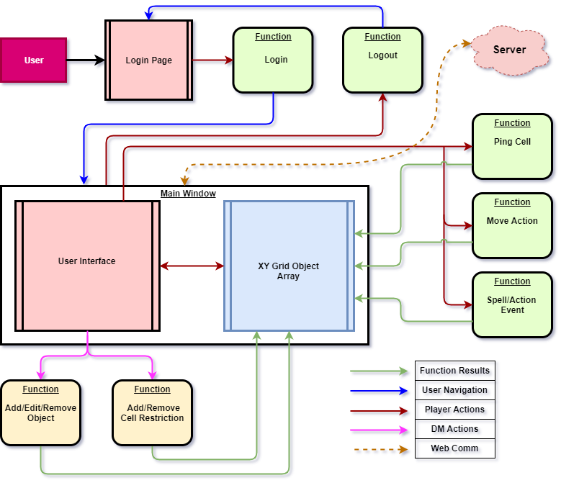
Web App Block Diagram
Landing page after login validation
Large Grid space
User interaction with the Grid table reflects these actions on the physical gameboard

Slide 34
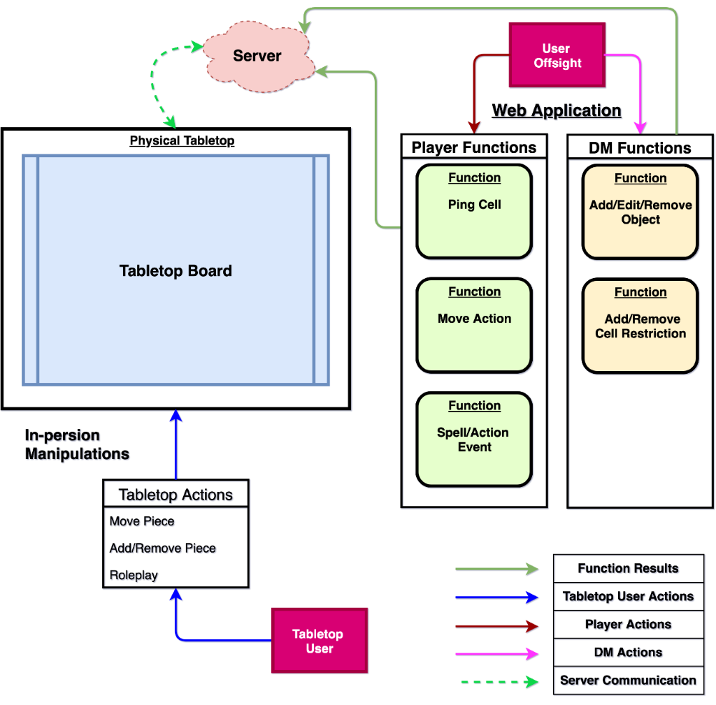
Tabletop Block Diagram
Landing page after login validation
Large Grid space
User interaction with the Grid table reflects these actions on the physical gameboard

Slide 35
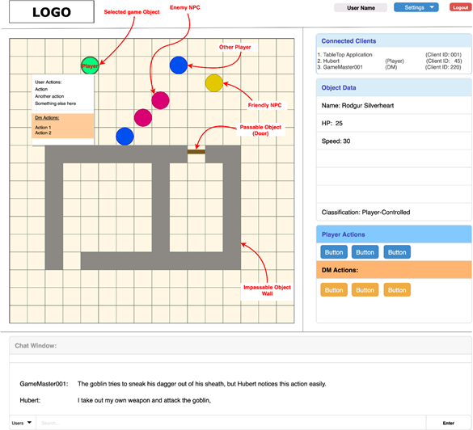
User Interface
The Game board matrix displays the current state of the board
Selected objects display basic information on the UI

Slide 36
Software Design
Graphical UI Advantages vs Disadvantages
Advantages | Disadvantages
Relatively easy to use, ideal for a beginner. | GUIs take a large amount of hard disk space compared to other interfaces
Easy to explore and find way around system using the WIMP/GUI interface method | Need significantly more memory(RAM) to run compared to other type interfaces
No need to learn complicated commands | Use more processing power compared to other type of interfaces
Help system available within the WIMP interfaces | Slow for experienced programmers. If experienced, CLI interfaces are better
Allows you to exchange data between different software applications

Slide 37
Administrative

Slide 38
Financing
Budget Expectations
Unit | Quantity | Cost
XY Plotter | 1 | $350
Sensors | 176 | ~$150
LEDs | 176(11x16) | $45
Controller | 1 | $15-$30
Server | 1 | $100
Power Source | 3 | $80
Magnet | Variable | ~$2-$20
PCB Frame |  | ~$700
Project Enclosure |  | ~150

Slide 39
Work distribution
 | X/Y plotter | Sensors/LED | PCB/ Schematic Desgin | WiFi Communication | Web Application/Server
Jose | X | X | X
Coraima | X | X | X
Hubert |  | X | X | X | X
Richard | X |  | X | X | X

Slide 40
Progress

Slide 41
Issues
Wifi connection
arduino plotter communication

