Slide 1
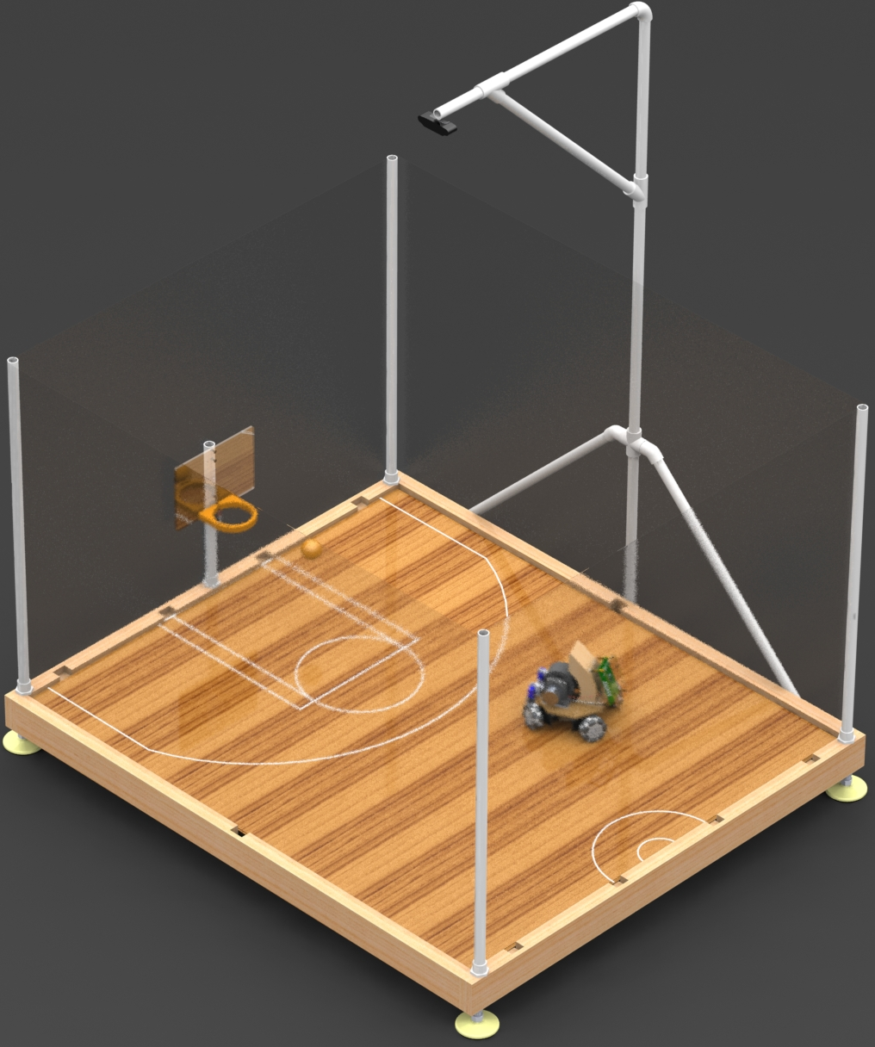
Robot Basketball
Summer/Fall 2019
Brandon Gross EE
Suvrat Jain CpE
Cory Ricondo CpE
Mat Schneider CpE
Notes:
BRANDON:
Hello, I am Brandon Gross, this is Suvrat Jain, Cory Ricondo, and Mat Schneider. We are group 9 and will be presenting our project, Robot Basketball.

Slide 2
Motivation
Entertainment
Robot Athleticism
Technologies and skills

Slide 3
Goals and Objectives
Arcade-style entertainment system
Eye-catching, engaging, and fun
Low-cost and scalable
Exciting Robot Capabilities

Slide 4
Realistic Design Constraints
Economic: Budget, Scalability, Affordable
Health and Safety: Flying projectiles
Manufacturability: Produced in high Volume
Sustainability: Maintainable by technicians

Slide 5
Impact
Entertainment industry
Interactive displays
New, unique experiences increases repeat-visits
Robotics Industry
Platform to test new and unique software
Expandable to a variety of sports and events

Slide 6
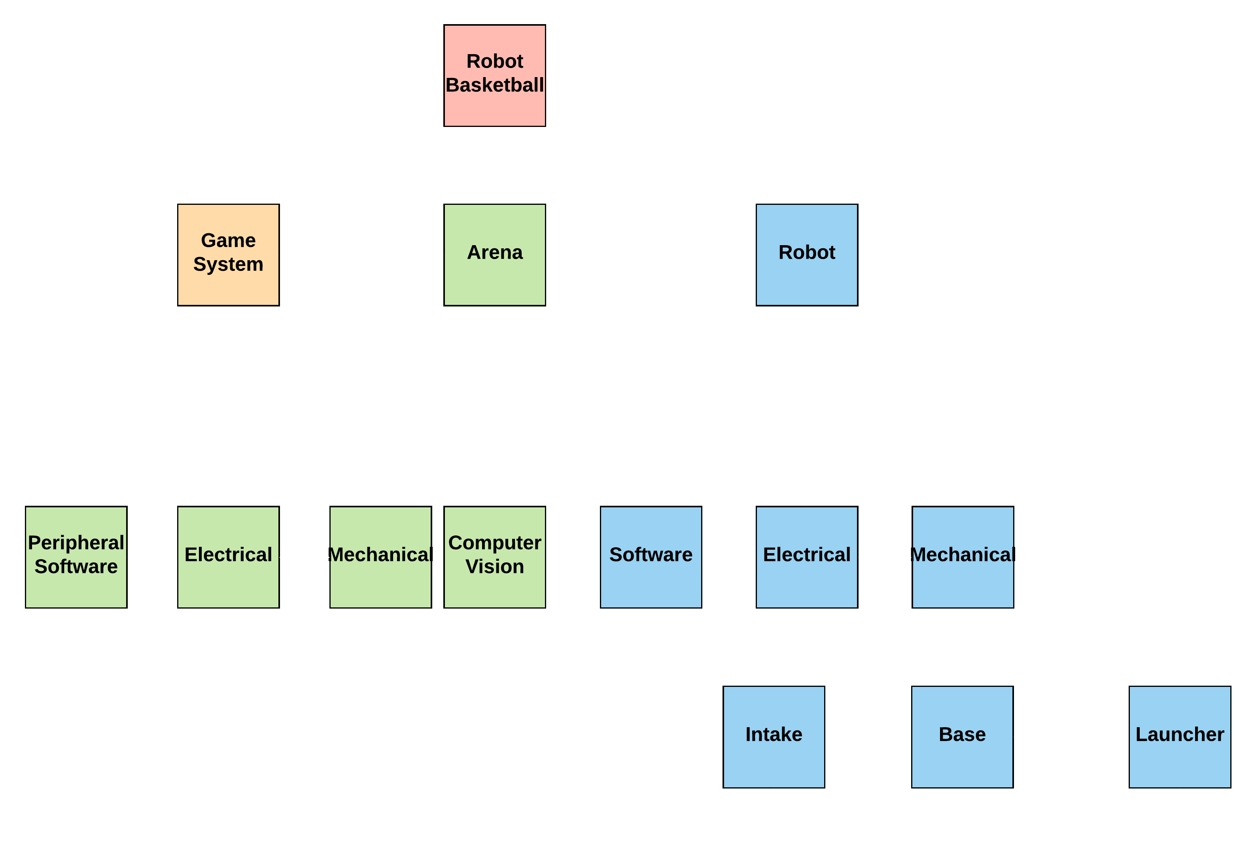
System Architecture
Notes:
BRANDON:
The general design philosophy to meet the project goals is to design a simple device-like robot that is commanded by a complex master system.
The shown architecture was developed to break the project into well-defined components:
Project is split into Game, Arena and Robot subsystems
Arena is Split into mechanical, electrical, computer vison, and peripheral software
Robot is split into software, electrical, and mechanical
Mechanical is made up of intake, base, and launcher subsystems
There are several critical interfaces identified, and a few implicit interfaces

Slide 7
Requirement Specifications
Requirement # | System | Requirement | Value | Unit
1 | Robot | The launcher shall launch a ball with a range of… | 1-5 | Feet
2 | Robot | The robot shall drive in any direction at a minimum velocity of at least… | 1.25 | Feet/ second
3 | Arena | The computer vision shall detect robot and ball position with an accuracy of at least… | 0.5 | Inches
4 | Arena | The computer vision shall detect robot orientation with an accuracy of at least… | 3 | Degrees
5 | Game | The game shall control the robot with a gamepad at a rate of at least… | 5 | Hz
6 | Game | The game shall prevent the robot from driving within a distance to the wall at most… | 1 | Inch
Notes:
BRANDON:
The requirement specifications shown are sampled from a larger set that we feel best describes the project’s verifiable operation.
The requirements pertain to launch range, drive speed, computer vision accuracy, and high-level game control

Slide 8
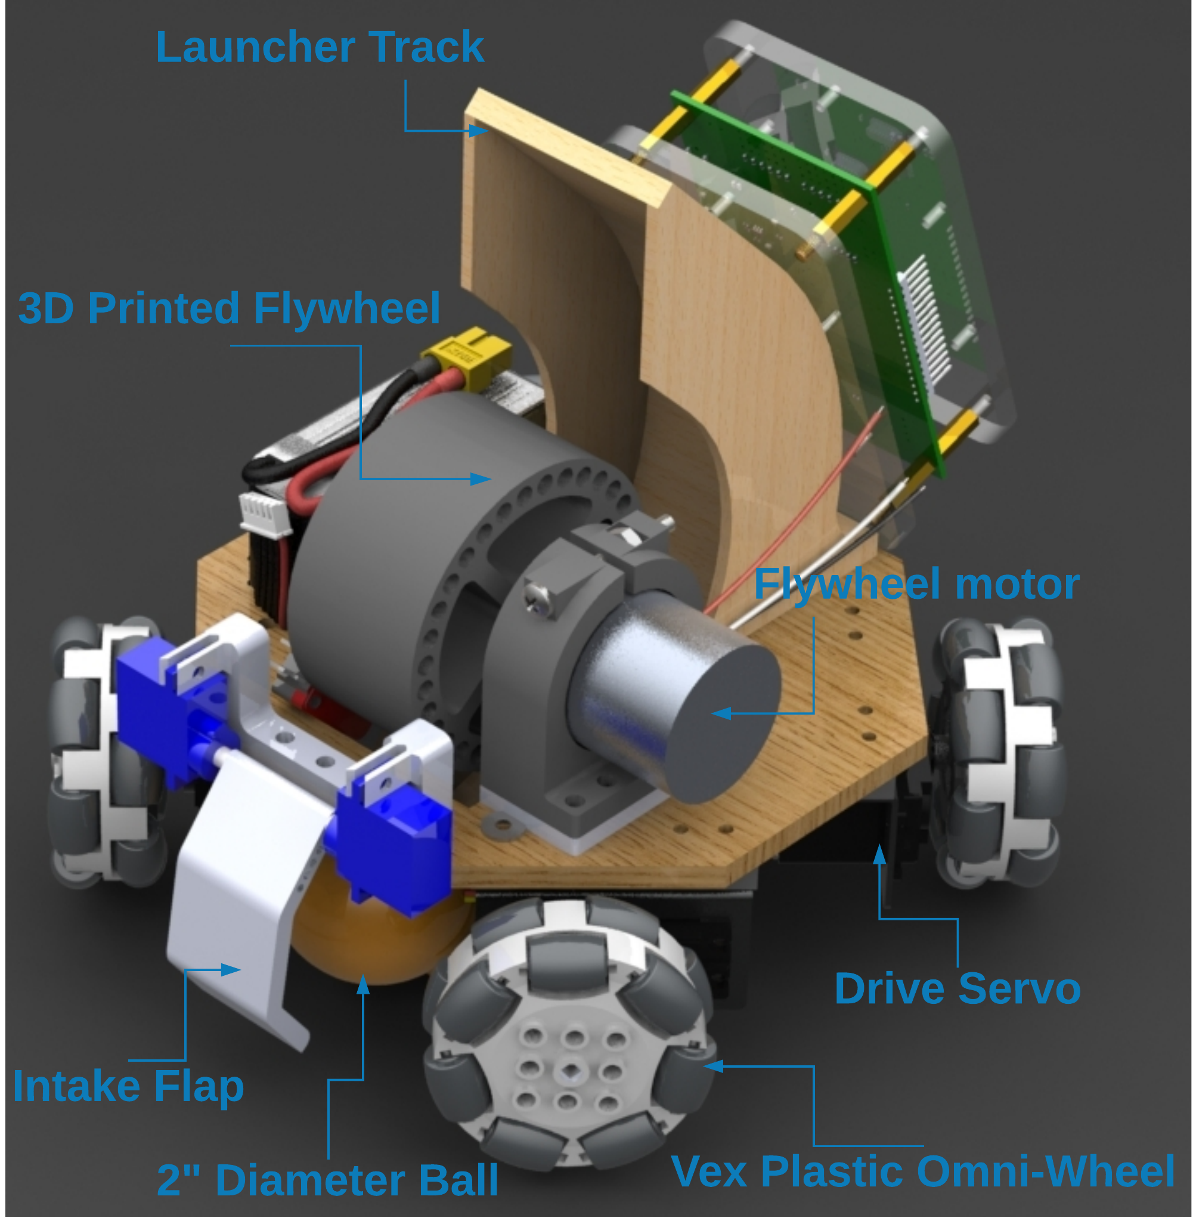
Robot
Notes:
MAT:
This is a render of our proposed robot design. <Point and read labels>

Slide 9
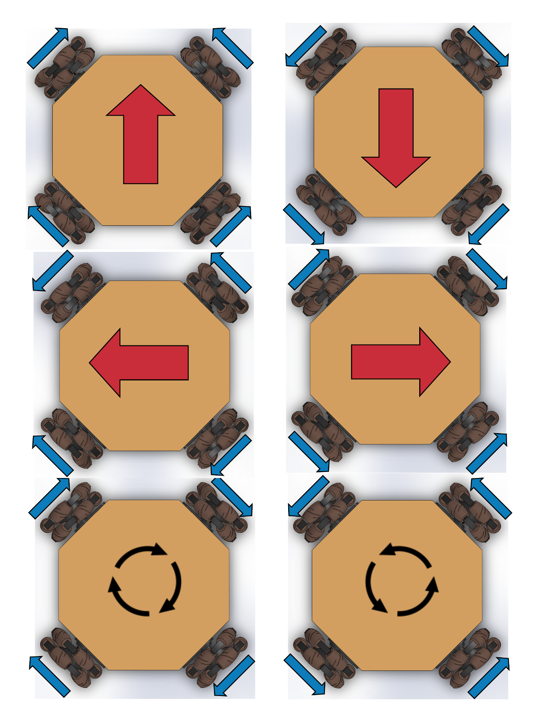
Mobile Base Design
Holonomic Drive with 4 Omni-Wheels
  Can maintain shot angle while traversing without turning
  Slightly faster motion
  Requires more torque
  Vector addition of Wheel outputs
Notes:
MAT:
Offers more flexibility over standard drive train.
Less vibrational effects on the base of the robot.

Slide 10
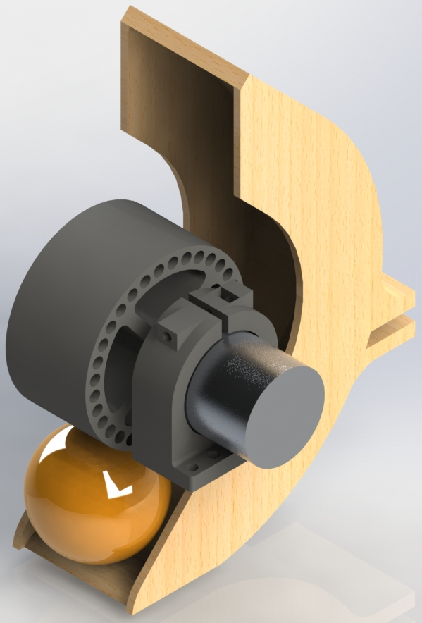
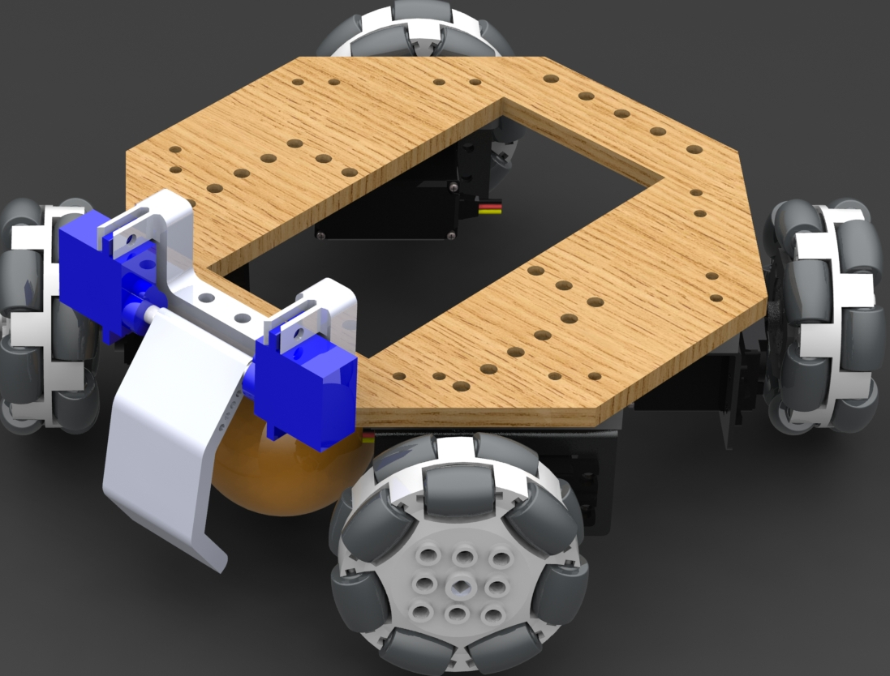
Robot Launcher/Intake Design
Flipper mechanism to trap ball and feed it into intake
  2-Servo flap that acts grabs and engages the ball with the flywheel
Flywheel to launch the ball from anywhere on the court
  DC Motor with fast response, up to 3200 RPM
Notes:
MAT:
Originally, we wanted to go with a launcher design similar to a ballista. However, as we tested and learned more, we found that the design needed to be more complex than we originally thought. Because of this we decided to go with a flywheel mech
-Initially, we decided to use brushless DC motor with an ESC that would be controlled with PWM
-However, that motor turned out to be extremely powerful to the point where it started vibrating the robot
-Therefore, now we are using a standard brushed DC motor and driving it using a motor controller

Slide 11
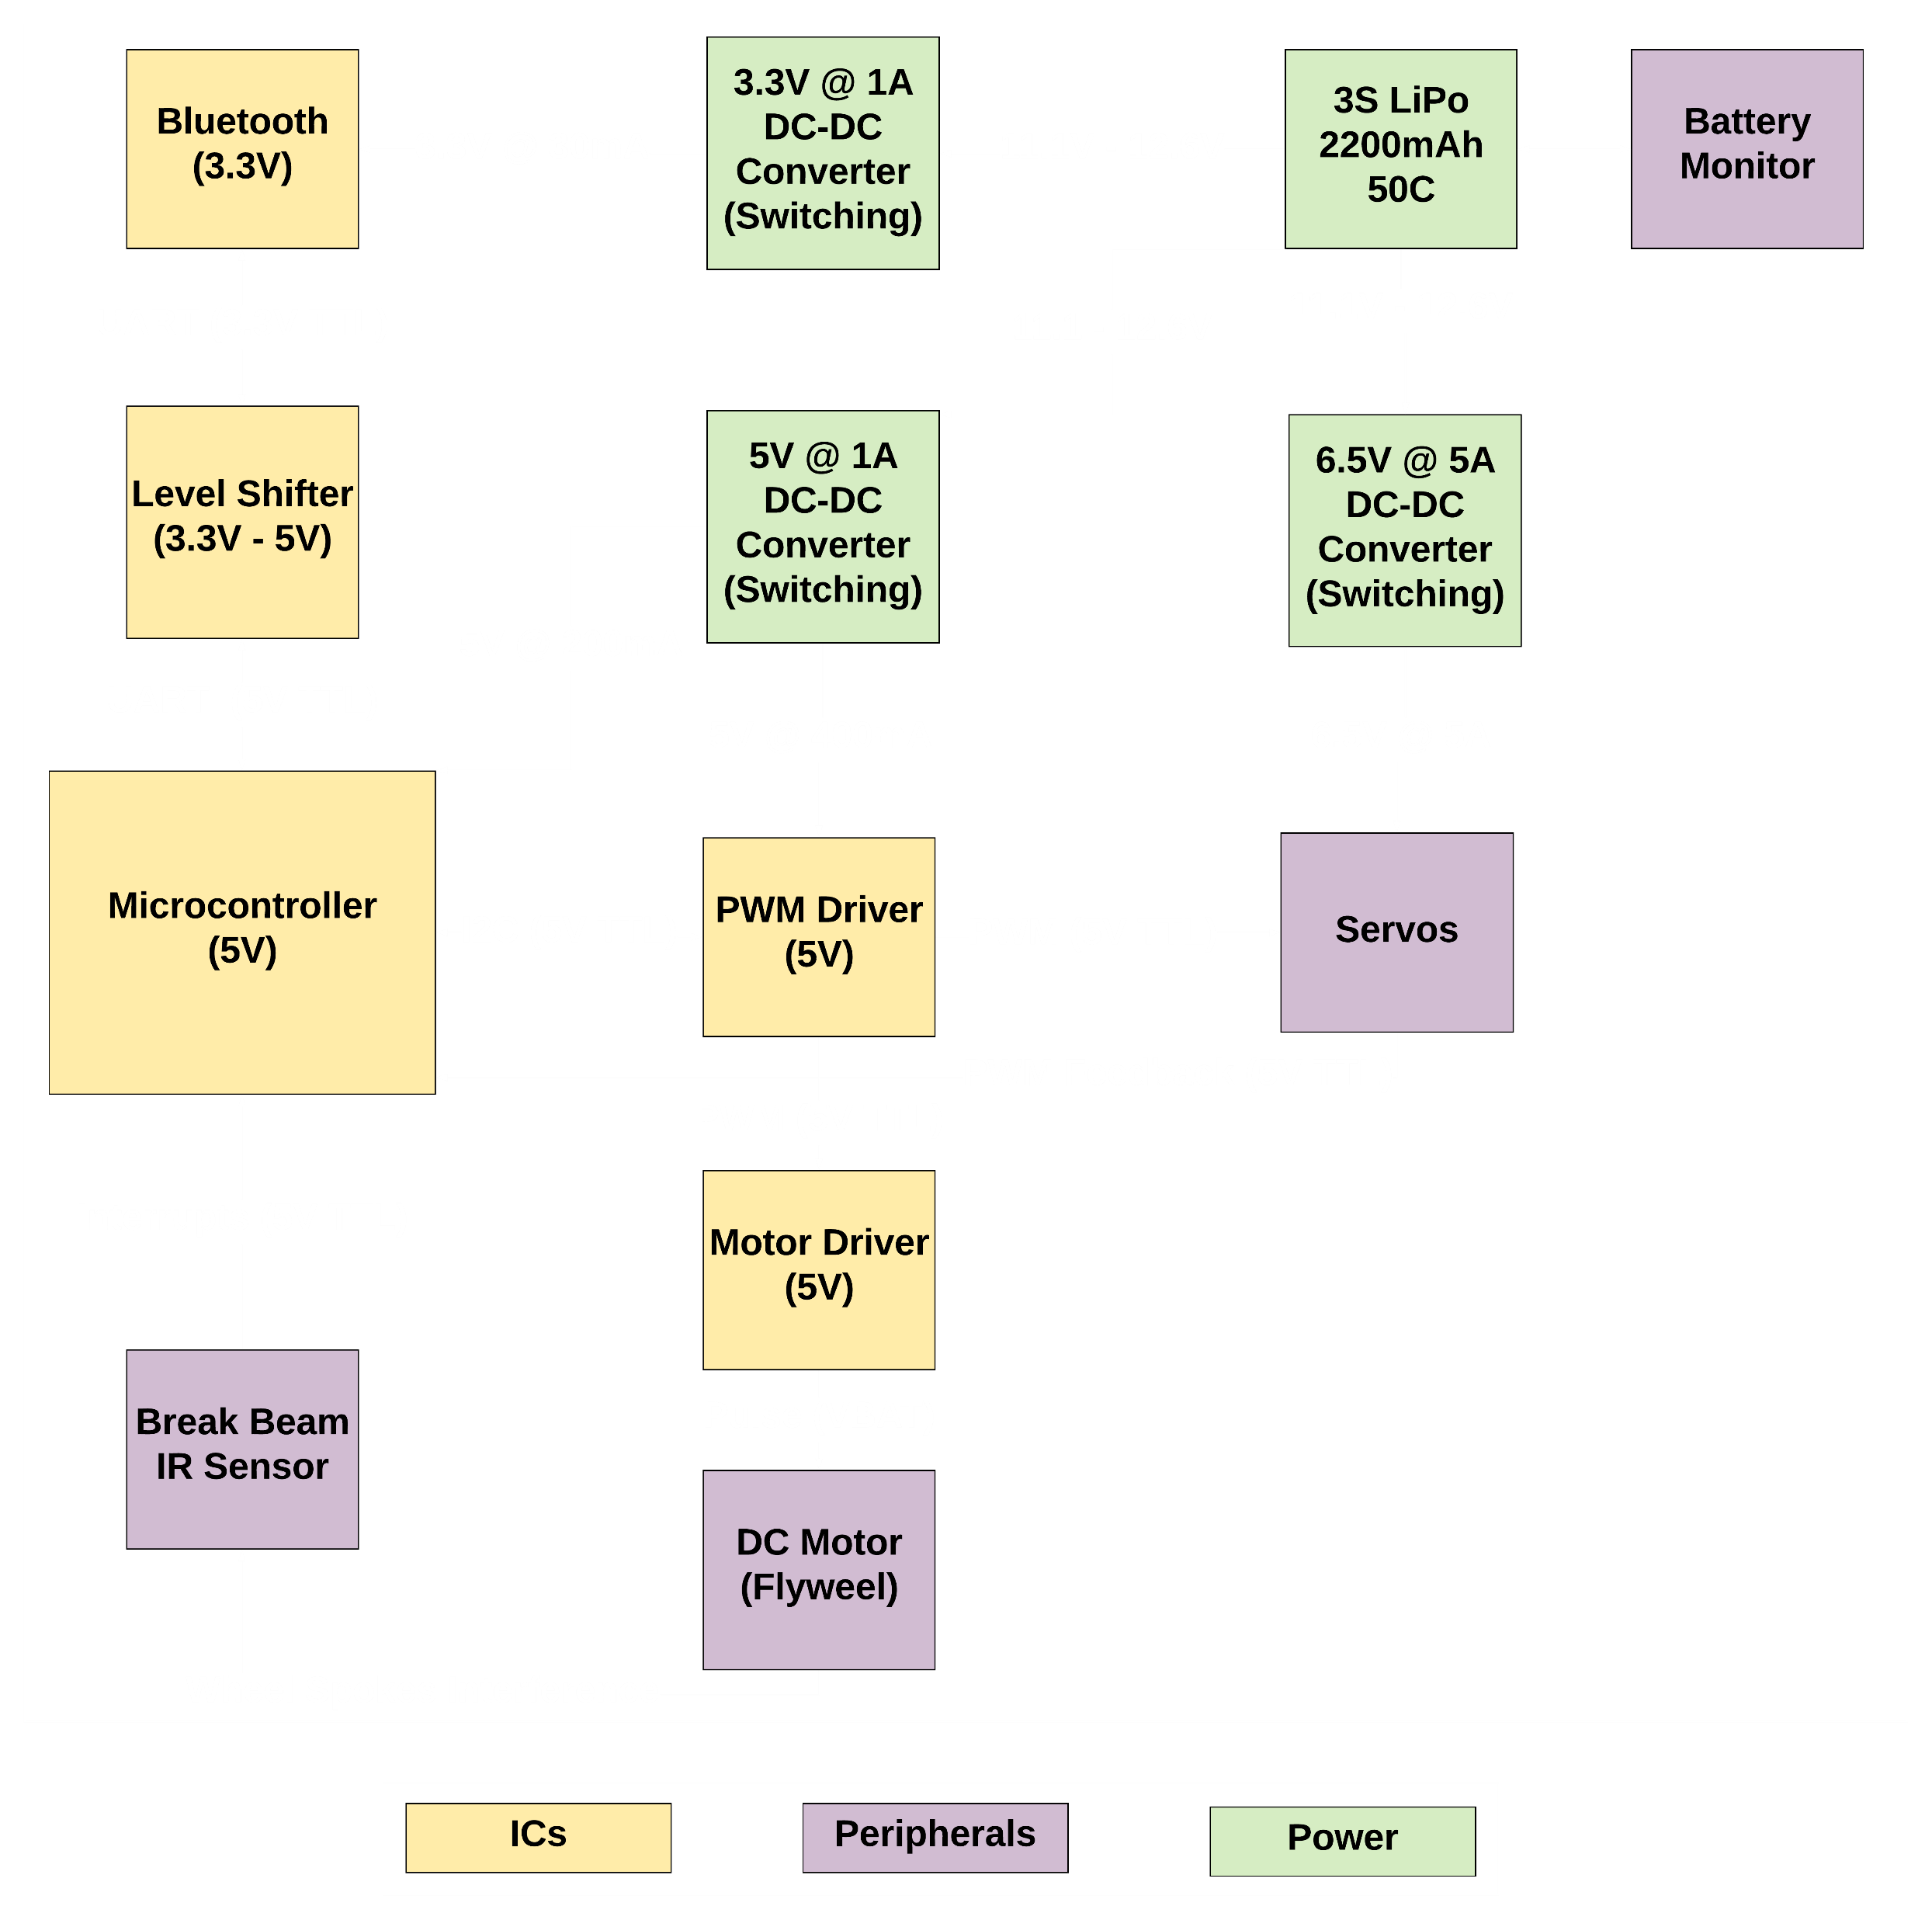

Robot PCB Overview
Notes:
SUVRAT:
-An Overview of Robot’s PCB
-The battery powers 3 switching regulators: 1 powers the servos, 1 powers the MCU and the PWM driver, and 1 powers the Bluetooth
-The microcontroller talks to PWM driver using I2C and the motor driver is controlled using the PWM driver
-A lever shifter is used to talk to Bluetooth via UART protocol and the feedback from drive servos is connected to the MCU’s GPIO pins
-The MCU is flashed with Arduino firmware and a FDTI board is used to program the PCB via UART
-Jumpers are used so that when they are in place the UART is used for Bluetooth but when removed then the UART is used to program the MCU

Slide 12
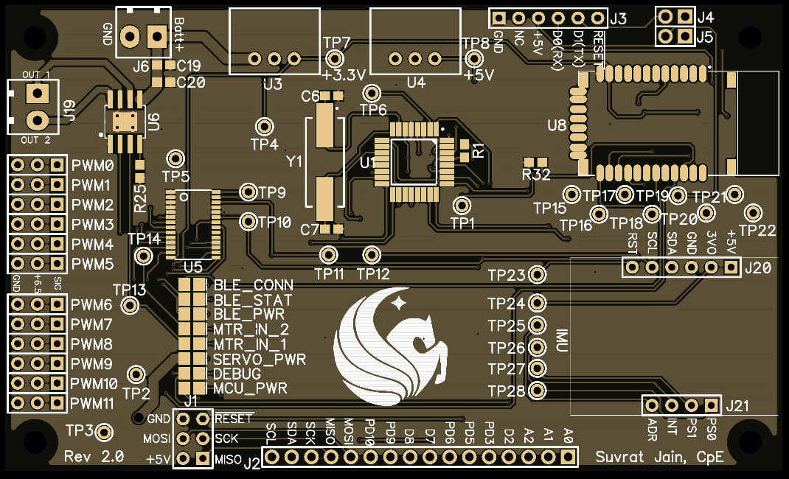
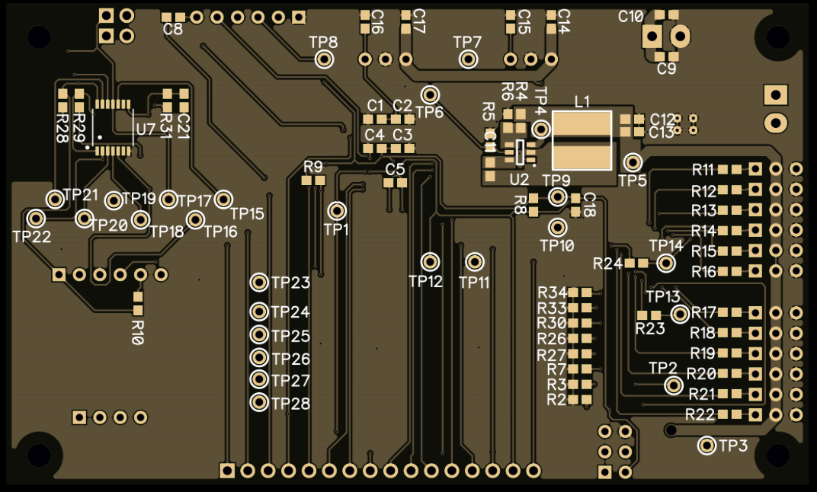
PCB Layout
Notes:
-Smaller than our first iteration by 40mm in one dimension
-The original PCB was 100mm x 100mm whereas this one is 100mm x 60mm
-Hand laid by our world class PCB designers in India, manufactured by our collegues in China and sponsored by our friends in America
-This is Top side

Slide 13
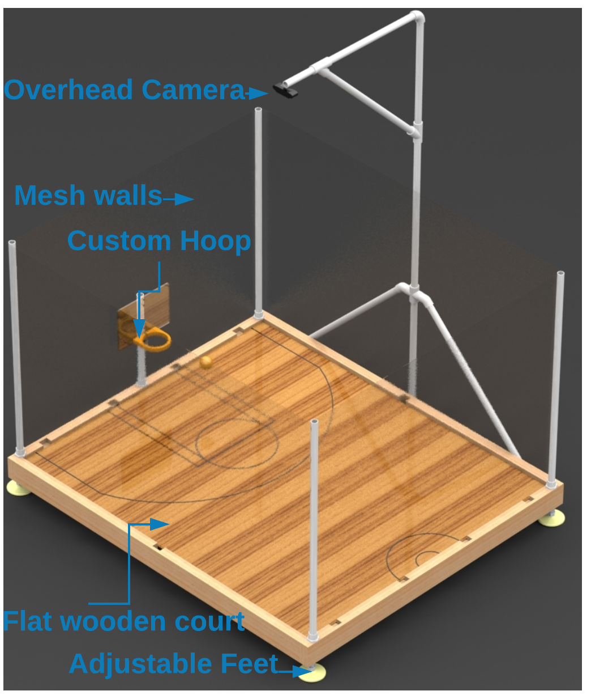
Arena
Notes:
CORY:
-The arena consists of 6 main components: The Overhead camera, Mesh walls, Custom Hoops, Flat wooden court, Frame, and Adjustable Feet

Slide 14
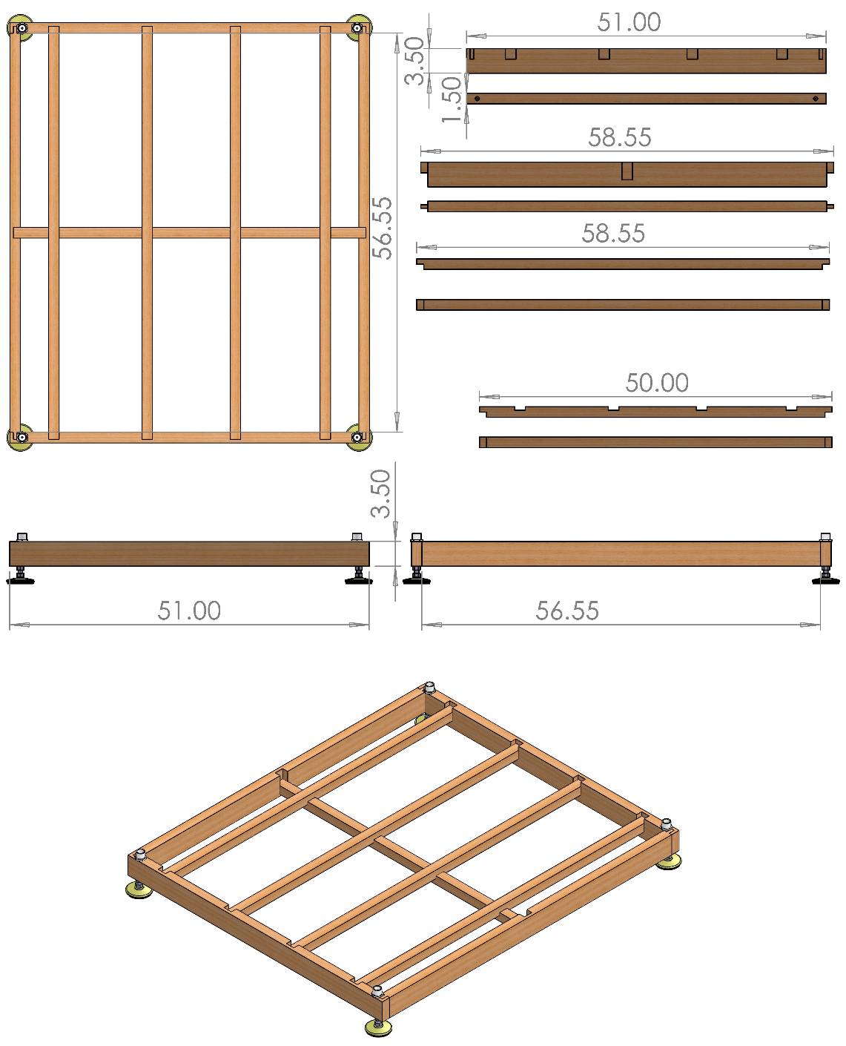
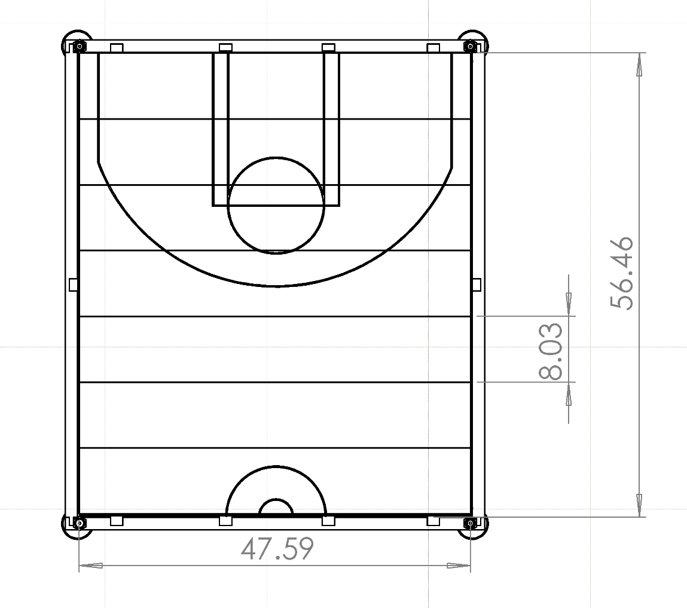
Arena - Frame & Court Design
Arena is 5’ length by 4’ Width by 3’ height (Minus camera mount)
Broken into several locking pieces without tools or hardware
Frame mounted on adjustable feet to level the floor
Wall mesh included to prevent projectiles flying outside the Arena
Notes:
CORY:
-The arena was built using 2x4 Kiln Dried wood for the frame which had locking joints cut in order to have each piece fit together effortlessly and with no hardware or tools.
-The flooring is removeable laminate flooring with basketball court markings painted on, keeping to the ratio of an NBA court as close as possible.
-The mesh wall posts are PVC pipe which is easily removed and placed back when constructing the arena.
-The hoop posts are also PVC pipe which fits into PVC caps attached to the frame of the court.
-The camera mount is again made of PVC and attached to the frame of the court.

Slide 15
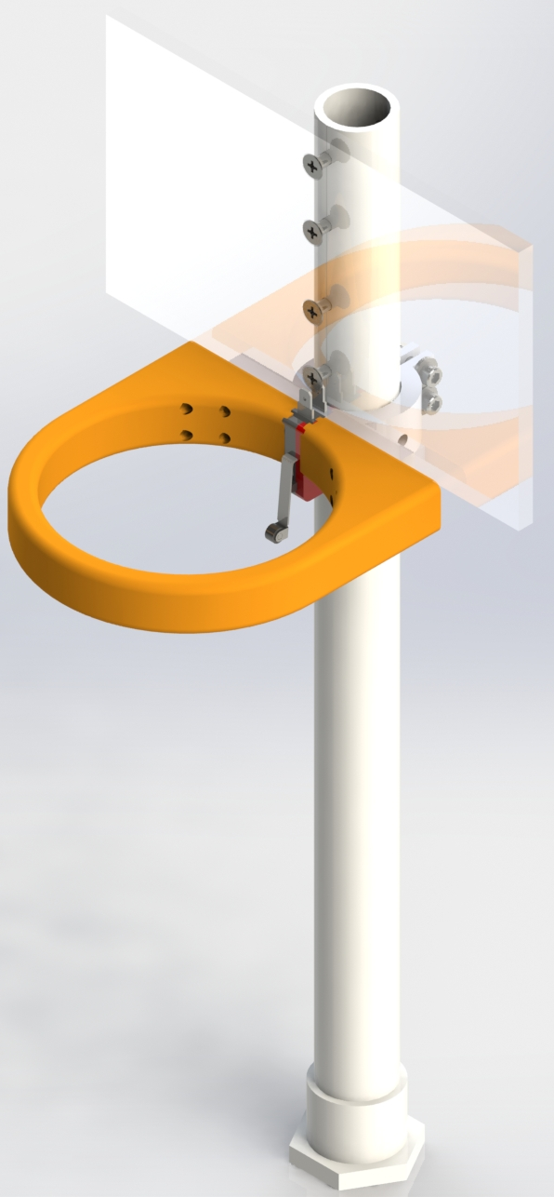
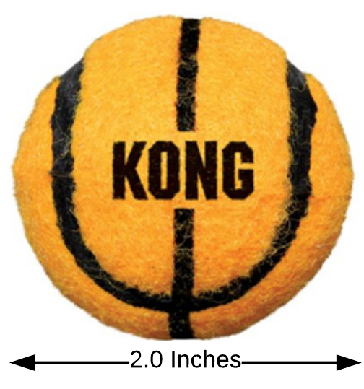
Arena - Ball & Hoop Design
Ball is a small-scale tennis ball with a basketball appearance
  Chosen because of size, appearance, and higher weight than a ping-pong ball
3D-Printed hoop and mount attached to a PVC post and an ABS backboard
IR Break Beam Sensor to capture when baskets are made
Notes:
CORY:
-A small-scale tennis ball was chosen because it resembles a basketball and is the smallest sized ball we could find that had the right feeling.
-A ping pong ball was also considered, but bounced too much in testing, was too light to consistently intake, and there was a worry that the flywheel might dent the ping pong ball when launching.

Slide 16
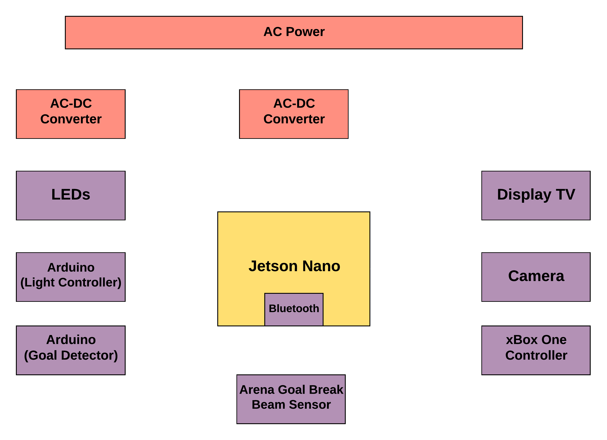
Arena - Electrical Design
The Arena is AC Powered
A 120V to 5V AC-DC converter is used to power the Nano
Another 5V AC-DC converter is used to power the LEDs
Nano does most of the processing for CV and Game System onboard
The XBox Controller inputs are taken in serially via USB and sent to the Robot via Bluetooth
The TV/Display is powered from an AC outlet as well
Notes:
CORY:
-The Arena is powered by an AC outlet
-Two AC-DC Converters are used. One powers the Jetson Nano and one powers the NeoPixels
-The TV Display is also powered by the AC outlet and therefore, a power strip will be attached to the arena for simplicity
-Jetson Nano interfaces with XBox Controller via USB interface and with the TV Display via HDMI
-Break Beam sensors are used to detect a “goal” and are connected to Arduino which serially sends the commands to the Jetson Nano
-NeoPixels need PWM because Nano is not a real time system and therefore another dedicated board (Arduino) is used to drive the animations

Slide 17
Arena Computer Vision System
Position & Orientation of Robot required for automatic control
Position of ball displayed in the game
Overhead camera used to be able to easily scale to more robots and objects
Notes:
CORY:
-We choose to use OpenCV for computer vision not only because it was free and open source, but also because it has 3rd party trackers that can easily be implemented and a vast community for support.
-The code for the implementation is pretty straightforward because most of the heavy lifting is done via the OpenCV libraries, so its just a matter of finding and using the library functions correctly.
-The third party tracker is called the Kernelized Correlation Filter or KCF tracking library. This tracker takes advantage of large overlapping data regions to track faster and more accurate than most other trackers.
-The KCF tracker does poorly when an object being tracked gets obscured and then comes back into view and it also doesn’t give the orientation of the robots.
-To counter this we are implementing background subtraction on the court prior to feeding the video data to the KCF tracker and we are using two colored dots on each side of the robot which will determine orientation.

Slide 18
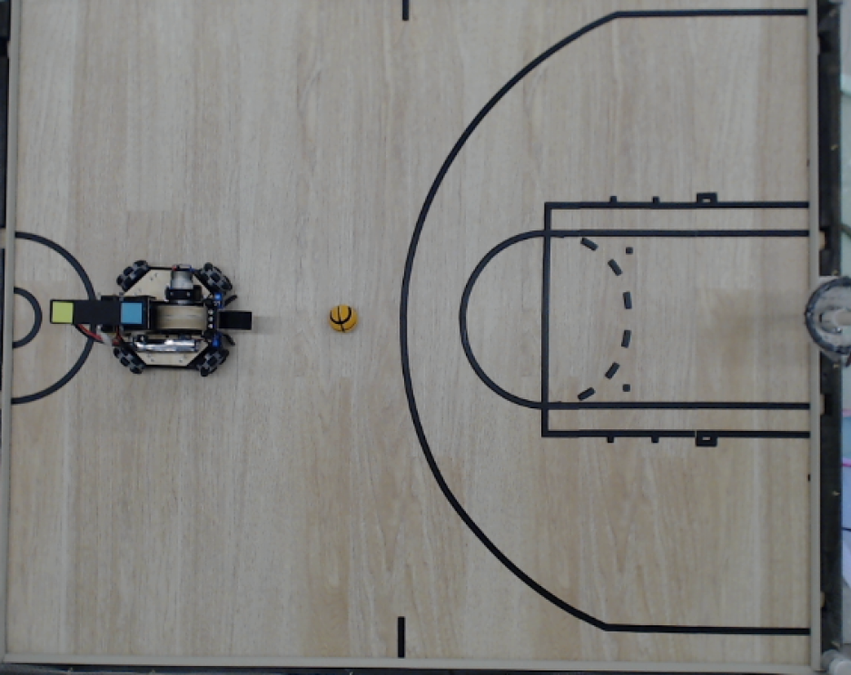
Step 1 – Collect the Frame
Capture and build a background model
Add objects to the court
Notes:
Initial camera frame grab.
Set the FPS.
Resize the frame.
Smooth with Gaussian blur.
Add the frame to the background subtraction object. (ONLY DONE FOR THE 1st 30 FRAMES to build the model)
Build the model with no objects on the court.

Slide 19
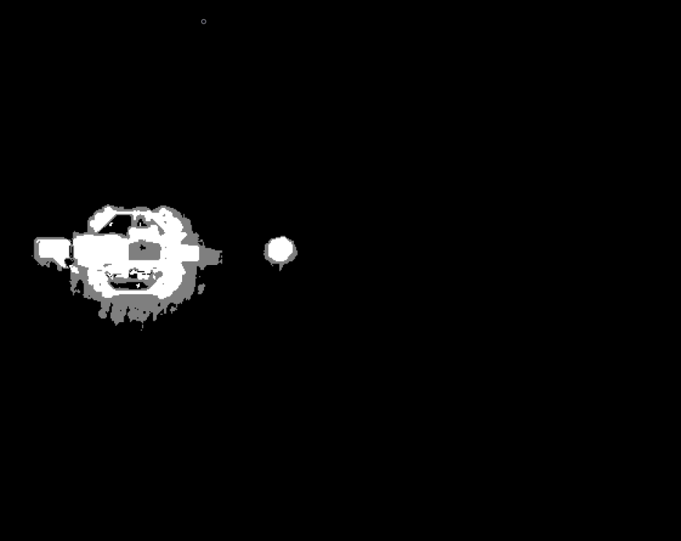
Step 2 – Foreground Mask
Apply background subtraction to get a foreground mask
Notes:
Foreground mask after creating model & adding 30 objects in

Slide 20
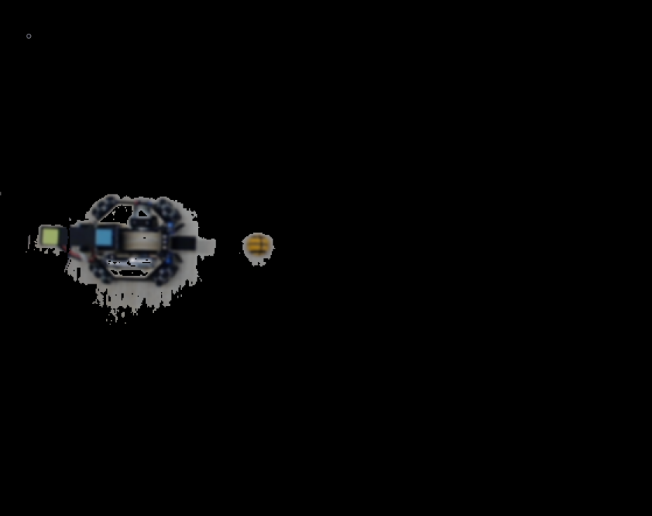
Step 3 – Background Mask 'AND' Frame
Perform bitwise 'AND' on the blurred frame and foreground mask to get a color image from the results of background subtraction
Notes:
Bitwise & of the mask and color to get a foreground in color

Slide 21
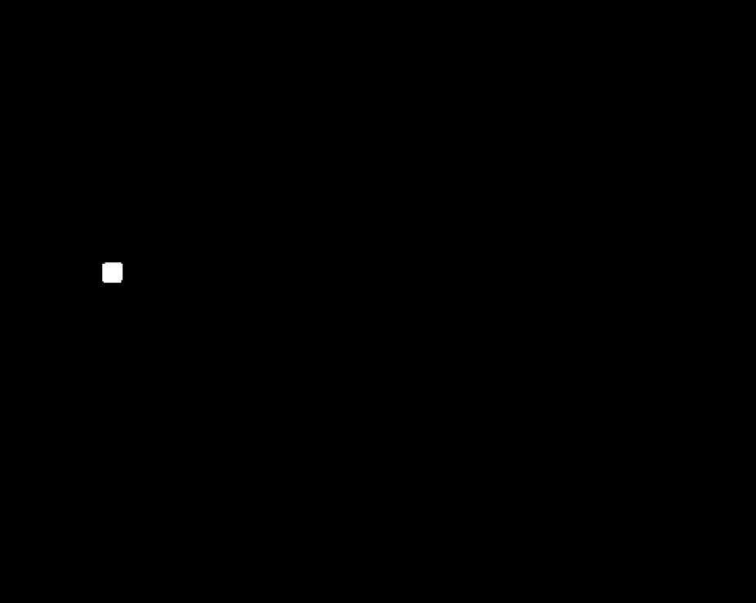
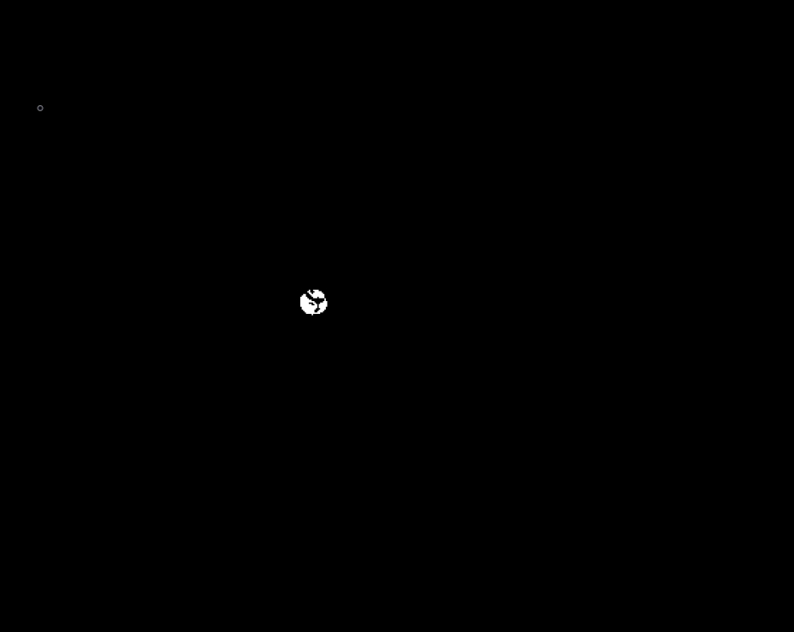
Step 4 – Color Filtering
Lower and Upper bounds for each color are created using the HSV color scale
An inRange() function is applied and a mask for each color is created
Colored Square
Orange Ball
Notes:
Note the orange ball is “occluded” by black lines

Slide 22
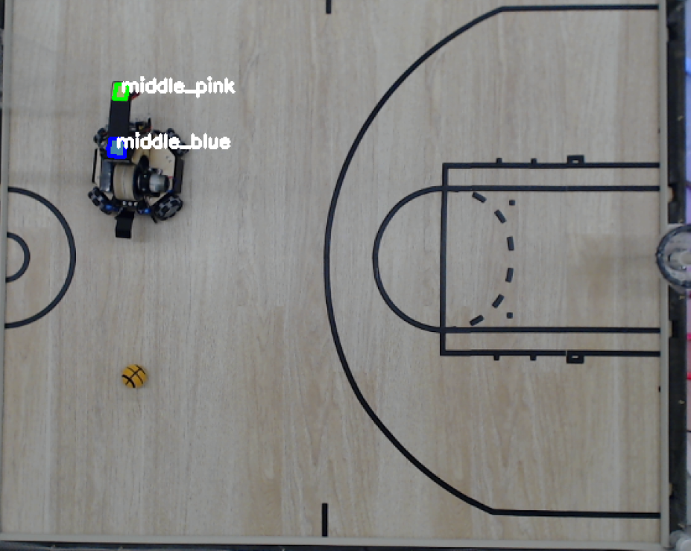
Step 5 – Contour Detection and Midpoint
Find the contours of the squares
Filter the list of contours by perimeter and number of sides
Use moments to find the midpoint of each square
Notes:
After lines are found

Slide 23
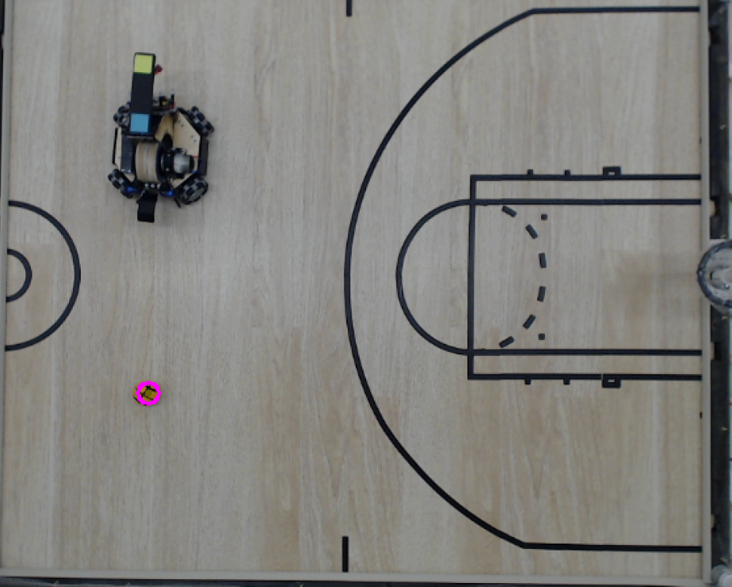
Step 6 – Canny Edge Detection & Hough Transform
A Canny Edge filter is applied to the orange mask
A Circle Hough Transform is applied, and the center is found
Notes:
Apply Canny Edge filter (This is similar to contouring for the squares)
Apply Hough Transform (A circle of best fit pretty much)
Find the center

Slide 24
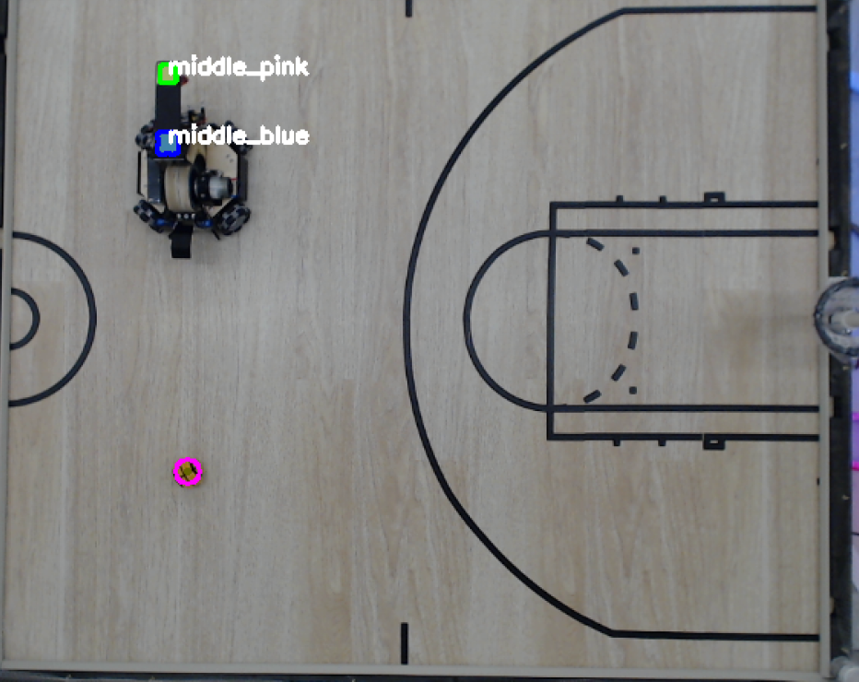
Final Output
A unit vector is created using the x,y center values of each square
The center of the robot is blue
The unit vector, center point of the robot, and center point of the ball is sent to the game
Notes:
Detect centers, find orientation

Slide 25
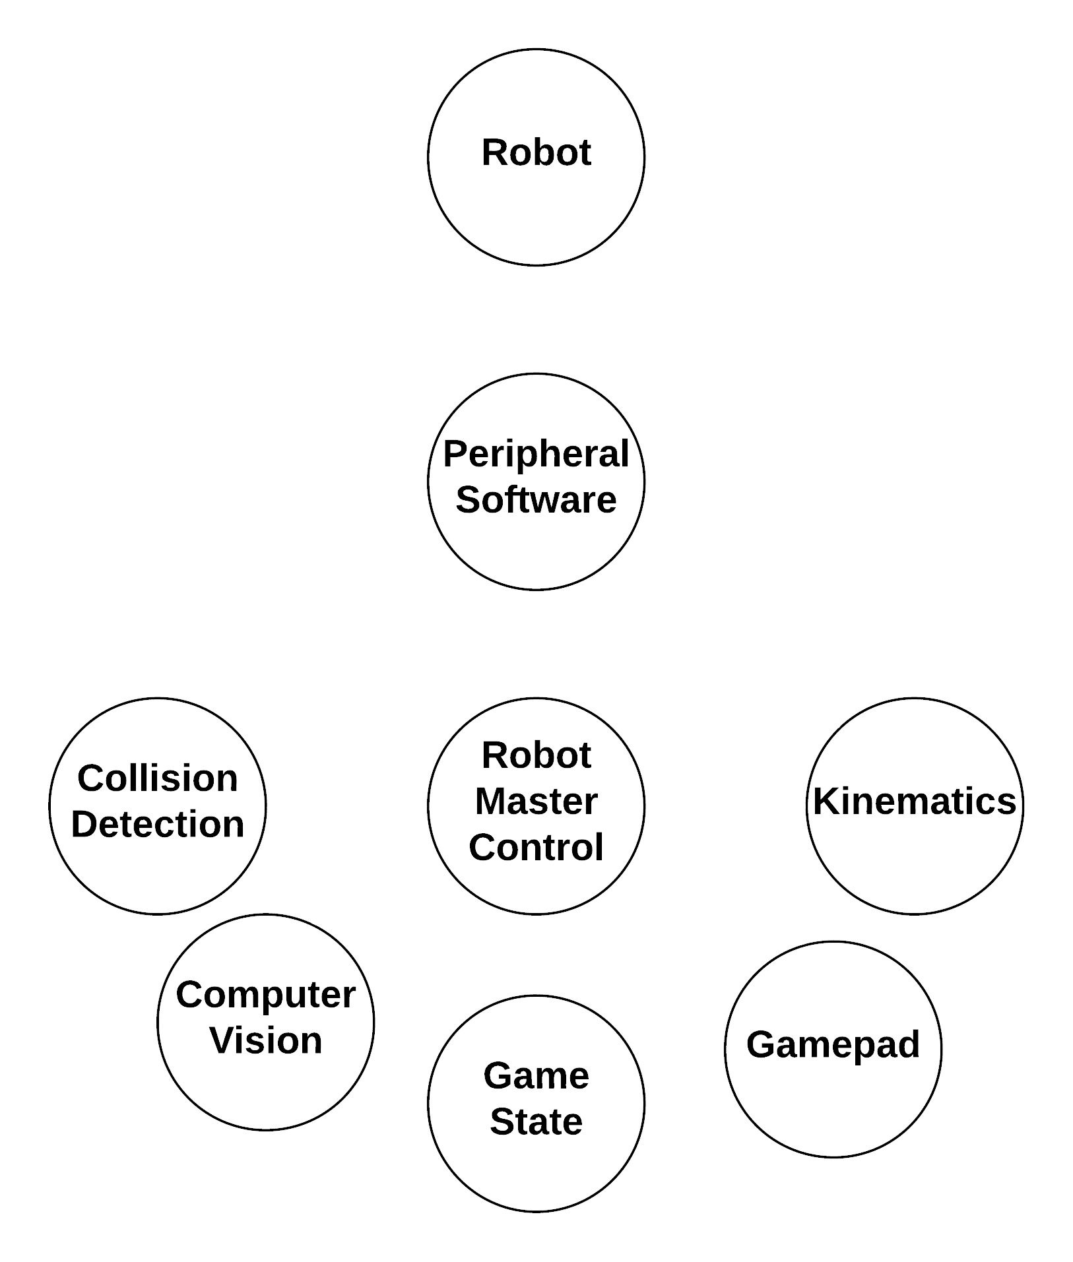
Game Overview
Notes:
MAT:
The collision detection is there to provide some feedback to the user, as well as a protective measure for the robot as it should help prevent the user from putting unneeded stress on the robot. Ex – Continuously running into the wall without the robot moving can burn motors.
Video Playback – Way of interacting with the user and adding an element of fun. Styled in the way of bowling alley animations.
Robot Control will take user input and positional data from the computer vision to correctly track and show the robots position in the game as well as to send it velocities to move where the user tells it to.

Slide 26
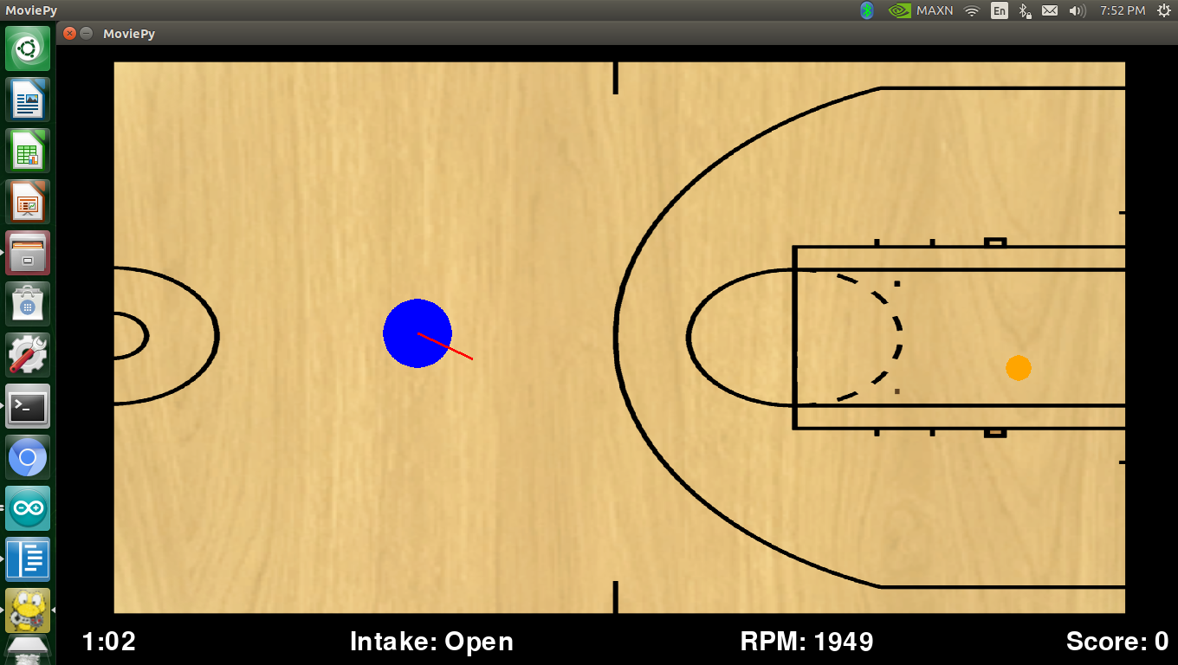
Autonomous Control in Easy Mode
Alignment
  Proportional Control minimizes angle to hoop
Flywheel Speed
  Linear Function
  Positional Data from computer vision
Notes:
Alignment is done through the use of a proportional controller to send dynamic speed commands to the robot. After the robot receives the command and moves, the next frame will then check the difference between the robots orientation and where the hoop is on the field before sending an updated speed command. This continues until either a timeout is reached or the angle difference is small enough.
The flywheel RPM is a linear function based off the magnitude of the vector between the hoop and the position given to the game by the computer vision.
Both these functions are only available in easy mode.

Slide 27
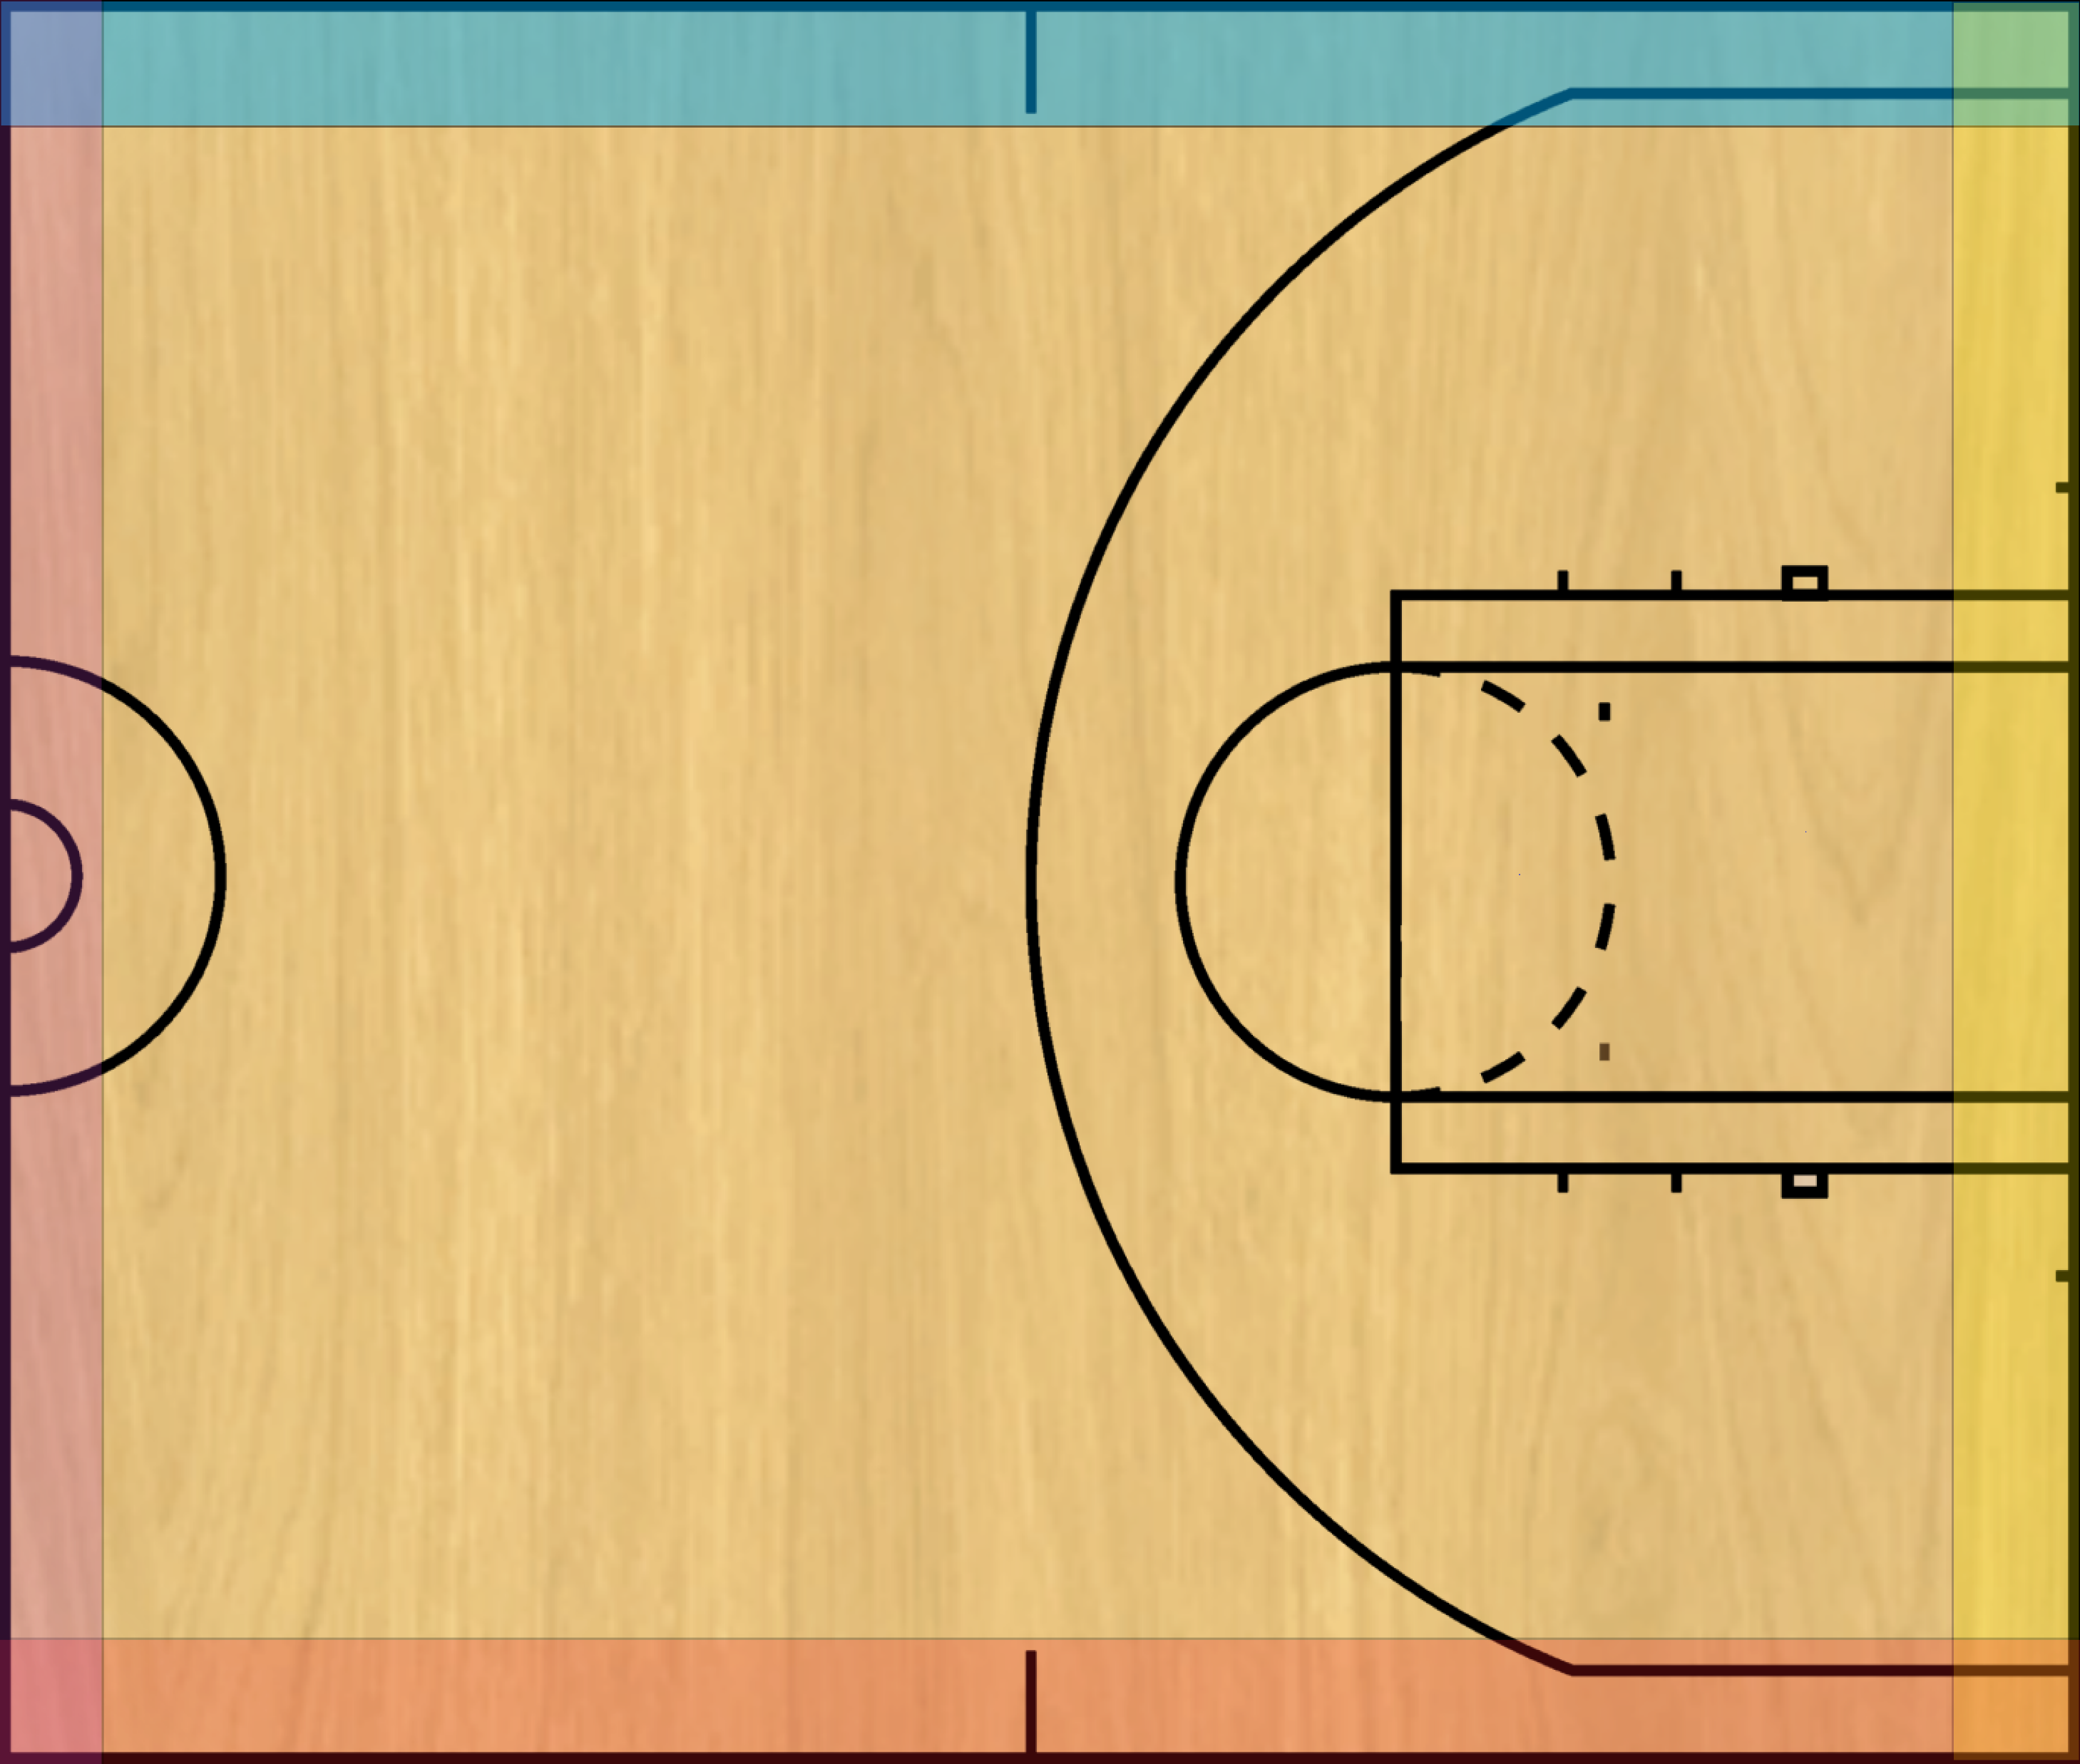
Collision Detection
Prevents robot from being driven off arena
Transform Robot Space to Task Space
  Check if components would take robot off arena, if so, remove component from vector
  Rotate new vector back to Robot frame
Notes:
The last primary function of the game is to perform collision detection to prevent the robot from being driven off the arena. This is done by rotating the vector made by the controller joysticks into the direction the robot is facing. There are a variety of zones around the field based off distance to the edge of the arena in computer vision. If our rotated vector would take us farther into those zones, that particular component of the vector is thrown out, and the vector is rotated back into the reference frame of the joystick before being mapped and sent to the robot in the packet. This allows the for the robot to slide along the boundary lines without going over them.

Slide 28
Testing
Design Verification (Subsystem Requirement Validation)
  Verify Robot Drive, Intake, and Launching capabilities
  Verify Computer Vision Accuracy
  Verify Game communication and control
Production Test (System Requirement Validation)
  Verify the final PCB meets specifications and performs appropriately
  Verify Game can fully control the robot and other peripherals
  Ensure all critical interfaces are functional and the final product functions appropriately
Focus Group (Market Requirement Validation)
  Ensure high-level market requirements are met by allowing players to test the final product and implement feedback as necessary

Slide 29
Feedback incorporation
Collision detection and avoidance added after walls found to be too small to stop robot from driving off the table
Reduced speed of the robot to maximize controllability
Added additional light animations to tell player when game is ending

