Slide 1
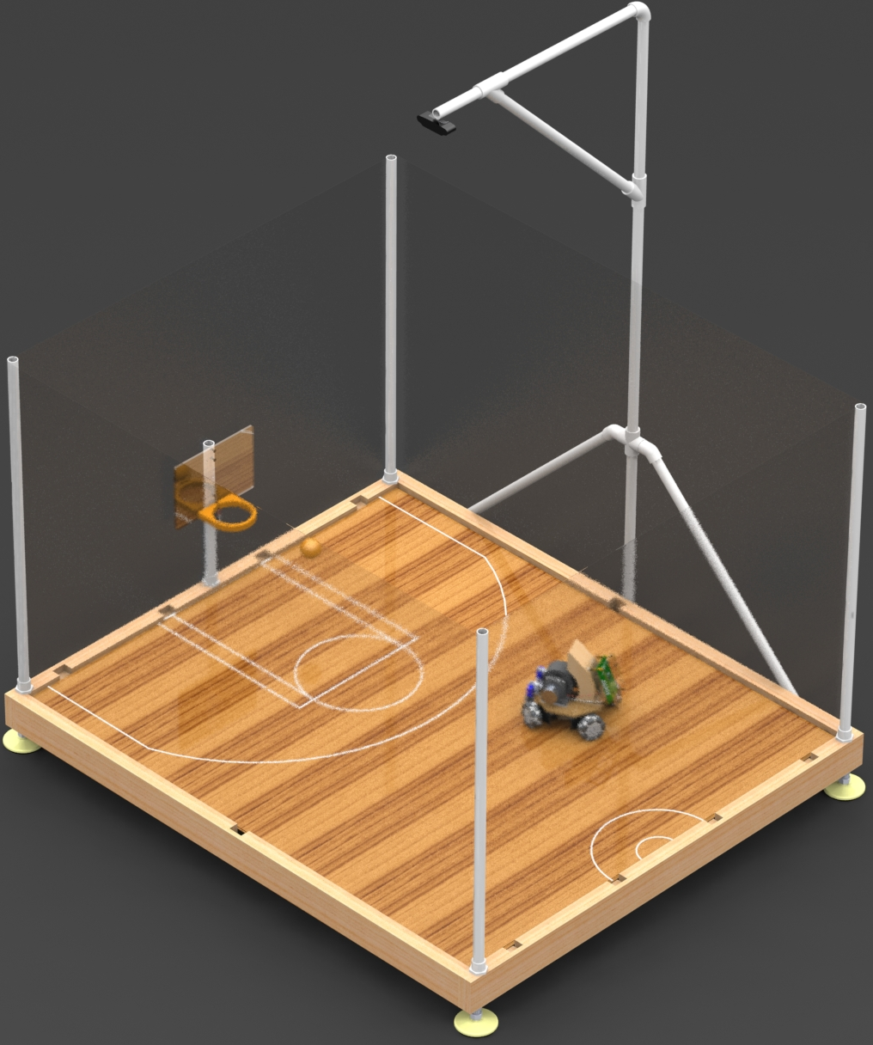
Robot Basketball
Group 9 - Summer/Fall 2019
Brandon Gross EE
Suvrat Jain CpE
Cory Ricondo CpE
Mat Schneider CpE
Notes:
BRANDON:
Hello, I am Brandon Gross, this is Suvrat Jain, Cory Ricondo, and Mat Schneider. We are group 9 and will be presenting our project, Robot Basketball.

Slide 2
Motivation
Entertainment
Robot Athleticism
Technologies and skills
Notes:
BRANDON:
Entertainment is a big part of the City of Orlando, so we wanted to incorporate entertainment with the modern technical challenge of robotics.
Combining sporting events and robotics is an exciting endeavor that can be enjoyed by anyone.

Slide 3
Goals and Objectives
Arcade-style entertainment system
Eye-catching, engaging, and fun
Low-cost and scalable
Portable
Robot Capabilities
Notes:
BRANDON:
The overall goal in this project is to create an arcade-style entertainment system that is both robust and intelligent.
The final product should be engaging and attractive, and it should be playable by one human player
The robot should be designed in a scalable manner to be able to incorporate many robot athletes in the future
The robot should be capable of quickly collecting and launching a ball into a scale hoop

Slide 4
Realistic Design Constraints
Economic
Health and Safety
Manufacturability
Sustainability
Notes:
BRANDON:
For realistic design constraints, we focus on 4 primary sections.
Economically, we had to establish a project budget that the team members could afford and agree upon, and the designs of the project should be scalable such that many robots or arenas can be built.
Health and safety is critical in this project due flying projectiles and relatively high energy components.
The system must be easily manufacturable with tools available to the team, and it must be easily repaired or added to without major effort in order to sustain over time.

Slide 5
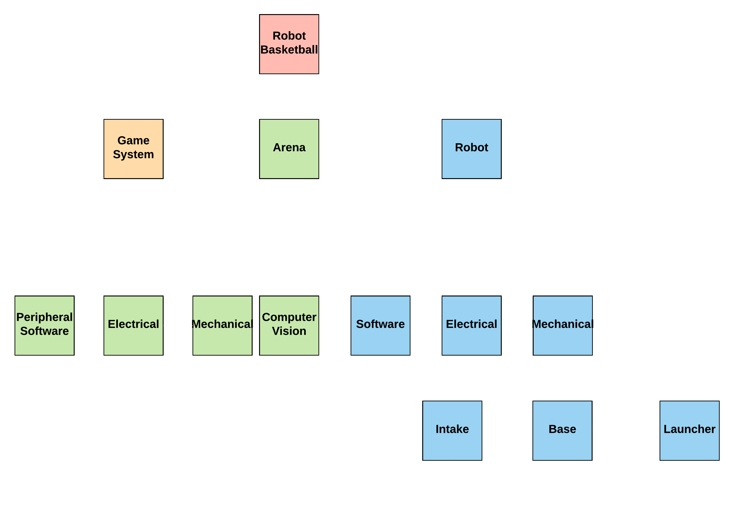
System Architecture
Notes:
BRANDON:
The general design philosophy to meet the project goals is to design a simple device-like robot that is commanded by a complex master system.
The shown architecture was developed to break the project into well-defined components:
Project is split into Game, Arena and Robot subsystems
Arena is Split into mechanical, electrical, computer vison, and peripheral software
Robot is split into software, electrical, and mechanical
Mechanical is made up of intake, base, and launcher subsystems
There are several critical interfaces identified, and a few implicit interfaces

Slide 6
Requirement Specifications
Requirement # | System | Requirement | Value | Unit
1 | Robot | The launcher shall launch a ball with a range of… | 1-5 | Feet
2 | Robot | The robot shall drive in any direction at a minimum velocity of at least… | 1.25 | Feet/ second
3 | Arena | The computer vision shall detect robot and ball position with an accuracy of at least… | .5 | Inches
4 | Arena | The computer vision shall detect robot orientation with an accuracy of at least… | 3 | Degrees
5 | Game | The game shall control the robot with a gamepad at a rate of at least… | 5 | Hz
6 | Game | The game shall prevent the robot from driving within a distance to the wall at most… | 1 | Inch
Notes:
BRANDON:
The requirement specifications shown are sampled from a larger set that we feel best describes the project’s verifiable operation.
The requirements pertain to launch range, drive speed, computer vision accuracy, and high-level game control

Slide 7
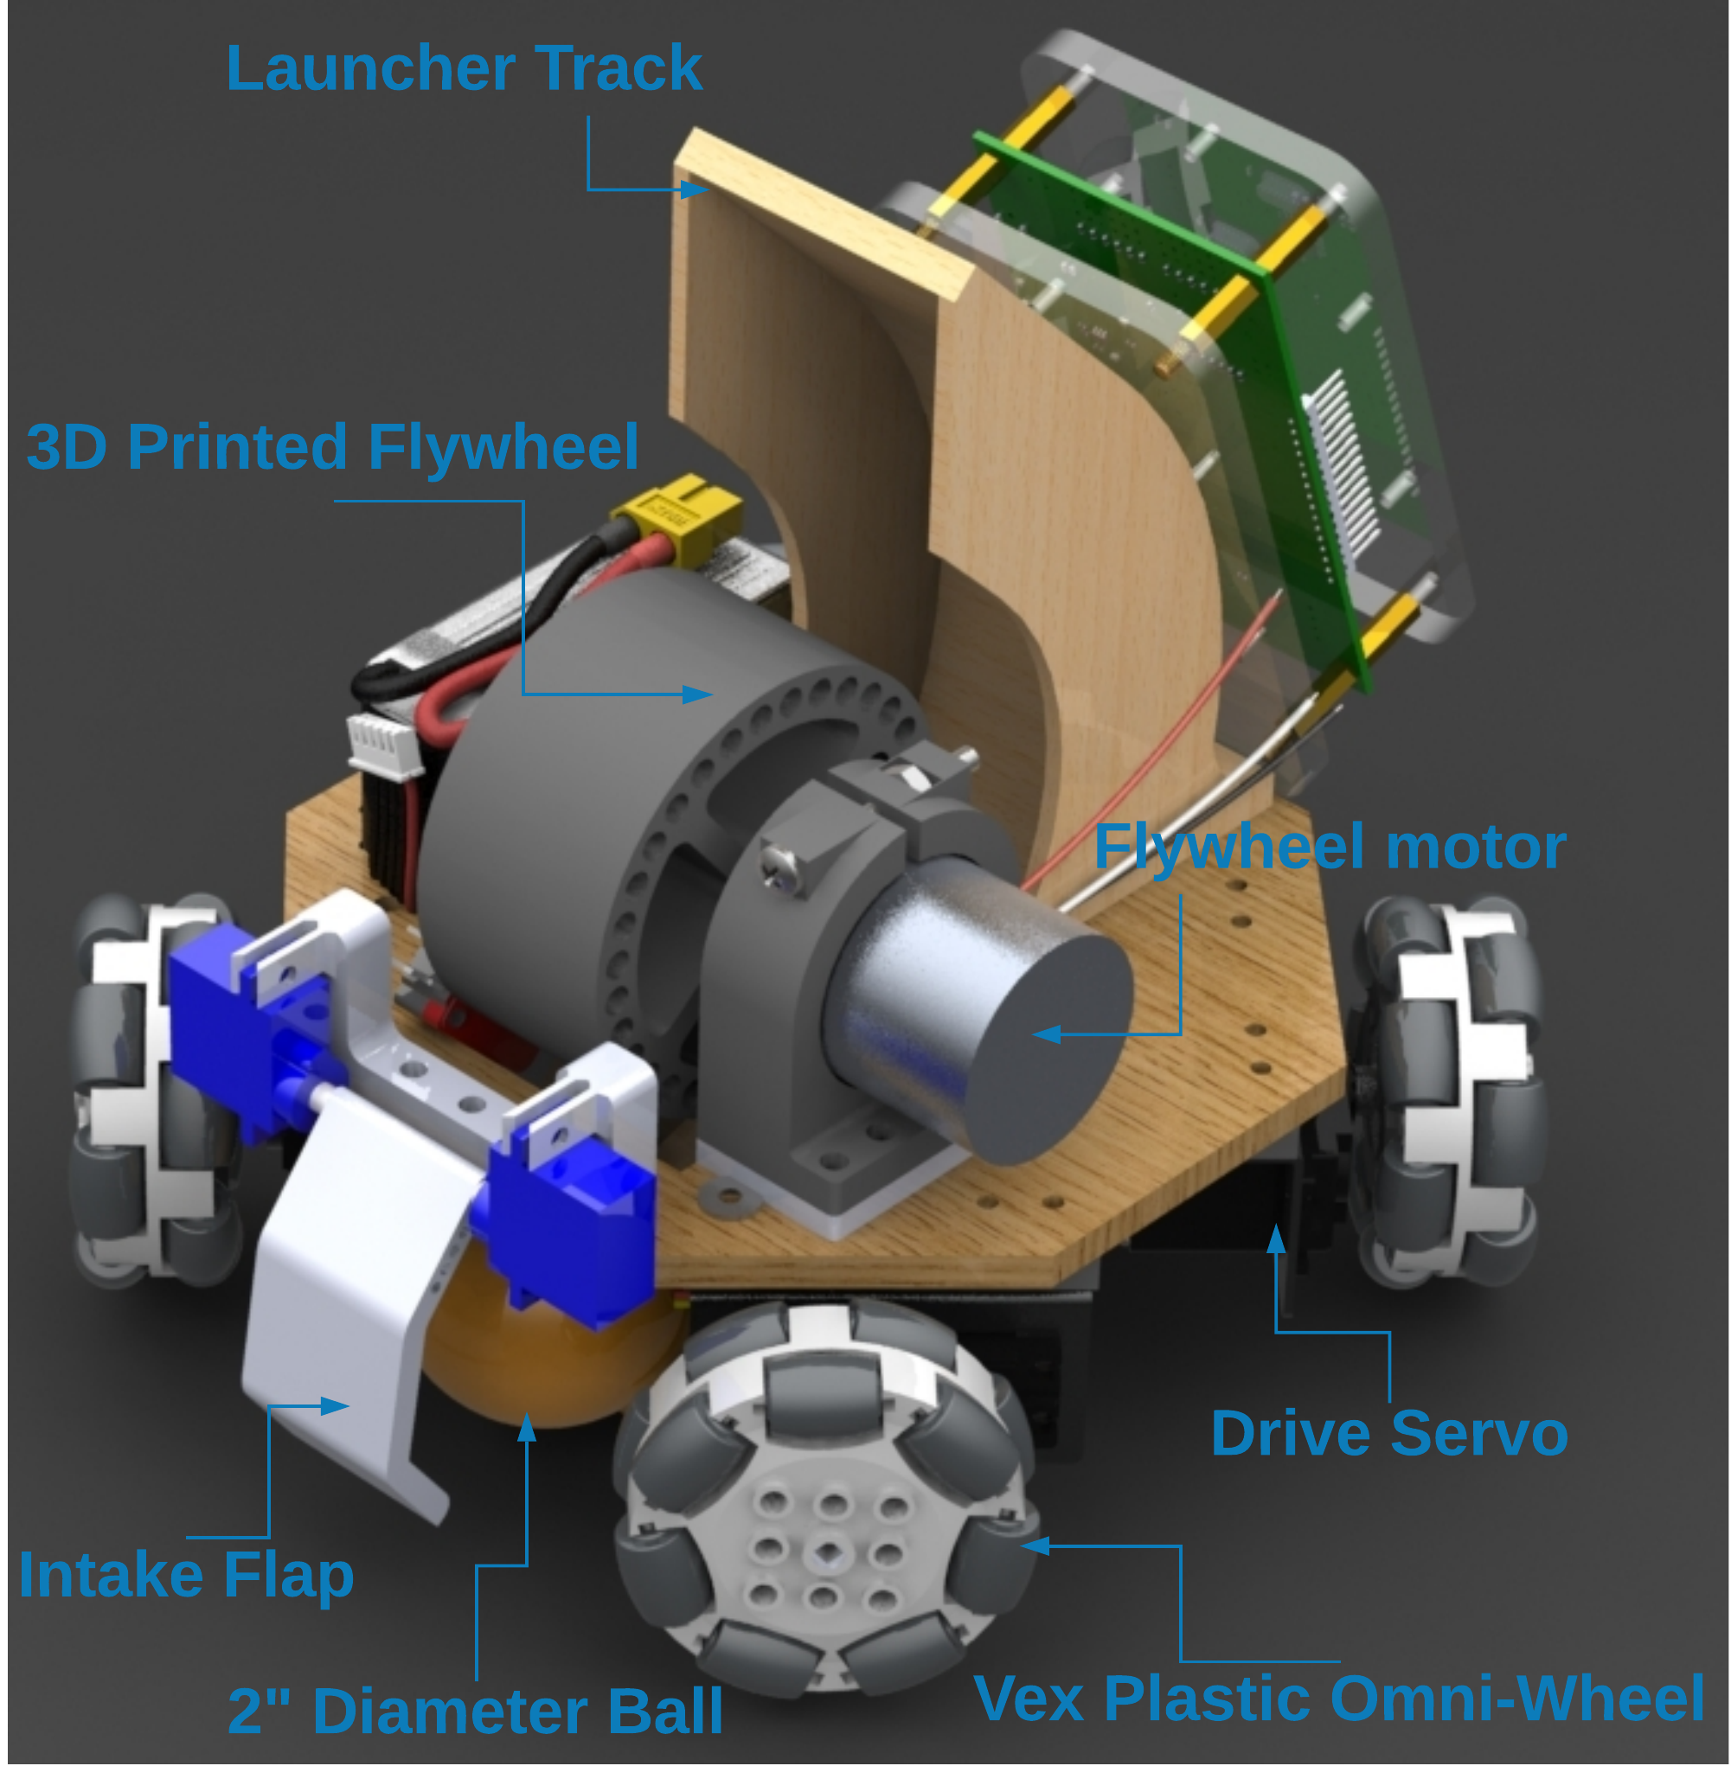
Robot
Notes:
MAT:
This is a render of our proposed robot design. <Point and read labels>

Slide 8
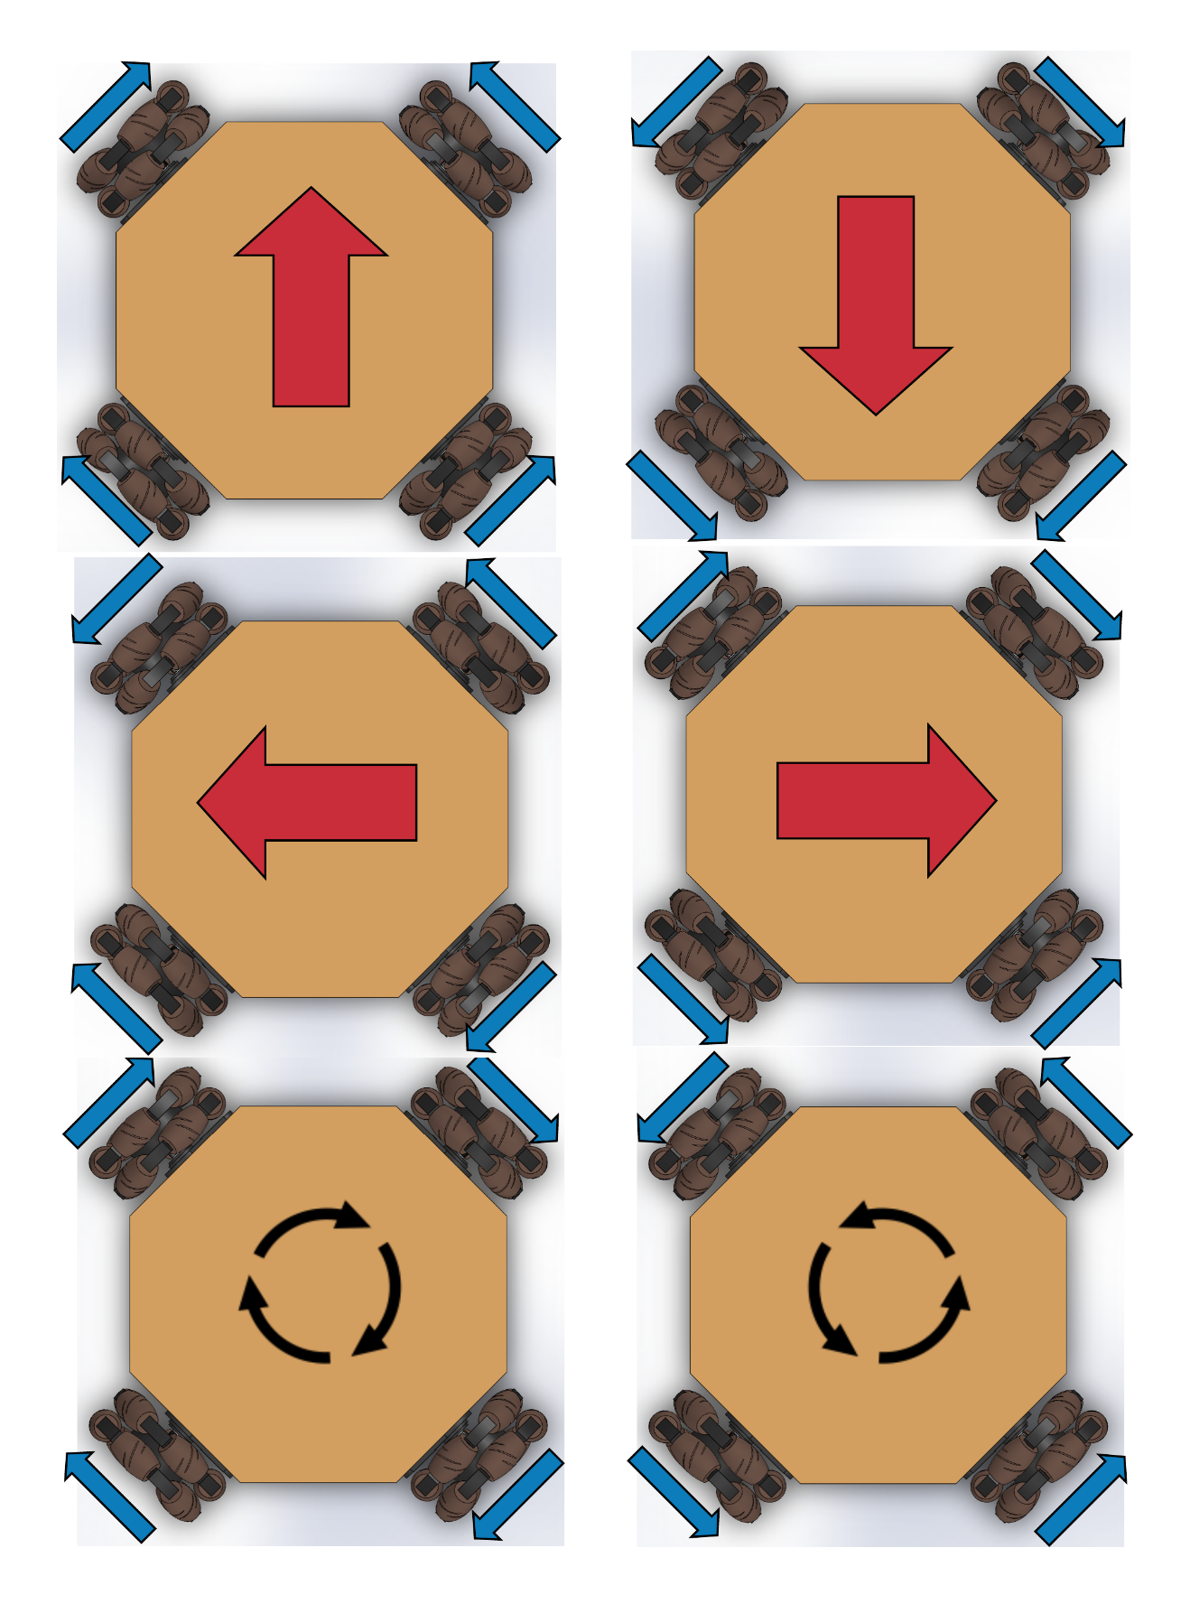
Mobile Base Design
Holonomic vs Skid-Steer
  Can maintain shot angle while traversing without turning
  Slightly faster motion
  Requires more torque
Notes:
MAT:
Offers more flexibility over standard drive train.
Less vibrational effects on the base of the robot.

Slide 9
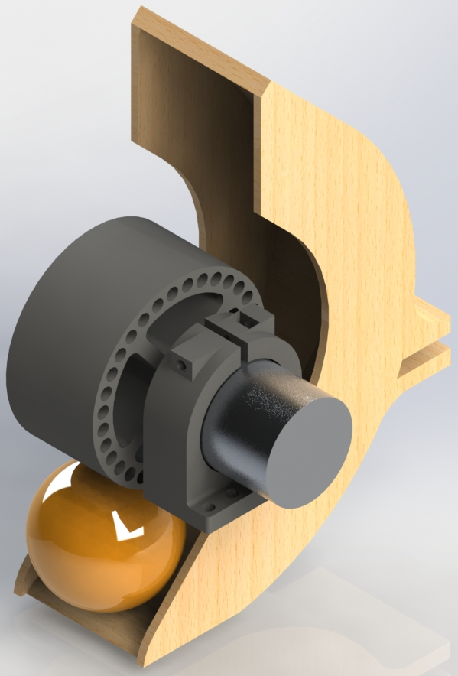
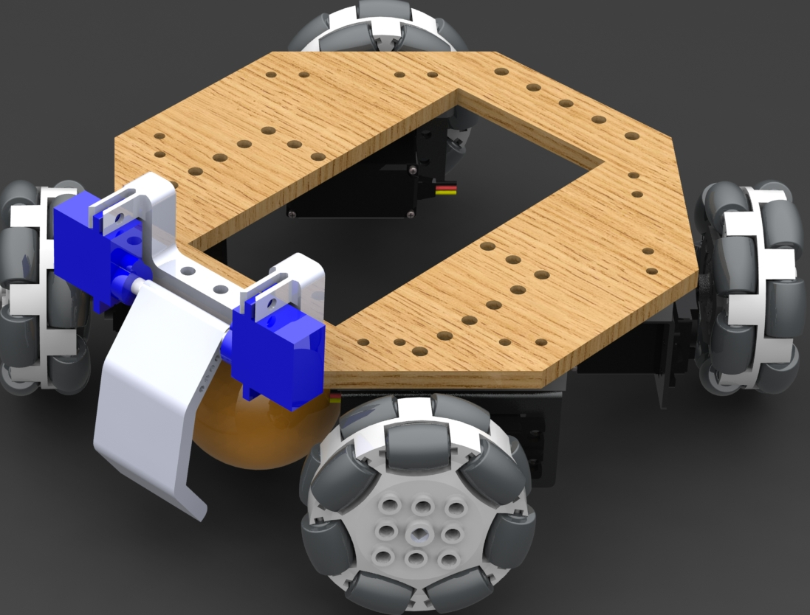
Robot Launcher/Intake Design
Flipper mechanism to trap ball and feed it into intake
Flywheel for launching simplicity
Issues
  Initially chose a brushless DC motor with very high RPM (10,000+), however this was significantly too fast on lowest speeds and caused damage through vibrations
  Significant energy loss in shot (500 RPM -> 3600 RPM)
Notes:
MAT:
Originally, we wanted to go with a launcher design similar to a ballista. However, as we tested and learned more, we found that the design needed to be more complex than we originally thought. Because of this we decided to go with a flywheel mech
-Initially, we decided to use brushless DC motor with an ESC that would be controlled with PWM
-However, that motor turned out to be extremely powerful to the point where it started vibrating the robot
-Therefore, now we are using a standard brushed DC motor and driving it using a motor controller

Slide 10
Component Selection Overview - Robot
Category | Part Description | Part Name (Qty.) | Manufacturer | Operational Voltage [Using] (V) | Operational Current (mA) | Power (W) (Peak) | Cost ($)
Base | Drive Motors | Servos (4) | Parallax | 5 - 8.4 [6.5] | 200 | ~5 | 112
Launcher | Flywheel | DC Motor (1) | Johnson Electric | 6 – 24 [11–12.5] | 3000 | 36 | 6.00
Launcher | IR Sensor | Break Beam | Adafruit | 5 | 20 | 0.1 | 1.95
Intake | Flippers | Servos (2) | Parallax | 4 – 6.5 [6.5] | 200 | ~3 | 26
Communication | Bluetooth | RN-42 (1) | Roving Networks | 3.3 | 30 | ~0.1 | 15.73
Electrical | Microcontroller | ATmega328p (1) | Microchip Technologies | 5 | 200 | 1 | 2.01
Electrical | Motor Driver | DRV8871 (1) | Texas Instruments | 6.5 – 45 [11–12.5] | 3600 (peak) | ~43 | 2.13
Electrical | PWM Driver | PCA9685 (1) | NXP | 5 | 400 | 2 | 2.33
Power | Battery | 3S LiPo | Turingy | 11-16 | 5000 | 63 | 27.00
Power | DC – DC converter | TPS56637RPAR | Texas Instrument | 4.5 – 28 [6.5] | 6000 | 39 | 1.10
Power | 5V Regulator | R-78E5.0-1.0 (1) | Recom | 7 – 28 [11 – 12] | 1000 | 12 | 3.26
Power | 3.3V Regulator | R-78E3.3-1.0 (1) | Recom | 7 – 28 [11 – 12] | 1000 | 12 | 3.26
Total |  |  |  |  |  | ~216 | 202.77
Notes:
SUVRAT:
-List of all the electrical components used to make the robot functional
-The Power and cost are calculated based on worst case scenario
-Typically the robot will use approximately 50 – 60 Watts if programmed correctly

Slide 11
Component Selection - Microcontroller
Microcontroller needs to be able to support various chip drivers such as motor driver, PWM driver
Microcontroller needs to have the ability to implement communication protocols for instance UART for Bluetooth data exchange
Microcontroller needs to have thorough documentation and help online to speed development process
Processor | ATmega328P | ATmega2560 | MSP430G2553
Operating/Input Voltage (V) | 5 | 5 | 3.3
CPU Speed (MHz) | 16 | 16 | 16
Analog IN/OUT | 6/0 | 16/0 | 8/8
Digital IO/PWM | 14/6 | 54/15 | 24
EEPROM [kB] | 1 | 4 | 0.128
SRAM [kB] | 2 | 8 | 0.512
Flash [kB] | 32 | 256 | 16
UART | 1 | 4 | 1
Cost ($) | 2.01 | 12.35 | 2.41
Notes:
SUVRAT:
-Arduino Uno is well known and has an extensive library along with online help and tutorials
-MSP430 would have required a lot more debugging and would be time consuming although it would give us more control over the hardware
-With ATmega328, we will use a SMD package component and flash Arduino Software on it using ICSP Programmer
-ATMega2560 is expensive and we do not see the need for it yet

Slide 12
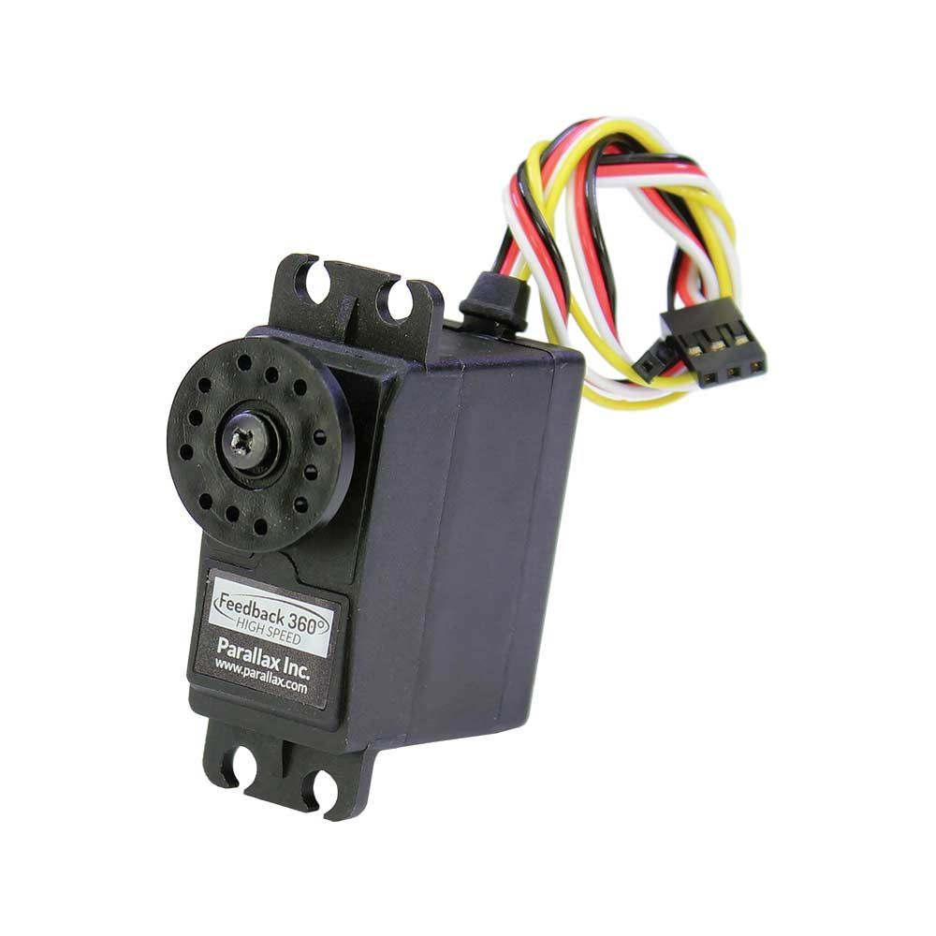
Component Selection – Drive Motors
Requires motors capable of driving the robot in high speed situations (0.3m/s)
Requires closed-loop velocity control to accurately control holonomic motion
Servo chosen because of the ease of control (Simplifies the drive code)
 | Heneng DC Motor | Feedback 360 High Speed Continuous Rotation Servo | High Speed Continuous Rotation Servo
Cost($) | 15 | 28 | 17
Manufacturer/ Distributor | Amazon | Parallax | Parallax
RPM | 100 | 140 | 180
Torque (Kg-cm) | 2 | 2.5 | 2.2
Voltage, Current (V), (A) | 9,1.2 | 6.5, 0.2 | 7.4,0.6
Power(W) | 10.8 | 7.8 | 4.44
Control | External Driver | PWM | PWM
Feedback | 2 CPR Quadrature Encoder | 2 CPR Hall Effect | None
Notes:
SUVRAT:
-We are using Feedback servos by parallax
-One of the reason was that we had them from Boe-Bit
-We discussed with using DC motors and then encoders for velocity control however these have built in encoders and therefore, can easily be pulsed-in via MCU’s GPIO
-Additionally, encoders need interrupts for accurate data capture and our microcontroller doesn’t have enough
-The Servos are run using a PCA9685 chip that can be talked to with I2C
-The chip supports 16 channels but only 7 will be used for the project and others can act as GPIO outputs

Slide 13
Component Selection - Motor Driver
The Motor Driver needs to drive a DC motor within the operating range of 6V – 24V
The Motor Driver needs to be small enough to save PCB space
The Motor Driver should support at least DC motor
Driver IC | L293D | L298 | DRV8871
Supply Voltage (V) | 5 - 36 | 6.5 - 45 | 6.5 - 45
Max Output Current (A) | 0.6 | 4 | 3.6
Number of Channels | 2 | 2 | 1
Footprint (mm²) | 12.6 x 7.4 | 15.8 x 10.9 | 4.90 × 6.00
Cost($) | 2.95 | 4.86 | 2.13
Notes:
SUVRAT:
-The motor driver drives the flywheel and needs to be robust for launching the ball
-All the motor drivers considered have almost similar specs however L298 and DRV8871 provide more current output
-This will help in providing more torque to the flywheel and thus dictate different shooting ranges
-L298 was not chosen because it has a bigger footprint and DRV8871 will use less footprint on the PCB
-Additionally, DRV8871 is the cheapest and has a dev board available on Adafruit for testing purposes

Slide 14
Component Selection - Communication
The Communication device must be wireless
The Communication device must be compatible with the Robot’s MCU and Arena’s computer
The Communication device must be low power and have open source schematics available to lay on the PCB
Bluetooth module | HC-05 | BlueSMiRF
Operational Voltage (V) | 3.3 | 3.3
Tx power (dBm) | <= 4 | <= 4
Bluetooth Chip | TI CC2541 | RN-42
Bluetooth Profiles Supported | SPP | SPP & HCI
AT Command Support | Yes | Yes
Linux Compatibility | Yes | Yes
Cost($) | ~10 | ~15
Notes:
SUVRAT:
-Bluetooth was chosen as the mode of communication because Arduino can interface with it simply by UART
-Bluetooth also uses less power compared to Wi-Fi and therefore will preserve Robot battery
-Both the Bluetooth have almost the same spec except BlueSMiRF also supports HCI Bluetooth profile in case SPP doesn’t work
-RN42 uses Bluetooth 2.0 and since we are only sending 32 bytes of data back and forth it seamed feasible
-There are schematics readily available online to put on the PCB
-Therefore, it is chosen even though it is slightly expensive but will save us the time and allow us to focus on other important things

Slide 15
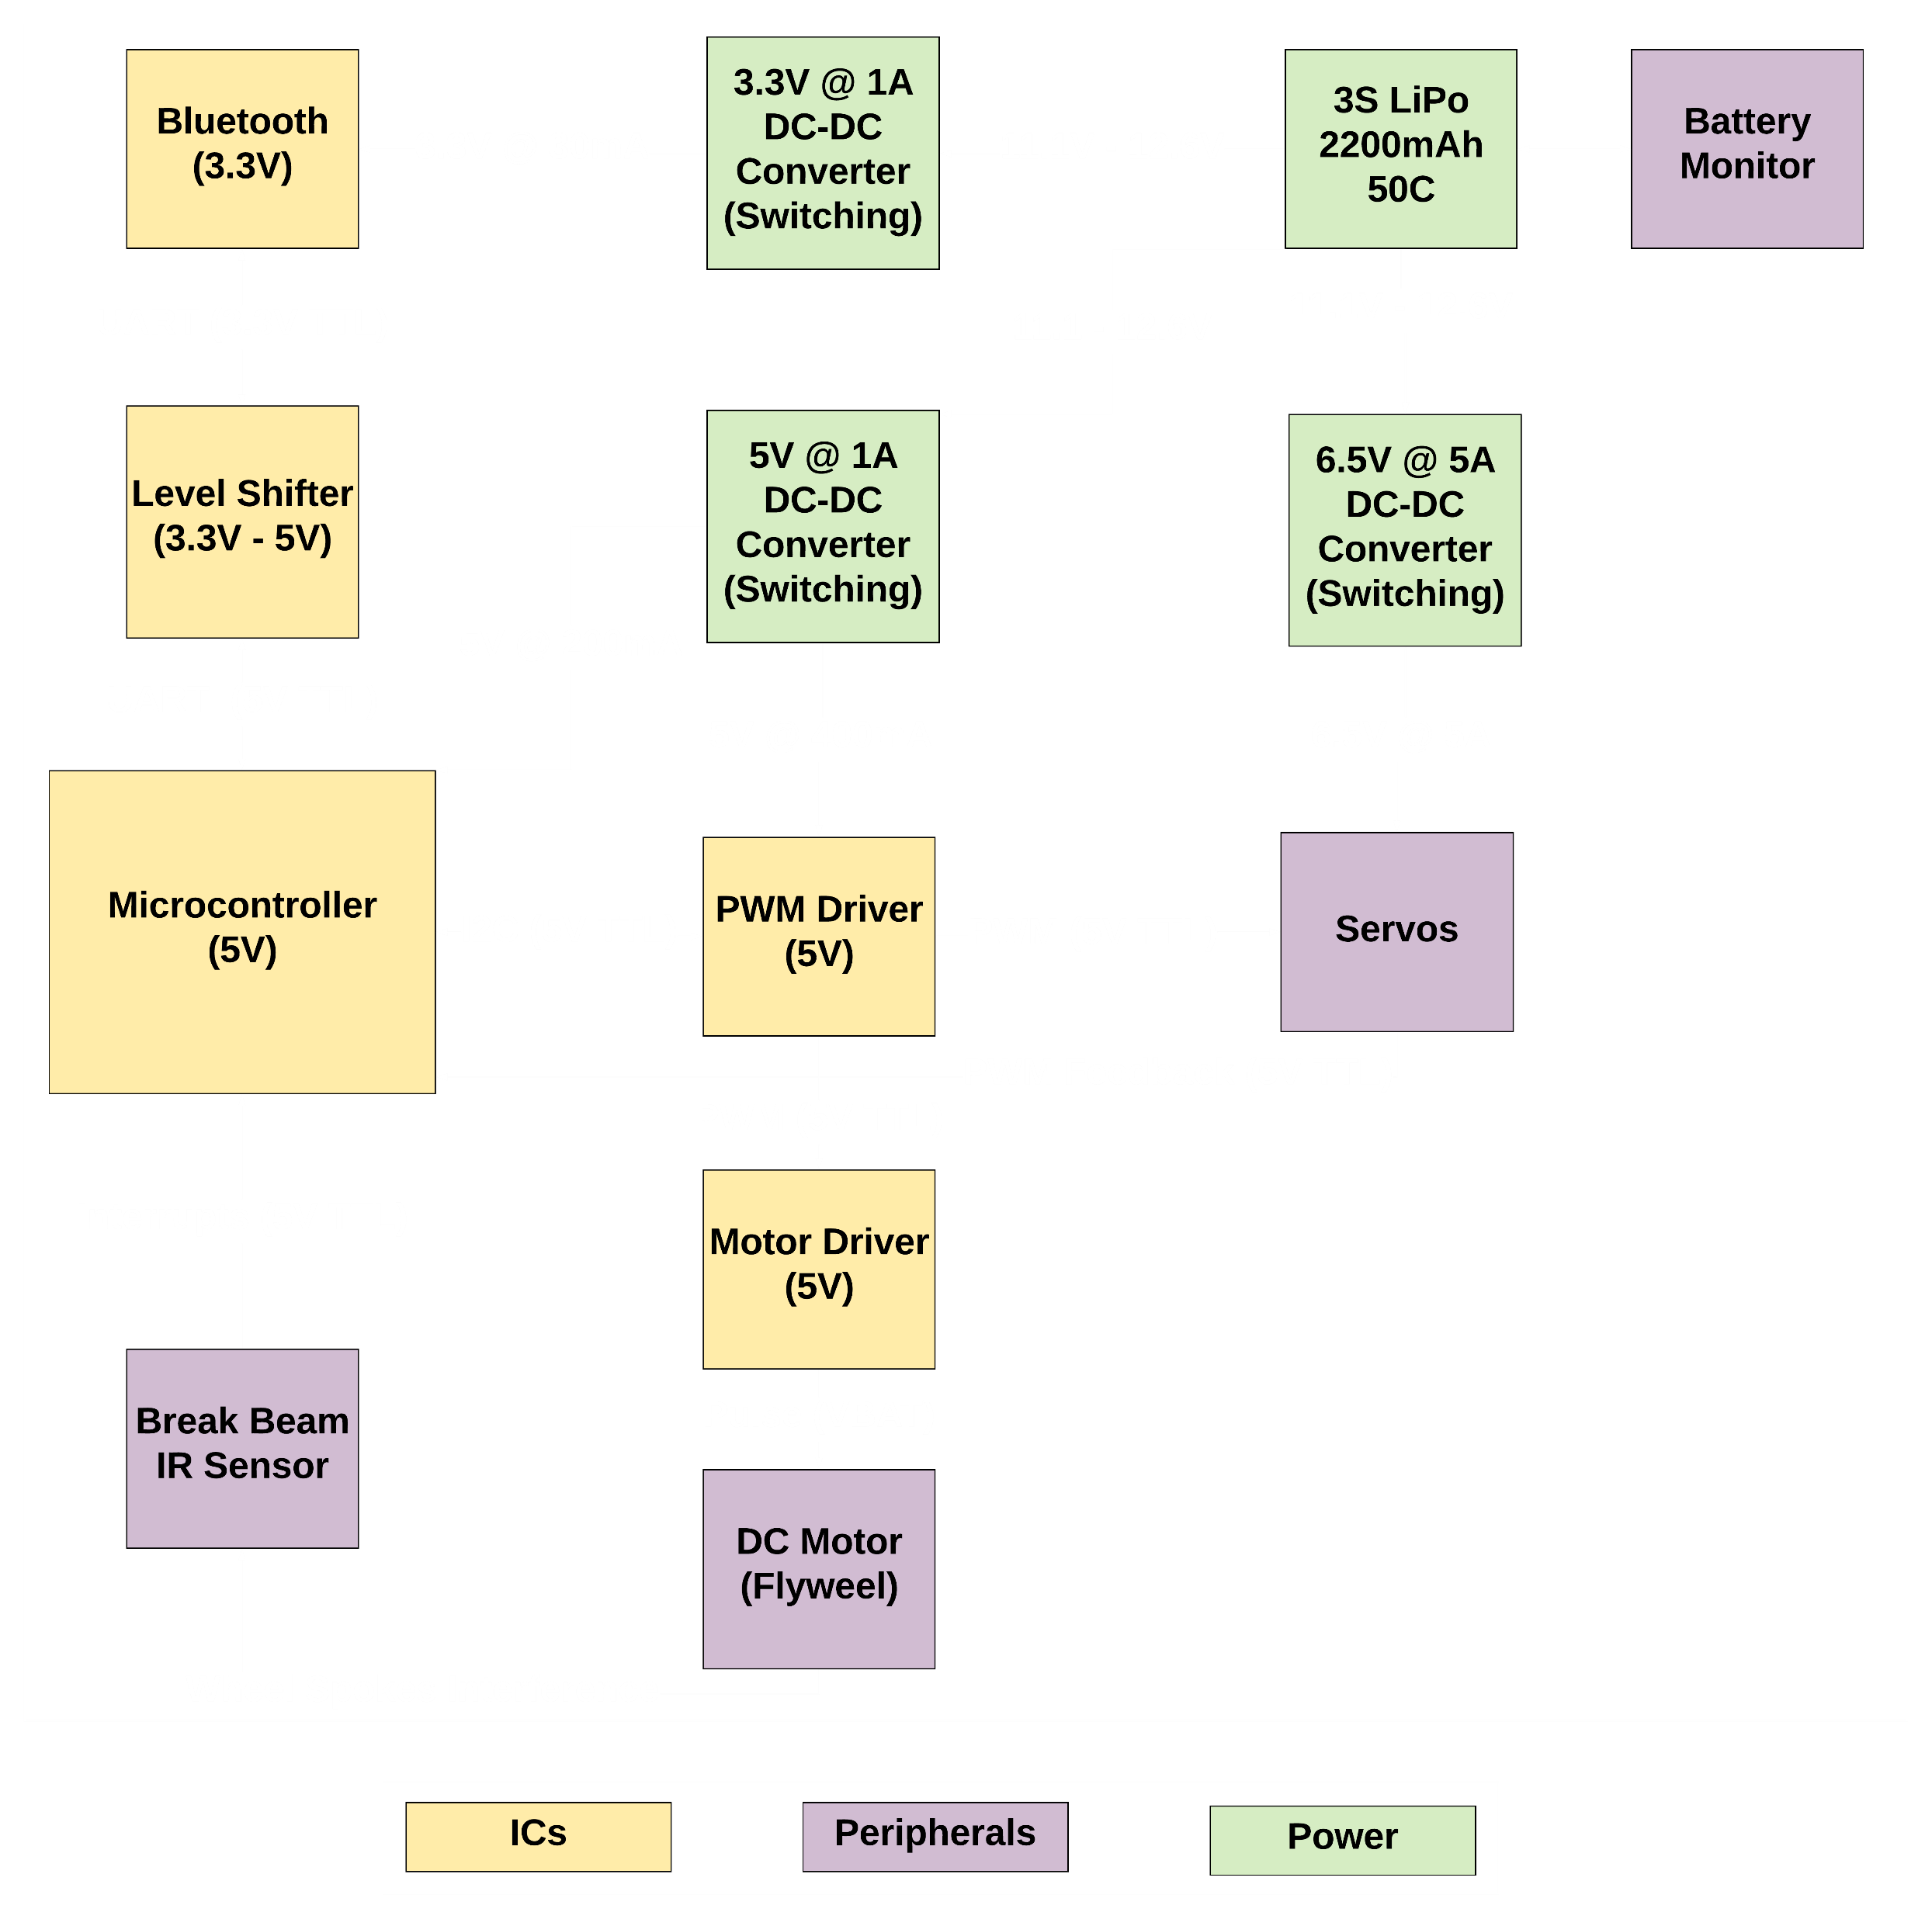

Robot PCB Overview
Notes:
SUVRAT:
-An Overview of Robot’s PCB
-The battery powers 3 switching regulators: 1 powers the servos, 1 powers the MCU and the PWM driver, and 1 powers the Bluetooth
-The microcontroller talks to PWM driver using I2C and the motor driver is controlled using the PWM driver
-A lever shifter is used to talk to Bluetooth via UART protocol and the feedback from drive servos is connected to the MCU’s GPIO pins
-The MCU is flashed with Arduino firmware and a FDTI board is used to program the PCB via UART
-Jumpers are used so that when they are in place the UART is used for Bluetooth but when removed then the UART is used to program the MCU

Slide 16
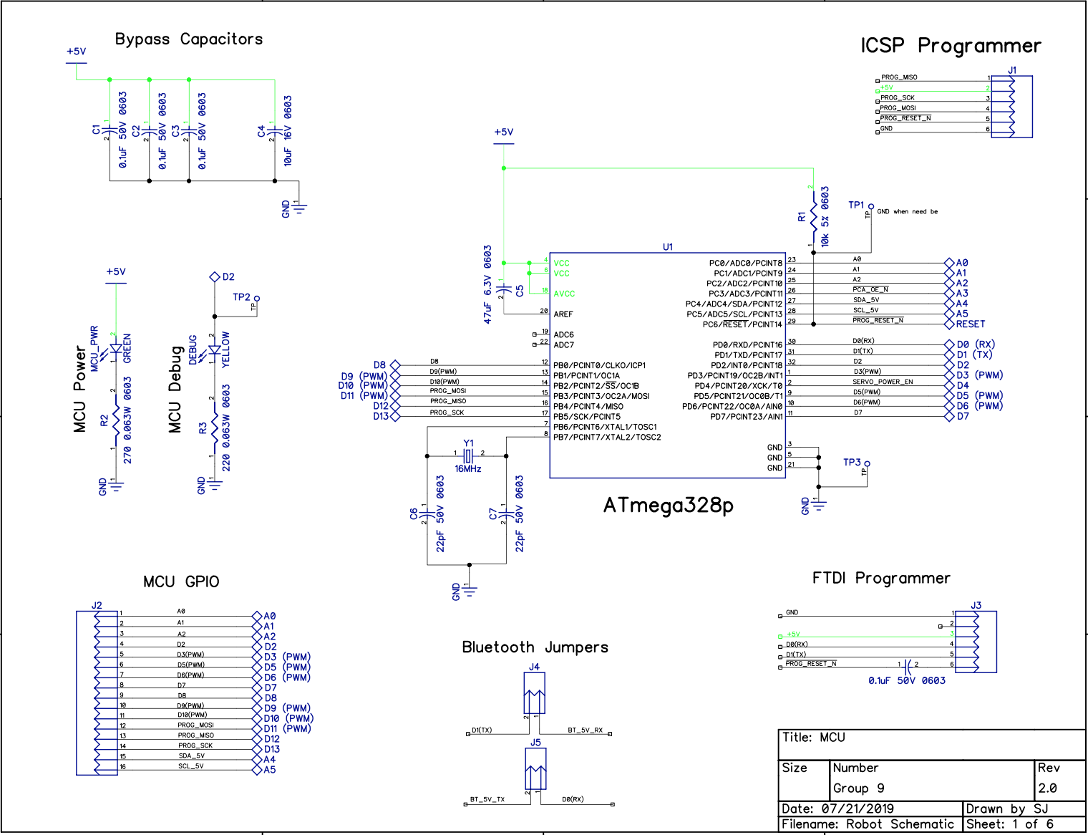
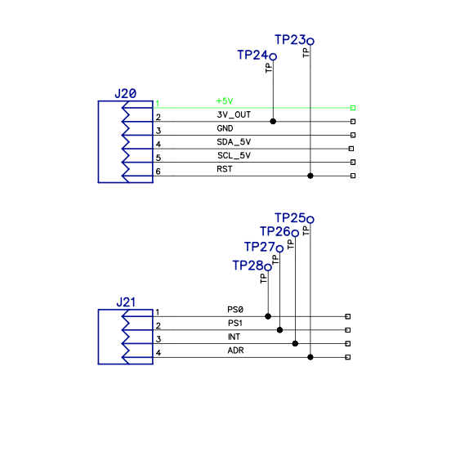
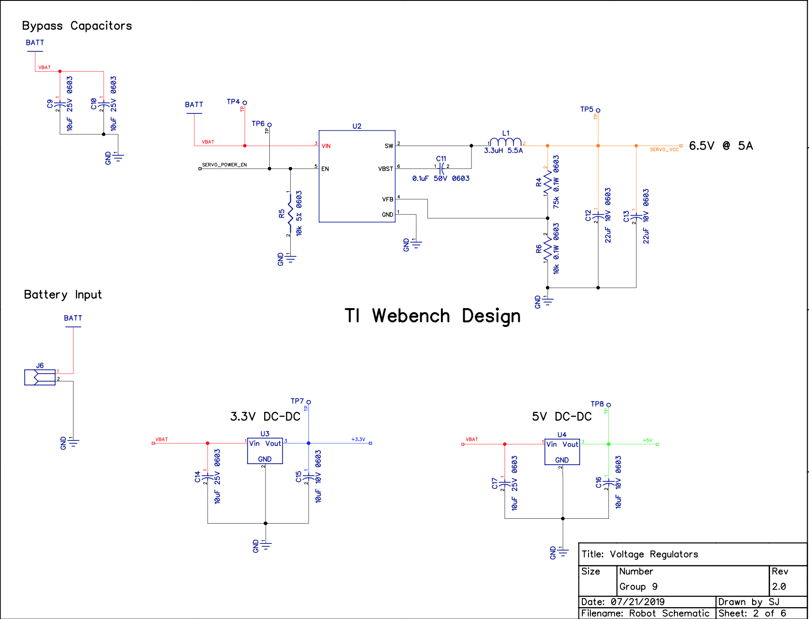
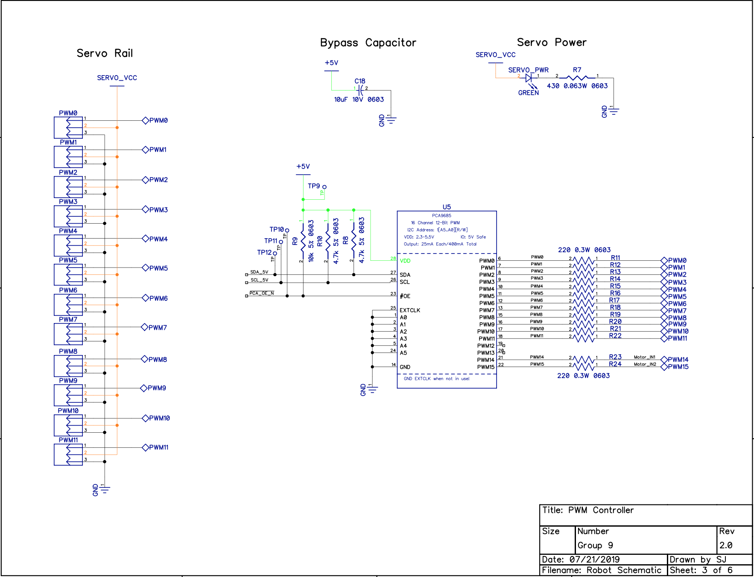
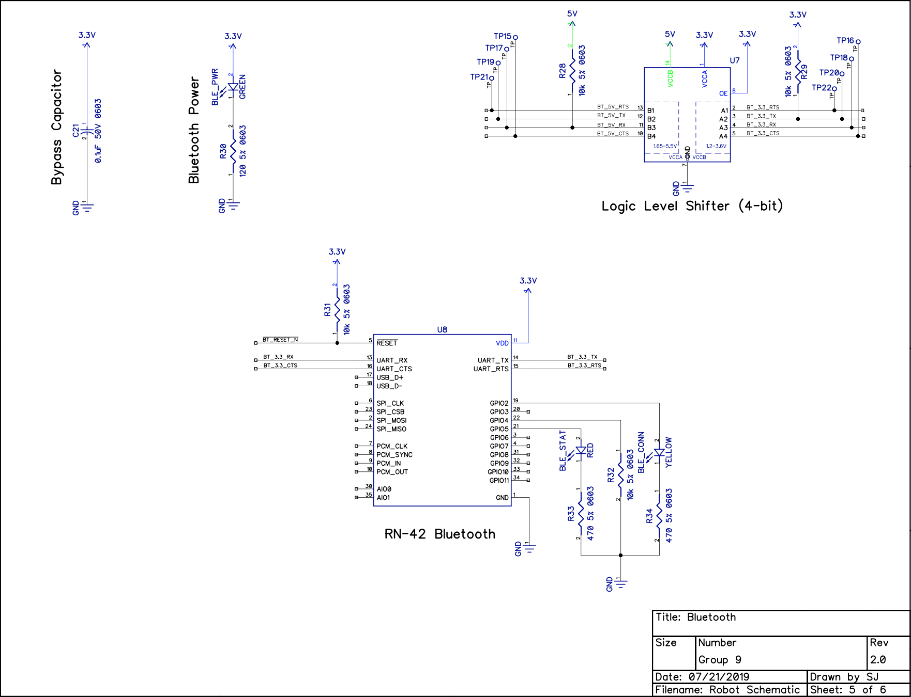
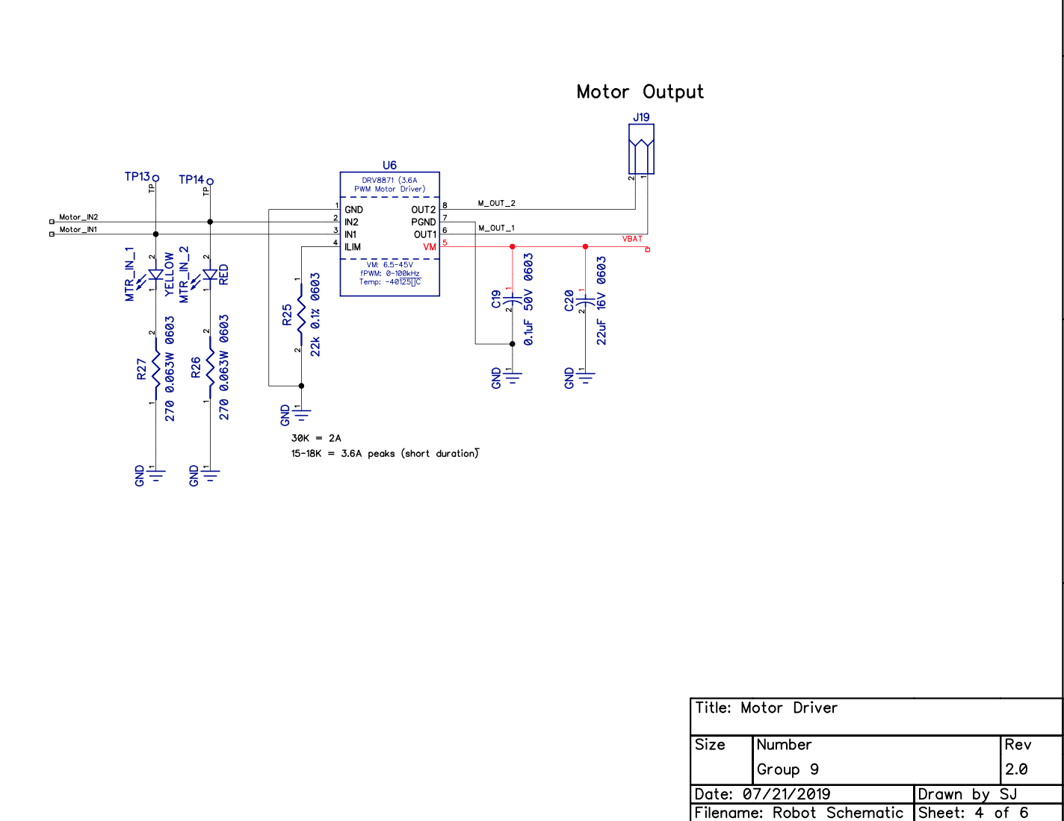
Overall Schematic

Slide 17
Robot Schematic: Microcontroller
Notes:
SUVRAT:
-Schematic of MCU
-ICSP is used to program and flash Arduino on it
-Then a FTDI Connector and Drivers is used to program the PCB directly via USB
-Bypass capacitors are used to reduce noise
-16Mhz crystal is used for the MCU
-Status LED is added to detect 5V input
-Another LED is attached to MCU’s pin 32 (Arduino’s D2) for debugging

Slide 18
Robot Schematic: Power Distribution
Notes:
SUVRAT:
-These are the three switching regulators
-One steps down 12V to 3.3V for Bluetooth
-One steps down 12V to 5V for MCU and PWM Driver
-One steps down 12V to 6.5V for the Servos
-For the battery we are using a LiPo
-A nice addition to this would reverse voltage protection. Maybe add a diode on the VBAT side of the Recom.
-Polarity protection was considered but then deemed unnecessary as the battery connector is keyed (Using a T Plug)

Slide 19
Robot Schematic: PWM Controller
Notes:
SUVRAT:
-PWM Schematic
-16 signals available 4 are used for driver servos, 2 are used for intake, and 2 are used for motor controller
-LED is attached with current limiting resistor for Servo VCC for status
-Pull up resistors are used on communication lines and test points are added to easily scope signals

Slide 20
Robot Schematic: Flywheel Motor Controller
Notes:
SUVRAT:
-Schematic of the Flywheel motor controller
-Uses a current limiting resistor and shuts off if motor stalls for some reason protecting the PCB and the chip
-Current Limiting Resistor value is calculated using the formula in the datasheet
-Motor and the chip are powered by the battery directly whereas PWM connects to PWM controller
-It has LEDs connected to PWM lines. So they get brighter as the flywheel spins faster

Slide 21
Robot Schematic: Bluetooth
Notes:
SUVRAT:
-Bluetooth Schematic
-RN-42 is chosen because it has built in firmware for HID profile
-The Bluetooth works on 3.3V and 4-bit logic level shifter is used because Arduino runs on 5V logic
-There are status LEDs to show Bluetooth power, and connection status.
-There were an array of problems with getting this to work. The one we had the most problem with was the connection between RTS and CTS lines.
-Essentially, after fixing all the software problems we reached a point where the Bluetooth on the robot would send data to Jetson Nano and jetson nano would send it back to the robot but sometimes we would receive the data and sometimes we wont.
-We thought putting a ground plane close to the antenna could have been the problem but the distance between Nano and Robot is not too large for that to occur
-The problem was CTS line. Essentially I had copied the schematic from Sparkfun’s open source schematic which had RTS and CTS lines open for users to use
-After multiple steps of debugging and reading the datasheet I found that RTS and CTS needed to be connected or CTS needed to be ground. This was our 2nd revision of PCB and we had already soldered up a brand new board and didn’t want to design it all over again just for that one fix. Thankfully, because I had testpoints almost everywhere, I just added a jumper cable and voila. We were in business.

Slide 22
Robot Schematic: Expansion Interface
Notes:
SUVRAT:
-Just some female header pins on the PCB
-The idea was to use the IMU sensor from adafruit and just slot it in in case we couldn’t get the orientation data from OpenCV
-Thankfully, Cory and Brandon figured it out so it saved me the hassle of laying it on the board
-Additionally, the sensor chosen is a ball grid part which would have been impossible to solder with the skills and money we have so I just added an interface to slot it in just in case we ended up needing it.
-After all the design and engineering and mishappening and arguments and sleepless nights. This is what was created….(Switch slide)

Slide 23
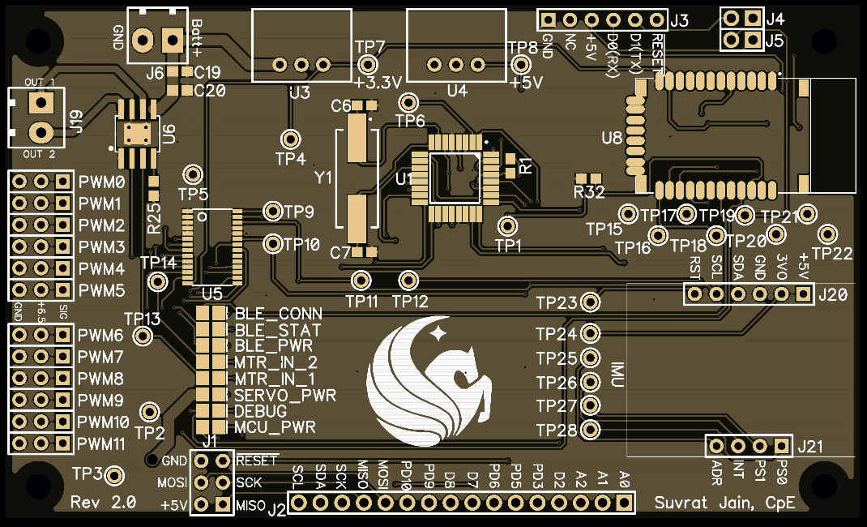
PCB Top Layout
Notes:
-Smaller than our first iteration by 40mm in one dimension
-The original PCB was 100mm x 100mm whereas this one is 100mm x 60mm
-Hand laid by our world class PCB designers in India, manufactured by our collegues in China and sponsored by our friends in America
-This is Top side

Slide 24
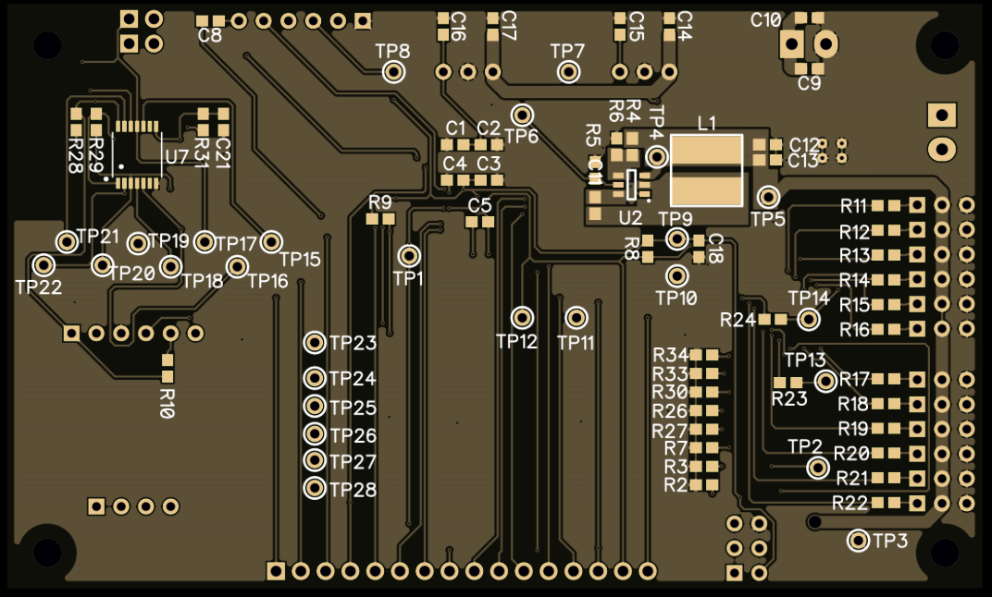
PCB Bottom Layout
Notes:
-This is the bottom side

Slide 25
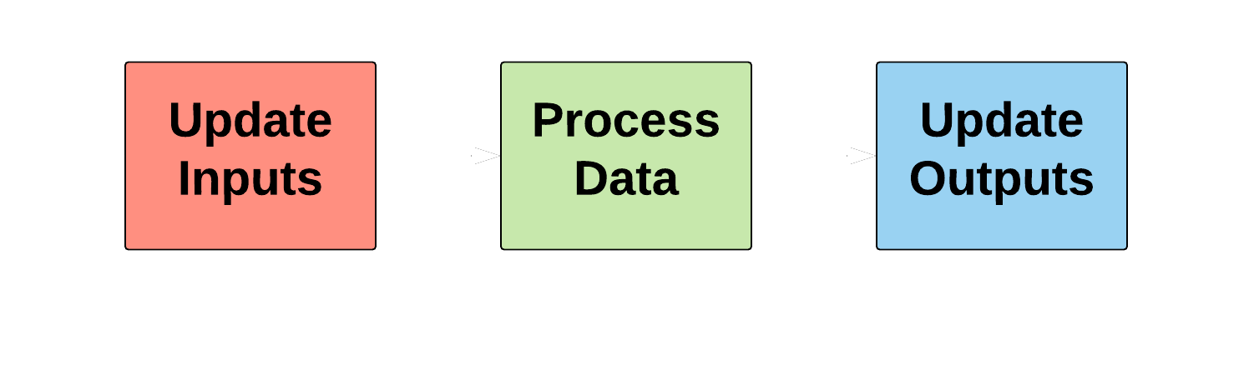
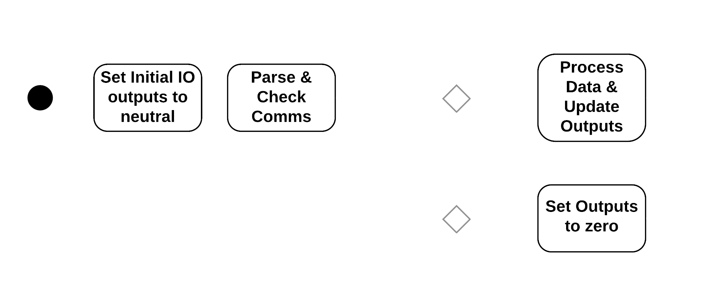
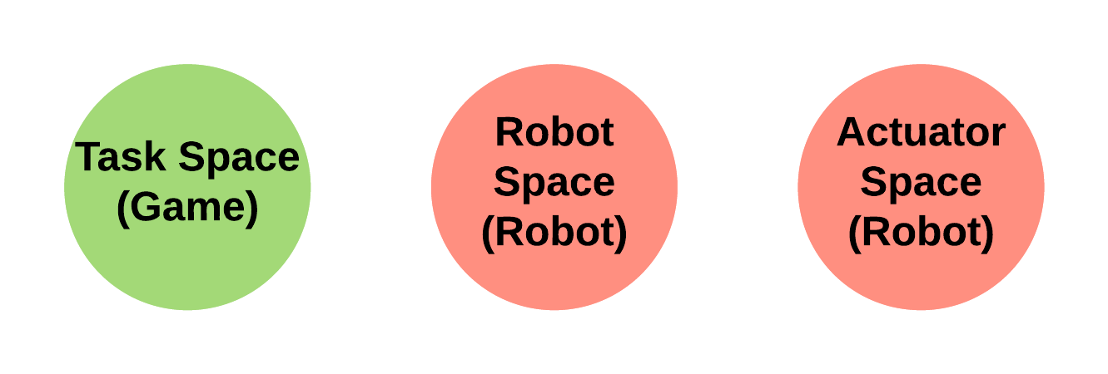
Robot Software Design
Data Flow
Robot acts as an I/O device that takes in data from sensors and commands from the Arena, and then executes the commands through actuations
Kinematics are done on the robot to abstract the control to the Game system
Closed-loop control is implemented on drive & Launcher systems
Outputs disabled when valid packets are not received after a short period of time
Control loop time runs at ~50hz
Communication Timeout
Space Transformations
Notes:
BRANDON:
The robot software design follows a general data flow of updating inputs from sensors, processing the data, and updating the outputs to the actuators.
We must stop actuations when valid data is not being received in order to protect the robot. This is done with a communication timeout
The software also implements kinematics to convert between different spaces such as Task space in Game/Camera Frame, Robot space in Base Frame, and actuator space in digital or analog signals. This is done so that the robots can be changed out without interface changes to the Arena.

Slide 26
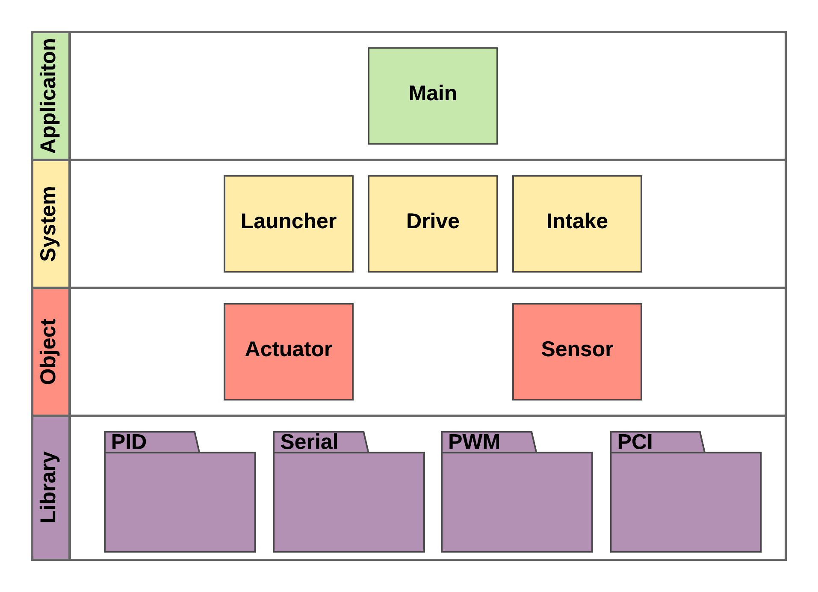
Robot Software Model
Notes:
BRANDON:
The robot software is implemented in 4 layers: Application Layer, System Layer, Object Layer, and Library Layer. Each layer implements services provided by layers below it.
The application layer is the master robot code that enforces the Data flow paradigm.
The Drive, Launcher, and Intake are implemented in the system layer and they create instances of actuators and sensors. These system layers handle closed loop control and kinematics where appropriate.
The actuator and Sensor objects have a variety of possible options and are designed to be abstract enough that they can be used with any type of actuator or sensor.

Slide 27
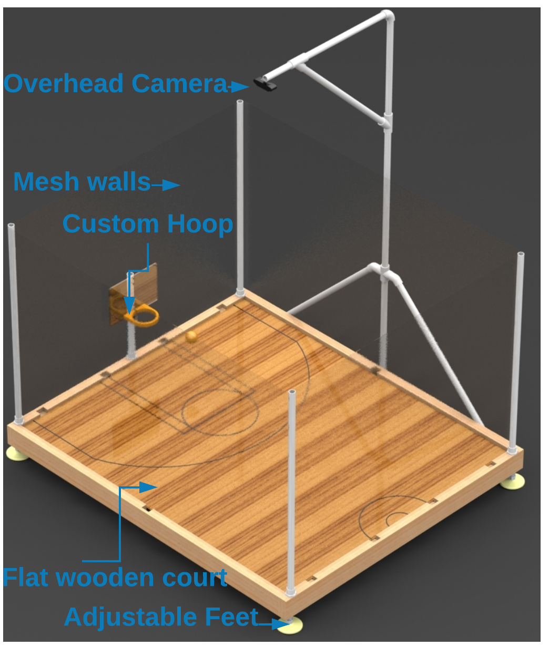
Arena
Notes:
CORY:
-The arena consists of 6 main components: The Overhead camera, Mesh walls, Custom Hoops, Flat wooden court, Frame, and Adjustable Feet

Slide 28
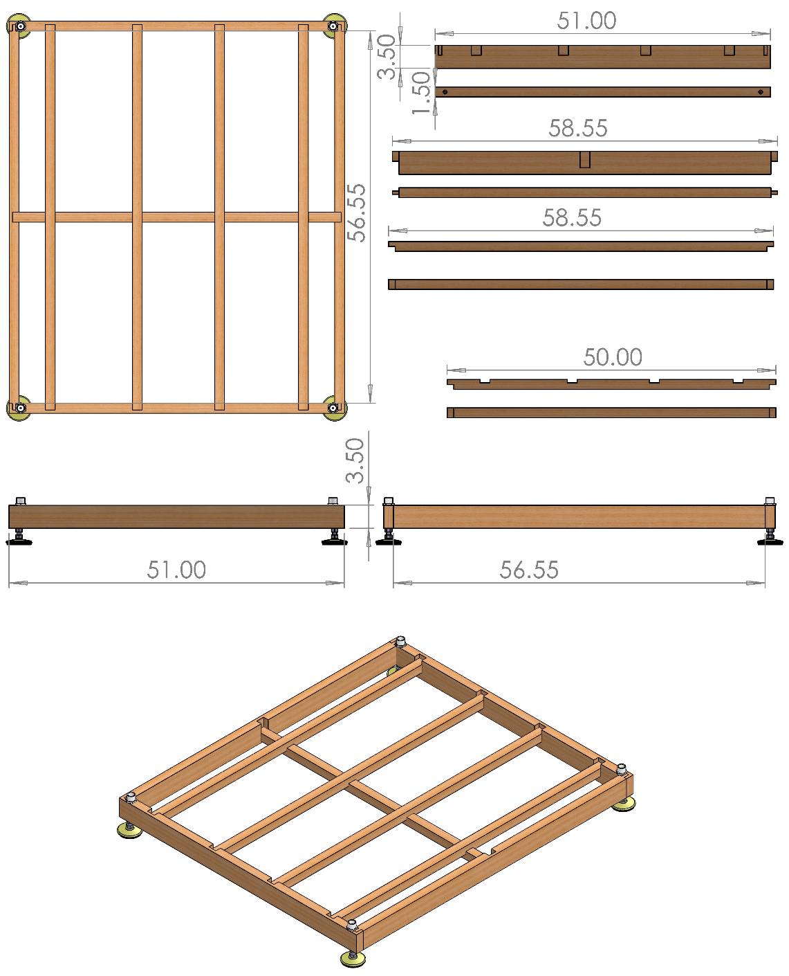
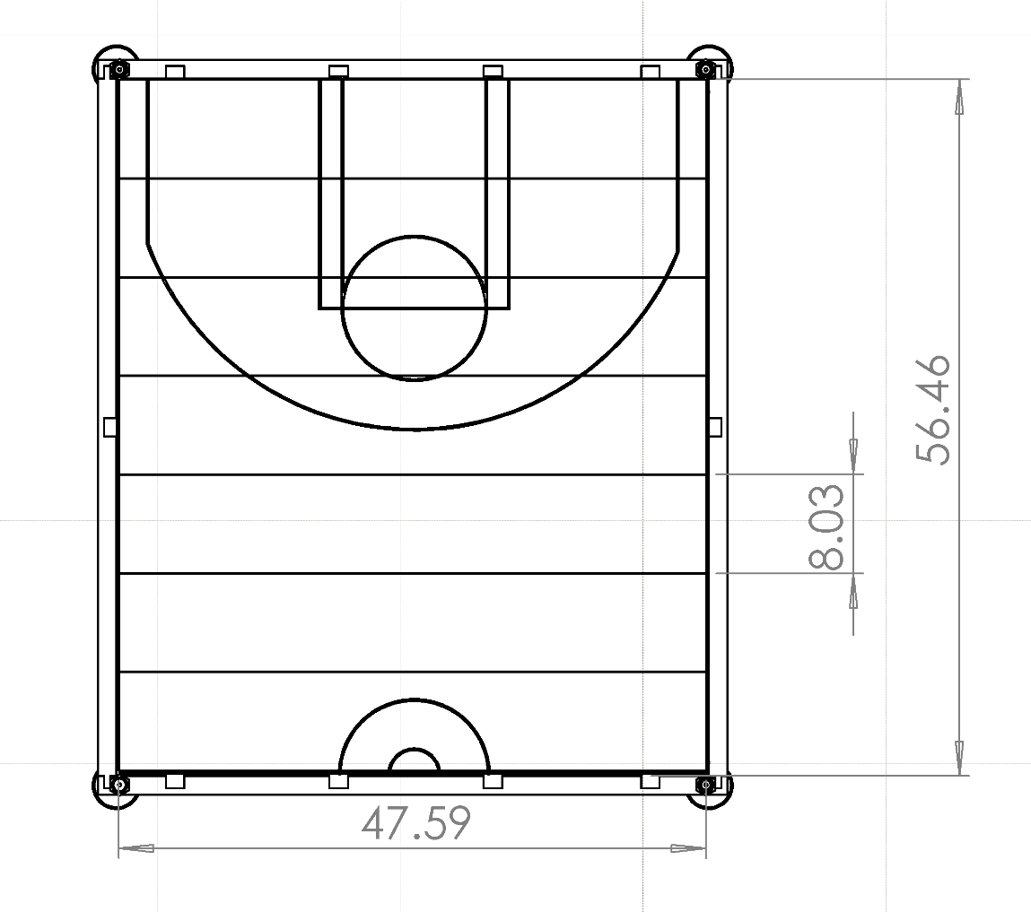
Arena - Frame & Court Design
Arena is 5’ length by 4’ Width by 3’ height (Minus camera mount)
Broken into several locking pieces without tools or hardware
Frame mounted on adjustable feet to level the floor
Wall mesh included to prevent projectiles flying outside the Arena
Notes:
CORY:
-The arena was built using 2x4 Kiln Dried wood for the frame which had locking joints cut in order to have each piece fit together effortlessly and with no hardware or tools.
-The flooring is removeable laminate flooring with basketball court markings painted on, keeping to the ratio of an NBA court as close as possible.
-The mesh wall posts are PVC pipe which is easily removed and placed back when constructing the arena.
-The hoop posts are also PVC pipe which fits into PVC caps attached to the frame of the court.
-The camera mount is again made of PVC and attached to the frame of the court.

Slide 29
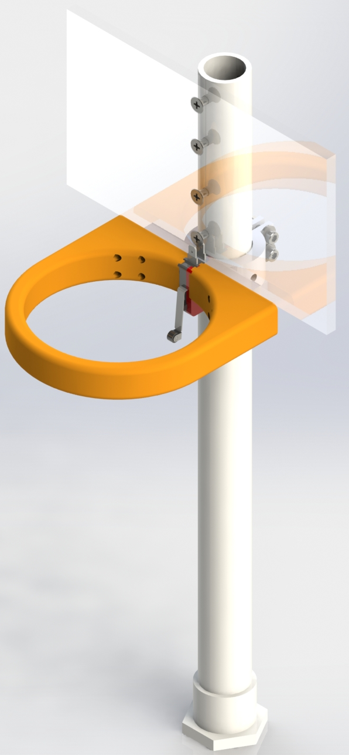
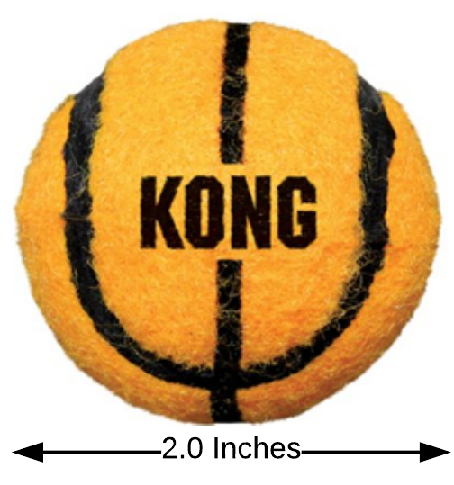
Arena - Ball & Hoop Design
Ball is a small-scale tennis ball with a basketball appearance
  Chosen because of size, appearance, and higher weight than a ping-pong ball
3D-Printed hoop and mount attached to a PVC post and an ABS backboard
IR Break Beam Sensor to capture when baskets are made
Notes:
CORY:
-A small-scale tennis ball was chosen because it resembles a basketball and is the smallest sized ball we could find that had the right feeling.
-A ping pong ball was also considered, but bounced too much in testing, was too light to consistently intake, and there was a worry that the flywheel might dent the ping pong ball when launching.

Slide 30
Component Selection – Embedded Computer
High-powered computing is required to process the computer vision data and game engine on a single device
It must also support a small number of I/O to aid in Arena intelligence
Feature | Raspberry Pi 3 Model B+ | Jetson Nano
CPU | 1.4 GHz 64-bit Quad-Core ARM Cortex A53 | 1.4 GHz 64-bit Quad-Core ARM Cortex A57 MPCore
GPU | Broadcom VideoCore IV | 128-Core Nvidia Maxwell
RAM | 1 GB LPDDR2 SDRAM | 4GB LPDDR4
Operation Performance | 21.4 GFLOPs | 472 GFLOPs
Wireless | Dual-band 802.11ac wireless LAN, Bluetooth 4.2 onboard | M.2 Key E Slot (None onboard)
USB Ports | 4x USB 2.0 | 4x USB 3.0
Video Ports | HDMI, DSI | HDMI, Display Port
Cost($) | 35 | 99
Notes:
CORY:
-Since both embedded computers use practically the same CPUs their other components become more important.
-Because we are processing a live video feed we will need a lot of processing power.
-OpenCV has the ability to use CUDA which uses the GPU to perform calculations therefore a better GPU will help our computer vision process video better.
-Computer vision requires a lot of operations to handle data coming in, therefore the operation performance between the two is very important.
-We are using Bluetooth LE 4.2 to communicate between the arena and robot and so the lack of a card on the Nano was a detriment because it just added more cost to an already expensive part.
-However, the Nano can handle 8 1080p video feeds at 30fps simultaneously or 18 720p video feeds at 30fps and that processing power alone mixed with CUDA ability just made the Nano a better choice.

Slide 31
Component Selection - Camera
 | Pixy2 | Logitech c920 | Logitech C270
Cost ($) | $59.00 | $60.00 | $40.00
Resolution | 1296x976 | 1280 x 720 1920 x 1080 | 1280 x 720
Field of View | 60° H x 40° V | 78° H x 43.3° V | 60° H x 40° V
Frame Rate | 60 FPS | 60 FPS @ 720p 30 FPS @ 1080p | 30 FPS
Mounting Height | 6 Feet | 5 Feet | 6 Feet
Actual Test Quality | Extremely Poor | Very Good | Poor
Notes:
CORY:
-The Pixy2 would have been the clear choice as it comes with it's own computer vision software and hardware so all we would have to do is train the algorithm.
-In testing though it performed very poorly from the distance it would be required to be mounted in order to see the entire arena.
-So, instead we choose the Logitech c920, mainly because it was the best of the two cameras our group already owned and in testing gave a very clear image from the height required to view the entire arena.
-The vertical FOV is actually the main limitation in the cameras because we have to keep mounting it higher and higher the lower the angle of the FOV becomes.

Slide 32
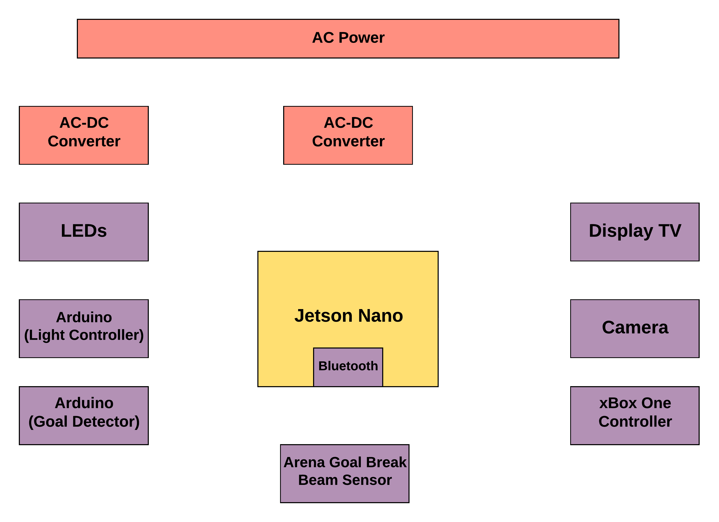
Arena - Electrical Design
The Arena is AC Powered
A 120V to 5V AC-DC converter is used to power the Nano
Another 5V AC-DC converter is used to power the LEDs
Nano does most of the processing for CV and Game System onboard
The XBox Controller inputs are taken in serially via USB and sent to the Robot via Bluetooth
The TV/Display is powered from an AC outlet as well
Notes:
CORY:
-The Arena is powered by an AC outlet
-Two AC-DC Converters are used. One powers the Jetson Nano and one powers the NeoPixels
-The TV Display is also powered by the AC outlet and therefore, a power strip will be attached to the arena for simplicity
-Jetson Nano interfaces with XBox Controller via USB interface and with the TV Display via HDMI
-Break Beam sensors are used to detect a “goal” and are connected to Arduino which serially sends the commands to the Jetson Nano
-NeoPixels need PWM because Nano is not a real time system and therefore another dedicated board (Arduino) is used to drive the animations

Slide 33
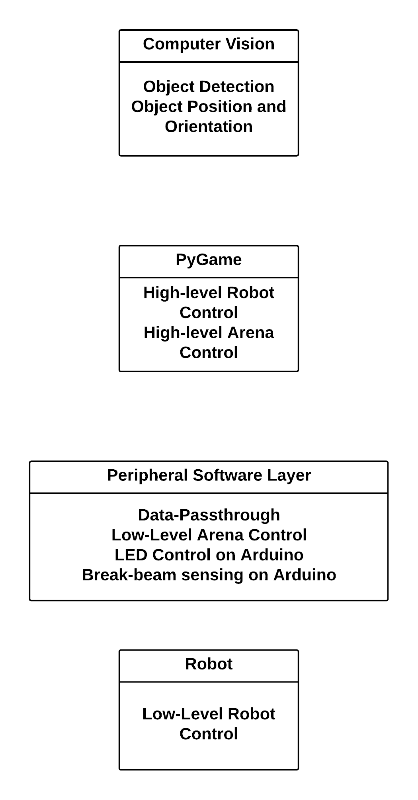
Arena Software Design
Peripheral software sends and receive data from the game engine as well as control local I/O from the arena.
LEDs are animated with Adafruit NeoPixel library
LED animations are changed via state-change requests over serial port
Break-beam data is sent as Boolean data over serial
Bluetooth communication utilizes PyBluez library
Notes:
BRANDON:
The Arena software is handled similarly to the robot software except that there are more communication links and fewer commands
The software handles local I/O from the Arena and passes data from the Game system directly to the Robot
The LEDs are controlled with preset animations that change based on serial commands from the game engine

Slide 34
Arena Computer Vision System
Position data is taken from markers mounted on the robot and the ball and then passed to the robot master control
Data includes an orientation and location from the middle of the robot and location of the ball
2D image from single camera with a relatively high resolution of 720p, and 30 Frames per second
Camera is mounted 5 feet high in order to see the entire field and objects on the field
Notes:
CORY:
-We choose to use OpenCV for computer vision not only because it was free and open source, but also because it has 3rd party trackers that can easily be implemented and a vast community for support.
-The code for the implementation is pretty straightforward because most of the heavy lifting is done via the OpenCV libraries, so its just a matter of finding and using the library functions correctly.
-The third party tracker is called the Kernelized Correlation Filter or KCF tracking library. This tracker takes advantage of large overlapping data regions to track faster and more accurate than most other trackers.
-The KCF tracker does poorly when an object being tracked gets obscured and then comes back into view and it also doesn’t give the orientation of the robots.
-To counter this we are implementing background subtraction on the court prior to feeding the video data to the KCF tracker and we are using two colored dots on each side of the robot which will determine orientation.

Slide 35
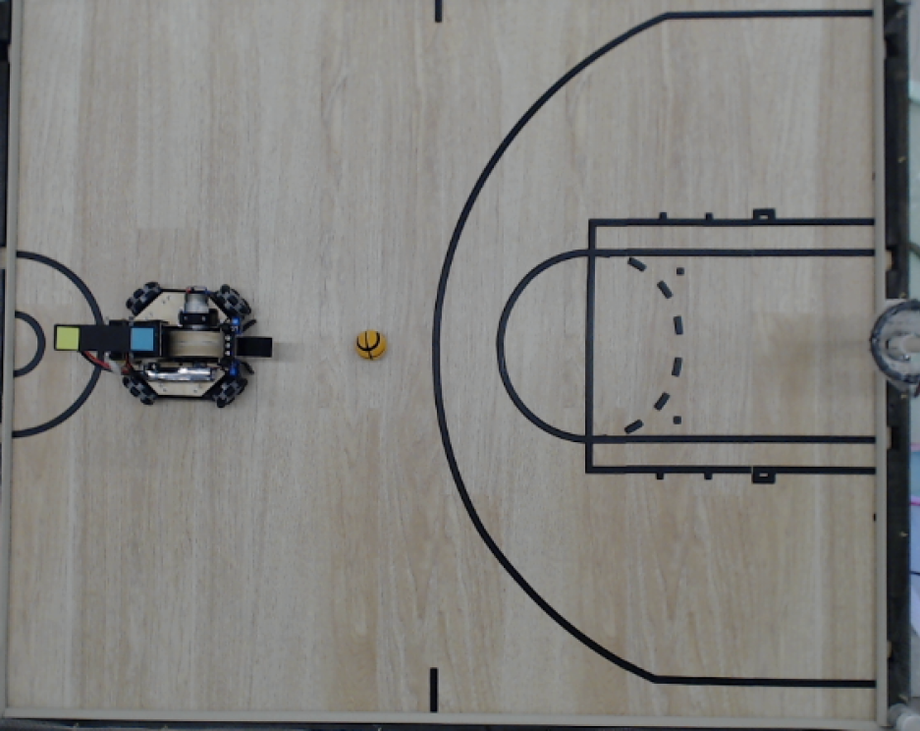
Step 1 – Collect the Frame
Open Video Capture Device
Set the FPS to 30 FPS
Resize the frame
Smooth with Gaussian Blur
Add frame to the background subtraction object (Only for the first 30 frames to build the model)
Building the model should be done with no objects on the court
Notes:
Initial camera frame grab.
Set the FPS.
Resize the frame.
Smooth with Gaussian blur.
Add the frame to the background subtraction object. (ONLY DONE FOR THE 1st 30 FRAMES to build the model)
Build the model with no objects on the court.

Slide 36
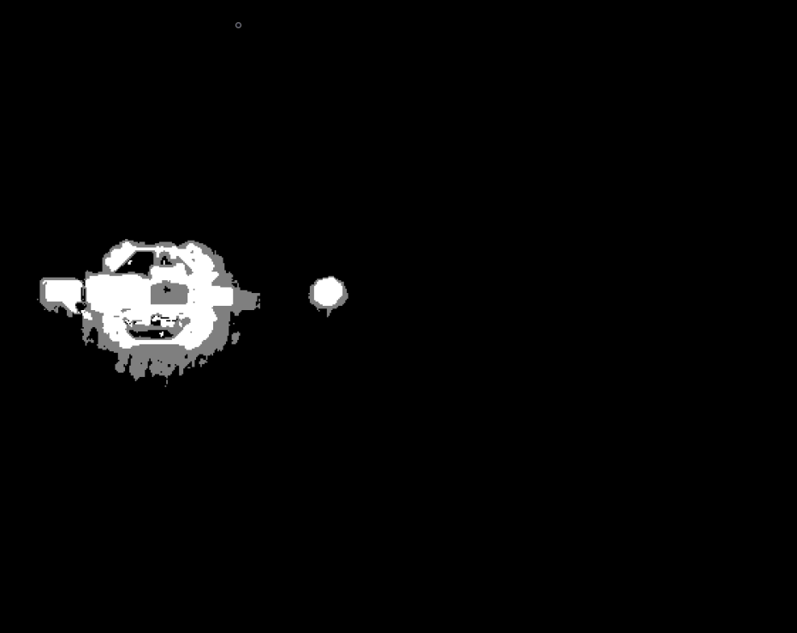
Step 2 – Foreground Mask
Apply background subtraction to get a foreground mask
Notes:
Foreground mask after creating model & adding 30 objects in

Slide 37
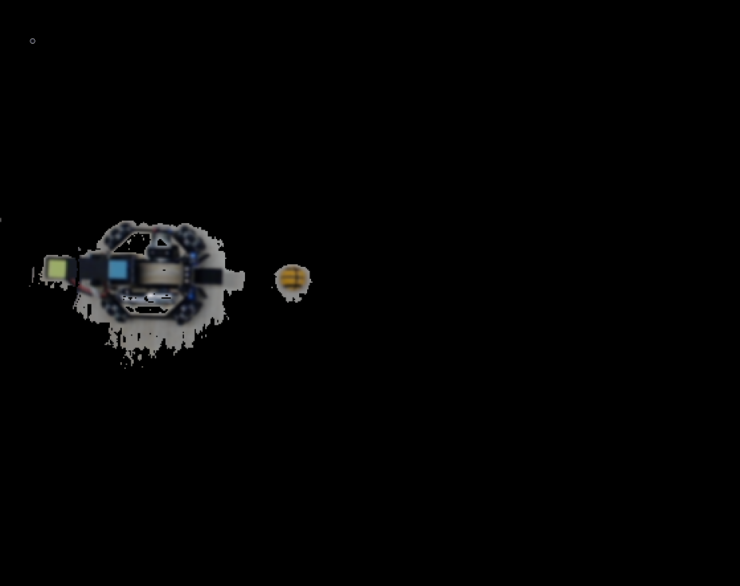
Step 3 – Background Mask 'AND' Frame
Perform bitwise 'AND' on the blurred frame and foreground mask to get a color image from the results of background subtraction
Notes:
Bitwise & of the mask and color to get a foreground in color

Slide 38
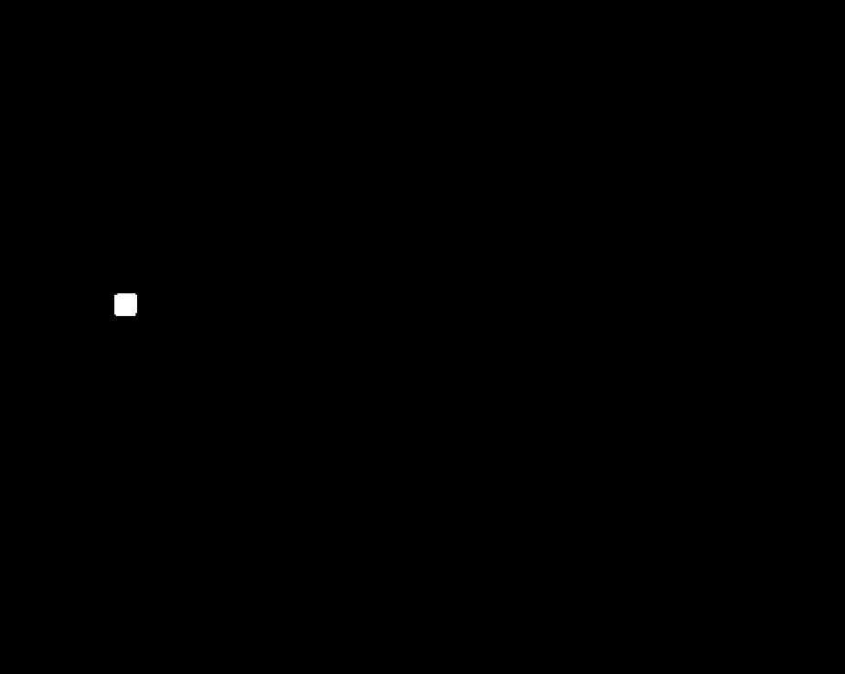

Step 4 – Color Filtering
Lower and Upper bounds for each color are created using the HSV color scale
An inRange() function is applied and a mask for each color is created
Colored Square
Orange Ball
Notes:
Note the orange ball is “occluded” by black lines

Slide 39
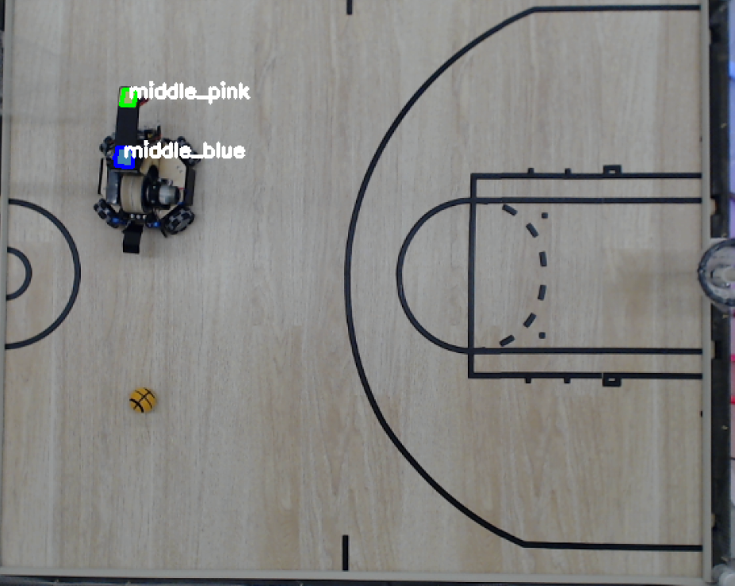
Step 5 – Contour Detection and Midpoint
Find the contours of the squares
Filter the list of contours by perimeter and number of sides
Use moments to find the midpoint of each square
Notes:
After lines are found

Slide 40
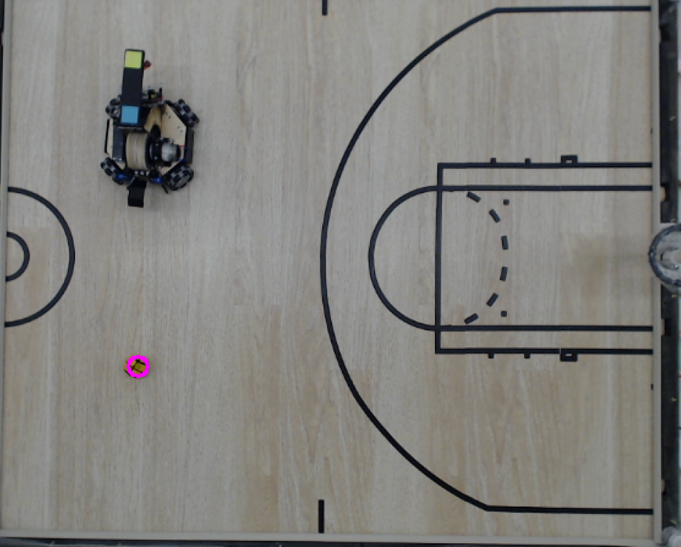
Step 6 – Canny Edge Detection & Hough Transform
A Canny Edge filter is applied to the orange mask
A Circle Hough Transform is applied, and the center is found
Notes:
Apply Canny Edge filter (This is similar to contouring for the squares)
Apply Hough Transform (A circle of best fit pretty much)
Find the center

Slide 41
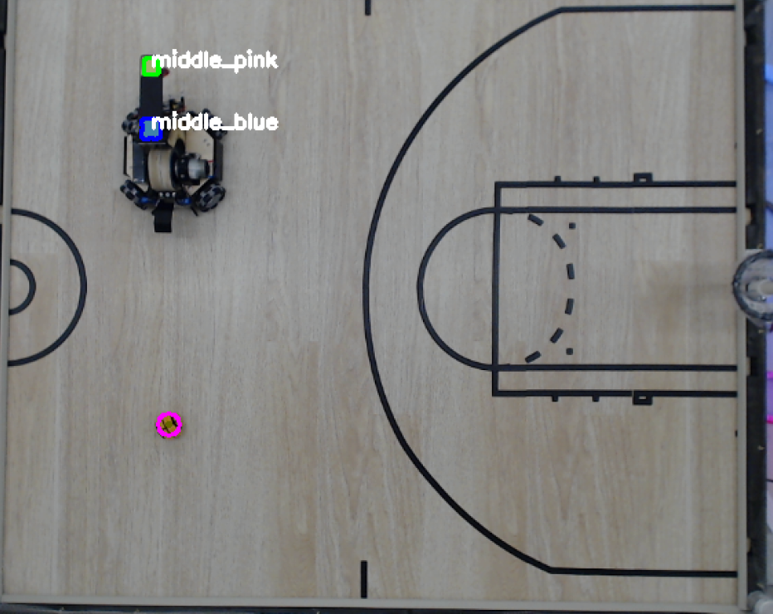
Final Output
A unit vector is created using the x,y center values of each square
The center of the robot is blue
The unit vector, center point of the robot, and center point of the ball is sent to the game
Notes:
Detect centers, find orientation

Slide 42
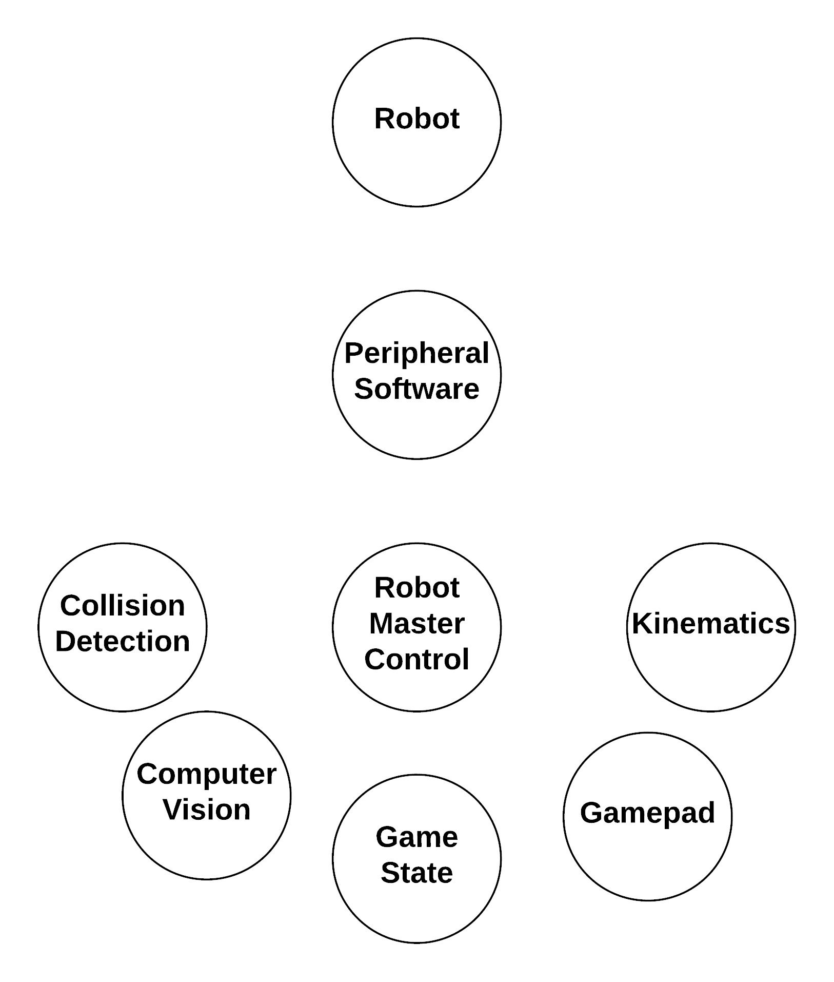
Game Overview
Game Engine
  PyGame
Collision Detection
  Prevents robot from moving towards edges
Video Playback
  Data playback after shot is made
Robot Control
  Joystick input and positional data
Notes:
MAT:
The collision detection is there to provide some feedback to the user, as well as a protective measure for the robot as it should help prevent the user from putting unneeded stress on the robot. Ex – Continuously running into the wall without the robot moving can burn motors.
Video Playback – Way of interacting with the user and adding an element of fun. Styled in the way of bowling alley animations.
Robot Control will take user input and positional data from the computer vision to correctly track and show the robots position in the game as well as to send it velocities to move where the user tells it to.

Slide 43
Component Selection – Game Engine
 | Cost($) | Vendor | Language | Community Support | IPC | 2D/3D | Editor Size
Godot | Free | Open Source | GDScript, C#,C++ | Low | TCP/IP Socket, Shared Memory | Both | Very Small
Unreal | Free | Epic Games | C++ | Medium | TCP/IP Socket, Shared Memory | Both | Large
Unity | Free | Unity Technologies | C#,C++ | High | TCP/IP Socket, Shared Memory | Both | Very Large
PyGame | Free | Open Source | Python | Medium-High | TCP/IP Socket, Shared Memory | 2D | No editor
Notes:
MAT:
In the beginning we looked at 3 game engines, Godot, Unreal, and Unity. With the exception of community support and the actual editor for the engine, there wasn’t much of a difference so we originally chose godot as the editor didn’t take up much space on the Jetson nano. Eventually we moved away from godot and to PyGame once we found that godot could not compile for the specific architecture of the Nano. Our decision for PyGame also had to do with already using python for IPC on the Nano

Slide 44
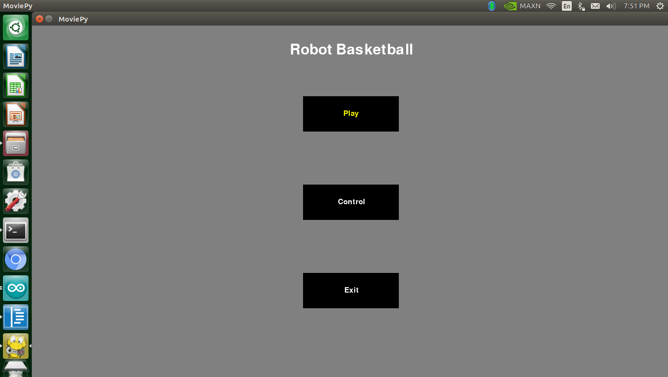
Main Menu
Central Hub for game
Leads to either the Control or
the Difficulty Selection screen
Notes:
Mat: The main menu consists of 3 buttons. Play, Controls and Exit. This screen is automatically returned to at the end of each game run.

Slide 45
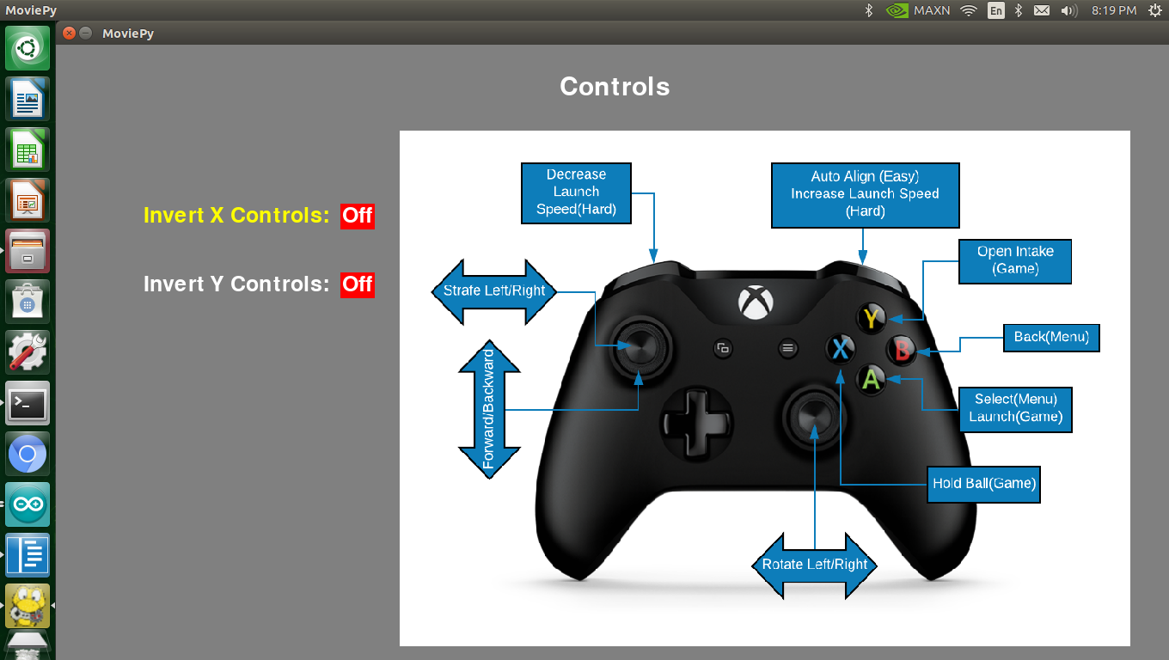
Controls
Mapping of controls
Allows for inversion of
X and Y axis control
Notes:
The main function of this screen is to show the player what each button on the controller does. It contains the controls for both the menu and during the game.
It also allows the player to invert either x or y axis control of the robot.

Slide 46
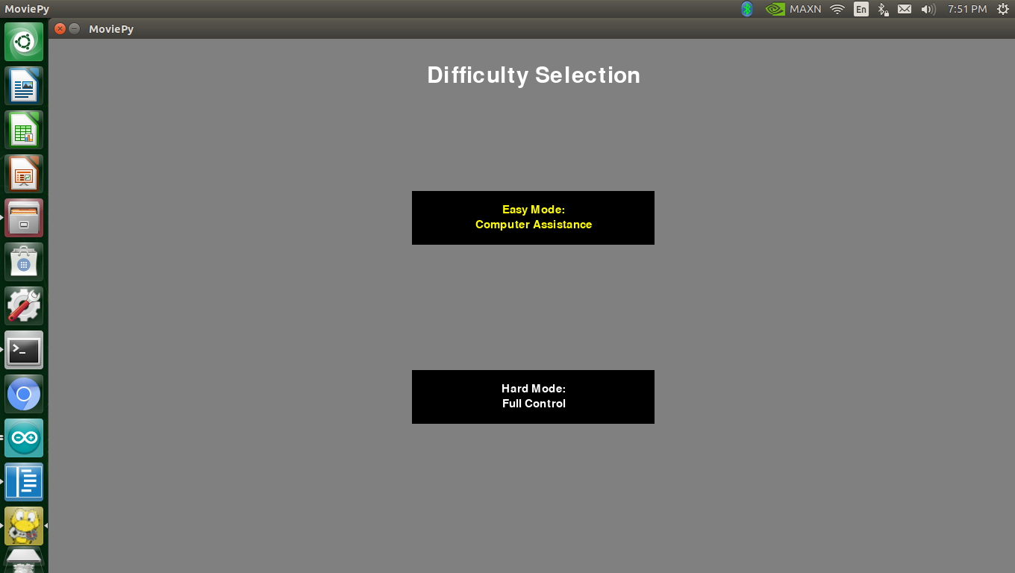
Difficulty Selection
2 modes
  Easy
    Computer assistance on
    aiming/shooting
  Hard
    Full manual control only
Notes:
The player is allowed to choose either easy or hard mode. Easy mode offers assistance to the player in the form of allowing the use of auto alignment and automatically scaling the launcher wheel using positional and orientation data from computer vision. Hard mode will not allow the user to auto align and the player must adjust the flywheel themselves through the use of the bumpers on the controller.

Slide 47
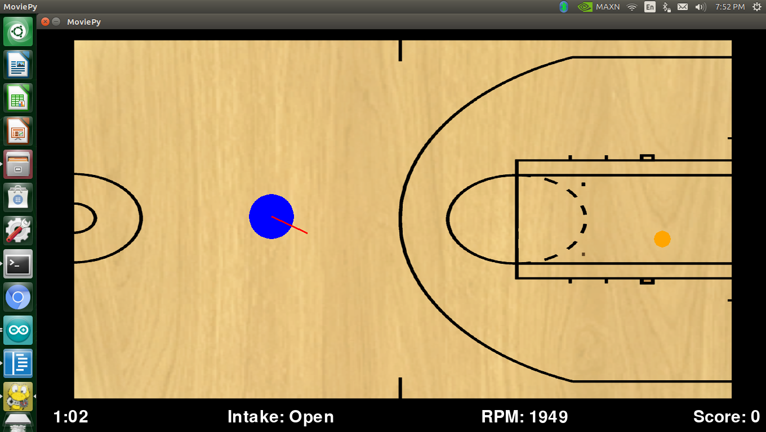
Autonomous Control in Easy Mode
Alignment
  Proportional Control minimizes angle to hoop
Flywheel Speed
  Linear Function
  Positional Data from computer vision
Notes:
Alignment is done through the use of a proportional controller to send dynamic speed commands to the robot. After the robot receives the command and moves, the next frame will then check the difference between the robots orientation and where the hoop is on the field before sending an updated speed command. This continues until either a timeout is reached or the angle difference is small enough.
The flywheel RPM is a linear function based off the magnitude of the vector between the hoop and the position given to the game by the computer vision.
Both these functions are only available in easy mode.

Slide 48
Playback
The game will replay positional
data for the robot and ball
when a goal is made.
Notes:
Playback will replay the positional data of the different objects like the ball and robot as well as an animation after the robot scores a goal

Slide 49
Collision Detection
Prevents robot from being driven off arena
Transform Robot Space to Task Space
  Check if components would take robot off arena, if so, remove component from vector
  Rotate new vector back to Robot frame
Notes:
The last primary function of the game is to perform collision detection to prevent the robot from being driven off the arena. This is done by rotating the vector made by the controller joysticks into the direction the robot is facing. There are a variety of zones around the field based off distance to the edge of the arena in computer vision. If our rotated vector would take us farther into those zones, that particular component of the vector is thrown out, and the vector is rotated back into the reference frame of the joystick before being mapped and sent to the robot in the packet. This allows the for the robot to slide along the boundary lines without going over them.

Slide 50
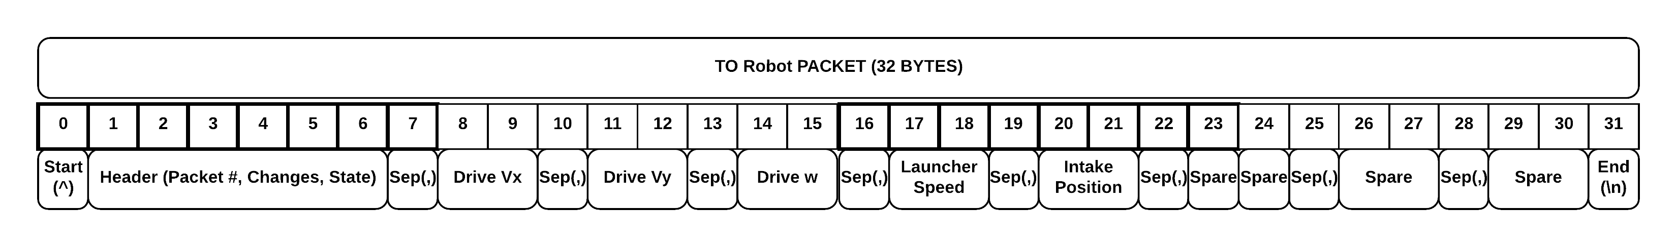
Critical Interfaces: Robot <-> Arena
  Data transferred to and from both Robot and Arena over channel (Bluetooth)
  Critical interface due to the data being transferred needing a clearly defined type and meaning (For example, linear velocity sent from Arena to Robot is an integer corresponding to some velocity in m/s)
  Control data sent as 2 Hex characters (1 Byte of resulting Data)
  Data is interpreted as -100% to 100% of the Robot’s max joint speed / position
  Flow control is implemented to prevent buffer overflow
Notes:
Brandon:
A critical interface between high-level components is found in the communication between the Robot and the Arena. The Game creates commands that the robot receives via passing through the Arena software
The robot must take that data and understand it correctly, thus a packet structure and meaning is strictly defined.
Commands for different joints are sent as 2 hex characters that map between -100 to 100 percent of the max joint output
Flow control had to be implemented to prevent buffer-overflow

Slide 51
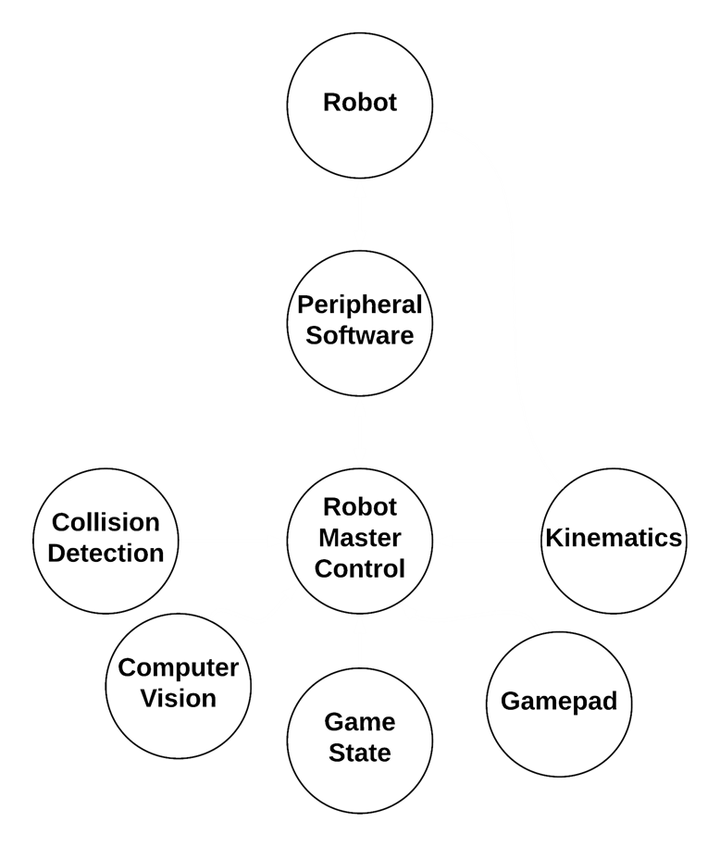
Critical Interfaces: Arena <-> Game
Uses serial and UDP socket connections
4 main systems integrating
  Computer vision
  NeoPixels
  IR Break Beam
  Game
Notes:
MAT:
The arena-game interface is a software-based interface that deals with the data transfer between the Arena and Game systems. There are 3 primary systems on the arena that must interface with the game. The switch to determine if a shot has been made, the NeoPixel lights and the computer vision.
There are two types of connections used. Serial and UDP sockets.
The serial connections are for the break beam and NeoPixel lights, while the sockets are used for communication between anything that resides on the nano. Such as the game, computer vision, and the robot peripheral software.
Data is sent from computer vision to the game to update the robots position on the screen and for use in the games functions. When the game has performed all of its functions, a packet is sent out via socket to the Robot peripheral script which handles the interfacing between the Game and the Robot

Slide 52
Budget & Spending - Robot
Budget Item | Quantity | Budget ($) | Budget Subtotal ($) | Item | Supplier | Price ($) | Subtotal
Launching Hardware | 1 | $20.00 | $20.00 | Assorted | Various | $25.00 | $25.00
Drive Hardware | 1 | $30.00 | $30.00 | Assorted | Various | $10.00 | $10.00
Servo Bracket | 4 | $5.00 | $20 | Lynx-motion servo bracket | Robotshop | $3.48 | $13.90
Wheels | 4 | $15.00 | $60 | Omni-Wheel | VEX | $5.00 | $20
Intake Hardware | 1 | $20.00 | $20.00 | Assorted | Various | $10.00 | $10.00
Intake Motor | 1 | $15.00 | $15.00 | Servo | Parallax | $3.00 | $3.00
Drive Motor | 4 | $20.00 | $80.00 | High speed Servo | Parallax | $27.00 | $108.00
Launch Motor | 1 | $20.00 | $20.00 | 3600 RPM DC Motor | Skycraft | $7.00 | $7.00
Controller | 1 | $20.00 | $20.00 | ATMEGA328P-AU | Microchip | $2.00 | $2.00
Battery | 1 | $30.00 | $30.00 | 1300 mAh 3S LiPo | Amazon | $27.00 | $27.00
PCB | 1 | $40.00 | $40.00 | Assorted | Various | $38.82 | $38.82
Bluetooth Module | 1 | $10.00 | $10.00 |  | Sparkfun | $16.00 | $16.00
Total per Robot |  |  | $345.00 |  |  |  | $280.72
Notes:
BRANDON:
Robot recreation cost is under-budget at this point due to the reduced cost of the wheels and other components
The total cost of development was much higher due to PCB iterations, unused components, buying in bulk, and broken parts

Slide 53
Budget & Spending - Arena
Budget Item | Quantity | Budget ($) | Budget Subtotal ($) | Item | Supplier | Price ($) | Subtotal
Frame Hardware | 1 | $ 100.00 | $ 100.00 | PVC Tube, Wood, Screws, PVC Fittings | Home Depot | $125.00 | $125.00
Camera | 1 | $ 60.00 | $ 60.00 | Logitech C920 | Amazon | $63.50 | $63.50
Controller | 1 | $ 100.00 | $ 100.00 | Jetson Nano | NVIDIA | $100.00 | $100.00
Power Supply (AC-DC) | 1 | $ 40.00 | $ 40.00 | Power Strip, 5A Power Supply, LED Driver | Amazon | $11+$11+$20 | $42.00
Bluetooth Module | 1 | $ 10.00 | $ 10.00 | Intel Dual Band Wireless-Ac w/ BT | Amazon | $23.00 | $23.00
Court Hardware | 1 | $ 25.00 | $ 25.00 | Flooring | Home Depot | $16.00 | $16.00
LEDs | 1 | $ 25.00 | $ 25.00 | Neopixels | Adafruit | $32.00 | $32.00
Gamepad | 1 | $ 25.00 | $ 25.00 | Xbox Controller | Amazon | $25.00 | $25.00
TV Display | 1 | $ 70.00 | $ 70.00 | 720p 19in Display | Amazon | $70.00 | $70.00
Total |  |  | $ 455.00 |  |  |  | $496.50
Notes:
BRANDON:
The frame hardware ended up being more expensive than we thought because of the initial design required many additions after being prototyped. The total cost of recreating the arena is about $500 which is over the initial budget.
The total cost of the project for recreation is around $800, but cost of development is closer to $1400.

Slide 54
Work Distribution
 | Primary | Secondary
Robot Mechanical | Brandon | Mat
Robot Electrical | Suvrat | Brandon
Robot Software | Brandon | Mat
Arena Mechanical | Cory | Mat
Arena Electrical | Suvrat | Cory
Arena Peripheral Software | Brandon | Suvrat
Computer Vision | Cory | Mat
Game | Mat | Brandon
Notes:
BRANDON:
The primary and secondary owners are shown for different systems, however just about all of us worked on each section at some point

Slide 55
Thank you
Questions?

