Slide 1

Robot Basketball
Group 9 - Summer/Fall 2019
Brandon Gross EE
Suvrat Jain CpE
Cory Ricondo CpE
Mat Schneider CpE
Notes:
BRANDON:
Hello, I am Brandon Gross, this is Suvrat Jain, Cory Ricondo, and Mat Schneider. We are group 9 and will be presenting our project, Robot Basketball.

Slide 2
Motivation
Entertainment
Robot Athleticism
Technologies and skills
Notes:
BRANDON:
Entertainment is an essential part of life, especially in Orlando. A wide variety of entertainment is available through Theme Parks, Arcades, and sporting events.
A hot topic in robotics today is the idea of robot athleticism, where robots can achieve super-human performance in sporting activities. Combining sports and robotics is an exciting endeavor that can be both productive and entertaining as shown in events such as RoboCup, or Battlebots.
The team proposes this project as a foundation for learning an array of skills including Robotics, Computer Vision, Machine Learning, PCB Design, Bluetooth communication, Game and App development, and real-time control.

Slide 3
Goals and Objectives
Arcade-style entertainment system
Eye-catching, engaging, and fun
Low-cost and scalable
Portable
Robot capable of full-court shots & high accuracy
Notes:
BRANDON:
The overall goal in this project is to create an arcade-style entertainment system that is both robust and intelligent.
The final product should be engaging and attractive, and it should be playable by at least one, but preferably two people.
The robot should be low cost such that multiple robots can be created.
The robot should be capable of quickly collecting and launching a ball into a scale hoop with high accuracy and precision.

Slide 4
Realistic Design Constraints
Economic: Budget, scalability
Health and Safety: Flying projectiles & mechanical components
Manufacturability: Hardware component fabrication
Sustainability: Easy to repair, and easy to add additional components
Notes:
BRANDON:
For realistic design constraints, we focus on 4 primary sections.
Economically, we had to establish a project budget that the team members could afford and agree upon, and the designs of the project should be scalable such that many robots or arenas can be built.
Health and safety is critical in this project due flying projectiles and high energy components.
The system must be easily manufacturable with tools available to the team, and it must be easily repaired or added to without major effort in order to sustain over time.

Slide 5
Requirement Specifications - Robot
Requirement
Weigh no more than 8 lbs.
Be capable of holonomic locomotion at a maximum speed of at least 1 ft/s
Support an embedded controller capable of processing controls for a minimum 6 motors
Communicate with the arena at a rate of at least 30Hz
Contain a launching mechanism capable of launching a 2.0” diameter rubber ball
Contain an intake mechanism for acquiring a 2.0” diameter rubber ball from ground level
Maintain at least 70% shot accuracy from anywhere on the court
Notes:
BRANDON:
Specific requirements to mention for the robot system are that the robot must be capable of holonomic motion at a quick speed so that the players can enjoy the control and be able to take shots at different distance swithout losing their launch angle.
Additionally, the robot must maintain a shot accuracy of at least 70% from anywhere on the court. A player in the NBA is considered above average at a 50% field goal percentage.

Slide 6
Requirement Specifications – Arena
Requirement
Be no larger than 6’ length, 5’ width, and 5’ height
Weigh no more than 75 lbs. total
Contain at least 1 rubber ball that is no smaller than 2.0” diameter
Contain at least 1 basketball hoop no smaller than 3.0” diameter
Contain a surface that is level within 1°
Support an Embedded Controller capable of running an Operating System
Support vision-based position tracking of the ball and robots in the court with update rate of at least 30 Hz
Notes:
BRANDON:
Notable requirements for the Arena are that the surface must be level within 1 degrees, and the arena must be capable of tracking the position of the ball and robots on the court at a rate of 30hz.

Slide 7
Requirement Specifications - Game
Requirement
Create a 2D visual representation of the Arena and Robot Status
Have a menu to start, pause, and reset a timed match
Display current score and game time
Playback past 10 seconds of gameplay upon a goal
Perform collision detection between the different objects
Notes:
BRANDON:
The game requirements determine the functionality of the game itself. A notable requirement is that the game must perform collision detection such that robots are not damaging themselves or the field.

Slide 8
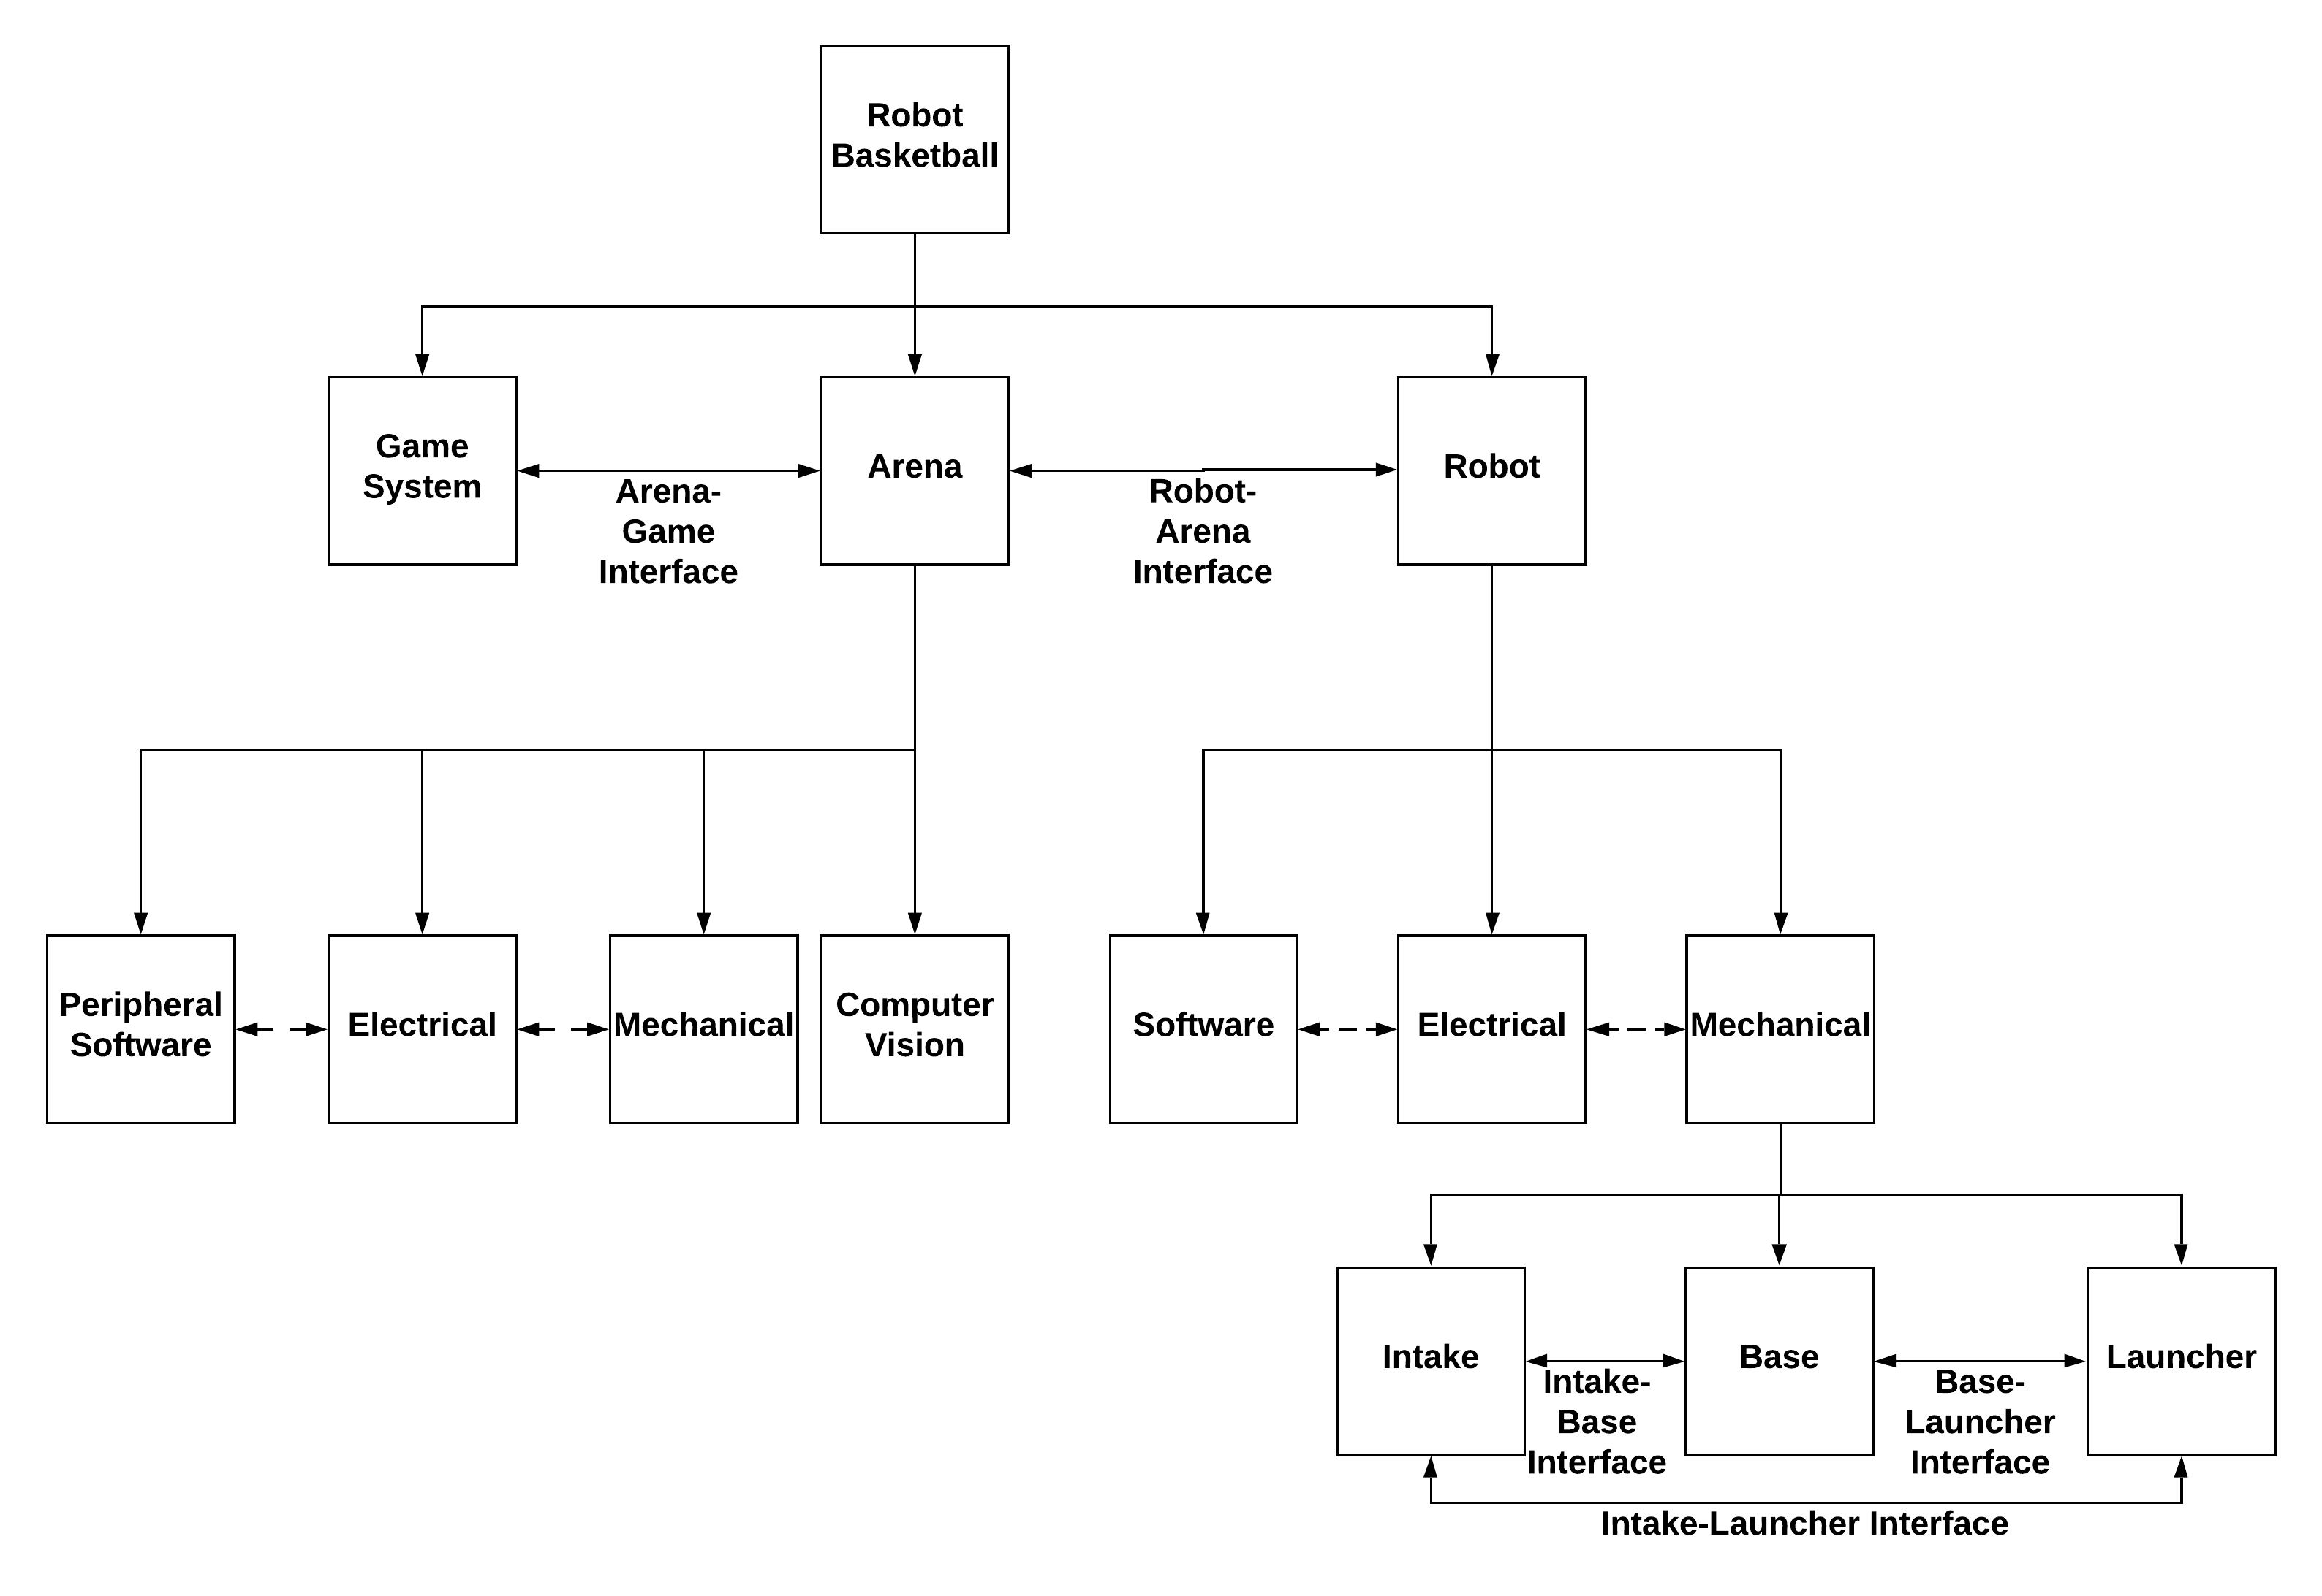
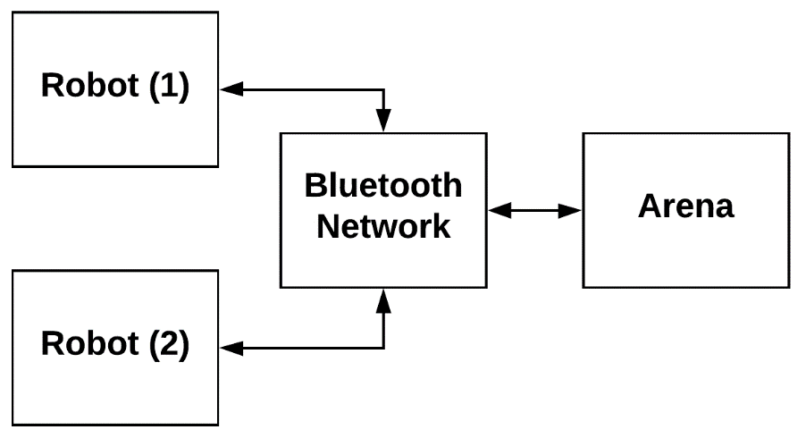
System Architecture Design
Notes:
BRANDON:
The System architecture design follows the following hierarchy:
Project is split into Game, Arena and Robot
Arena is Split into mechanical, electrical, computer vison, and peripheral software
Robot is split into software, electrical, and mechanical
Mechanical is made up of intake, base, and launcher
There are several critical interfaces identified, and a few implicit interfaces

Slide 9
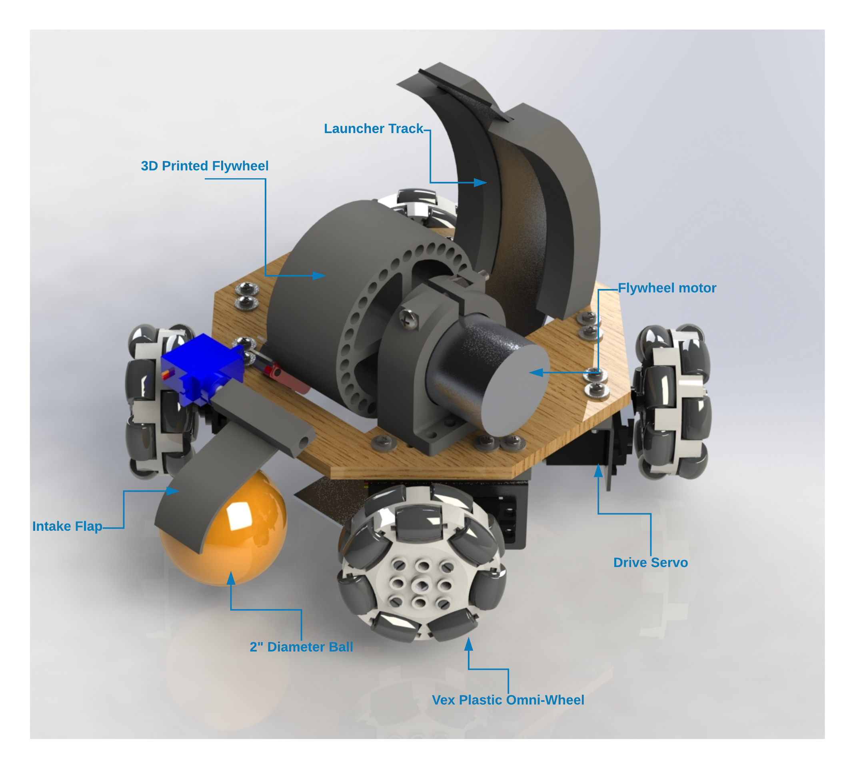
Robot
Notes:
MAT:
This is a render of our proposed robot design. <Point and read labels>

Slide 10
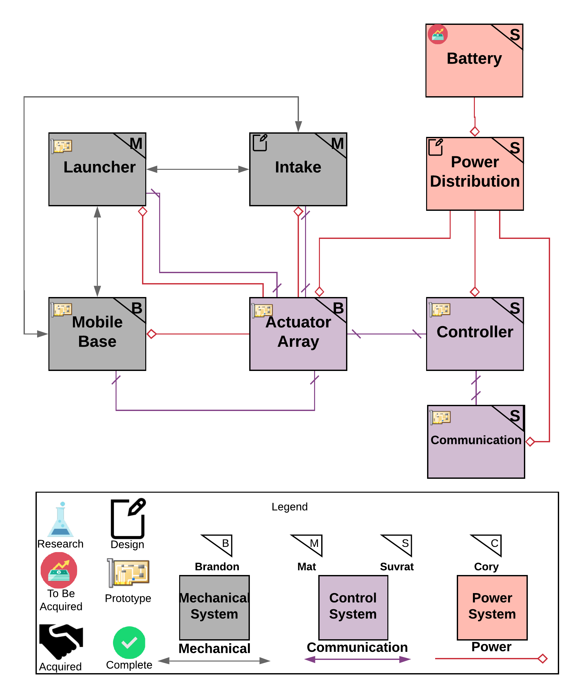
Robot Block Diagram
Battery
  Single power source for all robot systems
Power Distribution
  Includes convertors / Regulators to support loads
Controller
  MCU to process sensor data and control loads
Communication
  Transmit data to/from the Arena
Actuator Array
  Motor controller rail to support up to 6 DC motors/Servos
Intake
  Mechanism to capture and hold the ball when not launching
Launcher
  Launches the ball as a projectile toward a hoop
Mobile Base
  Locomotion platform for traversing the court
Notes:
MAT:
This is our overall block diagram that consists of these systems: Battery, Power distribution, Controller, Communication, Actuator Array, Intake, Launcher, and Base

Slide 11
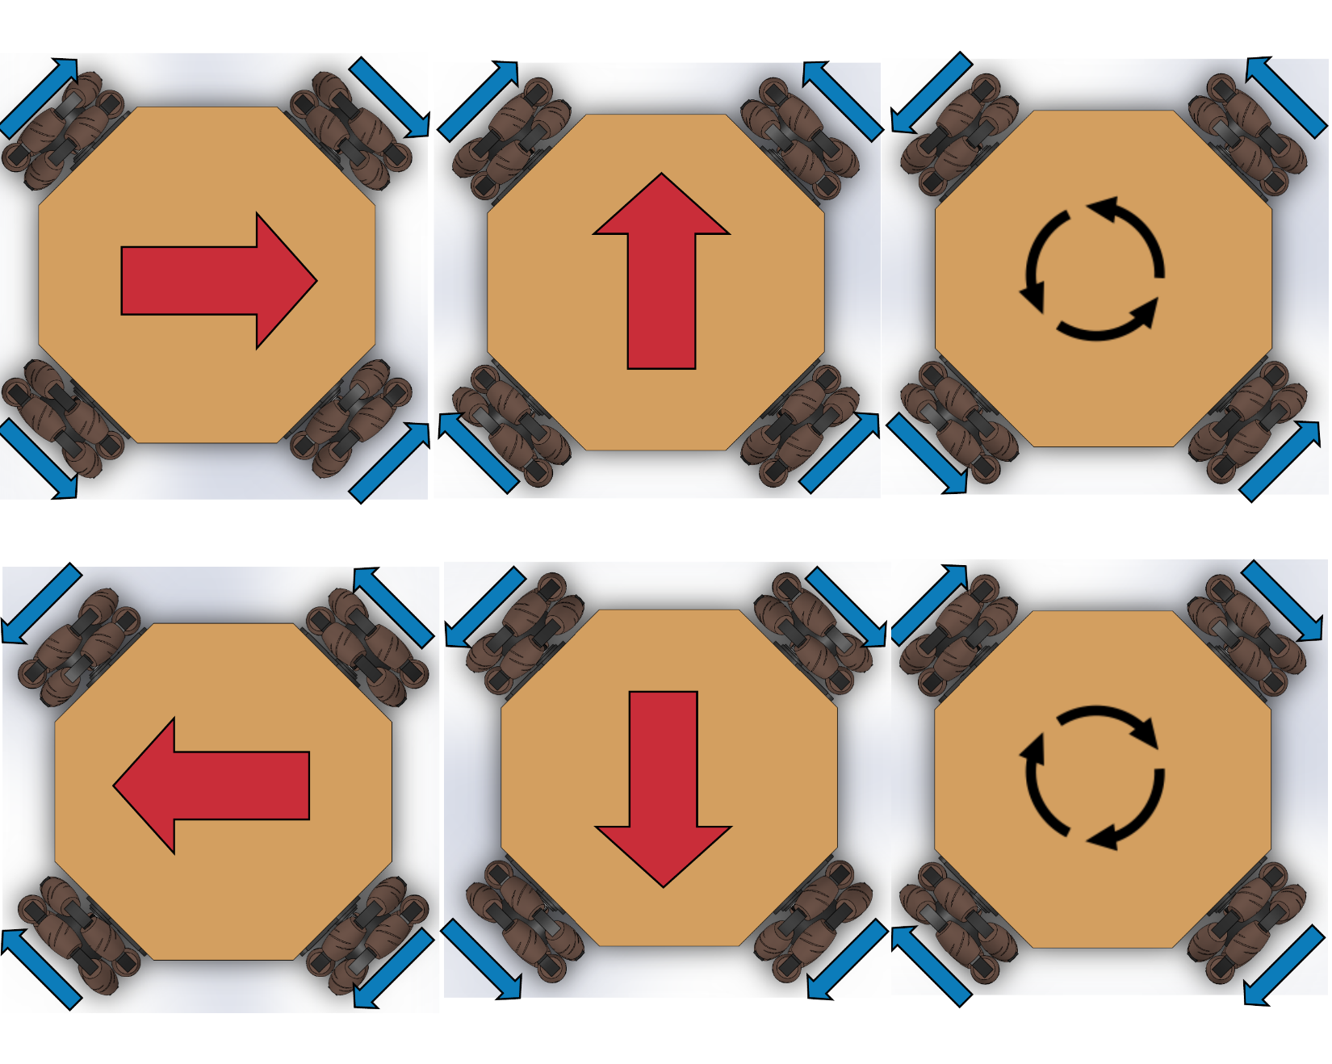
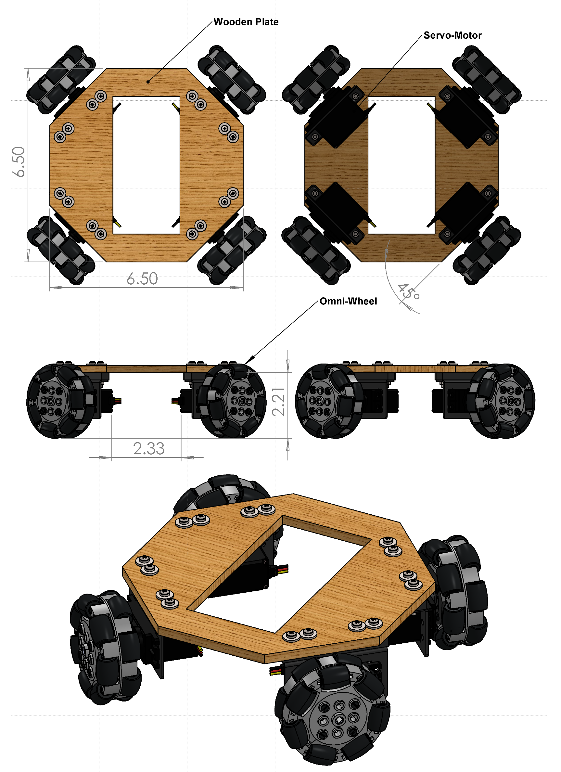
Mobile Base Design
Holonomic vs Skid-Steer
  Can maintain shot angle while traversing without turning
  Slightly faster motion
  Requires more torque
Notes:
MAT:
Offers more flexibility over standard drive train.
Less vibrational effects on the base of the robot.

Slide 12
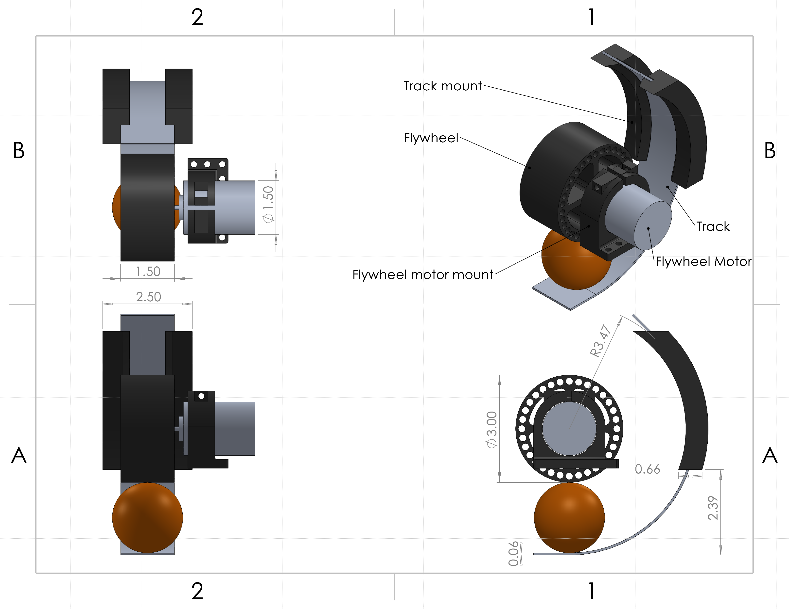
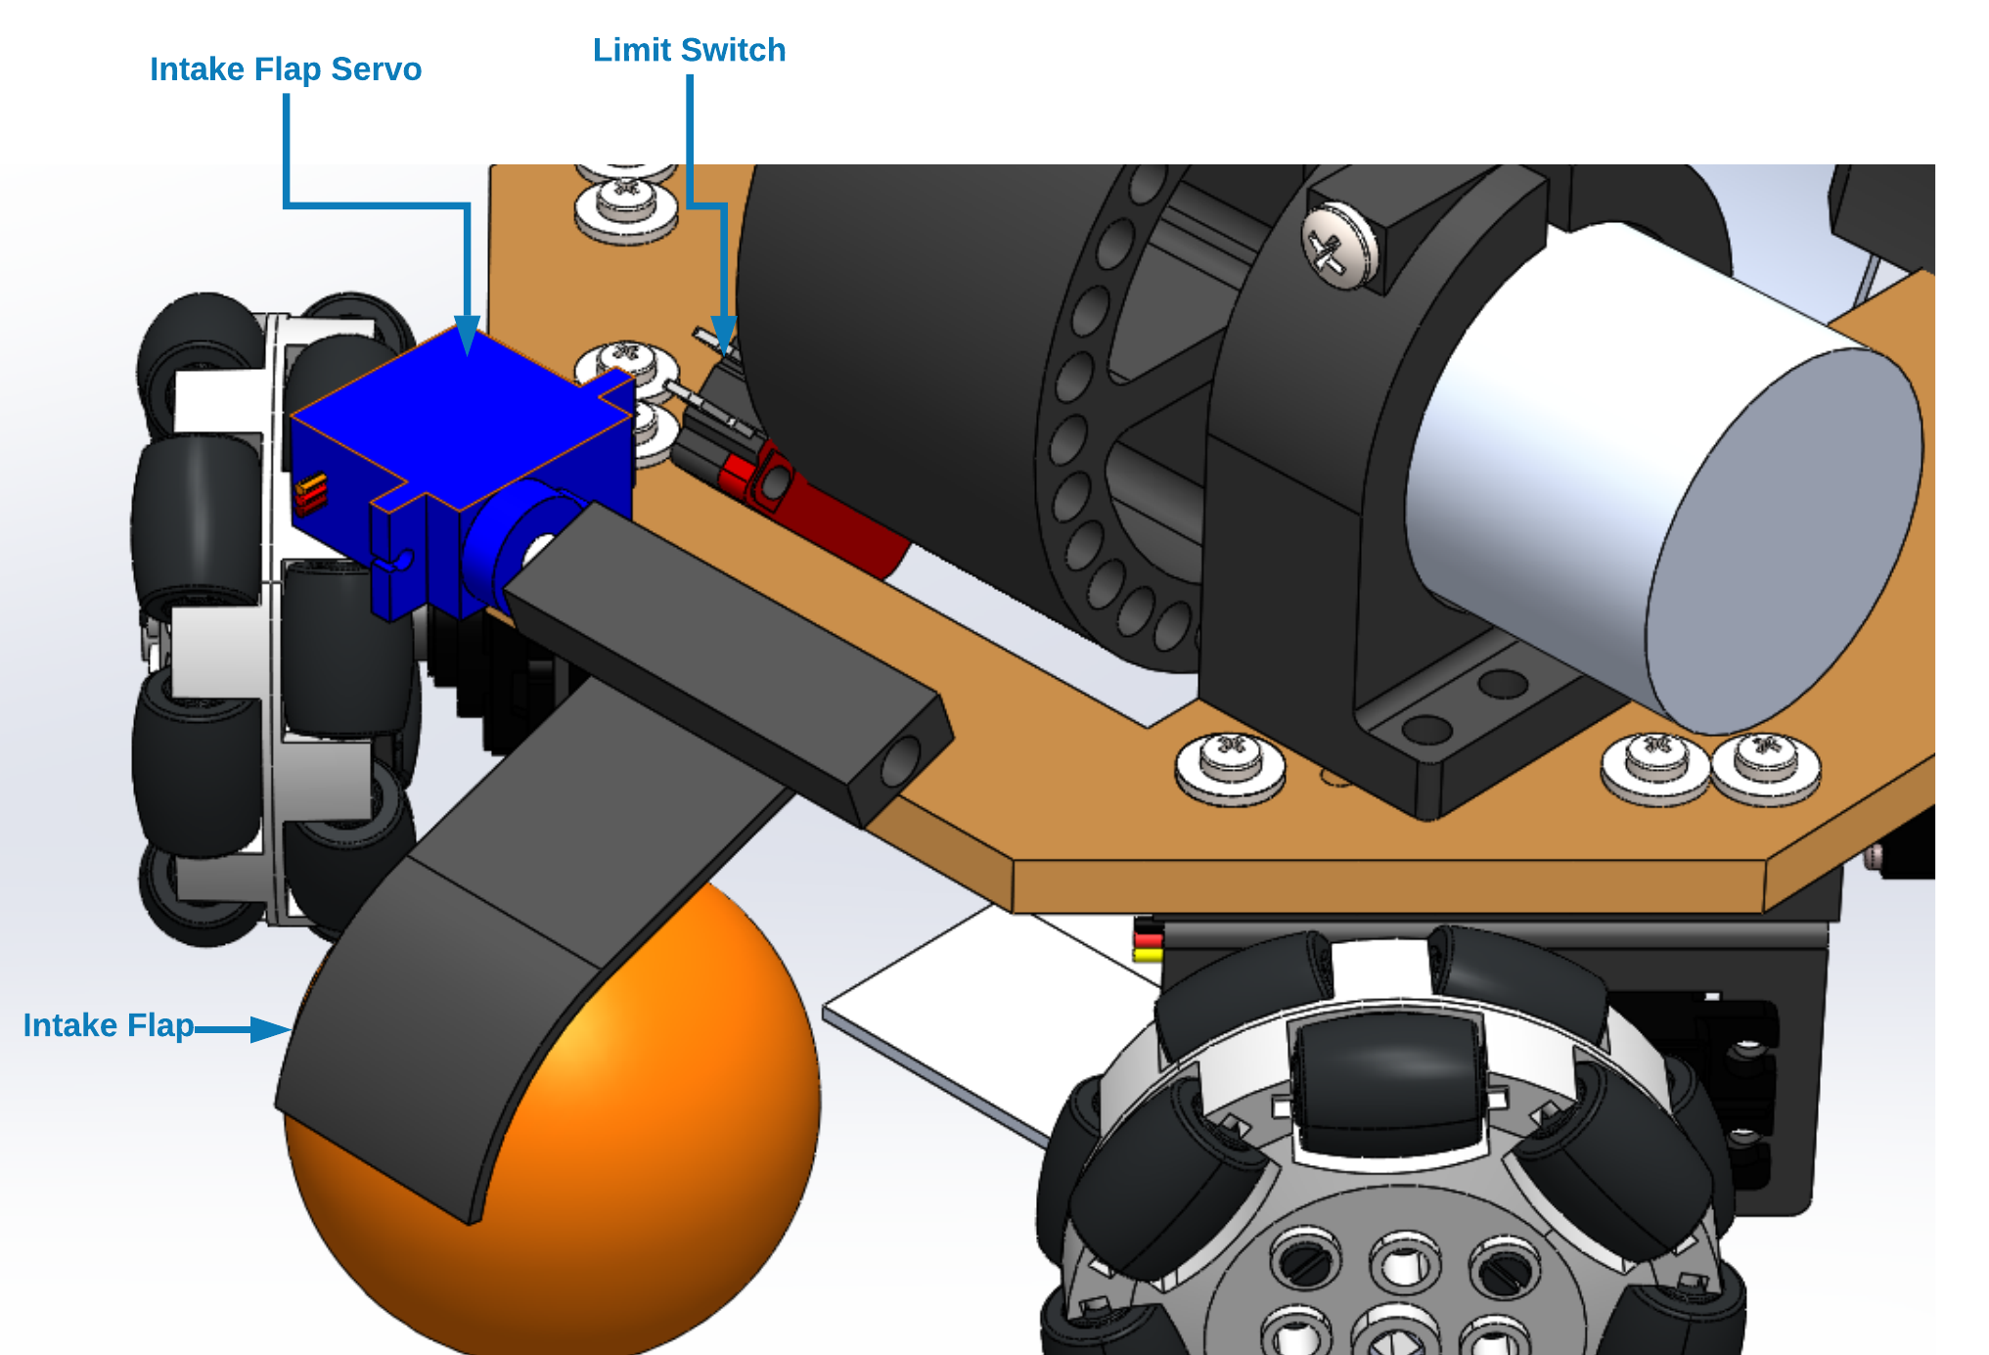
Robot Launcher/Intake Design
Flipper mechanism to trap ball and feed it into intake
Flywheel for launching simplicity
Issues
  Initially chose a brushless DC motor with very high RPM (10,000+), however this was significantly too fast on lowest speeds and caused damage through vibrations
  Significant energy loss in shot (500 RPM -> 3600 RPM)
Notes:
MAT:
Originally, we wanted to go with a launcher design similar to a ballista. However, as we tested and learned more, we found that the design needed to be more complex than we originally thought. Because of this we decided to go with a flywheel mech
-Initially, we decided to use brushless DC motor with an ESC that would be controlled with PWM
-However, that motor turned out to be extremely powerful to the point where it started vibrating the robot
-Therefore, now we are using a standard brushed DC motor and driving it using a motor controller

Slide 13
Component Selection Overview - Robot
Category | Part Description | Part Name (Qty.) | Manufacturer | Operational Voltage (V) | Operational Current (mA) | Power (W) (Peak) | Cost ($)
Base | Drive Motors | Servos (4) | Parallax | 6.5 | 1000 | 26 | 112
Launcher | Flywheel | DC Motor (1) | Johnson Electric | 12.0 | 3000 | 36 | 6.00
Launcher | Rotatory Encoder | TLE4946-2K (1) | Infineon | 5.0 | 50 | 0.25 | 0.74
Intake | Flippers | Servos (2) | Parallax | 6.5 | 1000 | 13 | 26
Communication | Bluetooth | RN-42 (1) | Roving Networks | 3.3 | 30 | 0.1 | 15.73
Electrical | Microcontroller | ATmega328p (1) | Microchip Technologies | 5.0 | 200 | 1 | 1.46
Electrical | Motor Driver | DRV8871 (1) | Texas Instruments | 12.0 | 10 | 0.12 | 2.13
Electrical | PWM Driver | PCA9685 (1) | NXP | 5.0 | 400 | 2 | 2.33
Power | Battery | 3S LiPo | Turingy | 12.6 | 5000 | 63 | 27.00
Power | DC – DC converter | TPS56637RPAR | Texas Instrument | 6.5 | 6000 | 39 | 1.10
Power | 5V Regulator | R-78E5.0-1.0 (1) | Recom | 11 - 12 | 1000 | 12 (max) | 3.26
Power | 3.3V Regulator | R-78E3.3-1.0 (1) | Recom | 11 - 12 | 1000 | 12 (max) | 3.26
Total |  |  |  |  |  | ~204 | $201.01
Notes:
SUVRAT:
-List of all the electrical components used to make the robot functional
-The Power and cost are calculated based on worst case scenario
-Typically the robot will use approximately 50 – 60 Watts if programmed correctly

Slide 14
Component Selection - Microcontroller
Microcontroller needs to be able to support various chip drivers such as motor driver, PWM driver
Microcontroller needs to have thorough documentation and help online to speed development process
Processor | ATmega328P | ATmega2560 | MSP430G2553
Operating/Input Voltage (V) | 5 | 5 | 3.3
CPU Speed (MHz) | 16 | 16 | 16
Analog IN/OUT | 6/0 | 16/0 | 8/8
Digital IO/PWM | 14/6 | 54/15 | 24
EEPROM [kB] | 1 | 4 | 0.128
SRAM [kB] | 2 | 8 | 0.512
Flash [kB] | 32 | 256 | 16
UART | 1 | 4 | 1
Cost ($) | 1.46 | 12.35 | 2.41
Notes:
SUVRAT:
-Arduino Uno is well known and has an extensive library alongwith online help and tutorials
-MSP430 would have required a lot more debugging and would be time consuming although it would give us more control over the hardware
-With ATmega328, we will use a SMD package component and flash Arduino Software on it using ISP Programmer
-ATMega2560 is expensive and we do not see the need for it yet

Slide 15
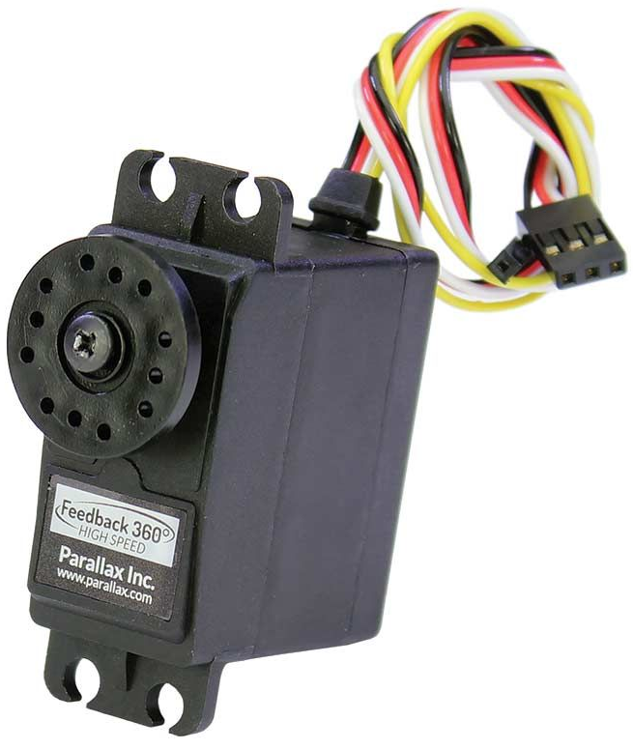
Component Selection – Drive Motors
Requires motors capable of driving the robot in high speed situations (0.3m/s)
Requires closed-loop velocity control to accurately control holonomic motion
Servo chosen because of the ease of control (Eliminates complexity in PCB)
Actuator | Cost ($) | Manufacturer/Distributor | RPM | Torque (Kg-cm) | Voltage, Current (V), (A) | Power (W) | Control | Feedback
Heneng DC Motor | 15 | Amazon | 100 | 2 | 9, 1.2 | 10.8W | External MC | 2 CPR Quadrature Encoder
Feedback 360 High Speed Continuous Rotation Servo | 28 | Parallax | 140 | 2.5 | 6, 1.2 | 7.2 W | PWM | 2 CPR Hall Effect (Absolute Encoder with PWM Output)
High Speed Continuous Rotation Servo | 17 | Parallax | 180 | 2.2 | 7.4, 0.6 | 4.44W | PWM | None
Notes:
SUVRAT:
-We are using Feedback servos by parallax
-One of the reason was that we had them from Boe-Bit
-We discussed with using DC motors and then encoders for velocity control however these have built in encoders and therefore, can easily be pulsed-in via MCU’s GPIO
-Additionally, encoders need interrupts for accurate data capture and our microcontroller doesn’t have enough
-The Servos are run using a PCA9685 chip that can be talked to with I2C
-The chip supports 16 channels but only 7 will be used for the project and others can act as GPIO outputs

Slide 16
Component Selection - Motor Driver
The Motor Driver needs to drive a DC motor within the operating range of 6V – 24V
The Motor Driver needs to be small enough to save PCB space
The Motor Driver should support at least DC motor
Driver IC | L293D | L298 | DRV8871
Supply Voltage (V) | 5 - 36 | 6.5 - 45 | 6.5 - 45
Output Current (A) | 0.6 | 4 | 3.6
Number of Channels | 2 | 2 | 1
Footprint (mm²) | 12.6 x 7.4 | 15.8 x 10.9 | 4.90 × 6.00
Cost($) | 2.95 | 4.86 | 2.13
Notes:
SUVRAT:
-The motor driver drives the flywheel and needs to be robust for launching the ball
-All the motor drivers considered have almost similar specs however L298 and DRV8871 provide more current output
-This will help in providing more torque to the flywheel and thus dictate different shooting ranges
-L298 was not chosen because it has a bigger footprint and DRV8871 will use less footprint on the PCB
-Additionally, DRV8871 is the cheapest and has a dev board available on Adafruit for testing purposes

Slide 17
Component Selection - Communication
The Communication device must be wireless
The Communication device must be compatible with the Robot’s MCU and Arena’s computer
The Communication device must be low energy
Bluetooth module | HC-05 | BlueSMiRF
Operational Voltage (V) | 3.3 | 3.3
Tx power (dBm) | <= 4 | <= 4
Bluetooth Chip | TI CC2541 | RN-42
Bluetooth Profiles Supported | SPP | SPP & HCI
AT Command Support | Yes | Yes
Linux Compatibility | Yes | Yes
Cost($) | ~10 | ~18
Notes:
SUVRAT:
-Bluetooth was chosen as the mode of communication because Arduino can interface with it simply by UART
-Bluetooth also uses less power compared to Wi-Fi and therefore will preserve Robot battery
-Both the Bluetooth have almost the same spec except BlueSMiRF also supports HCI Bluetooth profile in case SPP doesn’t work
-Therefore, it is chosen even though it is slightly expensive but will save us the time and allow us to focus on other important things

Slide 18
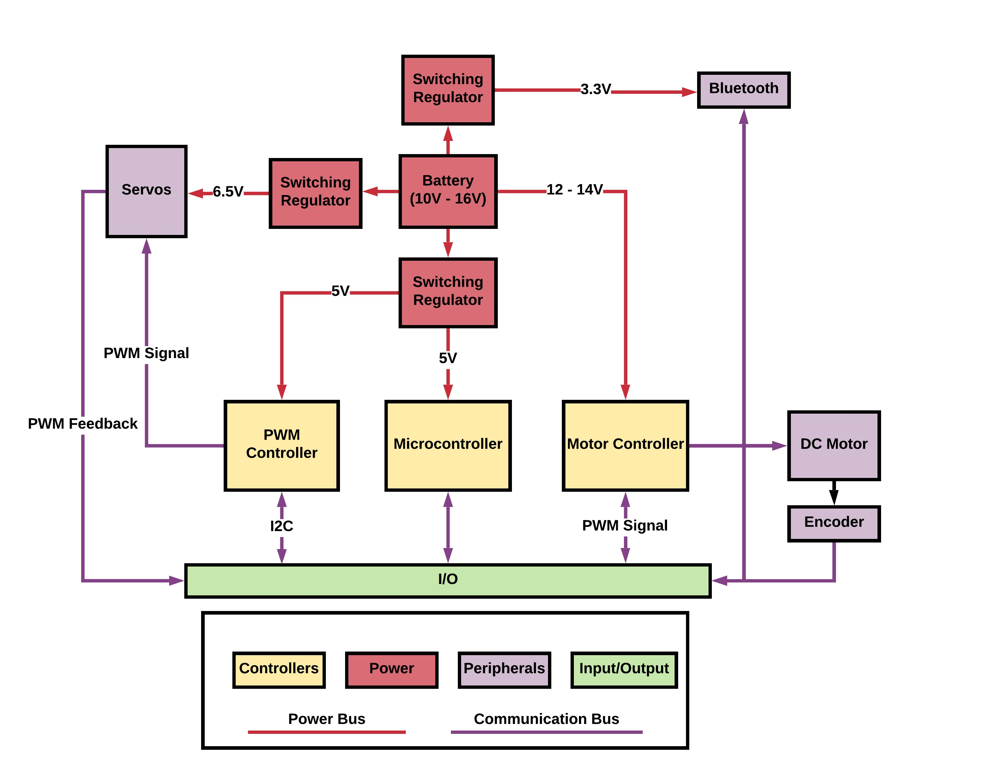
Robot PCB Overview
Notes:
SUVRAT:
-An Overview of Robot’s PCB
-The battery powers 3 switching regulators: 1 powers the servos, 1 powers the IC, and 1 powers the Bluetooth
-The microcontroller talks to PWM using I2C and motor controller talks to PWM controller using, well, PWM signal
-Bluetooth is interfaced with UART where as servo and encoder feedback is connected to MCU GPIO to get the input

Slide 19
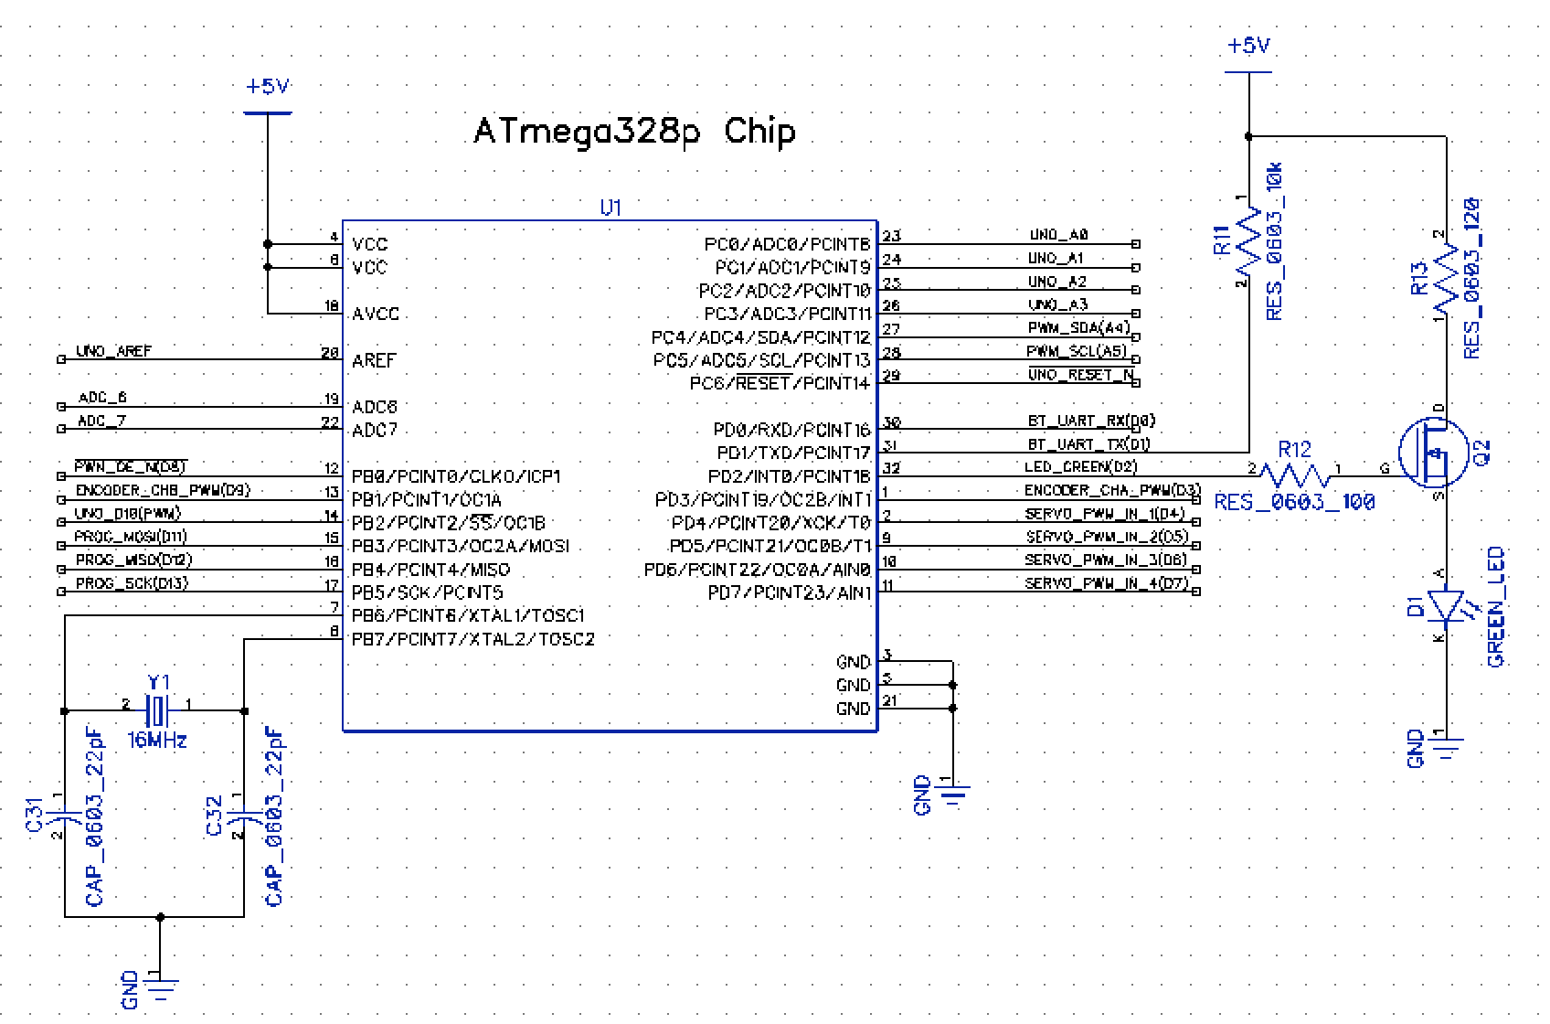
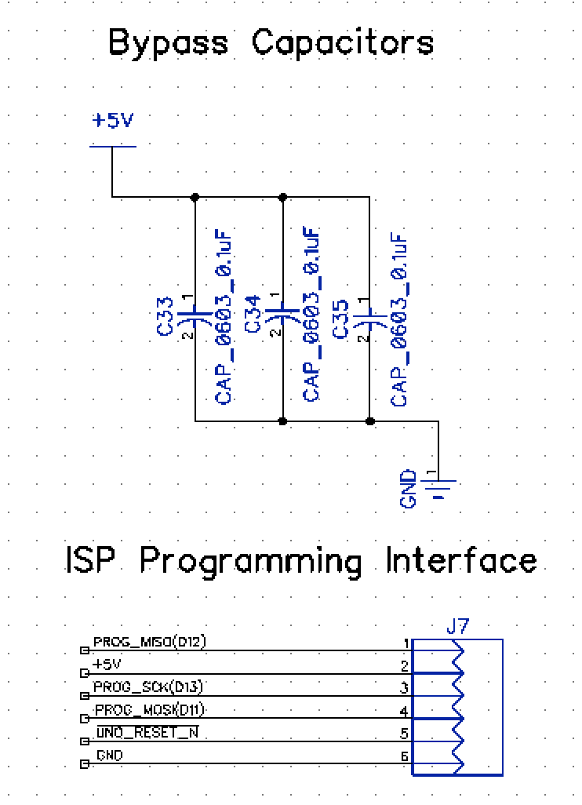
Robot Schematic: Microcontroller
Notes:
SUVRAT:
-Schematic of MCU
-ISP is used to program and flash Arduino on it
-Bypass capacitors are used to reduce noise
-16Mhz crystal is used and a FET is used to drive the LED

Slide 20
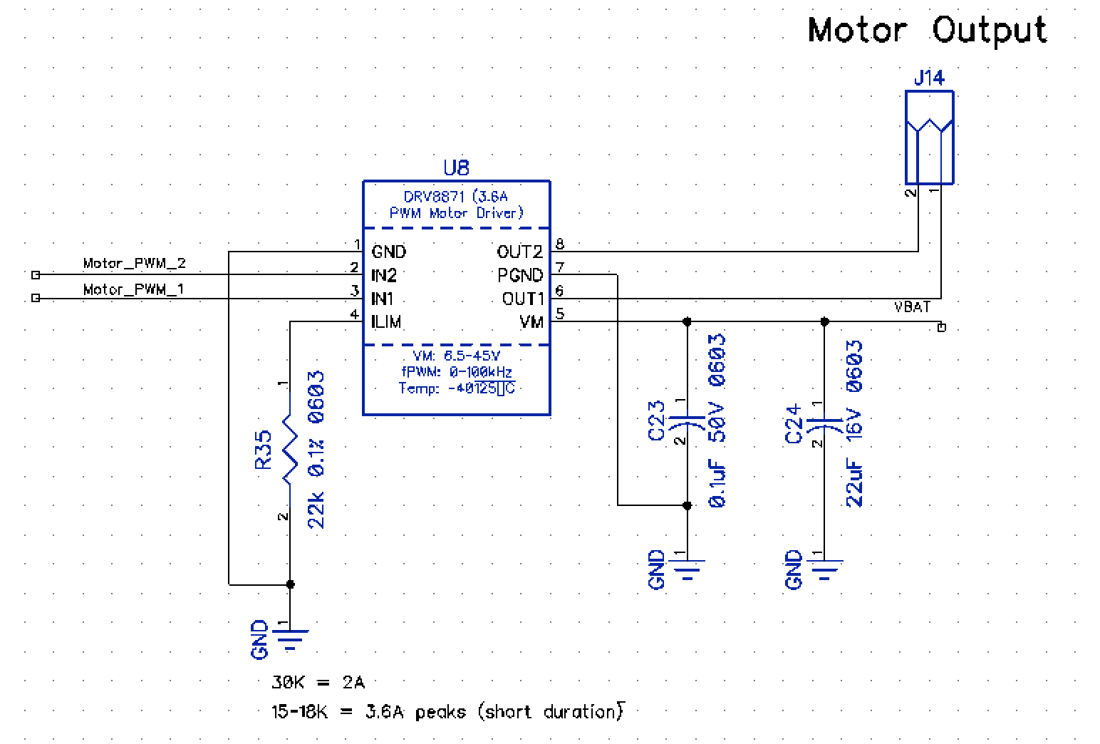
Robot Schematic: Motor Controller
Notes:
SUVRAT:
-Schematic of the Flywheel motor controller
-Uses a current limiting resistor and shuts off if motor stalls for some reason protecting the PCB and the chip
-Resistor value is calculated using the datasheet
-Motor and the chip are powered by the battery directly whereas PWM connects to PWM controller

Slide 21
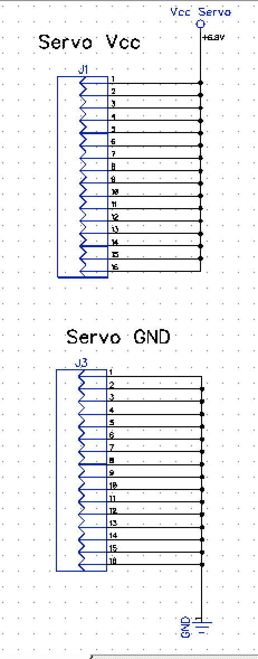
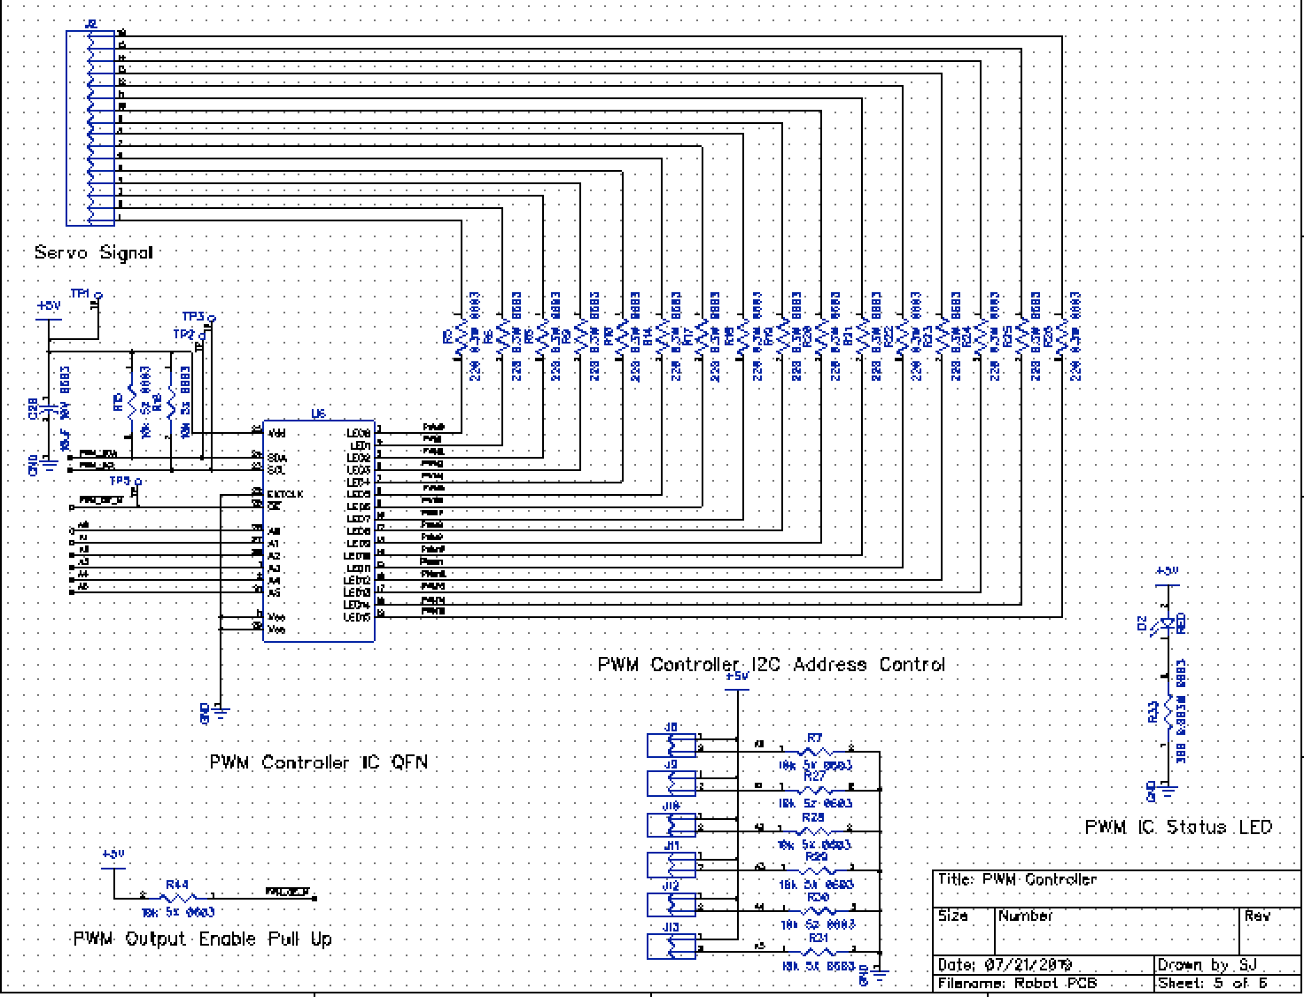
Robot Schematic: PWM Controller
Notes:
SUVRAT:
-PWM Schematic
-16 signals available 4 are used for driver servos, 2 are used for “gates”, and 2 are used for motor controller
-LEDs are added to check certain PWM controller status and enable pin is controlled by the MCU GPIO to turn all the outputs on or off in one toggle of the pin

Slide 22
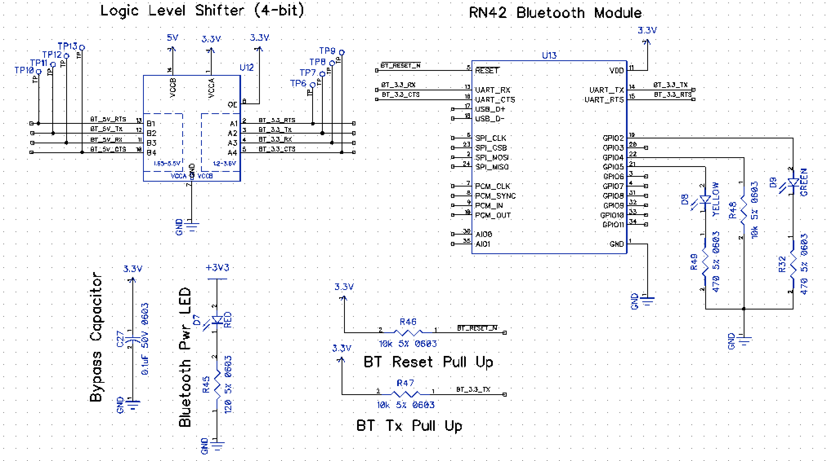
Robot Schematic: Bluetooth
Notes:
SUVRAT:
-Bluetooth Schematic
-RN-42 is chosen because it has built in firmware for HID profile
-The Bluetooth works on 3.3V and 4-bit logic level shifter is used because Arduino runs on 5V logic

Slide 23
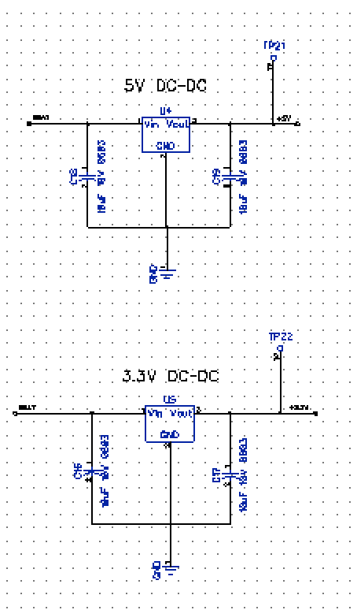
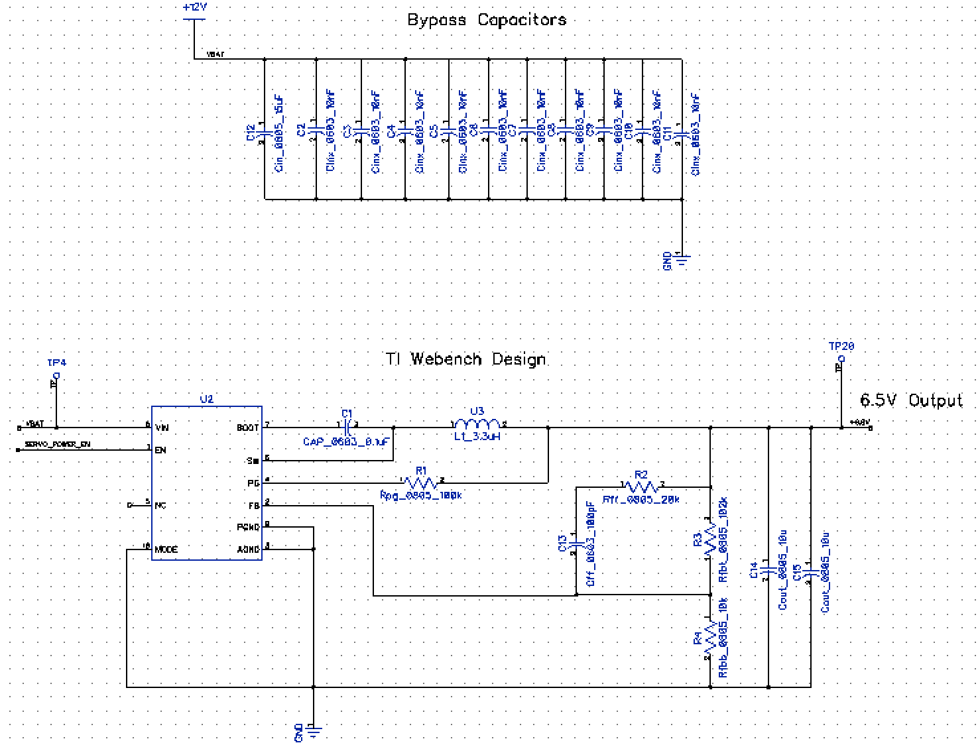
Robot Schematic: Switching Regulators
Notes:
SUVRAT:
-These are the three switching regulators
-One steps down 12V to 3.3V for Bluetooth
-One steps down 12V to 5V for MCU and PWM Driver
-One steps down 12V to 6.5V for the Servos

Slide 24
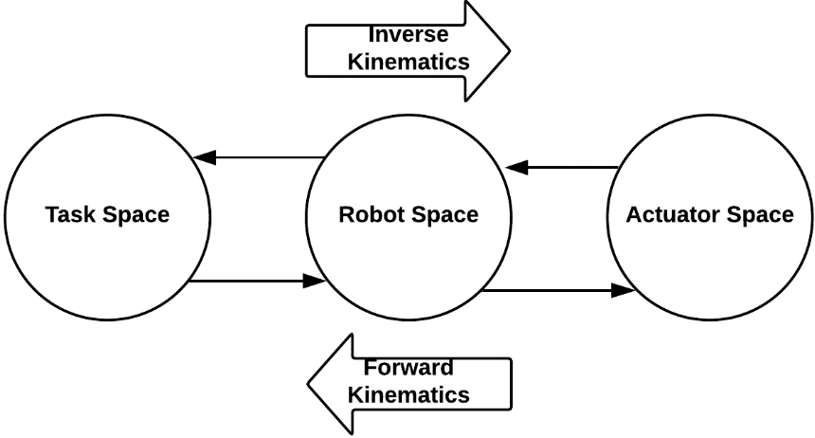
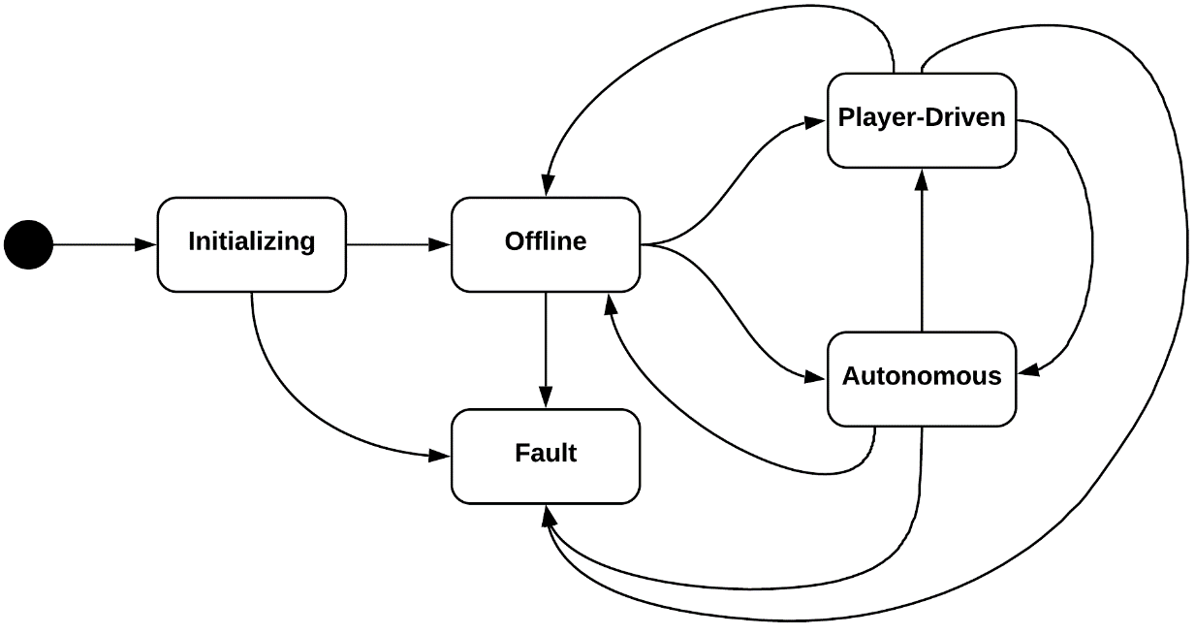
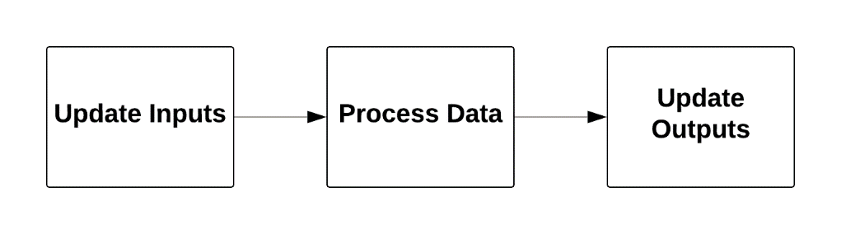
Robot Software Design
Robot acts as an I/O device that takes in data from sensors and commands from the Arena, and then executes the commands through actuations
The robot itself follows a master state machine that is driven primarily by Arena commands
Kinematics are done on the robot to abstract the control to the Game system
Kinematics processing
High-level data-flow
Robot state flow
Notes:
BRANDON:
The robot software design follows a general data flow of updating inputs from sensors, processing the data, and updating the outputs to the actuators.
The robot software follows the state machine shown, which indicates whether the robot is offline, or actively being driven by a player or semi-autonomously.
The software also implements kinematics to convert between different spaces such as Task space in World Frame, Robot space in Base Frame, and actuator space in digital or analog signals. This is done so that the robots can be changed out without interface changes to the Arena.

Slide 25
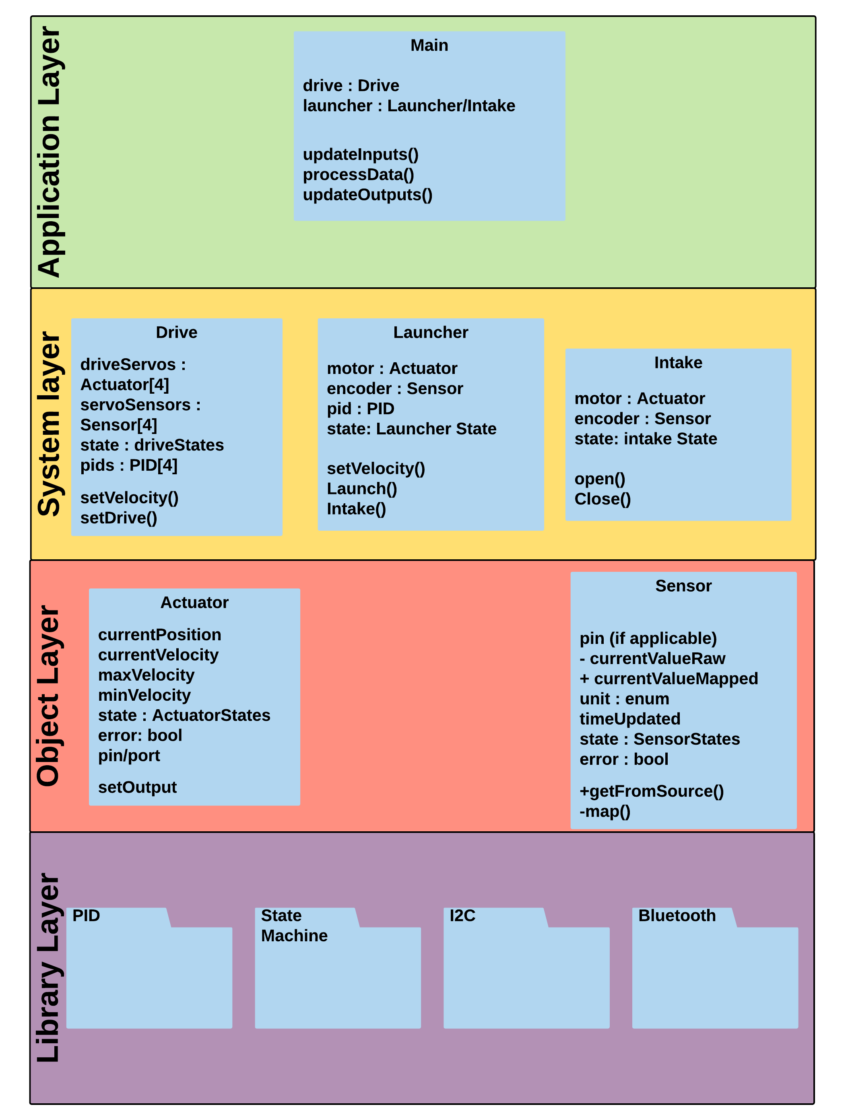
Robot Software Model
Main
  Cyclic calls and master state
Drive
  Provides functionality to move the robot. Implements kinematics
Launcher
  Handles velocity control of the flywheel
Intake
  Handles Intake servo flap and limit switch
Actuator
  Provides functionality for controlling outputs
Sensor
  Provides functionality for controlling inputs
PID
  Implements closed-loop control functionality
I2C
  Wrapper for PWM generation by the PCA9685 device
Bluetooth
  Provides functionality for communication with the Arena
Notes:
BRANDON:
The robot software is implemented in 4 layers: Application Layer, System Layer, Object Layer, and Library Layer. Each layer implements services provided by layers below it. The application layer is the master robot code that enforces the Data flow paradigm. It instantiates objects from the system layer. The Drive, Launcher, and Intake are implemented in the system layer and they create instances of actuators and sensors. These system layers handle closed loop control where appropriate. They also implement the kinematics. The actuator and Sensor objects have a variety of possible options and are designed to be abstract enough that they can be used with any type of actuator or sensor.

Slide 26
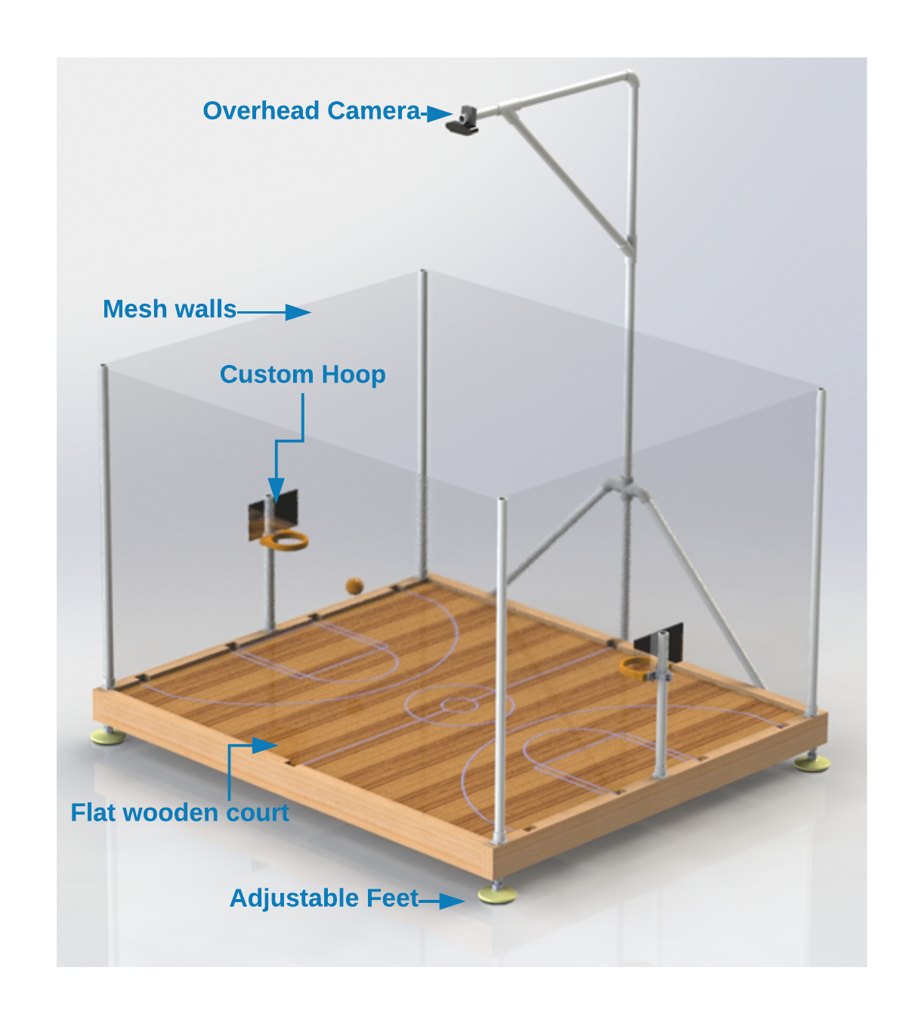
Arena
Notes:
CORY:
-The arena consists of 6 main components: The Overhead camera, Mesh walls, Custom Hoops, Flat wooden court, Frame, and Adjustable Feet

Slide 27
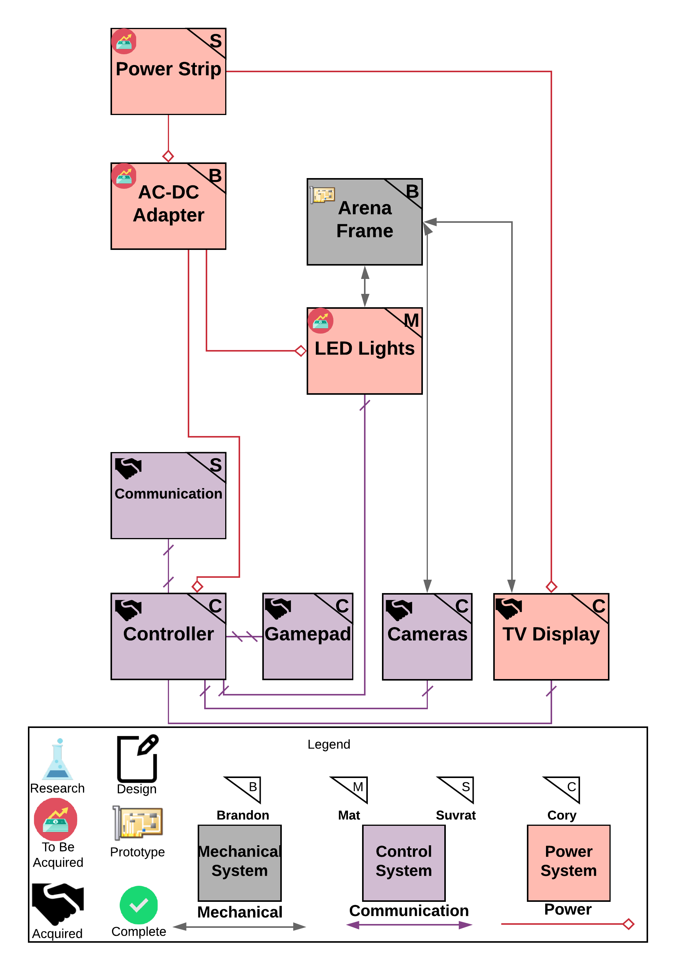
Arena Block Diagram
Power Strip
  Plugs into wall outlet and splits power between AC/DC Adapters and TV
AC-DC Adapter
  Converts 120V AC to DC power for Controller & LED Lights
LED Lights
  Colorful animated lights for player engagement
Arena Frame
  Mechanical structure to support court, robot, and other devices
Communication
  Device to transfer data between Arena and Robot(s)
Controller
  Embedded computer to process vision and game data
Gamepad
  Player-input device
Camera(s)
  Computer vision is performed to determine robot and ball positions
TV Display
  Display and sounds for the player
Notes:
CORY:
-Starting from the bottom we have a surge protector.
-There’s only three things attached to that: the AC-DC adapter for the nano, ac-dc adapter for LED’s, and the tv display
-From the Adapter we connect the Jetson nano and everything else plugs into that: the Bluetooth module into the M.2 Key E slot, the Xbox gamepad into a USB slot, and the camera into a USB slot.
-The camera will take in video data and send it to the Jetson Nano for processing and location calculations.
-When the user moves the robot using the Xbox gamepad the signal is sent via Bluetooth to the robot.

Slide 28
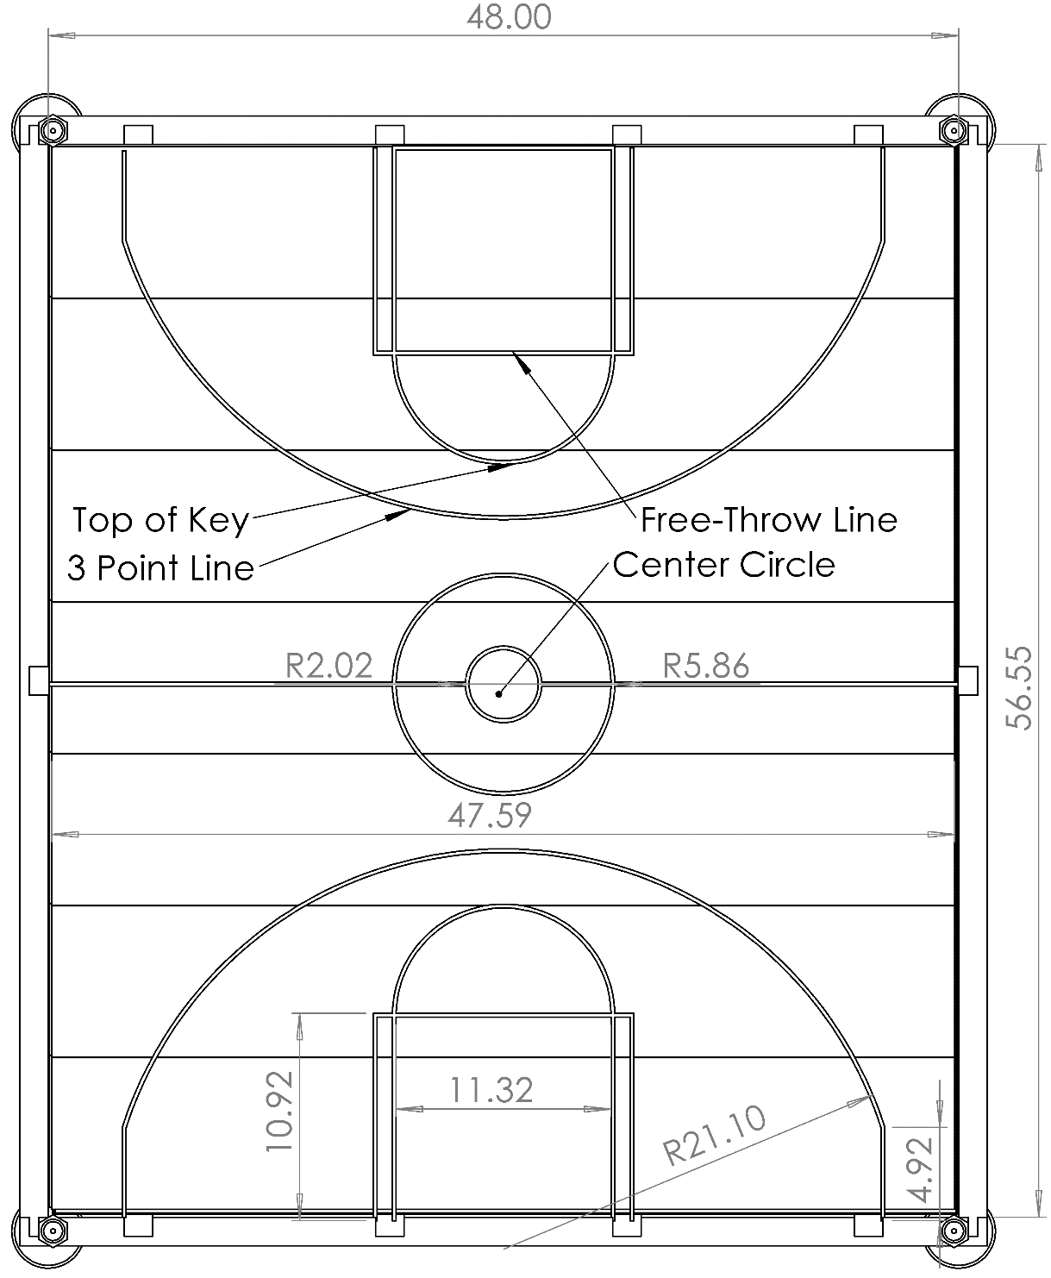
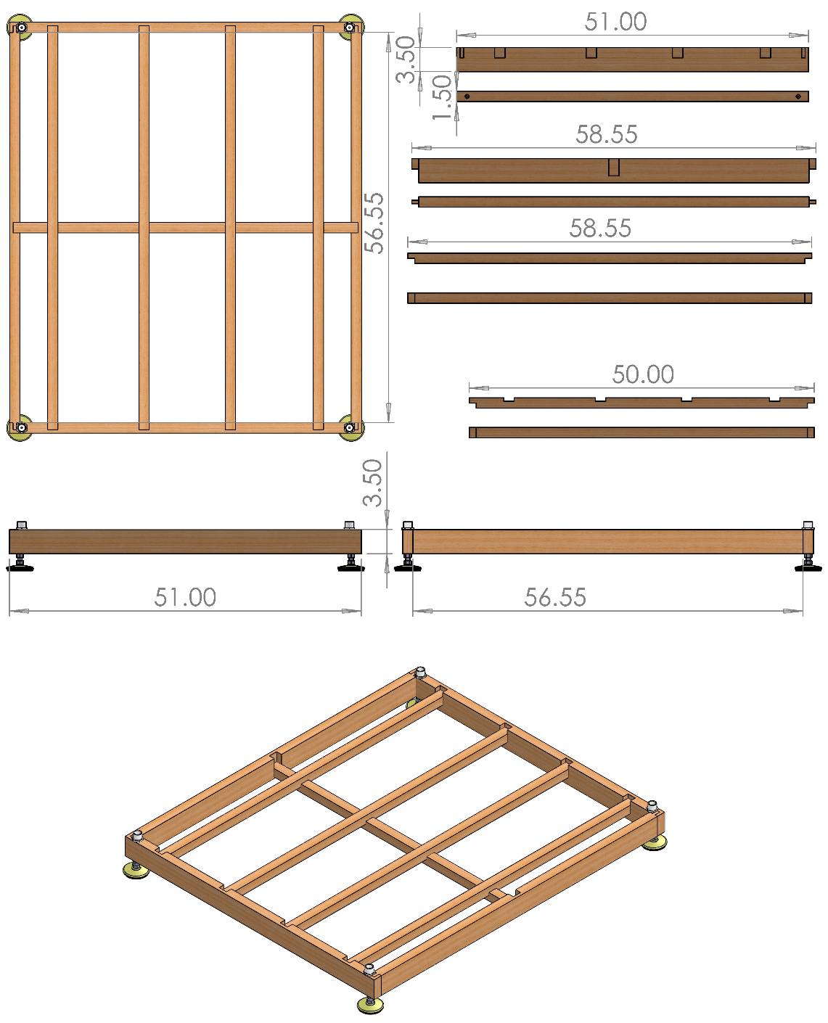
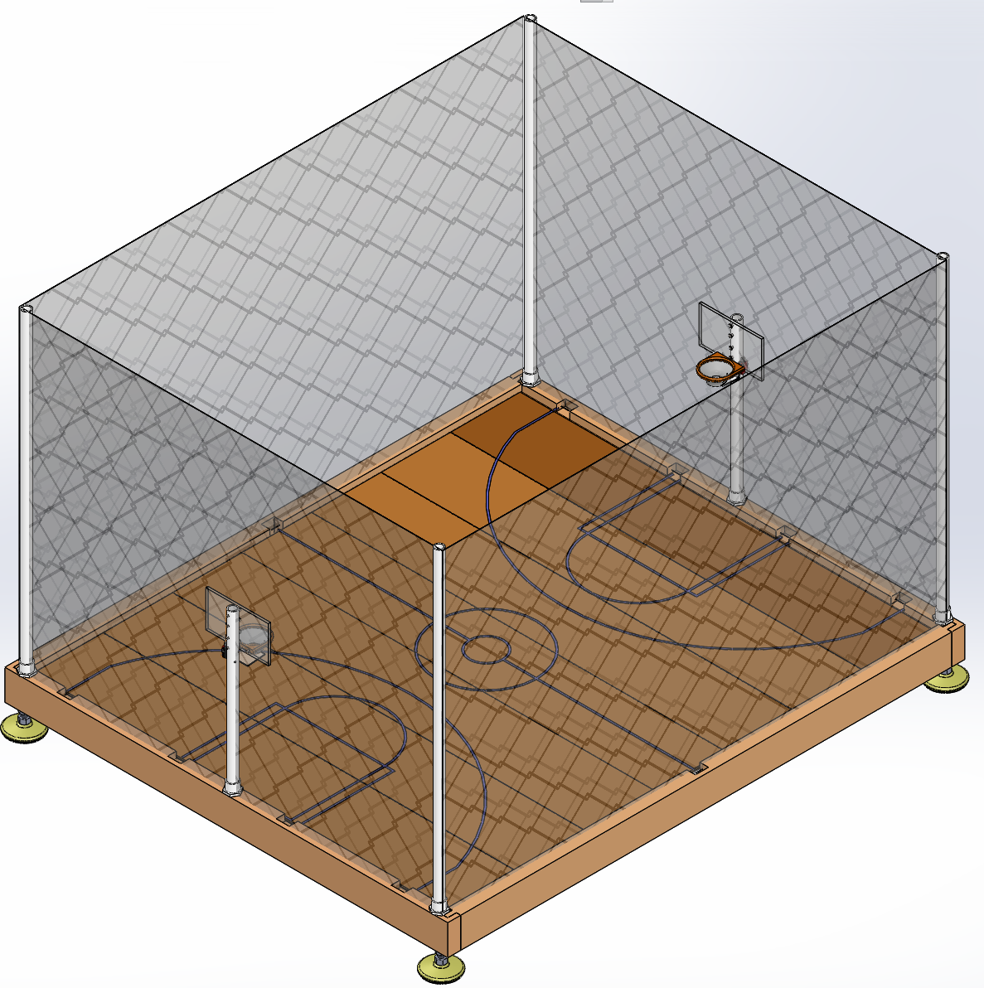
Arena - Frame & Court Design
Arena is 5’ length by 4’ Width by 3’ height (Minus camera mount)
Broken into several locking pieces without tools or hardware
Frame mounted on adjustable feet to level the floor
Wall mesh included to prevent projectiles flying outside the Arena
Notes:
CORY:
-The arena was built using 2x4 Kiln Dried wood for the frame which had locking joints cut in order to have each piece fit together effortlessly and with no hardware or tools.
-The flooring is removeable laminate flooring with basketball court markings painted on, keeping to the ratio of an NBA court as close as possible.
-The mesh wall posts are PVC pipe which is easily removed and placed back when constructing the arena.
-The hoop posts are also PVC pipe which fits into PVC caps attached to the frame of the court.
-The camera mount is again made of PVC and attached to the frame of the court.

Slide 29
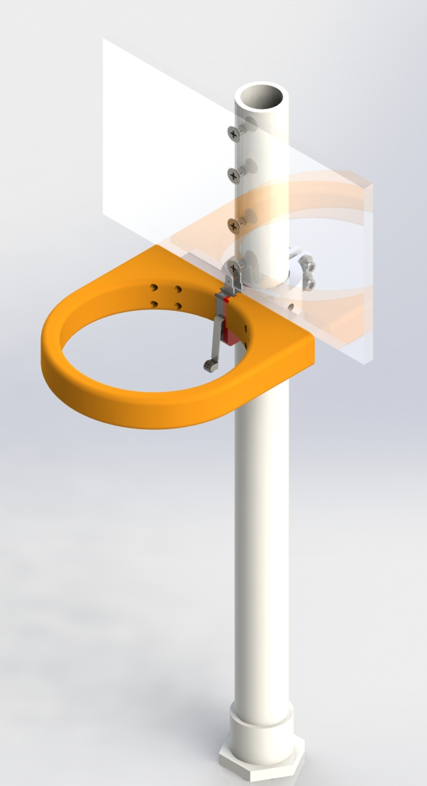
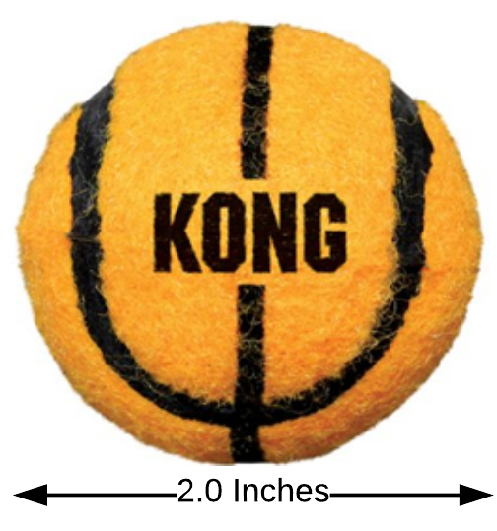
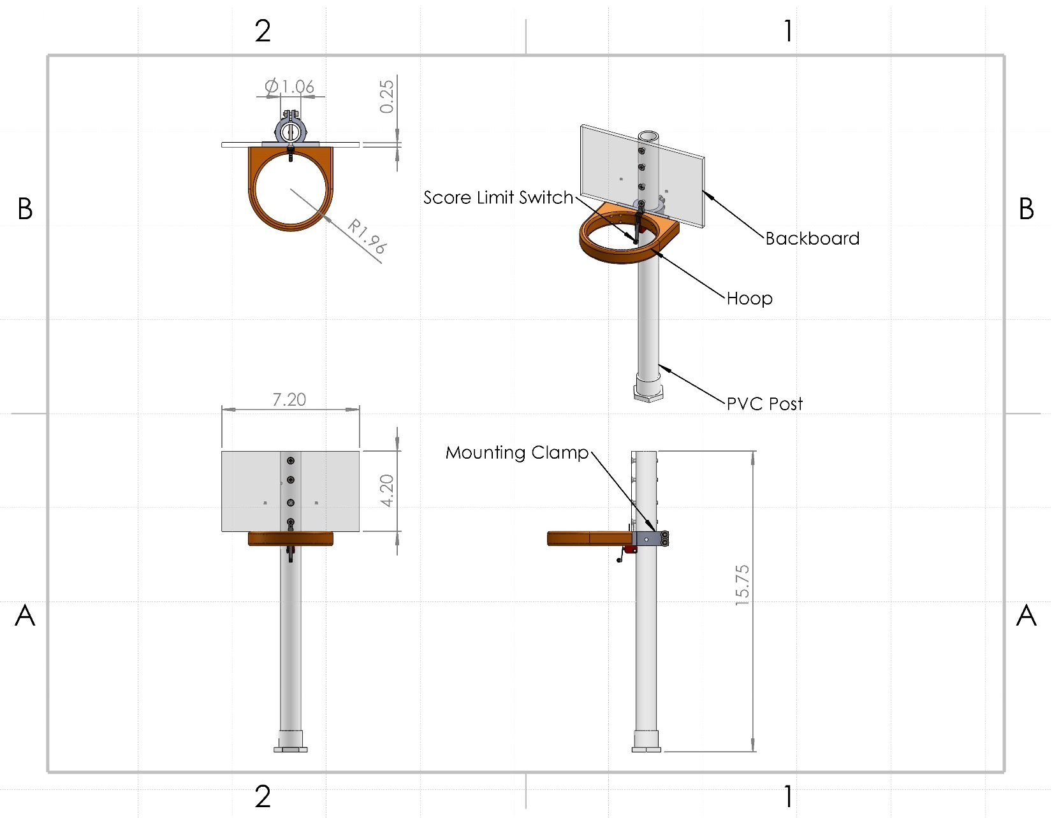
Arena - Ball & Hoop Design
Ball is a small-scale tennis ball with a basketball appearance
  Chosen because of size, appearance, and higher weight than a ping-pong ball
3D-Printed hoop and mount attached to a PVC post and an ABS backboard
Limit switch mounted such that the ball always hits it if makes it through the hoop
Notes:
CORY:
-A small-scale tennis ball was chosen because it resembles a basketball and is the smallest sized ball we could find that had the right feeling.
-A ping pong ball was also considered, but bounced too much in testing, was too light to consistently intake, and there was a worry that the flywheel might dent the ping pong ball when launching.

Slide 30
Component Selection – Embedded Computer
High-powered computing is required to process the computer vision data and game engine on a single device
It must also support a small number of I/O to aid in Arena intelligence
Feature | Raspberry Pi 3 Model B+ | Jetson Nano
CPU | 1.4 GHz 64-bit Quad-Core ARM Cortex A53 | 1.4 GHz 64-bit Quad-Core ARM Cortex A57 MPCore
GPU | Broadcom VideoCore IV | 128-Core Nvidia Maxwell
RAM | 1 GB LPDDR2 SDRAM | 4GB LPDDR4
Operation Performance | 21.4 GFLOPs | 472 GFLOPs
Wireless | Dual-band 802.11ac wireless LAN, Bluetooth 4.2 onboard | M.2 Key E Slot (None onboard)
USB Ports | 4x USB 2.0 | 4x USB 3.0
Video Ports | HDMI, DSI | HDMI, Display Port
Cost($) | 35 | 99
Notes:
CORY:
-Since both embedded computers use practically the same CPUs their other components become more important.
-Because we are processing a live video feed we will need a lot of processing power.
-OpenCV has the ability to use CUDA which uses the GPU to perform calculations therefore a better GPU will help our computer vision process video better.
-Computer vision requires a lot of operations to handle data coming in, therefore the operation performance between the two is very important.
-We are using Bluetooth LE 4.2 to communicate between the arena and robot and so the lack of a card on the Nano was a detriment because it just added more cost to an already expensive part.
-However, the Nano can handle 8 1080p video feeds at 30fps simultaneously or 18 720p video feeds at 30fps and that processing power alone mixed with CUDA ability just made the Nano a better choice.

Slide 31
Component Selection - Camera
 | Pixy2 | Logitech c920 | Logitech C270
Cost ($) | $59.00 | $60.00 | $40.00
Resolution | 1296x976 | 1280 x 720 1920 x 1080 | 1280 x 720
Field of View | 60° H x 40° V | 78° H x 43.3° V | 60° H x 40° V
Frame Rate | 60 FPS | 60 FPS @ 720p 30 FPS @ 1080p | 30 FPS
Mounting Height | 6 Feet | 5 Feet | 6 Feet
Actual Test Quality | Extremely Poor | Very Good | Poor
Notes:
CORY:
-The Pixy2 would have been the clear choice as it comes with it's own computer vision software and hardware so all we would have to do is train the algorithm.
-In testing though it performed very poorly from the distance it would be required to be mounted in order to see the entire arena.
-So, instead we choose the Logitech c920, mainly because it was the best of the two cameras our group already owned and in testing gave a very clear image from the height required to view the entire arena.
-The vertical FOV is actually the main limitation in the cameras because we have to keep mounting it higher and higher the lower the angle of the FOV becomes.

Slide 32
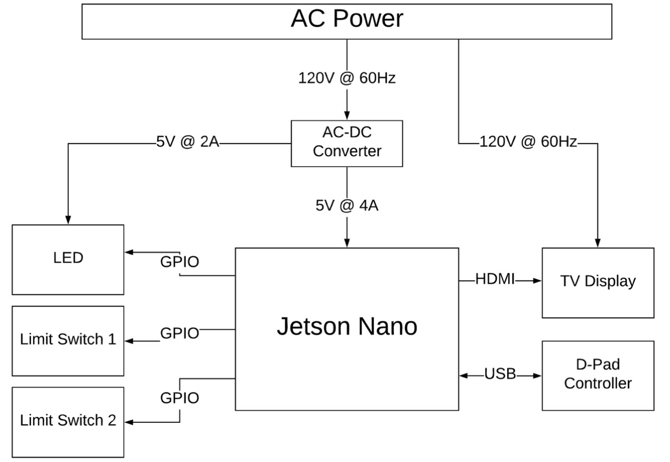
Arena - Electrical Design
The Arena is AC Powered
A 120V to 5V AC-DC converter is used to power the Nano
Nano does most of the processing onboard and controls LEDs and Limit Switches
The controller commands are accepted using USB and sent to the Robot via communication system (ideally Bluetooth)
The TV/Display is powered from an AC outlet as well
Notes:
CORY:
-The Arena is powered by an AC outlet
-Two AC-DC Converters are used. One powers the Jetson Nano and one powers the NeoPixels
-The TV Display is also powered by the AC outlet and therefore, a power strip will be attached to the arena for simplicity
-Jetson Nano interfaces with D-Pad using USB serial interface and with the TV Display via HDMI
-Limit Switches are used to detect a “goal” and are connected to Nano’s GPIO
-NeoPixels need PWM and because Nano is not a real time system, either SPI will be used or a small PCB will be designed to interface them with the Nano

Slide 33
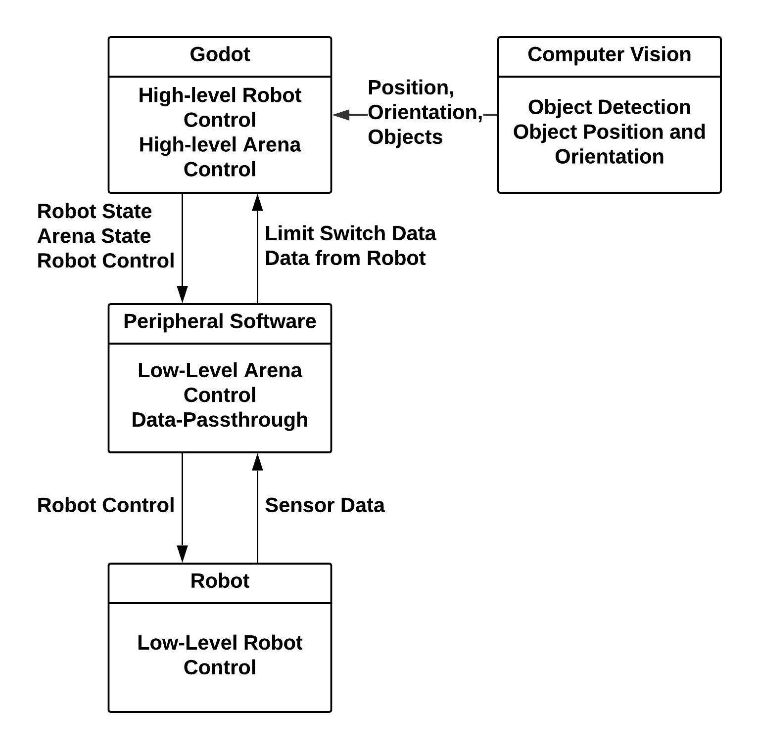
Arena Software Design
Peripheral software will send and receive data from the game engine as well as control local I/O from the arena.
Peripheral software will handle calculations to send to robot for velocity and position control.
Critical issue
  Jetson Nano cannot directly control NeoPixels due to the lack of real-time control over the GPIO. An extra external device such as an ATMEGA328 may be required.
Notes:
CORY:
- The arena software is split into two nodes: Peripheral software and computer vision.
- The peripheral software is responsible for handling GPIO and communication between the game engine, and robot.
- The software in this case does not need to be hard-real time, but still must achieve a soft-real time execution to handle the robot control 30hz requirement
- The lack of hard real-time with the Nano (Due to a native operating system) has introduced a critical issue for controlling the LED NeoPixels. NeoPixels require a precise digital signal to achieve proper animation.
- Due to this, an additional external device (such as an ATMEGA) may be required to properly animate the lights.

Slide 34
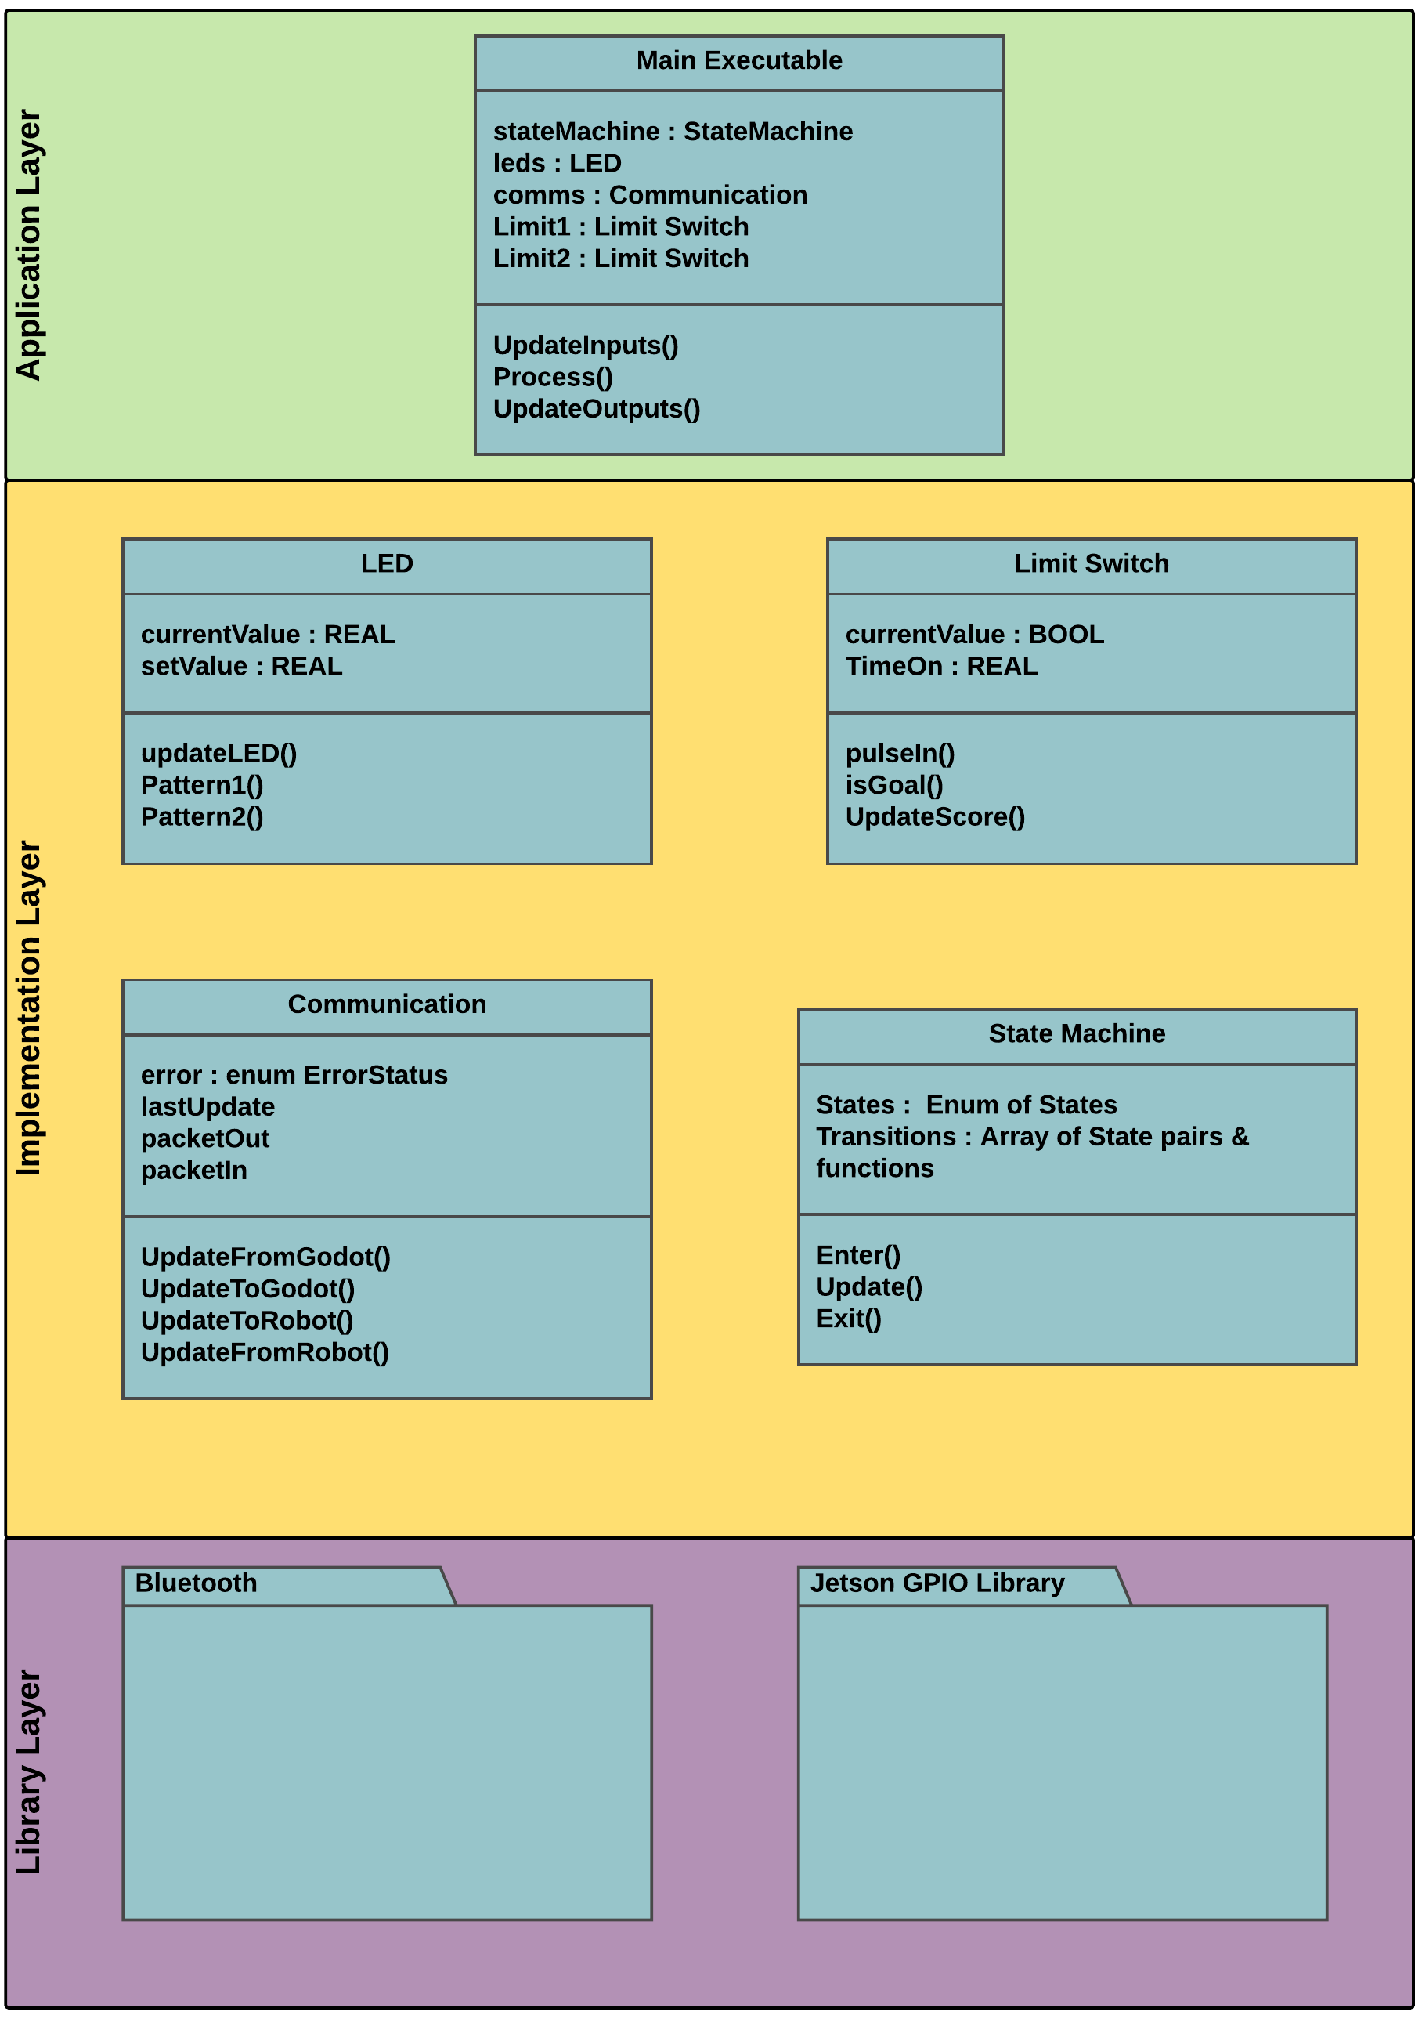
Arena Peripheral Software Model
Main Executable
  Cyclically checks I/O through subsequent layers, reports data to the game engine
LED
  Responsible for controlling the LED GPIO
Limit Switch
  Responsible for determining when a goal is achieved
Communication
  Responsible for communicating between the Game engine and Computer Vision Systems
State Machine
  Ensures non-blocking behavior
Bluetooth:
  Library to provide low-level Bluetooth network control
Jetson GPIO Library
  Library to provide low-level hardware functionality
Notes:
CORY:
- The peripheral software model is shown in this picture as being split between 3 layers: Application, Implementation, and Library layers.
- These layers only depend on services/functionality provided by layers beneath it.
- The main executable implements a similar data process to the robot: Update inputs, process data, and update outputs.
- In this case, the inputs are data from local sensors such as the hoop limit switches, and data from the game engine.
- Outputs include passing data from the game engine to the robot over Bluetooth and setting local outputs in the form of LEDs.
- The libraries utilized take care of GPIO control and Bluetooth functionality.

Slide 35
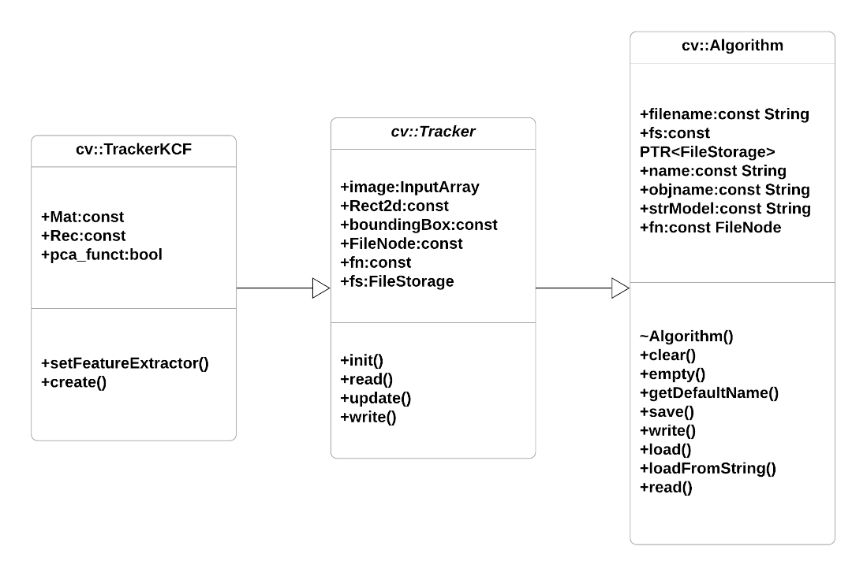
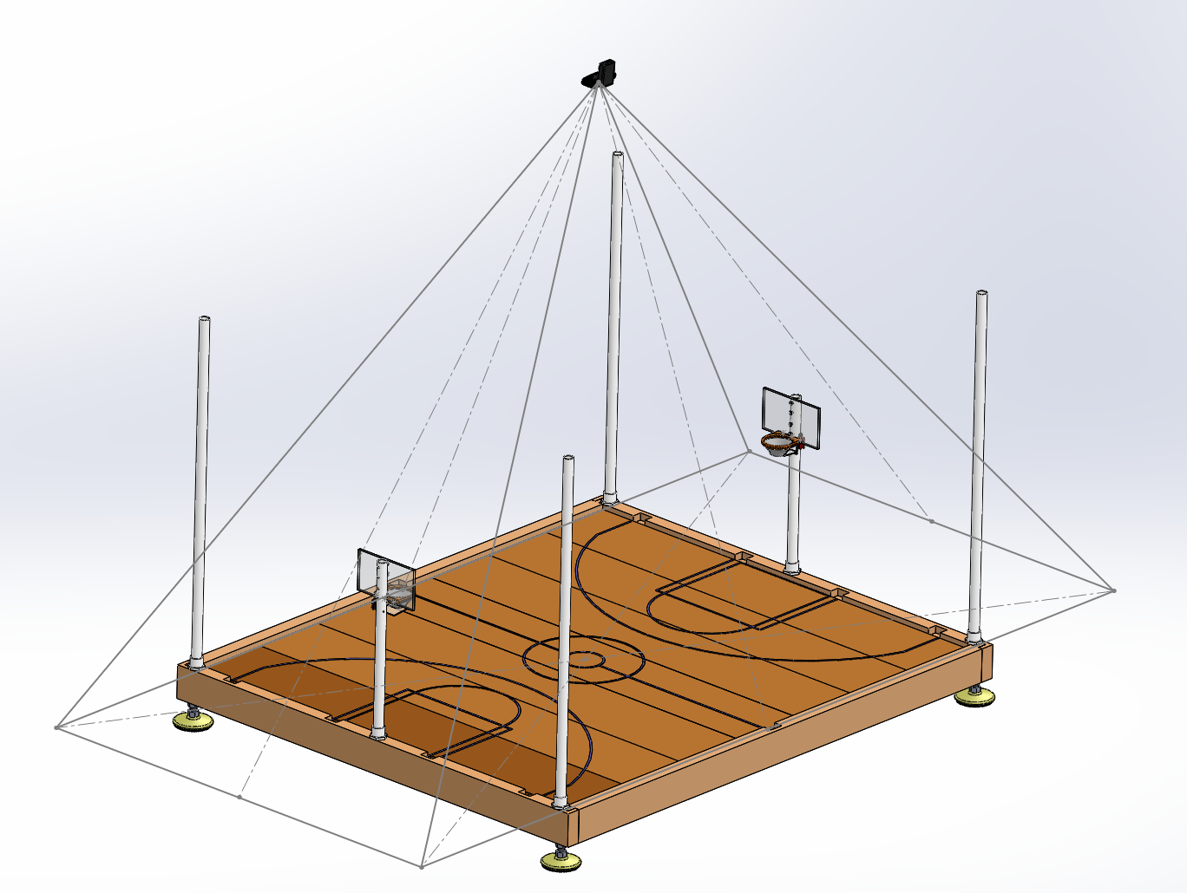
Arena Computer Vision System
Position data from the robots and ball to be passed to the robot master control
2D image from single camera with a relatively high resolution, and 30 Frames per second
Camera must be mounted high enough to see the entire field and objects on the field
Implemented using the open source OpenCV computer vision libraries and third party KCF tracker package along with background subtraction
Notes:
CORY:
-We choose to use OpenCV for computer vision not only because it was free and open source, but also because it has 3rd party trackers that can easily be implemented and a vast community for support.
-The code for the implementation is pretty straightforward because most of the heavy lifting is done via the OpenCV libraries, so its just a matter of finding and using the library functions correctly.
-The third party tracker is called the Kernelized Correlation Filter or KCF tracking library. This tracker takes advantage of large overlapping data regions to track faster and more accurate than most other trackers.
-The KCF tracker does poorly when an object being tracked gets obscured and then comes back into view and it also doesn’t give the orientation of the robots.
-To counter this we are implementing background subtraction on the court prior to feeding the video data to the KCF tracker and we are using two colored dots on each side of the robot which will determine orientation.

Slide 36
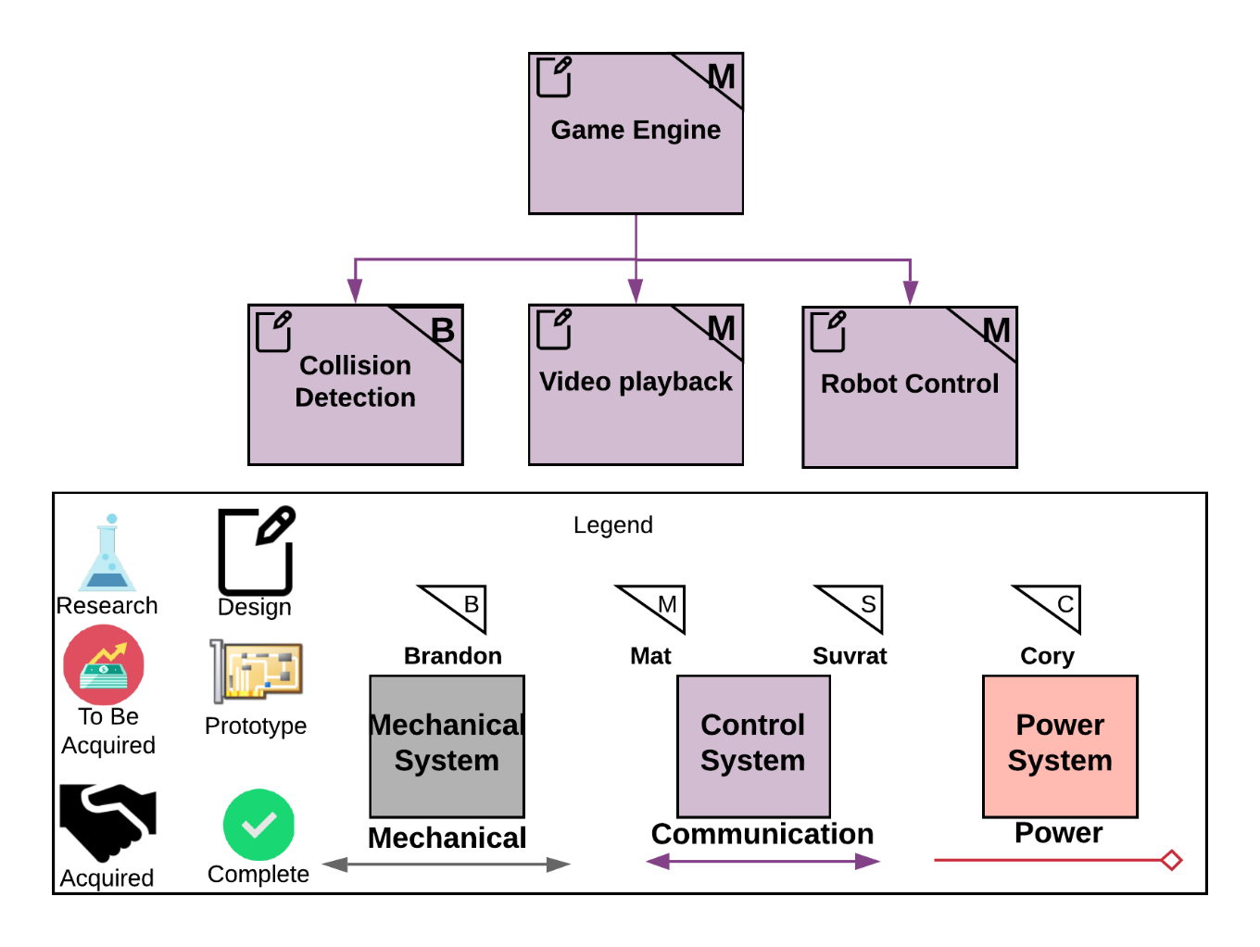
Game Block Diagram
Game Engine
  Godot
Collision Detection
  Alerts user when they are getting closer to the edge of the arena.
Video Playback
  Data playback after made or missed shot
Robot Control
  Joystick input and positional data
Notes:
MAT:
Our chosen game engine was the Godot 2D engine.
The collision detection is there to provide some feedback to the user, as well as a protective measure for the robot as it should help prevent the user from putting unneeded stress on the robot. Ex – Continuously running into the wall without the robot moving can burn motors.
Video Playback – Way of interacting with the user and adding an element of fun. Styled in the way of bowling alley animations.
Robot Control will take user input and positional data from the computer vision to correctly track and show the robots position in the game as well as to send it velocities to move where the user tells it to.

Slide 37
Component Selection – Game Engine
 | Cost($) | Vendor | Language | Community Support | IPC | 2D/3D | Editor Size
Godot | Free | Open Source | GDScript, C#,C++ | Low | TCP/IP Socket, Shared Memory | Both | Very Small
Unreal | Free | Epic Games | C++ | Medium | TCP/IP Socket, Shared Memory | Both | Large
Unity | Free | Unity Technologies | C#,C++ | High | TCP/IP Socket, Shared Memory | Both | Very Large
Notes:
MAT:
Godot uses its own python like language called GDScript. Unreal costs royalty on profit over 3000 dollars but this doesn’t apply to the project. Interprocess communication is handled pretty much the same way in all three but with slightly different implementations due to their libraries. In the end, we chose Godot because the 2D seemed to be easier to work with, but all 3 engine choices were viable options.

Slide 38
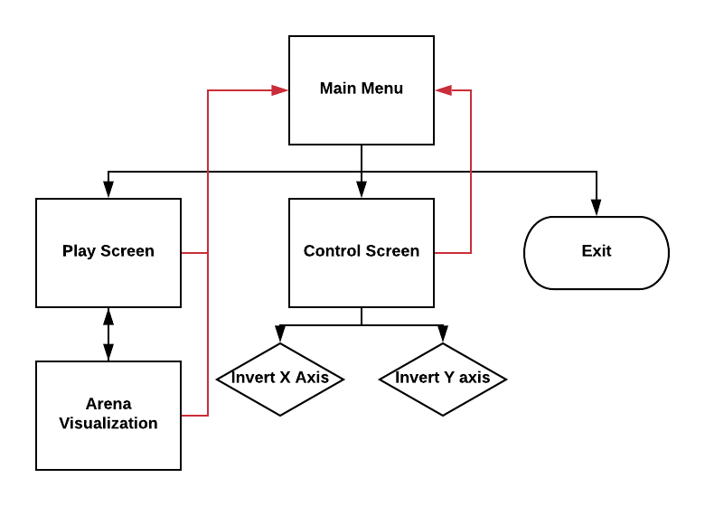
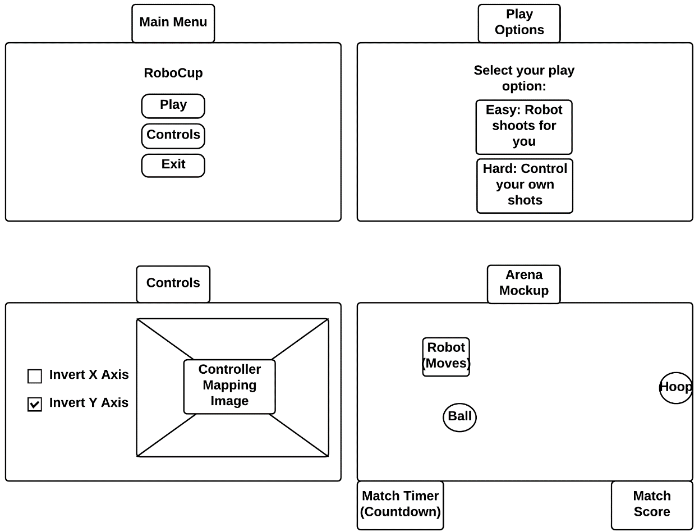
Game Interface Design
Notes:
MAT:
These are basic wireframe mockups of the individual screens needed for the game. There is a main menu, a “difficulty” selection, controller screen, and game screen. The game screen contains important match information such as time, score, and the position of important landmarks in the arena such as the robot or ball.

Slide 39
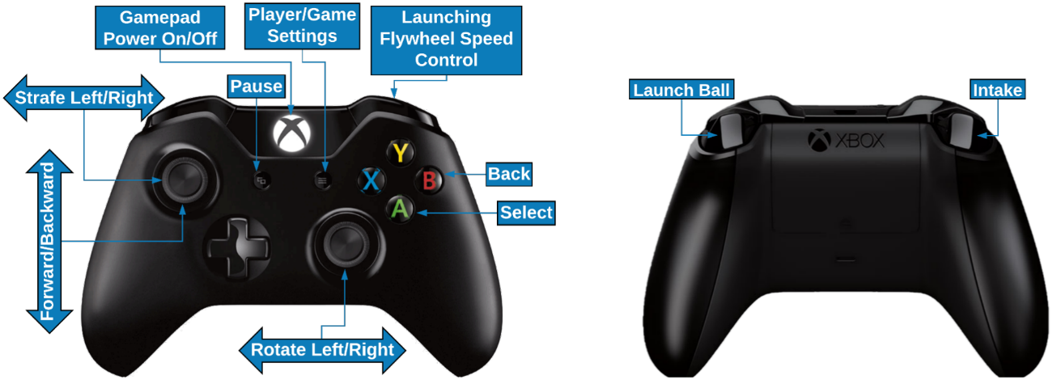
Gamepad
Xbox One controller will be used for controlling the robot
  More readily available to use
  Interfaces well with Godot
Notes:
MAT:
We looked at both Xbox one and PlayStation controllers, functionally there isn’t a difference between the two, however we found the xbox controller to be overall more comfortable to use.

Slide 40
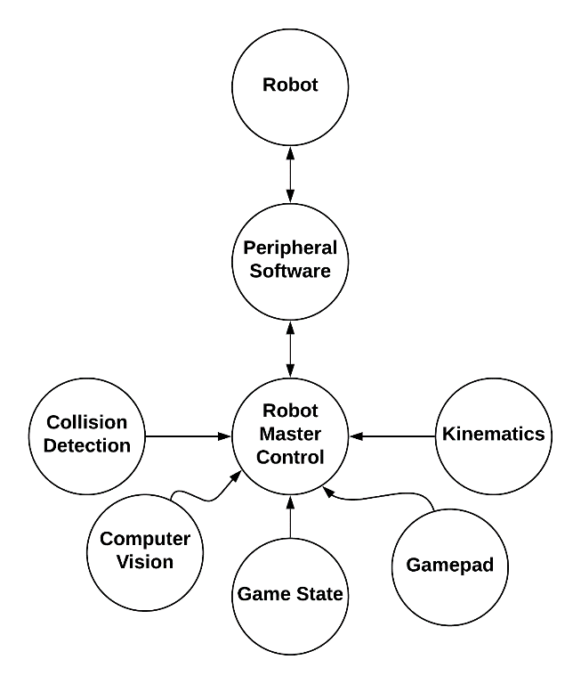
Game - Robot Master Control
Game software handles the overall control of the robot by taking inputs from the user, processing the data, and then sending the processed data to the peripheral software component. The peripheral software component (Arena software) communicates with the robot(s).
The data processing includes smoothing/filtering user inputs, determining robot state, and determining the required robot velocities for the drive and flywheel to drive and shoot appropriately.
Notes:
MAT:
Robot Master Control takes input from a variety of sources to make decisions on what data to send where. Using the input gamepad, computer vision, and current kinematics, it will send velocities to the robot to make sure it is able to move in the right direction. It will also use the position data and input to decide if it should alert the user to an imminent collision either with the arena or another robot.

Slide 41
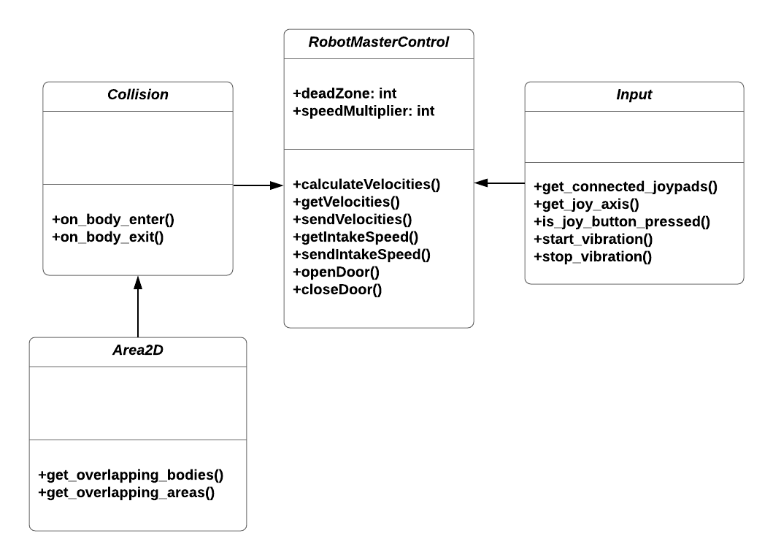
Game - Software Model
Notes:
MAT:
The software will have a central hub that takes in data such as joystick input and positional data from the computer vision aspect of the arena. This master control comp will be send data out to the peripheral software and then the robot afterwards.

Slide 42
Critical Interfaces
Arena <-> Game (Software/Communications Interface)
  Defined as the interface between the Arena and the Game
  Although the Arena and Game currently live on the same device, it is not required for the Game software to strictly live on the I/O device
  Like the Robot<->Arena interface, the type and meaning of transferred data must be clearly defined such that translation errors do not occur
  Arena to game: Estimated Vx, Vy, ω, flywheel velocity, error status, hoop limit switch
  Game to Arena: Vx, Vy, ω, state
Robot <-> Arena (Software/Communications Interface)
  Defined as the interface between the Robot(s) and Arena
  Data transferred to and from both Robot and Arena over channel (Bluetooth)
  Critical interface due to the data being transferred needing a clearly defined type and meaning (For example, linear velocity sent from Arena to Robot is an integer corresponding to some velocity in m/s)
Notes:
MAT:
The arena-game interface is a software-based interface that deals with the data transfer between the Arena and Game systems. This data includes the robot velocities, flywheel velocities, intake control, and error status to the Arena from the game. It also involves passing data from the robot to the game through the arena peripheral software.
SUVRAT:
-Accomplished via Bluetooth Low Energy
-Either SPP or HCI Bluetooth profile will be used depending on what works on Linux
-Ideally, Linux supports both and therefore, initially SPP will be used to send and receive sensor data
-Arena will use computer vision to measure the distance between the ring and the robot
-Then it will generate a packet which will contain velocity in x, y and omega (angular velocity)
-An interrupt will be generated by the Bluetooth to denote data has arrived and the buffer will be filled and then used in the main loop
-On the robot end, there will be a buffer that will continually be parsed for data and commands will be sent to motor/servo drivers

Slide 43
Budget & Spending - Robot
Budget Item | Quantity | Budget ($) | Budget Subtotal ($) | Item | Supplier | Price ($) | Subtotal
Launching Hardware | 1 | $20.00 | $20.00 | Assorted | Various | $14.00 | $14.00
Drive Hardware | 1 | $30.00 | $30.00 | Assorted | Various | $6.00 | $6.00
Servo Bracket | 4 | $5.00 | $20 | Lynx-motion servo bracket | Robotshop | $3.48 | $13.90
Wheels | 4 | $15.00 | $60 | Omni-Wheel | VEX | $5.00 | $20
Intake Hardware | 1 | $20.00 | $20.00 | Assorted | Various | $5.00 | $5.00
Intake Motor | 1 | $15.00 | $15.00 | Servo | Parallax | $20.00 | $20.00
Drive Motor | 4 | $20.00 | $80.00 | High speed Servo | Parallax | $27.00 | $108.00
Launch Motor | 1 | $20.00 | $20.00 | 3600 RPM DC Motor | Skycraft | $7.00 | $7.00
Controller | 1 | $20.00 | $20.00 | ATMEGA328P-AU | Microchip | $2.00 | $2.00
Battery | 1 | $30.00 | $30.00 | 1300 mAh 3S LiPo | Amazon | $27.00 | $27.00
PCB | 1 | $40.00 | $40.00 | Assorted | Various | $38.82 | $38.82
Bluetooth Module | 1 | $10.00 | $10.00 |  | Sparkfun | $16.00 | $16.00
Total per Robot |  |  | $345.00 |  |  |  | $277.72
Notes:
BRANDON:
Robot cost is under-budget at this point due to the reduced cost of the wheels and servo brackets compared to what were initially spec’d out.
The current total is $280, we do expect this to increase as we run into problems

Slide 44
Budget & Spending - Arena
Budget Item | Quantity | Budget ($) | Budget Subtotal ($) | Item | Supplier | Price ($) | Subtotal
Frame Hardware | 1 | $ 100.00 | $ 100.00 | PVC Tube, Wood, Screws, PVC Fittings | Home Depot | $85.00 | $85.00
Camera | 1 | $ 60.00 | $ 60.00 | Logitech C920 | Amazon | $63.50 | $63.50
Controller | 1 | $ 100.00 | $ 100.00 | Jetson Nano | NVIDIA | $100.00 | $100.00
Power Supply (AC-DC) | 1 | $ 40.00 | $ 40.00 | Power Strip, 5A Power Supply, LED Driver | Amazon | $11+$11+$20 | $42.00
Bluetooth Module | 1 | $ 10.00 | $ 10.00 | Intel Dual Band Wireless-Ac w/ BT | Amazon | $23.00 | $23.00
Court Hardware | 1 | $ 25.00 | $ 25.00 | Flooring | Home Depot | $16.00 | $16.00
LEDs | 1 | $ 25.00 | $ 25.00 | Neopixels | Adafruit | $32.00 | $32.00
Gamepad | 2 | $ 25.00 | $ 50.00 | Xbox Controller | Amazon | $25.00 | $50.00
TV Display | 1 | $ 70.00 | $ 70.00 | 720p 19in Display | Amazon | $70.00 | $70.00
Total |  |  | $ 480.00 |  |  |  | $481.00
Notes:
BRANDON:
We are currently slightly over-budget on the Arena due to the increased cost of some components. However, Additional costs are not expected to be incurred.

Slide 45
Timeline
Sprint # | Start | End | Important Deadline | Must-Complete
Sprint 1 | 8/27 | 9/3 | - | -
Sprint 2 | 9/3 | 9/10 | - | -
Sprint 3 | 9/10 | 9/17 | - | -
Sprint 4 | 9/17 | 9/24 | - | -
Sprint 5 | 9/24 | 10/1 | 10/26 CDR | Arena Hardware
Sprint 6 | 10/1 | 10/8 | - | Robot Hardware (Minus PCB)
Sprint 7 | 10/8 | 10/15 | - | Robot Software
Sprint 8 | 10/15 | 10/22 | 10/21 Mid-Term Demo | -
Sprint 9 | 10/22 | 10/29 | - | PCB
Sprint 10 | 10/29 | 11/5 | - | Game
Sprint 11 | 11/5 | 11/12 | - | Arena Software
Sprint 12 | 11/12 | 11/19 | - | Testing
Sprint 13 | 11/19 | 11/21 | 11/21 Final Demo | -
Notes:
BRANDON:
The robot should be nearly complete for the mid term demo, except for the final PCB. The entire project is expected to be finished 1-2 weeks before the final demo to ensure adequate time for stringent testing.

Slide 46
Work Distribution
 | Primary | Secondary
Robot Mechanical | Brandon | Mat
Robot Electrical | Suvrat | Brandon
Robot Software | Brandon | Mat
Arena Mechanical | Cory | Mat
Arena Electrical | Suvrat | Cory
Arena Software | Brandon | Suvrat
Computer Vision | Cory | Suvrat
Game | Mat | Brandon
Notes:
BRANDON:
The primary and secondary owners are shown for different systems

Slide 47
Progress
Notes:
BRANDON:
The arena mechanical is very nearly complete, as well as robot software, and arena electrical.
The areas that still need a lot of work are arena software, computer vison, and the game systems.

Slide 48
Immediate Plans
100% Arena hardware complete
Requires wall mesh weaving, 1 hoop print, and electrical box
Finalize robot hardware design & construction
Requires intake design & construction, and manufacturing final components
Complete working bread-board prototype of electrical system
Requires launcher, drive, and intake motor and sensor testing
1st PCB iteration purchase & Manufacturing
Long lead-time, many issues can arise
Notes:
BRANDON:
The Arena hardware is nearly complete, so that can be finished very soon
The robot hardware is a critical path so that must be completed soon. Specifically, the intake design must be finished, constructed and tested.
The electrical system must be tested and finalized prior to PCB Purchase, which is another component on the critical-path

Slide 49
Questions?
Notes:
BRANDON:
At this time we will answer questions and make any clarifications needed.

