Slide 1
MOIST
(Mesh-Operated Irrigation
Sensor Technology)
Ahmed Hamdy
Elange Pierre
Gabriel Santos

Slide 2
Problem Statement
-Excessive watering
-Costs
-Damages Lawn

Slide 3
Goals & Main Objectives
Monitoring moisture to reduce water waste
Solar-powered
Weather-resistant
Reliable network
User-friendly interface
Notes:
GABE
The devs or salesforce admins in our team use sandboxes which our workspace environments in which they can test out their code and data. Typically their code goes through different stages which are all different sandboxes before they are put into production. These stages are User Acceptance Testing, Quality Assurance, Integration, and then Production
As you can see in this slide, the production sandbox is much larger than all the other sandboxes. This is because the smaller sandboxes are only allowed a small limited storage in order to keep the costs of maintaining various sandboxes down for THD down. This is brings us to the issues that our team currently faces when transferring data between these sandboxes.
NOTES
Add problem statement slide

Slide 4
Specifications
Component | Parameter | Design Specification
Nodes | Power Consumption | 10 W
Wireless Range | Distance | 5 m
Test Area | Size | 30 x 20 sqft
Status Updates | Time | 1 update/hour
Moisture Readings | Accuracy | 5%
Child-to-Parent Network | Strength | 5:1

Slide 5
RF Module
Solar
Panel
Power
Communication
Node Block Diagram
MCU
Power Control
Peripherals
MCU
Sensor
Battery

Slide 6
RF Module
Solar
Panel
Power
Communication
MCU
Power Control
Peripherals
MCU
Sensor
Battery

Slide 7
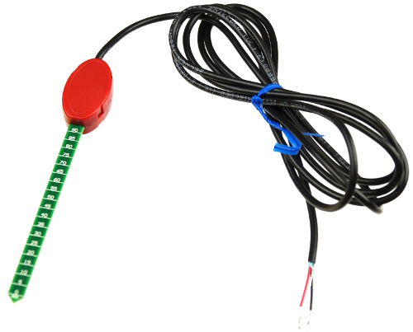
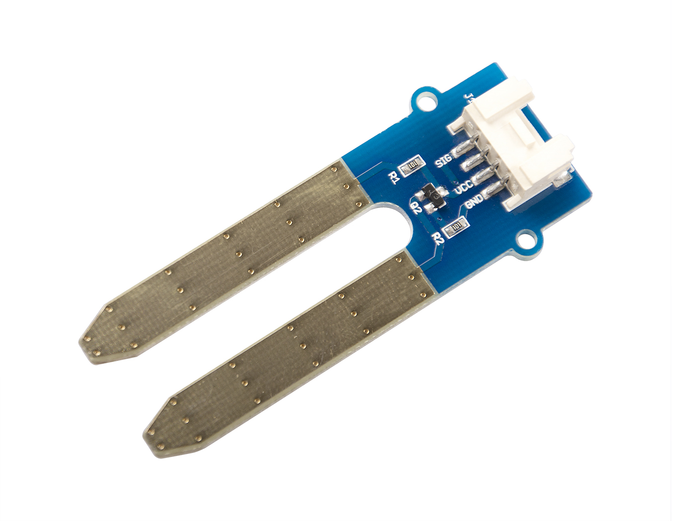
Soil Moisture Detector
Component | VH400 | SEN92355P
Accuracy | 2% | 0 - 950
Impedance | 10 kΩ | N/A
Power Consumption | 13 mA | 35 mA
Supply Voltage | 3.5 – 20 V | 3.3 - 5 V
VH400
SEN92355P
Notes:
Inexpensive
Portable
Accurate
Corrosion-Free

Slide 8
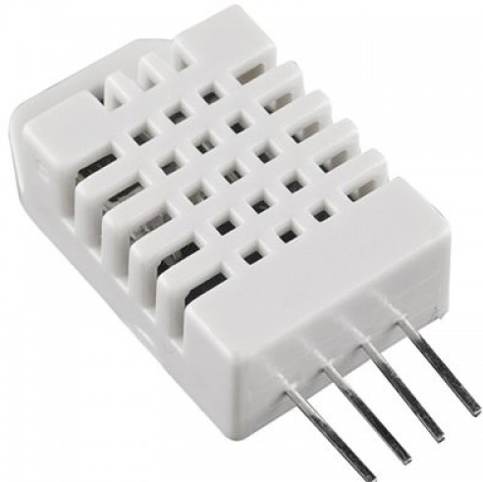
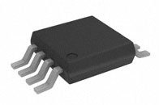
Temperature/Humidity Sensor
Component | DHT22 | AD7314
Temperature Reading | 40 – 80 °C | -35 – 85 °C
Operating Voltage | 5 V | 2.65 – 5.5 V
Max Current | 2.5 mA | 1.2 mA
DHT22
AD7314

Slide 9
RF Module
Solar
Panel
Power
Communication
MCU
Power Control
Peripherals
MCU
Sensor
Battery

Slide 10
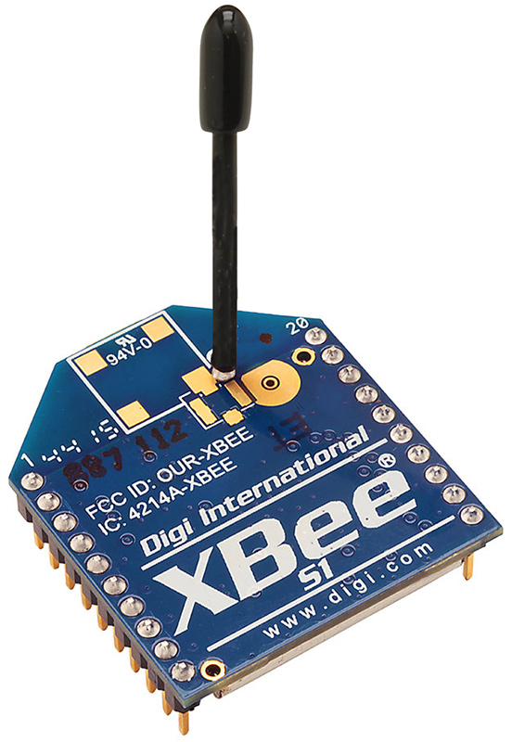
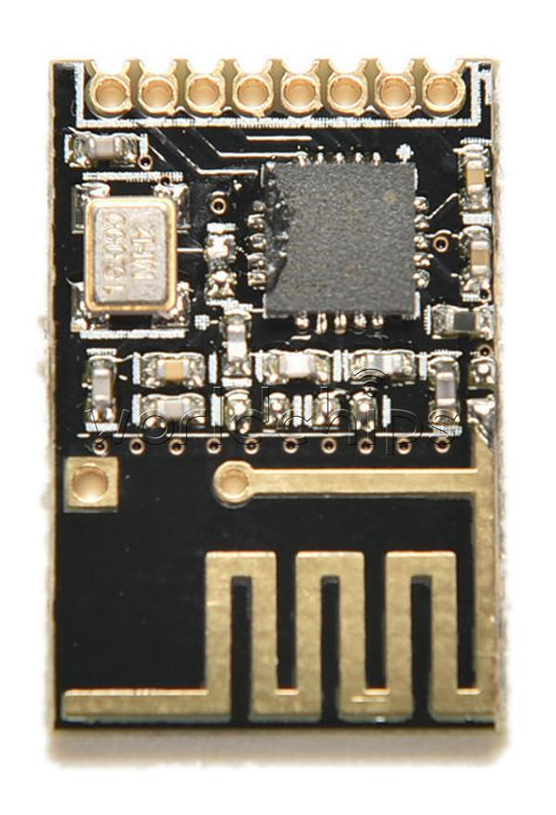
RF Module
Component | XBee | nRF24L01
Frequency | 2.4 GHz | 2.4 GHz
Size | 28 mm x 24 mm | 15 mm x 29 mm
Download Speed | 250 kbps | 256 kbps – 2 Mbps
Voltage | 2.8 – 3.4 V | 1.9 – 3.6 V
Range | 90 m | 100 m
Commercial Usage | Proprietary | Free License
XBee
nRF24L01

Slide 11
RF Module
Solar
Panel
Power
Communication
MCU
Power Control
Peripherals
MCU
Sensor
Battery

Slide 12
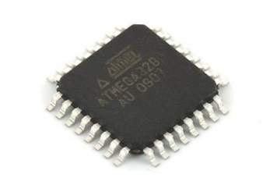
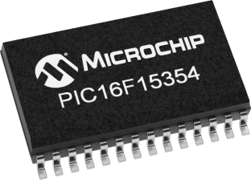
Microcontroller
Component | ATmega328P-AU | PIC16F15354 | BASIC Stamp 2
Frequency | 20 MHz | 32 MHz | 20 MHz
Program Memory | 32 kB | 14 kB | 2 kB
Data RAM | 2 kB | 1 kB | 32 B
Operating Voltage Range | 1.8 – 5.5 V | 1.8 – 5.5 V | 5 – 15 V
ATmega328P-AU
PIC16F15354
BASIC Stamp 2

Slide 13
RF Module
Solar
Panel
Power
Communication
MCU
Power Control
Peripherals
MCU
Sensor
Battery

Slide 14
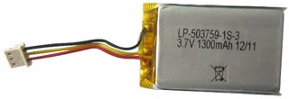
Battery
Component | 18650 Li-Ion | LP-503759-IS-3
Supply Voltage | 7.4 V | 3.7 V
Charge Capacity | 1800 mAH | 1350 mAH
18650 Li-Ion
LP-503759-IS-3

Slide 15
RF Module
Solar
Panel
Power
Communication
MCU
Power Control
Peripherals
MCU
Sensor
Battery

Slide 16
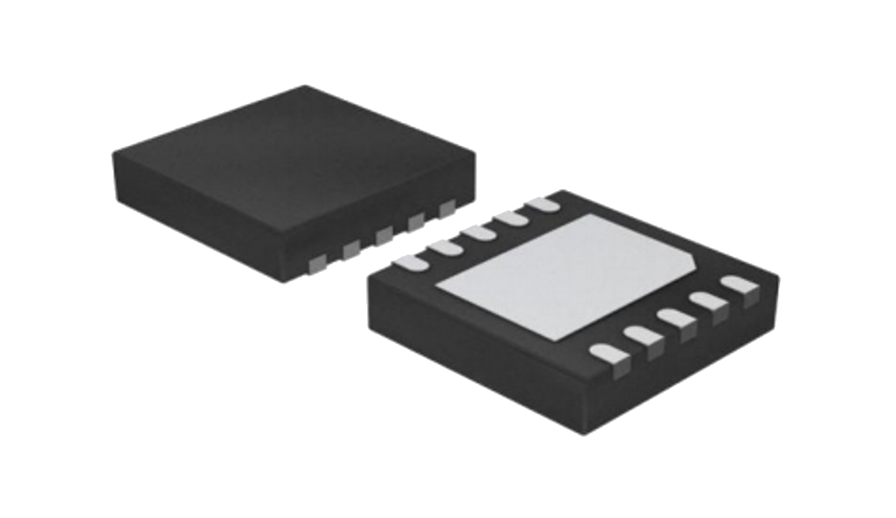
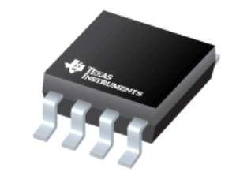
Charge Controller
Component | LTC4079 | bq2057
Input Voltage Max | 60 V | 18 V
Charge Current | 250 mA | 40 mA
LTC4079
bq2057
Notes:
Why We Chose It:
-Powerful
-Strong

Slide 17
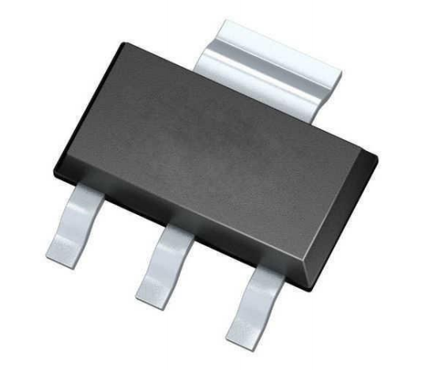
Voltage Regulator
Component | LM1117 | 7805 TO-220
Input Voltage Range | 7 – 20 V | 7 – 35 V
Output Voltage | 5 V/3.3V | 5 V
Max Current | 800 mA | 1.5 A
LM1117
7805 TO-220

Slide 18
RF Module
Solar
Panel
Power
Communication
MCU
Power Control
Peripherals
MCU
Sensor
Battery

Slide 19
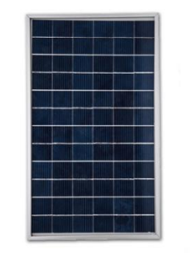
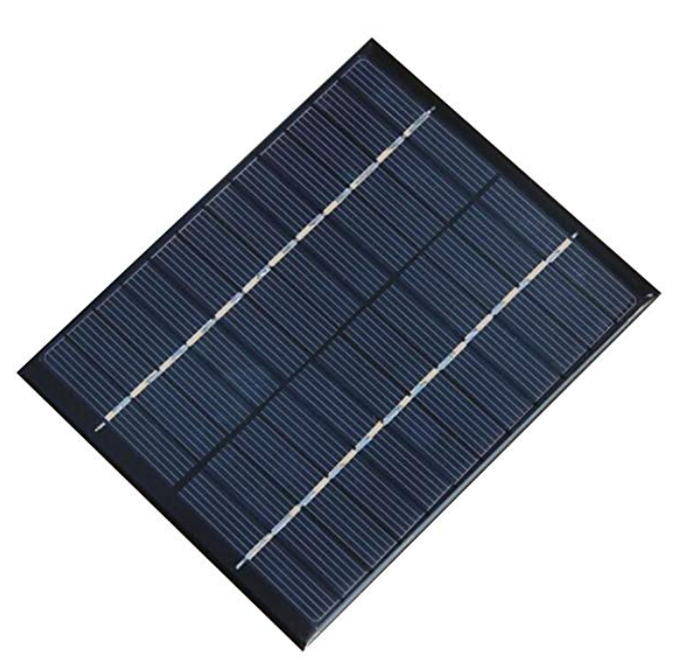
Solar Panel
Component | ECOWORTHY | NUZAMAS
Power | 5 W | 2 W
V_{op} | 17.9 V | 12 V
I_{op} | 0.28 A | 0.160 A
Dimensions | 10 x 7.6 in | 5.35 x 4.33 in
ECOWORTHY
NUZAMAS
Notes:
Why We Chose It:
-Powerful
-Strong

Slide 20
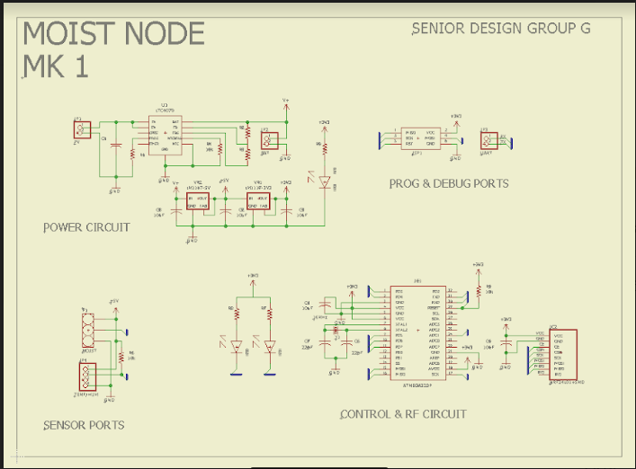
Node Circuit Schematic

Slide 21
Power
Communication
MCU
Peripherals

Slide 22
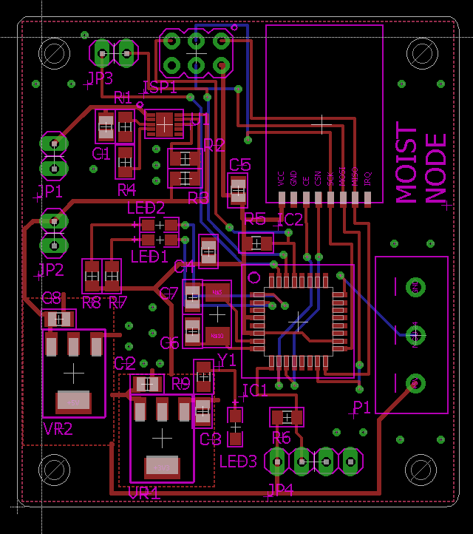
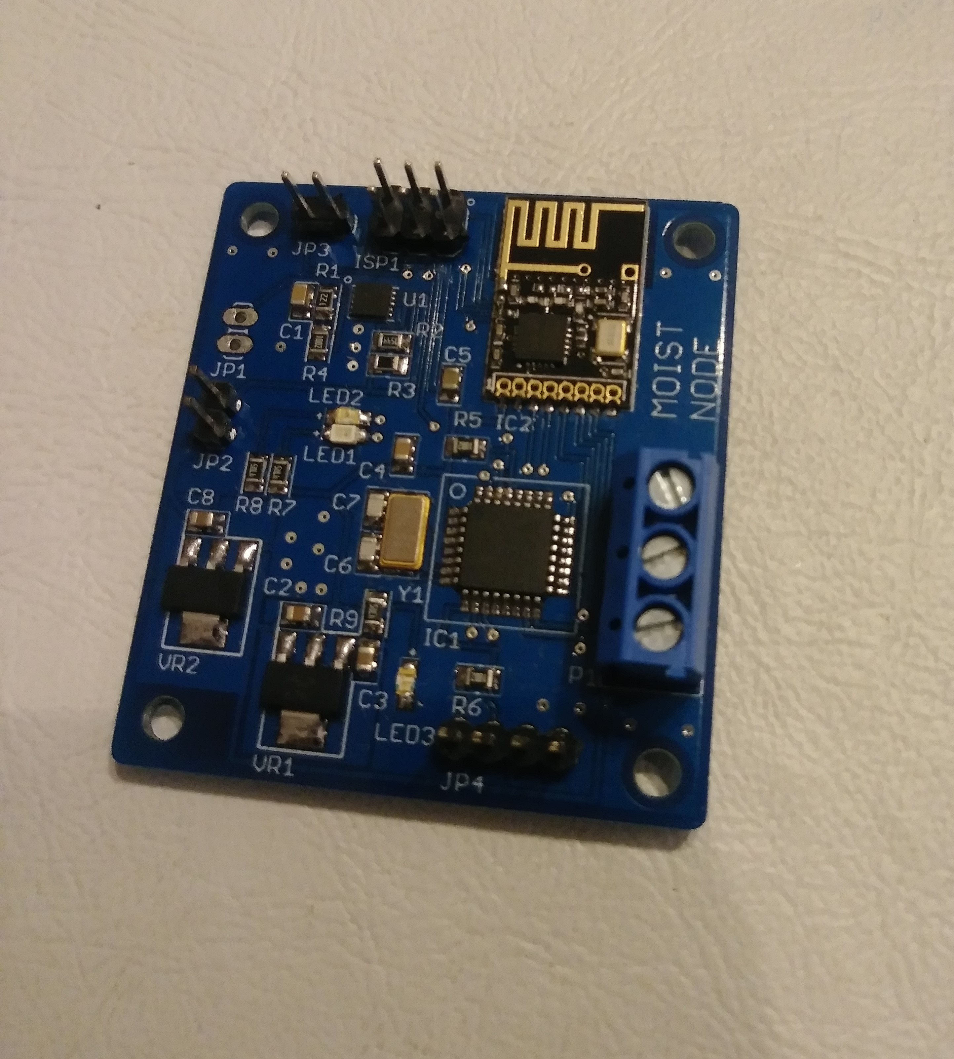
Node PCB Design

Slide 23
GPS Module
Node
GPS Block
Diagram
GPS Module
Node

Slide 24
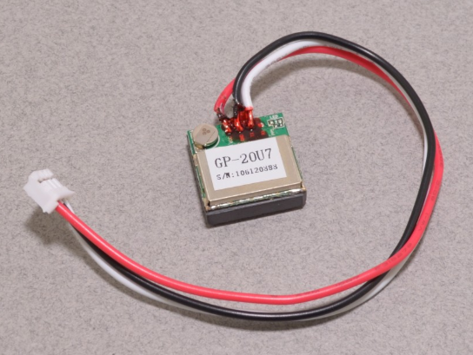
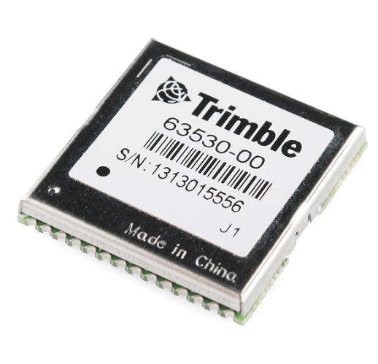
GPS Module
Component | GP-20U7 | Trimble Copernicus II
Input Voltage | 3.3 V | 2.7-3.3 V
Interface | UART | UART
Current Draw | 40 mA | 44 mA
Start Time | 29 s | 38 s
Frequency | 1.575 GHz | 1.575 GHz
GP-20U7
Copernicus II
Notes:
Why We Chose It:
-Powerful
-Strong

Slide 25
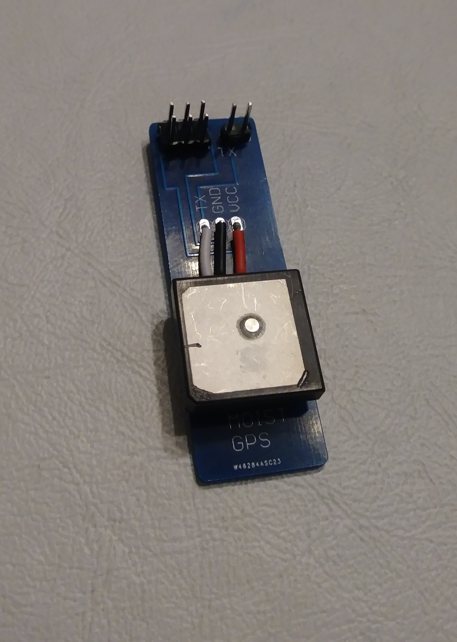
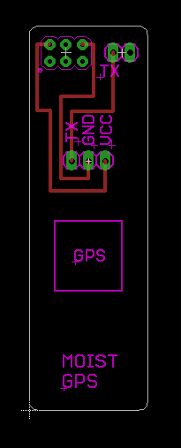
GPS PCB Design

Slide 26
RF Module
Web-App
Software
Communication
Computer
Gateway Block Diagram
Server
API’s
Database

Slide 27
RF Module
Web-App
Software
Communication
Computer
Server
API’s
Database

Slide 28
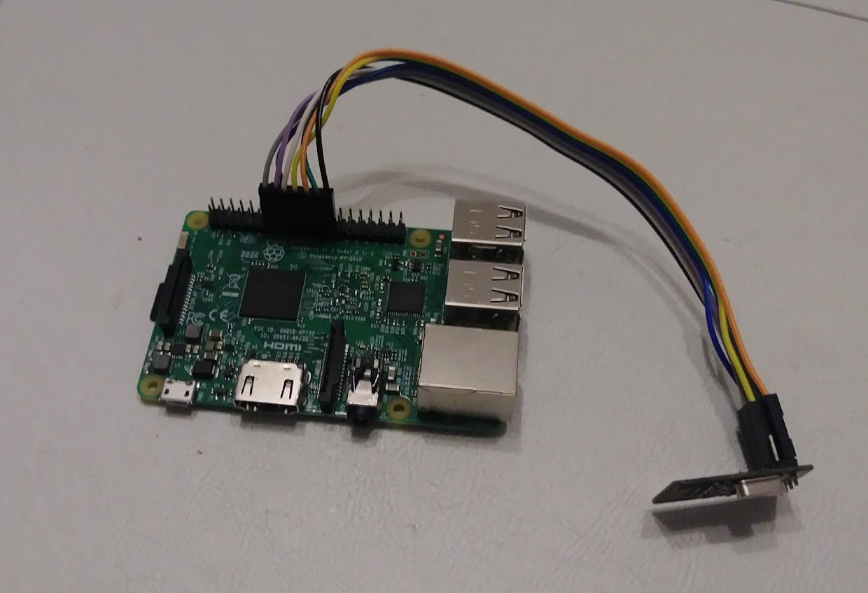
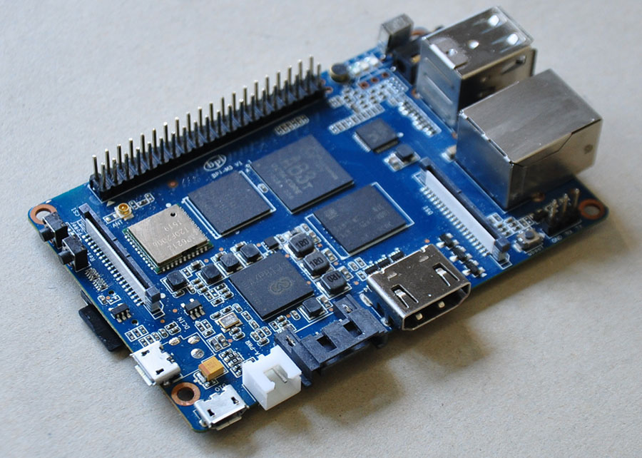
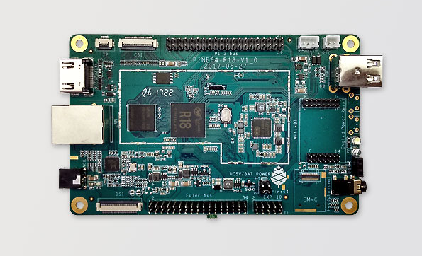
Embedded Server
Component | Raspberry Pi 3 B | Banana Pi M3 | Pine 64
RAM | 1 GB | 2 GB | 512 MB
Extra Storage | microSD | 8 GB eMMC | microSD
CPU | 1.2 GHz | 1.8 GHz | 1.2 GHz
WLAN | 802.11 n | 802.11 n/g/b | 802.11 n/g/b
External Attachments | 40 GPIO pins 4 USB ports | 40 GPIO pins 2 USB ports | 40 GPIO pins 2 USB ports
Raspberry Pi 3 B
Banana Pi M3
Pine64

Slide 29
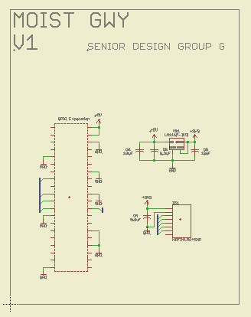
Gateway Shield Schematic

Slide 30
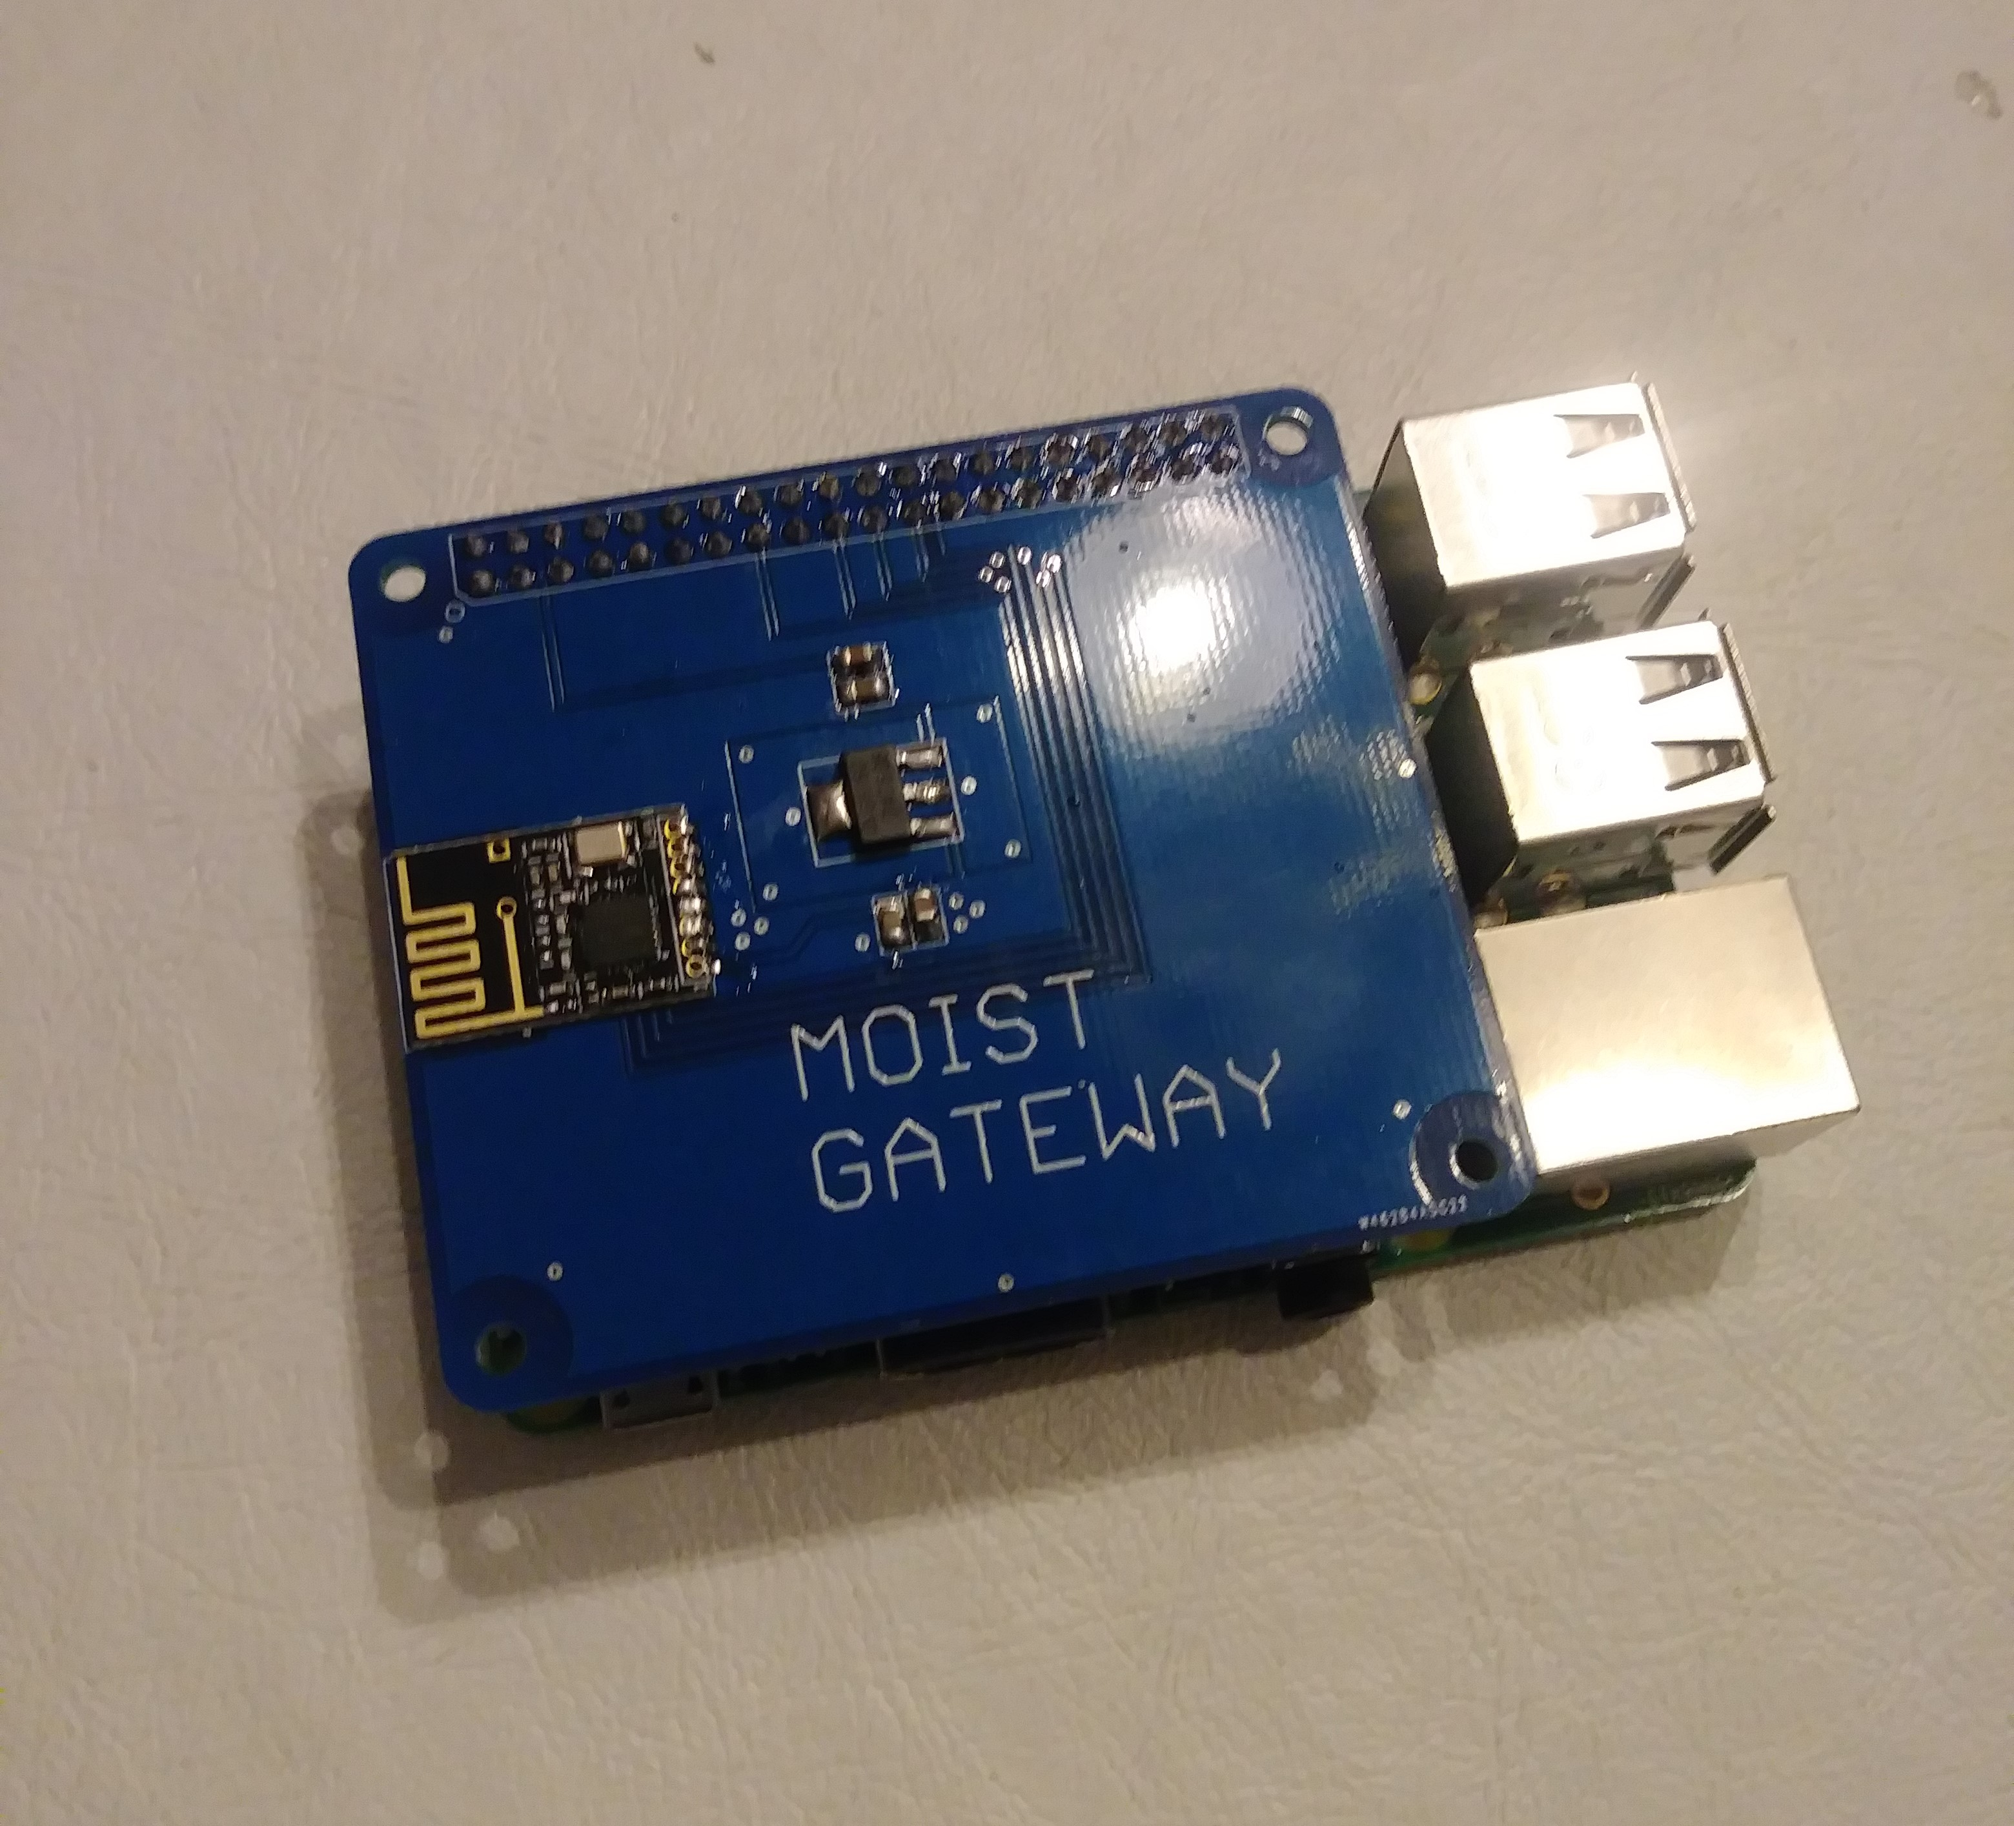
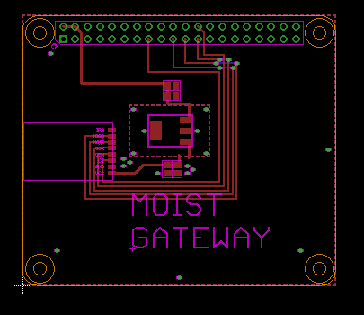
Gateway PCB Design

Slide 31
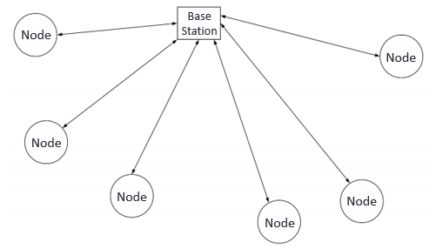
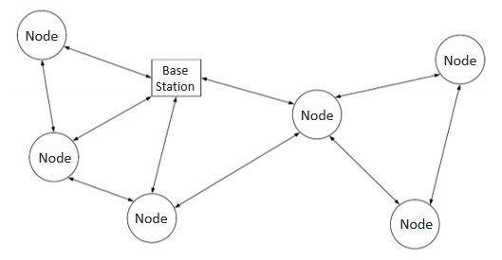
Network Topology
Star Network
Mesh Network

Slide 32
RF Module
Web-App
Software
Communication
Gateway
Solenoid
Server
API’s
Database

Slide 33
API Diagram
Front-End
Back-End
Database
Linux,
Apache
C++
Python
PHP,
HTML
MySQL
Notes:
-UI
-Status
-Commands

Slide 34
RF Module
Web-App
Software
Communication
Gateway
Server
API’s
Database

Slide 35
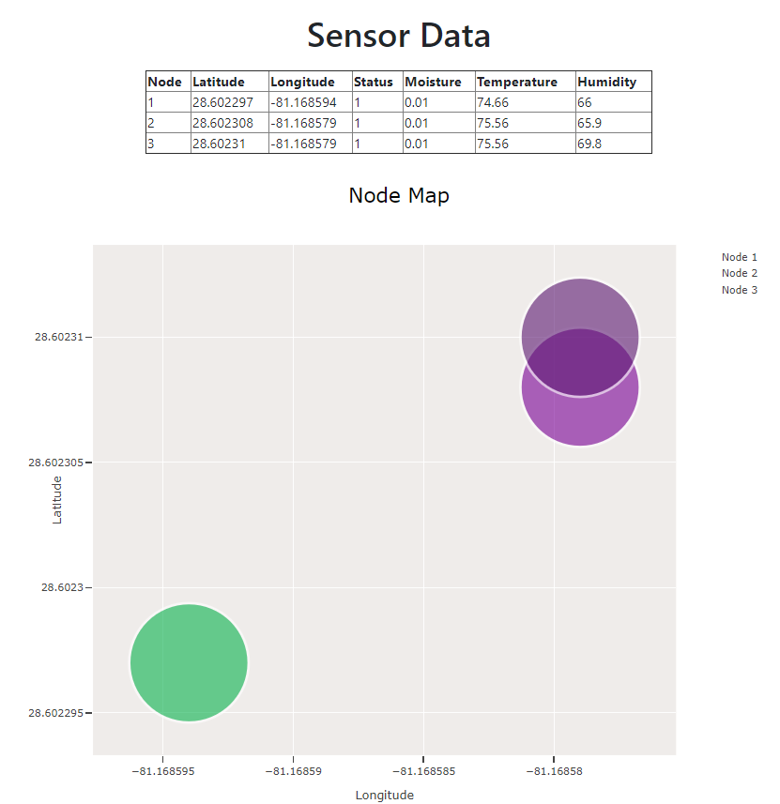
Web Page

Slide 36
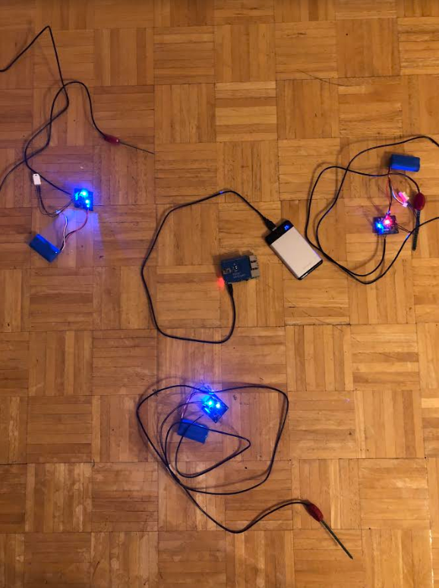
MOIST Setup

Slide 37
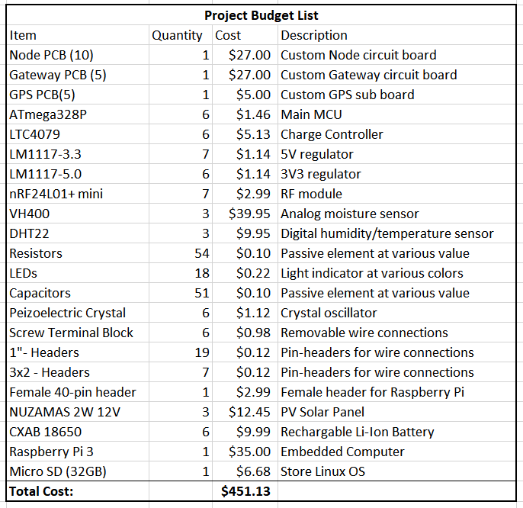

Slide 38
Work Distribution
 | Nodes | Communications/Control | Web-App/Database | Power
Ahmed | P | P | S | S
Elange | S | S | S | P
Gabe | S | S | P | S

Slide 39
Future Plans
Enclosure
Improved UI
Improved Network

Slide 40
Questions?

