Slide 1
Group A
Damo Park EE
Greg Mueth CpE
Mhelith Natavio CpE

Slide 2
Goals and Objectives
Key Fob
WIFI Integration
Status Indicator
Added Security - https, token
Easy Installation

Slide 3
Motivations
Cost
Convenience
Disabilities/Injuries
Misplaced/forgotten/lost/stolen keys

Slide 4
Engineering Requirements
System Requirements
 | Target | Actual | Comment
KeyFob Range | 1m | > 2m | Usability
Signal Frequency | > 350MHz | 433MHz | High powered signal
Supply Voltage | > 5V | 6V | Microcontroller VCC
Button/ KeyFob Latency | < 1 second | < 1 second | Usability
Mobile Latency | > 5 seconds | > 2 seconds | Usability
Battery Life | > 168 hours | 10 hours currently 3 months with low power | Cannot consume excessive amounts of power
Size of door module | 25cm x 7cm x 4cm | 14cm x 14cm x 6cm | For goal of not being unnecessarily large

Slide 5
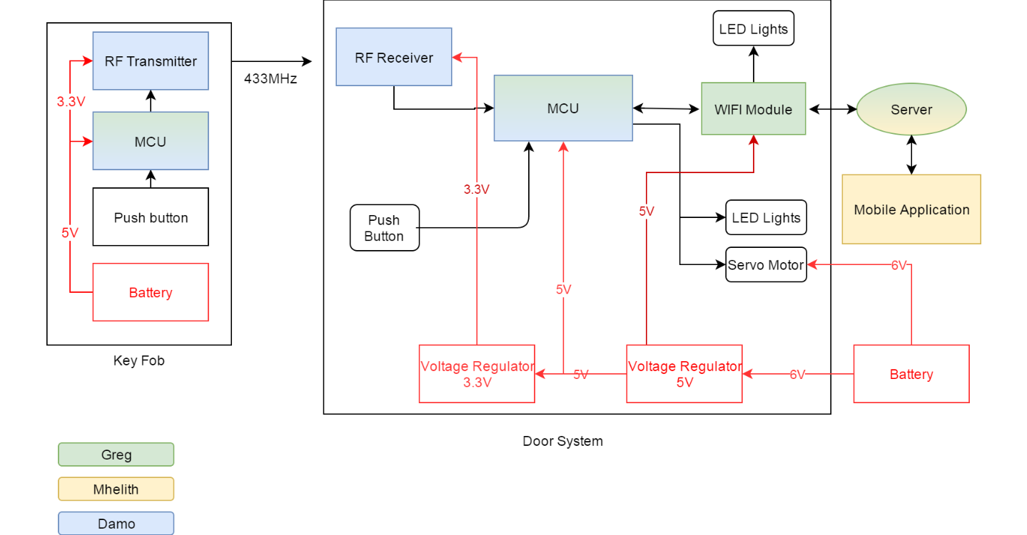
Block Diagram

Slide 6
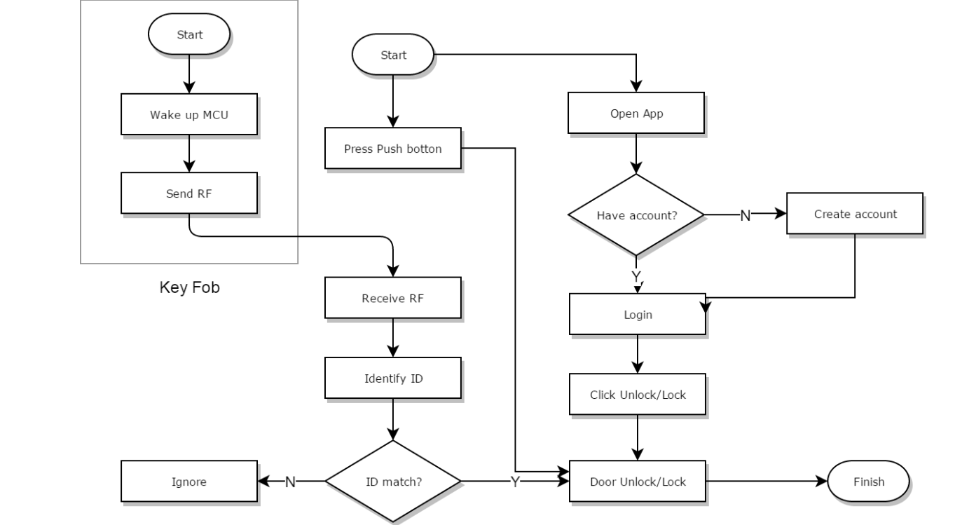
Operational Flow Chart
Notes:
Alright, here a operation flow chart.
There are Three ways to unlock/lock the door.
User can open with key fob or the button inside of the house and mobile application.
For using key fob, once user press button then the MCU on key fob will send radio signal through transceiver to the door module. Dooe module will recognize the signal, if it is match then the door will be locked or unlocked.
Also, there is a push button inside of the house. The button is connected to the WIFI module, once it is pressed, WIFI module will send singnal to the door module to lock or unlocked the door. At same time, WIFI module will update the statue to server.
Using mobile app, it will ask for account, after creation, the user can lock or unlock the door.

Slide 7
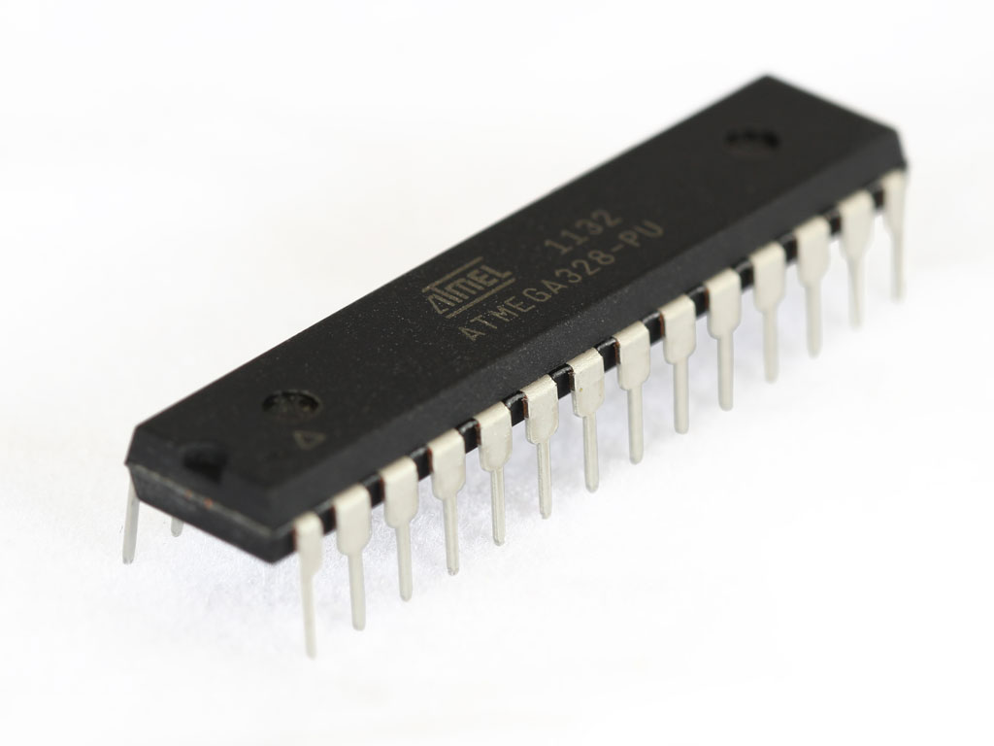
Microcontroller
ATMEGA328P
Familiarity
Extensive doccumentation
ISP with Arduino Uno
2 external interrupt pins
UART
MSP430g2553
Familiarity
Less widespread than ATMEGA
UART
ATMEGA328 Specifications
Cost | $4.00
Low Power Mode Current | .75uA (low power mode)
Performance | 20MHz
Memory | 32kB
MSP430 Specifications
Cost | $4.00
LPM4 Current | .1uA
Performance | 16MHz
Memory | 16kB

Slide 8
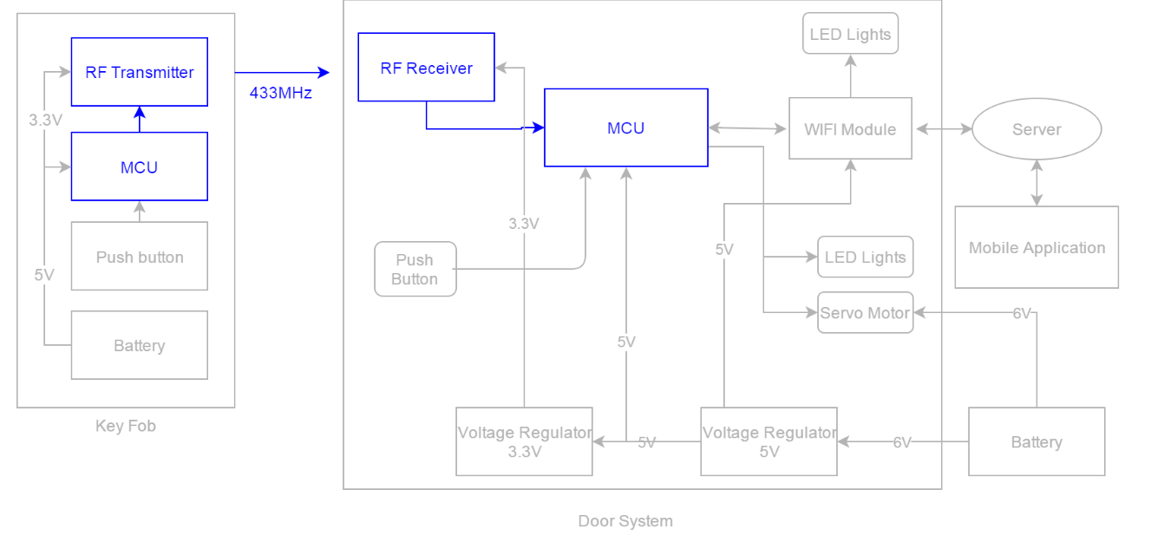
Keyless Entry Block Diagram
Notes:
Here is keyelss entry block diagram
Two microcontroller will be able to communicate through the transceivers.
There is a push botton on Key fob which is connected to MCU. once the user press that button, the MCU will send signal through transceiver. The MCU at the door module will recognize the signal, the door will be locked or unlocked.

Slide 9
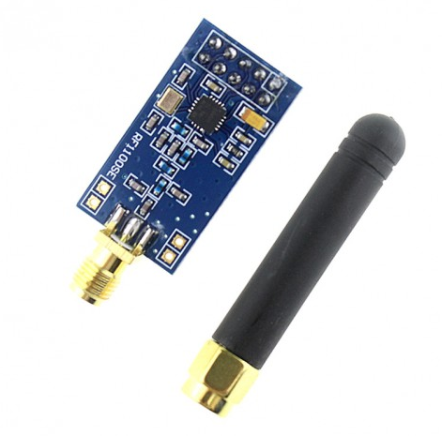
Keyless Entry High Frequency Transceiver
CC1101 RF Transceiver
Feature
Low power Voltage
Low Power Consumption
Wide Frequency Range
Purpose:
To communicate with Door PCB and Key Fob.
Specification | Value
Supply Votlage | -0.3V - 3.9V
Current in Sleep Mode | 200nA
Frequency Range | 300mHz - 928MHz
Notes:
CC1101 can be easily programed for operation at specific frequency. The main operating parameters and the 64- byte transmit/receive FIFOs of CC1101 can be controlled via an SPI interface. In a typical system, the CC1101 will be used together with a microcontroller and a few additional passive components.

Slide 10
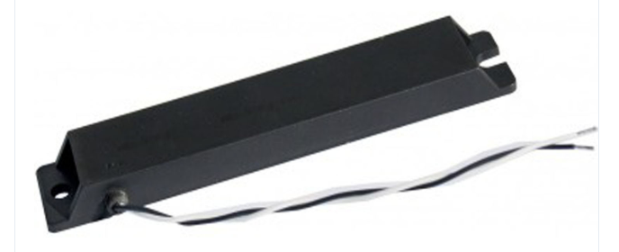
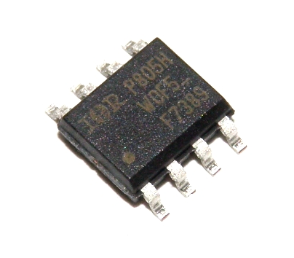
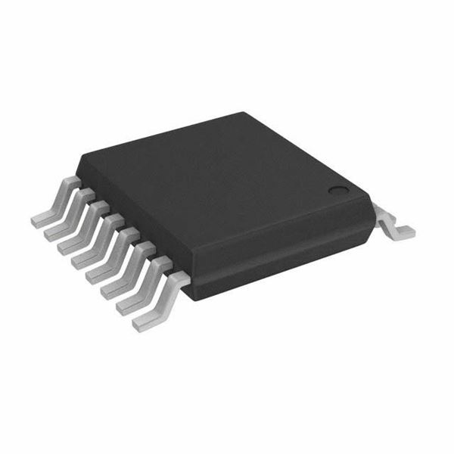
Low Frequency Transmitter/Receiver
KGEA-BFCR-B-0500J Antena
Transmitting low frequency
Low tolerance
Power mosfet IRF 7389
Consist of N mosfet and P mosfet
Fast switching speed
Low Frequency Wakeup Receiver : AS3933
Provides long range wake up
Enables long battery life
Eliminates false wakeup
Dimension : 145mmx26mmx12mm
Notes:
KGEA-BFCR-B-0500J antean is designed for transmitting low frequency as 20kHz, 125kHz, or 134kHz. Size of quite bigger than we expected.
It is really stable antena because it has low tolerance and high stability in temperature.
IRF 7389 is consist of n and p mosfet. Power mosfet will receive signal from microcontroller, and will be able to let power flow to LF antena to send signal.

Slide 11
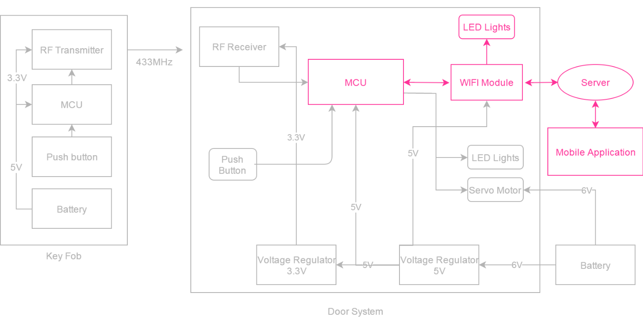
WiFi Integration Block Diagram

Slide 12
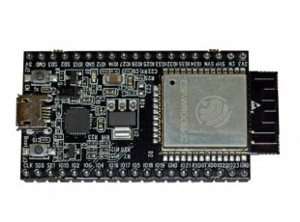
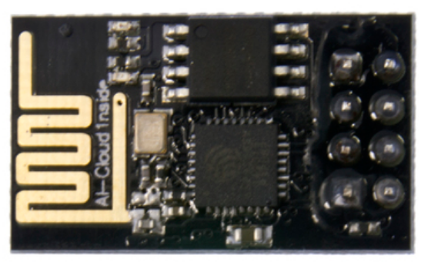
WIFI Module
Model: ESP32
Includes serial port to program directly
Has a multitude of GPIO pins
Has an extremely power efficient low power mode
More expensive than ESP8366
Larger than ESP8266
Model: ESP8266-01
Includes AT instruction set to complete HTTP requests
Can also be programmed directly with USB to UART converter
Communicates with via UART (9600 Baud)
ESP8266 Specifications
Dimensions | 25mm x 15mm
Cost | $4.00 per unit
Passive Current | .9mA
ESP32 Specifications
Dimensions | 570mm x 280mm
Cost | $12.00 per unit
Passive Current | .01mA

Slide 13
Server Back End
RESTful API
Node.js with Express framework
Familiarity
Node packages
Easy deployment
Validation with Joi
Error logging with Winston
Unit/Integration testing with Jest
Deployed on Digital Ocean Linux VM
Url purchased from GoDaddy
Certbot used to add https protocol
Endpoints secured with JSON webtokens

Slide 14
Mobile Application
Lower development cost
Open ended development language selection-- JAVA
Open Source with detailed explanations
Easily emulated for testing purposes
Easy debugging
Notes:
hdbvsdbv

Slide 15
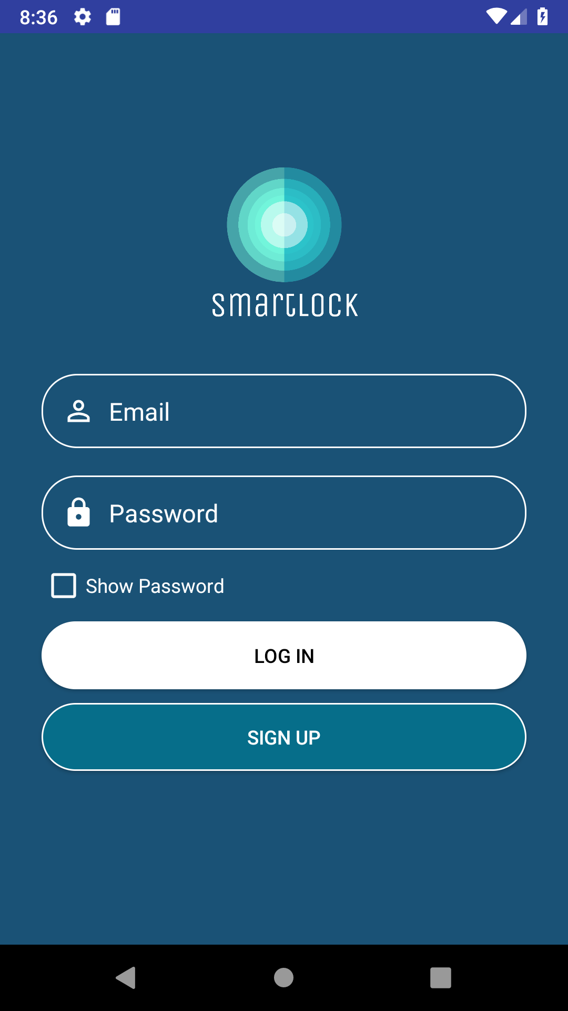
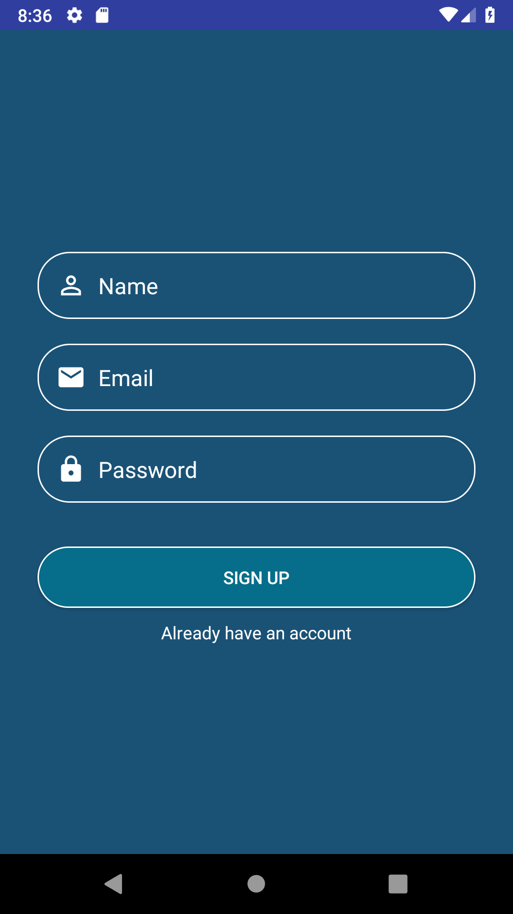
Mobile Application Features
Login
Unique username and password
Show password option
Register new account
Informations must be unique
LockID to connect to the system

Slide 16
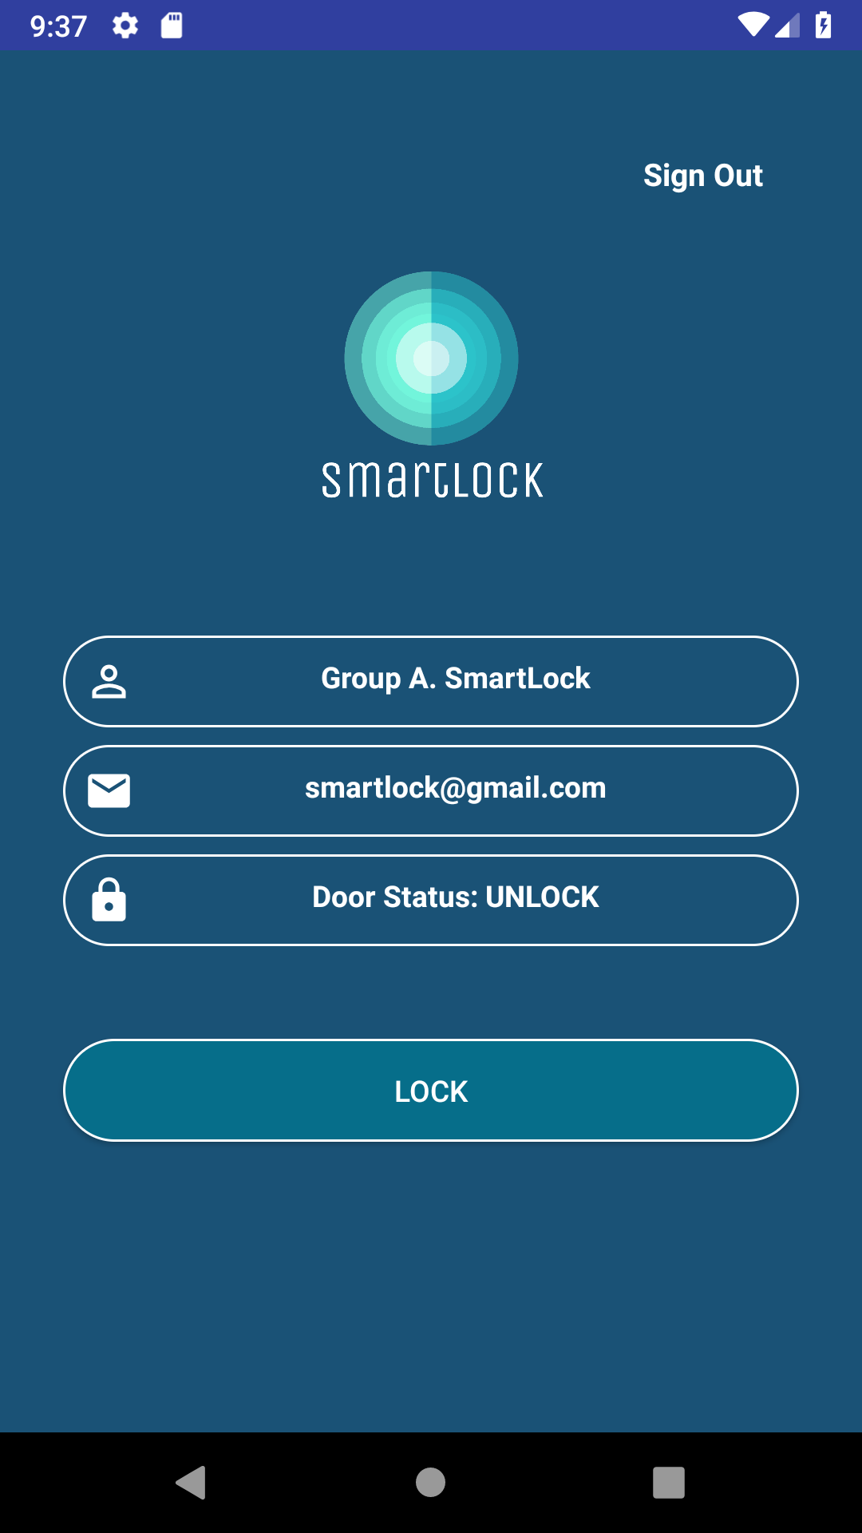
Mobile Application Feature
Displays
Name
Email
On time lock status
Sign Out link
Control
Lock/Unlock button
SmartLock Logo
Hatcful: online logo maker

Slide 17
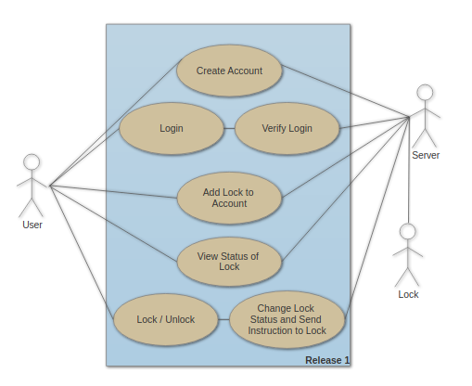
Use Case Diagram

Slide 18
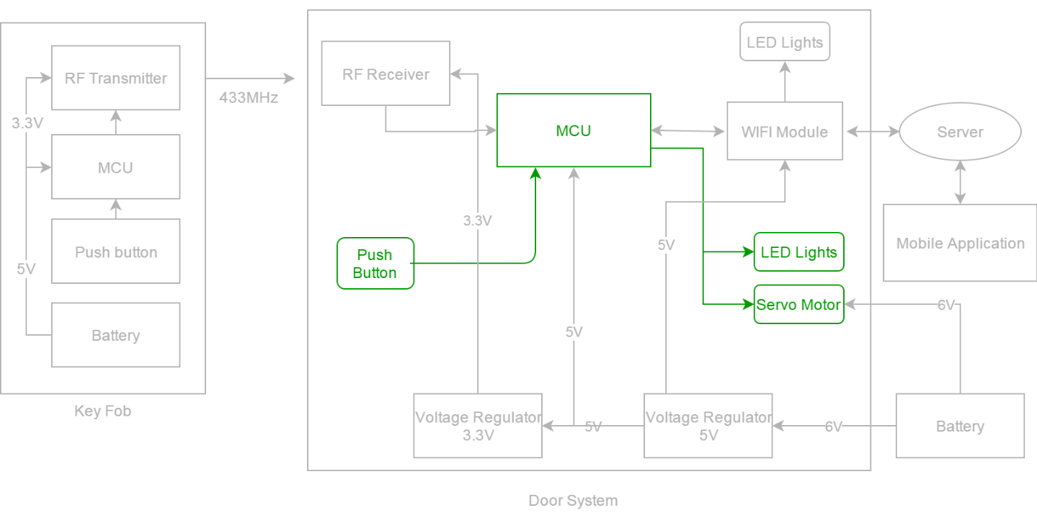
Additional Devices Block Diagram
Notes:
This block diagram shows our addional input output devices.
There is a indicating output devices and the LED light, which will be used red color.
Servo motor will be used the unlock or lock the deadbolt.
Bush button will be input device which can tell MCU if the door needs to unlock or lock.
Two LED indicators Green and Yellow will be used for statue of WIFi module.

Slide 19
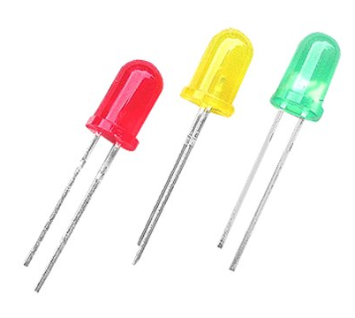
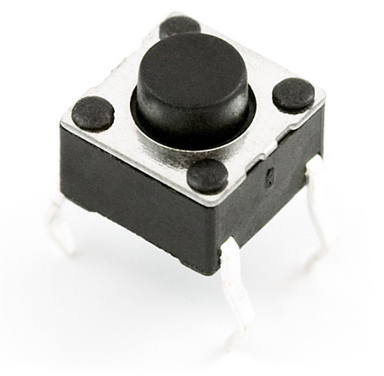
Indicating Devices/Input Button
Devices and Purposes
LEDs
Green : Connecting
Yellow: Connected
Red : ON - Unlocked / OFF - Locked
Input Button
Installed on door PCB
Use for unlock/lock the door
Notes:
Three LED lights will be used as indicator.
If Green is on, the WIFI is trying to connect with server, if Yellow is on the WIFI is conncected with server.

Slide 20
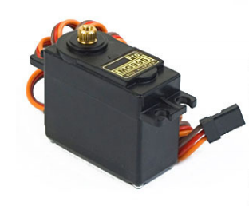
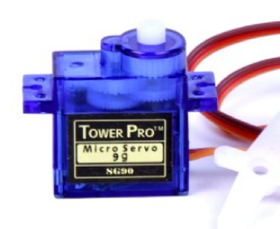
Servo Motor
Purpose
Using Servo motor, Door can be opened or closed.
TowerPro MG995R Metal Gear Servo SG90
Specifications
Cost | $9.90
Torque | 10kgfcm
Rotation | 120 degree
Weight | 55g
Operationg Voltage | 4.8V to 7.2V
PWM Period | 20ms
Specifications
Cost | $5.95
Torque | 2.5kgfcm
Rotation | 120 degree
Weight | 14.7g
Operationg Voltage | 4.6V to 6V
PWM Period | 20ms
Dimension: 40.7 x 19.7 x 42.9 mm approx
Dimension: 23 x 12 x 19.5 mm approx
Notes:
This is our servo motor will be used, towerpro mg995. The servo motor will be used to unlock or lock the deadbolt.
It can be operated between 4.8V and 7.2V voltage, the servo motor will be able to work properly powered by the main power source,6V.
It is able to rotate 120degree which will be enough to lock or unlock the deadbolt. Has enough torque 10kgfcm to rotate the deadbolt.

Slide 21
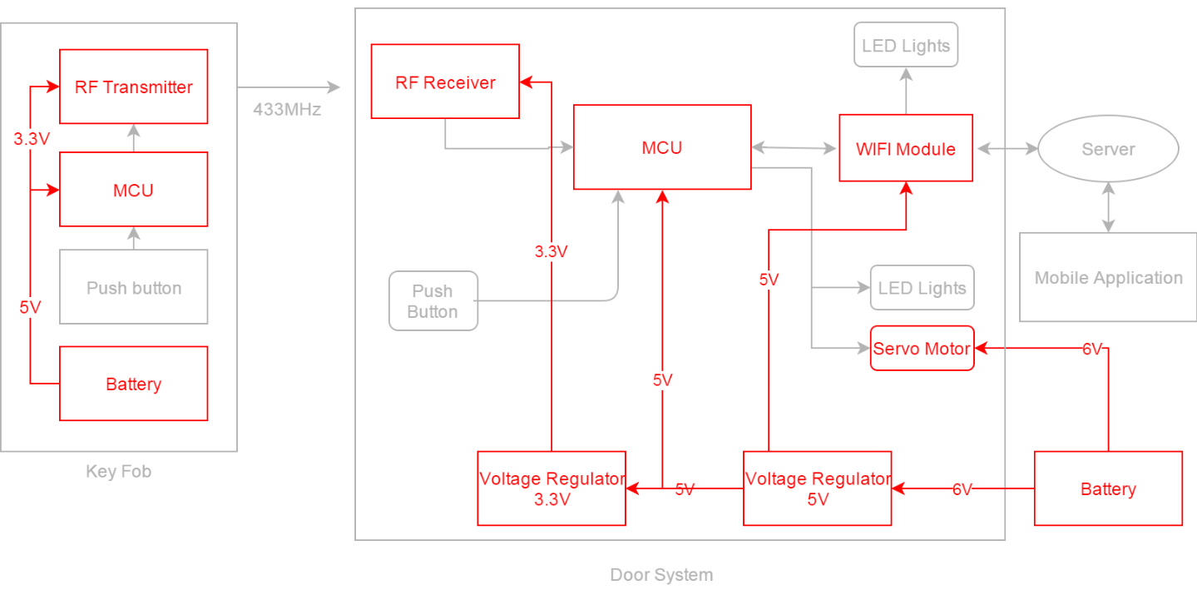
Power Flow Block Diagram

Slide 22
Power
Door PCB Battery : AA 1.5V x 4, 2CR5 (6V)
Key Fob Battery : CR2023 x 2 (6V)
5V regulator voltage: LM1117-5.0
3.3V regulator voltage : LM1117-3.3
Voltage | 6V | 5V | 3.3V
Components | Servo Motor | LED MCU for door WIFI module | LF transceiver RF transceiver

Slide 23
Door Schematic_Original

Slide 24
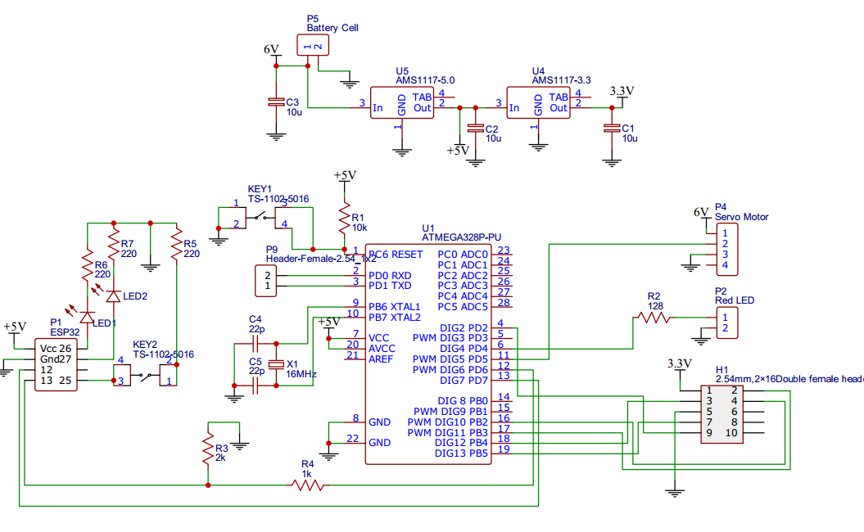
Door Schematic_Final

Slide 25
Key Fob Schematic_Original

Slide 26
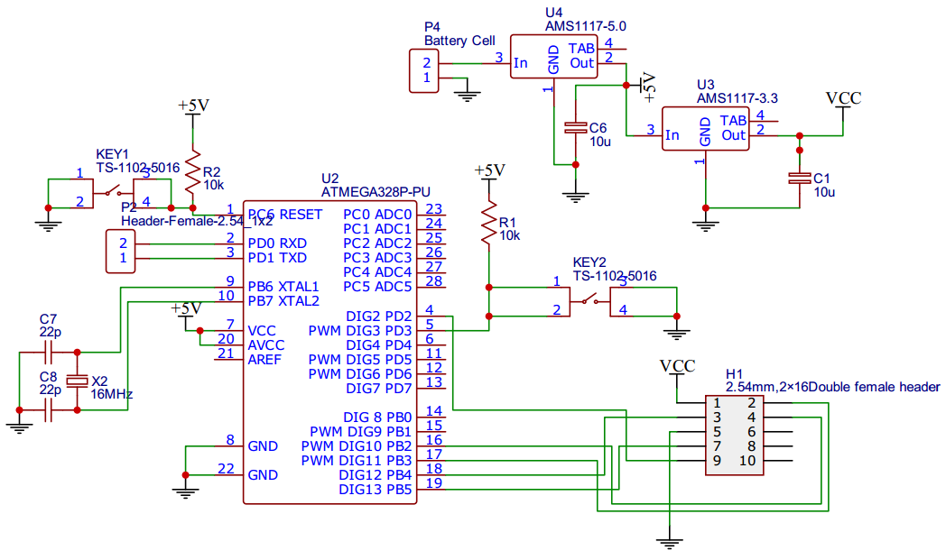
Key Fob Schematic_Final

Slide 27
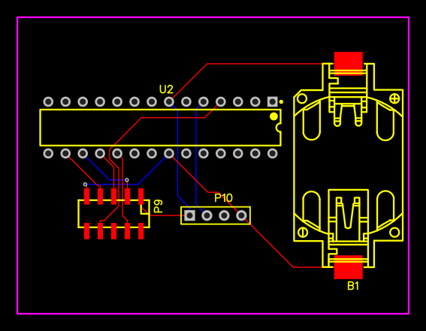
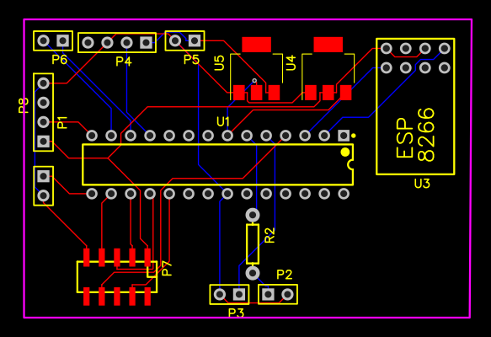
PCB Layout_Original
Key Fob
Main Door

Slide 28
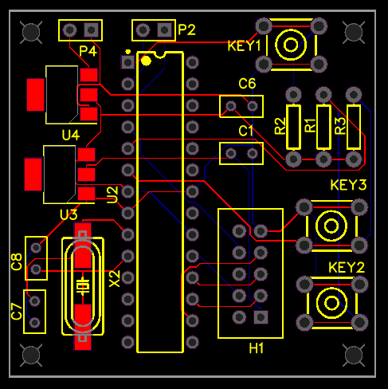
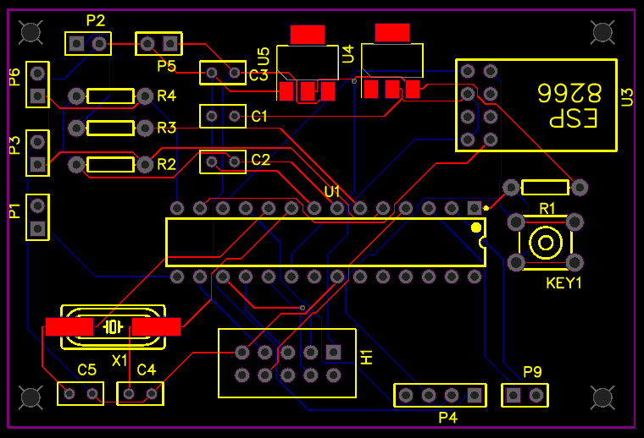
PCB Layout_Final
Key Fob
Main Door

Slide 29
Administrative Content

Slide 30
Work Distribution
 | Hardware Design | Mobile Application front end | Server backend | Embedded Programming
Damo Park | P |  |  | S
Greg Mueth | s | s | P | P
Mhelith Natavio |  | P | s

Slide 31
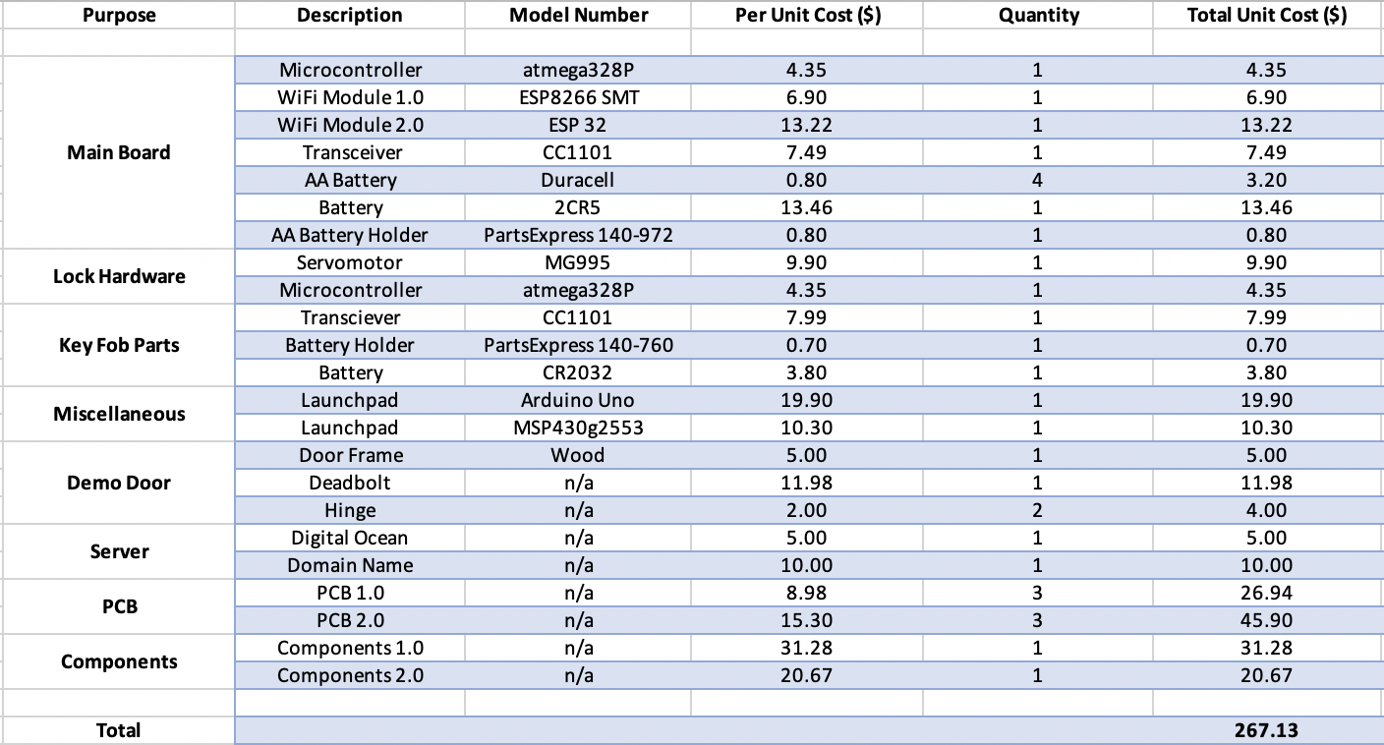
Development Budget
*
total cost is evenly distributed among members

Slide 32
Cost Per Unit

Slide 33
Learning Experiences
Low frequency 125kHz “wake up” signal
High frequency tranceiver (cc1101) library
Passive power consumption

Slide 34
Questions?

