Slide 1
SmartLock
Group A
Damo Park EE
Greg Mueth CpE
Mhelith Natavio CpE

Slide 2
Goals and Objectives
Keyless entry using a key fob (similar function to automobiles)
Wifi integration and mobile Android application
Interface mobile application lock and unlock through Internet
Mobile application shows current status of lock and logs
Optional push notifications locking action is completed
Status Indicator
Indicator LED lights for lock/unlock statuses
Unique tune indicating locking/unlocking the door
Added Security
Deadbolt automatically locks on closing after certain amount of time
Door unlock warning
Must fit existing door frames and be easy to install
Must not be larger than necessary or overly bulky/misshapen

Slide 3
Motivations
Lower cost alternative to marketplace products
Easy locking/unlocking of a door
Both hands are unavailable
People with disability or injured hand(s)
Misplaced/forgotten/lost/stolen keys
Checking whether the door is locked or not

Slide 4
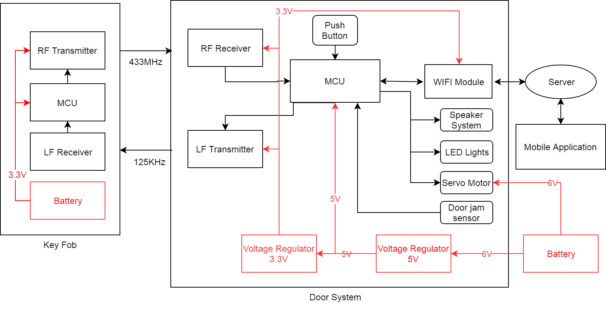
Block Diagram

Slide 5
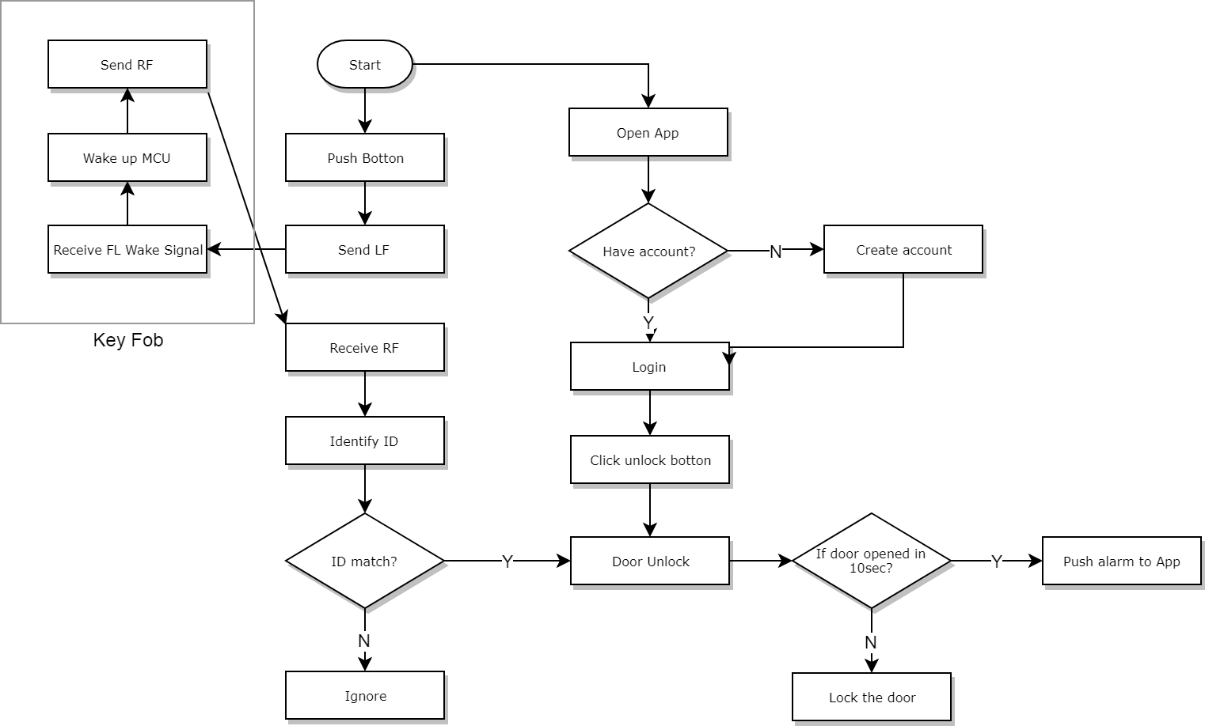
Operational Flow Chart D
LF
Notes:
Alright, here a operation flow chart.
There are two ways to unlock deadbolt, by pusing botton or using application.
Once the user push the botton, the microcontroller at main PCB will send low qrequency wake up signal to the key fob.
The low frequency receiver will receive the signal, the microcontroller at key fob will send radio frequency.
The radio frequecy transceiver at the main PCB will receive the signal, and identify ID.
If the ID is match, the dead bolt will be unlock, if the ID is not match, the door not gonna unlocked.
Using the app, once the user open the application, the user will be asked to login. If the user has account, user just can login, if not, user will create the account and then login.
By clicking unlock botton in the app the deadbolt will be unlocked.
One of the feature is even though the deadbolt is unlocked but the user do not open the door, the microcontroller will recognized by the door jamb sensor. The deadbolt will be locked automatically after few second.

Slide 6
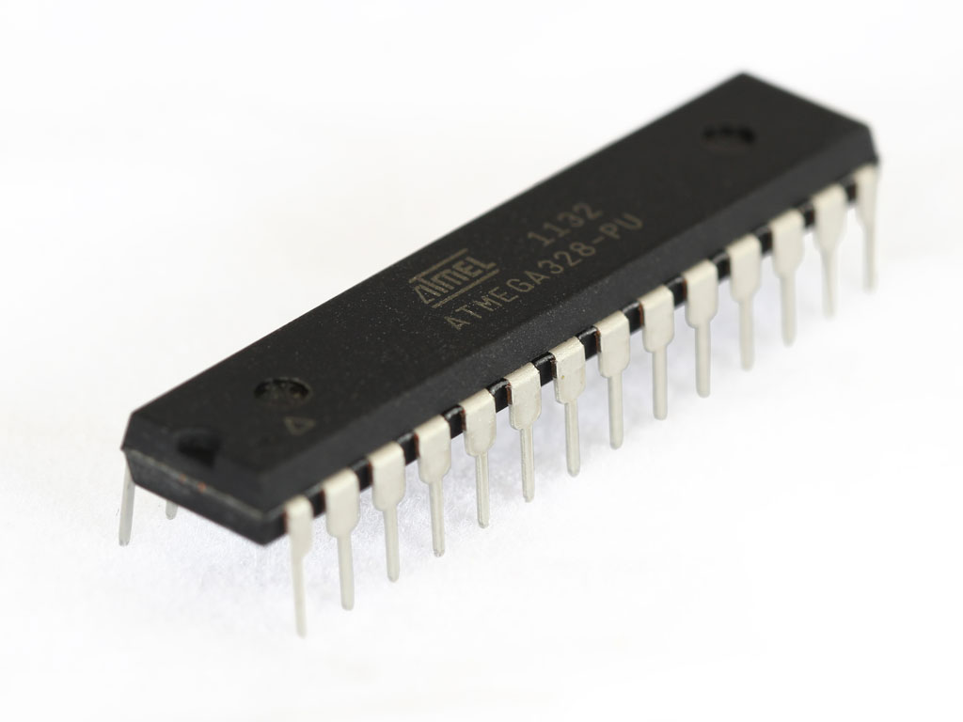
Microcontroller
ATMEGA328P
Familiarity
Extensive doccumentation
ISP with Arduino
External interrupts
UART
Specifications
Cost | $4.00
Power | .75uA (low power mode)
Performance | 20MHz
Memory | 32kB

Slide 7
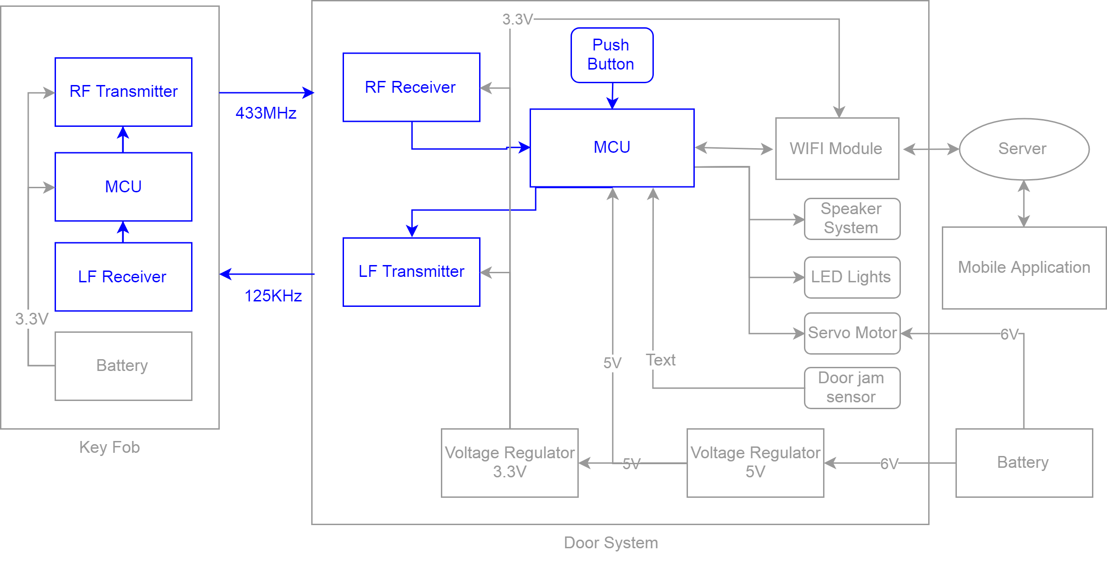
Keyless Entry Block Diagram
Notes:
Here is keyelss entry block diagram
Two microcontroller will be able to communicate through the transceivers.
Push botton is input device of main PCB, will be able to let microcontroller send signal.
Low frequency transmitter and receiver communicate in range of 125kHz.
Radio frequency transceiver will send or receive data in frequency range of 433Mhz

Slide 8
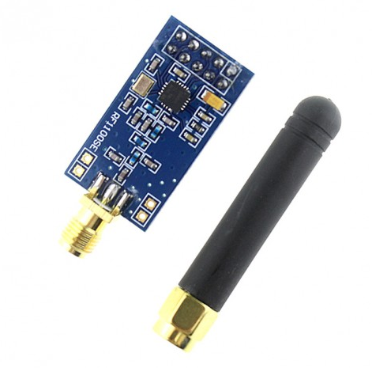
Keyless Entry High Frequency Transceiver
CC1101 RF Transceiver
Features
Low Voltage
Low Power Consumption.
Supply Voltage : -0.3V - 3.9V
200nA in Sleep mode
Transmission
Frequency range : 300mHz to 928Mhz
Purpose: Using 433MHz frequency band, door module is able to recognize key fob by reading RF.
Key Fob
Door Module
433MHz
Notes:
CC1101 can be easily programed for operation at specific frequency. The main operating parameters and the 64- byte transmit/receive FIFOs of CC1101 can be controlled via an SPI interface. In a typical system, the CC1101 will be used together with a microcontroller and a few additional passive components.

Slide 9
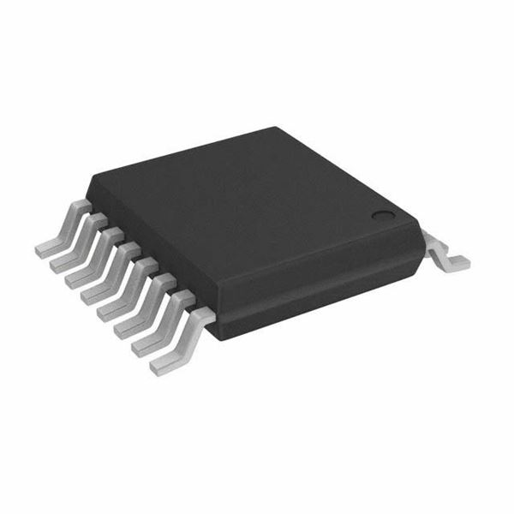
Low Frequency Wakeup Receiver
AS3933
Provides long range wake up
Enables long battery life
Eliminates false wakeup
Specifications
Listening Mode Power | 2.3uA
Wake up sensitivity | 225uV
Supply Voltage | 2.4V - 3.6V
Cost | $5.48
Frequency Range | 15 - 150kHz

Slide 10
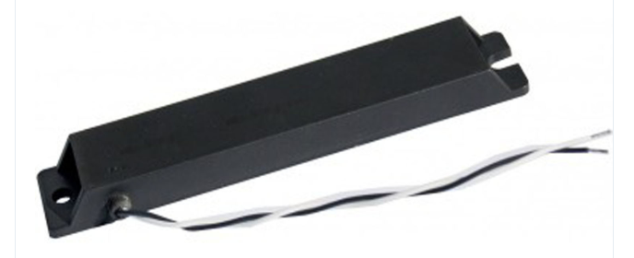
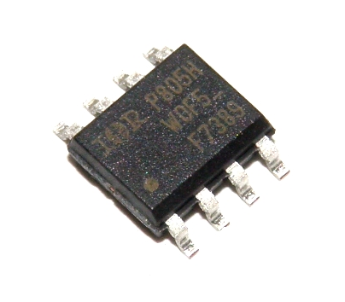
Low Frequency Transmitter
KGEA-BFCR-B-0500J Antena
Transmitting low frequency
Low tolerance
Power mosfet IRF 7389
Consist of N mosfet and P mosfet
Fast switching speed
Dimension : 145mmx26mmx12mm
Notes:
KGEA-BFCR-B-0500J antean is designed for transmitting low frequency as 20kHz, 125kHz, or 134kHz. Size of quite bigger than we expected.
It is really stable antena because it has low tolerance and high stability in temperature.
IRF 7389 is consist of n and p mosfet. Power mosfet will receive signal from microcontroller, and will be able to let power flow to LF antena to send signal.

Slide 11
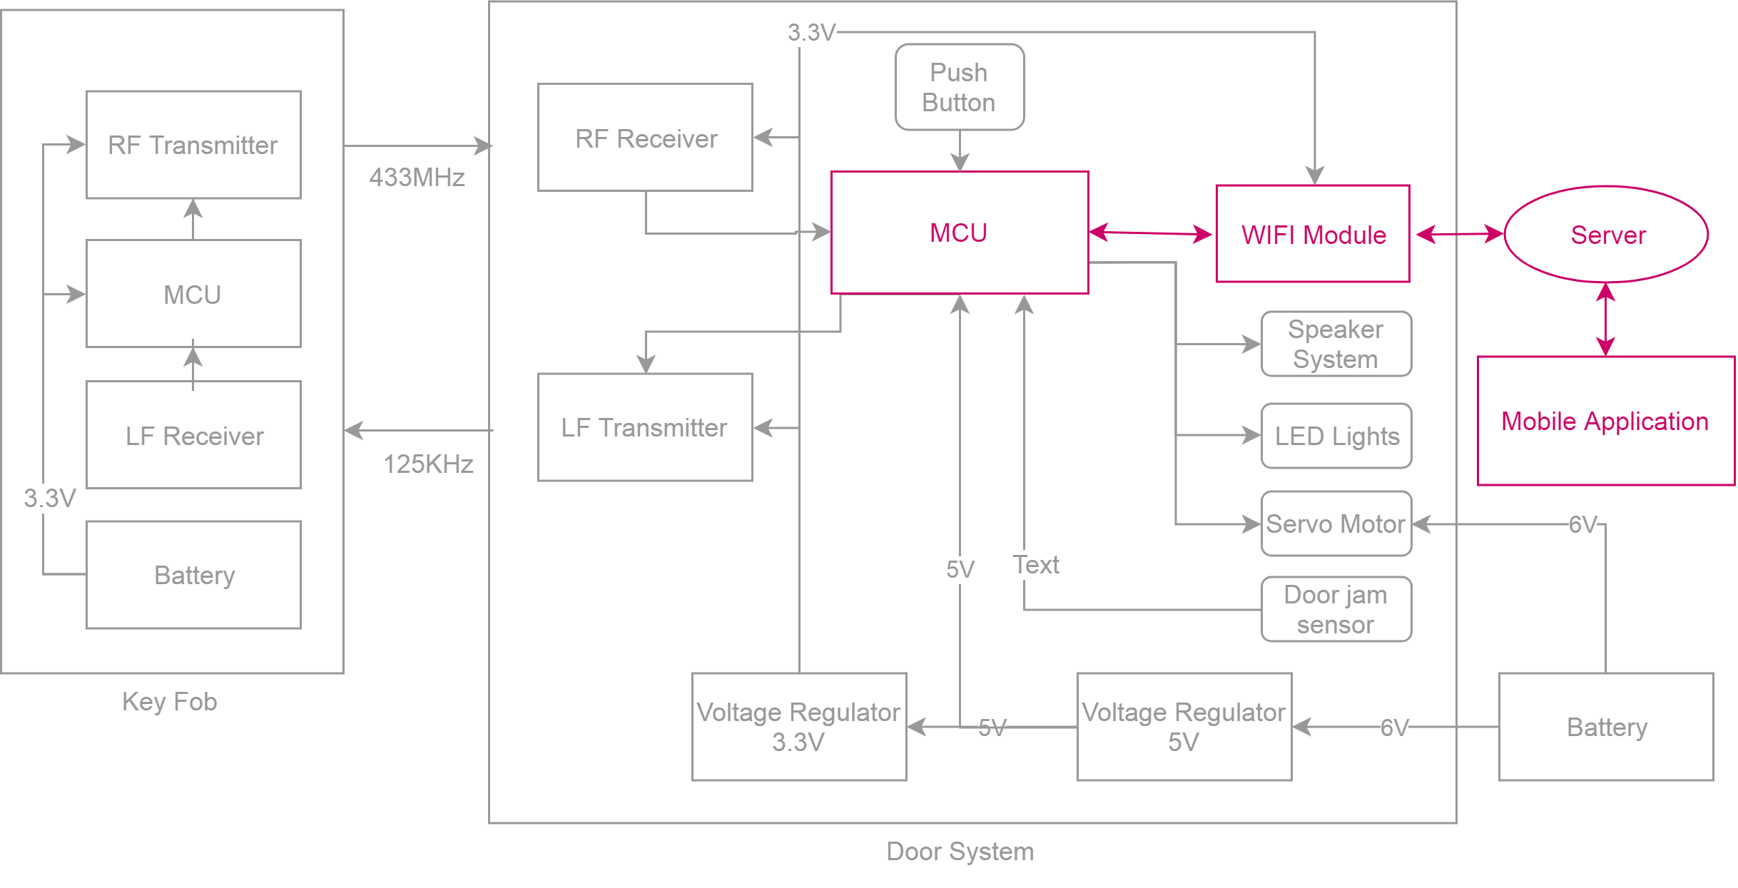
WiFi Integration Block Diagram

Slide 12
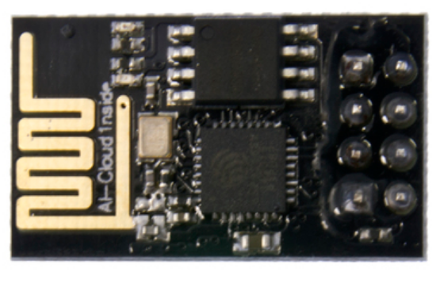
WIFI module
Model: ESP8266-01
Includes AT instruction set to complete HTTP requests
Can also be programmed directly with USB to UART converter
Communicates with microcontroller via UART (9600 Baud)
Specifications
Dimensions | 25mm x 15mm
Cost | $4.00 per unit
Passive Power | .9mA
Active Power | 50mA(R) 150mA(T)

Slide 13
Server Back End
LAMP Stack
Prolific
Extensive Doccumentation
Familiarity
Modular
Open Source
Self hosting on a Raspberry Pi

Slide 14
Mobile Application
Lower development cost
Open ended development language selection-- JAVA
Open Source with detailed explanations
Easily emulated for testing purposes
Easy debugging
Notes:
hdbvsdbv

Slide 15
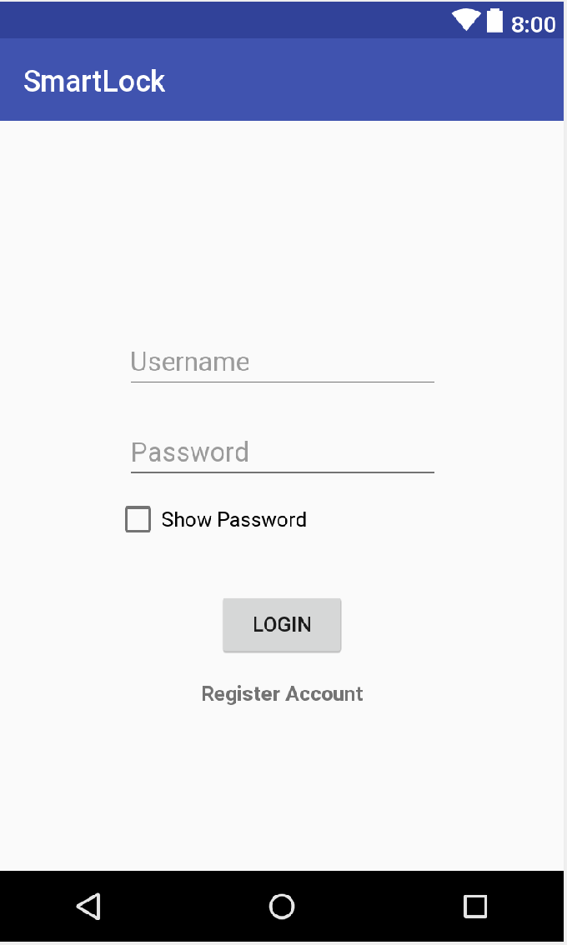
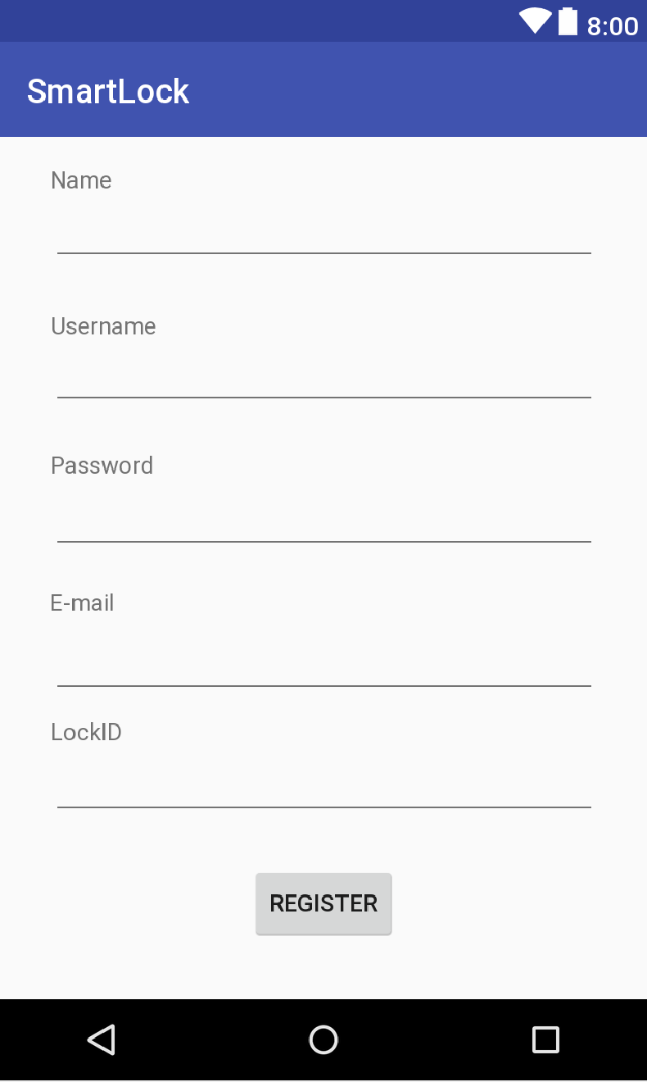
Mobile Application Features
Login
Unique username and password
Show password option
Register new account
Informations must be unique
LockID to connect to the system

Slide 16
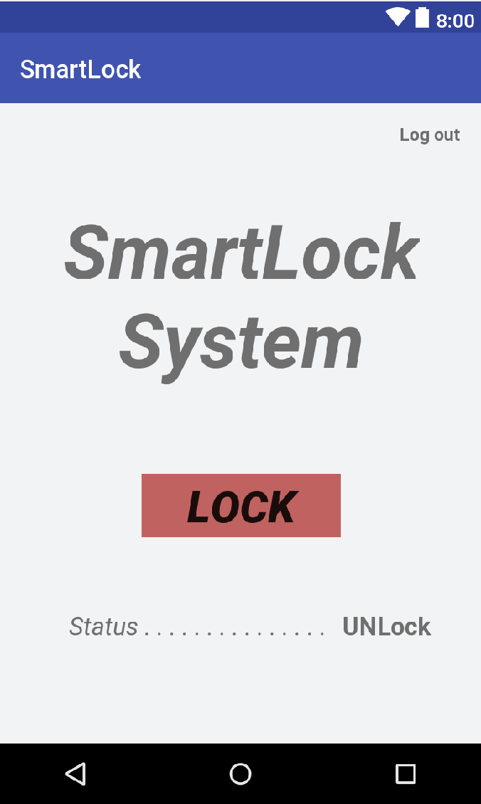
Mobile Application Feature
Displays
Name of the system
Lock/Unlock button
On time lock status
Log Out button
Control
Lock/Unlock the system

Slide 17
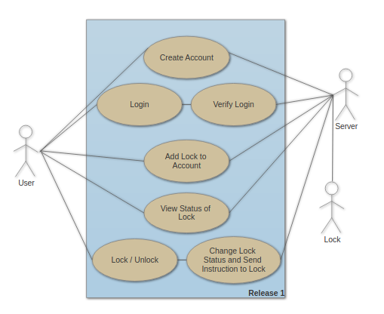
Use Case Diagram

Slide 18
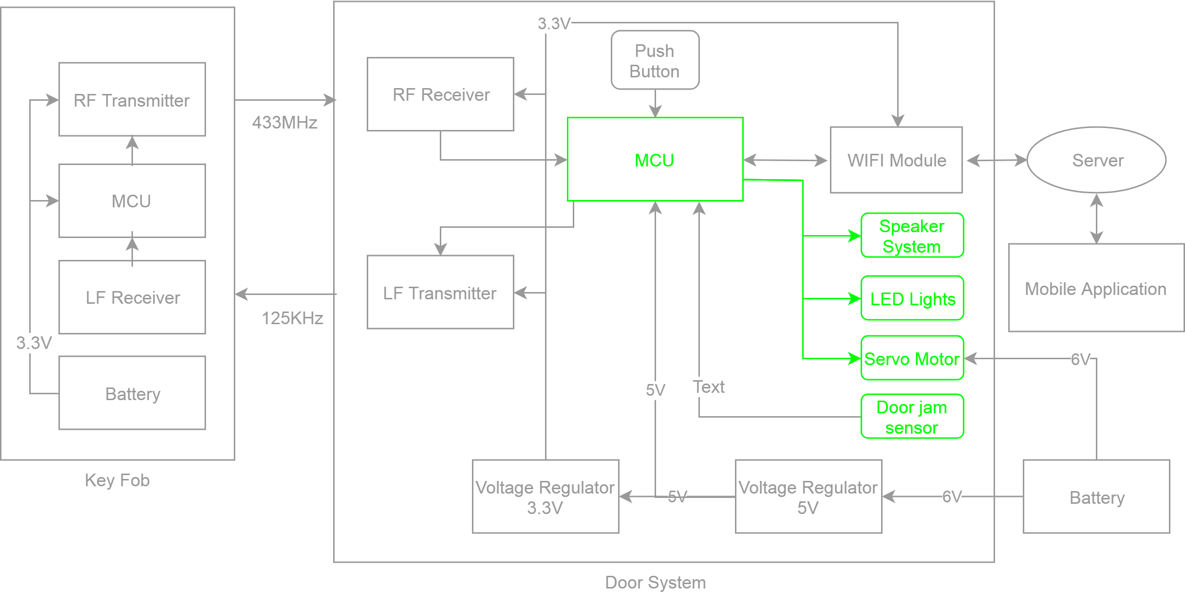
Additional Devices Block Diagram
Notes:
This block diagram shows our addional input output devices.
There is a indicating output devices, the speker and the LED light.
Servo motor will be used the unlock or lock the deadbolt.
And the door jamb sensor will be used as input device. The door jamb sensor will tell the microcontroller if the door is closed or opened.

Slide 19
Indicating Devices
Devices and Purposes
LED: Red and Green
Green : the door is closed/opened or deadbolt is locked/unlocked
Red : If the door is not closed completely, failure of unlock the deadbolt by pushing button..
Speaker
Three tones generated with PWM:
Deadbolt was locked
Deadbolt was unlocked
Trying to lock the deadbolt but door is not completely closed
Notes:
The speaker and LED are used for our indicating device.
Two led light will be used, one green and one red.
The Green LED light will be used when the door is closed or open. Also will be used if the deadbolt is locked or unlocked.
Red LED more likely used for warning. If the door is not closed completly. Or any failure of unlock the deadbolt by pushing button.
Speaker will be used for sound indicator. The three tones will be generated by microcontroller.
One tone will be used when the deadbolt was locked.
Another tone will be used when the dead bolt was unlocked.
Also, will be used for warning sound.

Slide 20
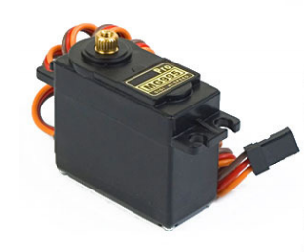
Servo Motor
TowerPro MG995R Metal Gear Servo
Purpose
Using Servo motor, Door can be opened or closed.
Specifications
Cost | $9.90
Torque | 10kgfcm
Rotation | 120 degree
Weight | 55g
Operationg Voltage | 4.8V to 7.2V
PWM Period | 20ms
Dimension: 40.7 x 19.7 x 42.9 mm approx
Notes:
This is our servo motor will be used, towerpro mg995. The servo motor will be used to unlock or lock the deadbolt.
It can be operated between 4.8V and 7.2V voltage, the servo motor will be able to work properly powered by the main power source,6V.
It is able to rotate 120degree which will be enough to lock or unlock the deadbolt. Has enough torque 10kgfcm to rotate the deadbolt.
As the servo motor is really light and small, the project will not be bulky which is one of our project objective.

Slide 21
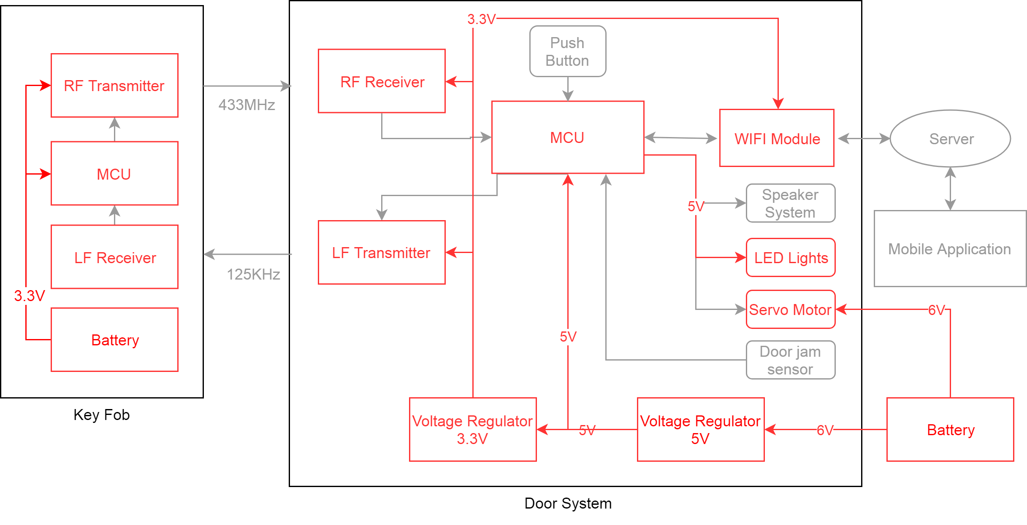
Power Flow Block Diagram

Slide 22
Power
Battery for door PCB : AA 1.5V x 4 (6V)
Battery for key fob : CR2023 (3V)
5V regulator voltage: AMS1117-5.0
3.3V regulator voltage : AMS1117-3.3
Voltage | 6V | 5V | 3.3V
Components | Servo Motor | LED MCU for door | LF transceiver RF transceiver WIFI module MCU for key fob

Slide 23
Door Schematic

Slide 24
Key Fob Schematic

Slide 25
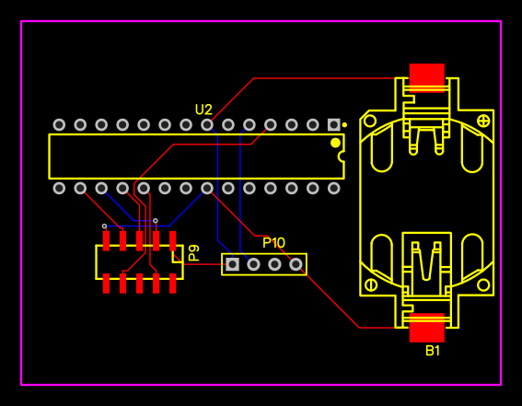
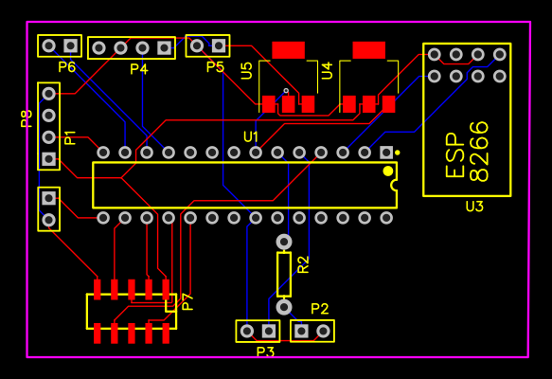
PCB Layout
Key Fob
Main Door

Slide 26
Administrative Content

Slide 27
Work Distribution
 | Keyless Entry | Mobile Application front end | Mobile Application back end | Power/ PCB Layout
Damo Park | Primary |  |  | Primary
Greg Mueth | Secondary | Secondary | Primary | Secondary
Mhelith Natavio | Secondary | Primary | Secondary

Slide 28
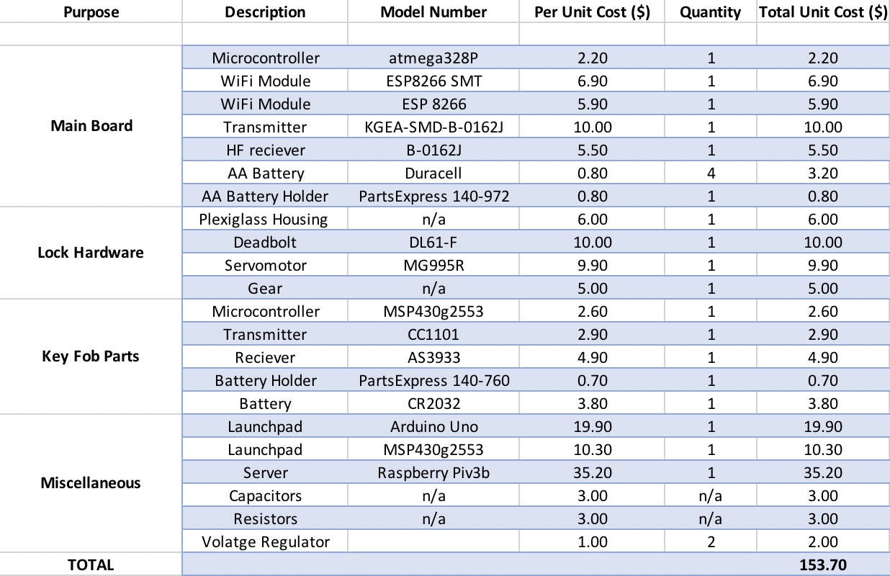
Development Budget M
*
* total cost is evenly distributed among members

Slide 29
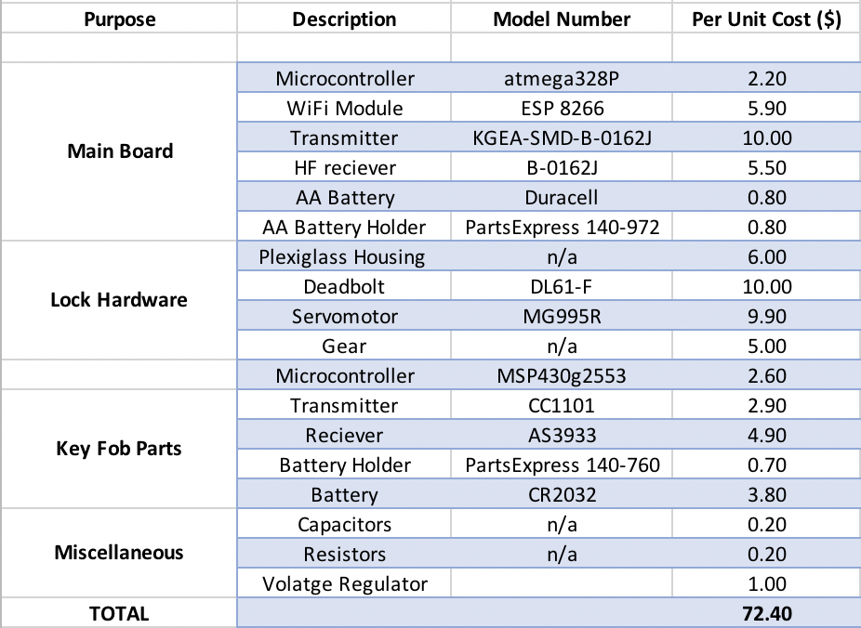
Cost Per Unit M

Slide 30
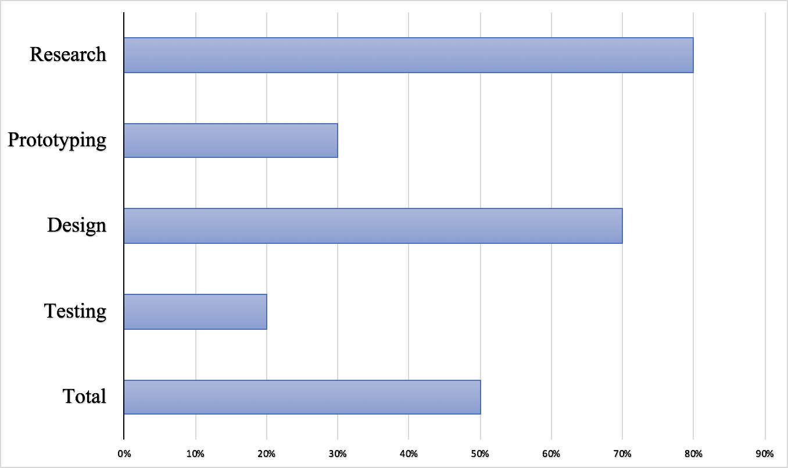
Current Progress M

Slide 31
Potential Roadblocks
125kHz wake up signal range with current power supply
Encryption / Security for transmitting radio signals
Connecting servo motor to deadbolt
Passive power consumption

Slide 32
Questions?

