Slide 1


Interactive
Chess Trainer
Group 7
Eric Roberts
Jean Melgarejo
Saeed Rahaman
Brandon Dupoux

Slide 2
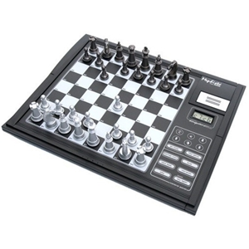
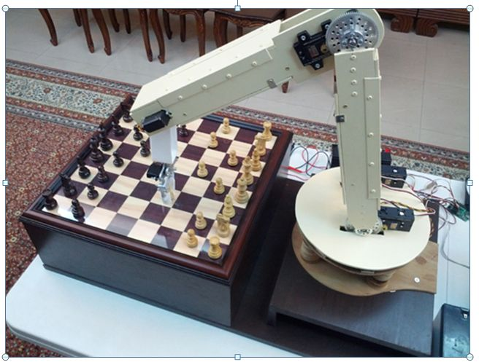
Motivation
Online chess is limited and non-physical
Robotic chess is expensive and infeasible
Basic training techniques are ancient
Playing chess promotes intellectual and social development

Slide 3
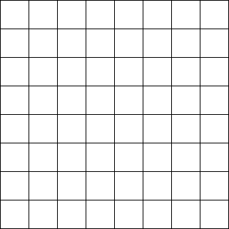
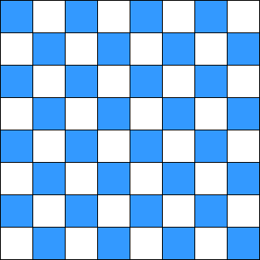
Goals and Objectives
Two playing modes
  Player vs Player
  Player vs Computer
Light up possible movements a selected piece can take
Utilize piece identification so multiple starting scenarios can take place*
RGB LED matrix as the output
*Player vs Player mode only

Slide 4
Specifications
Parameter | Specification
Battery Life | 2 hours
Weight | ~5 lbs
Event Response Time | 1-2 seconds
Cost (Prototype) | < $200

Slide 5
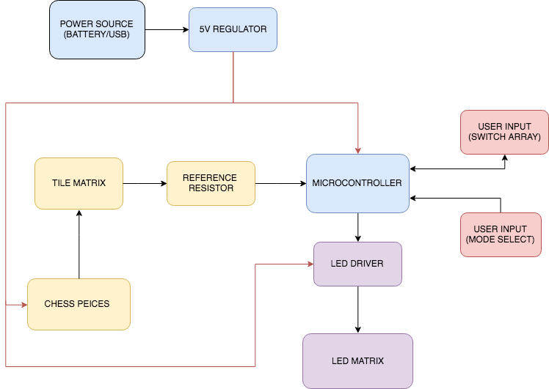
Top Assembly Block Diagram

Slide 6
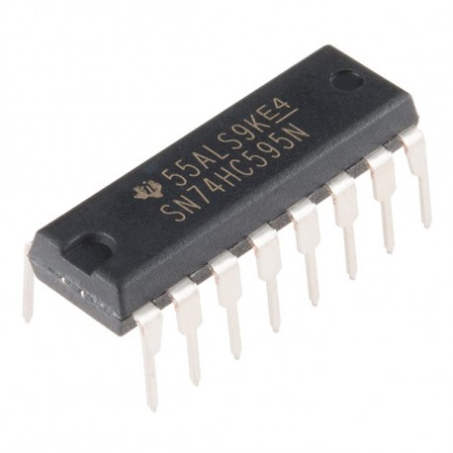
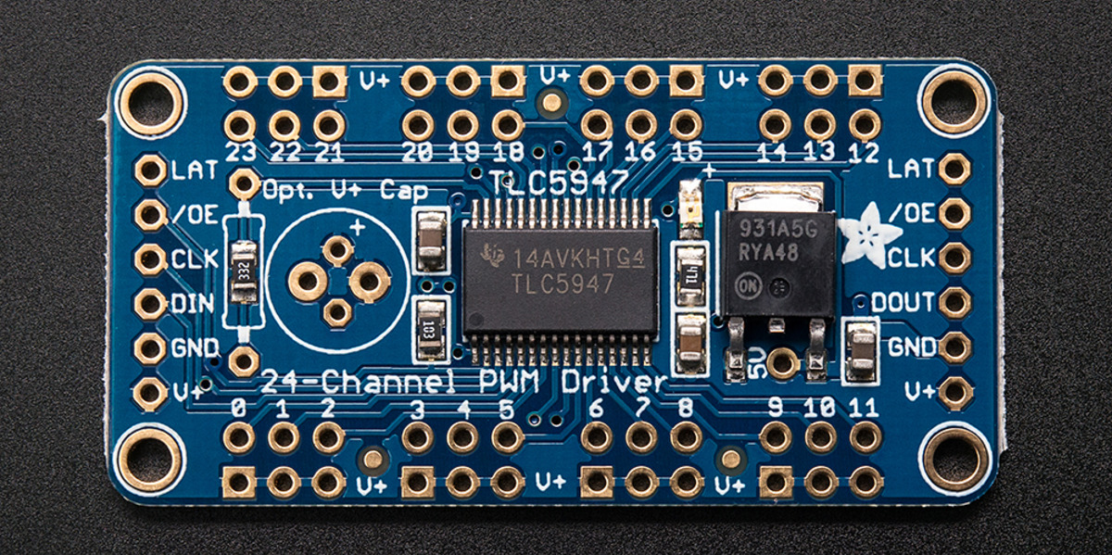
LED Lighting
System Purpose: Provide a visual output to the players
8x8 RGB LED matrix
LED controller and shift register
Pin reduction
Source provided by shift reg controlled BJTs
Refresh rate determined by CLK & SR latch speeds

Slide 7
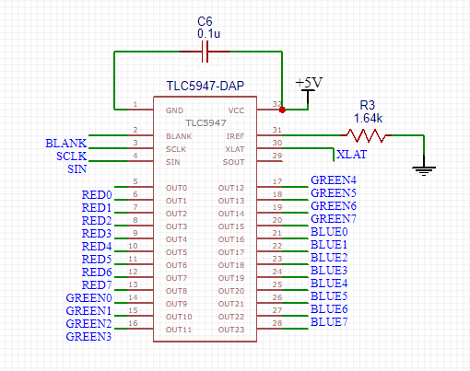
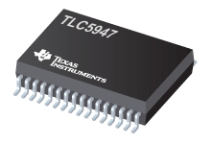
LED Controller
Model: TLC5947
Uses:
  LED column select
  PWM control
Pros:
  Constant current sink
  24 channel output
Specifications
Output Voltage Max |  |  |  |  | 33 V
Output Current Max |  |  |  |  | 30 mA
Cost |  |  |  |  | $3.47
Dimensions |  |  |  |  | 11.00 mm × 6.20 mm

Slide 8
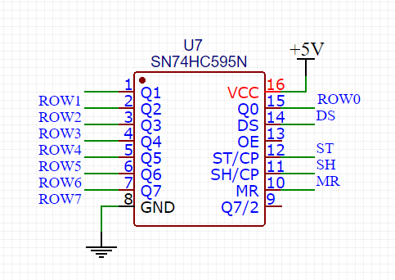
Shift Register
Model: SN74HC595N
Uses:
  LED row select
Pros:
  Control at high speeds (25 MHz)
  Sink up to 70 mA of current
Specifications
Output Voltage Max |  |  |  |  | 33 V
Output Current Max |  |  |  |  | 30 mA
Cost |  |  |  |  | $0.43
Dimensions |  |  |  |  | 19.31 mm × 6.35 mm

Slide 9
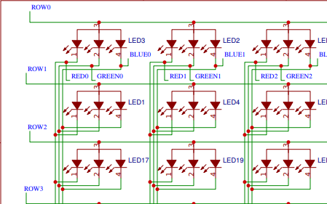
8x8 LED Matrix
Controlled using two components:
  TLC5947 and SN74HC595N

Slide 10
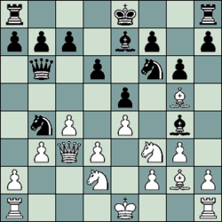
Piece Location
System Purpose: To detect when a chess piece is being moved by the user
Magnet Switches vs Pressure Switches
Low cost
Need a switch for each square on chess board (64)

Slide 11
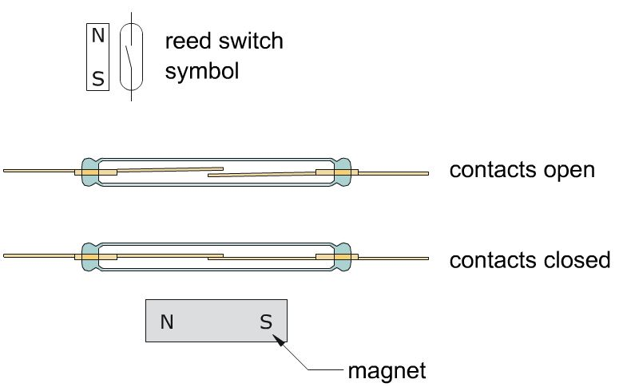
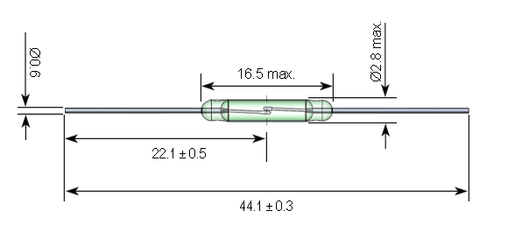
Reed Switch
Reed switch works with magnets
Magnet brings the contacts together

Slide 12
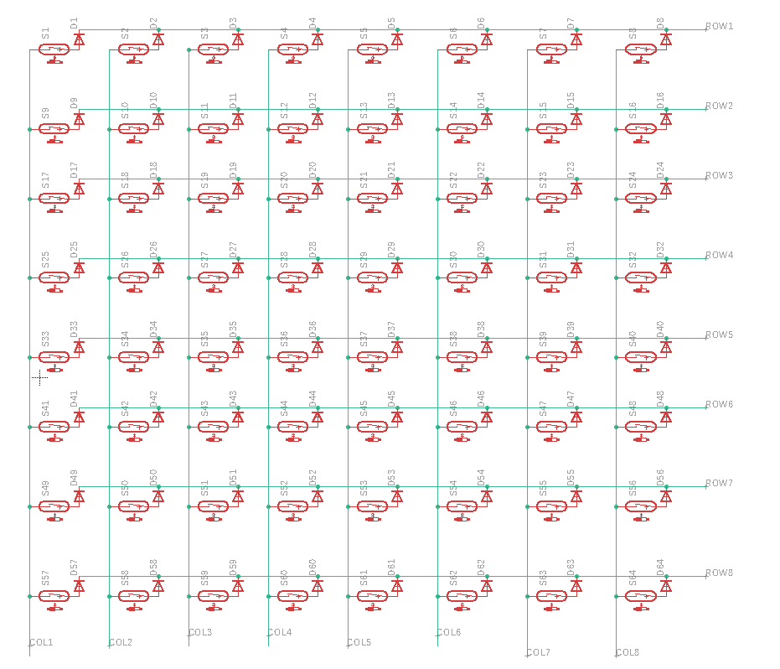
Reed Switch Matrix Design
Sample 1 row at a time, detect on columns
Diodes prevent ghosting

Slide 13
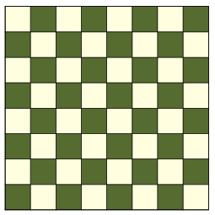
Piece Identification
System Purpose: Identify which piece has been added/removed from the board
Unique Resistors located in each chess piece
Microcontroller samples board for changes
2 magnetic contacts on each and every tile
15 BIT
ADC
All tile contacts are connected in Parallel

Slide 14
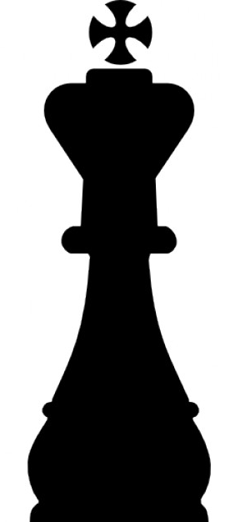
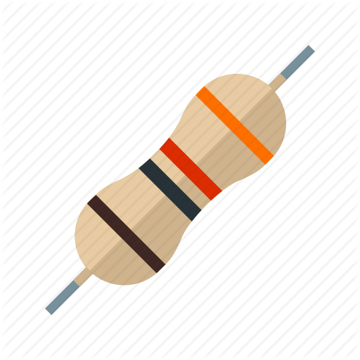
Piece Identification
Magnets embedded in each piece
Resistors soldered between magnets
32 chess pieces in a set
16 pieces per team
6 unique pieces on a team
12 total unique resistors needed
Values range from 100K to 10M
Resistor
Soldered Connections
Magnet

Slide 15
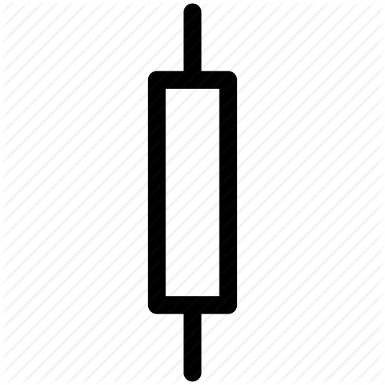
Piece Identification
Simple voltage divider design
Ability to detect within 152µV
Minimum change is 7.3mV for any scenario (48x)
More pieces on the board, harder it is to detect changes
Resolution is greatest when reference resistor is close to the value of the board resistance
Vcc
Equivalent Resistance of the Board
ADC
Reference Resistor
(10KΩ)

Slide 16
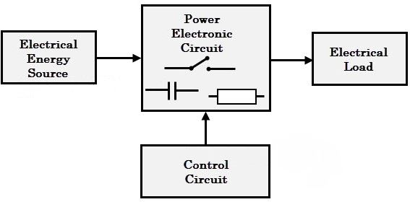
Power
System Purpose: Providing efficient and regulated energy distribution to microcontroller and integrated circuits.
Required Parts and Considerations:
  Lithium-Ion Battery (Rechargeable)
  Linear Voltage Regulator (Simple Design/Less Efficient)
  Step-Down Switching Regulator (More Efficient/Intricate Design)
  Power Consumption Overview (Current and Efficiency)

Slide 17
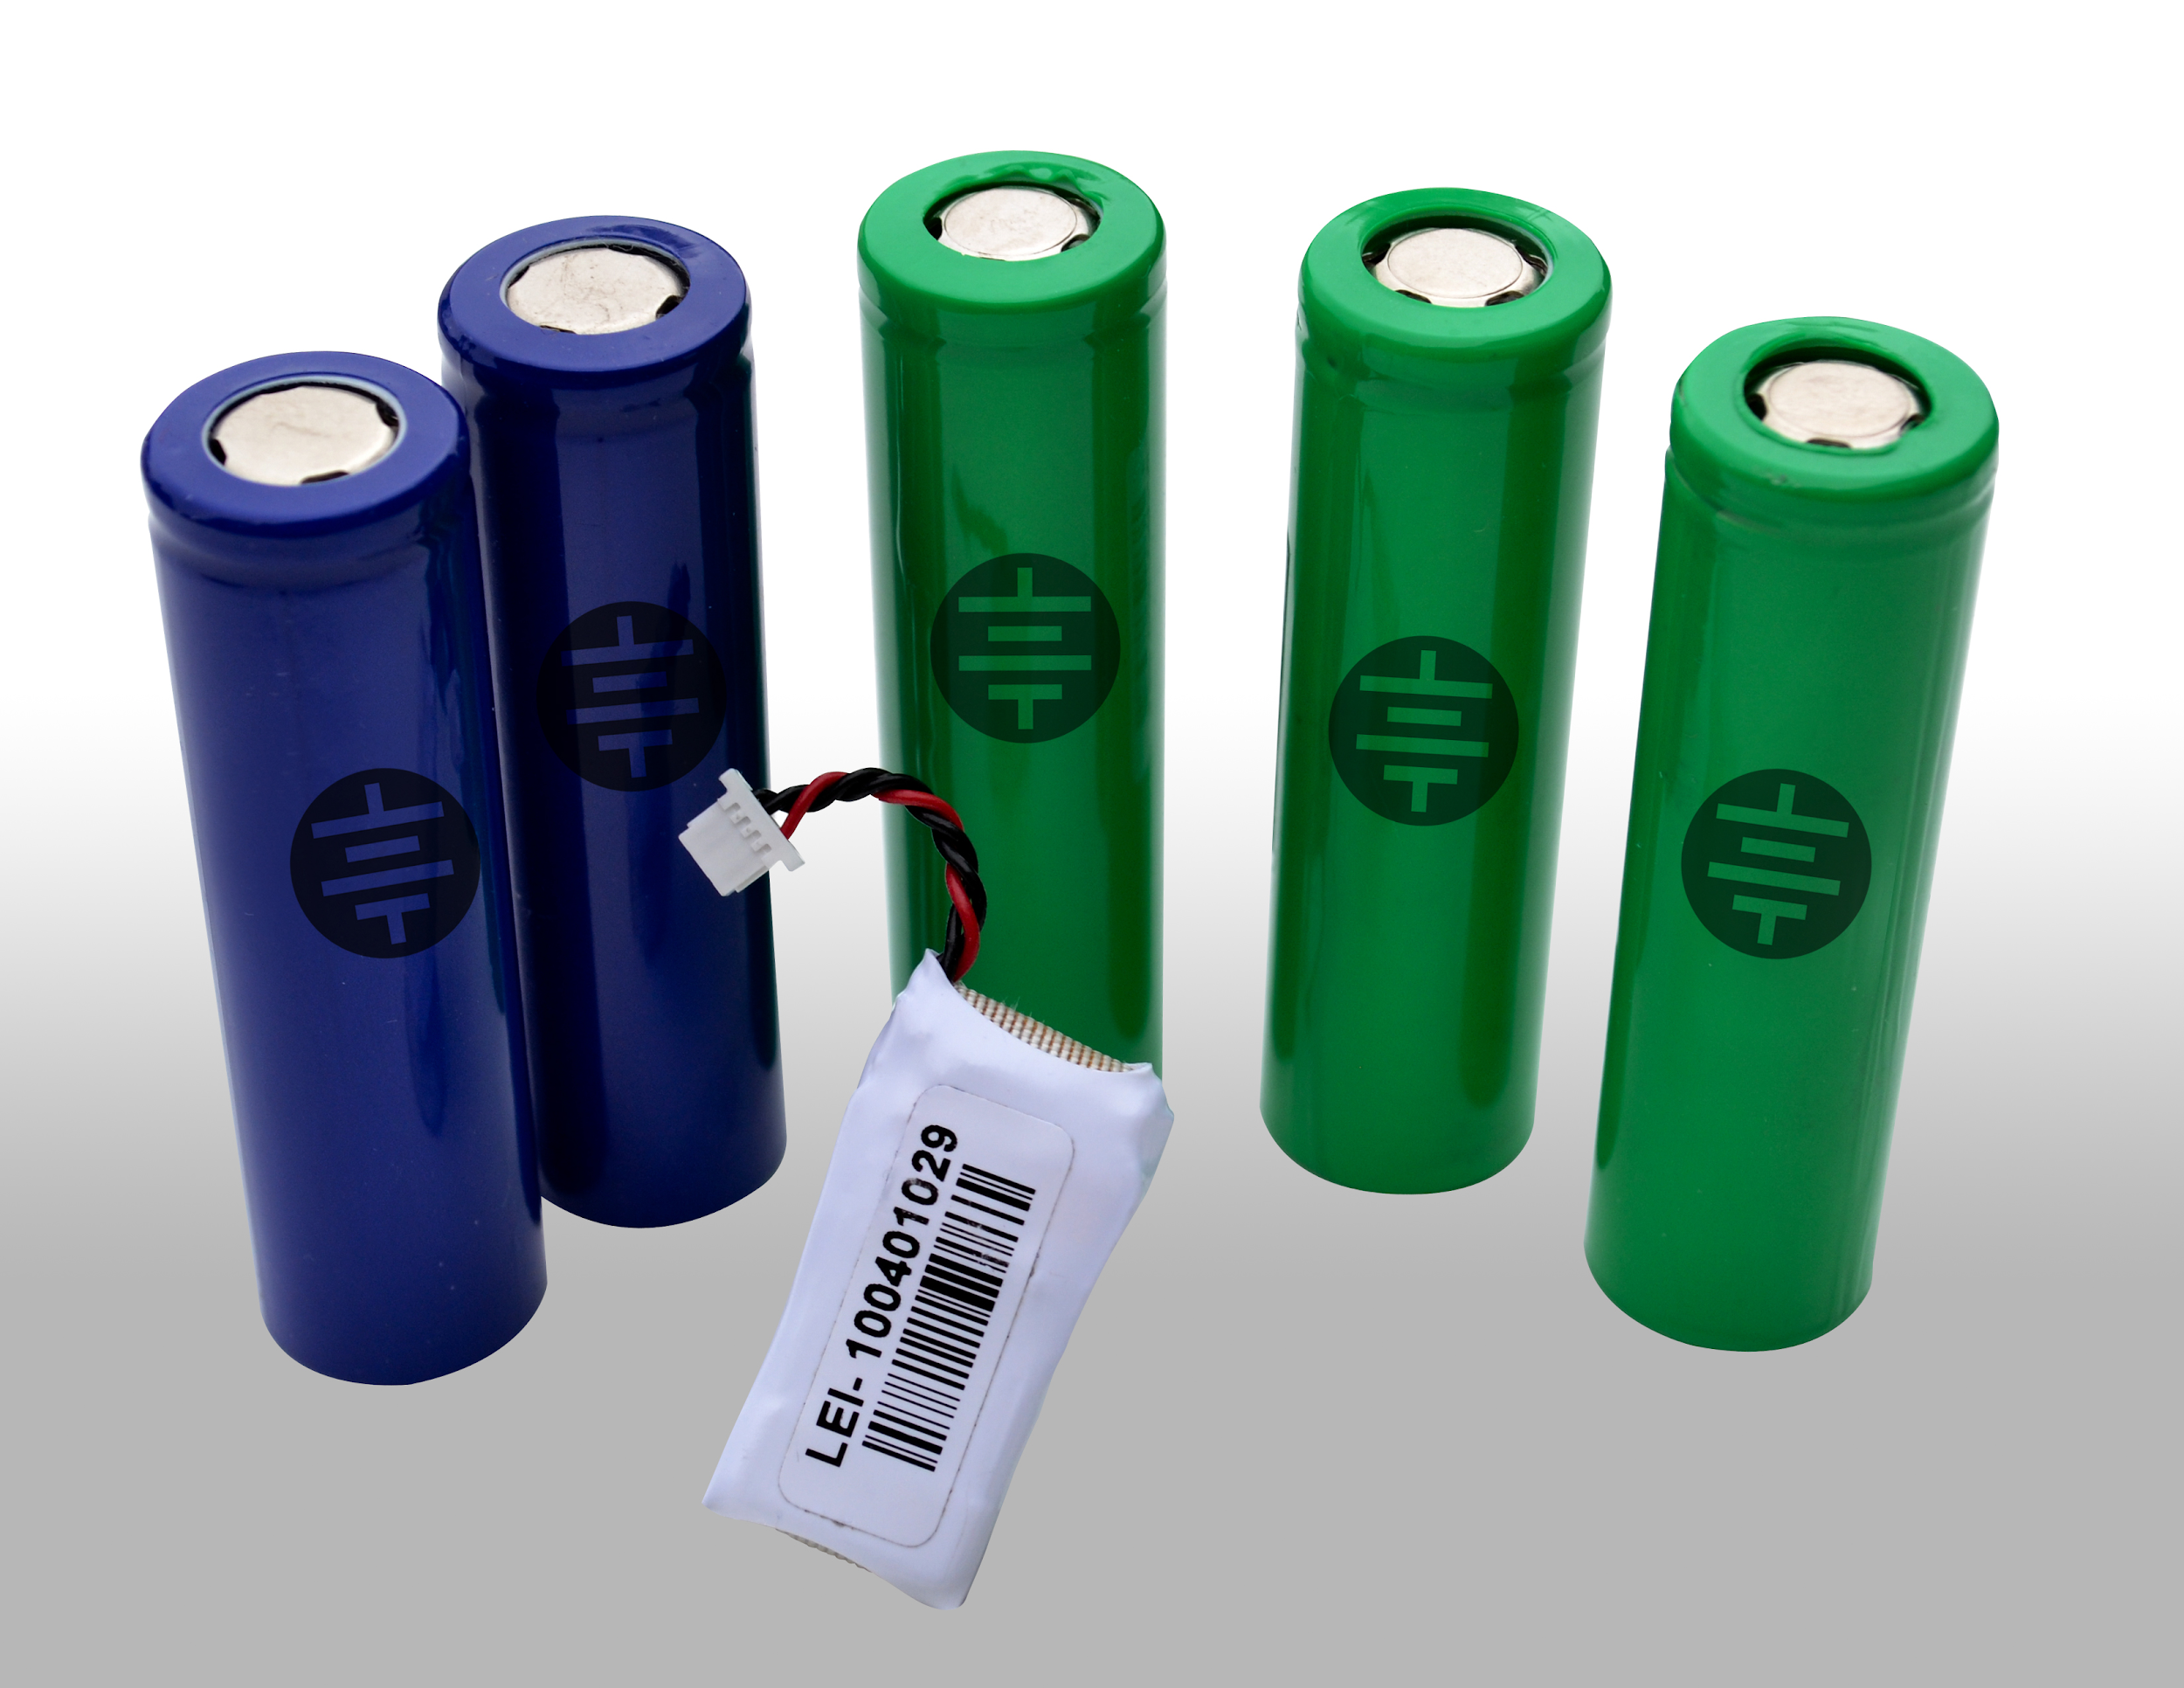
Lithium-Ion Battery
Rechargeable Electrical Device
Safety Consideration Required
Protective Power Circuits Embedded
Regulated to a Safe 5 Volts
Battery Capacity: (3400x4 mAh)
Input Voltage: (8.4-6 Volts)

Slide 18
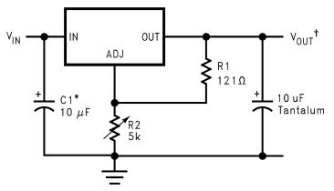
Linear Voltage Regulator
Pros:
  Simple Design Implementation
  Constant 5 Volt and 3 Amp Limit
  Cheaper
  Electrolytic Capacitor
Cons:
  Bad Efficiency ([Vin-Vout]*I)
  Heat Sink Required
LM1085

Slide 19
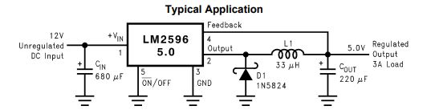
Switching Voltage Regulator
Pros:
  Very High Efficiency
  Constant 5 Volt and 3 Amp Limit
Cons:
  Ceramic Capacitor (Low-Impedance/High Frequency)
  Difficult Design Implementation (Surface Mount)
  Costly (Compared to Linear)
  Requires Extra Space (Noise)
LM2596

Slide 20
Power Consumption
Max power consumption when all 64 RGB LEDs displaying one color is 6.53 Watts plus microcontroller.
Battery life in worst case scenario is roughly 2 hours.
Realistically, chess board will not have all LEDs on at the same time for the full duty cycle.
Typical power consumption assuming a normal chess game should run around 5-6 hours.
Switching Voltage Regulator will be utilized only if battery life isn’t acceptable. (Microcontroller and IC’s draw more battery than expected)

Slide 21
Chess Engine
Multiple chess engines were tested
CPU load, time, move legality and size were checked for each
MicroMax was chosen to be the most efficient
Chess Engine | CPU Load | Time
Stockfish 9 | < 3 % | ~ 20 seconds
MicroMax | 3% | ~ 2 seconds
Faile | 30% | ~ 10 seconds
GNU Chess | 15% | ~ 5 seconds
Sunfish | 5% | ~ 4 seconds

Slide 22
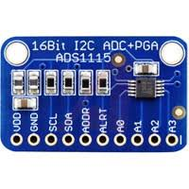
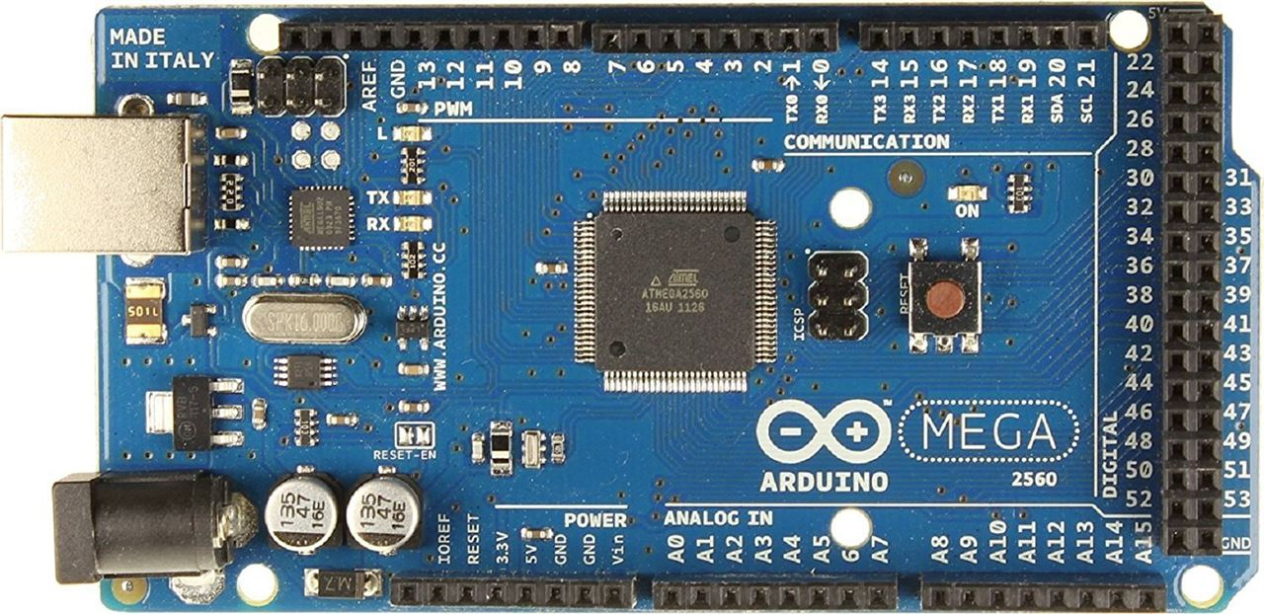
Microcontroller
System Purpose: Processing data from all the inputs and determining correct outputs
ATmega2560
  Lots of GPIO for Led Lighting and Piece Locator Matrices
  16Mhz clock speed for refresh rate
  Many PWM outputs for LED driver
  Will need external 15 bit ADC
  Developer Boards widely available an low cost
  Many designs built upon ATmega Platform

Slide 23
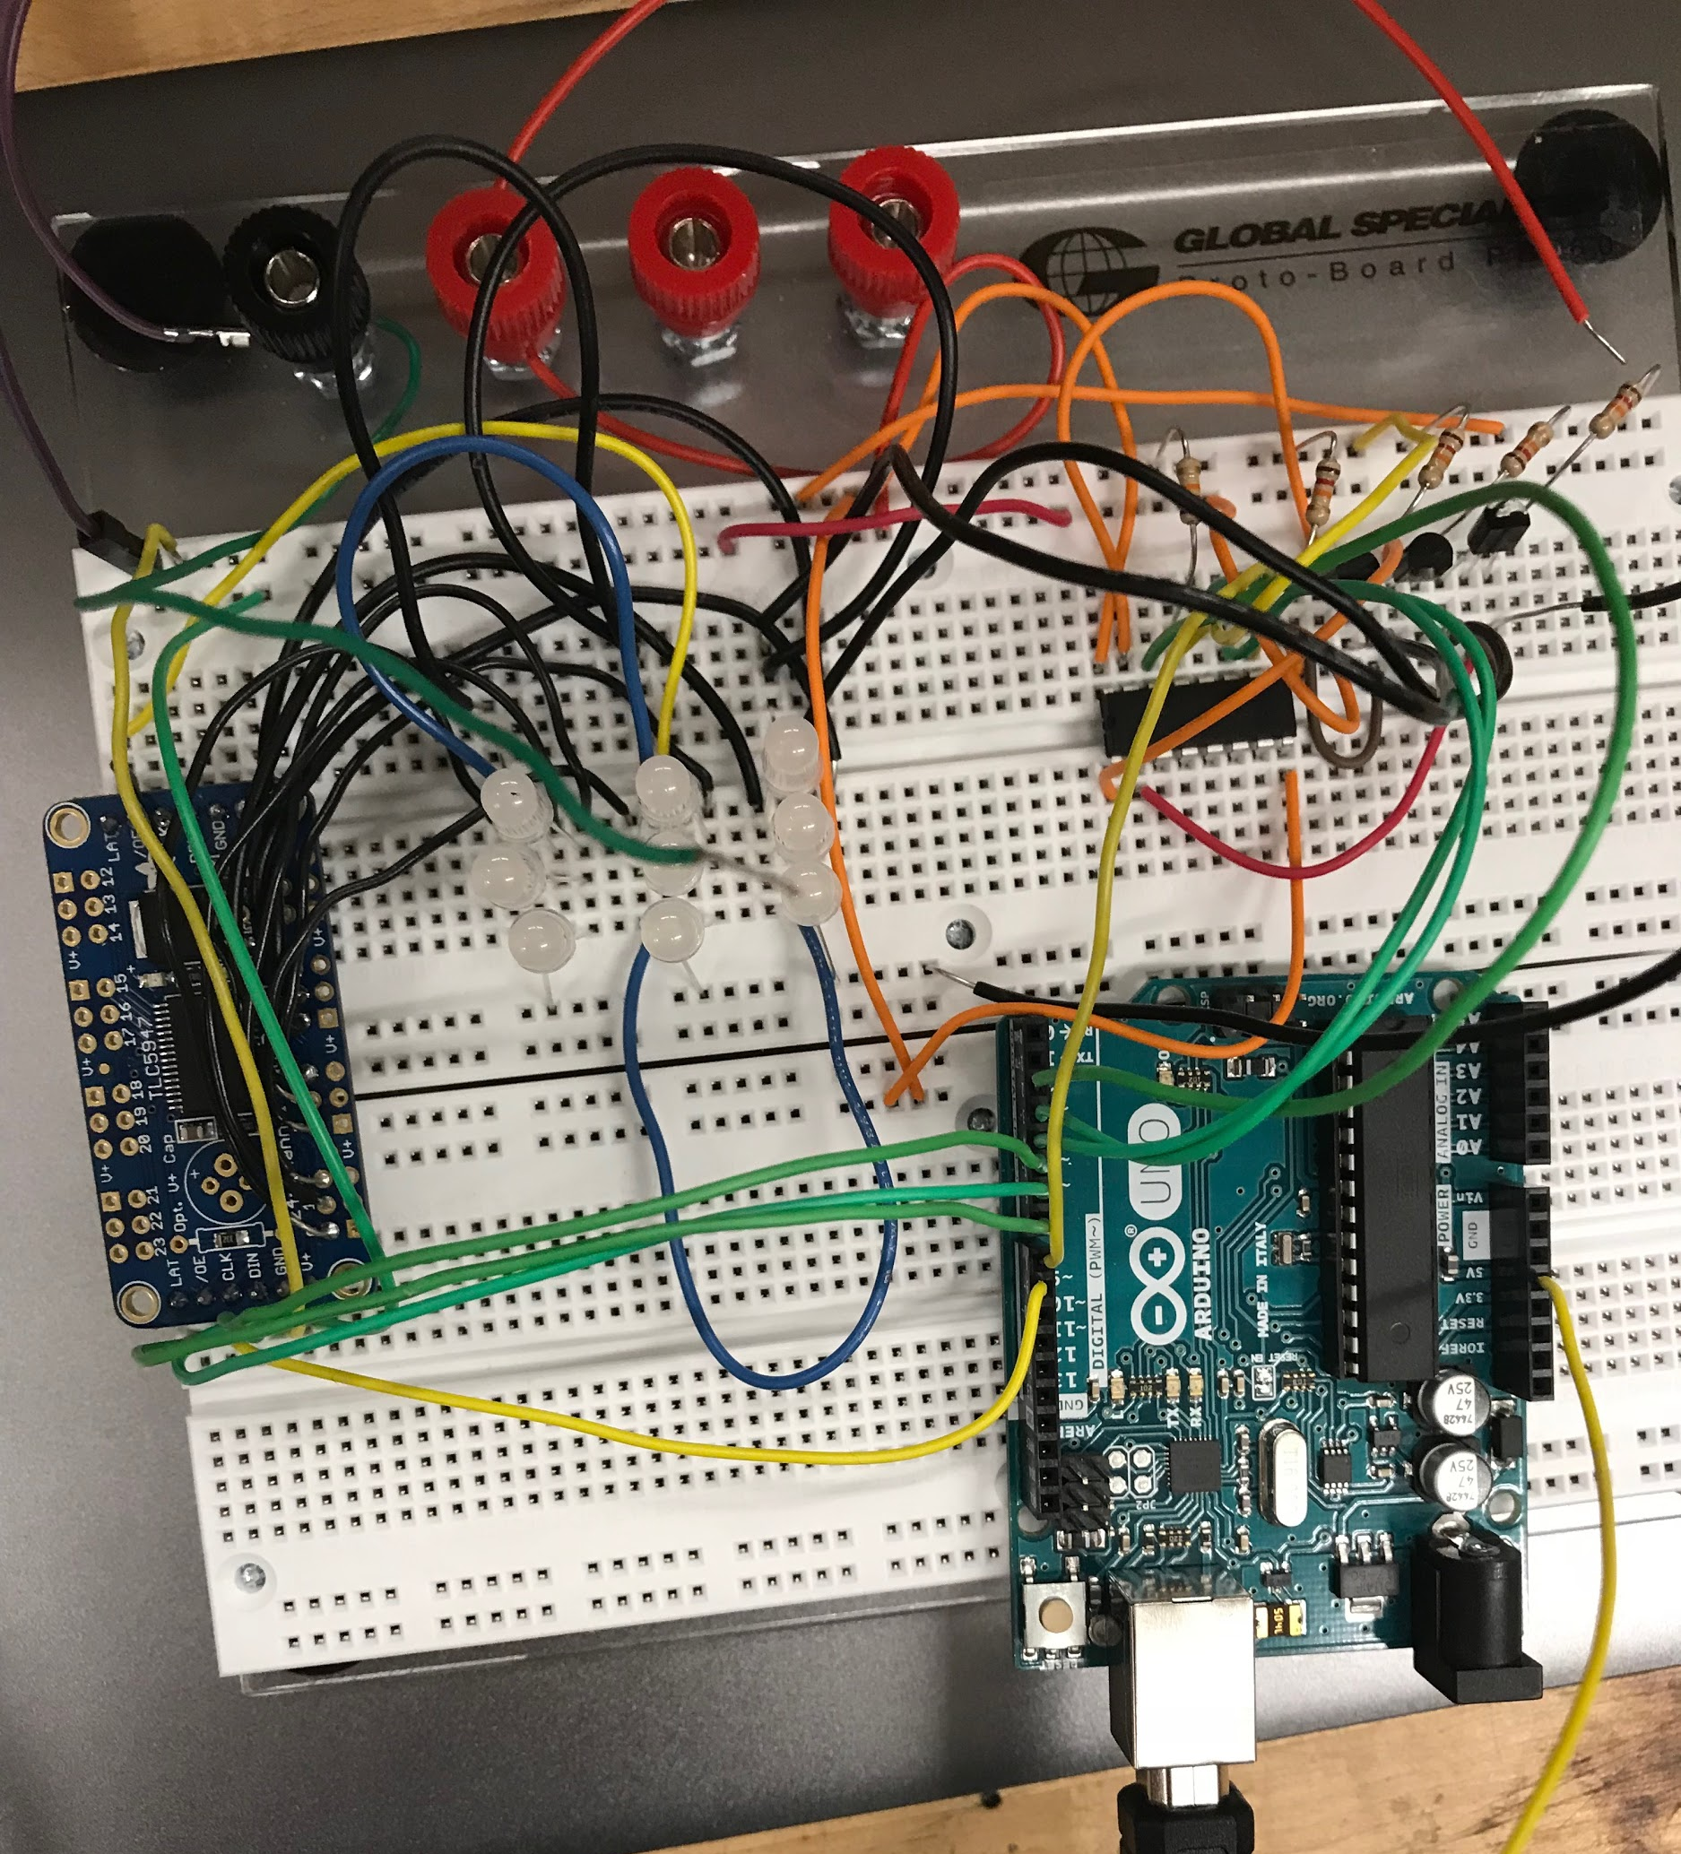
Prototyping (RGB LED Array)
SN74HC595N
3x3 Matrix
TLC5947

Slide 24
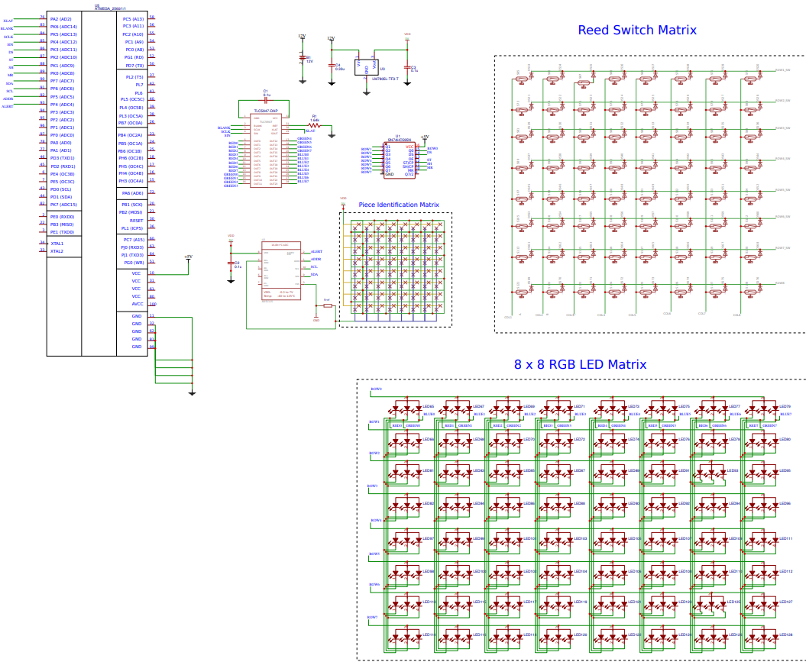
PCB Schematic

Slide 25
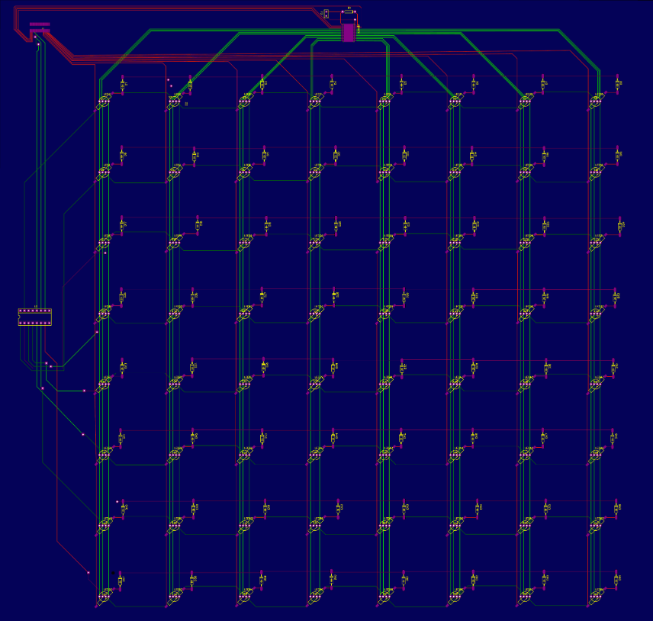
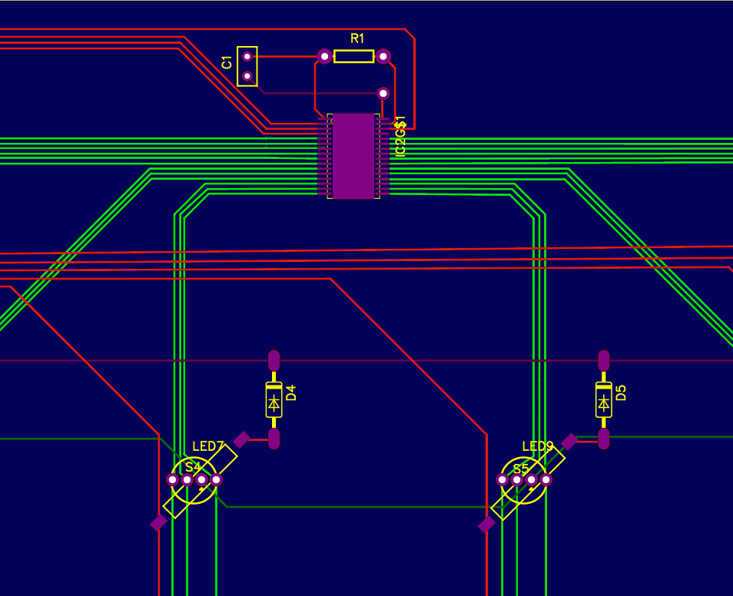
PCB Layout

Slide 26
ADMINISTRATIVE
CONTENT

Slide 27
Work Distribution
Work Distribution | LED Lighting | Piece Locator | Piece Identification | Power/ Microcontroller
Brandon | X
Saeed |  | X
Eric |  |  | X
Jean |  |  |  | X

Slide 28
Budget
Item | Supplier | Cost/Item | Number of items | Total Cost
Common Anode LEDs (pack 100) | Edgelec | 8.99 | 1 | 8.99
16bit ADC dev board | Hiletgo | 6.99 | 1 | 6.99
Chess Piece Set | Amazon | 11.08 | 1 | 11.08
Mux/Demux (pack 10) | TI | 7.99 | 1 | 7.99
24 Channel LED driver Dev Board | Adafruit | 18.97 | 1 | 18.97
Lauan Plywood | Lowes | 6.32 | 2 | 12.64
Magnets | Amazon | 22.29 |  | 22.29
Reed Switches | DigiKey | 0.51 | 100 | 39.16

Slide 29
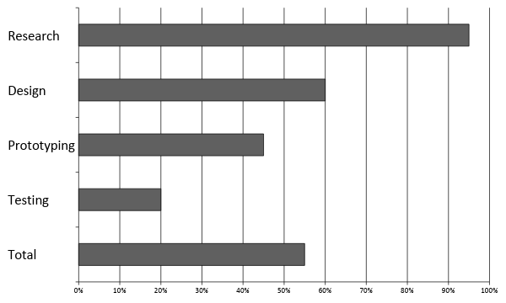
Progress

Slide 30
Issues
Reed Switch magnetic field inconsistencies
Magnets becoming weak after high heat from solder iron
Magnets interacting with multiple reed switches
LED driver frequency too low

Slide 31
QUESTIONS

