Slide 1
Smart Mirror
SM
Smart Mirror
Group 5:
Matthew Caserto, EE
James Timothy, EE
Menashe Mordachai, EE/PSE
Greg Eugene, EE/CPE

Slide 2
Goals and Objectives
Limit input mechanisms that don’t require touching the mirror.
  Optical grid
  Camera
Simple yet intuitive user interface in smart mirror application.
A variety of apps to accomplish daily tasks from the mirror.

Slide 3
Motivation
Our Smart Mirror
Create a useful device that can simplify the morning routine and help assist in getting daily tasks done easily.
Bring some innovation to the Smart Mirror scene by making a compelling package that works seamlessly.
Improve on what previous senior design projects accomplished.

Slide 4
Specifications
Hardware and Software
Component | Parameter | Design Specification
Microcontroller | I/O | 15 minimum
Multiplexers | inputs | 16
Gesture Sensor | Sensing Distance | 5 inches
IR Diode/PhotoDiode | Sensing Distance | 23 inches
Facial Recognition | Sensing Distance | 36 inches
Two-Way Mirror | Visibility | 30%

Slide 5
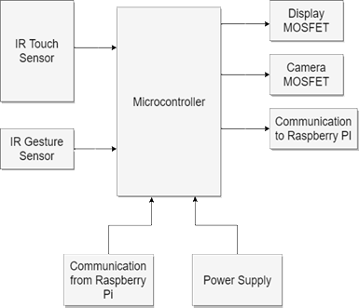
Block Diagram
Hardware

Slide 6
The Optical Grid
Each LED will have an opposing photodiode.
Photodiodes will be polled by the microcontroller waiting for an interrupt.
When an object obstructs the light onto the photodiodes, a location on the mirror will be determined.

Slide 7
Light Source
Why we chose LEDs instead of laser diodes
LED | Laser Diode
Wider emitting area, introduces noise | Narrow beam, alignment more important
Cost effective | Relatively expensive
More readily available | Runs hot, heat sink needed

Slide 8
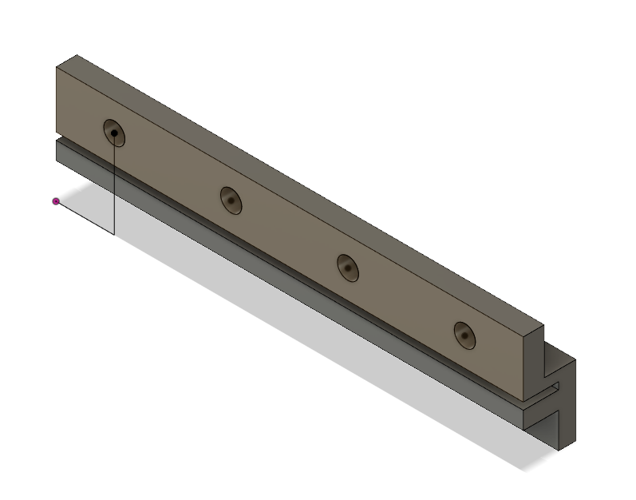
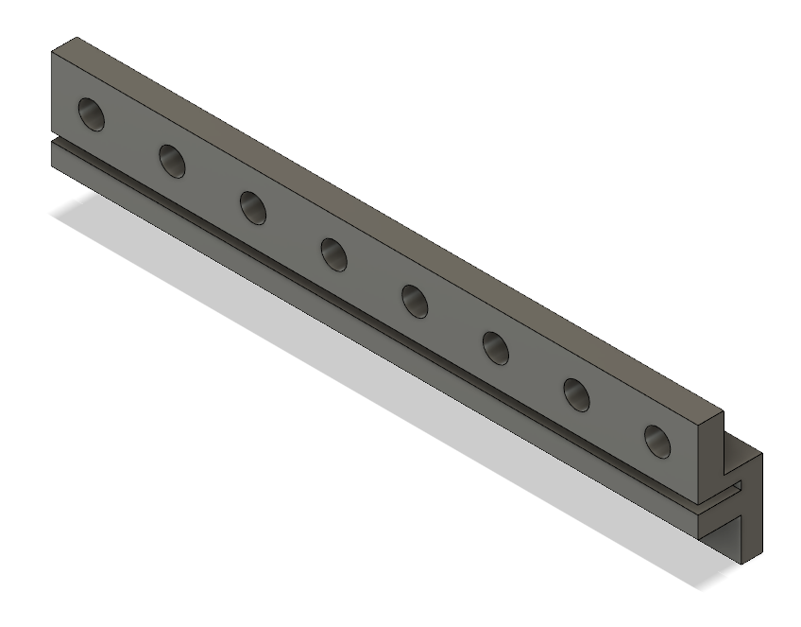
Frame Integration
3D printed spacers will be placed between the frame and mirror glass.
Spacers help prevent noise from adjacent LEDs.
Slot to hold mirror glass.

Slide 9
Hardware Relationships
Microcontroller vs. Microprocessor
Microcontroller Functions
Microprocessor Functions
Polls photodiode array and converts to touch input.
Sends sensor data to main processor.
Run application for User-Interface.
Handles Wi-Fi and Bluetooth connectivity.
Connects to Camera for facial recognition.

Slide 10
Microcontroller Selection
Positives and Negatives
Microcontroller | Atmega 328P | Atmega 32u4 | TI MSP430
Inputs/Outputs | 23 | 26 | 80
Max Clock Frequency | 16 MHz | 16 MHz | 25MHz
Arduino Bootloader | YES | YES | NO
USB Support | NO | YES | YES
Low Power mode | YES | YES | YES
Communication | UART/I2C/SPI | UART/I2C/SPI | UART/I2C/SPI

Slide 11
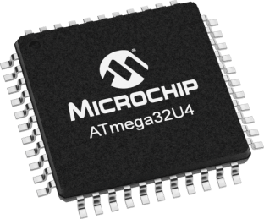
Atmega 32u4
Reasons behind choosing the
Enough I/O for our purpose.
Compatible with Arduino bootloader and IDE which means many libraries are available.
Native USB support allows it to send mouse and keyboard commands to main processor through USB.

Slide 12
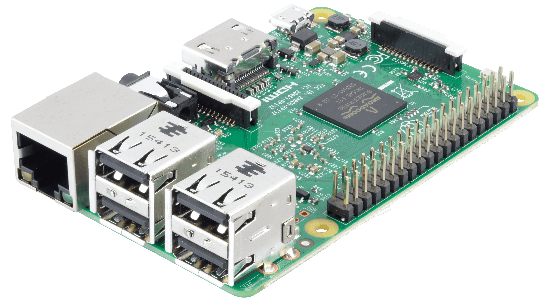
Raspberry Pi 3
Reasons behind choosing the
Powerful enough to run OpenCV.
Includes Wi-Fi and Bluetooth.
Is very small and will be easy to integrate into the mirror.

Slide 13
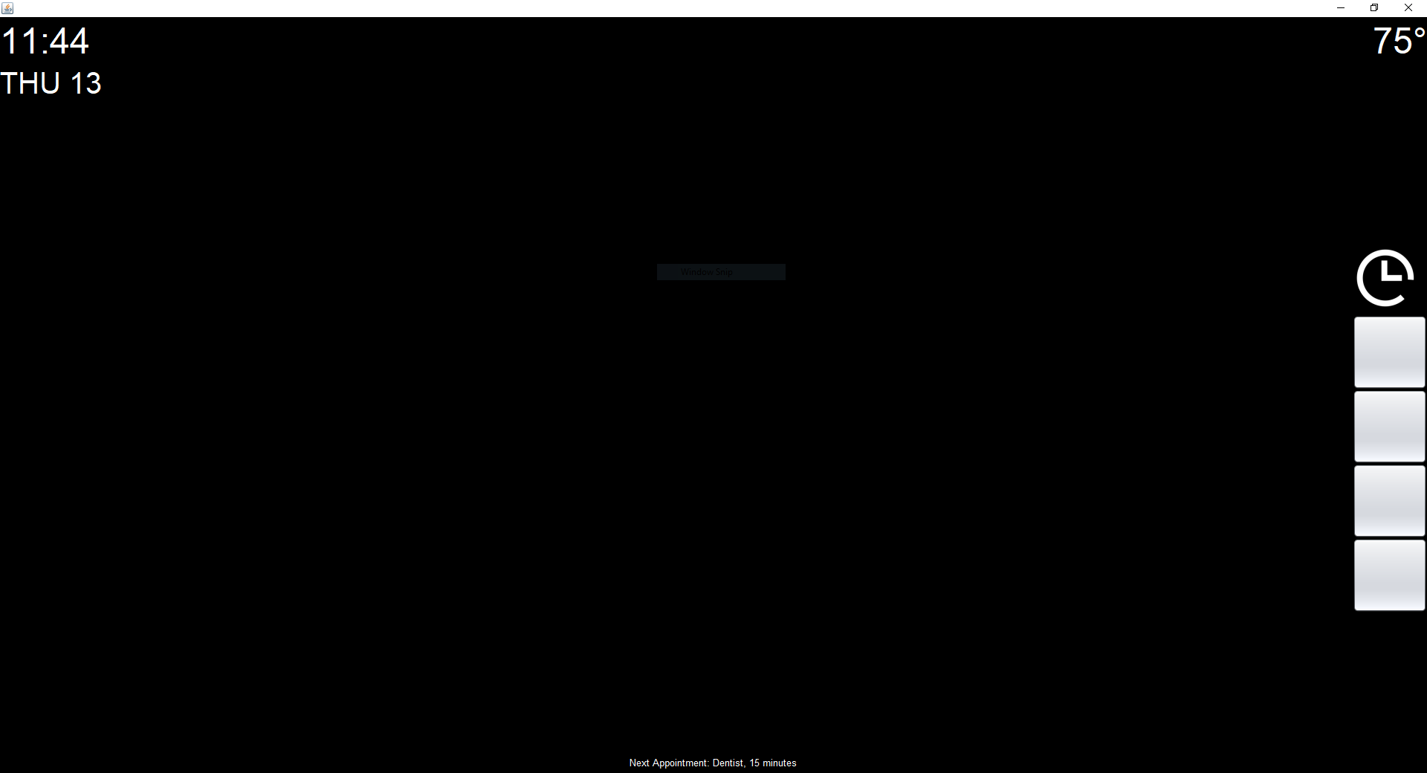
Smart Mirror OS
Application powering the mirror

Slide 14
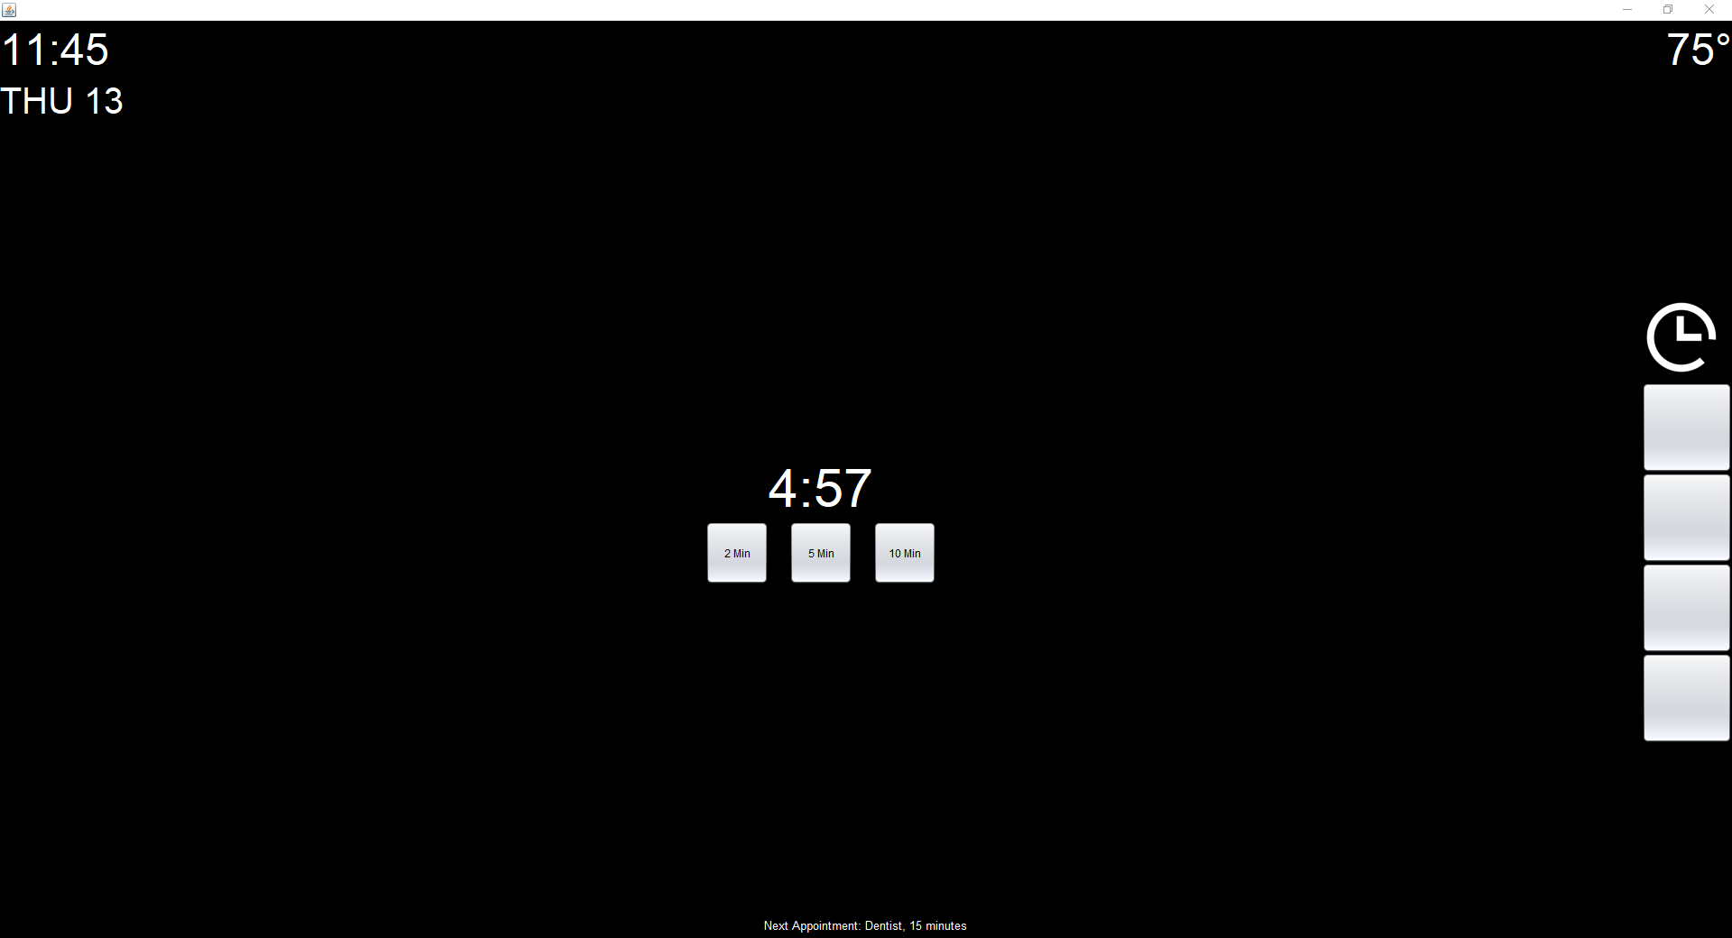

Slide 15
Programming Language
What powers our User-Interface
Language | Object-Oriented | Compatibility | GUI Capable | Testing
C | NO | HIGH | NO | HARD
C++ | YES | HIGH | YES | HARD
Java | YES | HIGH | YES | EASY
Python | YES | HIGH | YES | HARD

Slide 16

Java
Reasons behind choosing
Pros | Cons
Can run on almost any computer platform. | Can be slow since it’s a virtual machine.
Makes prototyping easy. | Swing GUI library is outdated
Only needs to be compiled once.

Slide 17
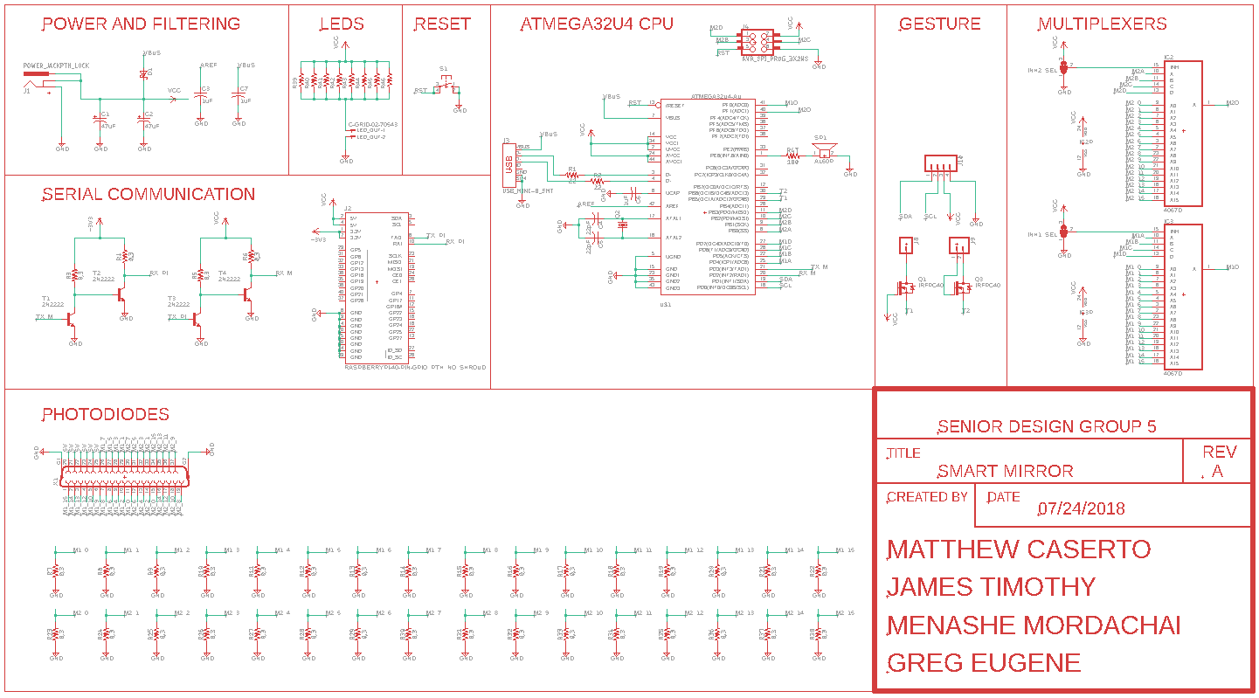

Slide 18
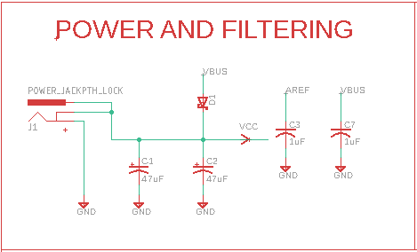
Diode to prevent current from flowing into the Raspberry Pi USB port
Capacitors used for DC coupling

Slide 19
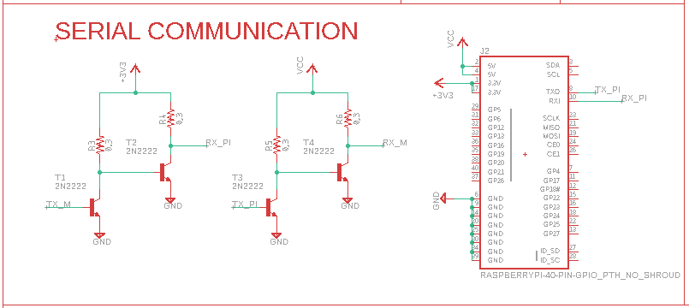
Logic level converter
Inputs 5v and outputs 3.3v
Inputs 3.3v and outputs 5v
Used to communicate with Raspberry Pi over Serial UART

Slide 20
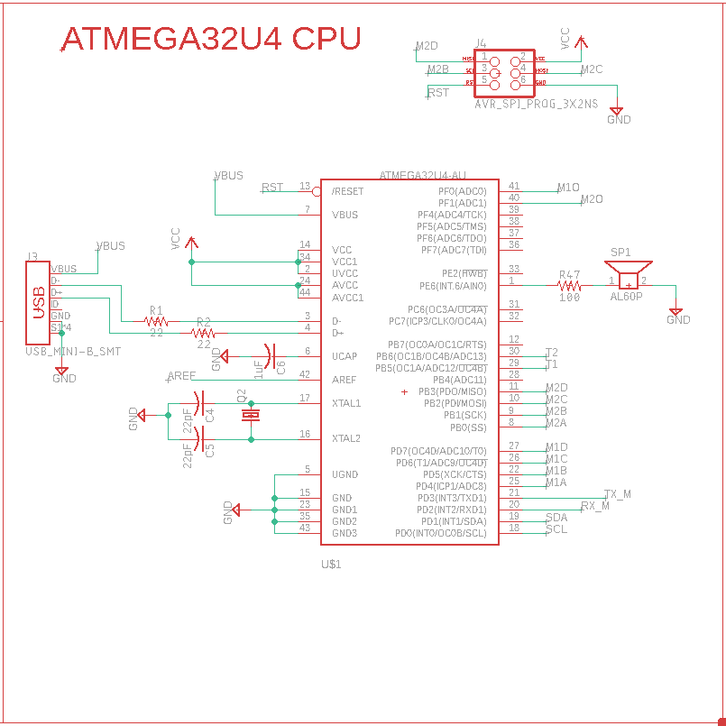
6 pin header to upload Arduino bootloader to microcontroller
External crystal oscillator for faster clock
USB port for programming microcontroller
Speaker for optional interface touch sounds

Slide 21
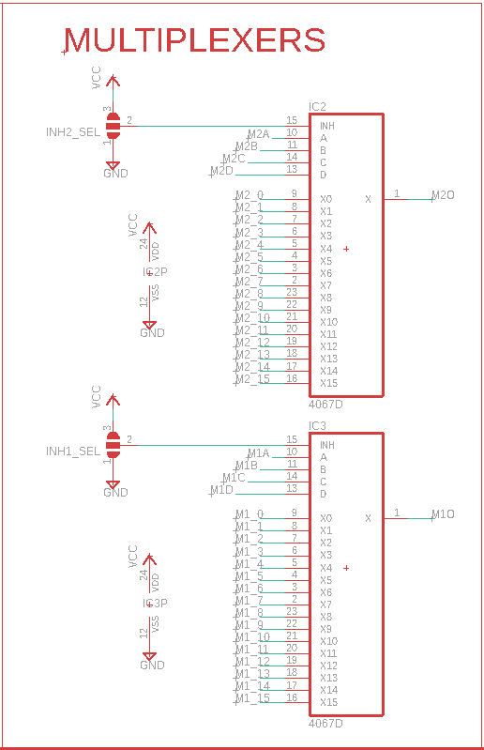
two 1 output, 4 control, and 16 input pins multiplexers are combined to form a 32 multiplexer input used for the 32 photodiodes
The control pins are used to select photodiode signal while the output goes into the Arduino
Used in conjunction with connector for IR touch frame

Slide 22
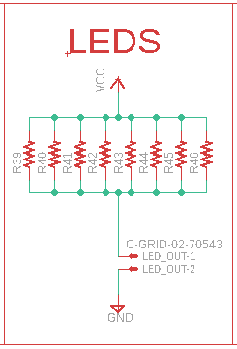
Voltage input connection for the 32 IR LEDs used for IR touch frame
Eight equivalent resistors to split current

Slide 23
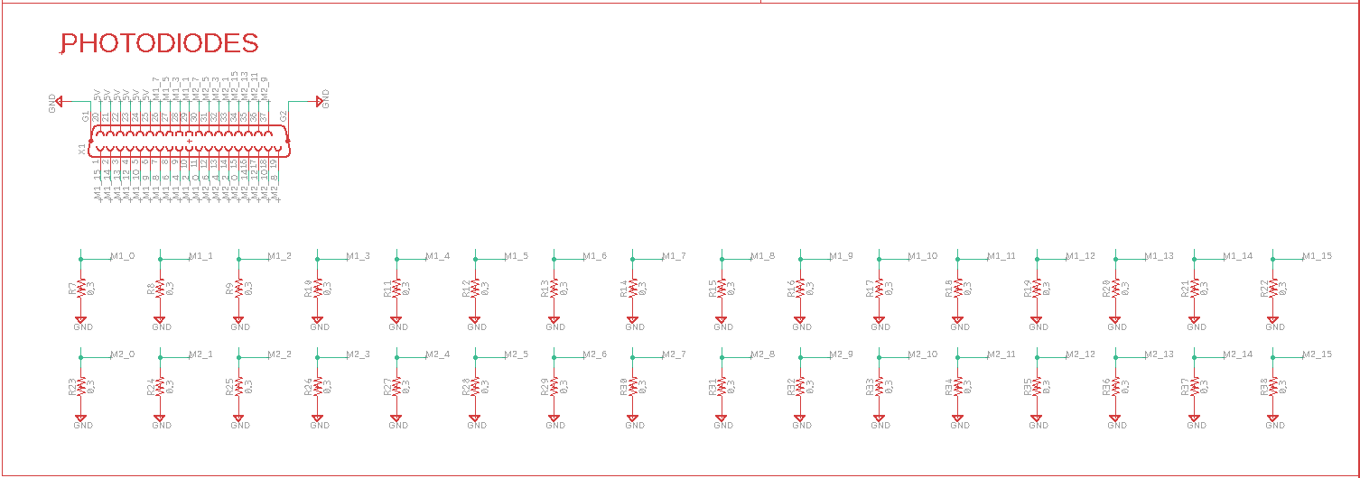
Connector, inputs 32 photodiodes along with multiplexers uses poling to determine whether IR LEDs connection has been severed
Determines user finger location to access IR touch frame

Slide 24
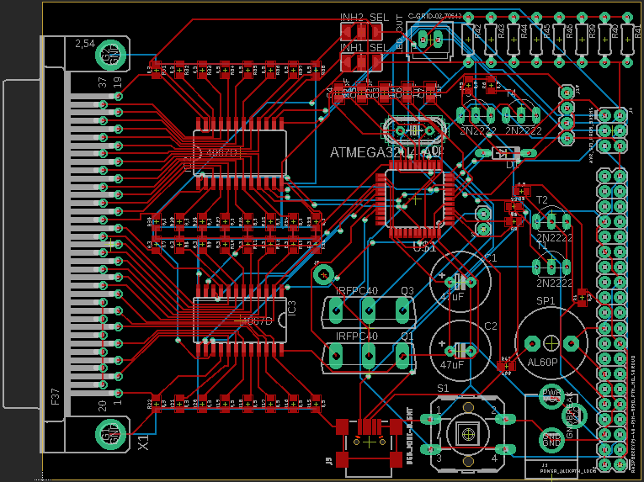
PCB Layout

Slide 25
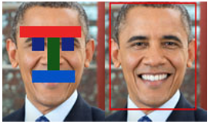
Face Detection
Purpose:
Face detection software extrapolates human faces from images and/or videos based on a set of mathematical rules used to define standard identifiers for human faces.

Slide 26
Face Recognition
Purpose:
This can either be accomplished using the relative position of points on a face or size and shape of an individual’s features.
With face recognition the goal is to determine the face and verify whether the system grants access to the user. Pattern matching is used to determine if the captured image has features consistent with a face and is them compared to data in the xml file.

Slide 27
Face Recognition
Algorithms
Local Binary Patterns
EigenFaces
Each image that is collected for training is divided into a set number of blocks.
  Euclidean Distance Calculation
  Binary Approximation
Eigenfaces are images that can be added to a mean (average) face to create new facial images. We can write this mathematically as
  Dataset Analysis
  Principal Components

Slide 28
Face Recognition
Algorithms
FisherFaces
By tuning the algorithm to extract useful features from the face of each individual separately rather than extracting features from all them combined it will not affect the other individuals feature extraction process. FisherFaces face recognizer algorithm extracts principal components that differentiate one person from another. In that sense, individual features do not become more dominant over the others.

Slide 29
Java Native Interface
Purpose:
An interface that allows Java to interact with code written in another language
Motivation for JNI
Code reusability
Reuse existing/legacy code with Java (mostly C/C++)
Performance
Native code used to be up to 20 times faster than Java, when running in interpreted mode

Slide 30
Unresolved Raspberry Pi Multithreading issues
our shared lib keeps the native code separately within its .so/.dll/.dylib file (depending on which Operating System we’re using) instead of being part of our classes. Because we are linking the native code with a dynamic shared library which then creates a unique set of threads that utilizes rendering the raspberry pi has no native way of handling this. It seems that OS allows rendering only in main thread, which as of the latest stable release is an issue that has not yet been resolved.

Slide 31
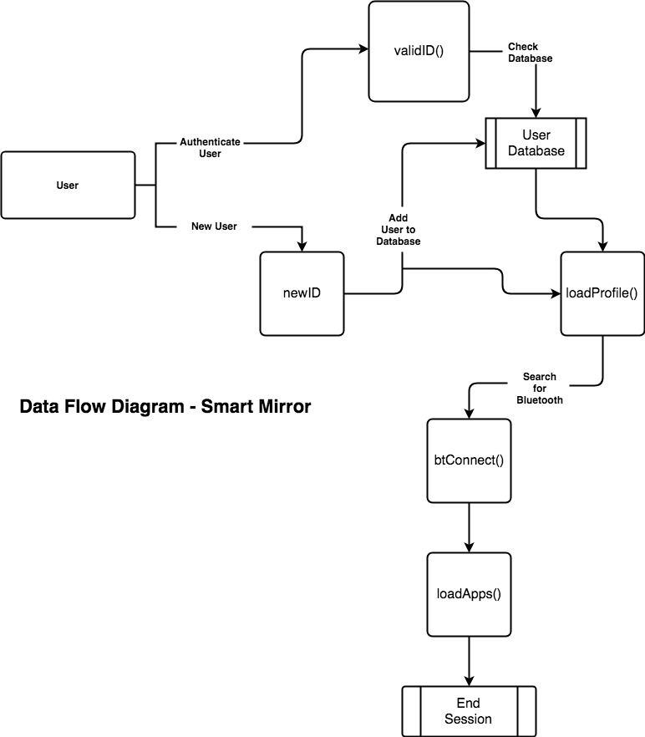
Data Flow Diagram

Slide 32
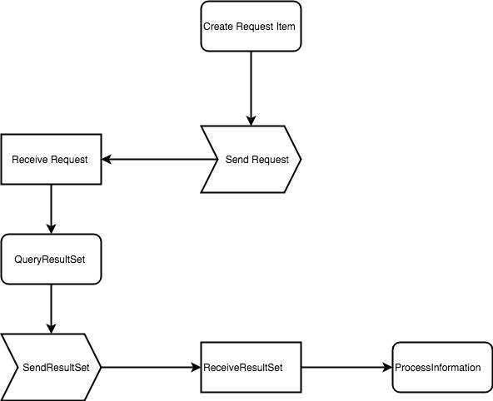
Data Flow Diagram
A fundamental part of improving our productivity is implementing preconfigured API’s that make complex processes very reusable with simple lines of code. The speed of the API allows us to build our application to keep up with pace of our application development.

Slide 33
Budget
Item | # of Units | Cost/Unit | Total Cost
Microcontroller | 3 | $4.12 | $12.36
Raspberry Pi 3 | 1 | $35 | $35
Multiplexers | 4 | $0.95 | $3.8
Camera | 1 | $22 | $22
Two-way mirror | 1 | $50 | $50
Framing wood | 1 | $100 | $100
Switching power supply | 1 | $9.97 | $9.97
Laptop power supply | 1 | $20 | $20
IR LED | 50 | $0.53 | $26.4
Photodiode | 50 | $0.53 | $26.4
PCB | 3 | $11.67 | $35
Display | 1 | $100 | $100
Various Connectors | 20 | $1.25 | $25
Total: $465.93

Slide 34
Work Distribution
Name | IR Frame | Microcontroller | Software | PCB | OpenCV | Power
Matthew Caserto |  | ✓ | ✓
James Timothy |  |  |  | ✓ |  | ✓
Menashe Mordachai | ✓ |  |  | ✓
Greg Eugene |  |  | ✓ |  | ✓

Slide 35
Progression

Slide 36
Problems Encountered
Java Swing library doesn’t have animation support.
Compatibility issues in Raspbian with development libraries.
Problems with crisscrossing when routing the multiplexers in PCB.

