Slide 1

A smarter way of watering your lawn
Group 4
Kenyatta Samuels EE
Marc Simon CpE
Winston Baptiste EE
Donald Miller CpE

Slide 2
Motivation
Average American family of 4 uses 400 gallons of water per day, and about 30% of that devoted to outdoor use
Some experts estimate that more than 50 % of commercial and residential irrigation water is waste due to evaporation, runoff, or over-watering
  Irrigation systems running in the rain
  Over and underwatering of lawn
  Ruptured piped

Slide 3
Goals & Objectives
Wi-Fi connectivity
Rain sensors
Flow meters
Mobile application
Motion detection
Solar powered
Low cost

Slide 4
Requirements Specifications
Identifier | Requirement | Values
SCS-1 | System shall turn system off when soil sensor has reached threshold value greater than 500 | 500
SCS-2 | System shall have the ability to communicate over a 2.4Ghz Wi-Fi connection | 2.4GHz
SCS-3 | System shall turn off when detecting object within 5 meters of PIR motion sensors | 5 meters
SCS-4 | System shall have a Cost of Production less than $1000 | $1000

Slide 5
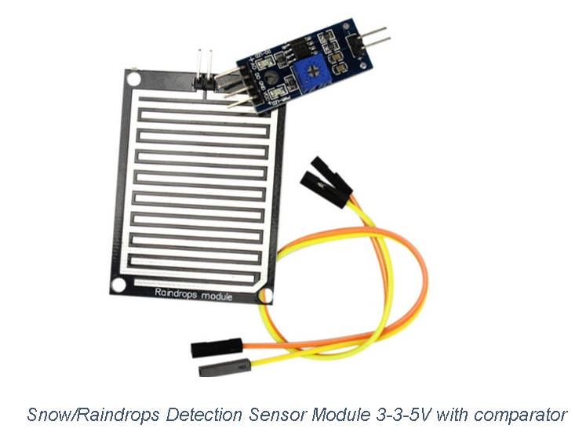
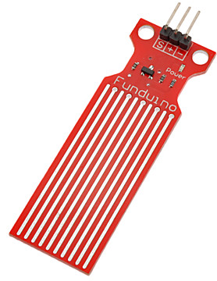
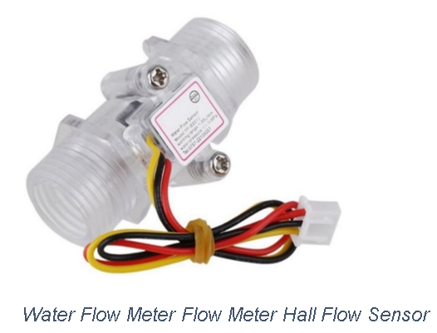
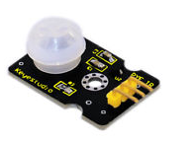
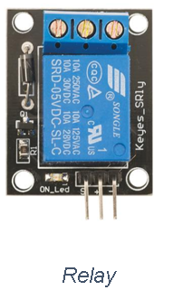
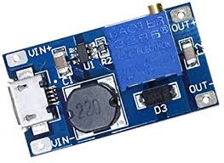
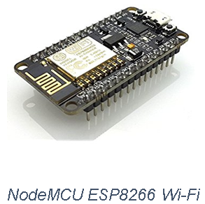

Some Major Parts
3.3-5V 15µA
5V 15mA
3.3-5V 15mA
5V 15mA
3.3V 170mA
5V 15mA
9V 240mA
DC 2-24V to 5V 9V 12V 24V 2A

Slide 6
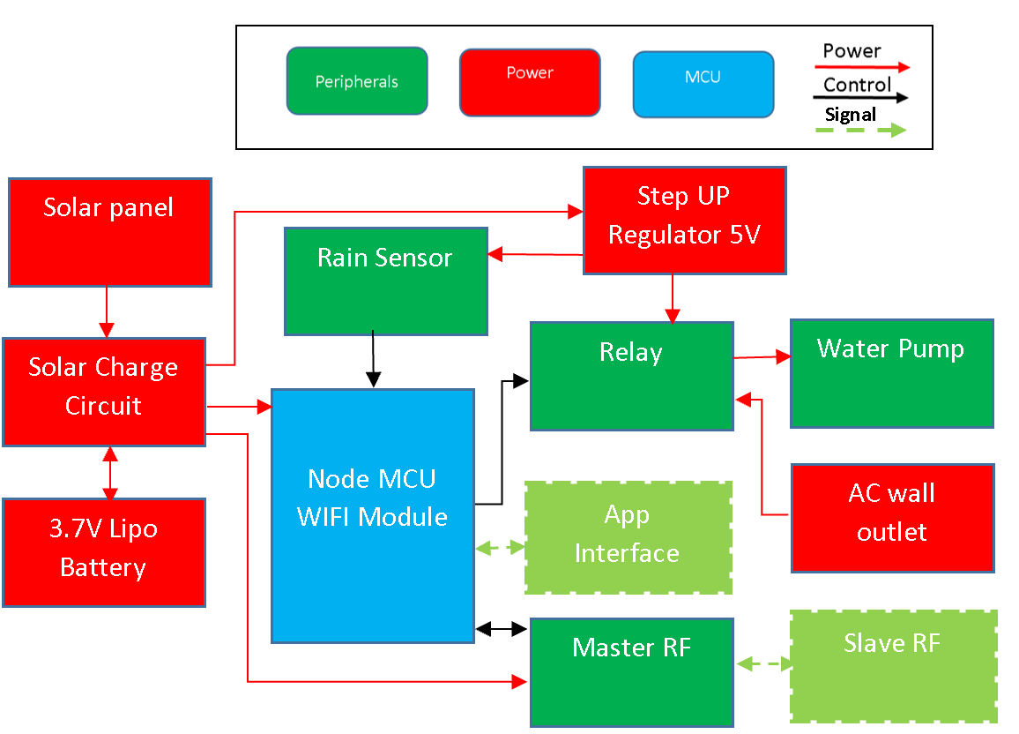
Base Station Block Diagram

Slide 7
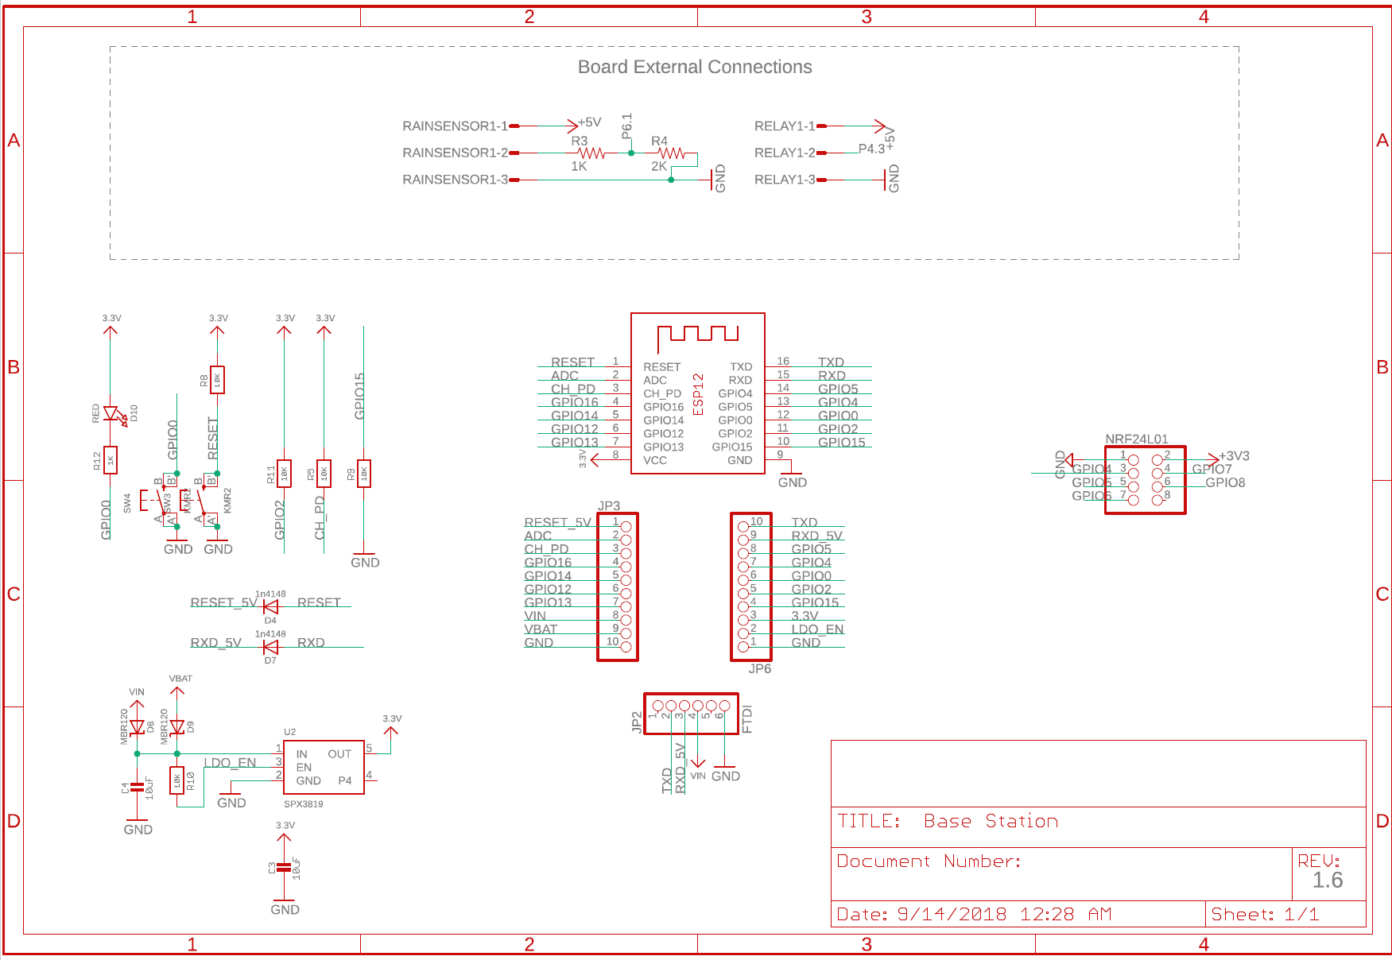
Base Station

Slide 8
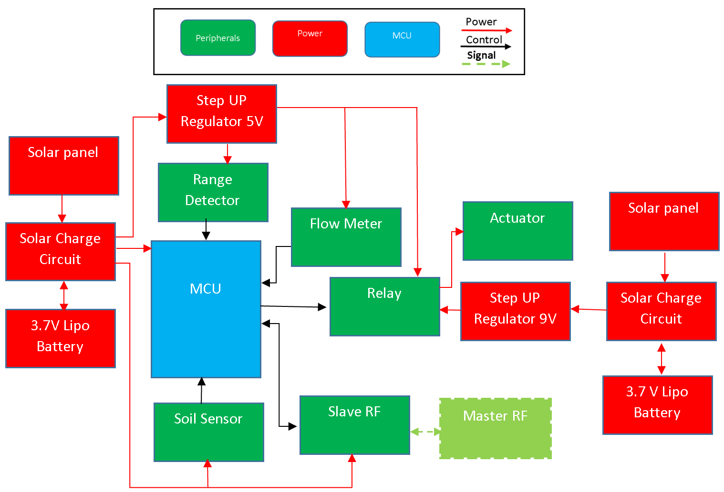
Sprinkler Station Block Diagram

Slide 9
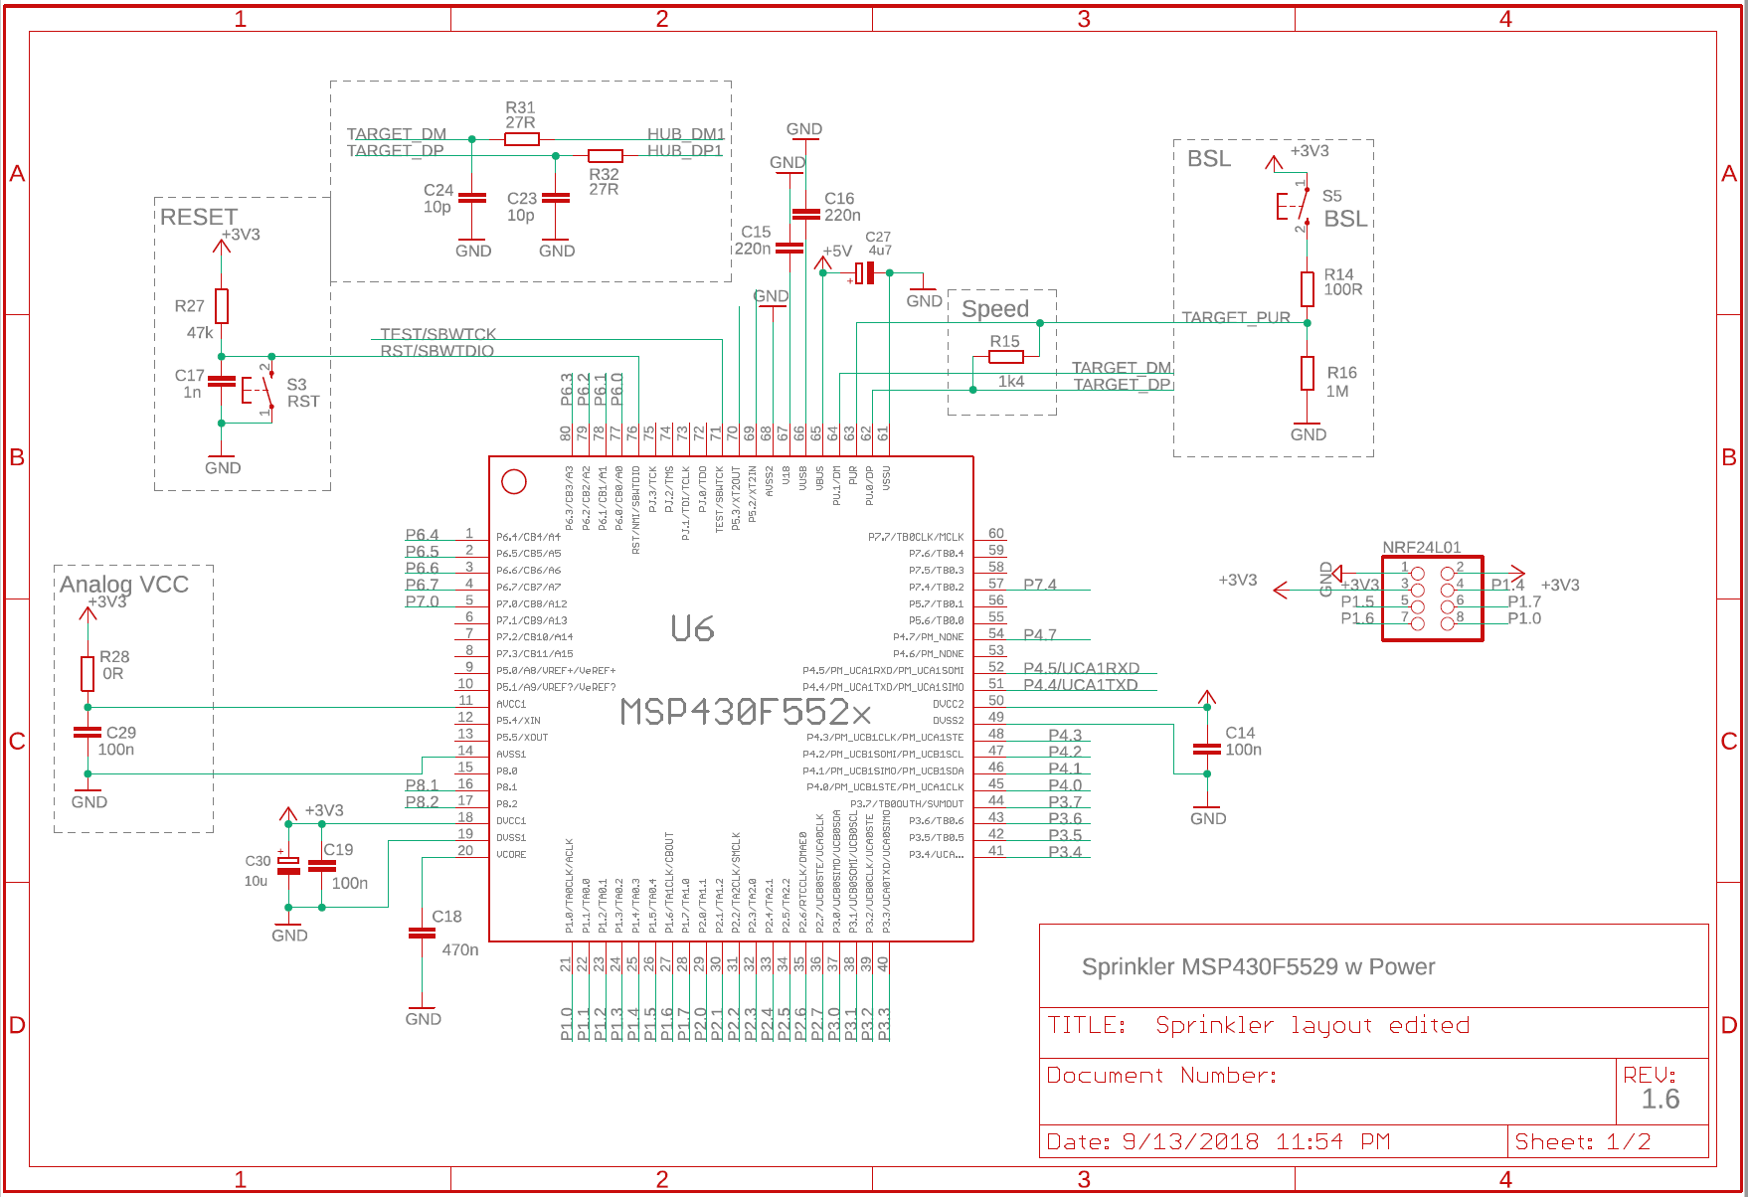
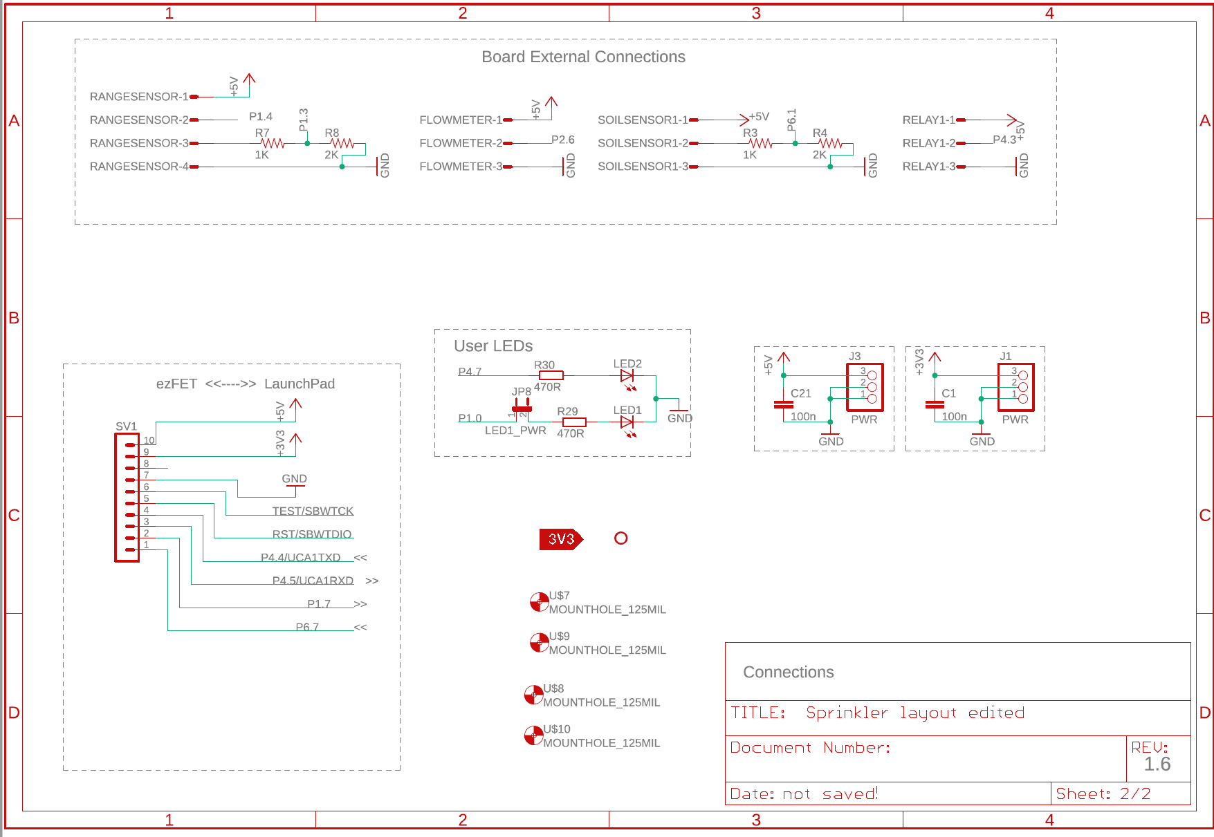
Sprinkler Station Schematic

Slide 10
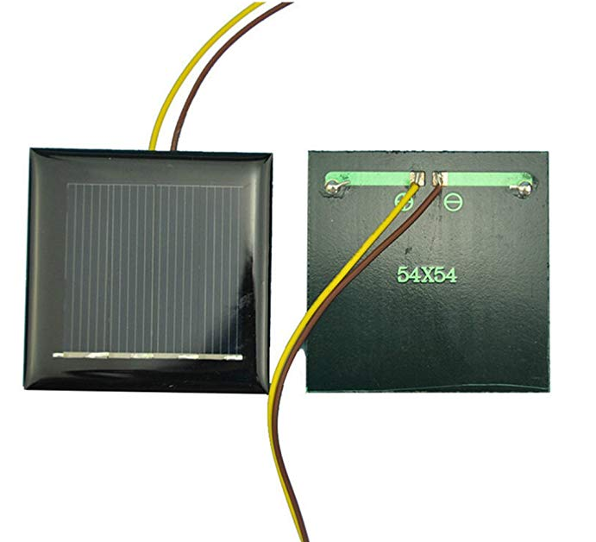
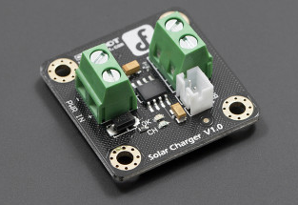
Solar & Charge Circuit
2V 130 mA solar cells photovoltaic panels
Tested maximum current & output voltage in sunny conditions 100 mA and 2.3V
Input Voltage: 4.4 ~ 6V
Charging Current: 500mA Max (Depending on the solar battery supply capability)
Charging Cutoff Voltage: 4.2V
Operating Temperature: -40 ~ 85℃

Slide 11
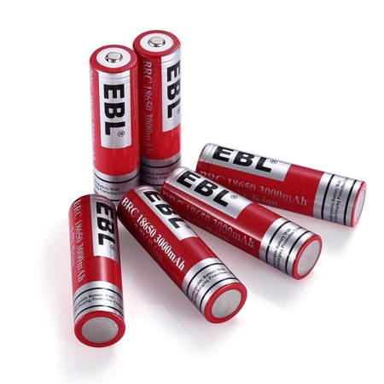
Lithium Battery
3.7 V 30oomAh
Parallel and spot-welded to a protection circuit that provides over-voltage, under-voltage and over-current protection
Max recommended discharge rate: 2.2A
Max recommended charging rate: 1A
Dimensions: 37mm x 37mm x 18mm

Slide 12
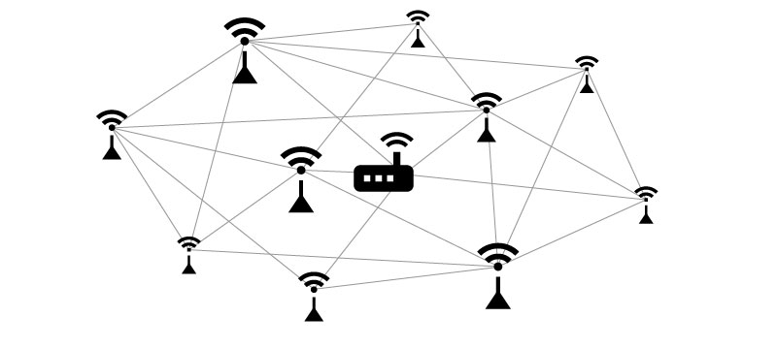
Wireless Mesh Network
Ideal for the Absolute Water system, compared to star or ring network
Self-configurable
Self-healing
Scalable

Slide 13
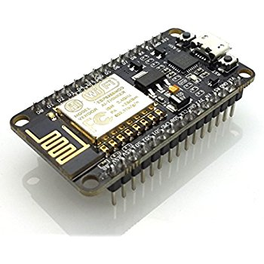
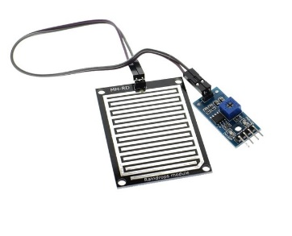
Base Unit Layout
x2 ESP8266 Wi-Fi
Easy to interface and program, will serve as the MCU with Wi-Fi capability.
5V 15ma Relay
Provide control over whole system, located in series between the wall outlet and irrigation pump.
MH-RD Rain Sensor
Only need one for each Absolute Water System

Slide 14
Base Unit Software
Wi-Fi
One of the ESP8266 maintains a connection the local Wi-Fi network. This module will send HTTP POST commands to containing packet data, and HTTP GET requests to receive commands from the web and mobile app.
Mesh Network
The other ESP8266 maintains a constant connection to the mesh network, requesting data from each sensor unit.
Rain Detection
Programmed to trigger the relay upon rain detection.

Slide 15
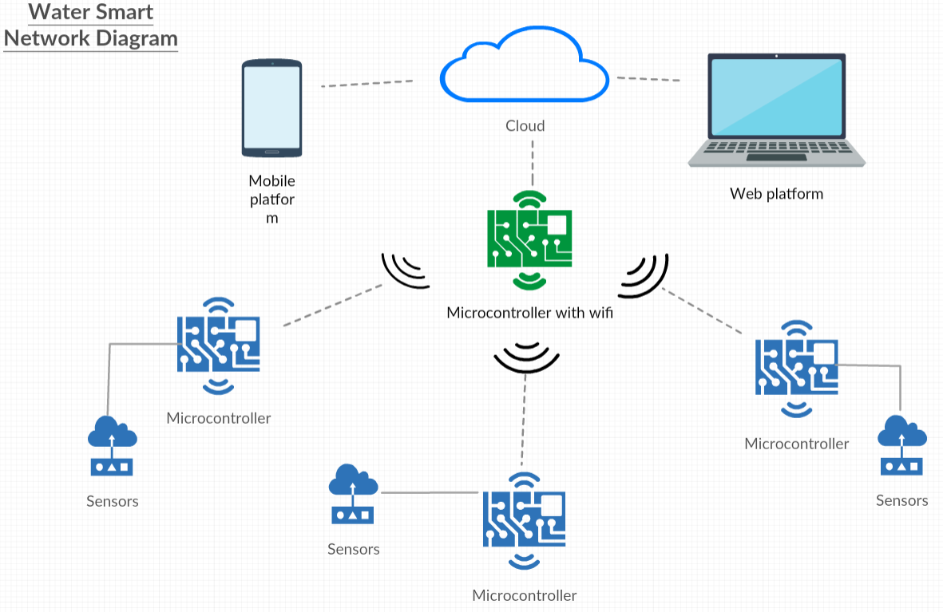
Mesh to Wi-Fi Bridge
Serial Connection
The two ESP8266 are connected physically on the PCB via UART connections. Once the ESP8266 connected to the mesh network receives a data packet, that packet is sent to the Wi-Fi ESP8266, then sent to the cloud analytics platform.

Slide 16
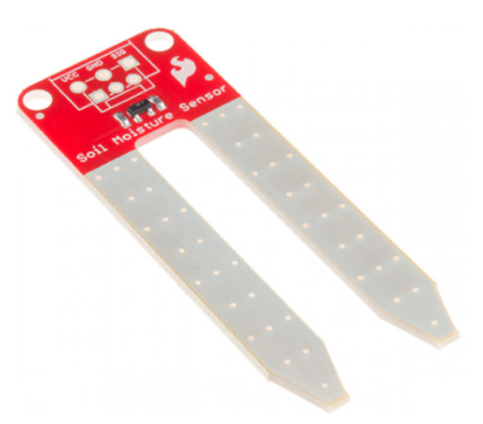
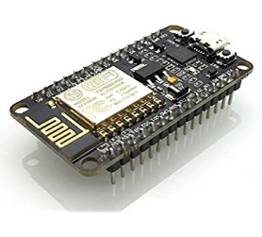
Sensor Unit Software
Motion Detection
Programed to trigger relay upon motion detection. The motion data ( 1 or 0) is also included in the data packet
Soil Moisture
Programmed to trigger relay when a configured threshold value is reached. This data (analog 0 – 1024) is added to the data packet
Flow Meter
Programmed to provide analog values through a digital pin, based on number of turbine revolutions.
Communication
Once a client request is received, the data packet is built and sent through the network

Slide 17
App Design
Steps | Artifacts
Gather Information | Written explanations in Senior Design document
Information Architecture | Site maps/User diagrams
Wireframes | Screen drawings
Workflows | InVision workflow model
Style Guide | Colors, fonts, widgets used throughout design
Development Planning (Agile Model) | Plan
Development | Code
Testing – during development | N/A
Testing – after development | N/A

Slide 18
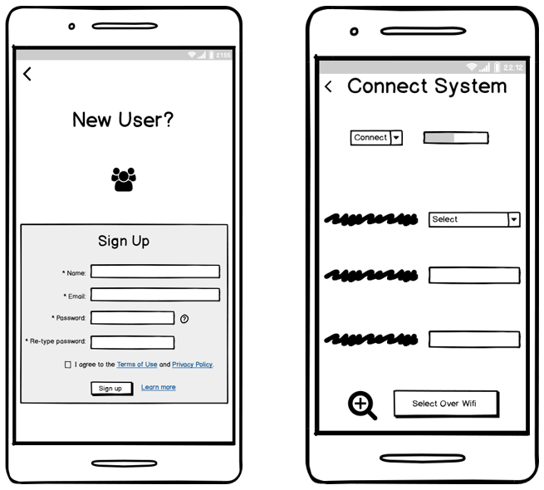
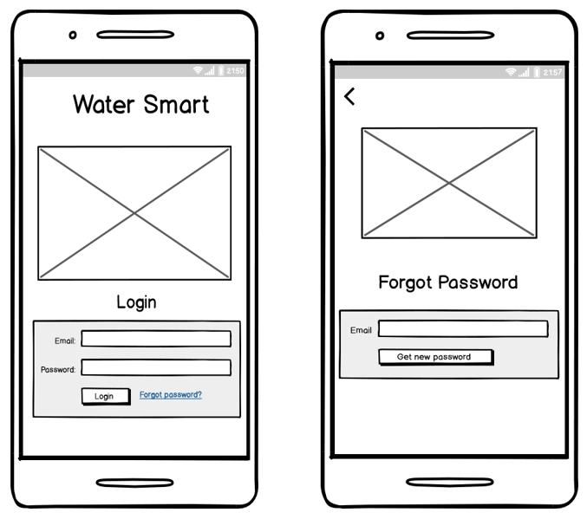
Wireframes

Slide 19
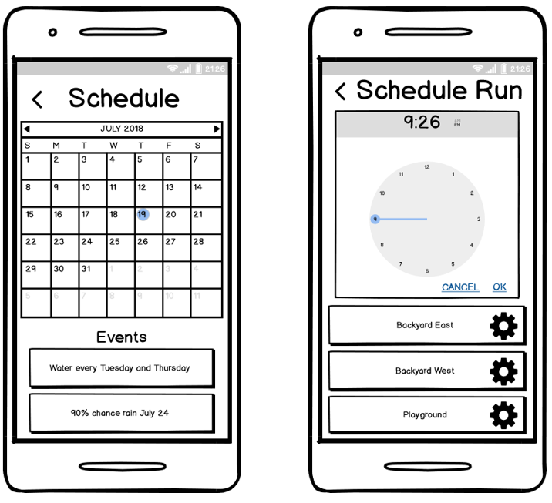
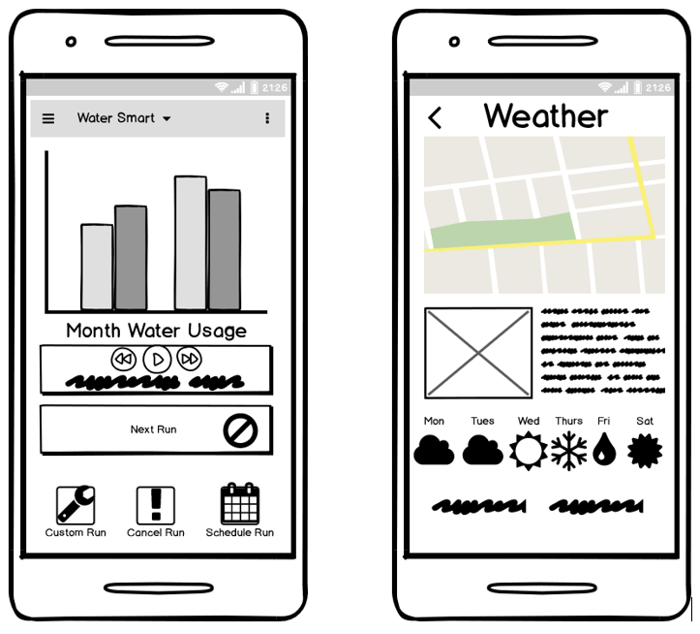
Wireframes

Slide 20
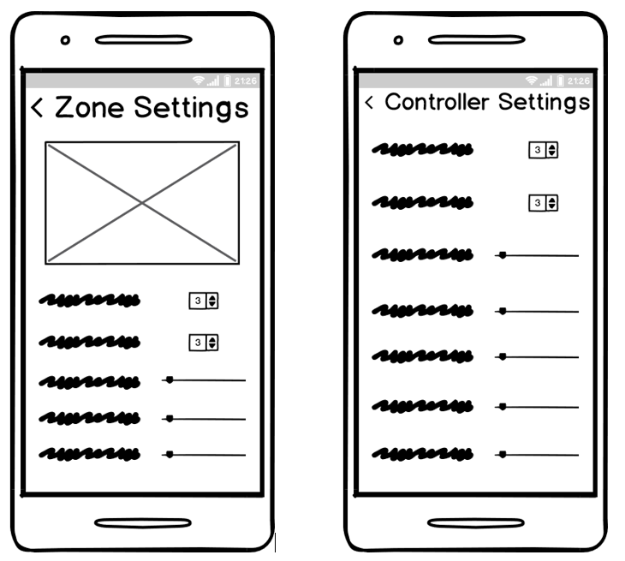
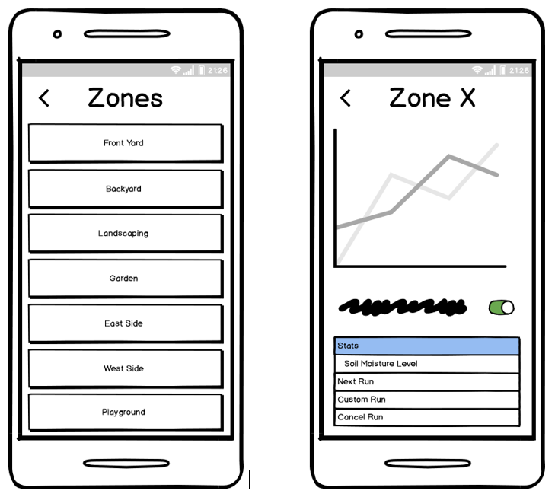
Wireframes

Slide 21
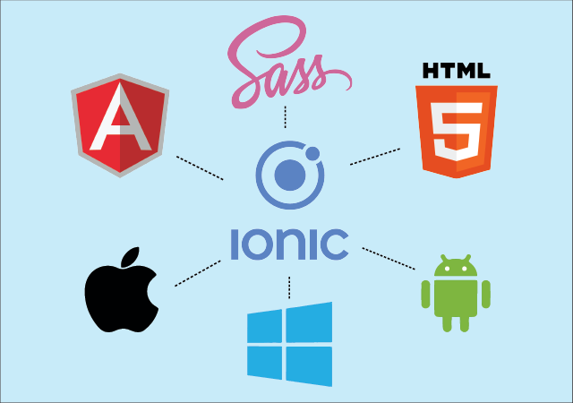
Ionic Framework
Benefits:
Platform Independent – versatile, adaptable
Familiar Angular base – good support, common in industry
Typescript, HTML, CSS – rich, beautiful UI design
Custom Components – don’t need to redesign components, less code

Slide 22

Cordova
Benefits:
Platform Independent – versatile, adaptable
Cordova Plugins – native mobile device features, extends functionality, notifications
Open Source – free to use
Easy to use – low ramp up time

Slide 23
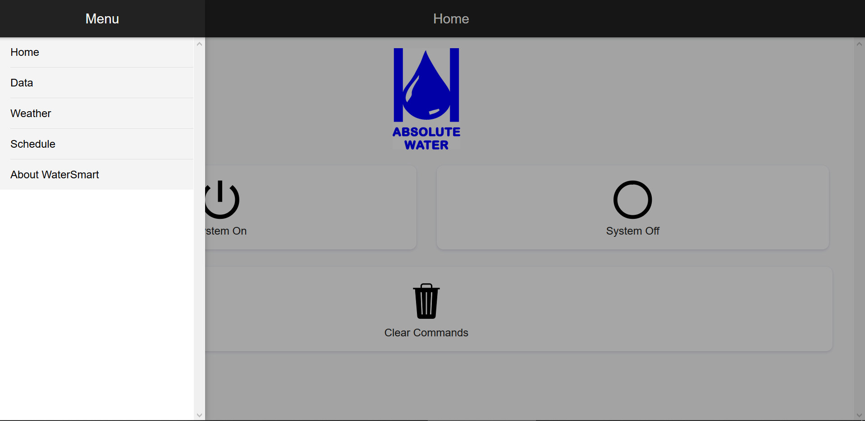
Main pages
Home
Data
Weather
Schedule
About

Slide 24
APIs using HTTP
ThingSpeak
TalkBack
OpenWeather

Slide 25
Issues and Solutions
Issue | Solution
Node package version dependencies | Using stack overflow and github find the best version combinations for packages.
Implementing API with unknown data | Create custom interface that mimics the data expected from APIs
Ionic build – white screen of death | Using Chrome Dev Tools and Android Emulator, debug the errors found
Sign up and Login | Given time constraints, remove sign up and login functionality for now and document as stretch goals
Weather Data only on Weather Page | Creating storage service, implement SQLlite to persist data across app and even offline

Slide 26
Budget

Slide 27
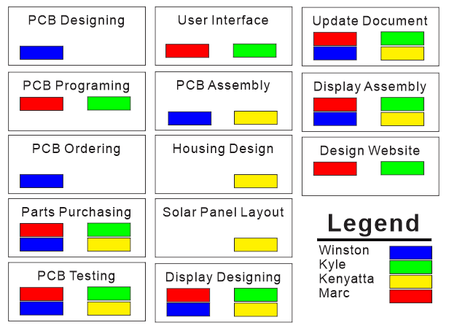
Distribution of Work

Slide 28
Questions?

