Slide 1
TankBot
Autonomous Turret Mounted Sentry Robot
Group 1
Stephen Greene, EE
Anthony Speake, EE
Conan Wilson, EE
Emanuel Sotomayor, EE
Notes:
Stephen 20 seconds

Slide 2
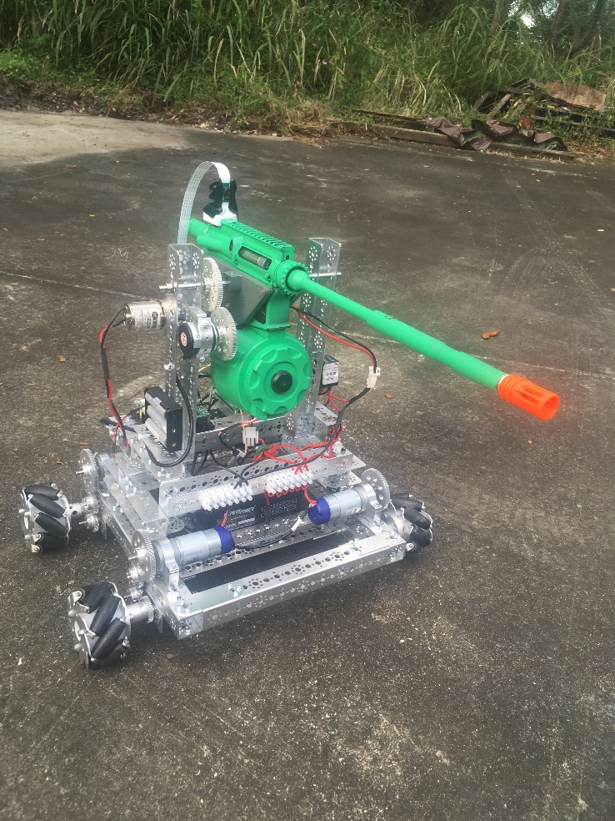
Introduction
TankBot is an autonomous robot featuring:
  A turret mounted airsoft gun, to simulate a firearm in the abstract
  A locomotive base, to facilitate both patrol and search and destroy missions
  A computer vision system, to identify threats
  A Desktop program for external control or mode setting
Notes:
Stephen 15 seconds

Slide 3
Motivation
TankBot is valuable for its ability to:
  Replace humans in dangerous situations(warfare, security, urban combat, etc)
  Operate independently from humans
  Make critical decisions in a timely manner.
Notes:
Stephen 25 seconds

Slide 4
Project Objectives
The external program will be able to:
  Put TankBot into various modes (Follow, attack, sleep, etc)
  Send commands to the robot for direct control
  Receive a direct video feed from the TankBot for real-time remote control
TankBot will be able to:
  Detect a target
  Follow a target
  Point the mounted weapon at a target
  Hit the target with a 20% accuracy.
Notes:
Stephen 40 seconds

Slide 5
Requirements and Specifications
Battery Life | 30 minutes minimum
Computer Vision Accuracy | Recognize 90% of targets at 20 ft.
Locomotion | Up to 1.5 MPH
Rotational Speed | 10 rpm
Firing Accuracy | 20% hit rate
Weight | Less than 30 lbs
Notes:
Stephen 35 seconds

Slide 6
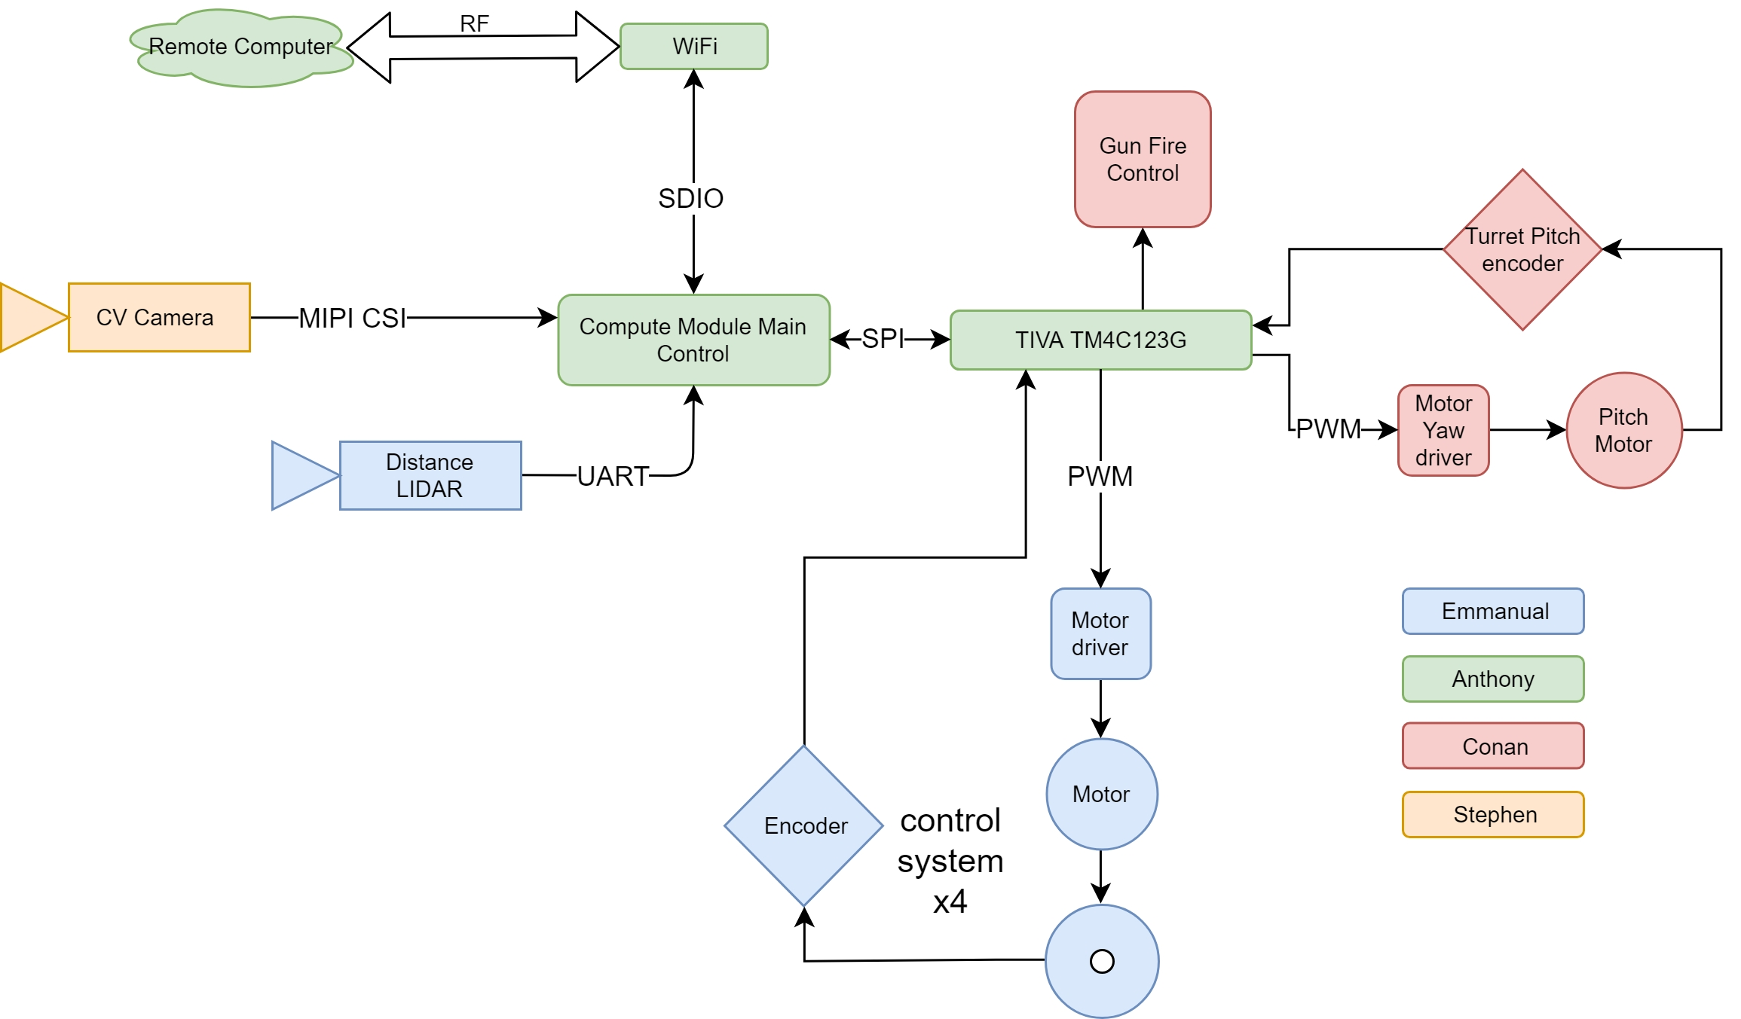
Overall System Hardware Design
Notes:
???
Conan

Slide 7
Overall System Hardware Design
The hardware of TankBot is split into 5 major component units:
  Firing System
  Wireless Access
  Information Acquisition
  Locomotive Systems
  Main Processor
Notes:
???
Conan

Slide 8
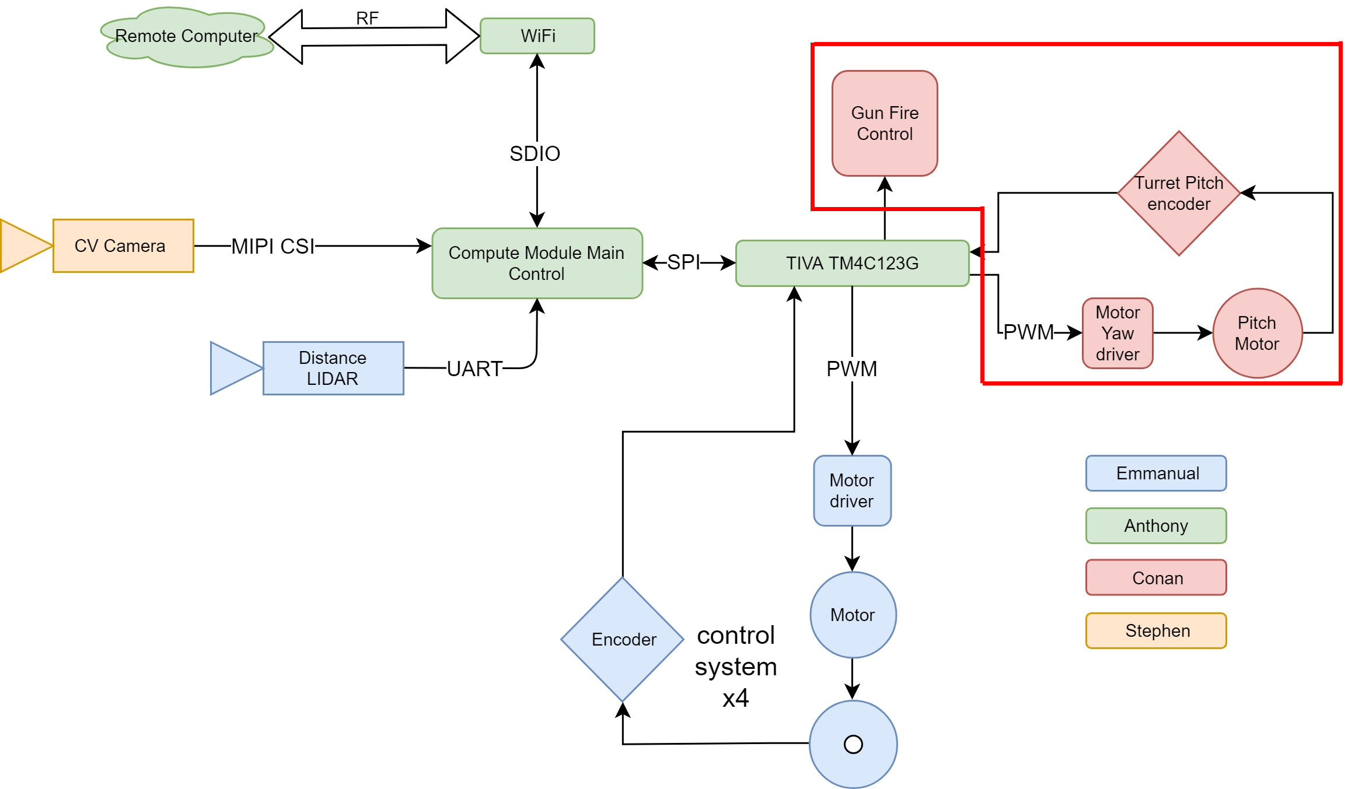
Firing System Control
Notes:
Conan

Slide 9
Fire System Control
Gun selection
  Non-negotiable factors influencing gun selection
    Fire rate (higher than design specifications)
    Weight and volume (as low as possible)
    Electronically controllable
    Construct material (metal)
  Final gun selection: M4 airsoft electronic gun
Notes:
Conan

Slide 10
Fire System Control
Frame
  Turret frame construction factors:
    Weight (as low as possible)
    Sturdiness (able to carry the gun and rotate effectively)
  Ultimately made of aluminum
  Use of high-strength gears
Notes:
Conan

Slide 11
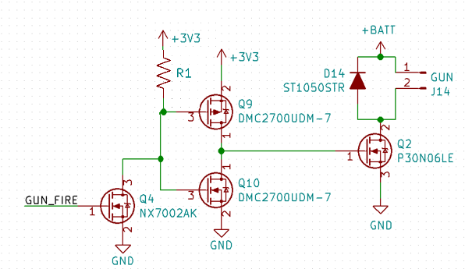
Fire System Control
Fire and Reload
  Gun-switching will be achieved by MOSFET push-pull with flyback diode circuit
    Power MOSFET will be utilized to drive external relay
  The central microcontroller will instruct the gun to fire or hold
  Reloading will be achieved by the same circuit as the gun-switching
Notes:
Conan

Slide 12
Fire System Control
Turret pitch
  Operated by full rotation DC motors through a coupled gear system
  Controlled through a Texas Instruments TIVA microcontroller
  Encoders will provide feedback about current angular positions of the turret
    This feedback is used to aim the gun and prevent the obstruction of the gun by the surroundings
Notes:
Conan 8-13

Slide 13
Fire System Control
The laser currently installed on TankBot will simulate the action of the gun
  The group couldn’t clear the airsoft gun on campus
  The same firing circuit it still in effect, it just powers the laser rather than the firing mechanism of the airsoft gun.

Slide 14
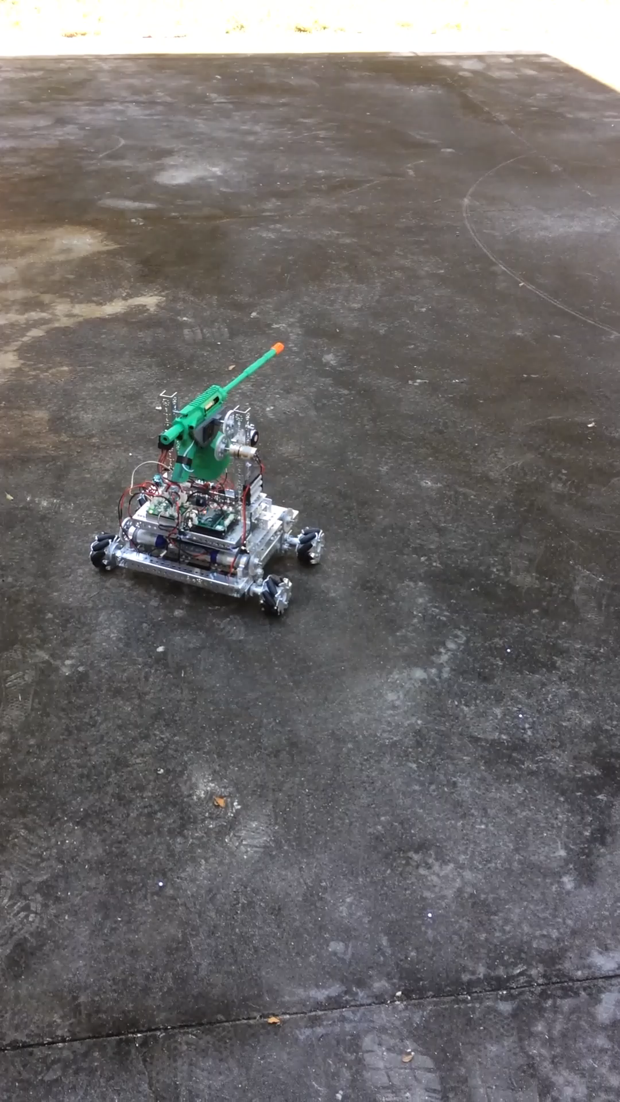
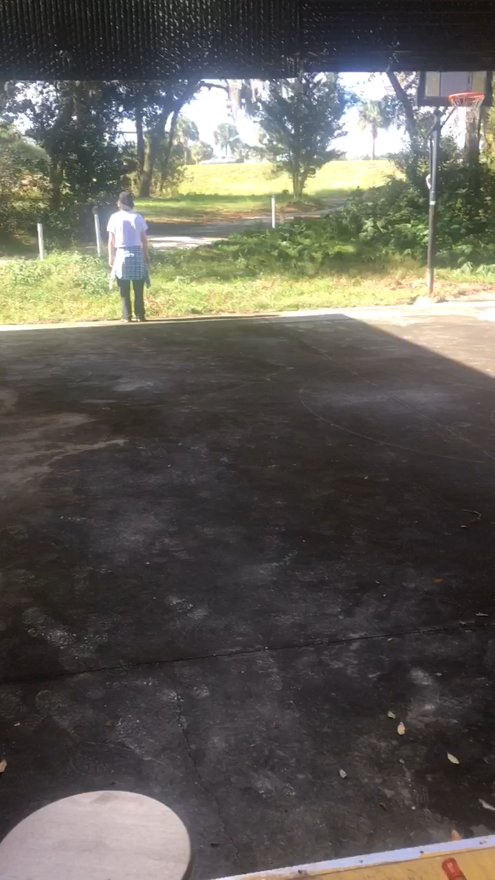
Gun Fire Example
Notes:
Conan

Slide 15
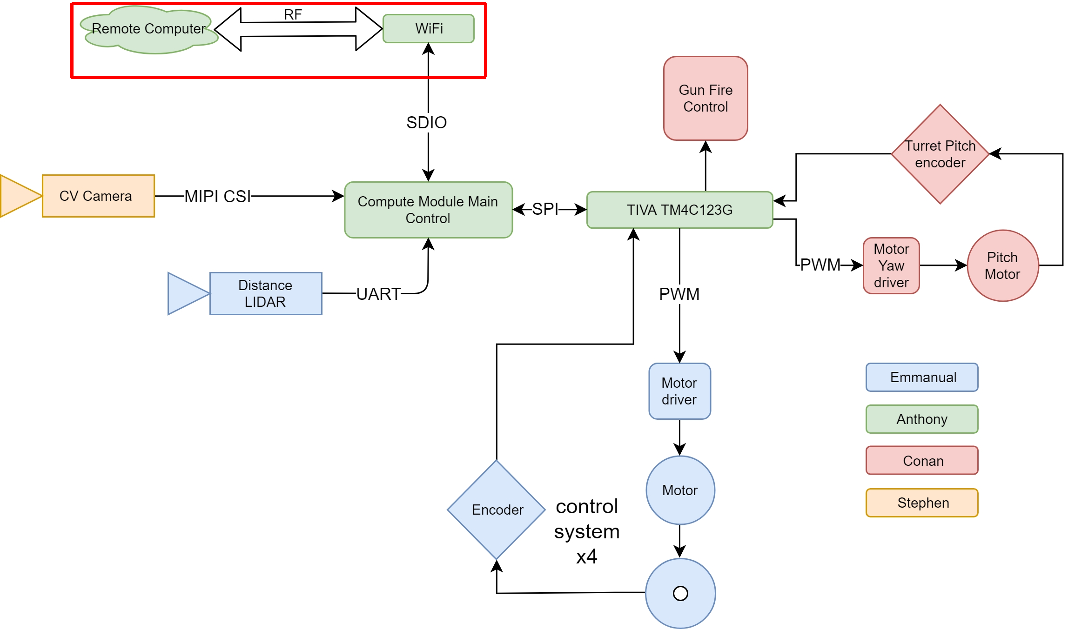
Wireless Access
Notes:
Anthony

Slide 16
Wireless Access
WiFi
  Hardware: ATWILC3000 wireless module
  Software: Modified Linux driver based on Linux4WILC source
Remote Program
  Control: byte stream from remote program to TankBot
  Commands: sends processed movement vector from controller, fire command and bot active state
Remote Control
  Xbox 360 Controller, or by GUI buttons
Notes:
Anthony

Slide 17
Wireless Access
WiFi chosen for high bandwidth video streaming and already available communication protocols.
Cheaper modules such as ESP offer lower speeds.
 | ESP8266 | ATWILC1000 | ATWILC3000
IEEE 802.11 Support | b/g/n | b/g/n | b/g/n
Bluetooth support | No | No | Yes BLE 5.0
Advertised max speed | 72.2 Mbps | 72.2 Mbps | 72.2 Mbps
Tested max speed | 4 Mbps | 4Mbps | 20Mbps
Driver Support | 3rd party | 1st party | 1st party
Power Output | +20.5 dBm | +19 dBm | +19 dBm
Sensitivity | -98 dBm | -98 dBm | -98 dBm
Antenna type | Integrated Trace | Integrated Trace | Integrated Chip
External Interface | SPI | SPI/SDIO | SPI/SDIO
Cost | $2-$4 | $7.34 | $10.14
Notes:
Anthony

Slide 18
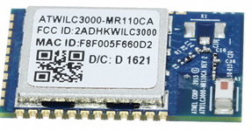
Wireless Access
ATWILC3000 WiFi+BT Wireless Module
Tested bandwidth speeds up to 20mbps
50MHz, 4 bit SDIO communication interface
Open source driver provides ability to port to different processors on Linux
Compact module provides easy integration
Cost: $10.14
Notes:
Anthony

Slide 19
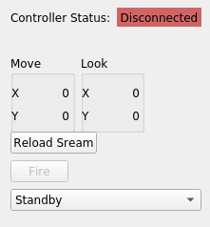
Remote Control Program Layout
Notes:
Anthony 14-17

Slide 20
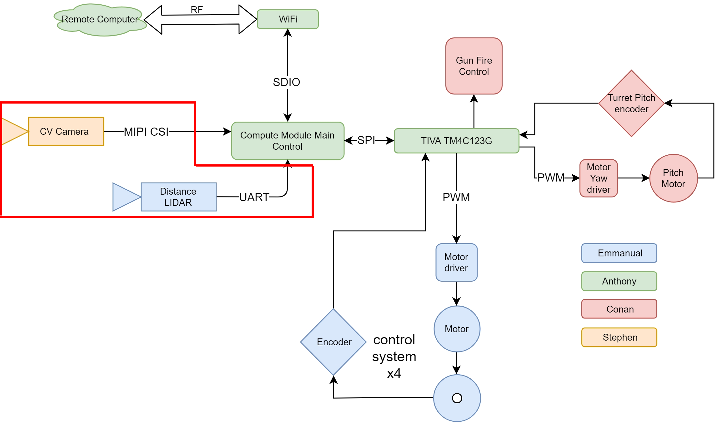
Information Acquisition
Notes:
Stephen 18-22 5 seconds

Slide 21
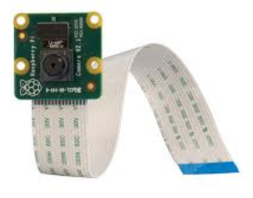
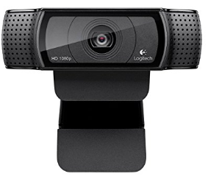
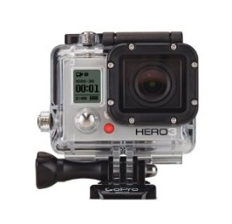
Information Acquisition
Name | Field of View | Frame Rate (max) | Resolution (max)
Raspberry Pi Camera Module v2 | Medium | 15 | 3240 x 2464
Logitech HD Pro Webcam | Ultrawide | 30 | 1920 x 1080
GoPro Hero3 White Edition | Wide | 30 | 2592 x 1994
Notes:
Stephen 40 seconds

Slide 22

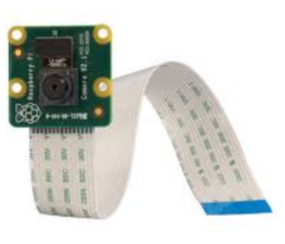
Information Acquisition
Camera Hardware
  The Raspberry PI Camera Module V2 has a variable resolution and frame rate allowing us to adjust these values to optimize the CV's recognition of targets at various distances.
  Sony IMX219 8-megapixel sensor
  Supports 1080p30, 720p60 and VGA90 video modes, as well as still capture
  Attaches via a ribbon cable to the CSI port
Notes:
Stephen 40 seconds

Slide 23
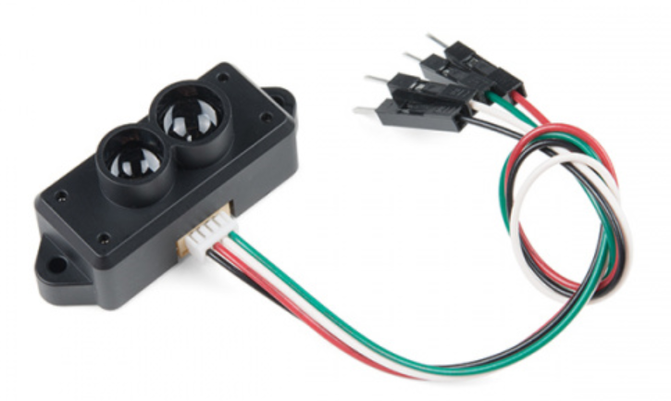
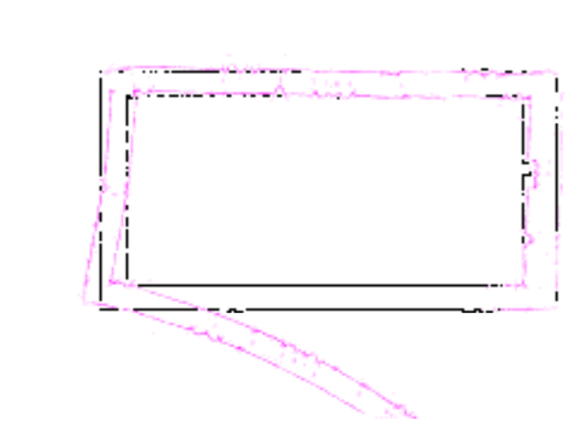
Information Acquisition
LiDAR
  The TFMini is small time of flight based LiDAR system with a max range of 12 meters.
  Using the LiDAR we will detect the distance of objects in front of the robot. This information will be used to determine whether the bot should move towards a target or maintain a distance from said target.
Example of Drift in SLAM mapping.
Notes:
Stephen 30 seconds

Slide 24
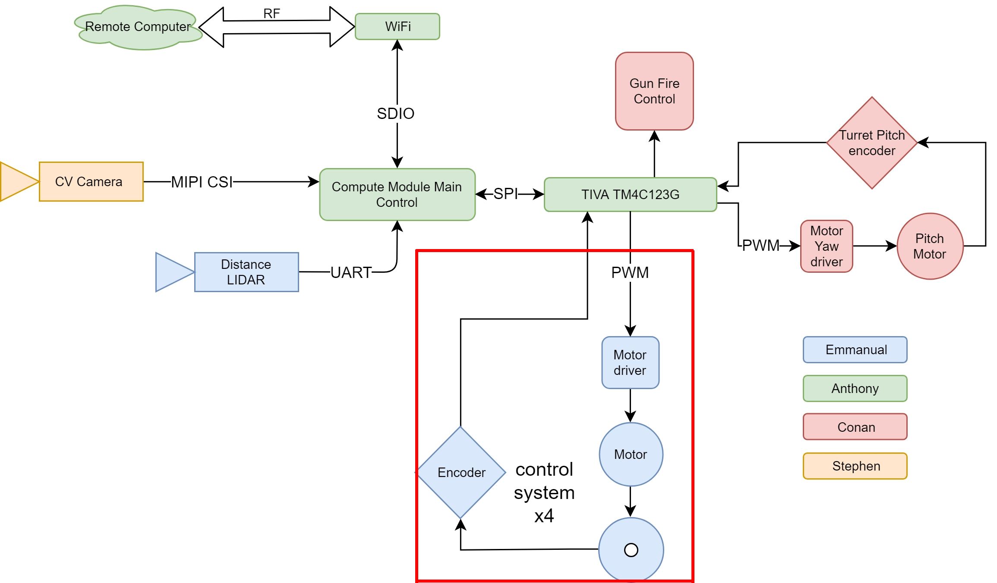
Locomotive System
Notes:
Emmanuel

Slide 25
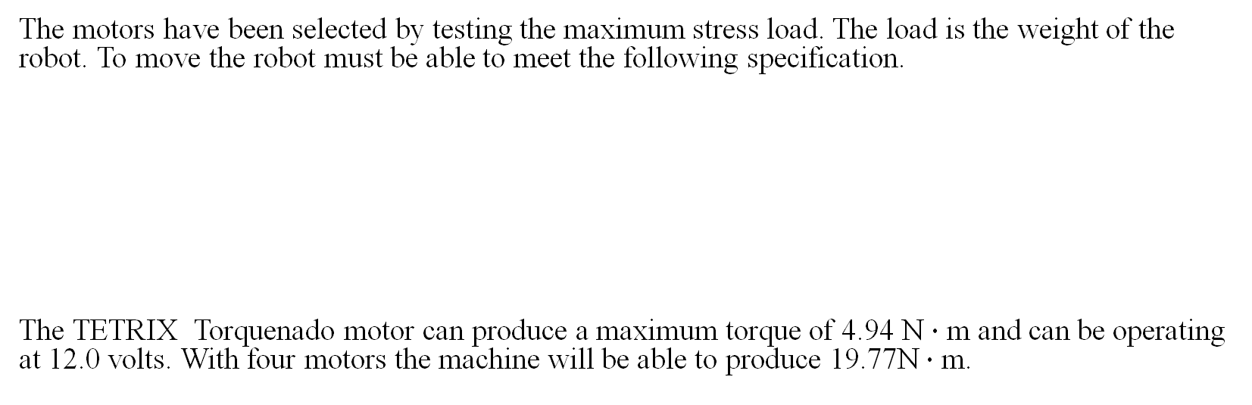
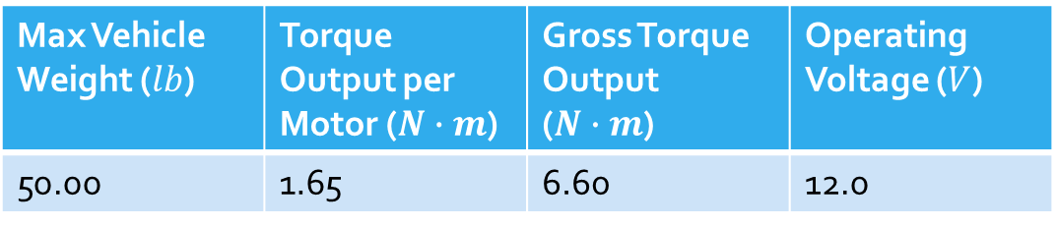
Motors
The motors have been selected by testing the maximum stress load. The load is the weight of the robot. To move the robot must be able to meet the following specification.
The TETRIX Torquenado motor can produce a maximum torque of 4.94 N $∙$ m and can be operating at 12.0 volts. With four motors the machine will be able to produce 19.77N $∙$ m.
Max Vehicle Weight ($lb$) | Torque Output per Motor ($N∙m$) | Gross Torque Output ($N∙m$) | Operating Voltage ($V$)
50.00 | 1.65 | 6.60 | 12.0
Notes:
Emmanuel

Slide 26
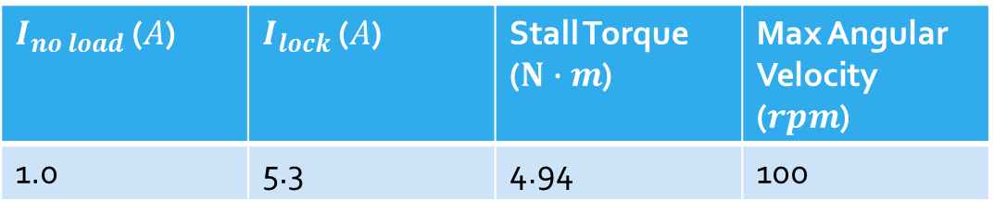
Motor Model
To model the motor the following equations were used.
The following table are the characteristics of the motor.
$I_{no load}$ ($A$) | $I_{lock}$ ($A$) | Stall Torque ($N∙m$) | Max Angular Velocity ($rpm$)
1.0 | 5.3 | 4.94 | 100
Notes:
Emmanuel

Slide 27
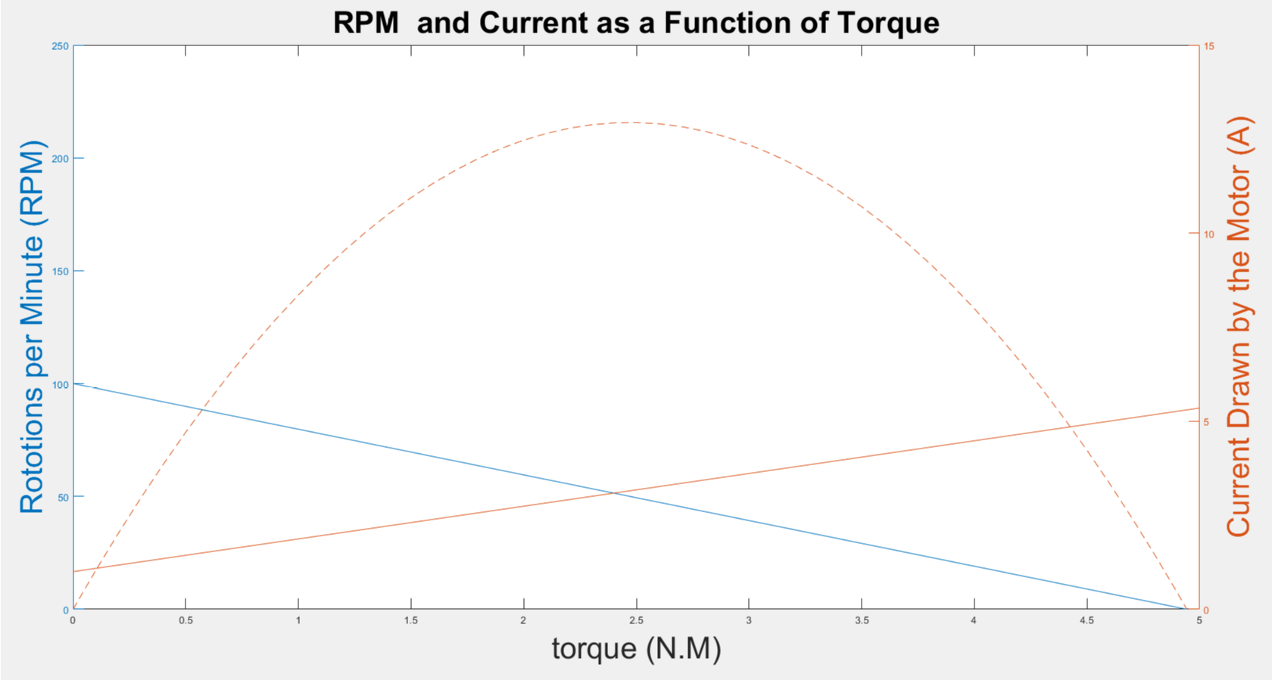
Characteristic of the Motor
Notes:
vEmmanuel

Slide 28
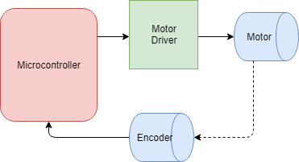
Control Feedback System
To control the movement of the wheels, the motors will be in a feedback system, reading the wheel movement back to the microcontroller (MCU).
The system will take the change in wheel position and get velocity and amount traveled.
Notes:
Emmanuel

Slide 29
Logic of Locomotion
The locomotion of the robot will be given by receiving orders from the main processor to the microcontroller that controls the driver.
The order will consist of data collected by Lidar and CV and processed into motor vector commands for each motor.
Notes:
Emmanuel

Slide 30
Motor Driver
The following specs were considered for the selection of the motor driver.
Another consideration will be the amount of heat produced by the device. The maximum power outputted will be 96 watts of power.
Voltage Input (V) | Voltage Output (V) | Current Output (A) | Dimension
12.0 | 12.0 | 8.00 | Small
Notes:
Emmanuel
23-29

Slide 31
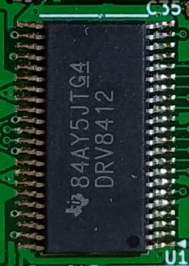
Motor Driver
Texas Instruments DRV8412
Benefits:
Can output up to 6 Amps of continuous current at the specified voltage
Integrated with self-protection circuits
Drawbacks:
For the maximum current output, there would be one driver per motor
Cost: free
Notes:
Emmanuel

Slide 32
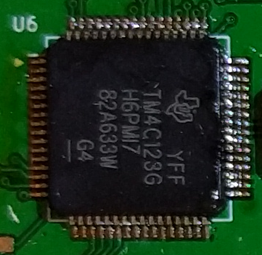
Motor Control Processor
Texas Instruments TIVA TM4C123GH6PMT7
ARM Cortex M4 Architecture.
Benefits:
  16 independent controllable PWM outputs designed specifically for motor control
  Outstanding processing performance combined with fast interrupting handling
  Cost: $11.27
Notes:
Emmanuel

Slide 33
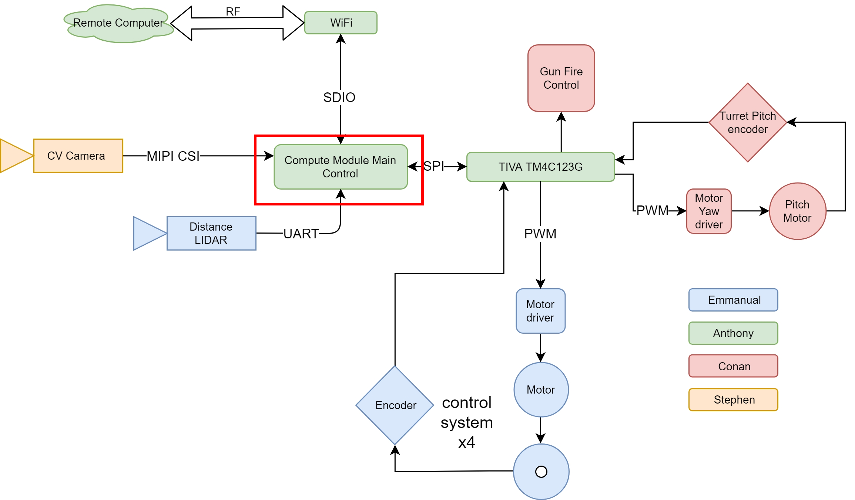
Main Processor
Notes:
Anthony

Slide 34
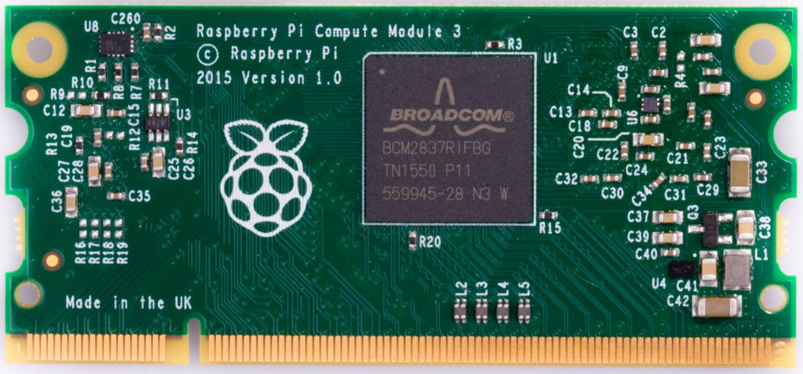
Main Processor
Broadcom BCM2837 in a DDR2 package (Raspberry Pi Compute Module 3)
Benefits:
  Re-usable between board revisions
  Cheaper than buying BCM2837 chip directly due to bulk sales
  Full ARM64 v8 instruction set with Linux support
  200pin DDR2 package offers a convenient breakout of all pins for use
Cost: $30-$45
Notes:
Anthony

Slide 35
Main Processor Power Supplies
5V power supply: MIC261201 Switching Buck Regulator
  4.5V-28V voltage input, 0.8V to 5.5V adjustable output
  Any Capacitor Stable, low to high ESR
  12A rated max continuous current output
  Up to 95% efficiency
  Cost: $0 (free samples)
3.3V and 1.8V power supply: PAM2306 Dual Switching Buck Regulator
  2.5V-5.5V input, 1.8V and 3.3V fixed output
  Chosen because of proven performance on all raspberry pi 2 and 3 models, low cost
  1A output on each rail
  Cost: $0.71
Notes:
Anthony

Slide 36
Battery Safety
Voltage Supervisor: LTC2953F
  Monitors input voltage, shuts off system when value falls below a programmable threshold, 9V for lithium.
  Controls power input to main processor for safe shutdown and power on.
  Push-Button control allows for manual startup in the event of a power fault or shutdown.
  Cost: $0 (free samples)
Notes:
Anthony

Slide 37
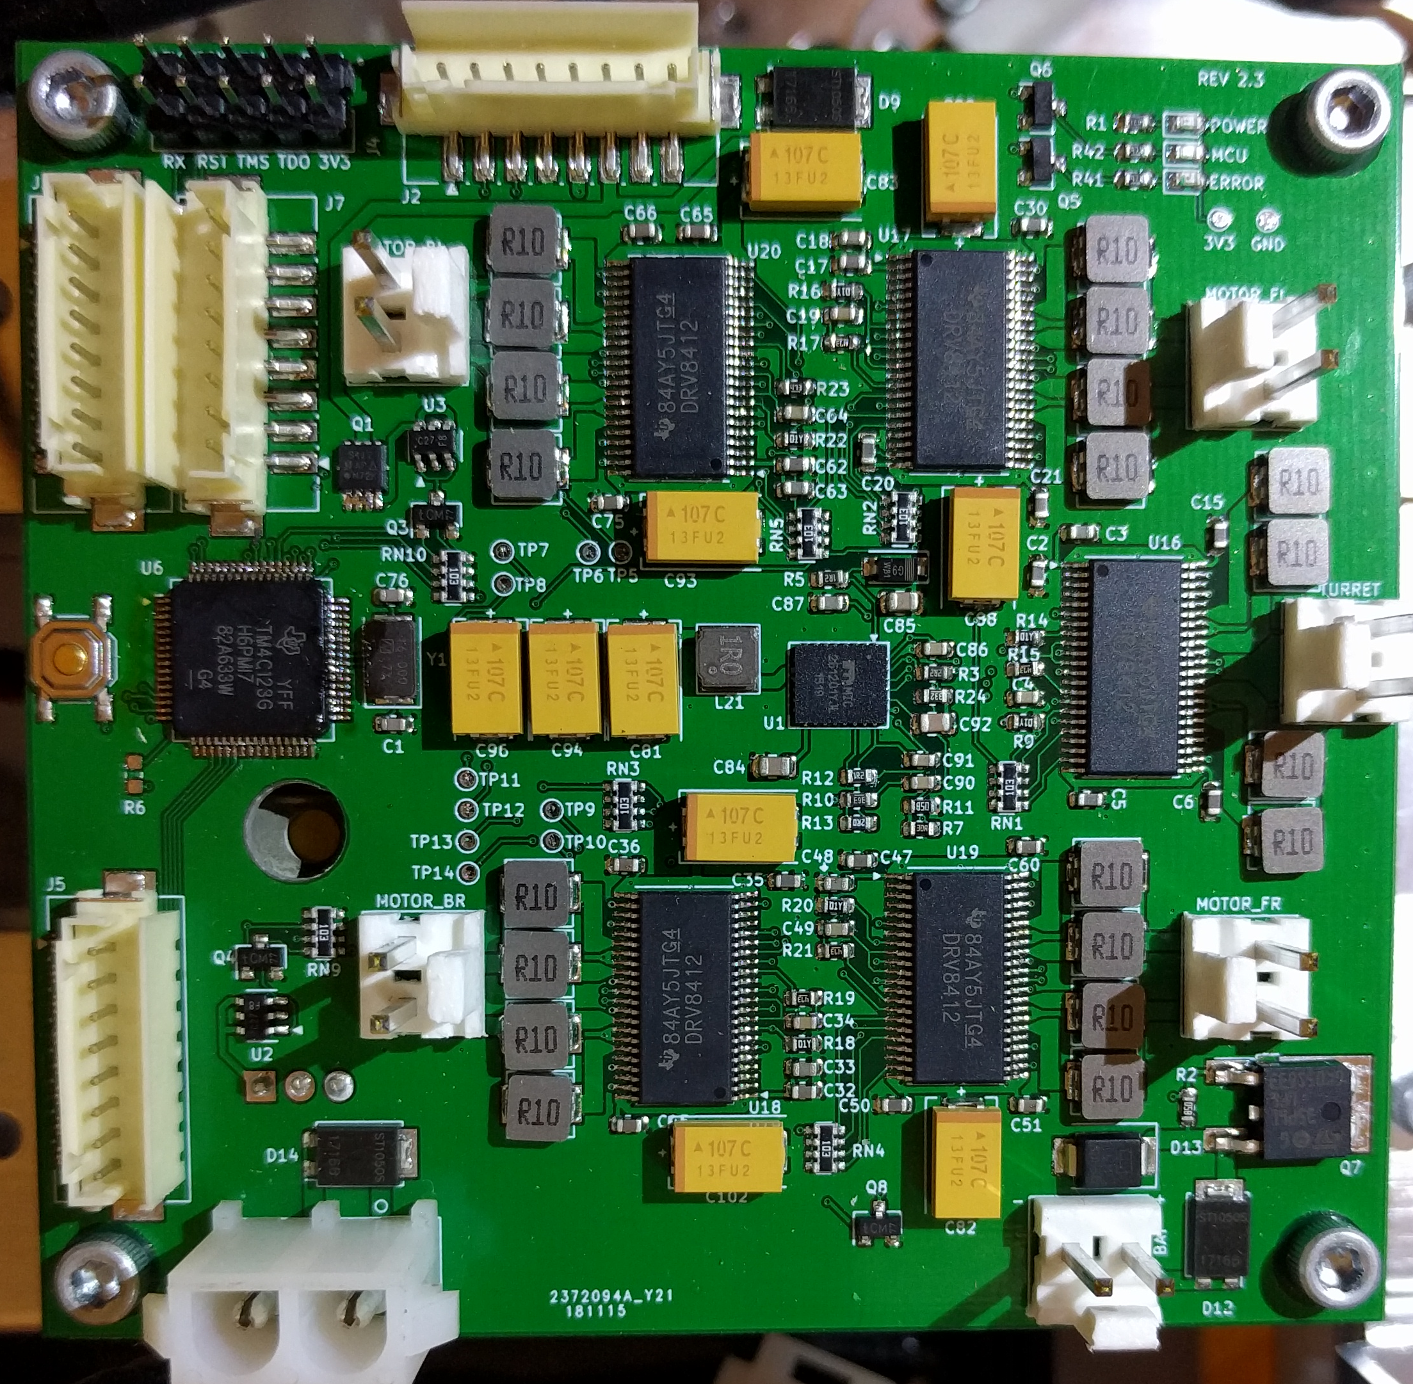
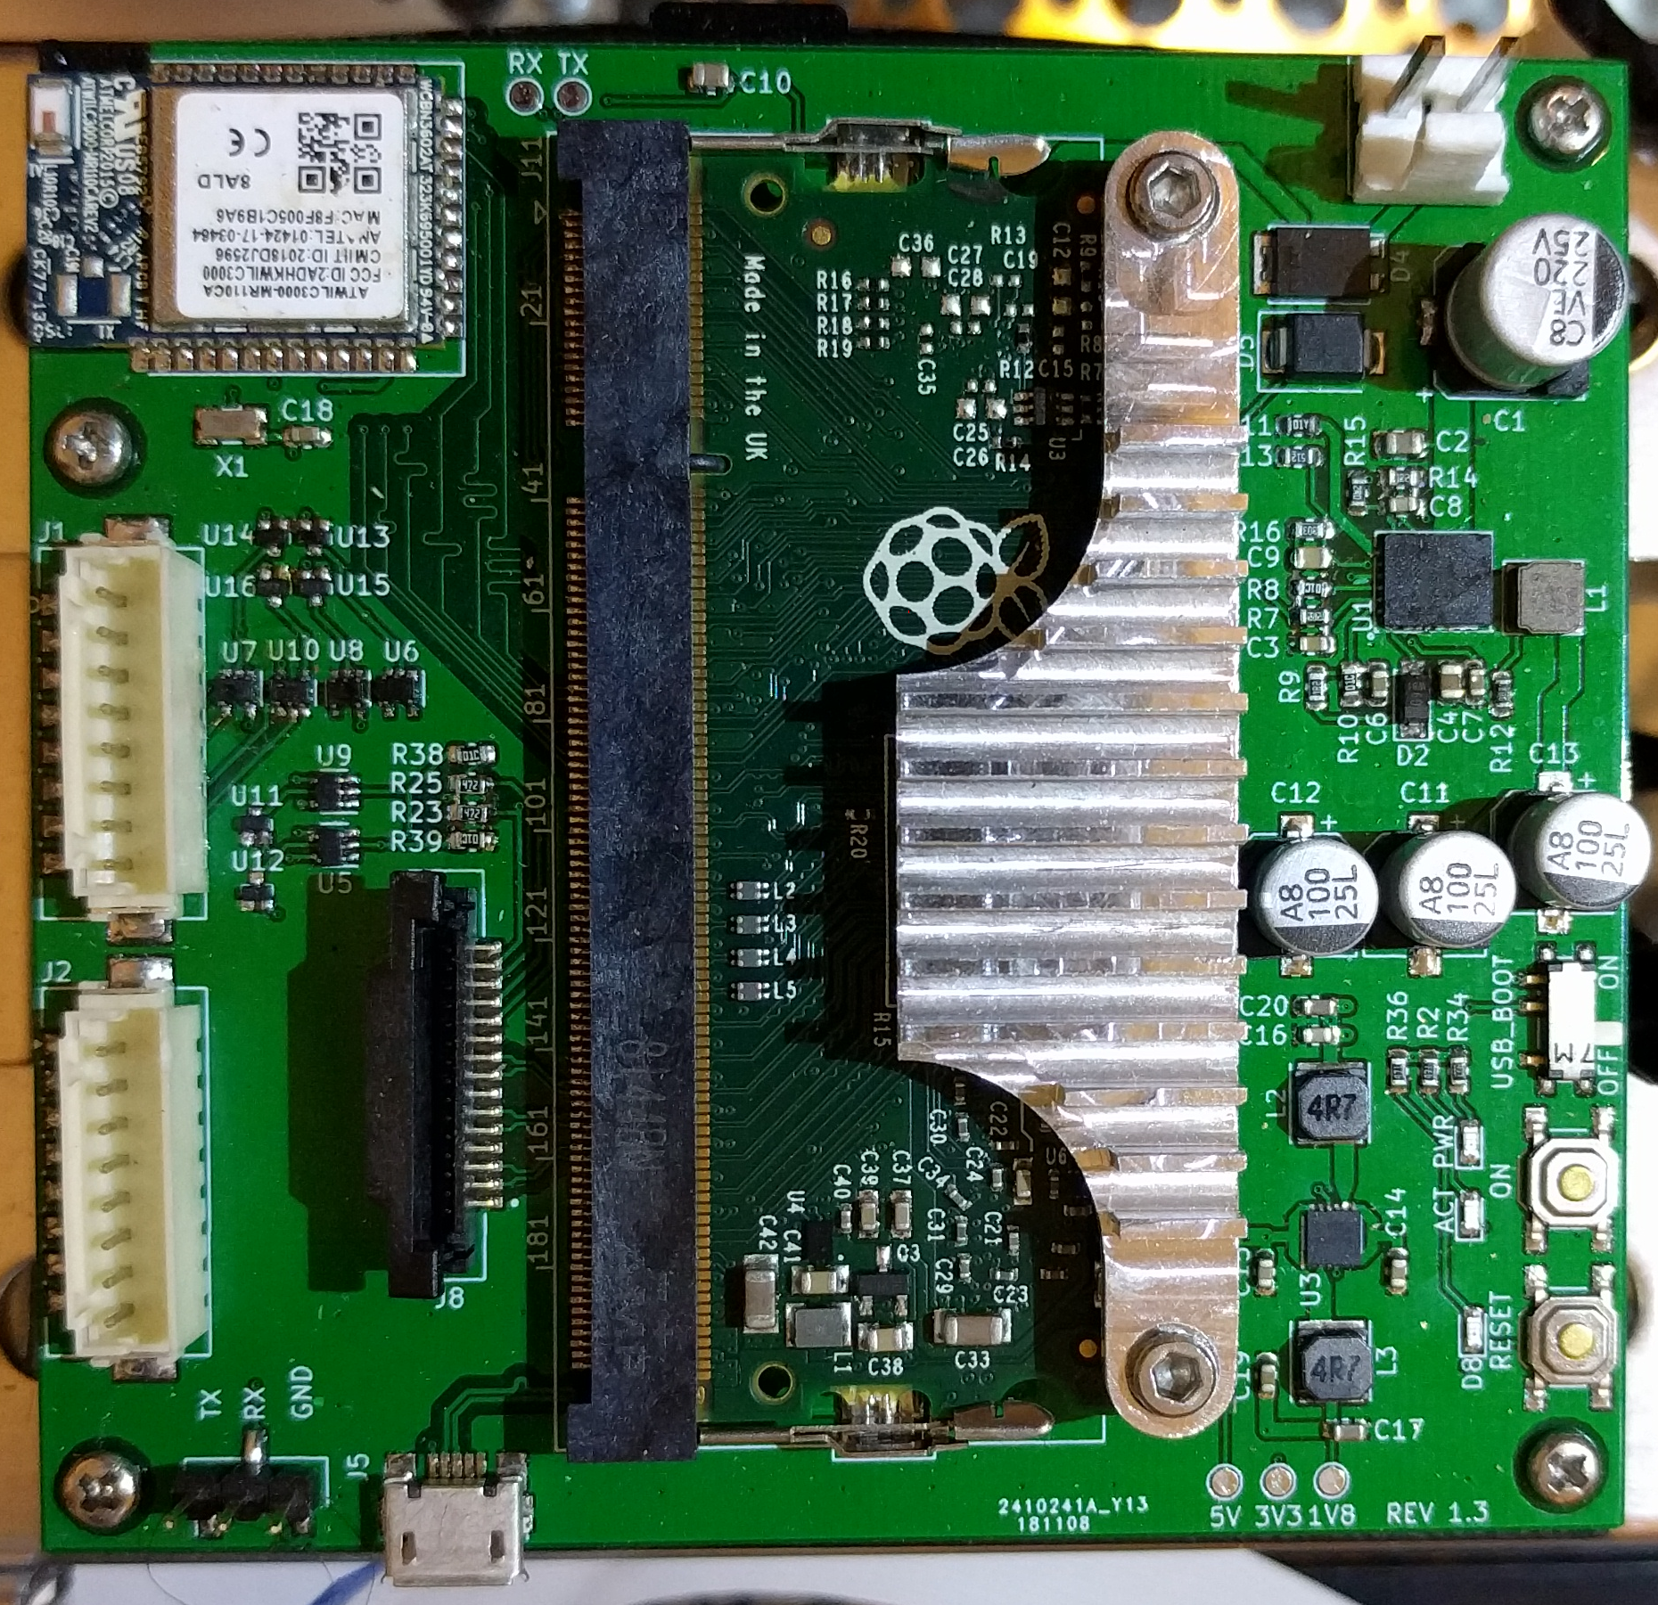
Main Control and Motor Control Boards
Notes:
Anthony

Slide 38
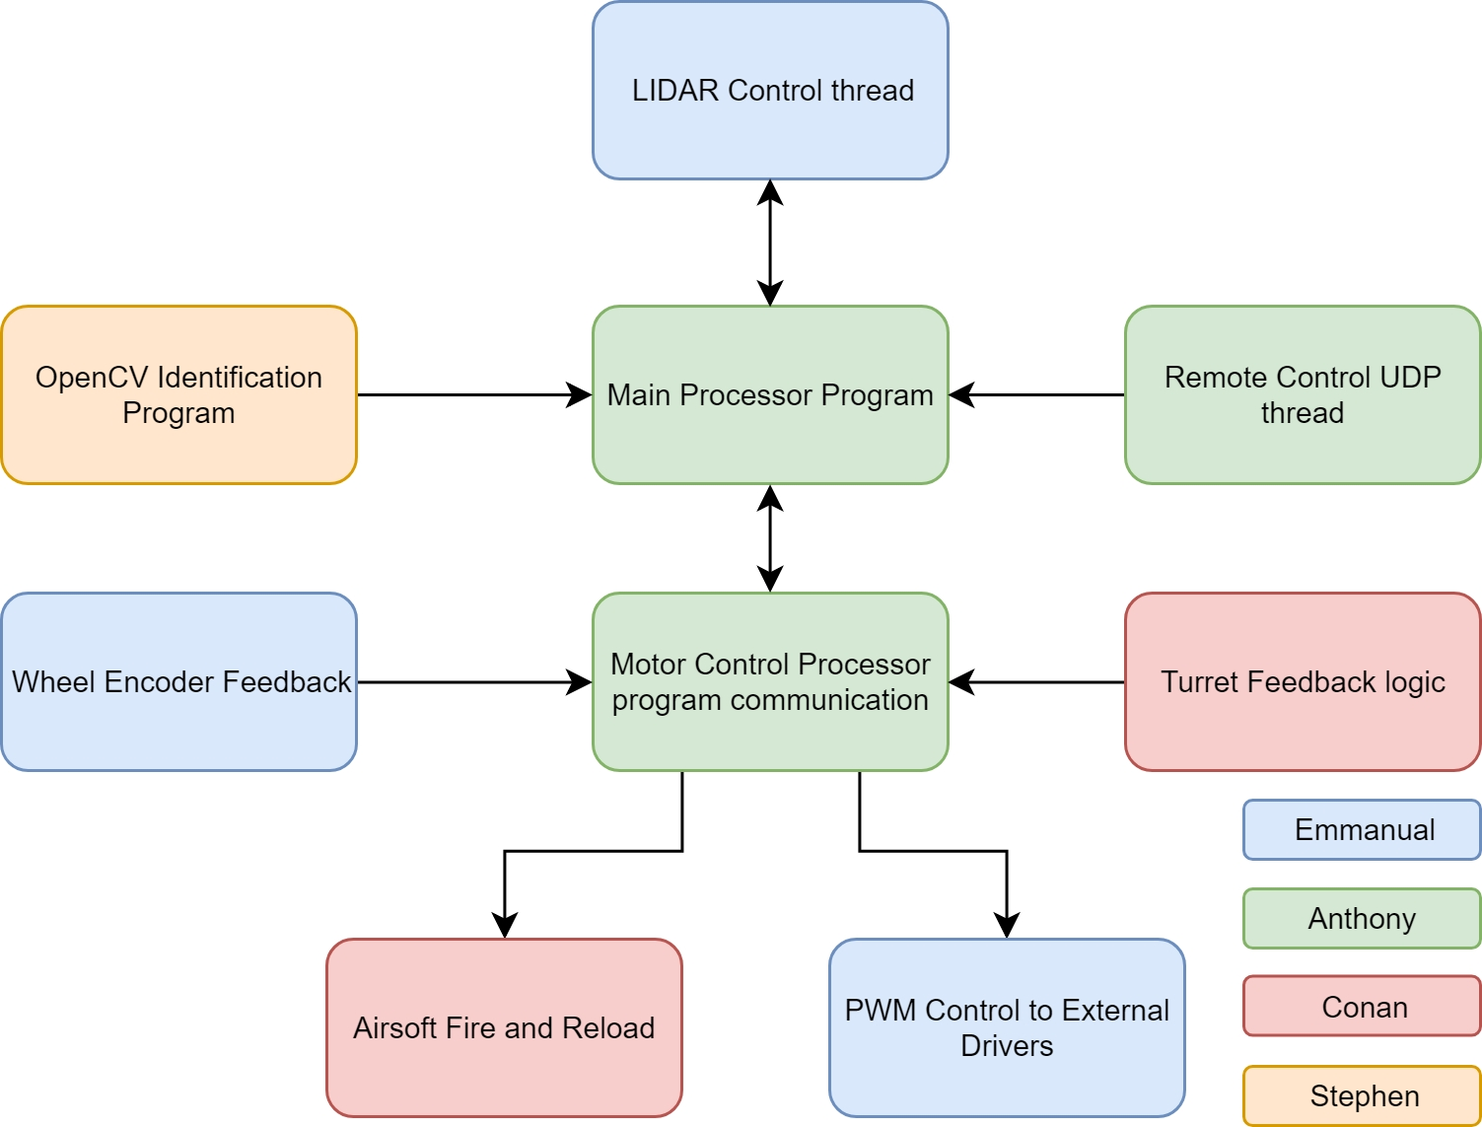
Overall System Software Design
Notes:
Anthony

Slide 39
Overall System Software Design
The main control software will run on the BCM2837 on top of the of the Linux kernel.
Peripherals will be managed through parallel threads.
Communication from remote control to main processor will be though web sockets.
Communication from main processor to auxiliary motor control will be through SPI.
Notes:
Anthony

Slide 40
Information Acquisition
Computer Vision Software
  The computer vision library we are using is open sourced by OpenCV, we will access this library to utilize Object Detection, Machine Learning, and Motion Tracking.
  CV works by assigning either RGB(red green blue) or HSI(hue, saturation, intensity) to every pixel in an image and preforming a variety of analysis of these values to accomplish tasks.
  Cost: Free!
Notes:
40 seconds

Slide 41
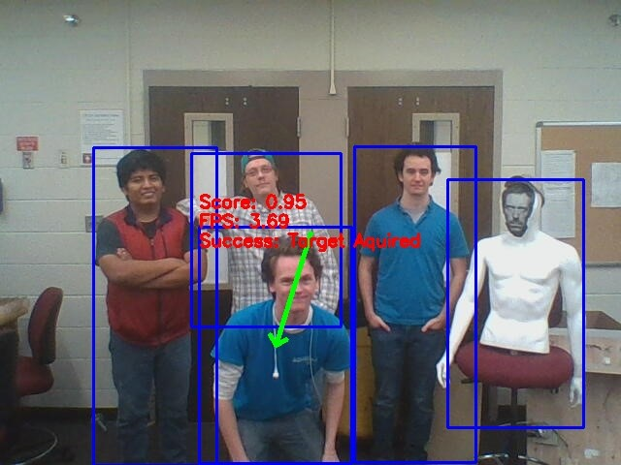
Information Acquisition
Computer Vision Processes
  Object Detection in OpenCV combines Edge Detection, Blob detection, Haar Cascades, and many other features to find objects in images.
  Machine Learning uses these features to train a Neural Network to find specific classes of objects, for this project, we focused on finding people.
  Motion tracking compares two frames of a video and looks for differences, specifically, its tracks the relative positions of objects with the same features between frames.
Human Detection Example
Notes:
Stephen 40 seconds

Slide 42
Information Acquisition
Machine Learning Systems
  Also called artificial intelligence
  We will utilize supervised learning via training sets in the TensorFlow Library.
  TensorFlow has many libraries preconstructed by Google Brain trained to identify specific items in an image.
  Open CV has deep learning subroutines in its library that can be used to “teach” the robot what a target looks like.

Slide 43
Gun Control Logic
Computer vision guides the BCM’s communication with the TIVA to adjust the turret pitch appropriately
  SPI is used to communicate between the BCM and TIVA
After target acquisition and aiming, the ‘trigger’ port on the TIVA is driven high and the gun fires continuously until the port is cleared
  The encoder ensures that the gun is not obstructed by the frame of the robot itself
The reloading of the gun is quite similar to firing
  The gun reloads itself from the extended magazine while firing

Slide 44
Budget Watch
Prototype |  | Prototype
Part | Price | Part | Price
Pi Module x 5 | 160.00 | Weapon | 45.00
DC Geared Motor with encoder (x2) | 70.00 | Turret | 8.00
Encoder(x4) | 19.00 | Self Made Body | 330.00
Camera | 26.99 | Battery(x2) | 37.73
BOM Parts per PCB revision | 496.65 | Motor(x2) | 29.98
PCB manufacturing | 378.52 | Gears - Various | 30.00
R&D | 1000.00 | Lidar | 39.99
 |  | Total To Date: | 3460.87
Notes:
Papaya
Mango
Green tea
Sugar cane

Slide 45

Questions?

