Slide 1
SmartKart
A smart shopping system
Group G
Victoria Abreu - CS Christina Heagney - CpE
Lucas Ryan - CS Doran Senior - CpE

Slide 2
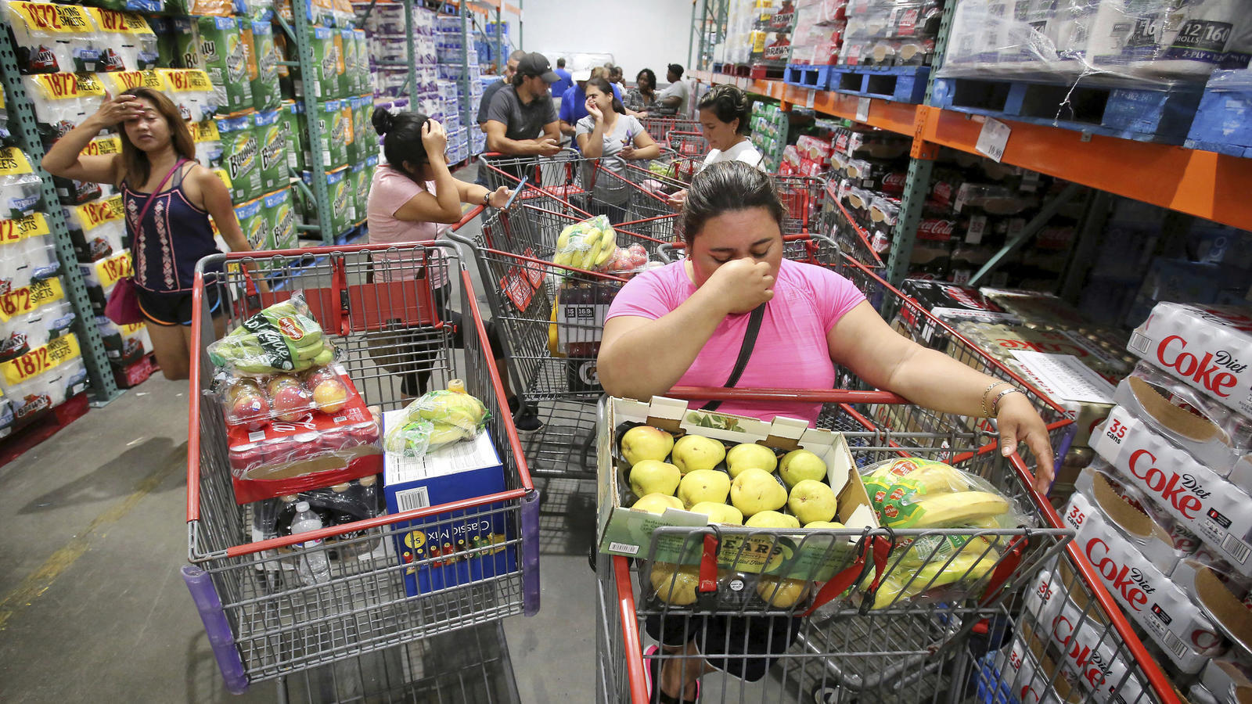
Project Motivation: What is the problem? Why do we care?
Currently, shopping can be a hassle:
Waiting in long checkout lines
Spending time collecting coupons
If on a budget, keeping track of subtotal manually
With all these factors, a simple task like
shopping becomes hectic and wastes
time.
Our SmartKart shopping system is
a solution to this.

Slide 3
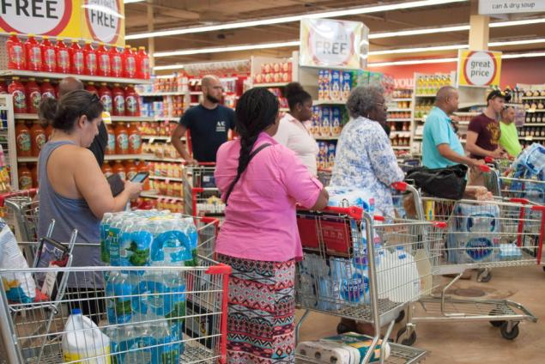
Project Overview: Our Goal
Motivated by the Amazon Go Supermarket, our project is a portable, lower-cost alternative.
The SmartKart will:
Remove the issue of long lines
Assist users by providing coupons available at the current store
Display the cost of the products in their shopping cart

Slide 4
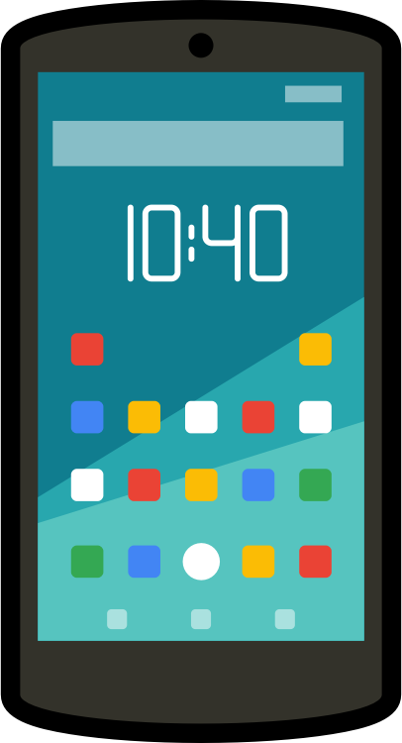
What is a SmartKart?
The SmartKart is a portable system that interfaces with a mobile app to improve the shopping experience:
RFID technology will track items that have been added/removed from the cart
Upon exiting the store, the customer's account will be charged, and an electronic receipt will be generated
GPS will monitor the cart’s current location to help prevent theft
The app will store the current coupons available, account information, and handle payment transactions

Slide 5
Project Requirements: General
The overall shopping cart shall be no bigger than 45"H x 25"W x 25"D
The overall system shall weigh no greater than 50 lbs
The overall system shall cost no more than $500 to build
The user shall be able to grasp the functionality of the GUI in approximately one minute
The device will allow users to purchase at least 25 items at a time

Slide 6
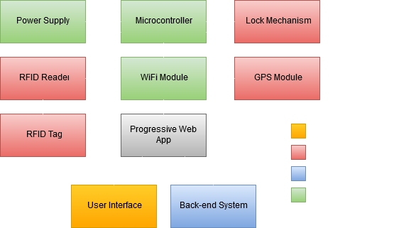
Overall System Design
r

Slide 7
Hardware

Slide 8
RFID System
RFID sensors and tags will keep track of all items a shopper adds/removes from their shopping cart
Each item will have a unique RFID tag
The RFID sensor will be placed on the inside railing of the shopping cart

Slide 9
RFID Comparison
Device | Dimensions | Range | Frequency | Price
RFID Reader ID-3LA | 0.7” x 0.8” | Up to 4” | 125 kHz | $25.95
PN532 NFC/RFID | 2.1" x 4.7" | Up to 4” | 13.56 MHz | $35.95

Slide 10
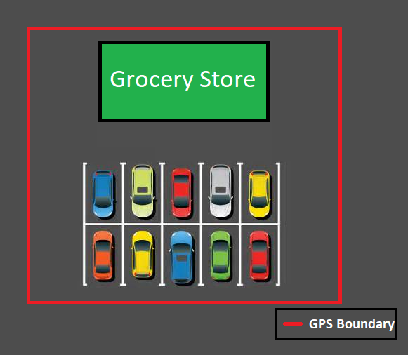
GPS/Locking System
A GPS/Locking system will be used to help prevent theft of carts
GPS will determine if a shopping cart has traveled outside of the store’s perimeter
If so, the lock will engage, and cart will lose mobility

Slide 11
GPS Comparison
Device | Satellites | Update Rate | Position Accuracy | Tracking Sensitivity
U-Blox NEO-6M GPS Module | 50 channels | 5 Hz (max) | N/A | -161 dBm
Adafruit Ultimate GPS Breakout | 22 Tracking w/ 66 channels | 1-10 Hz | 3m | -165 dBm

Slide 12
WiFi Module
Once an item is scanned, the WiFi module sends the following via a POST request to an HTTPS server:
Store ID (12 bytes)
Cart ID (12 bytes)
Product ID (7 bytes)

Slide 13
WiFi Module Comparison
Device | Connectivity Range | Interface | HTTPS Enabled | Cost
ESP8266-01 | ~1,000 feet | Serial | No | $6.99
Adafruit ATWINC1500 | ~800 feet | Serial, SPI | Yes | $24.95
ESP8266-12e | ~1,000 feet | Serial, SPI | Yes | $6.95

Slide 14
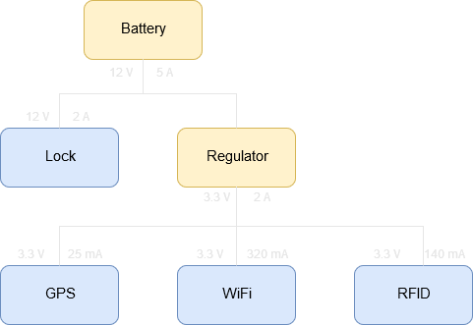
Power Distribution
Power Patrol Sealed Lead Acid Battery
Volts | 12V
Current | 5 A
Battery Life | 20 hours
Dimensions | 3.5 x 2.8 x 4 in

Slide 15
Microcontroller Comparison
Device | Operational Voltage | Memory | Speed | I/O Pins | Power Consumption | Price
MSP430G2553 | 1.8V – 3.6V | 16 KB FLASH 0.5 SRAM | 16 MHz | 24 | Active Mode: 230μA w/ 1 MHz Off Mode: 0.1μA | $9.99
ATmega2560 | 4.5V – 5.5V | 256 KB FLASH 4 KB EEPROM 8 KB SRAM | 16 MHz | 86 | Active Mode: 500μA w/ 1 MHz Off Mode: 0.1μA | $45.95
ATmega328P | 1.8V – 5.5V | 32 KB FLASH 1 KB EEPROM 2 KB SRAM | 20 MHz | 23 | Active Mode: 0.2mA w/ 1 MHz Off Mode: 0.1μA | $24.95

Slide 16
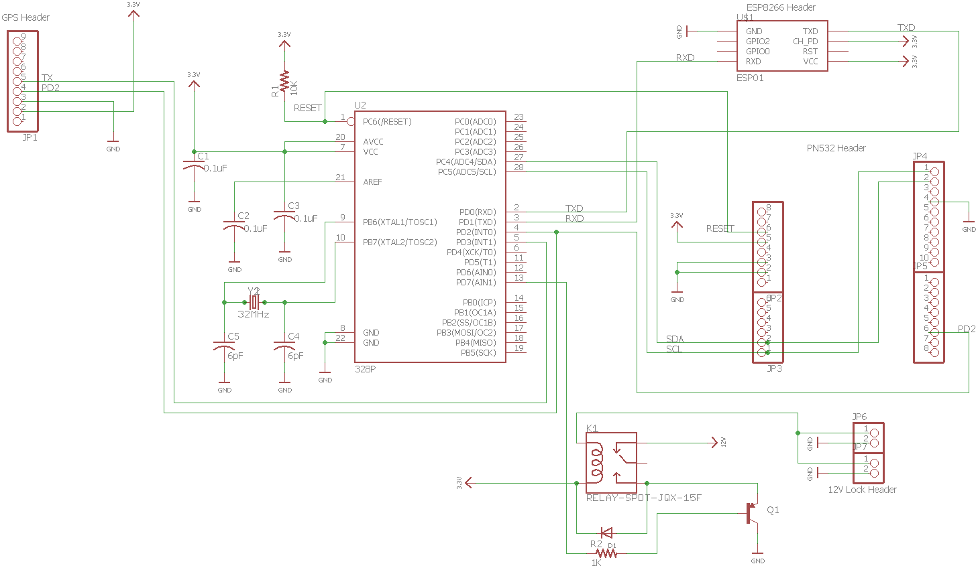

Slide 17
Voltage Regulator

Slide 18
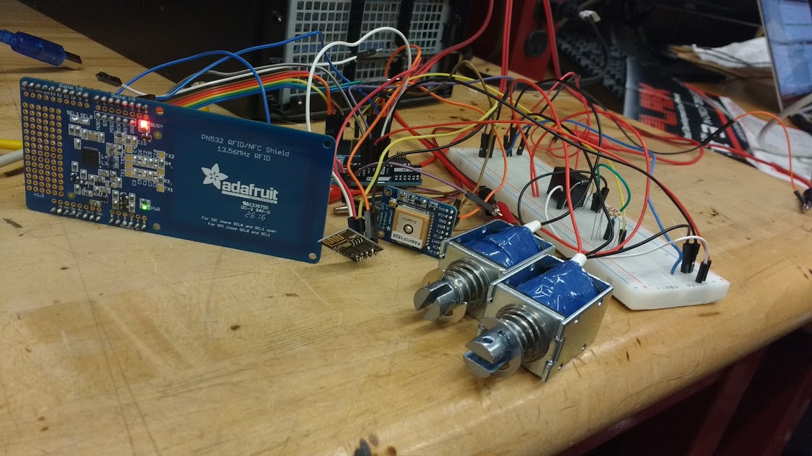
System Prototype

Slide 19
Software

Slide 20
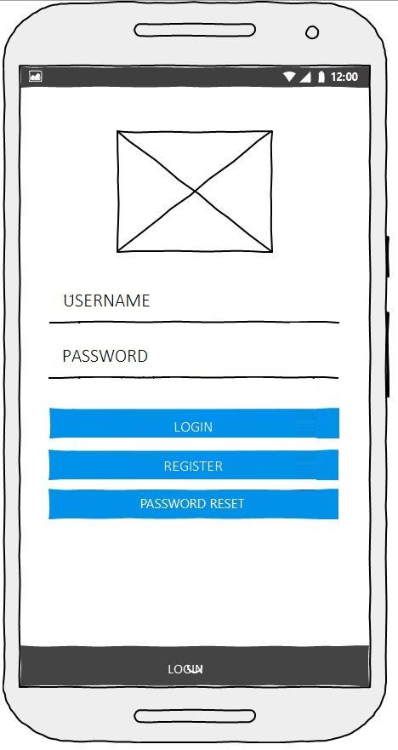
UI Design
Using Angular.js
Creating a Progressive Web App
Currently working on connecting the backend with the frontend

Slide 21
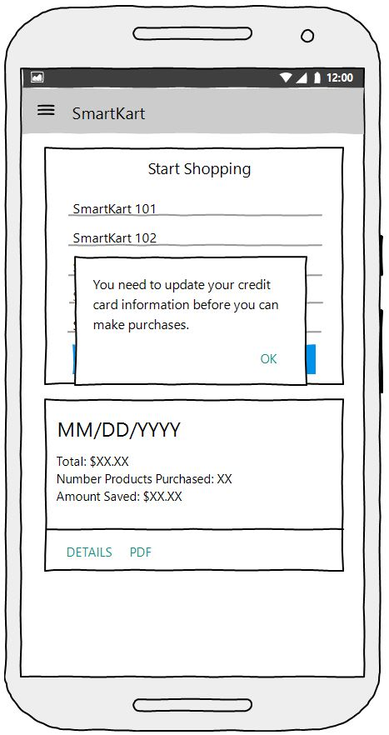
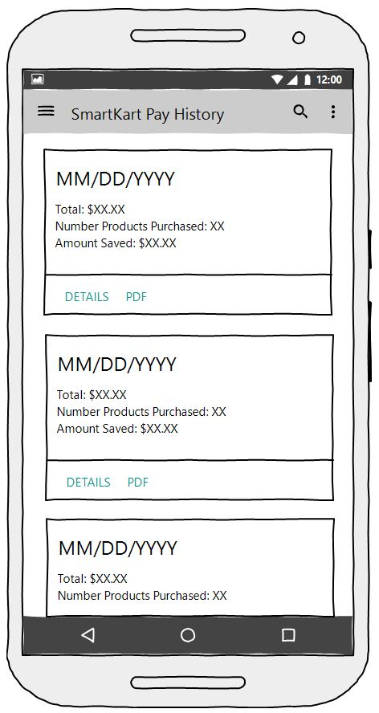
UI Wireframes

Slide 22
System Architecture
MongoDB (Database)
Express (Web Server)
Angular (FrontEnd)
Express-jwt (Web Tokens)
Socket.io (Web Sockets)
Stripe (Payment processing)
S3 (File storage)

Slide 23
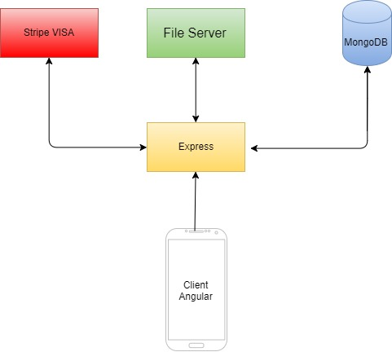
Block Diagram: Software

Slide 24
Business Logic
Bind user with selected cart in database and create their virtual shopping cart
Web sockets to update user’s running cart as they add/remove items from their cart
When users are being cashed out, we charge their card on account to the selected store’s bank account via Stripe
Users can view stores’ products and coupons, as well as calculate the cost of their shopping list in real time

Slide 25
Database
Collection:
Products
Coupons
Store Information
Account
Purchases
Storing payment sources (bank account/credit/debit cards) tokens from stripe for PCI compliance
Storing aws s3 url to account receipts to improve lookup time

Slide 26
Administrative Content

Slide 27
Work Distribution
Component | Primary | Secondary
Power | Doran Senior | Christina Heagney
GPS | Doran Senior | Christina Heagney
Locking Mechanism | Christina Heagney | Doran Senior
RFID System | Christina Heagney | Doran Senior
PCB | Christina Heagney | Doran Senior
Database | Lucas Ryan | Victoria Abreu
Payment System | Lucas Ryan | Victoria Abreu
Communication | Victoria Abreu | Lucas Ryan
User Interface | Victoria Abreu | Lucas Ryan

Slide 28
Budget
OBJECT | QUANTITY | EST. COST
RFID Scanner | 1 | $39.95
RFID Tags | 50 | $19.20
GPS 66 Channel Breakout Board | 1 | $39.95
Arduino Uno | 1 | $22.00
PCB | 2 | $70.00
Wifi Module | 1 | $4.00
Payment System | 1 | $50.00
Shopping Cart | 1 | $40.00
BreadBoard (830 pins) | 1 | $2.99
Battery | 1 | $11.99
 |  | Total: $300.08

Slide 29
Issues Encountered
RFID sensor is short-ranged
Longer range sensor is more expensive
Researching how to extend the range of our current sensor
Mapping Store coupons to products
Structure data that queries coupon products effectively that can scale well
Solution: keep id of all the coupons and products a store currently accepts/offers and filter through those arrays

Slide 30
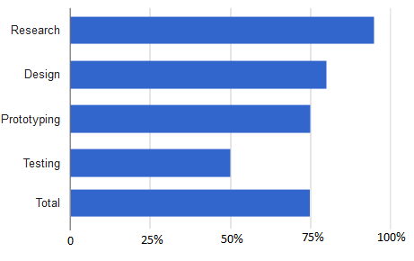
Progress

Slide 31
Questions?

