Slide 1
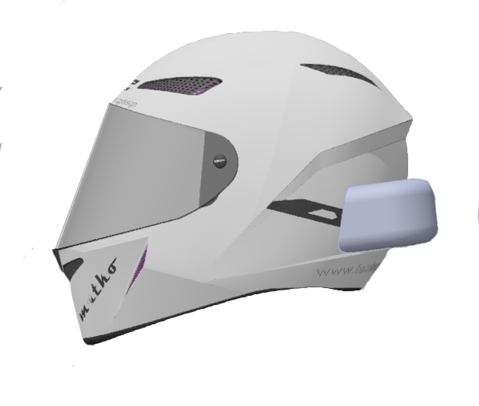

BRAIN Helmet
Group 4
Ryan Mortera EE Nada Algharabawi CpE
Jordan Yamson EE Stephen Morales CpE

Slide 2
Motivation
Riding a motorcycle, it is impossible to use any form of communication easily without distracting the rider
Nearly impossible to take phone calls or use GPS when riding a motorcycle
Utilizing features of a smartphone whilst riding a motorcycle isn’t possible without endangering the rider and others on the road

Slide 3
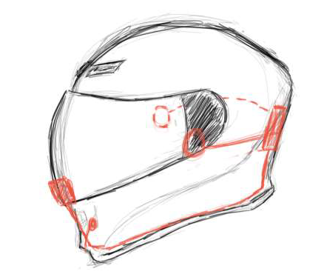
Goals and Objectives
Low-cost approach of implementing a smart Bluetooth motorcycle helmet
Allow the user of the helmet to accept phone calls, stream music, and be able to utilize GPS through an app
The GPS instructions will be sent to an On-Board HUD on the visor of the helmet, so that the user will be able to see the instructions without ever taking out their phone

Slide 4
Specifications
Helmet completely wireless between user’s phone and helmet
Dimensions 10.6 x 13.8 x 10.4 inches
2 speakers integrated into helmet at 0.25 in. thick.
A helmet will include a microphone wired through the helmet
HUD on the visor at a resolution of 128x64 pixels
Rechargeable battery of at least 6 hours (2000 mAh), No larger than 3 x 3 in.
Pairing distance of about 10 meters
Pairing process of less than 1 minute
5 buttons for answering phone calls, track control, and toggling display.
PCB will be attached and covered directly to the helmet.

Slide 5
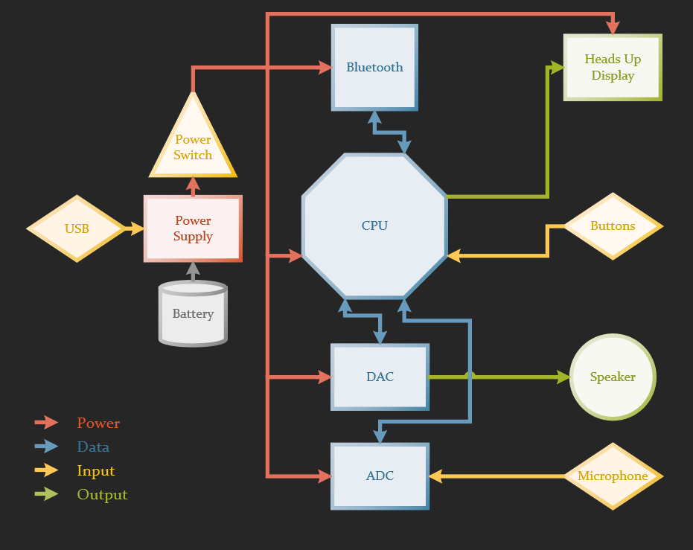
Overall Block Diagram

Slide 6

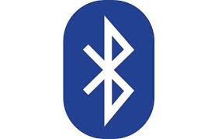

Wireless Technology Selection
Wireless connection between B.R.A.I.N Helmet and User’s Cellphone
Modern smart phones already have Bluetooth integrated
Wi-fi is off the scope of our project and Zigbee isn’t enough transfer rate
Bluetooth consumes less power

Slide 7
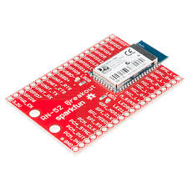
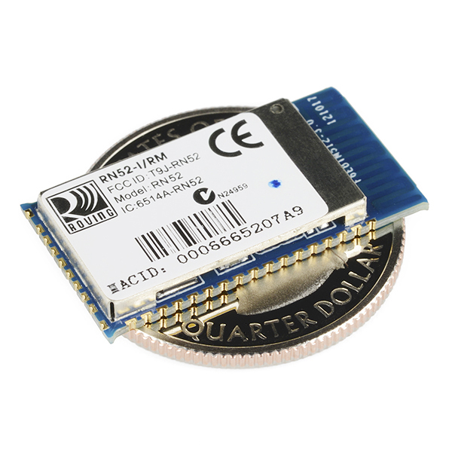
RN52 Bluetooth Module
The RN52 is easily implementable into our system
Bluetooth 3.0
Maximum data rate of 3 Mbps
Built in DAC, and ADC for speaker and microphone

Slide 8
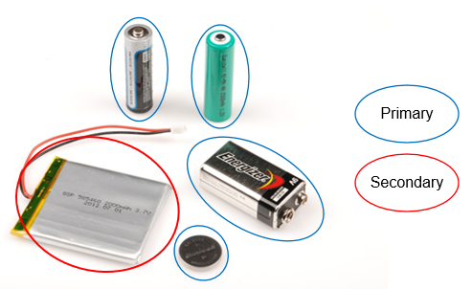
Power Options
There are multiple factors to account for when choosing a power source for the BRAIN Helmet.
Weight?
Economic?
Size?

Slide 9


Second to none?
 | Primary Batteries | Primary Batteries | Secondary Batteries
Weight
Energy Density
Battery Capacity (mAh)
Price
Legend | Green = Beneficial Red = Disadvantageous |  | Up arrow = Higher value Down arrow = Lower value
Choosing a reusable energy source for the BRAIN Helmet seems reasonable. Is there any concerns?

Slide 10
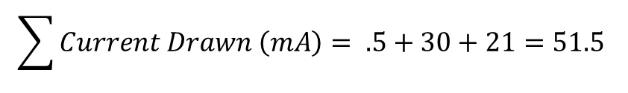
Stock Battery Consumption for Calculations
Device | Operational Voltage | Active current | Sleep current
Microprocessors
ATmega 2560 | 1.8 – 5V *Not using above 3.6V | ~500 μA | 0.1 μA
Bluetooth Modules
RN-52 | 3 ~ 3.6V | ~30 mA | <500 μA
Heads-Up Displays
LCD-13003 Breakout [48x64 pixels] | 3.3V *generates V _{LCD} = 7.0-7.5V | 10-20.9mA | <300 μA
$$Battery life \left(Hours\right)=0.7∗\frac{\left.Battery Capacity (Amphours\right)}{\left.Current Drawn (Amps\right)}$$
$$33.98 hours=0.7∗\frac{2500 mAh}{51.5 mA}$$
Battery Life Time Comparisons
Battery Capacity (mAh) | Battery Life Time (Hours)
1000 mAh | 13.59
2000 mAh | 27.18
2500 mAh | 33.98
6000 mAh | 81.55
$$\sum{Current Drawn \left(mA\right)= .5+30+21=51.5 }$$
The BRAIN Helmet will use a 2500 mAh 3.7V Adafruit 328 Lithium Polymer battery

Slide 11
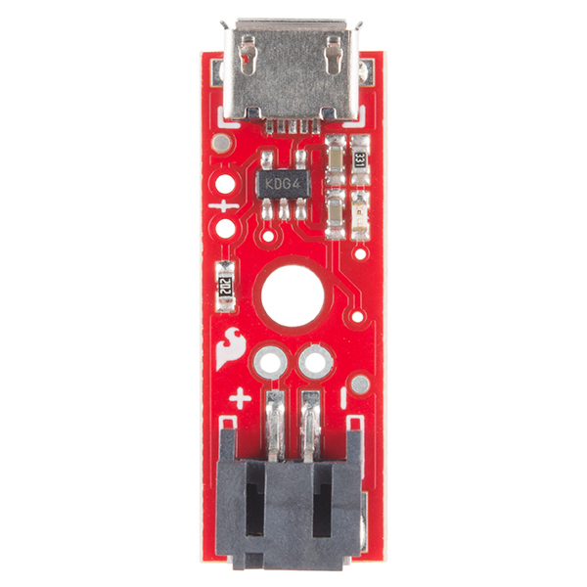
Proper Lithium-Ion charging
The SparkFun LiPo Charger prevents any damage to the battery with an adjustable charge current. (Set to 500 mA for a 3.7V Lithium-Ion Polymer battery)
Common JST Connector
Micro-USB connector to supply charge

Slide 12
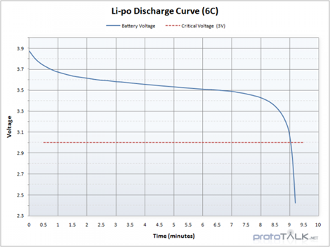
Implementing the battery
The Adafruit 328 peaks at a charge voltage of 4.2V and cuts off at 2.8V.
With a varying discharge voltage, the battery will be regulated via a voltage regulator on the BRAIN Helmet capable of outputting 800 mA.

Slide 13
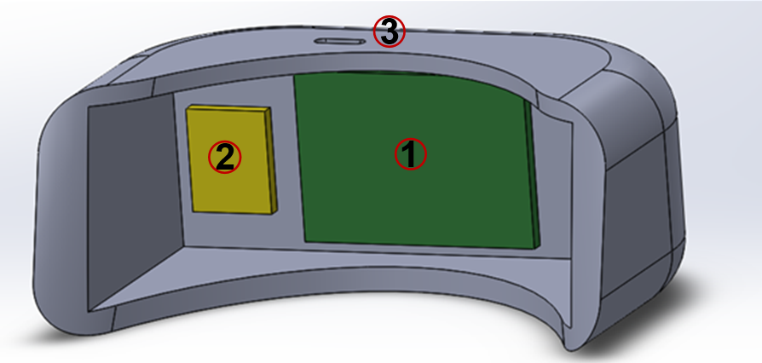
Power Block Diagram

Slide 14
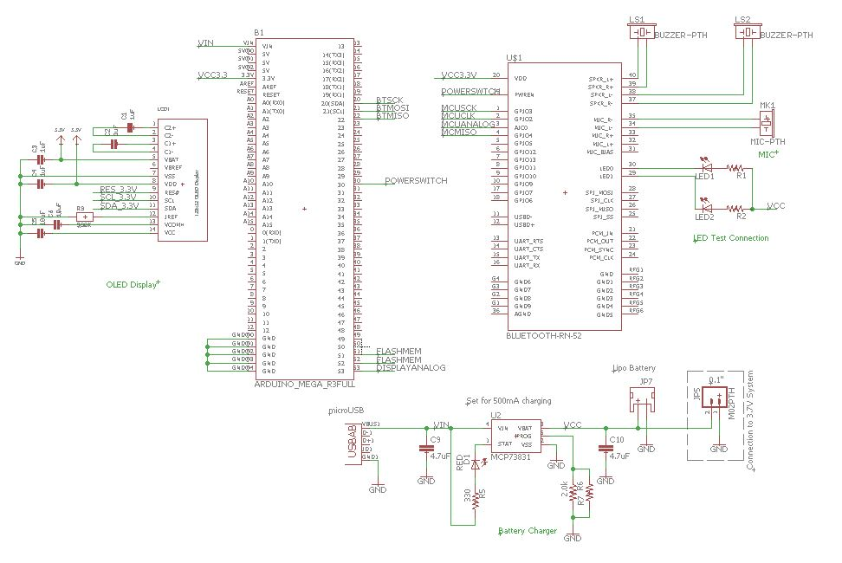
PCB Schematic

Slide 15
Prototyping

Slide 16
Work Distribution
Member | Bluetooth Comm. | Power System | Navigation App | MCU and HUD
Ryan | X
Jordan | X | X
Nada |  |  | X
Stephen |  |  | X | X

Slide 17
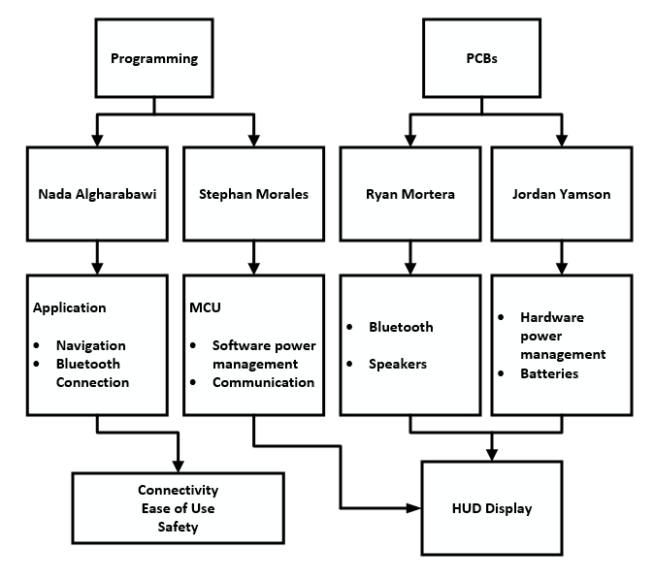
Replace last slide?

Slide 18
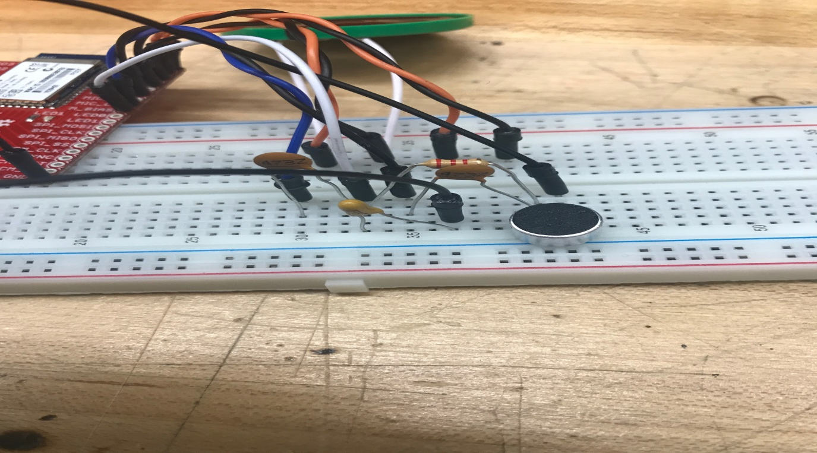
Difficulties
When working with the Bluetooth module, the microphone had a lot of noise when first integrated. Implemented a filter to reduce noise through the microphone.

Slide 19
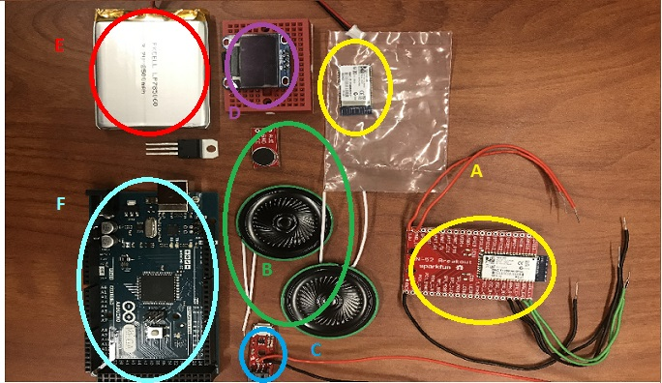
Overall Parts Selection

Slide 20
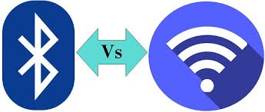
Mobile Wireless Connection
A wireless connection has to be established between main module and Android device
Almost all devices nowadays are able to be connected via Wi-Fi and Bluetooth
Bluetooth implementation is simpler and more secure
Wi-Fi implementation is difficult

Slide 21
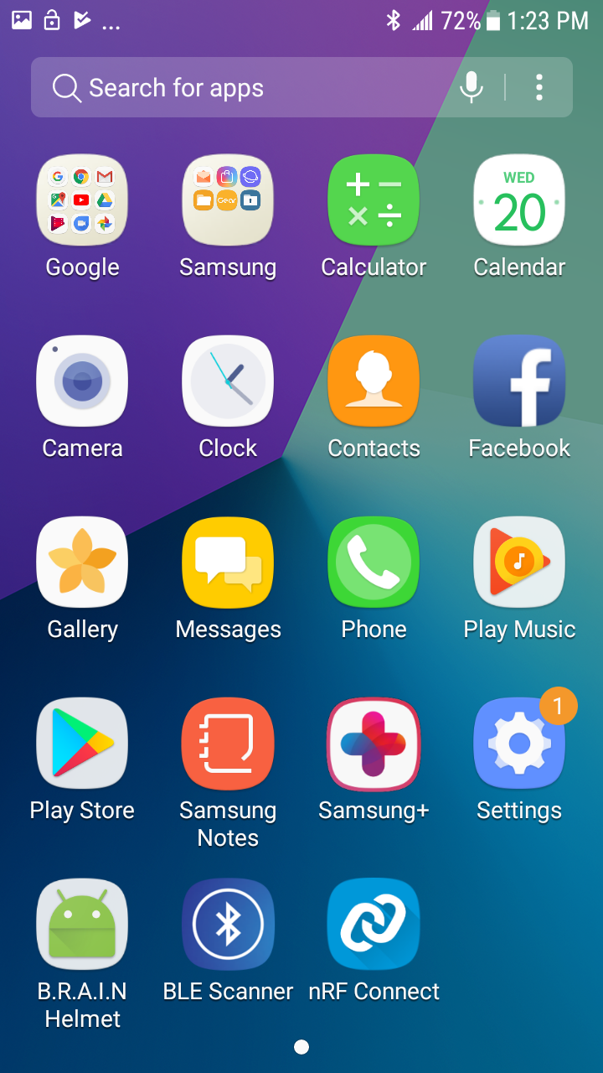
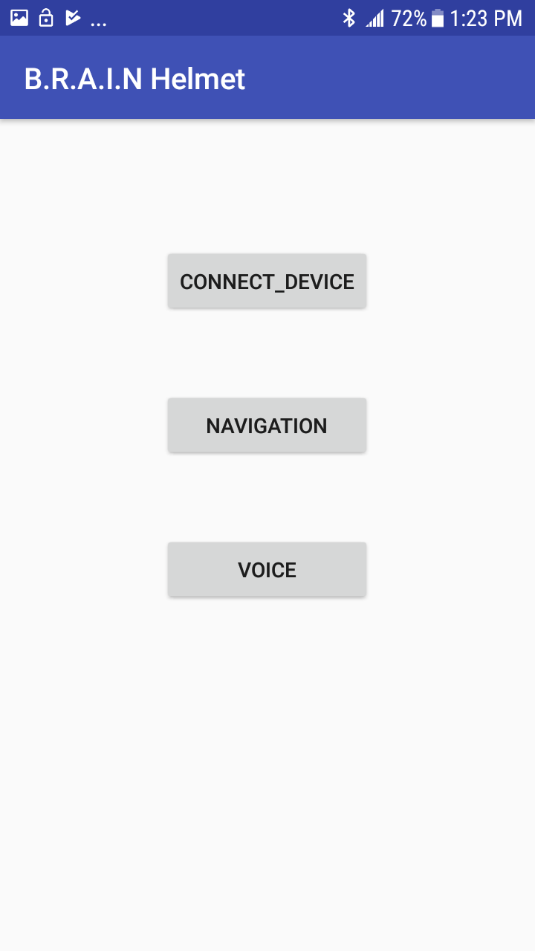
Mobile Application
First Step is to Tap on the Connect_Device Button
Phone Home Screen
App Main Screen

Slide 22
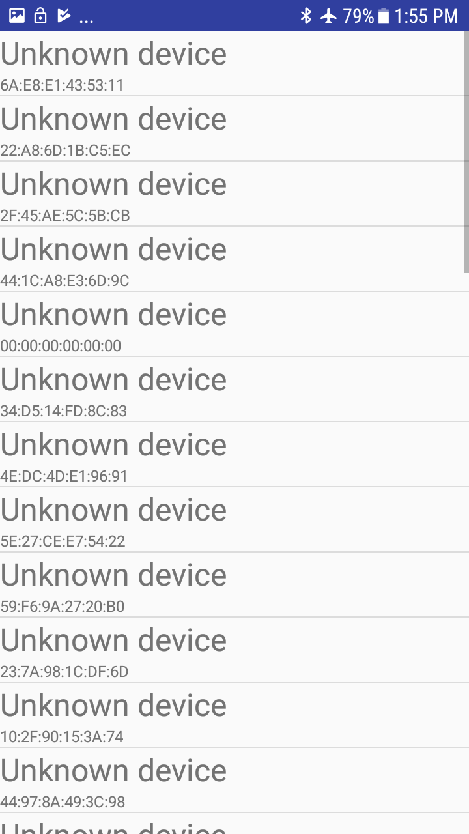
Scan for other Bluetooth devices
Query the local Bluetooth adapter for paired Bluetooth devices
Connect to other devices through service discovery
Transfer data to and from other devices
Second Step is to choose the desired device

Slide 23
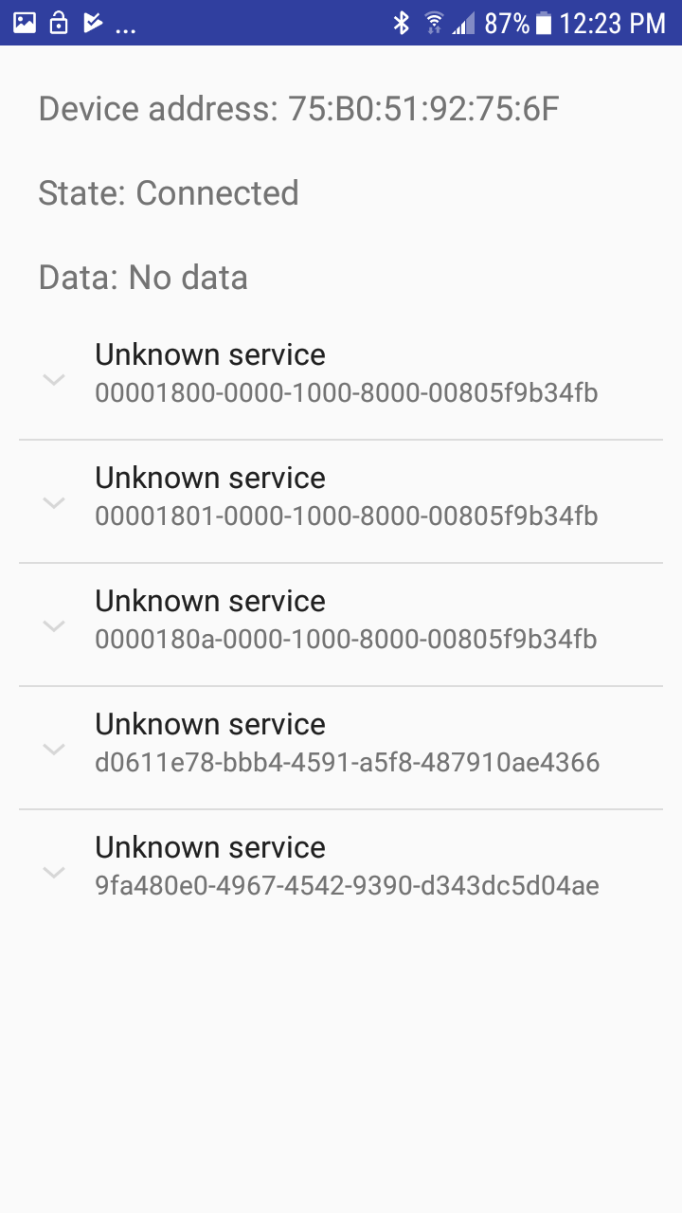
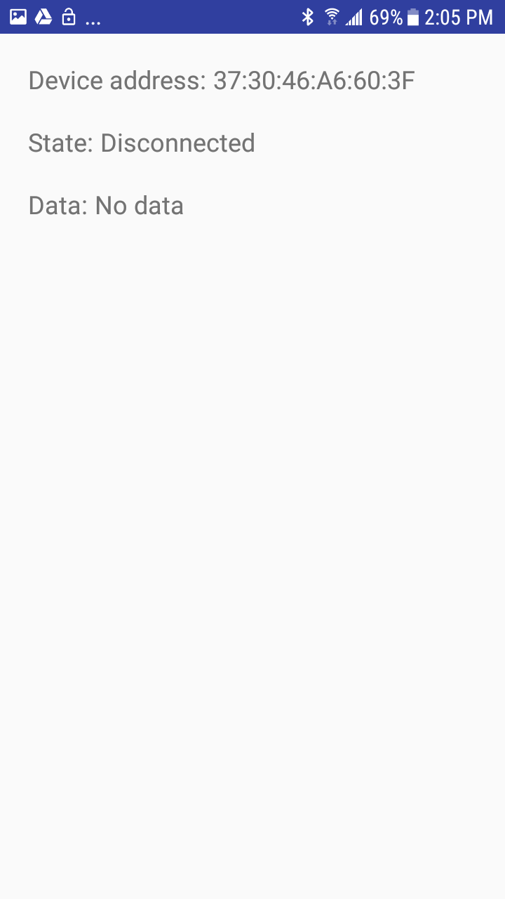
Connected Device
Disconnected Device

Slide 24
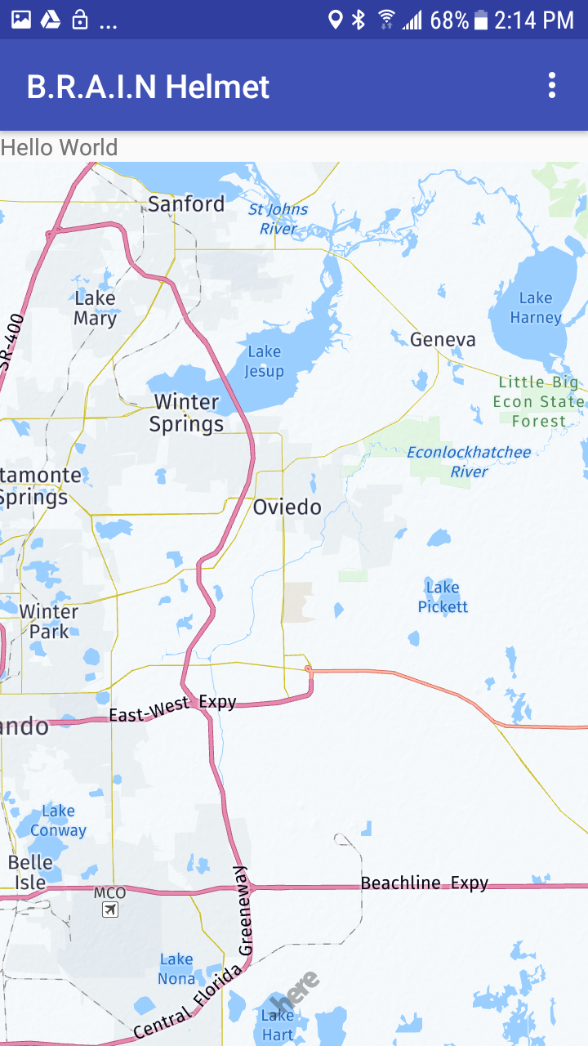
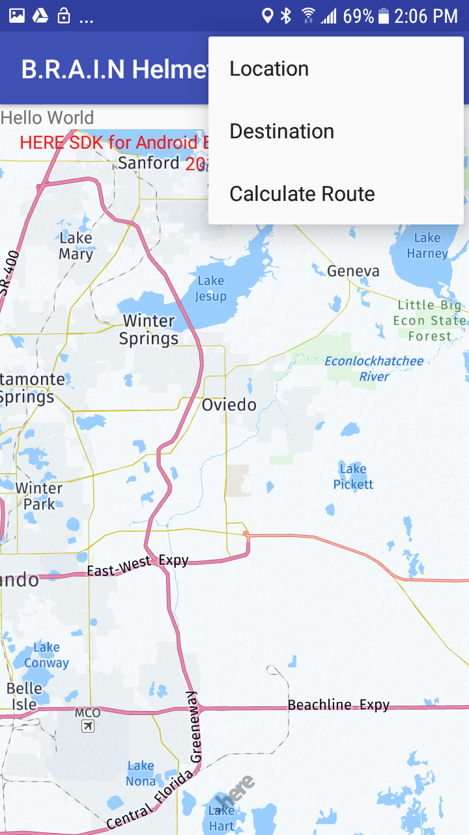
Navigation Setting
Third Step

Slide 25
Budget
 | Part Number | Unit Cost ($) | Quantity | Total Cost
Processor | MSP430F5529 | 8.06 | 1 | 8.06
 | ATmega2560 | 11.85 | 1 | 11.85
BT Module | RN52 | 12.50 | 2 | 25.00
 | RN52 Breakout | 22.50 | 2 | 45.00
Speaker (x2) | 00050016FP035A | 3.50 | 2 | 7.00
 | Com-10722 | 0.51 | 6 | 3.06
Microphone | BOB-12758 Breakout | 2.95 | 2 | 5.90
Battery | Adafruit 328 | 15.96 | 1 | 15.96
 | Ofeely 458292 | 13.59 | 1 | 13.59
LiPo Battery Charger | PRT-102177 | 7.95 | 2 | 15.90
Helmet | SH-FF0016 | 42.99 | 1 | 42.99
Buttons | COM-09339 | 1.95 | 0 | 0
 | Tactile Button | 0.50 | 0 | 0
Potentiometer | COM-09288 | 0.95 | 0 | 0
 | COM-09117 | 2.95 | 0 | 0
HUD | LCD-13003 | 14.95 | 1 | 14.95
 | DiyMall I2C OLED | 8.50 | 2 | 17.00
Voltage Regulator | COM-00526 | 1.95 | 3 | 5.85
Tools | Mini-Breadboards | 1.00 | 6 | 6.00
 | Solder-Kit | 25.50 | 1 | 25.5
 | Solder Tip Cleaner | 9.14 | 1 | 9.14
 |  |  | SUM = | 267.10

Slide 26
Progress

Slide 27
Questions?

