Slide 1
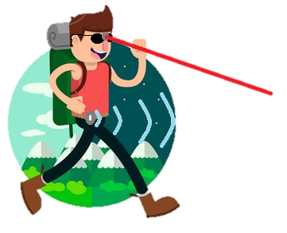
BatPack
Group 2 Christian Jackson EE
Connor Roggero CPE
Lucas Pasqualin CPE
Mike Ferraro CPE

Slide 2
Motivations
No advancement in technology for visually impaired
Breakthroughs in Computer Vision
39 million blind, 246 million legally blind (World Health Organization)
Improve quality of life for the visually impaired
Users of walking sticks have one hand occupied

Slide 3
Goals and Objectives
To build a device that will provide blind users with all of the functionality that a cane provides, but using modern technology. Users should be able to readily tell where they’re going, detect obstacles, and have both hands free while doing so.

Slide 4
Specifications
Unit Housing
Dimensions : Fit in Backpack
Weight : Less than 10lbs
Micro-Controller
I/O : I2C and SPI Communication Protocols
Power : Less than 1.5W
Ultrasonic Sensor
Distance : More than 2m
Laser Sensor
Distance : More than 5m
Vibration Unit(s)
Power : 150 mW
Signal : PWM
Camera
Resolution : Compatible for Computer Vision
Frame Rate : 24 Hz
Battery Supply
Capacity : At least 20000mAh
Duration : > 24hrs

Slide 5
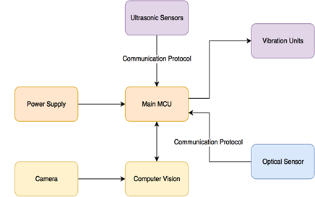
Modules
Main housing in a Traditional Backpack
Battery
PCB
Raspberry Pi
Storage for Glasses
Interface on straps
Belt across user’s waist for ultrasonic sensors and vibration units.
Glasses used for directed obstacle detection.
Camera for computer vision (Experimental)

Slide 6
How we got to the Batpack
The SideStick
Still have a hand occupied
Too bulky for comfortable use
The fanny pack
Limited space
No where to hold glasses
Not stylish
The BatPack
Easily holds all components needed, with extra space
Can hold collapsible walking stick
Room for user interface

Slide 7
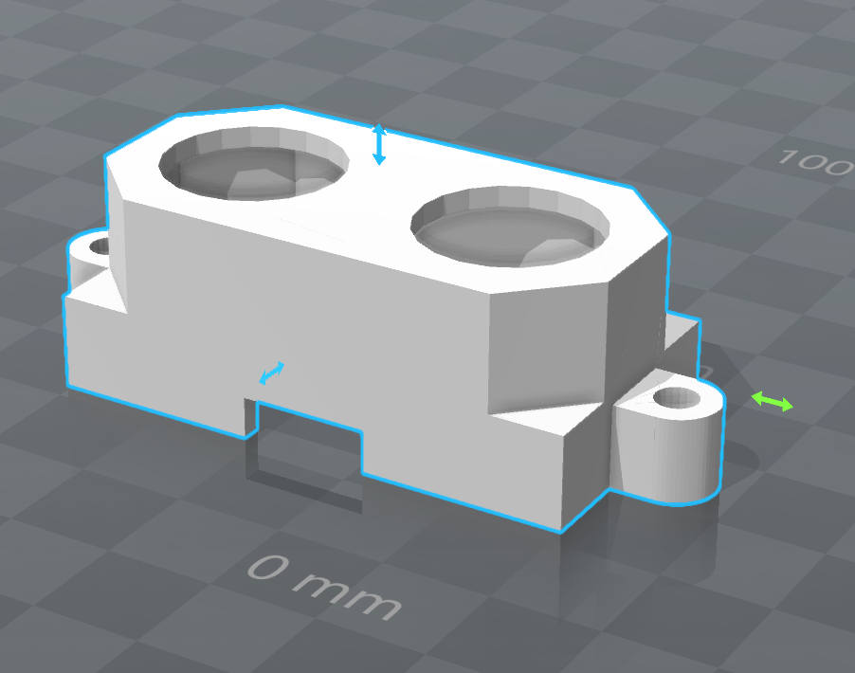
The Belt
Composed of 3 ultrasonic sensors around the front and side of the user.
Ultrasonic sensors in 3d printed housing.
Sewn into the belt.
Vibration units on user’s side for each sensor.

Slide 8
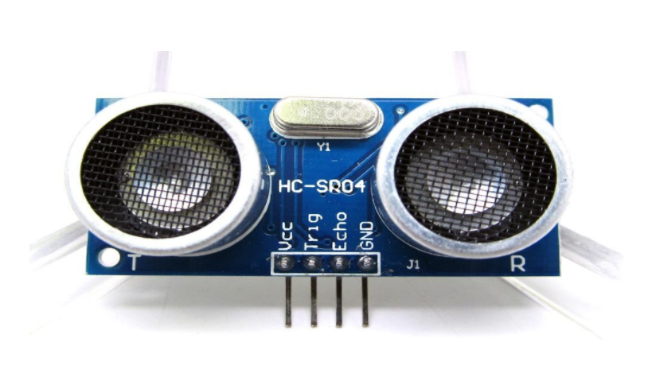
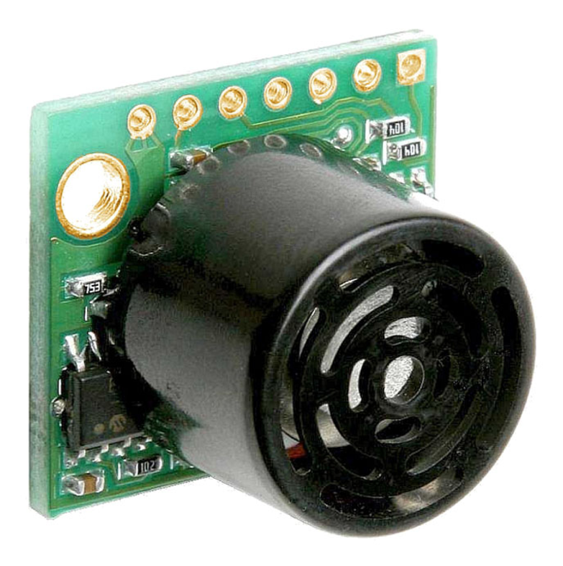
Ultrasonic Sensors
Working and Calculations
Considerations when measuring
Distance
Size of object
Size of beam
EZ: Emily’s Marathon

Slide 9
Ultrasonic Sensors - Specs

Slide 10
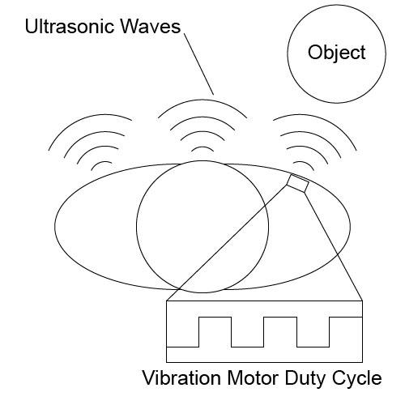
Ultrasonic Sensor - Layout
Cross-Talk
Filter Sensor Data
HC-SR04: average/median
Ezmax3: median

Slide 11
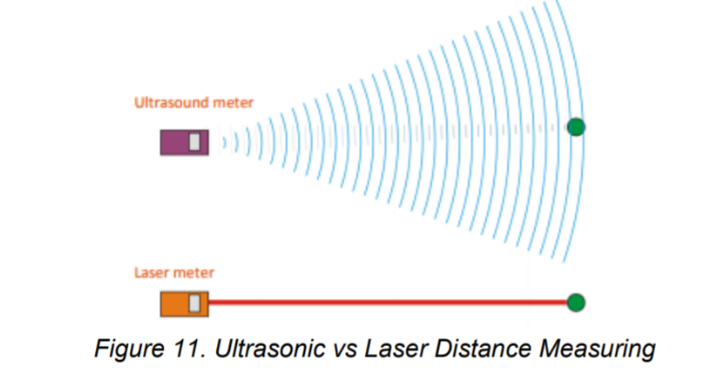
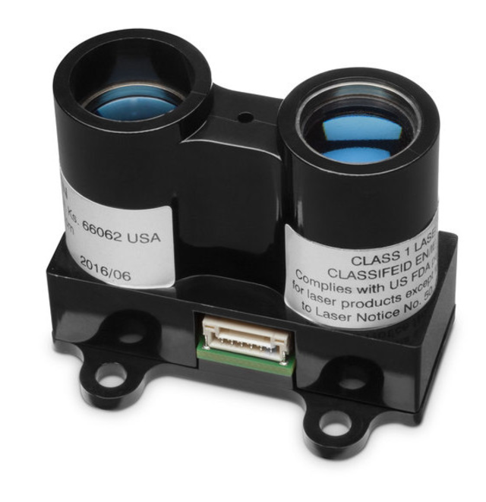
Optical Sensor
Considerations for measuring
How it works and calculations
Material
Reflectivity
Diffuse
Specular
Retro
Distance
Size of object

Slide 12
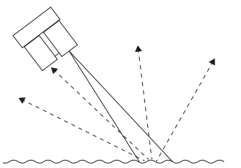
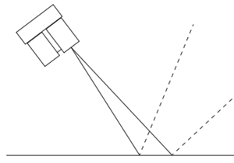
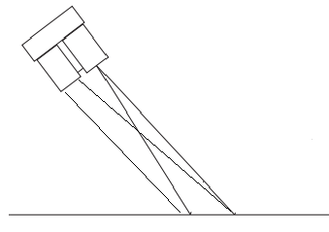
Reflectivity
Diffuse Reflectiveness
Rough surfaces cause energy to be reflected uniformly
Specular Reflectiveness
Smooth surfaces cause issues for laser sensors if they are not directly perpendicular to the surface.
Retro-Reflectiveness
Surfaces that reflect light with minimal scattering.

Slide 13
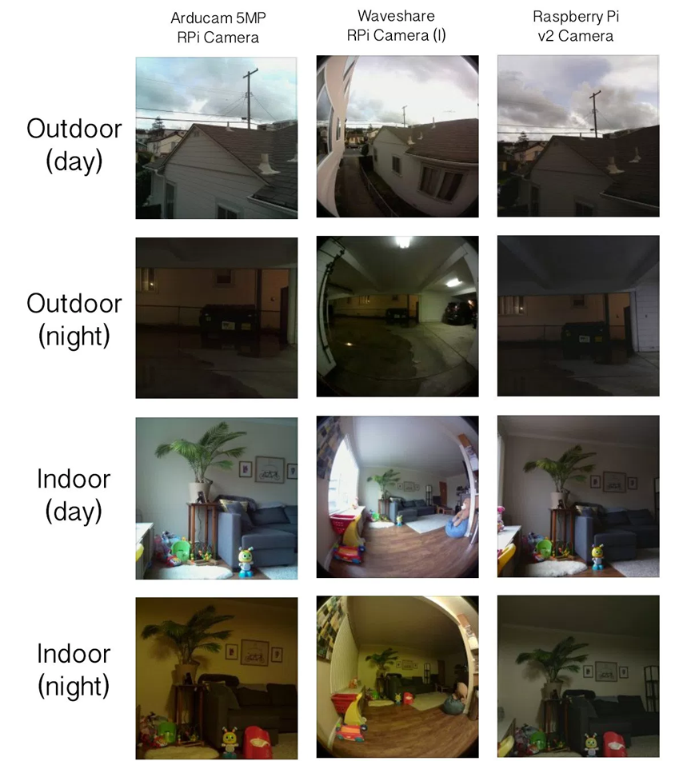
The Camera
Raspberry Pi Camera V2
IMX219 chipset
8 megapixel sensor
1080p at 30fps
Normalized colors
Small footprint for integration in glasses

Slide 14
Computer Vision – Sidewalk Detection
Goal - To Deduce the direction of the sidewalk
Two Approaches
Traditional Computer Vision Algorithms
Limited accuracy
Limited Generalizability/ Adaptability
Neural Networks
A lot of effort goes into training
Complex implementation

Slide 15
Color Thresholding
Converting to grayscale results in lost color layer data
RGB and HLS color definitions extracted
Only the R channel was chosen from RGB
Only the S channel was chosen from HLS
Both color spaces were thresholded and binarized before combining.

Slide 16
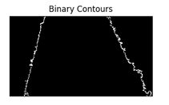
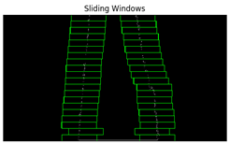
Contours and Sliding Windows
The largest contour was found within thresholded image.
Sliding windows were applied around the perspective transform to calculate a second order polynomial.
Both the right and left line calculated.

Slide 17
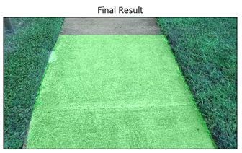
Final Result
Once the image was fully defined, it was brought back to normal perspective.
Based off average human height 5’ 7”
Can tell how off the user is to the center of the sidewalk
Left and right vibrations would activate accordingly

Slide 20
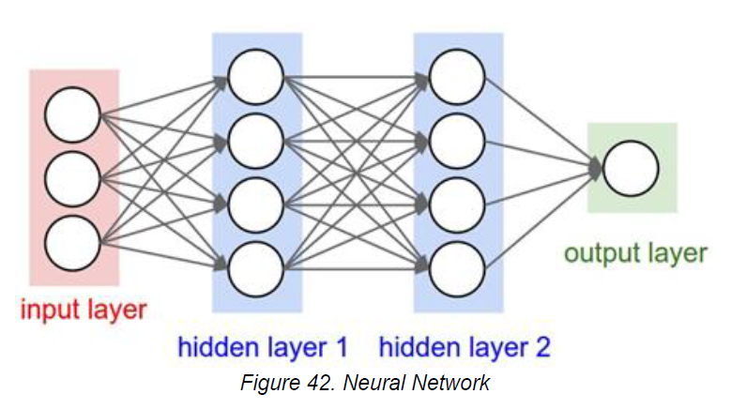
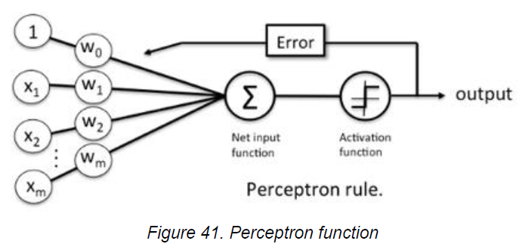
Neural Networks
What is a Neural Network?

Slide 21
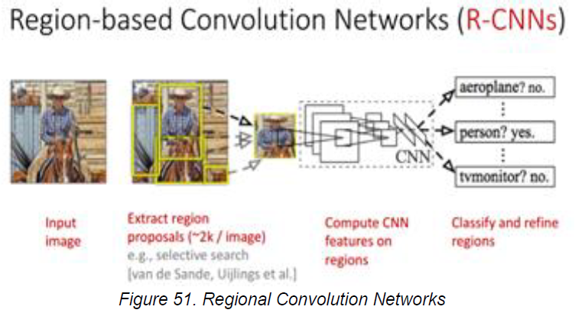
Neural Networks
State of the Art
Tools
Pytorch
Theanos/TensorFlow
Keras
Too slow

Slide 22
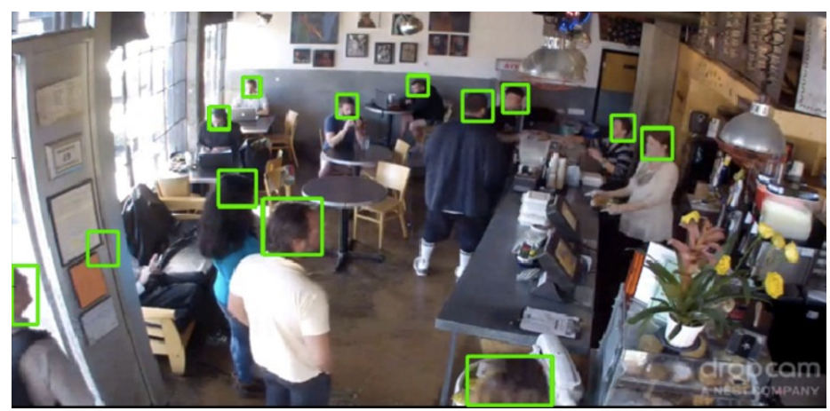
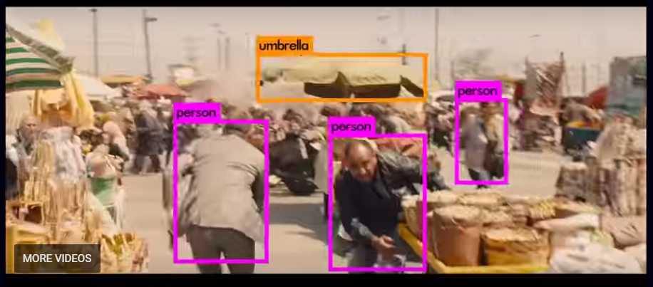
Neural Networks
TensorBox
YOLO

Slide 23
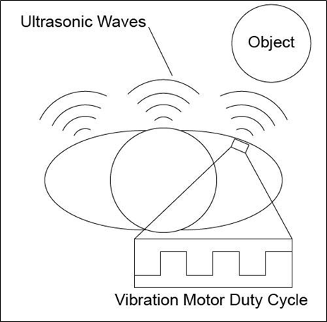
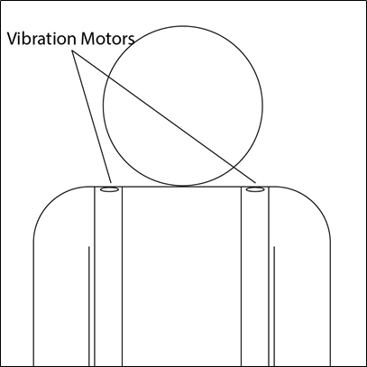
User Interface
Input
Switches on straps and belt
Controls on/off of Batpack, Laser Sensor, Computer Vision
Output
Haptic feedback
Belt Feedback
Sidewalk Detection Feedback

Slide 24
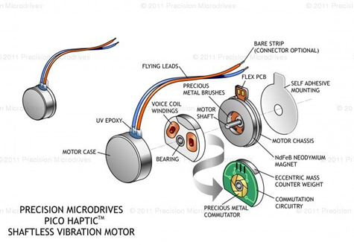
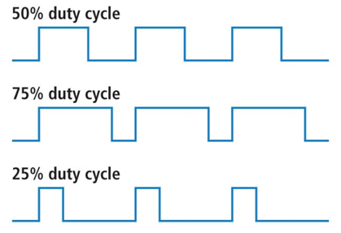
Vibrator Units
ERM (Eccentric Rotating Mass) Vibration Motor
Uses a centrifugal force while mass is rotating.
Slim enough to be sewn into belt and straps.
In one package
PWM (Pulse Width Modulation)
Used to determine vibration strength
Important feedback for object distance to user

Slide 25
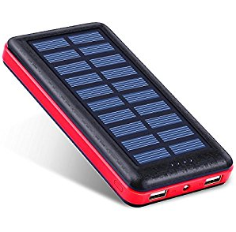
Power System
Two Phone Batteries
Commercially Available Phone Battery 1
5V Output, same voltage as most components need
3 Amp max current, 1A Port, and a 2A Port
22,400 mAh life
Solar Recharge
Very convenient
Easy to replace
Relatively inexpensive
Can be swapped out
Used to power main PCB

Slide 26
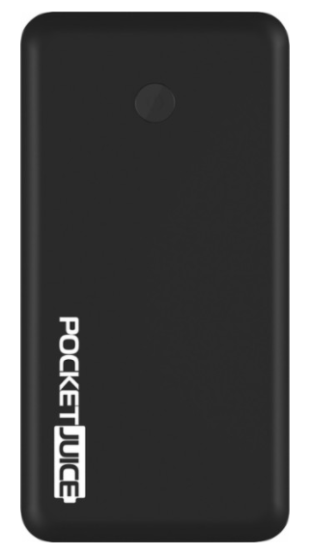
Power System
Commercially Available Phone Battery 2
3.4 Amps Max 5 Volt
2 USB Ports
12,000 mAh
Cheap
Used to power secondary PCB for laser and Raspberry Pi

Slide 27
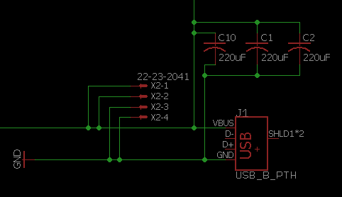
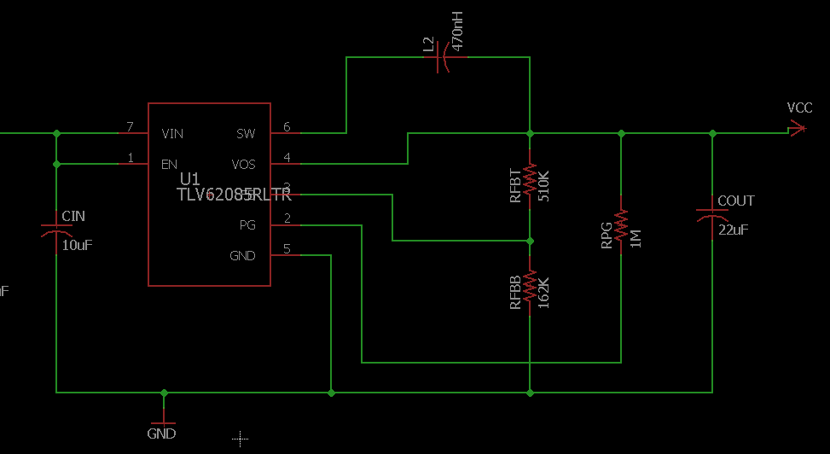
Power System
USB Power Delivery
Directly feeds to sensors & Microcontroller
Voltage Regulator
3V output
For vibrators

Slide 28
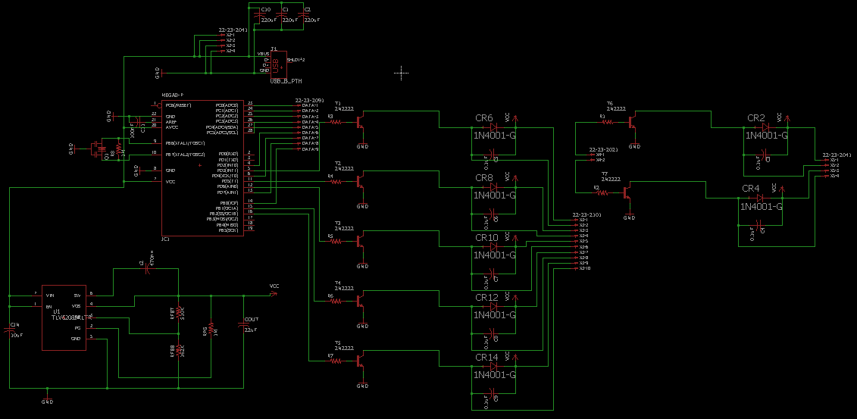
PCB Schematic

Slide 29
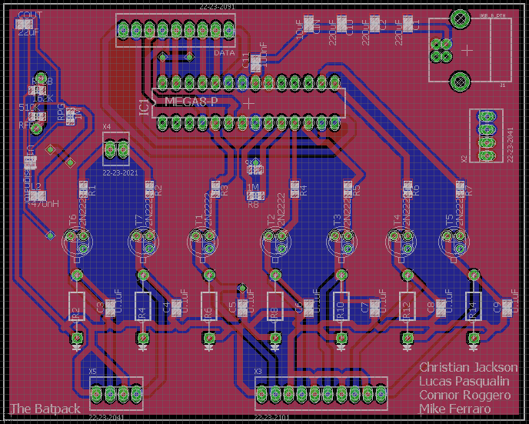
PCB Layout
Simple enough for two layers
Voltage Regulator
ATMega328
USB Power
Vibrator Driver Circuits

Slide 30
Administration

Slide 31
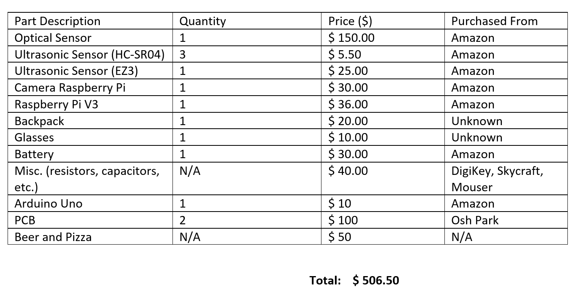
Budget

Slide 32
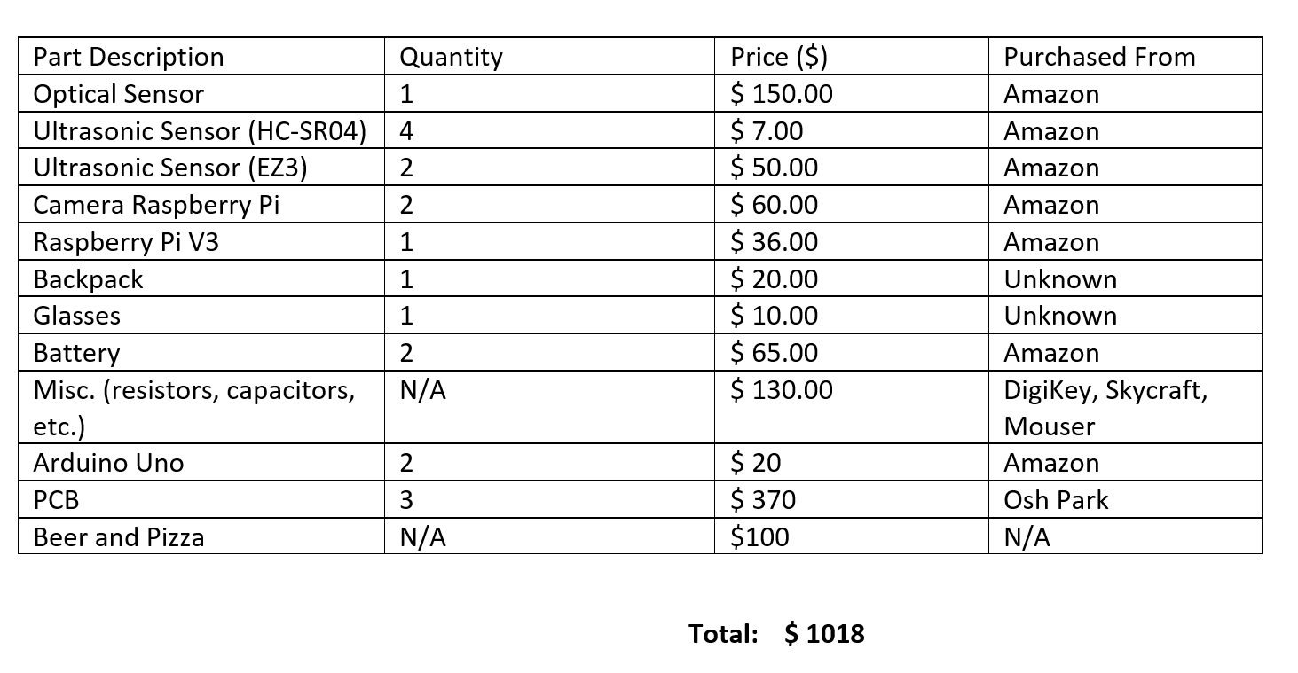
Actual Cost

Slide 33
Work Distribution
Name | PCB | Computer Vision | Laser Rangefinder | Ultrasonic Sensor | Human Factors
Christian | X | X | X | X | X
Connor | X | X | X | X | X
Lucas | X | X | X | X | X
Mike | X | X | X | X | X

Slide 34
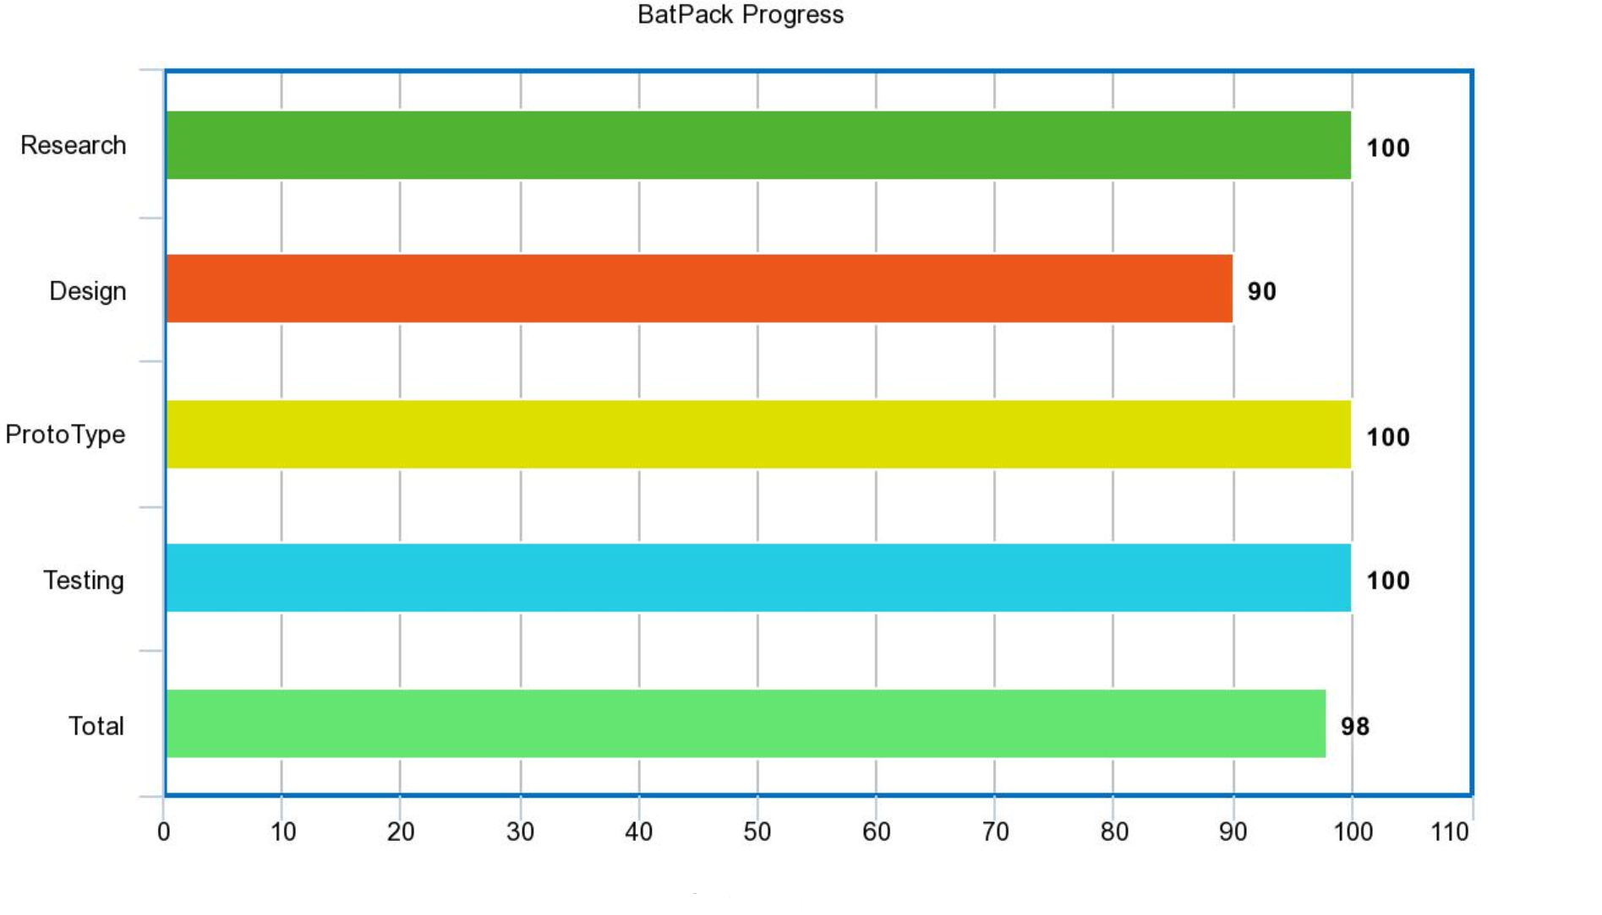

Slide 35
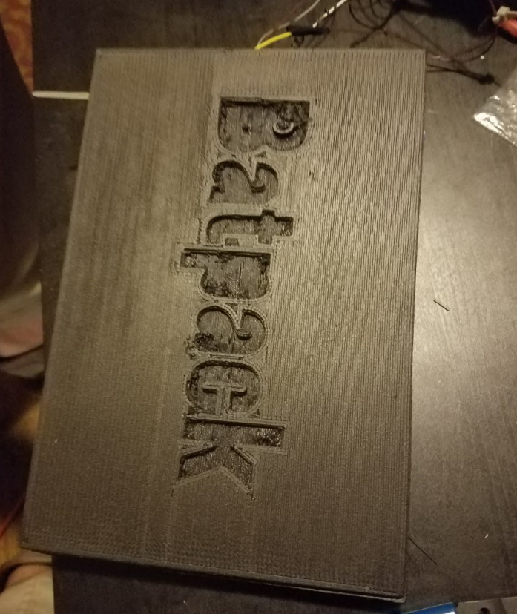
Issues

Slide 36
PCB Lessons Learned
PCB V1
PCB V2
Corrected Pinout for ATMega328
Voltage regulation circuit improved
More Precision
Higher Amperage
PCB V3
Added Crystal Clock
Direct soldering pads changed to molex connector pins
Added capacitor to aREF pinout
Added ground and power plane
Kitchen Knife
PCB V4 (Future)
Fix crystal grounding issue
Ground pour
Add data lines
Bypass capacitors
Separate laser and belt to individual circuits

Slide 37
Vibrators not working
Software
Bit Banging
Hardware
Transistors not grounded on PCB V3
Low Quality Vibrators avaIlable in the Market

Slide 38
Broken Components
EZ3
Burned while soldering
Rasp Pi v2 camera
Static discharge in car ride home from demo
Vibrators
Poor quality leads

Slide 39
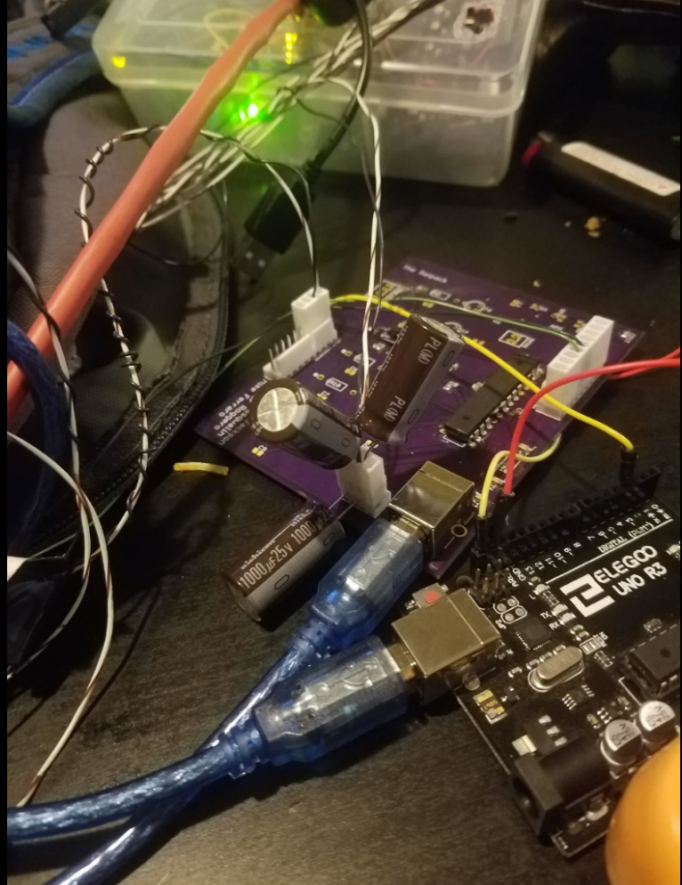
Laser Issues
I2C
NACKs
Cascading failure, crashing chip
Sensitive to change in voltage
Vibrator voltage changing too fast, crashed chip
Software fixes
PID Controlled software for controlled vibrators
Watchdog interrupt vector with both software and hardware resets
Hardware fixes
Tested 50uF, 400uF, 680uF, 1000uF, 2000uF, 3000uF bypass capacitors
Moved to seperate board
Redid wiring
Hot glue, hot glue, more hot glue

Slide 40
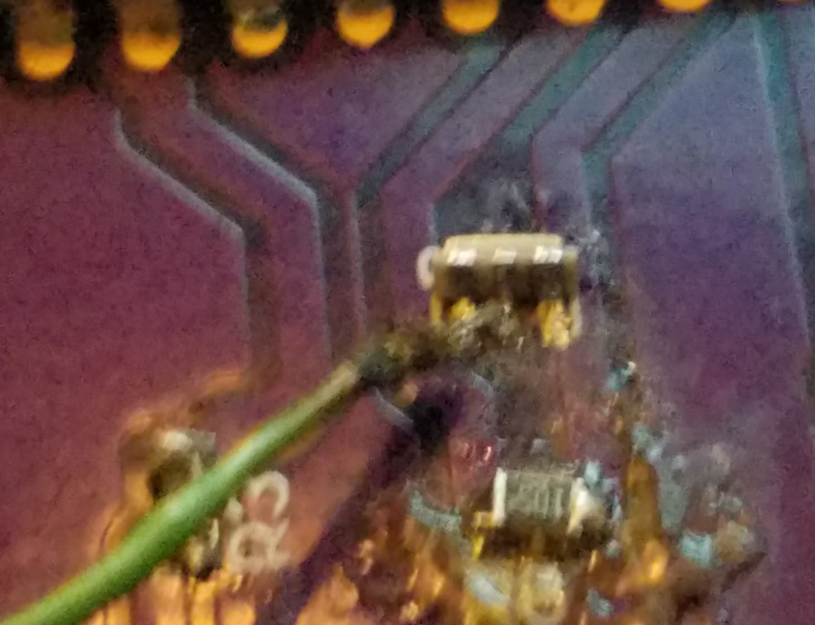
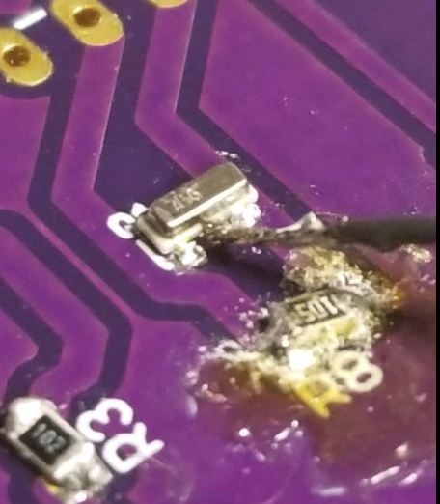
Microcontroller Issues
ATmega 328 vs ATmega 328p
Bootloader vs no Bootloader
Unable to flash fuses
No crystal in PCB 2
In PCB 3, the Crystal Resonator not grounded
Hardwire ground? Nope.
Internal 8MHz clock unavailable
Bad connections ? Soldering did not help.
Final solution
Using crystal resonator onboard the uno
Hardwired connections to necessary pins on PCB

Slide 41
Lessons Learned in Testing
Not enough time for Proper QA
When all vibrators run at once, it can be very confusing
Laser / Belt
Different methods of vibrating to the user, discrete and continuous were tested

Slide 42
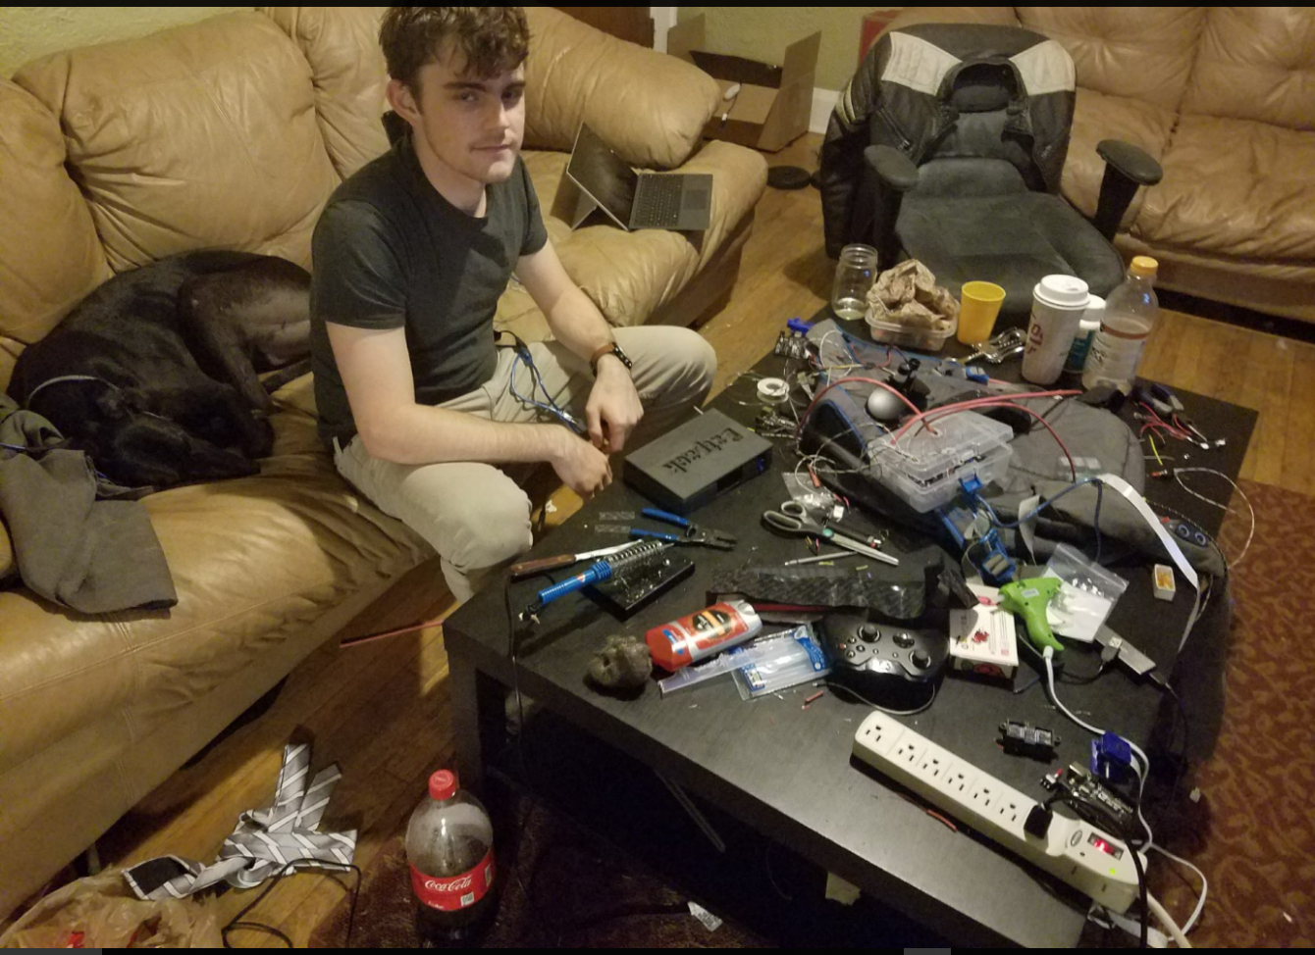
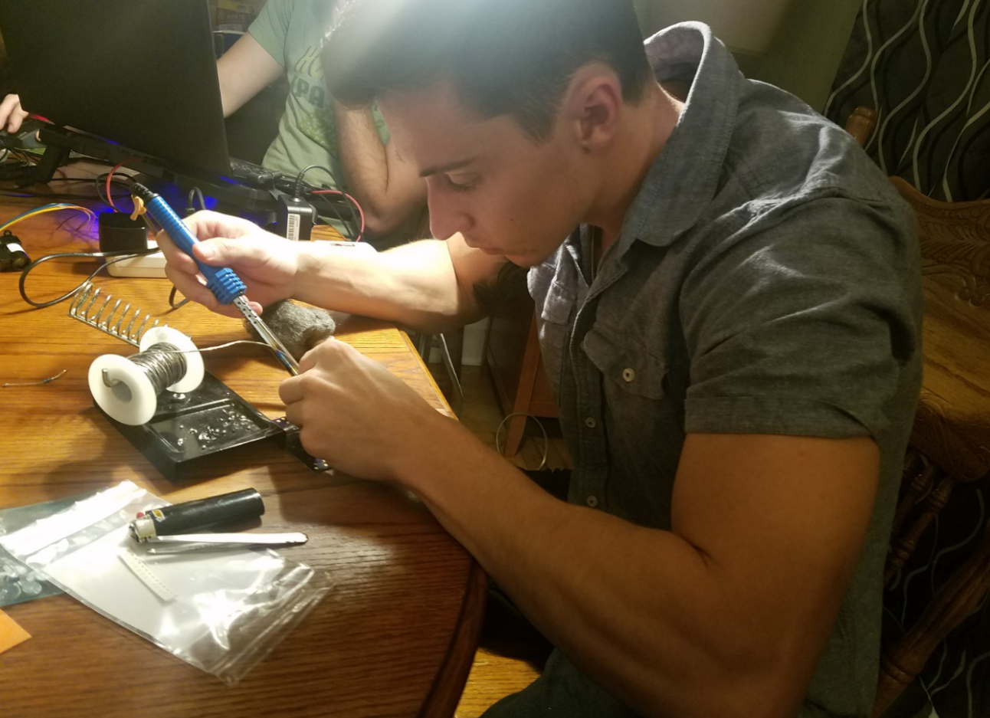
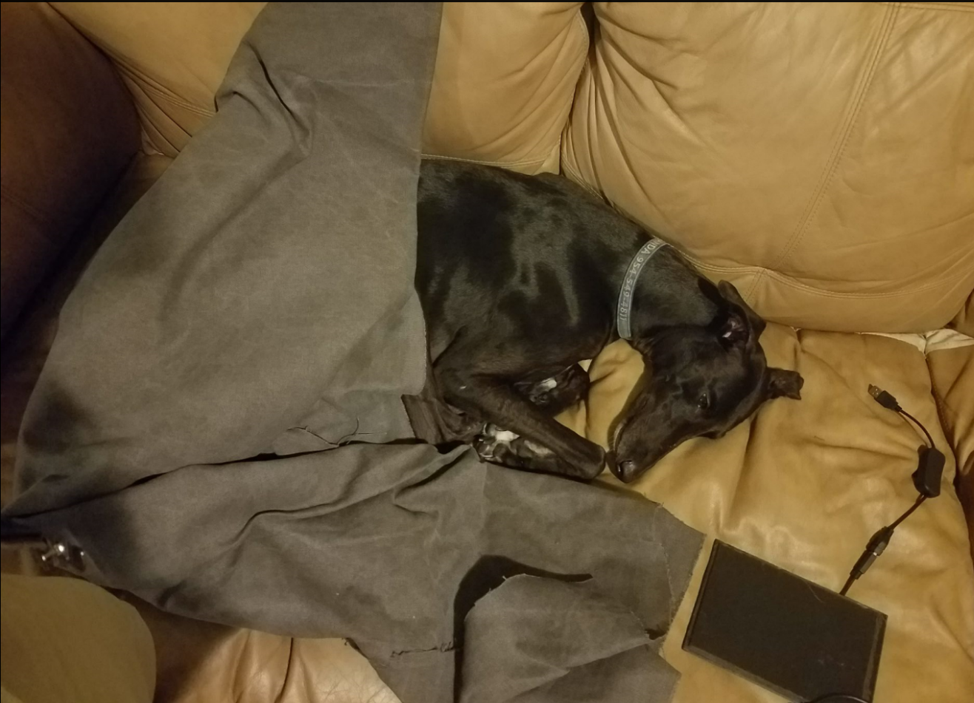
Bloopers

Slide 43
Questions?

