Slide 1
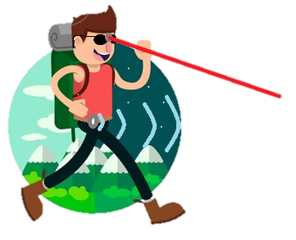
BatPack
Group 2 Christian Jackson
Connor Roggero
Lucas Pasqualin
Mike Ferraro

Slide 2
Motivations
No advancement in technology for visually impaired
Breakthroughs in Computer Vision
39 million blind, 246 million legally blind (World Health Organization)
Improve quality of life for the visually impaired
Users of walking sticks have one hand occupied

Slide 3
Goals and Objectives
To build a device that will provide blind users with all of the functionality that a cane provides, but using modern technology. Users should be able to readily tell where they’re going, detect obstacles, and have both hands free while doing so.

Slide 4
Specifications
Unit Housing
Dimensions : Fit in Backpack
Weight : Less than 2lbs
Micro-Controller
I/O : I2C and SPI Communication Protocols
Power : Less than 1.5W
Ultrasonic Sensor
Distance : More than 2m
Laser Sensor
Distance : More than 5m
Vibration Unit(s)
Power : Less than 0.1W
Signal : PWM
Camera
Resolution : Compatible for Computer Vision
Frame Rate : 24
Battery Supply
Capacity : At least 20000mAh
Duration : > 24hrs

Slide 5
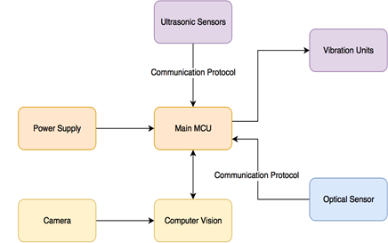
Components
Main housing in a Traditional Backpack
Battery
PCB
Raspberry Pi
Storage for Glasses
Interface on straps
Belt across user’s waist for ultrasonic sensors and vibration units.
Glasses used for optical sensor (directed obstacle detection) and camera for computer vision.

Slide 6
How we got to the Batpack
The SideStick
Still have a hand occupied
Too bulky for comfortable use
The fanny pack
Limited space
No where to hold glasses
Not stylish
The BatPack
Easily holds all components needed, with extra space
Can hold collapsible walking stick
Room for user interface

Slide 7
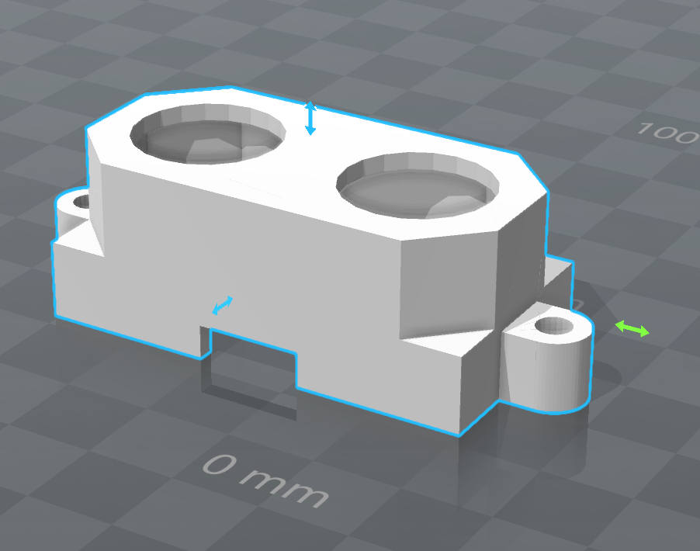
The Belt
Composed of 3 ultrasonic sensors in the front and one on the back of the BatPack.
Gives the user a 360 degree experience.
Ultrasonic sensors in 3d printed housing.
Sewn into the belt.
Vibration units on user’s side for each sensor.

Slide 8
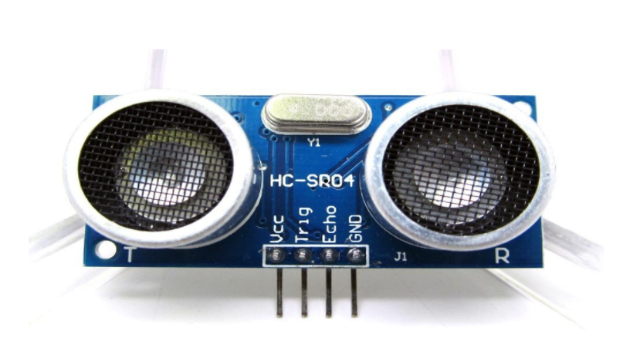
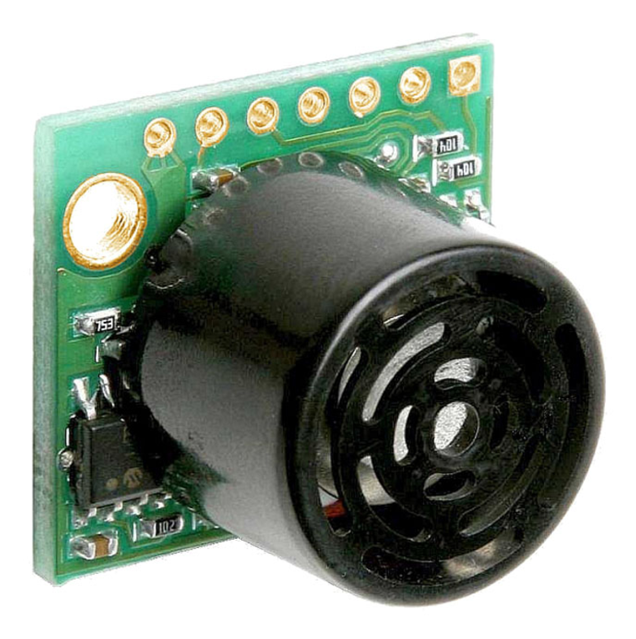
Ultrasonic Sensors
Working and Calculations
Considerations when measuring
Distance
Size of object
Size of beam

Slide 9
Ultrasonic Sensors - Specs

Slide 10
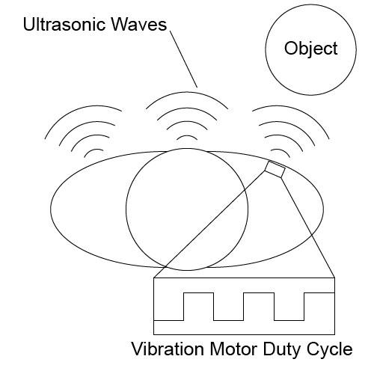
Ultrasonic Sensor - Layout
Cross-Talk
Filter Sensor Data
Ezmax3: median
HC-SR04: average

Slide 11
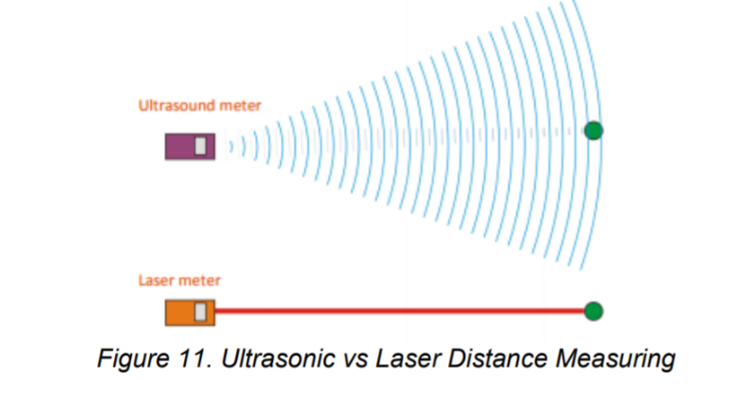
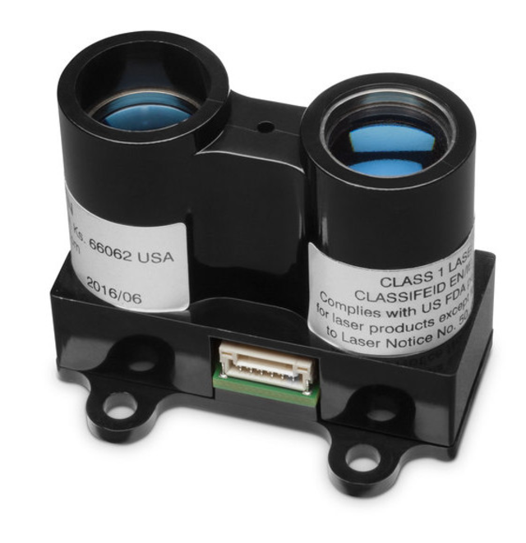
Optical Sensor
Considerations for measuring
How it works and calculations
Material
Reflectivity
Diffuse
Specular
Retro
Distance
Size of object

Slide 12
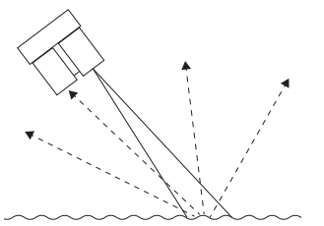
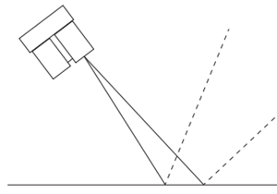
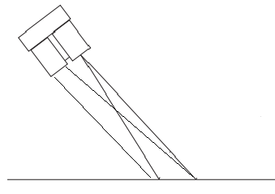
Reflectivity
Diffuse Reflectiveness
Rough surfaces cause energy to be reflected uniformly
Specular Reflectiveness
Smooth surfaces cause issues for laser sensors if they are not directly perpendicular to the surface.
Retro-Reflectiveness
Surfaces that reflect light with minimal scattering.

Slide 13
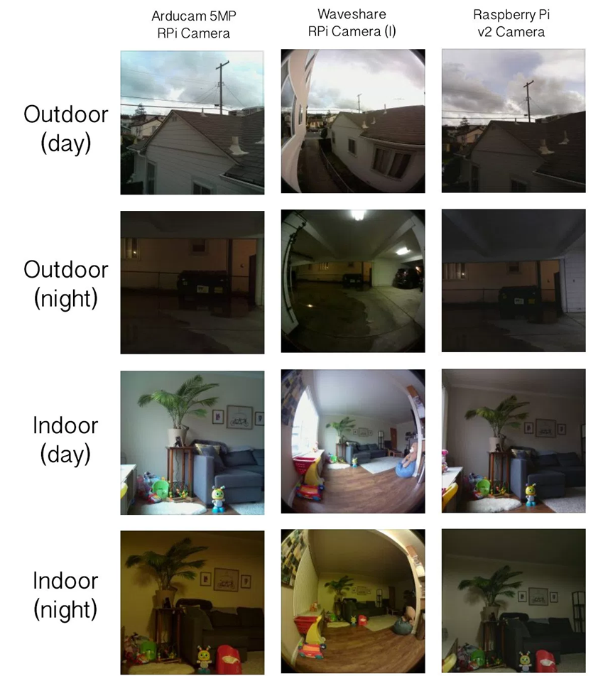
The Camera
Raspberry Pi Camera V2
IMX219 chipset
8 megapixel sensor
1080p at 30fps
Normalized colors
Small footprint for integration in glasses

Slide 14
Computer Vision – Sidewalk Detection
Goal - To Deduce the direction of the sidewalk
Two Approaches
Traditional Computer Vision Algorithms
Limited accuracy
Limited Generalizability/ Adaptability
Neural Networks
A lot of effort goes into training
Complex implementation

Slide 15
Traditional Computer Vision Algorithms
HSV Colorspace - Makes the algorithm more adaptable to changes in lighting
Canny Edge detection (Sobel) - Finds edges
Hough Transform Attempts to Look for - Lines in the edges
From the two lines, decide on a direction

Slide 16
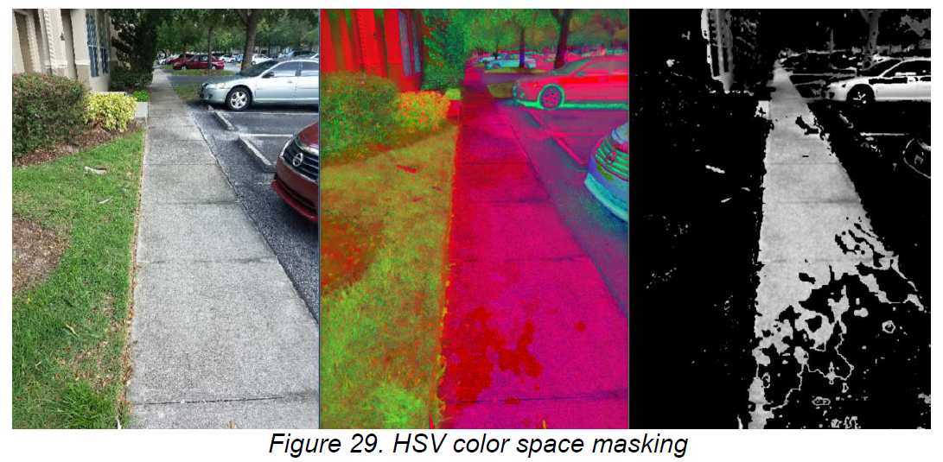
HSV

Slide 17
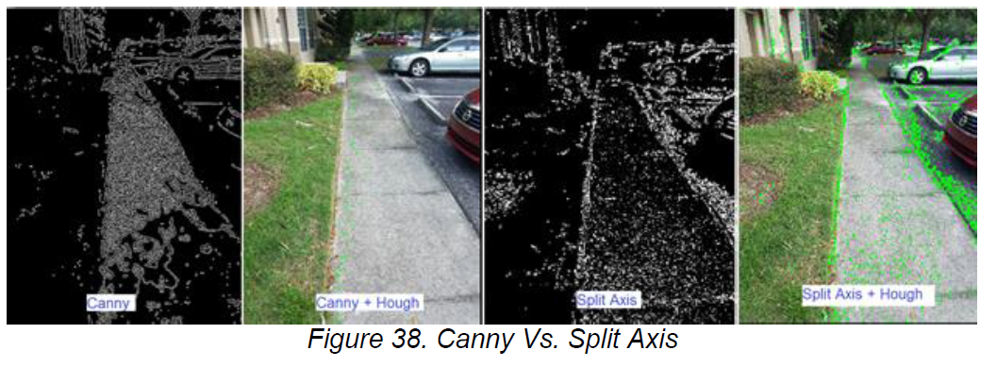
Canny + Hough

Slide 18
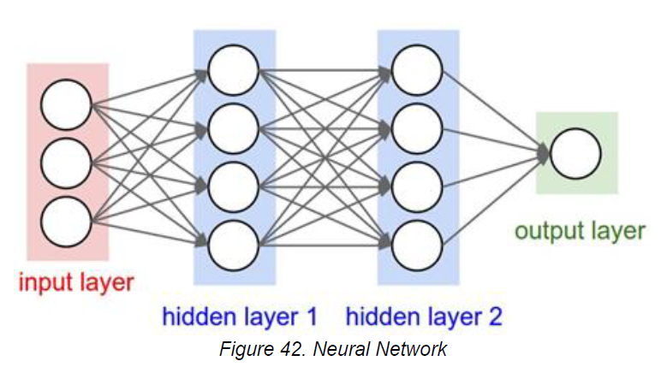
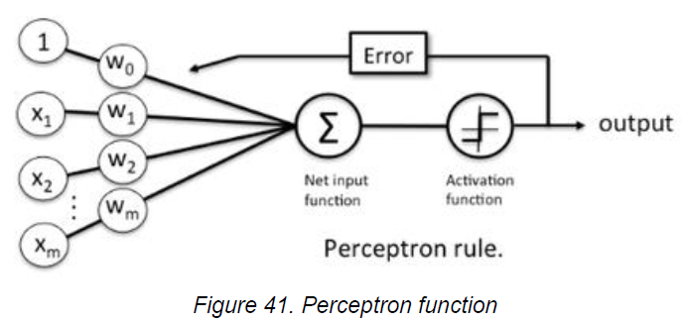
Neural Networks
What is a Neural Network?

Slide 19
Neural Networks
What is a Neural Network?

Slide 20
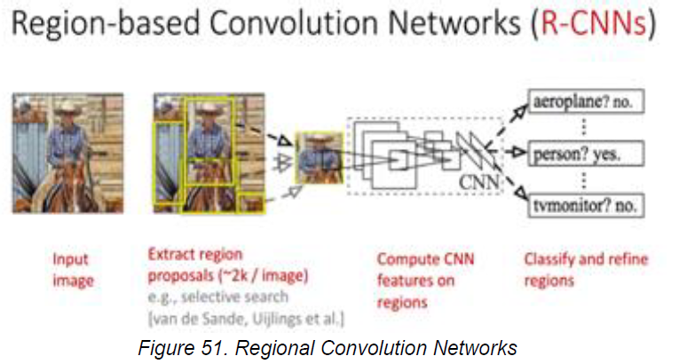
Neural Networks
State of the Art
Tools
Pytorch
Theanos
Spark

Slide 21
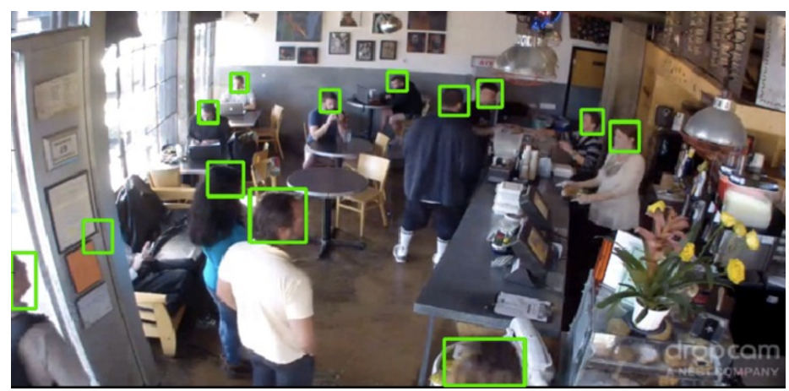
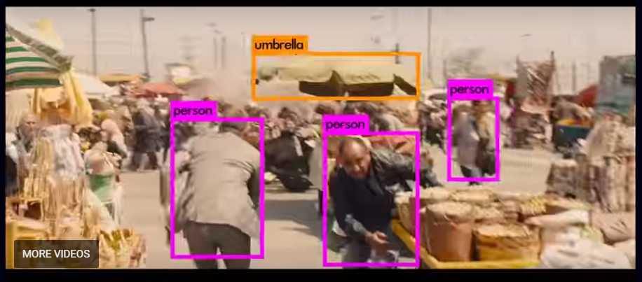
Neural Networks
TensorBox
YOLO

Slide 22
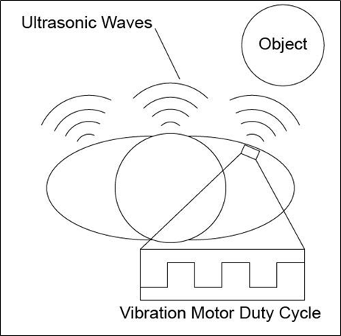
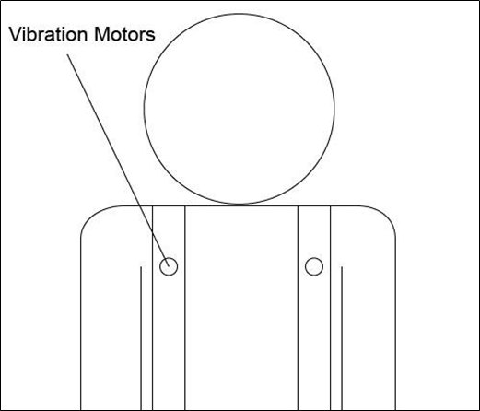
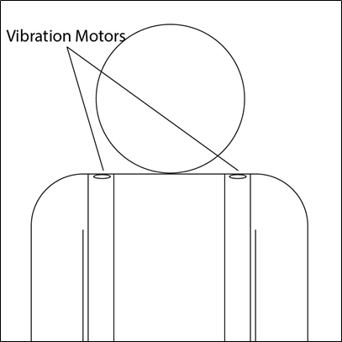
User Interface
Input
Buttons along straps of Batpack
Controls on/off of Batpack, Laser Sensor, Computer Vision
Output
Haptic feedback
Belt Feedback
Optical Sensor Feedback
Sidewalk Detection Feedback

Slide 23
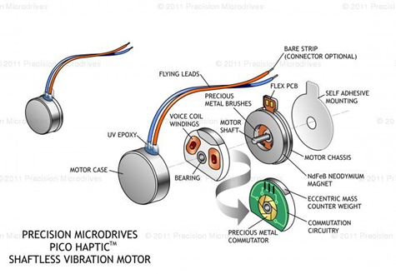
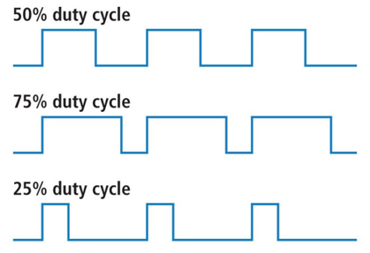
Vibrator Units
ERM (Eccentric Rotating Mass) Vibration Motor
Uses a centrifugal force while mass is rotating.
Slim enough to be sewn into belt and straps.
In one package
PWM (Pulse Width Modulation)
Used to determine vibration strength
Important feedback for object distance to user

Slide 24
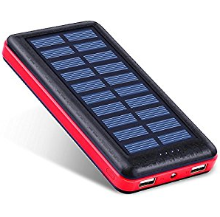
Power System
Commercially Available Phone Battery
5V Output, same voltage as most components need
22,400 mAh life
Solar Recharge
Very convenient
Easy to replace
Relatively inexpensive
Can be swapped out

Slide 25
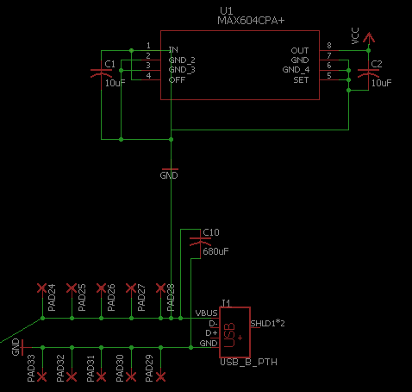
Power System
USB Power Delivery
Directly feeds to sensors & Microcontroller
Voltage Regulator
3V output
For vibrators

Slide 26
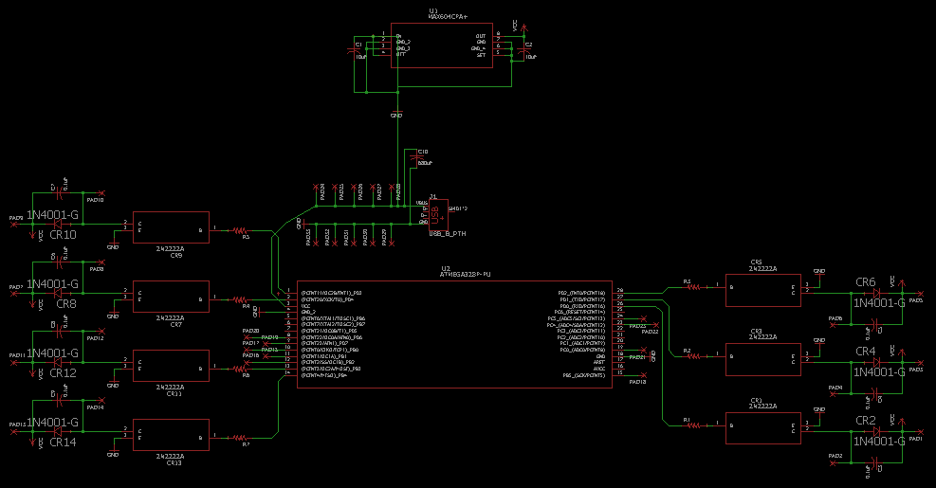
PCB Schematic

Slide 27
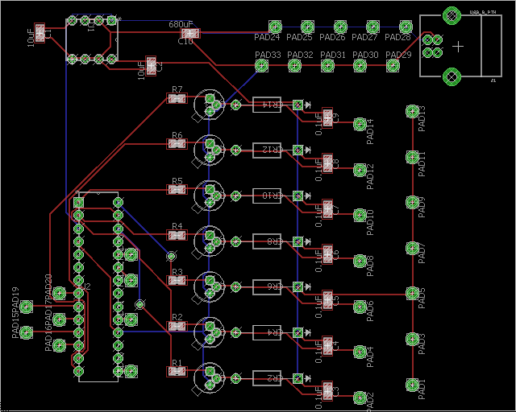
PCB Layout
Simple enough for two layers
Organized by power, microcontroller,
and vibrator circuits

Slide 28
Administration

Slide 29
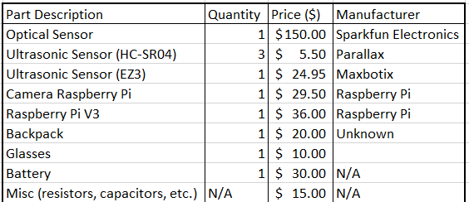
Budget
Total: $331.95

Slide 30
Work Distribution
Name | PCB | Computer Vision | Laser Rangefinder | Ultrasonic Sensor | Vibrator Calibration
Christian | X |  |  |  | X
Connor |  |  | X |  | X
Lucas |  | X |  |  | X
Mike |  |  |  | X | X

Slide 31
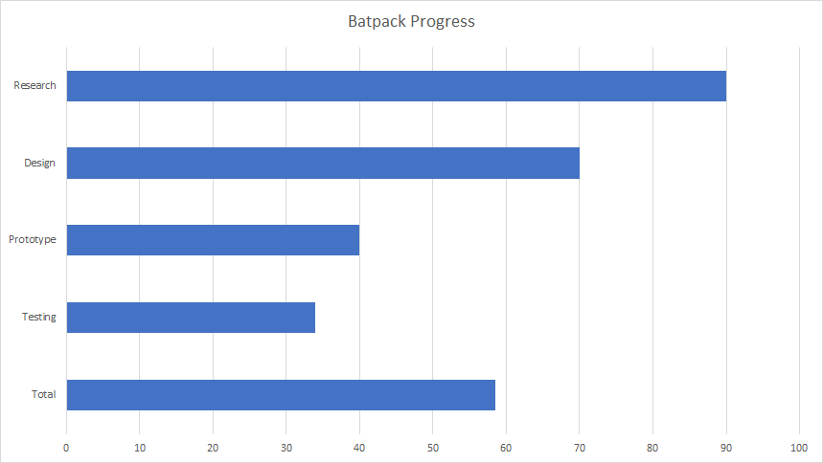

Slide 32
Current Issues
Computer Vision
Neural Network
Haptic Feedback - Output

Slide 33
Questions?

