Slide 1
Heart Racer Go-Kart EEL 4915 Group E Department of EECS University of Central Florida
Daniel Franco, EE
Steve Monroy, EE
Andre Barrett, EE
Fall 2015

Slide 2
Project Motivation
The concept of a Go-Kart, and the experience that comes with driving one, has remained unchanged since 1956 when Art Ingels invented the first one out of scrap metal and a lawn mower engine.
The purpose of this project is to present a revolutionary idea of what a Go-Kart should look like and the options it should have.
The main goal of the Heart Racer Go-Kart is to enhance the driving experience of the customer riding it by stimulating their senses and encouraging their nervous system to release more adrenaline than it regularly would with another, non-modified, Go-Kart.

Slide 3
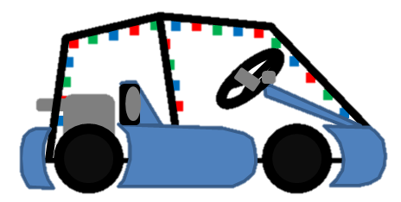
Objectives
LEDs and set of speakers attached to cage.
Pulse sensor and display mounted on steering wheel
Microcontroller attached to the back of the display.
The whole system will be powered by a 12V/7Ah battery.
Cage
Speakers
Display
Pulse Sensor
LED Lights

Slide 4
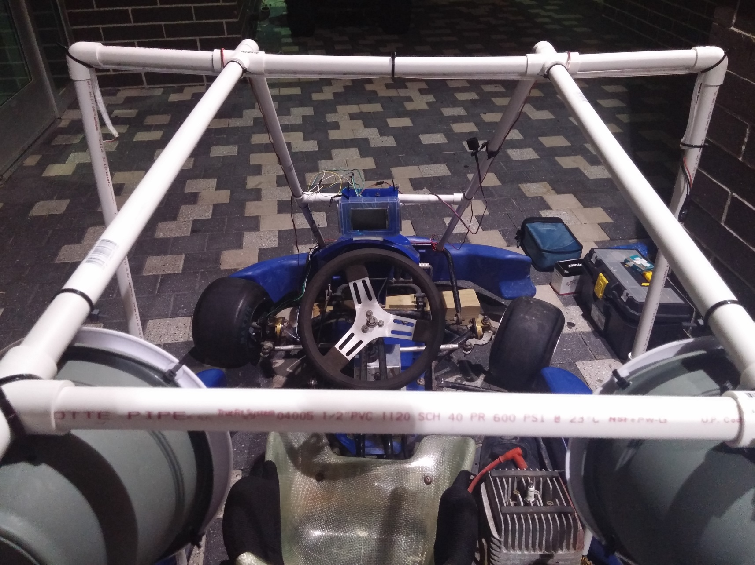
Objectives
LED LIGHTS
PULSE SENSOR
DISPLAY
CAGE
SPEED SENSOR
SPEAKERS

Slide 5
Challenges so far
Reduction of our group from four members to three.
Finding a proper location to store Go-Kart.
Speedometer we ordered did not fit.
Finding electronic parts that are compatible with each other.
Codes that blocked each other in one processor.
Testing of the PCB.
Deciding whether to implement speakers with display or not.

Slide 6
Specifications
Component | Parameter | Design Specification
Go-Kart | Power | 40+ mph
LED Lights | Pattern Variation | Responds to Pulse Sensor
Pulse Sensor | Accuracy of reading | Reads driver’s bpm every 5s
Speakers | Output level | 90dB– 110dB
Display | Accuracy to display info | Displays updated stats
Speedometer | Speed Test | Provides accurate readings
Battery | Power Electronics | 12V

Slide 7
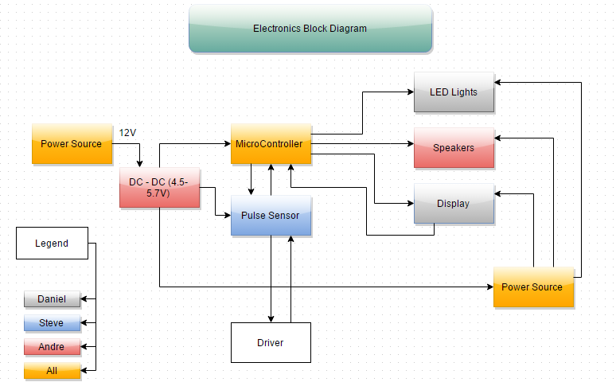
Block Diagrams

Slide 8
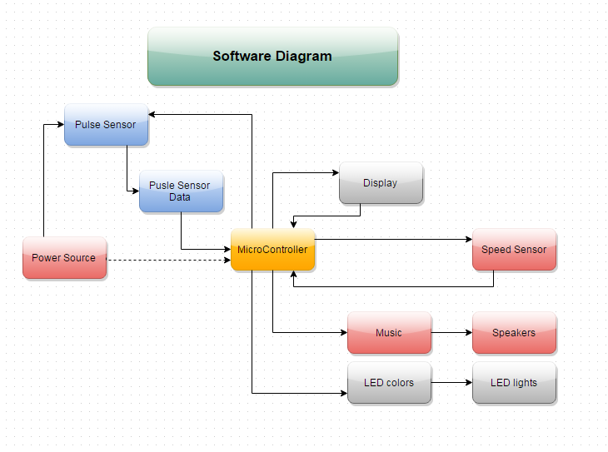
Block Diagrams

Slide 9
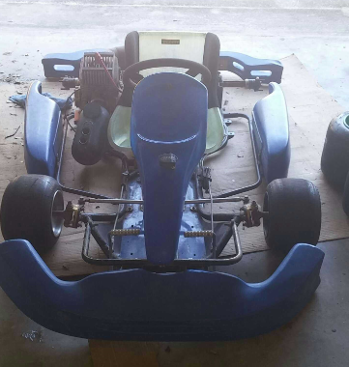
Components – Go-Kart
We decided to choose a racing Go-Kart to be able to reach high speeds.
The Go-Kart holds a Yamaha KT100 engine on it.
Large enough area to have all electrical equipment installed on the Go-Kart itself.
55” x 71”
Cost = $300
Purchased from Craigslist

Slide 10
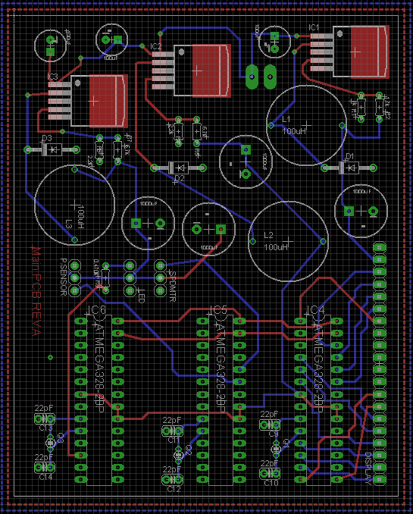
Components – Microcontroller
For initial testing purposes, all of the coding and testing was be done on Arduino UNO boards.
We transferred the ATmega328 processors to our designed PCB once design of code was complete.
More testing ensued upon transfer of processors.
Cost = $150
Designed on EagleCad
Purchased from AshPark
Printed Circuit Board containing Processors

Slide 11
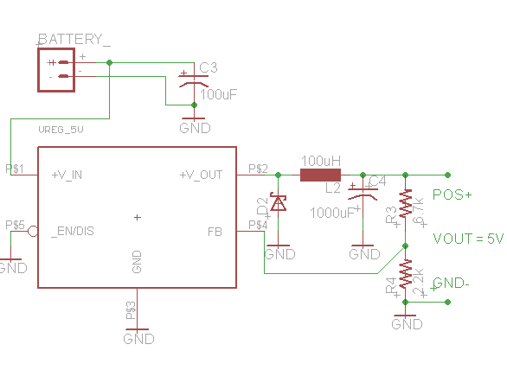
Components – Microcontroller
Power Supply #1 – Output 5V

Slide 12
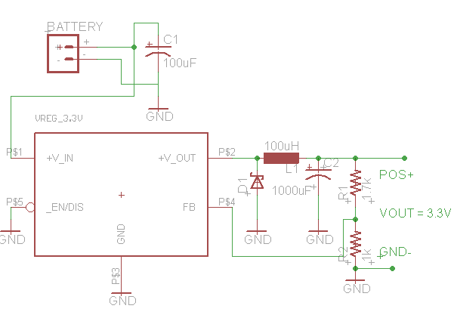
Components – Microcontroller
Power Supply #2 – Output 3.3V (Later Updated to output 5V)

Slide 13
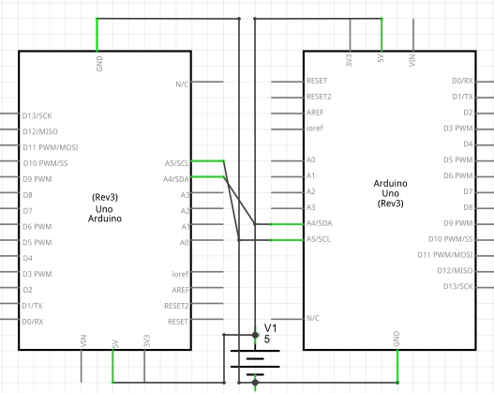
Components – Microcontroller
I2C Communication between Processors – Third processor not shown, but Daisy Chained in the same manner to the two

Slide 14
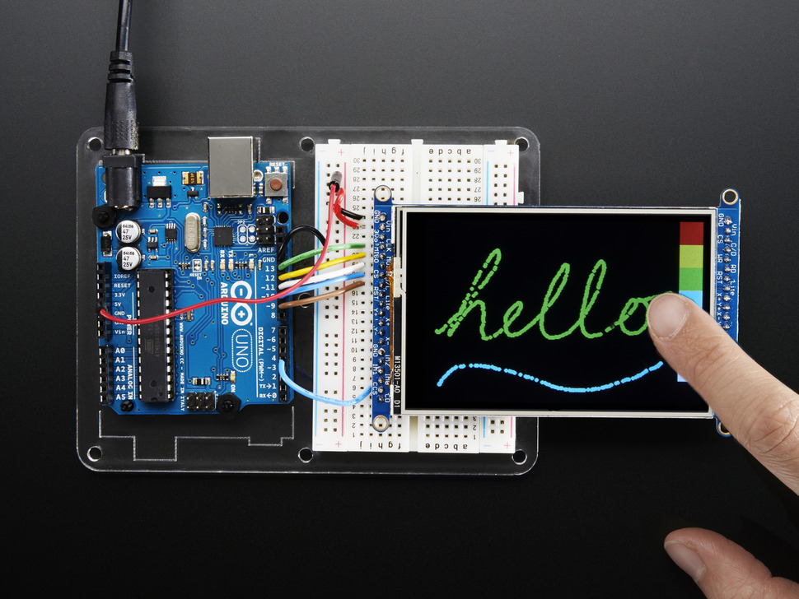
Components – Display
3.5” TFT 320x480 + Touchscreen Breakout Board w/MicroSD Socket – HXD8357D
Can be used in either of two modes: 8-bit or SPI.
Display is backlit by six white LEDs
Operates at a voltage rating between 3.3V and 5V
Reprinted with permission of Adafruit
Cost = $39.95
Purchased from Adafruit

Slide 15
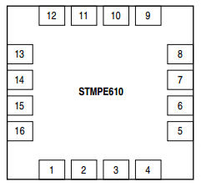
Display
Pin | Name | Function
1 | Y- | Y-/GPIO-7
2 | INT | Interrupt output (VCC domain, open drain)
3 | A0/Data Out | I2C address in Reset, Data out in SPI mode (VCC domain)
4 | SCLK | I2C/SPI clock (VCC domain)
5 | SDAT | I2C data/SPI CS (VCC domain)
6 | VCC | 3.3 −5V supply voltage
7 | Data in | SPI Data In (VCC domain)
8 | NC | -
9 | Mode | MODE In RESET state, MODE selects the type of serial interface "0" - I2C "1" - SPI
10 | GND | Ground
11 | IN2 | IN2/GPIO-2
12 | IN3 | IN3/GPIO-3
13 | X+ | X+/GPIO-4
14 | Vio | Supply for touchscreen driver and GPIO
15 | Y+ | Y+/GPIO-5
16 | X- | X-/GPIO-6
Pin assignments on display controller

Slide 16
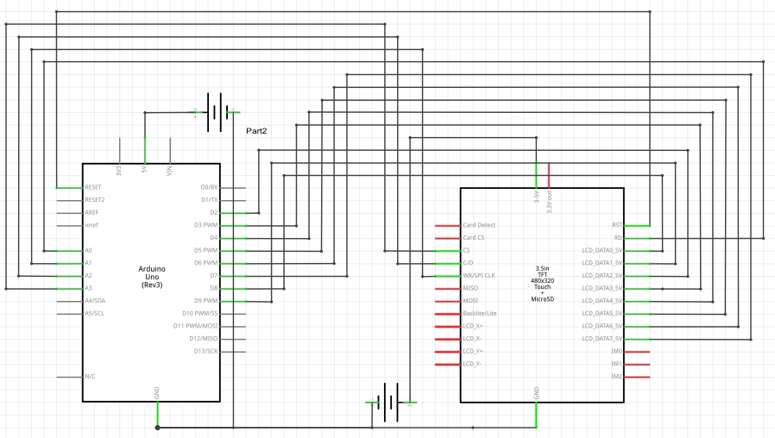
Display
Himax HX8357 PIN location and function

Slide 17
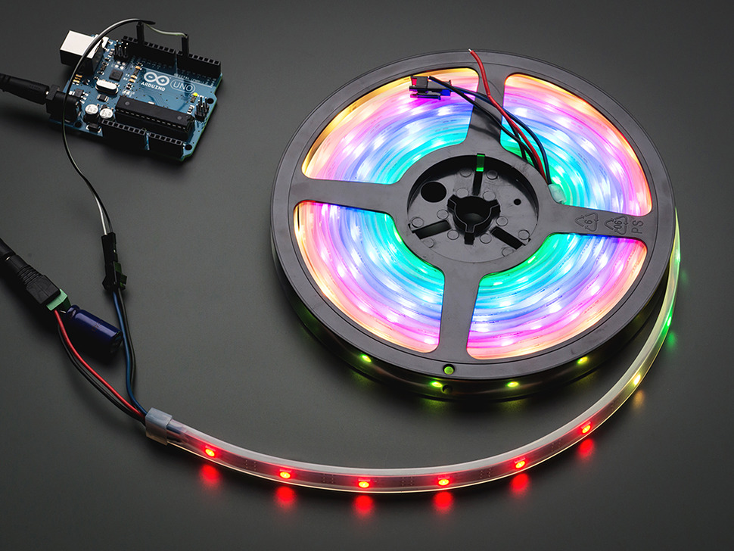
Components – LED Lights
Neopixels WS2812B
Had to decide between Neopixels or Digital RGB LED Weatherproof.
Each pixel can be addressed independently since they each have their own microcontroller.
Can be cut at any point of the strip.
Consume less power (9.5W/m)
5V – 2A Power supply.
Reprinted with permission of Adafruit
Cost = $16.95/m
Purchased two meters
Purchased from Adafruit

Slide 18
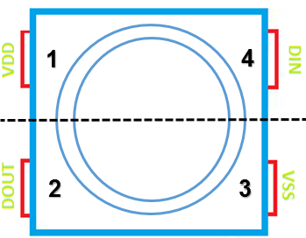
NeoPixel WS2812B
Pin | Name | Function
1 | VDD | Power Supply LED
2 | DOUT | Control Data Signal Output
3 | VSS | Ground
4 | DIN | Control Data Signal Input
Pin Distribution on NeoPixel WS2812B
Physical Distribution of single Pixel in NeoPixel

Slide 19
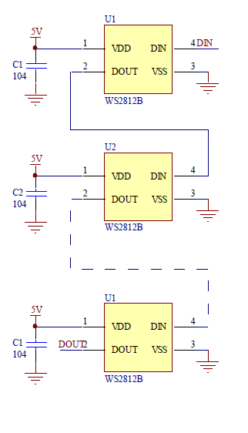
NeoPixel WS2812B
Application of the circuit

Slide 20
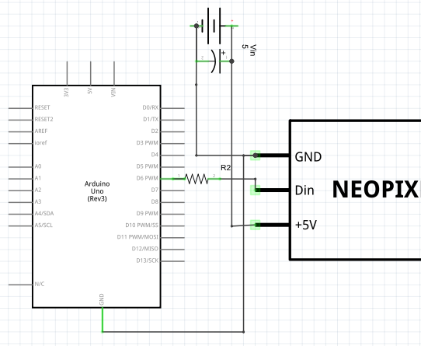
NeoPixel WS2812B
Circuit Schematic for LED lights

Slide 21
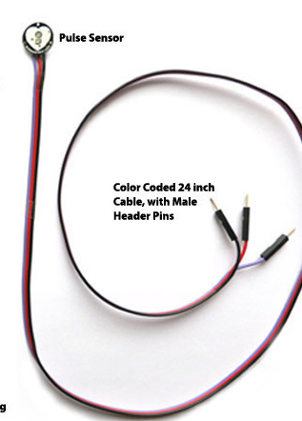
Components – Pulse Senor
Pulse Sensor SEN-11574
We decided to use this sensor because it was the most cost effective option and space efficient.
It will be mounted directly on to the drivers finger and will be connected to the PCB.
Signals gathered from the Sensor will ultimately control the LED Strip.
It will be programmed to gather data every 5 Seconds.
Pulse Sensor Kit
Cost = $24.95
Purchased 1 unit
Purchased from Sparkfun

Slide 22
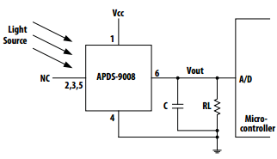
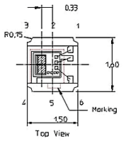
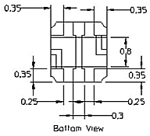
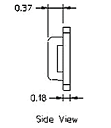
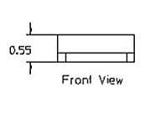
Pulse Senor
PIN | Name | Description
1 | VCC | VCC
2 | NC | No Connect
3 | NC | No Connect
4 | GND | Ground
5 | NC | No Connect
6 | A0 | Communication
Reprinted with permission from Avago Tech

Slide 23
Pulse Senor
Overall Pulse Sensor Circuit Schematic
Reprinted with Permission of Joel Murphy

Slide 24
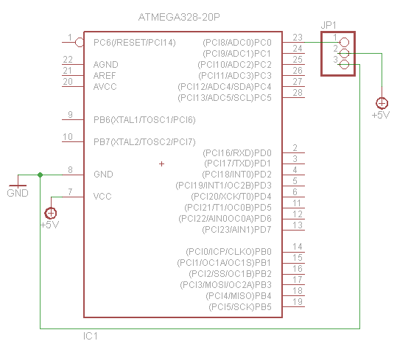
Pulse Sensor
Circuit Schematic for Pulse Sensor

Slide 25
Components-Speakers
Pyle PLMRKT2A 2-Channel Waterproof Amplified 6.5-Inch Marine Speaker System
This product was chosen due to its pricing, specifications and its design.
100 Watts RMS / 200 Watts Peak, the frequency response ranges from 80-20k Hz, contains an impedance of 40Ω, at 4Ω 2 x 100 Watts RMS, at 4Ω 2x200 Watts Max, at 2Ω 2 x 300 Watts RMS.
Light weight – only 6.97lbs.
Sound Output = >95dB
Reprinted with permission from Pyle
Cost = $65.29
Purchased from Amazon
Purchased 1 unit

Slide 26
Components-Speakers
Speakers Bridge Amplifier Schematic

Slide 27
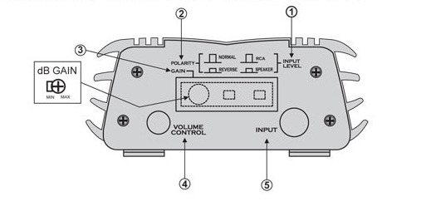
Pyle Hydra Speaker System
Pin Number | Pin Name
1 | Input Level
2 | Polarity
3 | Gain
4 | Volume Control
5 | Stereo RCA input
Permission to Reprint Requested from Pyle

Slide 28
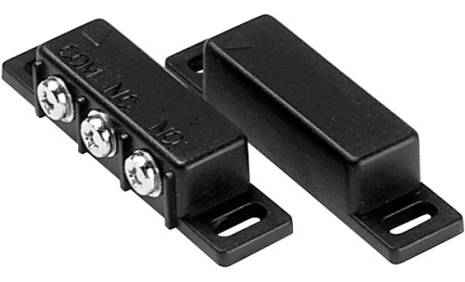
Components-Speedometer
Sunlite Speedometer, initially.
Reed Switch later.
Easy Installation
Cost effective
Reed Switch Sensor
Cost = $5.55
Purchased from Amazon
Purchased 1 unit
Reprinted with Permission from Sunlite

Slide 29
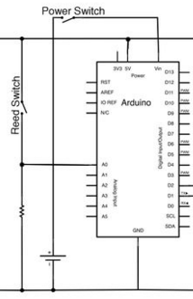
Components-Speedometer
Reed Switch Schematic

Slide 30
Components - Battery
Expert Power EXP1270 Black 12V 7 Amp Rechargeable Lead Acid Battery
BATTERY TYPE - 12 Volt 7 Amp 20 Hour Sealed Lead Acid Battery With F1 Style Terminals
Light weight and compact – only 3.2 pounds with the dimensions of 5.9 x 2.5 x 3.7 inches.
Easy to install
Cost effective
Reprinted with permission from Expert Power
Cost = $16.03.
Purchased from Amazon
Purchased 1 Units

Slide 31
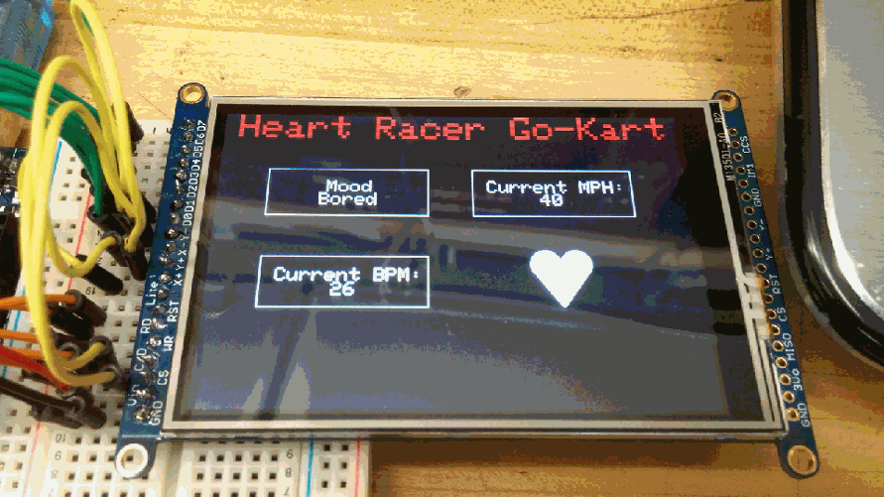
Components-Software
User Interface of the TFT Display

Slide 32
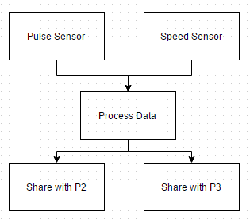
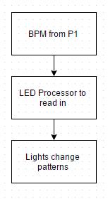
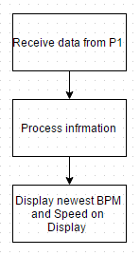
Components-Software
Software Development Cycle

Slide 33
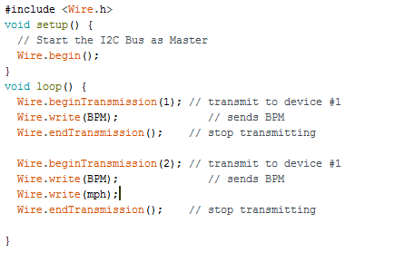
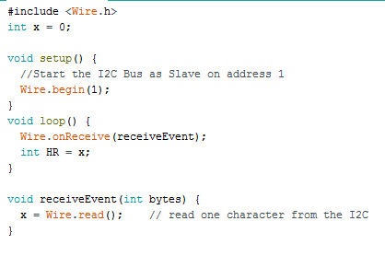
Software – I2C Communication
Slave Processors
Master Processor

Slide 34
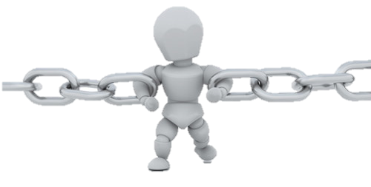
Design Constraints
Time
Progress Monitoring - Dropbox
Inaccurate Predictions – Will attempt to finish early to be able to correct errors
Motivation – Group meetings (2-3 times a week)
Locating Parts – Ordered primary parts first

Slide 35
Design Constraints
Power Consumption
Powering all electronics using only one battery
Recharging the battery under continuous load conditions
Accurate power distribution to each electronic component
Maximize operating time.

Slide 36
Design Constraints
Knowledge
As a group we need to understand elements in Electrical, Computer and Mechanical Engineering.
As a group we lack knowledge in Computer and Mechanical Engineering so we must accommodate.
Must learn how to implement multiple elements into a single microcontroller

Slide 37
Design Constraints
Safety
Driver is required to wear a helmet.
Caution when entering and exiting the Go-Kart due to the engine placement.
Cage must be properly built to prevent injury to the driver if involved in an accident.
Lighting that is too distracting to the driver.
Speakers being too loud could damage the drivers hearing.

Slide 38
Design Constraints
Size
The Go-Kart is a big piece with dimensions: 71”L X 55”W.
Storage: Member’s house
Transportation: 3 times max (to storage, to UCF for show, back to storage)
How to fit all components: Used parts that we knew would fit
Display
LEDs
Speakers
PCB

Slide 39
Standards
EPA phase III emission standards
IEEE standards
LED Lighting Standards (OSRAM)
IEC Standard, Publication 268-14 (1980)

Slide 40
Work Distribution
Name | Go-Kart | LED Lights | Pulse Sensor | Speakers | Display | Speedometer | Battery | Micro- Controller
Daniel Franco |  | ✓ |  |  | ✓ |  |  | ✓
Steve Monroy | ✓ |  | ✓ |  |  |  |  | ✓
Andre Barrett |  |  |  | ✓ |  | ✓ | ✓ | ✓

Slide 41
Budget
Item | Supplier | # Units | Price
Go-Kart | Craigslist | 1 | $400
Motor | Harbor Freights | 1 | $170
LED Lights | Adafruit | 2 | $30
Display | Adafruit | 1 | $70
Pulse Sensor | Sparkfun | 1 | $50
Speakers | Pyle | 1 | $50
Cage | Group E | 1 | $60
Speedometer | Sunlite | 1 | $60
12V Battery | Expert Power | 1 | $10
Micro-Controller | Arduino | 1 | $60
Wires | UCF | 5 (m) | $40
 |  | Total | $1000
Item | Supplier | # Units | Price
Go-Kart | Craigslist | 1 | $450
PCB | AshPark | 1 | $150
LED Lights | Adafruit | 2 | $33.90
Display | Adafruit | 1 | $39.95
Pulse Sensor | Sparkfun | 1 | $24.95
Speakers | Pyle | 1 | $65.29
Cage | Group E | 1 | $30
Speedometer | Sunlite | 1 | $20.45
12V Battery | Expert Power | 1 | $16.00
Micro-Controller | Arduino | 1 | $15
Wires | UCF | 5 (m) | $0
 |  | Total | $815.54

Slide 42
Financing
Initially we planned for the worst case scenario of not receiving a sponsor.
In this case each member would contribute $250.
We were able to receive a sponsorship from Boeing for the amount of $643.00.
Now each member will contribute a max of $119.

Slide 43
Progress

Slide 44
Immediate Plans
Present project to other students and faculty during Senior Design day
Update and submit project documentation
Create website

Slide 45
Questions?

