Slide 1
HARRIS CORPORATION
COLD PLATE TEST RIG
ME & EE Senior Design Team
April 28, 2015

Slide 2
Team Member Introduction
Harris Corporation Representatives
Donald George
Joel Johnson
Technical Advisor: Yingying Wang
ME Faculty Advisor: Professor Kurt Stresau
ME Team EE Team
Francisco Avila Patrick Armengol
Jason Carver Adam Blair
Beyonel Joseph Eric Guest
Jonathan Lopez JinJin Lin
Dan Zehl

Slide 3
Agenda
•Objective of Project
•Requirements
•System Diagrams
•Trade Studies
•System Performance
•Planned Course of Action / Schedule

Slide 4
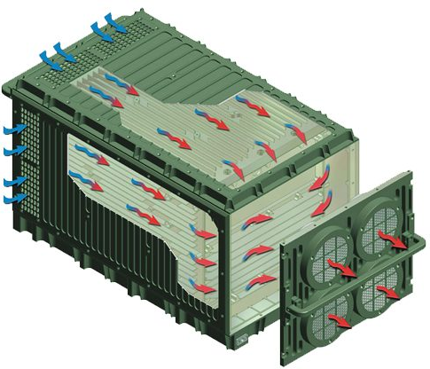
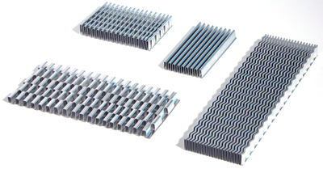
Harris Desired Objectives
Pulsating airflow conditions through chassis are causing phenomenon which Harris desires to investigate
Design test rig to test various cold plate articles for heat transfer coefficients
Explore and determine measured values of data under pulsating mass flow conditions
Typical types of fin stock

Slide 5
Agenda
•Objective of Project
•Requirements
•System Diagrams
•Trade Studies
•System Performance
•Planned Course of Action / Schedule

Slide 6
Key Requirements
•The test rig shall be capable of experimentally determining the flow Reynolds number, local Nusselt number (or j factor), and average friction factor
•Airflow through the test rig shall be laminar through the test section, (100 <Re<2000)
Airflow should be able to generate a steady-state velocity and pulsating sinusoidal velocity oscillation
•Data output in transient and time-averaged form

Slide 7
Conformance Verification Matrix
Paragraph | Title | Method
3.1.1 | AC Input Power | A,T
3.1.2 | AC Output Power | A,T
3.1.3 | DC Output Power | A,T
3.1.4 | EMI/EMC | T
3.1.5 | Fans | T
3.1.6 | Heater Elements | A,T
3.1.7 | Airflow Sensors | A,T
3.1.8 | Temperature Sensors | A,T
3.1.9 | Pressure Sensors | A,T
3.1.10 | DAQ | D
3.1.11 | Control Circuit | A,T
3.1.12 | Software | D
T = Test, D = Demonstration, A = Analysis, I = Inspection

Slide 8
Conformance Verification Matrix
Paragraph | Title | Method
3.1.12.1 | Operating Systems | D
3.1.13 | Electrical Safety | A,T
3.2.1 | Size | I
3.2.2 | Weight | I
3.2.3 | Thermally Conductive Plate | D
3.2.4 | Insulating Plate | A
3.2.5 | Supplemental Insulation | TBD
3.2.6 | Airflow Characteristics | A,T
3.2.7 | Heat Flux Characteristics | A,T
3.2.8 | Operational Safety | I
3.2.9 | Cable Assemblies | I
3.2.10 | Fasteners | I
T = Test, D = Demonstration, A = Analysis, I = Inspection

Slide 9
Conformance Verification Matrix
Paragraph | Title | Method
3.2.11 | Color and Finish | I
3.2.12 | Markings | I
3.2.13 | Workmanship | I
3.3.1.1 | Temperature | TBD
3.3.1.2 | Altitude | TBD
3.3.1.3 | Shock | TBD
3.3.1.4 | Vibration | TBD
3.3.1.5 | Humidity | TBD
3.3.1.6 | Dust | TBD
T = Test, D = Demonstration, A = Analysis, I = Inspection

Slide 10
Agenda
•Objective of Project
•Requirements
•System Diagrams
•Trade Studies
•System Performance
•Planned Course of Action / Schedule

Slide 11
Schematic Diagram
P/S = Pressure Sensor
T/C = Thermocouple
DAQ = Data Acquisition
Inlet Area
Housing
Thermocouples (~22/Plate)
Heater
Endplate
T/C
T/C
ORIFICE Plate
FAN
P/S
P/S
LOGIC CONTROL SYSTEM
Endplate
T/C
T/C
Heater
Discharge Area
DAQ
PC
AC Power /
VARIAC
DC Power Supply

Slide 12
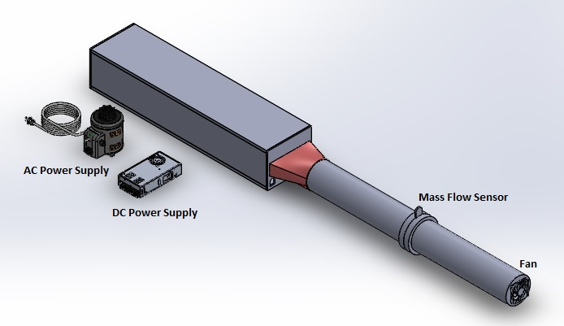
3-D System Diagram

Slide 13
3-D 360 Walkaround

Slide 14
Collapse Animation

Slide 15
Block Diagram
HOUSING
SENSORS & DAQ
FLUID DUCT SYSTEM
HARRIS COLD PLATE TEST RIG
POWER SUPPLIES
SOFTWARE
FLUID MANAGEMENT & PULSATION

Slide 16
HOUSING SUB-SYSTEM
HEATERS
HOUSING
INSULATION
FRAME

Slide 17
SENSORS & DAQ SUB-SYSTEM
THERMOCOUPLES
PRESSURE TRANSDUCERS
SENSORS & DATA ACQUISTION
ORIFICE PLATE
DAQ

Slide 18
FLUID SUB-SYSTEM
PLATE DUCT
EXHAUST TRANSITION
FLUID SYSTEM
PRE-ORIFICE PLATE CONSTANT DIAMETER
POST-ORIFICE PLATE CONSTANT DIAMETER

Slide 19
POWER SUPPLY SUB-SYSTEM
AC POWER SUPPLY (VARIAC)
POWER SUPPLIES
DC POWER SUPPLY

Slide 20
SOFTWARE SUB-SYSTEM
LABVIEW (NI VI)
SOFTWARE
MATLAB
(DATA POST PROCESSING)

Slide 21
FAN & LCS SUB-SYSTEM
FAN
FLUID MANAGEMENT
LINEAR CONTROL SYSTEM

Slide 22
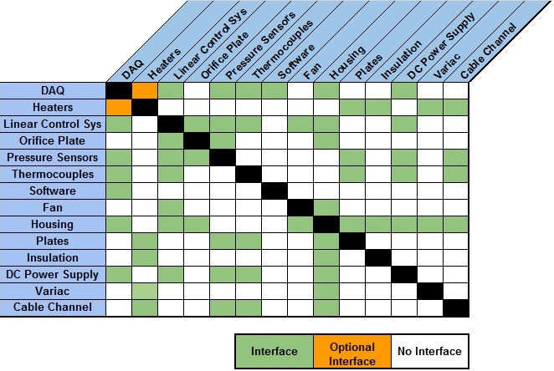
Interface Matrix

Slide 23
Agenda
•Objective of Project
•Requirements
•System Diagrams
•Trade Studies
•System Performance
•Planned Course of Action / Schedule

Slide 24
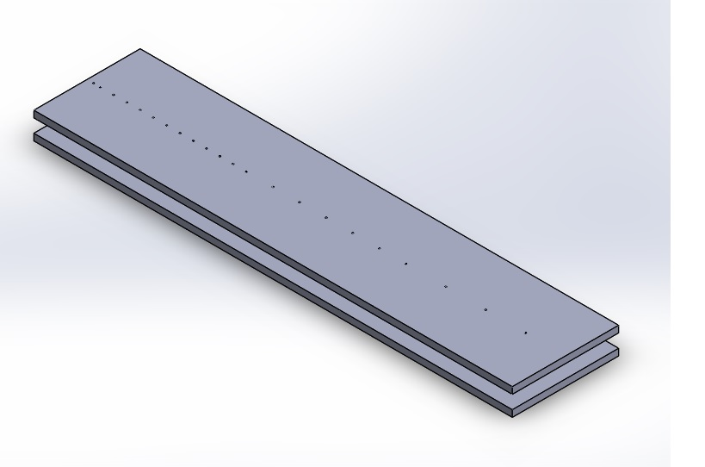
Test Article Dimensions
The test article dimensions were chosen to simulate a parallel plate channel so that the walls had no effect on the centerline velocity.
The total test article length shall be long enough for both hydraulically and thermally developed flow.
The dimensions of the test article will be:
Length (L)
Width (w)
Height (H), between two plates
Thickness (t)
Hydraulic diameter: $D_{h}=\frac{2wh}{w+h}$
L
H
w

Slide 25
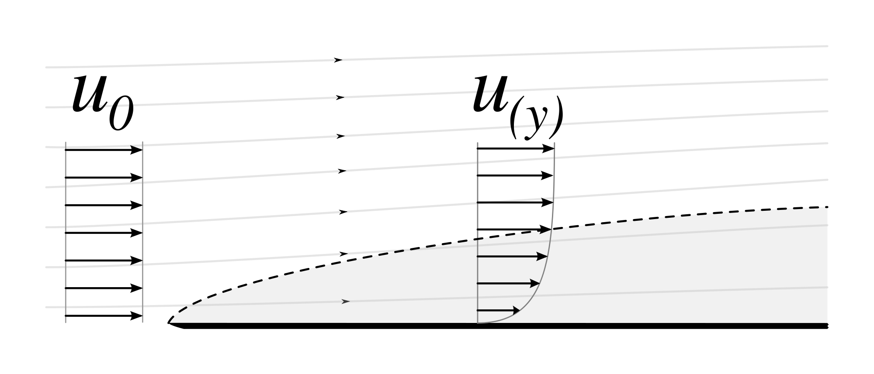
Total Test Article Length
Boundary layer length ($δ$) : $δ=\frac{5x}{\sqrt{{Re}_{x}}}$
Fully developed at $δ$ = H/2, $H=\frac{10x_{fd,h}}{\sqrt{{Re}_{x_{fd,h}}}}$
For ${Re}_{D}$ = 2000 and H = 1 inch:
Fluid Entry Length = $\frac{{(\frac{9}{16})}^{2}D_{h}{Re}_{D}}{100}$ = 11.25 inches
Thermal Entry Length = $\frac{{(\frac{9}{16})}^{2}D_{h}{Re}_{D}{Pr}^{2/3}}{100}$ = 8.94 inches
Based on these entry lengths:
Total Length: L = $20D_{h}≈$ 36 inches
$$δ$$
L

Slide 26
Thermocouple Placement
The exact number of thermocouples is TBD. They will be placed at various lengths from the inlet at the centerline of each plate.
The thermocouples near the inlet will be more closely spaced together than the thermocouples near the end of the plate.
Inlet

Slide 27
Corrections in Entry Length Calculation:
Velocity for ${Re}_{D}$ = 2000:
Fluid Entry Length for parallel plate channel:
$ξ_{H}aRe$ = 41.5 inches [1]
Where:
a = h/2
Re: Reynold’s Number = $\frac{4au}{ν}$
$ξ_{H}$: Dimensionless axial distance = 0.036
Corrections to be made going forward:
Thermocouple Placement
Thermal Entry Region
Plate Dimensions
[1] applied scientific research 51: 663-675, 1993.
© 1993 kluwer academic publishers. printed in the netherlands.

Slide 28
Analytical Solutions
$\text{Reynold}\text{’}\text{s} \text{Number}$: 100 – 2000
$${Re}_{D_{h}}= \frac{ρuD_{h}}{μ} → u= \frac{{Re}_{D_{h}}μ}{ρD_{h}}$$
Mass Flow Rate
$$\dot{m}= ρuA$$
Heat transfer rate through convection
$\dot{Q_{conv}}= \dot{m}C_{p}∆T_{air}$; $∆T_{air}≈ 10℃$
Total Heat flux
$\dot{Q}= \dot{Q_{conv}}+ \dot{Q_{Loss}}$ ;
Assuming,
$\dot{Q_{Loss}}≈0.2\dot{Q}$
$$\dot{Q}= \dot{\frac{Q_{conv}}{0.8}}=1.25\dot{Q_{conv}}$$
$$q^{′′}= \frac{\dot{Q}}{2wL}$$
Change in pressure
$∆p= ∆p_{entry}+ ∆p_{fd}$
$∆p_{fd}=f\frac{L}{D_{h}}\frac{ρu^{2}}{2}$ ;
$∆p_{entry}=4\overline{C_{f}}\frac{L}{D_{h}}\frac{ρu^{2}}{2}$ ;
For rectangular duct: $f=\frac{84.7}{{Re}_{D_{h}}}$
Through analytical calculation:
$$C_{f}=0.664{Re}_{x}^{−1/2}$$
$$\overline{C_{f}}= \frac{\int_{0}^{x_{fd,h}}{C_{f} dx}}{x_{fd,h}}$$
$$\overline{C_{f}}= \frac{1.328}{\sqrt{\frac{u}{ν}}\sqrt{x_{fd,h}}}$$

Slide 29
Analytical Solutions
Analytical Solutions used for Numerical Analysis

Slide 30
2D Numerical Analysis
Purpose
2D numerical analysis was performed to simulate the behavior of laminar air flow through the test section at three boundary conditions:
Re=100, Velocity u =0.034 m/s and q”=5.651$\frac{W}{m^{2}}$
Re=2000, Velocity u= 0.654 m/s and q”=113.02 $\frac{W}{m^{2}}$
Pulsating Velocity
The Numerical results for velocity, pressure and temperature were then used to be compared to the 3D numerical analysis and analytical results so that a proper width and length of the test section could be defined.
The dimensions should be enough so that the airflow could successfully reach a fully developed flow and temperature profile at the given conditions.

Slide 31
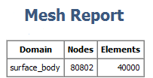
2D Numerical Analysis
Problem Setup

Slide 32
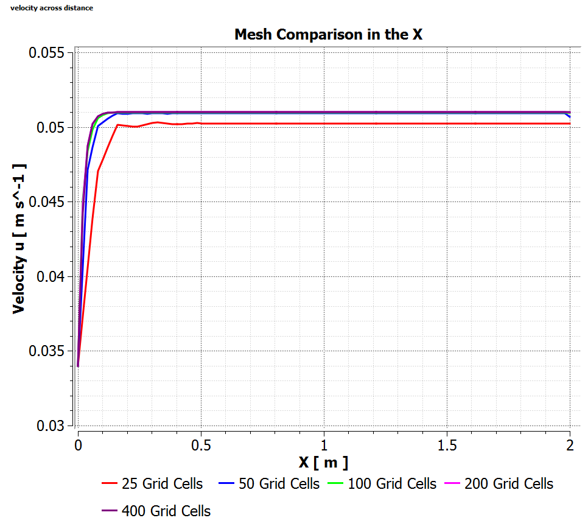
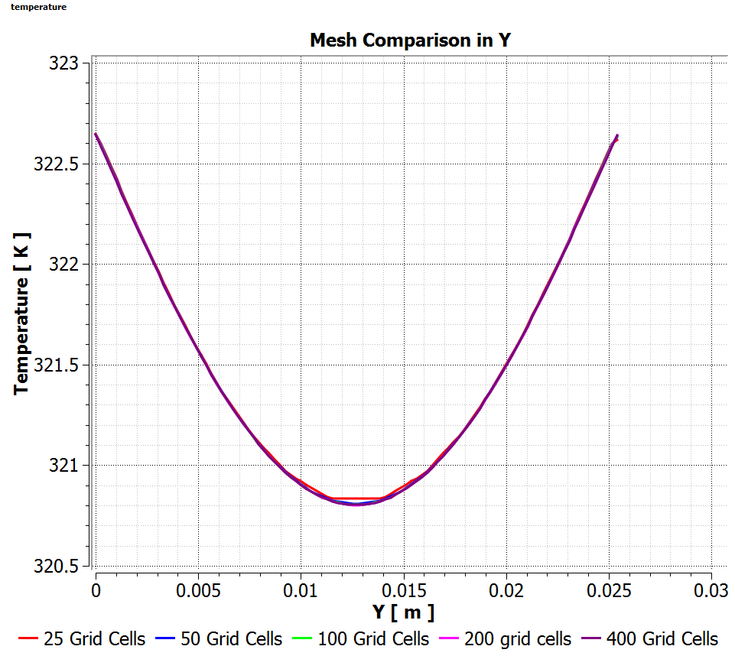
2D Numerical Analysis
Grid Independent Study in X and Y using Re=100 and q’’=5.651 $\frac{W}{m^{2}}$

Slide 33
2D Numerical Analysis
Re = 100, q’’ = 5.651$\frac{W}{m^{2}}$
Mesh Cells (x,y) | Max Velocity u in X (m/s) | Average temperature in Y (K)
25x25 | 0.05032 | 321.471
50x50 | 0.05094 | 321.467
100x100 | 0.05098 | 321.466
200x200 | 0.05099 | 321.466
400x400 | 0.05100 | 321.466
Grid independent solution value reached at:
X = 200 Grid Cells
Y = 100 Grid Cells
Grid Independent Study Table

Slide 34
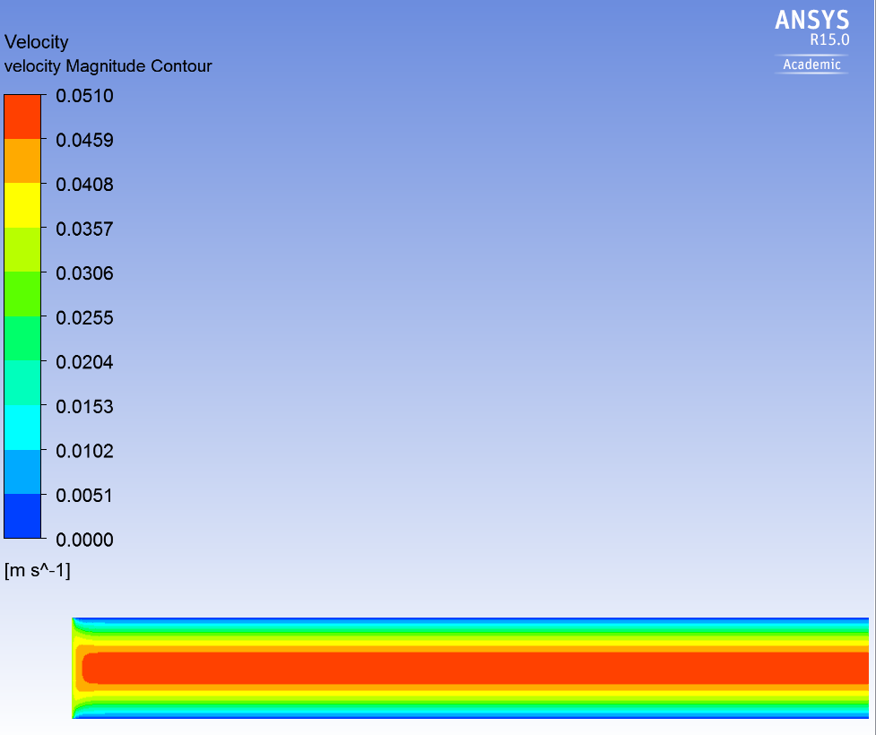
2D Numerical Analysis
Velocity magnitude contour at Re=100 and q’’=5.651 $\frac{W}{m^{2}}$
Inlet
Outlet

Slide 35
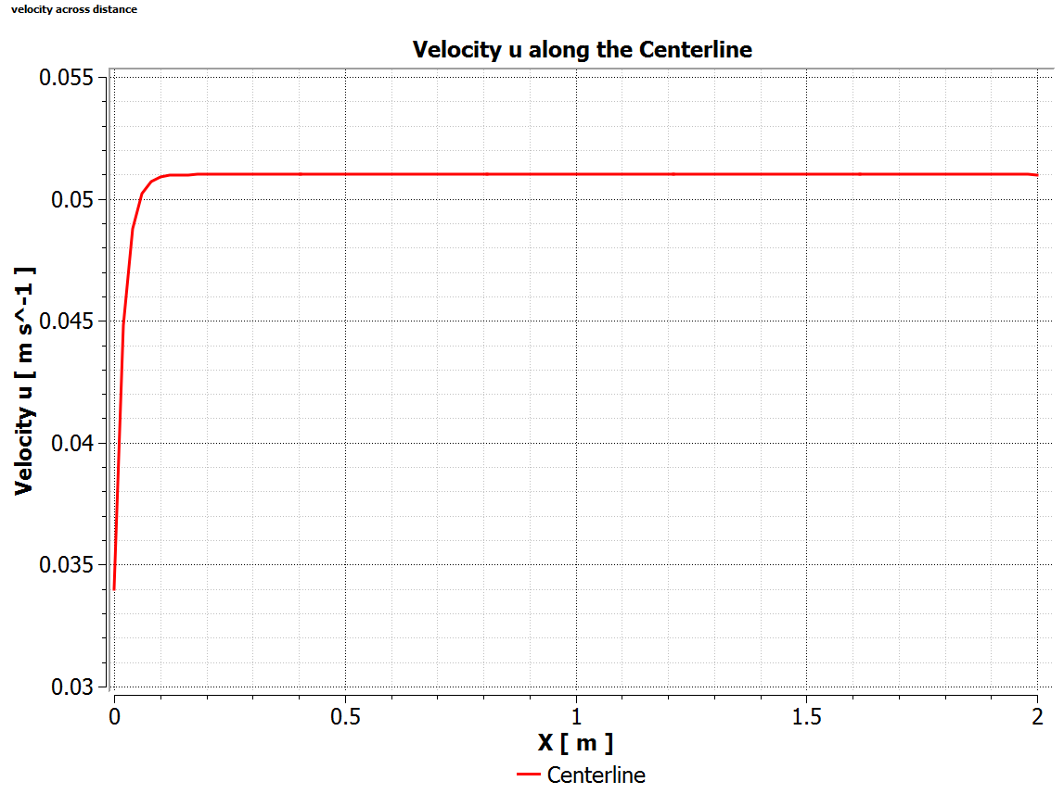
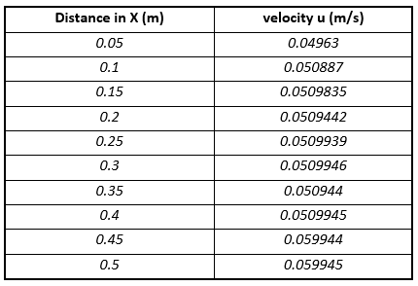
2D Numerical Analysis
Centerline Velocity at Re=100 and q’’=5.651 $\frac{W}{m^{2}}$

Slide 36
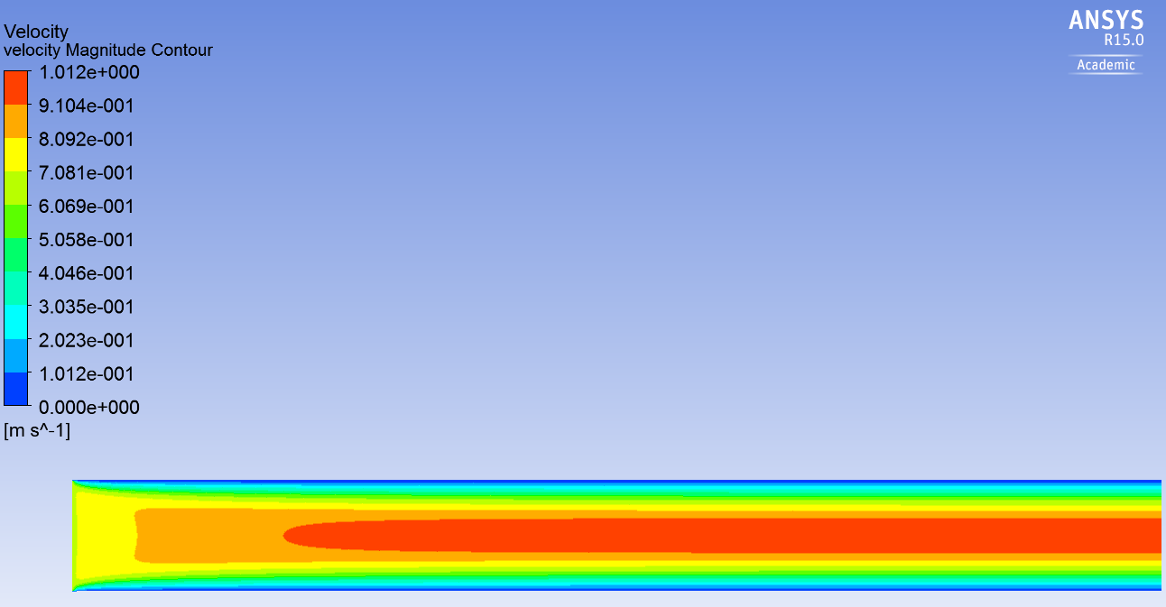
2D Numerical Analysis
Velocity Magnitude Contour at Re=2000 and q’’=113.02 $\frac{W}{m^{2}}$
Inlet
Outlet

Slide 37
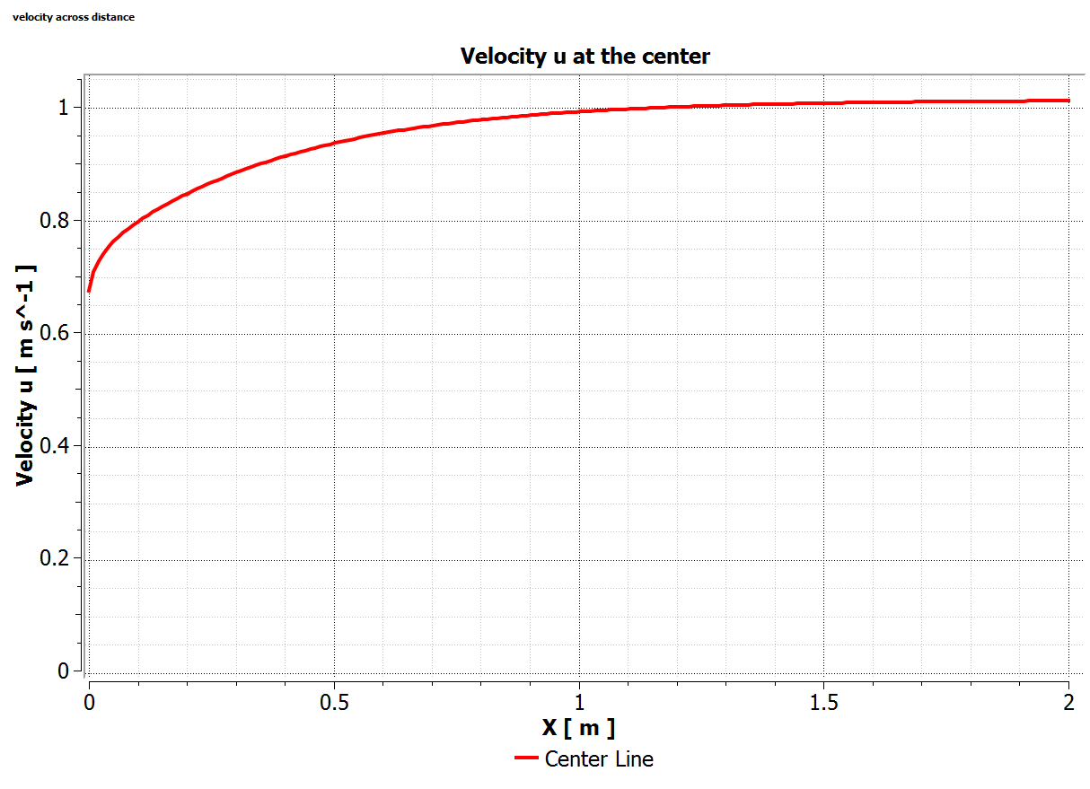
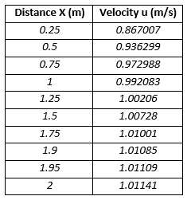
2D Numerical Analysis
Centerline Velocity at Re=2000 and q’’=113.02 $\frac{W}{m^{2}}$

Slide 38
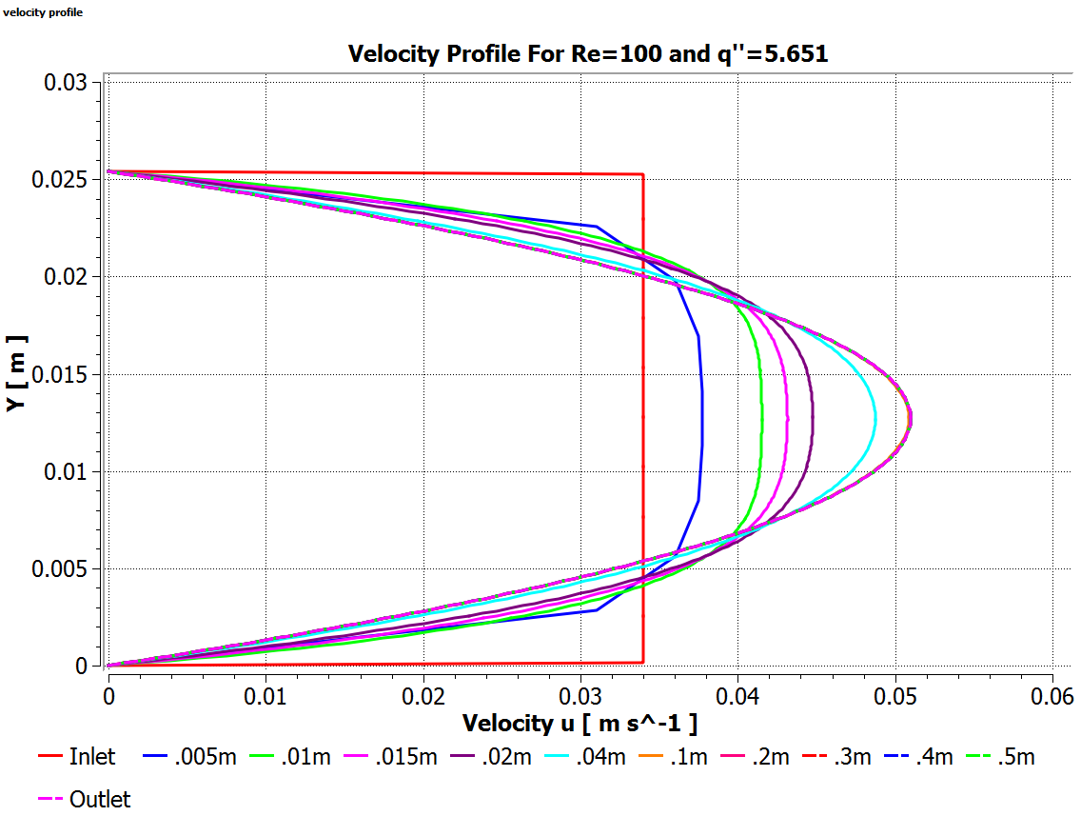
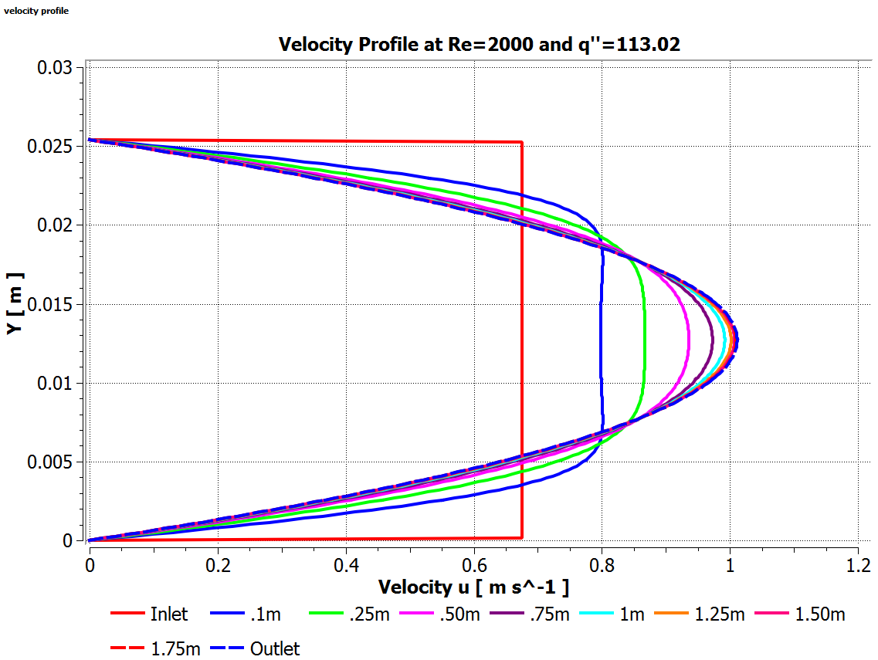
2D Numerical Analysis
Velocity Profile along x (m) for both cases

Slide 39
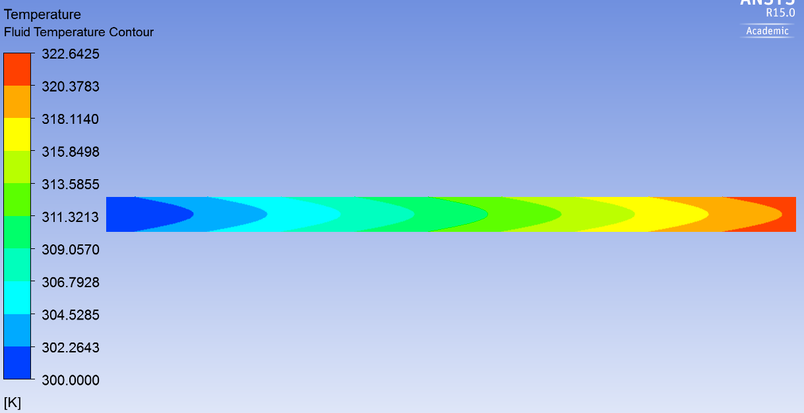
2D Numerical Analysis
Temperature Contour at Re=100 and q’’=5.651 $\frac{W}{m^{2}}$

Slide 40
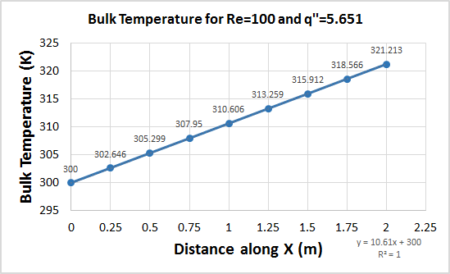
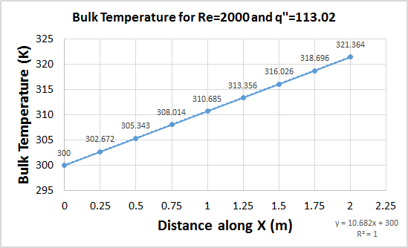
2D Numerical Analysis
Bulk Temperature along x(m) at for both cases
$$T_{b}=\frac{\int_{0}^{H}{uTdy}}{\int_{0}^{H}{udy}}$$

Slide 41
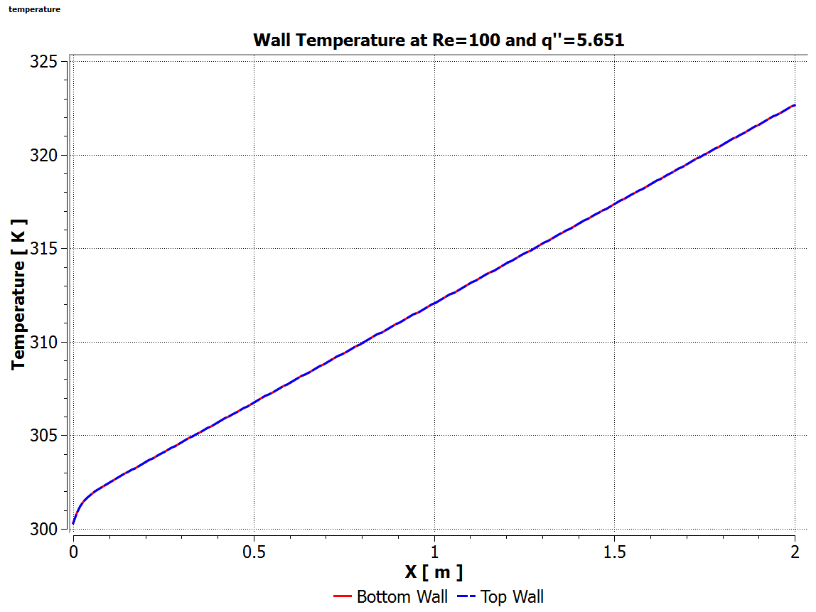
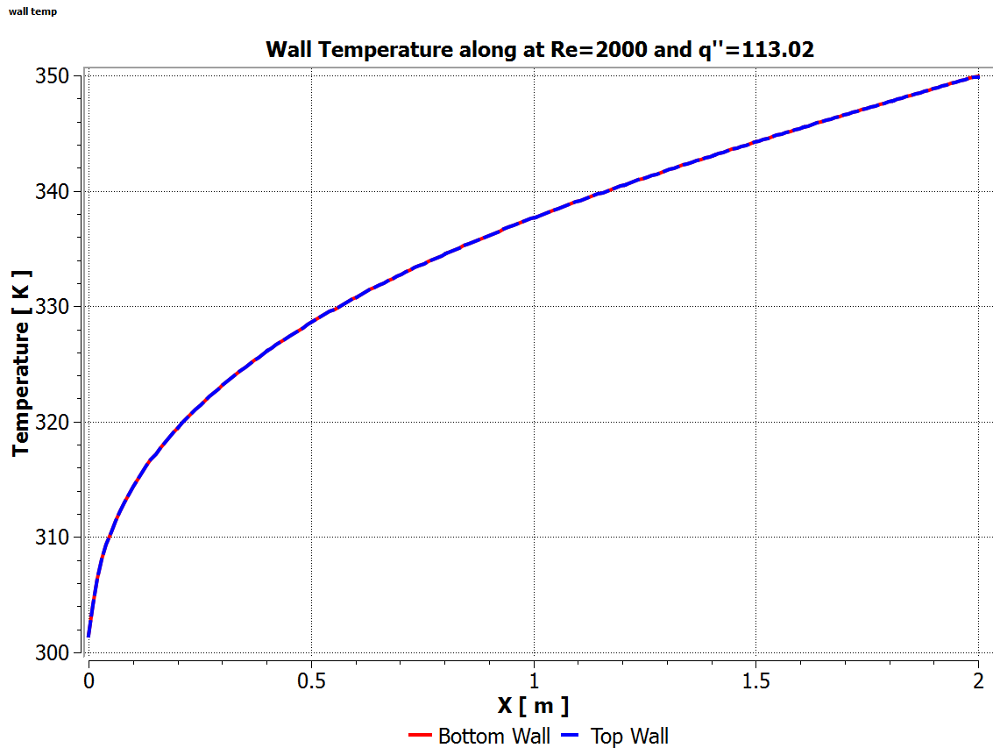
2D Numerical Analysis
Wall Temperature along X(m) for both cases

Slide 42
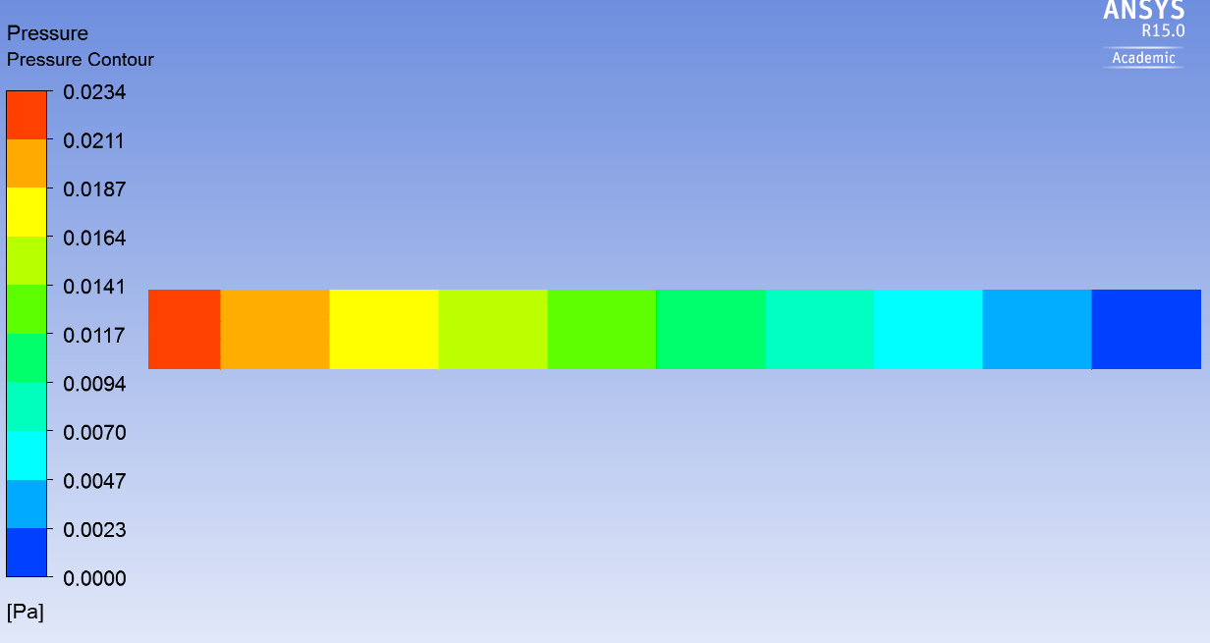
2D Numerical Analysis
Pressure Drop Contour at Re=100 and q’’=5.651 $\frac{W}{m^{2}}$

Slide 43
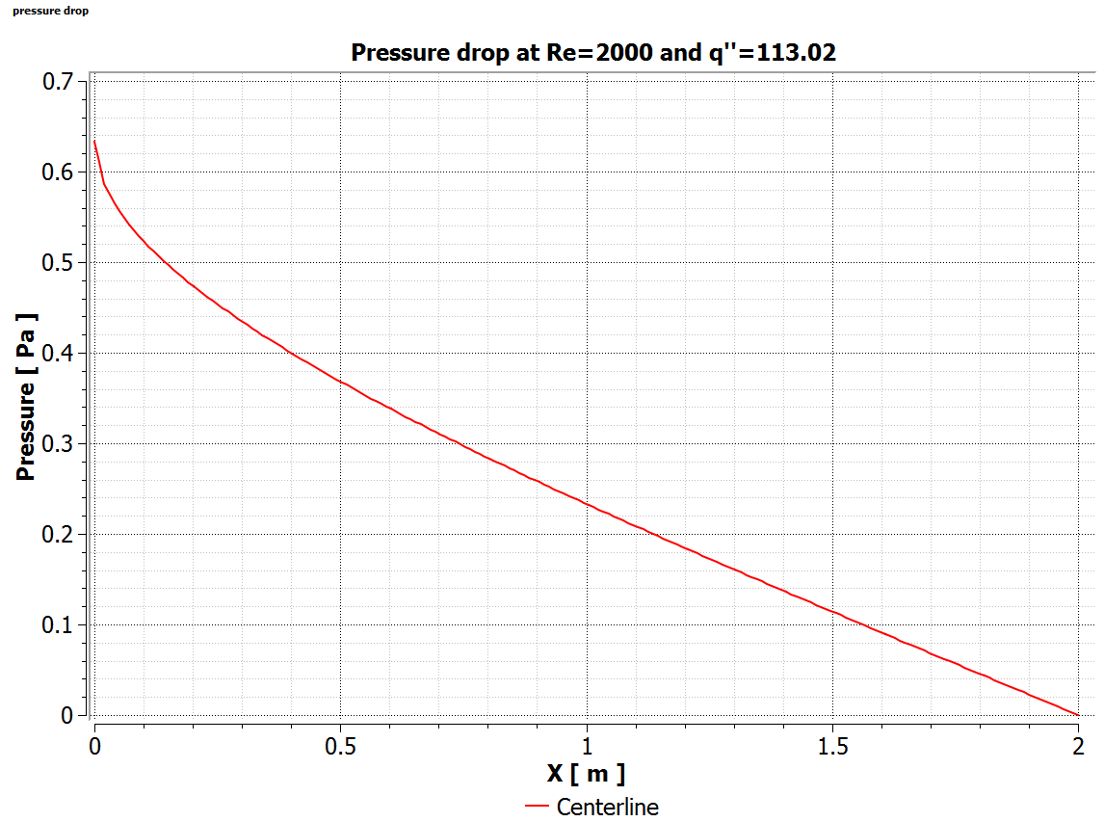
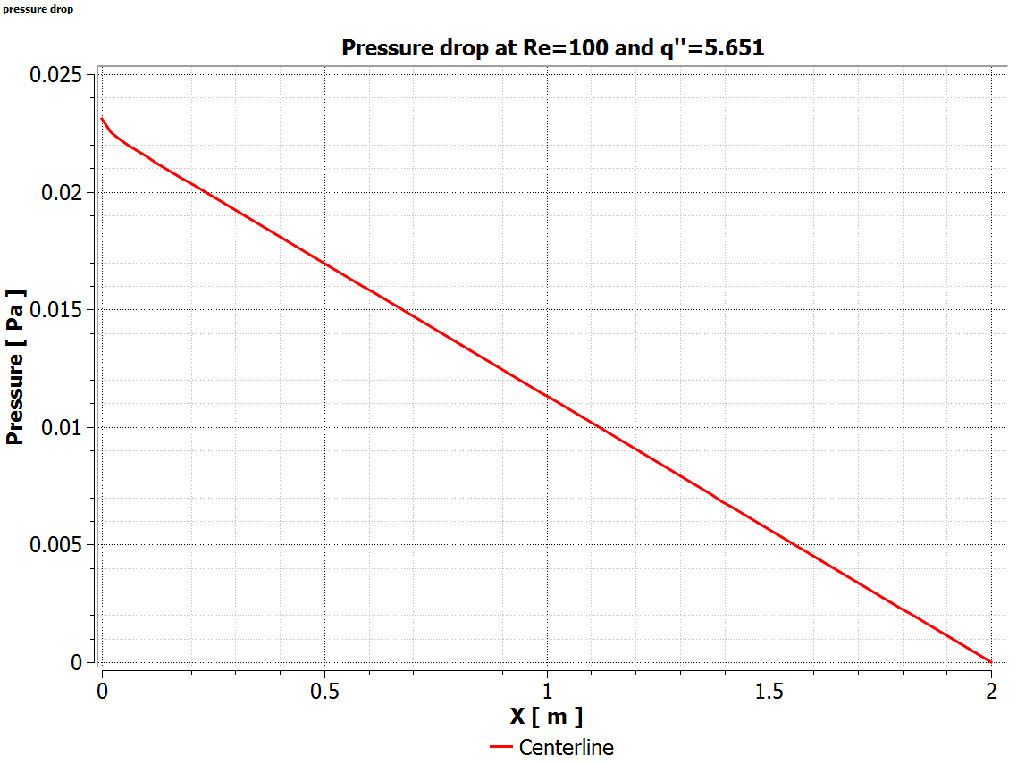
2D Numerical Analysis
Pressure drop along the centerline for both cases

Slide 44
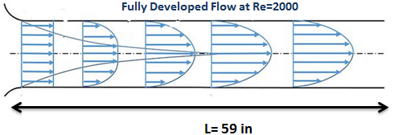
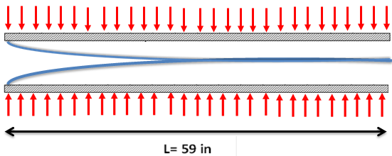
Trade Studies:2D Numerical Analysis
Conclusion
The Numerical results for Velocity, Pressure and Temperature led us to conclude to a have a suggested Length dimension of at least 59 in so that the Airflow could successfully reach a fully developed state.
Due the condition where we want the temperature profile to be fully developed after the flow has fully developed at Re of 2000 and q’’ of 113.02 $\frac{W}{m^{2}}$ we suggest that a detachable extension tube shall be added so that the flow could be fully developed before it enters the Test Section so that the it could then be heated and have Temperature profile that is fully developed inside the test section.
Detachable Extension
Test Section

Slide 45
Trade Studies:3D Numerical Analysis
Purpose
We performed the 3D numerical analysis to compare the results obtaining from the 2D analysis. Which was conducted at the following parameters:
Re=100 and q”=5.651 $\frac{W}{m^{2}}$
Re=2000 and q”=113.02 $\frac{W}{m^{2}}$
Pulsating Velocity
Another important reason for the 3D numerical analysis was to visualize and estimate the wall effect on the flow profile.
Using those parameters listed above, we ran the 3D analysis using Ansys Fluent. The velocity, pressure and temperature profile of the 3D analysis was then compared to the 2D case, and we estimated that the total length and width of the test plate is sufficient enough to produce a laminar and thermally developing flow.

Slide 46
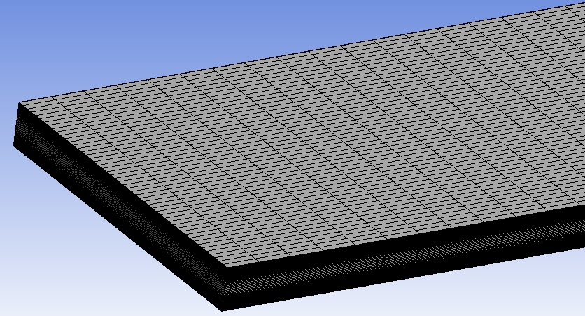
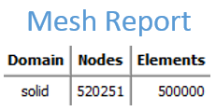
Trade Studies:3D Numerical Analysis
Problem Setup
Mesh

Slide 47
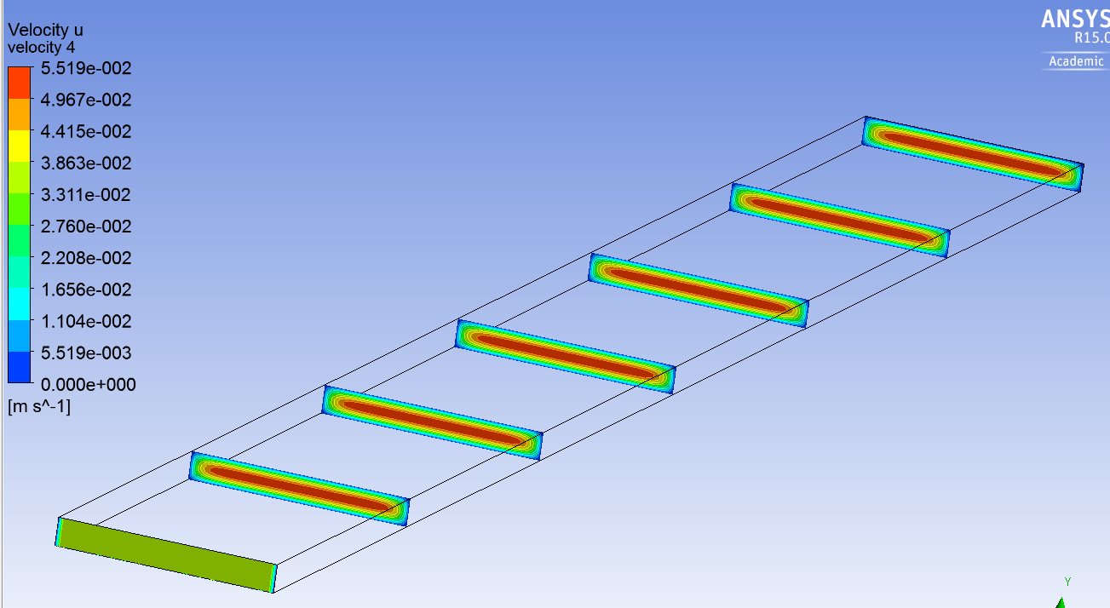
Trade Studies:3D Numerical Analysis
Case 1: Re= 100 Velocity contour along the center at several sections

Slide 48
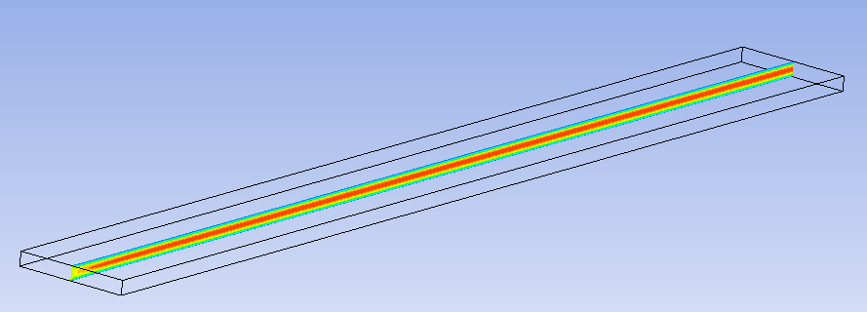
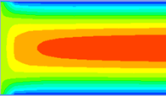
Trade Studies:3D Numerical Analysis
Case 1: Re= 100 Velocity Magnitude contour at the center
Inlet
Outlet

Slide 49
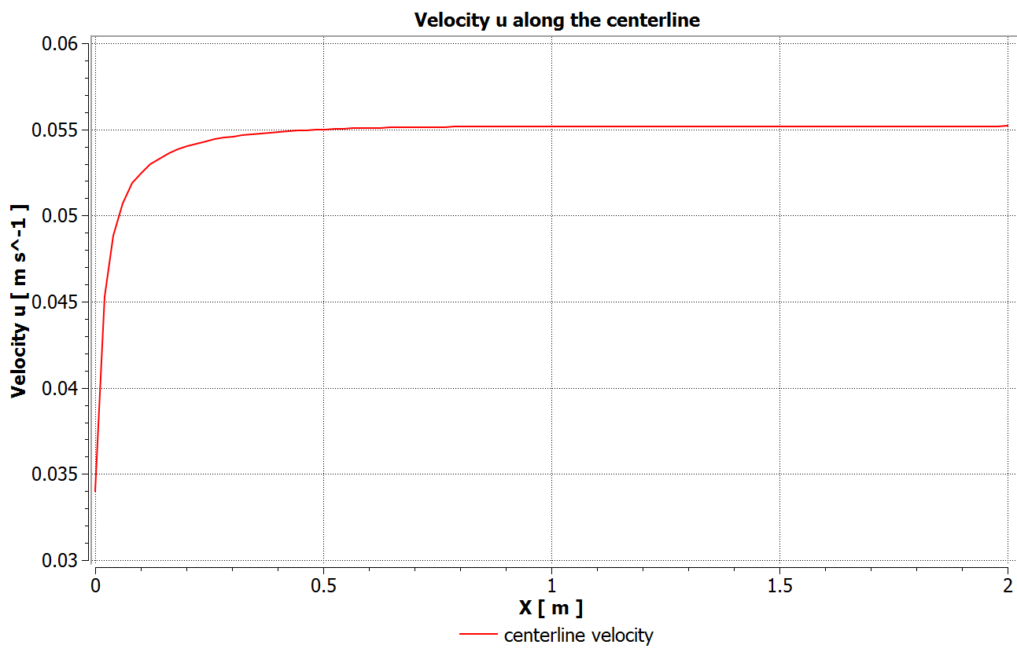
Trade Studies:3D Numerical Analysis
Centerline Velocity at Re=100
3D Analysis
2D Analysis

Slide 50
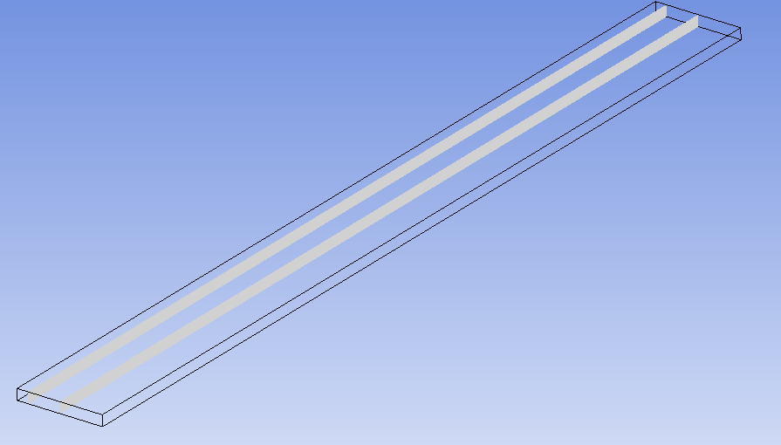
Trade Studies:3D Numerical Analysis
Centerline Velocity at Re=100
The velocity contour starts changing up to 0.5in from the wall, which shows the distance in which the wall will affect the velocity profile of the flow.
0.5in from the wall
4in from the wall

Slide 51
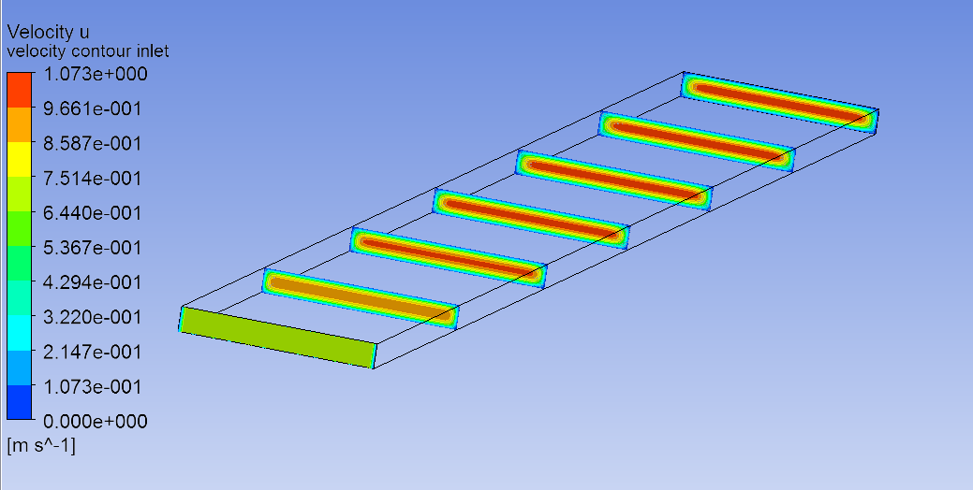
Trade Studies:3D Numerical Analysis
Case 2: Re= 2000 Velocity contour along the center at several sections

Slide 52
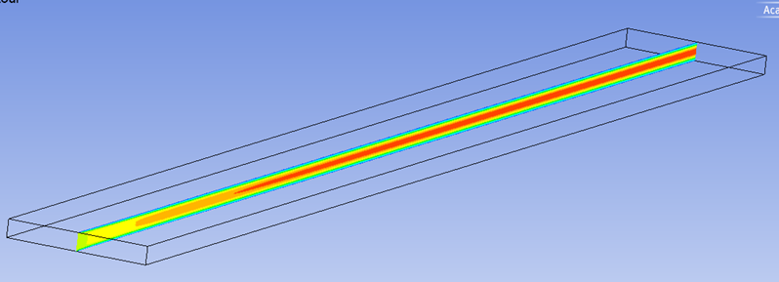
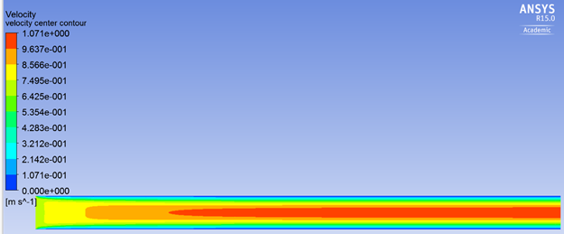
Trade Studies:3D Numerical Analysis
Condition 2: Re= 2000 Velocity Magnitude contour at the center
Inlet
Outlet

Slide 53
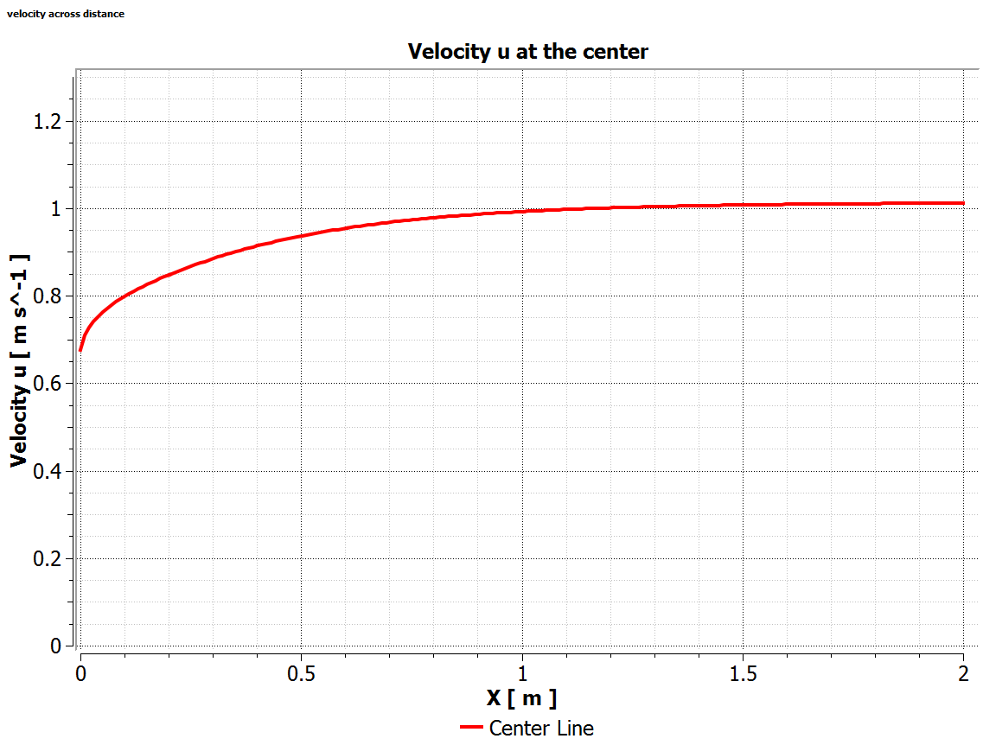
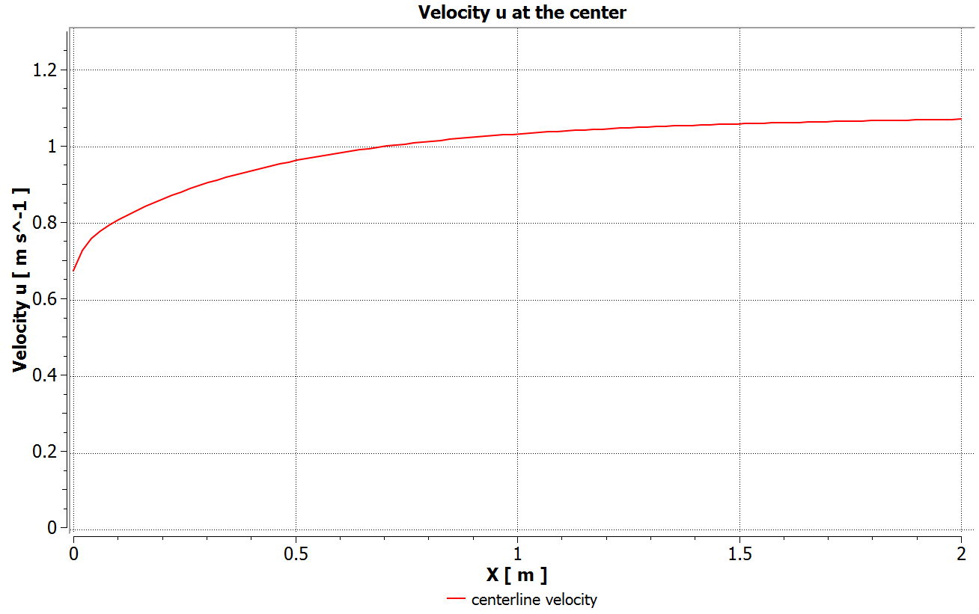
Trade Studies:3D Numerical Analysis
Centerline Velocity at Re=2000
3D Analysis
2D Analysis

Slide 54
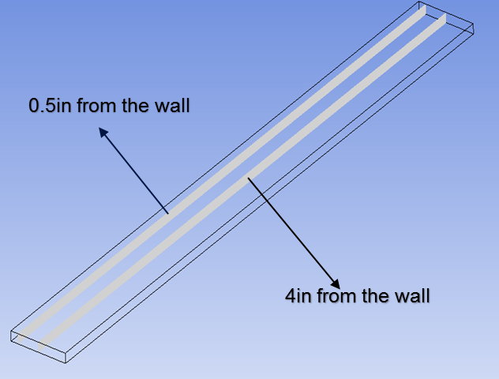
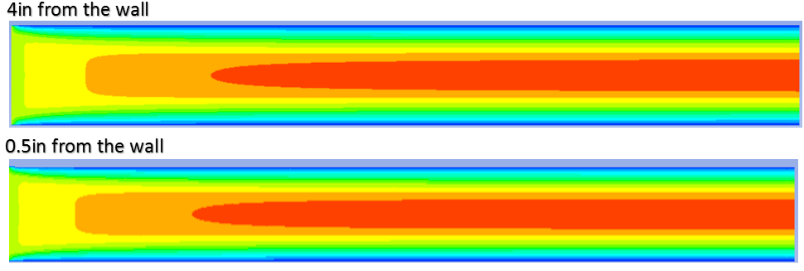
Trade Studies:3D Numerical Analysis
Centerline Velocity at Re=2000
The velocity contour starts changing up to 0.5 in from the wall, which shows the distance in which the wall will affect the velocity profile of the flow

Slide 55
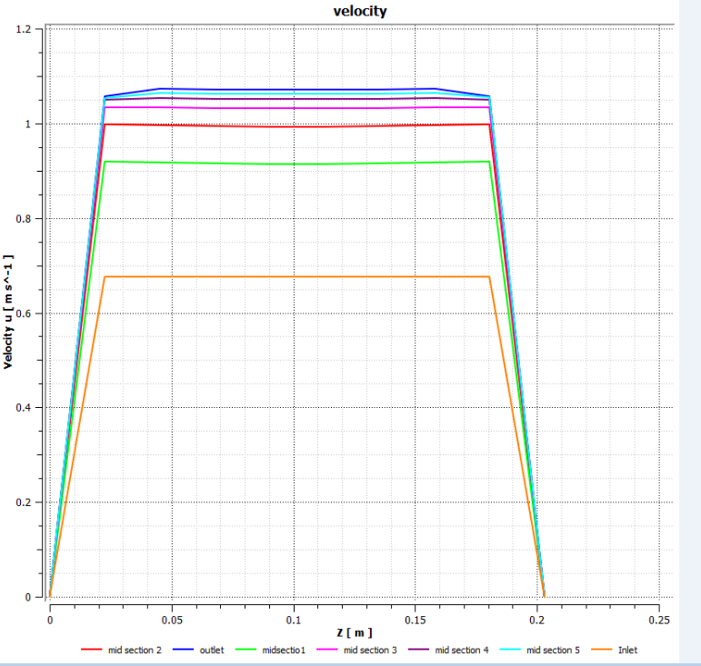
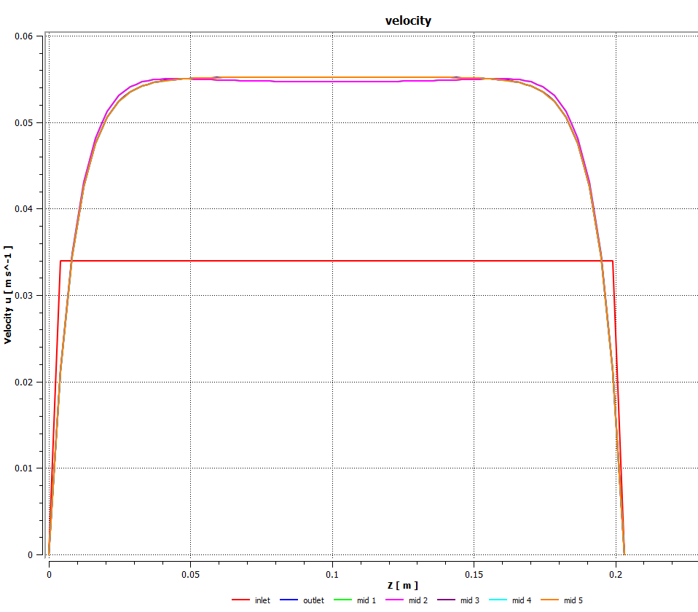
Trade Studies:3D Numerical Analysis
Velocity along the width (z-axis) at several cuts through the flow for Re=100
Velocity along the width (z-axis) at several cuts through the flow for Re=2000

Slide 56
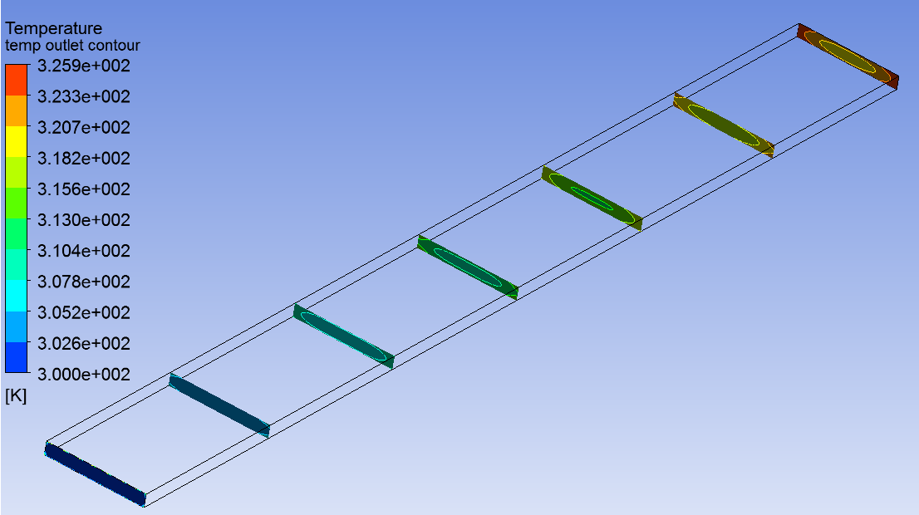
Trade Studies:3D Numerical Analysis
Temperature Profile along the center for Re=100 and q’’=5.651 $\frac{W}{m^{2}}$

Slide 57
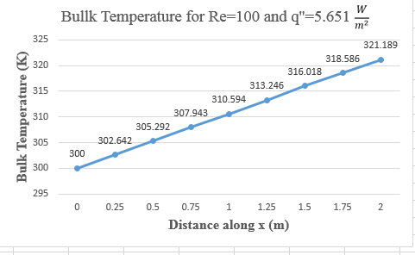
Trade Studies:3D Numerical Analysis
Bulk temperature along the x (m) distance for both 3D and 2D at
Re=100 and q’’=5.651 $\frac{W}{m^{2}}$
$$T_{b}=\frac{\int_{0}^{W}{\int_{0}^{H}{uTdydz}}}{\int_{0}^{W}{\int_{0}^{H}{udydz}}}$$
$$T_{b}=\frac{\int_{0}^{H}{uTdy}}{\int_{0}^{H}{udy}}$$
3D analysis
2D analysis

Slide 58
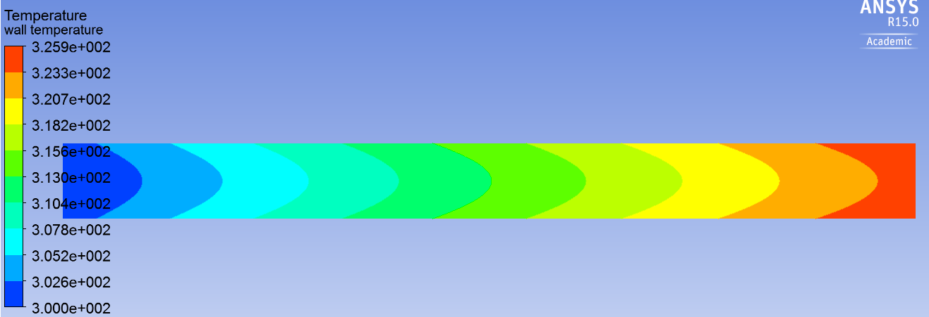
Trade Studies:3D Numerical Analysis
Wall temperature for Re=100 and q’’=5.651$\frac{W}{m^{2}}$

Slide 59
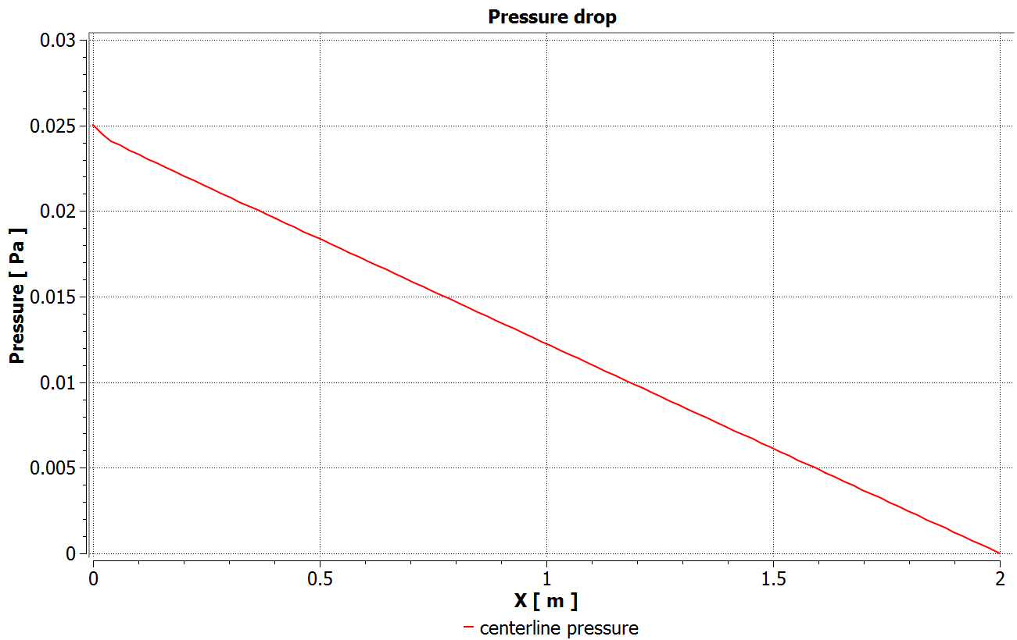
Trade Studies:3D Numerical Analysis
3D and 2D pressure drop along the centerline at Re=100 and q’’=5.651$\frac{W}{m^{2}}$
3D case
2D case

Slide 60
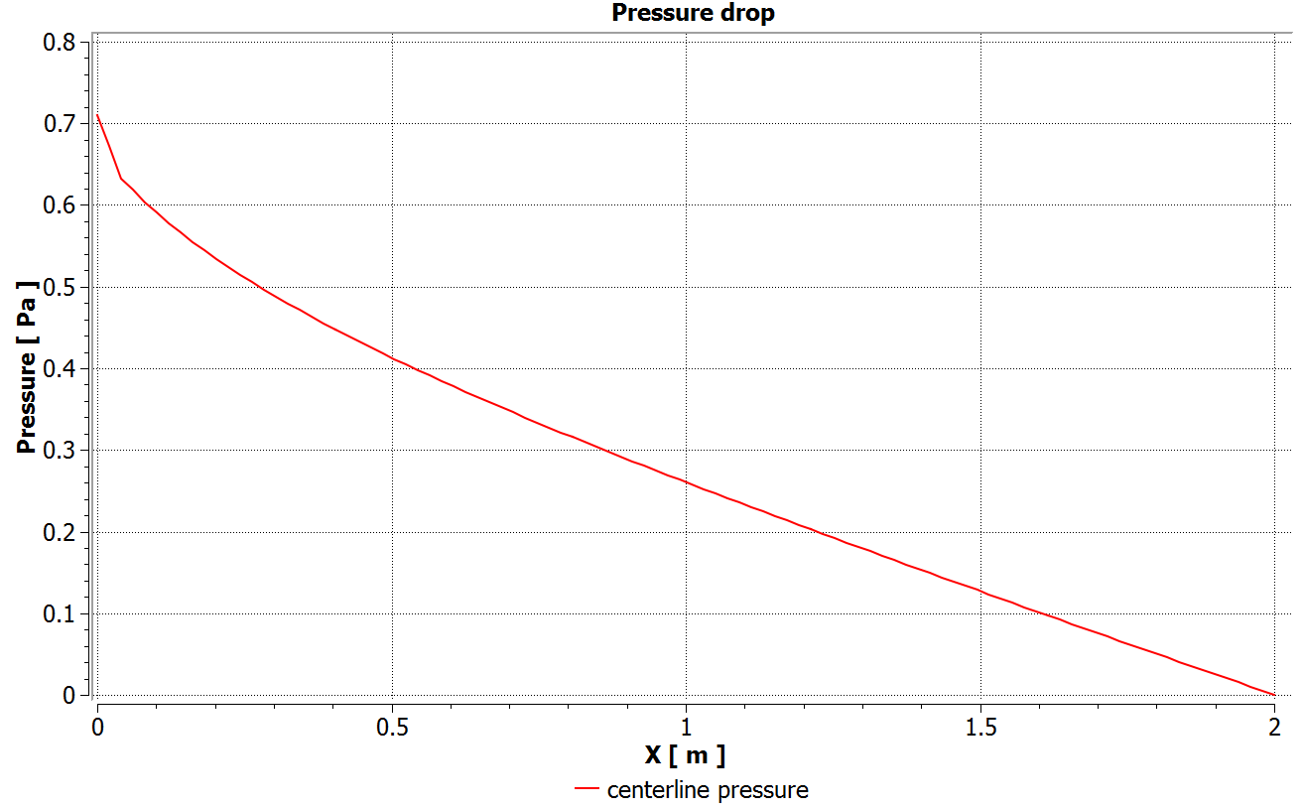
Trade Studies:3D Numerical Analysis
3D and 2D Pressure drop along the centerline at Re=2000 and q’’=113.02 $\frac{W}{m^{2}}$
3D case
2D case

Slide 61
Trade Studies:3D Numerical Analysis
Conclusion
Based on the numerical analysis, we ended up with the following dimensions:
L= 59 in
W= 8 in
H= 1 in
These numbers are based on the 2D and 3D numerical analysis in order to reach a fully developed region
Notes:
Copy the picture from John

Slide 62
Revisions
Corrections in Entry Length Calculation:
Velocity for ${Re}_{D}$ = 2000:
Fluid Entry Length = $ξ_{H}aRe$ = 41.5 inches
Where:
a = h/2
Re: Reynold’s Number = $\frac{4au}{ν}$
$ξ_{H}$: Dimensionless axial distance = 0.036
Corrections to be made going forward:
Thermocouple Placement
Thermal Entry Region

Slide 63
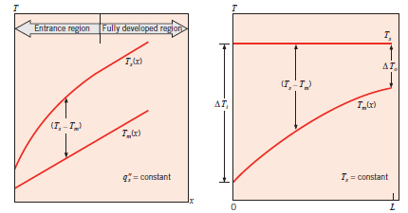
Materials Selection: Conductive Plate
– Cold Plate material selection is critical to ensure that data acquired during testing is representative of local temperature distribution along the plate
– Key parameters: Thermal conductivity (k) and thickness (t)
If k is large: There is no measured temperature gradient between thermocouples.
The boundary condition is closer to constant temperature than constant heat flux.
Design for constant heat flux not constant temperature

Slide 64
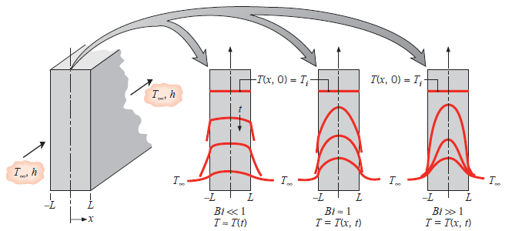
Materials Selection: Conductive Plate
If k is small: The Biot number will subsequently increase.
Measured data will not accurately represent actual data at high sample rate.

Slide 65
Materials Selection: Insulating Plate
– Insulating plate material selection is critical in order to minimize heat loss during testing
Thermal conductivity (k)
Conformance to desired analytical solution heat loss assumption

Slide 66
Materials Selection: Plates
T_{ambient}
h_{naturalconvection}
INSULATING MATERIAL
R_{insulation}
HEATER
T_{heater}
COLD PLATE
R_{coldplate}
FAN
h_{x}

Slide 67
Confirmation of Analytical
Material | Conductivity (W/m*K) | Thickness (m) | Heater Temp (°C) | Heat Loss(W) | Heat Loss %
6061 Aluminum | 167 | 0.0064 | 78.23 | 4.61 | 18
Aerogel Mat | 0.023 | 0.0079
6061 Aluminum | 167 | 0.0064 | 76.83 | 5.13 | 20
Delrin | 0.22 | 0.0127
Copper | 401 | 0.0064 | 77.86 | 4.75 | 18
Fiberboard | 0.048 | 0.0127
Copper | 401 | 0.0064 | 76.79 | 5.15 | 20
Nylon | 0.25 | 0.0127

Slide 68
Selection Matrices Overview
Heaters
Required to create a constant heat flux on the plates
Pressure Transducers
Required to measure pressure drop across duct system
Required to measure pressure drop across orifice plate
Temperature Sensors
Required to measure the temperature at multiple points along the plate
(contact measurement)
Required to measure inlet air temperature (air measurement)
Required to measure outlet air temperature (air measurement)

Slide 69
Selection Matrices Overview
Air Source
Required to move the air in the duct
Required to create pulsation in the air velocity
DC Power Supply
Required to power feedback controller / fan
Required to power thermocouple amplifiers
Required to power any digital logic
AC Power Supply
Required to power heaters

Slide 70
Heater Selection
All heaters could meet power requirements
Flexible heaters are easier to install
Silicon rubber heaters are inexpensive ($\$25−\$50 per 8{in}^{2}$)

Slide 71
Mass Air Flow Selection Intro
Mass Air Flow sensor is essential to the project
Mass air flow is required for the calculation of the Reynold's number and
friction factors
Mass air flow feedback is required to drive the feedback controller
Mass air flow measurement is required to create the correct air velocity profile
Requirements of the mass air flow sensor
The response time must be sufficient to resolve a 10Hz
pulsation in the air velocity
Must operate over the entire velocity range of the
air velocity function (0.034 – 0.67 m/s)
Must be cost effective
Must have analog output to drive feedback controller

Slide 72
Mass Flow Sensor Selection
The RTD probe exceeds the desired response time (> 2 sec response)
The hot wire probe is cost prohibitive (~ $6000)
and calibration is inconvenient (weekly)
The orifice plate has fast response time (~10ms)
and reasonable price ($400-600)

Slide 73
Orifice Plate
Measures flow rate by restricting airflow and measuring the pressure drop
Can be milled to observe a specified pressure drop at a specified flow rate with known diameter
Differential manometer can be used to measure the pressure drop
The duct must be regular, circular and unobstructed upstream and downstream of the plate

Slide 74
Linear Control System
The exact type of controller is TBD awaiting data from tests
By testing the response of the fan-duct system we can determine the location of the fan-duct system's transfer function poles
Based on the location of the transfer function poles we will decide on a type of controller

Slide 75
Oscillator
Oscillator Circuit Diagram
There are 4 digital potentiometers
R2 Controls oscillation amplitude
R1,R9 Controls oscillation frequency
R5 Controls DC value
$Vel=A(1+Bcos(2πft)$
0.034m/s ≤ A ≤ 0.67m/s
0.1Hz ≤ f ≤ 10Hz
0.3 ≤ B ≤ 0.8

Slide 76
Linear Control System - Data Acquisition
Purpose is to determine the response of the fans
Pitot tubes were used to obtain velocity data
Data for the transient response was insufficient for a usable model. Sensor with improved transient response needed.
Response time of fans tested is approximately 0.5-1s (1-2Hz)

Slide 77
Testing Rig

Slide 78
LabVIEW Instrumentation

Slide 79
Linear Control System - Data Acquisition
*Notional Data
Assuming a first order response:

Slide 80
LCS Test - Data

Slide 81
Data Acquisition
Requirements:
Inputs:
46 Thermocouple sensors (Amplified) (0-10 Volts)
2 Differential pressure sensors (0.5-4.5 Volts)
Outputs:
4 Digital outputs to control digital potentiometers
(3 pins for serial data + 1 pin for clock)
DT9813-10V Series – Low Cost DAQ ($445)
Simultaneous analog inputs
16 analog inputs (12-bit, 6 kS/s,±10V )
8 digital I/O lines
Compatible with LabVIEW and MATLAB
12-bit resolution gives 5mV resolution over ±10V
Software:
LabVIEW for data processing
3 DAQs can meet requirements

Slide 82
Data Acquisition / Digital Control
Currently being developed
FPGA implementation has more features that are beneficial to our project
Parallel synchronization and processing of multiple channel inputs
High sampling rate / transfer speed
Programmable custom functionality
ADC: 4 or 8 channel S/H,16-bit resolution, 100ksps rate, ±10V, SPI interface
16 bit resolution over ±10V gives resolution of 0.3mV
Expected total cost: ~$50
Full speed USB communication

Slide 83
Pressure Sensor Selection
Expected pressure difference of 0.4 Pa
Sensortronics LBA/LDE
0-25 Pa diff range
Sample cost: $136
Response time: 0.2 ms
Accuracy: 2% FSS

Slide 84
Air Source Selection
Compressed air and vacuum have excellent response time (10 Hz) and controllability but are too complex, could not meet flow requirements (only 2.85 CFM), and were cost prohibitive.
Fans have slow response time (~1-2 Hz) but are simple, cost effective, provide sufficient CFM, and have excellent controllability.

Slide 85
DC Power Supply
Two options: prebuilt or hand-built
It must have 110V AC input and +12V, -12V, and +5V output
Output amperage should be at least 4A@12V, 0.5A@-12V, and 0.5A@5V

Slide 86
DC Power Supply – 12V Rail

Slide 87
AC Power Supply (VARIAC)
Variac will be used to power silicon rubber heaters
Variac will require more electronic shielding on heater wires
May be cascaded with fixed transformer to get lower voltage
~0-200w power output required
Custom printed dial label indicating power output in watts

Slide 88
Temperature Sensor Selection
RTD and Thermistor have insufficient response times
Thermocouples have the best response time
Small output voltage must be amplified
Thermoelectric
effect

Slide 89
Summarize Selections
Insulating Plate Material
Insulating Fiberboard with Aerogel Mat
Cold Plate Material
TBD
Air Source
Fan
Pressure Transducer
Sensortronics LBA
Temperature Sensor
Thermocouple
Heater
Silicon Rubber Mat Heater
Mass Flow Sensor
Orifice Plate

Slide 90
Agenda
•Objective of Project
•Requirements
•System Diagrams
•Trade Studies
•System Performance
•Planned Course of Action / Schedule

Slide 91
Data Measurement/Processing
Measured quantities: Tw_{x}, T_{in}, T_{out}, u, $∆p$
Required Parameters: ${Re}_{D}$, ${Nu}_{x}$, $f$

Slide 92
Measurement of the Reynold’s Number
An orifice plate will measure velocity in a constant area circular duct by measuring pressure across the orifice plate (${∆p}_{OF}$), which is proportional to the square of the velocity (u):
$$u= \sqrt{\frac{2{∆p}_{OF}}{ρ}}$$
The Reynold’s number is related to the velocity using the equation for the Reynold’s number:
$${Re}_{D}= \frac{ρuD_{h}}{μ}$$

Slide 93
Measurement of local Nusselt Number
Temperature of the air will be measured at the inlet (Tin) and at the outlet (Tout). The temperature of the plate will be measured in 22 points along the centerline of each plate (Twx). The convection heat transfer rate from the plate to the air can be given as:
$${\dot{Q}}_{conv}= \dot{m}C_{p}\left(T_{in}−T_{out}\right)= h_{x}A_{s}({Tw}_{x}−T_{in})$$
Using this relation, the local heat transfer coefficient and the local Nusselt Number are:
$$h_{x}= \frac{\dot{m}C_{p}\left(T_{in}−T_{out}\right)}{A_{s}({Tw}_{x}−T_{in})}$$
${Nu}_{x}= \frac{h_{x}x}{k}$
$$A_{s}=heater surface area$$

Slide 94
Measurement of Friction Factor
Pressure differential is measured across the entire duct. Using this pressure differential, the friction factor can be given as:
$f= \frac{∆p}{L}\frac{D_{h}}{\frac{1}{2}ρu^{2}}$

Slide 95
Uncertainty Propagation
In one specific case:
Height is 1 inch
5 inches from the inlet
Inlet temperature is 23 °C and outlet temperature is 33 °C
Wall temperature 5 inches from the inlet is 78 °C
Fully developed velocity is 1.97 ft/s
Thermocouple accuracy = $±$ 1 °C
Pressure sensor accuracy = (2.25% of reading)
Pressure sensor is used for both friction factor and mass flow orifice plate measurements
${Re}_{D}=1775.6±39.95$ (2.25%)
${Nu}_{5}=12.853±1.87$ (14.5%)
$f=0.0927±0.0285$ (5.07%)

Slide 96
Agenda
•Objective of Project
•Requirements
•System Diagrams
•Trade Studies
•System Performance
•Schedule / Planned Course of Action

Slide 97
Preliminary Design Phase Activity
–Initial Meeting with Harris Representative 2/16/15
•Discussed test rig specifications
•Discussed measurement devices
–Engineering Design Specification 2/17/15 - 2/25/15
•Block Diagram / Functional Diagram
•Functional vs. Non-Functional requirements
•Shall & must statements
•Top level systems down to details
–Trade Studies 2/25/15 - Present
•Weighted selection matrices for all components
–CFD Training 2/27/15
•Fluent
•STAR-CCM+

Slide 98
Preliminary Design Phase Activity
–Analytical solution 2/26/15 - 2/30/15
•Fix variables to begin calculations
•Use standard and/or reasonable values for unknowns
•Use limiting parameters to establish dimensions
–Numerical Simulation 3/1/15 - Present
•Began construction of 2D &3D Model
•Ran simulations under various test conditions
•Compared results to analytical solutions

Slide 99
Preliminary Design Phase Activity
–Meeting with Harris Representatives 3/4/15
•Importance of data sampling rate
•Deliverables
•Individual configuration items (CI)
•Interfaces
•Established desired final outcome and exit criteria for each phase of project
–Validation of Previous Assumptions3/4/15 - Present
•Fan CFM
•Heater output
•Test section dimensions
–First Partial Test Section Prototype Construction 3/11/15 - 3/16/15

Slide 100
Preliminary Design Phase Activity
–Meeting with Harris Representative 3/25/15
•Established and/or Modified Requirements for PDR
•Discussed CFD Modeling
•Conformance Verification
–PDR Specification Document 4/1/15 – 4/27/15
–Uncertainty Analysis 4/3/15 – 4/14/15
–Representative Sub-System Construction and Testing 4/10/15 – 4/28/15
Fan testing
–PDR Presentation 4/28/15

Slide 101
Preliminary Design Phase Activity

Slide 102
Future Plans

Slide 103
Questions?

