Slide 1
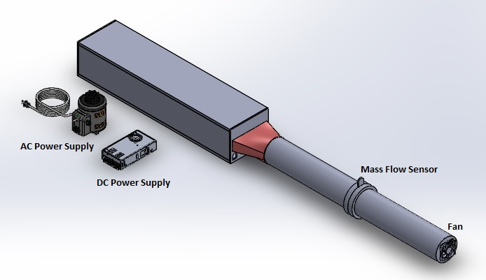
Harris Heatsink Test Rig
Patrick Armengol – CpE
Adam Blair – EE
Eric Guest – CpE
JinJin Lin - EE

Slide 2
Goals and Objectives
Testing Platform
Sensor measurements for data collection
Observe friction and temperature phenomena in steady state and pulsating airflow conditions
Analog feedback control
Data acquisition

Slide 3
Approach
Problem: Collect data from various sensors and precisely control fan speed
Solution:
Install pressure and temperature sensors in test unit
Collect data from sensors with custom-built DAQ
Pass data to computer as well as fan control system
Adjust fan speed and cycle rate given “desired” output and “actual” output from sensors

Slide 4
System Diagram
P/S = Pressure Sensor
T/C = Thermocouple
DAQ = Data Acquisition
Inlet Area
Housing
Thermocouples (~20/Plate)
Heater
Endplate
T/C
T/C
ORIFICE Plate
FAN
P/S
P/S
CONTROL SYSTEM
DC Power Supply
Endplate
T/C
T/C
Heater
AC Power /
VARIAC
Discharge Area
DAQ
PC

Slide 5
Interface Matrix

Slide 6
Requirements
Create a steady state pulsating air flow
Measure the temperature change
Measure the mass flow
Measure the differential pressure between two ends
Control the heaters and fans
Power various components
Collect temperature, mass flow, pressure data

Slide 7
Specifications
Input air flow is sinusoidal velocity
Pulsation frequency from 0.1 Hz to 10 Hz
Pulsation amplitude from 0.3 to 0.8
Constant heat flux boundary on both side of plate
The test rig shall be capable of easily replacing the test article
Data Output in transient and time domain
Response time shall be higher than 10Hz
All Dimension shall be form of inch

Slide 8
Design Constraints
Some of the following constraints have been taken in to account in our design:
Economic – although we have a large budget, we must be mindful of spending
Safety – we are dealing with considerable amount of power, heat, and weight. Our design must keep safety of the operator and surroundings in the forefront
Modularity – the heatsink plates must be removable and must be able to be disassembled
Longevity – the test bed needs to last a reasonable amount of time without service

Slide 9
Standards
Universal Serial Bus Standard
Guarantees fast transfer rates (480 Mb/s), high polling rate, standard connectors, and stable power source (4.45-5.25 VDC)
Power Supply Standards
DoE efficiency standards for PSUs – 10 CFR Part 430
Output Power | Min Average Efficiency | Max Power Under No Load
Pout < 1 W | > 0.497 × Pout + 0.067 | < 0.300
1 W < Pout < 49 W | > 0.075 × ln(Pout) + 0.561 | < 0.300
Pout > 49 W | > 0.860 | < 0.300

Slide 10
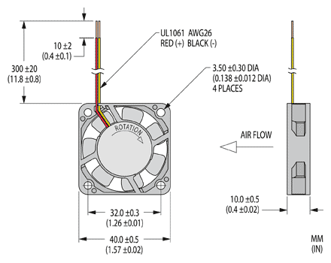
Fan
Capable of achieving relatively high cycle rates (~2-3 Hz in testing)
Easily meets max airflow requirement of 20 CFM
Simple to control by manipulating voltage
Potential problem: cycle rates lower than expected
Solution: change size of fan, increase peak voltage

Slide 11
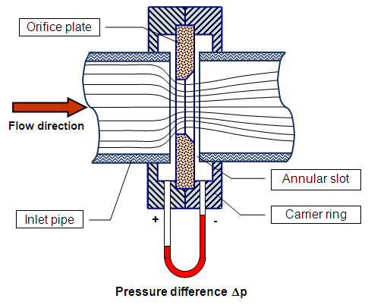
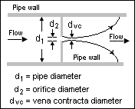
Orifice Plate
Measures flow rate by restricting airflow and measuring the pressure drop
Differential manometer can be used to measure the pressure drop

Slide 12
Fan Controller (Feedback Controller)
The exact type of controller is TBD awaiting data from tests
By testing the response of the fan-duct system we can determine the location of the fan-duct system's transfer function poles
Based on the location of the transfer function poles we will decide on a type of controller

Slide 13
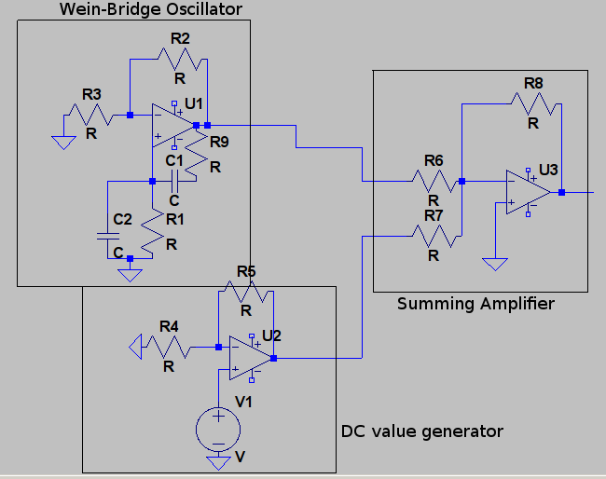
Oscillator
R2 Controls oscillation amplitude
R1,R9 Controls oscillation frequency
R5 Controls DC value
$Vel=A(1+Bcos(2πft)$

Slide 14
Thermocouple
Type T Thermocouple
Operating range from 0 to 149 °C
0.08 seconds response time, higher than 10 Hz
Excellent accuracy
Good linearity
0.001" diameter thermocouple
Small output voltage( mV) must be amplified

Slide 15
Thermocouple Placement
The exact number of thermocouples is 40. They will be placed at various lengths from the inlet at the centerline of each plate.
The thermocouples near the inlet will be more closely spaced together than the thermocouples near the end of the plate.
Length: 60” Width: 8”
Inlet

Slide 16
DAQ
PCB
Dev Board
Sensors
Signal Cond.
ADC
FPGA
USB Controller
PC

Slide 17
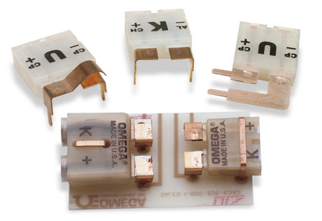
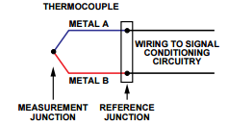
Thermocouple Connectors
Allows connection of thermocouple alloy to copper for PCB
Omega PCC-SMP-V-T-50-ROHS
Miniature
Vertical mount
T thermocouple calibrated
50 count
ROHS compliant
$126.00

Slide 18
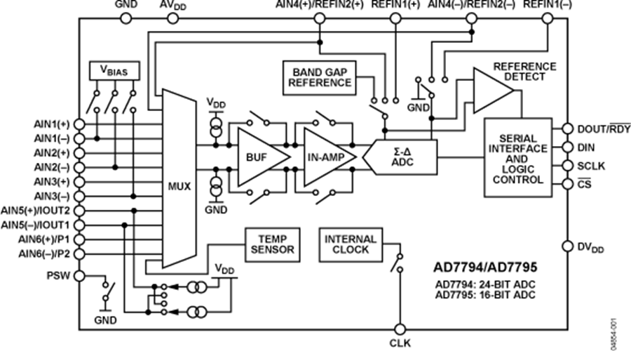
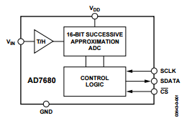
Analog-to-Digital Converters
AD7794
24-bit
6-channel
480 Sps
Low noise
Low power
Internal amplifier
Internal temp sensor for cold junction compensation
SPI
$6.90 * 7 = $48.30
AD7680
16-bit
1-channel
100 kSps
T/H
SPI
$6.97
6 channels * 7 ADCs = 42 inputs
7 ADCs * 24 bits * 480 samples/s = 80640 bits/s
480 samples/s / 6 channels = 80 samples/s for each input

Slide 19
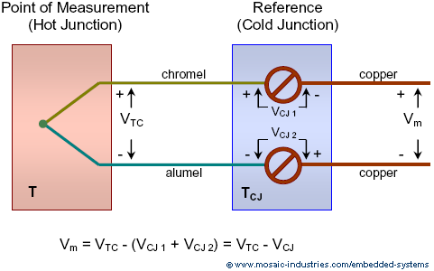
Cold Junction Compensation
Thermocouples are differential not absolute.
Voltage produced at reference junction (connector) depends on temperatures at both the measurement junction and the reference junction.
We must utilize equations provided by the National Institute of Standards and Technology (NIST) to determine the actual (absolute) temperature at the measurement point.

Slide 20
Why an FPGA?
Microcontrollers
Easy to use
Low cost
Built in functionality
FPGA
Custom interfaces
High speed parallel processing
Flexible timing
Large configurable I/O
Complex design

Slide 21
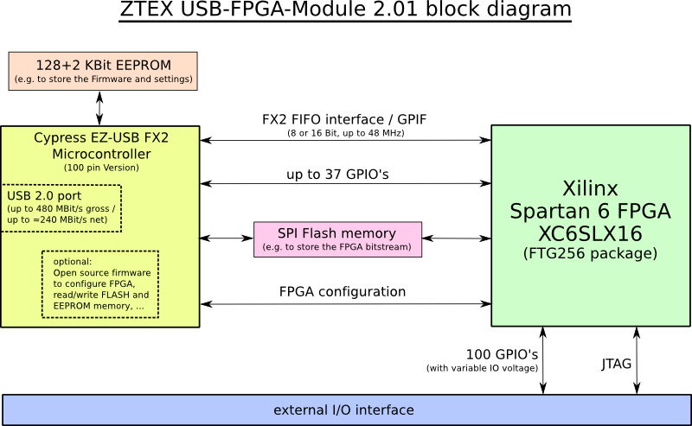
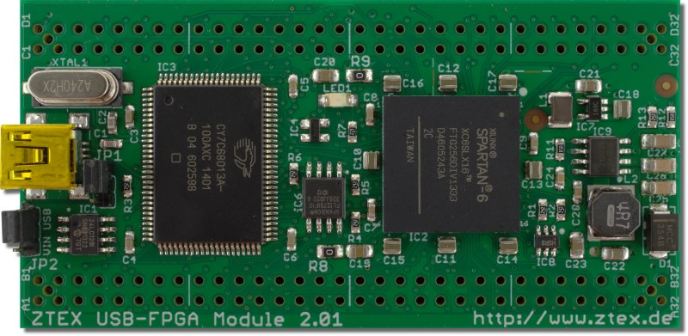
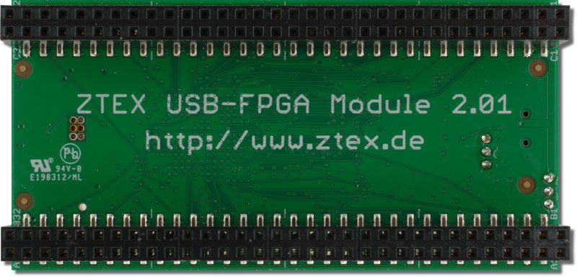
FPGA Board
ZTEX USB-FPGA Module 2.01
Open Source
Custom firmware
SDK and examples; ISE compatible
Configurable Flash memory
480 Mbit/s uplink rate
$108.90

Slide 22
Embedded Software
Written in Verilog
Utilization of open source code
opencores – SPI module
FPGAlink – Comm module
Customization for parallelization
Control
SPI Master Module
FIFO Buffer
Comm FPGA
USB Interface
Configuring the FPGA
Clock Divider

Slide 23
PC Software
Collection of USB data – FPGAlink
Cold junction compensation calculations
Translation to real measurement values (°C, psi)
Storage of data to file
Display of data on customizable graphs/tables
Control of SPI sampling rates
Written in Java
Compatibility with MatLab

Slide 24
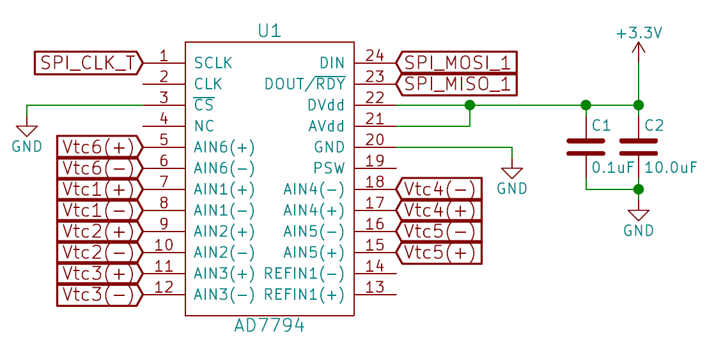
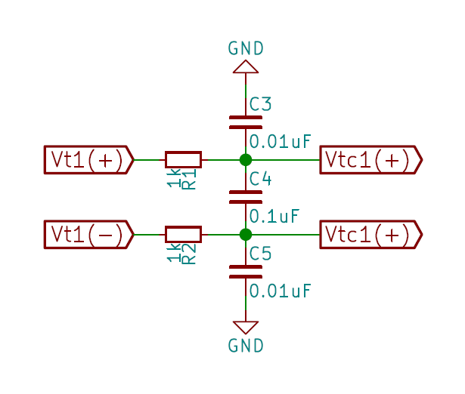
DAQ Flowchart and Schematic
Analog to Digital Conversion
Data collection and ordering
Data Transmission
Data Conversion and Display
Signal Conditioning
Sensor Sampling

Slide 25
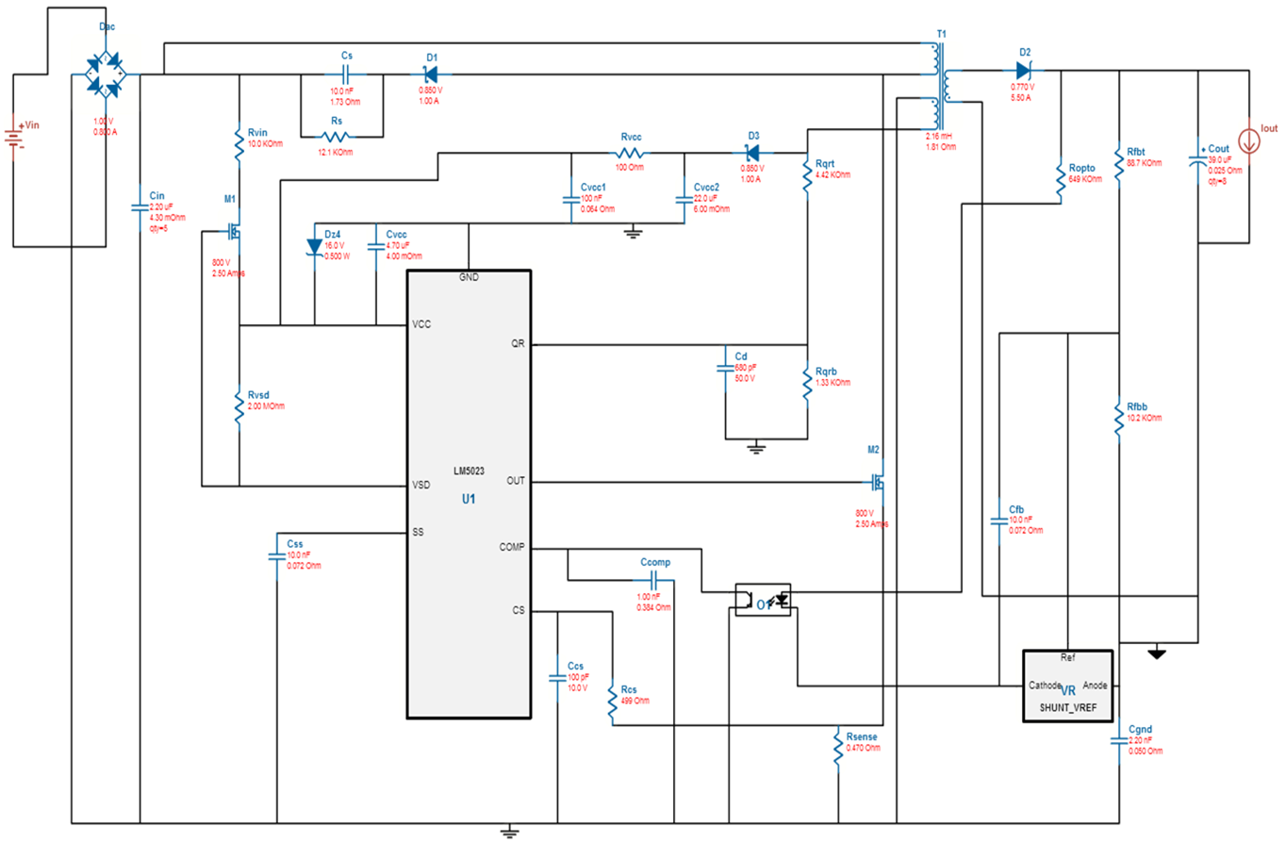
DC Power Supply
Input: 110V AC
Output: +12V@3A, -12V@0.5A,
and 3.3V@0.5A

Slide 26
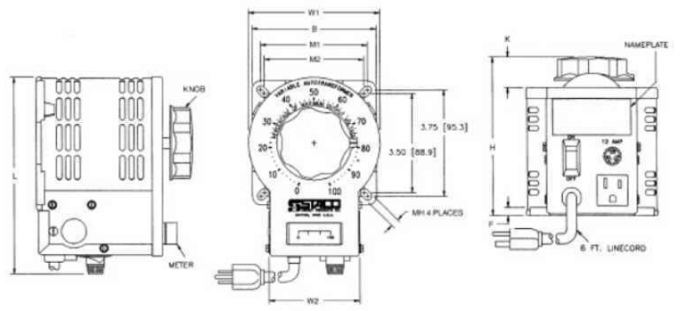
AC Power Supply (Variac)
The variac will be used to power the heaters
0-1500W power output required
Will feature printed label on dial indicating power output

Slide 27
PCB
Advanced Circuits - 4pcb.com
2-layer
60 sq. in
$33
Schematic and PCB design developed in KiCAD

Slide 28
Platform
Testing rig designed and manufactured by ME team
Initial testing platform for electrical components will be accomplished with breadboards, prototype boards, and lab equipment
PCB will house final design

Slide 29
Power Requirements
Component | Voltage Requirement | Current Requirement | Amount in System
Fan | 12V | 2 A | 1
Thermocouple ADC | 3.3V | 400 uA | 7
Pressure ADC | 3.3V | 4.8 mA | 1
Fan Controller | 12V and -12V | 20 mA | 1
Pressure Sensor | 3.3V | 2 mA | 2

Slide 30
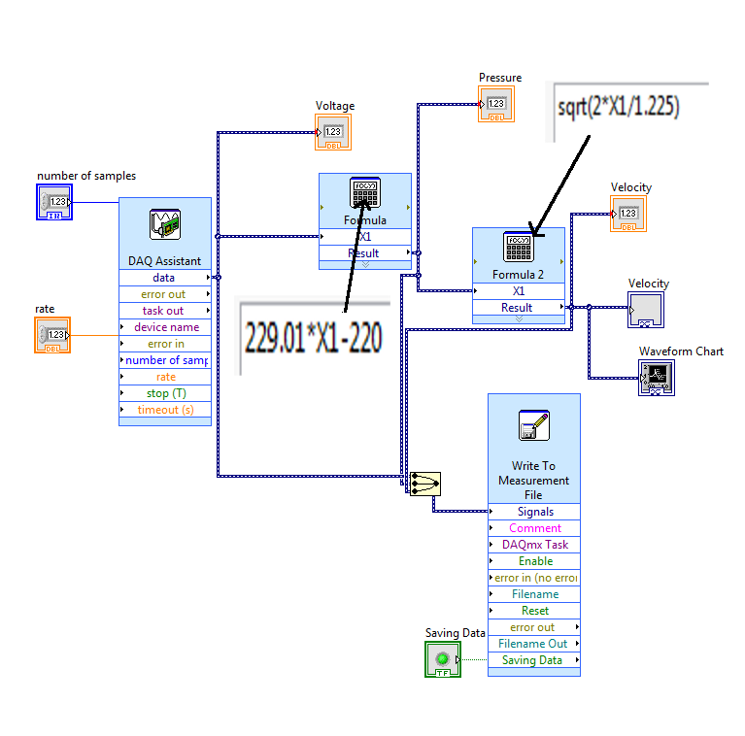
Testing
A small heated box will be created first to test the general concept
Values will be verified using a small pre-made DAQ
Steady-state cases will be verified first
Fan controller will be created based on data collected in testing

Slide 31
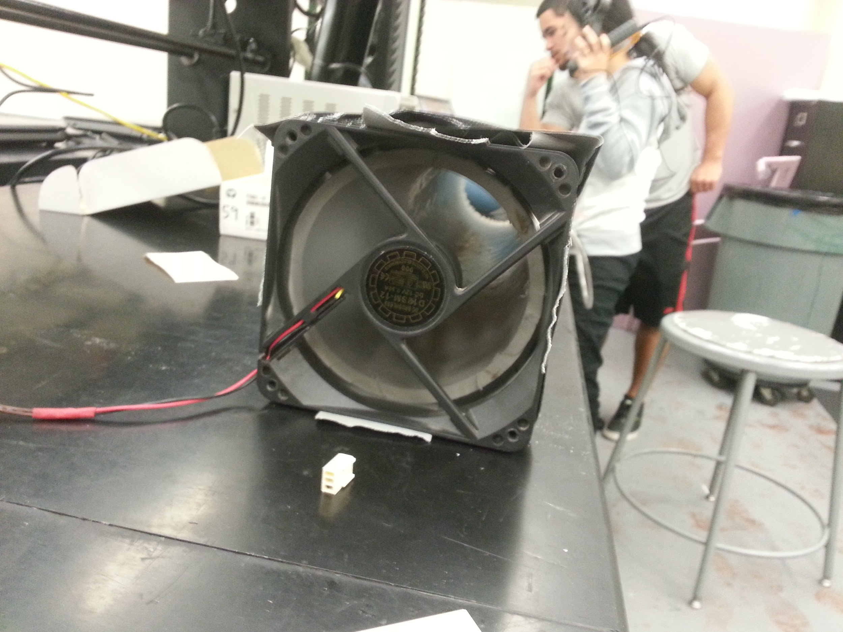
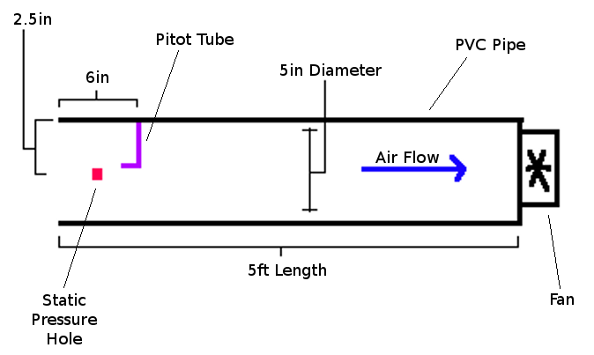
Fan Controller Preliminary Testing
Purpose is to determine the response of the fans
Pitot tubes were used to obtain velocity data
Data for the transient response was insufficient for a usable model. Sensor with improved transient response needed.

Slide 32
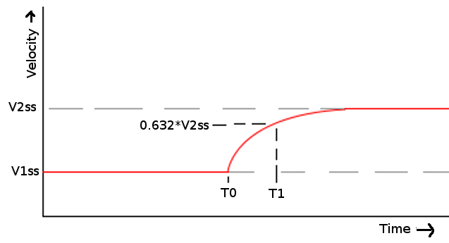
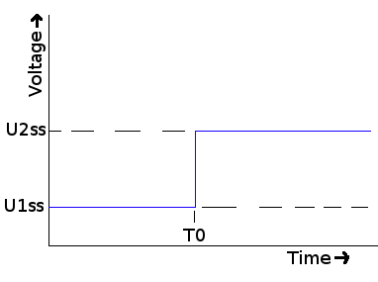
Fan Controller Preliminary Testing
Assuming a first order response:

Slide 33
Schedule / Milestones

Slide 34
Work Breakdown
Task | Patrick | Adam | Eric | Jinjin
DAQ | X |  | x
Software | X | x
Fan Control |  | X |  | x
Power |  |  | X | x
PCB | x | x | x | x
Sensor Interfacing | x | x |  | X

Slide 35
Progress

Slide 36
Budget
Part | Prototyping/Testing | Final
Fan | 2 x $13 = $26 | $15
Fan Control | - | $10
Heaters | $47 | 2 x $84 = $168
Thermocouples | - | $42
Thermocouple Adhesive | - | $21
Variac | - | $200
DC Power Supply | - | $50
Wiring | - | $15
DAQ | $400 | $282
Orifice Plate | - | $250
Pressure Transducer | - | 2x $100 = $200
PCB | $19 | $33
Total | $492 | $1286

Slide 37
Questions?

