Slide 1

S.M.A.R.T.-CHAIR
Sensor & Mind Automated Remote Technology Power Chair
Group ECE –C
Kelvin Ly
Cameron Johnson
(Electrical Engineering)
Rafael Arvelo
Aaron Sandow
(Computer Engineering)
Notes:
15 Seconds

Slide 2
Motivation
An estimated 6 million people live with paralysis and require wheelchairs/power chairs.
Most controller interfaces require movement of muscles.
By creating a Brain-Computer Interface (BCI) based on visually-evoked potential, we establish a system that only requires eye movement to control a wheelchair.
Gain the experience of designing a unique, complex system
Presenter: Cameron Johnson
Notes:
45 Seconds

Slide 3
Goals & objectives
Build a VEP-dependent BCI, usable by anyone with a healthy visual cortex
Interface the BCI with the wheelchair via a mechanical gimbal that manipulates the power chair joystick.
Build a board with four LEDs, programmable to flash at four different frequencies/patterns
Implement ultrasonic sensors to automate collision avoidance
Implement GPS tracking
Build Android app and implement Bluetooth connection for remote control option
Design and Implement Telemetry Interface
Presenter: Cameron Johnson
Notes:
45 Seconds

Slide 4

S.S.V.E.P.
Steady State Visually Evoked Potentials
Recorded EEG voltages
Signal Conditioning
Analog to Digital Converter
Embedded Signal Processing, Feature Extraction, Pattern Recognition
Presenter: Cameron Johnson
Notes:
45 Seconds
LEDs flashing at four different frequencies
When focused on an LED the same frequency can be determined through SSVEP
Discuss Benefits

Slide 5
Basic Project concept
3 Different Command Inputs
  EEG Data
  Peripheral Sensors
    Ultrasonic Range Finder
    GPS Sensor
  Mobile Application
Servo-Controlled Gimbal Manipulates Joystick
Entire system mounted on Quantum Q6 Edge Power Chair
Presenter: Rafael Arvelo
Notes:
35 Seconds
Before Mentioning any specific hardware, here is the Simplified Concept Diagram for our project design
Basically we have a Servo-Controlled Gimbal that Manipulates the Joystick of our Power Chair
Then we have custom electronics that allow us to decide between 3 different command options in parallel
Parse Data sampled from the users scalp via EEG
Remote commands through Bluetooth via Android Device
Peripheral Sensor Data (Specifically 2 Ultrasonic Range Finders and a GPS Module

Slide 6
requirements
Provide four different Flashing Frequencies that invoke the needed Visually Evoked Potentials from the user to move in the appropriate direction
Direction | Shape | Frequency
Forward | Up Arrow | 8 Hz
Backward | Down Arrow | 10 Hz
Left | Left Arrow | 12 Hz
Right | Right Arrow | 14 Hz
Provide at least a 1 Hz Space between flashing frequencies
Accept Commands with a latency less than 500 milliseconds
Presenter: Rafael Arvelo
Notes:
20 Seconds
Here are some of our major project requirements
We have to generate 4 different flashing frequencies that can be distinguished by the user (Research)
The Final Frequencies we chose are show in the table here
Our Research indicated that we needed to keep the frequencies low and provide a small cushion between each of them
We want to be able to accept commands from any of our sources within half a second

Slide 7
Specifications
Specification | Value | Constraints/Comments
Minimum Operable Battery Life | 4 hours | On a full battery charge with all components connected
Maximum User Weight | 300 lbs (136 kgs) | Derived from Quantum Power Chair specifications
Sampling Rate | 128 SPS | Samples Per Second
Minimum LED Frequency | 8 Hz
Maximum LED Frequency | 14 Hz
Presenter: Rafael Arvelo
Notes:
15 Seconds
Most of the specifications here were just derived from the hardware
Maximum user weight comes from the Power Chair we’re using
Min/Max LED Frequency is most effective from our research
Sampling Rate of 128 Samples Per Second is from the EEG were using so we just match that in our software

Slide 8
Design Summary
Hardware
SOFTware
SSVEP Flasher
  ATMEL Tiny AVR
EEG
  Emotiv
Bluetooth Remote and Sensor Hub
  Tiva C Microcontroller
Power Chair Controller
    MSP430 Microcontroller
BCI Processor
      Raspberry Pi 2
Judgment Algorithm
EEG Signal Processing
Telemetry Processing
  Qt C++ on Raspberry Pi 2
Bluetooth Remote and Sensor Processing
  CCS on Tiva C
Power Chair Controller
  CCS on MSP430
Android Application
  Android Studio
Notes:
30 Seconds
This is Quick Summary of all the Hardware and Software items we are going to discuss
We split our design into 5 major hardware sections
Distributed between those sections we have 4 microcontrollers, our Emotiv EEG Headset, the Servo-Controlled Gimbal, and of course the Power Chair
We have independent software blocks functioning on each microcontroller as well as the Mobile device and connect each them through simple message passing
Cameron will go into more detail on each hardware item now

Slide 9
HARDWARE DESIGN

Slide 10
Notes:
60 Seconds

Slide 11
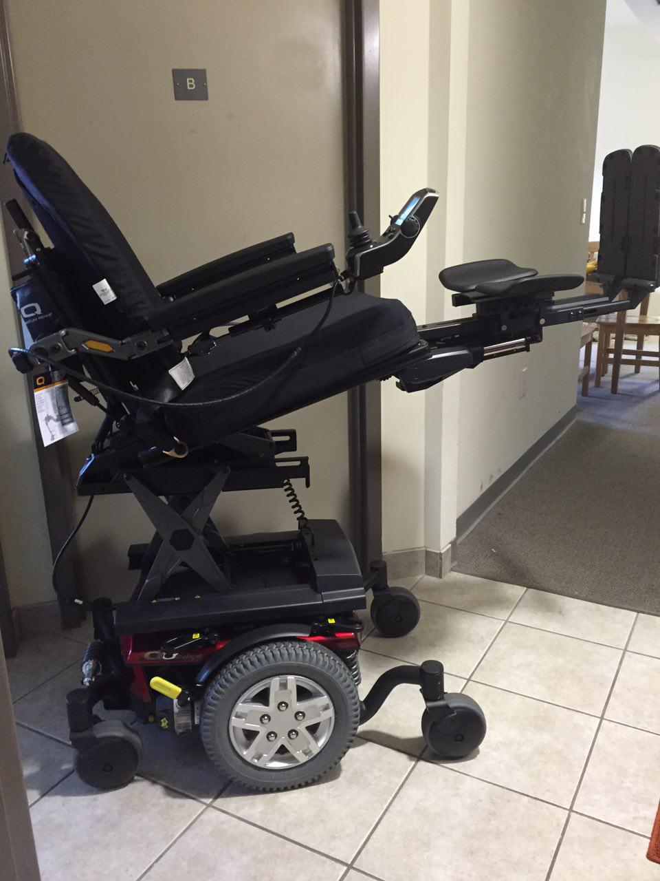
Q6 Edge power Chair
Six wheels on the ground for maximum stability
Enhanced performance over varied terrain
Speed Up to 6 MPH
Base Weight ~300 lbs
Presenter: Cameron Johnson
Notes:
15 Seconds

Slide 12
SSVEP Flasher
Specific Flashing Frequency Elicits Specific Neural Response
4 Separate Simultaneous Frequencies
Frequencies decided by BCI Processor, then sent to SSVEP Flasher
Hardware | Price | Supplier
ATMEL Tiny AVR | $1.19 | Mouser
RGB LEDs | $0.88 | Mouser
Presenter: Cameron Johnson
Notes:
30 Seconds

Slide 13
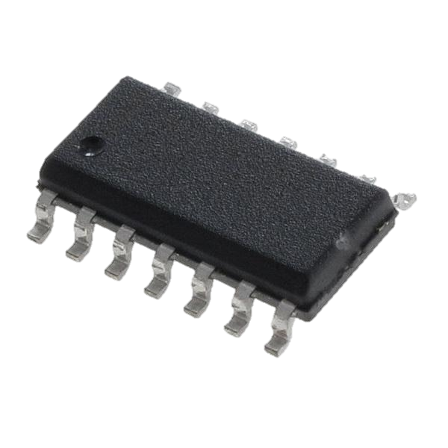
Atmel tiny Avr
Small, but powerful
Low processing power
Works in real time
Lots of I/O Pins
$1.68
Presenter: Cameron Johnson
Notes:
10 Seconds
Small
Low processing power
Works in real time
Lots of I/O Pins
$1.68 =4 LEDs

Slide 14
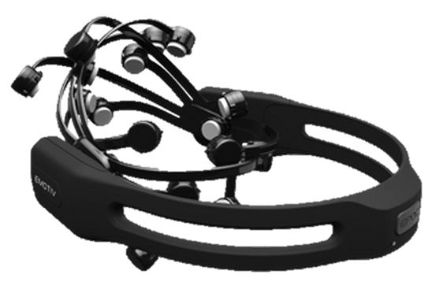
Emotiv Epoc EEG
Obtained through the UCF Medical Robotics Lab
EMOTIV EEG Helmet
Scalp
-
Contact saline sensors
Brainwaves
User
Built-in Polymer Battery (12 Hours of Recordings)
Raw EEG
Data
BCI
Bluetooth Transmitter
Processor
Bluetooth Dongle Transmitter
Presenter: Cameron Johnson
Notes:
30 Seconds

Slide 15
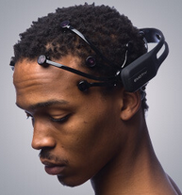
Emotiv epoc EEG
PRODUCT HIGHLIGHTS
14 channels
0.2 - 43Hz, digital notch filters at 50Hz and 60Hz
128 Samples Per Second
Compatible with Windows/Mac/Linux
Presenter: Cameron Johnson
Notes:
15 Seconds

Slide 16
B.R.S.H.
Bluetooth Remote and Sensor Hub
BRSH
Ultrasonic
Bluetooth
Remote
Commands
Hardware | Price | Supplier
TivaC | $18.95 | Sparkfun
Ultrasonic Range Finder | $25.95 | Sparkfun
GPS Sensor | $29.95 | Adafruit
RN-42 Bluetooth Module | $18.95 | Sparkfun
Range Finder
Module
Mobile
FRONT
Device
Telemetry
Ultrasonic
Data
Range Finder
GPS
SENSOR
BACK
Telemetry
Data
BCI
TivaC Microcontroller
Processor
Remote
Commands
Presenter: Cameron Johnson
Notes:
45 Seconds

Slide 17
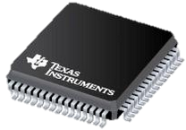

TIVA C Microcontroller
Bluetooth Remote and Sensor Hub
Features
Floating-point capable
256 KB Flash, 32 KB SRAM
Two 12-bit, 24-channel, 1-MSPS ADCs
Optional full-speed USB 2.0 with device, host, and OTG
Advanced motion control capability—up to 40 PWM outputs and two quadrature encoder interfaces
Low-power modes, including power-saving hibernate
64-LQFP, 100-LQFP, 144-LQFP, and 157-BGA package
Presenter: Cameron Johnson
Notes:
10 Seconds

Slide 18
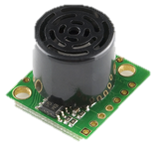
Ultrasonic Range Finder
Bluetooth Remote and Sensor Hub
Features:
42kHz Ultrasonic sensor
Operates from 2.5-5.5V
Low 2mA supply current
20Hz reading rate
RS232 Serial Output - 9600bps
Analog Output - 10mV/inch
PWM Output - 147uS/inch
Small, light weight module
https://www.sparkfun.com/products/639
Presenter: Cameron Johnson
Notes:
10 Seconds

Slide 19
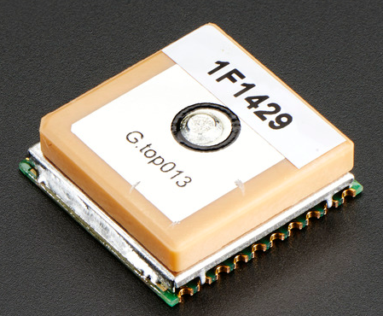
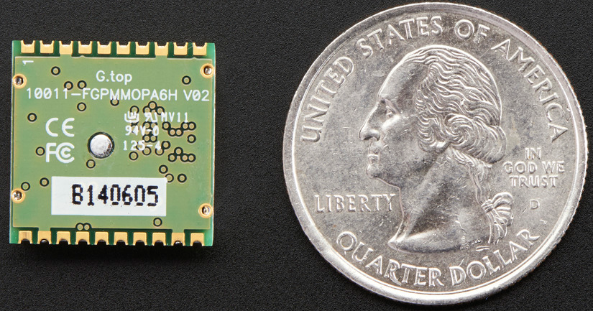
GPS Sensor
Bluetooth Remote and Sensor Hub
Features:
165 dBm sensitivity, 10 Hz updates, 66 channels
Ultra low power usage: 20mA current draw while tracking 3.3V operation
RTC battery-compatible
Built-in Datalogging
PPS output on fix
Works up to ~32Km altitude (the GPS theoretically does not have a limit until 40Km)
Internal patch antenna + connection for optional external active antenna
Fix status output
Ultra small size: only 16mm x 16mm x 5mm and 4 gram
http://www.adafruit.com/products/790
Presenter: Cameron Johnson
Notes:
10 Seconds

Slide 20
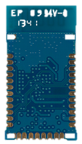
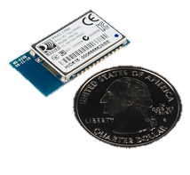
Rn-42 Bluetooth Module
Bluetooth Remote and Sensor Hub
Features:
Fully qualified Bluetooth module
FCC Certified
Fully configurable UART
UART Data rates up to 3Mbps
Over air data rate of 721kbps to 2.0Mbps
Low power sleep mode
Compatible with all Bluetooth products that support SPP
Includes support for BCSP, DUN, LAN, GAP SDP, RFCOMM, and L2CAP protocols
3.3V operation
Status pin
Bluetooth Technology v2.0 compatible
Class 2 power output
Presenter: Cameron Johnson
https://www.sparkfun.com/products/12574
Notes:
10 Seconds

Slide 21
BCI Processor
Presenter: Kelvin Ly
Notes:
45 Seconds

Slide 22
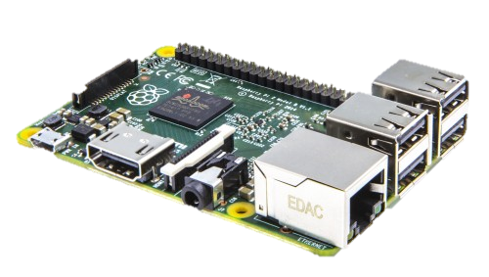

Raspberry Pi 2
Features:
Broadcom BCM2836 900MHz Quad-Core ARM Cortex-A7 CPU
1GB LPDDR2 SDRAM
Full Unix OS (Raspbian)
6X Speed of Raspberry Pi 1
40 GPIO Pins and 4 USB Ports
$35, Amazon
Presenter: Kelvin Ly
Notes:
10 Seconds

Slide 23
Power Chair Controller
Presenter: Kelvin Ly
Notes:
30 Seconds

Slide 24
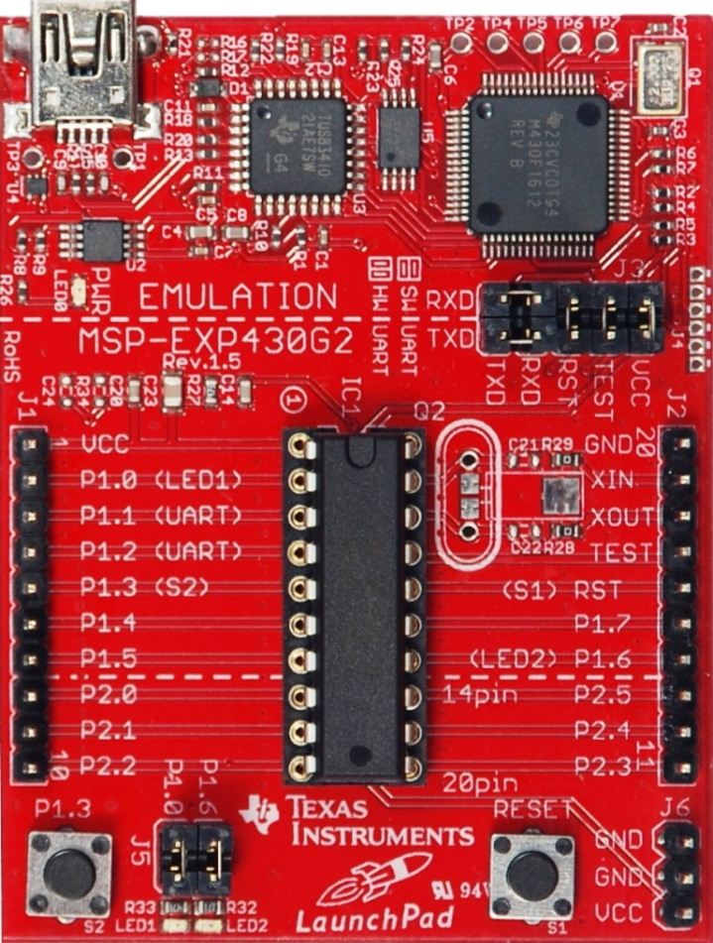
MSP430 G2553
Features:
Powerful 16 Bit RISC CPU
Low Supply-Voltage Range (1.8 V – 3.6 V)
UART Serial Interface
Configure Pins/Timer for Hardware PWM
Fast Wake up from Standby (less than 1μs)
Presenter: Kelvin Ly
Notes:
30 Seconds

Slide 25
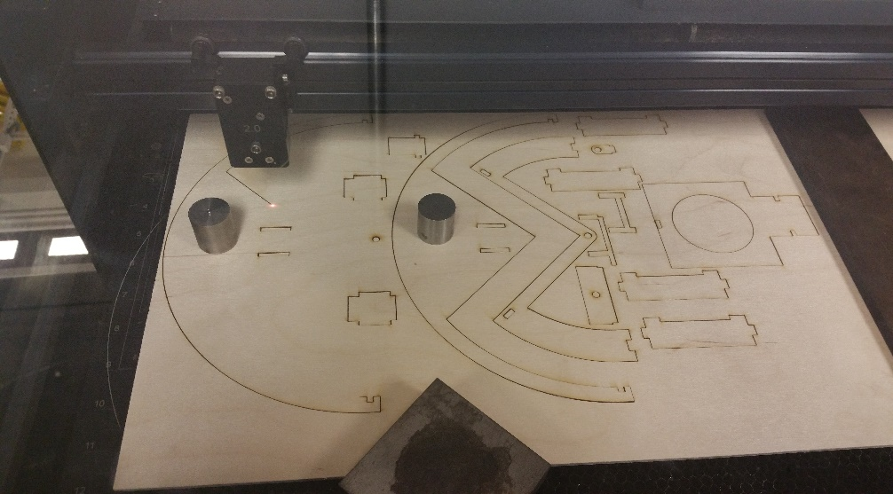
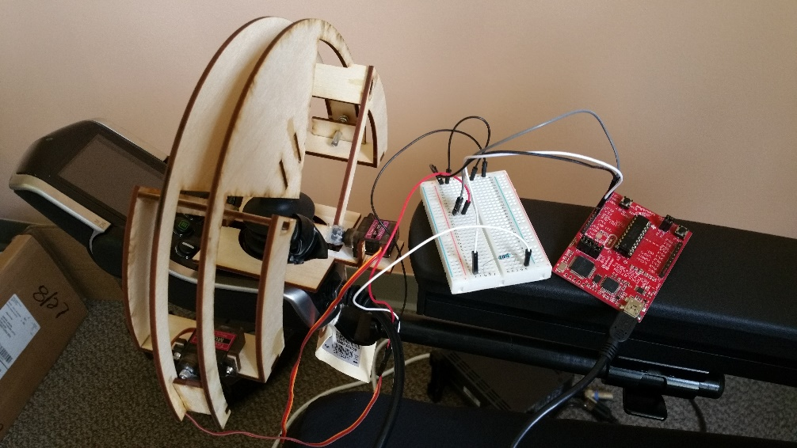
Servo Controller Gimbal
Laser Cut
Fast Prototyping
Affordable Materials
Readily Available
VS
3D Print
Longer Wait Times
More Detail than Needed
Less Margin for Error
Presenter: Kelvin Ly
Notes:
30 Seconds

Slide 26
HARDWARE challenges
PCB Design
  Bypass Capacitors
  Spacing
Communications
  UART and PWM
Gimbal
  Mechanical Complexity
Presenter: Kelvin Ly
Notes:
30 Seconds

Slide 27
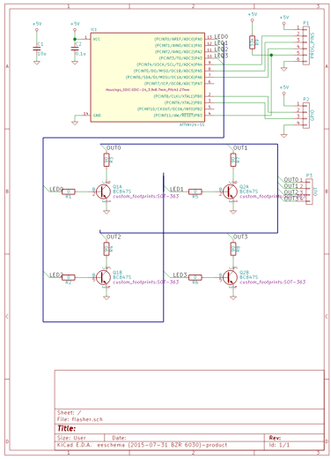
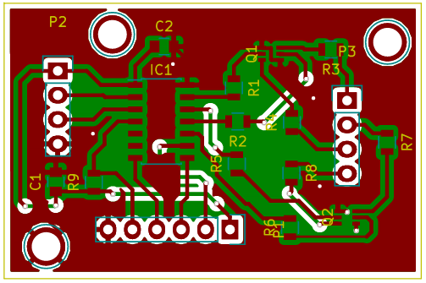
Schematic and PCB - flasher
Presenter: Kelvin Ly
Notes:
45 Seconds

Slide 28
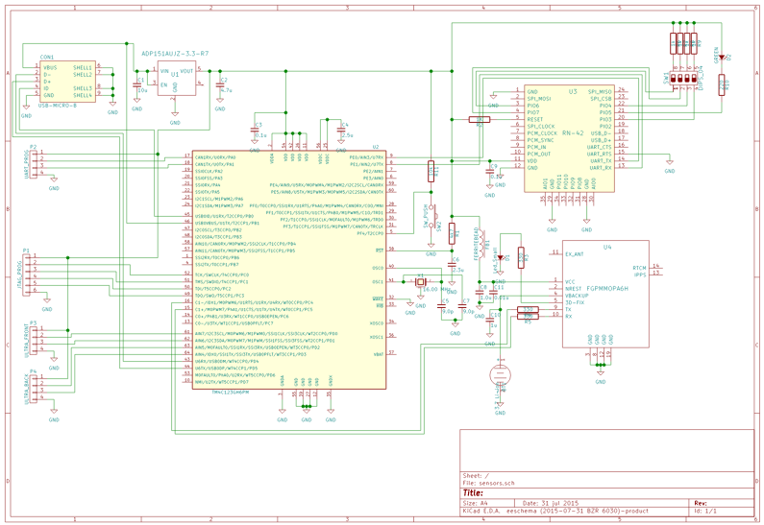
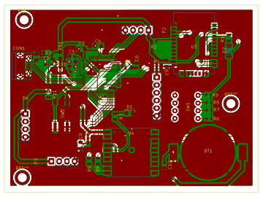
Schematic and PCB – sensor Block
Presenter: Kelvin Ly
Notes:
45 Seconds

Slide 29
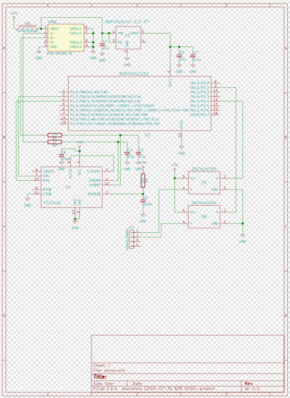
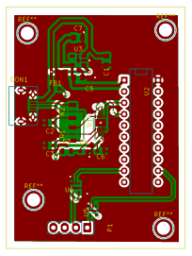
Schematic and PCB – servo BLOCK
Presenter: Kelvin Ly
Notes:
45 Seconds

Slide 30
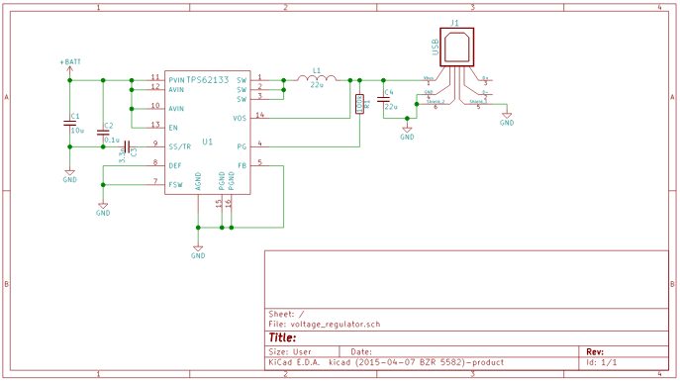
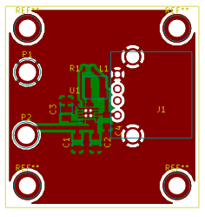
Schematic and PCB - voltage regulator
Presenter: Kelvin Ly
Notes:
45 Seconds

Slide 31
Power supply
Main switching regulator, 24 V -> 5 V 0.8 A
Individual linear regulators, 5 V -> 3.3 V
Individual regulators easier than 3.3 V rails
Noise reduction
Better power margins
Presenter: Kelvin Ly
Notes:
30 Seconds
Call it a portable battery vs chair battery

Slide 32
Software DESIGN
Presenters: Rafael/Aaron

Slide 33
Android Device
Android
Application
Sensors
BCI Core CPU
BRSH
Brainwave
KEY
Voltages
Bluetooth
Sensor
Emokit API
Signal
BRSH
Interface
Interface
Android Application
Processing
Interface
SSVEP RVS
BCI
Data
BCI
Algorithm
Interface
Bridge
Emotiv
PCC
EEG
Judgment
PCC
SSVEP
Algorithm
Interface
Power Chair Controller
BRS Processing
Flasher
Interface
BCI Interface
Brainwaves
Command
Parsing
SSVEP Flasher
User
Servo Output
Visual
LED
BCI
Stimulus
Outputs
Interface
Quantum Q
6
Controller
Presenter: Rafael Arvelo
Notes:
45 Seconds
Major Block Diagram of our Entire Project Software
Separated by 5 Major Hardware Sections
The Data Flow starts in the BCI Processor where we first boot up and spawn the signal processing thread then establish interfaces to all of the external devices
Once we’ve finished initializing we immediately start listening for EEG Signals and Remote and Sensor Data.
While listening we’re simultaneously sending a Telemetry Stream to the Android Device through the BRSH
Upon Receiving either a Remote Command, Sensor Data, or EEG Data, the judgment algorithm will decide a final command and send it to Power Chair Controller
The Power Chair Controller is what converts the Command into servo movements to manipulate the joystick and move the power chair

Slide 34
Abstract I/O Interfaces
Top Level API uses abstract function calls
I/O Classes are conditionally compiled for each interface
Improves Software testing efficiency by creating interface first
PCC_IO
+SendCommand()
PCC_IO_DEBUG
PCC_IO_MSP
+SendCommand()
+SendCommand()
BRS_IO
//Debug Configuration for testing
#define DEFAULT_EEG_TYPE EEG_TYPE_DEBUG
#define DEFAULT_BRS_TYPE BRS_TYPE_TIVA
#define DEFAULT_PCC_TYPE PCC_TYPE_MSP
#define DEFAULT_FLASHER_TYPE FLASHER_TYPE_ATMEL
+FetchBRSFrame()
BRS_IO_DEBUG
BRS_IO_MSP
+ FetchBRSFrame()
+FetchBRSFrame()
Notes:
30 seconds
Here is quick example of how we implemented all of our I/O classes
Basically all of our base I/O classes are abstract and the function calls for any I/O activities are pure virtual
Then the I/O functions are implemented in subclasses so that they all use the same interface
This allows us to use Debug Classes to send and receive nominal data to and from our top level software
So what we can do conditionally compile out certain hardware interfaces while including others and our top level software doesn’t know the difference
For example we can use simulated sensor data while using real EEG data to help develop our signal processing
Overall this helps streamline our software testing effort by designing the top level architecture for the nominal case first and then adjusting it with tests later

Slide 35
Software Task List
Task ID | Software Task | Software Section | Hardware | Related Class
001 | Generate RVS Flashing Frequencies at four different Rates | SSVEP RVS | BCI Processor | C_RVS
002 | Communicate RVS Rate to the Judgment Algorithm and SSVEP Flasher | SSVEP RVS | BCI Processor | C_RVS2JA
004 | Obtain Voltage Data from Emotiv EEG Headset | Emokit API | BCI Processor | C_EEG_IO
005 | Extract Features from Data and send to Judgment Algorithm | Signal Processing | BCI Processor | C_SignalProcessing
006 | Create Telemetry Data Packet from all Received Data | Judgment Algorithm | BCI Processor | C_TM
007 | Send Telemetry Data to BRSH | Judgment Algorithm | BCI Processor | C_JA2BRS
008 | Process EEG, Remote, and Sensor data into final Power Chair command | Judgment Algorithm | BCI Processor | C_JA
009 | Send command to Power Chair Controller | Judgment Algorithm | BCI Processor | C_JA2PCC
Presenter: Rafael Arvelo
Notes:
20 Seconds
Here is a textual representation of all the tasks that the BCI PROCESSOR is responsible for completing
The main functions of the BCI PROCESSOR are EEG Signal Processing, Judgement Algorithm, and I/O to all peripheral devices
The BCI Software has a Main Thread for the judgment algorithm, then separate threads for BRSH I/O, Signal Processing, and EEG I/O
So one thread for receiving EEG frames and another to process them
Processed EEG Data, Remote Commands and Sensor Data are all sent to Judgment Algorithm
Once the command is decided it is sent immediately to the Power Chair Controller

Slide 36
Software Task List
Task ID | Software Task | Software Section | Hardware | Related Class
010 | Send Logic Output to LEDs | SSVEP RVS | SSVEP MCU | C_LED_IO
011 | Provide User Interface for Remote Commands | Android Application | Mobile Device | See Table 24
012 | Obtain Remote Commands from mobile device | BRS Processing | BRSH | C_MobileDeviceIO
013 | Obtain Sensor Data from peripheral Sensors | BRS Processing | BRSH | C_SensorIO
014 | Combine Remote Commands and Sensor Data into a single packet | BRS Processing | BRSH | C_BRS
015 | Send Remote Commands and Sensor Data to BCI Processor | BRS Processing | BRSH | C_BRS2JA
016 | Send command to Power Chair | PCC Commands | Power Chair Controller | C_PowerChair_IO
Presenter: Rafael Arvelo
Notes:
20 Seconds
Here are the list of tasks for the rest of the software sections
Our Power Chair Controller Software just sits on the MSP430 and translates received commands into servo movements
The Bluetooth Remote and Sensor Processing simply sends sensor data back and forth between the BCI processor and Android Application
Combines remote commands from Android device into one packet with the sensor data and sends it to BCI processor
Lastly, the Android Application just provides a user interface for sending remote commands

Slide 37
Judgment algorithm
Decides Final Power Chair Command before sending to Power Chair Controller
Priority assigned to command request based on source
BCI will wait in STANDBY indefinitely until command request is received
PCC will hold the last successfully received command constant from the BCI until a new command is received.
Power Chair command priority
Software Source | Command Type | Priority Level
BRS Processing | Emergency Stop | First
SMART Remote | Remote Commands | Second
Judgment Algorithm | EEG Signal Processing | Last
Presenter: Rafael Arvelo
Notes:
30 seconds
JA is the component that handles all the logic behind deciding which command should be sent to the Power Chair Controller
It is the essentially the glue that holds all of the interfaces together
What happens is a priority is assigned to each potential command based on its origin
The Highest priority is assigned to the Emergency Stop Commands which are evoked from Ultrasonic Range Finders detecting a nearby object
If no object is in the way the software will check for remote commands
and finally only if no remote commands are available will the algorithm allow use of data from the EEG Signal Processing to decide the power chair command

Slide 38
BCI state machine
INITIALIZATION
Establish Connection to external hardware interfaces
Generate/Send SSVEP RVS Frequencies
Establish Telemetry Interface
STANDBY
Wait for EEG Data or Remote Commands
Transmit Telemetry to BRS Processing
PROCESSING
Perform Filtering/Signal Processing on EEG Data
Decide Final Power Chair Command from all Received Data
READY
Send Power Chair Command to Power Chair Controller via Serial UART Interface
Revert back to STANDBY
OFF
*Power Up*
STANDBY
*Initialization Complete*
INITIALIZATION
*Data Received*
*Command Sent*
PROCESSING
READY
*Command Finalized*
Presenter: Rafael Arvelo
Notes:
30 seconds
So as you may have assumed the BCI Processor Software functions as a simple state machine
After the system is powered on the software immediately establishes connections to the external interfaces
Then it moves to a Standby state where it will wait for a valid signal processing result, remote command, or sensor data packet
Once any of those have been received it will move to a processing state where the Judgment Algorithm Decides the final command
Any new data received in the processing state gets put into a Queue to be acted on later
And Finally the system moves to a ready state before it sends the command and reverts to standby to listen for more data

Slide 39



Development Environment
Android studio
Powerful Debugger
Great UI Framework and API
Code Composer studio
Excellent Tool Suite for TI Microcontrollers
Intuitive, Customizable IDE
Qt
Cross-Platform
Small Learning Curve, Uses C++
Quick Import of Libraries
Presenter: Rafael Arvelo
Notes:
40 Seconds
Okay so I’m going to speak briefly on our development environment
We used Android Studio to develop our mobile application basically because it had the most full featured debugging tools
Seemed to have the most developer support and resources online
For all of our Texas Instruments Microcontrollers, specifically the TIVA C on the BRSH and the MSP430 on the PCC we used CCS
We were very familiar with the IDE and Tool Suite and the Debugging Tools worked fairly well
Finally we used QT for the BCI Development because it had several useful libraries when it came to implementing a multithreaded application
Small learning curve since it uses C++
And now I’ll pass it off to Aaron

Slide 40

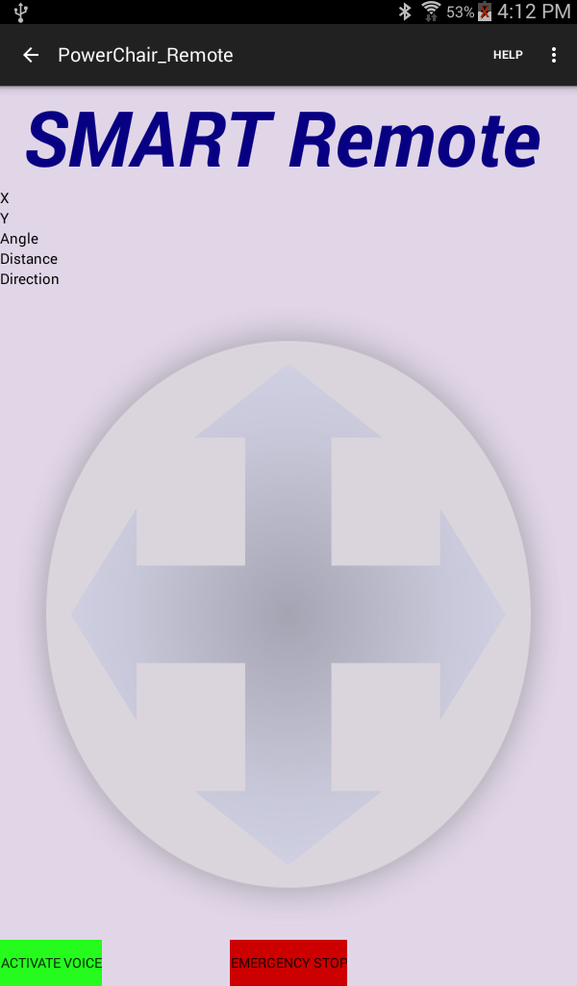
Android Application
Provides user control to override EEG
Voice Interaction
Readable information display on joystick heading
Simple Interface
Presenter: Aaron Sandow
Notes:
30 Seconds

Slide 41
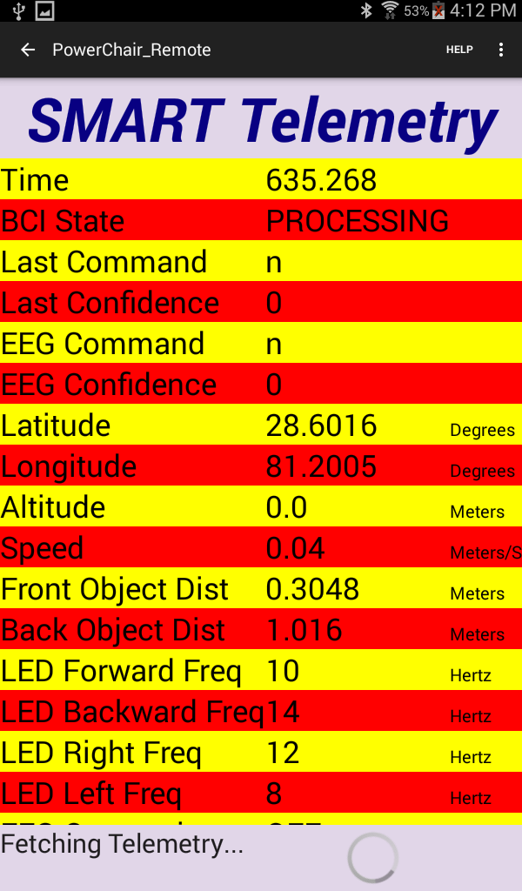
Android Application
Data feedback from on chair sensors
Ajax spinner to show data collection
Scrollable view
Presenter: Aaron Sandow
Notes:
20 Seconds

Slide 42
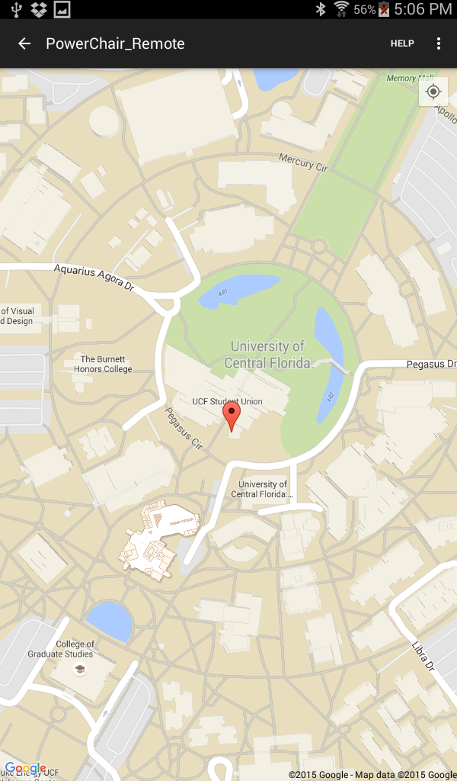
Android Application
Allows for tracking of chair
Interfaces with on board GPS
Screen will center to current location of chair
Presenter: Aaron Sandow
Notes:
20 Seconds

Slide 43
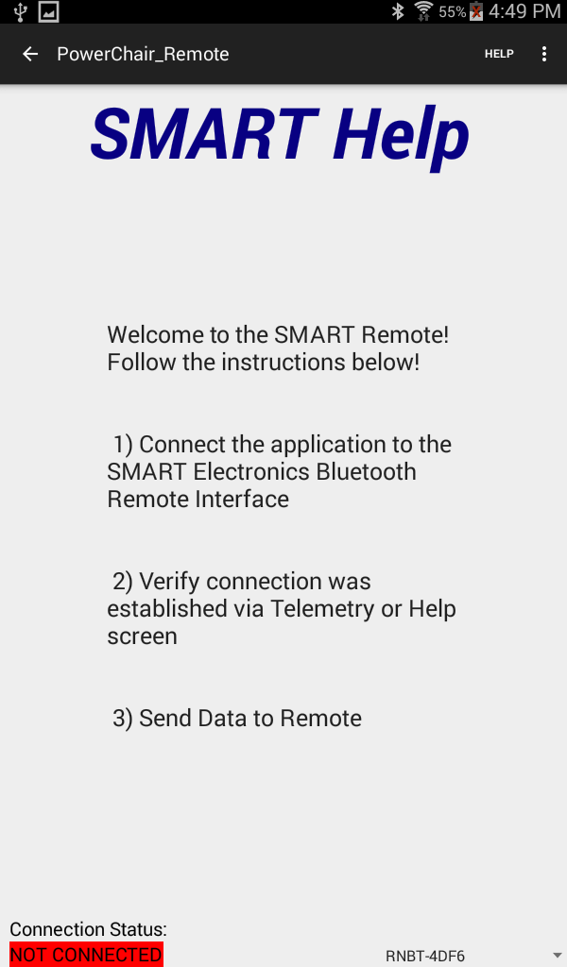
Android Application
Help screen to walk through new users
Easily Accessible
Bluetooth Selection
Presenter: Aaron Sandow
Notes:
10 Seconds

Slide 44
Software challenges
UART and Servo Pulse Width Modulation
Emokit
Parsing through lots of GPS data quickly
Presenter: Aaron Sandow
Notes:
45 Seconds
emokit = the build process wasn't the same as a standard installation on a unix environment
Difficult with the limited amount of configurable pins on MSP430 to get configure the UART and 2 Hardware PWM Pins

Slide 45
Administrative
Content
Presenter: Aaron Sandow

Slide 46
Project Testing
Modular, Incremental Testing
Mocking PCBs ahead of time
GitHub Overrides
EEG Recordings
Presenter: Aaron Sandow

Slide 47
Relevant Standards
Standard # | Description:
IEC 62209-2:2010 | Applies to any EMF transmitting device in close proximity (IEC 62209-2) to the human body. The allowable frequency range is 30MHz to 6GHz.
IEC 62031 Ed. 1.0 b:2008 | Applies to LED modules for use on AC supplies up to 1000V and 50-60 Hz (above necessary frequency for SSVEP). Elucidates general and safety requirements for LED modules.
ISO 7176-19:2008 | Applies to powered wheelchairs, intended for use for children and adults greater than 22kg. Specifies design, testing, and performance requirements, as well as user instructions and warnings. In the case that any developed system is to be implemented commercially, this standards document would need to be purchased and satisfied.
Presenter: Aaron Sandow
Notes:
30

Slide 48
Finances
Donations:
Power Chair (Quantum Rehab)
PCBs
(Bay Area Circuits)
EEG Headset (UCF Medical Robotics)
Boeing fund
Presenter: Aaron Sandow
Notes:
45

Slide 49



Sponsors

Slide 50
Hardware Assignments
Assignment | Primary | Secondary
LED Array | Kelvin | Cameron
Emotiv EEG | Cameron | Kelvin
Raspberry Pi 2 | Rafael | Kelvin
Atmel TivyAVR | Kelvin | Cameron
Tiva C | Rafael | Aaron
GPS Sensor | Cameron | Kelvin
Ultrasonic Range Finder | Cameron | Kelvin
Bluetooth Module | Cameron | Kelvin
Voltage Regulator | Kelvin | Cameron
PCB Design | Kelvin | Cameron
Presenter: Aaron Sandow
Notes:
10

Slide 51
SOFTWARE Assignments
Team Member | Primary | Secondary
SSVEP RVS Algorithm | Cameron | Kelvin
SSVEP Flasher Interface | Kelvin | Rafael
Judgement Algorithm | Rafael | Aaron
Android Application | Aaron | Rafael
Sensor I/O | Rafael | Aaron
Command Parsing | Aaron | Sandow
Power Chair Controller | Rafael | Aaron
Presenter: Aaron Sandow
Notes:
10

Slide 52
Milestone Schedule
Date | Milestone
8/28/2015 | Gimbal Designed
9/4/2015 | Gimbal Prototyped and MSP430 working with Servos
9/11/2015 | All parts ordered and mobile app controlling PCC
9/18/2015 | Configure Tiva/Amtel/MSP430; Assemble Flasher; Bluetooth Working
9/25/2015 | Solder and Test PCBs; Tiva Communicates with Pi
10/2/2015 | Configure Nautilus, create EEG interface
10/9/2015 | Test PCBs, Complete PCC
Presenter: Aaron Sandow
Notes:
10

Slide 53
Milestone Schedule
Date | Milestone
10/16/2015 | Test PCBs, Complete Android App
10/23/2015 | Incorporate SSVEP code
10/30/2015 | Working Demo
11/6/2015 | Testing/Improvements
11/13/2015 | Testing/Improvements
11/20/2015 | Testing/Improvements
11/27/2015 | Testing/Improvements
12/4/2015 | Senior Design Day
12/11/2015 | Complete website and documentation
12/19/2015 | Graduation
Notes:
10

Slide 54
Project Challenges
GPS does not work indoors
Gimbal does react to chair moving off course
Servos overheat after continuous use
Electronic Housing
Our own signal processing algorithms
Presenter: Aaron Sandow

Slide 55

Questions?

