Slide 1
Mini-Mixer: A Design Review
Thomas Bergens
CpE
William Tuggle
CpE

Slide 2
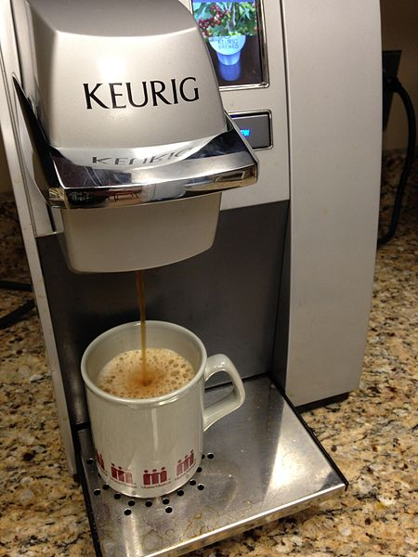
Goals and Objectives
Automatic drink mixer with flexible ingredient choices.
Small, kitchen appliance-sized unit.
Create custom recipes per user as well as suggested/top recipes.
Seamless set of steps from recipe creation to drink in hand.
Wirelessly control the entire process.
Source: "Coca-Cola Freestyle Logo" by Source (WP:NFCC#4), Wikipedia
Source: Wikipedia

Slide 3
Requirements Specifications
Requirement | Specification
The unit will be designed to be very compact. | Weight <= 40 lb
The “mixing” process is to be reasonably fast. | Time <= 60 s
The “mixing” process should have good accuracy. | Each Ingredient +/- 10 % error
The variety of drinks should be sufficiently large. | 6 Fluid Ingredients
The mixer should be able to produce a mixture at a chilled temperature. | Mixture Temperature <= 55 F
The mobile application should be able to create all possible combinations of the given fluids in the mixing unit. | At least 64 subsets of mixture combinations
The mobile application should limit the total mixture size to a value that satisfies the expected size of general mixtures. | Final mixture <= 8 oz

Slide 4
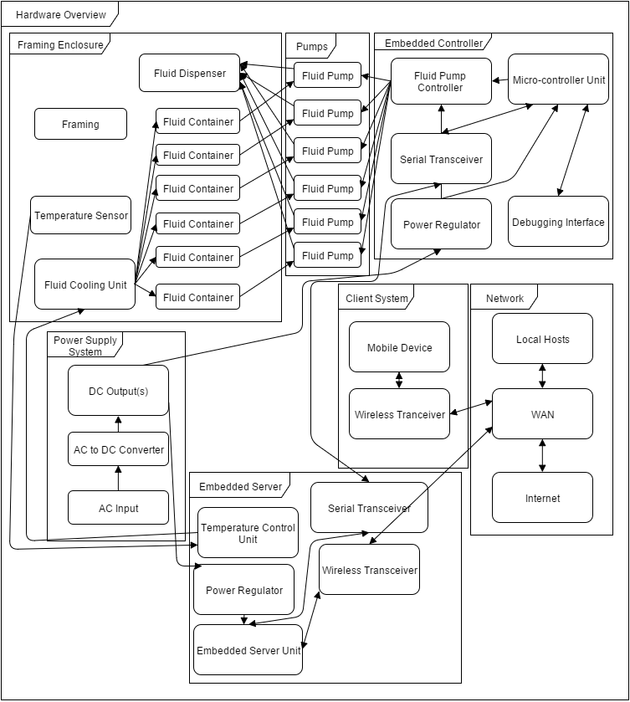
High-Level Block Diagram
Modular(mostly)
Three major components:
Client
Server
Controller
Remaining components are mainly relational representations between major components

Slide 5
Hardware Overview

Slide 6
High-Level Block Diagram

Slide 7
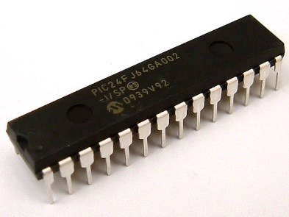
Microcontrollers
MSP430G2553 Texas Instruments Frequency: 16MHz
20 pin DIP
24 GPIO pins
I2C/SPI/UART support
Cost: $2.59
ATmega328P Atmel Frequency: 20MHz
28 pin DIP
23 GPIO pins
I2C/SPI/UART support
Cost: $3.70
PIC24FJ64GA002 Microchip Frequency: 32MHz
28 pin DIP
21 GPIO pins
I2C/SPI/UART support
Cost: $3.35
*PIC24F picture from: http://akizukidenshi.com/img/goods/C/I-02000.jpg

Slide 8
Microcontrollers
MSP430G2553 Texas Instruments Frequency: 16MHz
20 pin DIP
24 GPIO pins
I2C/SPI/UART support
Cost: $2.59
ATmega328P Atmel Frequency: 20MHz
28 pin DIP
23 GPIO pins
I2C/SPI/UART support
Cost: $3.70
PIC24FJ64GA002 Microchip Frequency: 32MHz
28 pin DIP
21 GPIO pins
I2C/SPI/UART support
Cost: $3.35
*PIC24F picture from: http://akizukidenshi.com/img/goods/C/I-02000.jpg

Slide 9
Texas Instruments SN754410 Half-H Bridge Driver
Accepts a small voltage PWM signal input
Drives DC motors and pumps up to 36V/1A
Supports two bidirectional motors or four single direction motors
Simple 16 pin DIP, easy to prototype with
Each pump of the Mini-Mixer is connected to one of these
Multiple chips can be chained together to satisfy higher current demands

Slide 10
High-Level Block Diagram

Slide 11
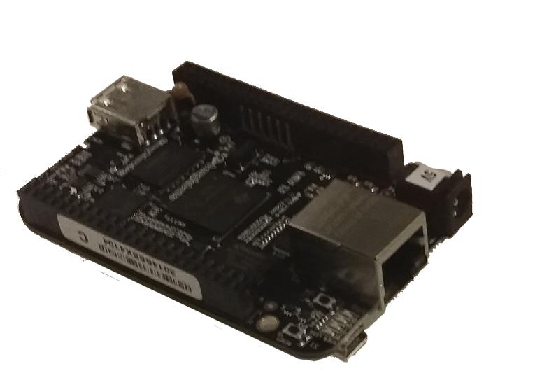
Embedded Server
Needed something to host web server.
Many GPIO pins for expanded features.
Prefer to have lower power consumption the.
We don’t need the GPU, Display, USB ports provided by the alternative.
 | BB Black Rev. C | RPi B+
GPIO Pins | 65 | 40
Storage | 4GB onboard eMMC | SD Slot
CPU | AM335x@1GHz | BCM2835@700MHz
Price | $45 | $35
Power | 5V@210-460mA | 5V@700-1k mA

Slide 12
High-Level Block Diagram

Slide 13
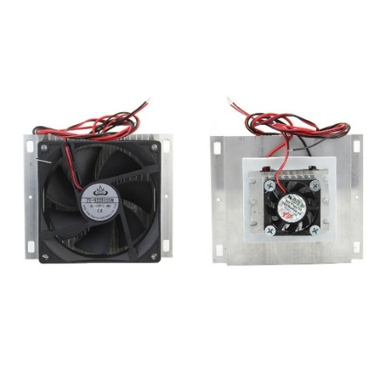
Cooling System
It is a requirement of the Mini-Mixer to serve drinks chilled below room temperature. To achieve this, a thermoelectric Peltier plate will be used, in addition to user provided ice
The Peltier plate’s operation is simple conceptually; it moves heat from one side to the other
The embedded server (BeagleBone Black) will be responsible for controlling this device to achieve the desired temperature
Will consume anywhere from 75-90 watts of power
Digital temperature sensor to help control Cooling(DS18B20).
Current Mode Boost Controller for Peltier Plate(TPS40210).
Source: eBay
Current Controller | TPS40210
Vin(V) | 4.5-52
Vout(V) | 5-260
Iout(I) | 6
Price($) | 1.26

Slide 14
Fluid Pump System
Peristaltic Pump
Liquid never touches pump
Tubing is “squeezed” by pump.
Great accuracy
Liquid is dispersed in short “bursts”.
Relatively low current draw(~0.8A).
Other options were either too: costly, heavy, wildly inaccurate. Liquid distortion was also a concern.

Slide 15
Fluid Containment
Containers:
14 Oz Rubbermaid Sport Bottles
Short and thin to fit in our enclosure.
Nice plastic top to anchor tube fittings.
Clear container for easy visibility.
$6 for all 6 containers
Tubing/Fittings:
White Silicone Rubber Tubing
FDA and NSF 51 certified.
Clear for visibility
Tube-to-Tube fittings
Elbow shaped to keep from ripping it out of container during use.
Tubing fittings for both sides – one side to pump and one side into the bottle.
Source: McMaster-Carr

Slide 16
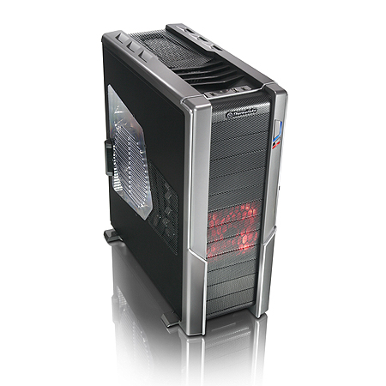
Frame and Enclosure
Thermaltake Spedo Advance Full ATX chassis
21.1” x 9.1” x 24”
Clear acrylic side-panel for visibility, modified for the Mini-Mixer
Cable management built in

Slide 17
High-Level Block Diagram

Slide 18
Power Supply
Thermaltake TR2 500W Switching PSU
7” x 10” x 4”
Contains SATA and 4 pin Molex connectors
Mini-Mixer utilizes 4 pin Molex connectors to power various electronic components

Slide 19
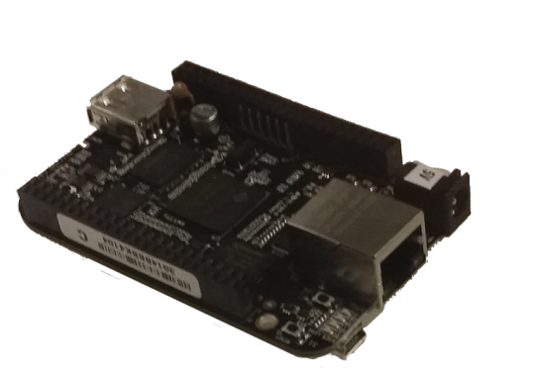
High-Level Software Overview
Client System
The Client System includes the Client Interface that is used to control and command the Mini-Mixer.
Embedded Server System
The Embedded Server is responsible for controlling and communicating between the other major systems, namely the Client System and Embedded Controller System.
Embedded Controller System
The Embedded Controller System contains an embedded microcontroller used to control the pumps for dispensing liquid.

Slide 20
High-Level Software Overview
Client System
The Client System includes the Client Interface that is used to control and command the Mini-Mixer.
Embedded Server System
The Embedded Server is responsible for controlling and communicating between the other major systems, namely the Client System and Embedded Controller System.
Embedded Controller System
The Embedded Controller System contains an embedded microcontroller used to control the pumps for dispensing liquid.

Slide 21
Client System
Client Hardware:
Any Android phone or tablet with Wi-Fi P2P hardware will be supported(most modern devices).
Device must support Android 4.0(API level 14) or later.
Client Platform: Android
Robust, Documented SDK
Built-in libraries for Wi-Fi P2P.
Open Source (mostly).
Free to develop and publish (third-party)
Source: Android

Slide 22
Client: Main Menu

Slide 23
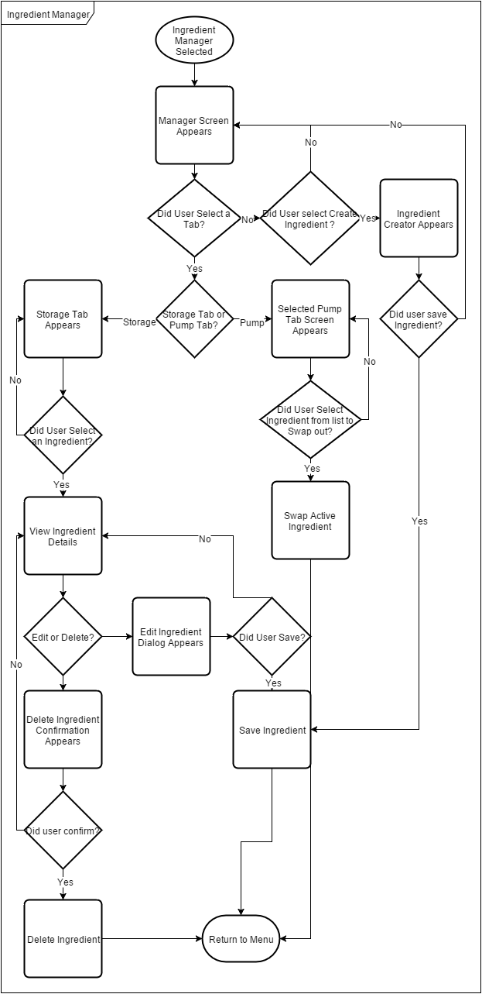
Client: Drink Manager
Entry point to anything related to drink ingredients.
Add, edit, remove ingredients.
Navigation is organized using tabs and lists of Card widgets.
Two main tabs:
Storage
Any ingredients you have used in the past and haven’t removed.
Pump
Ingredients currently in the unit.
Name, type, amount of each ingredient can be edited on their respective card.

Slide 24
Client System Dev Tools
Android Studio
Supported by Google
Based on robust Jetbrains IDE
Free!
Android SDK
Personal phone/tablet
Android Emulator
JDK 8
Source: Wikipedia

Slide 25
High-Level Overview
Client System
The Client System includes the Client Interface that is used to control and command the Mini-Mixer.
Embedded Server System
The Embedded Server is responsible for controlling and communicating between the other major systems, namely the Client System and Embedded Controller System.
Embedded Controller System
The Embedded Controller System has an embedded microcontroller used to control the pumps for dispensing liquid.

Slide 26
Embedded Server Software
Language: Python 2.7
Framework: Django
Accounting framework built-in.
Great built-in ORM.
Developer server allows source changes on-the-fly.
Framework: Django REST
Aid in creation of RESTful API.
Source: Python Software Foundation
Source: Django Software Foundation
Source: Django REST Framework

Slide 27
Embedded Server API Endpoints
Resource | Description | Example
/connection | Server-side wireless connection configuration. | POST /connection/set
/user | Account Management, Authentication | POST /user/create
/ingredients | Describes single(or many) ingredient and properties. | POST /ingredients/add
/sensor | Provides sensor state info(temperature, uptime) | POST /sensor/calibrate
/recipes | Describes one(or many) drink recipes and actions. | GET /recipes/suggest
/mixer | Manages submission and status of drink orders. | POST /mixer/order/create

Slide 28
Embedded Server Dev Tools
Atom text editor
Open source
Robust set of plugins(linter-pylint, atom –Django)
Familiarly
Google Chrome
API calls made with Postman extension
Chrome dev tools to help with debugging
WinSCP
Uses SFTP to sync files over to BeagleBone Black nearly instantly
Allows seamless deployment between dev and test environment
Source: Wikipedia
Source: WinSCP

Slide 29
Client-Server Communication
Communication needs to be as seamless as possible to the user.
We have to account for a Setup Mode and Normal Mode.
Multiple wireless devices connected to Server.
*Strongly* prefer HTTP support.
 | Bluetooth | Wi-Fi | Wi-Fi P2P
Pros | Low power No interference with Internet connections. | Medium range. All devices keep other network connections. | Medium range No need for routing/switching.
Cons | Short range Server-Client would have to be serial. | Requires router/AP. | Possibly no Internet connection on either device.

Slide 30
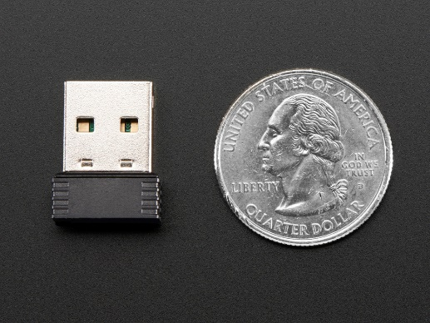
Client-Server Communication
Service Discovery using Zero-configuration networking (zeroconf) standard.
Allows Mini-Mixer to announce itself over Wi-Fi in Setup/Normal mode.
Two communication modes:
Wi-Fi Direct/P2P
Required for Setup Mode.
Optional for Normal Mode.
Wi-Fi
Preferred for Normal Mode.
Wi-Fi module must support a mixed-mode operation to allow for P2P and Normal Modes.
Virtual adapters will be used for this.
Slows down speeds but we don’t care.
RTl8192 supports nl80211 headers(Needed for multimode)
Source: Adafruit

Slide 31
High-Level Overview
Client System
The Client System includes the Client Interface that will be used to control and command the Mini-Mixer.
Embedded Server System
The Embedded Server is responsible for controlling and communicating between the other major systems, namely the Client System and Embedded Controller System.
Embedded Controller System
The Embedded Controller System has an embedded microcontroller used to control the pumps for dispensing liquid.

Slide 32
Embedded Controller Dev Tools
Arduino IDE
Easy to use
Lacks debugging features
Will be used for initial functional prototyping
Atmel Studio 7 IDE
Learning curve involved
Contains useful debugging features

Slide 33
Server-Controller Communication
Communication between the embedded controller and embedded server is established via UART.
The embedded server receives a request from the client system, and generates an ASCII instruction string that is transmitted to the embedded controller.
The embedded controller is responsible for converting each respective part of the string into it’s intended primitive data type, and then processing the request appropriately

Slide 34
Embedded Software Design Pump Operation & Abstraction
The Mini-Mixer will have two modes of pumping operation
Parallel Operation
Sequential Operation
This is necessary to be as time efficient as possible, all the while allowing the option to administer certain ingredients in a sequential order for recipes that call for it
The software will abstract each of these out into its own structure/class.
These abstractions will come with a one character label (‘A’ – ‘F’)

Slide 35
Recipe Instruction Conceptualization
With the following operation modes and abstractions in mind, a simple yet effective instruction format will be used with the following rules:
An instruction will always contain single character start and end commands, to allow the controller to know when to start and stop reading input from the embedded server
Parallel mode will be executed first, followed by sequential mode
Each pump will be referred to in the instruction by its character label

Slide 36
Recipe Instruction Format Generic Format
Request Command | # of Parallel Pumps | # of Sequential pumps | Pump Label | Amount (Oz) | . . . . . | . . . . . | Pump Label | Amount (Oz) | . . . . . | . . . . .
‘R’ | uint | uint | char | float | . . . . . | . . . . . | char | float | . . . . . | . . . . .
M # of
Parallel Pumps
6 – M (max) # of
Sequential Pumps

Slide 37
Recipe Instruction Format Example Request
Request Command | # of Parallel Pumps | # of Sequential pumps | Pump Label | Amount (Oz) | Pump Label | Amount (Oz) | Pump Label | Amount (Oz) | Pump Label | Amount (Oz)
R | 2 | 2 | B | 1.1 | C | 0.2 | A | 0.8 | F | 2.3
Parallel Pumps
Sequential Pumps

Slide 38
Relevant Standards Hardware
ASTM D2000
Used to standardize rubber products in automotive applications
Standard is focused on testing methods for the integrity of the material in various environmental conditions (compression, tension, etc)
Tubing must comply with this standard
IP-2221A
Generic standard that details everything surrounding PCB design
This includes materials, general requirements, physical properties, electrical properties, thermal management, assembly, and quality assurance among many other topics

Slide 39
Relevant Standards Software
IEEE 802.11
These are a complete set of specifications and standards that define a wireless local area network (WLAN) over a specific set of frequencies.
RS-232 (EIA-232)
This is the basis of most serial communications, defining the protocol and transmission of data in point-to-point connections.

Slide 40
Relevant Standards Food
NSF International Standard/American National Standard 170
This standard is essentially a glossary of terms that defines food equipment terminology that is to be found in subsequent standard specifications.
NSF/ANSI 2
This contains a set of requirements detailing the materials, design, and assembly for equipment that handles food products

Slide 41
Issues
Controller PCB had one pin grounded when it was necessary to be connected to VCC; a simple jumper fix was required
Capacitors, capacitors, capacitors. The pumps are very power-noisy circuits, that required all power inputs to be decoupled from the rest of the system to avoid voltage fluctuation for other parts.
Incorrect capacitors were originally soldered to the crystal on the controller PCB, thereby altering the expected 16MHz frequency and ultimately UART communications. These were replaced to ultimately fix the issue

Slide 42
Bill of Materials
Part | Quantity | Price
BeagleBone: Black | 1 | $53.42
Atmel ATMega328p | 1 | $3.70
Peristaltic Pump | 6 | $179.94
ATX Computer Chassis | 1 | $120
Power Supply | 1 | $23.98
H-Bridge IC’s | 3 | $18.06
Lighting | N/A | $23.96
Tube connectors | 6 | $8.00
Rubber Tubing | 12 | $2.50
Wi-Fi Module | 1 | $12.00
Temperature Sensor | 1 | $4.00
Current Controller(A/C) | 1 | $1.26
TOTAL: |  | $450.82

Slide 43
Division of Labor
Task | Davidson | TJ
Enclosure Construction | Secondary | Secondary
Hardware Assembly | Primary | Secondary
Embedded Server Programming | Secondary | Primary
Embedded Controller Programming | Primary | Secondary
Client Mobile App | Secondary | Primary
Functional/System Testing | Secondary | Secondary
Documentation | Secondary | Secondary

Slide 44
Questions?

