Slide 1
Solar Blinds

Slide 2
Group 11
Artis Coleman - Computer Engineer
Sean Diamond - Optical Engineer
Dakota Jordan - Computer Engineer
Stephen Walsh - Electrical Engineer

Slide 3
Motivation
Renewable energy source
Complement an energy-efficient home
Easily added to any residential home

Slide 4
Goals
High Energy Efficiency
Easy installation
Remote controllable
Self-sustaining operation
Relatively low-cost
Lightweight

Slide 5
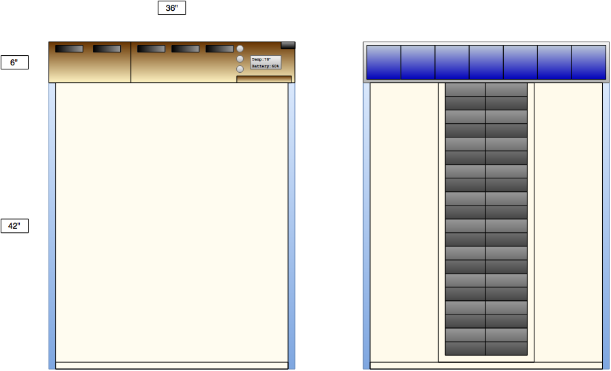
Concept
Front View Back View

Slide 6
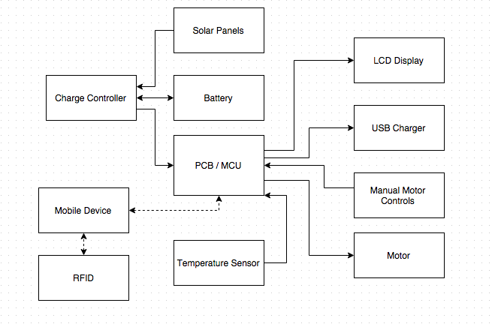
Block Diagram

Slide 7
MCU

Slide 8
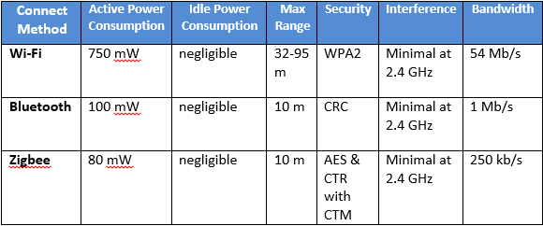
MCU
Wifi vs. Bluetooth vs. Zigbee

Slide 9
MCU
Needed an ARM processor
We first considered the Atmel SAM3N00A & TI CC3200
CC3200 had more features than we needed & used WiFi, so we looked into the CC2640 instead
 | Atmel SAM3N00A | TI CC2640
Sleep Current @48MHz | 8.4mA | 0.550 mA
Active Current @48MHz | 18 mA | 2.938 mA
Bluetooth | Requires additional module | On-board, requires additional antenna

Slide 10
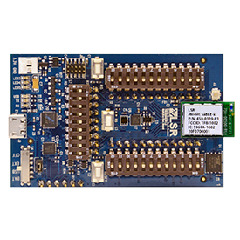
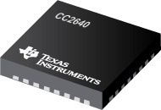
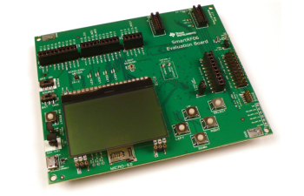
MCU
Texas Instruments CC2640
Dev Board SmartRF06
SaBLE-x Evaluation Kit
Part | Vendor | Cost | Shipping/Tax | Total
CC2640 | Mouser Electronics | $6.25 | $7.99 | $14.24
SmartRF06 | Mouser Electronics | $149.00 | $7.99 | $156.99
SaBLE-x Evaluation Kit | Digi-Key | $69.99 | $5.99 | $75.98
$247.21

Slide 11
Motor

Slide 12
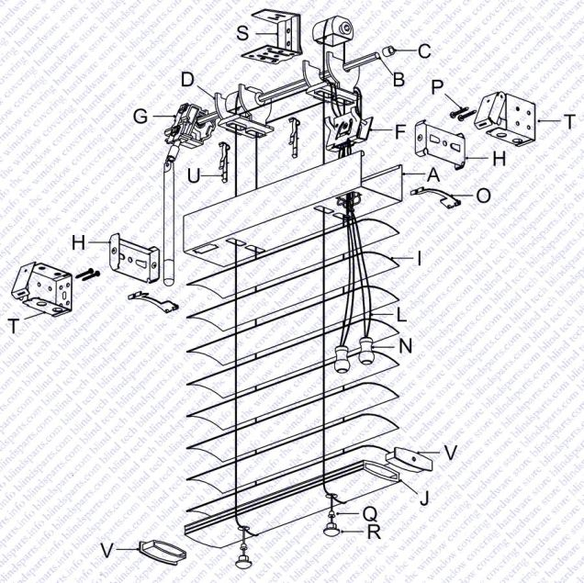
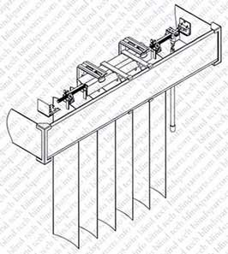
Motor
Motor selection depends on blind type
Horizontal and vertical blinds originally considered, both required two motors
Horizontal Slats Vertical Slats
Source: Blinds Parts

Slide 13
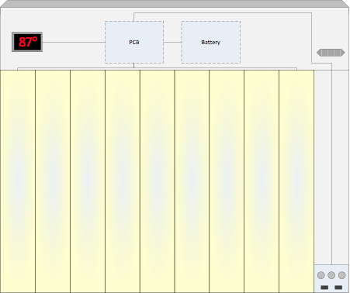
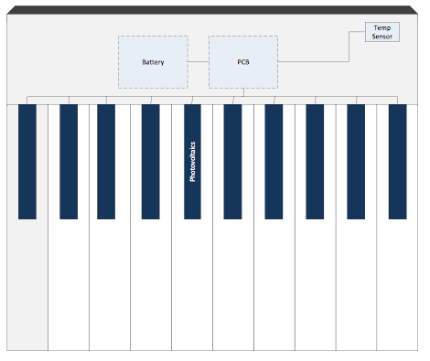
Motor
Original design required two motors and complex wiring for photovoltaics

Slide 14
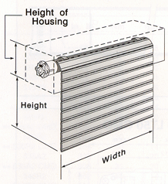
Motor
Benefits of rolling blinds:
One motor
Easier to design for different windows
Easier to mount solar panels
Less complex wiring
Saves power
Simpler manual button controls
Source: Innovative Openings

Slide 15
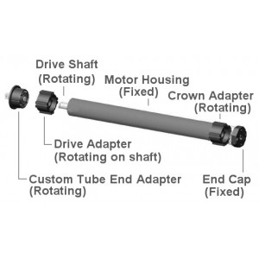
Motor
Attributes | Value
Manufacturer | RollerTrol Automation Systems
Lift Capacity | 12 lbs
Torque | 1.5 Nm
Speed | 28 rpm
Nominal Voltage | 12 V DC
Minimum Voltage | 9.5 V DC
Current Consumption | 1.5 A
Stall Current | 3 A
Lifetime | 30,000+ cycles
Total Cost | $118.00
Source: RollerTrol

Slide 16
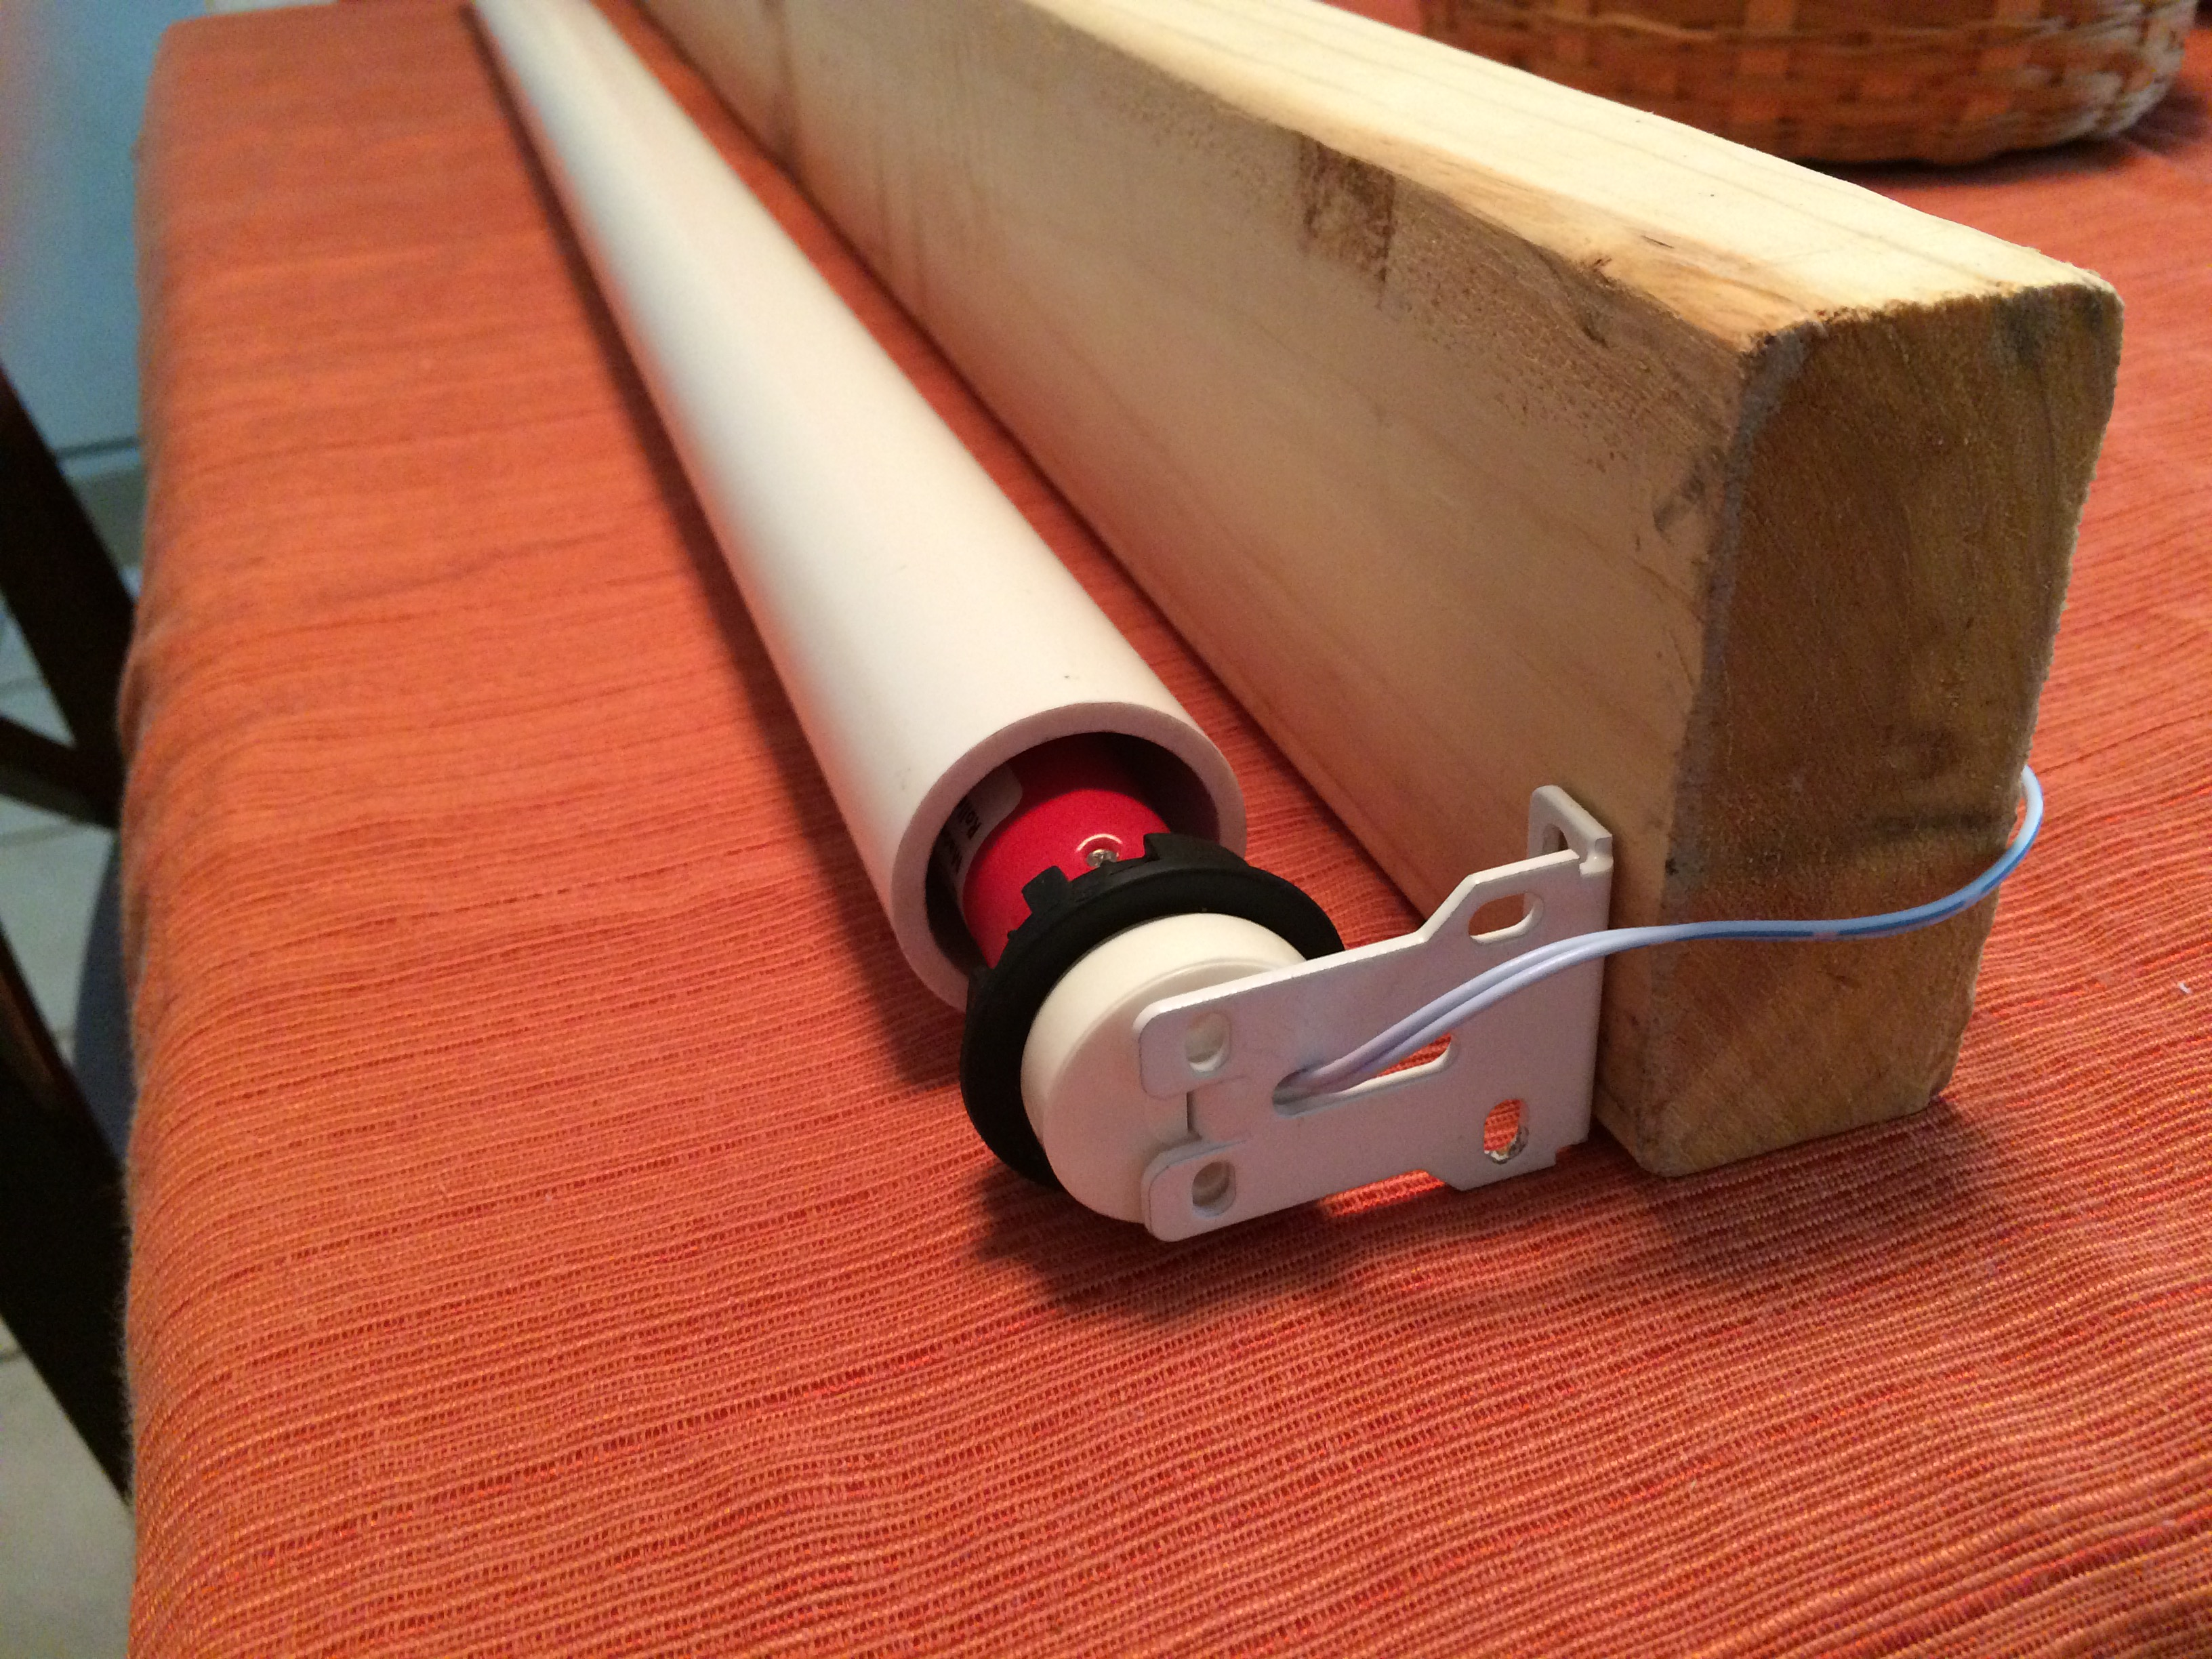
Motor

Slide 17
Solar Cells

Slide 18
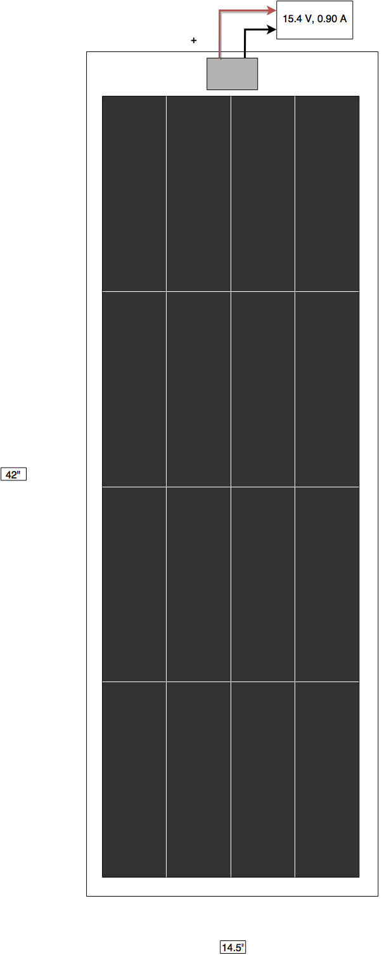
Solar Cells: Thin Film Module
Attribute | Value
Manufacturer | PowerFilm
Model | R-14
Size | 14.5" x 42"
Power | 14 W
Max Voltage | 15.4 V
Max Current | 0.9 A
Total Cost | $185.99
Built in blocking diode

Slide 19
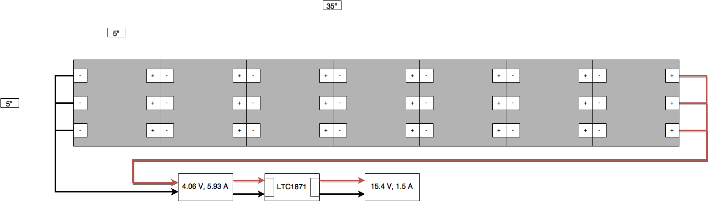
Solar Cells: Monocrystalline Module
Attribute | Value
Manufacturer | Sunpower
Module Size (7 Cells) | 35" x 5"
Module Power | 23.1 W
Max Voltage (after boost) | 15.4 V
Max Current (after boost) | 1.5 A
Total Cost (10 Cells) | $46.99

Slide 20
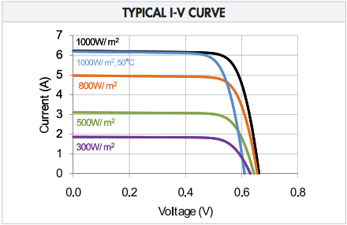
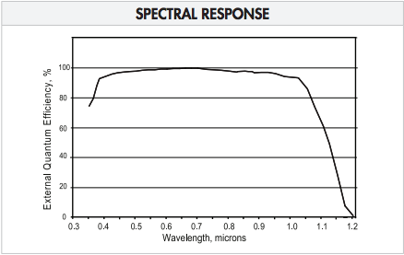
Solar Cells: Monocrystalline Module
Source: Sunpower

Slide 21
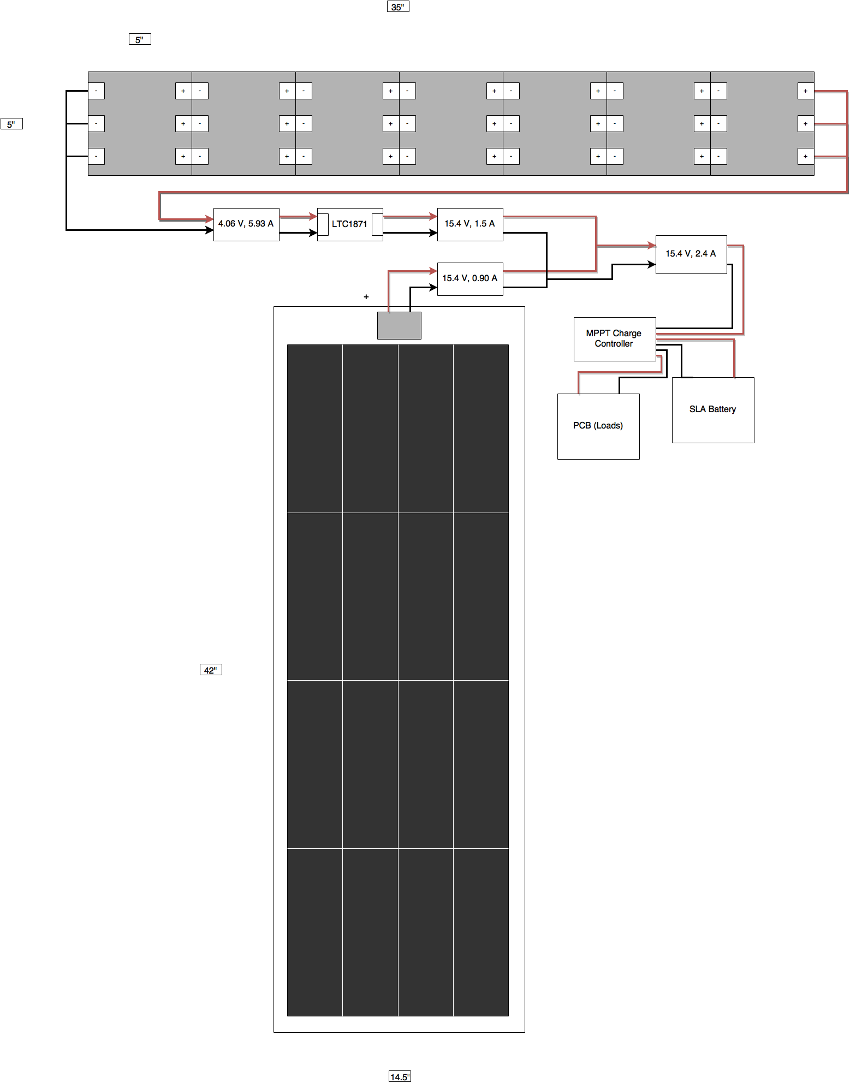
Solar Cells: Combined Module
Attribute | Value
Connection | Parallel
Total Power | 36.96 W
Max Voltage | 15.4 V
Max Current | 2.4 A
Charge Controller | Genasun Gv-5 MPPT
Charge Controller Refresh Rate | 15 Hz
Charge Controller Cost | $75.00

Slide 22
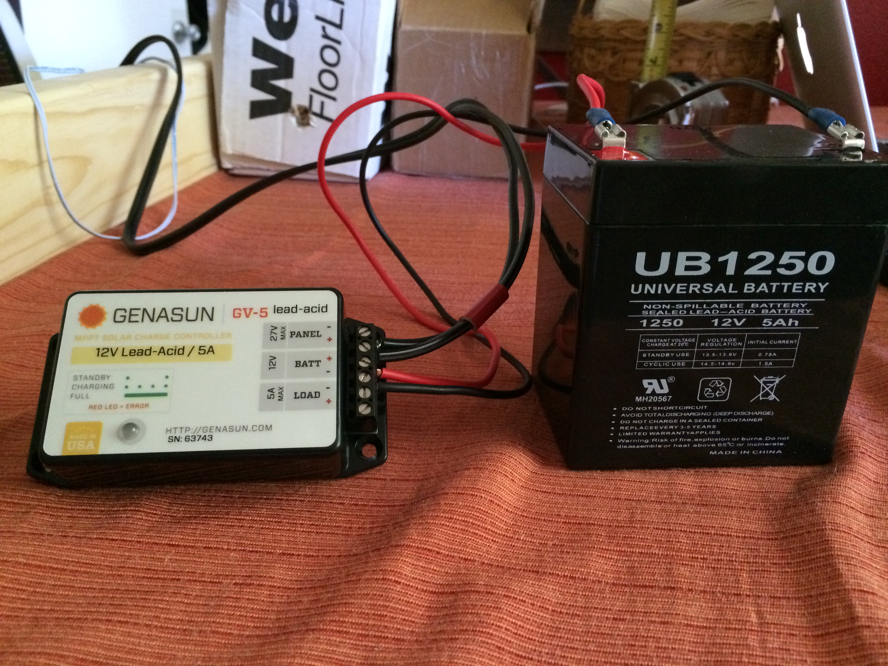
Battery
Attribute | Value
Manufacturer | Universal Power Group
Model | UB1250 (SLA AGM)
Capacity | 60 Wh (12V, 5Ah)
Dimensions | 3.54" x 2.76" x 3.98"
Maximum Charge Current | 2.4 A
Lifetime (50%-30% discharge) | 500-1200 cycles
Total Cost | $14.93

Slide 23
Power Generation
Light Condition | Solar Power | Time to Charge 60 Wh Battery
100% Max Power | 36.96 W | 1.62 Hr
75% Max Power | 27.72 W | 2.16 Hr
50% Max Power | 18.48 W | 3.25 Hr
25% Max Power | 9.24 W | 6.49 Hr

Slide 24
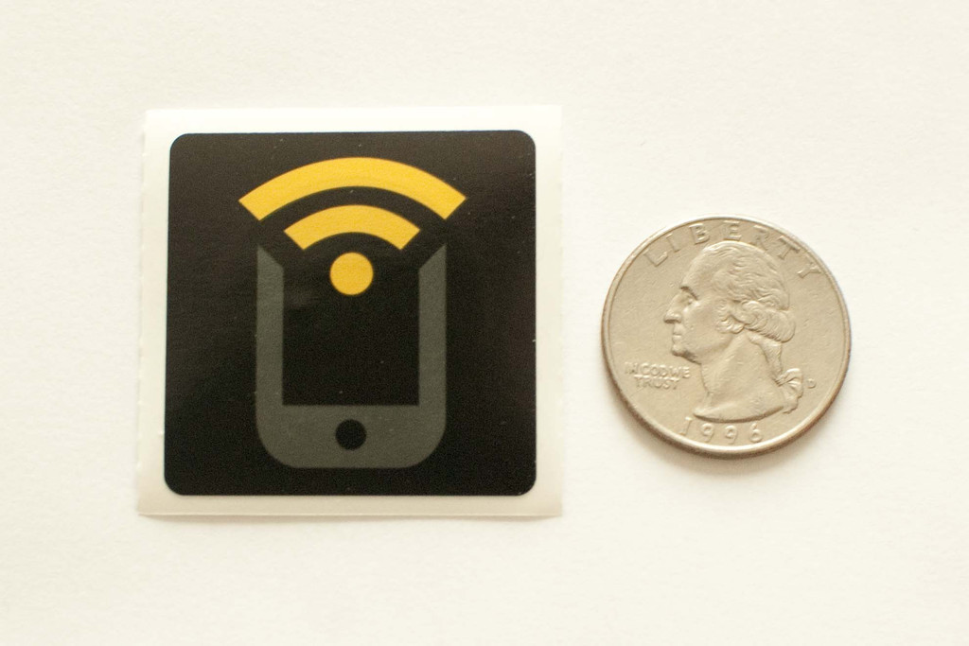
RFID
NFC = Near Field Communication, subset of the RFID band
Requires tag & reader
Recent Android phones have NFC reader built-in
Source: TagStand
Part | Vendor | Cost | Shipping/Tax | Total
NFC Tag | TagStand | $1.00 | $2.99 | $3.99

Slide 25
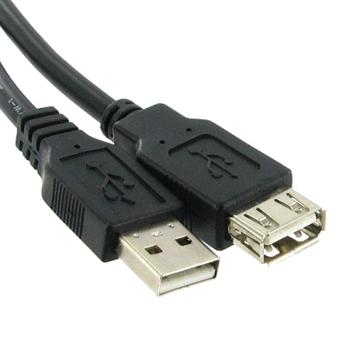

USB Charger
Mainly for phone charging
Will not be using the data lines
Mounted directly on PCB with extender port mounted on the housing
Source: Global Sources
Source: USB Gear

Slide 26
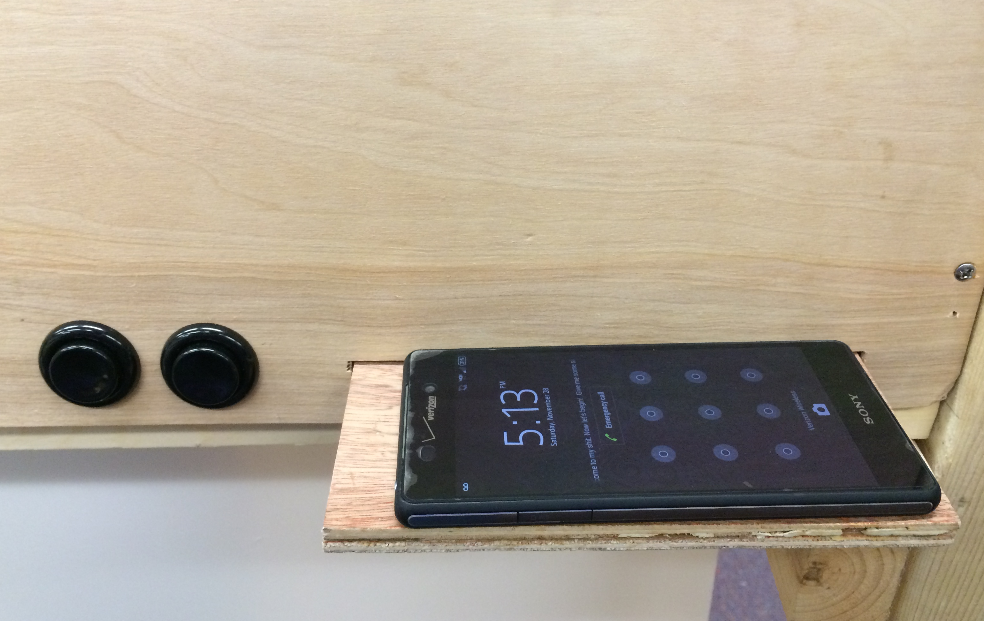
Other Features
Manual motor control buttons
Phone Holder (for use while charging)

Slide 27
Power Consumption
Component | Voltage | Current | Power
Motor | 12V | 1500mA | 18W
USB | 5V | 500mA | 2.5W
MCU | 3.8V max | 2.94mA | 11.17mW
Bluetooth RX | 3.8V max | 5.9mA | 22.42mW
Bluetooth TX | 3.8V max | 9.1mA | 34.58mW

Slide 28
PCB

Slide 29
PCB
CC 2640 Bluetooth Chip
USB Charger
Motor Controls
LCD
Switching Regulators
Temperature Sensor

Slide 30
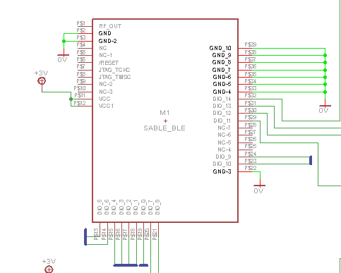
PCB
MCU

Slide 31
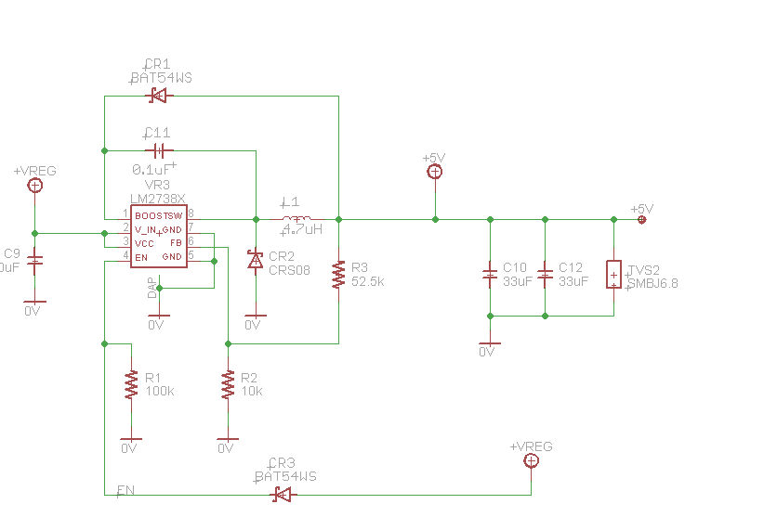
PCB
Switching
Regulators

Slide 32
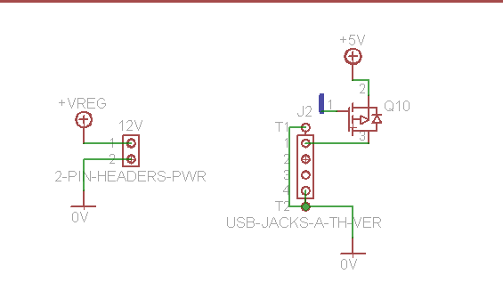
PCB
USB Charging

Slide 33
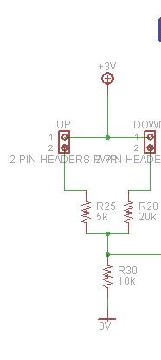
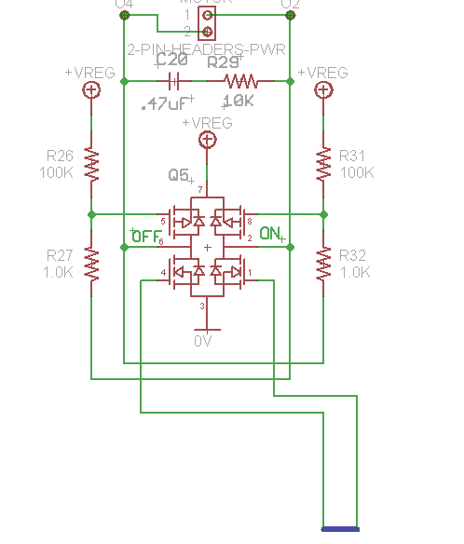
PCB
Motor
Controls

Slide 34
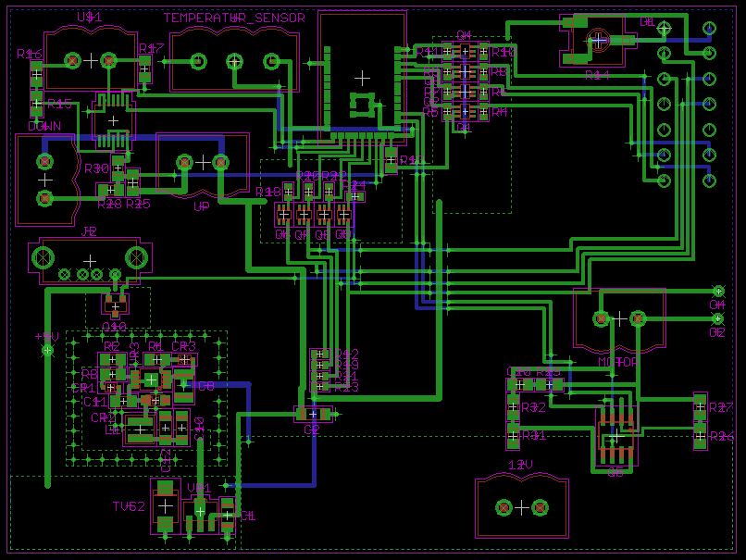
PCB
Part | Vendor | Cost | Shipping/Tax | Total
PCB | APC Circuits | $60.00 | $30.00 | $90.00
Components | Digi-Key | $66.59 | $11.32 | $77.91

Slide 35
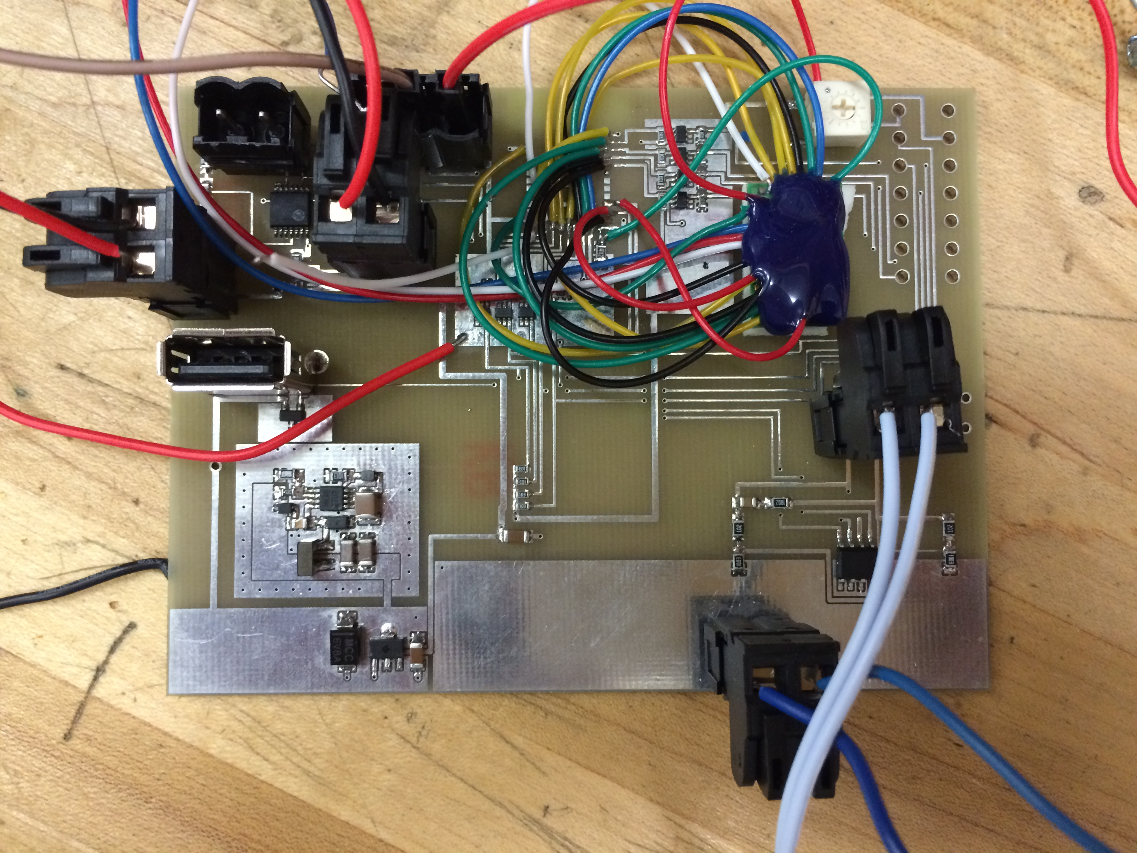
PCB

Slide 36
Mobile Application

Slide 37
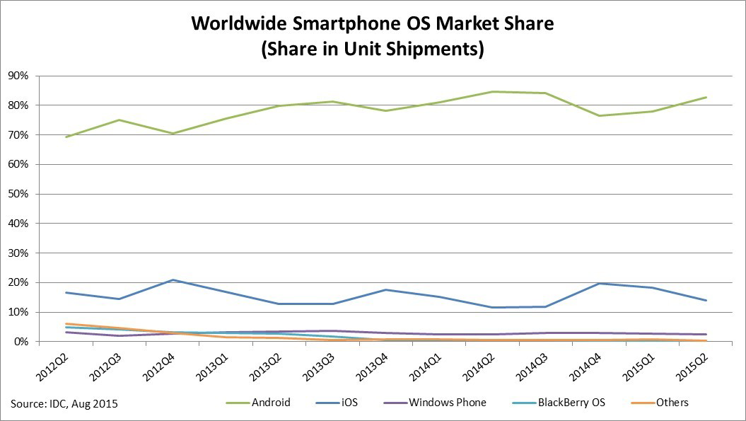
Mobile Application
Want to target many users without developing for multiple OS
By popularity: Android > iPhone > Windows

Slide 38
Mobile Application
Desired Functionality:
Control blinds securely
Display info about usage
Report info on battery life
Display any other relevant info

Slide 39
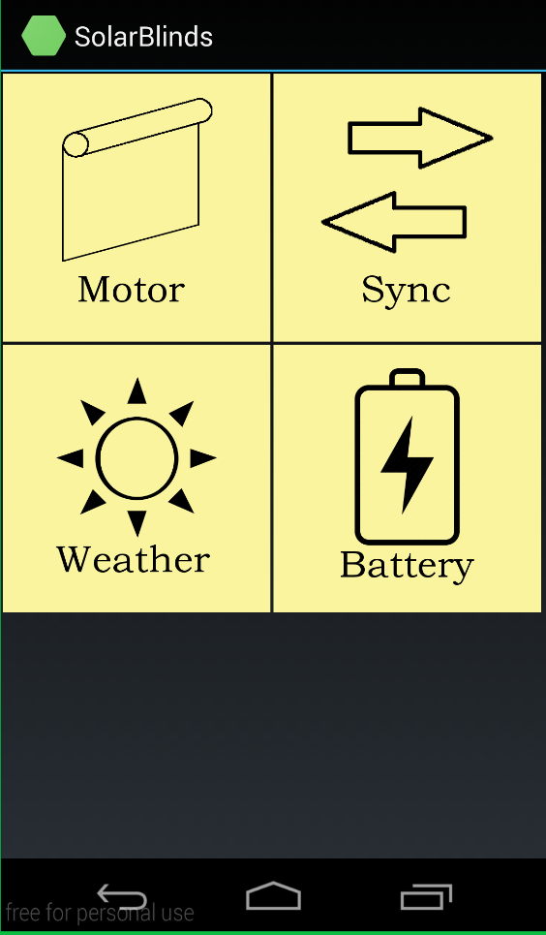
Main Menu
Controls blinds up/down
Controls sync between phone & RFID tag
Shows local weather info with embedded API
Shows battery info & statistics

Slide 40
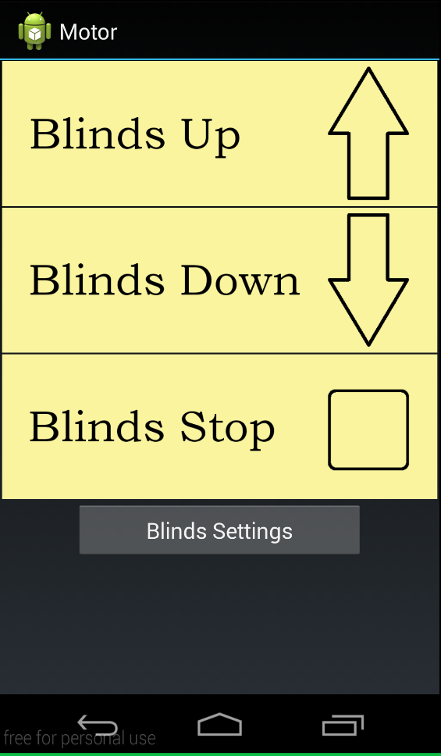
Motor
Toggle blinds to roll up
Toggle blinds to roll down
Stop motor

Slide 41
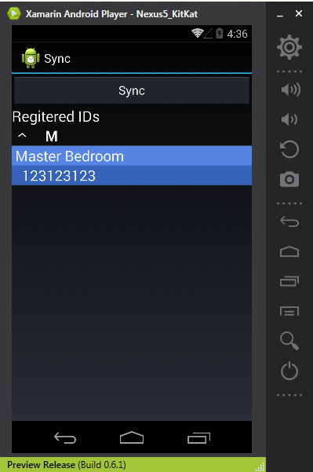
Sync
Begin Sync
List of Registered Devices
Device #1
Additional Synced Devices Here

Slide 42
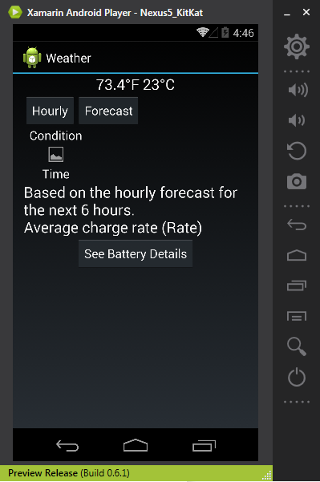
Weather
Room Temperature
Forecast Display Toggle
Forecast Chart
Forecast Effect on Battery
Go to Battery screen

Slide 43
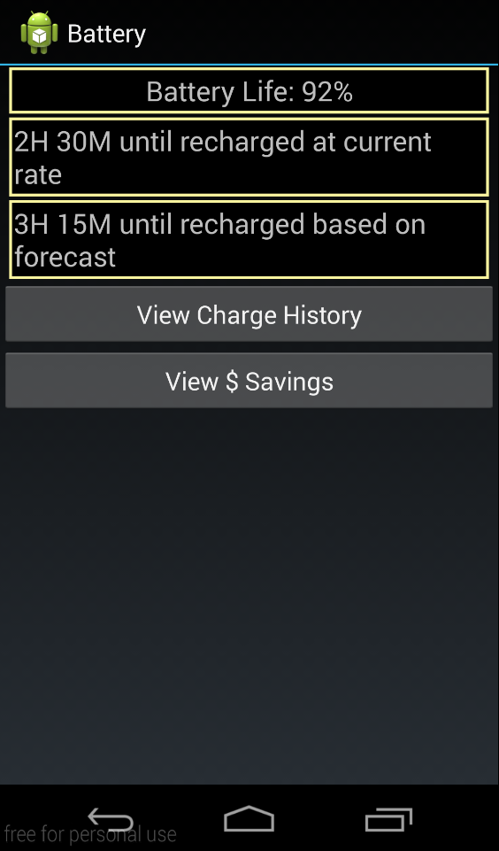
Battery
Battery in blinds
Time to recharge from solar
Based on info from weather screen
Display graph based on history since device sync
Displays another graph based on selected $ rates

Slide 44
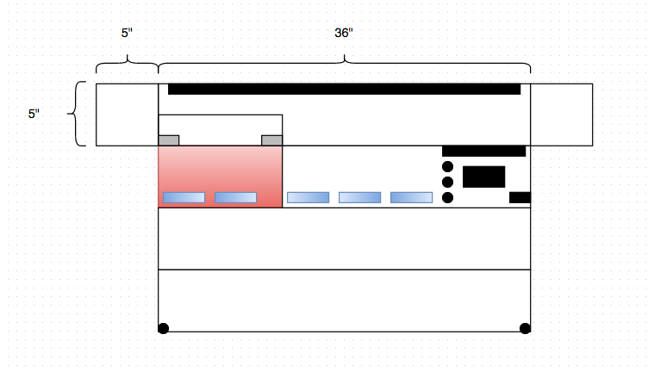
Housing
Bottom ->
Room side ->
Top ->
Window Side ->

Slide 45
Testing
Test reflectance/ transmittance for energy efficient glass
Test voltages and currents for individual and combined solar modules and compare to expected values
Test PCB points to ensure power is being delivered correctly

Slide 46
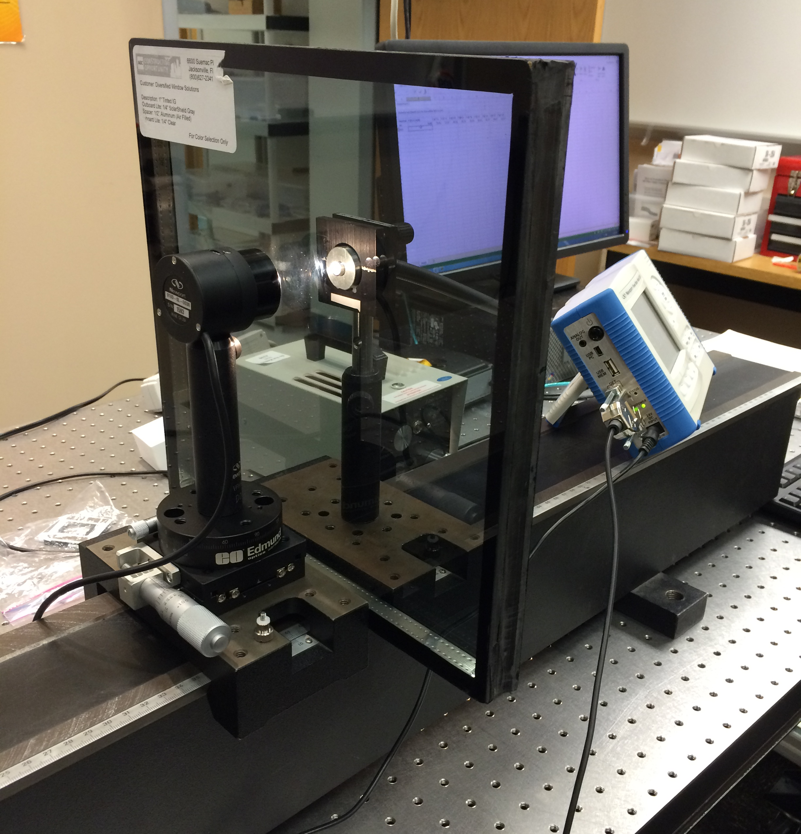
Glass Testing
Equipment used:
Newport Power Meter Model 1918-R
Dolan-Jenrier Industries Fiber-Lite High Intensity Illuminator
StellarNet Inc Spectrometer
Glass Tested:
AGC Tinted Single & Double Pane
Solarban 60 Low-E Single & Double Pane

Slide 47
Glass Testing
Glass Type | Transmittance
AGC (Tinted, Single-Pane) | 61.87%
AGC (Tinted, Double-Pane) | 41.25%
Solarban 60 Low-E (Single-Pane) | 74.52%
Solarban 60 Low-E (Double-Pane) | 49.67%

Slide 48
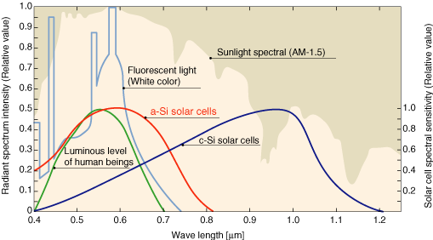
Glass Testing
Source: Panasonic

Slide 49
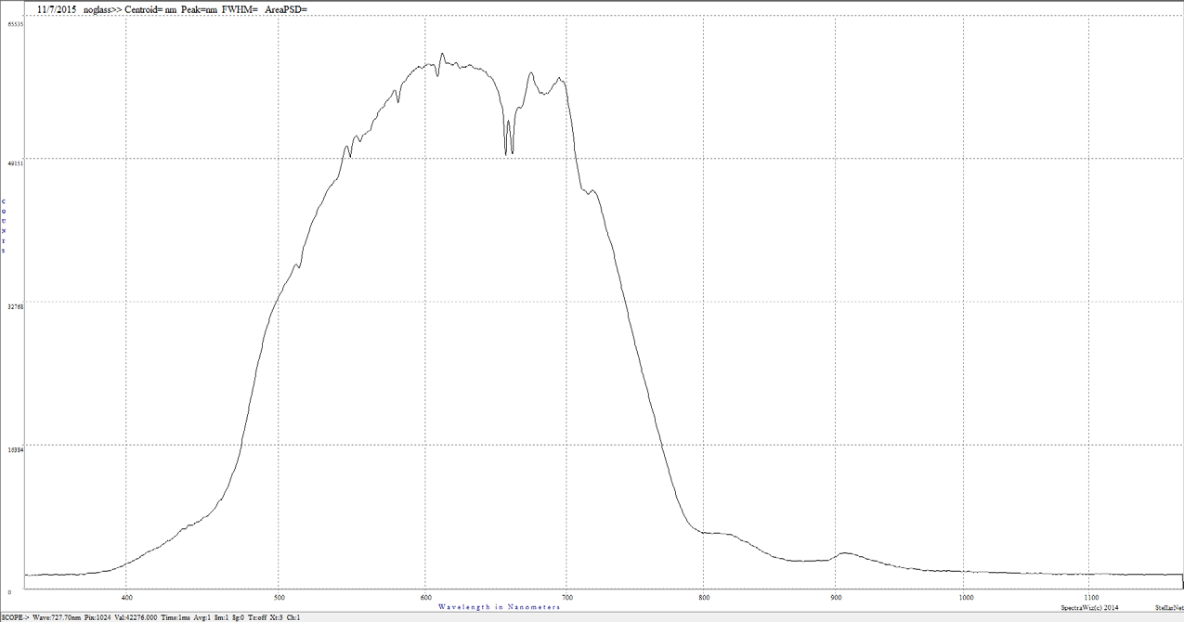
Glass Testing
Incident light spectrum

Slide 50
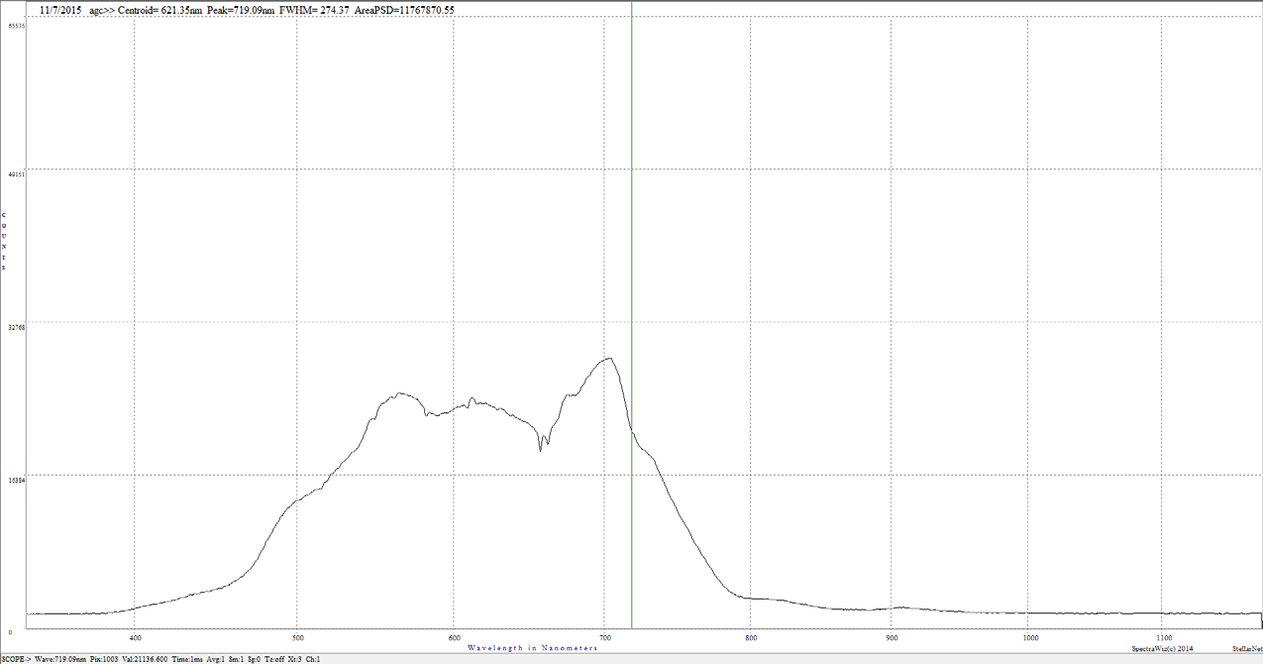
Glass Testing
AGC (Tinted, Double-Pane) Transmission Spectrum

Slide 51
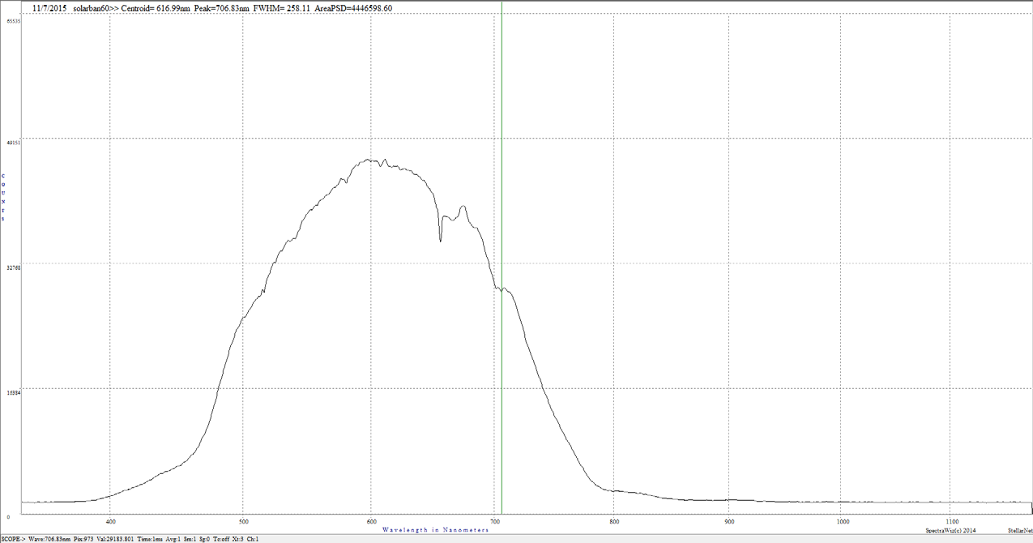
Glass Testing
Solarban 60 Low-E (Double-Pane) Transmission Spectrum

Slide 52
Solar Test Data
 | Monocrystalline Module (before boost) | Monocrystalline Module (after boost) | Thin Film Module | Combined Module
Expected V_{max} (V) | 4.06 | 15.40 | 15.40 | 15.40
Tested V_{max} (V) | 3.86 | 15.40 | 15.32 | 15.32
Expected I_{max} (A) | 5.93 | 1.50 | 0.90 | 2.40
Tested I_{max} (A) | 5.33 | 1.21 | 0.88 | 2.16
Expected P_{max} (W) | 24.08 | 23.10 | 13.86 | 36.96
Tested P_{max} (W) | 20.57 | 18.63 | 13.48 | 33.09

Slide 53
PCB Testing
 | Expected V (V) | Tested V (V) | Expected I (A) | Tested I (A)
12 V Plane | 12 | 11.98 | x | x
5 V Plane | 5 | 5.05 | x | x
3 V Plane | 3 | 3.01 | x | x
Up Motor Button | 1 | 1 | 1.5 | 0.85
Down Motor Button | 2 | 2 | 1.5 | 0.85
USB Charger | 5 | 5 | 0.5 | 0.09-0.5

Slide 54
Work Distribution
 | Artis | Dakota | Sean | Stephen
Power |  |  | Primary | Secondary
PCB |  |  |  | Primary
Mobile App | Primary | Secondary
Embedded | Secondary | Primary
Housing |  | Primary | Secondary

Slide 55
Budget
Component | Vendor | Budget | Actual
Hard solar cells | Genasun | 46.99 | 46.99
Flex solar cells | PowerFilm Solar | 185.99 | 185.99
Boost converter | RioRand | 10.04 | 15.99
Battery | 1000Bulbs | 9.93 | 14.93
Battery Monitor | Avnet | 0.00 | 5.44
GV-5 Charge Controller | Genasun | 75.00 | 75.00
Microcontroller CC2640 | Mouser Electronics | 13.08 | 14.24
Development Boards | Mouser Electronics | 37.17 | 232.97
USB Charger | Donated by member | 19.50 | 0.00
PCB Assembly | APC Circuits | 30.00 | 90.00
PCB Components | Digi-Key | 0.00 | 77.91
Temperature Sensor | Maxim | 0.00 | 4.89
RFID Chip | TagStand | 0.00 | 3.99
Housing | Donated by member | 0.00 | 0.00
Display | Digikey | 21.72 | 12.85
Motor | Rollertrol | 100.00 | 118.00
Canvas | Lowe's | 0.00 | 7.00
Wooden Test Frame | Lowe's | 0.00 | 4.00
 | TOTAL | $549.42 | $919.19

Slide 56
Issues
Energy transfer from thin film solar module to the battery
Space issues in the enclosure for electronics
Programming MCU on PCB
Data exchange over Bluetooth

Slide 57
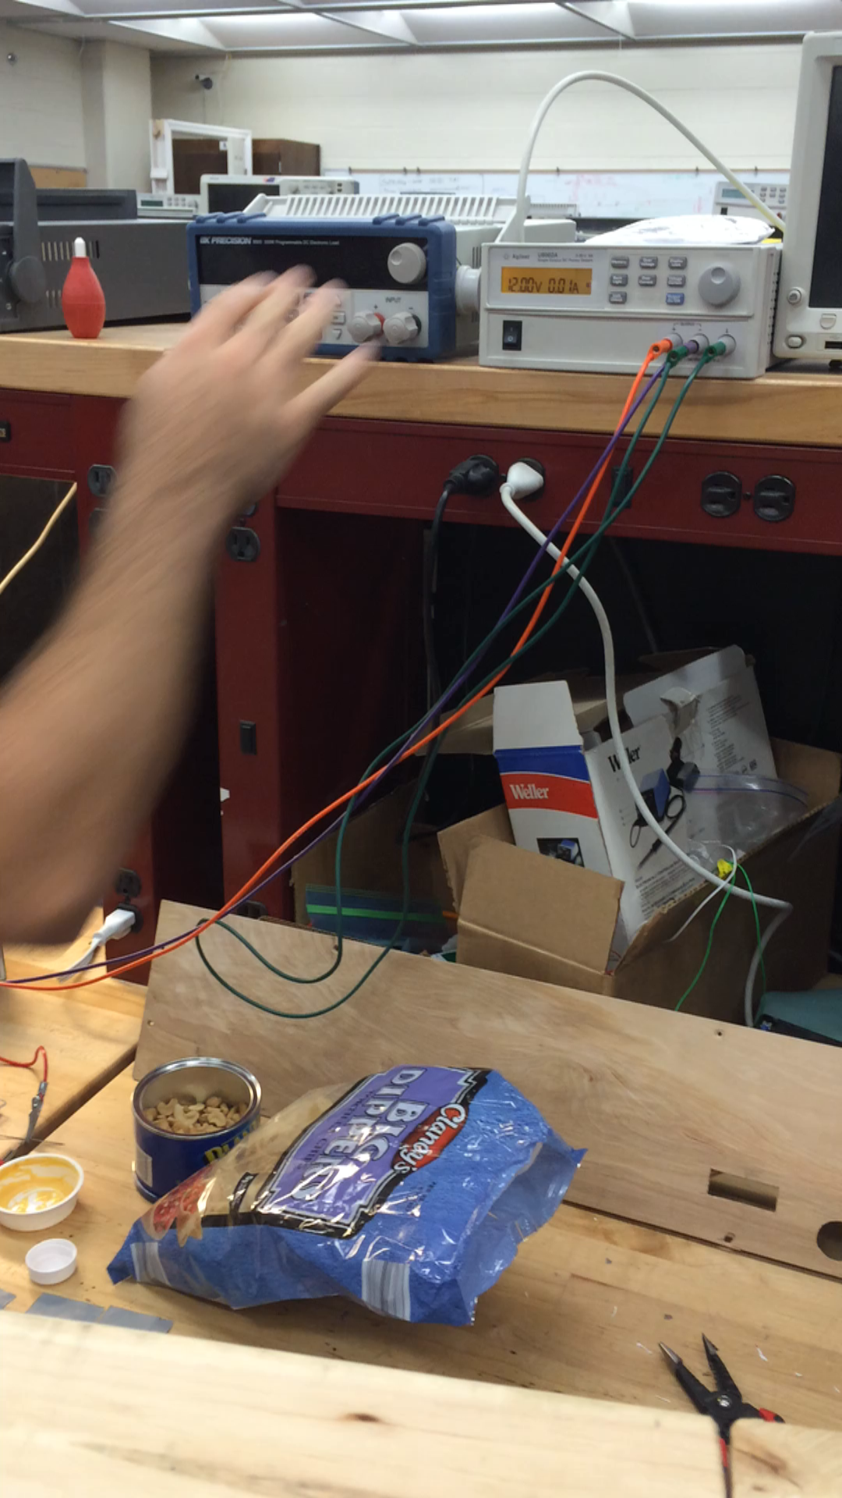

Slide 58
Questions

