Slide 1
ORQC: Oculus Rift Quadcopter Controller
Group 6
Craig Thompson(EE)
Gunnar Skotnicki (CPE)
Gustavo Gonzalez (CPE)
Matthew Grayford (CPE)

Slide 2
Motivation
Wanted something fun and exciting.
Initial ideas based around drones.
After drone was decided to be a core component, Oculus Rift was suggested.
Immersive experience desired (Controller concept).

Slide 3
Goals and Objectives
Three independent working components combined to one
Create visual experience for user with Oculus
Enhance capabilities and control of Quadcopter via controller
Laser Tag ( Desired Add-On if time allows)

Slide 4
Issues/Design Constraints
Quadcopter payload
Quadcopter battery life
Digital to Analog conversion
Movement constraints - User and Copter

Slide 5
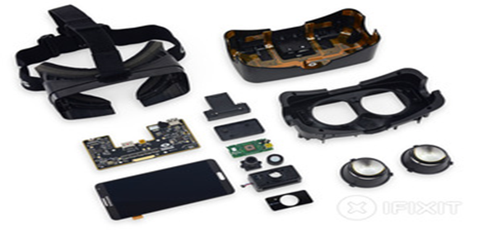
Oculus Rift DK2
Accessible hardware for VR experience.
Strong Developer support.
Game Engine support and tools to
Make implementation easier.

Slide 6
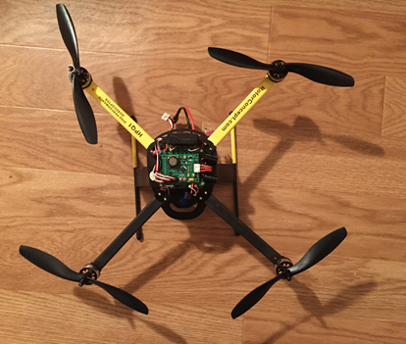
HPQ1 QuadCopter
Initial Prototyping was done with HPQ1 model.
Advertised flight controller failsafes.
Maximum battery life of 25 Minutes
Maximum Payload of about 3 pounds.
Quickly ran into some issues.

Slide 7
Raspberry Pi 2
Linux Environment
Popularity and support
Compact
Compatible with GStreamer for video feed
Copter Mounted Pi can be powered by 0.308 pound 4400mAh USB battery pack.

Slide 8
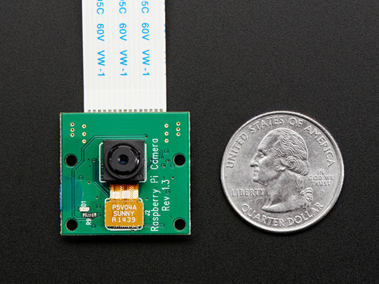
Camera System
Centered around Raspberry Pi 2
Fully compatible, lightweight.
High resolution (1080p possible)
Affordable

Slide 9
Glove Microcontroller Prototyping
 | TI Launchpad | Arduino Uno | Propeller Education Kit - 40
Microcontroller | TI M430G2553 | ATMega328 | P8X32A-D40
Data Bus | 16 bit | 8 bit | 32 bit
Speed | 16 MHz | 16MHz | 80 MHz
Storage | 16KB | 32 KB | 32.7 KB
RAM | 512 B | 2 KB | 32.7 KB
Digital I/O | 8 channels | 14 channels | 32 channels
Analog I/O | 8 channels | 6 channels | 0 channels
Kit cost | $4.30 @ TI.com | $24.95 @ Adafruit | $129.99 @ Parallax
MPU cost | $1.90/1 chip | $1.86/1 chip | $7.99/1 chip

Slide 10
Microcontroller Component Choices
 | SparkFun Triple Axis Accelerometer and Gyro Breakout | FLORA 9-DOF Accelerometer/ Gyroscope/ Magnetometer | 10-DOF IMU Breakout
Part(s) # | MPU-6000A | LSM9DS0 | L3GD20H, LSM303DLHC, and BMP180
Gyroscope sensitivity | 250 dps 500 dps 1000 dps 2000 dps | 245 dps 500 dps 2000 dps | 245 dps 500 dps 2000 dps
Gyroscope noise @ 50Hz | 0.033 dps/sqrt(Hz) | N/A | 0.011 dps/sqrt(Hz)
Accelerometer sensitivity | 2 g 4 g 8 g 16 g | 2 g 4 g 8 g 16 g | 2 g 4 g 8 g 16 g
Accelerometer noise | 400 ug/sqrt(Hz) @ 10Hz | N/A | 150 ug/sqrt(Hz) @ 100Hz
Price per kit | $39.95 | $19.95 | $29.95
Price per part | $4.02 | $3.69 | L3GD20H @ $4.01 LSM303D @ $4.31 BMP180 @ 4.95

Slide 11
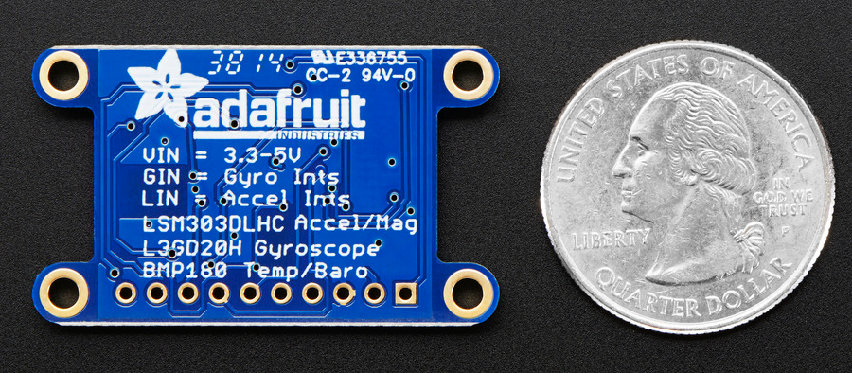
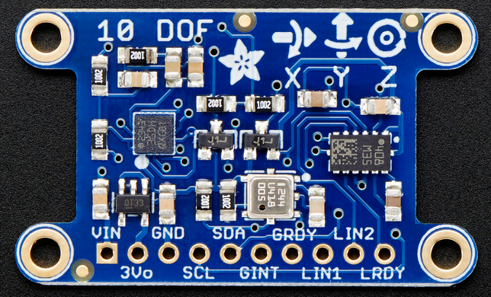
10-DOF
Accelerometer
Gyroscope
Altimeter
Easy compatibility with Arduino Uno

Slide 12
Arduino Pros/Cons
Pros:
Libraries available for 10-DOF
Familiar with Arduino environment
Simple calibration
Plug and play
Reasonable cost
Cons
Smaller data bus
Lower speed
Smaller RAM

Slide 13
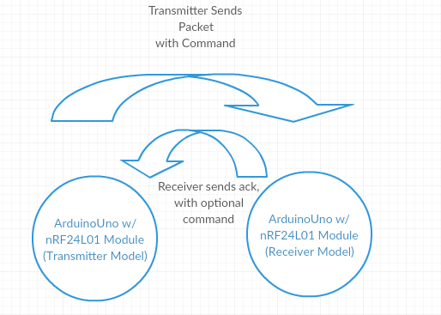
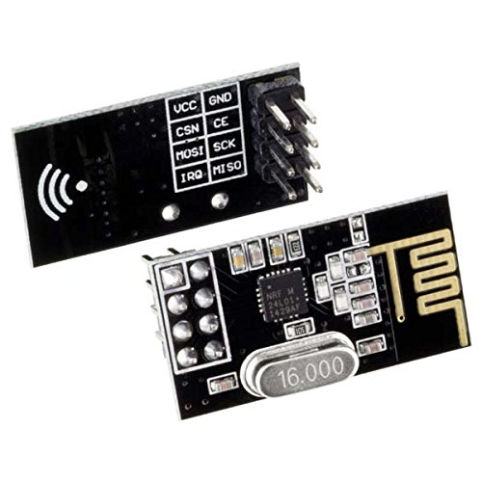
Glove Communication
Two ArduinoUNO’s with nRF24L01 2.4 Ghz Tranceivers through an SPI connection.
Decent range of 100m+ and well documented libraries for Arduino.

Slide 14
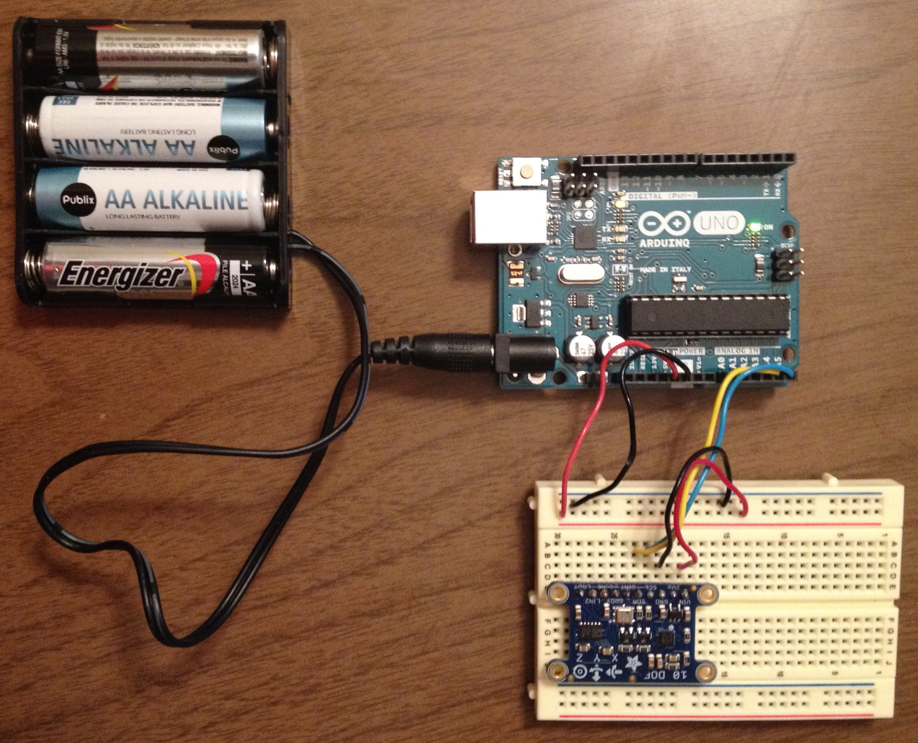
Glove Power
10-DOF 3.3/5V
Arduino input voltage 6-12V
Planned to be powered by 6V DC battery pack

Slide 15
LiPo Battery Set
 | Standard Traxxas | ZOP 3.7V 1000mAh 20C Lipo Battery | Syma X5C-1 X5C X5A | Standard HPQ1 | Turnigy 5000mAh 4S 30C Lipo Pack | Multistar High Capacity 3S 4000 mAh Multi-Rotor Lipo Pack
Voltage | 3.7V | 3.7V | 3.7V | 3.2V | 3.7V (per cell) | 3.7V(per cell)
Amp Hours | 650mAh | 1000mAh | 680mAh | 2200mAh | 5000mAh | 4000mAh
Disharge Rate | 20C | 20C | 20C | 20C | 30C | 20C
Weight | 8.5 grams | 35 grams | 14.17 grams | 180 grams | 556 grams | 244 grams
Cost | $10.56 | $9.98 | $14.00 | $69.95 | $37.39 | $19.96

Slide 16
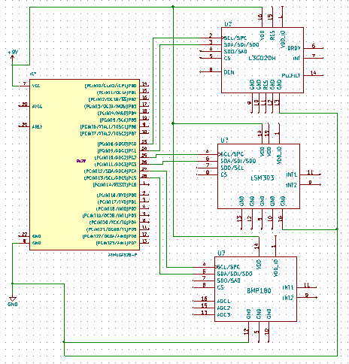
PCB
Combination of Arduino,10 DOF, and nRF24L01 2.4 Ghz Tranceiver
Amateur Radio Club contacted
Using KiCAD for drafting
Will either use OSH Park or 4PCB for manufacturing

Slide 17
Overall Block Diagram

Slide 18
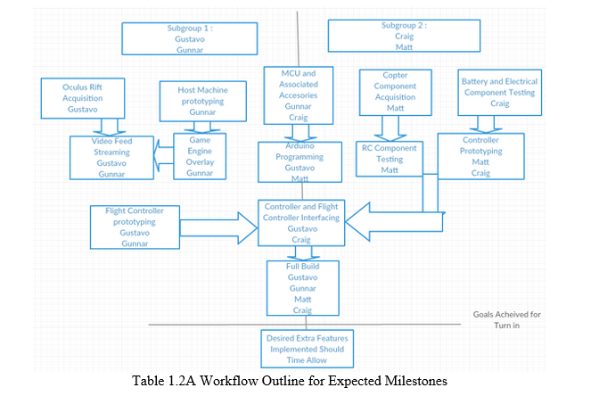
Work Distribution

Slide 19
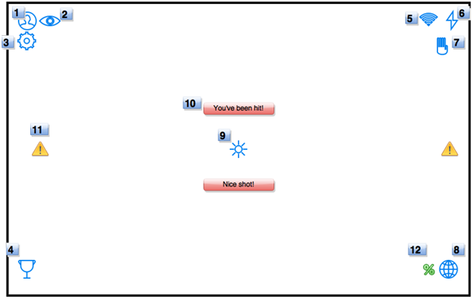
Desired Add-Ons
Laser Tag
Game Engine Overlay

Slide 20
Budget
Parts | Prices
Copter Components (Propellers, Hull, Motors) | Donated, Possible ~$100 upgrade
Flight Controller | $60
Gyroscope, Accelerometer, Sensors | $100
Oculus Rift | $250
Quadcopter Battery | $50
Raspberry Pi Battery | $20
RC transmitter/receiver | $20
MicroControllers | $100
Camera | $25
Wifi Transmitter/Receiver | $50
Wifi Range Extender | $25
PCB | $50
Total | ~$850

Slide 21
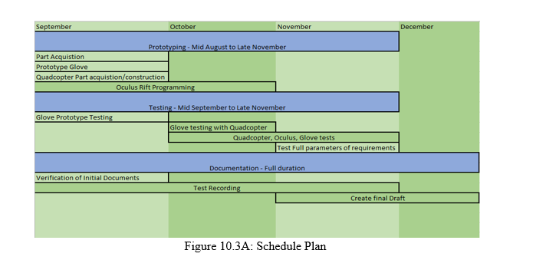
Progress

Slide 22
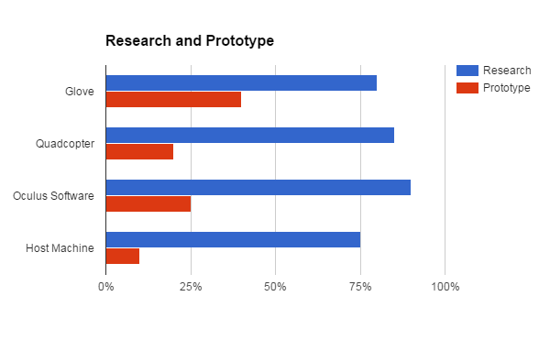
Current Progress

Slide 23
Questions?

