Slide 1
Laser Rangefinder
Group 2
Kourtney Bosshardt, CpE
Keith Hargett, EE
Jackson Ritchey, CpE
Aaron Smeenk, EE

Slide 2
Motivation
Lidar technology is useful for solving a large variety of problems
3D Maps, obstacle avoidance, scanning 3D geometry
There are not many affordable scanning lidar solutions for hobbyists
The price of lasers and photodiodes has dropped in recent years but lidar price has not
Notes:
AARON

Slide 3
Goals, Specs, & Constraints
Goals:
Accurate
Reliable yet simplistic
Low cost
Specifications & Requirements:
Minimum 1Hz scanning frequency
Minimum 100 points per scan
Range: 0.1 – 30 m
Field of View: > 180°
Must work indoors
Constraints:
Financial
US-oriented ANSI Laser Safety Standard (ANSI Z136.1)
Notes:
KOURTNEY
Financial – we are paying out of our own pockets
IEC – International Electrotechnical Commision

Slide 4
Lidar
Uses laser technology to measure distances of targeted objects
Common uses:
Visualization and Gaming
NBA Live, Tiger Woods PGA Tour
Crime scenes
Vehicles
Autonomous Cars, Navigation
Imaging
“House of Cards” by Radiohead
System consists of a range finder, something to spin it or hold it (base module) and something to display the data produced
Notes:
KOURTNEY
By calculating the amount of time it takes for the light to hit the target and bounce back to the device.
Explain the functions of each.
Visualization and gaming:
Lidar allows any physical object to be re-created on a computer. Once digitized, they can be manipulated with different software to create highly detailed environments (cities, landscapes, race tracks) in a very short amount of time.
Video games like NBA live and Tiger Woods PGA Tour use Lidar technologies to digitize real-life scenes.
Lidar systems can be used to scan scenes of accidents or crimes so that the scene can be accurately recorded and cleared.
Autonomous cars, like the Google Chauffeur, uses lidar to create 3D maps of its surrounding environment, combines them with high-resolution maps, and determines the exact details.

Slide 5
Overall System Diagram
Communication Line
Power Supply
Rangefinder Module
External Device
Power Control
Microcontroller
Computer
Time-to-Digital
Converter
Base Module
GUI
Microcontroller
Laser
Receiver
Laser
Transmitter
Motor
Control
Encoder
Motor
Target
Notes:
KOURTNEY

Slide 6
Range Finder
Communication Line
Power Supply
Rangefinder Module
External Device
Power Control
Microcontroller
Computer
Time-to-Digital
Converter
Base Module
GUI
Microcontroller
Laser
Receiver
Laser
Transmitter
Motor
Control
Encoder
Motor
Target
Notes:
KOURTNEY

Slide 7
Process of Operation
Laser diode sends out a pulse through lens. Pulse reflects off target and back to device
Photodector on device collects reflected laser
Distance is measured using:
Time of Flight
Laser Interferometry
Laser Phase Shift
Notes:
KOURTNEY
Talk about how the three ways to measure distance are different

Slide 8
Focusing Lens
Laser Diode
Diffuse Surface
Front-End Functions
Photodetector
Optical Filter
Diffuse Reflection
Device
Optical Behavior
Notes:
KOURTNEY

Slide 9
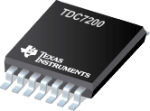
Time of Flight
Distance is the time it takes for laser to leave from and return back to device.
High-speed digital counter begins once laser is produced.
TDC7200
Distance per tick = speed of light x counter clock period / 2
Advantages:
Oversampling
Simple clock
Avoid high-speed electronics
Notes:
KOURTNEY

Slide 10
Distance Measurement Parameters
Detector
Sensitivity
Bandwidth
Accuracy
Pulse shape
Signal Processing
Laser peak power
Beam divergence
Optics
Time-of-Flight
Notes:
KOURTNEY
Parameter that effect distance measurements are:
Laser peak power, the divergence of the beam, the optics that will be used, the photo detector’s sensitivity to laser light and it’s bandwidth. Also the accuracy which breaks down to the shape of the pulse given of by the laser signal, and processing the signal.
Accuracy Increases with smaller pulse length, faster rise and fall time, and higher bandwidth of the detector

Slide 11
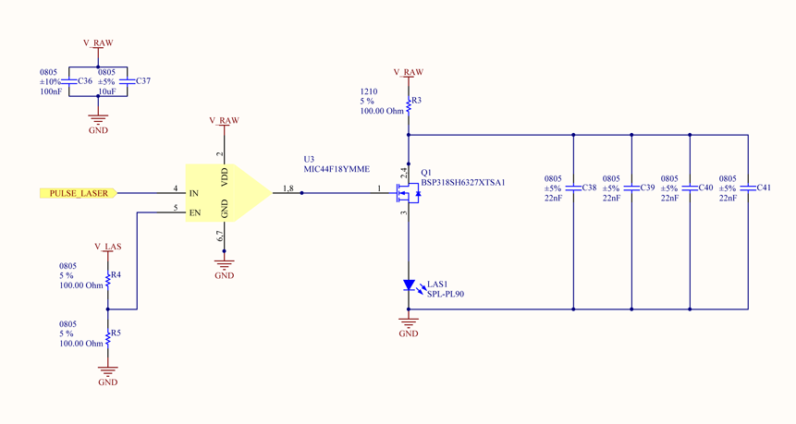
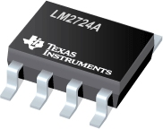
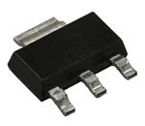
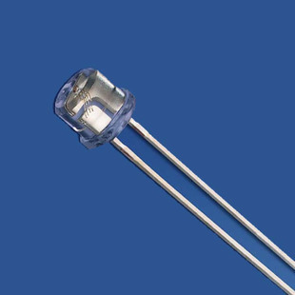
Transmitter
Contains laser driver and driver electronics
MOSFET Driver
N-Ch MOSFET
SPL_PL90
Notes:
KOURTNEY
MOSFET Driver N-Channel MOSFET switch make up the laser driver

Slide 12
Receiver
SFH 2701
Photodiode
Transimpedance amplifier
Notes:
AARON
Photodiode send current to transimpedance amplifier once it has been excited by laser light.
The transimpedance amplifier then transforms that current into a voltage.

Slide 13
Receiver
Time-to-Digital Converter
Comparator
Notes:
The voltage then travels to the comparator.
If its over the threshold, it sends a positive voltage to the TDC chip telling the chip to stop counting, because the laser light has reached the photo detector.
Propagation delay

Slide 14
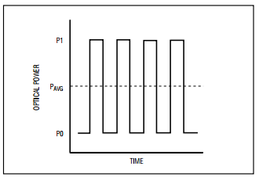
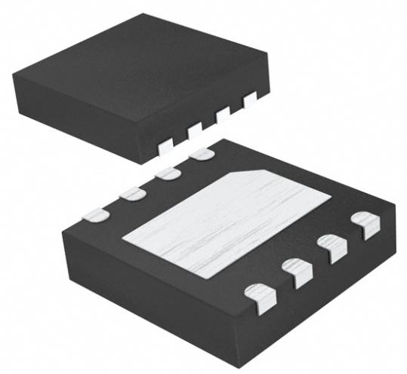
Transimpedence Amplifier
Integrated high gain transimpedance amplifier
Average current output
Part Number | MAX3658AETA+T
Manufacturer | Maxim
Cost | $4.87
Notes:
AARON

Slide 15
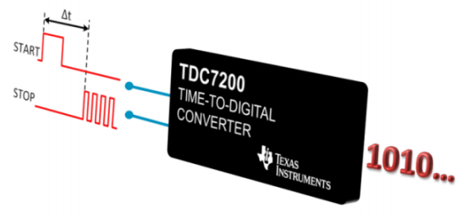
Time-to-Digital Converter
55ps resolution
Multi-cycle averaging
8-16 MHz clock input
Internal self-calibrated
time base
Part Number | TDC7200
Manufacturer | Texas Instruments
Cost | $8.26
TDC7200
Notes:
AARON

Slide 16
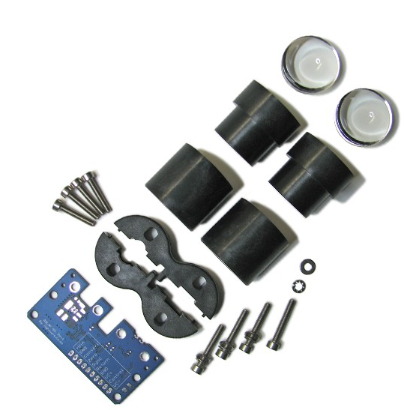
Optics
Affordable
Open-source
Easy to assemble kit
Part Number | OSLRF-01 Kit
Manufacturer | Lightware Optoelectronics
Cost | $32.00
OSLRF-01
Notes:
AARON

Slide 17
Base Module
Communication Line
Power Supply
Rangefinder Module
External Device
Power Control
Microcontroller
Computer
Time-to-Digital
Converter
Base Module
GUI
Microcontroller
Laser
Receiver
Laser
Transmitter
Motor
Control
Encoder
Motor
Target
Notes:
KEITH

Slide 18
Base Module Overview
Electric Motor & Encoder
Mirror
Object to
Detect
Base
Module
Communicate with Range Finder Module
Communicate with external devices
Control Range Finder motor
Range Finding Device
Notes:
KEITH

Slide 19
Base Module: Mechanical Design
Notes:
KEITH
Talk about frame design

Slide 20
Base Module: MCU
32-bit ARM Cortex Processor
Negligible power usage in low power mode
180 MHz clock speed meets our specification
Adjustable clock for power or
performance
Best balance of feature and cost
Same MCU as range finder for
simplified coding
Part Number | STM32F427
Manufacturer | STMicroelectronics
Cost | $13.00
Notes:
KEITH

Slide 21
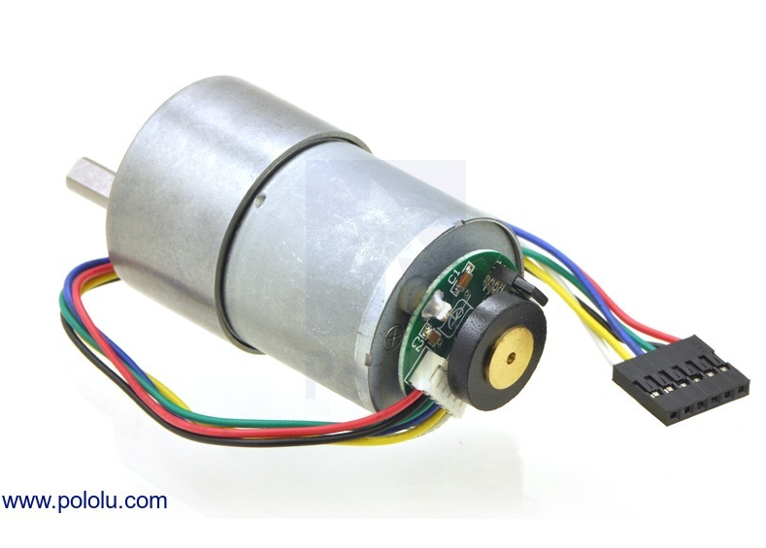
Motor and Encoder
Desired Features for Motor:
High RPM
Smooth continuous motion
Desired Features for Encoder:
Highest resolution possible
High accuracy
Part Number | 1442
Manufacturer | Pololu
Cost | $39.95
Brushed Motor
Positives | Negatives
Simple | More prone to noise
Cheap | Less Power Efficient
Notes:
KEITH

Slide 22
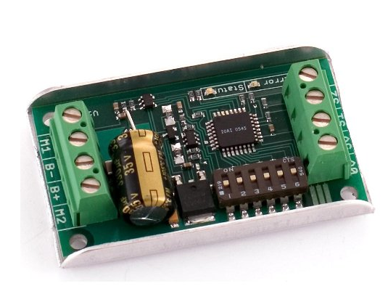
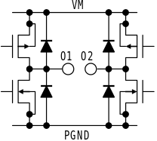
Motor Driver
Electrical:
6 – 24V voltage
10A max current
Interface:
Analog control
PWM control
Serial control
Operation:
Assist motor control
Manages power usage
Part Number | SYREN10
Manufacturer | Dimension Engin.
Cost | $49.99
Generalized H-Bridge
Notes:
KEITH

Slide 23
Base Module: Communication
Uses UART to communicate to the Range Finder Module
Sends point cloud data to an external computer
Has a USB port for sending data through a virtual com port (VCP)
Notes:
JACKSON

Slide 24
Power Supply
Communication Line
Power Supply
Rangefinder Module
External Device
Power Control
Microcontroller
Computer
Time-to-Digital
Converter
Base Module
GUI
Microcontroller
Laser
Receiver
Laser
Transmitter
Motor
Control
Encoder
Motor
Target
Notes:
KEITH

Slide 25
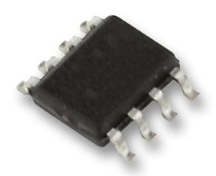
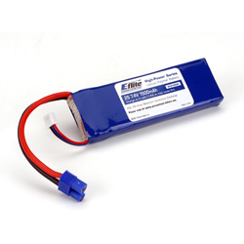
Battery & Regulation
Lithium Polymer:
High cell voltage
High power density
Fast charge time
Part Number | MC34063A
Manufacturer | Texas Instr.
Cost | $0.68
Part Number | ELFB15002S
Manufacturer | E-Flite
Cost | $18.79
Optimal Power Monitoring:
INA219 is a high-side power monitor that communicates power consumption via I2C
Notes:
JACKSON

Slide 26
Power Consumption
Component | Quantity | Expected Voltage (Volts V) | Average Current (Amps A) | Average Power (Watts W)
OSLRD-01 | 1 | 12 | 0.05 | 0.6
Pololu, 19:1 Gear Motor w/ Encoder | 1 | 12 | 0.30 | 3.6
STM32F407 Microcontroller | 2 | 3.2 | 0.39 | 1.29
LTC4411ES53TRMPBF (Ideal Diode OR) | 1 | 5.5 | 0.00004 | 0.0022
TPD2E001DRLR (TVS Diode) | 2 | 3.3 | 0.0000001 | 0.00000033
MIC44F18YMME (Mosfet Driver) | 1 | 5.5 | 0.025 | 0.01375
MAX3658AETA+T (Transimpedence Amplifier) | 1 | 3.3 | 0.026 | 0.0858
LMV7219M7?NOPB (Comparator) | 1 | 3.3 | 0.0011 | 0.011979
LTC1799CS5#TRMPBF (Clock) | 1 | 5 | 0.0011 | 0.0055
TDC (TOF) | 1 | 3.3 | 0.00135 | 0.004455
Total Power Consumption |  |  |  | 6.9
Notes:
KEITH

Slide 27
System Software
Communication Line
Power Supply
Rangefinder Module
External Device
Power Control
Microcontroller
Computer
Time-to-Digital
Converter
Base Module
GUI
Microcontroller
Laser
Receiver
Laser
Transmitter
Motor
Control
Encoder
Motor
Target
Notes:
JACKSON

Slide 28
Demonstration Software
Hardware
Demo Software
Web Visualizer
Lidar
System
Data Server
Native Visualizer
Data Flow
Android Visualizer
Notes:
JACKSON

Slide 29
Data Server
Written in Nodejs
Communicates with Lidar System using USB VCP Driver
Serves data to other demonstration software and visualizers
Cross platform (Linux/Mac/Windows)
Sends data in SLIP frames
Notes:
JACKSON

Slide 30
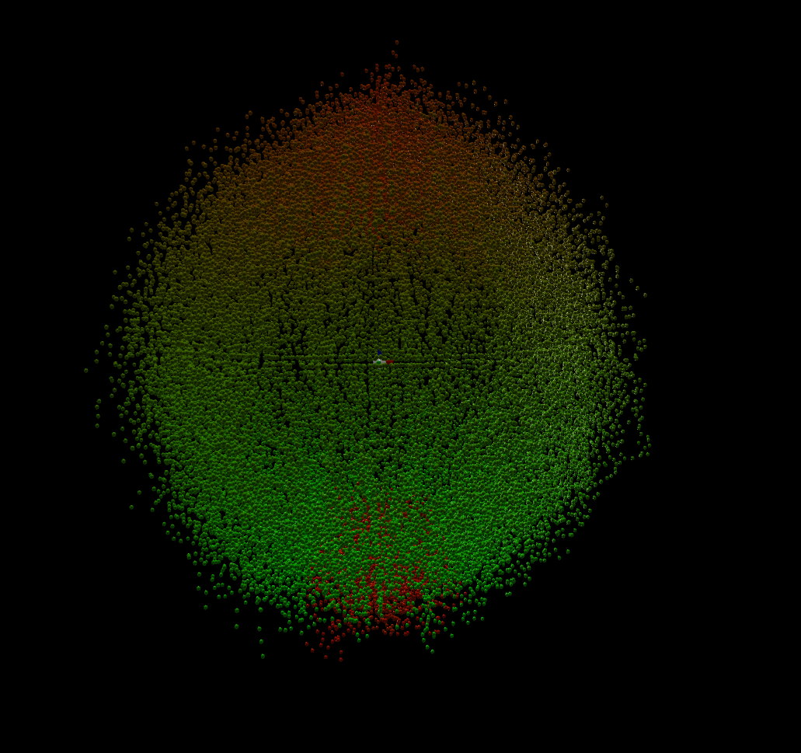
Web Visualizer
Connects to data server
Runs in an internet brower
Multiple users can access the Lidar data at the same time
Renders data in realtime
Old data points change from green to red as they age
Notes:
JACKSON

Slide 31
Web Client
Live Data Visualizer/

Slide 32
Firmware Design
OAL – Operating System Abstraction Layer
HAL – Hardware Abstraction Layer
Application Layer
OAL
Driver Layer
HAL
Notes:
JACKSON

Slide 33
Middleware
CMSIS – Cotex Microcontroller Software Interface Standard
FreeRTOS – RTOS used for creation and sunchronization
STMCubeF4 – Library provided by STMicroelectronics to access STM32F427XX microcontroller peripherals
STM32 USB Device Library – Library written by STMicroelectronics for implementing USB stack and implementing the VCP device class
Notes:
JACKSON

Slide 34
Firmware Development
Eclipse IDE w/ GNU-ARM plugin
GIT Version Control
Gcc-arm-none-eabi toolchain
Cross compiled on linux then uploaded using jlink debugger through SWD port on the STM32F427XX
Notes:
JACKSON

Slide 35
PCB Development
Notes:
AARON

Slide 36
Range Finder Testing
Direction | Pulses to Change
Higher
Lower
Pulses to Change Average Current
Number of Samples | Measured Distance (cm) | Actual Distance (cm) | Percent Error
1 | 1
10 | 1
100 | 1
1 | 10
10 | 10
100 | 10
Range Finder Percent Error
Notes:
AARON

Slide 37
Base Module Testing
Connectivity of the base module microcontroller
Communication between the base module and the range finder
Validate data sent between components
Successful operation of motor, encoder, and driver
Find optimal scan speed for range finder motor
Notes:
AARON

Slide 38
Demonstration Testing
Pipe randomly generated data to visualizers
Test performance of system
Network limitations
Data processing limitations
Reliability of software
Notes:
JACKSON

Slide 39
Budget
Item | Supplier | Price/Unit | Qty. of Units | Total Price
Motor and Encoder | RobotShop | $39.95 | 1 | $39.95
Motor Mount | RobotShop | $7.95 | 1 | $7.95
Shaft Mount | RobotShop | $7.95 | 1 | $7.95
Motor Driver | RobotShop | $49.99 | 1 | $49.99
Microcontroller | DigiKey | $14.24 | 2 | $28.48
PCB | Advanced Circuits | $15.00 | 2 | $30.00
OSLRF-01 Kit | Lightware Electronics | $32.00 | 1 | $32.00
Laser Diode | Jameco Electronics | $9.95 | 1 | $9.95
Photodiode | DigiKey | $0.87 | 1 | $0.87
TDC7200 | DigiKey | $8.26 | 1 | $8.26
Total Cost |  |  |  | $215.40
Notes:
KOURTNEY
Goal not to exceed $200/person = total $800.

Slide 40
Administrative Distribution
 | Range Finder | Base Module | Hardware | Software
Kourtney | Secondary | Primary | Secondary | Primary
Keith | Secondary | Primary | Primary | Secondary
Jackson | Primary | Secondary | Secondary | Primary
Aaron | Primary | Secondary | Primary | Secondary
Notes:
KOURTNEY

Slide 41
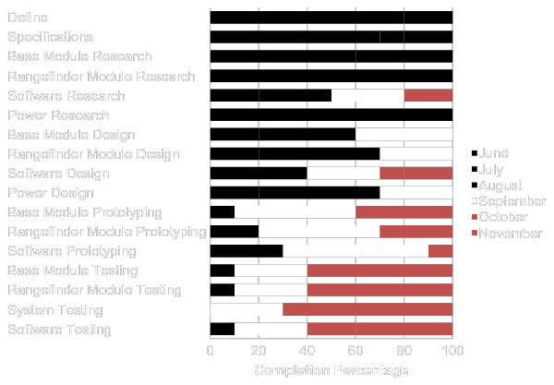
Milestone
Notes:
KOURTNEY
The black represents everything we have accomplished in the last three months. The while is what we are currently working on throughout this month. The red signifies what we plan to accomplish within the last two months as we reach the total completion of our project.

Slide 42
Difficulties
Time measurement and detecting laser pulses on the range finder
Determining starting position of the motor that spins the mirror on the base module
Finding an optics solution that is affordable
Lens, filters, mounts, etc.
Designing a frame to mount everything
Notes:
AARON

Slide 43
Questions

