Slide 1

SR3D
Short Range 3D Scanner
Group 9
Franco Zavagnini (CpE)
Nirav Kotadia (CpE)
Naufal Rihani (EE)
Gabriel Akenten (EE)

Slide 2
Introduction
3D Scanning is a method that obtains an object’s 3D physical form and converts it into digital data to be processed via an electronic data processor to subsequently display it in a data representation software.
The idea of displaying a 3D model of a physical object is to analyze, design, and recreate this object to further display it.

Slide 3
Motivation and Goals
High interest in Computer Vision, Point Cloud, Embedded Systems, and 3D Modeling Software.
To be able to design a low-cost scanning system and implement a laser to generate a 3D digital model of an object.
Our project will be presenting a hardware and software system for digitizing the shape of a medium sized object.
To rotate an object 360° to get every geometric shape by scanning with a camera and laser pointing to it while data processing it to further display the 3D model.

Slide 4
Project Requirements
Low Cost 3D Scanner
Medium size object
Easy to use
Practical and User-Friendly Interface
USB Connection

Slide 5
Project Specifications
Detail Resolution - 5 mm
Scan Speed - 10 min
Max Weight on Turntable -1kg
Scan Volume -
  Diameter - 5 in
  Height – 2 in to 6 in
Scanner Weight - 5 kg

Slide 6
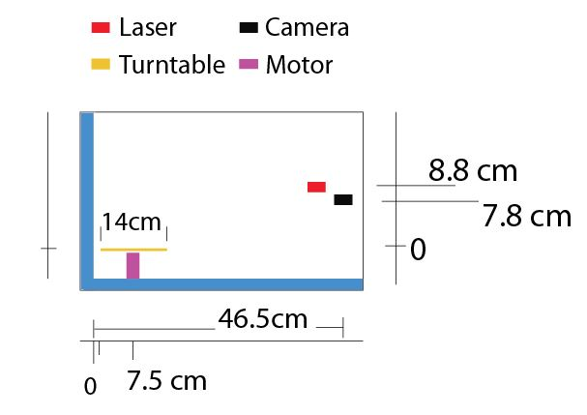
Layout of Box
Side View

Slide 7
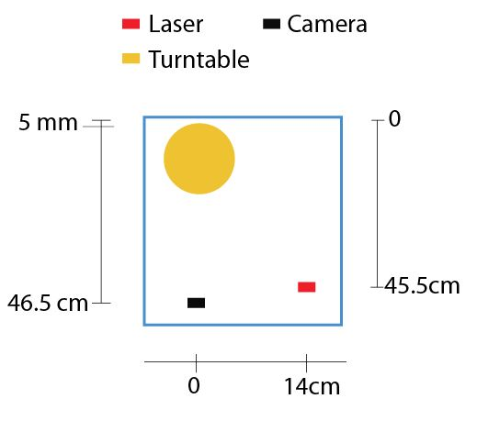
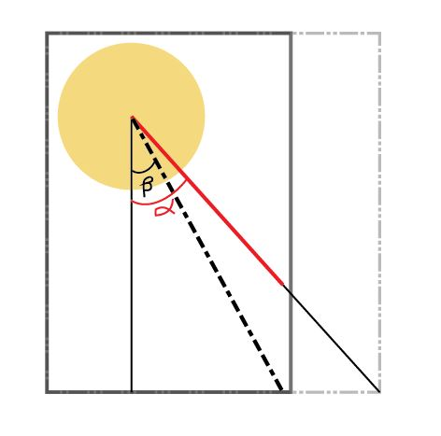
Layout of Box
Top View
Wide Angle

Slide 8
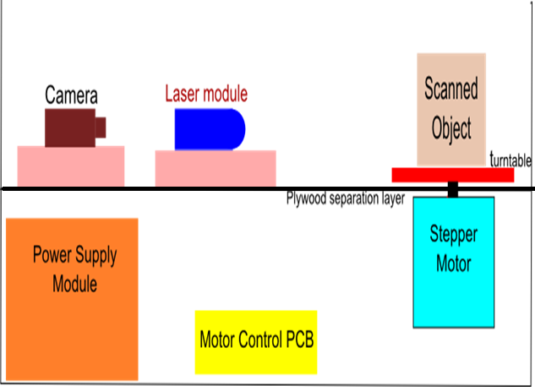
Layout of Box
Components

Slide 9
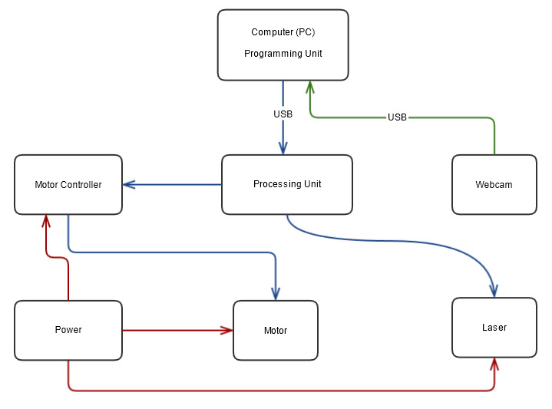
System Block Diagram
Power
Control Signal
Data Signal

Slide 10
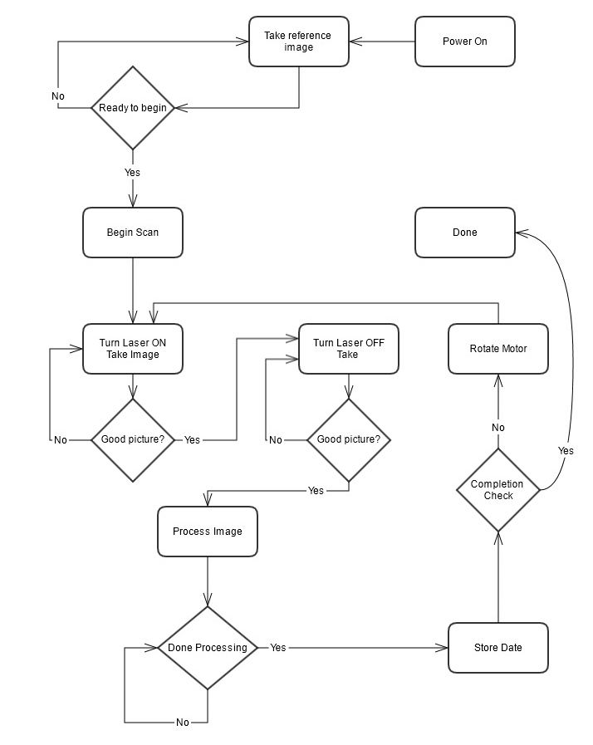
System Flow Diagram

Slide 11
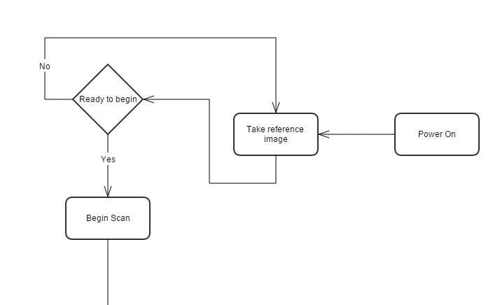
System Flow Diagram

Slide 12
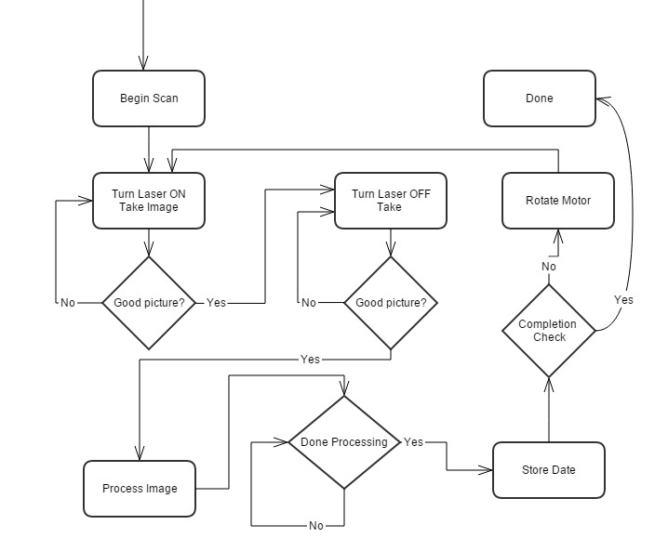
System Flow Diagram

Slide 13
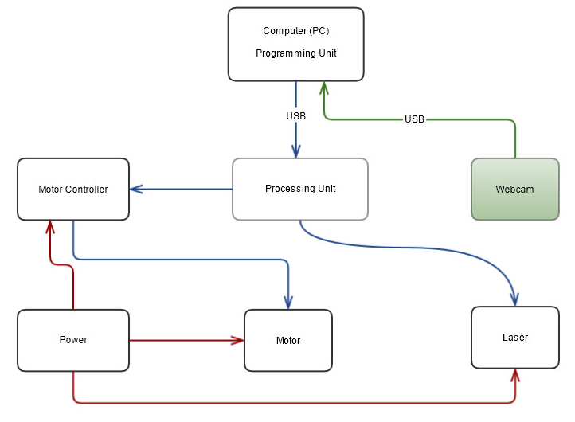
Webcam

Slide 14
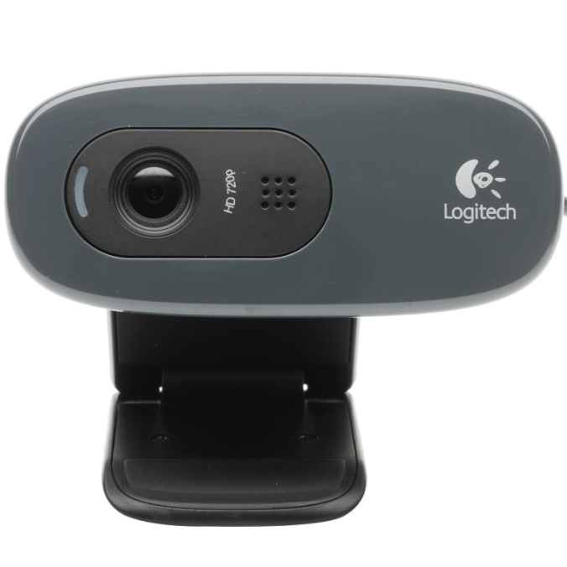
Webcam
Logitech C270
6.7 cm
Resolution 720p (1280 x 720)
USB 2.0 connectivity
3 Megapixels
Relatively Small
$20
3 cm

Slide 15
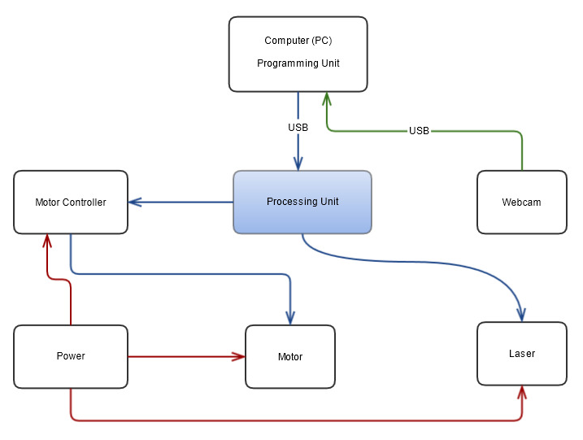
Processing Unit
Power
Control Signal
Data Signal

Slide 16
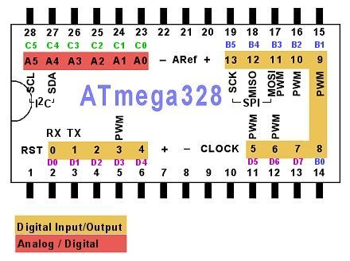
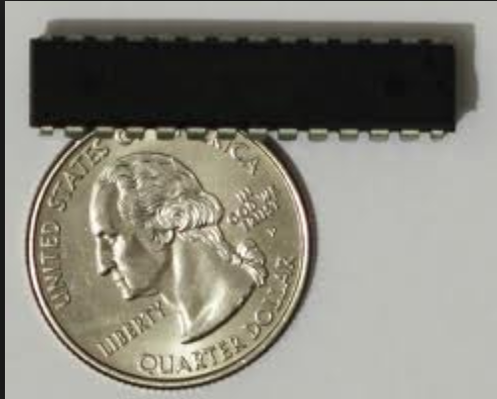
Processing Unit
Atmel AT-Mega 328 P
8-bit Microcontroller
I/O Pin – 20

Slide 17
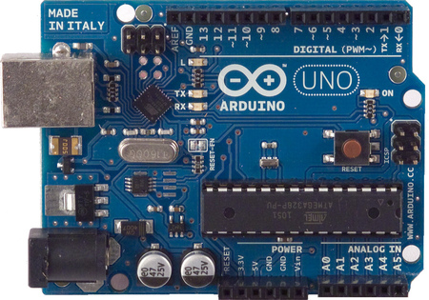
Processing Unit
Evaluation Board
6.86 cm
Arduino UNO Rev 3
Good for Testing
Easy to program
$27
5.34 cm
8-bit Microcontroller
I/O Pin – 20
Memory Size – 32 kB
RAM – 2 kB

Slide 18
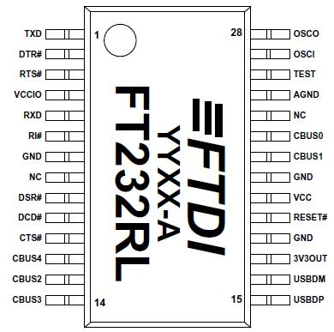
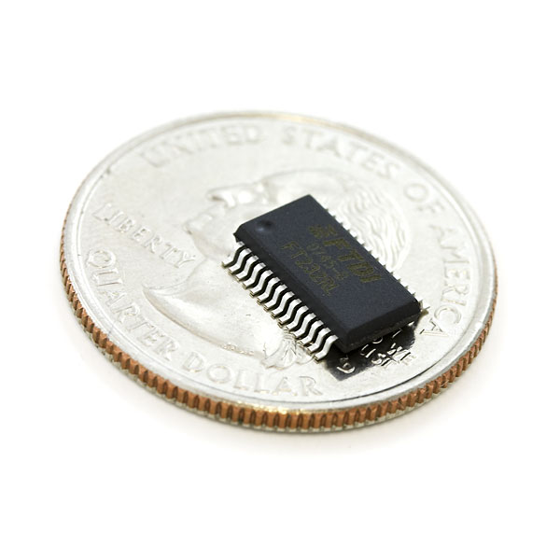
Communication
Sending one command byte at a time to MCU, and receiving on byte back to the computer running the program
USB-To-Serial communication: FTDI FT232R

Slide 19
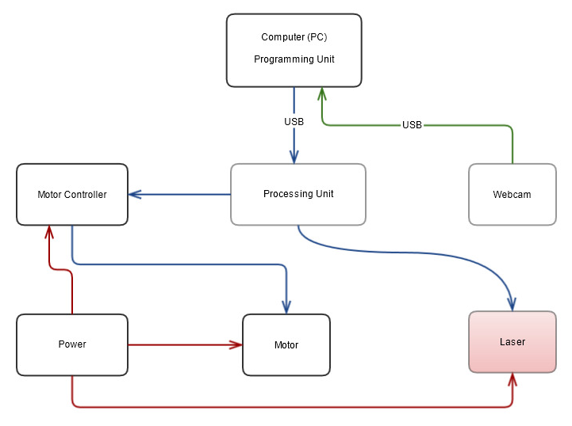
Laser

Slide 20
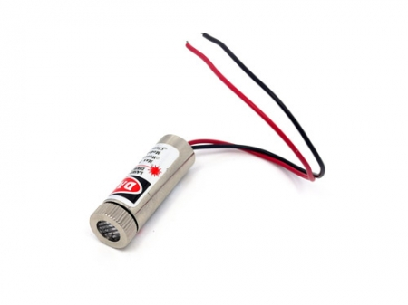
Laser
Linienlaser (103A2B)
Output Power:
Min Typical Max
2.5mW 3.0mW 5.0mW
Working current:
Min Typical Max
10mA 20mA 25mA
Working voltage:
Min Typical Max
2.3 V 4.5 V 8.0 V
Wavelength: 650nm
Working Temperature:
Min Typical Max
-15°C 25°C 35°C
3.5 cm
1.2 cm

Slide 21
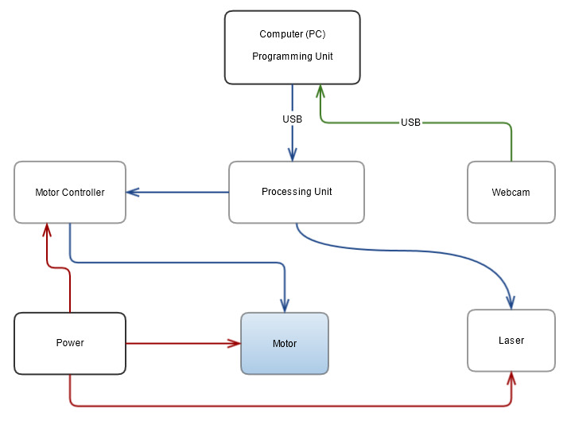
Motor
Power
Control Signal
Data Signal

Slide 22
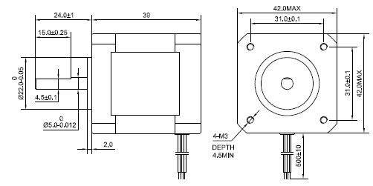
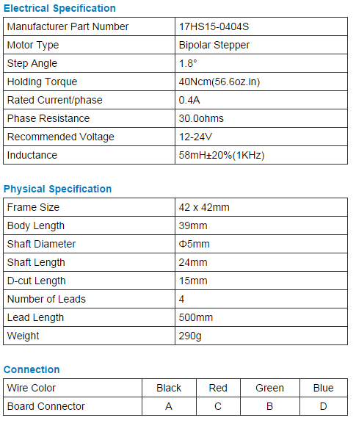
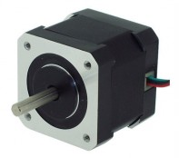
Motor
Stepper Motor (NEMA 17HS15-0404S)

Slide 23
Motor
Weight: 350 g (13 oz)
Shaft diameter: 5 mm “D”
Steps per revolution: 200
Current rating: 1.2 A per coil
Voltage rating: 4 V
Resistance: 3.3 Ω per coil
Holding torque: 3.2 kg-cm (44 oz-in)
Inductance: 2.8 mH per coil
Lead length: 30 cm (12″)

Slide 24
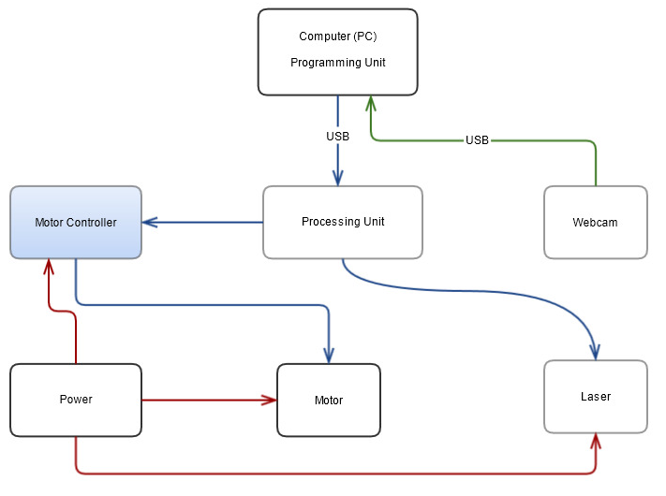
Motor Control
Power
Control Signal
Data Signal

Slide 25
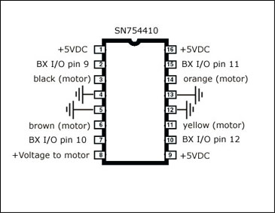
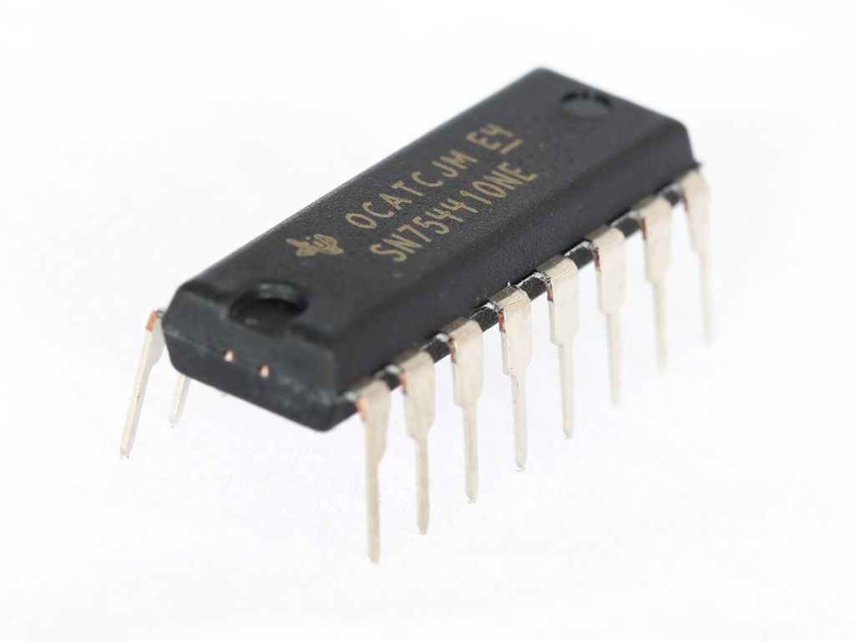
Motor Control
Stepper Motor Driver (SN754410)
Output-Current Capability Per Driver
• Applications Include Half-H and Full-H
Solenoid Drivers and Motor Drivers
• Designed for Positive-Supply Applications
• Wide Supply-Voltage Range of 4.5 V to 36 V
• TTL- and CMOS-Compatible
High-Impedance Diode-Clamped Inputs
• Separate Input-Logic Supply
• Thermal Shutdown
• Internal ESD Protection
• Input Hysteresis Improves Noise Immunity
• 3-State Outputs
• Minimized Power Dissipation

Slide 26
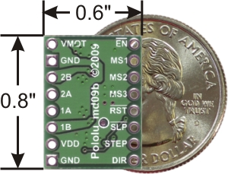
Motor Driver
A4988 Stepper Motor Driver
Minimum operating voltage: 8V
Maximum operating voltage:35V
Minimum logic voltage: 3V
Maximum logic voltage 5.5V
Microstep resolution: full,1/2,1/4,1/8,1/16

Slide 27
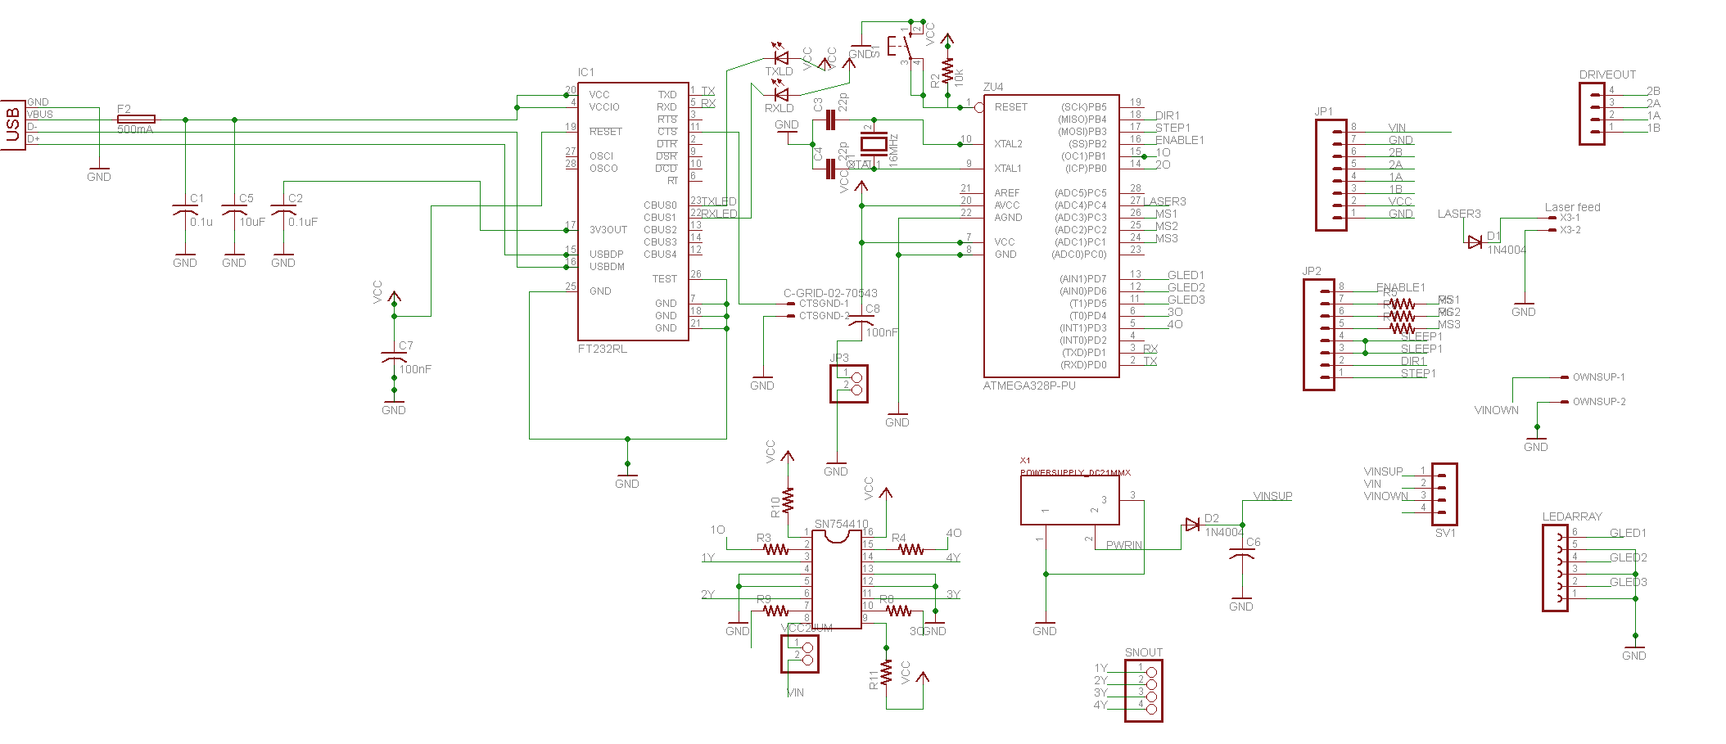
PCB Schematic

Slide 28
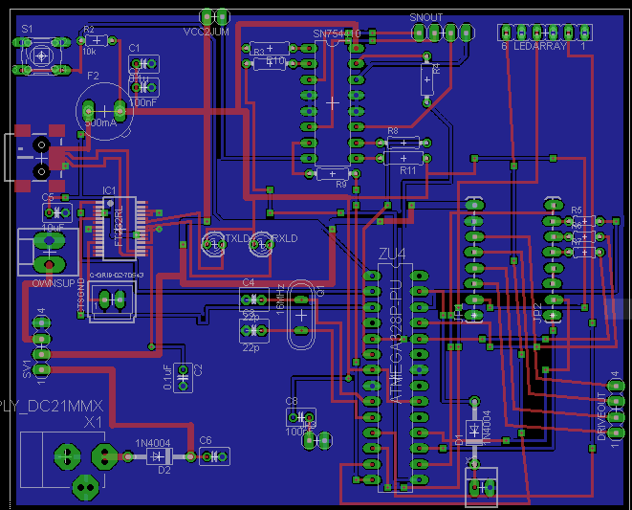
PCB Board Lay-out
3.3in x 4in (2 layer)

Slide 29
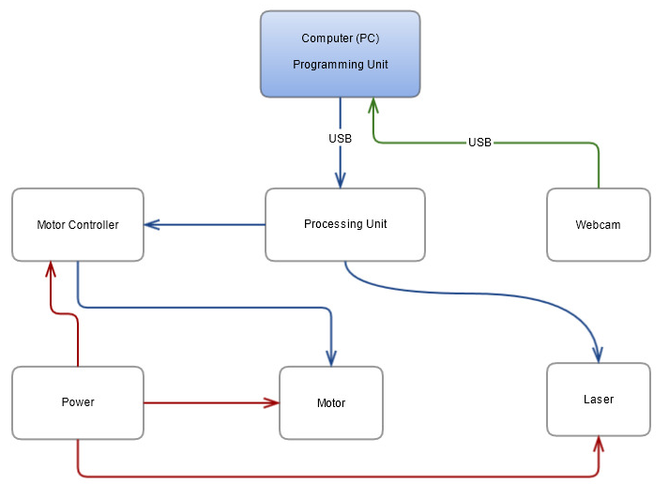
Programming Unit
Power
Control Signal
Data Signal

Slide 30
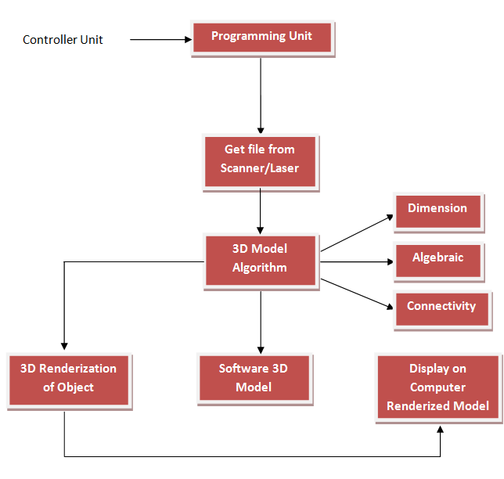
Programming Unit Block Diagram
Via USB/FireWire

Slide 31
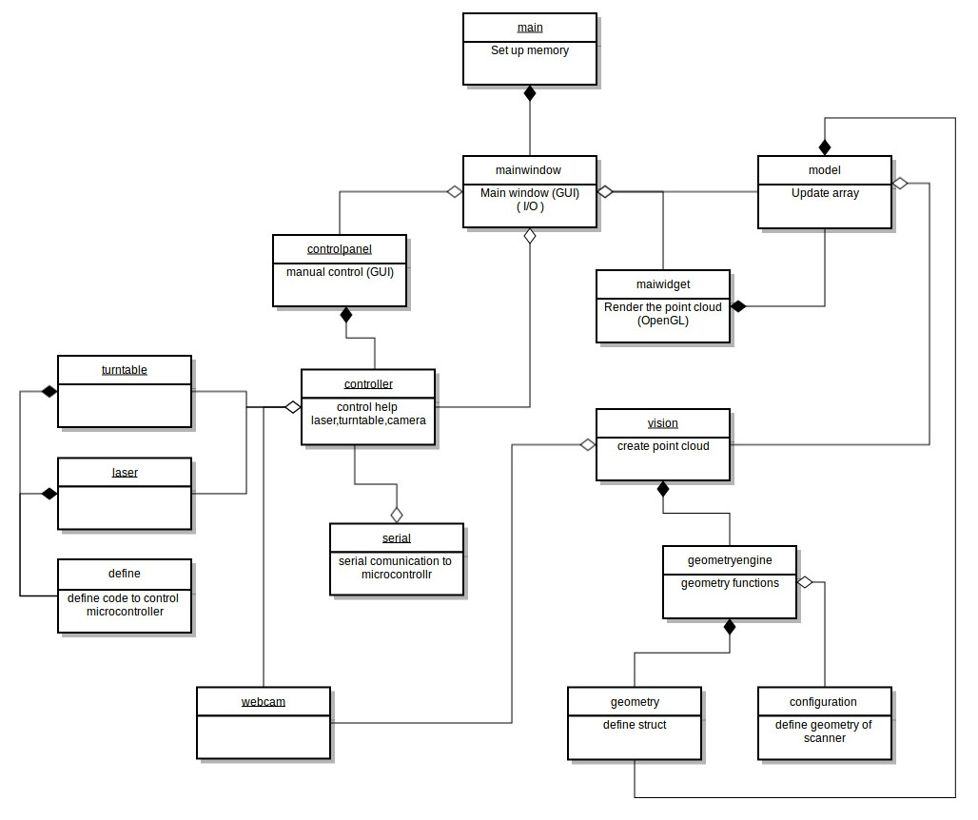
Programming Unit class Diagram

Slide 32
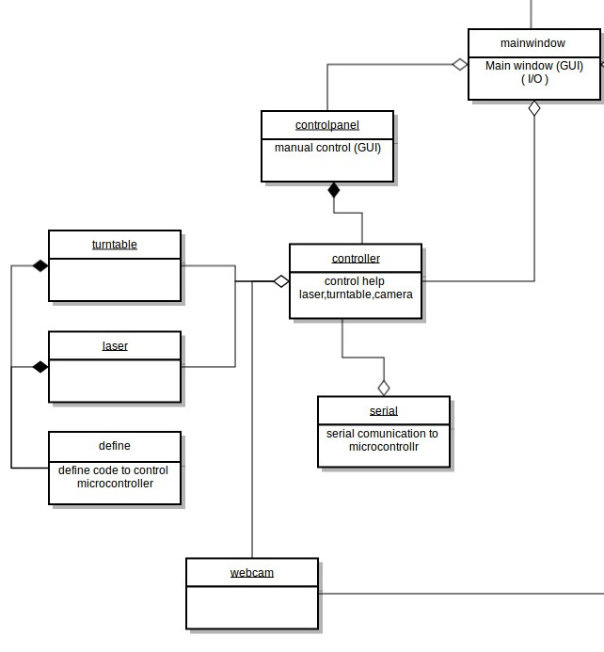
Programming Unit Class Diagram

Slide 33
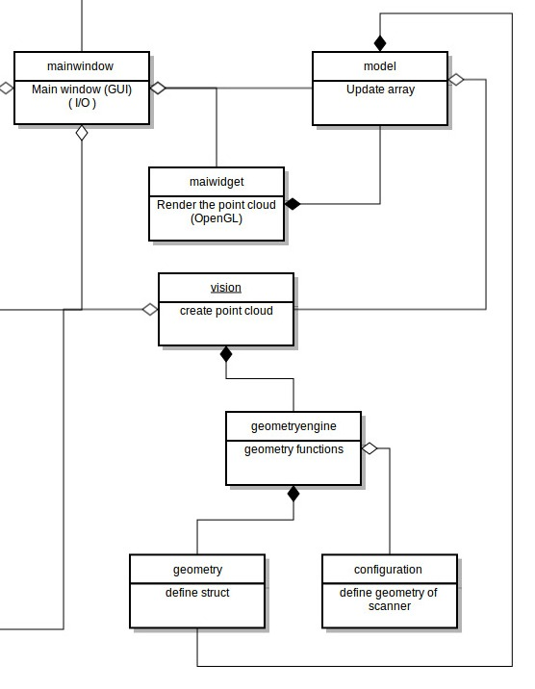
Programming Unit class Diagram

Slide 34
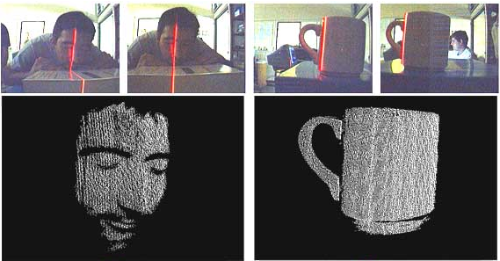
Laser Triangulation
The fundamental of our project is based on the principle of laser triangulation which means the measurement of distance by calculating the angle.

Slide 35
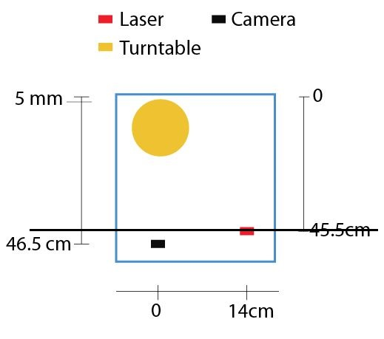
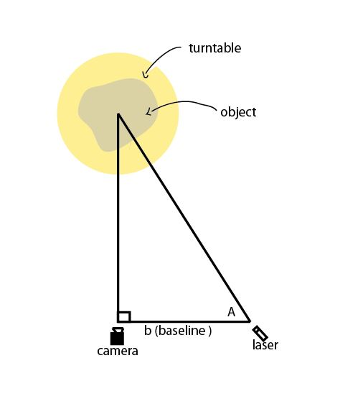
Laser Triangulation

Slide 36
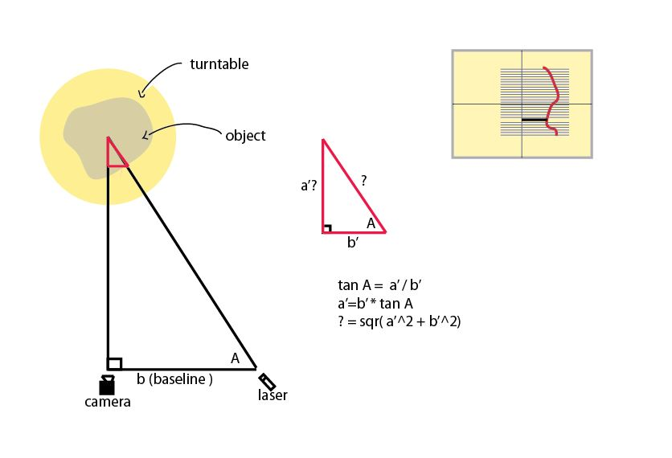
Laser Triangulation

Slide 37



Data Processing
OpenCV
Open Source
Computer Vision Libraries
C++
Open Source
Large Scale, Standalone, and Open Project for 2D and 3D images.
Image and Point Cloud Processing
Point Cloud Library
MeshLab
Process and edits 3D triangular meshes
Rendering, modeling, cleaning, remeshing, coloring, and inspection of 3D meshes

Slide 38
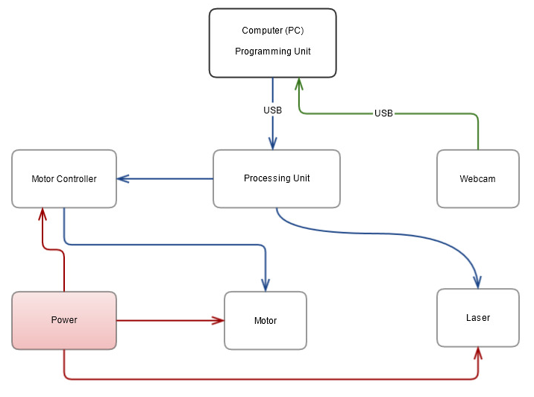
Power Supply

Slide 39
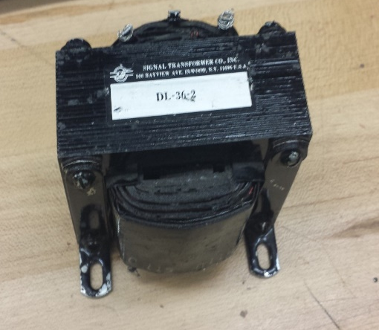
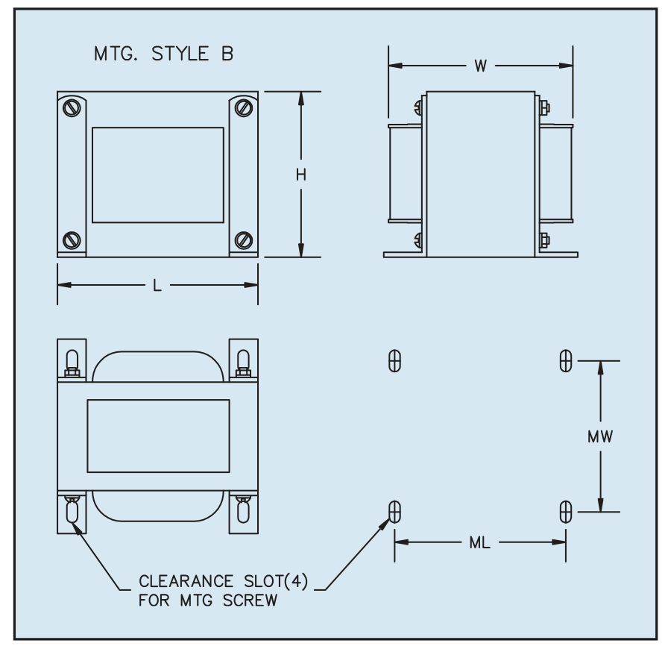
Power Supply
(DL-36-2) Transformer
General Specifications
• Power - 10 VA to 2800 VA
• Dielectric Strength - 1500 Vrms Hipot
• Primaries - Single, tapped or dual primaries, 105V, 115V, 125V, 230V - 50/60 Hz
• Secondaries - Dual center tapped windings may be connected in series or parallel
• Insulation System - Class B insulation, 130º C

Slide 40
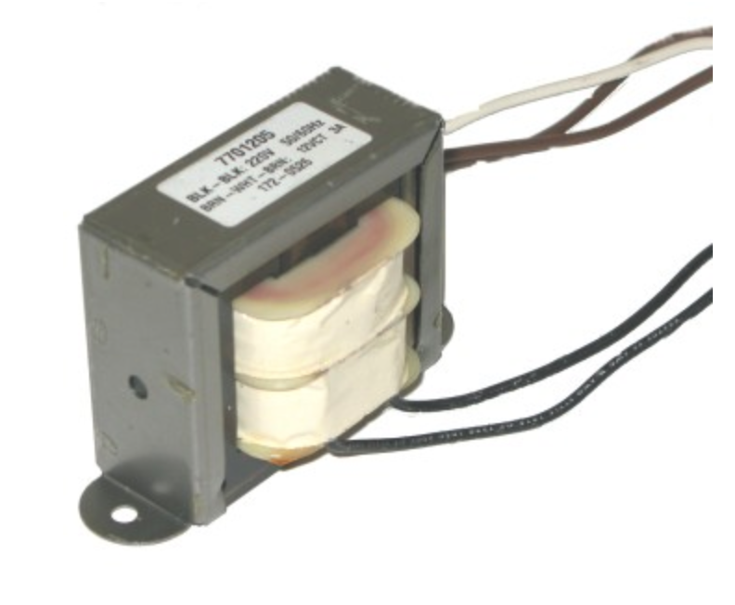
Power Supply
12 cm
12 Vct Power Transformer
Center tapped giving either
6v or 12v ac output
Rated current 3amps.
1.5 pounds
5.5 cm

Slide 41
Power Supply
 | Linear | Switching
Function | Only steps down, so input voltage must be greater than output voltage | Step up(boost), buck, inverts.
Efficiency | Low to medium, but efficiency is high if difference between input and output voltage is small | High, except at very low load currents(micro amps), where switch mode is quiescent current is higher
Waste heat | High, if average load and or input to output voltage difference is high | Low, as components usually run cool for levels below 10W
Complexity | Low, usually requiring only the regulator and bypass capacitor | Medium to high, usually requiring inductor, diode, and filter caps in addition to the IC.
Size | Small to medium in portable designs, but maybe larger if heatsinking is needed | Larger than linear at low power, but smaller at power levels for which linear requires a heat sink
Total Cost | Low | Medium to high, largely due to external components.

Slide 42
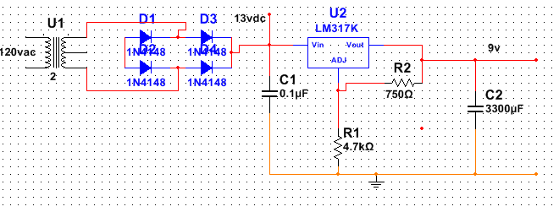
Power Supply
Circuit Layout

Slide 43
Administrative Content
Budget
First, the base of our budget and finances discussion starts with the initial amount of money we want to put into this project. Based on the regular book budget for textbook in the two semesters of the senior design class, we get about $100 each, totaling $400 for all four of the members.
This is an arbitrary amount, and only after our cost analysis we can talk about allocating a higher or lower amount. This analysis will be mainly focused on the parts we will need for this project. Also, we will be paying out of pocket since in this term we could not find any sponsor.

Slide 44
Administrative Content
Item | Part # | Vendor | Price(estimate) | Price(so far)
Arduino UNO |  | Arduino.cc | 25.74 | 29.99
Motor Driver | SN754410 | Mouser Electronics | 2.99 | 2.99
PCB fabrication |  | 4PCB | 33.00 | 33.00
Solder | AT31504 | Amazon | 10.00 | 10.00
Stepper Motor | 17HS15-0404S | Pololu | 19.95 x 2 | 39.90
Line Laser | 01012561 | Miniinthebox.com | 7.99 | 7.99
Web Cam | C270 | Logitech | 21.99 | 21.99
Power Transformer | DL-36-2 | Skycraft | 34.99 | 34.99
Voltage Regulator | LM7805 | Adafruit | 1.99 x 3 | 5.97
Box(parts) |  | Home Depot | 50.00 | 74.99
Electronics (parts + Tax + shipping ) |  | Various | 68.87 | 68.87
Total |  |  | <400 | $330.68

Slide 45
Administrative Content
Division of Labor
Names | Programming | PCB Design | Scanner Design | Power | Testing | Documentation
Franco Zavagnini |  |  | X |  |  | X
Nirav Kotadia | X |  |  |  | X
Gabriel Akenten |  |  |  | X |  | X
Naoufal Rihani |  | X |  |  | X

Slide 46
Administrative Content
Milestone
Senior Design II
Design Confirmation | 07/31/2014
Order Parts | 08/18/2014 – 09/01/2014
Build and Test Platform | 09/01/2014 – 09/22/2014
Build and Test Stepper Motor | 09/08/2014 – 09/29/2014
Install and Test Camera | 09/15/2014 – 10/06/2014
Test Laser/Controller Unit | 09/22/2014 – 10/13/2014
Install Power Supply | 09/29/2014 – 10/20/2014
Subsystem Integration Testing | 10/06/2014 – 10/27/2014
Testing/Debugging | 10/27/2014 – 11/10/2014
Final Testing and Debugging | 11/17/2014 – 11/19/2014
Presentation | 11/20/2014

Slide 47
Progress

Slide 48
Issues
Difficulty with the programming language and libraries (PCL, C++)
Power Supply optimization

Slide 49

Questions?

Slide 50
Spoiler

Slide 51
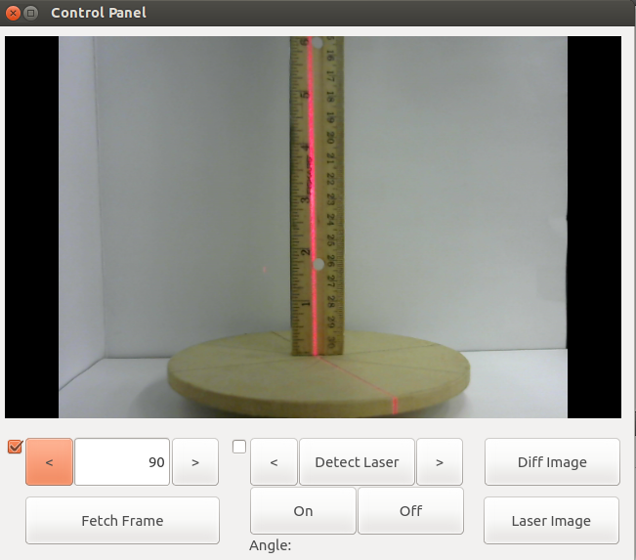

Slide 52

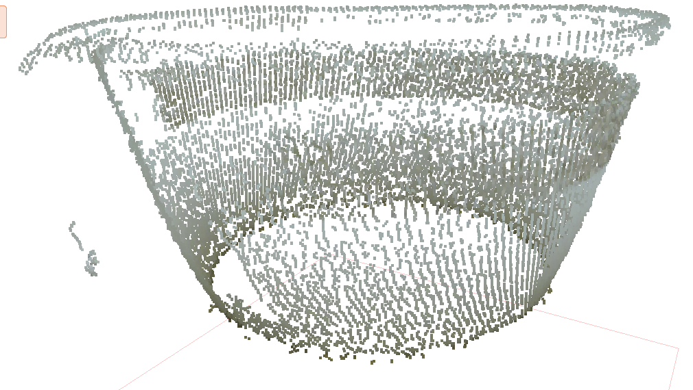

Slide 53

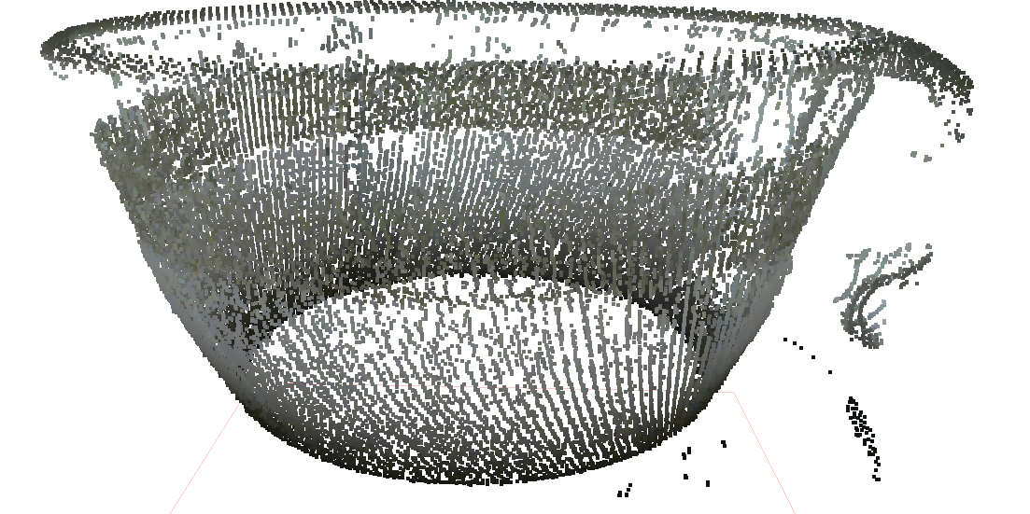

Slide 54
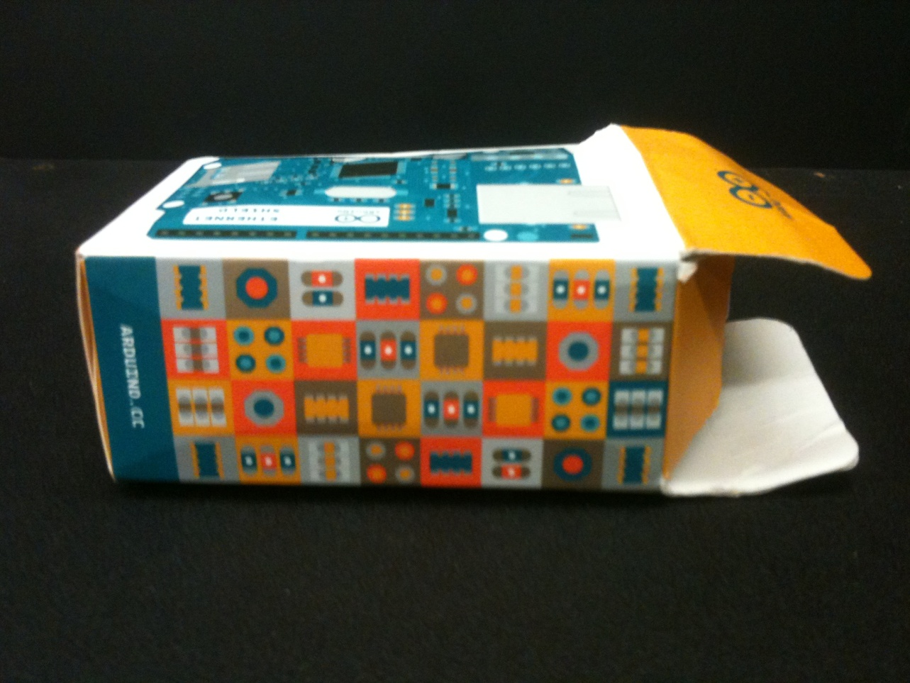
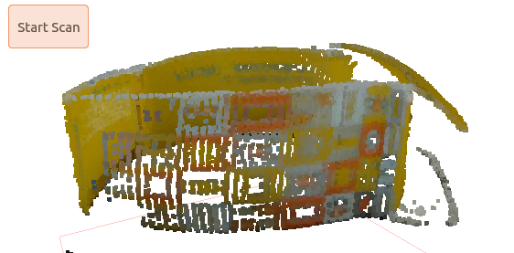

Slide 55
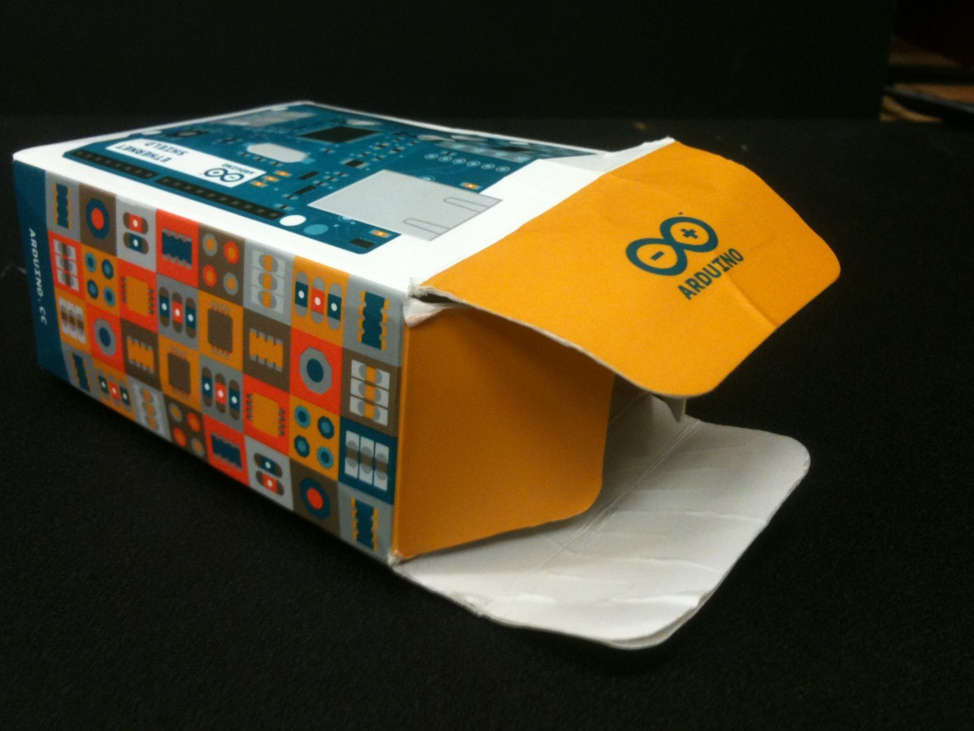
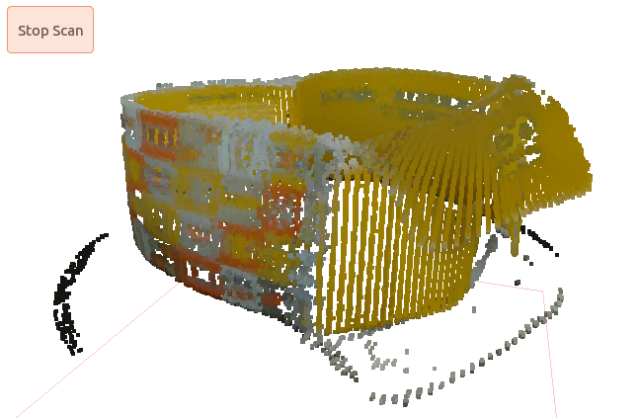

Slide 56
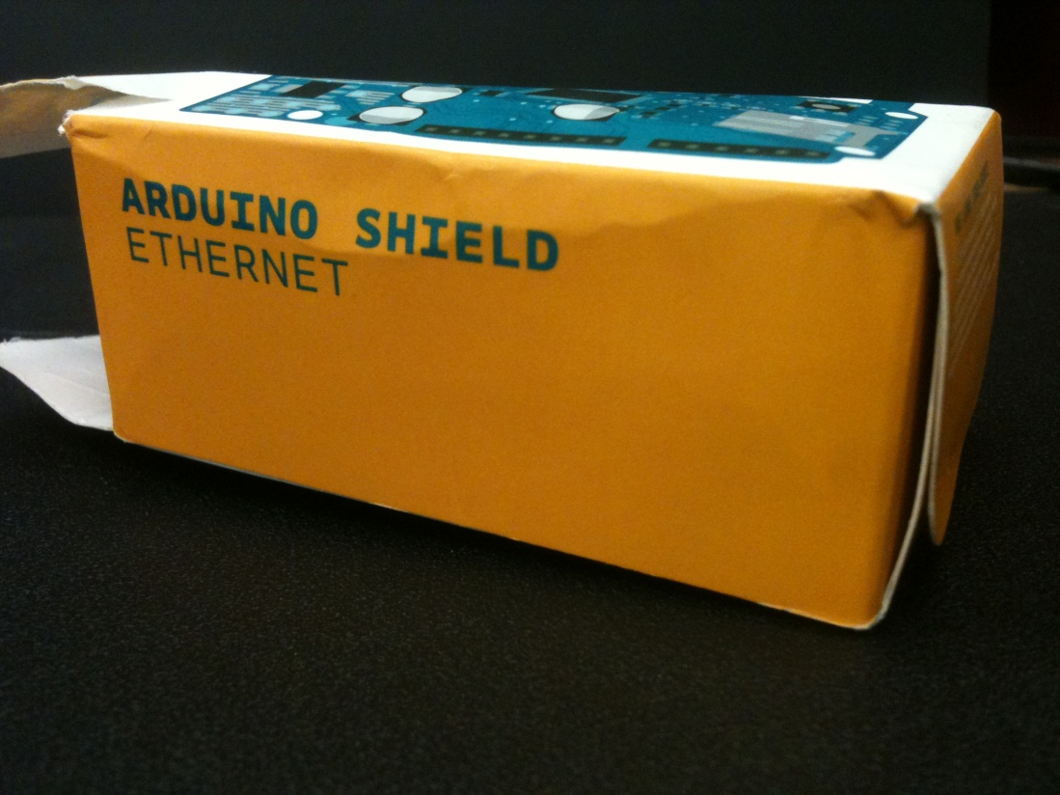


Slide 57





Slide 58



