Slide 1
MAGLEV
Critical Design Review
Group 2
Julio Arias
Sean Mawn
William Schiller
Leo Sell

Slide 2
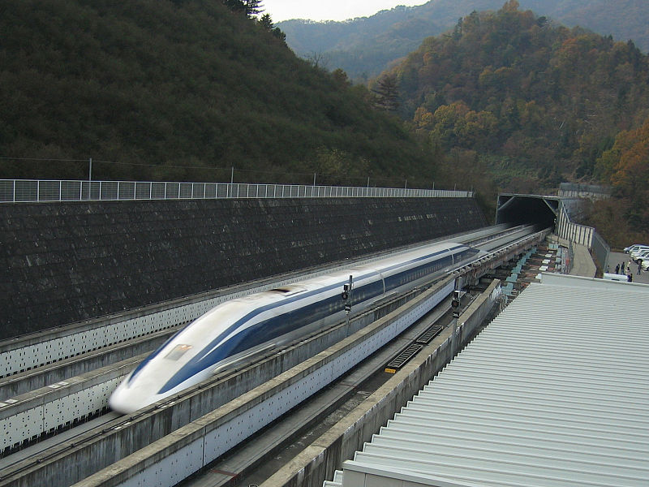
Motivation
Increase awareness of related technology
Clean technology

Slide 3
Specifications
Track | 26” x 5.5”
Power Supply | 15V and 9V
Wireless Connectivity | RN-42 Bluetooth Module
Magnetic Field Detection | 3x A1301 Hall Effect Sensors
Linear Motor | 3x Air Core Solenoid
Wireless Device | Android
Vehicle | 5” x 5.5”
Propulsion | 32 1”x0.5”x0.125” N45 60 1”x0.25” N48 Cylinder
Levitation | 22 2”x0.5”x0.1875 N48 10 1”x0.5”x0.125” N45

Slide 4
Goals and Objectives
Main goal is to replicate an existing technology that uses magnetic fields as a sole method of propulsion and levitation
Three objectives
Magnetic levitation
Magnetic propulsion
Wirelessly controlled

Slide 5
Levitation
Passive design
Opposing polarity rails to minimize motor gap magnetic field interference.
Levitation achieved through like-pole repulsion

Slide 6
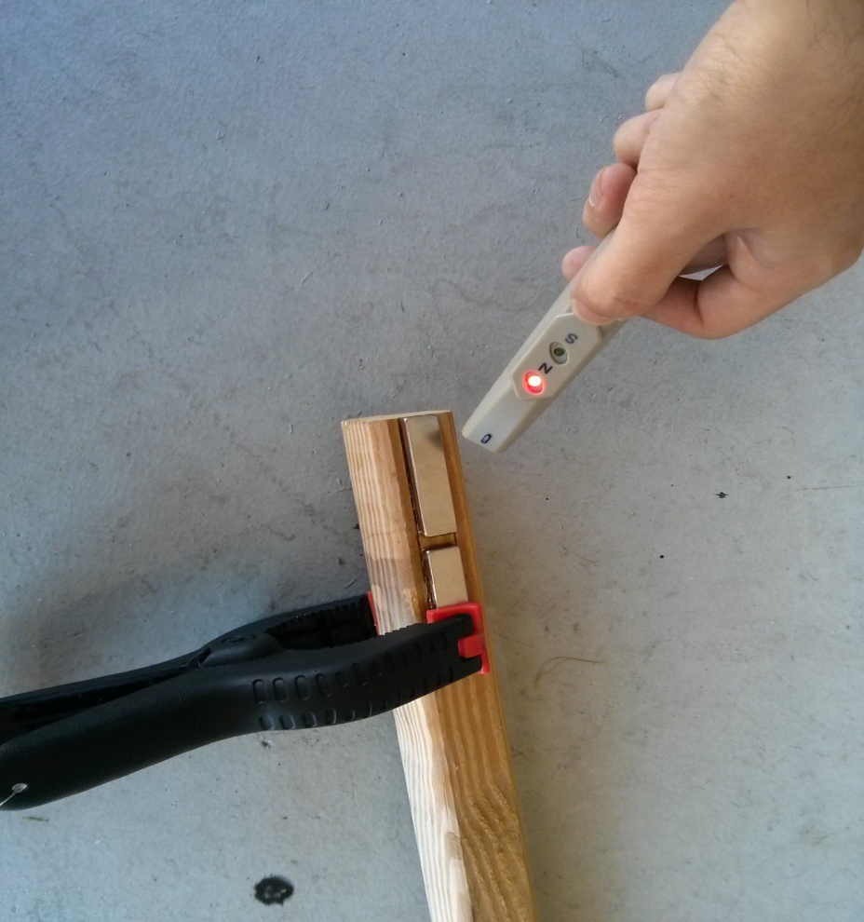
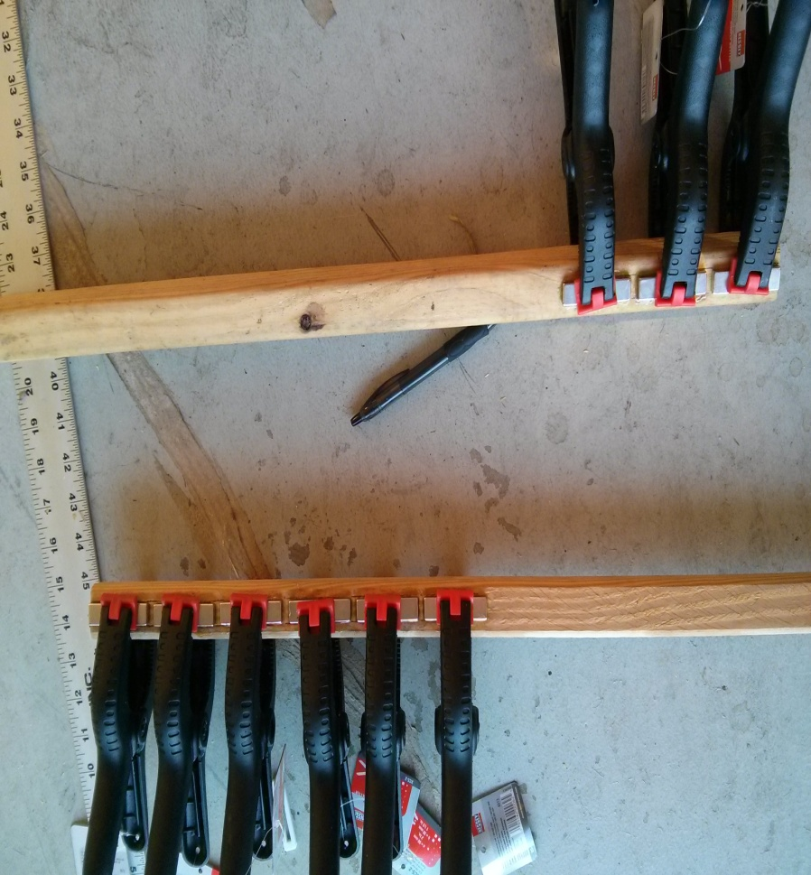
Levitation

Slide 7
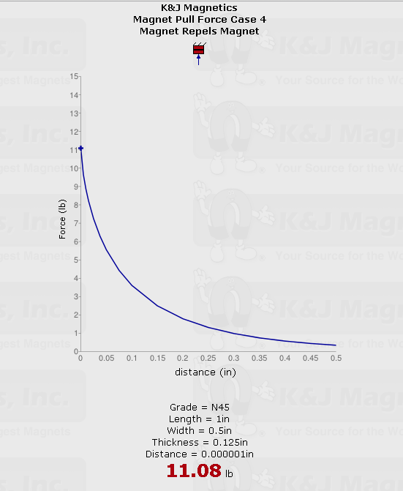
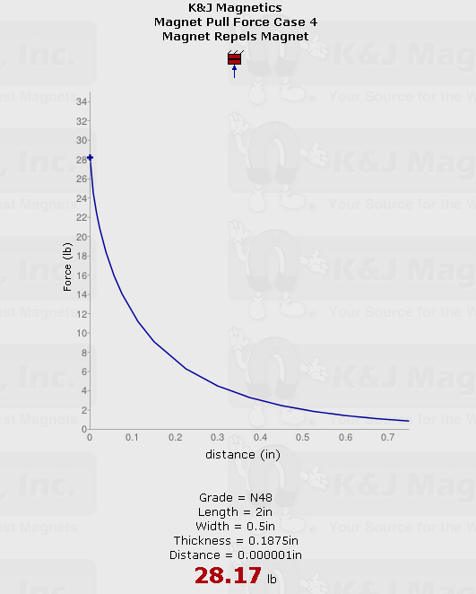
Repelling Force Test: Car and Track

Slide 8
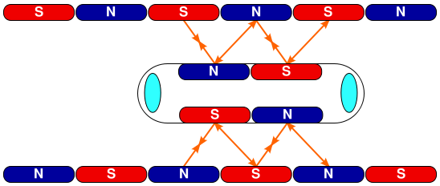
Propulsion
Using alternating polarity magnets on each rail, the solenoids will achieve a push pull force to create movement

Slide 9
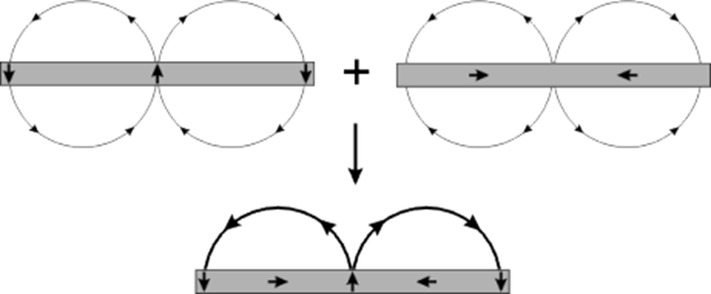
Propulsion – The Halbach Array
The proper propulsion technique is achieved using a Halbach Array. For the array we used N48 grade cylindrical Neodymium magnets

Slide 10
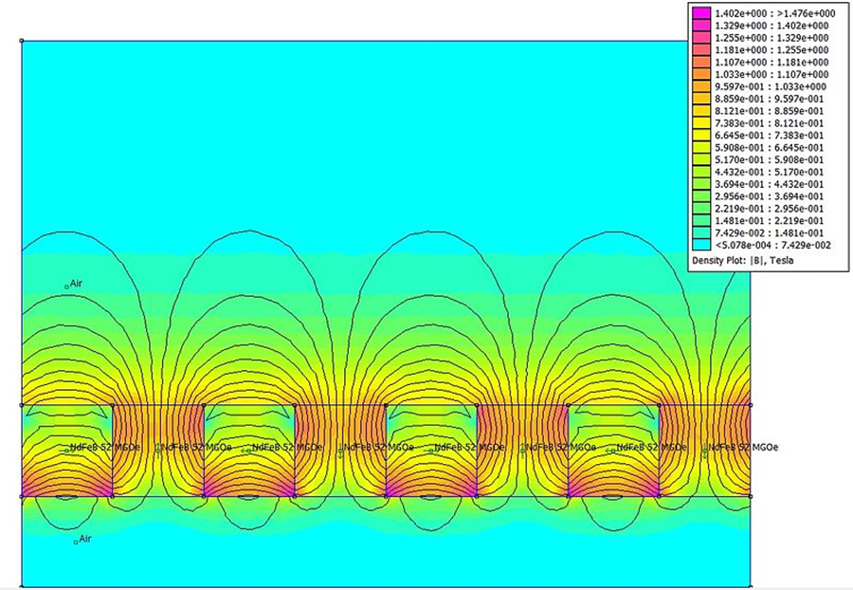
Halbach Array cont.
Field on the other side of the Halbach field is reduced to near zero
By directing the field towards the motor gap in the track, the solenoid motor is saturated by the drive magnet field

Slide 11
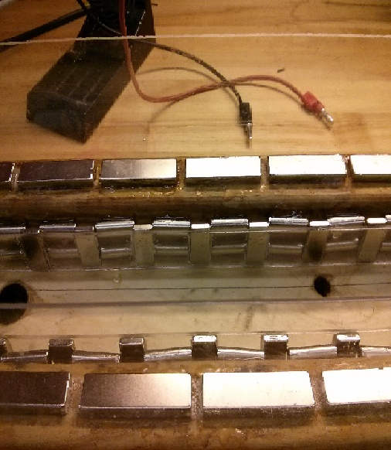
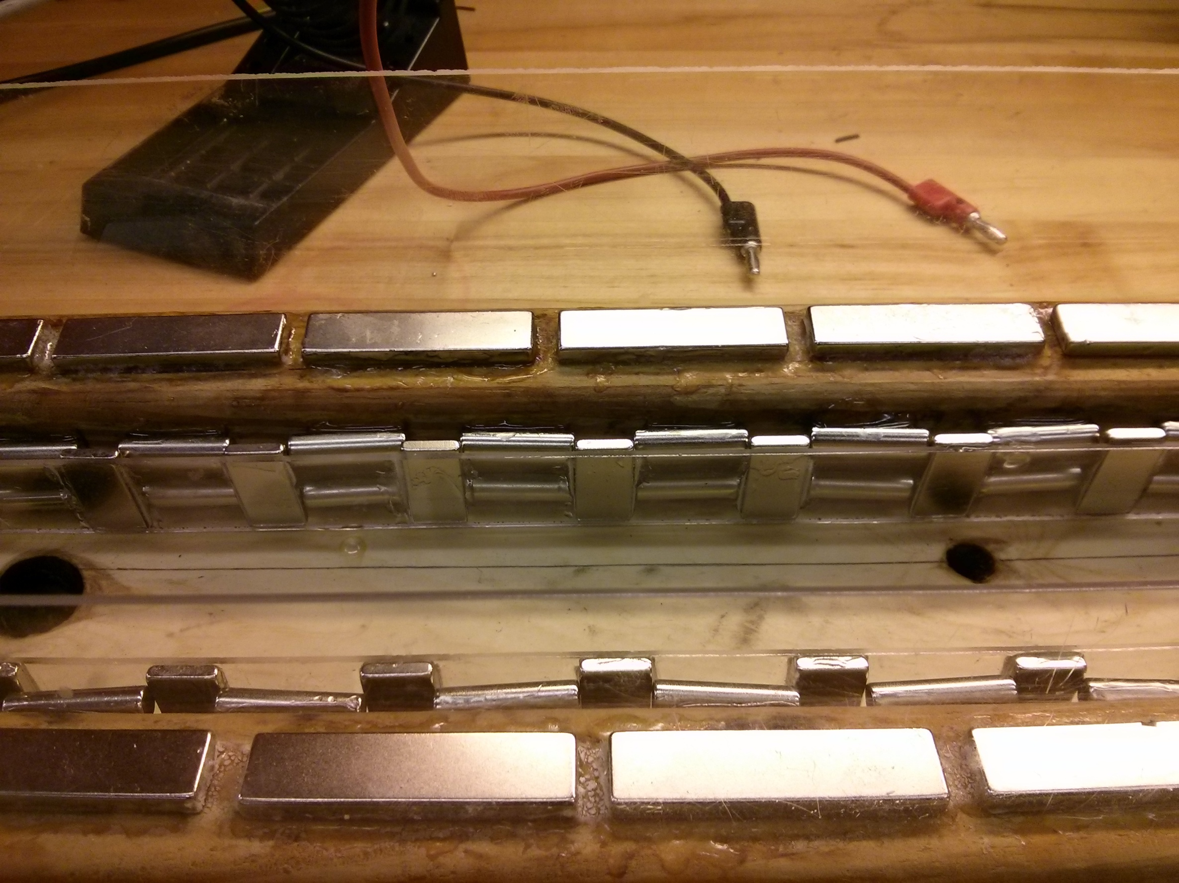

Slide 12
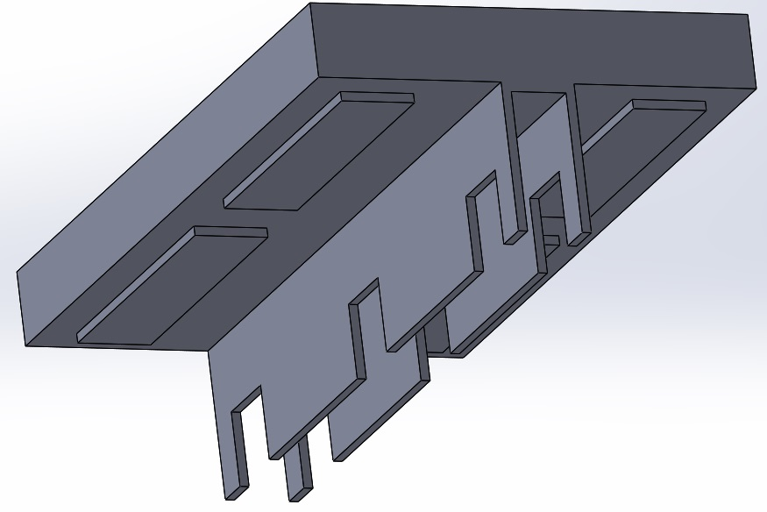
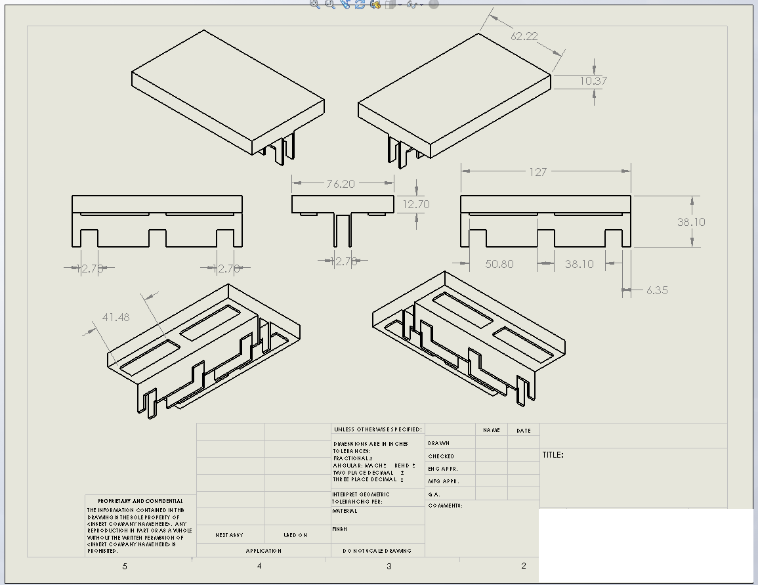
Vehicle
Design | T-shape
Dimensions | 5.5’’ x 5’’
Magnets | 10 N45 magnets (5 on each side). Opposite polarity rails.
Solenoid housing | 5.5’’ x .75’’ x .5’’ aluminum C channel
Circuitry | Board mounted top side and wired through the channel

Slide 13
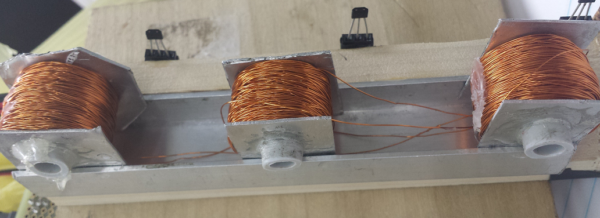
Electromagnets
Current draw per solenoid (A) @ 9V | .34 - .46
Resistance (Ω) | 19 - 26
Core Type | Plastic (air core)
Wire | 1000’ of 30 AWG enameled copper
Connections | Wire connected to h-bridge driver outputs

Slide 14
Hardware Block Diagram
Solenoids
ATmega328
H-Bridge IC’s
18V source
Hall Effect Sensors
Android App
9V Battery
5 Volt regulator
Bluetooth

Slide 15
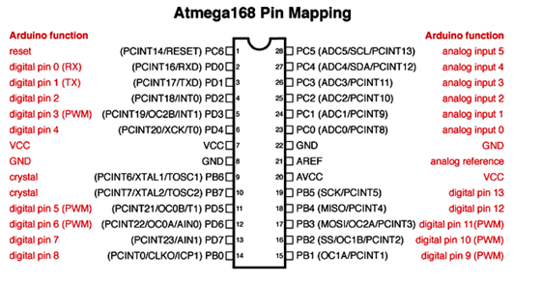
MCU
Atmega328P
Sensors use 3 analog inputs (6 analog inputs total)
H-Bridge’s use 6 Digital I/O’s (14 total, 2 reserved for Bluetooth connection)
16 MHz crystal
Programmed through an Arduino Uno development board

Slide 16
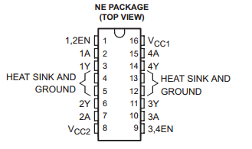
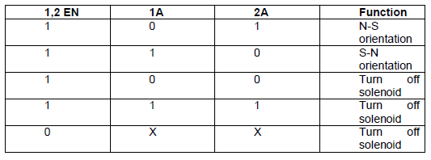
H-Bridge IC Usage
TI SN754410
4.5V – 36V operating range
1A output-current per driver
Operating Temp, -40 to 85⁰C
3 state outputs
Cost: $2.35 ea

Slide 17
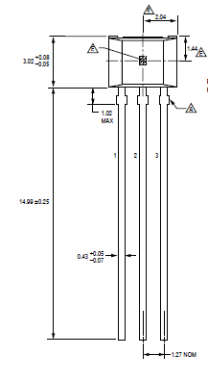
Hall-Effect Sensors
 | Allegro A1301 | Optek OH090U | Melexis US1881
Operating Voltage (V) | 4.5-6 | 4.5-24 | 3.5-24
Polarity | Bi-polar | Uni-polar | Bi-polar
Output type | Linear | Logic Level | Logic Level
Magnetic sensitivity (mV/Gauss) | 2.5 | N/A | N/A
Magnetic operating point (Gauss) | N/A | 90 | 60
Magnetic release point (Gauss) | N/A | 65 | -60
Vout @ B=0 (V) | 2.5 | 0 | 0

Slide 18
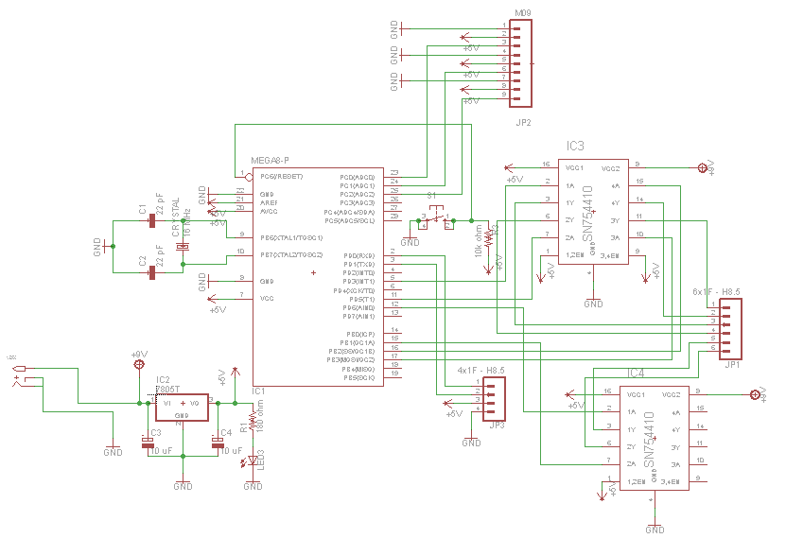
MagLev Schematic

Slide 19
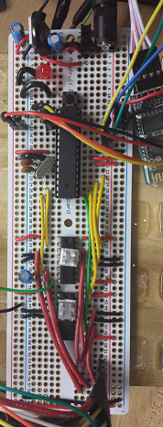
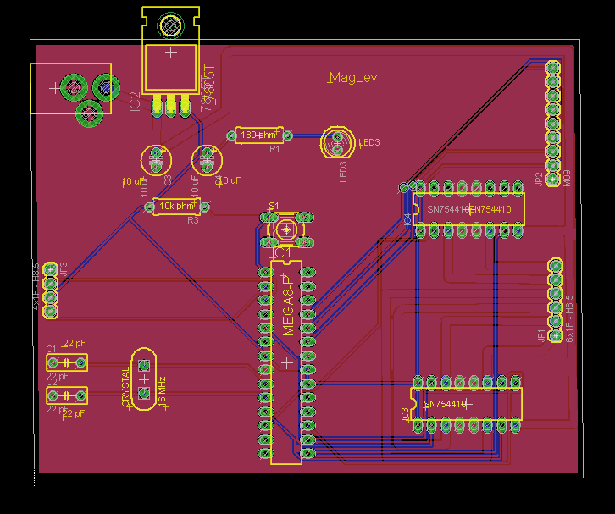
Eagle PCB board vs. DOT PCB
 | Eagle PCB | DOT PCB
Size (mm) | 100 x 80 | 160 x 55
Drill holes(mm) | ≈ 1 | 1.2
Traces | 7 mil and 50 mil for power | N/A
Layout | User defined in Eagle Lite | 60 rows of 10-holes
Cost | $34 ea | $6.667 ea

Slide 20
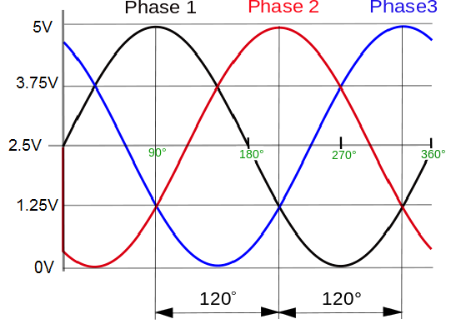
Three - Phase Drive system
Sensor orientation sends a three phase voltage signal back to MCU
120 degrees apart based on the position of the sensors on vehicle
Each phase represents one sensor coupled with a solenoid
Sensor output voltage ranges depict solenoid polarity

Slide 21
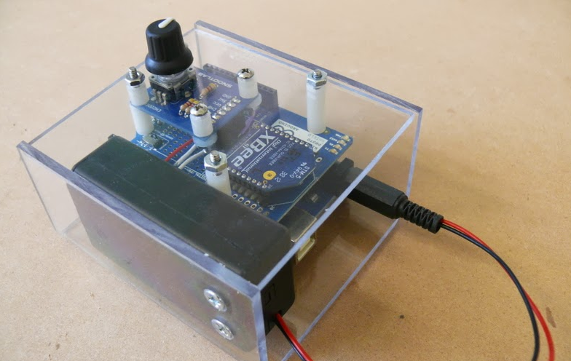
Controlling the System
Analog Controller
Arduino Uno R3 (MakerShed # MKSP11, Sparkfun # DEV-11021)
Arduino Wireless Protoshield (Maker Shed # MKSP13)
XBee Series 01 802.15.4
Wireless Module (Maker Shed # MKAD14)
SnootLab Encoder
9V Battery (logic)
Jumpers of various lengths
Approximate Cost = $95.00

Slide 22

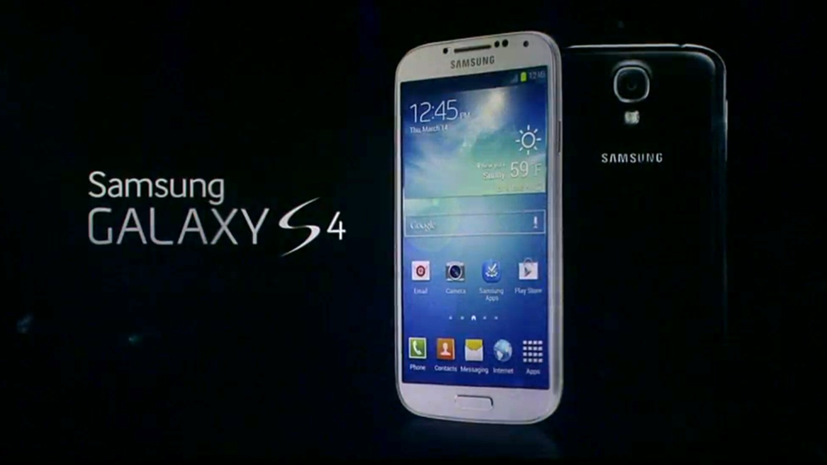
Controlling the System
Smartphone Controller
Application Development
Bluetooth/Wifi Capability
Approximate Cost =$0.00

Slide 23
Android vs. IPhone
Developing | IPhone | Android
Machine | Mac/Apple Laptop only | Any laptop (HP, Lenovo, Asus, Mac, Toshiba, etc.)
Environment | XCode only | Eclipse, Netbeans, Intellij, etc.
Cost | $99.00 Developer Fee | $00.00
Programming Language | Objective-C | Java
Interfacing with Peripherals | Apple only devices | Any viable device
Coding Samples/Open Source | Limited | Numerous

Slide 24
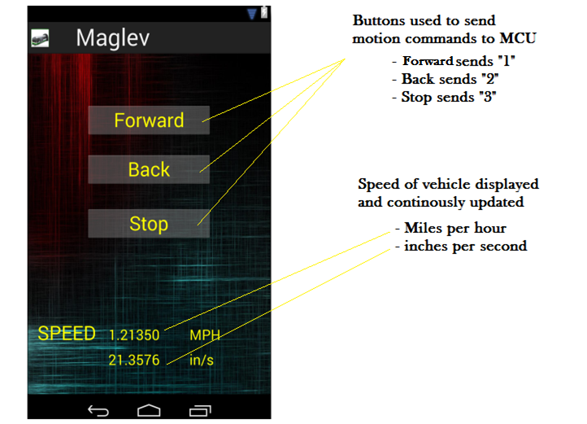
User Interface

Slide 25
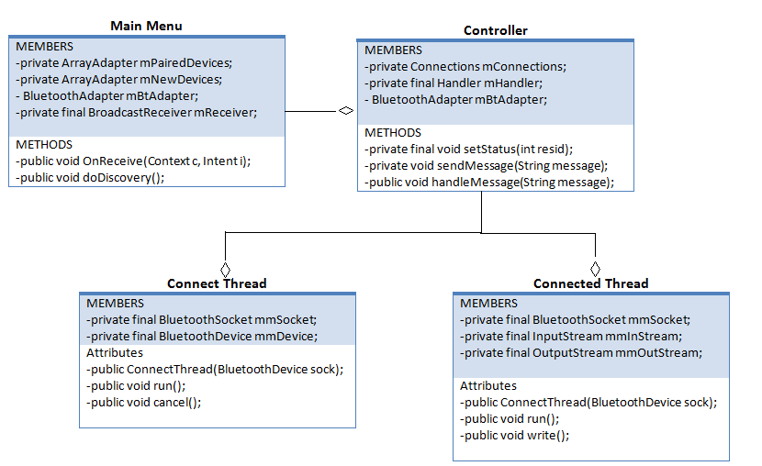
App Class Diagram

Slide 26
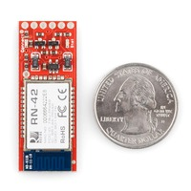
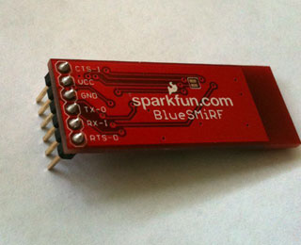
Bluetooth Slave Module
RN-42

Slide 27
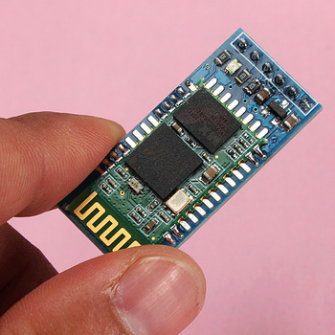
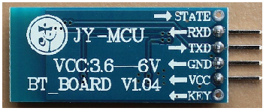
Bluetooth Slave Module
HC-06
Feature/Specs
Bluetooth protocol | v2.0+EDR
Frequency | 2.4GHz ISM band
Modulation | GFSK(Gaussian Frequency Shift Keying)
Emission power | <= 4dBm, Class 2
Sensitivity | Asynchronous: 2.1 Mbps(Max)/160kbps, Synchronous: 1Mbps/1Mbps
Security | Authentication, Encryption
Profiles | Bluetooth, Serial Port
Power Supply | +3.3 - 6 V DC, 50 mA
Working Temperature | -20 ~ +75 Centigrade
Dimensions | 26.9 mm x 48.26mm x2.2 mm
Cost | $6.13

Slide 28
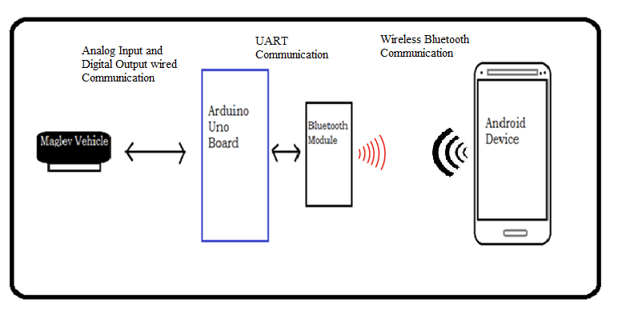
Communication Through System

Slide 29
MCU Movement Control
Receive direction Signal
Receive Hall Effect Readings
Control logic determines electromagnet outputs
MCU changes H-Bridge logic
H-Bridge controls electromagnet

Slide 30
Microcontroller Signals
I/O | Pin | Device
I | A1,A2,A3 | Allegro A1301
I | D0,D1 | Bluetooth Module
O | D7,D8 | TI SN754410 #1
O | D9,D10 | TI SN754410 #2
O | D11,12 | TI SN754410 #3

Slide 31
Input Output expectation
Android Input | Expectation
1 | Forward
2 | Reverse
3 | Stop
Digital I/O | Pin Val | Electromagnet
7 | High | N-S
8 | Low
7 | Low | S-N
8 | High
7 | Low | Off
8 | Low

Slide 32
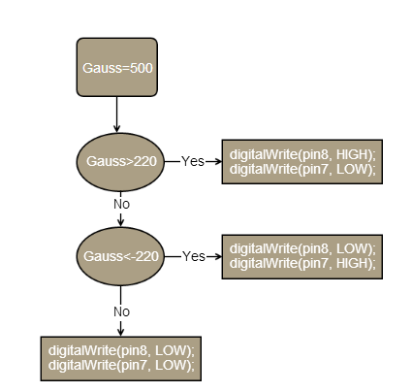
MCU HES Logic
Notes
Hall effect sensor converts 0V-5V to -1024-1024 gauss
-1024 is N pole
1024 is S pole

Slide 33
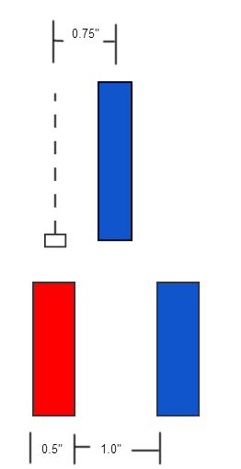
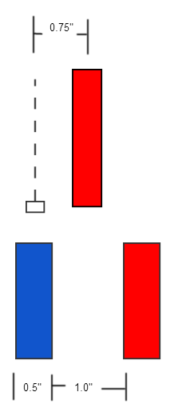
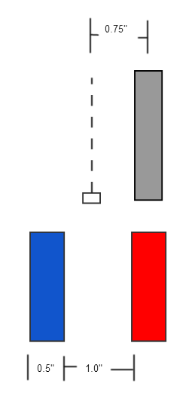
Allegro A1301 and Solenoid Combination
South
North
No-Field
Gauss>220
Gauss<-220
-220<Gauss<220

Slide 34
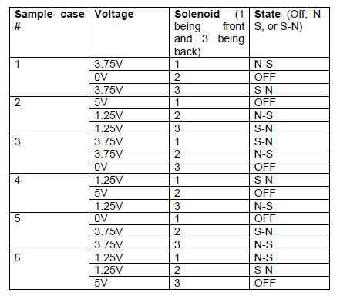
MCU Electromagnet

Slide 35
Braking and Magnet count
Magnet Count
Whenever the HES passes Min value the MCU will increase a counter.
The counter keeps track of the distance the car has traveled.
We keep track of the distance in order to determine speed and position.
Braking
1st and 3rd solenoid turn off
2nd solenoid pulls toward the magnet in the opposite direction of movement
Brake
Forward
Hold

Slide 36
Administrative Content
Project Progress
Budget and Financing
Work Distribution
Issues

Slide 37
Project Progress

Slide 38
Budget and Financing

Slide 39
Work Distribution
 | Track Design | Vehicle Design | MC Coding | Remote Controller | Circuit Design
Julio Arias |  |  |  | X
Leo Sell |  |  | X
Sean Mawn | X | X
William Schiller |  | X |  |  | X

Slide 40
Issues
The originally planned circular track design was not feasible due to budget and costs
Manual variable speed wasn’t implemented due to final track length
Working with magnets presented magnetic interference issue in testing affecting circuit, power, and Bluetooth Module Connection
Stability problems throughout designing and testing

Slide 41

Questions

