Slide 1

GROUP 13 OSCAR CEDENO CESAR ROMERO CAMILO ROMERO
E-SKATE

Slide 2
Goals and Objectives
Create a skateboard with simple user feedback
Create a fast transportation method inside a college campus
User will control the E-Skate by a wireless controller
Portable and easy to charge
Low cost

Slide 3
Specifications
$500 Budget for Project
Under 30 Pounds
2 Hours Battery Life
10 Feet Range for Wireless Communication
Cruising in Clear Weather Conditions
12 V Battery System
8 Amp-Hours per Battery
100 Watts DC Motor

Slide 4
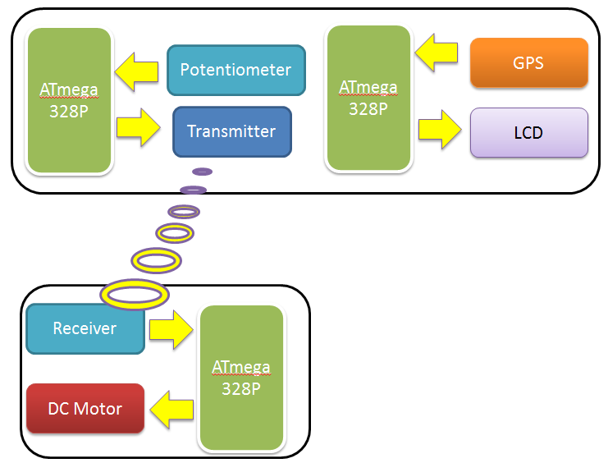
Design

Slide 5
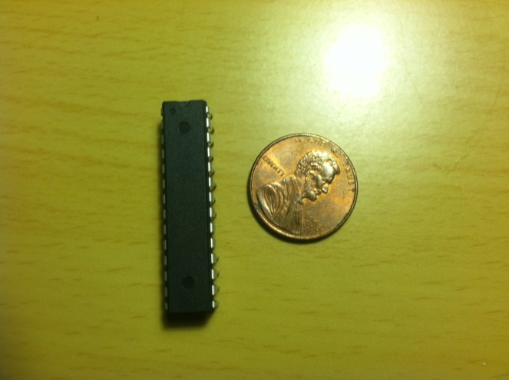
ATMEGA 328P
32 Kbytes Flash Memory
Max operating frequency 20 MHz
Serial Communications SPI, RS232, I²C
Operating Voltage: 1.8 to 5.5 V
Internal Temperature Sensor
23 I/O Pins
6 Channel 10 bit ADC
6 PMW Channels
Price: $ 4

Slide 6
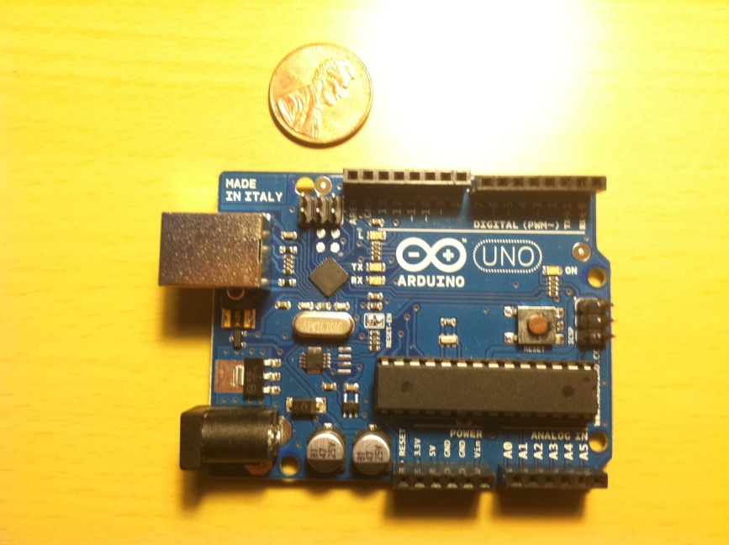
ARDUINO DEVELOPMENT BOARD
5V Operating Voltage
7-12V Input Voltage
14 Digital I/O Pins
6 Pins provide PWM output
6 Channel 10 bit ADC
40 mA DC Current per I/O Pin
16 MHZ Clock Speed
Programmed with Arduino Software
Price: $ 30

Slide 7
WIRELESS CONTROL
ATmega 328P
POTENTIOMETER
XBEE TRANSMITTER
XBEE RECEIVER

Slide 8
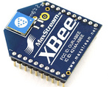
XBEE
3.3V @ 50mA
250kbps Max data rate
1mW output (+0dBm)
300ft (100m) range
Built-in antenna
6 10-bit ADC input pins
8 digital IO pins
128-bit encryption
Local or over-air configuration
Price: $ 25 Each

Slide 9
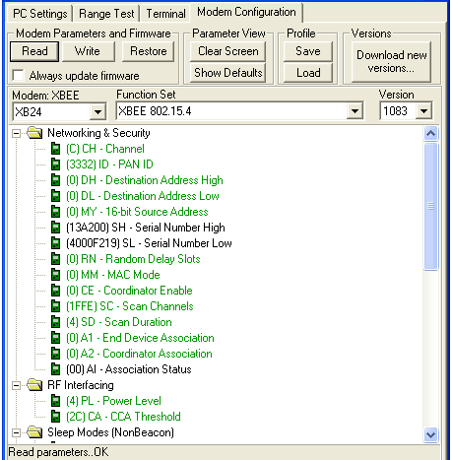
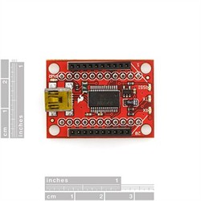
XBEE XPLORER/ XCTU
Programming Xbee in 57600 Baud Rate Frequency

Slide 10
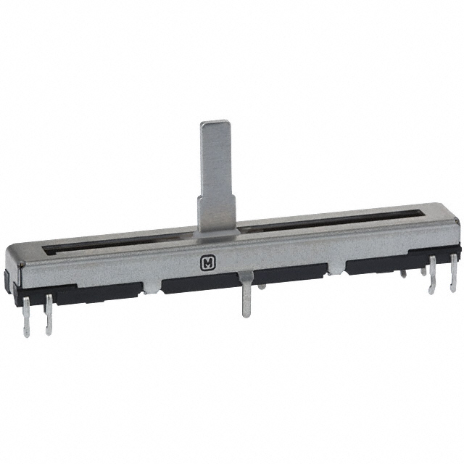
POT
Linear variable resistance of 10 KΩ
Low noise
Long operating life
Highly accurate attenuation
Power consumption of 0.1W
Price: $ 2.70

Slide 11
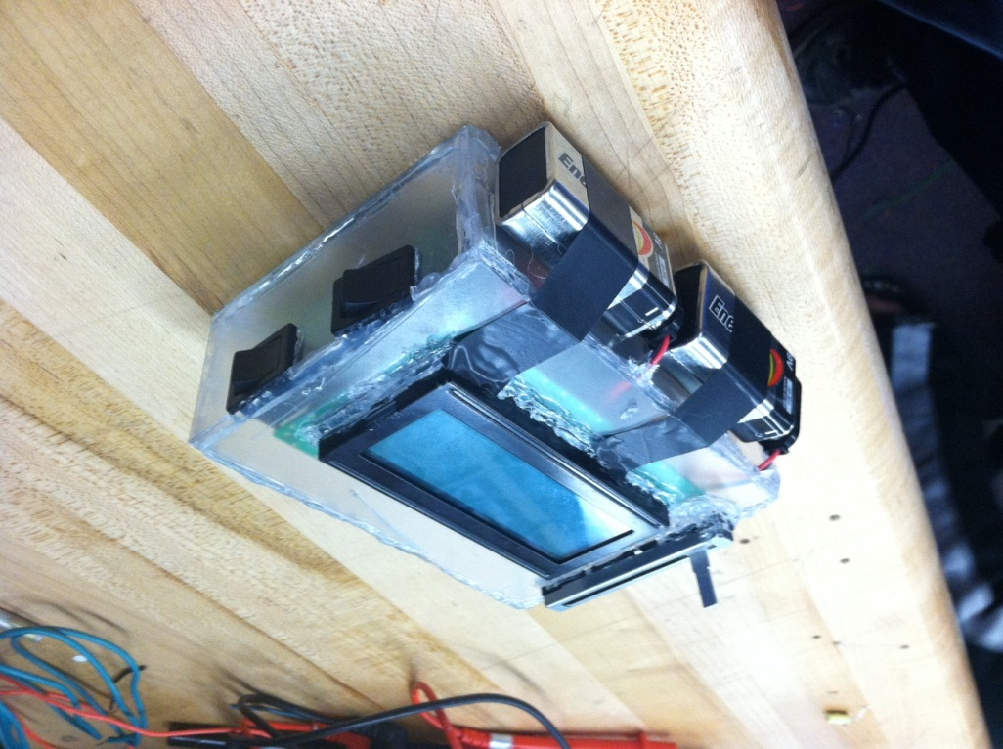
HANDS ON REMOTE CONTROL
LCD SCREEN
POTENTIOMETER
LCD POWER SWITCH
9V BATTERY
ON/OFF SWITCH

Slide 12
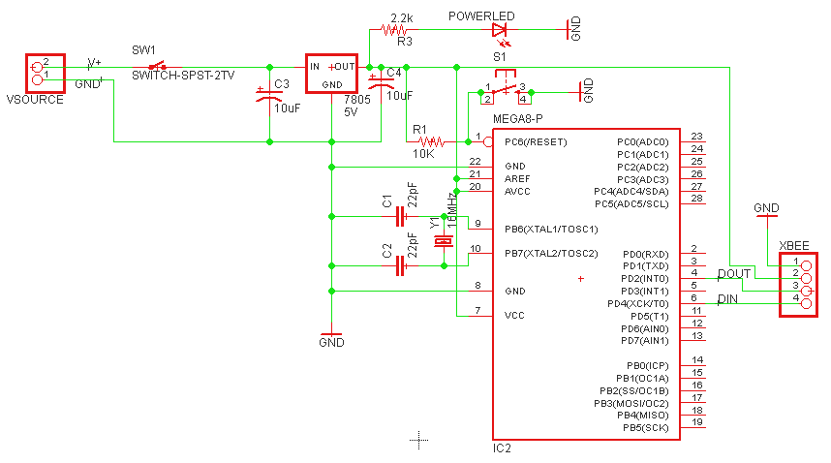
CONNECTING XBEE TO ATMEGA 328P

Slide 13
DATA CONTROL
ATmega 328P
LCD
GPS

Slide 14
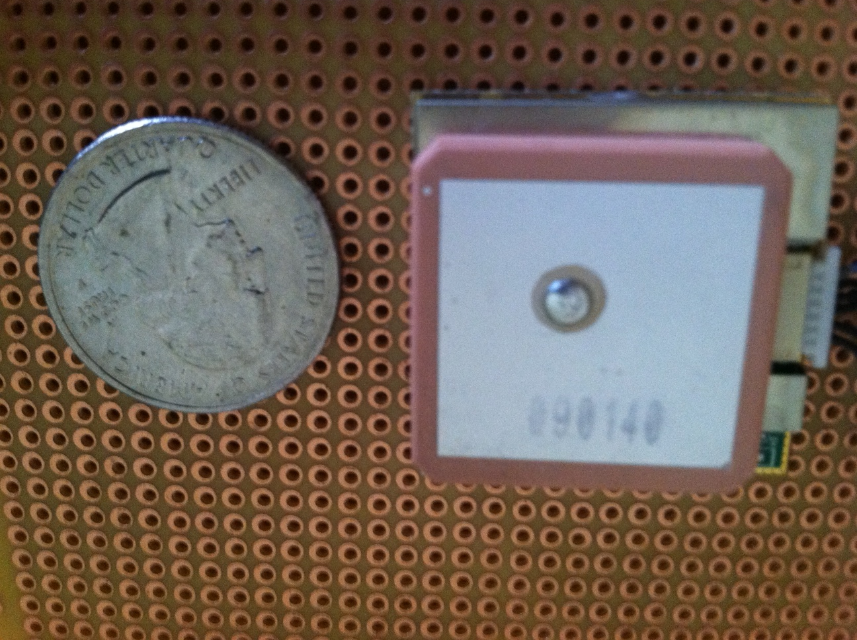
GPS Module

Slide 15
EM-406a Module
20-Channel Receiver
10m Positional Accuracy / 5m with WAAS
Outputs NMEA 0183 and SiRF binary protocol
Small foot print : 30mm x 30mm x 10.5mm
Built-in LED status indicator
6-pin interface cable included
Hot Start : 1s
Warm Start : 38s
Cold Start : 42s
70mA at 4.5-6.5V
Price : $ 40
Pin Layout

Slide 16
NMEA 0183 Protocol
Some Protocol Descriptions:
$GPGSV,3,1,12,20,00,000,,10,00,000,,25,00,000,,27,00,000,*79
Message | Description
GGA | Time, Position, Fix Type
GSA | GPS receiver operating mode, Satellite used in position solution. DOP values
GSV | The number of GPS satellites in view, satellite ID number, Elevation Azimuth, SNR values.
RMC | Time, Date, Position, Course, Speed
$GP which start the message all the time
Next would be the message which in this case is the GSV, which is described in Table
Each data element is separated by a comma, and the data elements are terminated by the * character
There is a 8-bit XOR of each character between $ and * to form the checksum
Finally the last two characters are hexadecimal representation of the calculated checksum.

Slide 17
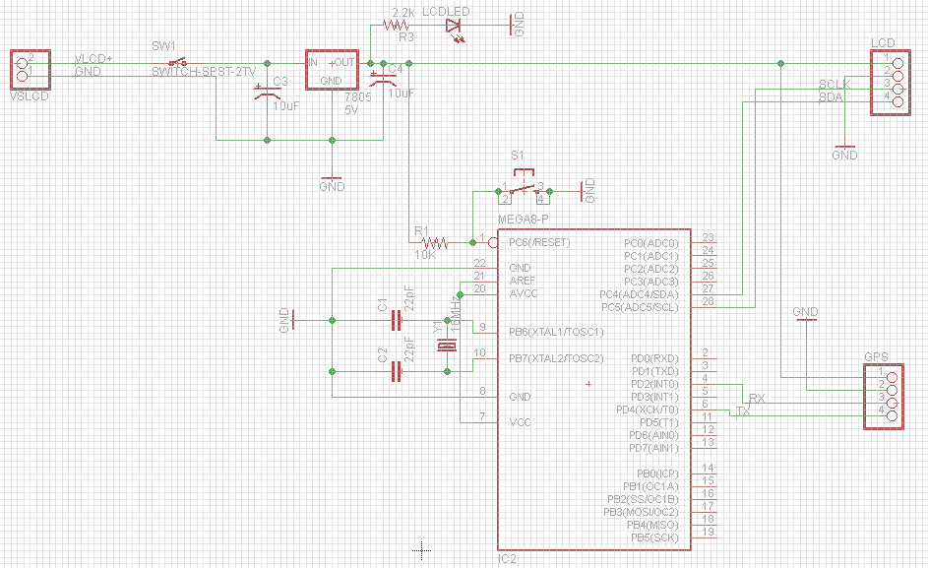
GPS Schematic

Slide 18
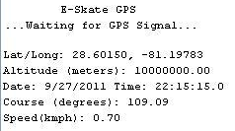
Arduino’s GPS Serial Monitor
EM-406a is sending data to the Arduino development board and it is displayed on the computer screen.

Slide 19
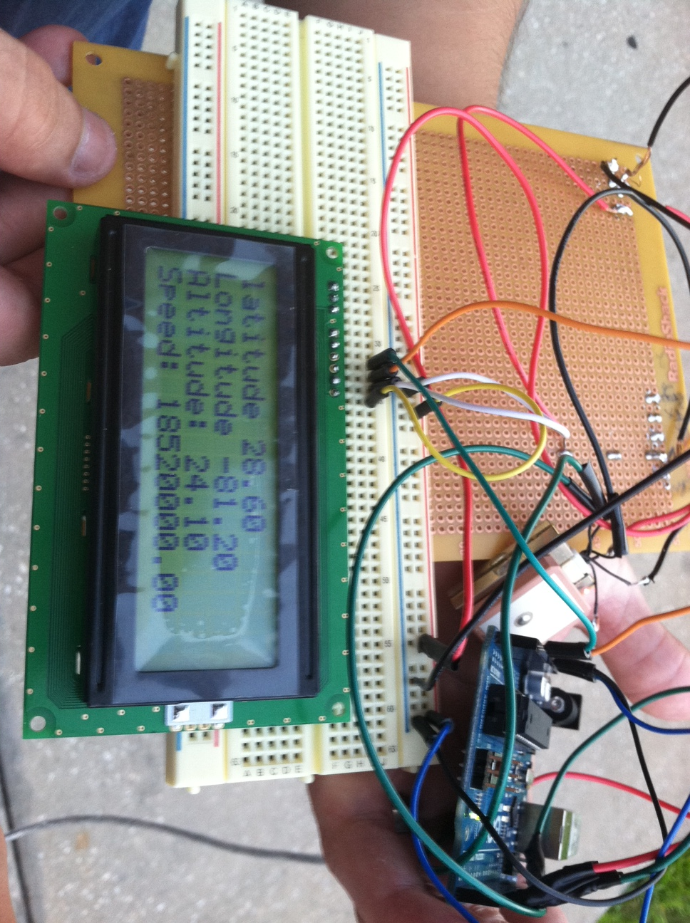
GPS, Arduino, LCD
GPS is connected hardware to the Arduino board and it send data to the computer.

Slide 20
Data Microcontroller
Microcontroller will display data to LCD
Will take input from GPS
Separate unit from microcontroller which controls motor

Slide 21
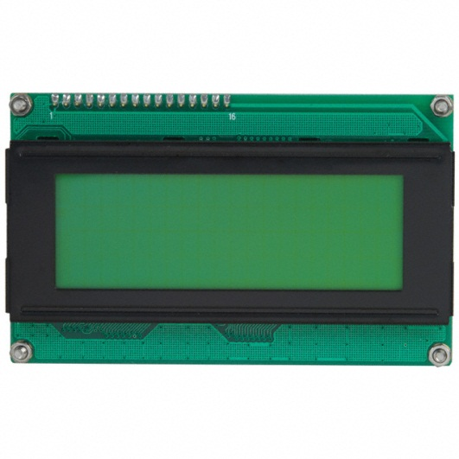
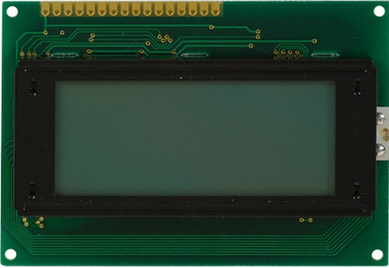
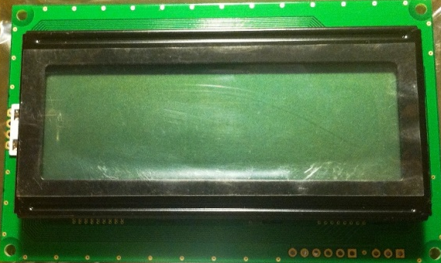
LCD
 | Lumex LCM-S01604DSF | Newhaven 0420D3ZFLGBW | Matrix Orbital LK204-25
Display Format | 16 x 4 | 20 x 4 | 20 x 4
Connection Type | Parallel | I²C, RS232, and SPI | I²C, RS232, and TTL
LCD Type | Transflective | Transflective | Transmissive
Voltage | 5 V | 5 V | 5 V
Outline Area | 8.7 cm x 6 cm x 1.27 cm | 9.8 cm x 6 cm x 1.35 cm | 9.8 cm x 6 cm x 2.75 cm
Price | $29.73 | $24.90 | $69.75

Slide 22
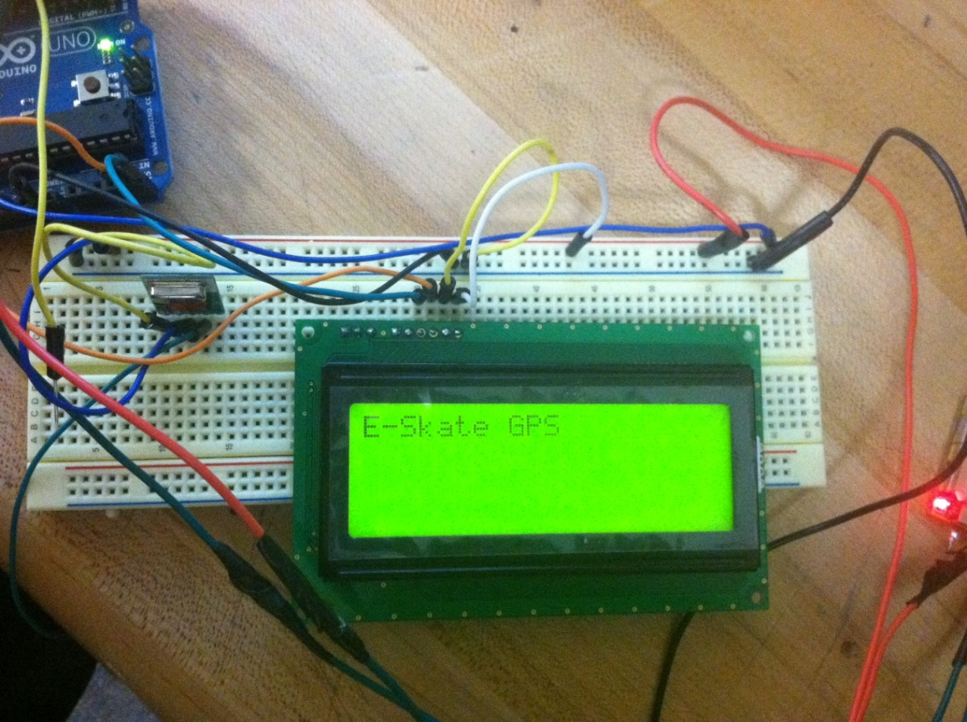
Newhaven LCD
Display data related to E-Skate state
GPS Location
Velocity
Altitude

Slide 23
Newhaven LCD

Slide 24
LCD Programming
Arduino playground LCDi2cNHD library
Implements Arduino Wire Library
Connects to microcontroller through the I²C protocol
Only needs 2 wires to connect to the microcontroller
Allows for easier control of LCD

Slide 25
Software Design
Data Control
Motor Control
Wireless Control

Slide 26
Data Control Software
Creates instances of serial connection to GPS, GPS and LCD
Virtual Serial connection allows for us to connect any pin to the GPS
Allows for easy troubleshooting from PC
Instance of GPS allows for different functions for NME0183 string parsing
Instance of LCD allows for easier code programming on the LCD

Slide 27
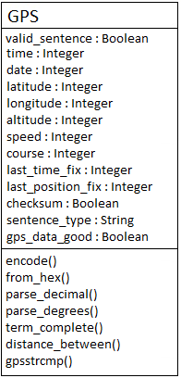
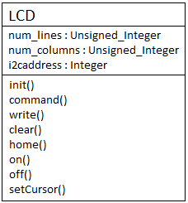
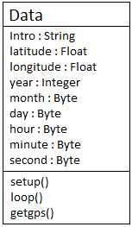
Data Microcontroller UML Diagram

Slide 28
Wireless Microcontroller
Creates instance of Xbee
Read from potentiometer
Values from 0 to 1023 (2¹⁰ -1)
Values are converted to values between 0 – 255

Slide 29
Setup Variables
Setup Xbee and Pins
Read Value from Potentiometer
Divide by 4
Send data to Xbee

Slide 30
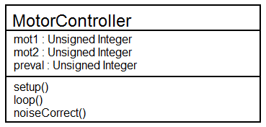
Motor Microcontroller
Creates an instance of Xbee for communication
Uses Pulse-Width Modulation (PWM) to control the motor
Controlled using a duty cycle of 0 to 255
Has self correcting noise code

Slide 31
MOTOR CONTROL
DC Motor
ATmega 328P
XBEE RECEIVER
H-BRIDGE
BATTERY
CHARGER

Slide 32
BTN7971B HALF BRIDGE
Low quiescent current of typ. 7 μA @ 25 °C
PWM capability of up to 25 kHz combined with active freewheeling
Current limitation level of 50 A (steady state) / 70 A (Max)
Status flag diagnosis with current sense capability
Overtemperature shut down with latch behavior
Overvoltage lock out
Undervoltage shut down
Price: $ 8

Slide 33
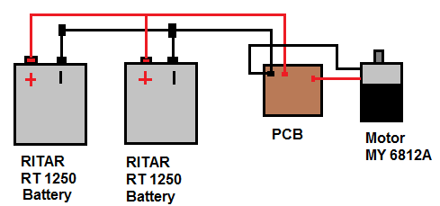
POWER SYSTEM

Slide 34
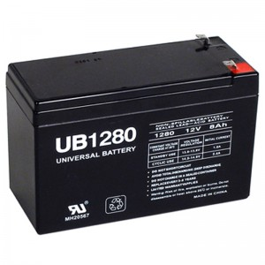
Battery UB 1280
Cells Per unit : 6
Voltages Per Unit : 12
Capacity: 8 AH at 20hr-rate to 1.75V
Weight : 4.96 Pounds
Maximum Discharge Current: 50 A
Maximum Charging: 1.5A
Operating Temperature Range:
Discharge: -20C - 60C
Charge: 0C - 50C
Storage: -20C - 60C
Price: $ 18

Slide 35
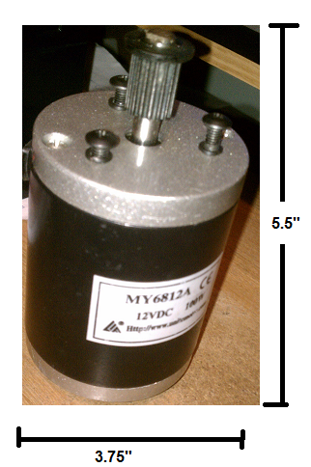
Motor MY6812A
12Volts DC 100W drive motor
Max non-load speed 3400 RPM
Max load speed 2700 RPM
Heavy duty and used by scooter companies
Rated torsion:0.28 N·m
Transmission output: Cam Belt
Price: $ 20

Slide 36
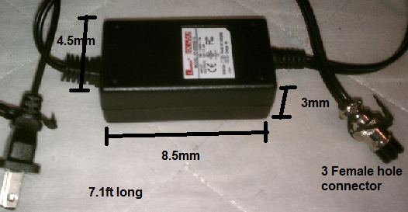
KY-05036S AC Charger
AC power Adapter 5V-12V
Input of 100 - 240 V @ 1A
Price: $ 25

Slide 37
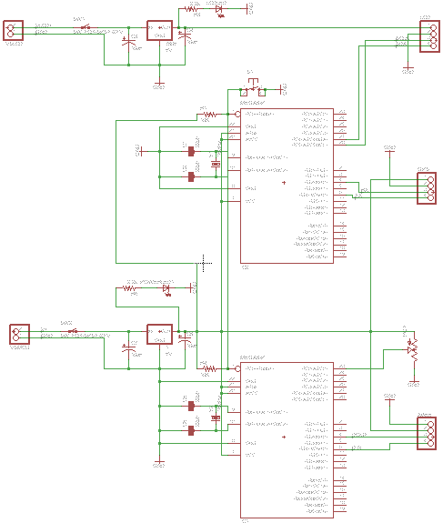
FINAL PCB DESIGN

Slide 38
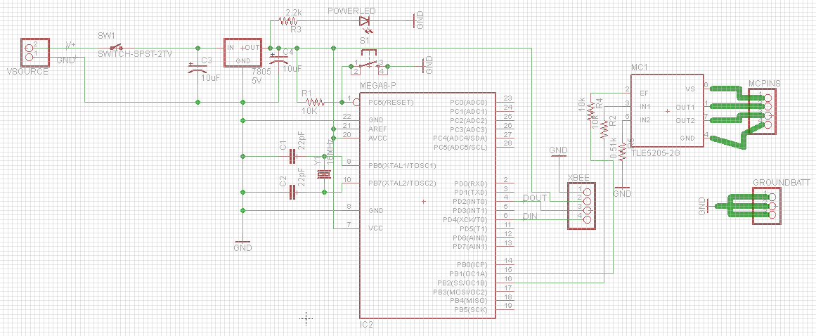
FINAL PCB DESIGN

Slide 39
Problems
Battery Life using a voltage divider
Receiving noise in Xbee
Overheating cables, traces, and H-Bridge

Slide 40
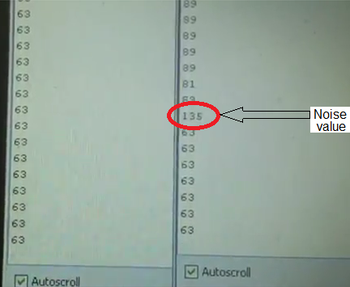
Solutions
Noise Detection

Slide 41
Noise Correction
During testing, it was shown that there was an abundant amount of noise
Many noise values, most abundant were 141 and 128
Noise correcting code saves the previous value outputted and then compares the present value to predetermined noise values

Slide 42
Battery Voltage Divider
Allows for knowledge of how much battery is left based on how much voltage is provided by battery
Range of 11-13V
Voltage divider lowers battery voltage to a readable voltage by the microcontroller
Unity Gain Buffer used for controlling current, has low current going into the microcontroller

Slide 43
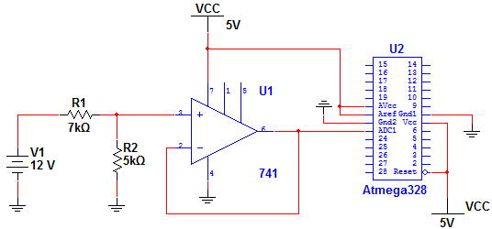
Battery Voltage Divider
R2/R1 + R2 = Vout / Vin

Slide 44
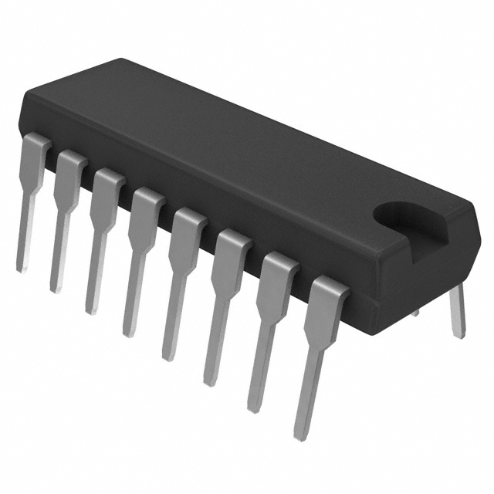
SN75441
1 A OUTPUT- Current per Driver
It was not enough to handle the current to move to motor attach to the wheel

Slide 45
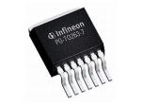
TLE 5206 – 2G Problems
Was used for second prototype
Only allows 5-Amps

Slide 46
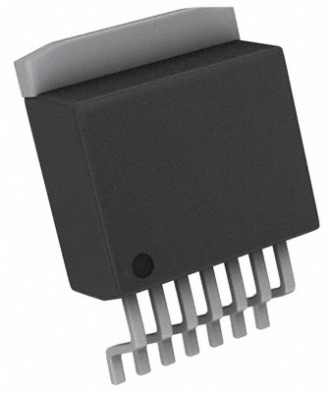
BTN 7971 Problems
Original H-Bridge that was to be used
Overheated and would melt the solder joints
A PCB trace burnt from
the current
4 H-Bridges internal circuitry
burned out

Slide 47
Additional Solutions
Overheating solved by replacing connections with better gauge cables
Traces burnt, so we built a backup Perfboard
H-bridge overheating solved by heat sink

Slide 48
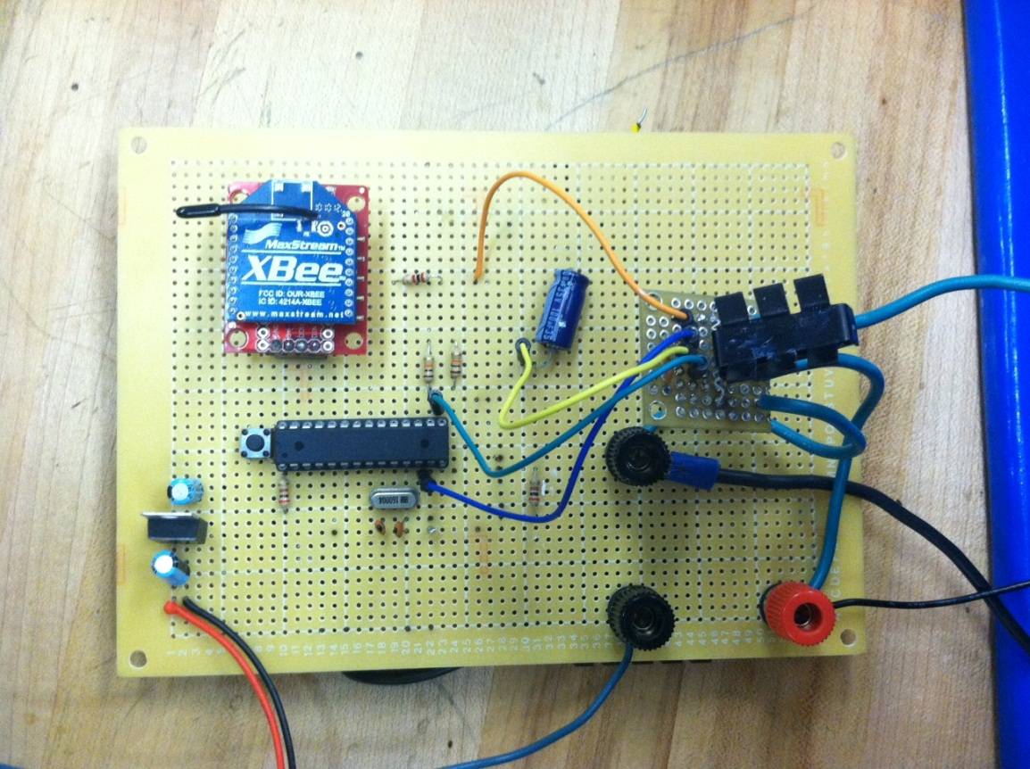
Back Up
Built a backup motor controller Perfboard with a spare 5A H-Bridge from previous testing

Slide 49
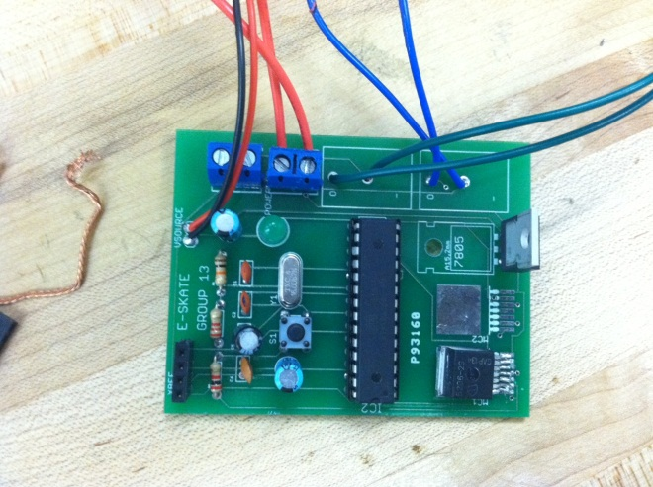
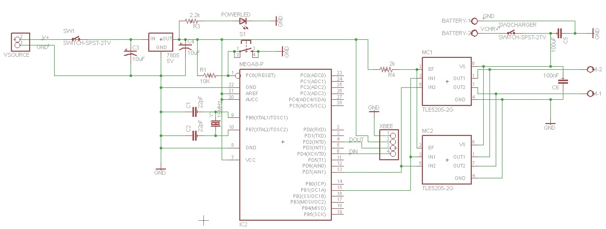
Back Up Board

Slide 50
COMPLETED

Slide 51
BUDGET
 | ORIGINAL | ACTUAL
ITEM | AMOUNT $ | AMOUNT $
Battery/ Charger | 80 | 43
GPS | 70 | 40
RC Unit | 10 | 50
Skateboard | 40 | 25
Motor | 80 | 20
Electronics | 40 | 30
PCB | 150 | 120
LCD Display | 35 | 25
TOTAL | $ 505 | $ 353

Slide 52
WORK DISTRIBUTION

Slide 53
VIDEO
http://www.youtube.com/watch?v=dMxc1bsSjT0

Slide 54
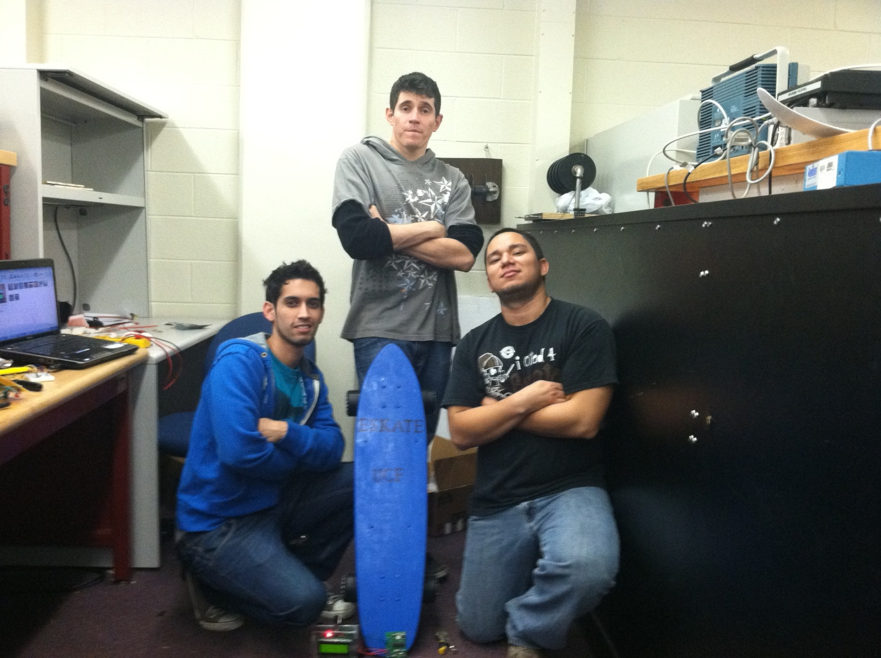
DEMO

Slide 55
Questions?

