Slide 1

GROUP 13
OSCAR CEDENO
CESAR ROMERO
CAMILO ROMERO
E-SKATE

Slide 2
Goals and Objectives
Create a skateboard with simple user feedback
Create a fast transportation method inside a college campus
User will control the E-Skate by a wireless controller
Portable and easy to charge
Low cost

Slide 3
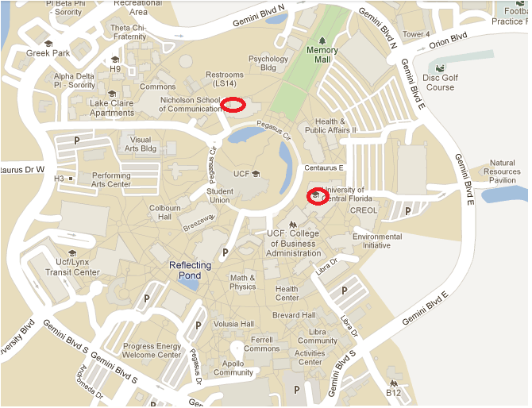

Slide 4

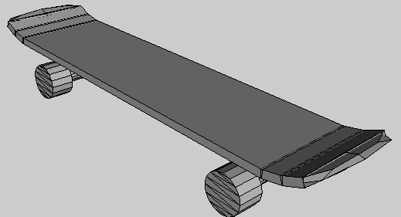
E-SKATE OVERVIEW
LCD
WIRELESS
REMOTE CONTROL
(Used while
E-Skating)
BATTERY + ELECTRONICS
DC MOTOR

Slide 5
Specifications
$500 Budget for Project
Under 15 Pounds
3 Hours Battery Life
10 Feet Range for Wireless Communication
Cruising in Clear Weather Conditions
12 V Battery System
5A per Battery
100 Watts DC Motor

Slide 6
Design
BATTERY SENSOR
ATmega 328P
POTENTIOMETER
TRANSMITTER
ACCELEROMETER
ATmega 328P
GPS
MOTOR ENCODER
LCD
WIRELESS CONTROL
DATA CONTROL
ATmega 328P
DC Motor
RECEIVER
BATTERY
MOTOR CONTROL

Slide 7
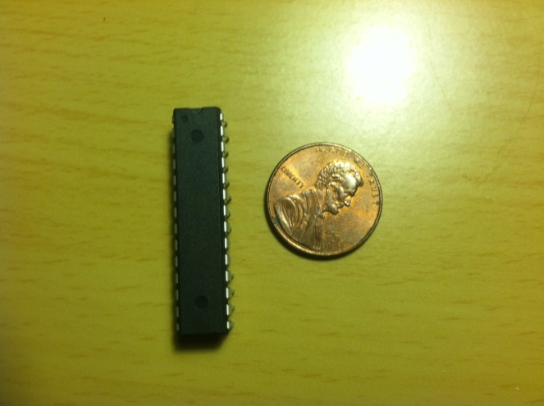
ATMEGA 328P
Max operating frequency of 20 MHz
Serial Communications SPI, RS232, I²C
Operating Voltage: 1.8 to 5.5 V
Internal Temperature Sensor
32 Kbytes Flash Memory
23 I/O Pins
6 Channel 10 bit ADC
6 PMW Channels
Price: $4.87 / Free

Slide 8
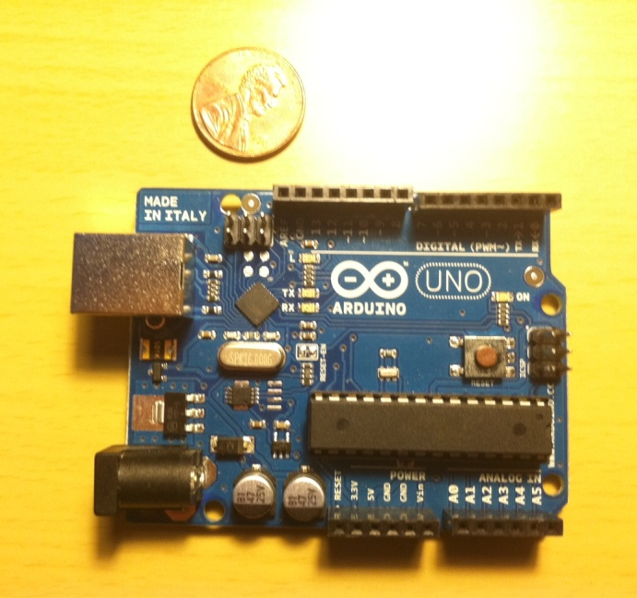
ARDUINO DEVELOPMENT BOARD
16 MHZ Clock Speed
5V Operating Voltage
7-12V Input Voltage
14 Digital I/O Pins
6 Channel 10 bit ADC
6 Pins provide PWM output
40 mA DC Current per I/O Pin
Programmed with Arduino Software
Price: ~$30.00

Slide 9
WIRELESS CONTROL
ATmega 328P
POTENTIOMETER
TRANSMITTER
RECEIVER

Slide 10
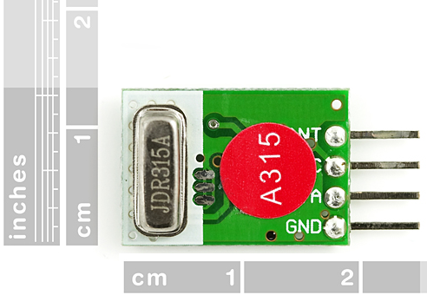
RF LINK TRANSMITTER
WRL-08945
315 MHz Transmitter Frequency
500 Feet Range
2400 or 4800bps Transfer Rate
Operational voltage 1.5-12 V
Operational Temperature of -20 to 85 C
Price: $ 1.95

Slide 11
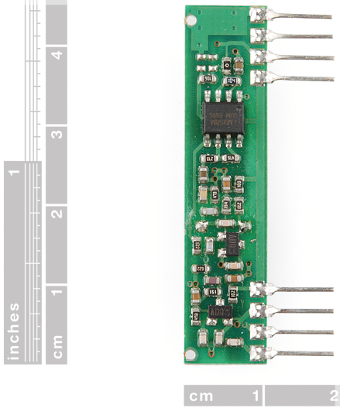
RF LINK RECEIVER
WRL-10533
Frequency Range: 315MHz
Modulate Mode: ASK (Amplitude Shift Keying)
Date Rate: 4800 bps
Supply Voltage: 5V
Price: $ 4.95

Slide 12
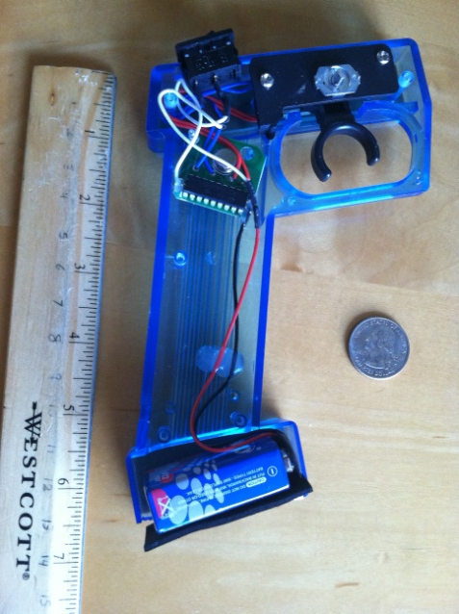
HANDS ON REMOTE CONTROL
ON/OFF SWITCH
SIGNAL SWITCH
ATMEGA 328 + TRANSMITTER + POTENTIOMETER
9V BATTERY

Slide 13
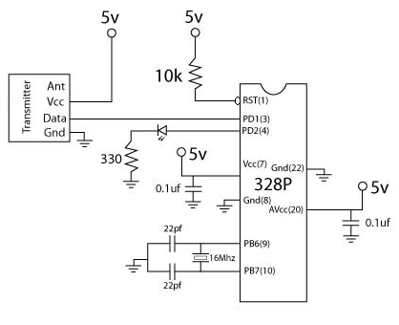
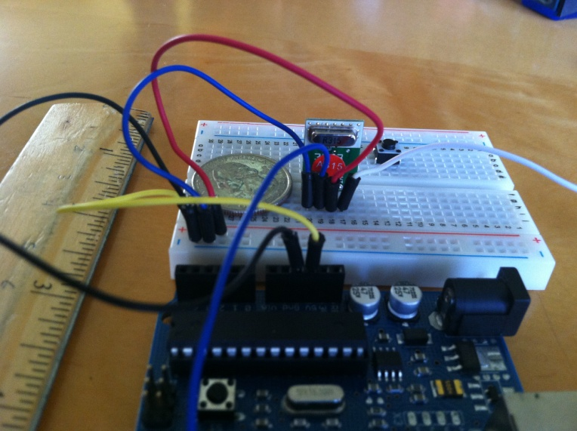
CONNECTING TRANSMITTER TO ATMEGA 328P

Slide 14
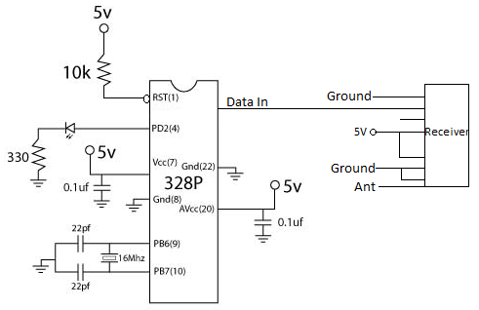
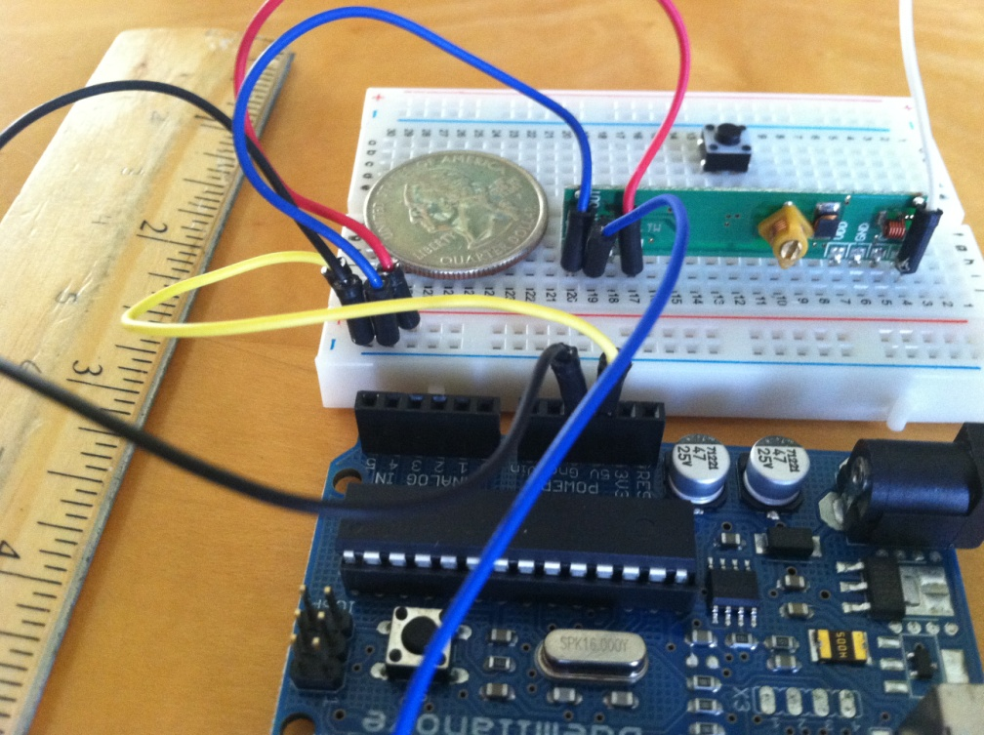
CONNECTING RECEIVER TO
ATMEGA 328P

Slide 15
DATA CONTROL
BATTERY SENSOR
ACCELEROMETER
ATmega 328P
GPS
MOTOR ENCODER
LCD

Slide 16
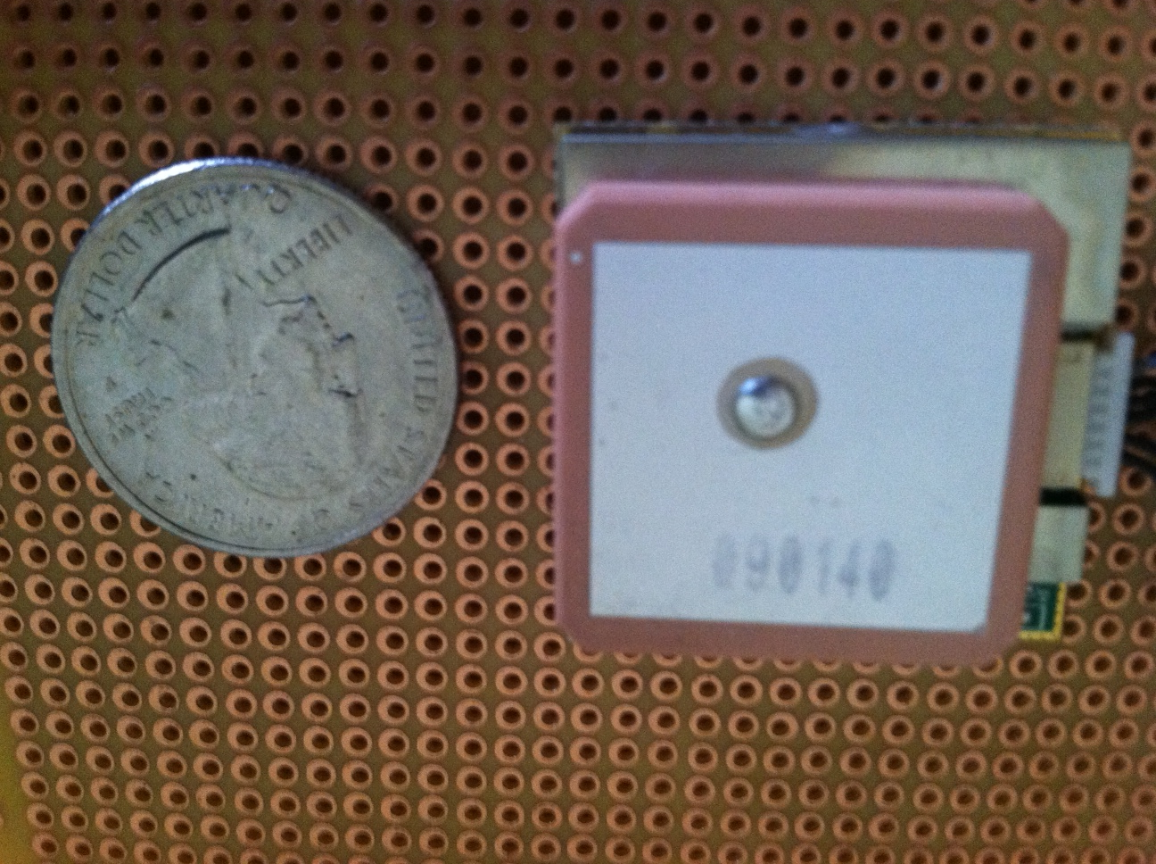
GPS Module

Slide 17
EM-406a Module
20-Channel Receiver
10m Positional Accuracy / 5m with WAAS
Hot Start : 1s
Warm Start : 38s
Cold Start : 42s
70mA at 4.5-6.5V
Outputs NMEA 0183 and SiRF binary protocol
Small foot print : 30mm x 30mm x 10.5mm
Built-in LED status indicator
6-pin interface cable included
Price : $40.00
Pin Layout

Slide 18
NMEA 0183 Protocol
Some Protocol Descriptions:
$GPGSV,3,1,12,20,00,000,,10,00,000,,25,00,000,,27,00,000,*79
Message | Description
GGA | Time, Position, Fix Type
GSA | GPS receiver operating mode, Satellite used in position solution. DOP values
GSV | The number of GPS satellites in view, satellite ID number, Elevation Azimuth, SNR values.
RMC | Time, Date, Position, Course, Speed
$GP which start the message all the time
Next would be the message which in this case is the GSV, which is described in Table
Each data element is separated by a comma, and the data elements are terminated by the * character
There is a 8-bit XOR of each character between $ and * to form the checksum
Finally the last two characters are hexadecimal representation of the calculated checksum.

Slide 19
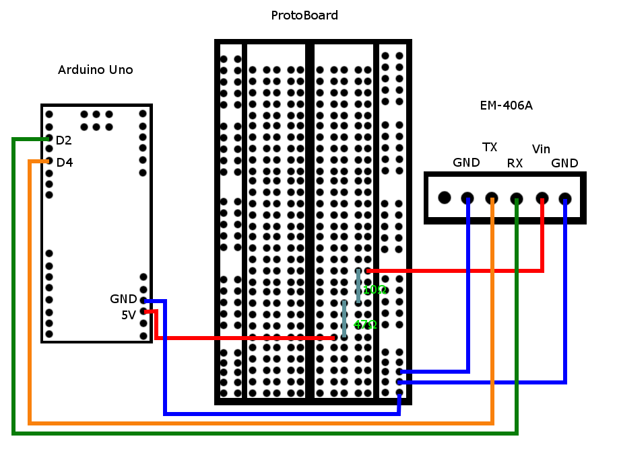
GPS Schematic for the Arduino

Slide 20
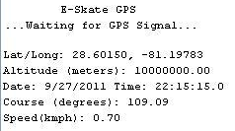
Serial Monitor of the Arduino
EM-406a is sending data to the arduino development board and it is displayed on the computer screen.

Slide 21
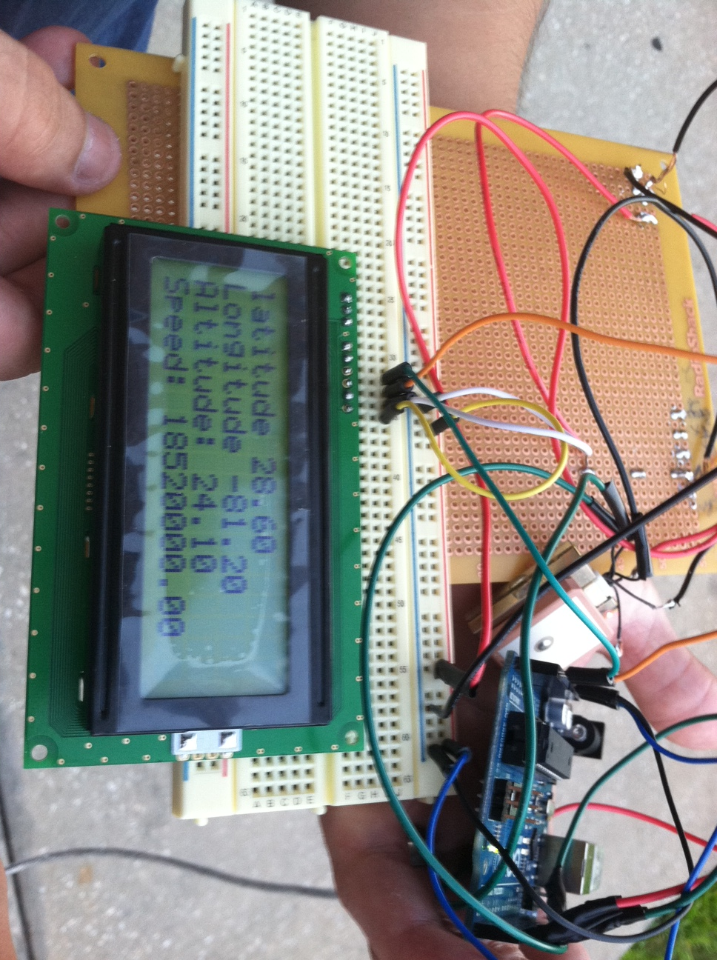
GPS And Arduino And LCD
GPS is connected hardware to the arduino board and it send data to the computer.

Slide 22
Data Display Microcontroller
Microcontroller will display data to LCD
Will take input from sensors and GPS
  Sensors include Accelerometer, Motor Encoder and a Battery Sensor
Separate unit from microcontroller which controls motor

Slide 23
Data Microcontroller
GPS
LCD
Accelerometer
Battery Sensor
Motor Encoder

Slide 24
Programming
Programming through Arduino which is similar C++
Use libraries Wire.h, inttypes.h, LCDi2cNHD.h, TinyGPS.h, NewSoftSerial.h
With these create a new LCD instance, GPS instance, and a Serial Connection Instance
Able to call functions to get data from GPS and to print to LCD

Slide 25
Data Microcontroller Flowchart
Setup Variables
Read from Sensors and GPS
Check GPS, Sensors
Make Calculation
Send Welcome
to LCD
Output data to LCD
Start Devices
Go back to read Sensor and GPS

Slide 26
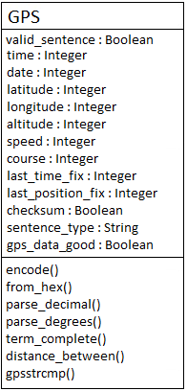
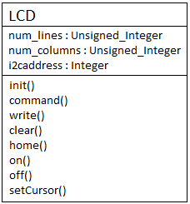
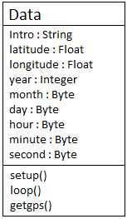
Software UML for Data Microcontroller

Slide 27
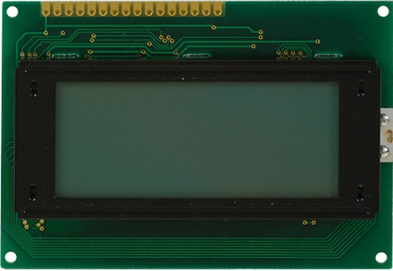
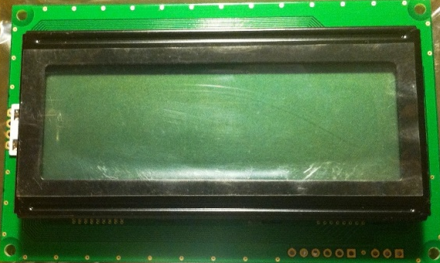
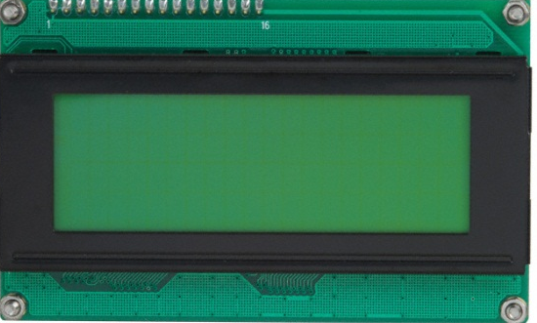
LCD
 | Lumex LCM-S01604DSF | Newhaven 0420D3ZFLGBW | Matrix Orbital LK204-25
Display Format | 16 x 4 | 20 x 4 | 20 x 4
Connection Type | Parallel | I²C, RS232, and SPI | I²C, RS232, and TTL
LCD Type | Transflective | Transflective | Transmissive
Voltage | 5 V | 5 V | 5 V
Outline Area | 8.7 cm x 6 cm x 1.27 cm | 9.8 cm x 6 cm x 1.35 cm | 9.8 cm x 6 cm x 2.75 cm
Price | $29.73 | $24.90 | $69.75

Slide 28
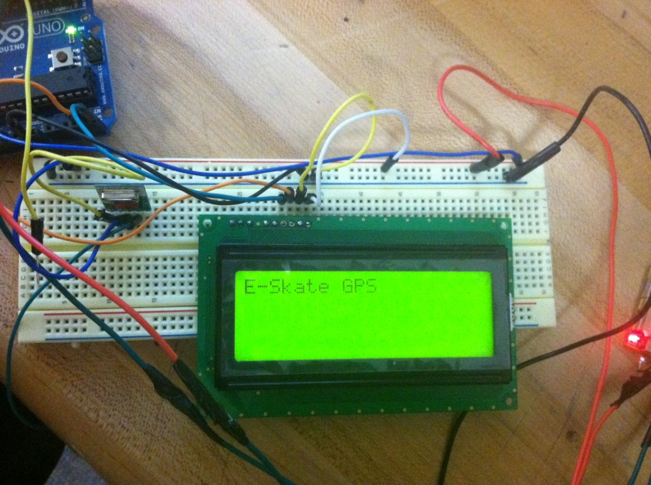
Newhaven LCD
Display data related to E-Skate state
Distance Traveled
GPS Location
Velocity
Time Used
Battery Left
Motor RPM
Acceleration

Slide 29
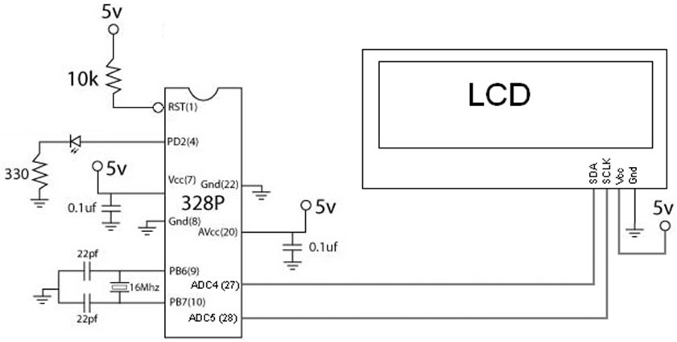
Newhaven LCD

Slide 30
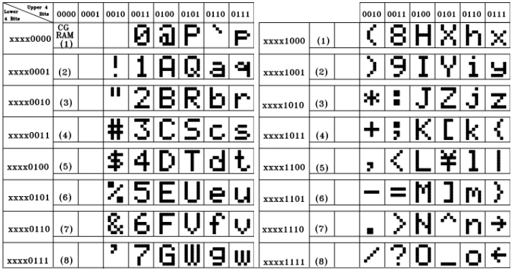
LCD Built In Character Table
Has to be programmed into microcontroller

Slide 31
LCD Programming
Arduino playground LCDi2cNHD library
Implements Arduino Wire Library
Connects to microcontroller through the I²C protocol
  Only needs 2 wires to connect to the microcontroller
Allows for easier control of LCD

Slide 32
Accelerometer
Records acceleration data
Can provide data on how hard E-Skate hits a rock or a crack
Easily implemented into the Arduino Environment

Slide 33
Accelerometer
 | Dimension Engineering DE-ACCM2G2 | Freescale MMA7361L Accelerometer
Axis | 2 | 3
Operation Voltage | 3.5V-15V | 2.2V-3.6V
Selectable g Sensitivity | No | Yes
Output Buffers | Yes | No
Size | 1cm x 1.8 cm x .8cm | 1 cm X 1.27 cm
Price | $23.00 | $12.00

Slide 34
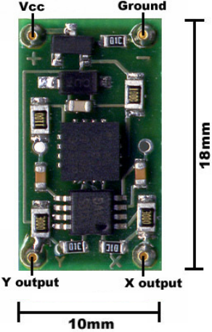
DE-ACCM2G2 Accelerometer
Dual axis ±2g sense range
660mV/g sensitivity
500Hz bandwidth
Operating voltage 3.5V to 15V
Standard DIP-14 form factor
Draws under 2mA
<4% typical 0g bias deviation
from 1.65V which is V_{cc}/2

Slide 35
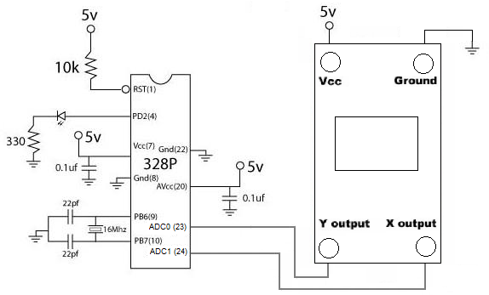
DE-ACCM2G2 Accelerometer

Slide 36
Battery Sensor
Allows for knowledge of how much battery is left based on how much voltage is provided by battery
Range of 10.5 - 13V
Voltage divider lowers battery voltage to a readable voltage by the microcontroller
Unity Gain Buffer used for controlling current, has low current going into the microcontroller

Slide 37
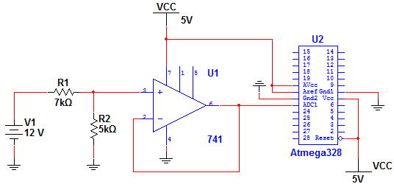
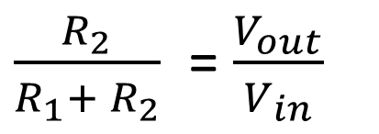
Battery Sensor
$\frac{R_{2}}{R_{1}+ R_{2}}$ = $\frac{V_{out}}{V_{in}}$

Slide 38
MOTOR CONTROL
ATmega 328P
DC Motor
RECEIVER
BATTERY

Slide 39
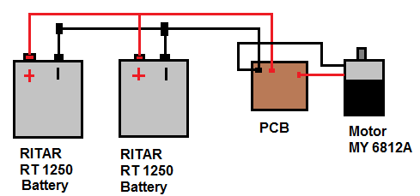
POWER SYSTEM

Slide 40
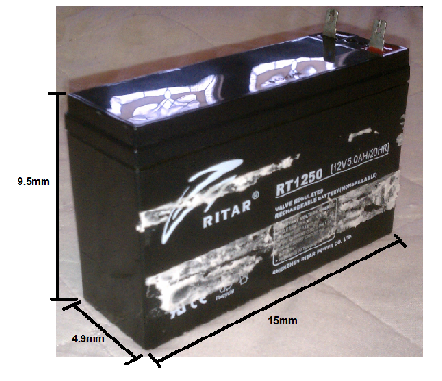
Battery RT 1250
Cells Per unit : 6
Voltages Per Unit : 12 V
Capacity: 5.0Ah at 20hr-rate to 1.75 V
Weight : Approx. 1.60 Kg
Maximum Discharge Current: 50 A (5 sec)
Internal Resistance: Approx. 35 mΩ Operating Temperature Range:
  Discharge: -20 - 60C
  Charge: 0 -50C
  Storage: -20 - 60C
Recommended Maximum Charging: 1.5A
Price: $17.99

Slide 41
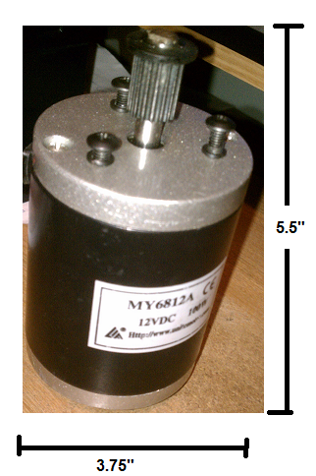
Motor MY6812A
12Volts DC 100W Drive Motor
3400 RPM
It is heavy duty and used by companies for electric scooters
Price: $19.50

Slide 42
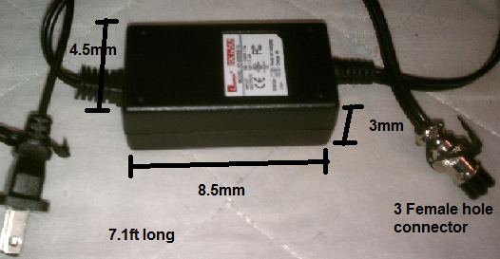
KY-05036S AC Charger
Leadman KY-05036S-12 AC power Adapter 5V-12V
Input 100Volt~240 Volts / 1A
The Dimensions are 125x48x31mm
Output 12 Volt / 1.5A
Price: $25

Slide 43
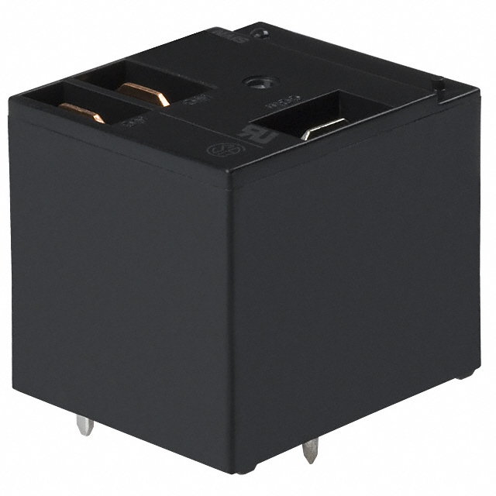
JTN1S-TMP-F-DC12V Relay
Relay Type: General Purpose
Contact Rating (Current): 20A
Coil Current: 66.7mA
Coil Voltage: 12VDC
Turn On Voltage (Max): 9 VDC
Turn Off Voltage (Min): 1.2 VDC
Quick Connect
  Coil Power: 800 mW
  Coil Resistance: 180 Ohms
Price: $4.00

Slide 44
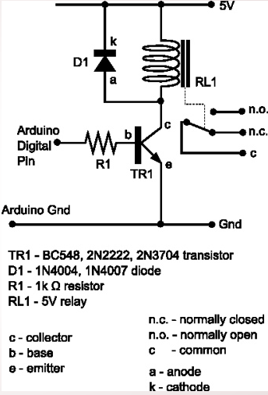
Design

Slide 45
COMPLETED SO FAR

Slide 46
BUDGET SPENT
CURRENT SPENDING
ITEM | AMOUNT
Battery/ Charger | $65
GPS | $40
RC Unit | $7
Skateboard | Donated
Motor | $20
Electronics | $20
PCB
LCD Display | $25
TOTAL | $ 177
REMAINING BUDGET | $ 323

Slide 47
WORK DISTRIBUTION

Slide 48
Remaining Tasks And Problems
PCB Design in Eagle CAD
Testing Motor
GPS Velocity is off
Testing Receiver and Transmitter
Finish Programming
Power Regulator and Potentiometer to be Designed

Slide 49

Lets Start E-Skating!
Questions?

