Slide 1
PUTR
All in one putting system
Group 16
Dylan Reuter
Ryan Pham
Austin Collins
Dominic Dicaterino

Slide 2
Project Description & Motivation
PUTR is a technology infused putting mat.
Complete with aim line projection, variable terrain and controlled by a mobile app for ease of use.
Aims to be much more cost efficient than other devices of similar nature
Still having all the technological benefits
Also having much more mobility than other devices.

Slide 3
Objectives
Accessible
$400-500 to the average user
Compete with driving ranges
Main objectives:
Variable Grass Surface
Projection
Position Settings
Path Planning
Practice and Play modes
Supports human weight
Bluetooth

Slide 4
Specifications & Requirements
Attribute | Description
Dimensions | Surface area of 4x6 feet
Cost | $400 goal
Weight | <100 lbs
Surface | Artificial grass atop a wooden frame with controlled linear actuators
Projection | Lightweight and capable of covering the entire surface area. Compatible with Raspberry Pi.
Sensors | Camera to track the golf ball and its path
Computing | Raspberry PI and MSP430
Controls | Physical and bluetooth controls
Power | 12V AC/DC Power supply as well as a 5V and a 3.3V DC supply

Slide 5
Constraints
Space constraints
6X4
Small form factor to fit in small spaces
Weight constraints
Less than 100lbs
Lightweight to transport easier
Time constraint
2 months
Economic constraints
$400
Lighting constraints
To display the projection, there needs to be low lighting
Cameras have night vision so low light is not an issue for detection

Slide 6
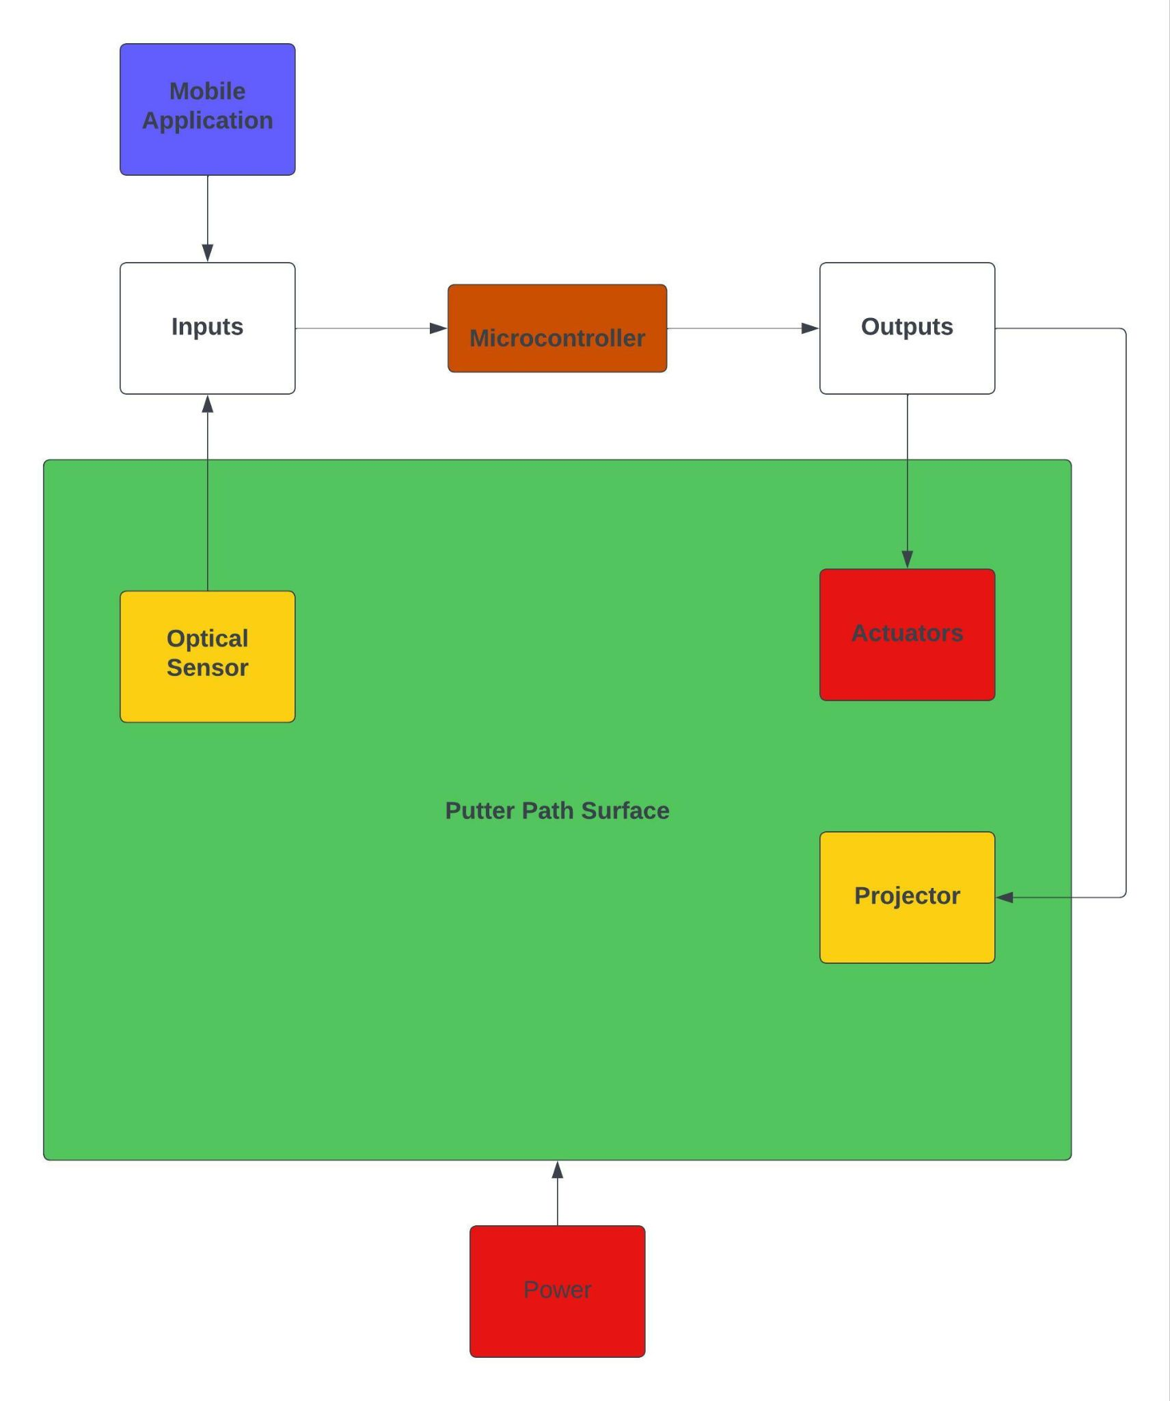
System Block Diagram
Red - Dominic
Blue - Austin
Orange - Dylan
Yellow - Ryan

Slide 7
Line Projection System Overview
To identify the golf ball and it’s relative location on the putt surface
Calculate the distance from golf ball to hole
Display line through projection showing a line from ball to hole
Lots of possibilities for more to be added when main objective is finished.

Slide 8
Line projection and Calculating the Ideal Line
A^2 + B^2 = C^2
Margin of error = +-90 degrees

Slide 9
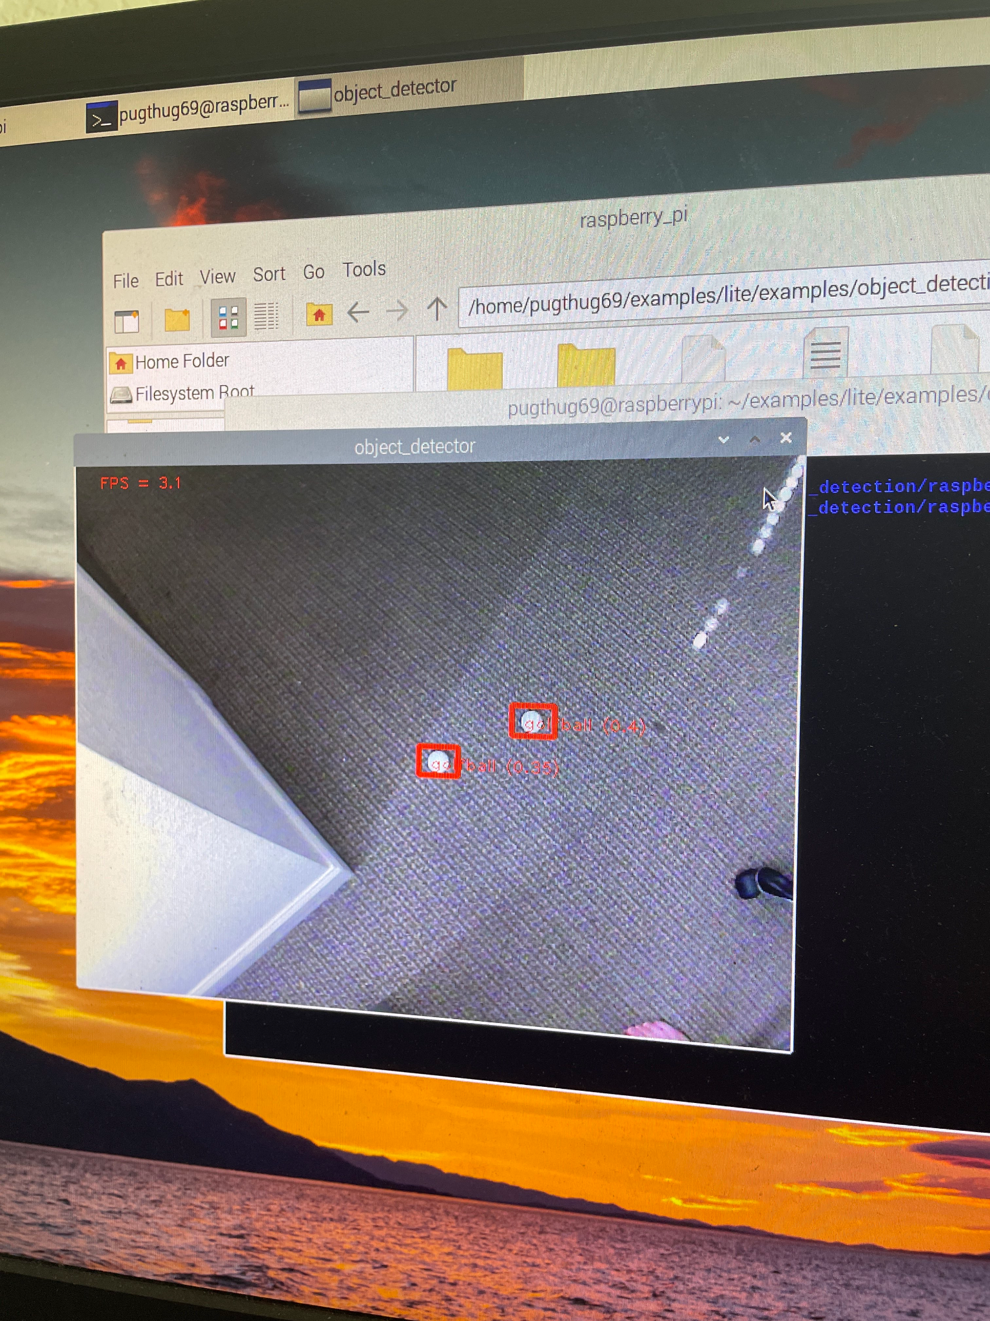
Raspberry Pi 3
Great to use with computer vision (Easy to install)
Loaded with Python IDEs
Free
Quad Core Processor & 16 GB RAM
USB Ports for Camera and HDMI Ports for Projector

Slide 10
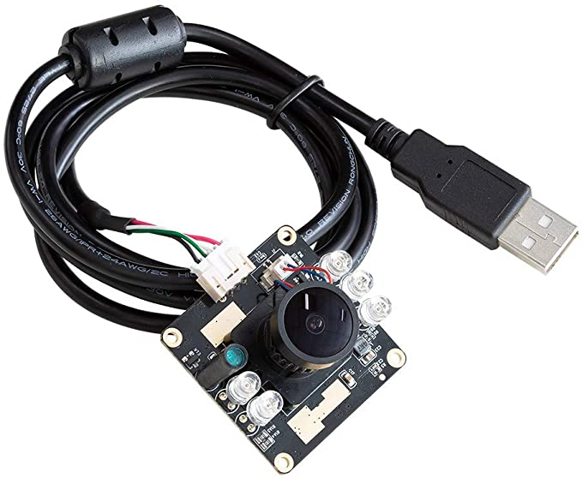
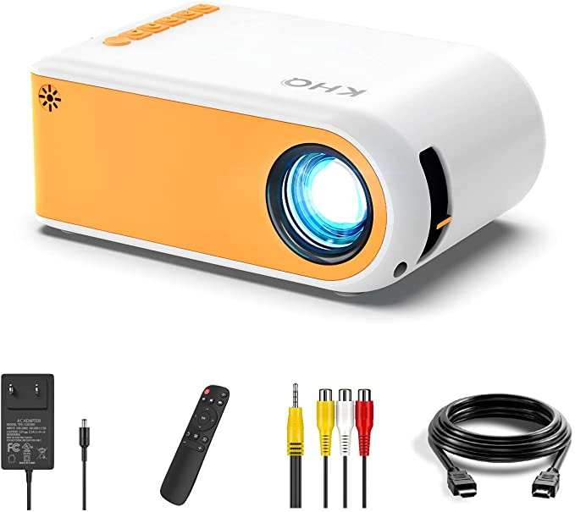
USB Camera & Projector
Basic USB Camera that is compatible with the Raspberry Pi
Allows us to know an approximate location of the golf ball using object detection
Need USB extension for high angle and view of putt surface
Very lightweight projector that is compatible with Raspberry Pi
Displays image in 16:9 format so will need to be angled properly over surface
Used to display lines and other graphics on course
Python graphic library

Slide 11
Python & Program Flow
Python is main language (Lots of great libraries)
OpenCV for computer vision applications
Graphics libraries for projection
Wait for change in golf ball coordinates and loop
5
Use object detection to find golf ball location
Save the image and project onto surface
1
4
2
3
Use coordinates and calculate distance from golf ball to hole using our distance formula
Draw specified distance using Python graphics library

Slide 12
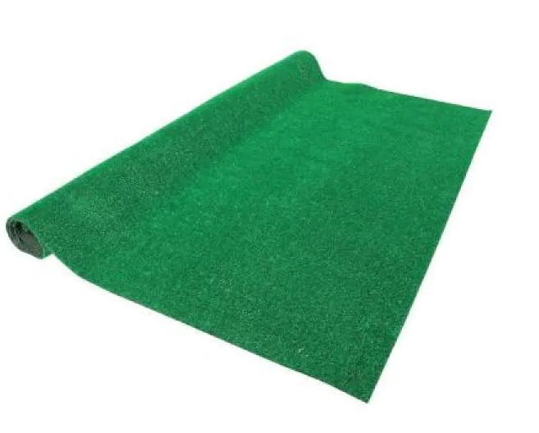
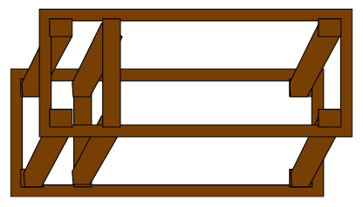
Surface and Framing
An array of linear actuators underneath an artificial grass surface will provide the variable elevation of this design.
Wooden framing will elevate the grass surface giving the actuators clearance to stand underneath.
The framing will be stained and sealed to mitigate any wear from use or weathering.
Artificial turf will be secured onto the frame with slack to give room for elevation changes by the actuators.

Slide 13
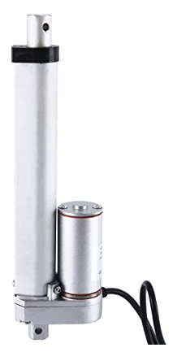
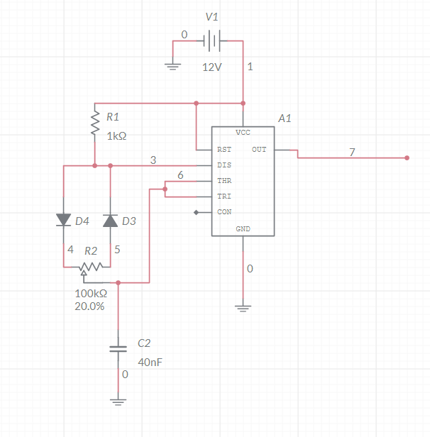
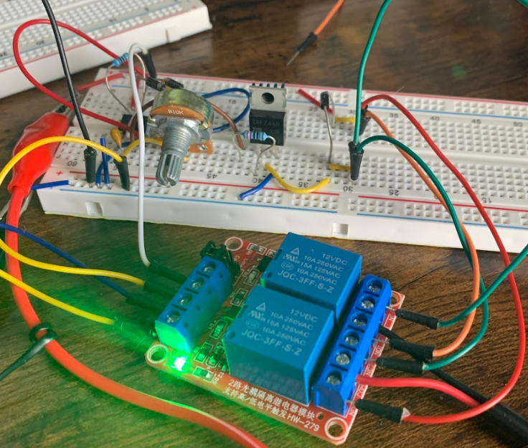
Actuators
The actuator array consists of four 12V linear actuators, each individually capable of moving up to 225 pounds.
The current draw of each actuator is dependent on the load it is supporting with 3 amps being the maximum.
The actuators are rated with a duty cycle of 25% to avoid overheating.
Given the duty cycle specification, a 555 timer based PWM circuit will be used to drive the motors

Slide 14
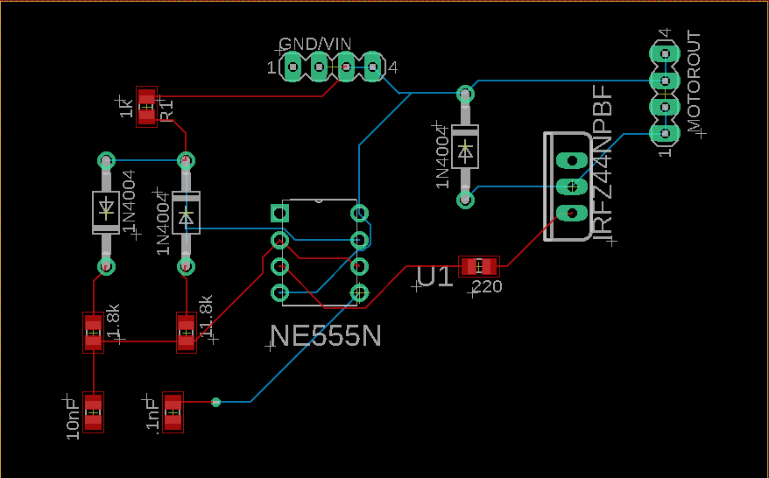
PCB 1- NE555 PWM Circuit

Slide 15
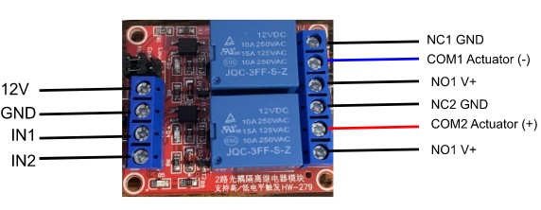
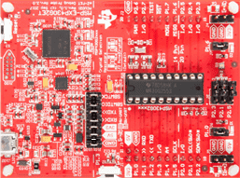
Controls
PUTR will be controlled with physical buttons as well as bluetooth inputs.
Controls will be input to the MSP430 microcontroller with a HC-05 bluetooth module.
Options will include presets as well as custom position settings.
The microcontroller will output signals to the actuators through a pair of relays that will move the actuator up or down depending on what relay is activated.
Inputs 1&2 will activate their respective relays, connecting the actuator to either a positive or negative voltage. Thus, making it move up or down.

Slide 16
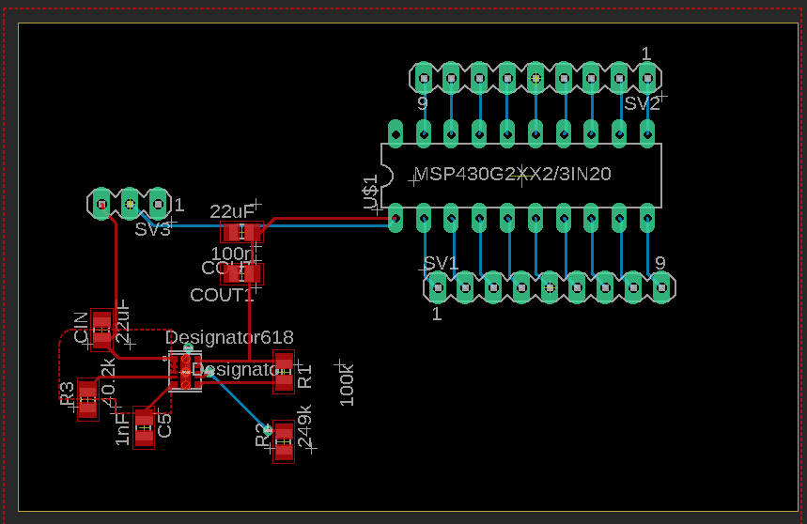
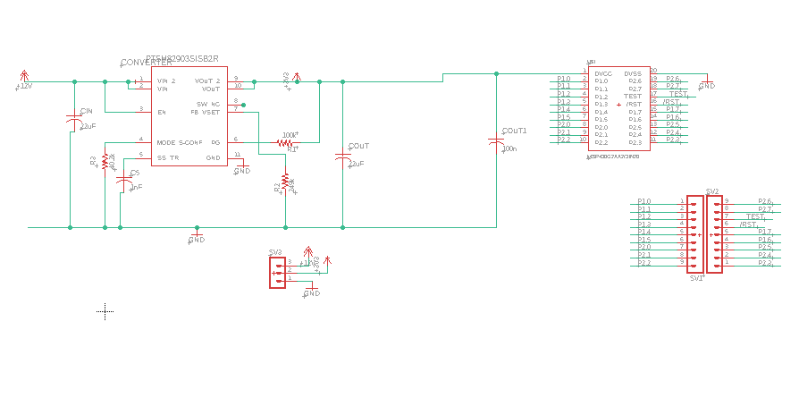
Power/PCB 2
The system will be powered by a 12 Volt 40 Amp switched-mode power supply capable of providing 480W of power.
The supply has 3 channels at 12 volts each.
The actuators and relays will use the full 12V. But,A dc/dc converter will also be needed to step down the voltage to 5 and 3.3 volts for the other electronics.
Uses the TPSM82903 synchronous buck converter (may change due to availability)

Slide 17
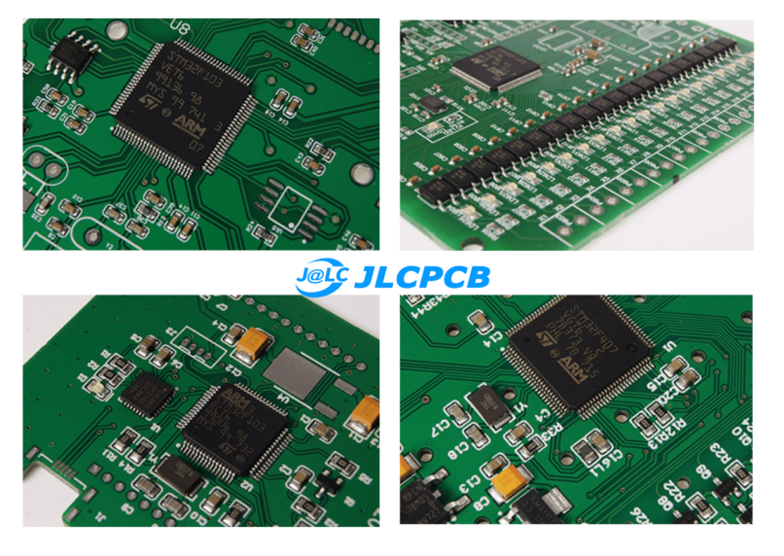
PCB vendor
JLCPCB
affordable , reliable
Minimum quantity of 5
Shipping time: 1-2 weeks
Production time: 3 days
Throughhold components to to keep the cost low but we will have to solder the components ourselves

Slide 18
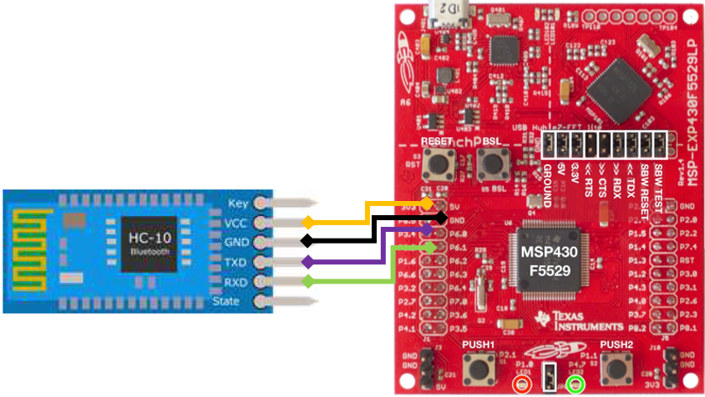
Software Application Communication
MSP430
Android/iOS Bluetooth network stack
API:
Bluetooth Adapter API
Bluetooth Device API
Bluetooth Socket API
Bluetooth Class API
Allows for the application to communicate with the actuators

Slide 19
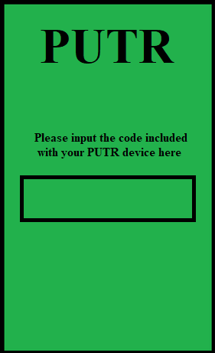
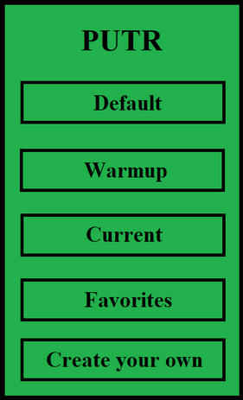
Mobile Application
The purpose of the code screen is added security.
With the main screen allowing for easy traversing of the application while still being easy to read.

Slide 20
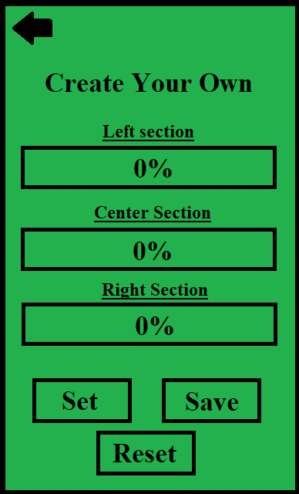
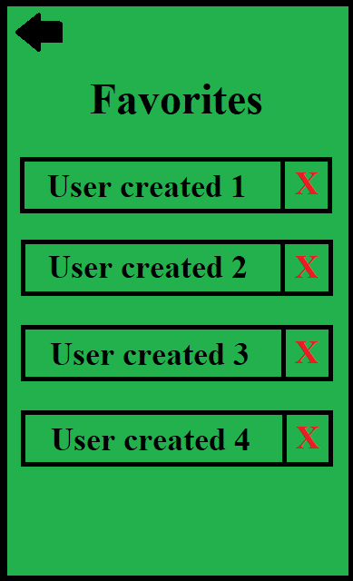
Mobile Application (cont.)
The create your own is integral as it allows the user to customize their experience with the PUTR.
While the favorite page allows the User to keep their favorite courses.

