Slide 1
Facial Recognition Lockbox
Group 4
Ryan Wiegman, Cpe
Julian Boaz, Cpe
Che’ Baptiste, Cpe
Bryce Dere, EE

Slide 2
Background
In 2021, an estimated $870.8 billion dollars were spent on e-commerce sales, increasing by 14.2 percent from the previous year.
40% of Americans have been the victims of package theft and more than 60% know somebody who has fallen victim
Relevant Lockboxes, price range between $300-$1000+ dollars.
These Lockboxes range from having none to several smart technologies features.
None including Facial Recognition.

Slide 3
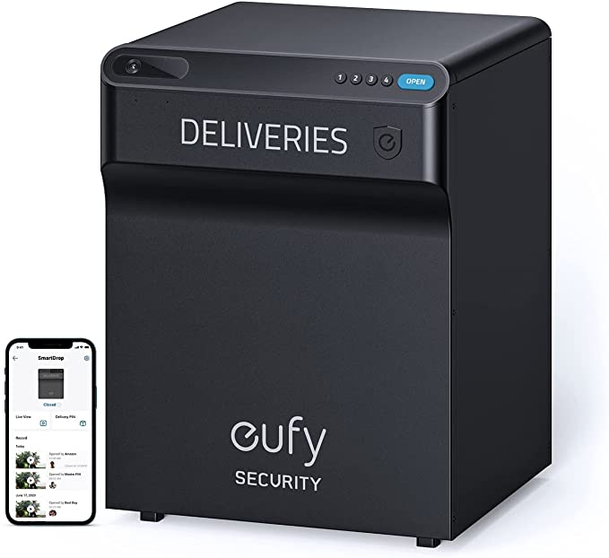
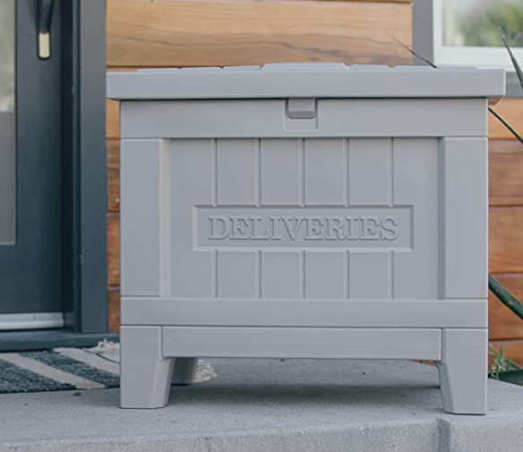
Relevant Solutions & Comparisons
Eufy Security SmartDrop
Can be opened via PIN or with a mobile app
Two-way communication through box and app
Battery powered
Cost: $400
Yale Smart Delivery Box
Can be opened via PIN or with a mobile app
Battery Powered
Cost: $300

Slide 4
Motivation
Reduce the amount of at home package thefts, deterring porch pirates.
Design a multipurpose Lockbox; food, packages, mail.
Create a efficient and cost effective high tech Lockbox.
Learn new skill for future endeavors.

Slide 5
Goals and Objectives
Features
Container to prevent package theft with added security
Cloud storage to keep account information secure
Keypad for interaction between user and lockbox
Microcontroller controls microprocessor
Mobile application to manage accounts, send images, and receive 6 digit passcode
2 factor authentication with 6 digit passcode and facial recognition
Email Verification
Speaker to aid in user interaction with Lockbox

Slide 6
How does our solution compare to existing ones?
Facial recognition decreases user friction
Using outlet power connection is more available, easier, and more efficient than using battery power
Specifically implementing elements for keeping food safe while also being able to accept non-food deliveries
Lower overall cost

Slide 7
Specifications
Component | Requirement Specifications
Software | The AI facial recognition software must be able to identify a user with 95% accuracy
Software | The AI facial recognition software must have an execution process between 3 to 7 seconds
User Interface | The user interface must have an execution time of 1-3 seconds to upload an image to the cloud service
Main Unit | The system will have a 6-digit code lock, as a form of 2 factor authentication.
Main Unit | Main Unit must notify user of next needed action or if something went wrong.
Hardware | The locking mechanism must be able to withstand 150 pounds of force.
Cost | Cost of main unit, hardware, and cloud service should not exceed $200
Notes:
Goals, specifications, features, and functions

Slide 8
Relevant Standards
ANSI Grade 3; Must be able to withstand:
200,000 cycles
2 door strikes
150 pounds of weight
2 hammer strikes
Generally used on residential door locks, which is ideal as a deterrent but still weak enough to be opened forcefully in an emergency
Lock Security

Slide 9
Itemized Budget
Item | Price
Microprocessor | $FREE
Lockbox | $75
Camera module | ~$15
Electronic latch | $10
Amazon Web Services Server | ~$0.016 per hour
Power supply | ~$20
Total | ~$120

Slide 10
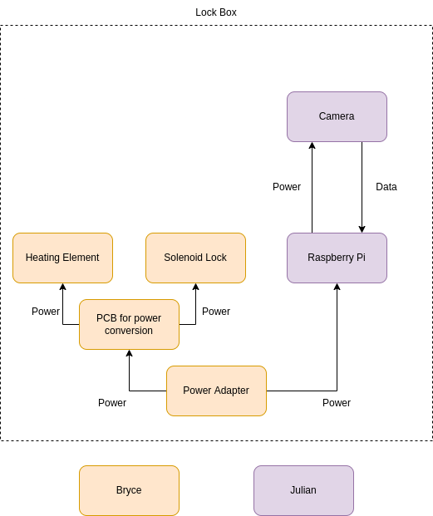
Hardware Block Diagram

Slide 11
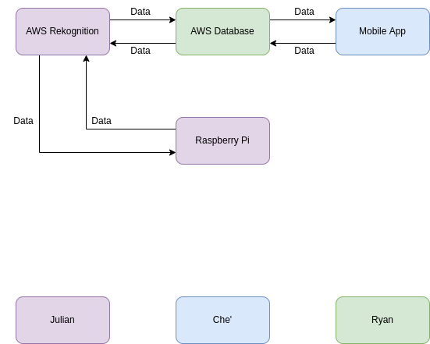
Software Block Diagram

Slide 12
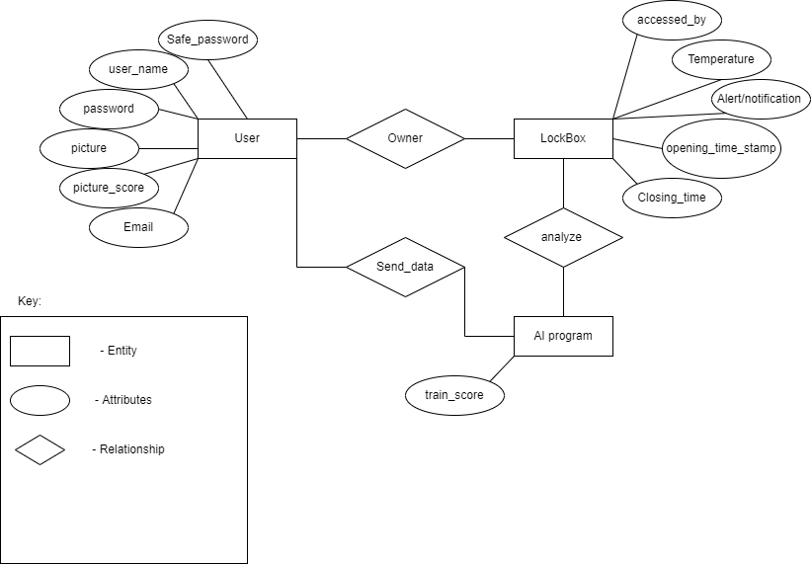
ER Diagram
user_number
serial_number
security_pin
take_photo
compare_faces
AWS Rekognition
accuracy

Slide 13
Amazon Web Services
AWS Rekognition will be used for artificial intelligence model
AWS S3 will be used for storing user data
AWS will keep all of the data needed for identifying users
AWS allows us to reduce the hardware requirements of the lock box, as well as our user’s cell phones
AWS is the only DoD approved cloud service, ensuring security
AWS has the ability to scale with the program, as user data increases.

Slide 14
Raspberry Pi Scripts
Used Python packages to receive input and send output to microcontroller, make AWS API calls, and generate text-to-speech
User is instructed on how to interact with the Pi through the text-to-speech
User can interact with Python script via keyboard for pin entry and keystroke for taking the photo
Both the 6 digit pin and photo must match what is associate with their account in order to gain access to the interior of the box

Slide 15
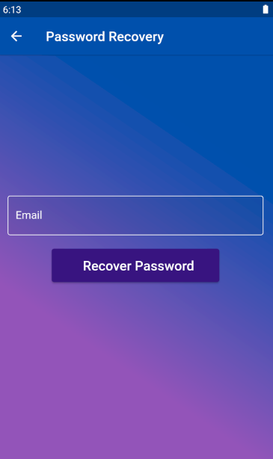
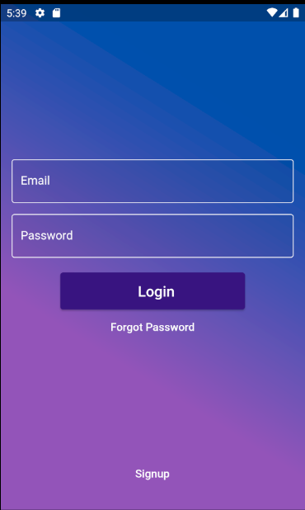
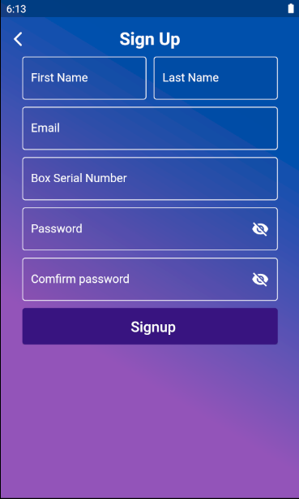
User Interface/Mobile App
Here are the 3 immediately accessible pages
For signup, password has to be strong and meet certain specifications (8 characters long, at least 1: capital letter, lowercase letter, number, and special character
Signup requires all fields be filled
Both Signup and Password Recovery send confirmation emails for user for added security
Password Recovery Page
Login page
Signup Page

Slide 16
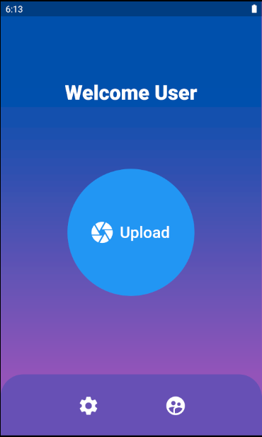
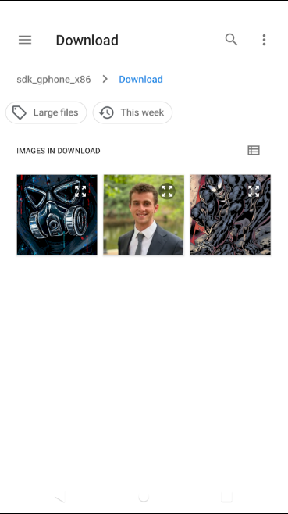
User Interface/Mobile App (cont.)
User home page (as seen on left)
3 buttons
Upload
Settings
About Us
Upload button will take you to your gallery
Failure to upload image will result in a dialog box appearing

Slide 17
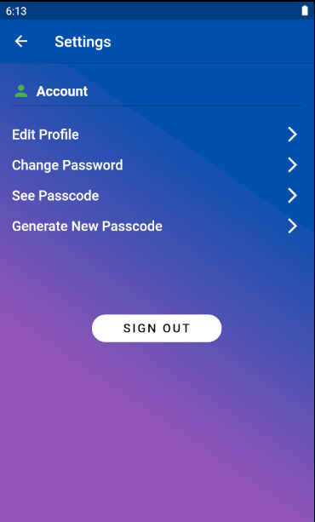
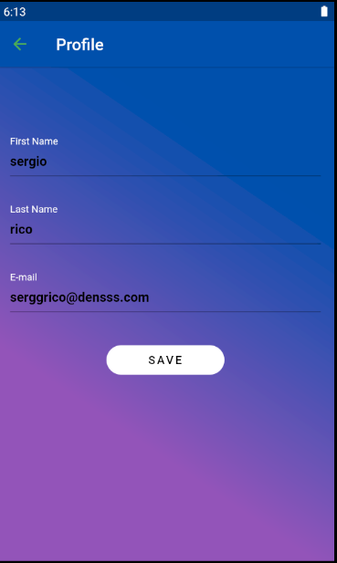
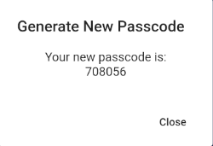
User Interface/Mobile App (cont.)
Settings Page
Allows user to:
Edit Profile (change name and email)
Change password
See current passcode
Generate a new passcode
The Profile Page
User’s account information automatically loaded

Slide 18
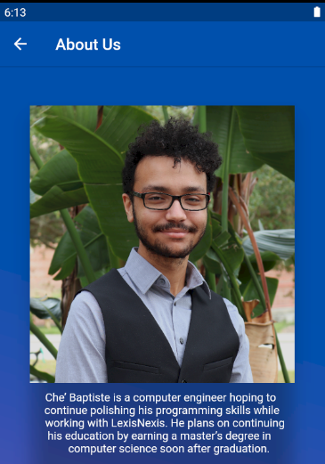
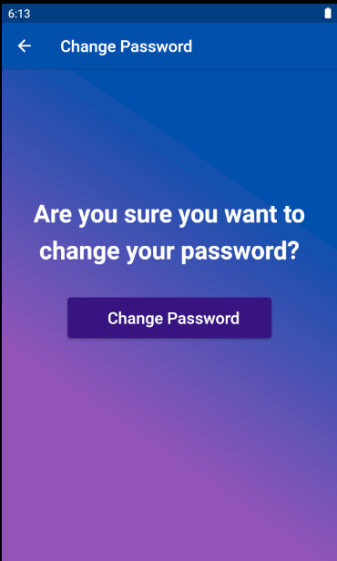
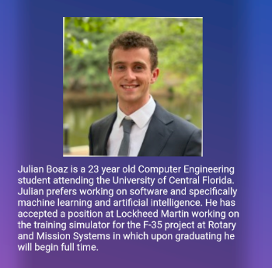
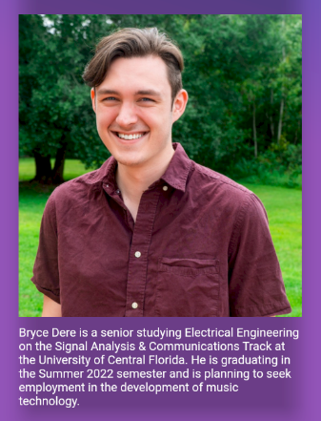
User Interface/Mobile App (cont.)
Change password makes sure user wants to change your password before continuing
Email confirmation will also be sent
About Us page seen on right

Slide 19
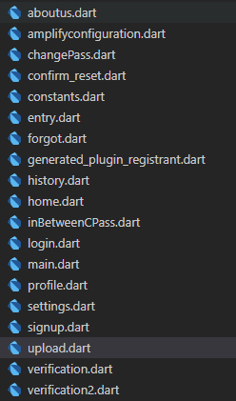
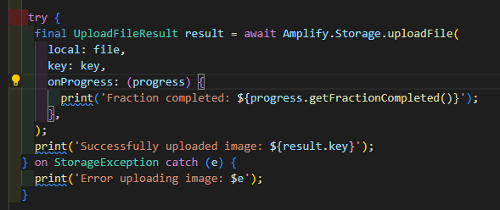
User Interface/Mobile App (cont.) - How it’s all done

Slide 20
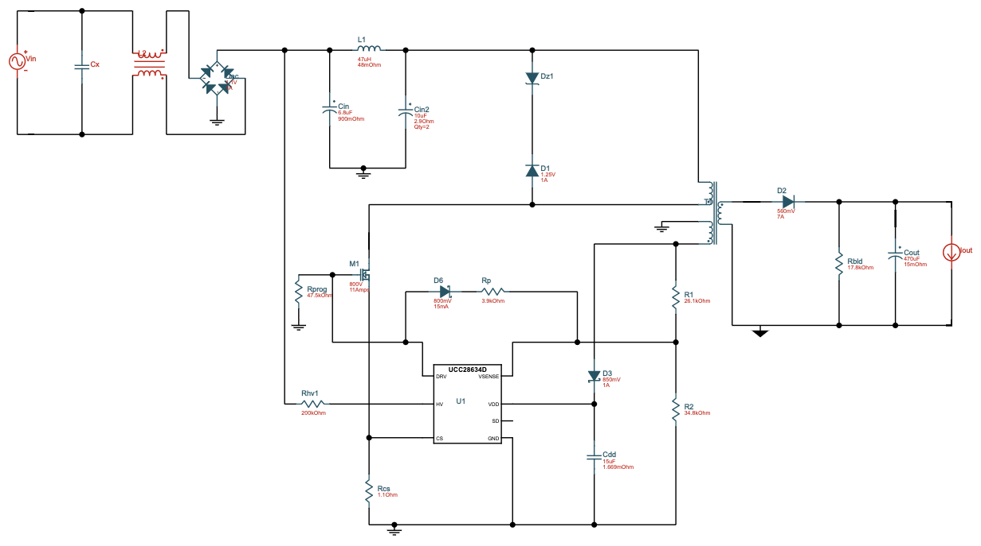
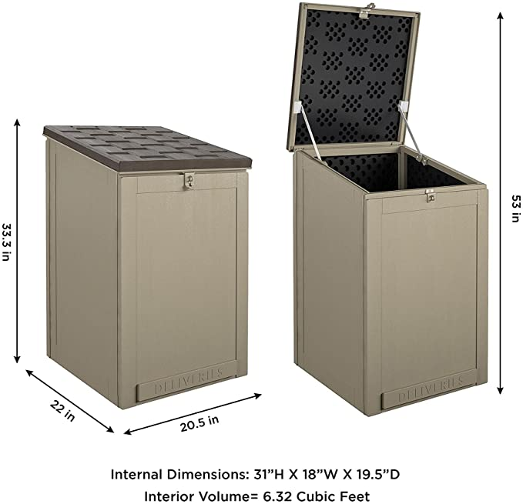
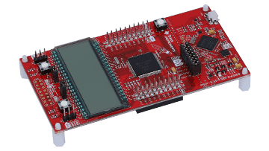
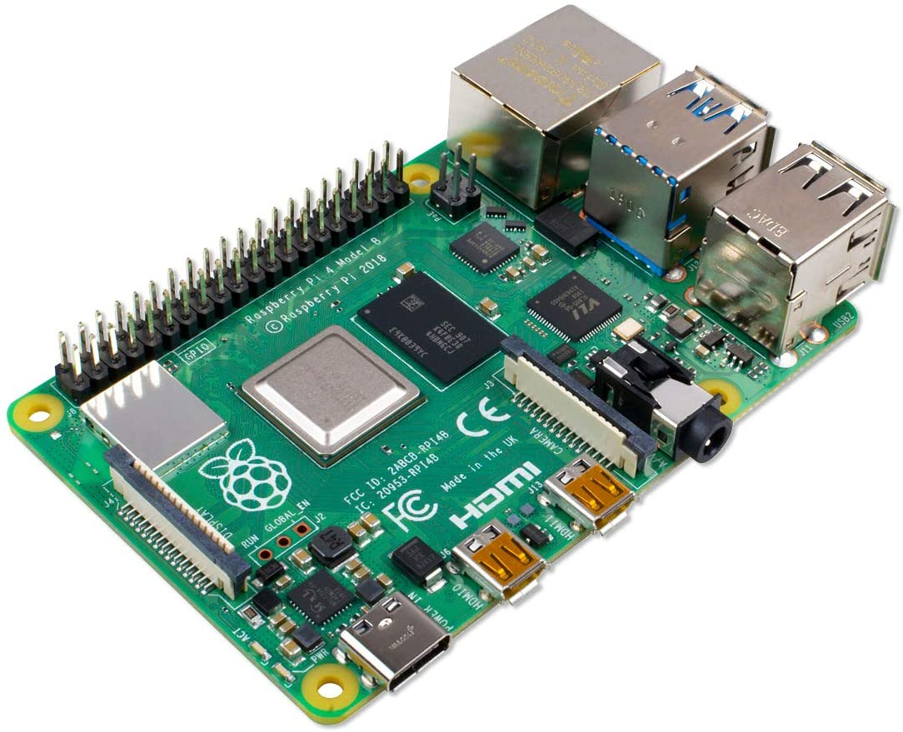
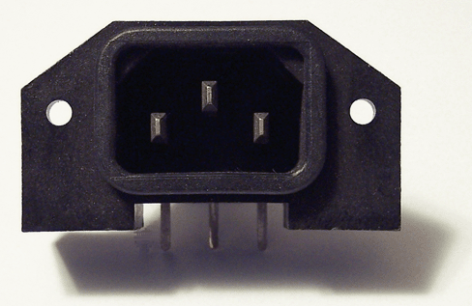
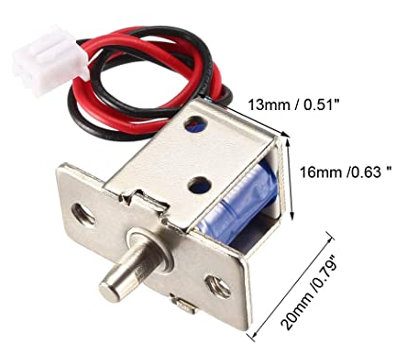
Hardware Design
Circuit to convert power for MCU & solenoid switching
Raspberry Pi to communicate with Facial Recognition algorithm and activate lock and heater
Microcontroller to trigger peripherals and consolidate signals to/from microprocessor
Power connection for Raspberry Pi, heater, and solenoid
Solenoid lock controlled by processor

Slide 21
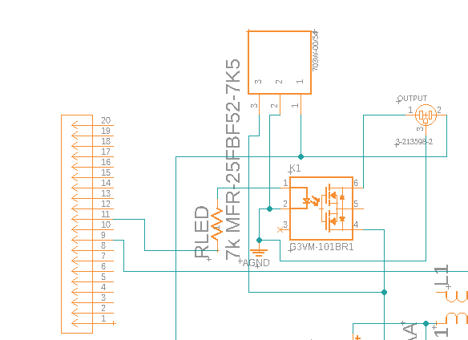
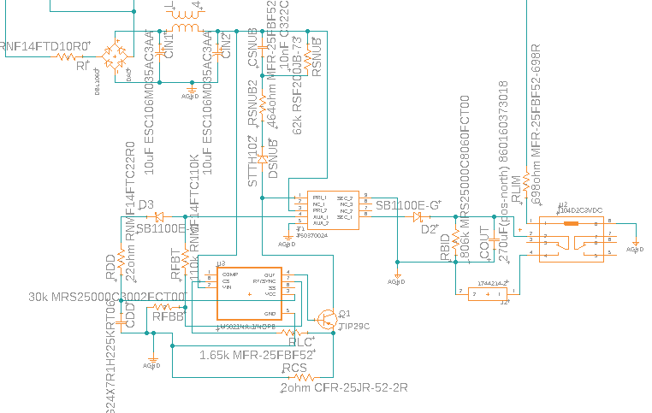
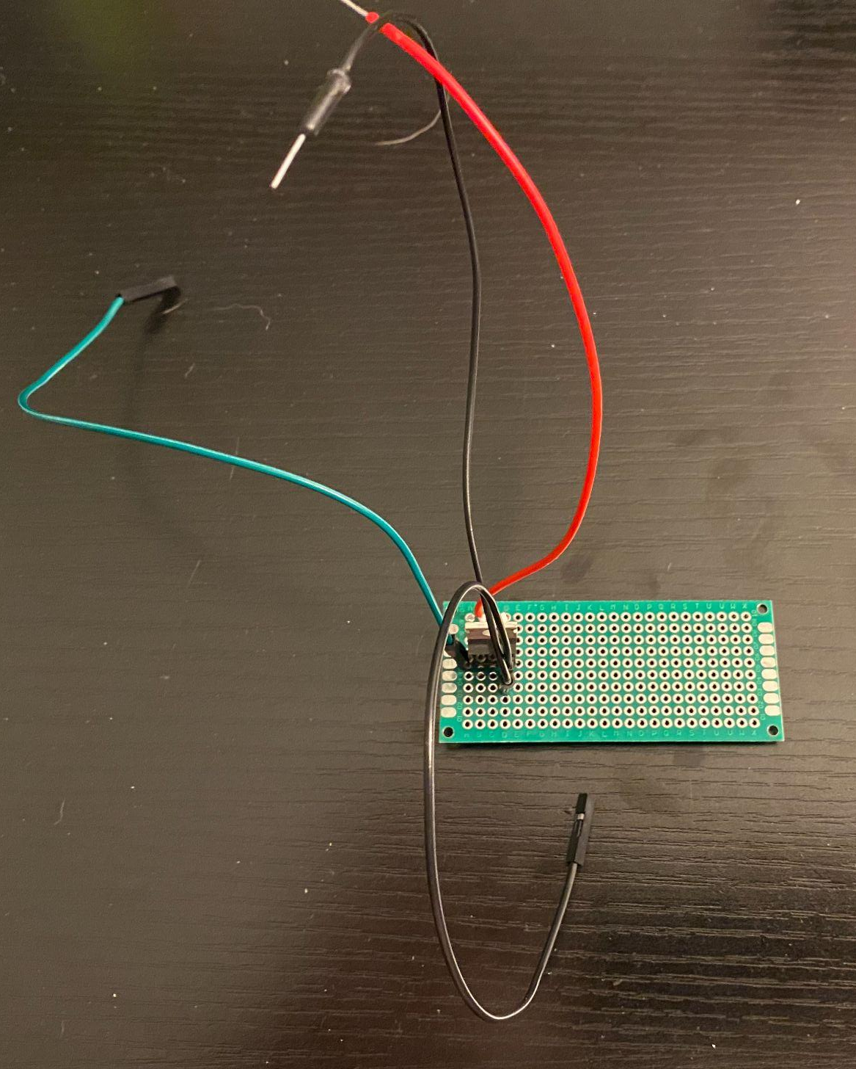
Original PCB Design vs Final Implementation

Slide 22
Why use a solenoid for the locking mechanism?
Easier to implement than repurposing other electronic locks (e.g. door locks)
Requires a relatively low amount of power
Only needs one GPIO pin on the processor, leaving more pins open for other uses

Slide 23
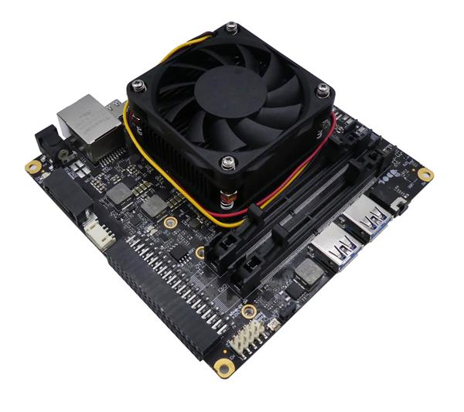
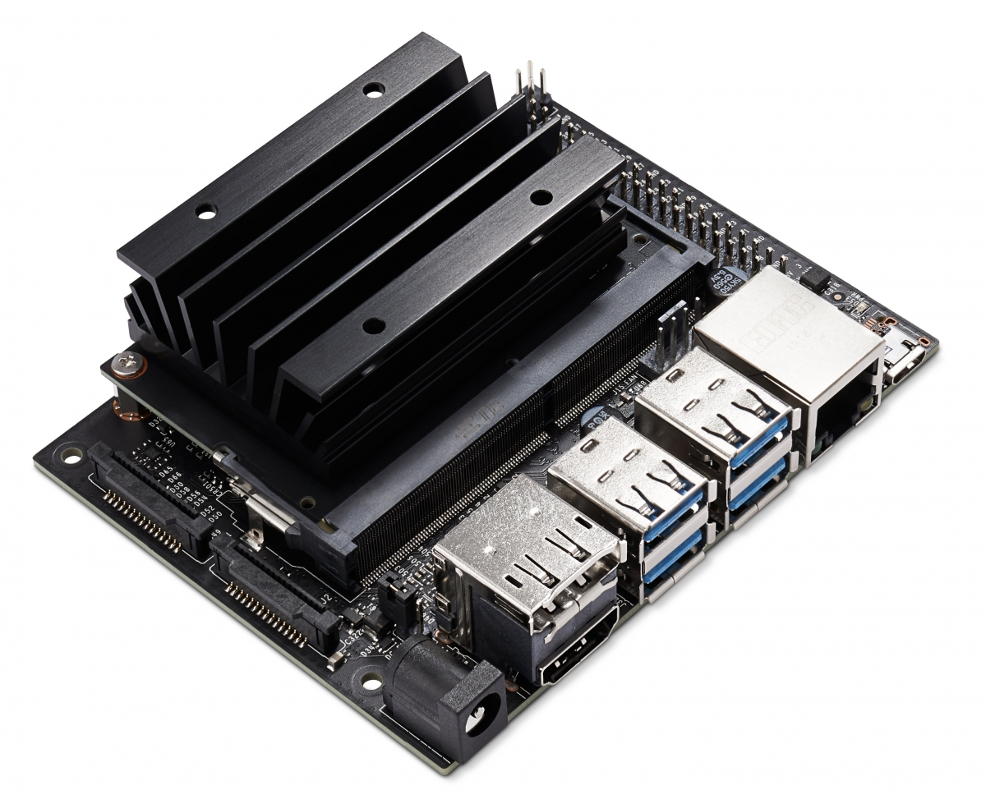
Single-Board Computers
a.
Controller | CPU | RAM | Speed | GPIO | SD card support | Native USB | Camera support | Cost
Raspberry Pi 4 (a) | Quad-core Cortex-A72 | 4 GB | 1.5GHz | 40-pin | Yes | Yes | Yes | ~$100-$120
UDOO BOLT V3 | AMD Ryze Embedded V1202b Dual Core | 2x Ddr4 Dual-channel 64-bit | 2.3ghz | 40-pin | Yes | Yes | Yes | ~$450.00
NVIDIA Jetson Nano (c) | Quad-core ARM A57 | 4 GB | 1.43 GHz | 40-pin | Yes | Yes | Yes | ~$350 Dollars
b.
c.

Slide 24
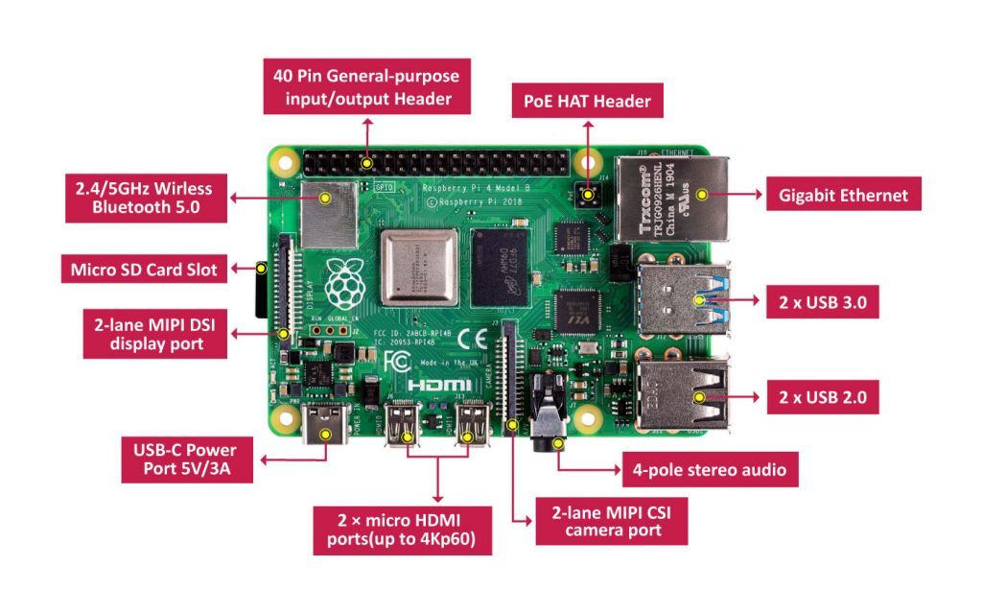
Why the Raspberry Pi?
Meets hardware specifications
Compatible with other hardware and software requirements
Group has experience using
With chip shortage and supply chain stress, Raspberry pi was already available
Applicable with several different cameras, quality depending on the camera

Slide 25
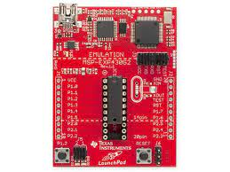
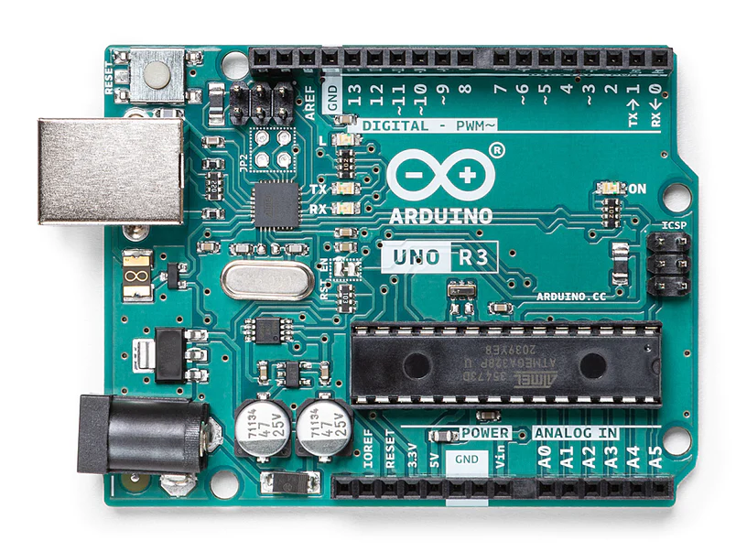
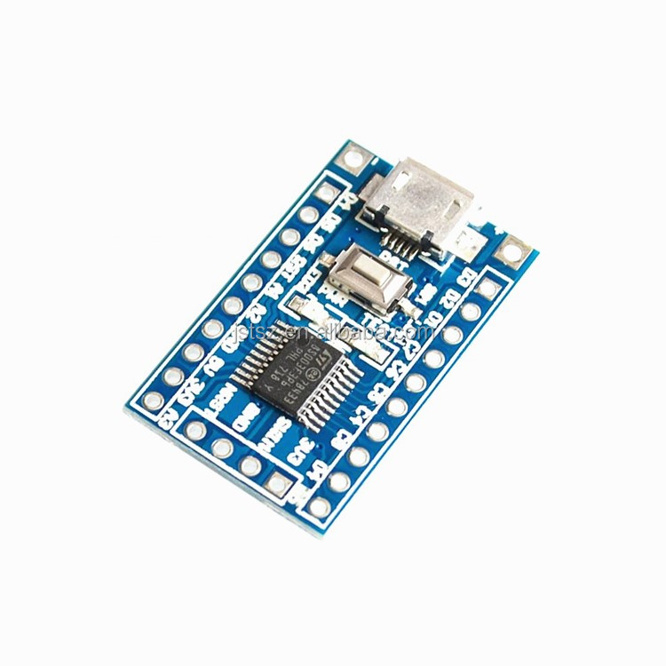
Microcontrollers
Controller | Microcontroller | Memory | Speed | GPIO | Power | USB | Price
MSP430- FR6989 (a) | MSP430 | 2 KB | 16MHz | 83-pin | 1.8V ~ 3.6V | No | ~$30
Arduino UNO R3 (b) | ATmega328P | 2KB SRAM / 32 KB Flash | 16MHz | 39-pin | 5V | Yes | ~$30
STM8S103F3 (c) | STM8 core | 1 Kb | 16 MHz | 32-pin | 2.95 - 5.5 V | Yes | <$10

Slide 26
Testing
User registering account and uploading picture to database.
Interaction with microcontroller triggering recognition script on microprocessor.
Camera on lockbox being able to take picture of user, and AI accurately analyzing picture to picture in database.
AI outputting either a yes or no to unlock device, sending signal to microcontroller to unlock solenoid locking mechanism.

Slide 27
Software Challenges
Connecting the mobile application to AWS (unsupported features for app build, trouble connecting to correct userpool)
Due to using the Raspberry Pi, we have to use an unsupported version of AWS CLI
AWS account was compromised due to setting up permissions incorrectly
Package management for Python scripts (text-to-speech and microcontroller interaction packages)

Slide 28
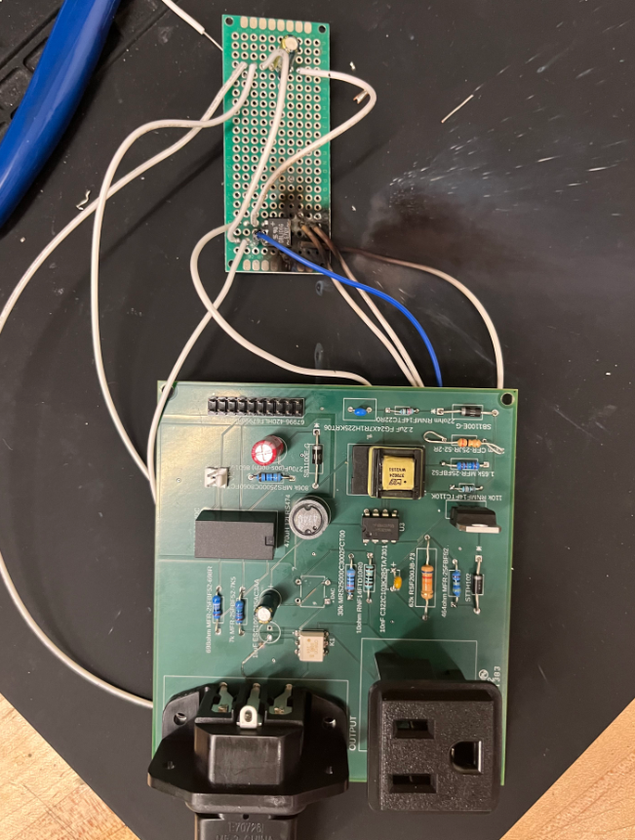
Hardware Challenges
During testing, we found that our version I board design, a trace between terminals of the diode rectifier shorted.
In version II of our board, another trace on the board short-circuited in the same location; this connection was removed to a vector board where the same problem was had. This problem was bypassed for testing by using an existing power conversion circuit.
While trying to connect the MSP and Pi together, our group had difficulties in getting the signal to be sent and read by each device.
Due to time constraints, the heating element was removed from the design.

Slide 29
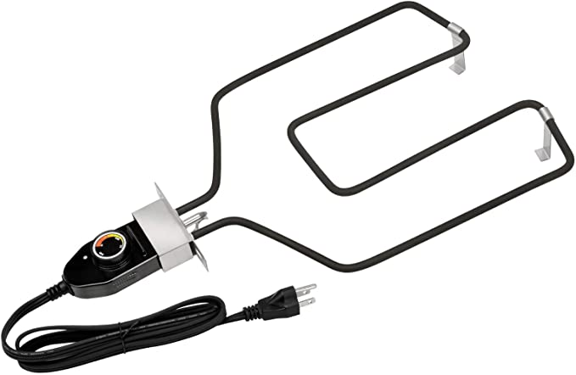
Relevant Standards
The FDA recommends hot foods be held at 120-140° F
Safe holding time at outdoor temperature is about one hour; for holding times longer than this, a heating element will be used
An adjustable heating element will allow the user to set the desired warming temperature with a dial; the element pictured is capable of heating up to 200° F
Food Heating

