Slide 1
Facial Recognition Lockbox
Group 4
Ryan Wiegman, Cpe
Julian Boaz, Cpe
Che’ Baptiste, Cpe
Bryce Dere, EE

Slide 2
Motivation
Reduce the amount of at home package thefts, deterring porch pirates.
Design a multipurpose Lockbox; food, packages, mail.
Create a efficient and cost effective high tech Lockbox.
Learn new skill for future endeavors.

Slide 3
Background
In 2021, an estimated $870.8 billion dollars were spent on e-commerce sales, increasing by 14.2 percent from the previous year.
40% of Americans have been the victims of package theft and more than 60% know somebody who has fallen victim
Relevant Lockboxes, price range between $300-$1000+ dollars.
These Lockboxes range from having none to several smart technologies features.
None including Facial Recognition.

Slide 4
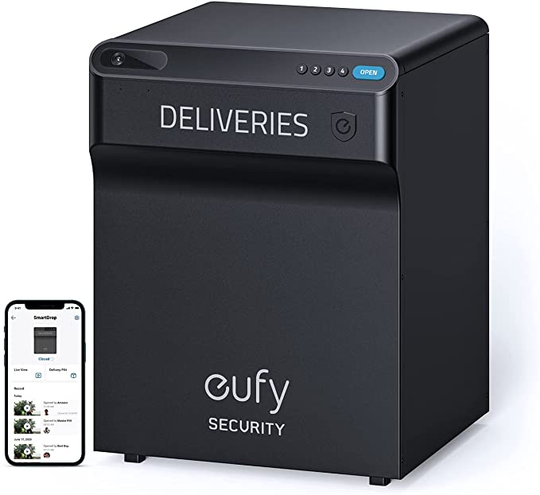
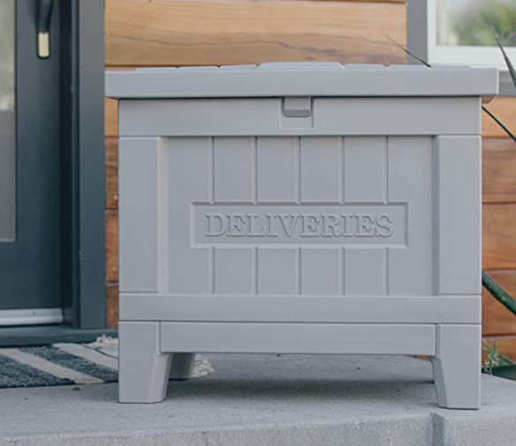
Relevant Solutions & Comparisons
Eufy Security SmartDrop
Can be opened via PIN or with a mobile app
Two-way communication through box and app
Battery powered
Cost: $400
Yale Smart Delivery Box
Can be opened via PIN or with a mobile app
Battery Powered
Cost: $300

Slide 5
How does our solution compare to existing ones?
Facial recognition decreases user friction
Using outlet power connection is more available, easier, and more efficient than using battery power
Specifically implementing elements for keeping food safe while also being able to accept non-food deliveries
Lower overall cost

Slide 6
Specifications
 | Requirement Specifications
1. | The AI facial recognition software must be able to identify a user with 80% accuracy
2. | The AI facial recognition software must have an execution process between 3 to 7 seconds
3. | The FRL application will work with AI facial recognition and storage database to log user’s facial ID
4. | The FRL application will notify users of attempted theft or breach of the system
5. | The FRL application will notify users of deliveries to the system
6. | The system will have a 6-digit code lock, in case of facial recognition failure.
7. | The power supply shall be capable of powering multiple sensors and accessories
8. | The FRL application database allows up to 20 GB of storage

Slide 7
Project Constraints
 | Project Specifications
1. | The system shall be no taller than 4.5ft
2. | The system shall be no wider than 3ft
3. | The system shall not weigh more than 100lbs
4. | .The system shall maintain a maximum temperature of 140° F
5. | The system shall regulate average temperature of 73° F
6. | The facial recognition camera shall be no larger than 3 x 2 x 4.5 inches
7. | Requires outlet source for Power

Slide 8
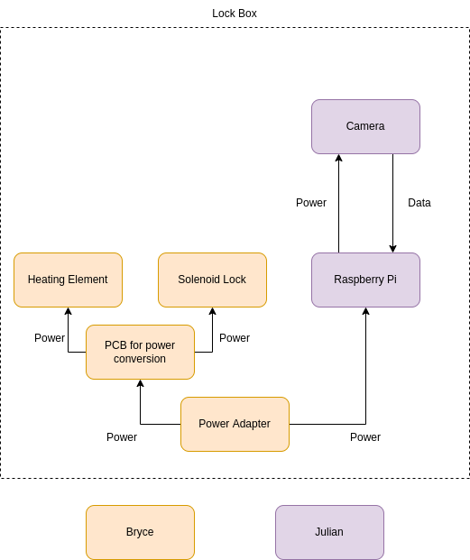
Hardware Block Diagram

Slide 9
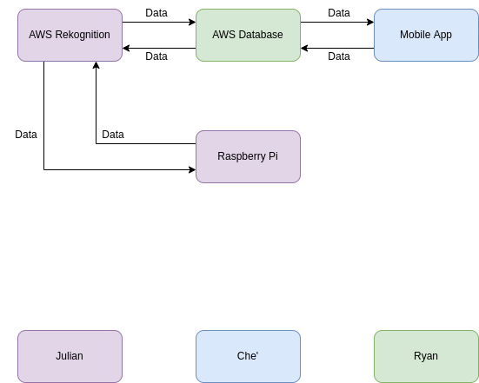
Software Block Diagram

Slide 10
Amazon Web Services
AWS Rekognition will be used for artificial intelligence model
AWS S3 will be used for storing user data
AWS will keep all of the data needed for identifying users
AWS allows us to reduce the hardware requirements of the lock box, as well as our user’s cell phones
AWS has the ability to scale with the program, as user data increases.

Slide 11
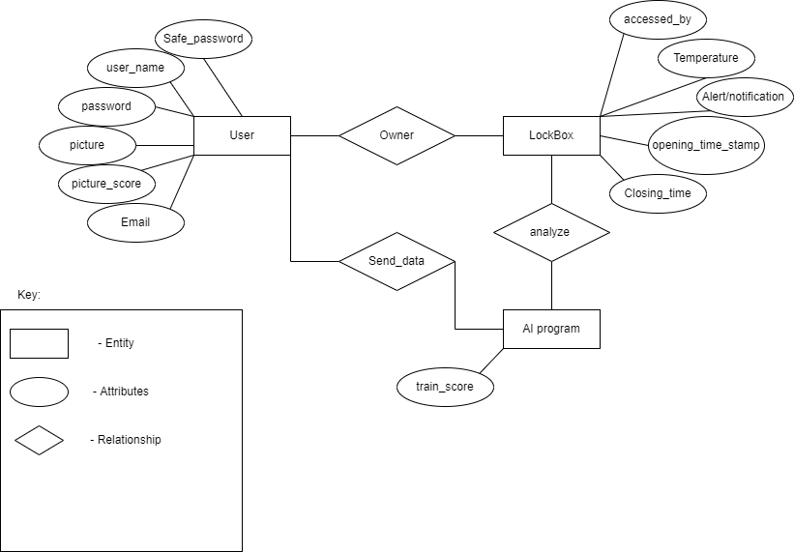
ER Diagram

Slide 12
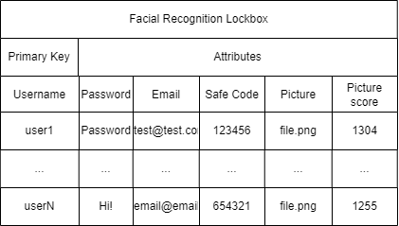
Database Structure
Key-value type database.
Three individual tables: User, Lockbox, AI.
Both Lockbox and AI tables have dependency on User table
Each user will have a unique username saved in the database, acting as the primary key.
The primary key will give access to all other attributes to that specific user.

Slide 13
Database Security
AWS will provide the main source of security.
Providing a continuous monitoring system with threat detection, encryption, and key management.
Failed attempt notification, allowing implementation of failsafe code.
High-alert security at vital points across database, filtering incoming and outgoing traffic.
Modifiable to fit our design of the Lockbox.

Slide 14
Database Optimization
Proper Indexing, allowing for quick location and access to files.
Only take in relative and necessary data.
Good Programming

Slide 15
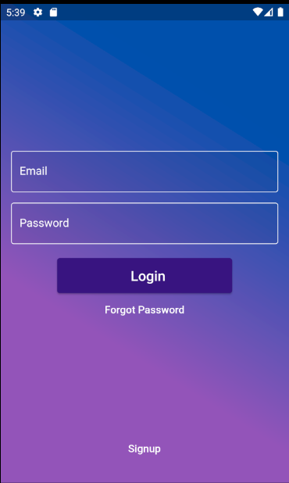
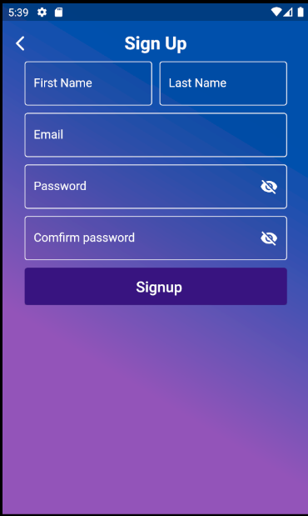
User Interface/Mobile App
←
Login page - takes in user email and password
Forgot password allows user to reset their password
Signup allows user to make a new account
→
Signup page - takes in a variety of user input fields
Requires user to confirm password
Requires password to meet certain specifications (has a number, capital and lowercase letter, a symbol, and is a length of 8 or above)

Slide 16
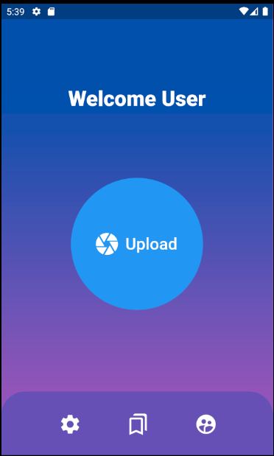
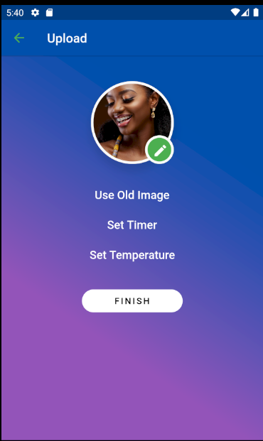
User Interface/Mobile App (cont.)
(cont.)
←
Home page for user
Middle icon - Upload Page
Bottom left - Settings Page
Bottom middle - History Page
Bottom Right - About Us Page
→
The Upload Page
Allows user to:
Upload a new image
Use an old image by accessing the History Page
Set timer for the Lockbox
Set temperature of Lockbox

Slide 17
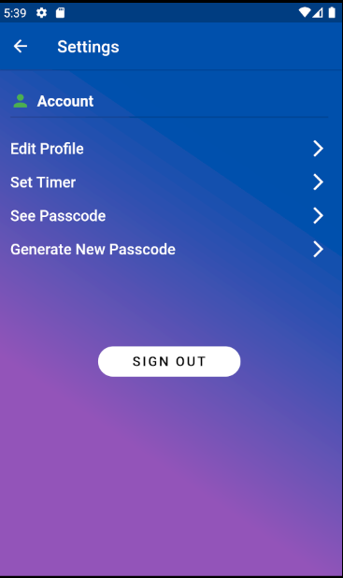
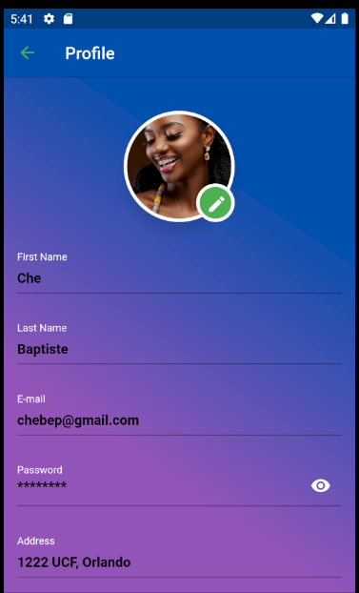
User Interface/Mobile App (cont.)
(cont.)
←
Settings Page
Allows user to:
Edit Profile
Set timer for their profile
See current passcode
Generate a new passcode
→
The Profile Page
Allows user to:
Change their first name
Change their last name
See their email (but cannot change it)
Change their password
Change their address

Slide 18
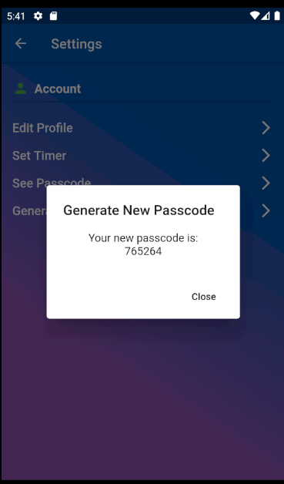
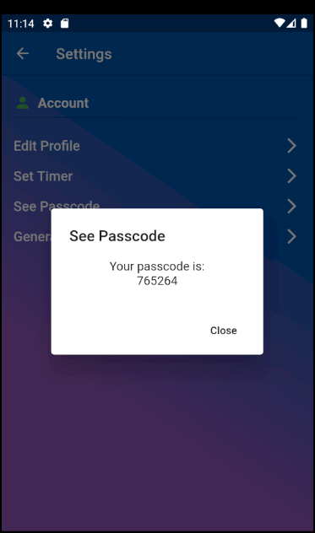
User Interface/Mobile App (cont.)
←
Generate new passcode
A text box appears showing the user their new passcode
Clicking the button again will generate a new passcode
→
See passcode
Allows user to see current password
Can click this one as much as you like, without changing your current passcode

Slide 19
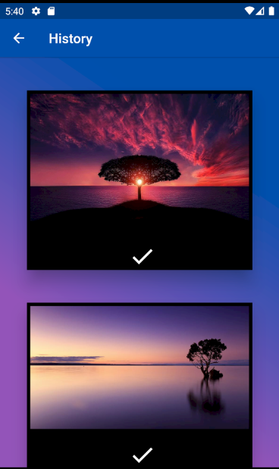
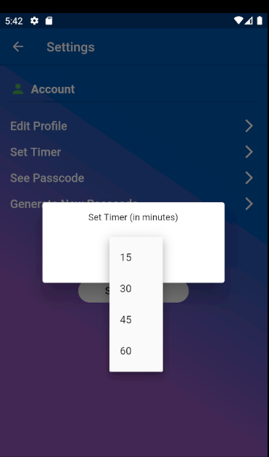
User Interface/Mobile App (cont.)
(cont.)
←
Set timer
Allows user to change their default timer
Timer is in minutes
→
History Page
Allows user to see a list of images that they have previously used
Clicking the image will take them to the upload page with the image loaded

Slide 20
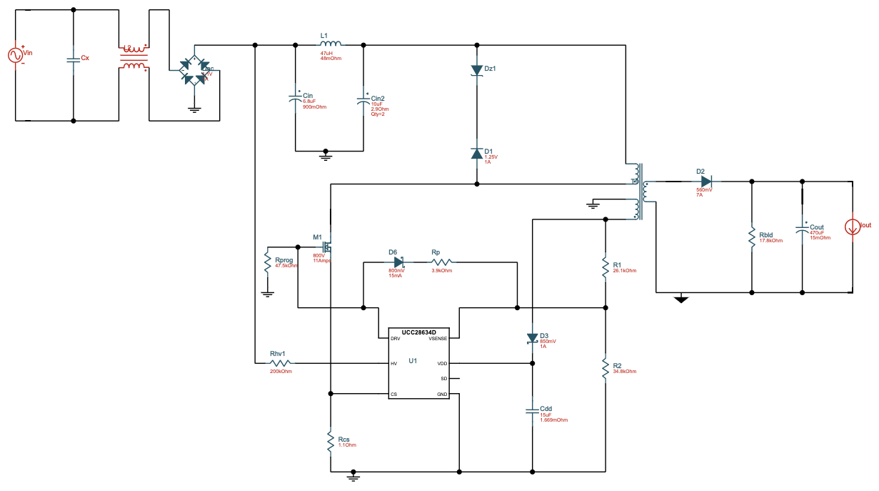
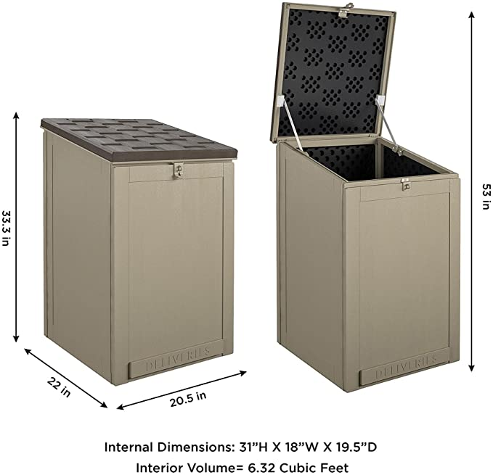
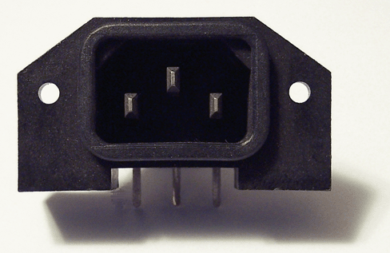
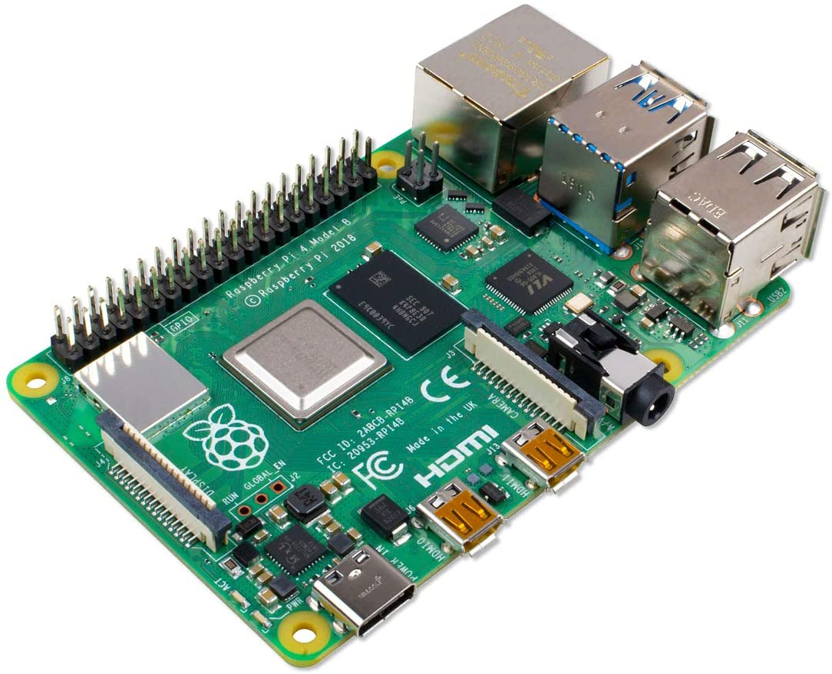
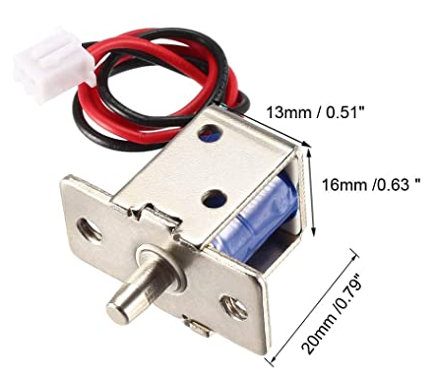
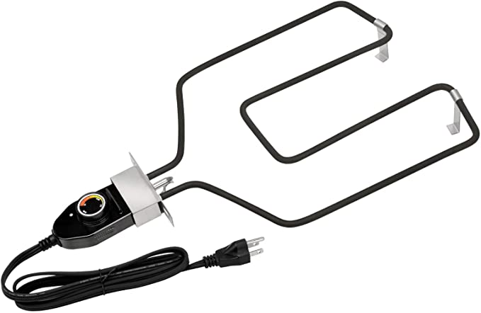
Hardware Design
PCB to convert power for heater and solenoid switching
Raspberry Pi to communicate with Facial Recognition algorithm and activate lock and heater
Power connection for Raspberry Pi, heater, and solenoid
Solenoid lock controlled by processor
Heater placed at bottom to keep food warm

Slide 21
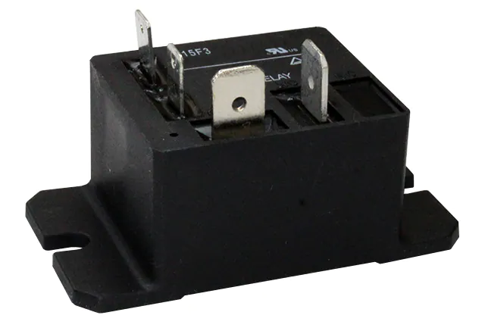
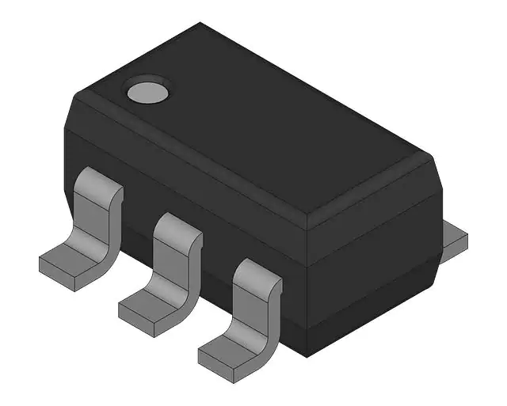
PCB Design Flowchart
AC/DC power conversion for solenoid (12 V at 0.54 A)
Electrical relay to allow the MCU to switch on power to the heating element
Switch to deliver DC power to solenoid
Raspberry Pi to control hardware elements
Adjustable heating element
Solenoid lock controlled by processor

Slide 22
Why use a solenoid for the locking mechanism?
Easier to implement than repurposing other electronic locks (e.g. door locks)
Requires a relatively low amount of power
Only needs one GPIO pin on the processor, leaving more pins open for other uses

Slide 23
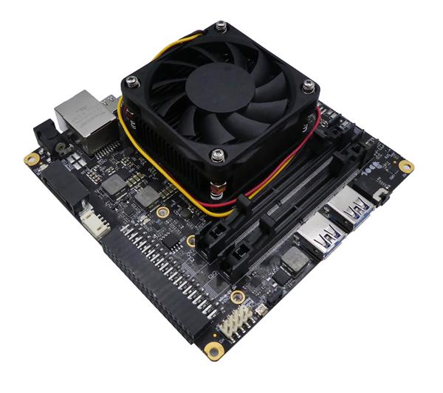
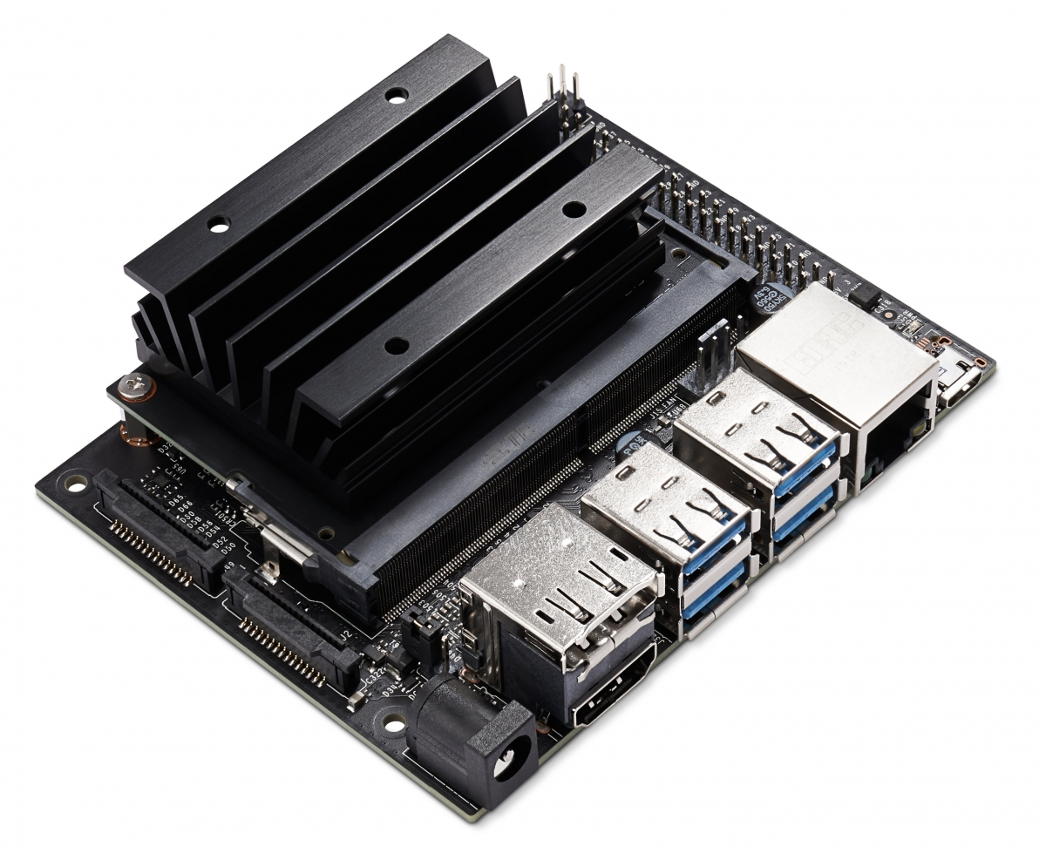
Single-Board Computers
a.
Controller | CPU | RAM | Speed | GPIO | SD card support | Native USB | Camera support | Cost
Raspberry Pi 4 (a) | Quad-core Cortex-A72 | 4 GB | 1.5GHz | 40-pin | Yes | Yes | Yes | ~$100-$120
UDOO BOLT V3 | AMD Ryze Embedded V1202b Dual Core | 2x Ddr4 Dual-channel 64-bit | 2.3ghz | 40-pin | Yes | Yes | Yes | ~$450.00
NVIDIA Jetson Nano (c) | Quad-core ARM A57 | 4 GB | 1.43 GHz | 40-pin | Yes | Yes | Yes | ~$350 Dollars
b.
c.

Slide 24
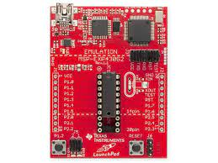
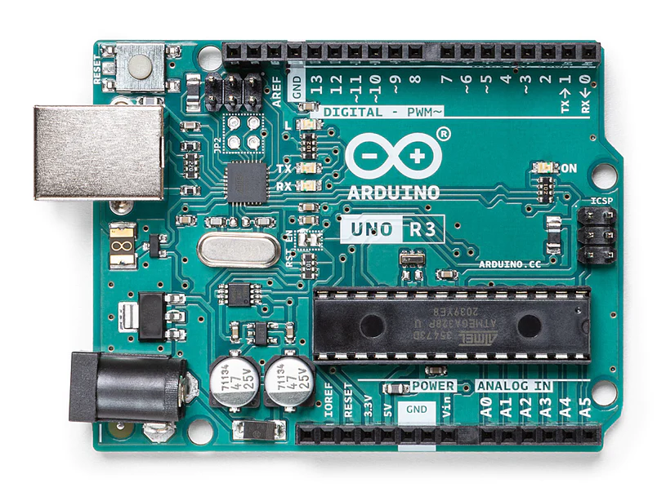
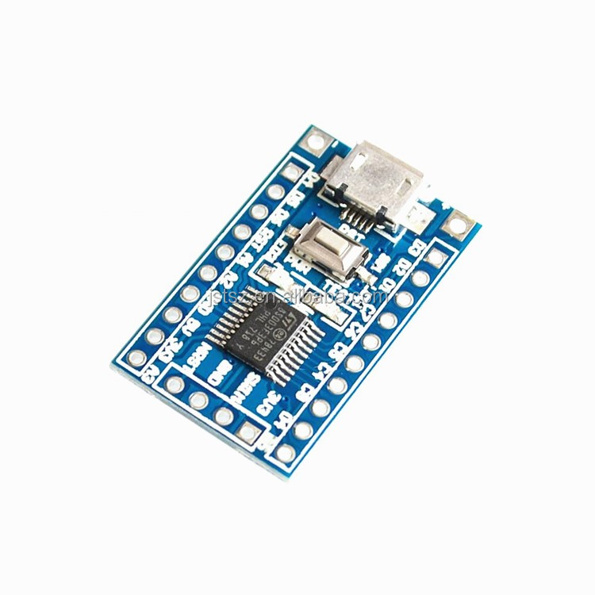
Microcontroller
Controller | Microcontroller | Memory | Speed | GPIO | Power | USB | Price
MSP430- FR6989 (a) | MSP430 | 2 KB | 16MHz | 83-pin | 1.8V ~ 3.6V | No | ~$30
Arduino UNO R3 (b) | ATmega328P | 2KB SRAM / 32 KB Flash | 16MHz | 39-pin | 5V | Yes | ~$30
STM8S103F3 (c) | STM8 core | 1 Kb | 16 MHz | 32-pin | 2.95 - 5.5 V | Yes | <$10

Slide 25
Administrative Content

Slide 26
Itemized Budget
Item | Price
Microprocessor | $FREE
Lockbox | $75
Camera module | ~$15
Electronic latch | $10
Amazon Web Services Server | ~$0.016 per hour
Power supply | ~$20
Heating Element | $40
Total | ~$160

Slide 27
Relevant Standards
The FDA recommends hot foods be held at 120-140° F
Safe holding time at outdoor temperature is about one hour; for holding times longer than this, a heating element will be used
An adjustable heating element will allow the user to set the desired warming temperature with a dial; the element pictured is capable of heating up to 200° F
Food Heating

Slide 28
Relevant Standards
ANSI Grade 3; Must be able to withstand:
200,000 cycles
2 door strikes
150 pounds of weight
2 hammer strikes
Generally used on residential door locks, which is ideal as a deterrent but still weak enough to be opened forcefully in an emergency
Lock Security

Slide 29
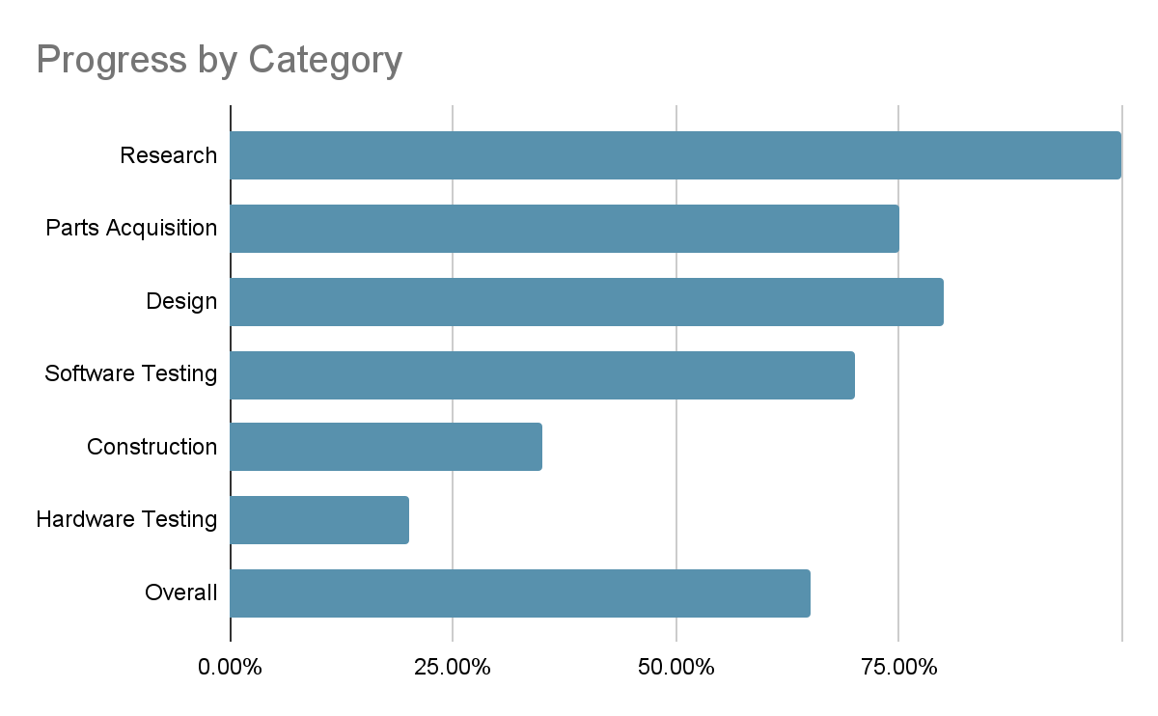

Slide 30
Projected Semester Schedule
Currently End of Week 3
Weeks 4-7: Design PCB & Assemble Prototype
Weeks 8-11: Test Prototype & Fix Software Bugs
Week 12: Finalize Documentation & Presentation
Week 13: Prepare for Presentation
Week 14: Final Presentation

Slide 31
Issues
AWS CLI

Slide 32
Questions?

