Slide 1
PTZ Camera
Group 26:
Andre Samaroo, Cp.E
Chisom Ikejiani, Cp.E
Michael Serignese, Cp.E
Notes:
andre?

Slide 2
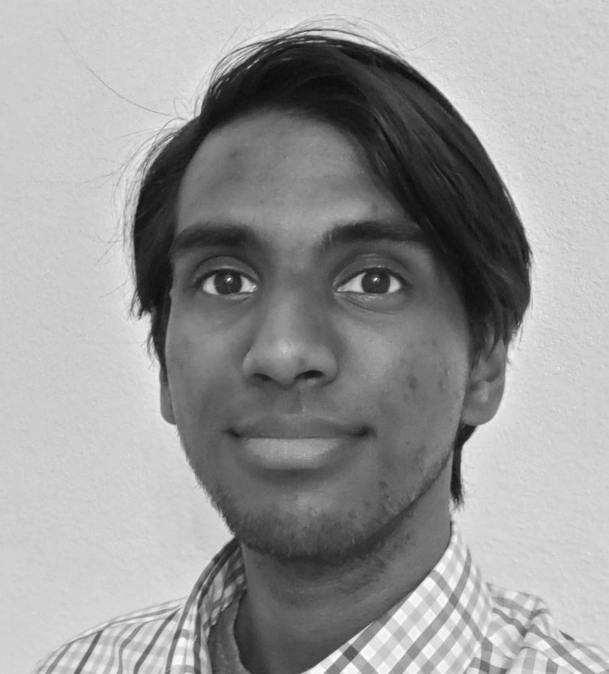
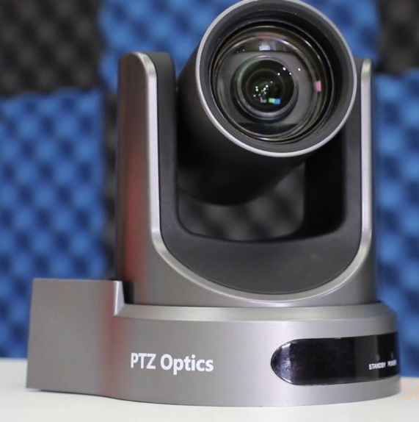
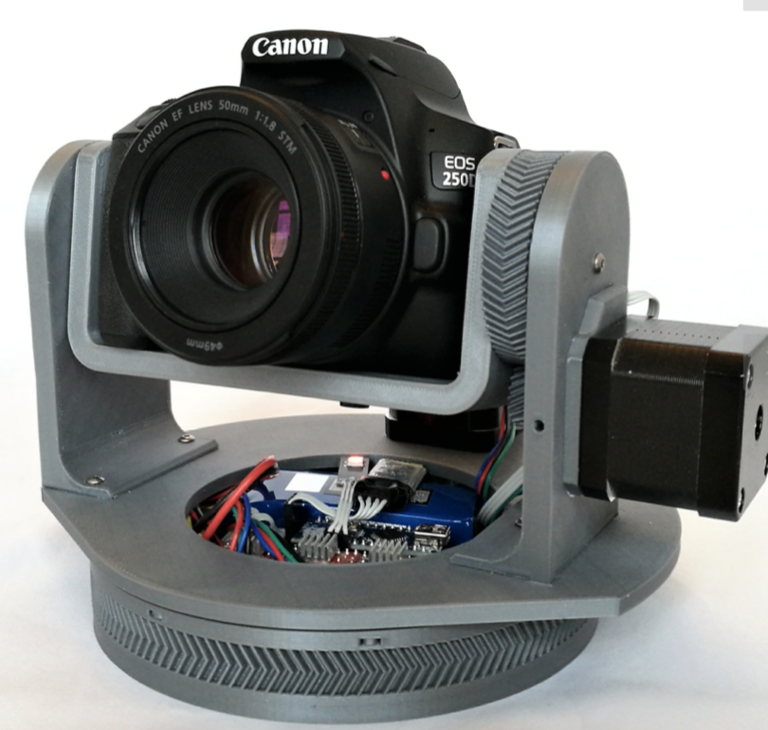
Administrative Introduction
Based on the sponsored QwikCut project, we wanted to make an inexpensive PTZ camera system that uses as few cables as possible.
We used various PTZ camera implementations as references in order to implement the design with minimal extra cables.
Notes:
andre

Slide 3
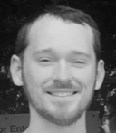
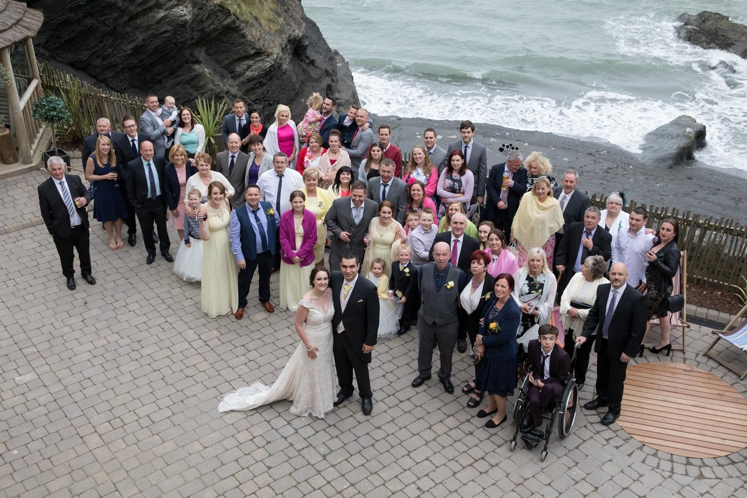
Project Impacts
Low cost, widely available parts
For sports events, weddings, etc.
Makes professional video angles more accessible to the average person
Notes:
New slide (record audio) Michael

Slide 4
Administrative Overview
Pre-Production considerations
Hardware Subsystems
Software Discussion
Project Assessment
-Goals and Objectives
-Requirements
-Constraints
-Camera
-Motors
-Control Boards
-Case
-Workstation software
-Servo Control software
-Controller software
-Success and Challenges
-Budget and Financing
-Progress
-Plans for Completion
Notes:
andre

Slide 5
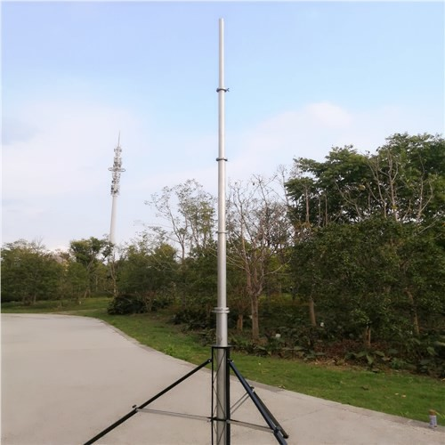
Goals and Objectives
Create a tripod-mounted sports action camera
Tripod is 25 ft. tall for ideal camera angling
Controller operates camera for ease of use
Stretch Goal:
Computer-vision assisted tracking
Notes:
Mike

Slide 6
Specifications and Requirements
The camera meets the standards:
Lightweight at 1 lb. or less
Waterproof in moderate rain (0.10 inches / hour)
Stable in moderate windspeed (15 miles / hour)
Pan-tilt-zoom all accessible through the controller
Notes:
Mike

Slide 7
Design Constraints
Budget | Cables | Group Dynamics
Under $400 | Power/data delivery | 3 members
Self funded | Number of cables | All CPE
Notes:
andre

Slide 8
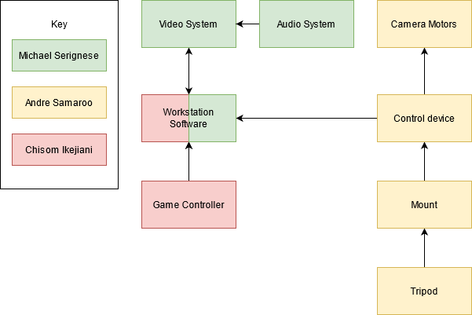
Hardware Block Diagram: Overview
System divided into key parts:
Audio-video
Controls
Motor
Notes:
Mike

Slide 9
Hardware Block Diagram: Camera-to-Controller
Notes:
Mike

Slide 10
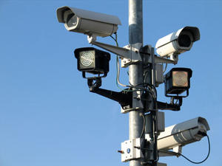
Camera Options: Security Cameras
Many options for premade security cameras
Even tend to include built-in pan-tilt-zoom controls
Include anti-features harmful to the budget
Ruled out in favor of action cameras
Notes:
Mike

Slide 11
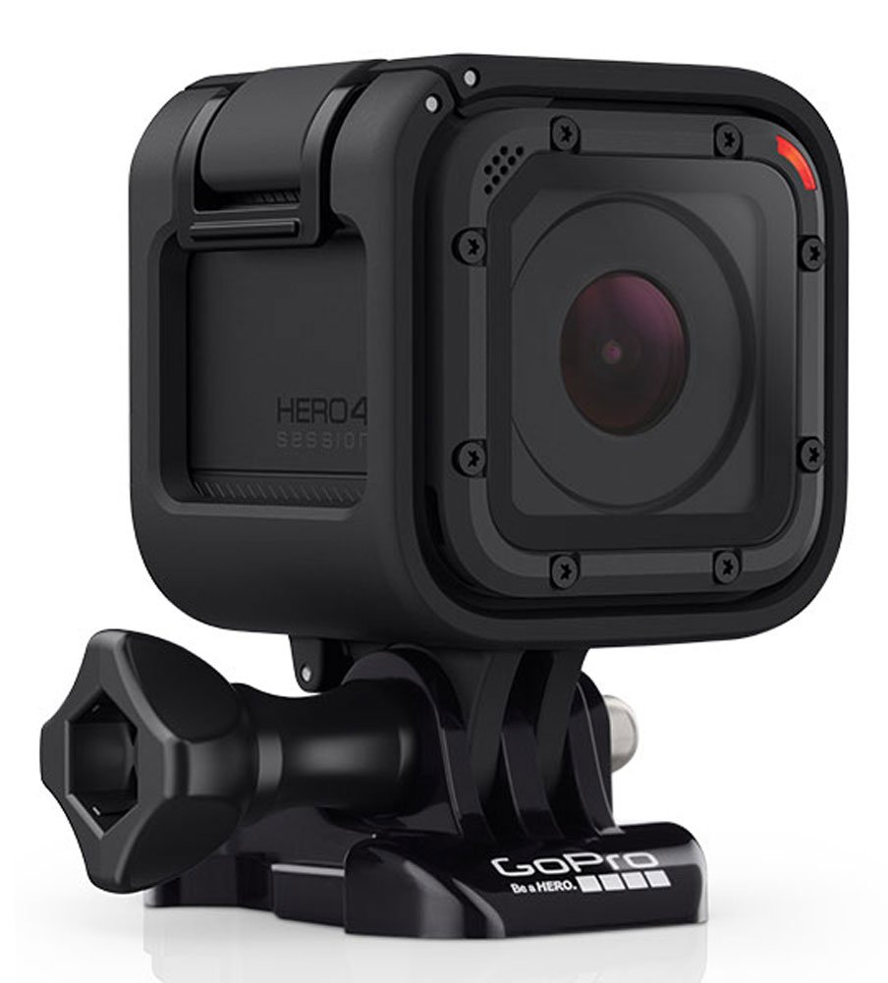
Action Cameras
Intended for capturing sports -- ideal defaults
Overall, the clear prebuilt choice for this design GoPro Hero 7
Price: $250.00
Resolution: 4k or 1080p
Framerate: 30fps or 60fps modes
WiFi: 5GHz b/g/n
Notes:
Mike

Slide 12
Media Transmission Systems
WiFi: the standard for action cameras, and meets requirements.
GoPro Hero 7:
Supports 5GHz and 2.4GHz frequencies with b/g/n technology
Theoretical top transmission speed of 300Mbit/s
Probable actual speed: 64 Mbit/s
This bitrate is sufficient to transport our stream
Notes:
Mike

Slide 13
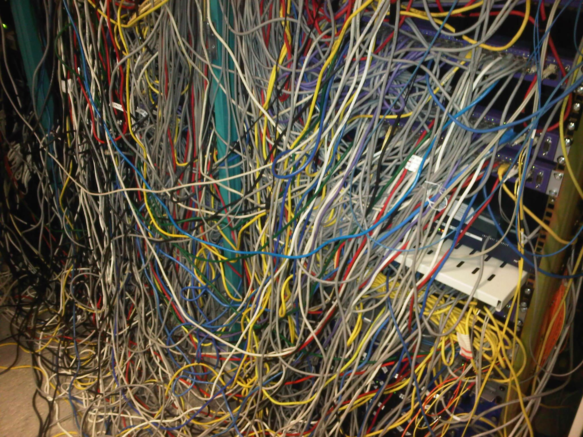
Alternative Transmission Systems
USB: cable too long
PoE: nonstandard for action cameras
Bluetooth: Insufficient bandwidth
WiFi: “None of the Above”!

Slide 14
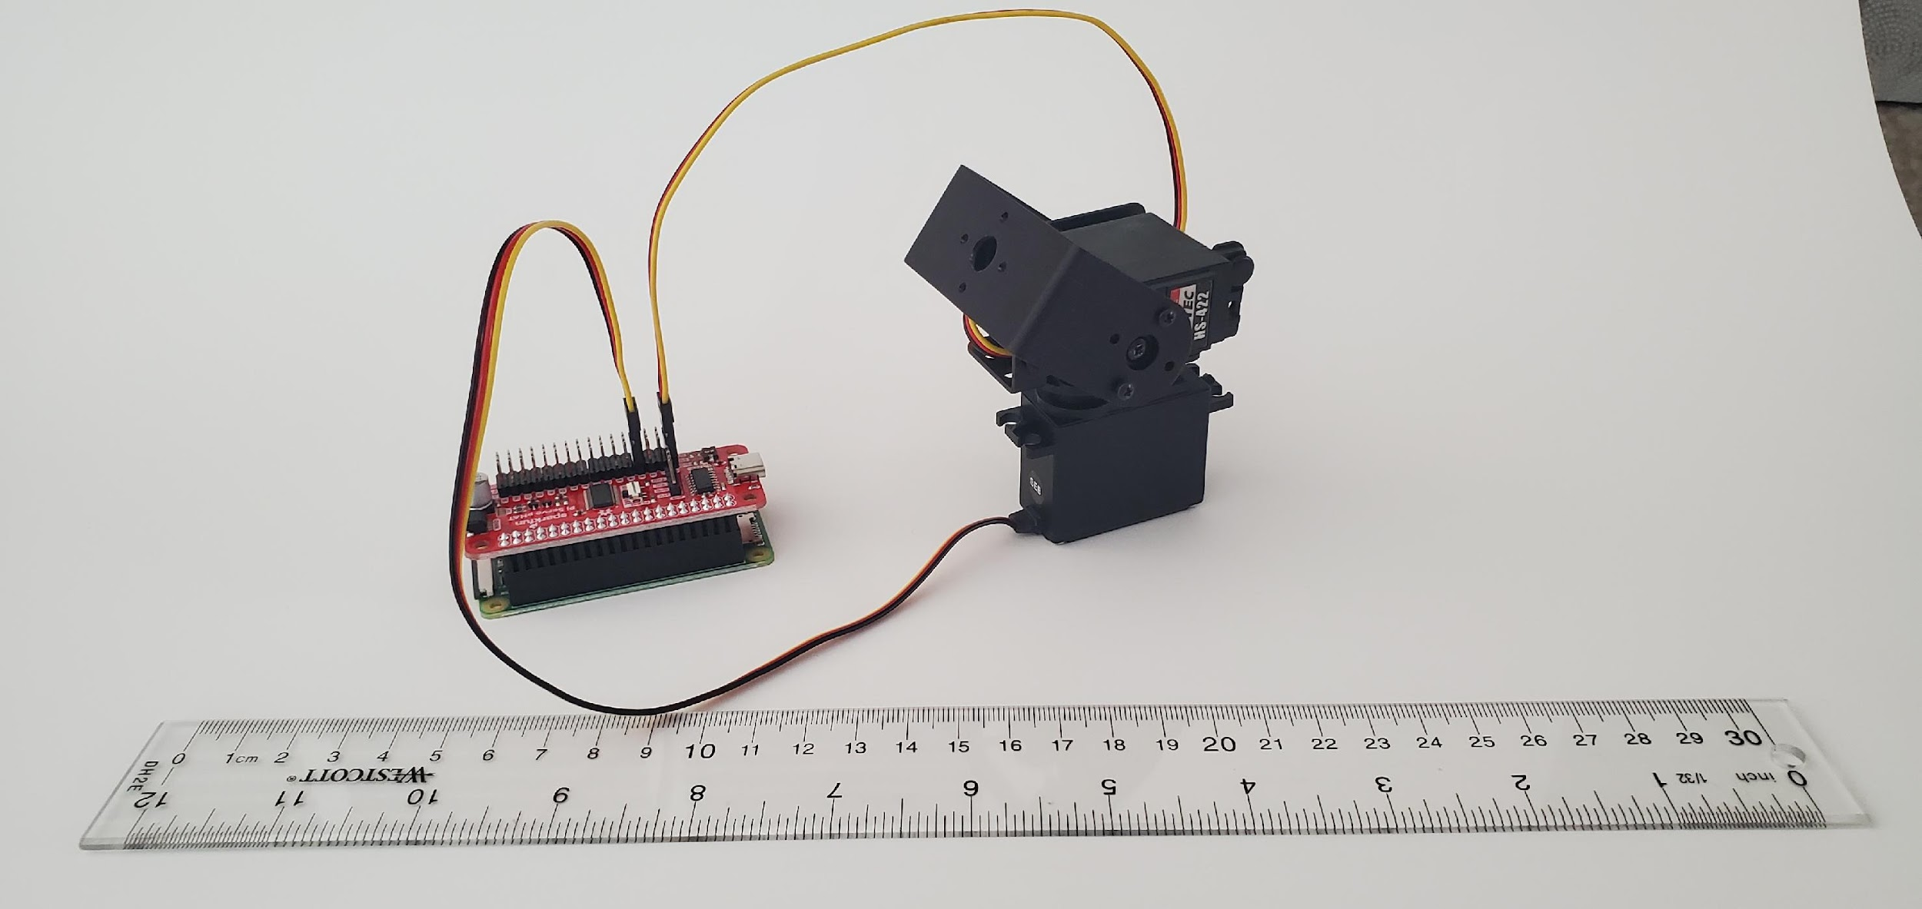
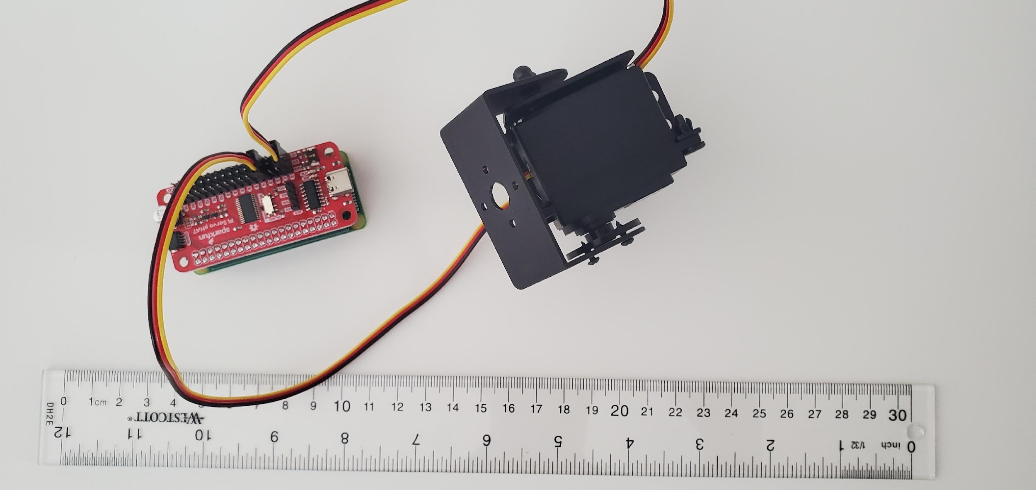
Motor Hardware: Servos and Control boards
2 servos – 1 for panning, 1 for tilt
Servo control board
Main control and communication board
Notes:
andre

Slide 15
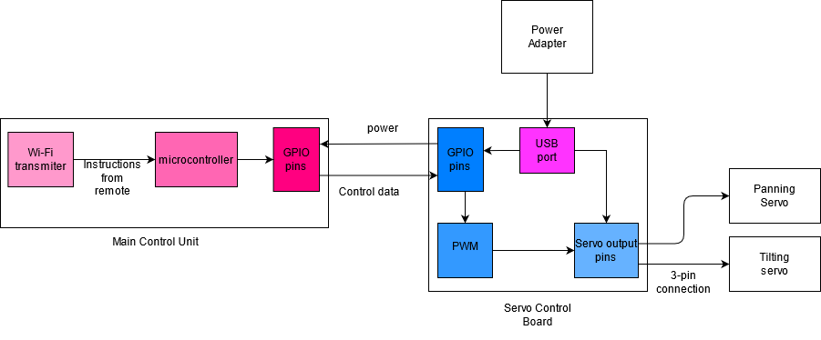
Hardware Block Diagram: Motor-to-MCU interface
Notes:
andre

Slide 16
Motor Hardware: Control Boards
Sparkfun servo pHAT
Uses PCA9685
PWM control
Raspberry Pi Zero W
Broadcom BCM43438
Easy to use
Power cables
Use a barrel plug-to-usb converter
Notes:
andre

Slide 17
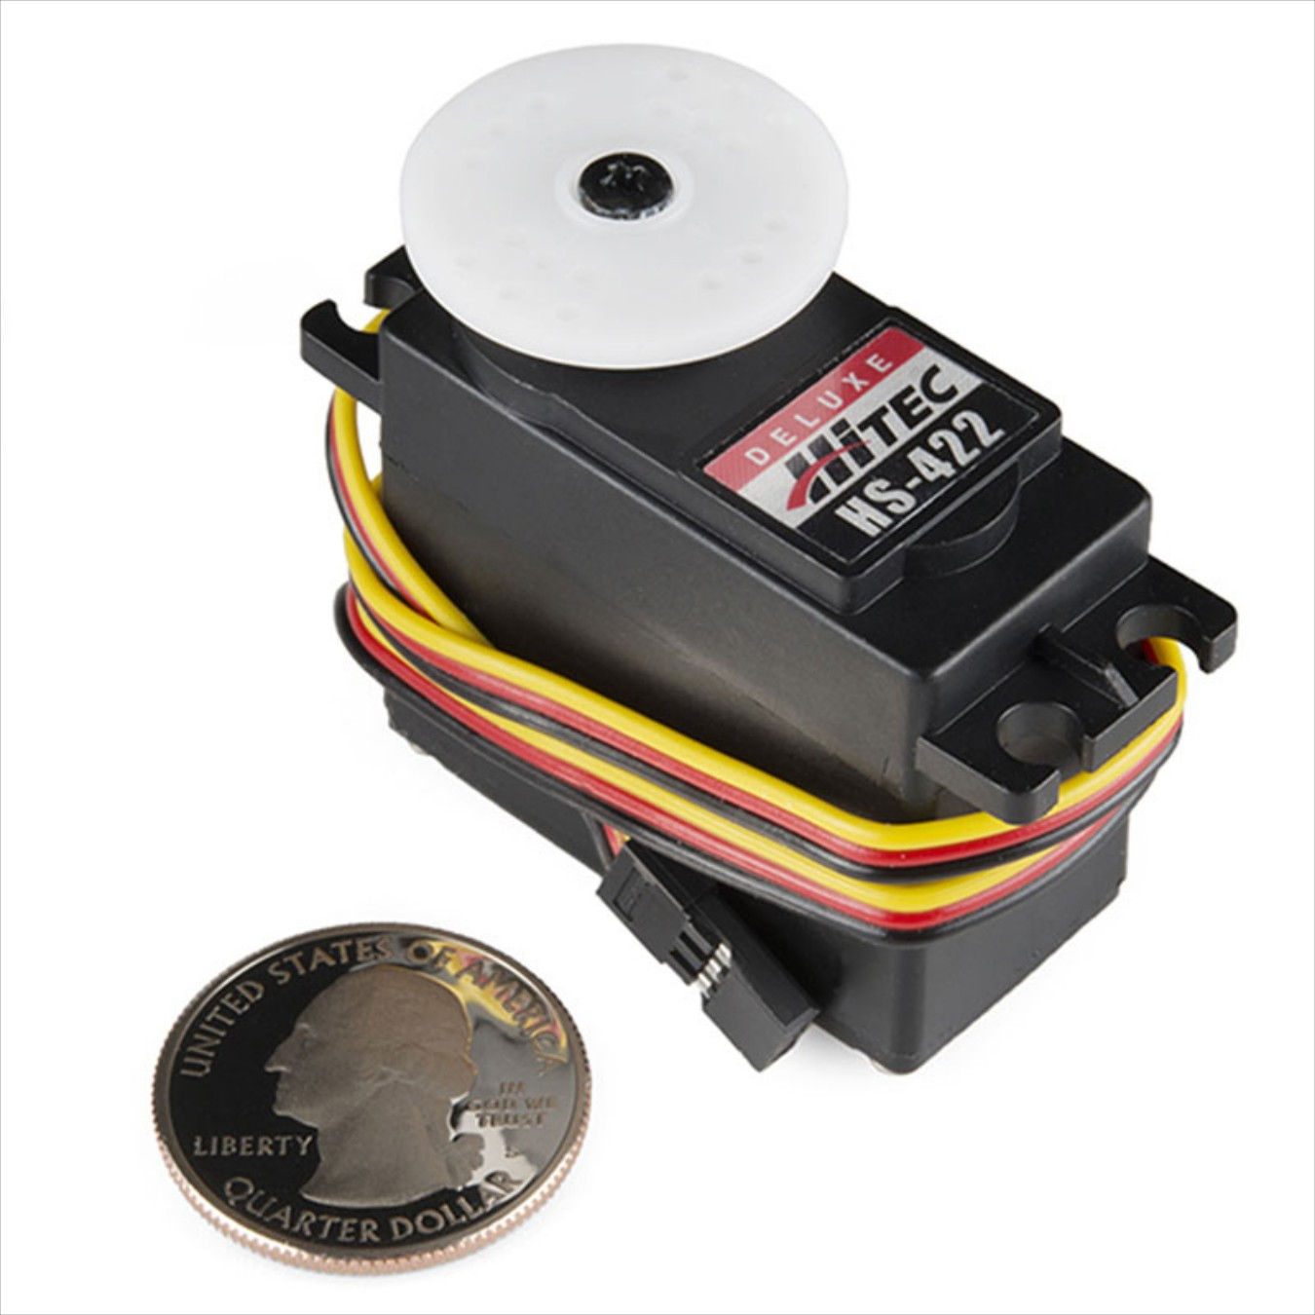
Motor Hardware: Servo Details
Why servo motors?
Precision
Low Power
High torque
Hitec HS-422 servo motor
180 degree motion, 0.16sec/60◦ ~0.5 sec response
3 pin input, voltage, ground, signal
Notes:
andre

Slide 18
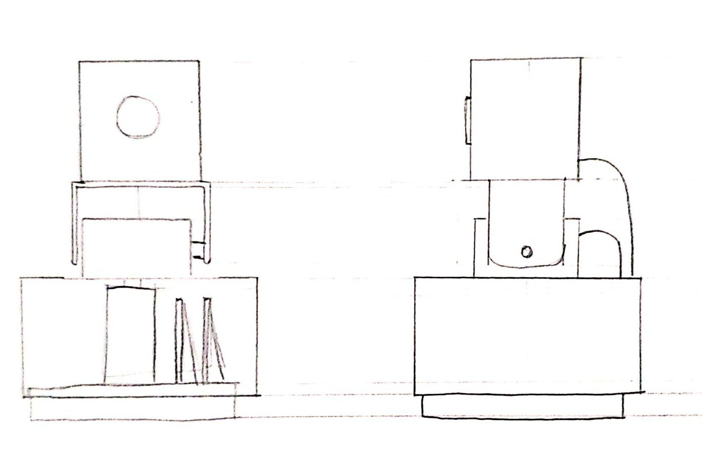
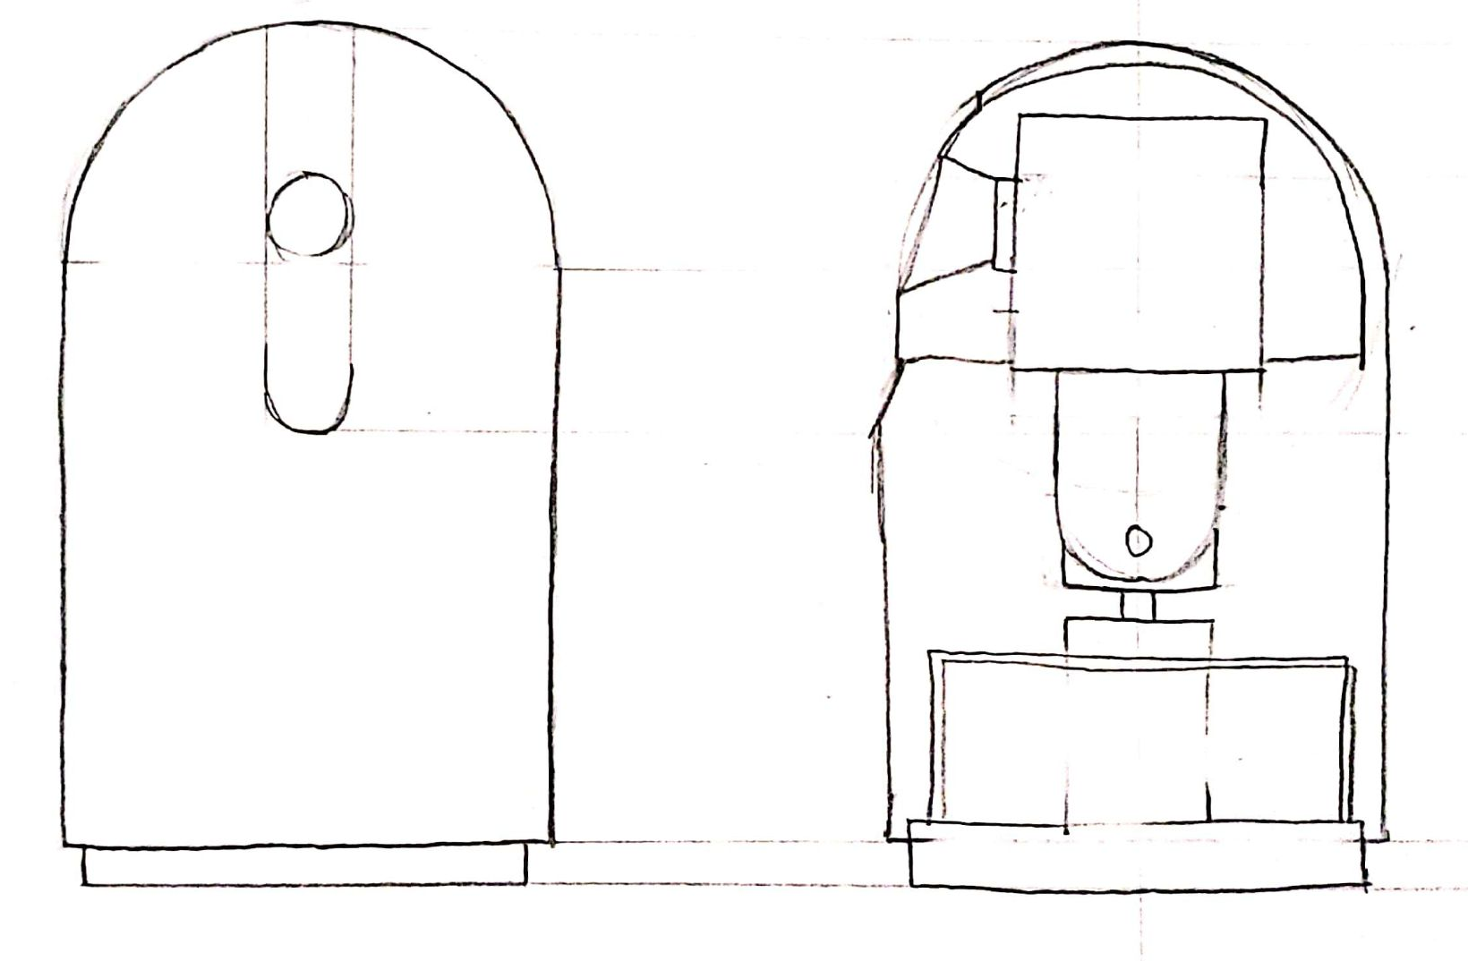
Device Housing: Sample Illustrations
Design 1
Design 2
Notes:
andre

Slide 19
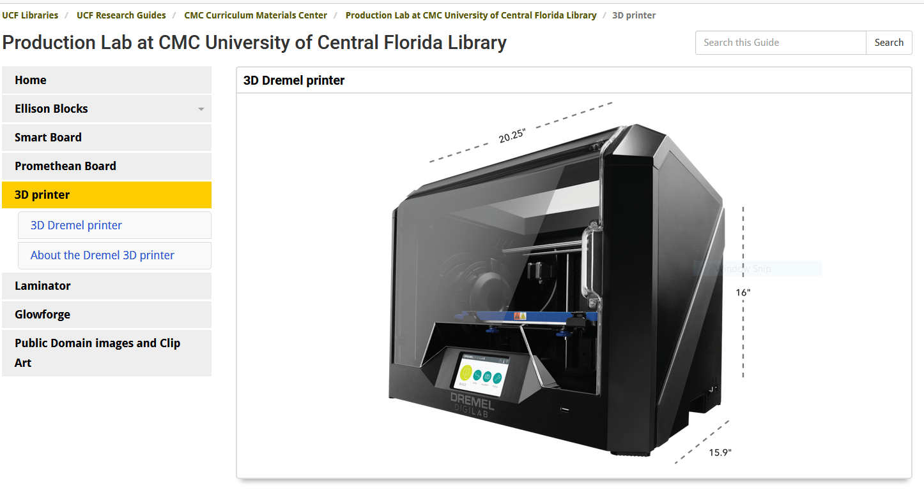
Device Housing: A 3D-printed Case
Using ABS plastic
Print in either TI lab or on Library printer
File made on tinkerCAD
Notes:
andre

Slide 20
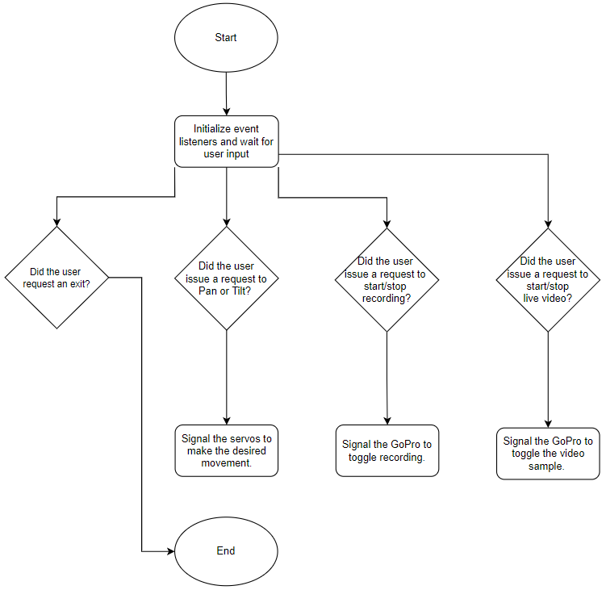
Software Overview
Controller Software
Workstation Software
Control Board Software
Notes:
Chisom

Slide 21
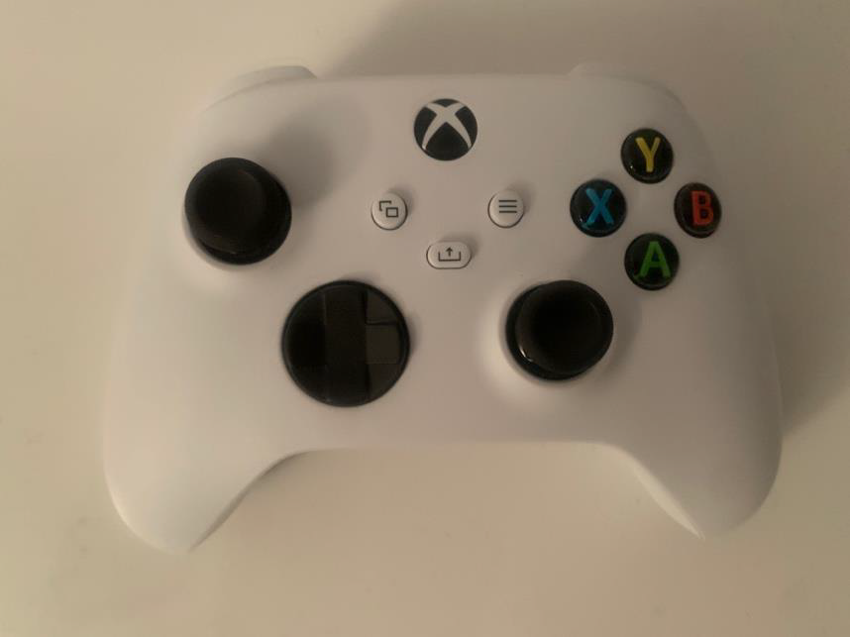
The Controller
Xbox Series X Controller
Interacts well with the Windows native
libraries
Can be used over Bluetooth

Slide 22
Controller Software
Hosted on the computer
Sends input from user via Xbox Controller to computer
Uses the Xinput library to receive byte level information representing the controller's current state
Interprets data and sends user selected command over to the main control board
Notes:
Chisom

Slide 23
Workstation Software: Overview
Features:
Physical and Digital Control over PTZ camera
User can control the movement speed of camera
Live video feed
Display sensor status such as battery life of camera, recording status, and current action.
Coordinates controller input
Possible Features:
Object Tracking (SimpleCV, OpenCV, and Imutils)
Notes:
Chisom
(add more about CV and Object tracking)

Slide 24
Workstation Software: Graphical User Interface
NodeJs
Electron
Cross platform GUI software
Minimal memory usage
Locally packaged
Notes:
Chisom

Slide 25
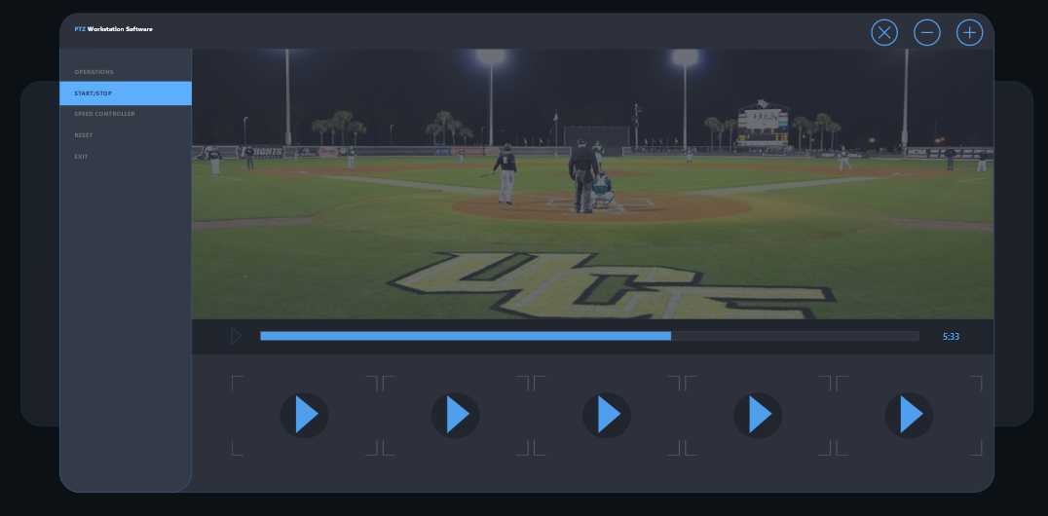
Workstation Software: GUI (Concept Design)
Notes:
Chisom

Slide 26
Control Board Software: Servo Control Design
Translates received data into servo controlling commands using the gpizero library
Data is sent to the servos using the GPIO pins on the raspberry Pi
Notes:
Chisom

Slide 27
Project Flow: A Success Story
We desire to deliver a product while minimizing design complexity
We accomplished that without sacrificing control over our requirements
Premade parts are a success that enabled immediate testing and integration
Notes:
Mike

Slide 28
Project Flow: A Challenge Story
Predesigned cameras include features and anti-features
Predesigned cameras simplify implementation, but are out of our control
Designing our own high-quality camera greatly increases complexity
A difficult choice between project designs with unique consequences
Notes:
Mike

Slide 29
Tests: Waterproofing
Waterproofing Test:
Test Environment: Camera mounted upright with housing attached.
Test Description: 0.10 inch per hour water dripped on housing for one minute.
Test Criterium: The device continues functioning normally.
Test Result: Success

Slide 30
Tests: Wind Stability
Wind Stability Test:
Test Environment: Area free of additional wind interference.
Test Description: The tripod-mounted device is subjected to 10 miles per hour wind for 30 seconds.
Test Criteria: The tripod feet are not displaced vertically or horizontally.
Test Result: Success.

Slide 31
Tests: Control Delay
Control Delay Test:
Test Environment: N/A
Test Description: Measure the delay from a controller command to the beginning of its execution on the GoPro.
Test Criterium: If the delay is greater than one second, failure. Otherwise, success.
Test Result: Success.
The average command delay duration was approximately 300 milliseconds.

Slide 32
Budget and Financing
Item | amount | status | Cost
Servo PTZ kit | 1 | acquired | $33
PI zero W | 1 | acquired | $10
Sparkfun Servo pHAT | 1 | acquired | $10
GPIO pin header | 1 | needed | $1
USB-to-barrel adapters | 2 | needed | $13
Power cables | 2 | needed | $20
Camera | 1 | needed | $250
Controller | 1 | acquired | $58
total | -- | -- | $395
Notes:
andre

Slide 33
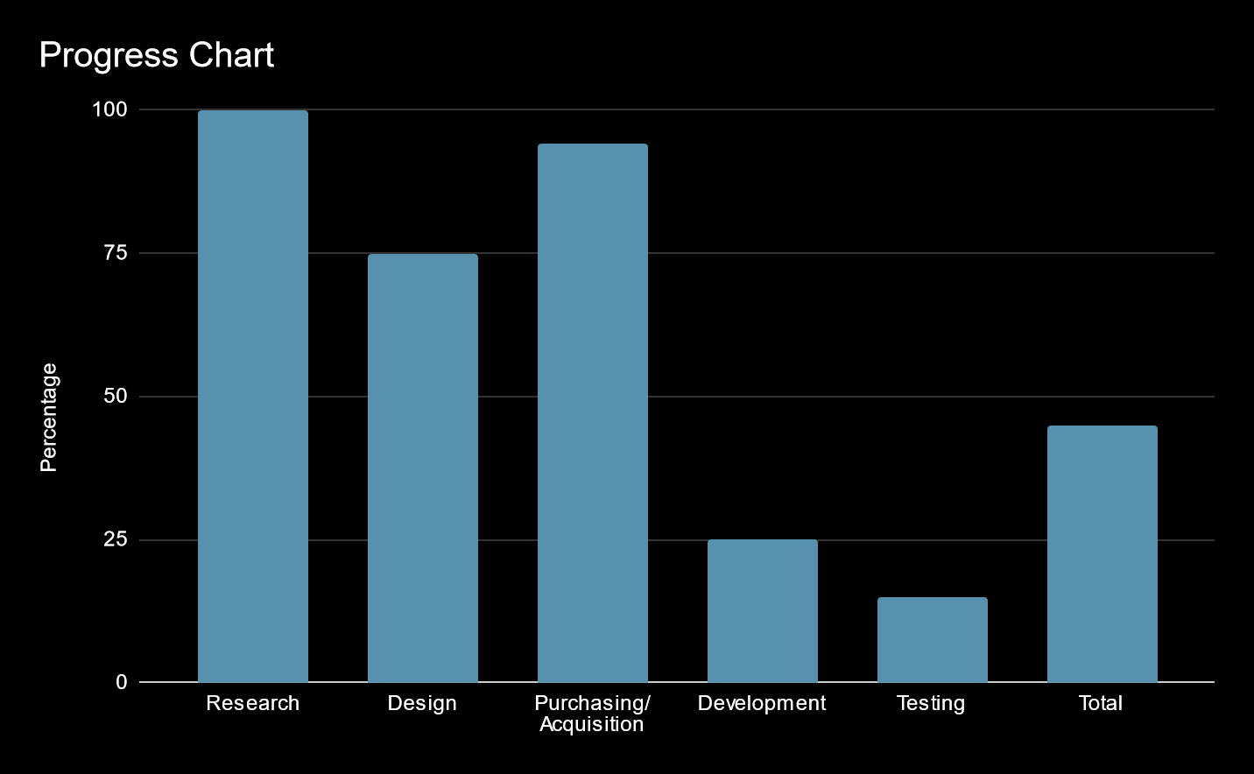
Current Progress
Notes:
Chisom

Slide 34
Plans to complete
Workstation Software
GUI
Controller interface
WiFi Media Stream
Complete Motor Testing
Finish assembly for waterproofing and wind-stability testing

Slide 35
Future Plans
Current Plans
Fine tune the servos
Complete the graphical user interface
Add the remaining workstation functionality
Add servo speed control
Stretch Goal Plans
Add automated positioning
Object identification and tracking
Notes:
Chisom

Slide 36
Thank You For Your Time
Notes:
New slide(record audio) Chisom

