Slide 1
Smart Door
Security System Group 15
Adam Stefanik, EE
Moisess Rodriguez, CpE
Reham Hammad, EE
Zachary Jackovich, CpE

Slide 2
Group 15 Team Members
Reham Hammad
Electrical Engineering
Moisess Rodriguez
Computer Engineering
Adam Stefanik
Electrical Engineering
Zach Jackovich
Computer Engineering

Slide 3
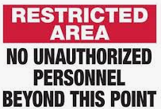
Introduction/Problem Statement
Many security systems can be disarmed with a physical key, token or PIN entry
This opens the potential for unauthorized access
Our project is a smart door lock with two-factor authentication
The Smart Door Security System (SDSS) unlocks after any two of the following authentication methods are satisfied: facial recognition, voice recognition, and/or PIN entry

Slide 4
Goals and Objectives
Design, build and test a cutting-edge smart door lock system that uses advanced facial and voice recognition for homeowner authentication
Two-factor authentication, greatly improves home security
Maintain ease of accessibility, or even improve accessibility, when compared to a standard deadbolt and key lock system

Slide 5
Specifications
Specification | Metric
Facial Recognition | Shall recognize authorized users 95% of the time.
Voice Recognition | Shall recognize authorized users 95% of the time.
PIN Entry | Shall recognize correct PIN entry 95% of the time.
Unlock | The door shall unlock 95% of the time if and only if two out of three authentication methods are validated.
LED Status Lights | Shall indicate correct status 95% of the time.
Notifications* | Shall be sent upon sensing an unauthorized person 95% of time.
Sonar Sensor | Shall run facial and voice recognition upon sensing movement within 2m of the system.
External Speaker* | Shall announce a greeting message 95% of the time.
LCD Screen* | The SDSS shall implement an LCD screen to print messages and prompt users.
Auto Relock | The door shall auto relock upon closing 95% of the time.
Input Power | The SDSS shall run when supplied with 12V input.
Input Power Usage | The SDSS shall not consume more than 120W.

Slide 6
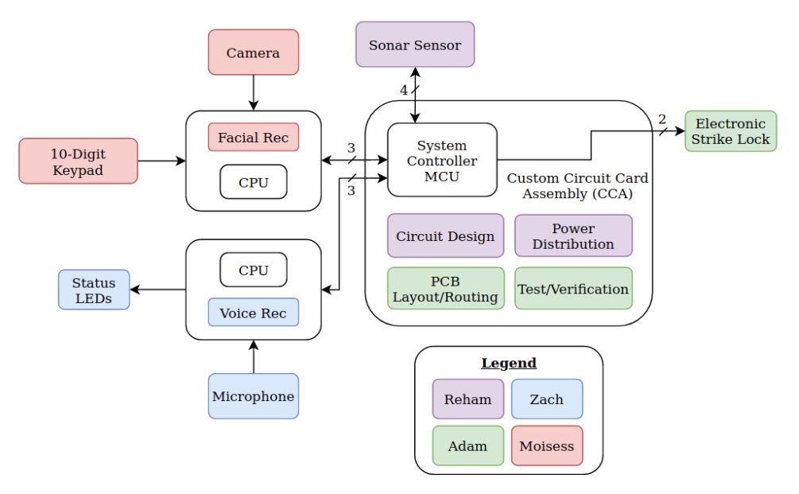
System Block Diagram

Slide 7
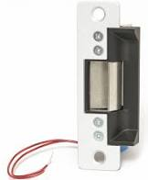
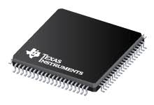
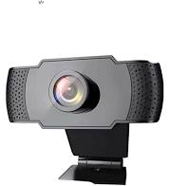
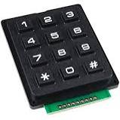
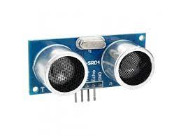
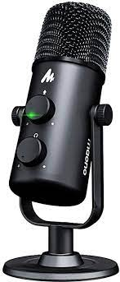
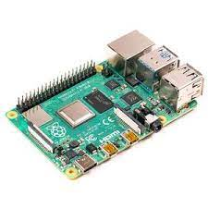
Power Specification for primary devices
12V
3.3V
Device | Voltage | Current
Electric Strike | 12V | 500mA
Ultrasonic Sensor | 5V | 15mA
Raspberry pi 4 | 5V | 1.8A
Peripherals | 5V | 1.2A
MAONO MIC | 5V | 500mA
Wansview 1080p webcam | 5V | 500mA
Keypad | 5V | 30mA
LED Strip Light | 5V | 400mA/5cm
MSP430FR6989 | 3.3V | 100mA
5V

Slide 8
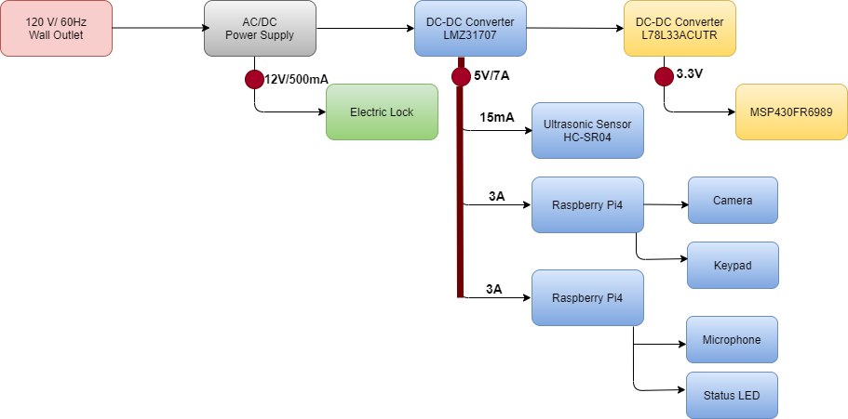
Power Diagram

Slide 9
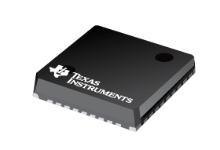
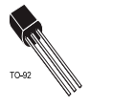
DC-DC Converters Specifications
LMZ31707
L78L33ACUTR
Features:
Small footprint, 10mm × 10mm × 4.3mm package
Output current 7A
Wide-output voltage adjust 0.6 V to 5.5 V
Overcurrent and overtemperature protection
Achieves 95% efficiency and excellent power dissipation capability
Standard QFN mounting and testing techniques.
Features:
Output current up to 100 mA
Output voltages of 3.3V
thermal overload protection
Short-circuit protection
No external components are required

Slide 10
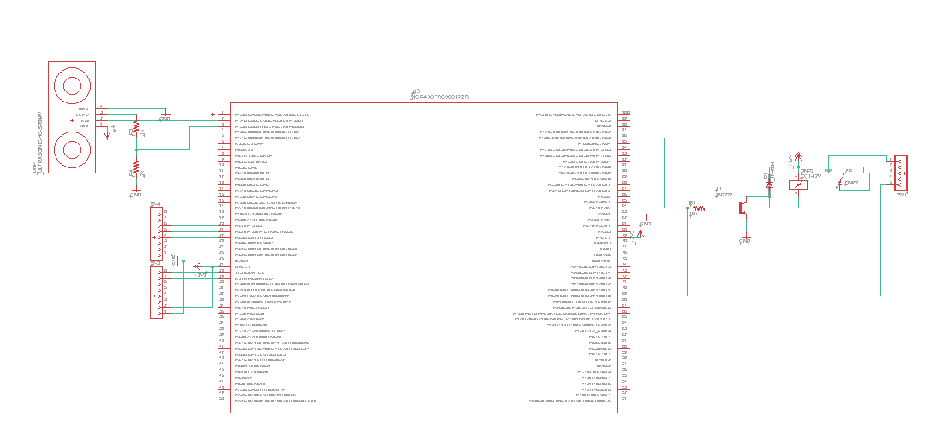
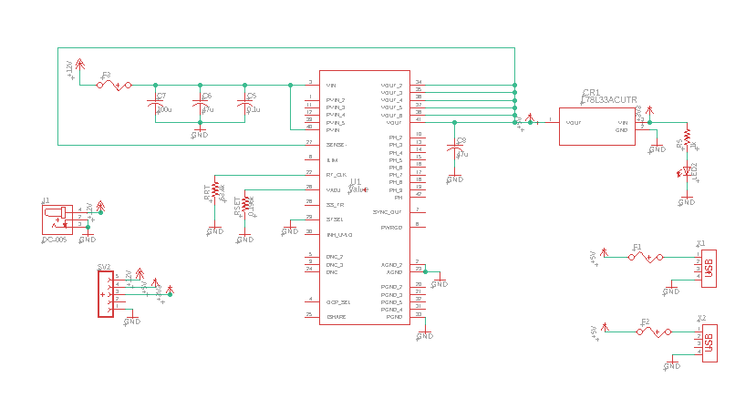
PCB Schematic
Electric Relay
MCU
Power Circuit
Notes:
Our PCB acts as a System Controller and power distribution board
Raspberry Pis perform facial and voice recognition, the results of which are communicated to the MSP430, which then makes the decision to unlock the door

Slide 11
Electric Relay
MCU

Slide 12
Power Circuit
Input Capacitors
Output Capacitor
Rset
Notes:
Power comes in on a high current 12V DC jack.
Power is converted to 5V and output to raspberry Pis using USB.
5V is dropped to 3.3V for internal use by the MSP430, 3.3V is not output to any peripherals
Fuses are used to regulate current and protect the board
An LED is used at the 3.3V, so we know that is the LED turns on, we have power at all voltage levels.

Slide 13
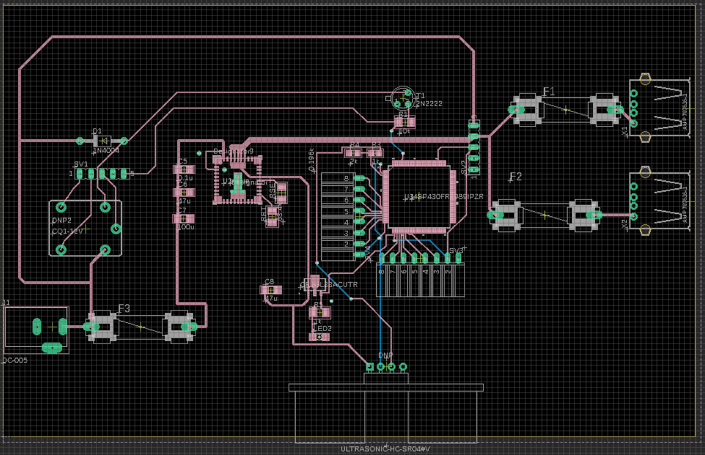
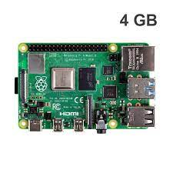
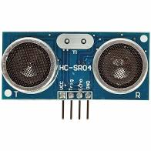
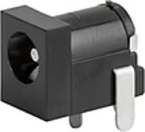
PCB Layout
2oz Copper
50mil
5V Converter
MCU
3.3V Converter
Input Jack
Notes:
We had to use 2 oz copper traces due to power concerns

Slide 14
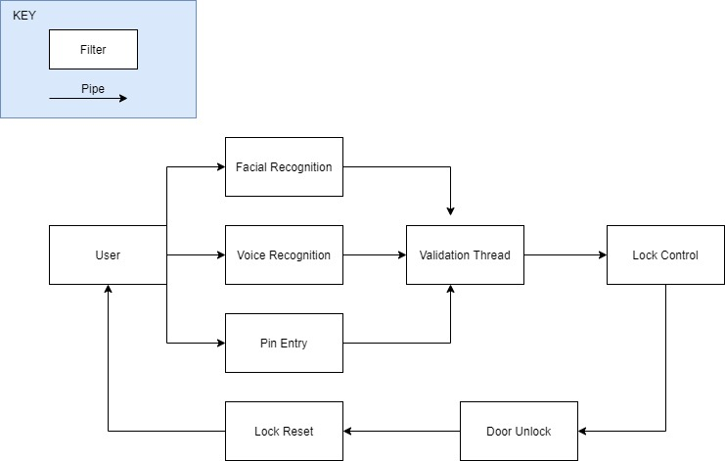
Software Flow

Slide 15
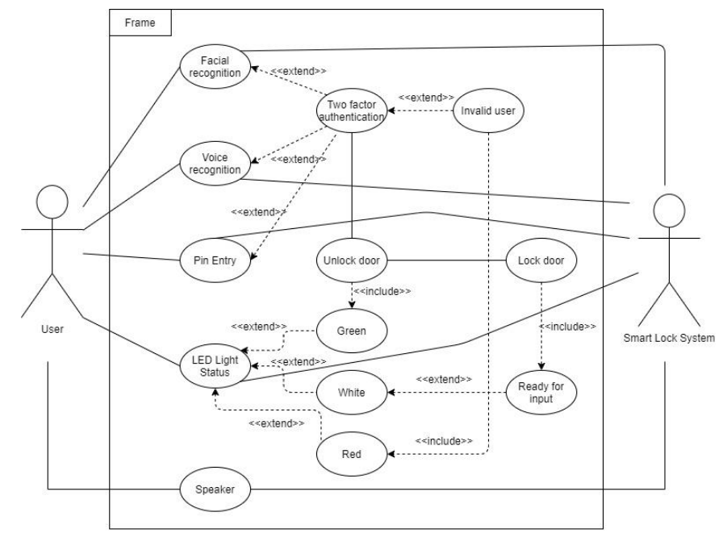
Software Overview

Slide 16
Two Factor Authentication
The Two Factor Authentication method will work by validating two out of the three validation requirements.
Being Facial Recognition, Voice Recognition, and Keypad entry.
Once two out of the three methods are validated then a flag will be raised from the software stating that the user is authenticated.
If the user fails to be validated by the system, then another flag will be raised, red LEDs will flash, and the door will not unlock.
The systems software will then reset and repeat the process.
By implementing the two-authentication method, our system will be able to provide an additional layer of security. Rather than using only one validation requirement. Since our system will open up a door to our users' residence or workplace, security is a major concern.

Slide 17
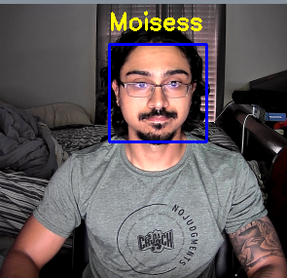
Facial Recognition
We will be using open CV to implement facial recognition.
To train our model we are required to upload multiple images of the new user.
There is an infinite loop which runs forever.
Inside of this loop the algorithm will compare the person who is in frame in real-time, to the saved users.
If the user is authorized then a validation variable will be set, satisfying the requirement.
If the user is not authorized then a flag will be raised.

Slide 18
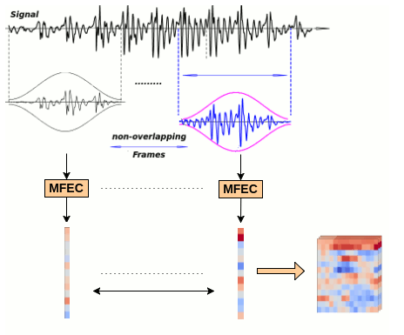
Voice Recognition
Voice (Speaker) Recognition vs. Speech Recognition (Speech-to-Text)
Still researching the best open source implementations available, that meet our system's requirements
Most likely we will use a TensorFlow based implementation using 3D Convolution Neural Network to verify the Speaker
Main priority as we head into the second half of SD2

Slide 19
System Cost
Smart Door Security System Cost Analysis
Raspberry Pi 4 CPU’s (Qty 2) | $90
Camera | $25
Keypad | $20
Electric Strike Lock | $40
Populated CCA (Qty 5) | $400
General Jumper Wires for Peripherals | $20
Speaker | $30
Microphone | $25
LCD Screen | $10
LED Strip Light | $20
Total: | $735 - $183.75/member

Slide 22
Thank you!

