Slide 1
Smart Door
Security System Group 15
Adam Stefanik, EE
Moisess Rodriguez, CpE
Reham Hammad, EE
Zachary Jackovich, CpE

Slide 2
Group 15 Team Members
Reham Hammad
Electrical Engineering
Moisess Rodriguez
Computer Engineering
Adam Stefanik
Electrical Engineering
Zach Jackovich
Computer Engineering

Slide 3
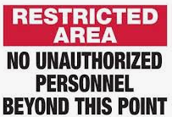
Introduction/Problem Statement
Many security systems can be disarmed with a physical key, token or PIN entry
This opens the potential for unauthorized access
Our project is a smart door lock with two-factor authentication
The Smart Door Security System (SDSS) unlocks after any two of the following authentication methods are satisfied: facial recognition, voice recognition, and/or PIN entry

Slide 4
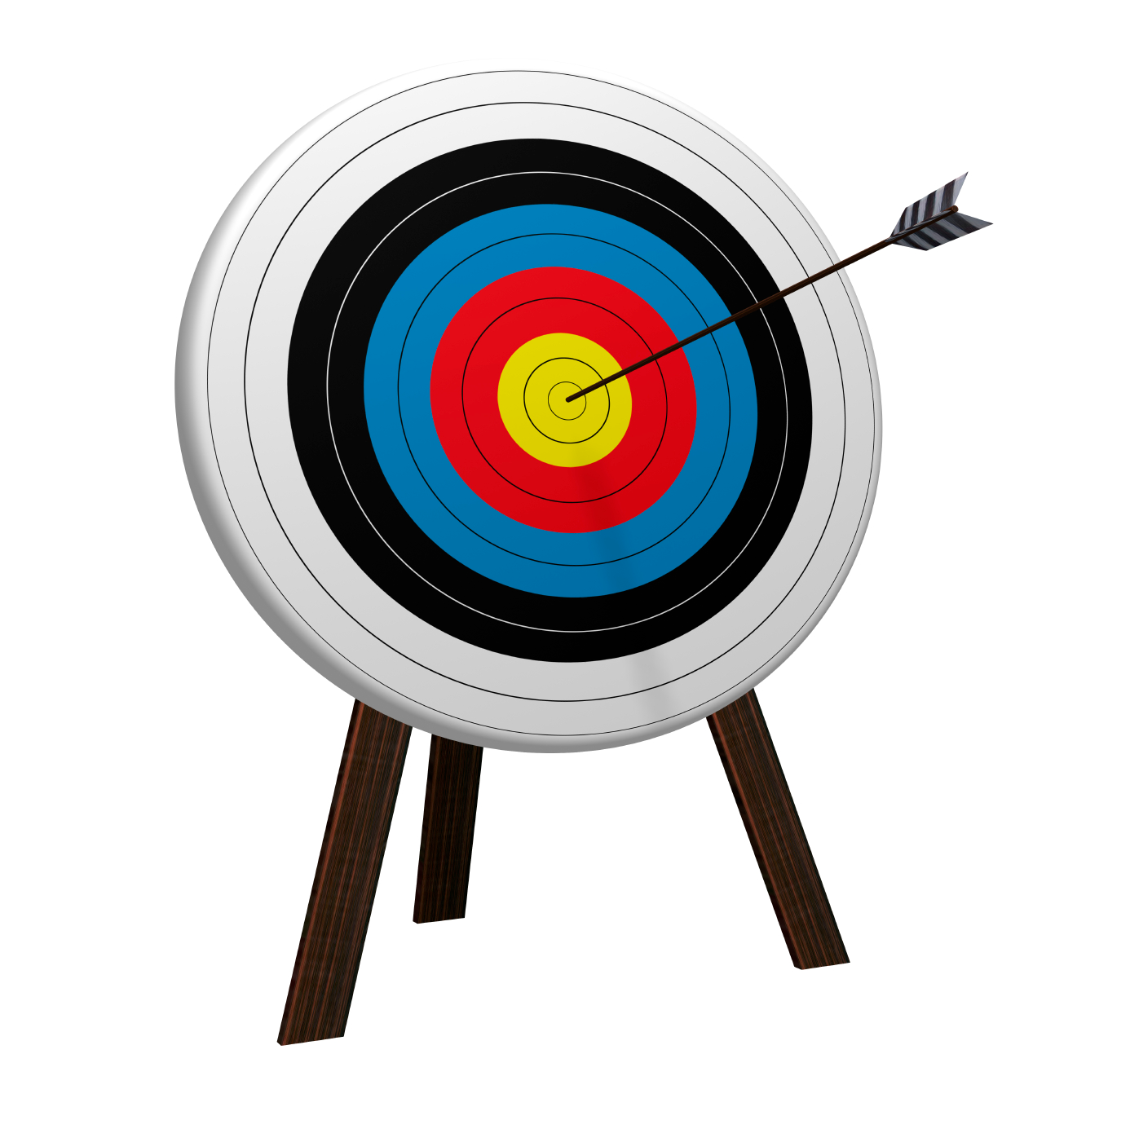
Goals and Objectives
Design, build and test a cutting-edge smart door lock system that uses advanced facial and voice recognition for homeowner authentication
Two-factor authentication, greatly improves home security
Maintain ease of accessibility, or even improve accessibility, when compared to a standard deadbolt and key lock system

Slide 5
Specifications
Specification | Metric
Facial Recognition | Shall recognize authorized users 95% of the time.
Voice Recognition | Shall recognize authorized users 95% of the time.
PIN Entry | Shall recognize correct PIN entry 95% of the time.
Unlock | The door shall unlock 95% of the time if and only if two out of three authentication methods are validated.
LED Status Lights | Shall indicate correct status 95% of the time.
Notifications* | Shall be sent upon sensing an unauthorized person 95% of time.
Sonar Sensor | Shall run facial and voice recognition upon sensing movement within 2m of the system.
External Speaker* | Shall announce a greeting message 95% of the time.
LCD Screen* | The SDSS shall implement an LCD screen to print messages and prompt users.
Auto Relock | The door shall auto relock upon closing 95% of the time.
Input Power | The SDSS shall run when supplied with 12V input.
Input Power Usage | The SDSS shall not consume more than 120W.

Slide 6
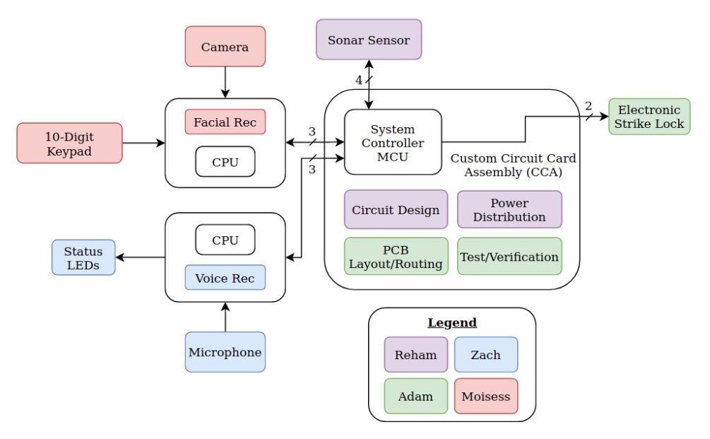
System Block Diagram

Slide 7
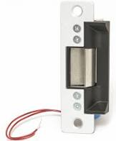
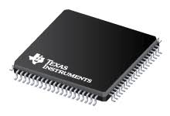
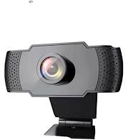
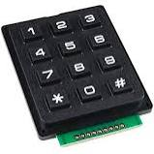
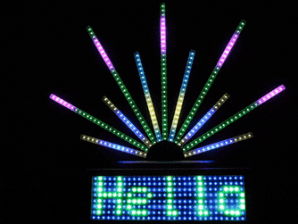
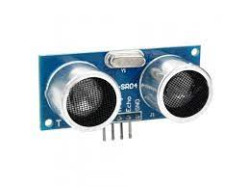
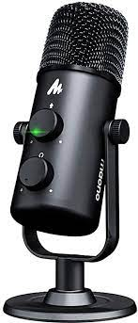
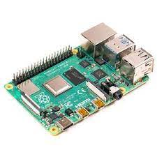
Power Specification for primary devices
12V
3.3V
Device | Voltage | Current
Electric Strike | 12V | 500mA
Ultrasonic Sensor | 5V | 15mA
Raspberry pi 4 | 5V | 1.8A
Peripherals | 5V | 1.2A
MAONO MIC | 5V | 500mA
Wansview 1080p webcam | 5V | 500mA
Keypad | 5V | 30mA
LED Strip Light | 5V | 400mA/5cm
MSP430FR6989 | 3.3V | 100mA
5V

Slide 8
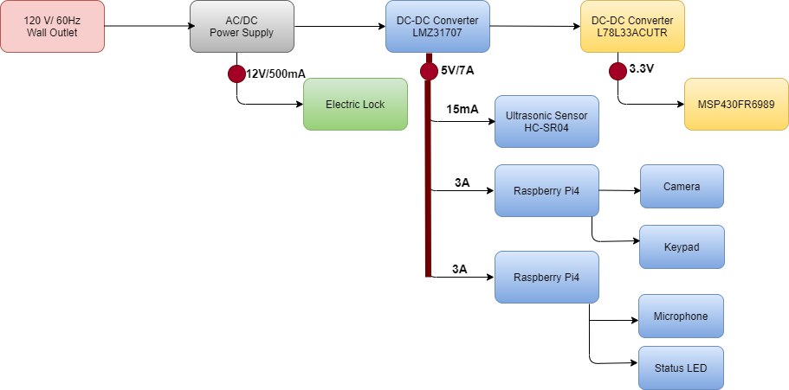
Power Diagram

Slide 9
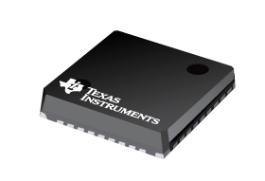
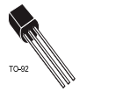
DC-DC Converters Specifications
LMZ31707
L78L33ACUTR
Features:
Small footprint, 10mm × 10mm × 4.3mm package
Output current 7A
Wide-output voltage adjust 0.6 V to 5.5 V
Overcurrent and overtemperature protection
Achieves 95% efficiency and excellent power dissipation capability
Standard QFN mounting and testing techniques.
Features:
Output current up to 100 mA
Output voltages of 3.3V
thermal overload protection
Short-circuit protection
No external components are required

Slide 10
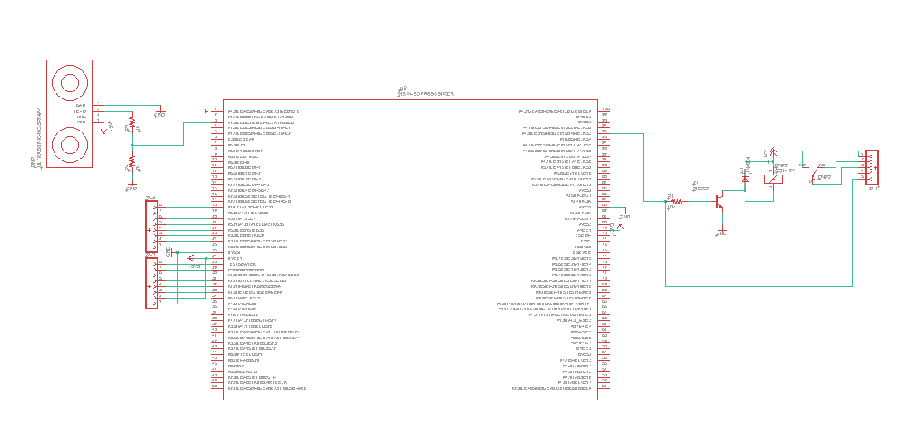
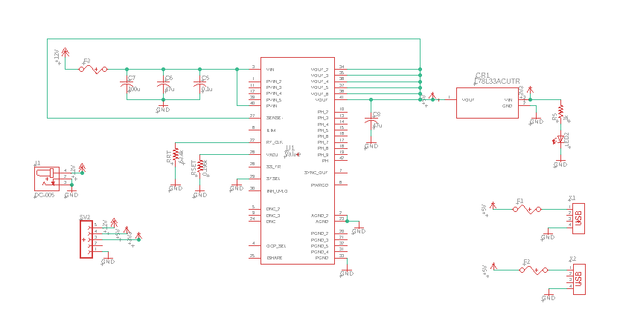
PCB Schematic
Electric Relay
MCU
Power Circuit
Notes:
Our PCB acts as a System Controller and power distribution board
Raspberry Pis perform facial and voice recognition, the results of which are communicated to the MSP430, which then makes the decision to unlock the door

Slide 11
Electric Relay
MCU

Slide 12
Power Circuit
Input Capacitors
Output Capacitor
Rset
Notes:
Power comes in on a high current 12V DC jack.
Power is converted to 5V and output to raspberry Pis using USB.
5V is dropped to 3.3V for internal use by the MSP430, 3.3V is not output to any peripherals
Fuses are used to regulate current and protect the board
An LED is used at the 3.3V, so we know that is the LED turns on, we have power at all voltage levels.

Slide 13
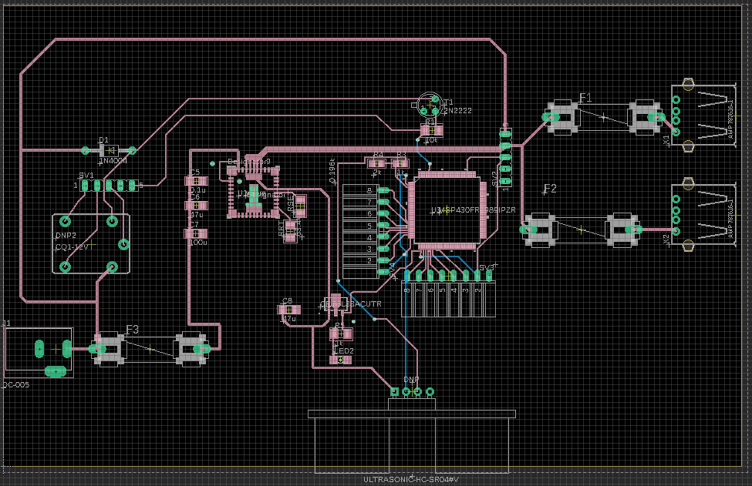
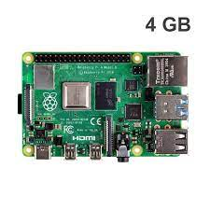
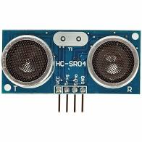
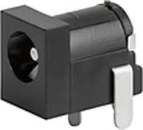
PCB Layout
2oz Copper
50mil
5V Converter
MCU
3.3V Converter
Input Jack
Notes:
We had to use 2 oz copper traces due to power concerns

Slide 14
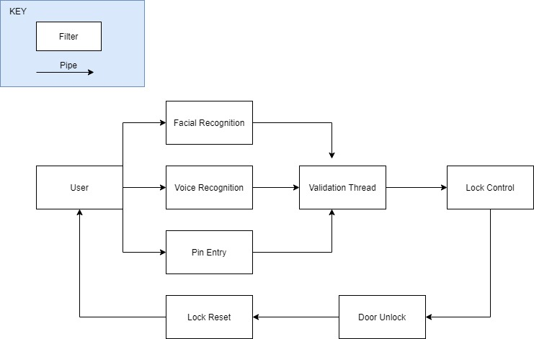
Software Flow

Slide 15
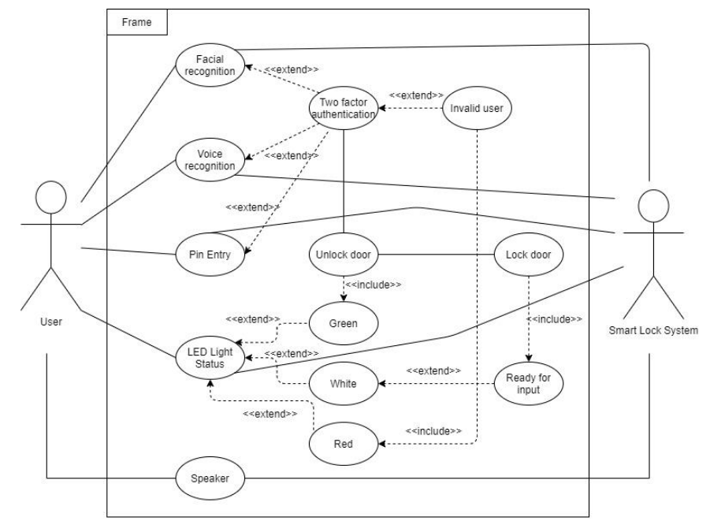
Software Overview

Slide 16
Two Factor Authentication
The Two Factor Authentication method will work by validating two out of the three validation requirements.
Being Facial Recognition, Voice Recognition, and Keypad entry.
Once two out of the three methods are validated then a flag will be raised from the software stating that the user is authenticated.
If the user fails to be validated by the system, then another flag will be raised, red LEDs will flash, and the door will not unlock.
The systems software will then reset and repeat the process.
By implementing the two-authentication method, our system will be able to provide an additional layer of security. Rather than using only one validation requirement. Since our system will open up a door to our users' residence or workplace, security is a major concern.

Slide 17
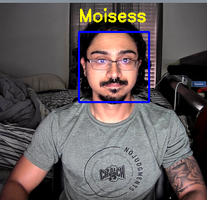
Facial Recognition
We will be using open CV to implement facial recognition.
To train our model we are required to upload multiple images of the new user.
There is an infinite loop which runs forever.
Inside of this loop the algorithm will compare the person who is in frame in real-time, to the saved users.
If the user is authorized then a validation variable will be set, satisfying the requirement.
If the user is not authorized then a flag will be raised.

Slide 18
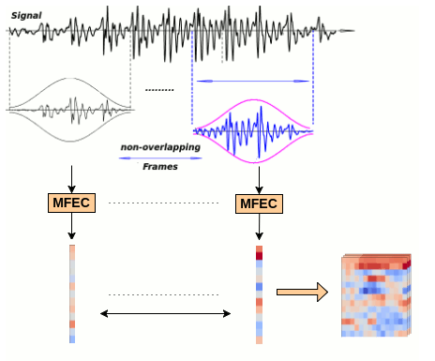
Voice Recognition
Voice (Speaker) Recognition vs. Speech Recognition (Speech-to-Text)
Still researching the best open source implementations available, that meet our system's requirements
Most likely we will use a TensorFlow based implementation using 3D Convolution Neural Network to verify the Speaker
Main priority as we head into the second half of SD2

Slide 19
System Cost
Smart Door Security System Cost Analysis
Raspberry Pi 4 CPU’s (Qty 2) | $90
Camera | $25
Keypad | $20
Electric Strike Lock | $40
Populated CCA (Qty 5) | $400
General Jumper Wires for Peripherals | $20
Speaker | $30
Microphone | $25
LCD Screen | $10
LED Strip Light | $20
Total: | $735 - $183.75/member

Slide 20
Post integration and current status
Currently we have successfully integrated and tested the system
We decided to pursue Speech to Text rather than Voice Recognition.
This is due to processing and memory limitations in relation to the raspberry pi.
Also, by using Speech to Text we are able to implement true Two Factor Authentication.
Facial recognition was still implemented, as well as taking input from a user via keypad entry.

Slide 21
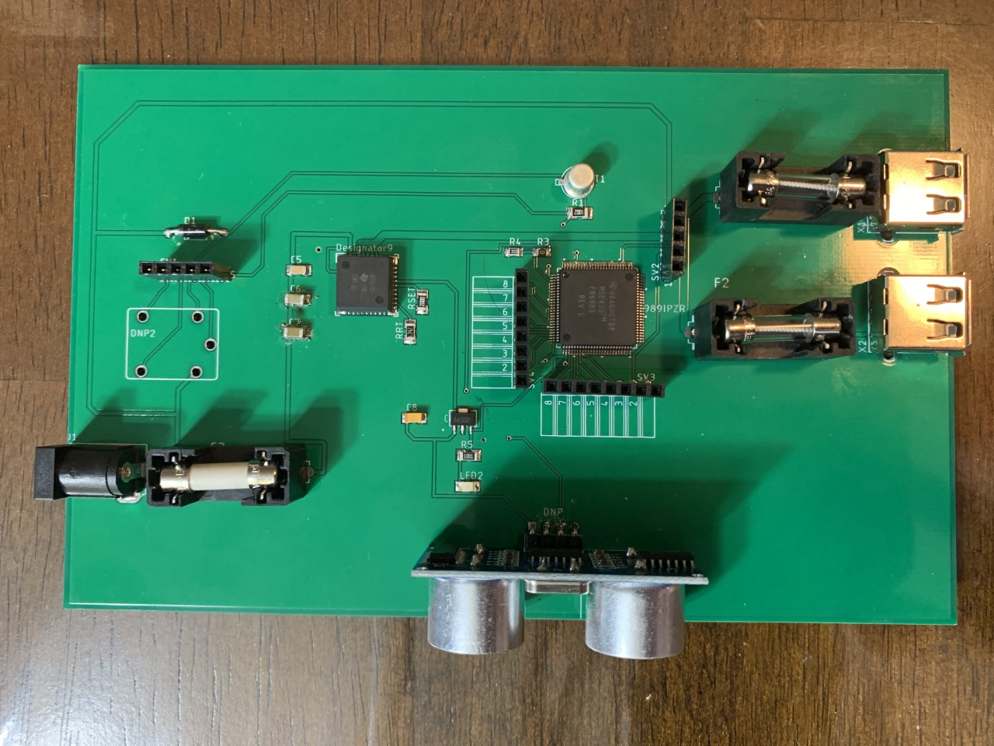
Testing and Trouble shooting

Slide 22
LMZ31707
L78L33ACUTR

Slide 23
L78L33ACUTR Output
Cut Trace
Solder Points

Slide 24
LMZ31707 Output
Voltage Drop

Slide 25
LMZ31707 Output

Slide 26
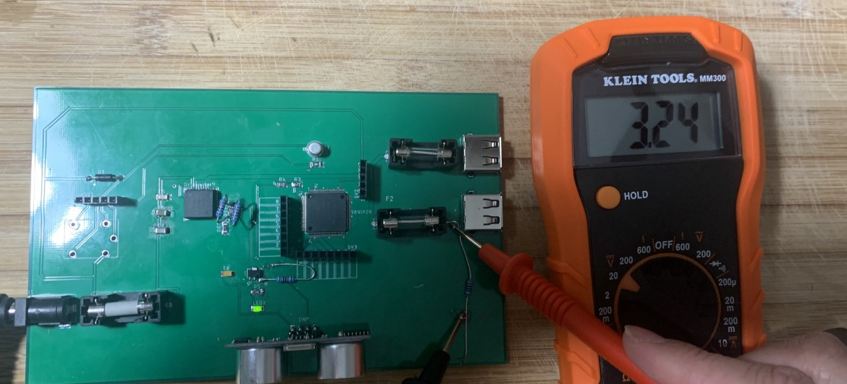
Loading Effects

Slide 27
Test results
Once we integrated the entire system we ran into some issues that we did not anticipate.
Most issues were related to the communication method that we chose.
Setting specific GPIO pins between devices to signal an event turned out to be an unreliable method.
Sometimes the GPIO pins on the raspberry pi would read as high or low when it shouldn’t have, which would trigger events at unwanted times
Such as the MSP430 waking up the system, or the pi to pi communication sending faulty signals.

Slide 28
Ways to improve accuracy of the facial recognition method
The facial recognition algorithm would sometimes recognize an unauthorized user as an authorized one.
This could be due to the quality of the camera, lighting, as well as the number of images we chose to train the model with.
So by getting a better camera, improving the lighting, and using more images to train the model we can improve the accuracy of the facial recognition algorithm.
The accuracy of the facial recognition algorithm after testing came out to be 72%.

Slide 29
Ways to improve accuracy of the Speech to Text method
The Speech to Text method was very reliable.
Although, rarely the microphone would detect unwanted words. Which would result in the system comparing each word to stored pins, and once the system determines that the pin is invalid it would request the user to enter another pin.
If the user is also saying pins without waiting for the system to catch up, the system may crash or take a while to catch up
To fix this we could create some logic which parsed through the input string of the user and looks for specific integer values. However, this issue will arise regardless due to the nature of the system.
For instance, if someone is approaching the door and talking on the phone or with someone next to them then the system will pick up those words.
Accuracy of the door could also be improved by selecting a higher quality microphone.
The accuracy of the Speech to Text Algorithm resulted in 76%.
Notes:
Talk about the person having to wait instead of constantly shouting out pins, this could delay the system.
Talk about someone trying to open the door but talking on the phone or to a neighbor.

Slide 30
Final Results
The keypad entry was very accurate, and the system read the users input correctly every time.
In conclusion for the door being a prototype, the accuracy of the entire system after 100 tests came out to be around 75%.
The biggest issues we faced besides for the PCB situation, was with the GPIO pins incorrectly reading values.
We noticed that by turning off the devices it would reset the GPIO pins to low.
To improve the accuracy of this system we would implement some other form of communication.
However, given the circumstances, the system was accurate!

Slide 31
Thank you!

