Slide 1
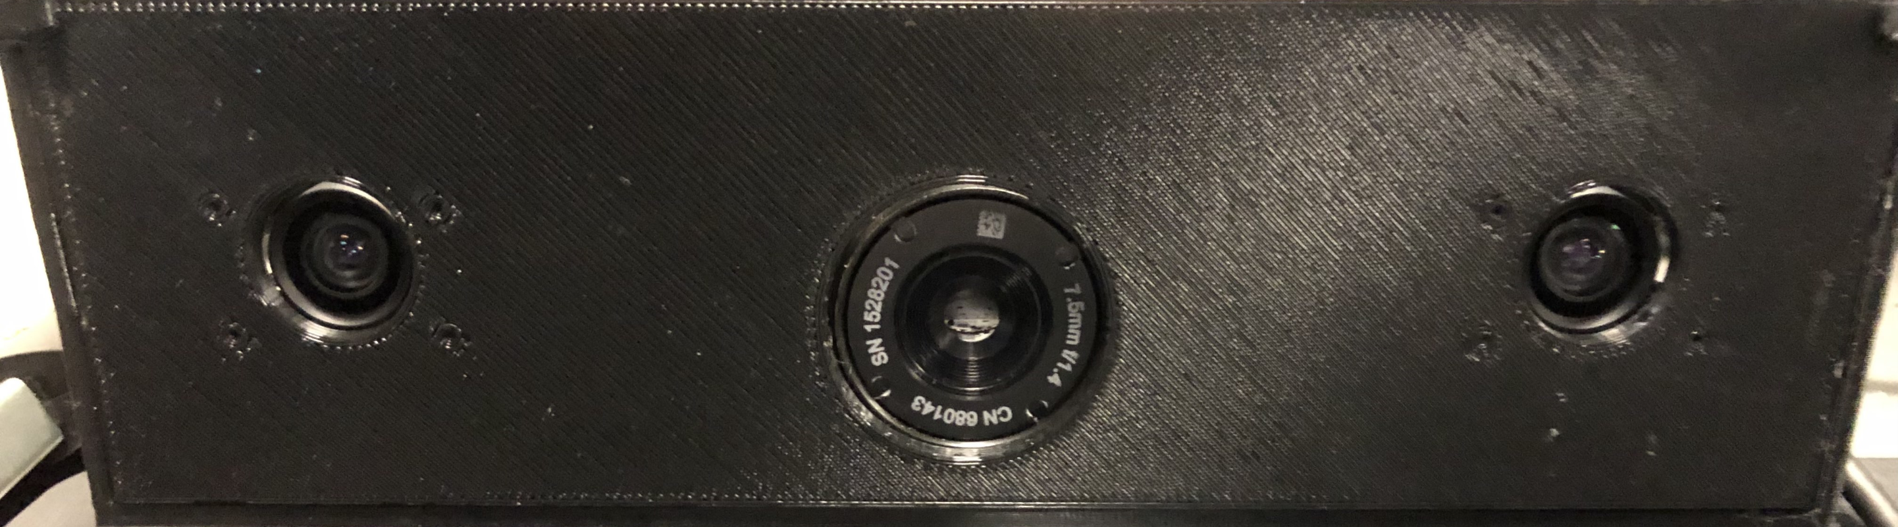
Multi-sensor Passive ranger (MSPR) Midterm demo
Group 3:
Pedro A. Alvarez Fernandez Photonic Science and Engineering
John Haynes Electrical Engineering
Ilina Sunkara Photonic Science and Engineering
Taylor Whitton Computer Engineering

Slide 2
Specifications and requirements
Category | Specification
Range estimation accuracy | ±10% of true value
Range estimation speed | 1/sec
Background/Target differentiation | 1 s
Time of arrival estimation (velocity) | ±10% of true value
Disparity image | 7.5 FPS
Object motion tracking | 1 s

Slide 3
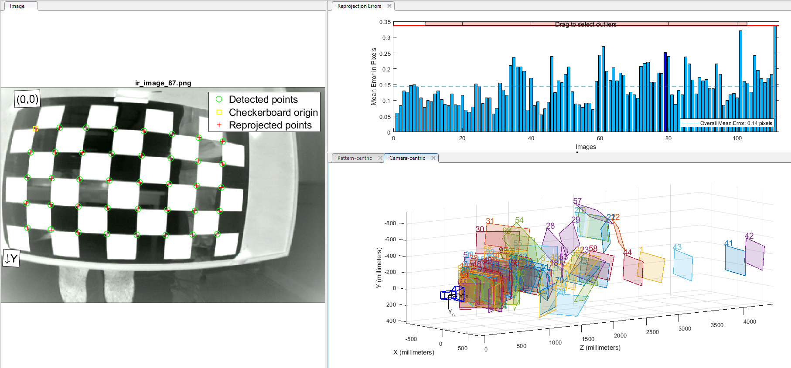
Calibration results (IR)

Slide 4
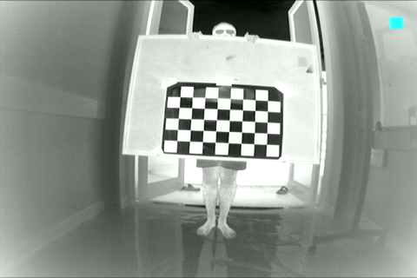
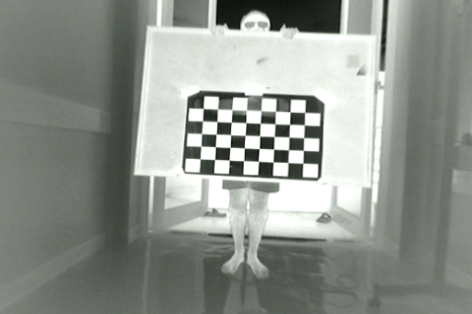
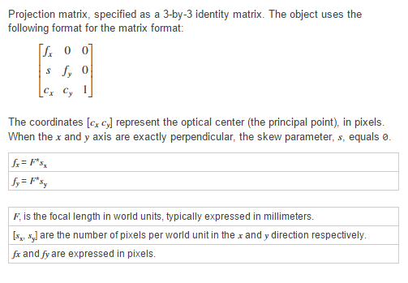
Distorted vs Undistorted
Fx=338.1651 | 0 | 0
S=0 | Fy=295.719 | 0
Cx=241.0331 | Cy=159.0301 | 1
Radial distortion | -0.4516 | 0.2484 | 0.07661
Tangential distortion | 7.2740E-4 | 0.001340 | -

Slide 5
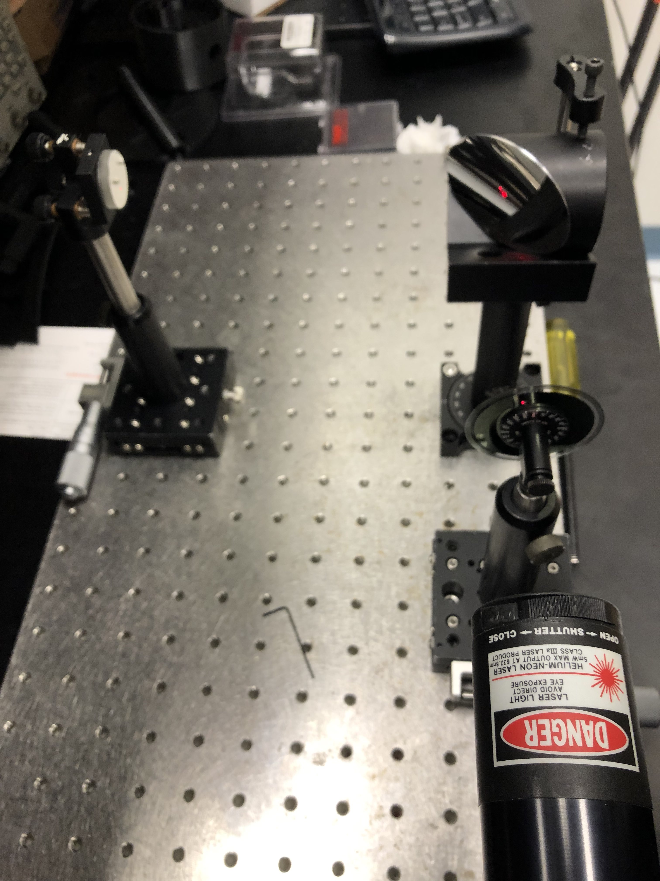
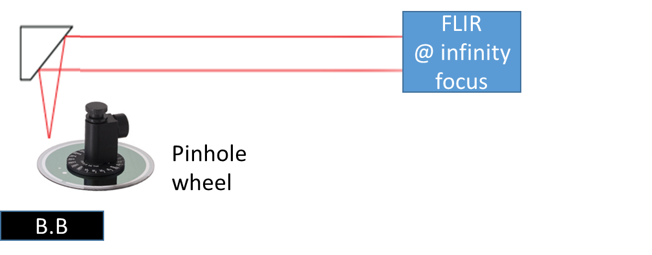
Closing object simulation and alignment

Slide 6
Corner Extraction and Reprojection

Slide 7
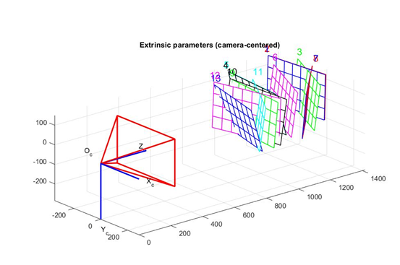
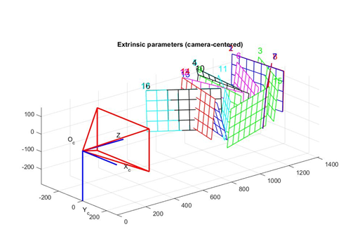
Extrinsic Parameter Visualization
Left Camera Visualization
Right Camera Visualization

Slide 8
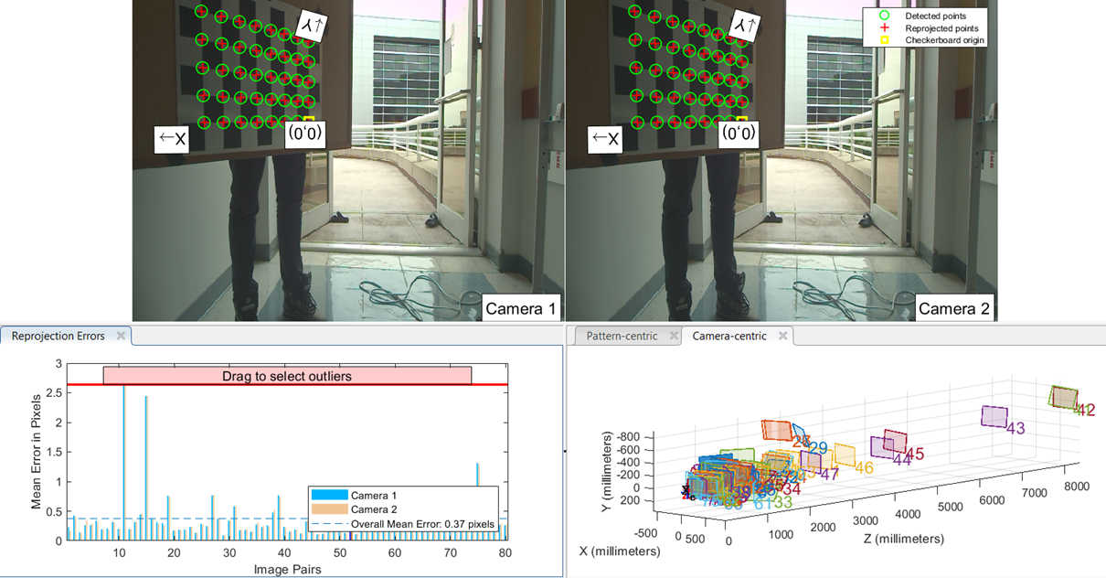
Calibration Results (Visual)

Slide 9
Proposed Final demo
Hot object: cube/sphere/flat surface/car.
Perhaps coat it with common application paint.
How will it move to camera?
RC car, drone, string pulled trolley,
Where?
Inside (long hallway)
Outside (open field)
Or Parking garage
MSPR
m<100 m

Slide 10
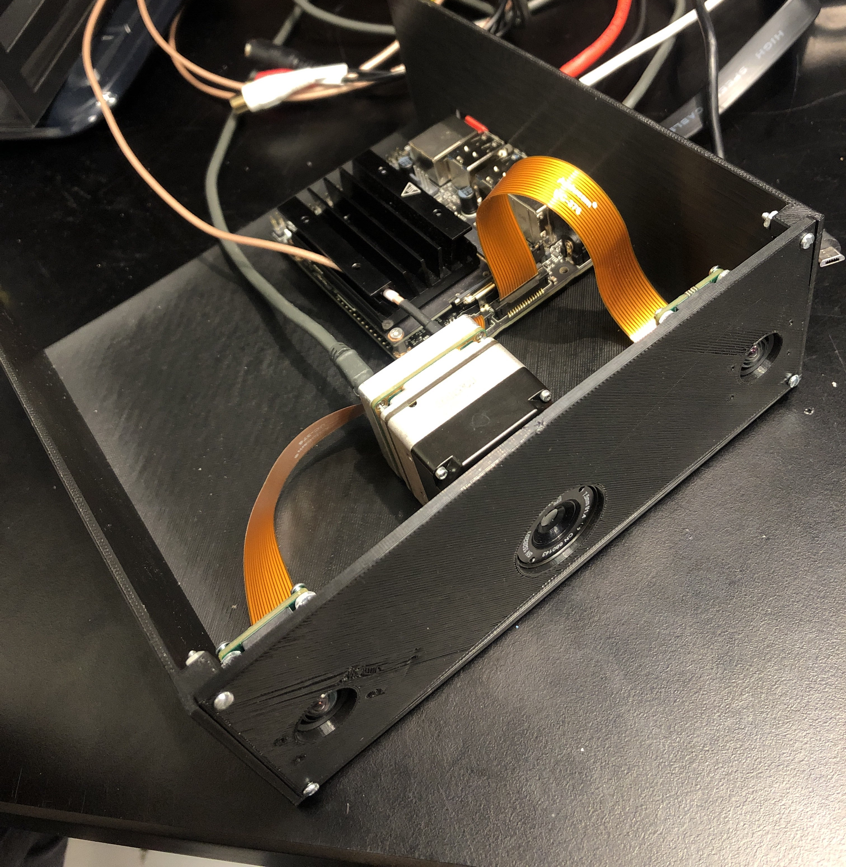
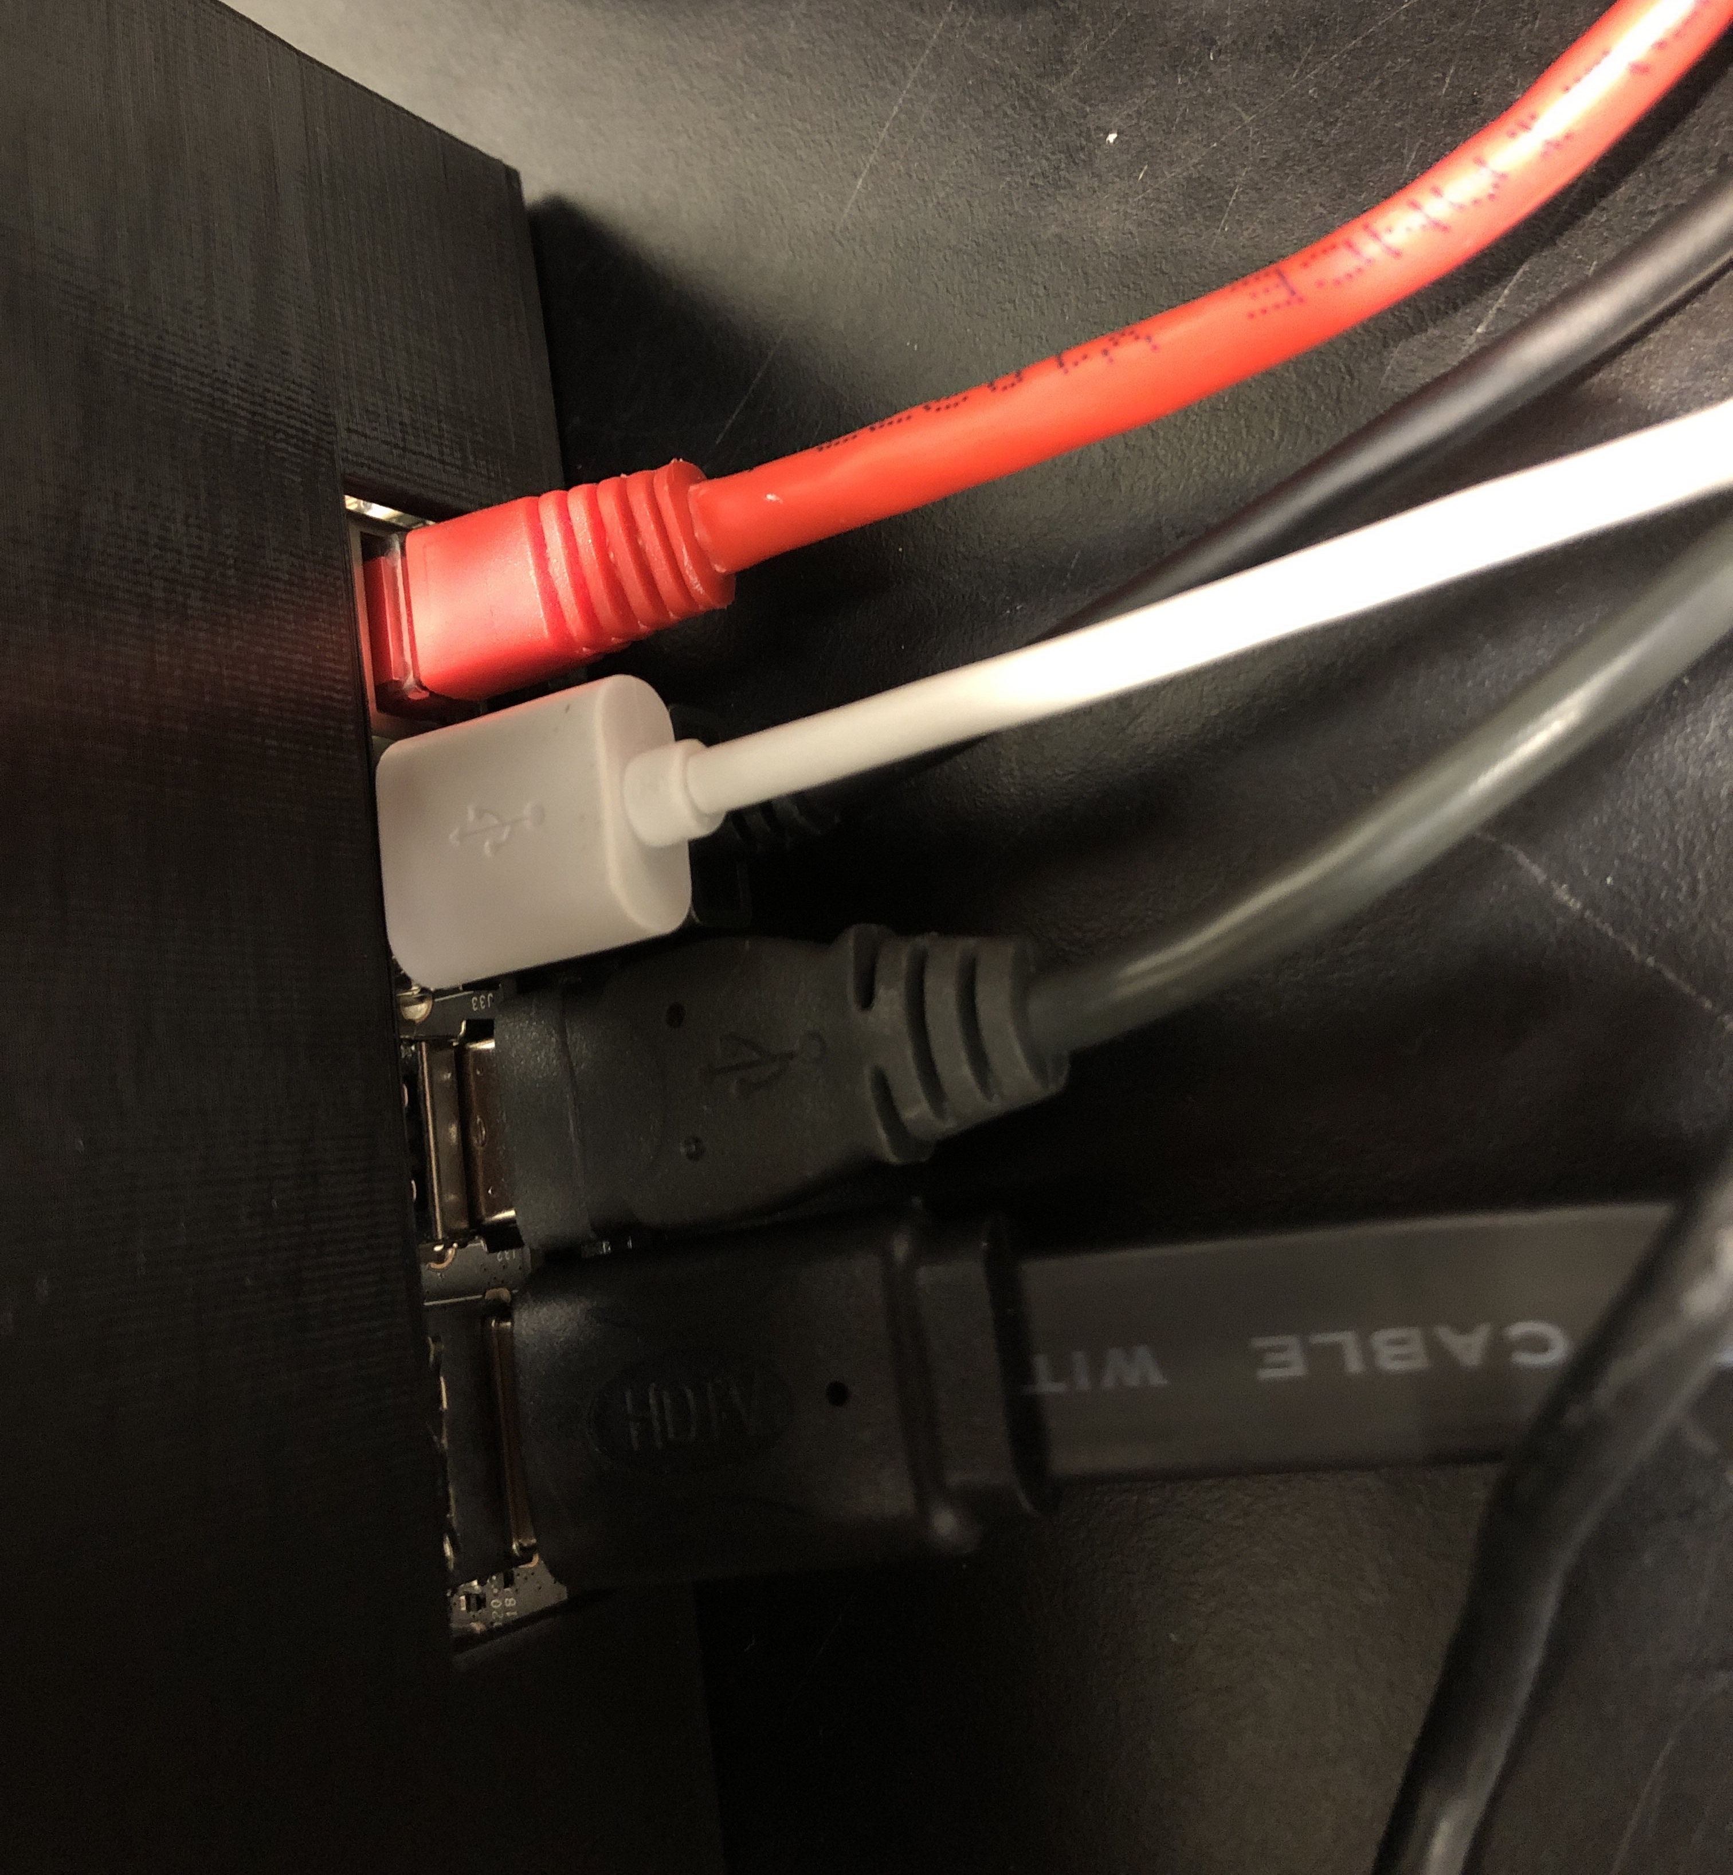
Housing

