Slide 1
Multi-sensor Passive ranger (MSPR)
Group 3:
Pedro A. Alvarez Fernandez Photonic Science and Engineering
John Haynes Electrical Engineering
Ilina Sunkara Photonic Science and Engineering
Taylor Whitton Computer Engineering

Slide 2
Overview/Skip
• overall project block diagram, or system design diagram
• discuss the project design approach and proposed implementation
• discuss and support significant design decisions and significant component decisions
• discuss the impact of realistic design constraints including economic, environmental,
social, political, ethical, health and safety, manufacturability, and sustainability
• Identification and review of related standards
• discuss project successes and difficulties for each project subsystem
• show the project budget and financing to date, and to the end of the project
• clear statement of current progress made by the group (% done by category)
• discuss the group's immediate plans for the successful completion of the project

Slide 3
Motivation
In military applications, the element of surprise is of vital importance:
Many range-finding systems utilize detectable means of obtaining the range of a given object.
These systems rely on “active” methods that require the system to send out some form of signal to detect the distance of the object
Radar and laser-based range-finding systems
Ideally, a military adversary should not be aware that they are being tracked, to keep the element of surprise.
General Surveillance purposes (mobile, non-mobile)
For surveillance we want to receive as much information as possible (range, speed, identification)

Slide 4
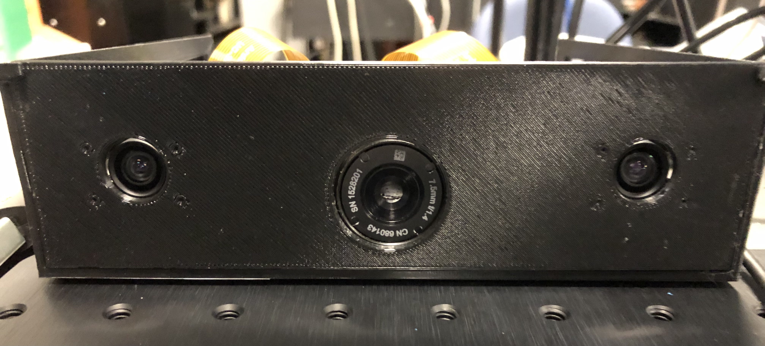
Solution
We present the Multi-Sensor Passive Ranger (MSPR) as our solution to the problem with “active” range finding systems.
Make use of both stereo and infrared cameras to accurately range the distance of an object.
No risk of detection since these cameras only absorb input from the environment, rather than producing some form of output.
The IR band can track in no visible light scenarios and low visibility
Each system can feed information to each other for accuracy

Slide 5
Goals and objectives
Produce a system that can accurately find the range of an object in a passive, undetectable manner.
Other systems, such as radar, transmit radio waves.
Systems can detect these radio waves, leading them to be detectable.
This is suboptimal for military applications where one wants to restrict the enemy’s knowledge as much as possible.
A real-time stream of range data that can be used to continuously monitor an object’s position relative to the device.
Cross reference the range data from the IR camera and the stereo system to detect inconsistencies.
Implement a software algorithm that can extract range from IR camera images

Slide 6
Specifications and requirements
Category | Specification
Range estimation accuracy | ±10% of true value
Range estimation speed | 1 times/sec
Background/Target differentiation | 1 s
Time of arrival estimation (velocity) | ±5% of true value
Disparity image | 15 FPS (480p<)
Object motion tracking | 1 s
Temperature sensitivity | ±5°C or ±5% of reading

Slide 7
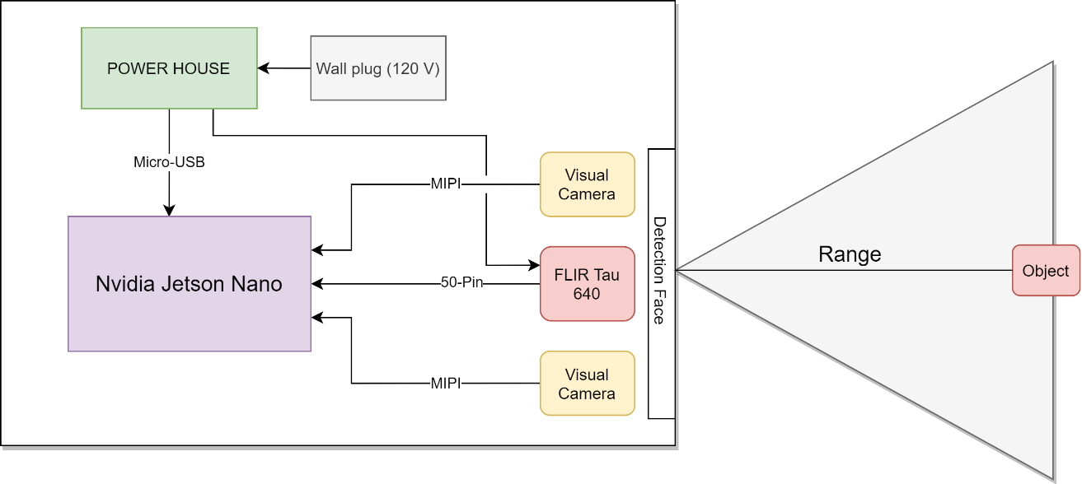
Layout Design: overall
USB Interface

Slide 8
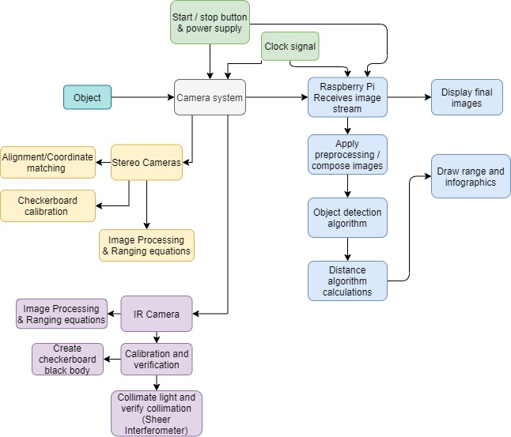
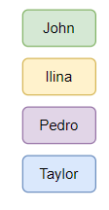
Block Diagram: overall

Slide 9
Block Diagram: Electrical

Slide 10
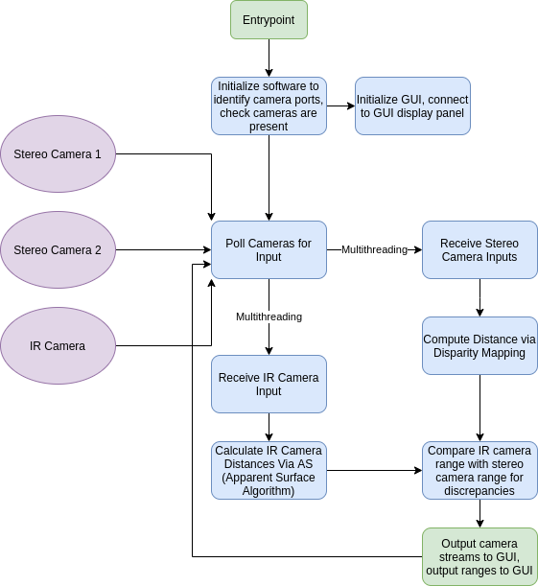
Software Flowchart

Slide 11
Software Design
The basic flow of the software system is simple:
Initialize a connection to each camera
Iteratively retrieve a frame from each camera
Run each image through each system’s respective distance calculating algorithm to extract the range of the object
Nvidia TensorRT with the MobileNet Single Shot Detector v1 to detect object
Trained on the COCO dataset (common objects in context)
Output result to GUI, await next frame

Slide 12
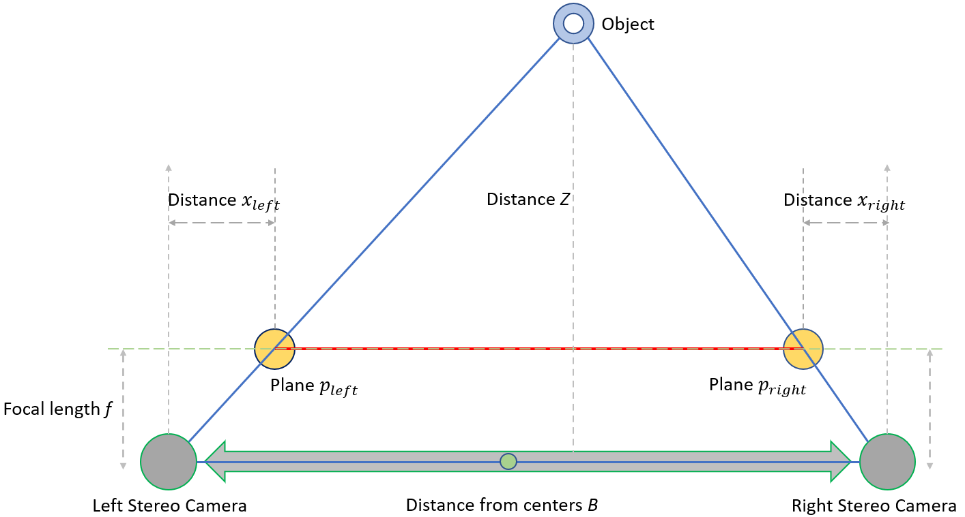
Layout Design: Visual Cameras
Planes p_{left} and p_{right}
Represent intersections between the image plane and lines from the camera centers to the object
Since the two triangles shown in the diagram are similar, the ratios of base to height in both should be equivalent.
$\frac{B}{Z} =\frac{p_{left}{×p}_{right}}{Z−f}$
$p_{left}{×p}_{right}=B−\left(x_{left}+x_{right}\right)$
By taking the center from the distance between the cameras as the origin, the $x_{left}$ can be represented as positive and $x_{right}$ as negative
$Z=f\left(\frac{B}{x_{left}−x_{right}}\right)$
Depth and disparity have an inverse relationship, where the distance Z increases as the disparity $(x_{left}−x_{right})$ decreases

Slide 13
Ir Ranging Theory (Point source)
To be considered a point source, R needs to be larger than 5X the source diameter, or $A_{source}=\frac{A_{source}}{R^{2}}<\frac{A_{detector}}{f^{2}}$ (1).
A point source is subject the inverse square law which says that irradiance (H) decreases as (1/R^2), with R being the distance away from the point source
The point source radiant intensity is given by $I\left(\frac{w}{sr}\right)=L_{source}A_{source}$ (2) and the detected irradiance at the detector is $H\left(\frac{w}{cm^{2}}\right)=\frac{P}{A_{pupil}}=\frac{I}{R^{2}}=L_{source}A_{source}/R^{2}$ (3)
From this equation we also arrive at the equation for detected power $P=I\frac{πD^{2}}{4R^{2}}=I\frac{A_{pupil}}{R^{2}}=L_{source}A_{source} \frac{A_{pupil}}{R^{2}} (4)$
Diagram inspired from Steve Marlow (AFRL)
Notes:
In terms of IR detection, we need to understand that IR imaging is thermal imaging. Every object off a certain amount of radiation depending on how hot it is. So the hotter the object the more thermal radiation and more the IR sensor detects. In this case we take into account a point source where

Slide 14
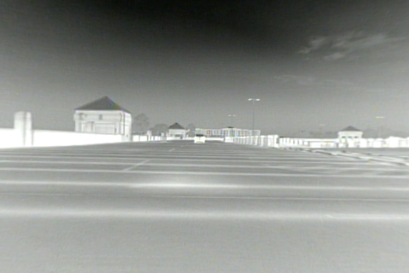
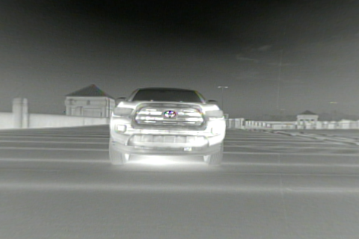
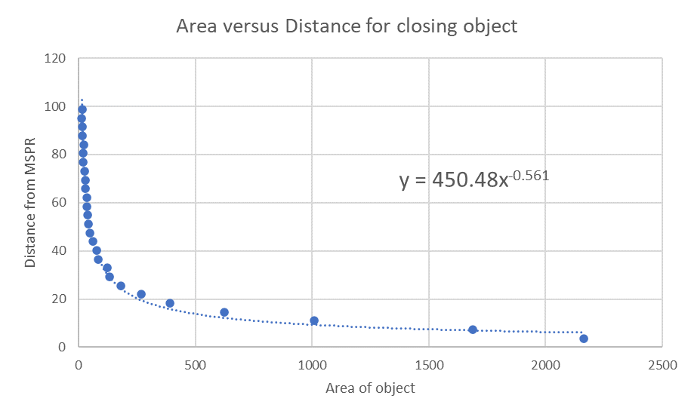
Ir Ranging Theory (Extended source)
Apparent surface algorithm:
Good method for moving objects
Initial information required:
Reference distance needed
Changes in distance needed
Useful for Extended Targets
Ranging equation:
$$R=−2A\frac{1}{\frac{dA}{dR}}$$
Apparent surface algorithm (modified):
Created a model for objects of known size and movement
Car moving straight towards the camera
Recorded area above threshold for the car at every slab distance
Car at far and close positions

Slide 15
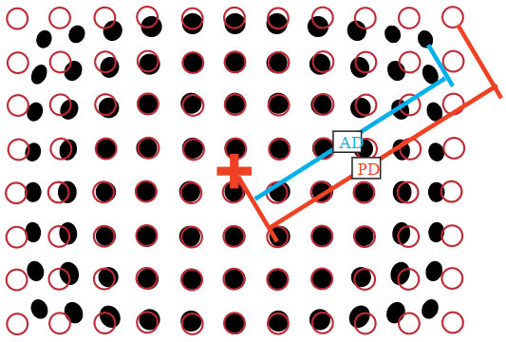
Camera alignment and spatial calibration
Scotch™ Brand 88 black vinyl electrical tape
Emissivity of 0.96 ( for 3-5 um and 8-12 um wavelengths)
Aluminum sheet metal
Emissivity close to 0
$$D=\frac{AD−PD}{PD}∗100$$

Slide 16
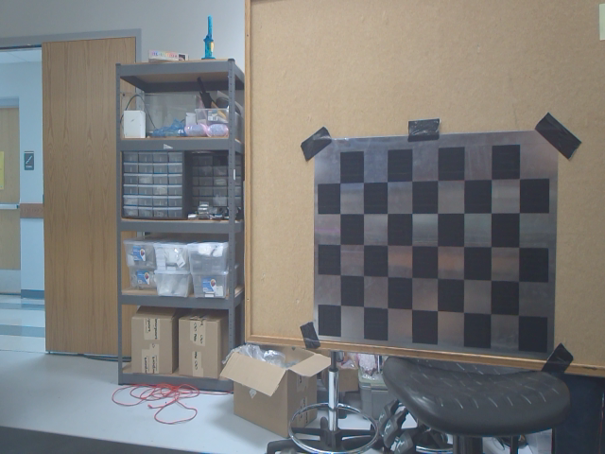
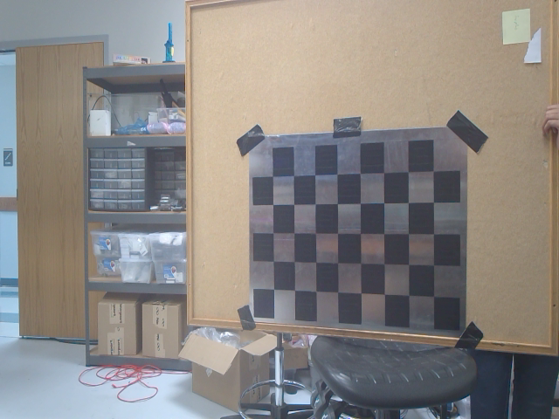
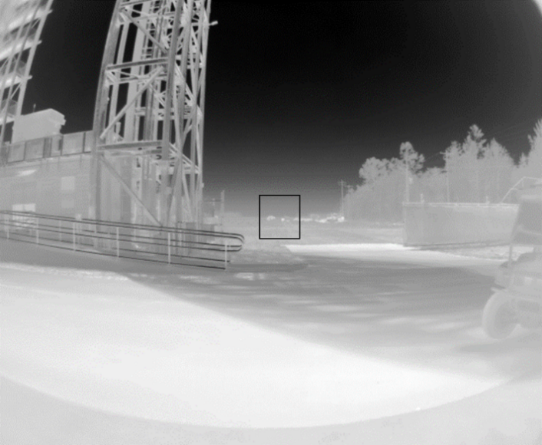
Sample Calibration pictures taken
Scotch™ Brand 88 black vinyl electrical tape
Emissivity of 0.96 ( for 3-5 um and 8-12 um wavelengths)
Aluminum sheet metal
Emissivity close to 0
Tau 640 with 7.5mm Lens for 4ft high x 5ft wide panel at 200 meters ( taken AFRL).

Slide 17
Part Selection: computer System
Microprocessor Selection
 | Nvidia Jetson Nano | Raspberry Pi 8GB | Google Coral Dev Board 1GB
CPU | ARM A57 | Cortex-A72 | Cortex-A53, Cortex M4F
CPU clock rate | 1.43 GHz | 1.5 GHz | 1.3 GHz
CPU cores | 4 | 4 | 4
Coprocessor | - | - | Google Edge TPU
GPU | 128-core Nvidia Maxwell |  | Integrated GC7000 Lite
Network Connectivity | Gigabit Ethernet | Gigabit Ethernet, 802.11ac wireless, Bluetooth | Wi-Fi, Gigabit Ethernet
Storage | MicroSD | MicroSD | MicroSD, 8GB eMMC
RAM | 4 GB 64-bit LPDDR4 | 8 GB 64-bit LPDDR4-3200 SDRAM | 1 GB 64-bit LPDDR4
MIPI Lanes | 1x MIPI CSI-2 DPHY | 1x MIPI CSI, 1x MIPI DSI | 1x MIPI-DSI, 1x MPIP-CSI2
USB Ports | USB 3.0, USB 2.0, Micro-B | 2x USB 3.0, 2x USB 2.0 | Type-C, Type-A 3.0, Micro-B
Display Ports | HDMI, DP | 2x micro-HDMI | HDMI 2.0a

Slide 18
Part Selection: Programming Language
Programming Language Selection
 | C | C++ | Python | Rust
Paradigms | Imperative | Imperative, Object Oriented | Imperative, Object Oriented | Imperative, Object Oriented
Compilation | Compiled | Compiled | Interpreted | Compiled
Language Level | Medium | Medium | High | Medium
Libraries | Libccv, TensorFlow, OpenCV | OpenCV, TensorFlow, Pytorch | OpenCV, TensorFlow, PyTorch, SimpleCV, Matplotlib, Keras | OpenCV, TensorFlow, PyTorch
Type System | Strong Statically | Strong Statically | Weak Dynamically | Strong Statically
Safety Design | Unsafe | Unsafe | Safe | Safe
Portability | Highly Portable | Highly Portable | Highly Portable | Highly Portable
Standard Library | Large, Extensive | Large, Extensive | Large, Extensive | Large, Extensive

Slide 19
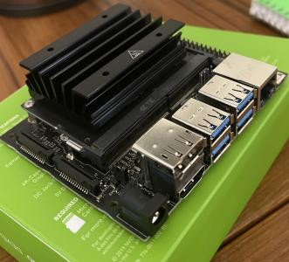
Jetson nano
The Jetson Nano was suitable for this project for several reasons:
Onboard GPU
Runs on Nvidia’s custom Ubuntu distribution
2x MIPI ports for stereo vision
High-performance quad-core processor
Enough RAM for our use-case
Cost of $119.99

Slide 20
Python
Python was chosen as the language of choice for most of the code base for several reasons:
Large selection of libraries relating to computer vision.
Rapid development and prototyping.
Seamless integration with MATLAB and C++ where necessary.
A memory safe language.
Supports parallelism to take advantage of the quad-core microprocessor.

Slide 21
IR camera
Parameter | FLIR A65 25 mm | Tau 2 7.5 mm
FOV | 25° × 20° | 90° x 69°
iFOV | 0.68 mrad | 2.267 mrad
Pixel pitch | 17 μm | 17 µm
Frequency/framerate | 30 Hz | 30/60 Hz (NTSC)
Temp. range | -25°C to +135°C | -25°C to +135°C
Sensitivity | ±5°C (±9°F) | < 30 mK (NETD)
Shock rating | 25 g (IEC 60068-2-27) | 200g shock pulse w/ 11 msec sawtooth
Size | 4.2" × 1.6" × 1.7" | 1.75" x 1.75" x 1.18"
Thermal imager | Focal Plane Array (FPA), Uncooled VOX microbolometer | Uncooled VOX Microbolometer
Connection | Ethernet | 50-pin Hirose / BNC with VPC
Input voltage | 10–30 VDC | 4.0 - 6.0 VDC
Price | $8000 | $6000

Slide 22
IR Lens selection

Slide 23
Part Selection: Visible Cameras
 | SainSmart IMX219 Camera Module | 8MP Sensor | 160 Degree FoV | Arducam MINI High-Quality Camera IMX477 HQ Camera Module | Arducam IMX219 Wide Angle Camera Module
Sensor | Sony IMX219 | Sony IMX477 | Sony IMX219
Optical Format | 1/4 inch | 1/2.3” | 1/4 inch
Resolution | 8MP | 12.3MP | 8MP
Interface | 2-lane MIPI | 2-lane MIPI | 2-lane/4-lane MIPI
Frame Rate | 1080p @ 30fps, 720p @ 60 fps and 640 x 480 | 1920×1080 @ 60fps 4032×3040 @ 30fps | 30fps@8MP, 60fps@1080p, 180fps@720p
Focal Length | 3.15mm | 3.9mm | 2.5mm
Aperture | F2.35 | F2.8 | F2.8
Field of View | 160° | 75° (H) | 175(D) x 155(H) x 115(V)
Board Size | 24mm × 25mm | 24mm × 25mm | 36mm x 36 mm
Price (Per Camera) | $29.99 | $64.99 | $54.99

Slide 24
Part Selection: Power 1
12V to 5V DC-DC Regulator Comparison
120V to 12V AC-DC Flyback Controller Comparison
 | TPS56623x | TPSM84624 | TPS543620
Efficiency of Circuit at maximum power (5 amps) | 95.6% | 94.4% | 94.5%
Efficiency of Circuit at half power (2.5 amps) | 96.3% | 94.3% | 95.4%
Efficiency of Circuit at .5 amps | 94.8% | 83.3% | 89.3%
Current Range (at 5 Volts) | Up to 6 amps | Up to 6 amps | Up to 6 amps
BOM count | 15 | 8 | 17
Recommended Maximum Power at 5 volts | 30W | 30W | 30W
Vout peak to peak at 5 volts and 5 amps output | 8.71 mV | 11.9 mV | 8.32 mV
Circuit Footprint | 130 mm² | 145 mm² | 237 mm²
 | UCC28730-Q1 | UCC28631 | LM5023
Efficiency of Circuit at maximum power (3 amps) | 83.4% | 87.2% | 86%
Efficiency of Circuit at half power (1.5 amps) | 84.5% | 87.8% | 85%
Efficiency of Circuit at .5 amps | 84.2% | 84.5% | 78%
Current Range (at 12 Volts) | Up to 8.33 amps | Up to 5 amps | Up to 3.43 amps
BOM count | 26 | 23 | 37
Recommended Maximum Power | 100W | 60W | 41W
Vout peak to peak at 12 volts and 3 amps output | 75.47 mV | 62.27 mV | 92.04 mV

Slide 25
Power design 1 schematic

Slide 26
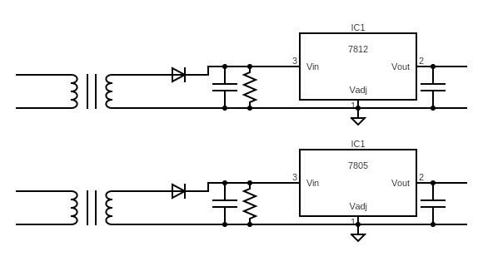
Power design 2

Slide 27
Constraints
Economic
IR camera was donated by Air Force Research Labs
Some optical components given by CREOL
All other costs come from out of pocket
Environmental
Power usage of board
Ethical / Political / Social
Could be used by military purposes
Our system is only being built to range objects
Specific applications are entirely up to user
COVID19
Precautions and limitations to what can be done as group
Must maintain 6 ft distance between group members when working in person
Time

Slide 28
standards
IPC-2220 (IPC-2221)
Follows the IPC-2220 Generic Standards on Printed Board Design
UL 1642
Follows the UL 1642 Standard for Safety of Lithium Batteries
FLIR Tau 640
Has use restrictions defined by Sony Semiconductor Solutions Tau2
Compliant with the following directives and regulations:
Directive 2002/95/EC, “Restriction of the use of certain Hazardous Substances in electrical and electronic equipment (RoHS)”.
Directive 2002/96/ EC, “Waste Electrical and Electronic Equipment (WEEE)”.
Regulation (EC) 1907/2006, “Registration, Evaluation, Authorization and Restriction of Chemicals (REACH)”.
Arducam MINI 12.3MP IMX477 Camera
Has use restrictions defined by Sony Semiconductor Solutions Corporation (SSS)
Nvidia Jetson Nano
Compliant with the Federal Communications Commission (FCC)

Slide 29
Financing
Item Number | Item Type | Model | Price
1 | IR Camera | FLIR Tau w/ 7.5 mm lens | $6000
2 | Variable pinhole | Thorlabs Pinhole Wheel (PHW16) | $496.70
3 | Off-Axis Parabola | Thorlabs Ø2" 90° OAP (MPD239-P01). | $375.50
4 | Stereo Camera Set | 2X | $128.98
5 | Microprocessor | Nvidia Jetson Nano Microprocessor B01 Model | $119.99
6 | Touch Display | Elecom 7” Display | $73.00
7 | Jumper cables and breadboard | - | $20.00
8 | 120V to 12V AC-DC converter circuit |  | $10.00
9 | 12V to 5V DC-DC converter circuit |  | $5.00
10 | 12V battery | - | $10.00
11 | Misc Electrical Components (resistors, capacitors, etc.) | - | $200.00
12 | Checkerboard Material | Aluminum Metal | $0.00
13 | Checkerboard coating | Scotch™ Brand 88 black vinyl electrical tape | $5.00
14 | Blackbody Source | TC-720 thermoelectric temperature controller | $1000.00
15 | Mechanical-Optical components | - | -
Total | - | - | $8264.17
*donated

Slide 30
Work Distribution
Team Leadership:
Primary Team Lead: Pedro Alvarez
IR theory
Extraction of IR range function
Project planning
Secondary Team Lead: Taylor Whitton
Handled source control
Software architecture

Slide 31
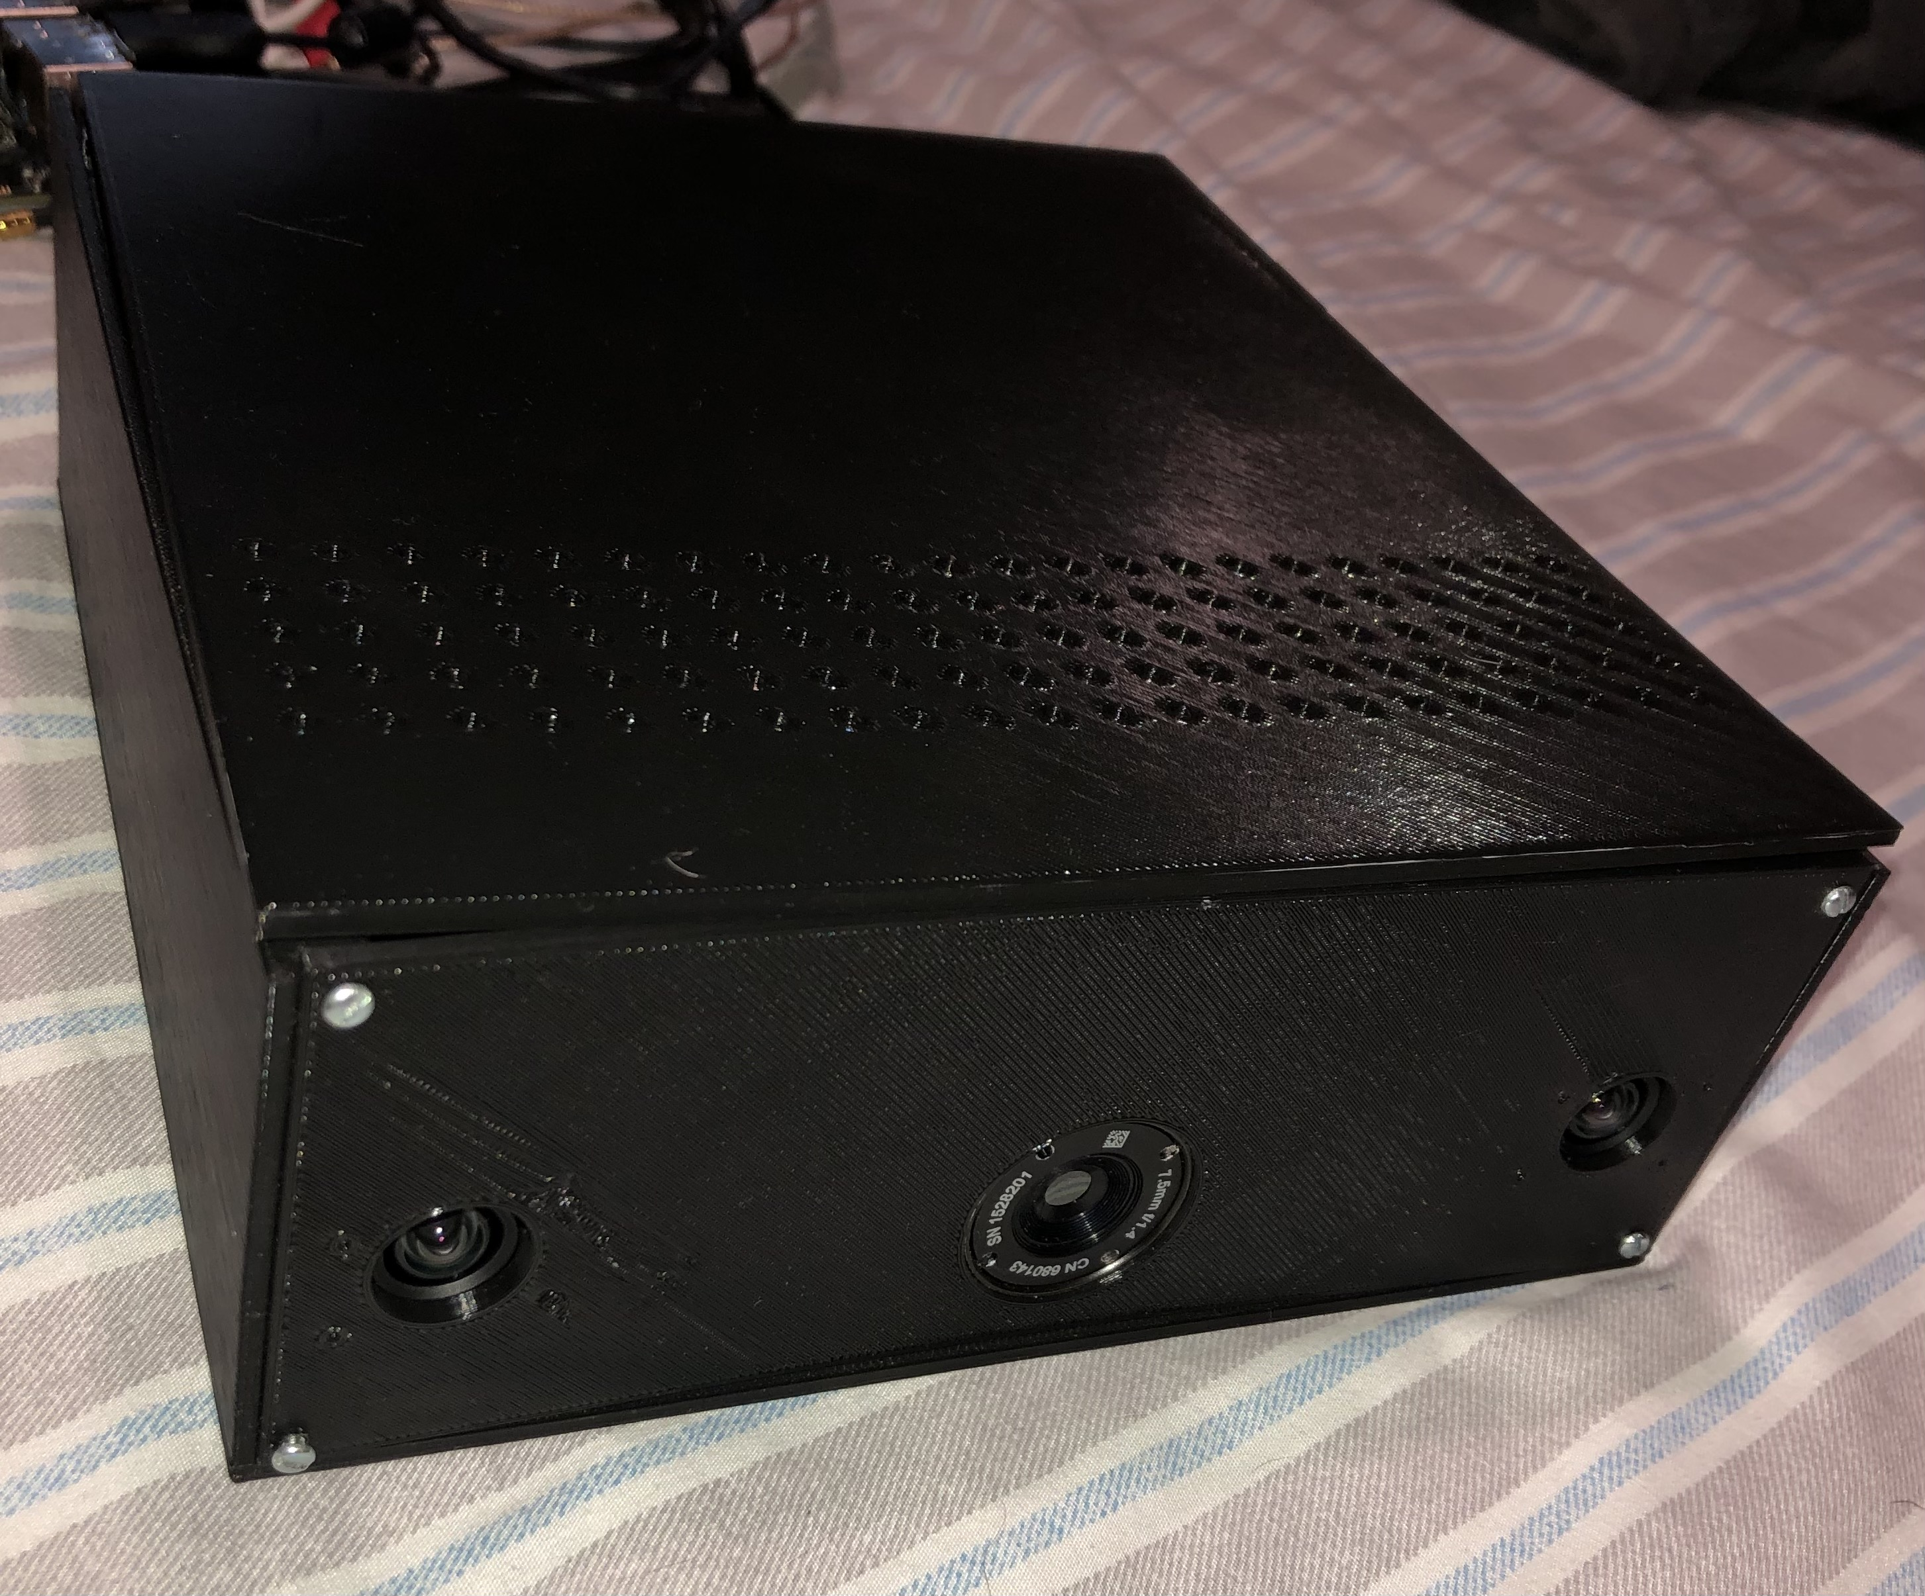
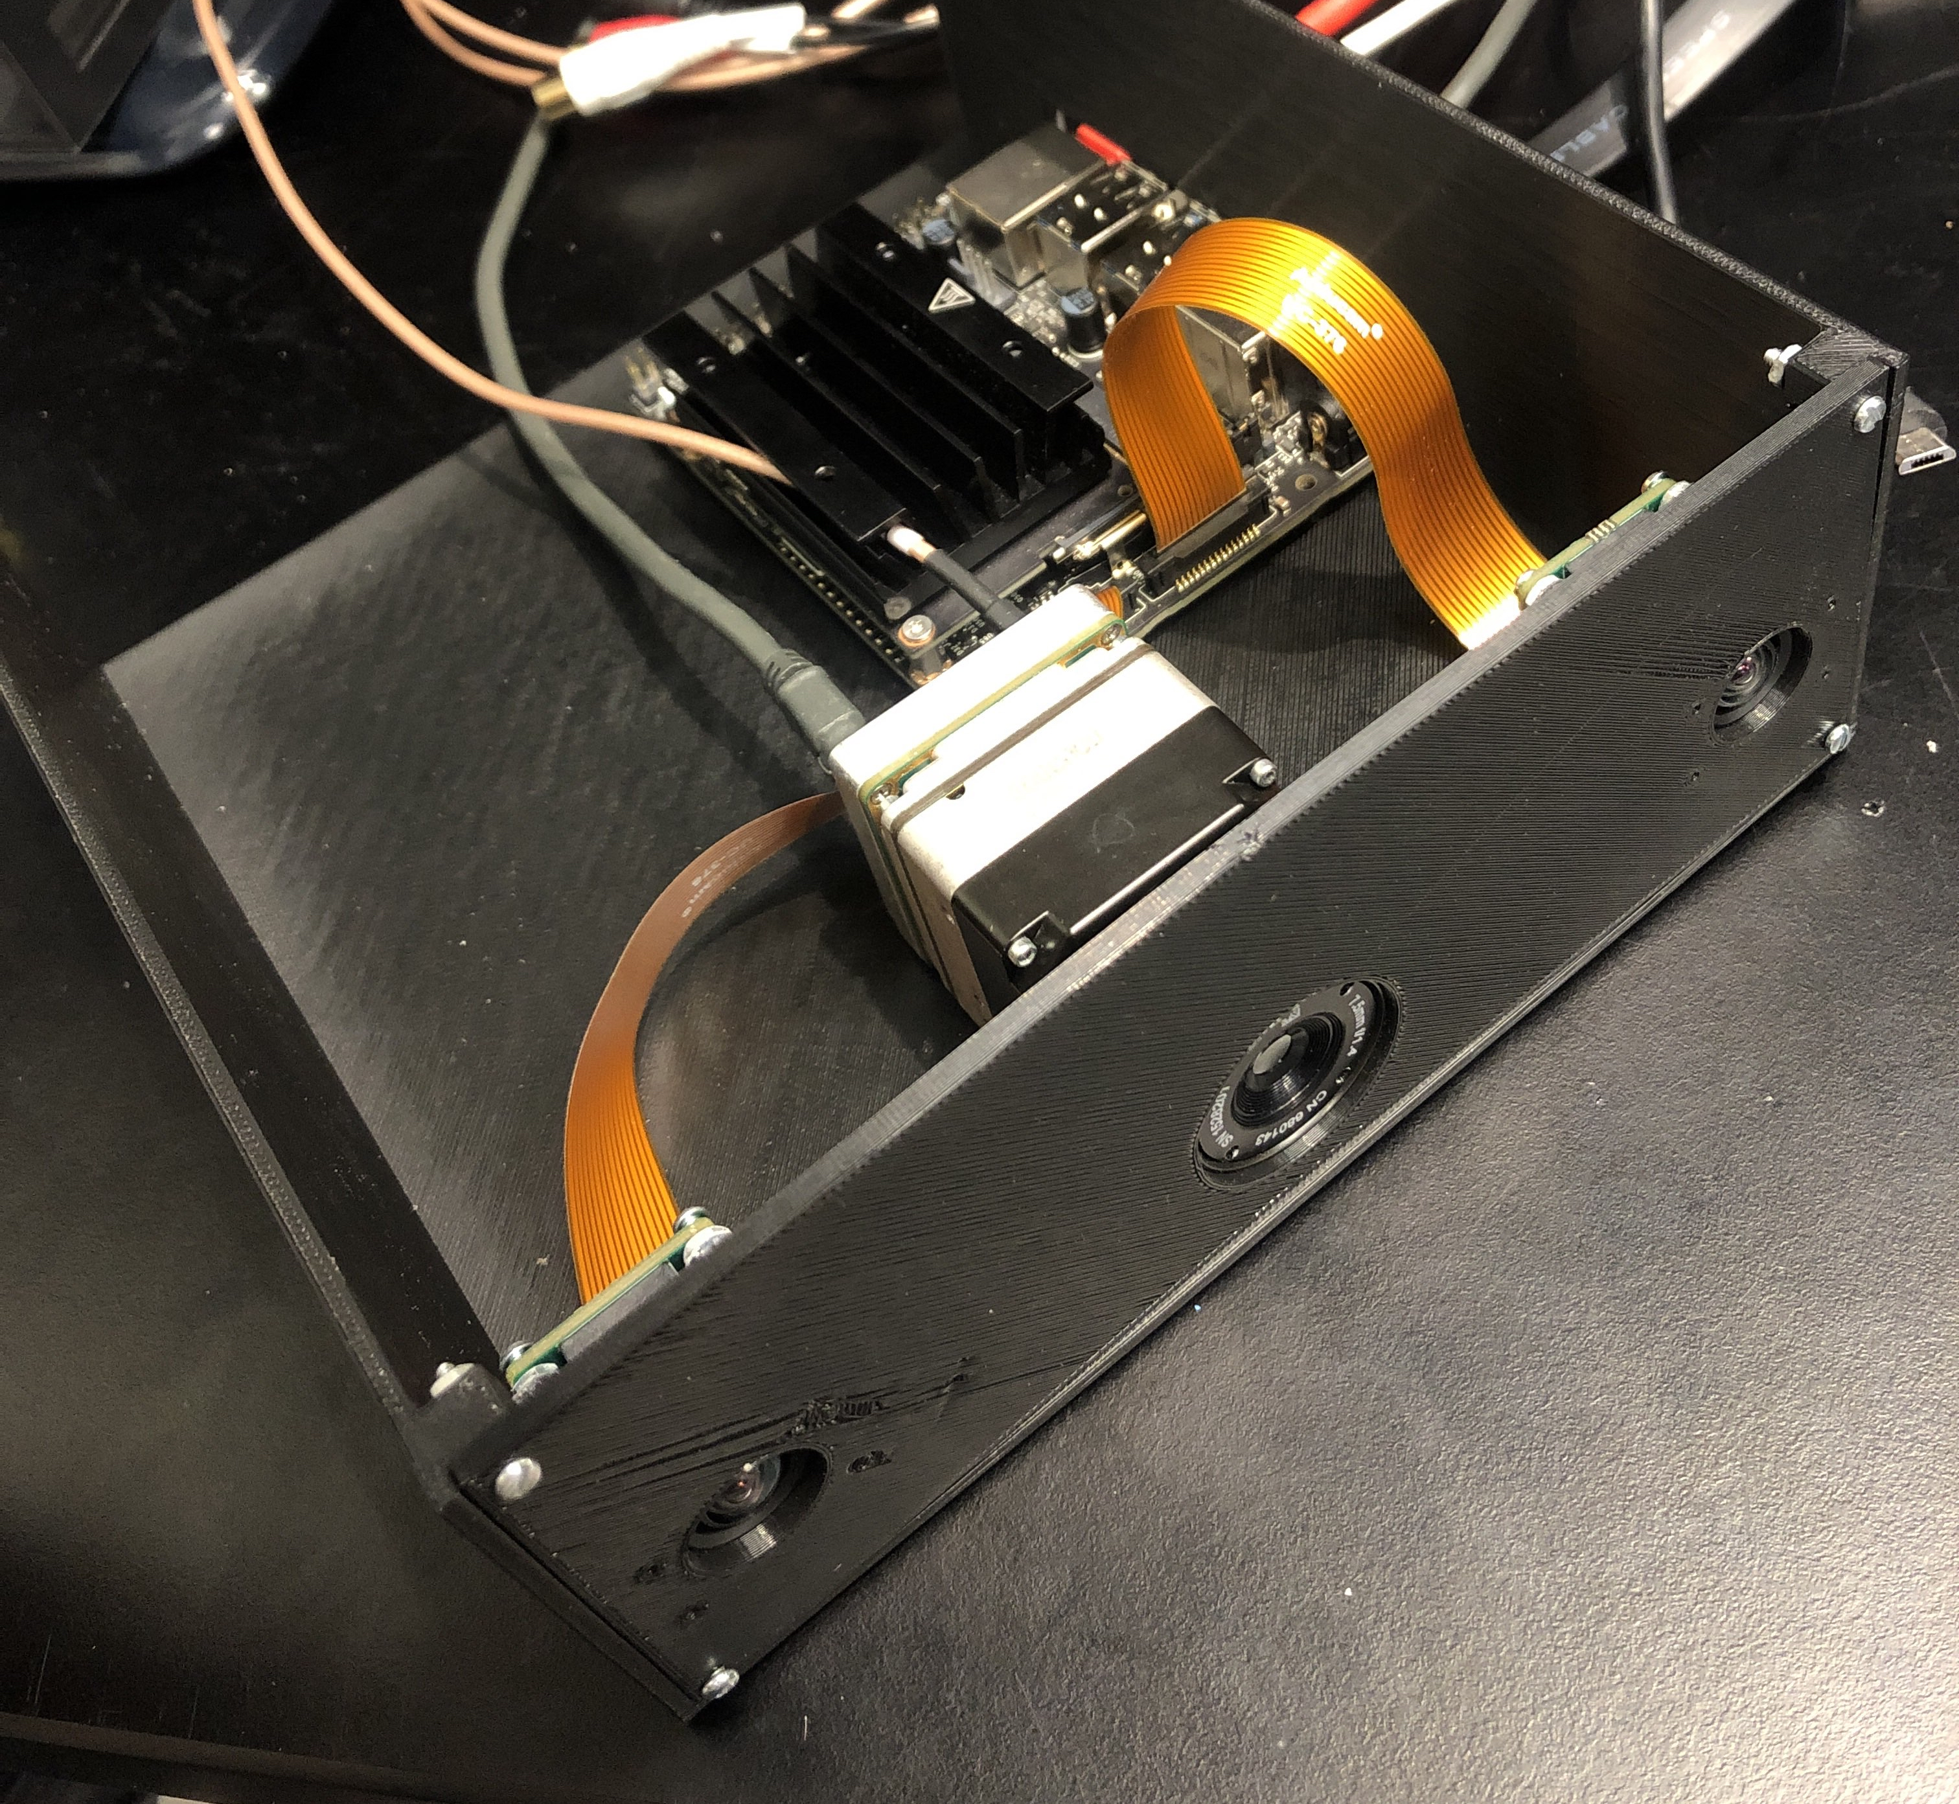
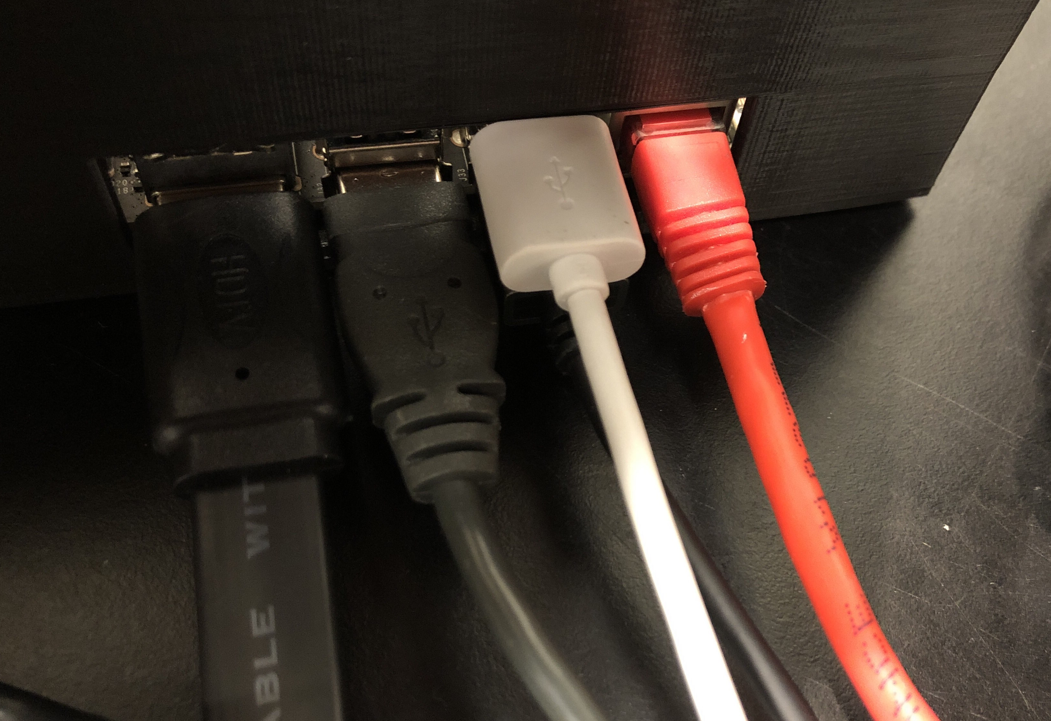
Results
Object Tracking
Contour motion detection approach
Slower but versatile (CPU)
Prone to errors
Single shot Nvidia TensorRT object detection
Fastest (Graphics card)
Precise and extensive
Stereo system
Able to calculate range given the right object coordinates
Process expensive and slow but requires no object training
Better for closer range
IR system
Can range object up to 100 m as long as object can be detected with specific requirements and some information is known
Harder to detect object through single shot algorithm but good with motion tracking algorithm
Requires extensive radiometric calibrations for best results
Power House
Can output desired voltages although not under load
Unable to integrate onto overall system

Slide 32
Successes and Difficulties - Computer
Successes
Project structure allowed quick updates
Difficulties
Libraries were time consuming to configure
Git for version control
Optimized code to use the GPU
Difficulties with object tracking
Optimizing for performance

Slide 33
Successes and Difficulties - Power
Successes
Difficulties
Power system outputs the required voltages
Drawing too much current from the wall caused by rush in without transformer in front under load
2 different power solutions
Capacitance not high enough for voltage to stay high enough for Jetson Nano under load
Integration into final system.

Slide 34
Successes and Difficulties – Visible Cameras
Successes
Difficulties
Able to calibrate and rectify images to create disparity map​
Could not guarantee the alignment of the cameras until housing was built and cameras were secured in place
Able to detect objects
Able to determine distance of objects within certain range
Difficult to test with certain objects and in certain lighting conditions

Slide 35
Successes and Difficulties – IR Camera
Successes
IR image undistortion
Difficulties
Contrast issues (radiometric calibration)
IR object detection and tracking
IR range extraction
Needs ideal conditions to function properly

Slide 36
Future work and expansion possibilities
How do we improve?
Stronger processing power
Can achieve better detection due to more detail and speed
More ranging algorithms able to run simultaneously for more accuracy and consistency
Extensive object training and software optimization
Is there a future for this technology?
Passive ranging is of great interest
Vital for surveillance sensor hubs
Race for autonomous technology (such as cars)
Quantum computing opens new doors

