Slide 1
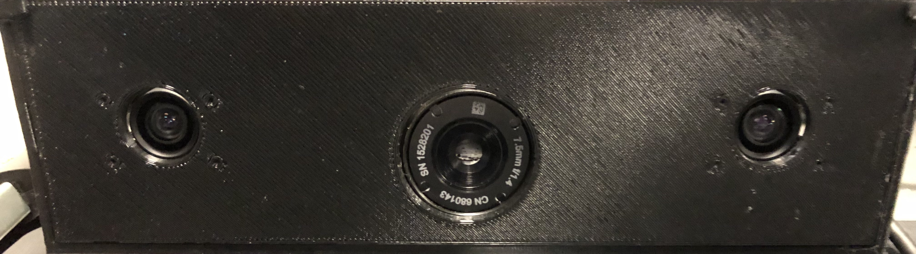
Multi-sensor Passive ranger (MSPR) Final demo
Infrared search and track (IRST) system for general purpose surveillance / detection of vehicles and people
Group 3:
Pedro A. Alvarez Fernandez Photonic Science and Engineering
John Haynes Electrical Engineering
Ilina Sunkara Photonic Science and Engineering
Taylor Whitton Computer Engineering

Slide 2
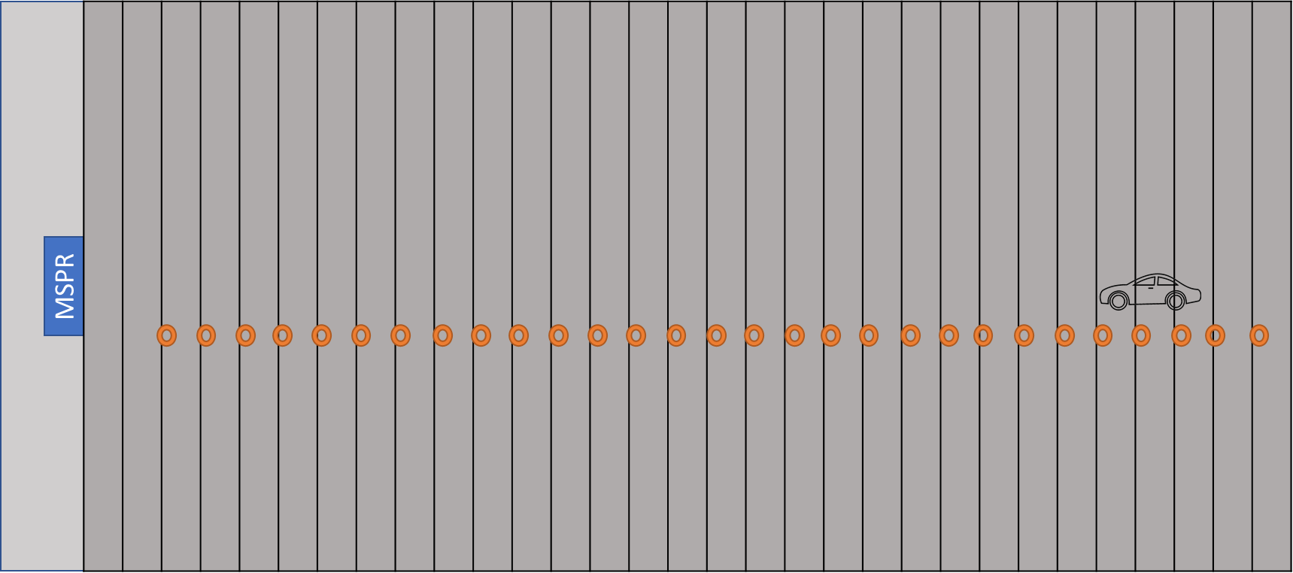
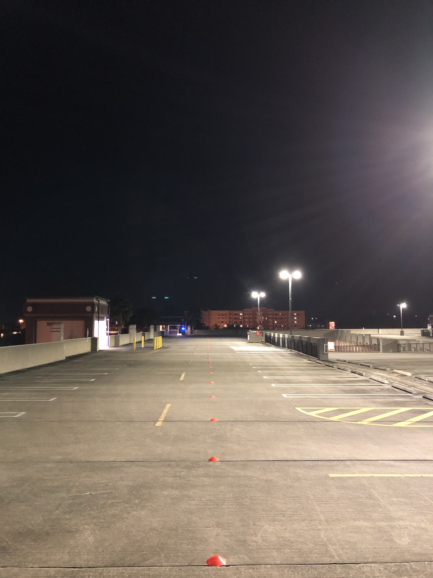
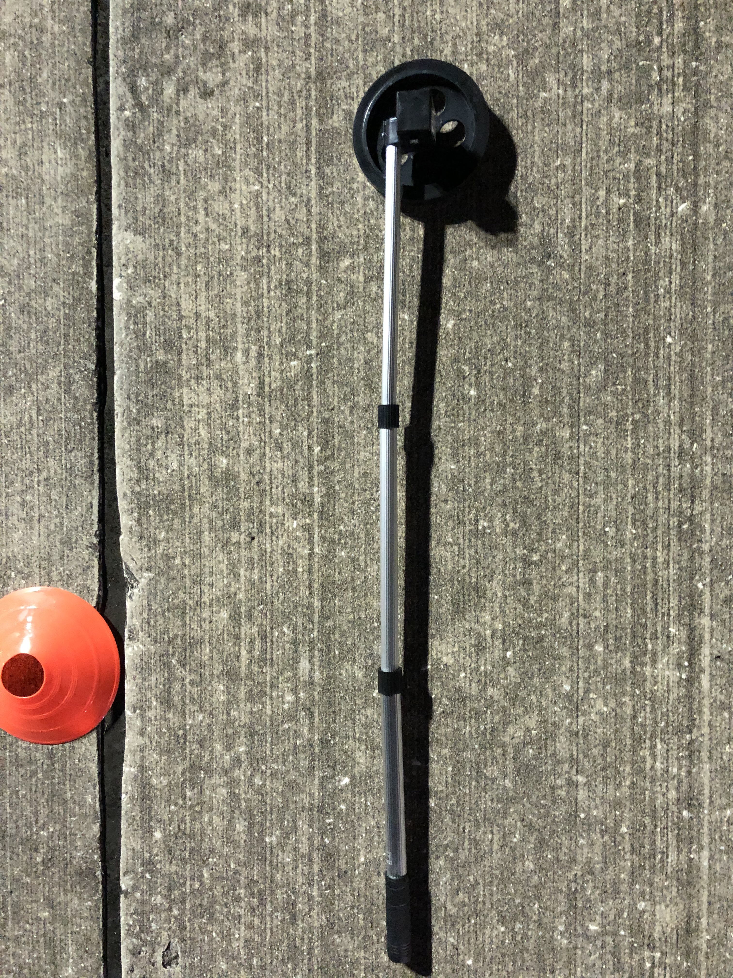
Final demo
103 mm
3.66 m
*Not to scale
Measured Slab length: 3.66m
Available travel distance: 107 m
Conditions: Nighttime

Slide 3
Specifications and requirements
Category | Specification
Range estimation accuracy | ±10% of true value
Range estimation speed | 1/sec
Background/Target differentiation | 1 s
Time of arrival estimation (velocity) | ±10% of true value
Disparity image | 7.5 FPS
Object motion tracking | 1 s

Slide 4
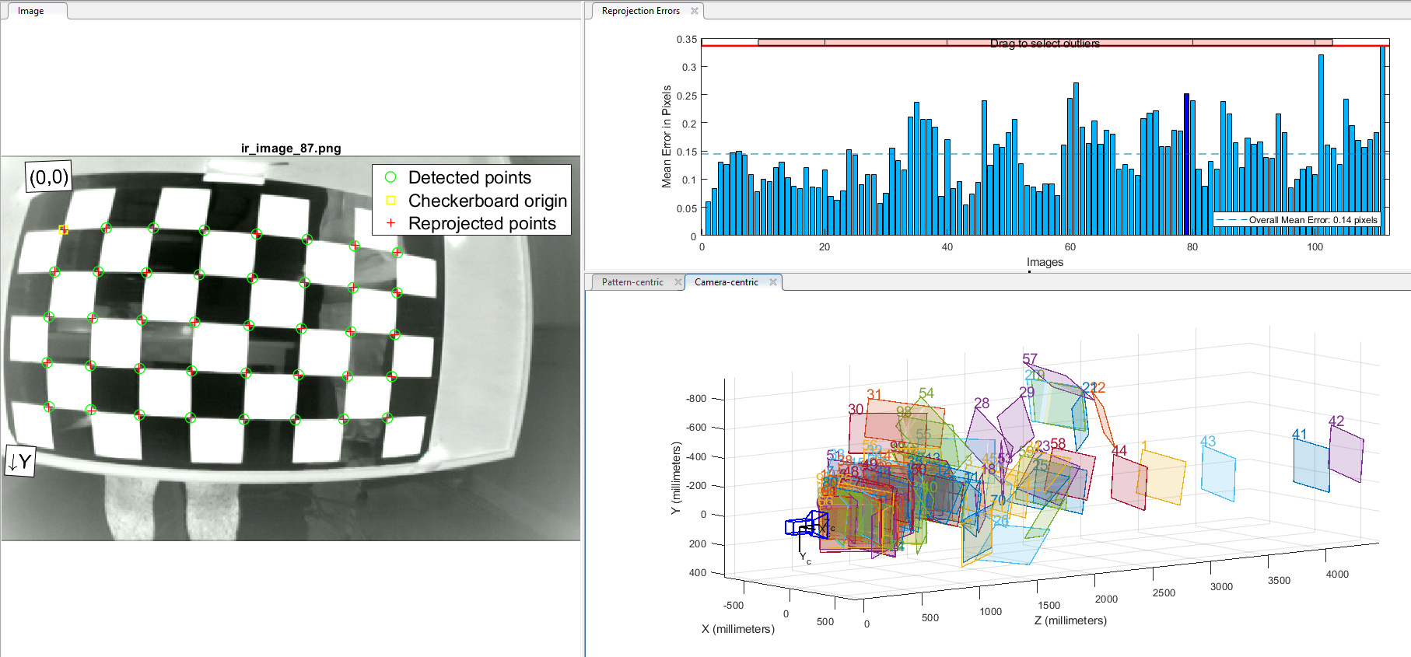
Calibration results (IR)

Slide 5
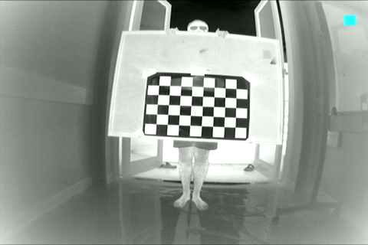
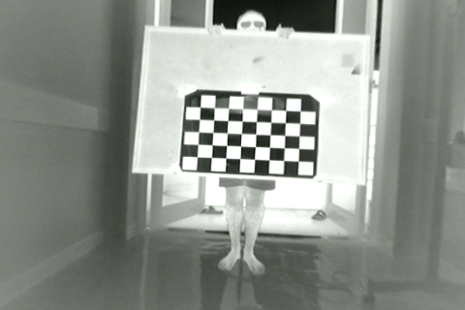
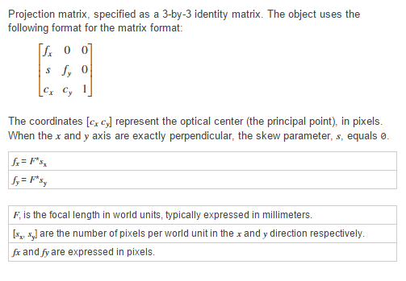
Distorted vs Undistorted
Fx=338.1651 | 0 | 0
S=0 | Fy=295.719 | 0
Cx=241.0331 | Cy=159.0301 | 1
Radial distortion | -0.4516 | 0.2484 | 0.07661
Tangential distortion | 7.2740E-4 | 0.001340 | -

Slide 6
Corner Extraction and Reprojection

Slide 7
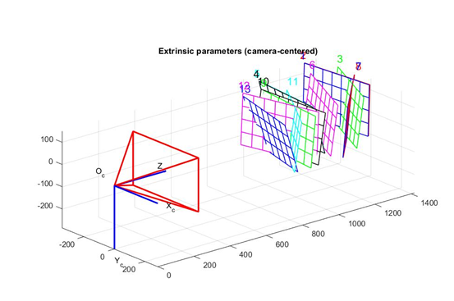
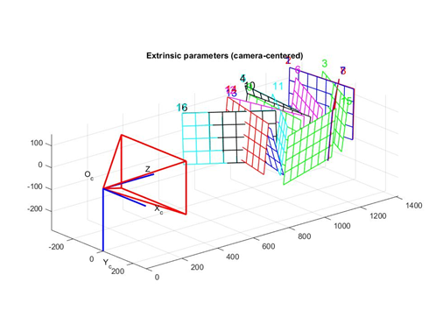
Extrinsic Parameter Visualization
Left Camera Visualization
Right Camera Visualization

Slide 8
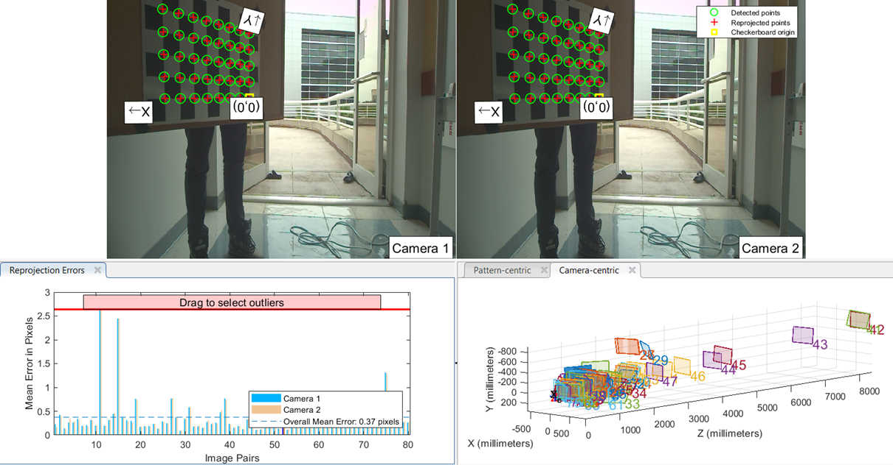
Calibration Results (Visual)

Slide 9
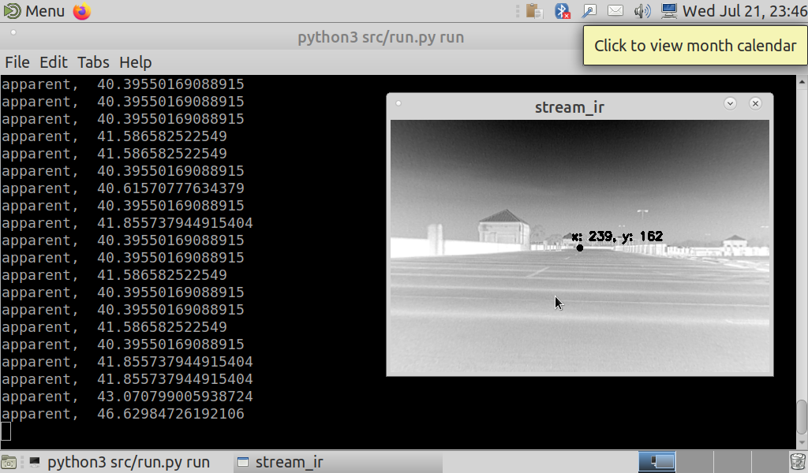
IR Ranging (contour object detection)

Slide 10
Ranging accuracy

Slide 11
Ir Single Shot background target differentiation

Slide 12
Single Shot tracking
Classified: Truck
Classified: Car

Slide 13
Stereo Ranging

Slide 14
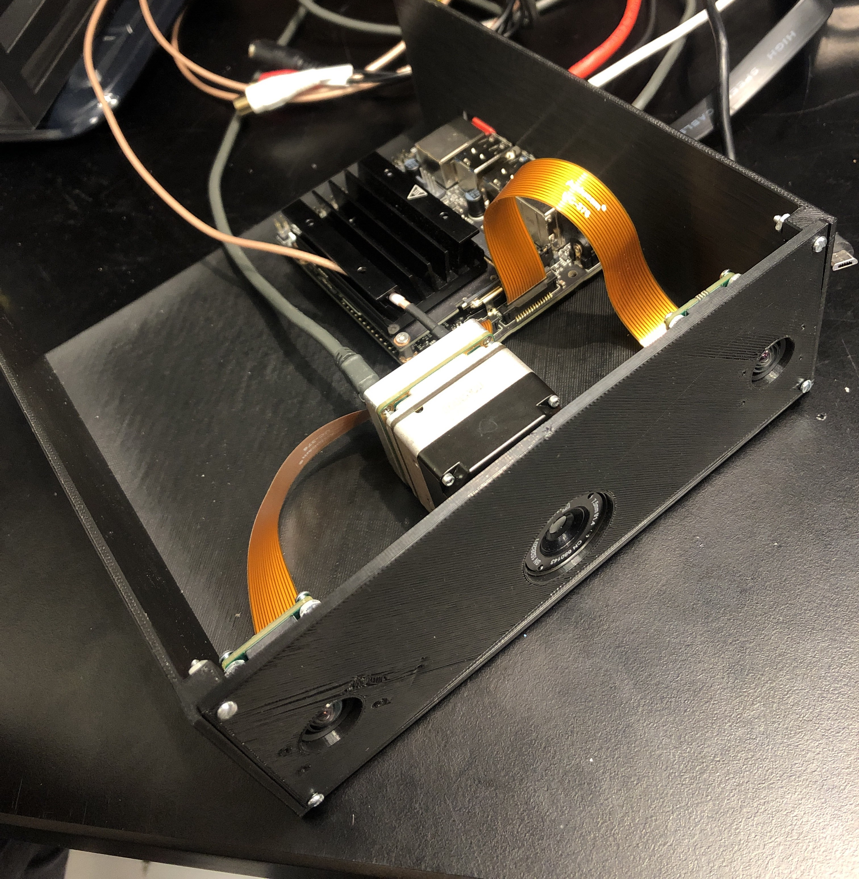
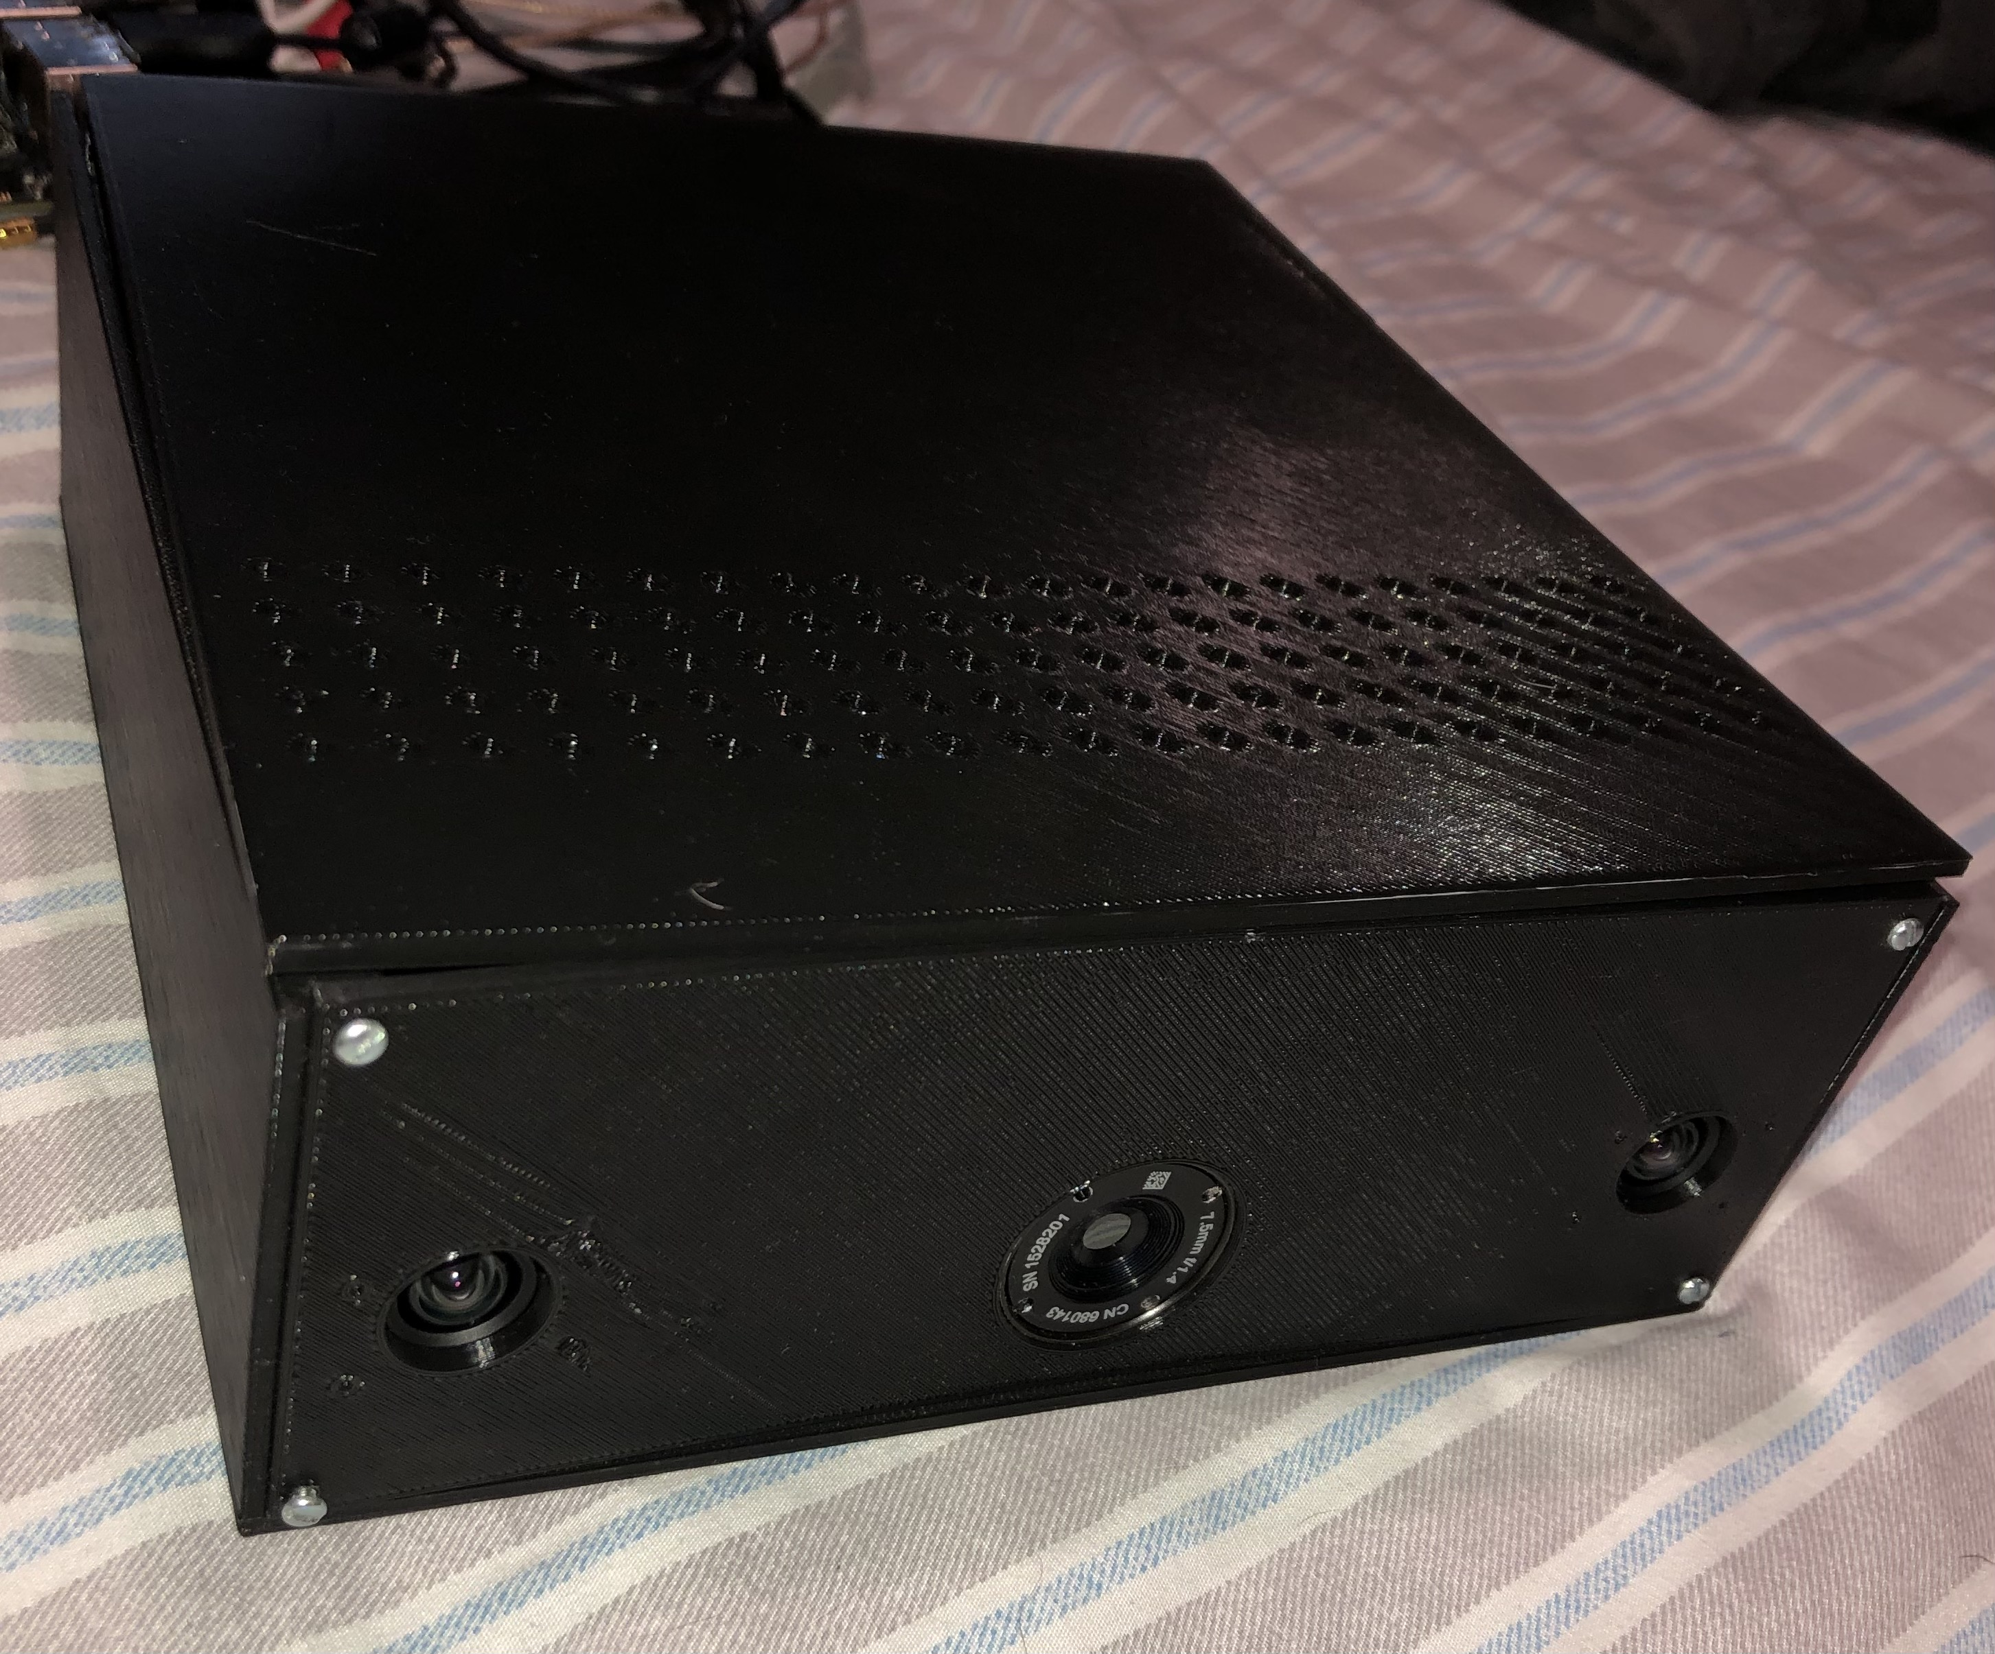
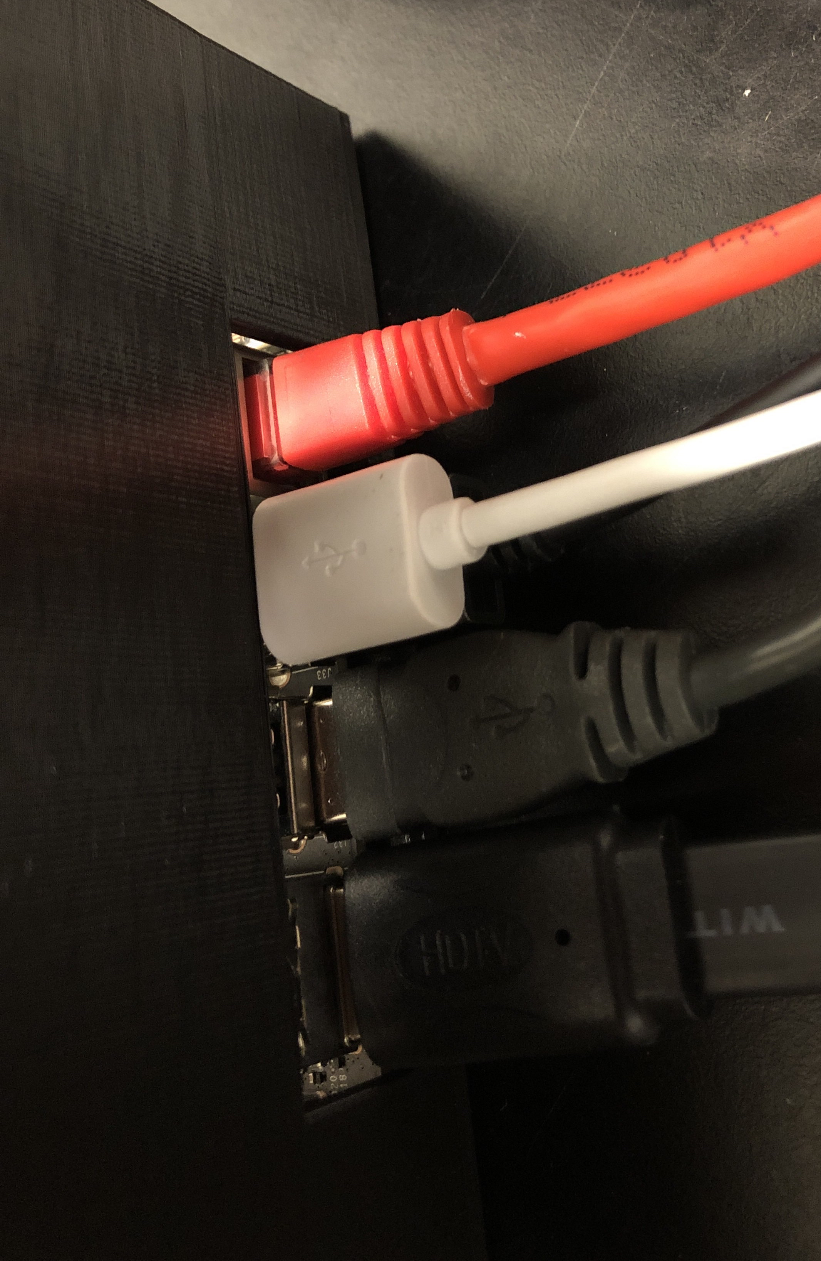
Housing

Slide 15
First Power Design

Slide 16
Second Power Design

Slide 17
Second Power Design

Slide 18
Future Work and improvement
Power System Integration
Given more time, we could fully integrate the power system
More processing power
The Jetson Nano is a microprocessor, were we to scale up to a full-size computer or cloud computing solution, we could process at a much higher rate
Higher resolution cameras
More pixels means we have more detail from which we can detect objects
Training our own neural network using IR images to improve detection rate

Slide 19
Thank you

